Slide 1
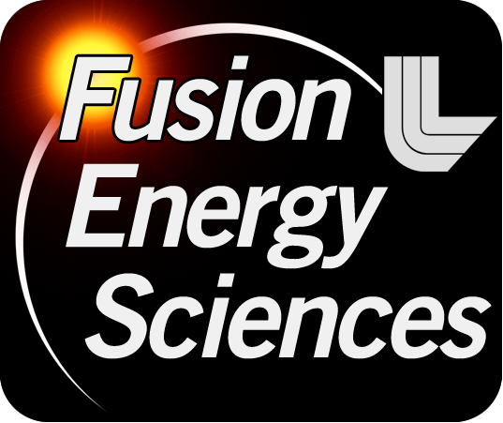




NSTX
Supported by
The snowflake divertor: a game-changer for magnetic fusion devices ?
Columbia U
CompX
General Atomics
FIU
INL
Johns Hopkins U
LANL
LLNL
Lodestar
MIT
Nova Photonics
New York U
ORNL
PPPL
Princeton U
Purdue U
SNL
Think Tank, Inc.
UC Davis
UC Irvine
UCLA
UCSD
U Colorado
U Illinois
U Maryland
U Rochester
U Washington
U Wisconsin
V. A. Soukhanovskii
Lawrence Livermore National Laboratory
Culham Sci Ctr
U St. Andrews
York U
Chubu U
Fukui U
Hiroshima U
Hyogo U
Kyoto U
Kyushu U
Kyushu Tokai U
NIFS
Niigata U
U Tokyo
JAEA
Hebrew U
Ioffe Inst
RRC Kurchatov Inst
TRINITI
NFRI
KAIST
POSTECH
ASIPP
ENEA, Frascati
CEA, Cadarache
IPP, Jülich
IPP, Garching
ASCR, Czech Rep
Workshop on Innovation in Fusion Science and US-Japan Workshop on Compact Torus Plasma August 16-19, 2011 Seattle, Washington

Slide 2
Acknowledgements
D. D. Ryutov, T. D. Rognlien, M. V. Umansky (LLNL),
R. E. Bell, D. A. Gates, A. Diallo, S. P. Gerhardt, R. Kaita,
S. M. Kaye, E. Kolemen, B. P. LeBlanc, J. E. Menard, D. Mueller, S. F. Paul, M. Podesta, A. L. Roquemore, F. Scotti (PPPL),
J.-W. Ahn, R. Maingi, A. McLean (ORNL),
D. Battaglia, T. K. Gray (ORISE),
R. Raman (U Washington),
S. A. Sabbagh (Columbia U)
Supported by the U.S. DOE under Contracts
DE-AC52-07NA27344, DE AC02-09CH11466,
DE-AC05-00OR22725, DE-FG02-08ER54989.

Slide 3
Outline: Experimental results from snowflake divertor experiments in NSTX are very encouraging
Tokamak divertor challenge
Snowflake divertor configuration
Snowflake divertor in NSTX
  Magnetic properties realized in steady-state
  Core H-mode confinement unchanged
  Core impurities reduced
  Divertor heat flux significantly reduced
  Consistent w/ 2D edge transport model
Conclusions and outlook

Slide 4
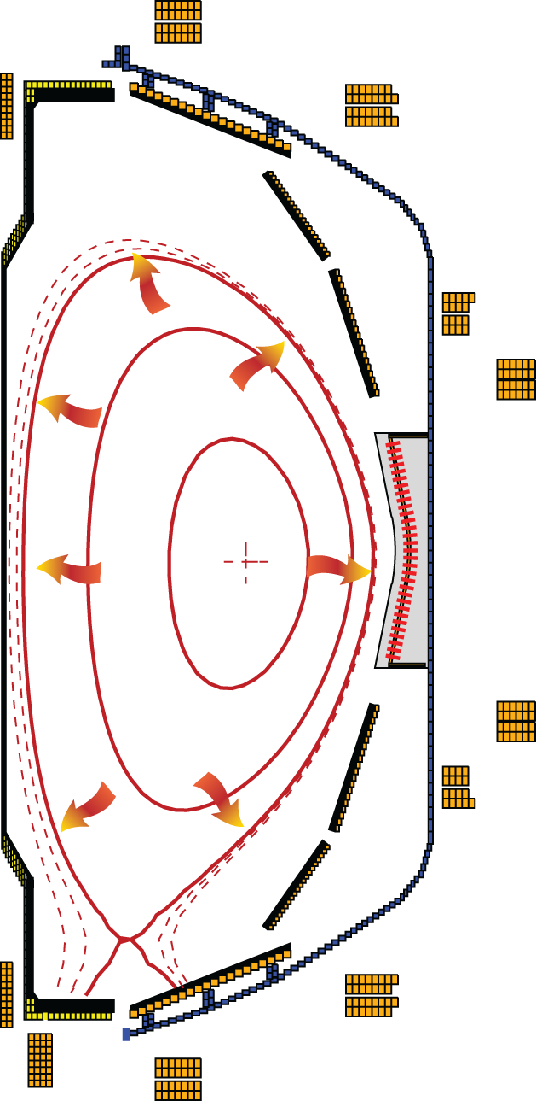
Poloidal divertor concept enabled progress in tokamak physics studies in the last 30 years
Divertor challenge
  Steady-state heat flux
      present limit q_{peak} ≤ 10 MW/m²
      projected to q_{peak} ≤ 80 MW/m² for future devices
  Density and impurity control
  Impulsive heat and particle loads
  Compatibility with good core plasma performance
Spherical tokamak: additional challenge - compact divertor
NSTX (Aspect ratio A=1.4-1.5)
  I_{p} ≤ 1.4 MA, P_{in} ≤ 7.4 MW (NBI), P / R ~ 10
  q_{peak} ≤ 15 MW/m², q|| ≤ 200 MW/m²
  Graphite PFCs with lithium coatings
National Spherical
Torus Experiment

Slide 5
Various techniques developed for reduction of heat fluxes q|| (divertor SOL) and q_{peak} (divertor target)
Promising divertor peak heat flux mitigation solutions:
  Divertor geometry
    poloidal flux expansion
    divertor plate tilt
    magnetic balance
  Radiative divertor
Recent ideas to improve standard divertor geometry
  X-divertor (M. Kotschenreuther et. al, IC/P6-43, IAEA FEC 2004)
  Snowflake divertor (D. D. Ryutov, PoP 14, 064502 2007)
  Super-X divertor (M. Kotschenreuther et. al, IC/P4-7, IAEA FEC 2008)

Slide 6
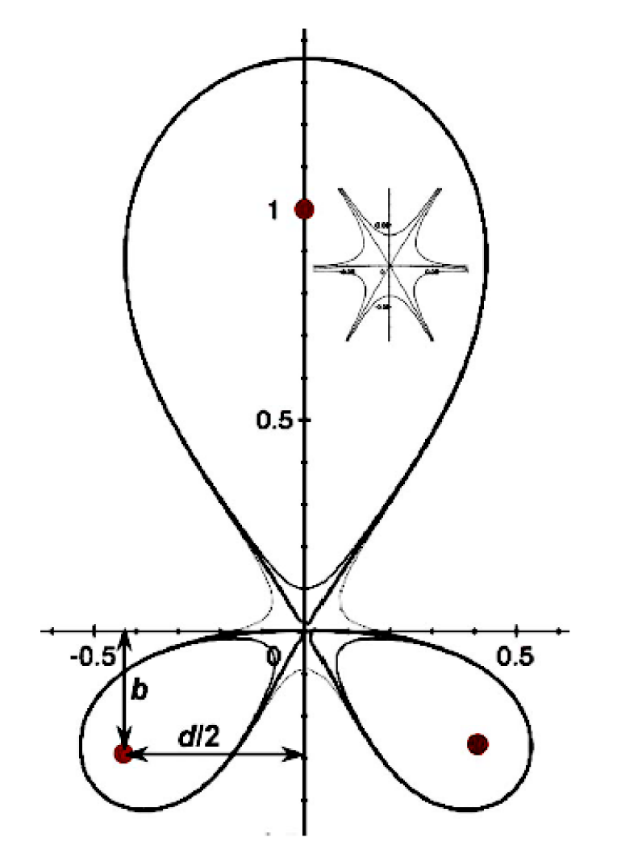
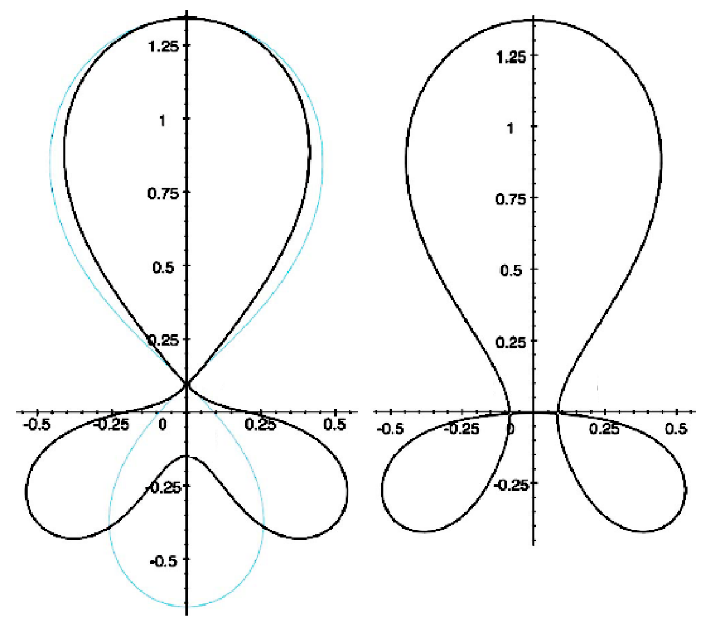
Snowflake divertor geometry attractive for heat flux mitigation
Snowflake divertor
  Second-order null
      B_{p} ~ 0 and grad B_{p} ~ 0 (Cf. first-order null: B_{p} ~ 0)
  Obtained with existing divertor coils (min. 2)
  Exact snowflake topologically unstable
Predicted geometry properties (cf. standard divertor)
  Larger region with low B_{p} around X-point: ped. stability
  Larger plasma wetted-area A_{wet} : reduce q_{div}
  Larger X-point connection length L_{x} : reduce q_{II}
  Larger effective divertor volume V_{div} : incr. P_{rad} , P_{CX}
Experiments
  TCV (F. Piras et. al, PRL 105, 155003 (2010))
  NSTX
Exact
snowflake
divertor
snowflake-minus
snowflake-plus
D. D. Ryutov, PoP 14, 064502 2007

Slide 7
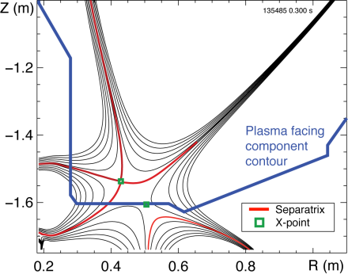
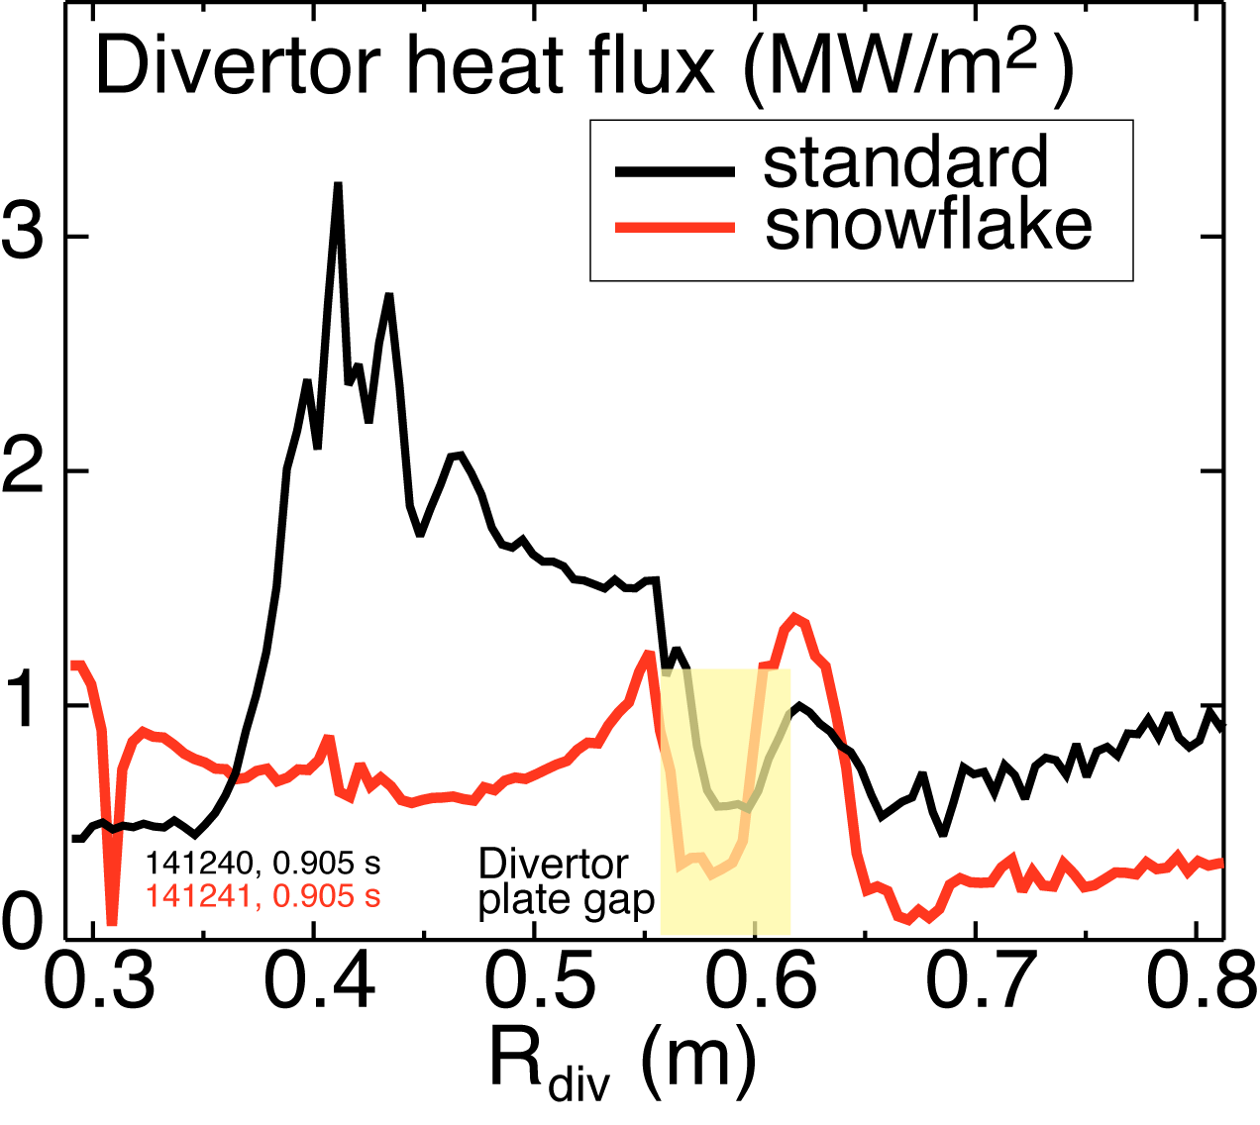
Outline: Experimental studies of snowflake divertor in NSTX
Tokamak divertor challenge
Snowflake divertor configuration
Snowflake divertor in NSTX
  Magnetic properties realized in steady-state
  Core H-mode confinement unchanged
  Core impurities reduced
  Divertor heat flux significantly reduced
  Consistent w/ 2D edge transport model
Conclusions and outlook

Slide 8
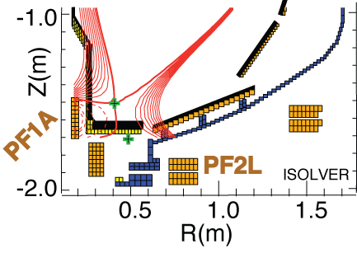
Possible snowflake divertor configurations were modeled with ISOLVER code
ISOLVER - predictive free-boundary axisymmetric Grad-Shafranov equilibrium solver
  Input: normalized profiles (P, I_{p}), boundary shape
  Match a specified I_{p} and β
  Output: magnetic coil currents
Standard divertor discharge below:
B_{t}=0.4 T, I_{p}=0.8 MA, δ_{bot}~0.6, κ∼2.1
Quantity | Standard divertor | Simulated snowflake
X-point to target parallel length L_{x} (m) | 5-10 | 10
Poloidal magnetic flux expansion f_{exp} at outer SP | 10-24 | 30-60
Magnetic field angle at outer SP (deg.) | 1.5-5 | ~1-2
Plasma-wetted area A_{wet} (m²) | ≤ 0.4 | 0.95

Slide 9
Snowflake divertor configurations obtained in NSTX with three existing divertor coils
Standard
Snowflake
f_{exp}
B_{p}

Slide 10
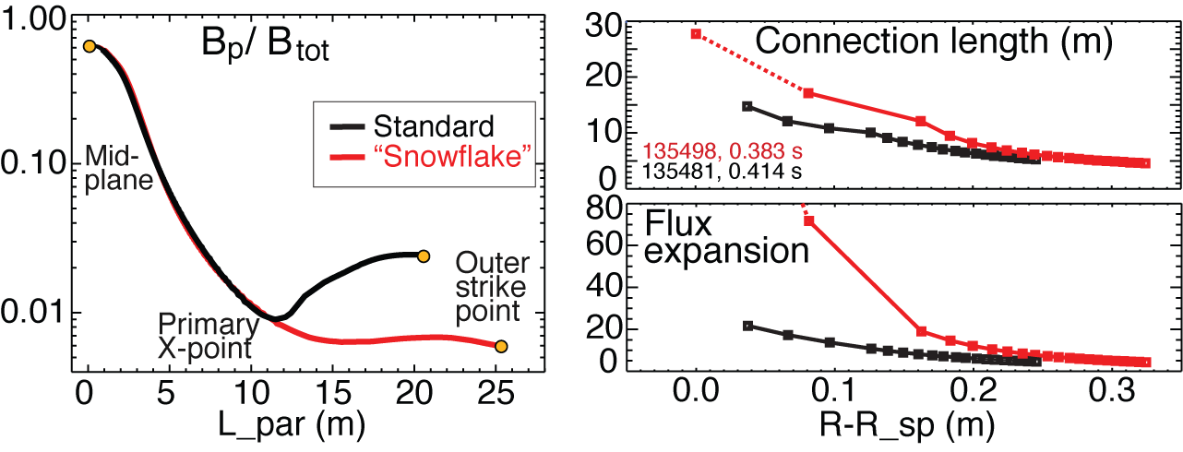
Plasma-wetted area and connection length are increased by 50-90 % in NSTX snowflake divertor
These properties observed in first 30-50 % of SOL width
B_{tot} angles in the strike point region: 1-2º, sometimes < 1º
  Concern for hot-spot formation and sputtering from divertor tile edges

Slide 11
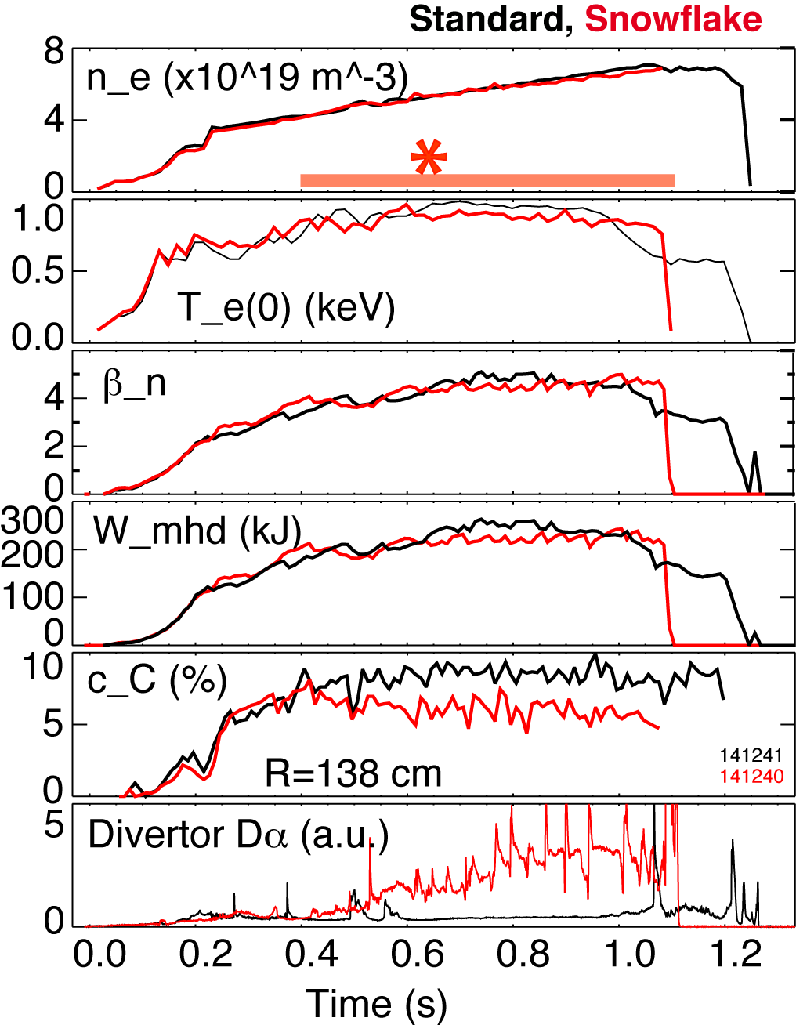
  Good H-mode confinement properties and core impurity reduction obtained with snowflake divertor
0.8 MA, 4 MW H-mode
κ=2.1, δ=0.8
Core T_{e} ~ 0.8-1 keV, T_{i} ~ 1 keV
β_{N} ~ 4-5
Plasma stored energy ~ 250 kJ
H98(y,2) ~ 1 (from TRANSP)
Core carbon reduction due to
  Type I ELMs
  Edge source reduction
    Divertor sputtering rates reduced due to partial detachment

Slide 12
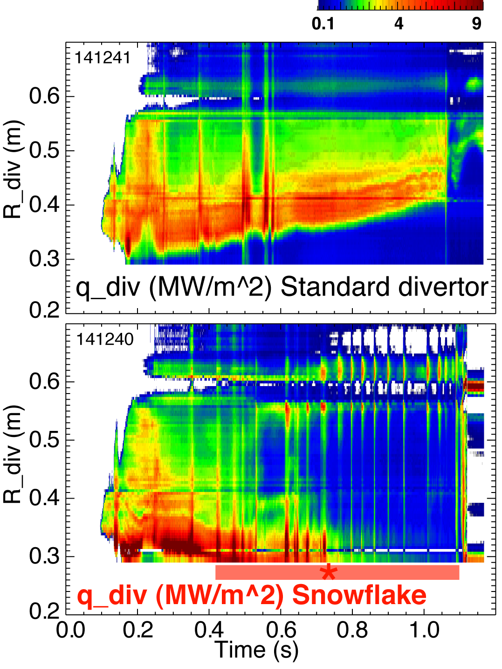
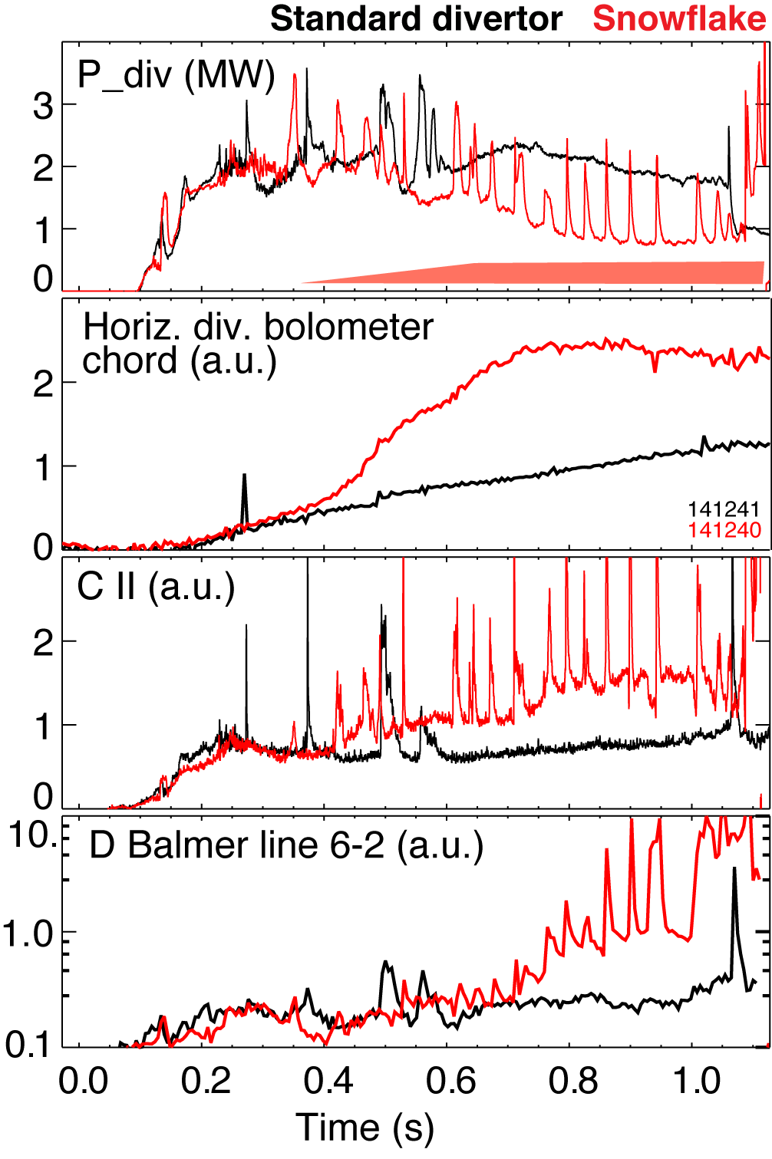
Significant reduction of steady-state divertor heat flux observed in snowflake divertor (at P_{SOL}~ 3 MW)
Partial detachment at or after snowflake formation time
  Heat and ion fluxes in the outer strike point region decreased
  Divertor recombination rate and radiated power are increased

Slide 13
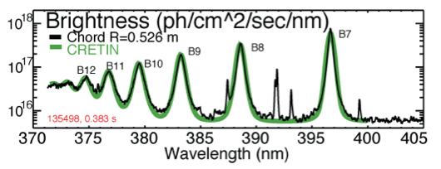
Divertor profiles show low heat flux, broadened C III and
C IV radiation zones in the snowflake divertor phase
Heat flux profiles reduced to nearly flat low levels, characteristic of radiative heating
Divertor C III and C IV brightness profiles broaden
High-n Balmer line spectroscopy and CRETIN code modeling confirm outer SP detachment with T_{e} ≤ 1.5 eV,
n_{e} ≤ 5 x 10²⁰ m⁻³
  Also suggests a reduction of carbon physical and chemical sputtering rates

Slide 14
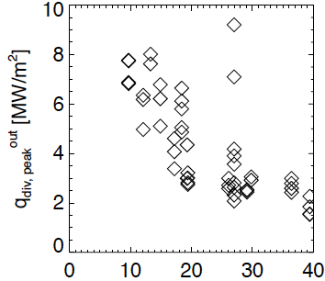
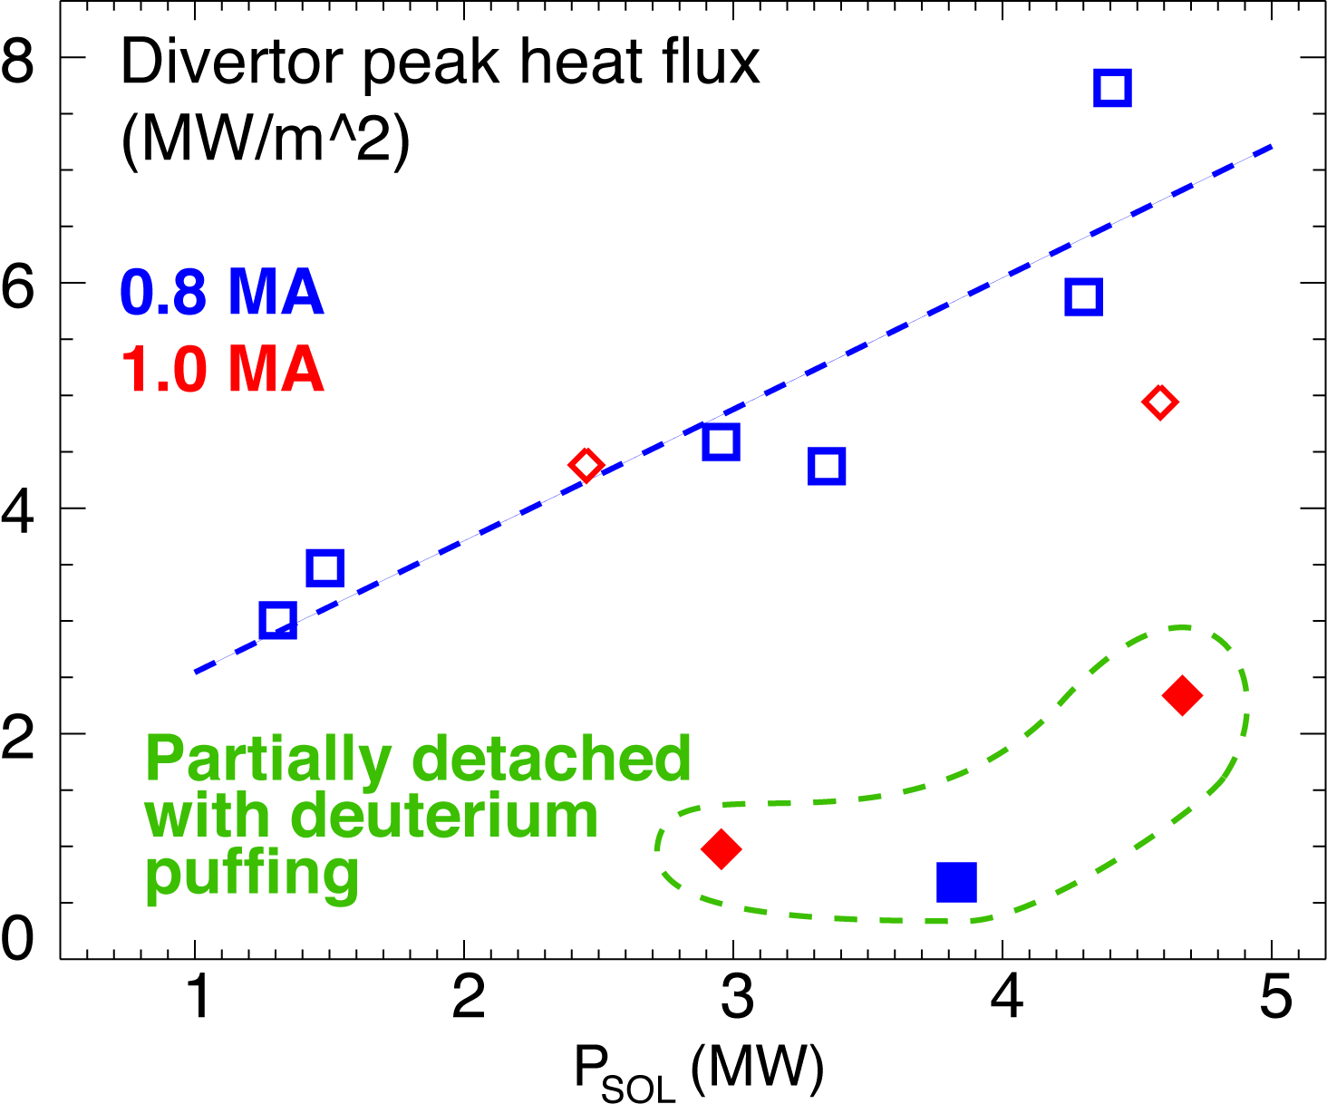
Snowflake divertor heat flux consistent with NSTX divertor heat flux scalings
0.8 MA
*
*
*
50
flux expansion
Snowflake divertor (*): P_{SOL}~3-4 MW, f_{exp}~40-60, q_{peak}~0.5-1.5 MW/m²
  Low detachment threshold
T. K. Gray et. al, EX/D P3-13, IAEA FEC 2010
V. A. Soukhanovskii et. al, PoP 16, 022501 (2009)

Slide 15
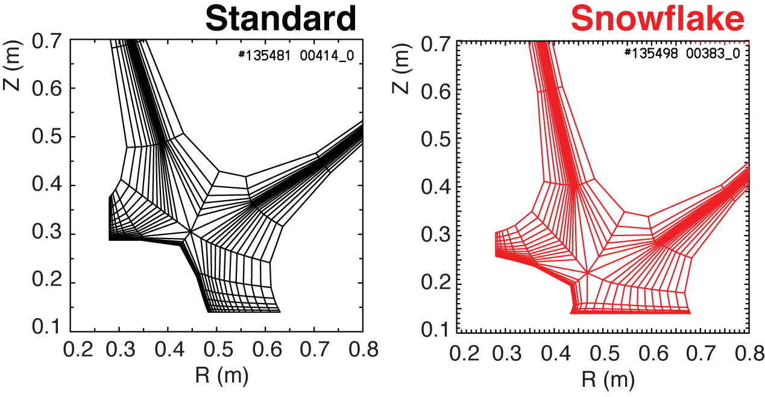
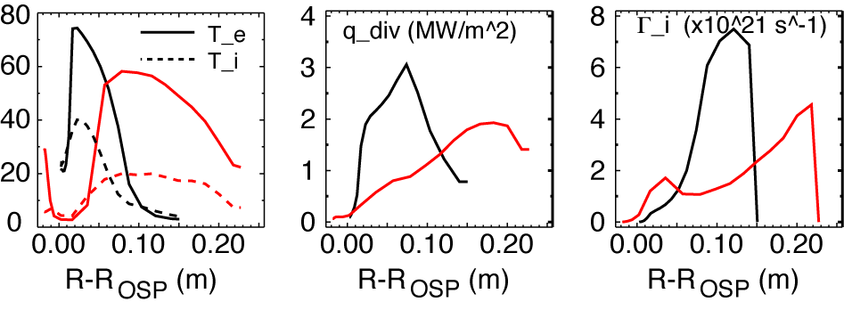
2D modeling shows a trend toward reduced temperature, heat and particle fluxes in the snowflake divertor
2D multi-fluid code UEDGE
  Fluid (Braginskii) model for ions and electrons
  Fluid for neutrals
  Classical parallel transport, anomalous radial transport
    D = 0.25 m²/s
    χ_{e,i} = 0.5 m²/s
  Core interface:
    T_{e,i} = 120 eV
    n_{e} = 4.5 x 10¹⁹
  R_{recy} = 0.95
  Carbon 3 %

Slide 16
Outline: Experimental studies of snowflake divertor in NSTX
Tokamak divertor challenge
Snowflake divertor configuration
Snowflake divertor in NSTX
  Magnetic properties realized in steady-state
  Core H-mode confinement unchanged
  Core impurities reduced
  Divertor heat flux significantly reduced
  Consistent w/ 2D edge transport model
Conclusions and outlook

Slide 17
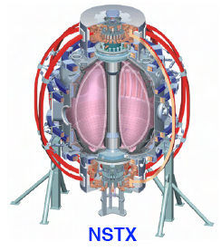
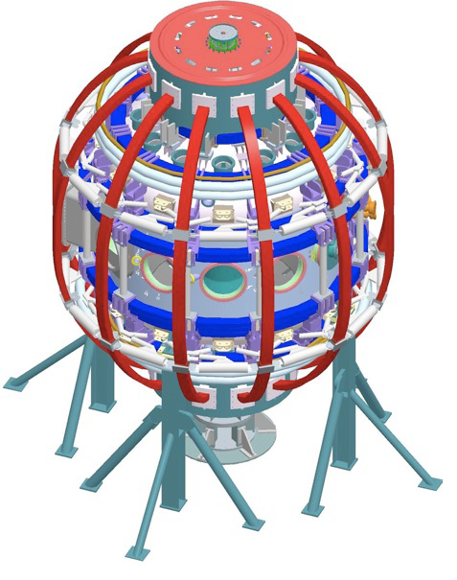
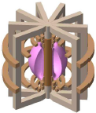
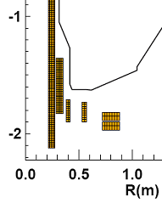
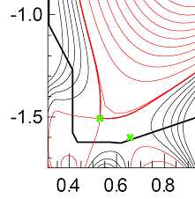
Divertor heat flux mitigation is key for present and future fusion plasma devices
ST / NSTX goals:
  Study high beta plasmas at reduced collisionality
  Access full non-inductive start-up, ramp-up, sustainment
  Prototype solutions for mitigating high heat & particle flux
NSTX-Upgrade
  Development of divertor solutions to address
    2-3x higher input power
    Projected peak divertor heat fluxes up to 24 MW/m²
    Up to 30 % reduction in Greenwald fraction
    3-5 x longer pulse duration
  Additional divertor coil PF1C
    Flux expansion variation with fixed X-point height
NSTX
NSTX-U
ST-based Plasma Material Interface (PMI) Science Facility
ST-based Fusion Nuclear Science (FNS) Facility

Slide 18
NSTX studies suggest the snowflake divertor configuration may be a viable divertor solution for present and future tokamaks
Steady-state snowflake (up to 600 ms, many τ_{E}’s)
Good H-mode confinement (τ_{E}, T_{e,i}(0), β_{N}, H98(y,2) )
Reduced core carbon concentration
Significant reduction in divertor steady-state heat flux
Potential to combine with radiative divertor for increased divertor radiation

Slide 19
Backup slides

Slide 20
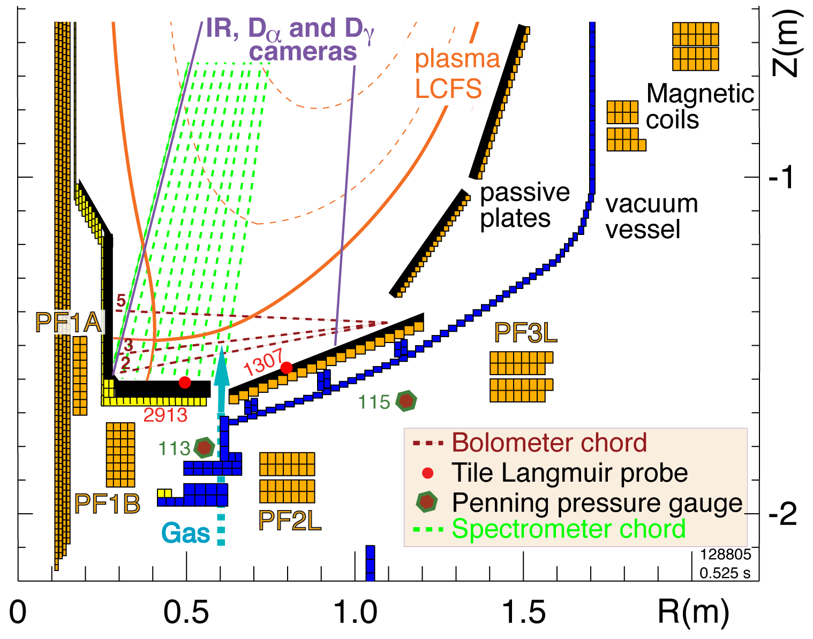
Open divertor geometry, three existing divertor coils and a good set of diagnostics enable divertor geometry studies in NSTX
I_{p} = 0.7-1.4 MA
P_{in} ≤ 7.4 MW (NBI)
ATJ and CFC graphite PFCs
Lithium coatings from lithium evaporators
Three lower divertor coils with currents 1-5, 1-25 kA-turns
Divertor gas injectors (D₂, CD₄)
Extensive diagnostic set

Slide 21
Heat flux mitigation is more challenging in compact divertor of spherical torus
NSTX
  I_{p} = 0.7-1.4 MA, t_{pulse} < 1.5 s, P_{in} ≤ 7.4 MW (NBI)
  ATJ and CFC graphite PFCs
  P / R ~ 10
  q_{pk} ≤ 15 MW/m²
  q|| ≤ 200 MW/m²
Quantity | NSTX | DIII-D
Aspect ratio | 1.4-1.5 | 2.7
In-out plasma boundary area ratio | 1:3 | 2:3
X-point to target parallel length L_{x} (m) | 5-10 | 10-20
Poloidal magnetic flux expansion f_{exp} at outer SP | 5-30 | 3-15
Magnetic field angle at outer SP (deg.) | 1-10 | 1-2

Slide 22
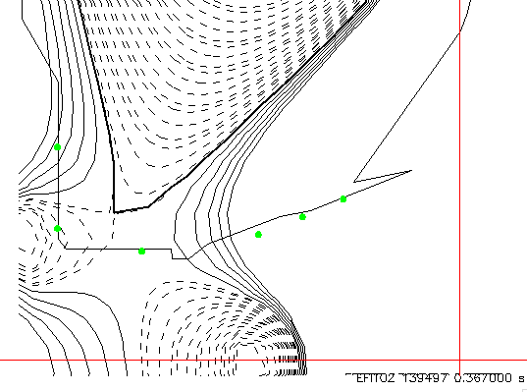
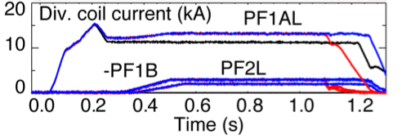
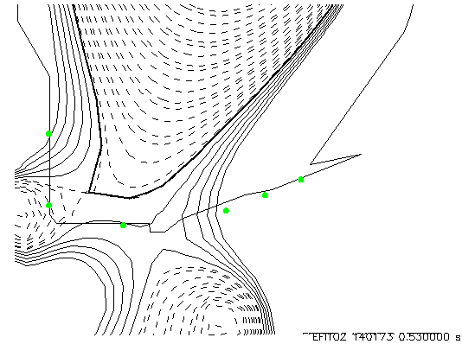
Steady-state asymmetric snowflake-minus configuration has been obtained in FY2010 experiments in NSTX
Snowflake-minus with three coils (w/ reversed PF1B) transformed from a standard medium-δ LSN at ~ 500 ms
Snowflake with three coils (w/ reversed PF1B) transformed from a standard high-δ LSN at ~ 500 ms

Slide 23
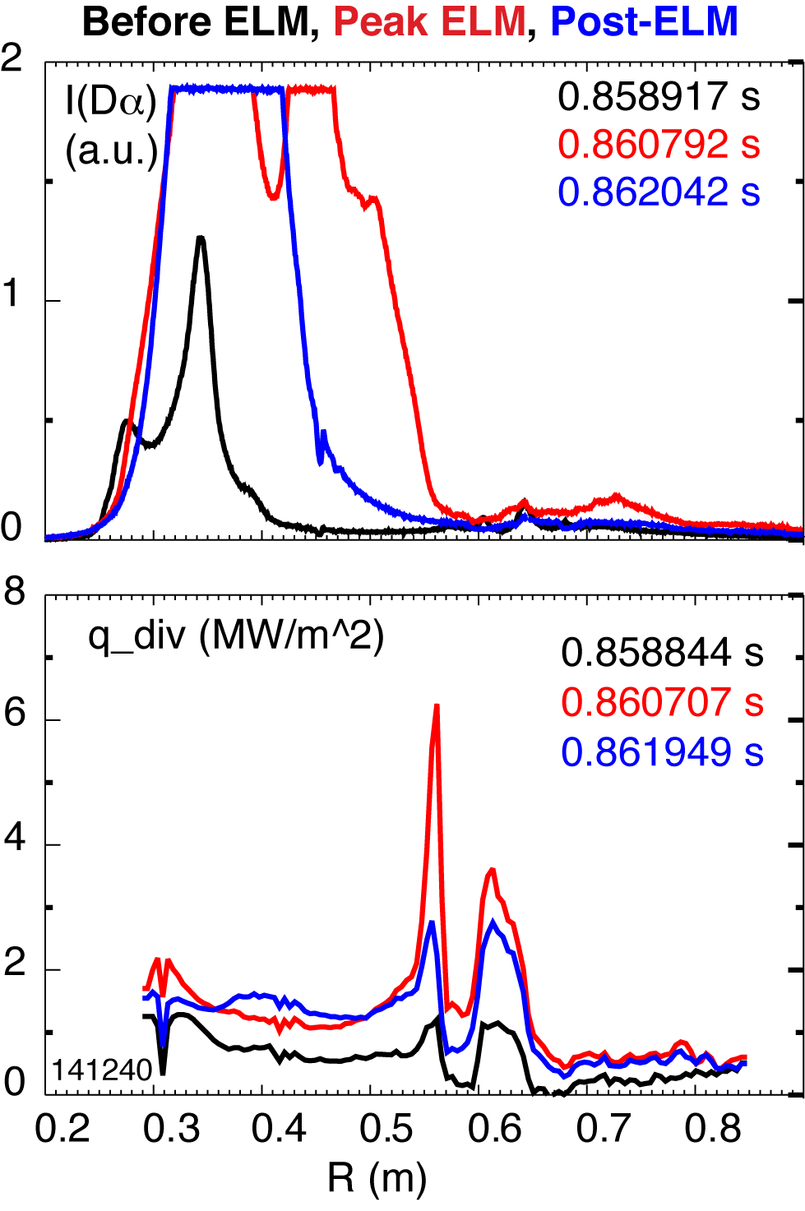
Preliminary indications that ELM heat flux is effectively dissipated in snowflake divertor
Type I ELMs is a concern for divertor lifetime
  Erosion
  Evaporation, melting
Radiative buffering of ELMs ineffective
In NSTX snowflake divertor
  Type I ELMs 5-12 % ΔW/W
  Significant dissipation of ELM energy in strike point region
  Reduction in low flux expansion region (at larger R_{div})
  Need more data to analyze mechanisms and trends
    Heat diffusion over longer conn. length
    Field line mixing in null-point region
    Radiative / collisional dissipation
    Plasma-wetted area effect

Slide 24
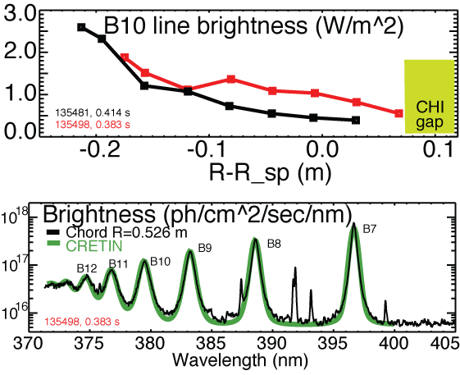
High-n Balmer line emission measurements suggest high divertor recombination rate, low T_{e} and high n_{e}
Balmer series spectra modeled with CRETIN; Spectra sensitive to
  Line intensity <-> Recombination rate
  T_{e} <-> Boltzman population distribution
  n_{e} <-> Line broadening due to linear Stark effect from ion and electron microfield
T_{e}=0.8-1.2 eV, n_{e}=2-7 x 10²⁰ m⁻³ inferred from modeling

Slide 25
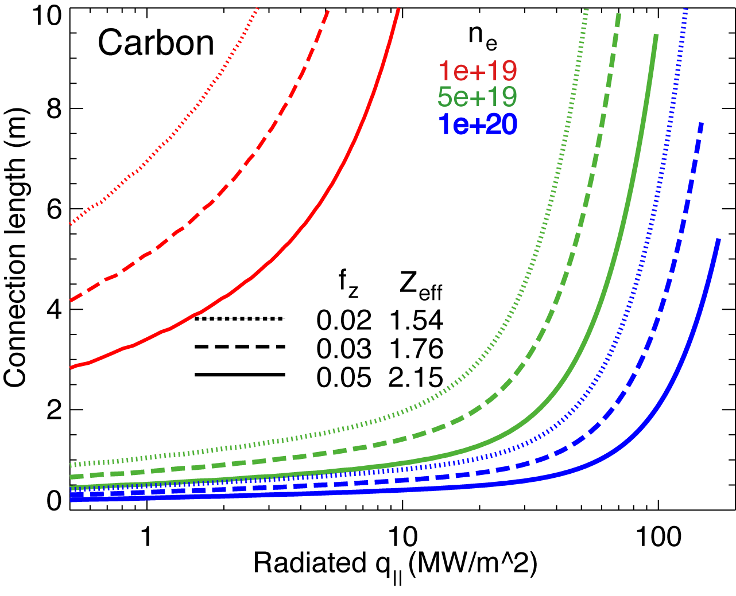
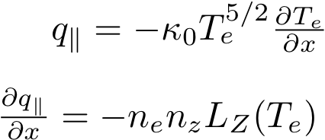
1D estimates indicate power and momentum losses are increased in snowflake divertor
1D divertor detachment model by Post
  Electron conduction with non-coronal carbon radiation
  Max q|| that can be radiated as function of connection length for range of f_{z} and n_{e}
  -> Greater fraction of q|| is radiated with increased L_{x}
Three-body electron-ion recombination rate depends on divertor ion residence time
  Ion recombination time: τ_{ion}~ 1−10 ms at T_{e} =1.3 eV
  Ion residence time: τ_{ion} ≤ 3-6 ms in standard divertor, x 2 in snowflake
  -> Greater parallel momentum sink

Slide 26
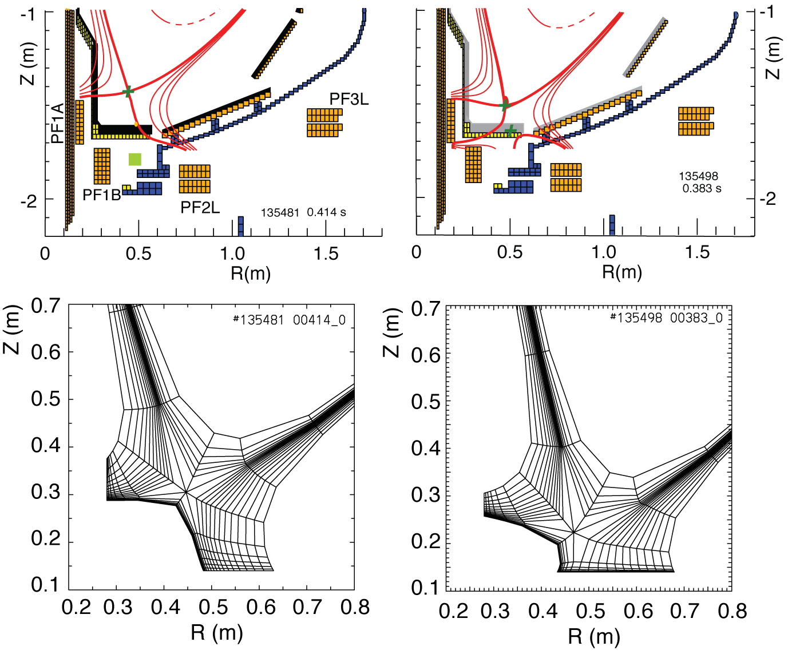
2D multi-fluid edge transport code UEDGE is used to study snowflake divertor properties
Fluid (Braginskii) model for ions and electrons
Fluid for neutrals
Classical parallel transport, anomalous radial transport
Core interface:
  T_{e} = 120 eV
  T_{i} = 120 eV
  n_{e} = 4.5 x 10¹⁹
D = 0.25 m²/s
χ_{e,i} = 0.5 m²/s
R_{recy} = 0.95
Carbon 3 %
Standard Snowflake

Slide 27
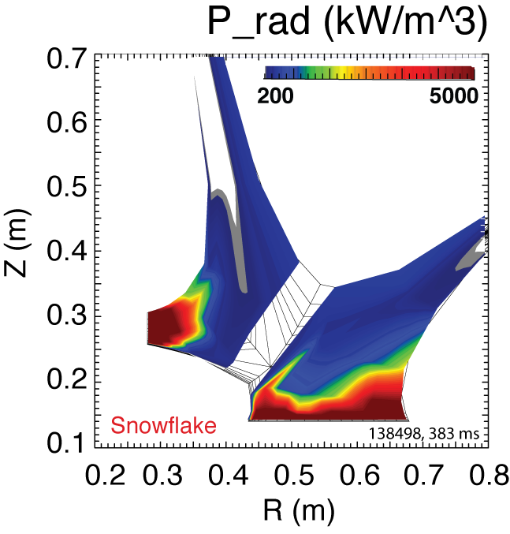
Radiated power is broadly distributed in the outer leg of snowflake divertor
UEDGE model

