Slide 1
The IFMIF Target Facility Engineering Design and the Validation of Key Issues within the IFMIF/EVEDA Project
2nd International Symposium on Lithium Applications
Princeton, 27-29 April 2011
F. Groeschel
On behalf of the IFMIF-EVEDA Project Team

Slide 2
Outline of talk
Scope of IFMIF and of the IFMIF/EVEDA Project
IFMIF Loop Concept and ELiTe Loop for off-beam tests
Li Target Assemblies and validation of free surface flow
Li purification system and its validation
Li safety issues for IFMIF and ELiTe
Summary and conclusions

Slide 3
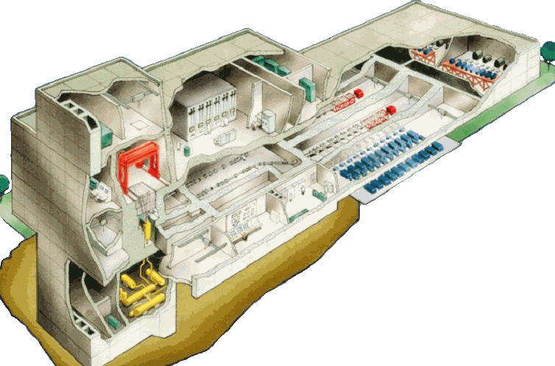
IFMIF “Artist View” (CDR, 2003)
Post Irradiation Experiment
Facilities
Test Modules inside
Test Cells
Ion Source
RF Quadrupole
Drift Tube Linac
High Energy Beam transport
Li Target
0 20 40 m
Li Loop

Slide 4
Principle of IFMIF
Accelerator
(125 mA x 2)
Lithium Target
25^{±1} mm thick, 15 m/s
Test Cell
LEBT
MEBT
L
Source
140 mA D⁺
RFQ
HEBT
M
Half Wave Resonator
Superconducting Linac
H
100 keV
5 MeV
9 14.5 26 40 MeV
Beam shape:
200 x 50 mm²
High (>20 dpa/y, 0.5 L)
Medium (>1 dpa/y, 6 L)
Low (<1 dpa/y, > 8 L)
RF Power System
Typical reactions
  ⁷Li(d,2n)⁷Be
  ⁶Li(d,n)⁷Be
  ⁶Li(n,T)⁴He

Slide 5
Objectives of the IFMIF/EVEDA Project
Produce a detailed, complete and fully integrated engineering design of the International Fusion Materials Irradiation Facility and all data necessary for future decisions on the construction, operation, exploitation and decommissioning of IFMIF
Validate continuous and stable operation of each IFMIF subsystem by designing, manufacturing and testing scalable models to ensure engineering feasibility
Article 1 of Annex 1 of BA Agreement, February 2007

Slide 6
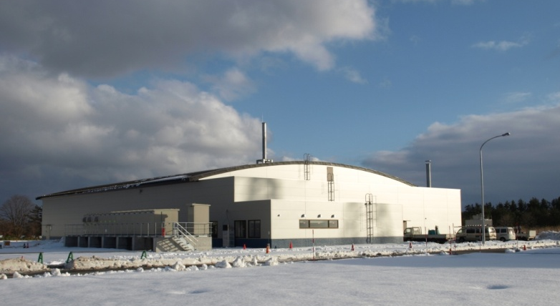
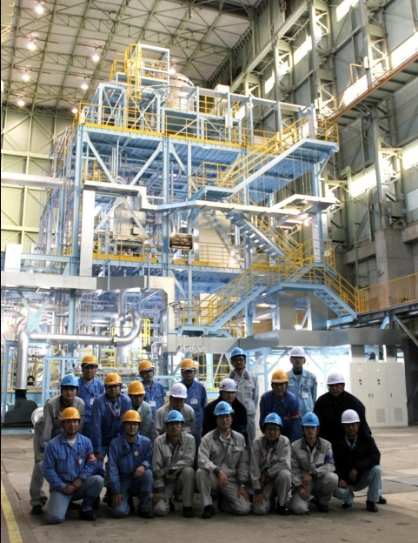
Engineering Validation & Engineering Design Activities
Rokkasho
IFMIF/EVEDA Accelerator Building
Oarai
Validation goals
Stable free surface Li flow in the target assembly
Achievement of low impurity levels of oxygen, nitrogen, hydrogen (< 10 wppm)
Lithium Test Loop
(scale 1/3)

Slide 7
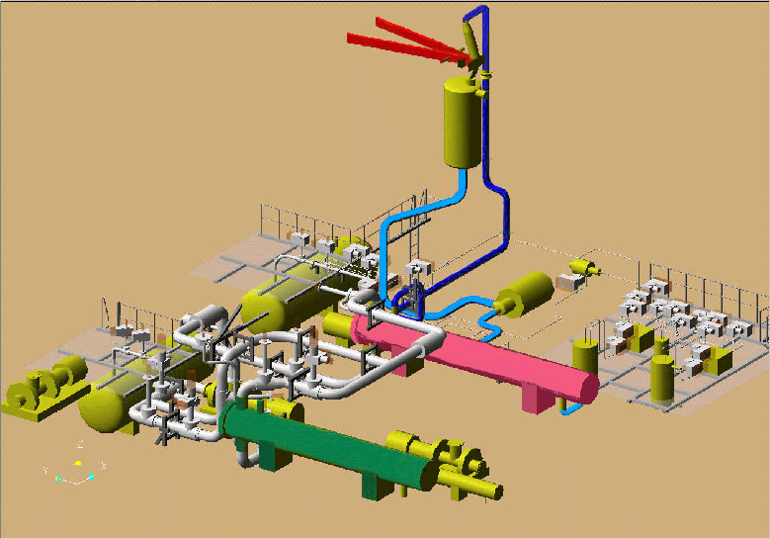
IFMIF Li loop baseline concept (2003)
Loop properties
Li inventory | 4.5 to
Li flow rate | 130 l/s
Piping | 8/10“
Operating temperature | 250-350C
Heat to be removed | 10 MW
Secondary cooling | oil
Tertiary cooling | water
Deuteron Beams
Quench Tank
Li flow
EM Pump
Dump Tank
HX(Li / Organic Oil)
T Hot Trap
Cold Trap
HX(Organic Oil / Water)

Slide 8
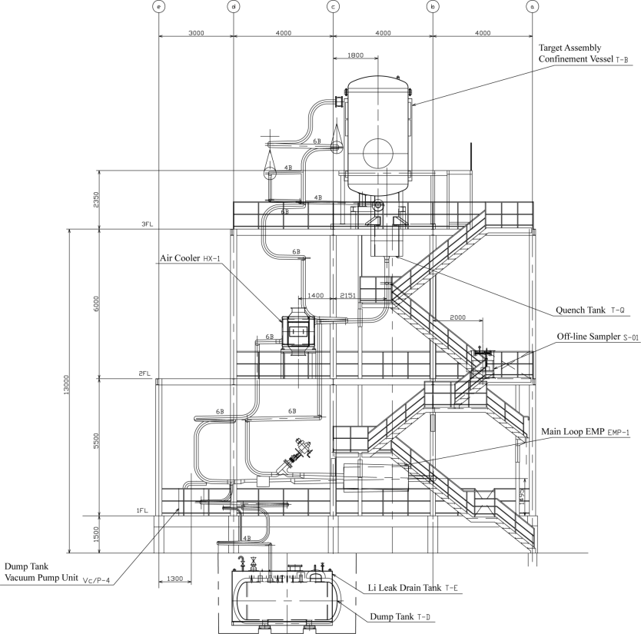
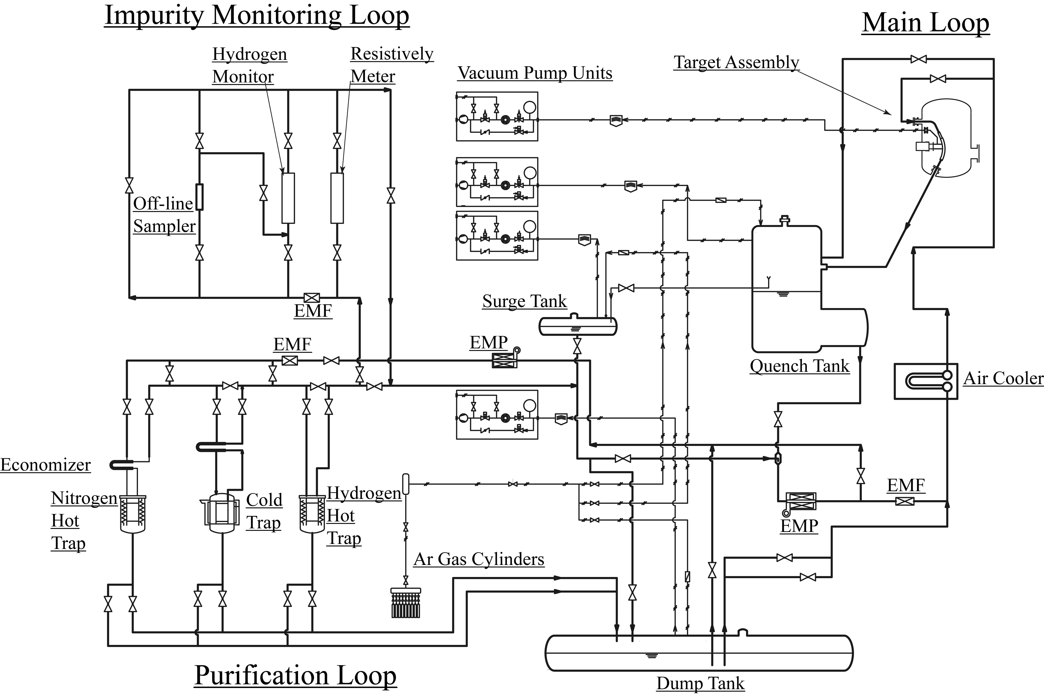
ELiTe loop layout
Li inventory | 2.5 to
Li flow rate | 50 l/s
Piping | 6/8“
Design pressure | 7.5 bar(g)
Design temperature | 400C
Operating temperature | 250-350C
Heat to be removed | 150 kW
Design acceleration | 0.36g h/0.24g v
Structural material | AISI 304
Scaling in flow rate 1:2.6
NPSH requires similar height as IFMIF
Air cooler, no secondary loops
Bypass branch for target assembly to facilitate start of flow through target assembly
Purification system integrated in main structure
Purification branch with small EMP (10 l/s)

Slide 9
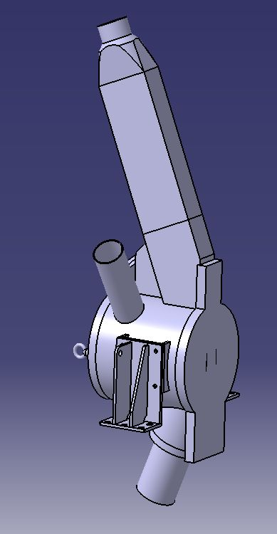
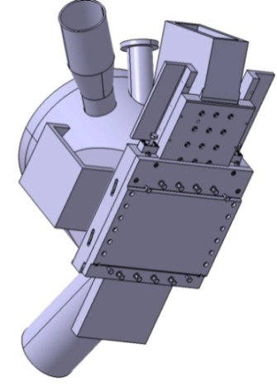
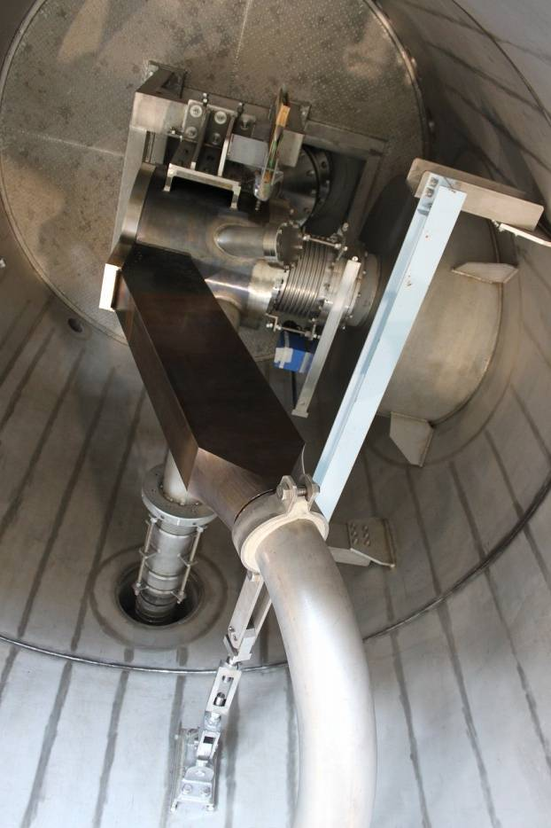
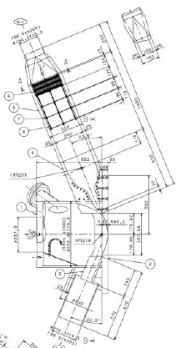
Target assembly concepts
The target assembly conditions and shapes the flow to form a 260 mm wide, 25 mm thick Li jet flowing in an concavely shaped open channel
Three concepts have been developed in the past
TA with integrated backwall (tested in ELS, ISTC)
Lipseal welded and clamped backplate concept
Bayonet backplate concept
Two concepts are realized and tested in the ELiTe loop
Integrated backwall TA made of stainless steel
Bayonet backplate concept made of F82H/Eurofer
Li jet width | 100 mm
Li jet height | 25±1 mm
Flow channel curvature | 250 mm → 7 m
Flow veolcity | 10-20 m/s
Nozzle | Shima two stage
Nozzle reduction ratio | 10:2.5.:1
Nozzle and channel roughness | < 3 μm
Vacuum pressure | 10⁻⁴ to 10⁻³ Pa
Argon pressure | < 0.1 Mpa(a)

Slide 10
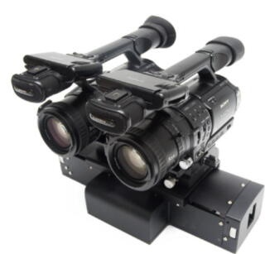
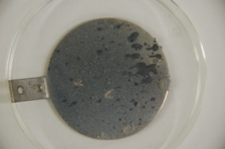
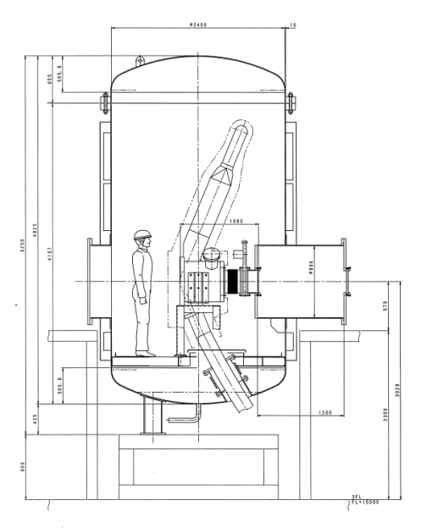
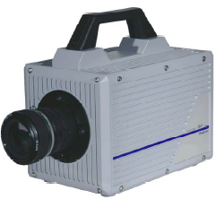
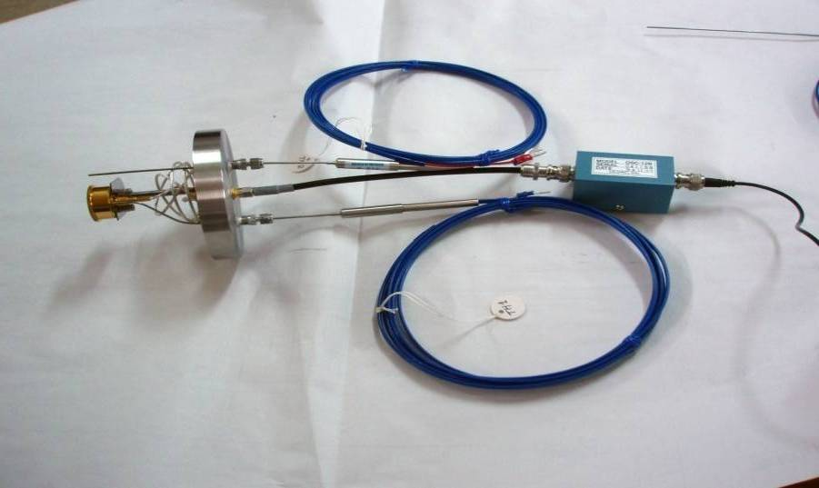
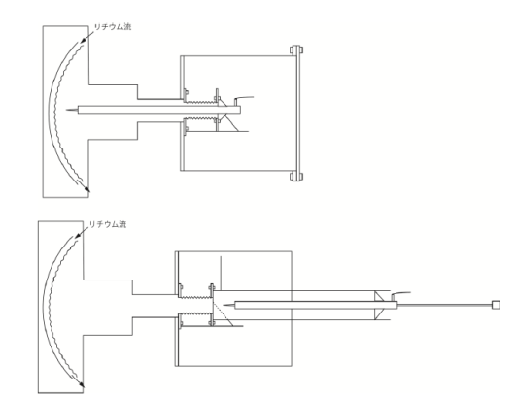
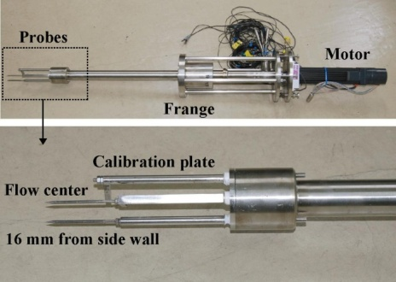
Li free surface flow validation
How to assure stable Li free surface flow in the beam footprint; i.e. thickness variation < ±1 mm
How to manage Li evaporation from the free surface
Li deposition sampler
Stereo-Scopic Imaging System
HSV
Quartz microbalance
Electro-contact probe
Diagnostics developed by Osaka University and qualified in Osaka loop
CFD modeling by several institutes

Slide 11
Lithium Purification in IFMIF and Validation
Lithium has to be purified
  To maintain the liquid metal properties (viscosity, avoid plugging)
  To mitigate corrosion/erosion. Nitrogen enhances corrosion in stainless steels by forming a soluble CrLiN-compound
  To reduce the radioactive inventory and the limit the radiation field around the loop. Production of ³H is about 7.5 g/fpy and of ⁷Be is about 1.5 g/fpy in IFMIF. Corrosion products from the target assembly and others passing through the target assembly are activated
Purification system
  Cold trap operating below the loop temperature
  Nitrogen hot trap operating at 580-600C
  Hydrogen isotopes trap operating at 280-300C
  On-line composition monitors (hydrogen, resistivity, plugging meter)
  Li samplers for off-line analysis
Target impurity level design values
  10 wppm for H, N and corrosion products
  1 wppm for ³H
11

Slide 12
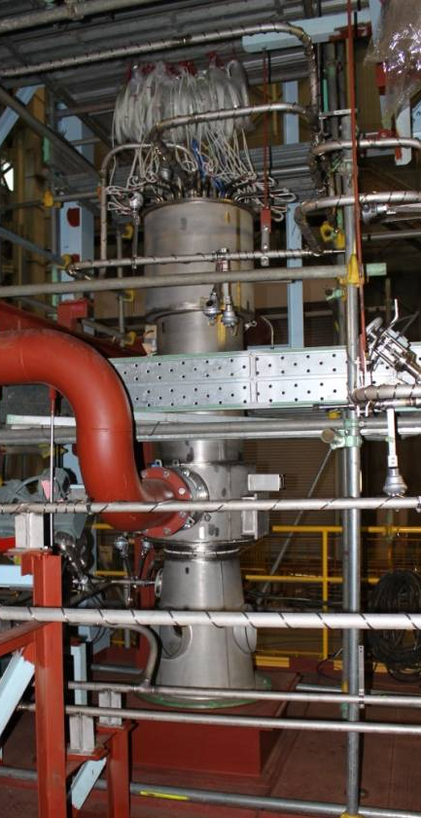
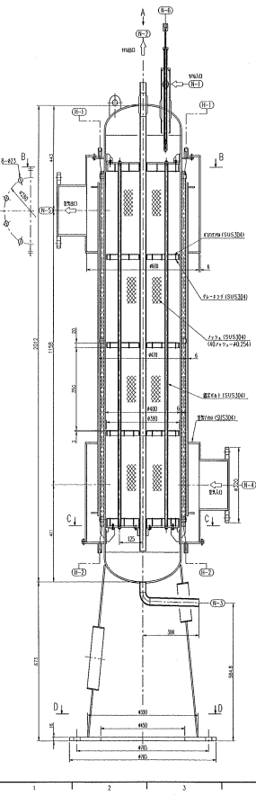
IFMIF cold trap and ELiTe validation
Cold trap design is based on Na experience
Main source term is
  Initial oxidized steel surface (1 g/m²)
  Recontamination of surfaces during maintenance
Intermittent operation could be envisable
Trapping of Be during beam operation is not very effective due to low temperature gradient to main loop
Li out (190 °C)
Li in (210 °C)
Properties | IFMIF ref |  | ELiTe
Loop surface | 800 m² |  | 120 m²
Getter | 304 wire mesh
Volume of mesh | 153 l | 160 l (mesh 40)
Capacity for oxygen | 25 kg | 4.2 kg
Li flow rate |  | 10 l/min
Residence time |  | 10 min
Air out (55 °C)
Air in (30 °C)
Li drain
IFMIF
ELiTe
12

Slide 13
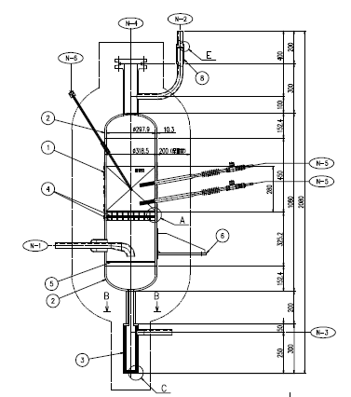
IFMIF nitrogen trap and ELiTe validation
IFMIF reference design uses Ti sponge getter
University of Tokyo develops Fe-Ti getter with 5-10 at.-% Ti to overcome saturation due to formation of TiN layer on pure Ti
Qualification of getter material on laboratory scale by UoT (in stagnant vessel and in small 1 l Li loop)
Main source term is
  Initial Li impurity
  Surface coverage of initial loop surface (1 g/m²) → same assumption as for O
  Recondamination of surfaces and Li during maintenance
Properties | IFMIF ref | ELiTe
Getter | Ti sponge | Fe-5% Ti pebbles 0.16 mm diam.
Operating temp. | 580-600C
Getter mass | 230 kg | 95 kg
Capacity for nitrogen | 45 kg (30% margin) | 4.2 kg
Li flow rate |  | 10 l/min
Residence time |  | 10 min
IFMIF
ELiTe
13

Slide 14
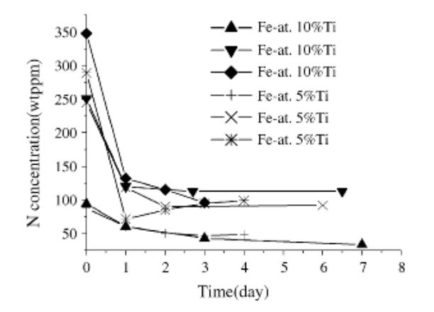
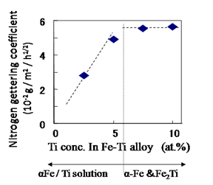
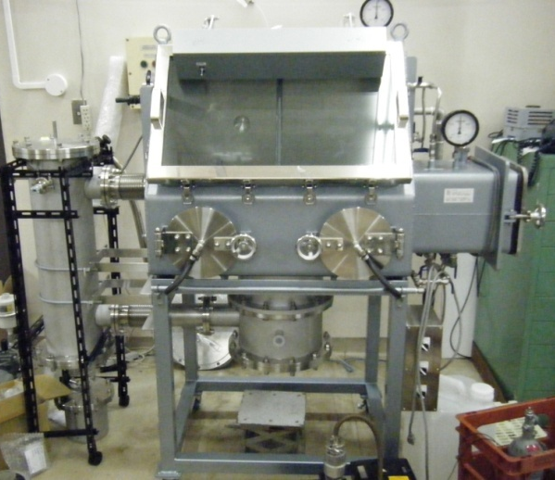
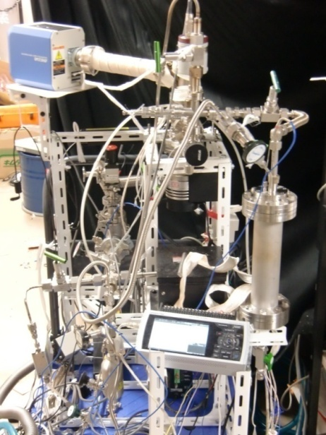
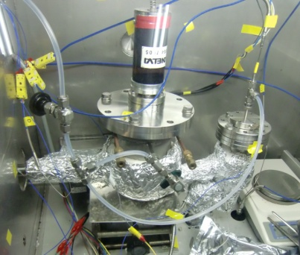
Development and qualification of N getter material
University of Tokyo loop for nitrogen trapping
Setup for membrane qualification

Slide 15
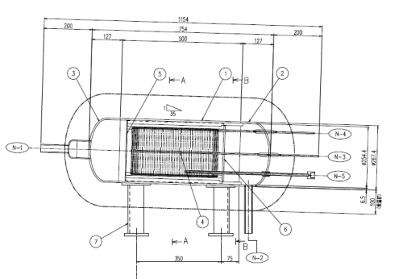
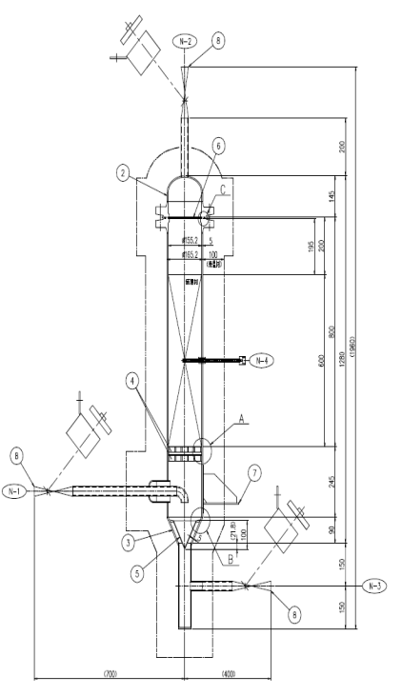
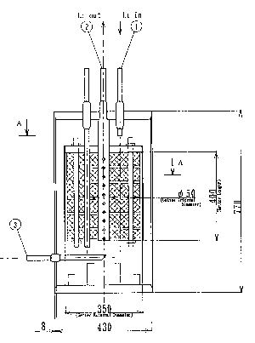
IFMIF hydrogen trap and ELiTe validation
IFMIF reference design uses Yttrium sponge
Kyushu University develops Yttrium getter based on pebbles saturation
Qualification of getter material on laboratory scale by KU (in stagnant vessels and a small flowing device)
Initial activation of Yttrium surface using HF is important
Cross contamination needs to be avoided
Main source term is
  Deuterium from neutron beam and reaction products of Li-d and Li-n interaction
  D:H:T is 100:6:3
Hydrogen permeator
Properties | IFMIF ref |  | ELiTe
Getter | Yttrium sponge |  | Yttrium pebbles, 1 mm diameter
Operating temp. | 280-300C
Getter mass | 70 kg | 25 kg
Capacity for H | 3 kg | 1.2 kg
Li flow rate |  | 10 l/min
Residence time |  | 10 min
IFMIF
ELiTe
15

Slide 16
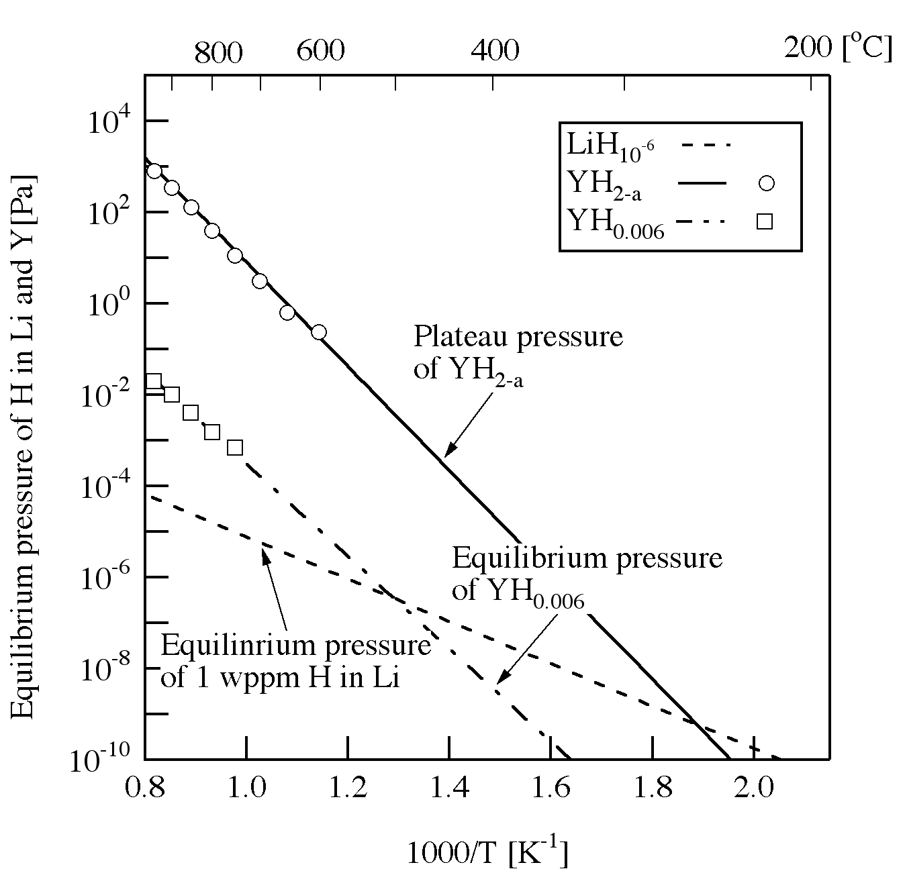
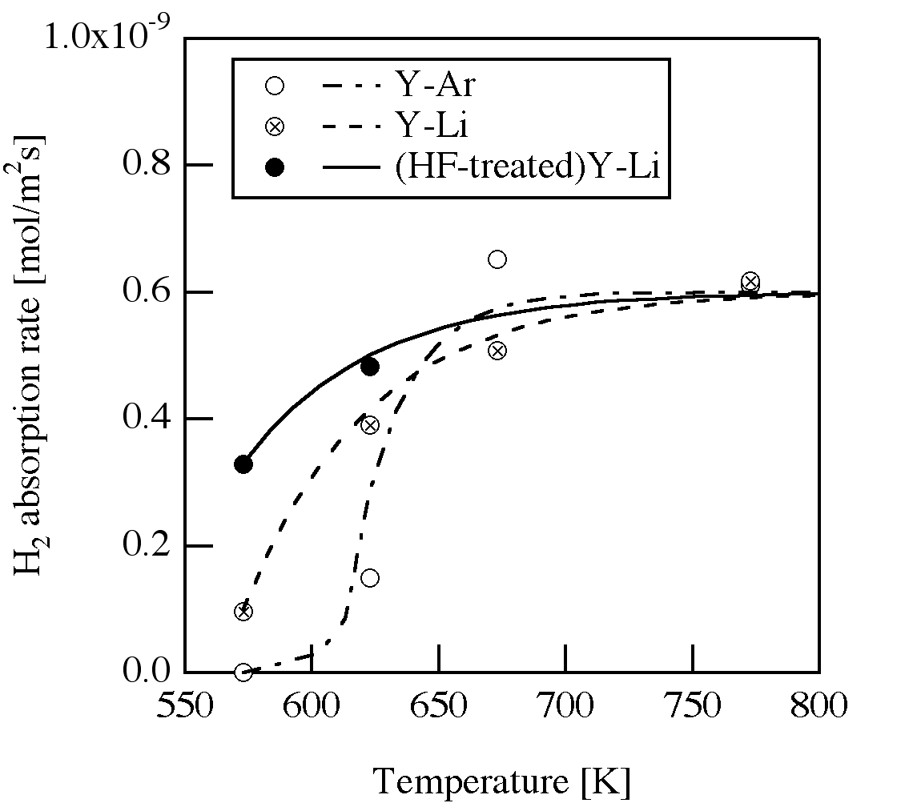
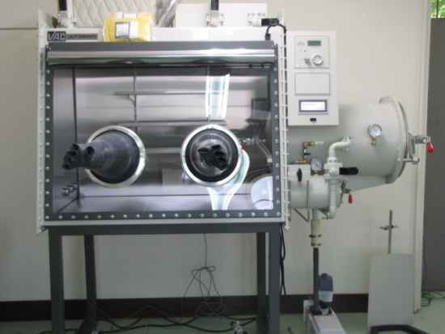
Development and qualification of H getter material
Kyushu University flowing device for hydrogen trapping

Slide 17
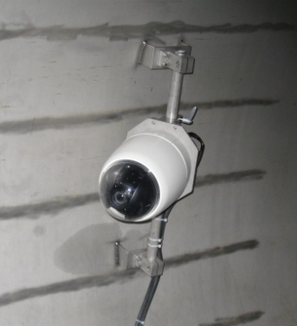
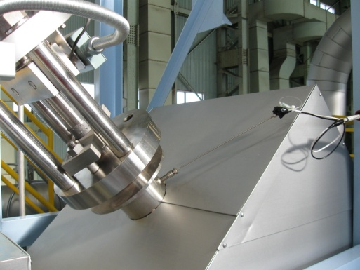
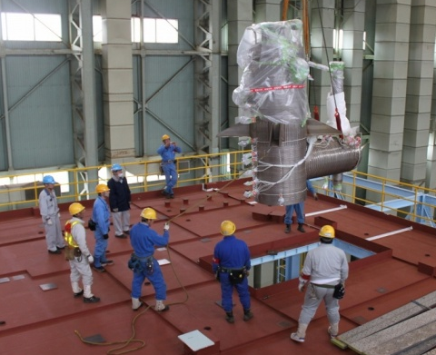
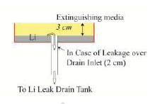
ELiTe safety measures to control spill and fire
ELiTe loop safety approach is based on the rules established for operation of large Na loops in the JAEA Na lab at Oarai
  Rules have been extended to Li operation, but specifity of Li needs to be considered (e.g. reactivity, operating temperature range, weight and specific heat, toxicity, etc.)
  Safety measures have been widely copied in order to facilitate licensing
Detection and control of spills by
  Leak detection wires placed along the piping an all welds placed in the surfaces below the thermal insulation
  Leak detectors on valve stems
  Segmented catch pans (5 m²) with drain pipes to a storage vessel
  Video-sureillance of platform
  Emergency draining of loop

Slide 18
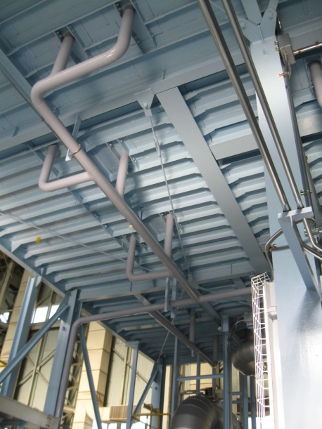
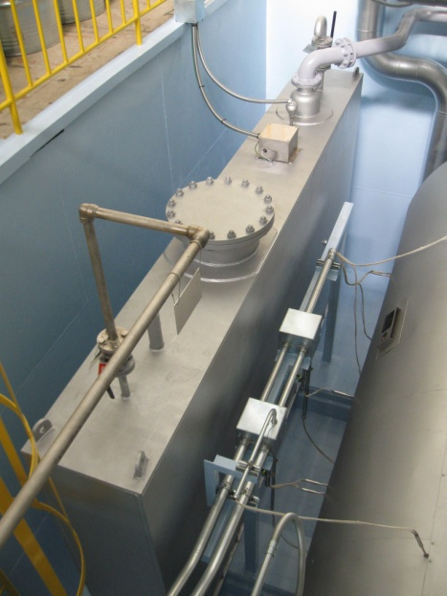
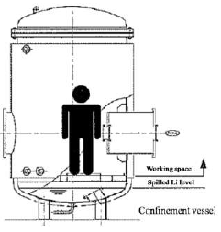
ELiTe safety measures to control spill and fire
Detection and control of fires
  Smoke detectors
  Ar flooding of air ducts and vessels
  Human intervention to extinguish fires with specific agent NATREX-L (protective clothing and independent air supply)
Containement vessel for target assembly
  Operation under Ar atmosphere
The loop itself is exposed to air
  Li fire in case of spills can thus not be excluded
  Assessment of possible leakages based on accident scenarios

Slide 19
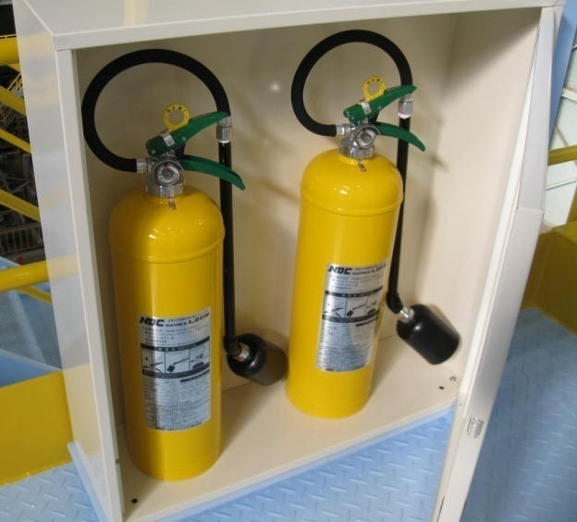
Qualification of fire extinguishant
Natrex-L (mostly NaCl) has been selected
Coverage with several cm of extinguishant is required to suppress flames and cause drop of pool temperature
The fire-extinguishing behavior of dry sand applied to lithium
The fire-extinguishing behavior of lithium by application of Natrex-L

Slide 20
IFMIF safety measures
The main requirement for IFMIF is to safely contain the radioactive inventory and do not exceed the legal release limits under normal or any accident situation
Additional measures are therefore required
The rooms (about 1500 m³) containing the Li loop are conceived as a containment, flooded with Ar and kept under a pressure slightly lower than the surrounding rooms
The Ar is conditioned such that a fire cannot develop in case of a leak (minimum air content, low humidity)
The Ar atmosphere needs to be conditioned, since
  Air ingress cannot be excluded
  Tritium diffuses through the loop piping (about 1 MBq/h)
→ Recycling of Ar after extraction of the air and of the tritium
20

Slide 21
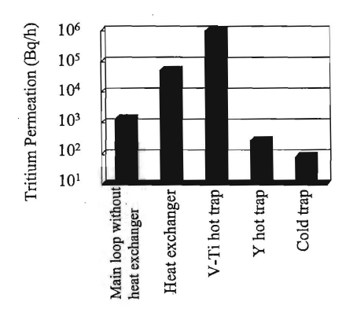
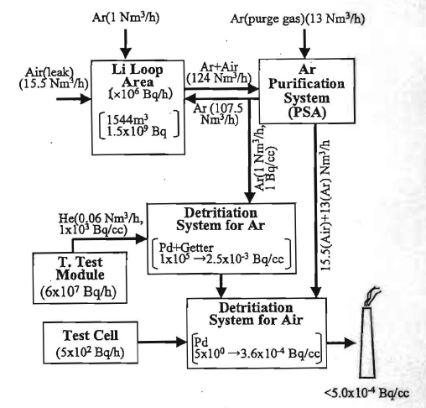
IFMIF safety measures
Matsushiro et al., Fusion Science and Technology 2005
21

Slide 22
Summary and conclusions
Engineering design and validation tasks are closely linked
The proof of principle that stable flow and low impurity levels can be achieved would be an important step forward, but many other issues which may affect operability, performance and costs still have to be resolved until construction
Unfortunately we run out of time in the project which needs to be completed by 2013
22

