Slide 1
The Present Status and Future Perspective of the Application of Liquid Metals as Plasma-Facing Materials in Magnetic Fusion Devices
The ISLA group: Y. Hirooka (NIFS, Japan), G. Mazzitelli (ENEA, Italy), S. Mirnov (TRINITI, Russia), M. Ono (PPPL, USA), M. Shimada (JAEA, Japan) and F.L. Tabarés (CIEMAT, Spain)
It has widely been recognized in the magnetic fusion research community that plasma-wall boundary control plays an important role in determining core plasma confinement [1, 2]. For the boundary control in fusion experiments, a variety of wall conditioning techniques have been developed to improve plasma confinement.
Among all these techniques, lithium coating on plasma-facing components has been found to be most effective in improving plasma cleanliness as well as energy confinement. Unfortunately, it is also true that, as plasma operation proceeds, solid lithium coatings become saturated with implanted hydrogen isotopes, forming lithium hydride, which then requires plasma shutdown for wall re-conditioning.
To avoid surface saturation, several innovative concepts have been developed over the past decade. As such, the application of liquid metals as plasma-facing materials continues to expand and to improve via problem solving. This paper reviews some of the important findings in recent fusion and laboratory experiments, and provides a future perspective of the plasma-wall boundary control by innovative liquid metal application concepts.
REFERENCES
[1] Y. Hirooka et al. (Ed.); Proc. 1st ISLA, Fusion Eng. and Des. 85(2010) issue 6.
[2] M. Ono (Ed.); Proc. 2nd ISLA, Fusion Eng. and Des. 87(2012) issue 10.

Slide 2
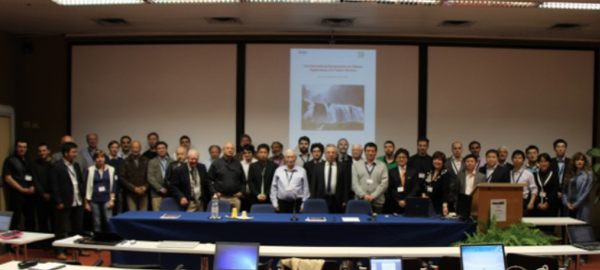
3rd International Symposium on Lithium Applications for Fusion Devices
ENEA, Frascati, October 9-11, 2013
ISLA-2013 - The largest and most important meeting dedicated to liquid metal application for the magnetic fusion research. Overall, 45 presentation plus 5 posters were given representing 28 institutions from 11 countries. Sessions were devoted to Lithium (Li) in magnetic confinement experiments, liquid lithium (LL) technology, Li laboratory test stands, Li theory / modeling / comments, Innovative Li applications, and Li-safety and Li handling.

Slide 3

Worldwide Participation on Liquid Lithium/Metal Research
Presented at ISLA 2013, Frascati, Italy
Magnum/Pilot-PSI
T10, T11-M
z
IFMIF-EVEDA
RFX
KTM
NSTX/LTX
TJ-II
FTU
EAST, HT-7
PPPL, USA
LLNL, USA
SNL, USA
ORNL, USA
U. Illionis, USA
CIEMAT, Spain
FOM-DIFFER, NL
ENEA, Frascati, Italy
ENEA-CNR, Italy
U. Latvia, Latvia
Kurchatov, RF
Trinity, RF
Red Star, RF
StP-SPU, RF
AEI, Kazakhstan
ASIPP, China
Funan U. China
NIFS, Japan
JAEA, Japan

Slide 4
Why Liquid Lithium for fusion reactor?
Lithium (Li) is highly reactive and Li pumps hydrogenic species and impurities such as oxgen.
Li with 181° melting point can naturally stay liquid in reactor environment.
Li coating of PFCs improves plasma performance – low recycling and collisionality (observed in nearly all the confinement systems using lithium)
Li coating reduces divertor heat flux (NSTX LLD) and protects PFC substrates (in nearly all LL systems)
Liquid Li (LL) collects / pumps particles/tritium/impurities and dust
A modest lithium loop can bring collected particles and dust to outside of reactor chamber for removal (essential for steady-state reactor operation.)

Slide 5
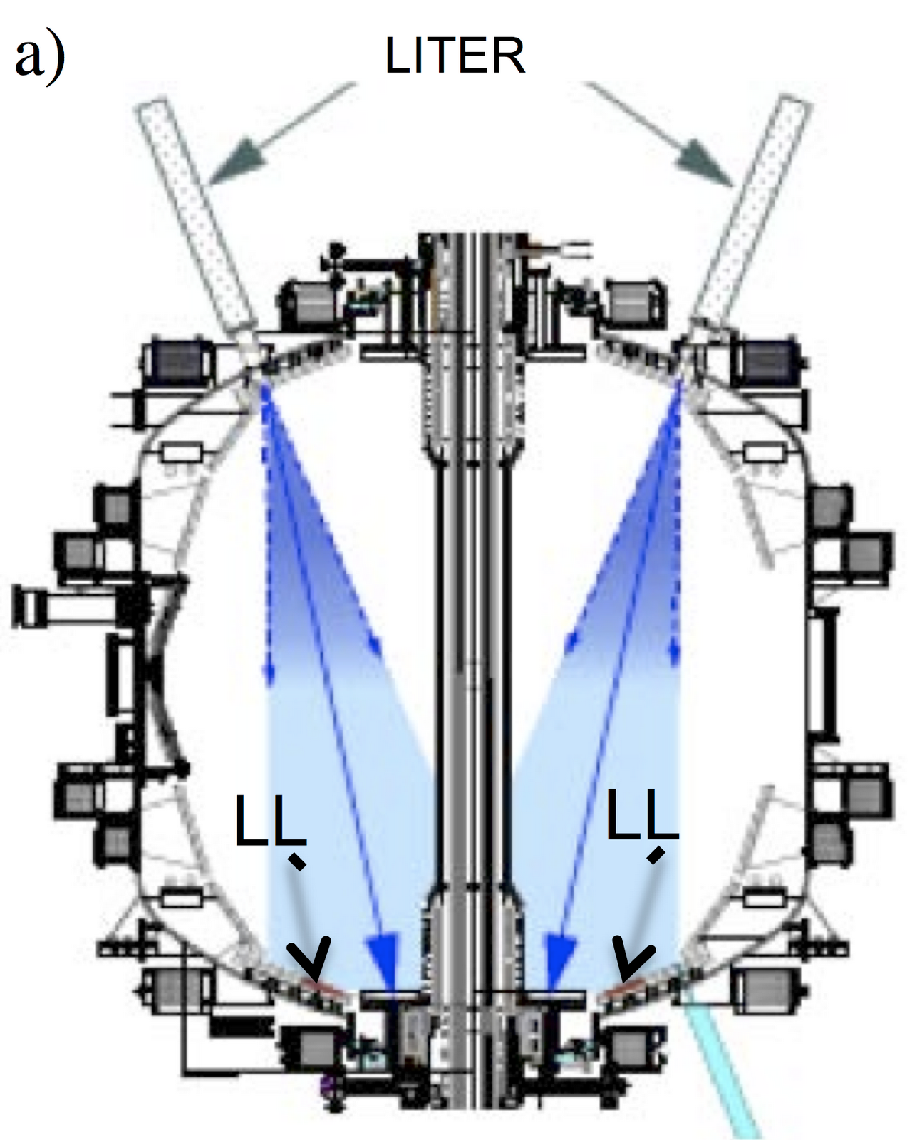
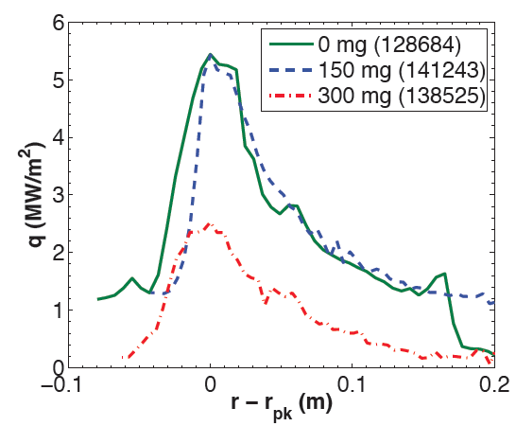
NSTX LLD Produced Many Beneficial Effects
Lithium Improves H-mode Performance via Strong Pumping
Yet, lithium does not contaminate the plasma core
Lithium Evaporation is shown to Reduce λq and Peak Divertor Heat Flux
Travis K. Gray et al.,
Lithium could provide strong divertor radiation, reducing heat flux and protect divertor PFCs. M. Ono, NF 2013

Slide 6
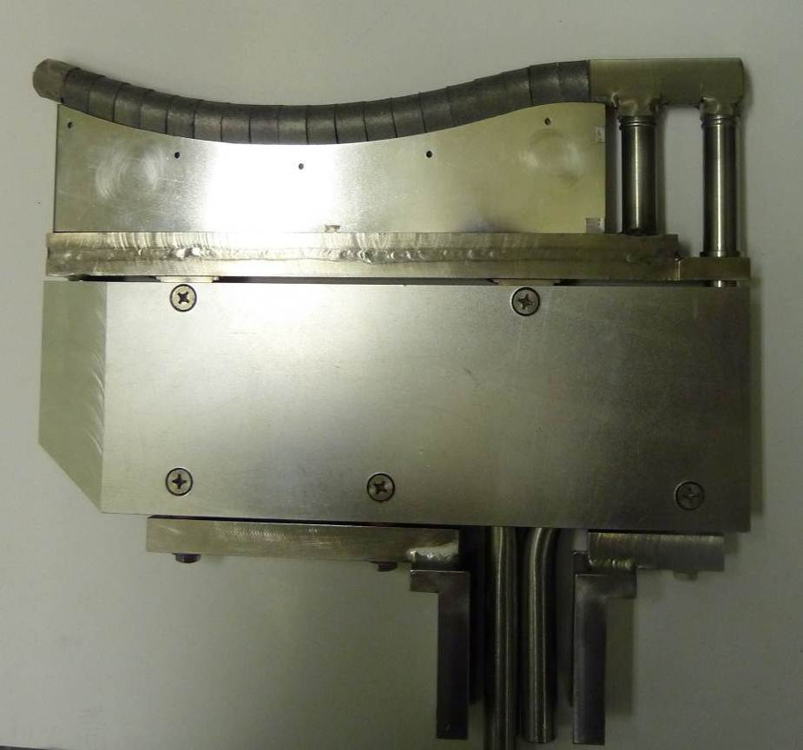
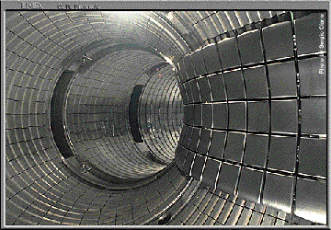
Liquid Lithium Experiments on FTU
G.Mazzitelli
Cooled Lithium Limiter (CLL)
CPS W structure
CLL
Melting point 180.6 °C
Boiling point 1342 °C

Slide 7

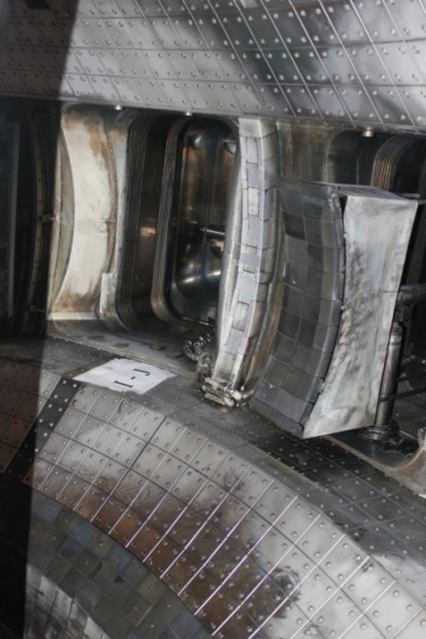
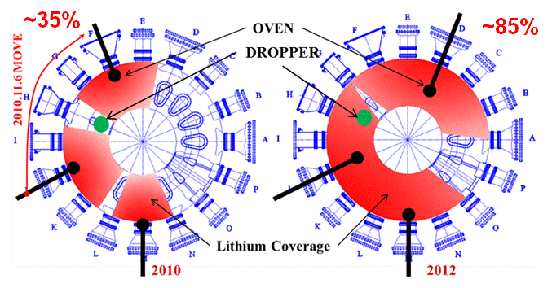
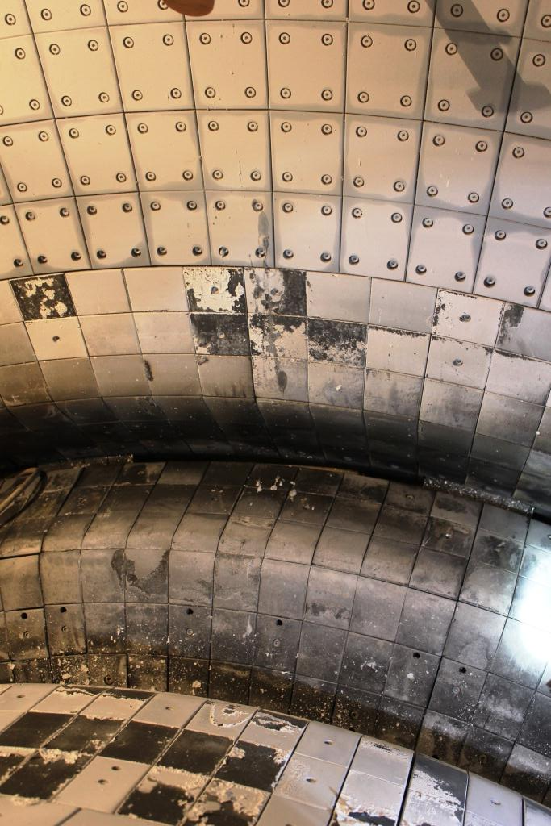

New progresses of Li applications on HT-7 and EAST in 2012
New Results: increase coverage and coat on Mo
ASIPP
Increasing Li Coverage (85% in 2012 vs 30% in 2010)
Lithium coating are more uniform than in 2010
Li well coated on C divertor.
Li well coated on Mo first walls
Need one more oven for full surface coating.
J.S. Hu et al.,
Jiansheng Hu / the 3rd International Symposium on Lithium Applications for Fusion Devices

Slide 8
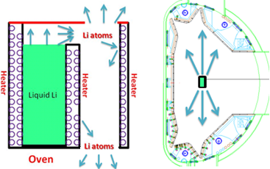
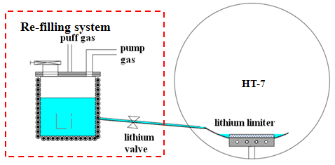
Li granules injection on EAST
Lithium delivery systems in EAST and HT-7
Upgraded Li coating system in 2012
  Liquid Li Limiters experiments on HT-7
First observations of ELM triggering by injected lithium granules in EAST, by D.K. Mansfield, et al.,

Slide 9
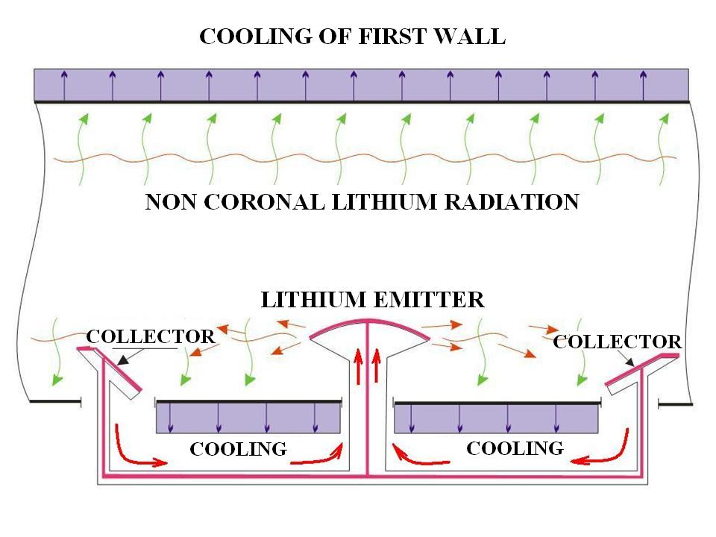
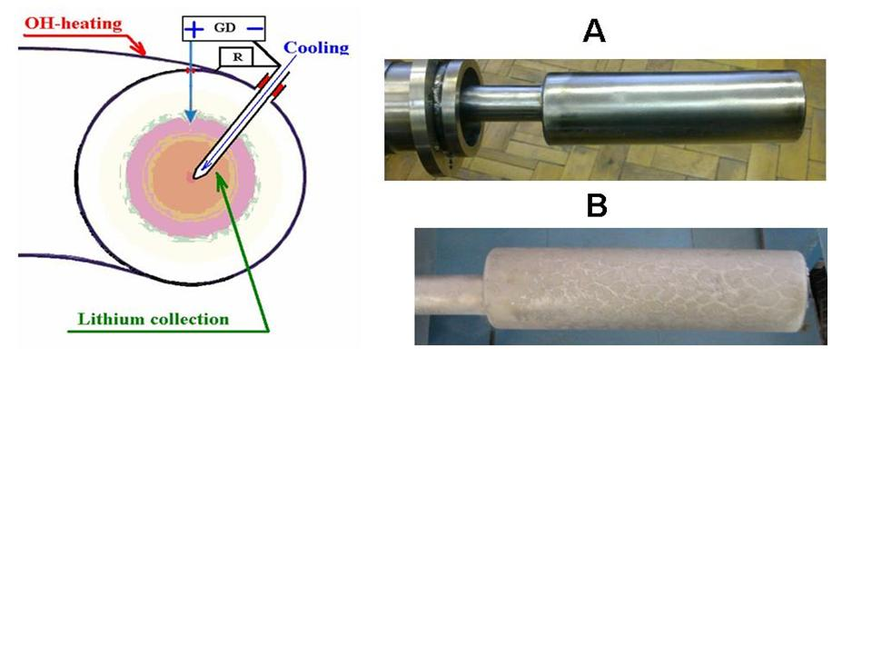
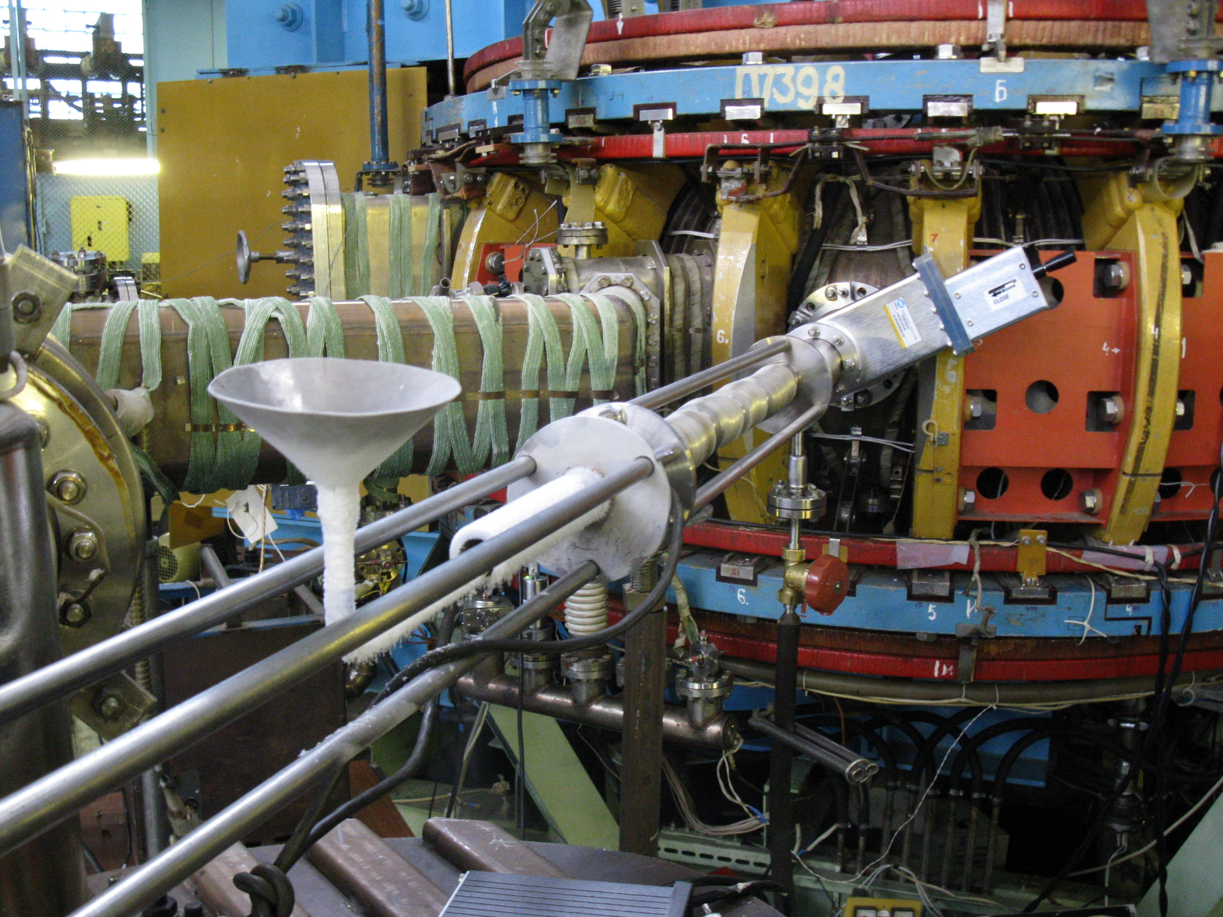
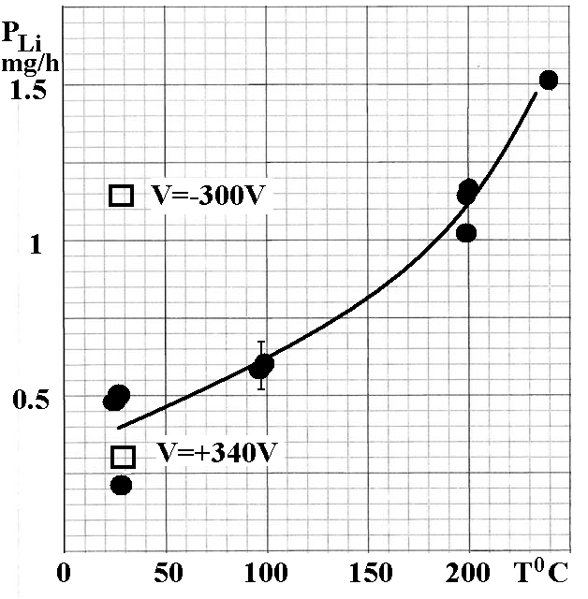
Mirnov S.V. and V.B. Lazarev, et al.,
Cryogenic target in T-11M chamber for lithium recovery
The view A of target is before installation, the view B is after exposure
An evolution of the lithium collection rate with increasing of the wall heating (black rings, target connected electrically with the wall), two rectangular are cases with two different electric potentials of target relative to the wall

Slide 10
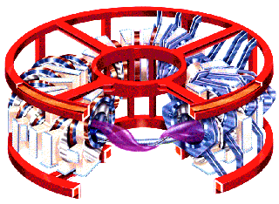
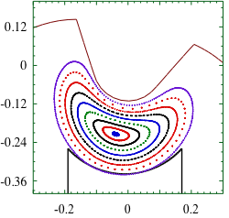
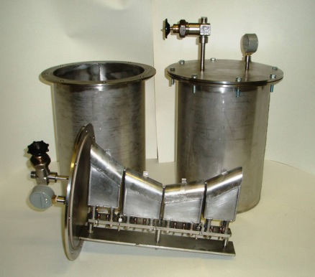


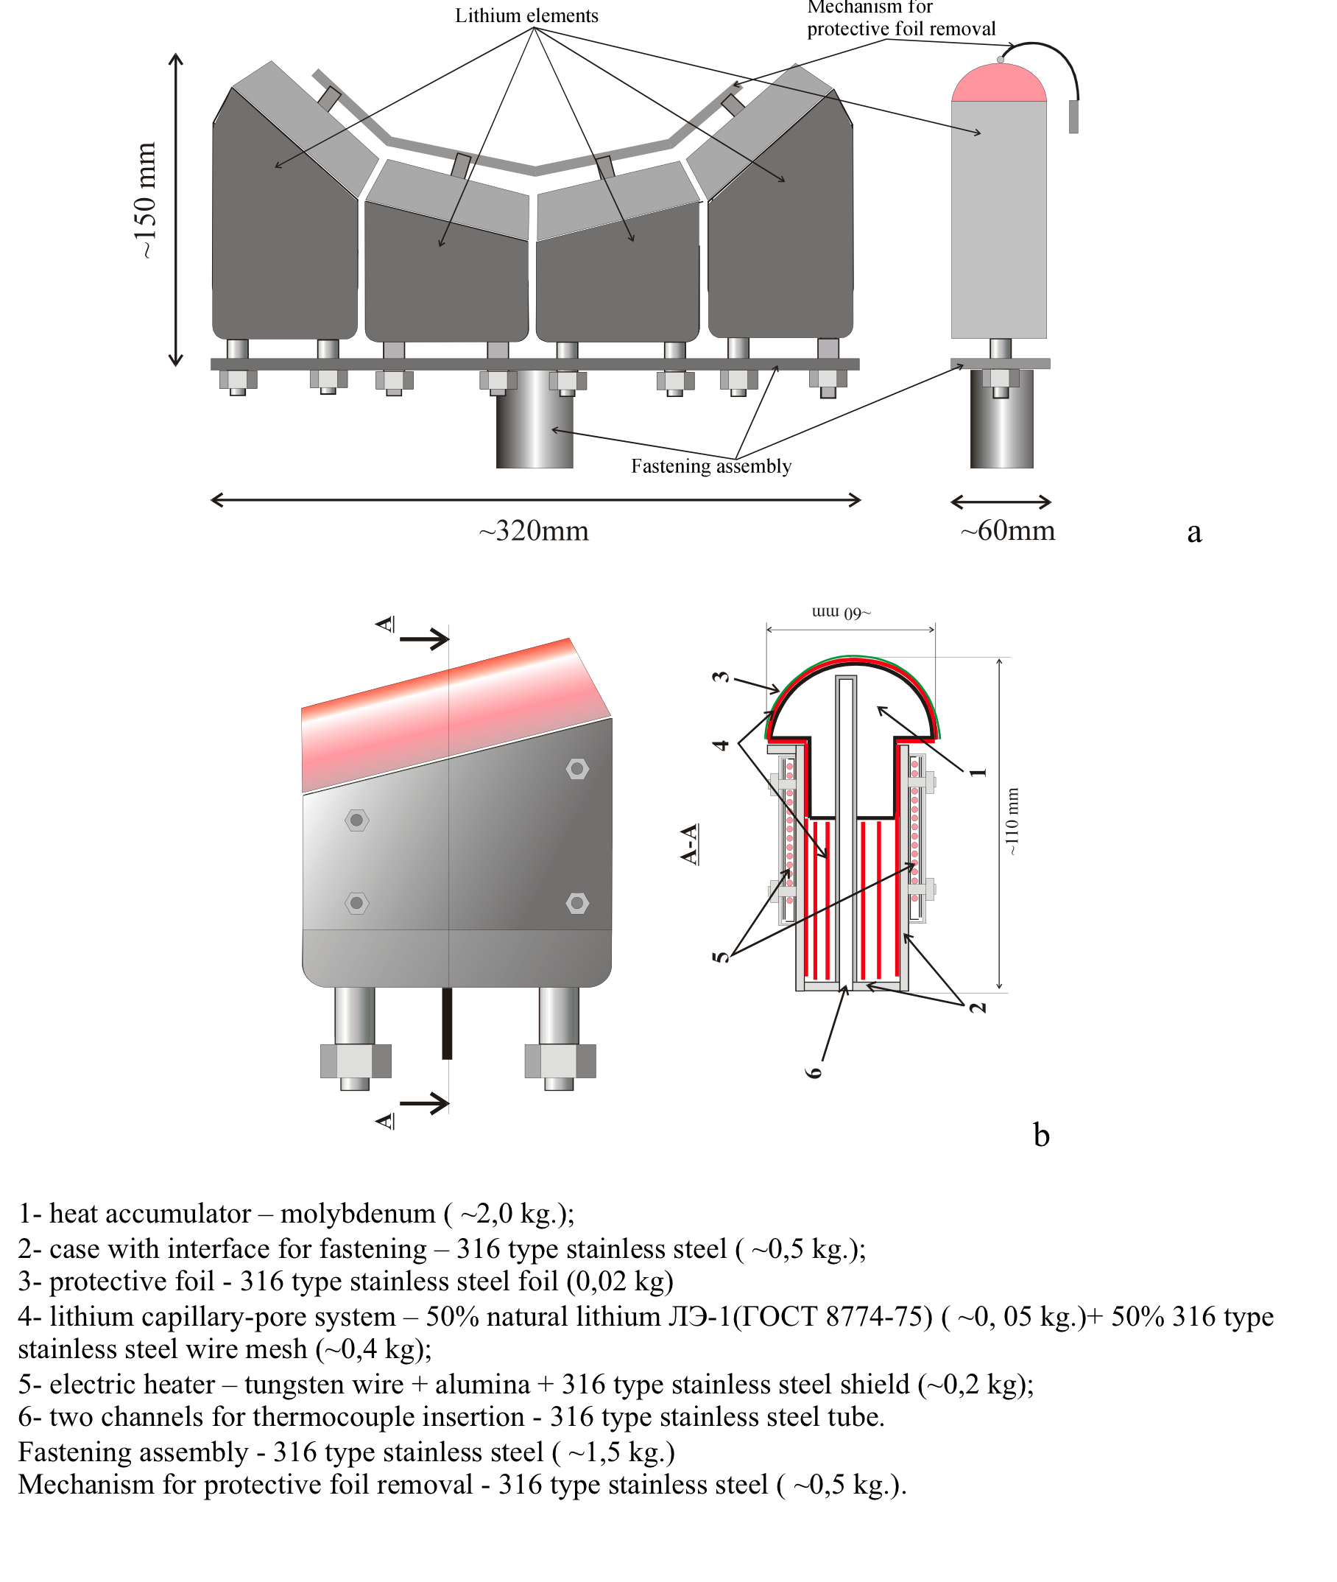
TJ-II experiments for testing lithium as a possible PFC for a Fusion Reactor
CPS-LLL in TJ-II: Description F. Tabarés et al.,
LLL in TJ-II (Red Star) installation achieved in 2012
Two equivalent LLL installed in lower vertical ports of opposite sections of TJ-II.
Special vacuum volume equipped with two vacuum gates, own pumping system, heater of the walls and mass-spectrometer provides:
- allows for TDS studies on hydrogen sorption – desorption study on liquid lithium at several T’s
Electrically insulated from vacuum chamber, possibility for biasing
LLL is provided with temperature control in the range of 20-550ºC.

Slide 11
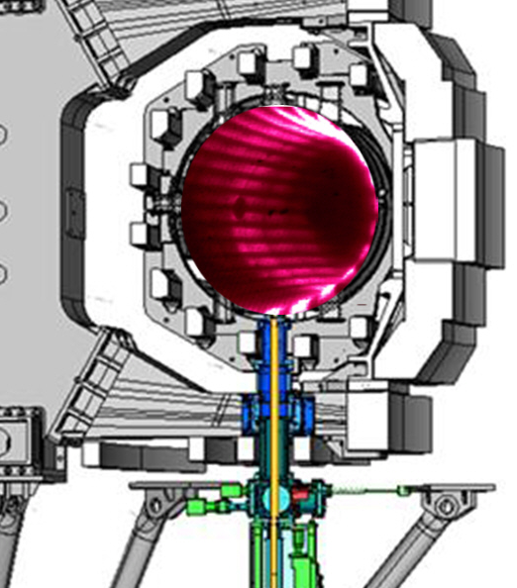
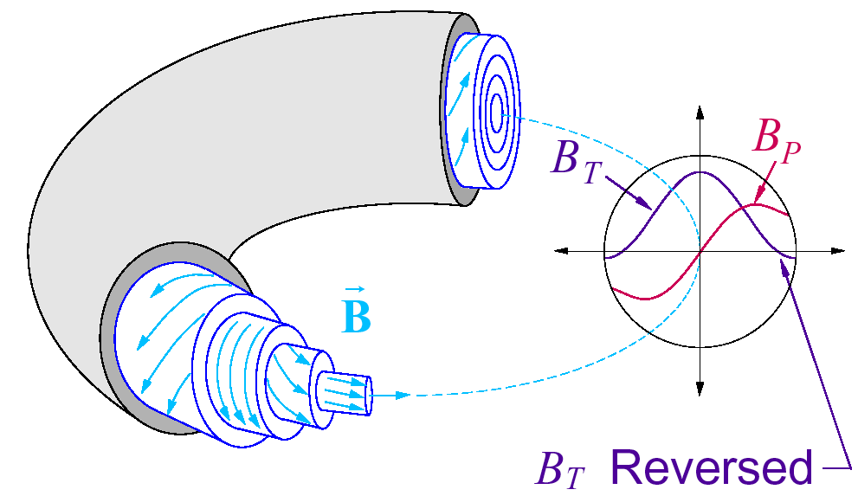
Lithium wall conditioning experiments on RFX-mod reversed field pinch experiment by PP. Innocente et al.,
On RFP configuration edge field lines are nearly poloidal
Poor toroidal distribution of ablated lithium
Partial solutions:
1) High edge toroidal field
2) Externally induced stationary helical deformation intersecting LCPS (to move Li along the helical)
LCPS as Liquid Lithium Limiter (LLL)

Slide 12
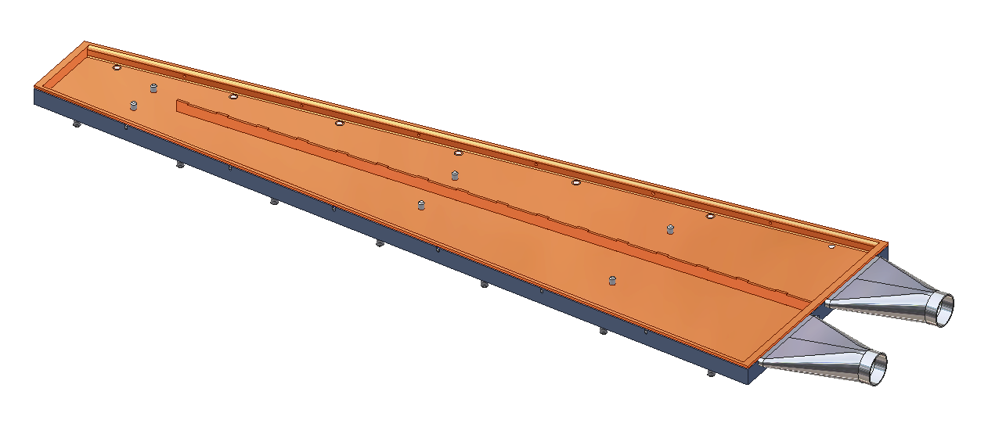
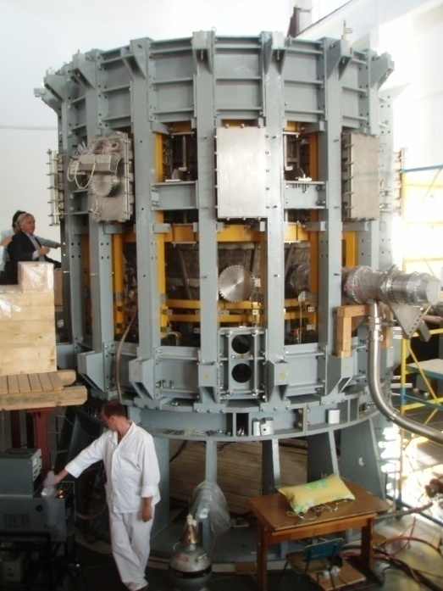
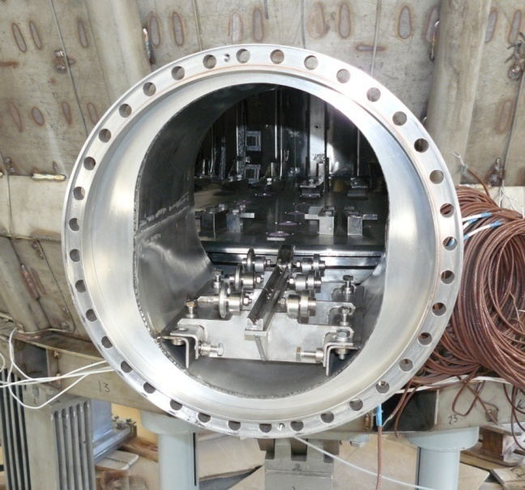
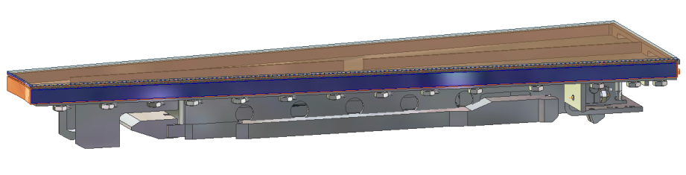
TESTS OF MODULES OF LITHIUM DIVERTOR ON BASIS OF CAPILLARY-POROUS SYSTEM AT THE EXPERIMENTAL COMPLEX TOKAMAK KTM
The lithium divertor module design with the simple scheme of heat-transfer media (Na-K) circulation has been chosen
Na-K flow direction
Cooling channel
Module of lithium divertor will be placed on one of the ports of KTM
Na-K
Tazhibayeva, I. Lyublinski, et al.

Slide 13
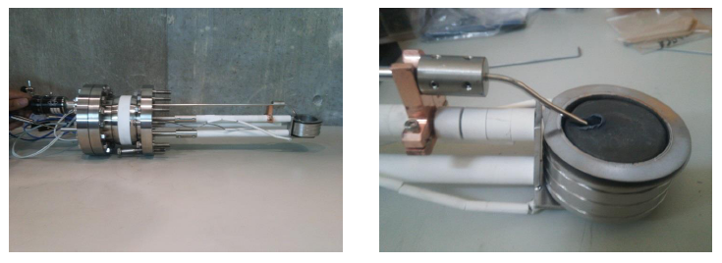
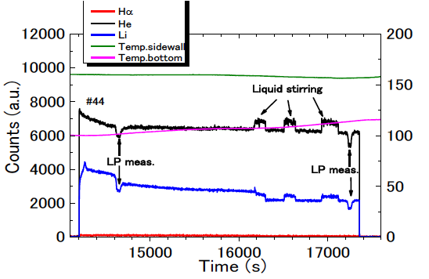
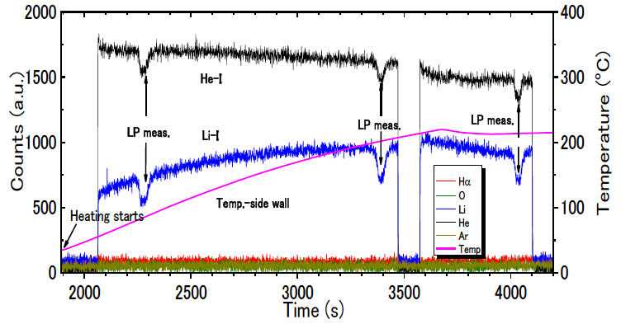
Liquid stirring effects on hydrogen and helium recycling from molten lithium under steady state plasma bombardment by Y. Hirooka et al.,
Active liquid metal stirring setup
Liquid stirring effects on He-recycling
Liquid stirring effects on H-recycling
Liquid stirring
⇒decrease in surface temperature
⇒decrease in (He-solubility in Li + Li-vapor pressure)
⇒increase in He-I + decrease in Li-I
Liquid stirring can de-saturate near-surface H and break solid impurity layers to restore H-absorptivity.

Slide 14
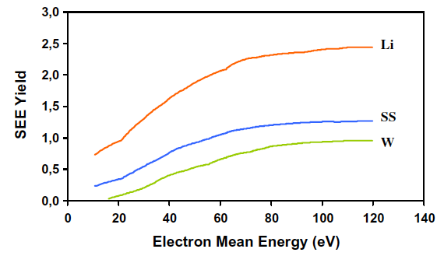
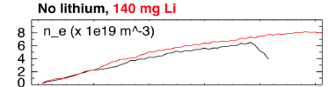
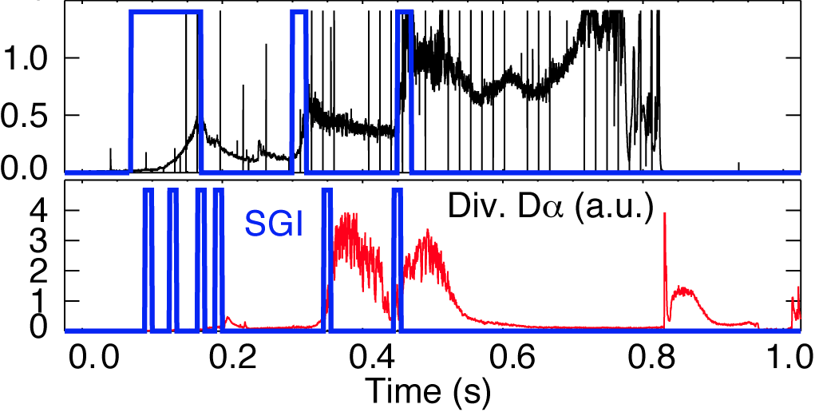
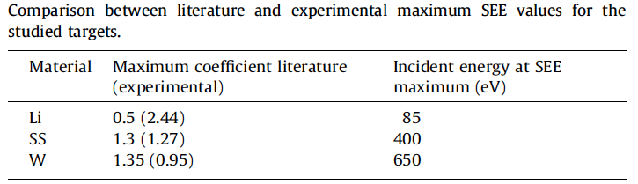
Anomalous secondary electron emission (SEE) yields founds for Li coating
Li surface properties investigated
A supersonic gas jet was used to demonstrate strong divertor pumping by lithium coatings
Results of the Li, SS and W SEE Yields vs. mean electron energy of the suprathermal electrons arriving to the targets at each bias.
V. A. Soukhanovskii et al.,
A new mechanism of deuterium retention by
lithium coatings on graphite was proposed
Li-O-C-D chemistry
• D is bound by O and CO
• Carbon sputtering reduced
• Deuterium recycling reduced
• Lithium brings oxygen to surface
J. P. Allain and P. S. Krstic et. al,
E. Oyarzabal, A.B. Martín-Rojo, et al.,

Slide 15
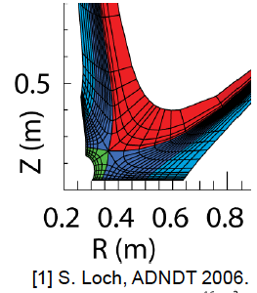
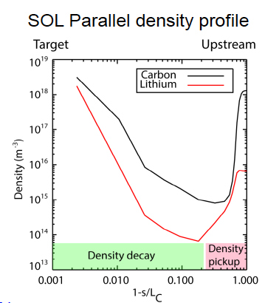
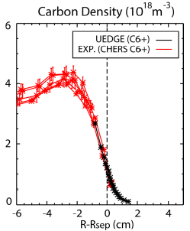
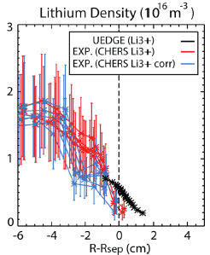
Li Transport Physics Investigated in NSTX
Showing strong lithium divertor retention and small penetration factors
Stronger divertor retention (n_{min}/n_{target}) for Li than carbon
- controlled by difference in source profile
- due to short ionization _{mfp}
2D multi-fluid UEDGE simulations performed to investigate reasons for small lithium penetration factors
s distance from midplane
LC midplane-target connection length
F. Scotti, V. A. Soukhanovskii NF 2013

Slide 16
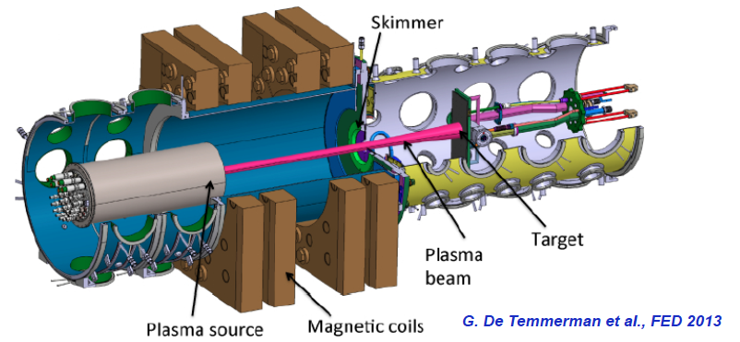
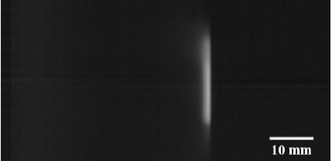
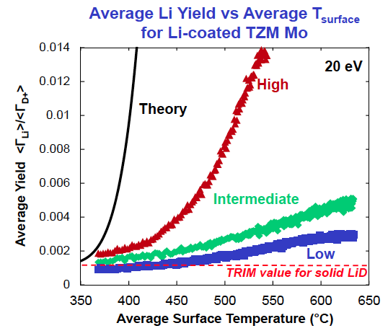
Magnum-PSI linear plasma device ideal for testing model
Picture of vapor-cloud PMI already showing rich physics
• Observation of reduced current to target consistent with
- Increased effective ion mass due to large lithium fraction
- Increased neutral particle bombardment
• Increased heating to the target consistent with
- Increased plasma and neutral energy deposition due to replacement of high-Z target with low-Z lithium surface
- Requires increased neutral particle flux due to decreased ion bombardment
• Three different erosion "regimes" observed for Li-coated TZM Mo
• Even high-yield regime shows significantly less
erosion than Langmuir lawevaporation + TRIM
Tyler Abrams et al.,
Mike Jaworski et al.,

Slide 17
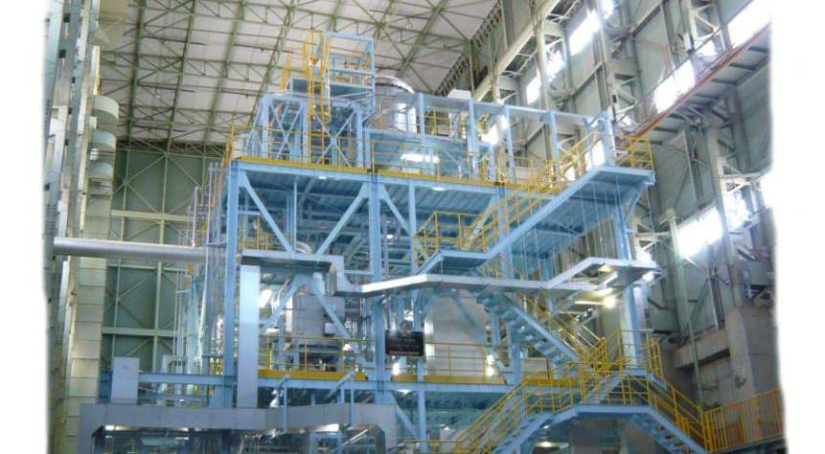
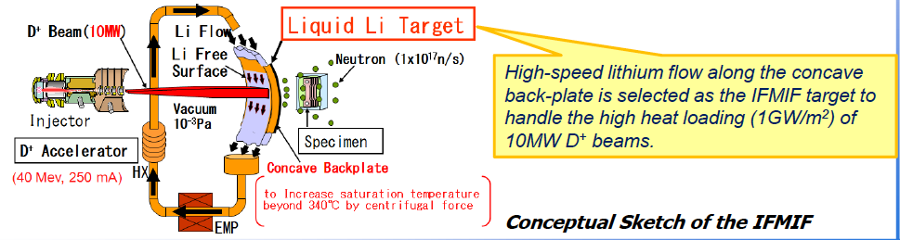
Development of Lithium Safety Handling Technology under IFMIF-EVEDA
Objective
To dedicate data needed for design relating safety and lithium treatment and impurity monitoring.
Research works
➢Experiments of Li chemical reaction
➢Chemical analysis of impurity in Li
➢Experiments of Li fire
T. Furukawa and E. Wakai et al.,

Slide 18
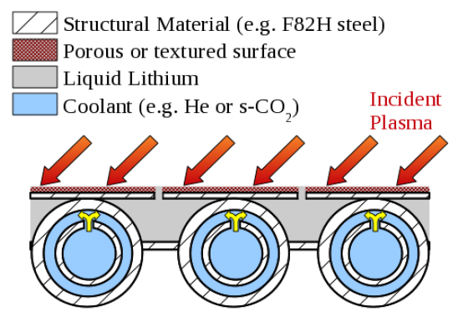
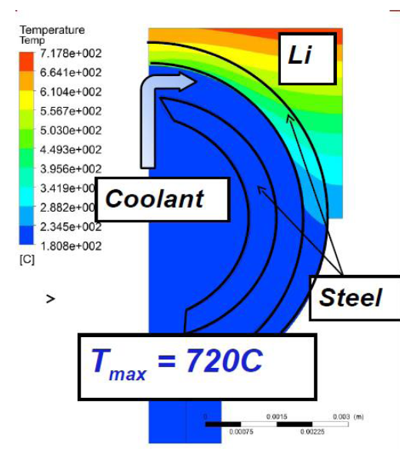
Actively-Supplied, Capillary-Restrained System
An Approach to a Liquid Metal PFC
Closely connected primary coolant and liquid lithium reservoir/supply structure
Continuous flow to the surface to flush gettered material and maintain wetted surfaces (substrate protection)
Multiple coolant options exist (T-tube impinging jets shown as example)
• T-tube1 uses impinging gas jets to increase local heat transfer coefficient
  • Altered T-tube for these simulations to have:
  • Smaller radius
  • Steel structure, s-CO2 coolant (No tungsten)
  • 10 MW/m2 incident
  • Consistent with strength limits of ODS-RAFM steel
• Previous studies considered <400C as limit for hydrogen retention
M. Jaworski et al.,

Slide 19
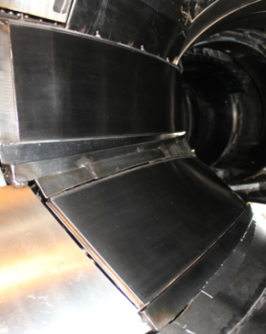
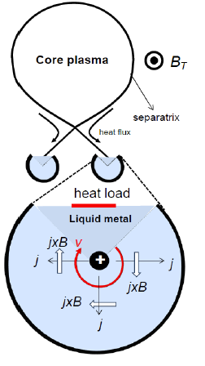
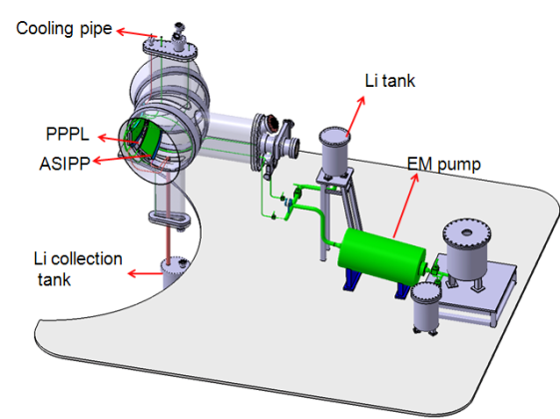
Actively circulated liquid metal divertor
Michiya Shimada, Yoshi Hirooka
Innovative Liquid Lithium/Metal PFC Ideas
FLLL with slowly moved thin Li film on EAST
With L. Zakharov from PPPL

Slide 20
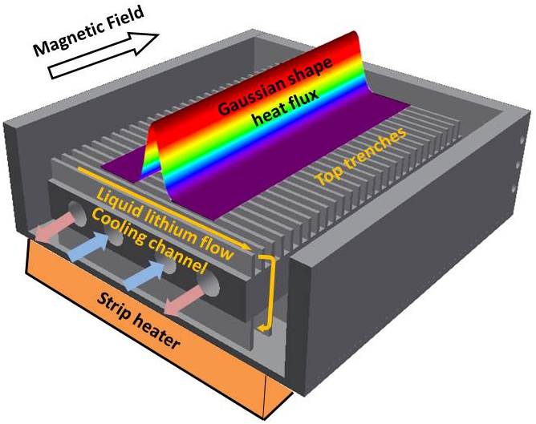
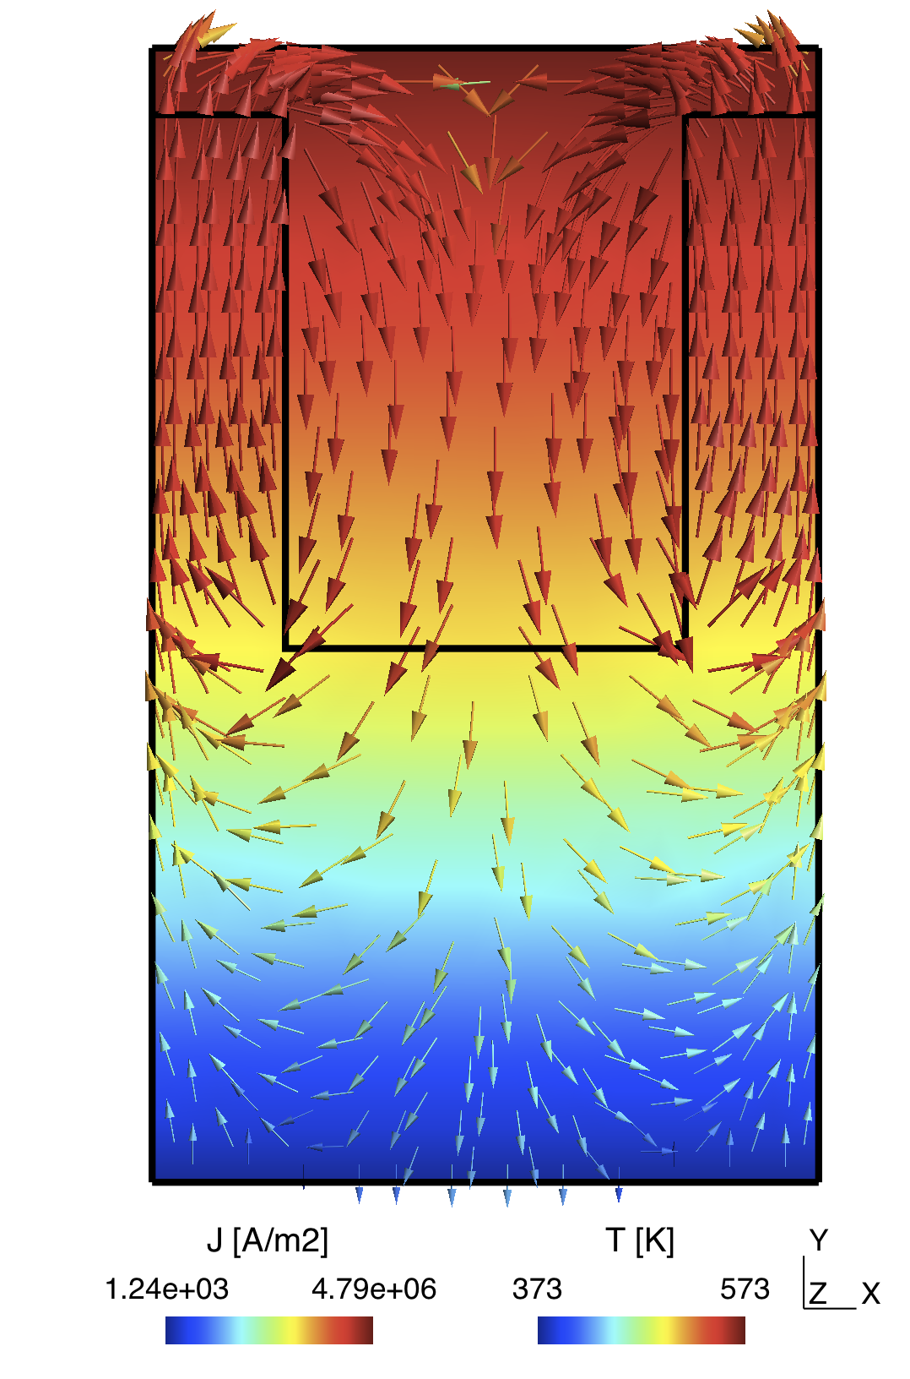
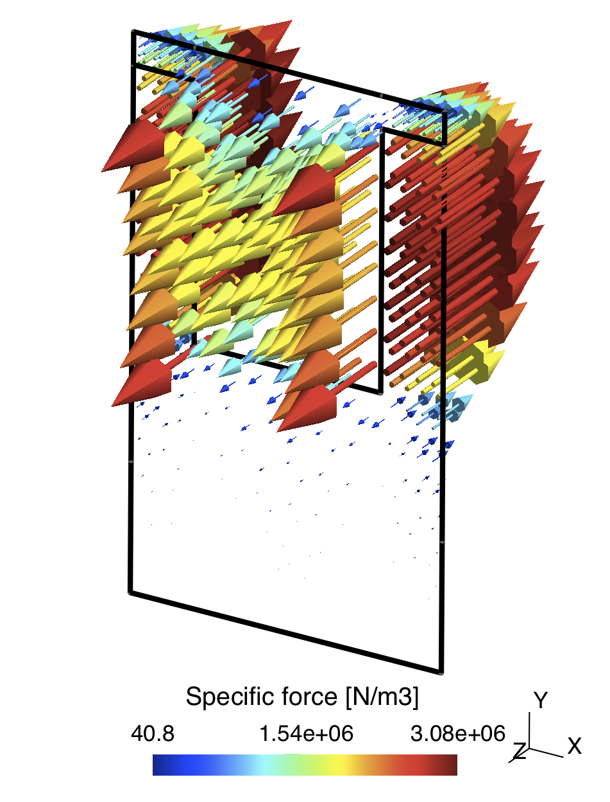
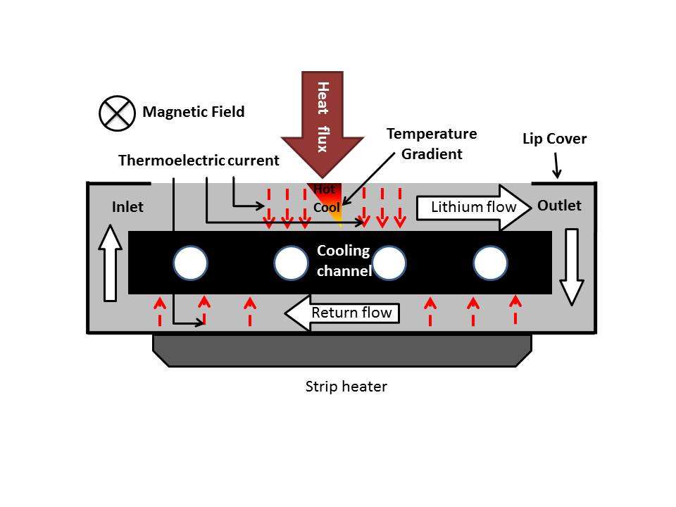
LiMIT: “Lithium/Metal Infused Trenches”
David N. Ruzic and the CPMI Fusion Group
Magnetic Field
F
WenyuXu, Davide Curreli and David N. Ruzic

Slide 21
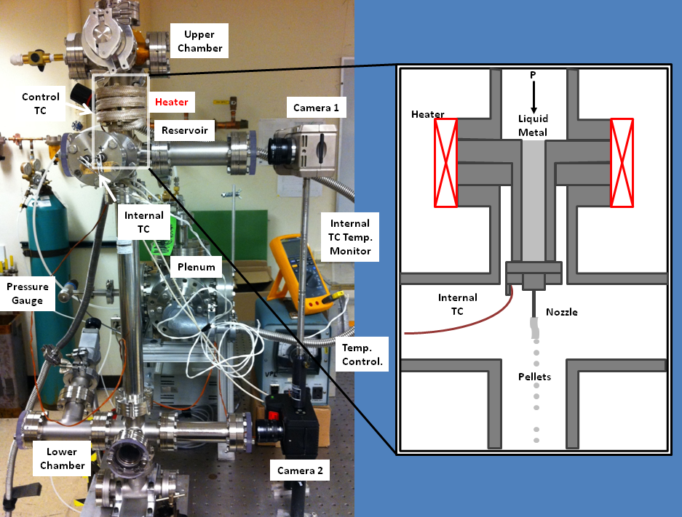
NSTX-U Liquid Lithium R&D
E-beam Lithium Flash Evaporator
Liquid Li Pellet Dripper
A. L. Roquemore, D. Andruczyk, et al.,

Slide 22
Is lithium PFC viable in magnetic fusion reactors?
(Questions from Dr. M. Shimada)
Handling high divertor heat flux – Vapor shielding and high Li radiation to reduce heat flux to acceptable level ~ 5 MW/m2
Removal of deuterium, tritium, and impurities from liquid lithium – External lithium loop
Removal of high steady-state heat flux from divertor – High Li radiation to spread heat flux over divertor chamber
Flowing of liquid lithium in magnetic fields – 1 l/s flow is modest
Longer term corrosion of internal components by liquid lithium – Engineering R&D required, IFMIF
Safety of flowing liquid lithium, - Leverage experience from IFMIF and
Compatibility of liquid lithium with a hot reactor first wall – Two T operation with Li divertor at lower T ≤ 450°C while the first wall in the main chamber at elevated T ≥ 600°C.
First Lithium Symposium in 2010: Y. Hirooka. et al., Nucl. Fusion (2010)
Second Lithium Symposium in 2011 : M. Ono, et al., Nucl. Fusion (2012)
Notes:
17:00

Slide 23
Li Provides Several Protective Layers
Vaporization, Ionization, Radiation
Power and particle flux
Divertor
Entrance
M. Ono
Li Injection (ARLLD)
~ 100 MJ/mole
Divertor side wall
Li Radiative Cooling (RLLD)
~ 100 MJ/mole
Radial Transport
Charge Exchange Loss
Li Ionization
1st ionization – 0.5 MJ /mole
2nd ionization – 7.3 MJ /mole
3rd ionization – 11.8 MJ /mole
Li Vapor Shielding
M. Jaworski et al.,
Li Vaporization (150 kJ mole)
LLD Tray
T. Abram et al.,

Slide 24
Radiative Liquid Lithium Divertor Concept
RLLD configuration permits operation at lower T < 450 °C
Lower RLLD Operating Temperature:
• Avoids excessive Li vaporization and provides effective pumping
Impurity and Dust Removal by LL Circulating Loop
Divertor Heat and Particle Flux
T ~ 0.5 g /s
Fueling
Edge Plasma
000000000000
Condensed liquid lithium
Core Reacting
Plasma
Pumping: LL ~ 1 l/s
First Wall / Blanket
At 500°C – 700°C
Lithium Radiative Mantle
Lithium Evap. / Ionization
Flowing LLD Tray
To RLLD
From RLLD
T – 0.5 g/s
Heat Exchanger
LL ~ 1 l/s
Imp. ~ 1%
Scrape Off Layer
LL
Cold Trap
Removes
T, D, H, N, C, O, and dust to ~ 0.1% level at 500 °k
T – 0.5 g/s
Tritium Recycling
Closed RLLD
LL
Circulation
Pump
LL 1 l/s
Tritium
Separater
Imp. ~ 0.1%
Flowing LLD Tray
200 – 450 °C
LL In
LL Out
LL In
~ 1 l/s available for pumping >> ~ 10 g/s needed for RLLD
Deuterium &
Other impurities as well as dust
M. Ono et al., NF 2013
Notes:
21:00

