Slide 1
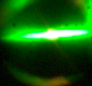
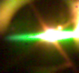
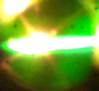
Lithium granule ablation and penetration during ELM pacing experiments at DIII-D
d_{G} ≈ 400 μm
600 μm
800 μm
by R. Lunsford, A.Bortolon, A.L.Roquemore, D.K.Mansfield, A.Nagy, R.Maingi, P.B. Parks, G.Jackson, E.Gilson C.P. Chrobak, and the DIII-D Team

Slide 2
Talk Outline
ELM triggering through granule injection
Granule Ablation Model
Pellet Penetration Depth
Future Granule Injector Experiments

Slide 3
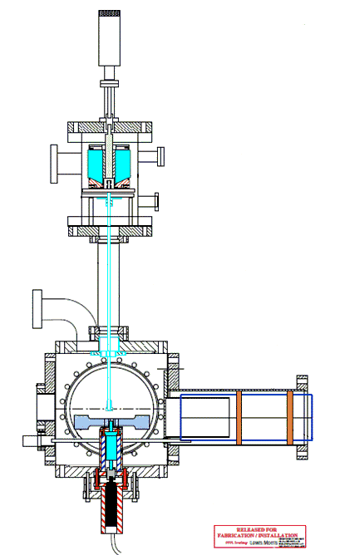
Lithium Granule Injector
Target granules are housed within the 4-chamber segmented dropper.
Particle drop rates are controlled by a piezoelectric disk.
Granules driven into the plasma by a pneumatic rotary impeller
Available sizes (approximate) :
900μm, 700μm, 500μm, 300μm
Injection Velocity :
50 – 150 m/sec
Granule to Granule Injection Frequency : 50 – 500 Hz

Slide 4
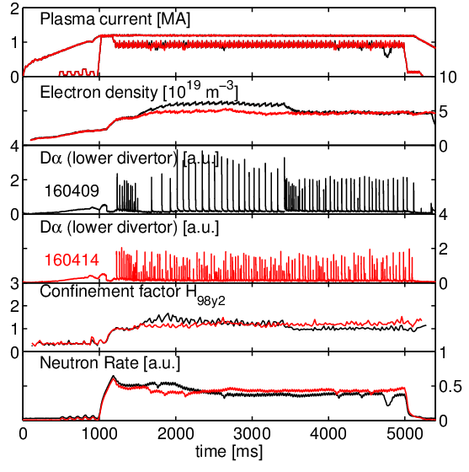
Full shot ELM pacing obtained with 0.4 mm granules
Reference ELMy H-mode
  1.2 MA, β_{N} = 1.4,
  P_{NBI}=2.3 MW, T_{NBI}=0.6 N m
  “Natural” f_{ELM} = 12 Hz
  MHD for t>350ms
No LGI
LGI pacing (1.5 < t < 5 s)
  Granule diam. 0.4 mm
  Granule velocity 105m/s
  Average f_{LGI} =140 Hz
  f_{ELM} = 38 Hz (3X)
  n_{e} reduced by ~15%
  Small or no confinement degradation
  No MHD
LGI

Slide 5
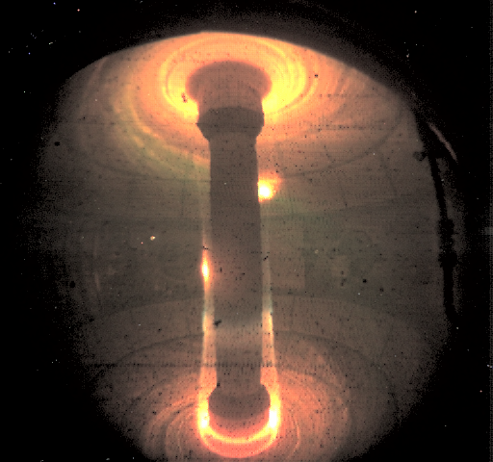
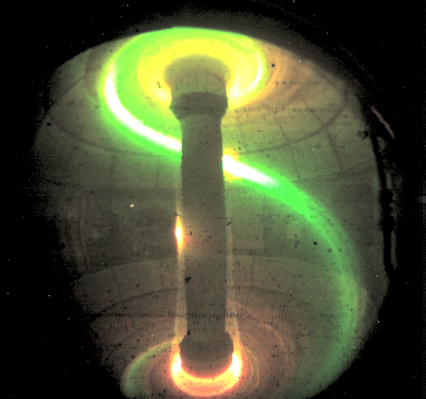
Stimulating ELMs through granule injection
Injected granules create an asymmetric high density filament
Sonic expansion leads to perpendicular pressure gradients
Flux tubes become ballooning unstable resulting in an edge localized mode (ELM)
ELM intensity is inversely proportional to frequency
ΔW_{ELM} x f_{ELM} ~ const
Rapid triggering of ELMs (pacing) leads to a reduction in the peak ELM intensity.
Paced ELM heat fluxes are now reduced to a level tractable for the PFCs
Injection of low velocity (~5m/s) lithium clumps (~2mm) into NSTX (2008)

Slide 6
Neutral Gas Shielding (NGS) Model
Neutral Ablatant Cloud
Ionized Lithium
v_{P} shown
into the page
Lithium Granule
magnetic field
Electron influx sublimates the pellet surface
High density neutral cloud forms around the granule
Heat transfer ionizes the cloud which streams along field lines

Slide 7
d_{G} ≈ 400 μm
600 μm
800 μm
The following movie is a montage of 3 separate granule ablations

Slide 8
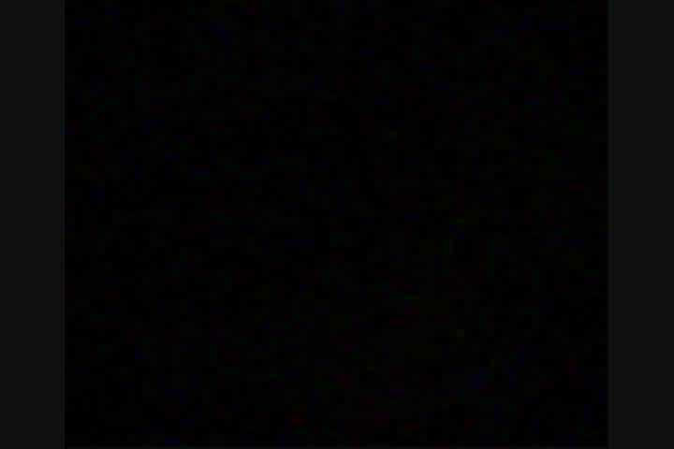
Combined filmstrip of 3 separate size granule injections
DIII-D
0 μs
Fast color camera Miro 80x64, 20 kHz
50 μs
Ablation events proceed from small to large and then the filmstrip restarts
Size 1 ~ 400 micron, 200 μsec
Size 2 ~ 600 micron, 400 μsec
Size 3 ~ 800 micron, 600 μsec
100 μs

Slide 9
Granule Ablation & Dα Emission (lower divertor)
400 μm
600 μm
800 μm
time (sec)
time (sec)
time (sec)
Ablation Camera Trace
Dα Emission
Nominal 300 micron granules
Triggering efficiency ~ 30%
Nominal 700+ micron granules
Triggering efficiency > 80%

Slide 10
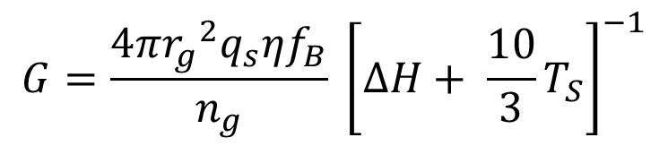
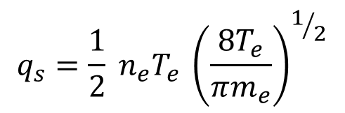
Granule Ablation Model
Ablation Rate of the injected granule :
$$G=\frac{4π{r_{g}}^{2}q_{s}ηf_{B}}{n_{g}} {\left[∆H+ {\frac{10}{3}T}_{S}\right]}^{−1}$$
η : Cloud Shielding Parameter
f_{B} : Field directed heating anisotropy
ΔH_{Li} : Sublimation Energy
T_{S} : Granule Surface Temperature
$$q_{s}=\frac{1}{2} {n_{e}^{}T}_{e }{\left(\frac{8T_{e}}{πm_{e}}\right)}^{1/2}$$
800 μm
600 μm
Camera saturation results in clipping of the intensity
400 μm
Adapted from Parks et al. Nucl. Fusion 34 (1994) & Kocsis et al. PPCF 41 (1999)

Slide 11
Granule Ablation Depth
Calculated Granule Diameter
v_{G} = 90 m/sec
Granules ablate rapidly upon entering the pedestal region
While some portion of the granule does penetrate deeply, the primary mass deposition is located further out
Ablatant Deposition
Major Radius (m)

Slide 12
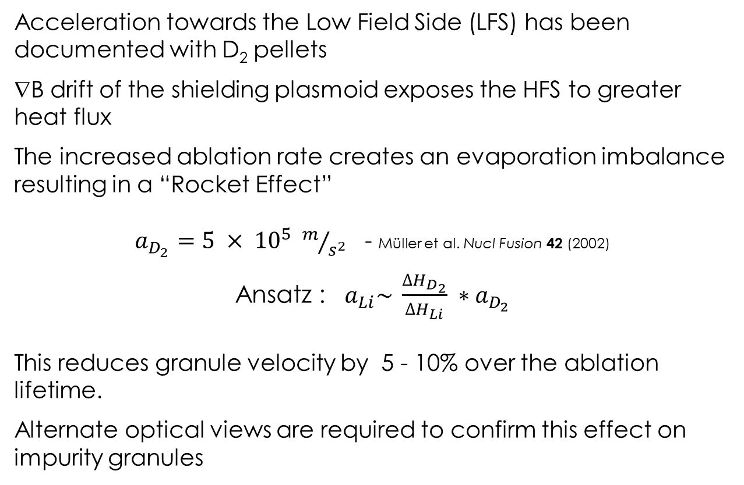
Granule Deceleration
Acceleration towards the Low Field Side (LFS) has been documented with D₂ pellets
∇B drift of the shielding plasmoid exposes the HFS to greater heat flux
The increased ablation rate creates an evaporation imbalance resulting in a “Rocket Effect”
$a_{D_{2}}=5 × {10}^{5} m/{s^{2}}$ - Müller et al. Nucl Fusion 42 (2002)
Ansatz : ${ a}_{Li}\sim \frac{{∆H}_{D_{2}}}{∆H_{Li}} ∗a_{D_{2}}$
This reduces granule velocity by 5 - 10% over the ablation lifetime.
Alternate optical views are required to confirm this effect on impurity granules

Slide 13
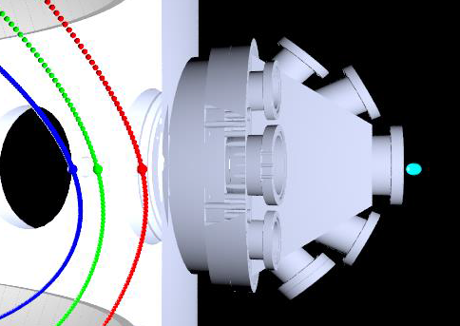
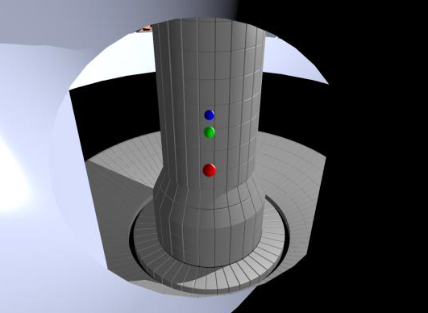

Extended imaging suite will measure penetration depth
Camera
Location
Camera View
Ψ_{N}=0.6
Separatrix
Limiter
Diagnostic Setup: F. Scotti LLNL
Additional cameras will be fielded on NSTX-U during LGI experiments through diagnostic collaboration with LLNL
This allows direct measurement of injection velocity and penetration depth.

Slide 14
Future research with the Granule Injector
Granule injectors are presently fielded on EAST, DIII-D, and NSTX-U to look at complementary granule injection behaviors
Upcoming DIII-D Experiments:
ELM pacing with alternate impurity granules
ELM pacing in ITER low torque discharges
Upcoming NSTX-U Experiments:
ELM pacing studies via multi-species granule injection
Lithium granule injection into ELM free lithiated discharges.
  Determination of minimal perturbation required to reliably trigger ELMs for impurity control.

Slide 15
Conclusion
The Lithium Granule injector is an exciting new tool for ELM pacing and edge physics research.
Granules ablate rapidly upon encountering the plasma edge and deposit a majority of the ablation material within the steep gradient region.
Granule ablation intensity is not a strong predictor of Dα level, indicating that the strength of the triggered ELM is more likely due to pedestal parameters rather than triggering mechanism.
Upcoming experiments will increase understanding of ablation physics for multiple injection species

Slide 16
Backup

Slide 17
Using controlled Lithium injections to benchmark
plasma response
Active Radiative Liquid Lithium Divertor (ARLLD) :
M. Ono NF 2013, FE&D 2014
Divertor Heat and Particles Flux
B₀
Particle pumping by Li coated wall
Active Liquid Lithium Injection
~ 1 l/sec(ARLLD)
Explore how lithium enters and interacts with the edge plasma
LGI can examine the radiative properties of saturated lithium flux tubes
Bolometery quantifies the radiative energy per granule of injected lithium as it is ionized
Flowing LL Particle Pumping Surfaces
Li⁺⁺⁺
Li⁺⁺
Li Radiative Mantle
Li wall coating /
condensation
Heat Exchanger
Li⁺
Li path
Li Evap. /
Ionization
(RLLD)
Li⁰
Divertor Strike Point
Reduced Divertor Heat and Particle Flux
LL Purification System to remove tritium, impurities, and dust
Notes:
Lithium PFC concepts benefit from minimally perturbative experiments in-situ testing prior to installation

Slide 18
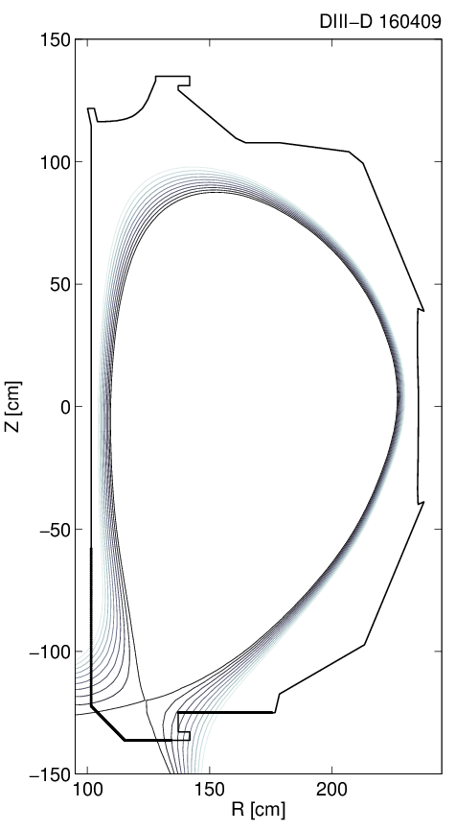
Summary of the experimental activities
Two full experimental days
  Total 50 plasma shots (~ 550 mg of Li injected)
Injection frequency ~ 100-500 Hz,
Granule speed ~ 50-150 m/s
4 granule sizes (0.3, 0.5, 0.7, 0.9 mm)
Low power H-modes
  Minimize natural ELM frequency
  ITER-like shape
Comparison with D₂ pellets within the same discharges
LGI

Slide 19
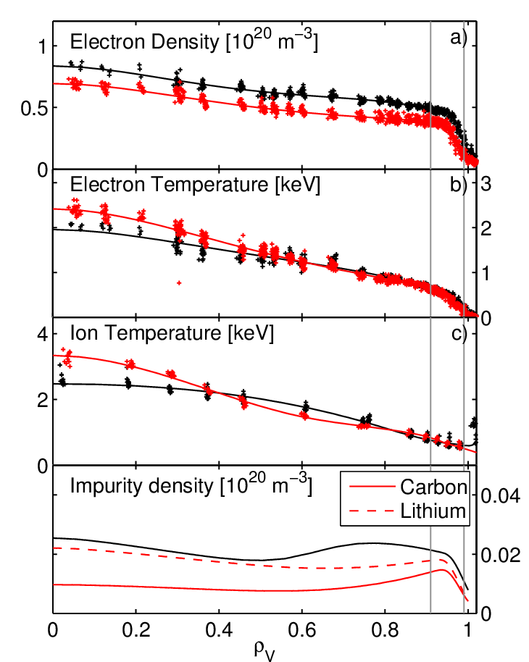
Global effects on kinetic plasma profiles observed
160409, Ref. f_{ELM} = 12 Hz
160414, LGI f_{ELM} = 38 Hz
Reduced N_{e} at pedestal top
  Unchanged T_{e}, T_{i}
25% increase in core T_{e} & T_{i}
  Due to increased peaking
  Transport? Residual MHD?
Lithium dominant core impurity
  Flat Li³⁺ density profile
  C⁶⁺ density reduced by 50%
  N_{Li} inferred by combining
  multi-chord VBE and
  carbon density from CER
Notes:
In reality, the high frequency pacing

Slide 20
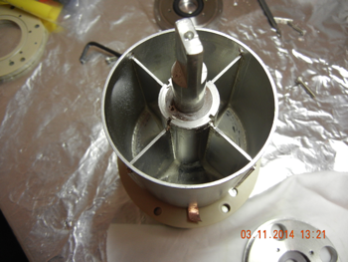
Segmented Dropper and Gate Valve Baffle
Rotating doorway (manual)
Divider blades
Piezo disk
2.25 kHz
Mobile Baffle
Bearing Rings
TIV
Mobile baffle extends during operation to protect TIV from granule contamination.
Inserted at the beginning of the day, stays in throughout, and is retracted at the end of the day.

Slide 21
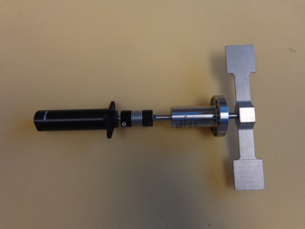
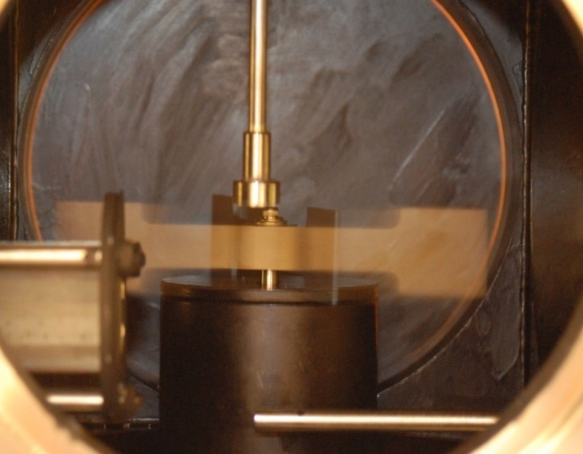
Granule Impeller
Drive train:
Impeller: Glass filled PEEK with nickel coating
Rotary feedthrough (Ferrotech – SS-250-SLCA) rated for 15,000 rpm for 2 min.
Recent tests at EAST show feedthrough is leak tight to He at 15,000 rpm.
Bellows coupling (Ruland BC10-3-3-A) rated for >10,000 rpm with load.
Air motor up to 28,000 rpm

Slide 22
Ablation Triggering Events vs D-alpha height
Shot 160406
Nominal 300 - 500 micron granules
Average Granule Injection frequency - 143 Hz
Triggering efficiency ~ 30%
Shot 160416
Nominal 700 - 900 micron granules
Average Granule Injection frequency - 22 Hz
Triggering efficiency > 80%

Slide 23
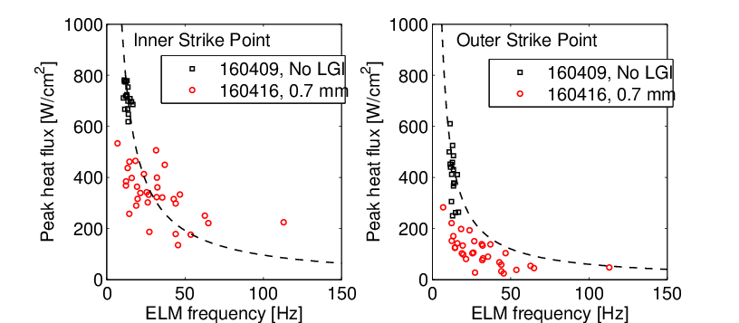
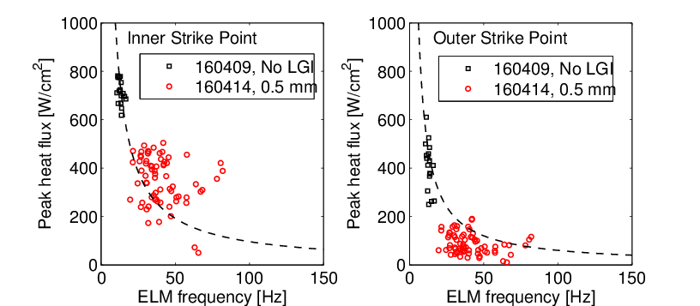
Peak heat flux dependence on ELM frequency
Peak heat flux q_{p} from IR imaging of divertor (IRTV)
Test q_{peak} = const/f_{ELM} with statistical approach
  Consider sets of single
  LGI-induced ELMs
  f_{ELM} = 1/(t_{ELM,n}-t_{ELM,n-1})
Reduced q_{p} with higher f_{ELM}
Outer Strke point
  q_{peak} < 1/f
Inner Strike Point
  Larger scatter
  q_{peak} > 1/f for 0.5 mm

Slide 24
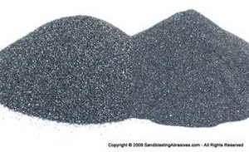
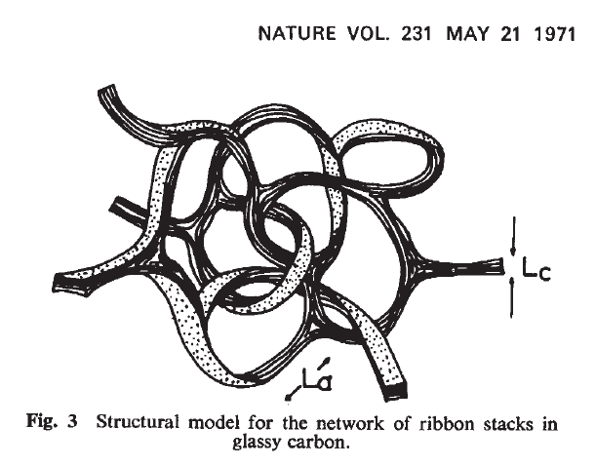

Electron inventory calculation for multi-species particle injection
 | Deuterium Slush | Lithium | Boron Carbide | Carbon (Vitreous)
Density | .237 g/cm ³ | .534 g/cm ³ | 2.52 g/cm ³ | 2.09 – 2.23 g/cm ³
Mass in a 1mm sphere (mg) | 0.993 | 2.237 | 10.556 | 9.09
Atomic Weight (g/mol) | 4.028 | 6.94 | 55.255 | 12.011
Number of atoms/molecules | 1.484E+20 | 1.941E+20 | 1.150E+20 | 4.557E+20
Number of electrons | 1.484E+20 | 5.823E+20 | 2.991E+21 | 2.734E+21
Deuterium Multiplier | 1.00 | 3.92 | 20.15 | 18.42
Sublimation Energy (eV/atom) | 0.0155 | 1.65 | 5.3 (B) | 7.5
Sublimation Energy Per Granule (J) | 0.4 | 51.3 | 529.0 | 547.6
First Ionization Energy (eV) | 13.6 | 5.3917 | 8.2980 (B) | 11.2603
Second Ionization Energy (eV) |  | 75.64 | 25.1548 (B) | 24.3833
B₄C
C
Li
Mansfield NF 53 (2013)

Slide 25
Lithium granule ablation and penetration during ELM pacing experiments at DIII-D
R. Lunsford¹, A. Bortolon¹, A.L. Roquemore¹, D.K. Mansfield¹, A. Nagy¹, R. Maingi¹, P. Parks², G. Jackson², E. Gilson¹, C.P. Chrobak²
¹ Princeton Plasma Physics Laboratory, Princeton NJ 08543, USA
² General Atomics, San Diego CA 92186-5608, USA
The unmitigated transient power flux transported to the divertor and wall during an edge localized mode(ELM) in a burning plasma device such as ITER is projected[1] to be substantially above the damage threshold of the current plasma facing component (PFC) designs. One of the baseline strategies for mitigating this heat flux is to rapidly pace the ELMs so that the amount of energy exhausted to the PFCs is reduced inversely with the triggering frequency[2]. A method to augment the natural ELM frequency is the frequent injection of non-fueling impurity granules from the low field side of the discharge. The ablation of these granules in the edge plasma are hypothesized[3] to lead to the creation of high density filaments which create 3-D pressure gradients that destabilize ballooning modes which manifest as ELMs. At DIII-D, four sets of lithium granules ranging in size from 300 to 900 microns in diameter were injected into various discharges with low natural ELM frequencies to test this principle. A vibrating piezoelectric disk gravitationally fed a rotating impeller which drove granules into the edge plasma at velocities ranging from 50-150 m/sec. This resulted in an increase in the ELM frequency from its natural 20-25 Hz to 50-100 Hz, with a corresponding reduction of the peak heat flux measured by IR thermography at the divertor strike points. The increased ELM frequency and the corresponding particle outflux were also observed to clamp the rise of Ni impurity buildup within the core. Utilizing high speed imaging along the granule insertion trajectory, we have captured the dynamic of expansion of the ablation cloud and measured ablations times of the order of several hundred microseconds. The inferred granule penetration depths range from 2 to 5 cm dependent upon the size of the injected granules. This data allow an accurate estimation of the perturbation to the density profile in the steep gradient region which corresponds to the ability of the injected granule to trigger an ELM. The lithium granule ablation data will be compared to the prevailing neutral gas shielding models. In addition future experiments with the lithium granule injector on DIII-D and NSTX-U will be discussed, including using the granule injector to benchmark the energy dissipated by injected lithium for radiative liquid lithium divertor scenarios.
[1] T.E. Evans, J. Nucl. Mater. 438 (2013) S11-S18
[2] L.R. Baylor et. al., Phys. Rev. Lett. 110 (2013) 245001
[3] S. Futatani et. al., Nucl. Fusion 54 (2014) 073008

