Slide 1




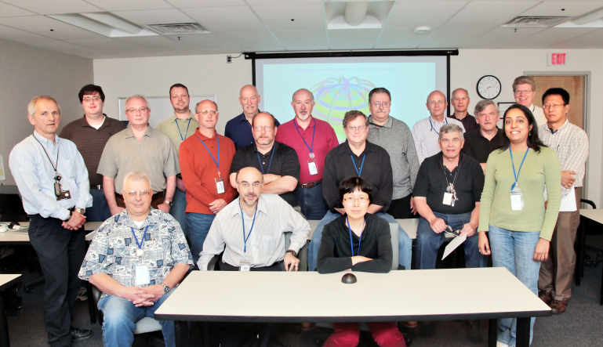
NSTX-U
Supported by
NSTX Accomplishments and NSTX-U Research Plans in Support of Fusion Next-Steps
Coll of Wm & Mary
Columbia U
CompX
General Atomics
FIU
INL
Johns Hopkins U
LANL
LLNL
Lodestar
MIT
Lehigh U
Nova Photonics
ORNL
PPPL
Princeton U
Purdue U
SNL
Think Tank, Inc.
UC Davis
UC Irvine
UCLA
UCSD
U Colorado
U Illinois
U Maryland
U Rochester
U Tennessee
U Tulsa
U Washington
U Wisconsin
X Science LLC
Jon Menard (PPPL)
J. Bialek, J. Canik, J. Chrzanowski, D. Gates, S. Gerhardt, W. Guttenfelder,
S. Kaye, E. Kolemen, R. Maingi, M. Mardenfeld, D. Mueller, C. Neumeyer,
M. Ono, E. Perry, S. Raftopoulos, R. Ramakrishnan, R. Raman, Y. Ren,
S. Sabbagh, V. Soukhanovskii, T. Stevenson, R. Strykowsky, P. Titus,
K. Tresemer, H. Zhang, Y. Zhai, A. Zolfaghari, and the NSTX-U Team
Culham Sci Ctr
York U
Chubu U
Fukui U
Hiroshima U
Hyogo U
Kyoto U
Kyushu U
Kyushu Tokai U
NIFS
Niigata U
U Tokyo
JAEA
Inst for Nucl Res, Kiev
Ioffe Inst
TRINITI
Chonbuk Natl U
NFRI
KAIST
POSTECH
Seoul Natl U
ASIPP
CIEMAT
FOM Inst DIFFER
ENEA, Frascati
CEA, Cadarache
IPP, Jülich
IPP, Garching
ASCR, Czech Rep
25th Symposium on Fusion Engineering (SOFE)
June 10-14, 2013
The Stanford Court Hotel
San Francisco, California

Slide 2
Outline
NSTX-U mission and capabilities
NSTX results highlights, NSTX-U goals
  Non-inductive current drive
  Heat-flux mitigation
Progress toward completing NSTX-U Project
Proposed longer-term (5 year plan) enhancements
Summary

Slide 3
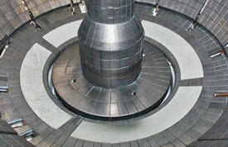
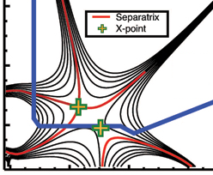

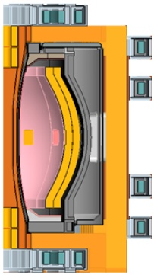
NSTX Upgrade mission elements
Advance ST as candidate for Fusion Nuclear Science Facility (FNSF)
  Motivation for ST as FNSF: high neutron wall loading, potentially smaller size, cost, and tritium consumption, accessible / maintainable
Develop solutions for the plasma-material interface challenge
  Exploit strong heating + smaller R → high P/R and P/S approaching FNSF/Demo levels
Explore unique ST parameter regimes to advance predictive capability - for ITER and beyond
  Fast-ion instabilities and transport
  Electromagnetic turbulence
  High β, rotation, shaping, for transport, MHD
Develop ST as fusion energy system
ST-FNSF
Lithium
“Snowflake”
ITER
ST Pilot Plant

Slide 4

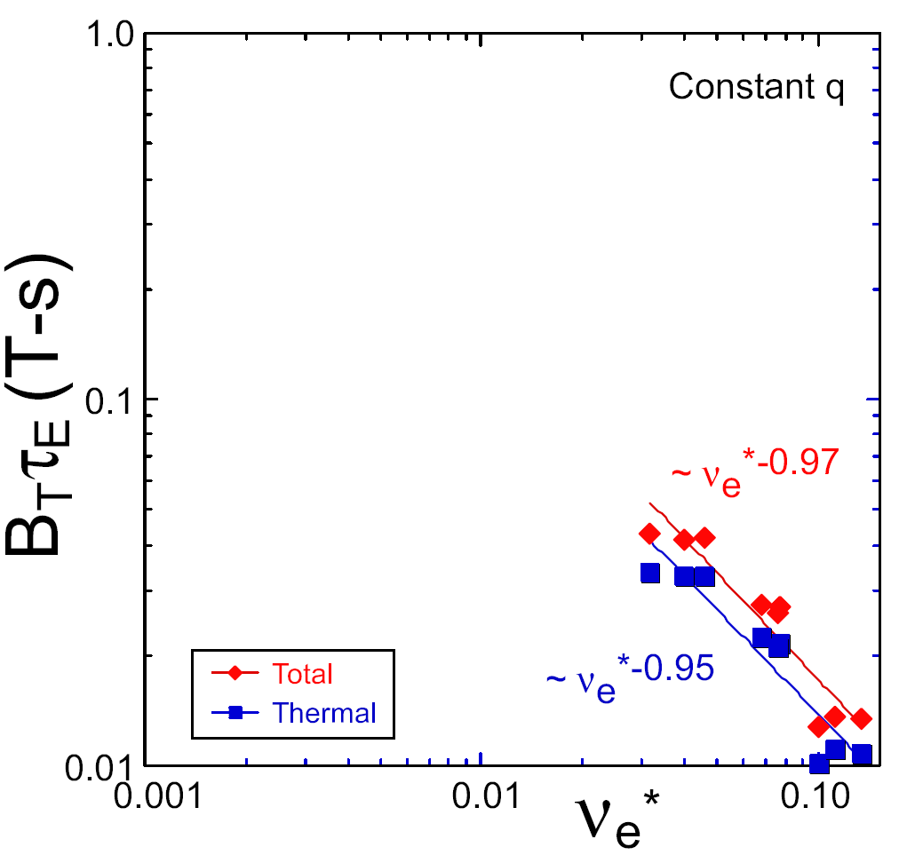
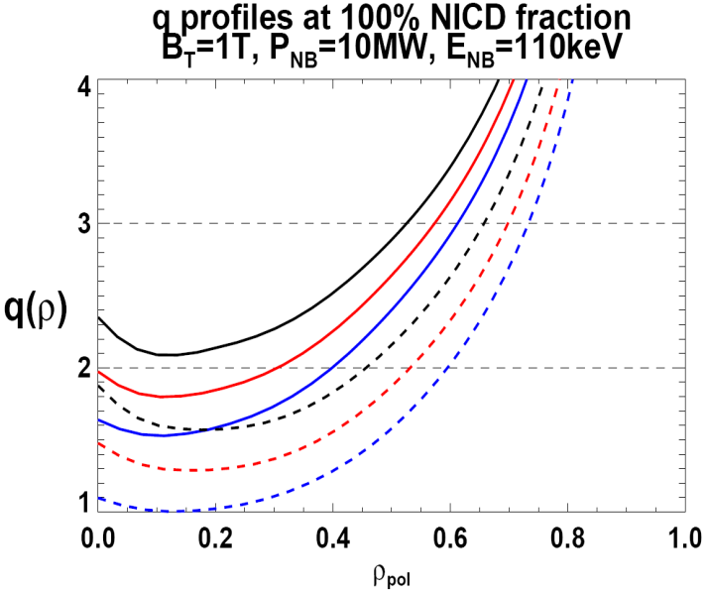

NSTX Upgrade incorporates 2 new capabilities:
Previous
center-stack
New
center-stack
ST-FNSF
Expect 2x higher T by doubling B_{T}, I_{P}, and NBI heating power
  Reduces ν* → ST-FNSF values to understand ST confinement
  5x longer pulse-length
  q(r,t) profile equilibration
  Test non-inductive ramp-up
constant q, β, ρ∗
NSTX Upgrade
?
NSTX
ITER-like scaling
TF OD = 20cm
TF OD = 40cm
Normalized e-collisionality ν_{e}* ∝ n_{e} / T_{e}²
I_{P}=0.95MA, H_{98y2}=1.2, β_{N}=5, β_{T} = 10%, B_{T} = 1T, P_{NBI} = 10MW, P_{RF} = 4MW
  2x higher CD efficiency from larger tangency radius R_{TAN}
100% non-inductive CD with core q(r) profile controllable by:
  NBI tangency radius
  Plasma density, position (not shown)
n
e
/
n
Greenwald
0.95
0.72
R_{TAN} [cm]
__________________
50, 60, 70, 130
60, 70,120,130
70,110,120,130
Present NBI
New 2nd NBI

Slide 5
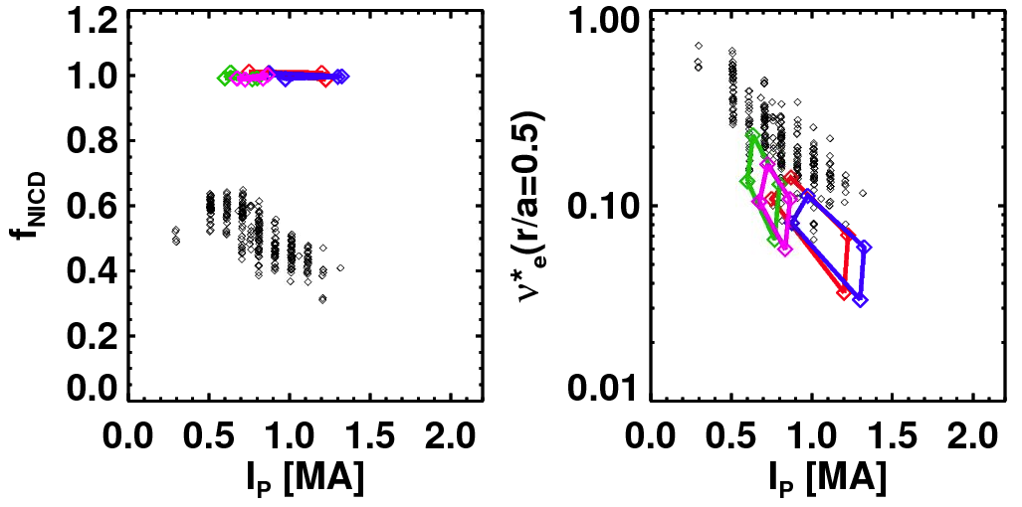
100% non-inductive current drive is essential for steady-state operation of AT/ST next-steps – including FNSF
NSTX achieved:
NSTX-U projections (TRANSP):
Maximum sustained non-inductive fractions of 65% w/NBI at I_{P} = 0.7 MA
70-100% non-inductive transiently with HHFW current-drive + bootstrap
100% non-inductive at I_{P} = 0.6-1.3MA for range of power, density, confinement
Contours of Non-Inductive Fraction
NSTX-U projections
Total non-inductive current fraction
NSTX Results
H_{98y2}
ITER H-mode confinement scaling multiplier
via high harmonic FW
I_{p} (MA)
I_{P}=1 MA, B_{T}=1.0 T, P_{NBI}=12.6 MW

Slide 6

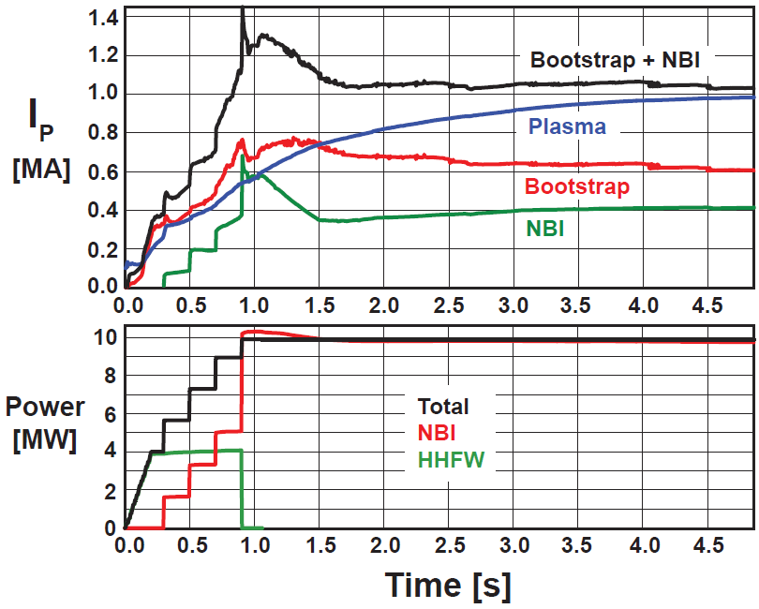
Simulations indicate NSTX-U can test plasma initiation with small or no transformer – required for an ST-based FNSF
TSC code (2D) successfully simulates CHI I_{P} ~200kA achieved in NSTX
TRANSP: NSTX-U more tangential NBI → 3-4x higher CD at low I_{P} (0.4MA)
TSC: non-inductive ramp-up from 0.4MA to 1MA possible w/ BS + NBI
1.0 ms
1.6 ms
2.7 ms
2
1
Z (m)
0
-1
-2
0
1
2
0
1
2
0
1
2
R (m)
R (m)
R (m)
TSC + proposed tools support CHI I_{P} → 400kA in NSTX-U
  Higher injector flux, B_{T}, and CHI voltage
  1MW 28GHz ECH (increases T_{e})

Slide 7
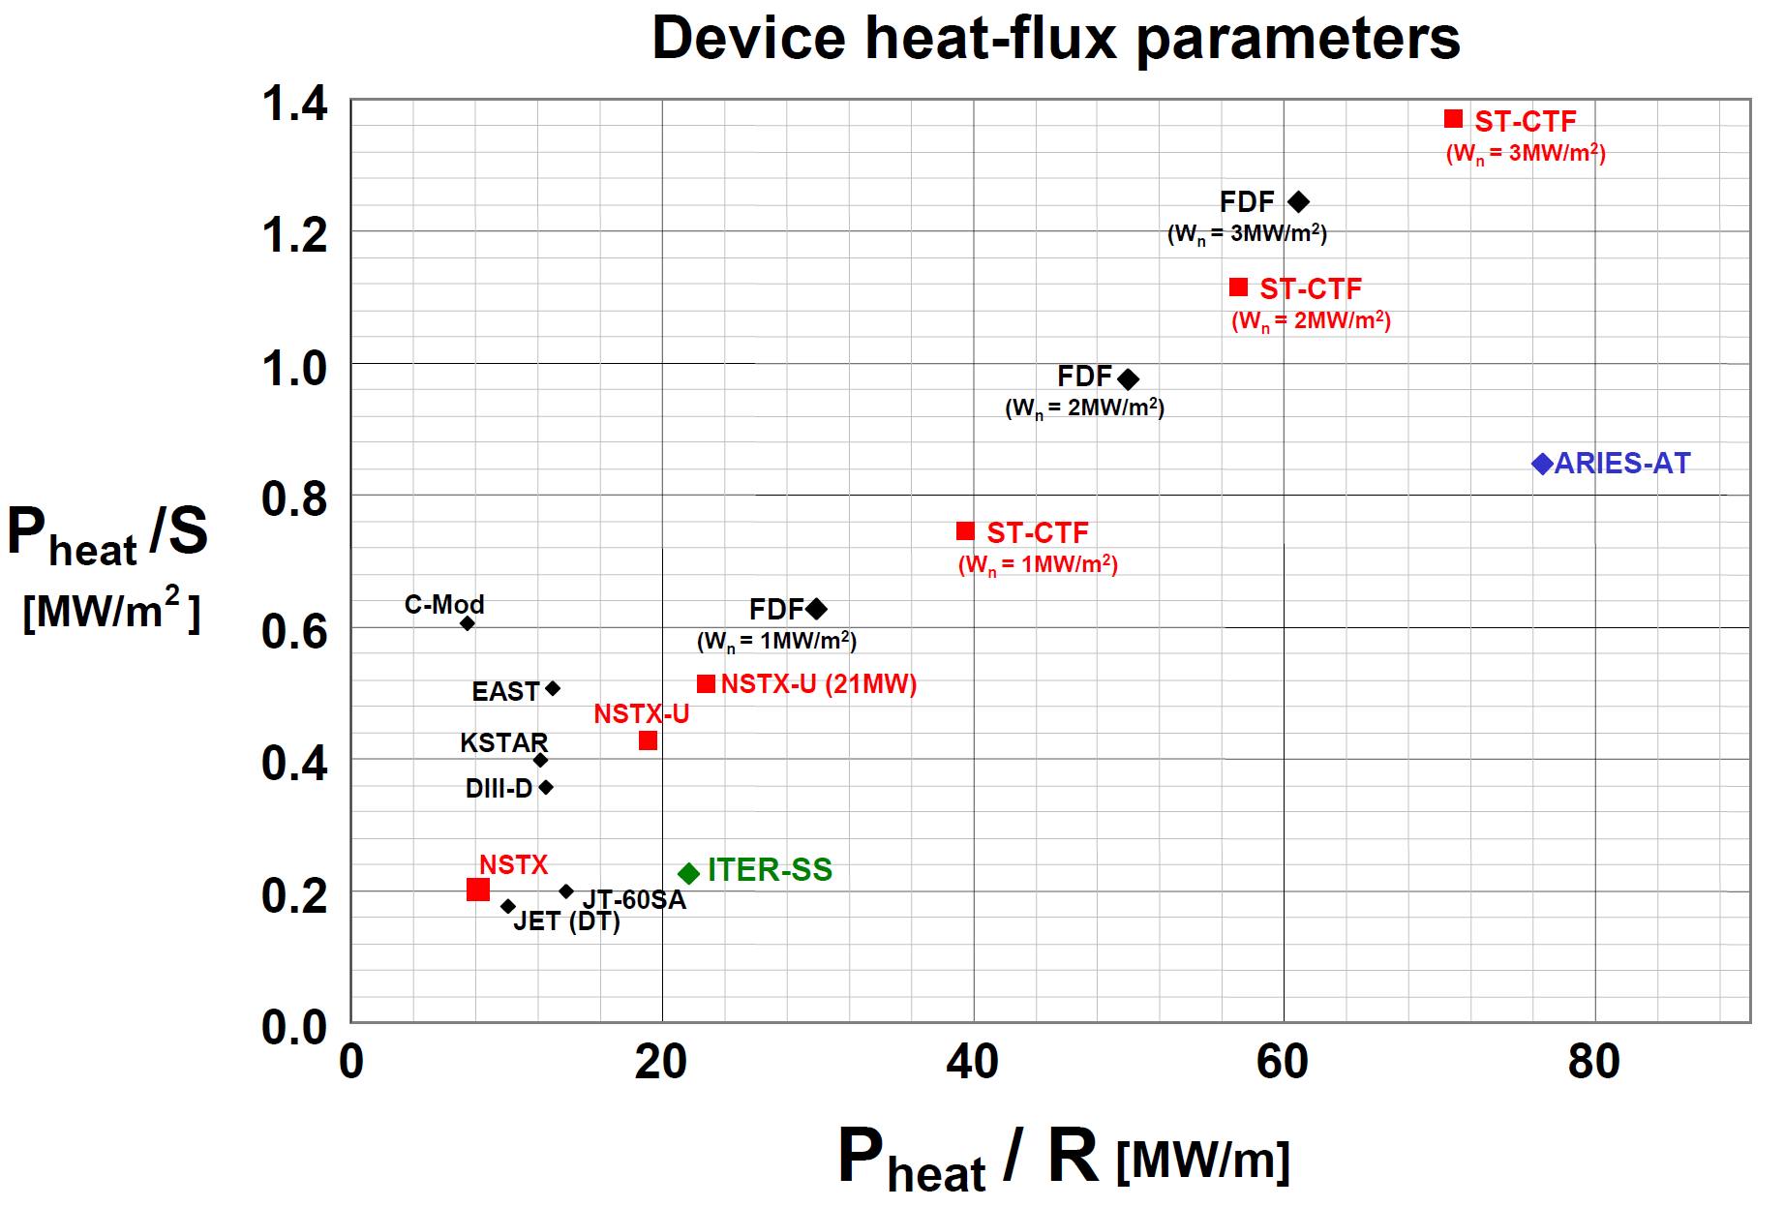
NSTX Upgrade will extend normalized divertor and first-wall heat-loads much closer to FNSF and Demo regimes
W_{n} = wall neutron loading

Slide 8
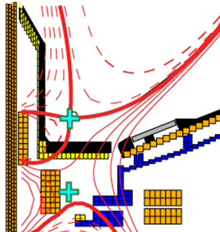
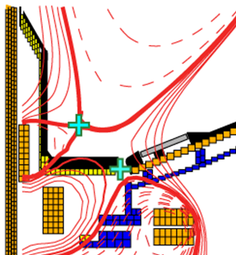
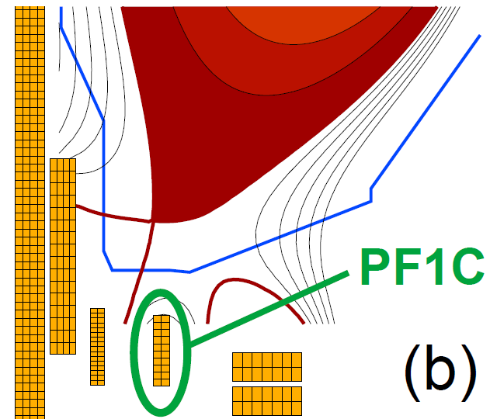
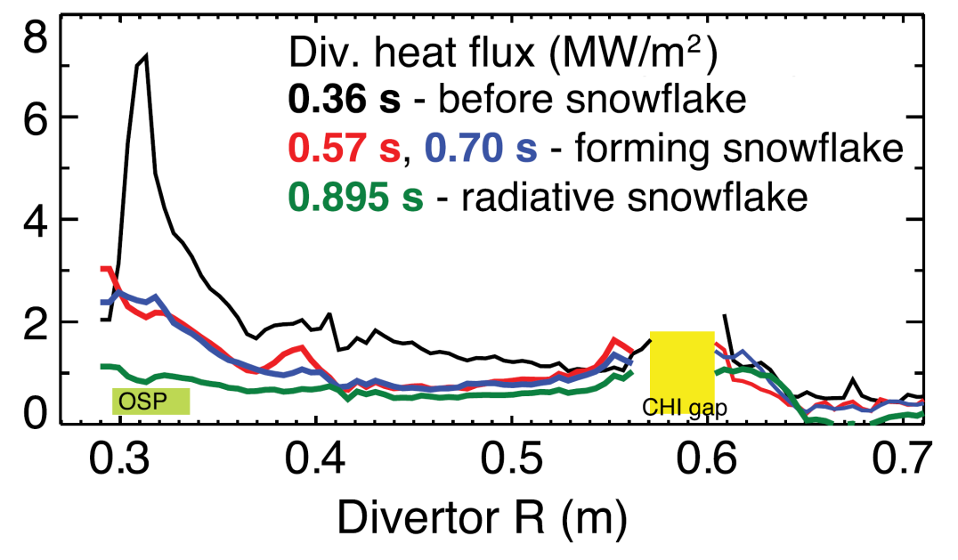
NSTX-U will test ability of radiation and
“snowflake” divertor to mitigate very high heat-fluxes
NSTX: reduced heat flux 2-4× via partial detachment (radiation)
Snowflake → additional x-point near primary x-point
  Lower B_{P} → high flux expansion = 40-60 lowers incident q⊥
  Longer field-line-length promotes temperature drop, detachment
Standard Divertor
Snowflake Divertor
NSTX-U peak heat fluxes will be up to 4-8× higher than in NSTX
NSTX-U has additional coils for up-down symmetric snowflakes, improved control

Slide 9
Outline
NSTX-U mission and capabilities
NSTX results highlights, NSTX-U goals
  Non-inductive current drive
  Heat-flux mitigation
Progress toward completing NSTX-U Project
Proposed longer-term (5 year plan) enhancements
Summary

Slide 10
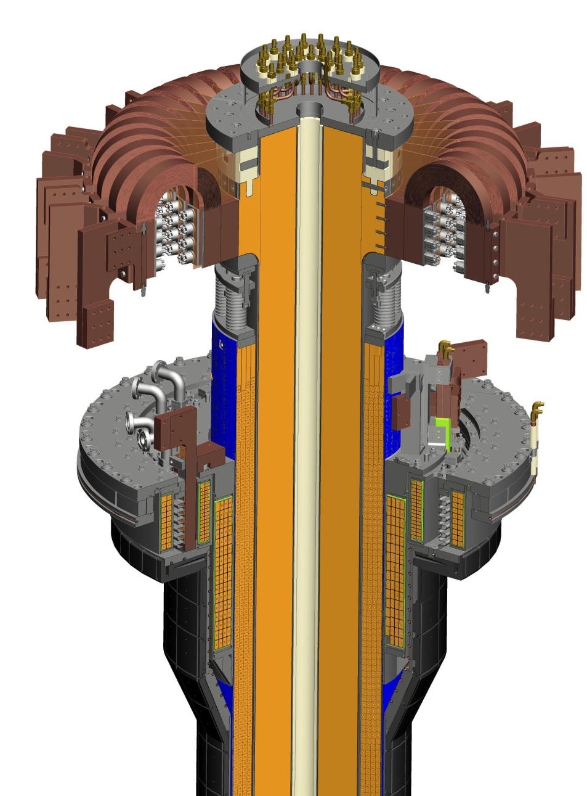
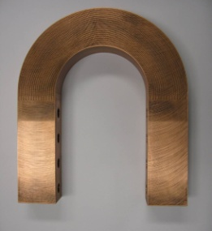
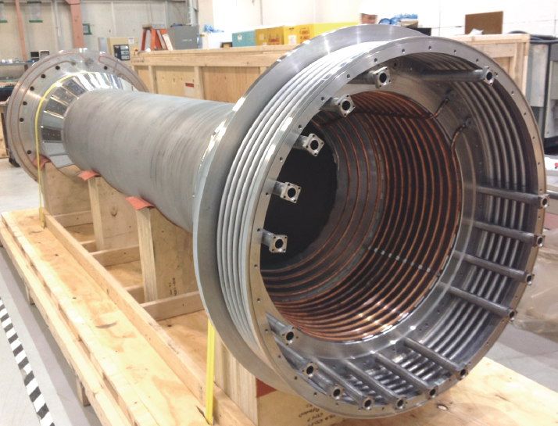
Improved center-stack design to handle increased forces
Identical 36 TF conductors and innovative flex-bus design
TF conductor
TF cooling lines
Electric Discharge Machining Cuts
Friction-stir welded TF flag joints
TF flex-bus
CTD-425 cyanate ester epoxy blend insulation
Tested for
300k cycles
CHI bus
PF coil 1C
PF coil 1B
PF coil 1A
CS casing
OH coil
See TO2-5 by S. Raftopoulos today at 12:15PM

Slide 11
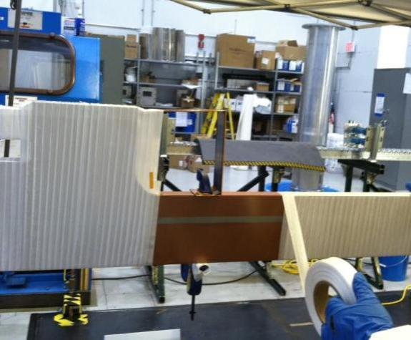
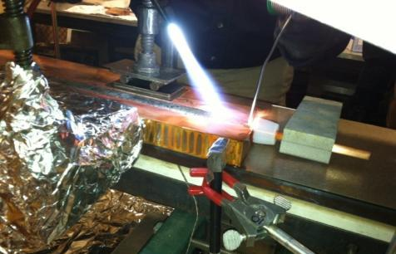
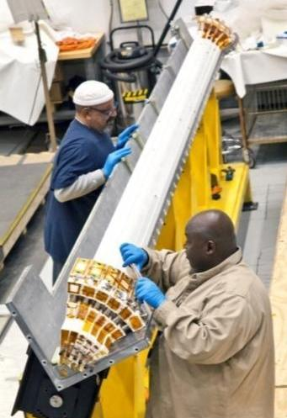
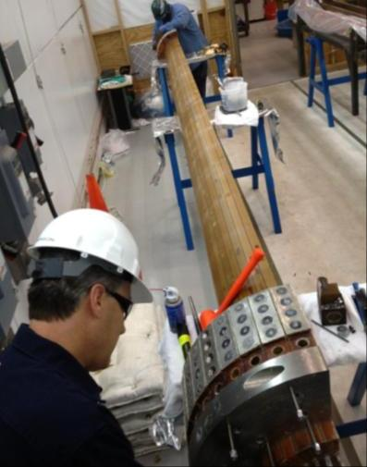
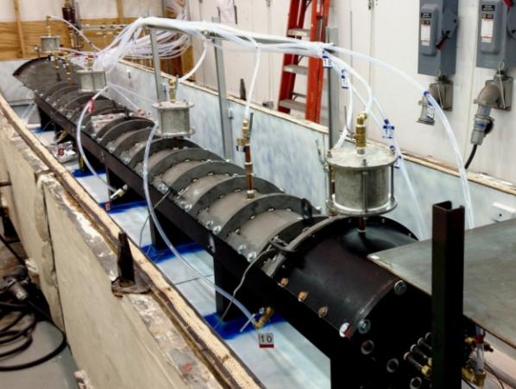
Center-stack fabrication & assembly proceeding well
Innovative manufacturing techniques developed
Cooling tube soldered with resin-based flux into inner TF conductor
Conductor being wrapped with fiberglass insulation
Insulated conductor being placed into mold
Assembled TF mold ready for Vacuum Pressure Impregnation (VPI) w/ CTD-425
3 of 4 quadrants successfully VPI’d !

Slide 12
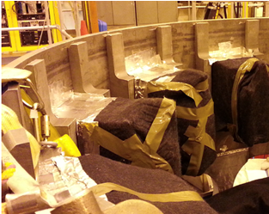
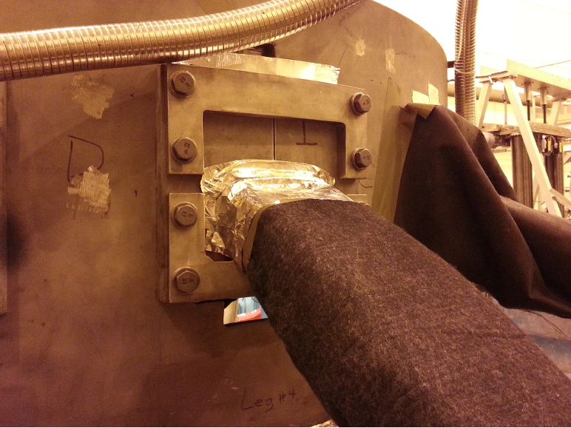
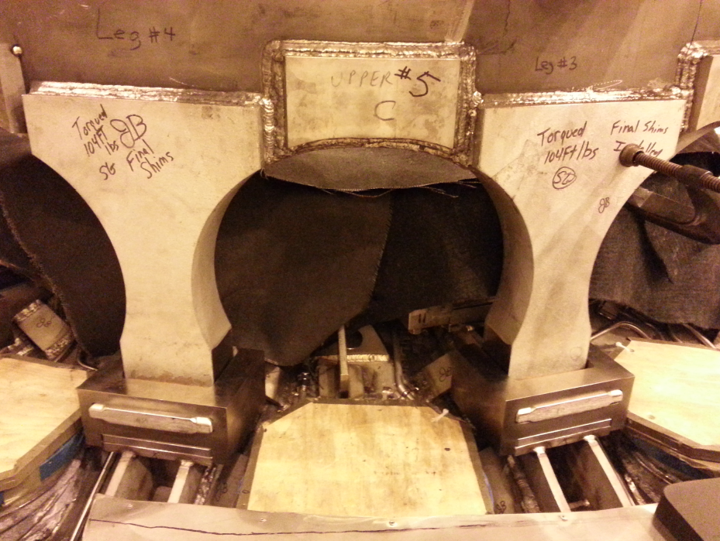
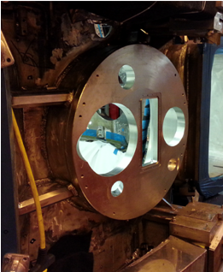
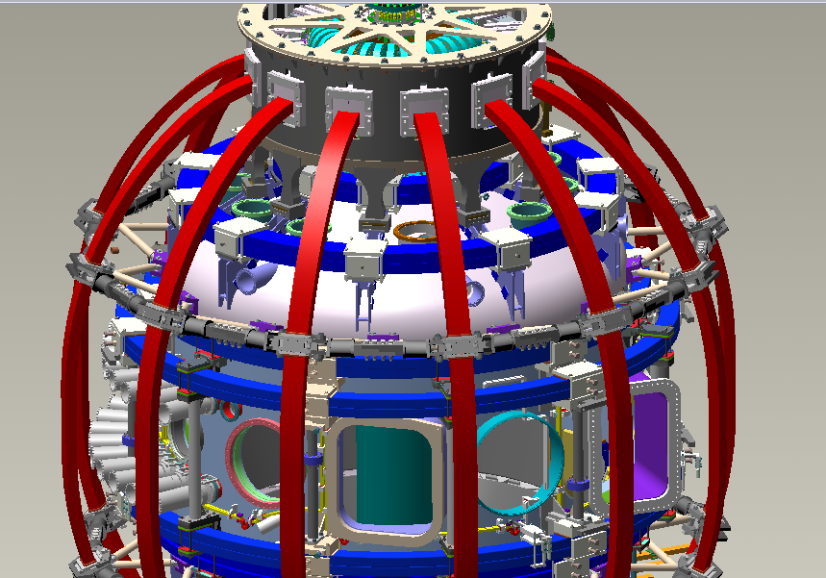
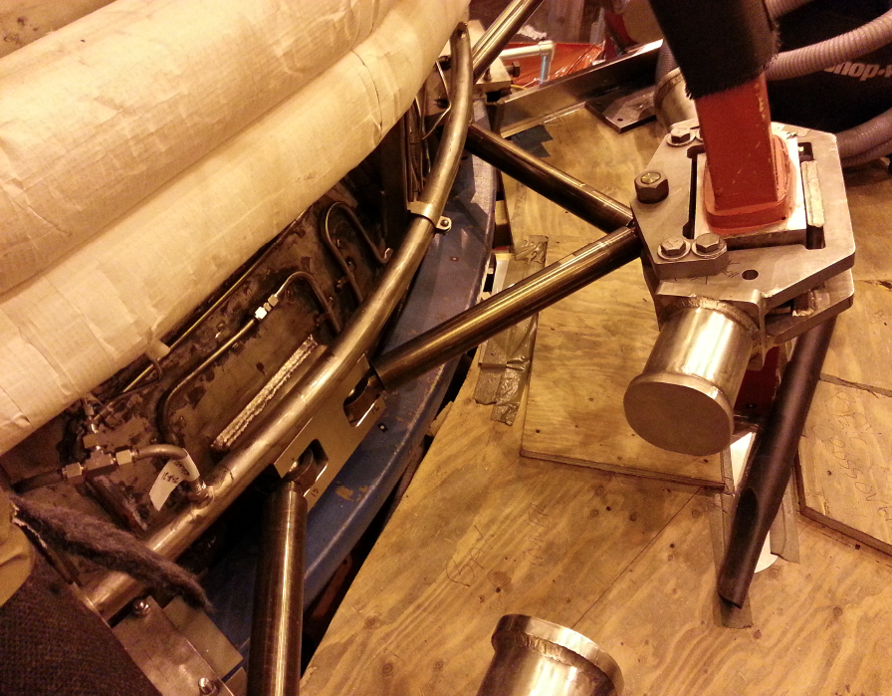
Substantial structural and vacuum vessel upgrades
Must handle 4x higher electromagnetic loads
Upper Aluminum Block Internal Reinforcements
Upper Aluminum Block External Reinforcements
Upper Umbrella Arch Reinforcements
Bay-L Cap
TF-Vessel Clevis, TF Outer Leg Support

Slide 13
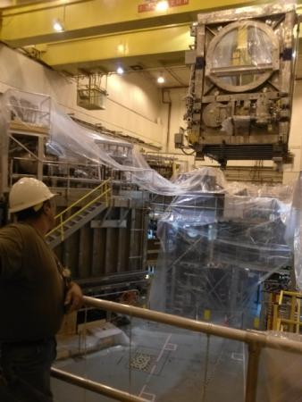
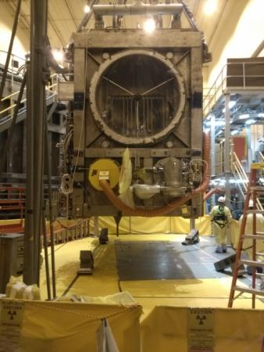
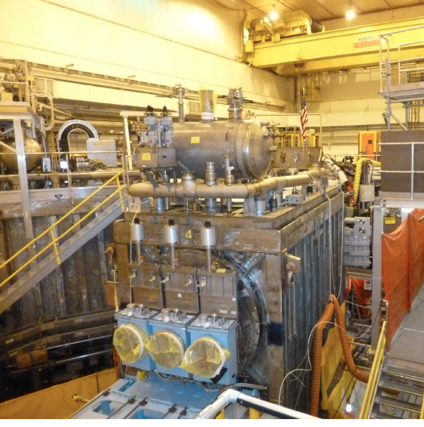
Relocation of the 2nd NBI beam line box from
the TFTR test cell into the NSTX-U test cell completed
TFTR NBI beam box and components successfully tritium decontaminated
Beam Box being lifted over NSTX
Beam Box placed in its final location and aligned
Beam Box being populated with components

Slide 14
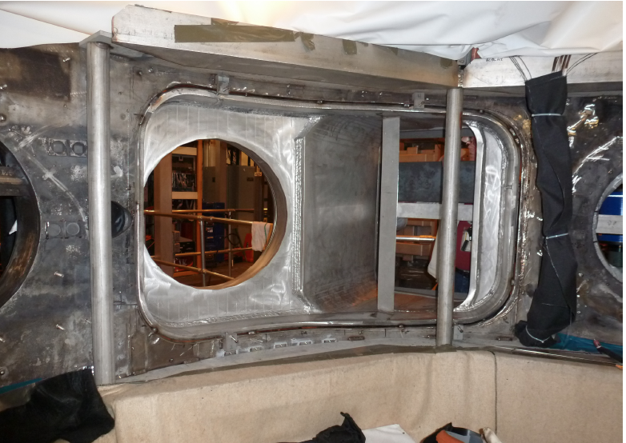
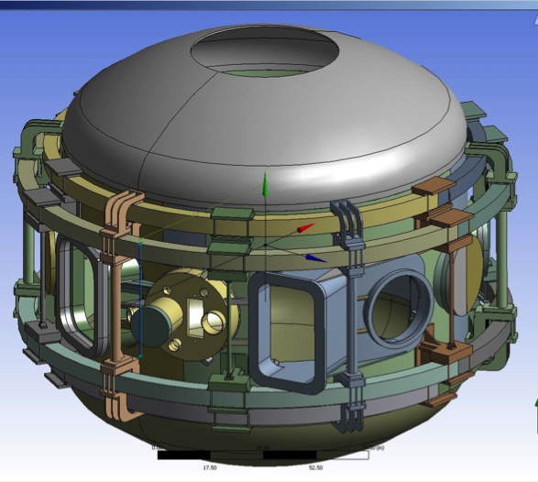
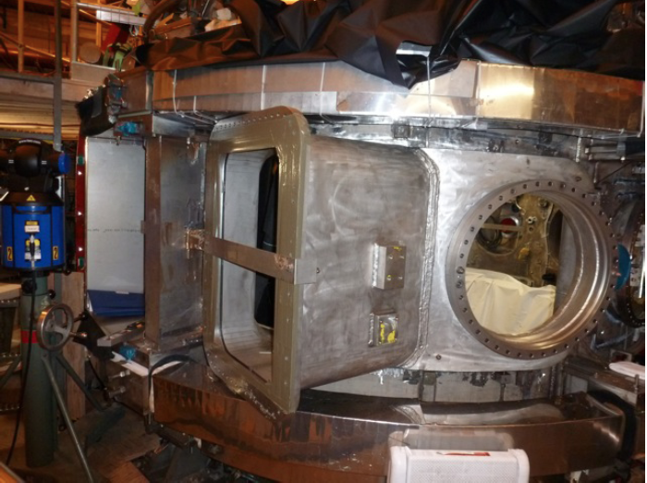
Highly tangential 2nd NBI enabled by new port
Outer wall radius moved outward to avoid beam clipping
Interior View of Bay J-K
Exterior View of Bay J-K
JK cap

Slide 15
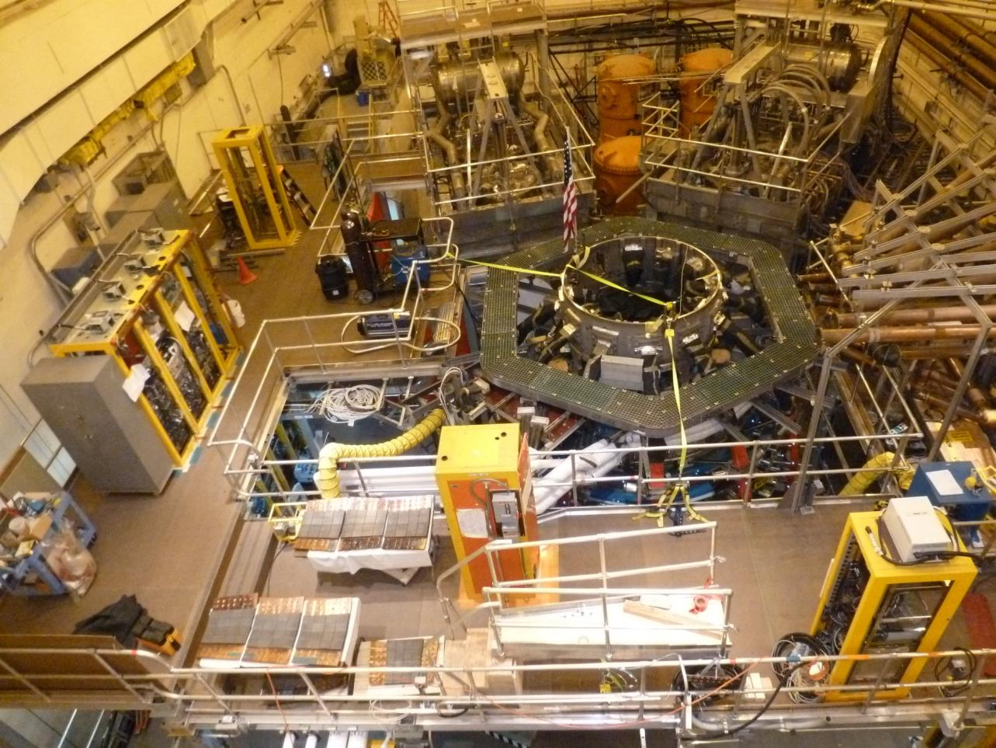
Aerial View of the NSTX-U Test Cell (May 2013)
2nd NBI
1st NBI
HHFW
System
NSTX-U

Slide 16
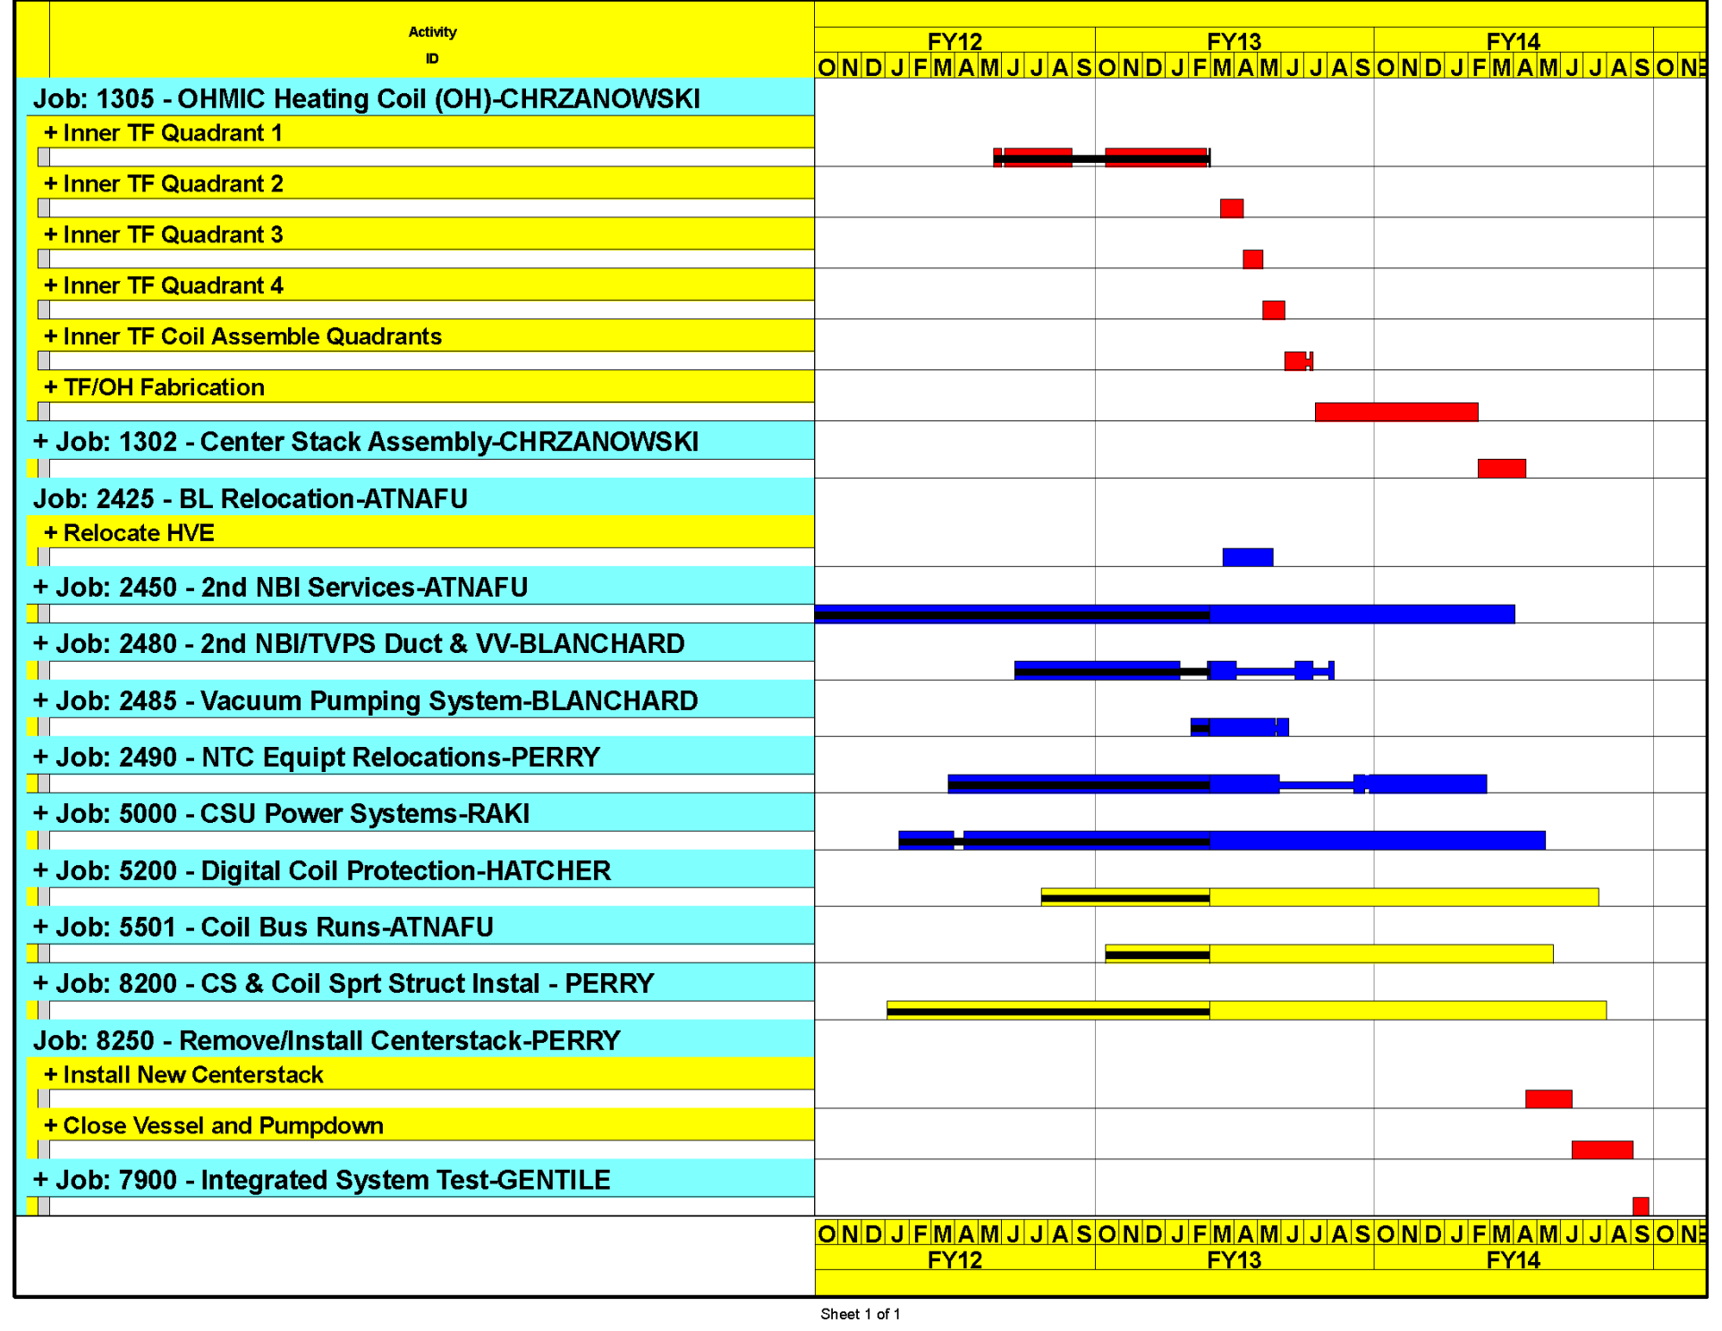
Upgrade schedule on track for early finish
Aiming to start research operation in early FY 2015
Critical path through the centerstack fabrication and installation
Forecast Mid October 2014

Slide 17
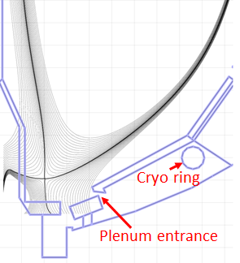
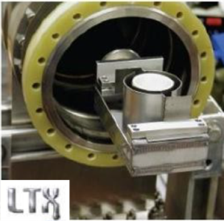
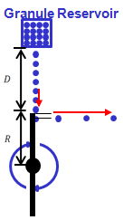
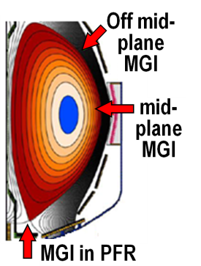

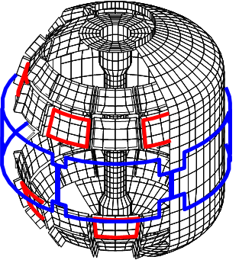
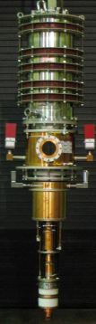
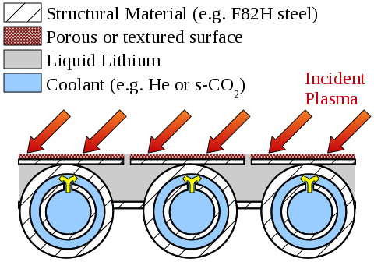
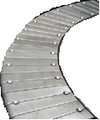
NSTX-U team is proposing longer-term facility enhancements to fully utilize Upgrade capabilities, support ITER and FNSF
Upward Li evaporator
Divertor cryo-pump
Li granule injector (LGI)
Improved particle control tools
  Control deuterium inventory and trigger rapid ELMs to expel impurities
  Access low ν*, understand role of Li
Disruption avoidance, mitigation
  3D sensors & coils, massive gas injection
ECH to raise start-up plasma T_{e} to enable FW+NBI+BS I_{P} ramp-up
Begin transition to high-Z PFCs, assess flowing liquid metals
Midplane + off-midplane non-axisymmetric control coils (NCC)
Extended low-f MHD sensor set
1-2MW
28 GHz
gyrotron
High-Z tiles
Actively-supplied, capillary-restrained, gas-cooled LM-PFC

Slide 18
Summary: NSTX-U will make leading contributions to fusion science and next-step applications
Provide ST basis (and assist AT) for FNSF and for ITER
  Actuators + controls for 100% non-inductive at high confinement, β
  Non-inductive formation and ramp-up - needed for ST, benefits AT
  RWM control, disruption warning, novel disruption mitigation
  Non-linear Alfvénic mode dynamics, turbulence at high β and low ν*
Novel plasma-material-interface solutions for next-steps
  Lead “snowflake” development, combine with radiation/detachment
  Lead in liquid metals for recycling/erosion control, vapor-shielding
NSTX-U project is on cost and schedule
  Project ~65% complete
  First plasma projected for October 2014

Slide 19
NSTX-U and ST-FNSF presentations
NSTX Accomplishments & Plans
Jon Menard
Oral - Tuesday 11:00
NSTX Upgrade
NSTX Operations
NSTX Vacuum Vessel Modification
Magnet Design & Fabrication
CHI System
Neway Atnafu
Steve Raftopoulos
Roger Raman
Poster Thursday 2:00-4:00
Oral - Tuesday 12:15
Poster Tuesday 2:00-4:00
Power & control system changes
TF Bundle Failure Cause
Raki Ramakrishnan
Larry Dudek
Lithium Flash Evaporator
Posters (2) Tuesday 2:00-4:00
Poster Tuesday 2:00-4:00
Lane Roquemore
Poster-Thursday 2:00-4:00
Digital Coil Protection System (DCPS) Software
Coolant Tube Solder Technique
Keith Erickson
Steve Jurczynski
NSTX Lithium Pellet Fueling
Oral -Thursday 12:05
Poster Tuesday 2:00-4:00
Daniel Andruczyk
DCPS Overview
Aqua pour coil winding
Poster-Thursday 2:00-4:00
Ron Hatcher
Mike Mardenfeld
Poster Thursday 2:00-4:00
Poster Tuesday 2:00-4:00
DCPS I/O & Data subsystem
Divertor Tile Modif. (CHI gap Protection)
Greg Tchilinguirian
Kelsey Tresemer
Poster-Thursday 2:00-4:00
Poster- Thursday 2:00-4:00
ST-FNSF
TBR and Shielding - L. A. El-Guebaly
Configuration - T. G. Brown
Mission and Performance - J. Menard
Power and Particle Exhaust - J. Canik
Oral -Thursday 11:35
CS TF Radial Cooling - R. D. Woolley
Poster Tuesday 2:00-4:00

