Slide 1
NSTX
Supported by
Design Description of the Coaxial Helicity Injection (CHI) System on NSTX-U
College W&M
Colorado Sch Mines
Columbia U
Comp-X
General Atomics
INL
Johns Hopkins U
LANL
LLNL
Lodestar
MIT
Nova Photonics
New York U
Old Dominion U
ORNL
PPPL
PSI
Princeton U
Purdue U
SNL
Think Tank, Inc.
UC Davis
UC Irvine
UCLA
UCSD
U Colorado
U Maryland
U Rochester
U Washington
U Wisconsin
Culham Sci Ctr
U St. Andrews
York U
Chubu U
Fukui U
Hiroshima U
Hyogo U
Kyoto U
Kyushu U
Kyushu Tokai U
NIFS
Niigata U
U Tokyo
JAEA
Hebrew U
Ioffe Inst
RRC Kurchatov Inst
TRINITI
KBSI
KAIST
POSTECH
ASIPP
ENEA, Frascati
CEA, Cadarache
IPP, Jülich
IPP, Garching
ASCR, Czech Rep
U Quebec
R. Raman, T.R. Jarboe, B.A. Nelson
(University of Washington, Seattle, WA)
D. Mueller, S.C. Jardin, C. Neumeyer, M. Ono, J.E. Menard
(Princeton Plasma Physics Laboratory, Princeton, NJ)
and the NSTX Research Team
This work is supported by US DOE contract numbers FG03-96ER5436, DE-FG02-99ER54519 and DE-AC02-09CH11466
25th Symposium on Fusion Engineering
San Francisco, California, June 11-14, 2013

Slide 2
Motivation for CHI Start-up
A FNSF based on the Spherical Torus (ST) concept will have very restricted space for a central solenoid
  A method for solenoid-free start-up is very likely required
Eliminating the solenoid also simplifies the tokamak concept
  Solenoid not needed during steady-state operation
  Provides greater flexibility in the choice of the aspect ratio
Transient CHI has generated 200kA of high-quality plasma current in NSTX
  When induction is applied, the current ramped-up to 1MA, while requiring 35% less inductive flux than a discharge without CHI start-up

Slide 3
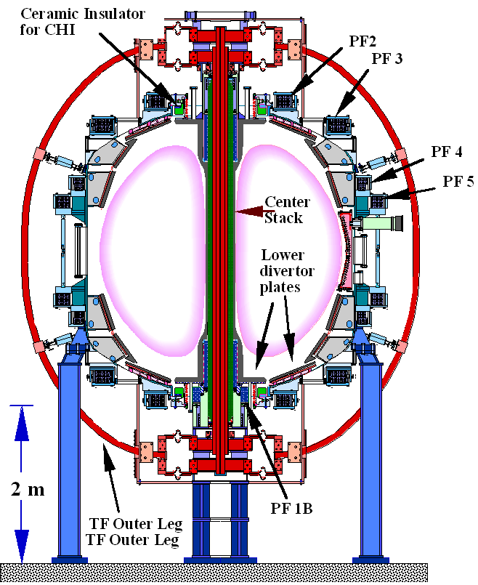
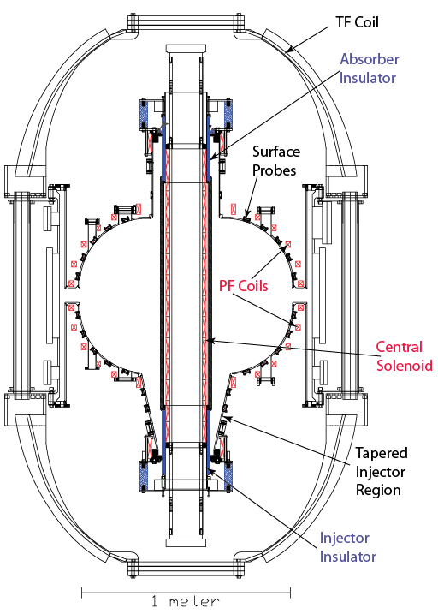
NSTX and NSTX-U CHI Research Follows
Concept Developed in HIT-II
Both machines shown approximate to scale
Concept exploration device HIT-II
Built for developing CHI
Many close fitting fast acting PF coils
4kV CHI capacitor bank
Proof-of-Principle NSTX device
Built with conventional tokamak components
Few PF coils
1.7kV CHI capacitor bank (2-3kV on NSTX-U)
NSTX plasma is ~30 x plasma volume of HIT-II

Slide 4
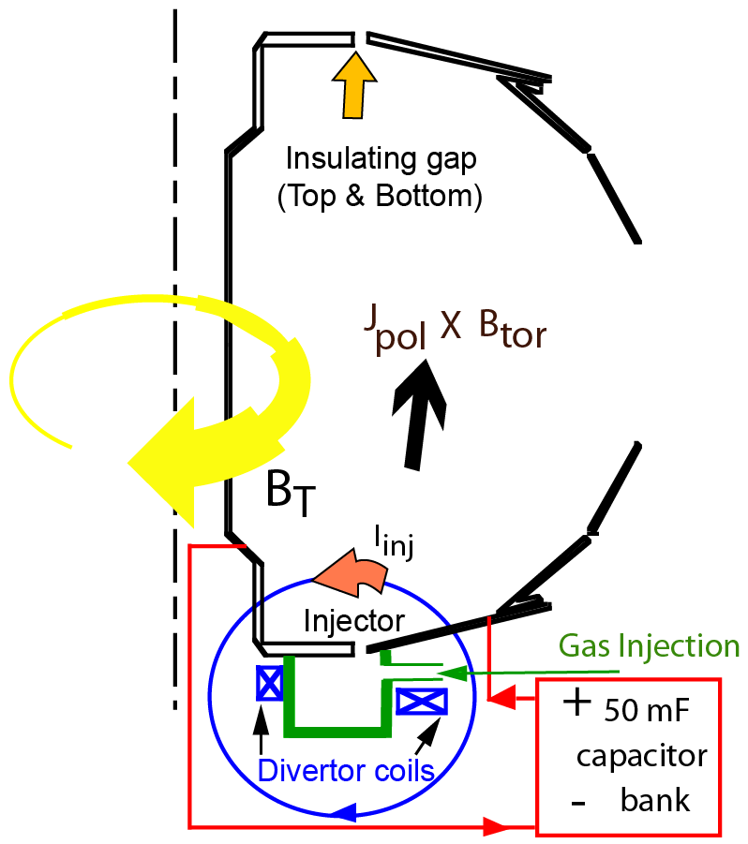

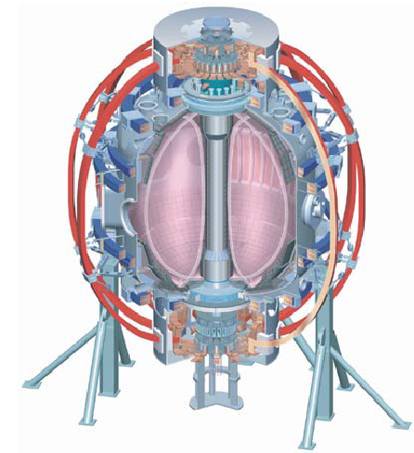
NSTX-U Will Use Transient CHI For Solenoid-free Plasma Start-up With Subsequent Current Ramp-up Using NBI
Transient CHI Start-up
  - Generate injector poloidal flux using divertor coils
  - Ensure divertor flux footprints are narrow
  - Inject 2 Torr.L of D2 below divertor plate gap
  - Discharge 25-50mF capacitor bank (2 kV)
  Injected current rapidly decays
  Toroidal plasma currents remains on closed flux surfaces
Fast camera: F. Scotti, L. Roquemore, R. Maqueda
CHI for an ST: T.R. Jarboe, Fusion Technology, 15 (1989) 7
Transient CHI: R. Raman, T.R. Jarboe, B.A. Nelson, et al.,
PRL 90, (2003) 075005-1

Slide 5
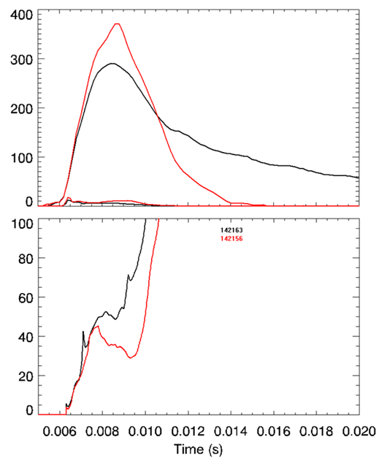
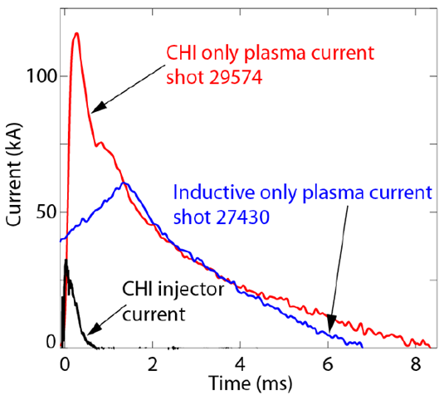
Very High Current Multiplication (Over 70 in NSTX)
Aided by Higher Toroidal Flux
HIT-II
NSTX
(kA)
Plasma current
Injector
Current
30kA of injector current generates 120kA of plasma current
Best current multiplication factor is 6-7
Current multiplication factor in NSTX is 10 times greater than that in HIT-II
Current Multiplication Factor
- Over 200kA of current persists after CHI is turned off
R. Raman, B.A. Nelson, D. Mueller, et al., PRL 97, (2006) 17002

Slide 6
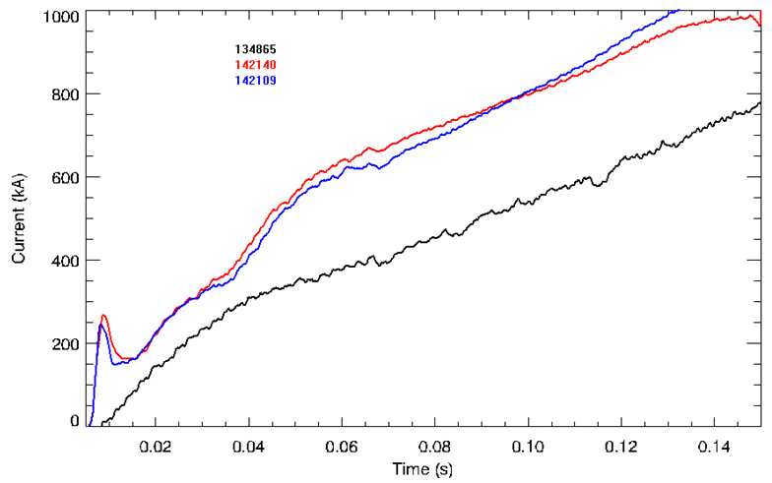
Standard L-mode NSTX Discharge Ramps to 1MA Using 50% More Inductive Flux than a CHI Started Discharge
2010 results
Plasma current
CHI started
Reference NSTX Inductive start-up
Reference Inductive discharge: Uses 396mWb to get to 1MA
CHI started discharge: Uses 258 mWb to get to 1MA (53% less flux)
NSTX inductive start-up: 138mWb flux typically generates 400kA of plasma current
Best CHI-startup discharges: 138mWb flux generated 650kA

Slide 7
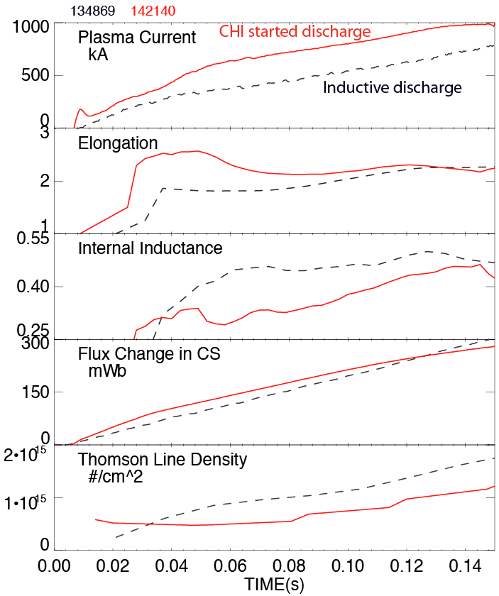
Plasma discharge ramping to 1MA requires 35% less inductive flux when coaxial helicity injection (CHI) is used
CHI assisted startup in NSTX
High elongation
CHI generates plasmas with high elongation, low l_{i} and n_{e}
Results imply a doubling of closed flux current > 400kA in NSTX-U
Low inductance
Low density

Slide 8
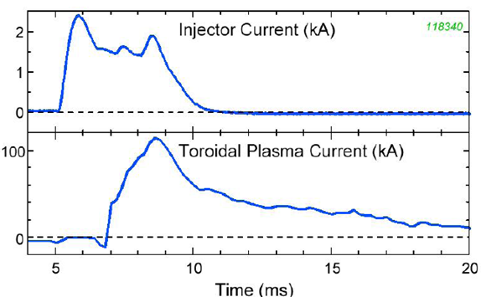
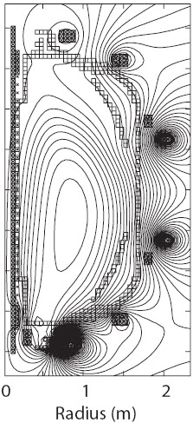
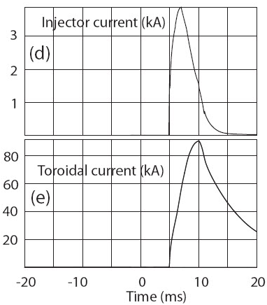
TSC Simulations are being used to Understand CHI-Scaling with Machine Size (NSTX)
Time-dependent, free-boundary, predictive equilibrium and transport
Solves MHD/Maxwell’s equations coupled to transport and Ohm’s law
Requires as input:
  - Device hardware geometry
  - Coil electrical characteristics
  - Assumptions concerning discharge characteristics
Models evolutions of free-boundary axisymmetric toroidal plasma on the resistive and energy confinement time scales.
NSTX vacuum vessel modeled as a metallic structure with poloidal breaks
  - An electric potential is applied across the break to generate the desired injector current
NSTX Experimental result
TSC simulation
TSC: Developed by S.C. Jardin (PPPL)

Slide 9
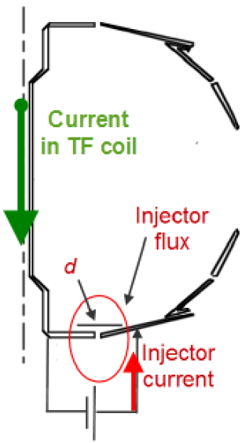
Externally Produced Toroidal Field makes CHI much more Efficient in a Lower Aspect Ratio Tokamak
Bubble burst current*:
= injector flux
= flux foot print width
= current in TF coil
Current multiplication increases with toroidal field
  - Favorable scaling with machine size
  - Increases efficiency (10 Amps/Joule in NSTX)
  - Smaller injector current to minimize electrode interaction
Injector current
Toroidal flux
* T.R. Jarboe, Fusion Tech. 15, 7 (1989)

Slide 10
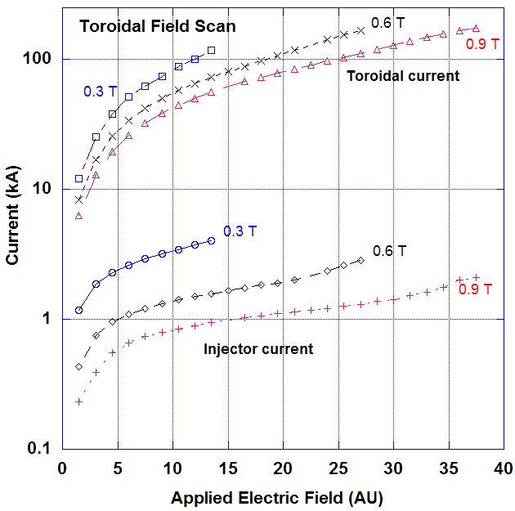
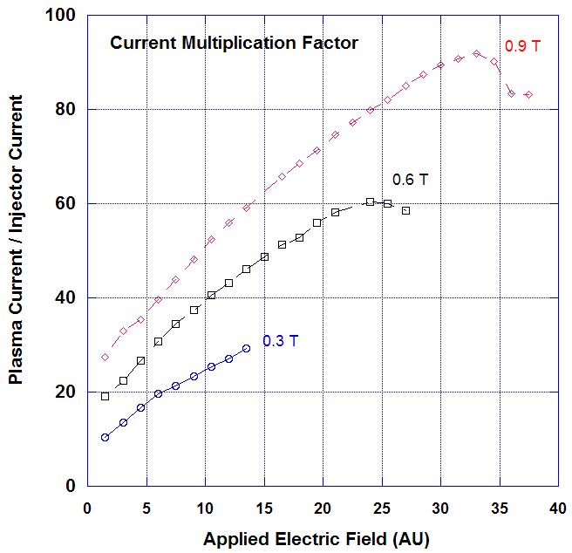
TSC Simulations Show Increasing Current Multiplication as TF is Increased
Observed current multiplication factors similar to observations in NSTX
  - Higher toroidal field important as it reduces injector current requirement
R. Raman, S.C. Jardin, J. Menard, T.R. Jarboe et al., Nuclear Fusion 51, 113018 (2011)

Slide 11
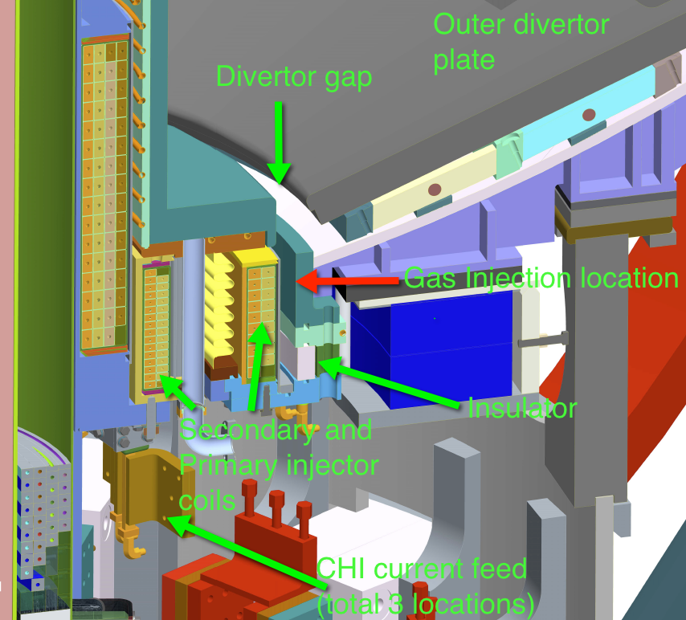
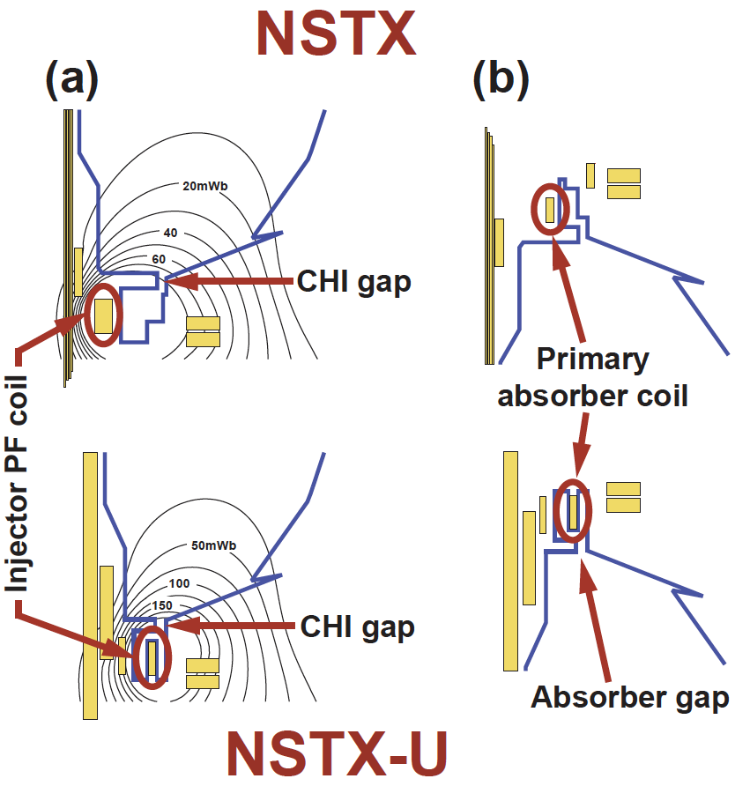
NSTX-U Upgrades that Facilitate CHI Start-up
NSTX-U Machine Enhancements for CHI
  > 2.5 x Injector Flux in NSTX (proportional to I_{p} )
  Absorber coil much better positioned to suppress spurious arcs

Slide 12
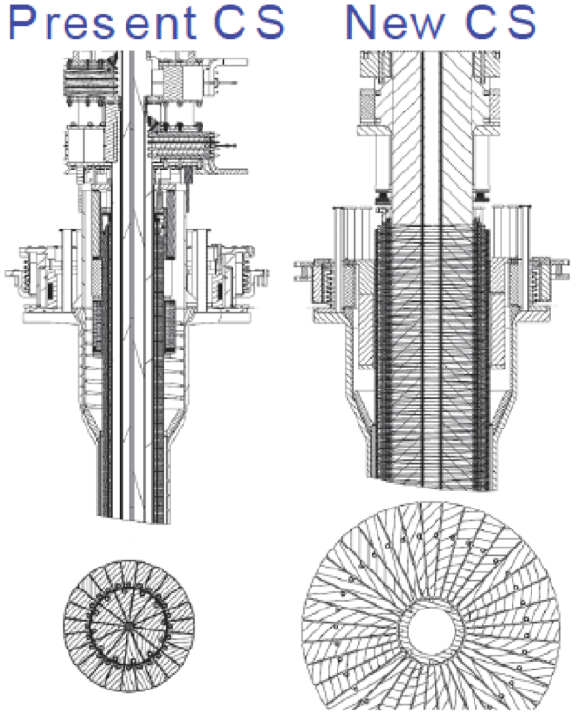
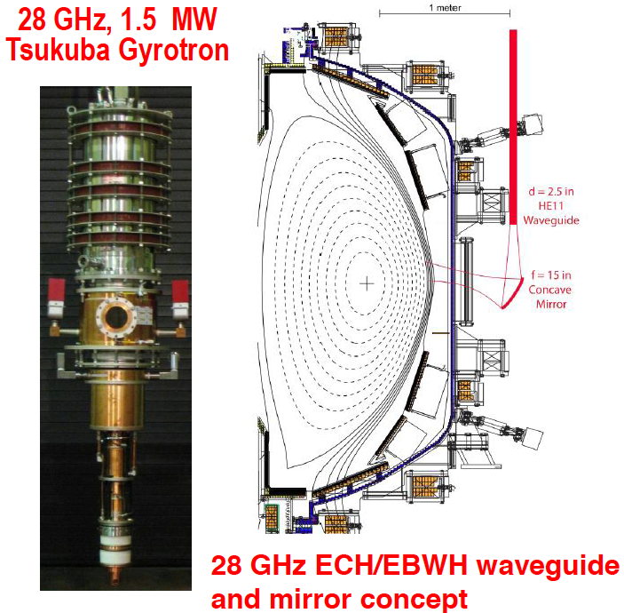
Increased TF and ECH Beneficial for Increasing Electron Temperature in CHI-Started Discharges
TF increased to 1T (0.55 T in NSTX)
  Increases current multiplication factor defined as plasma current/capacitor bank current (facilitated by larger center stack)
28 GHz (1 MW) ECH system
  Will increase electron temperature
20 cm OD 40 cm OD

Slide 13
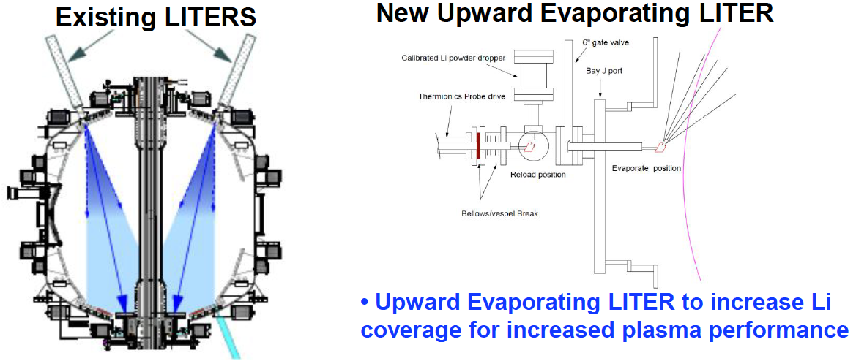
Increased Li Coverage of Vessel to Reduce Low-Z Impurities
Metal divertor plates and Cryo Pump Upgrades (post FY2016) Will allow CHI plasma temperature to increase as a result of reduced low-Z impurity influx and plasma density pump-out

Slide 14
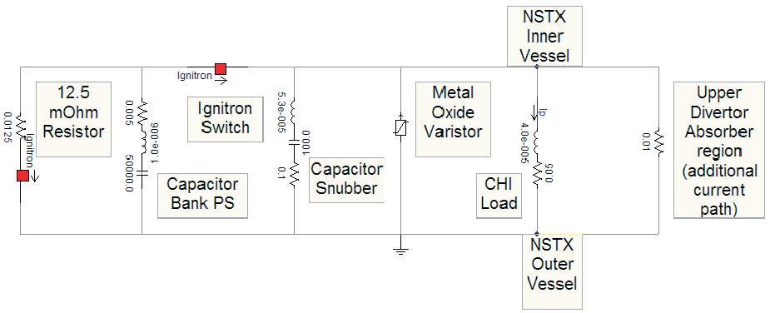
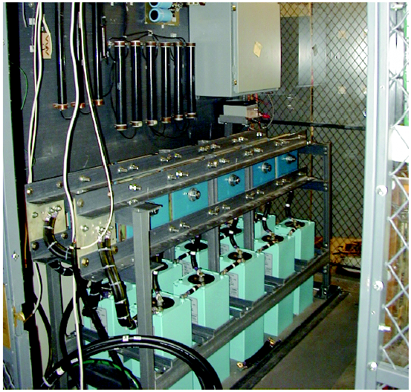
2-3kV Capacitor Bank Upgrades Allow Injection of More Poloidal Flux into NSTX-U (Injector Flux is Proportional to Ip)
NSTX-U CHI capacitor bank PS
50mF, 2.0 kV capacitor bank (5mF x 10): 100kJ
Present plans to upgrade to 3kV capacitors in FY2017 to allow capability to inject more poloidal injector flux
Fast crowbar system to interrupt injector current
Three, variable capacitance, and individually triggered modules to shape injector voltage waveform
Programmable thyristor power supply (2kV, 50kA) also available to support steady-state type CHI discharges
R. Hatcher and S. Ramakrishnan

Slide 15
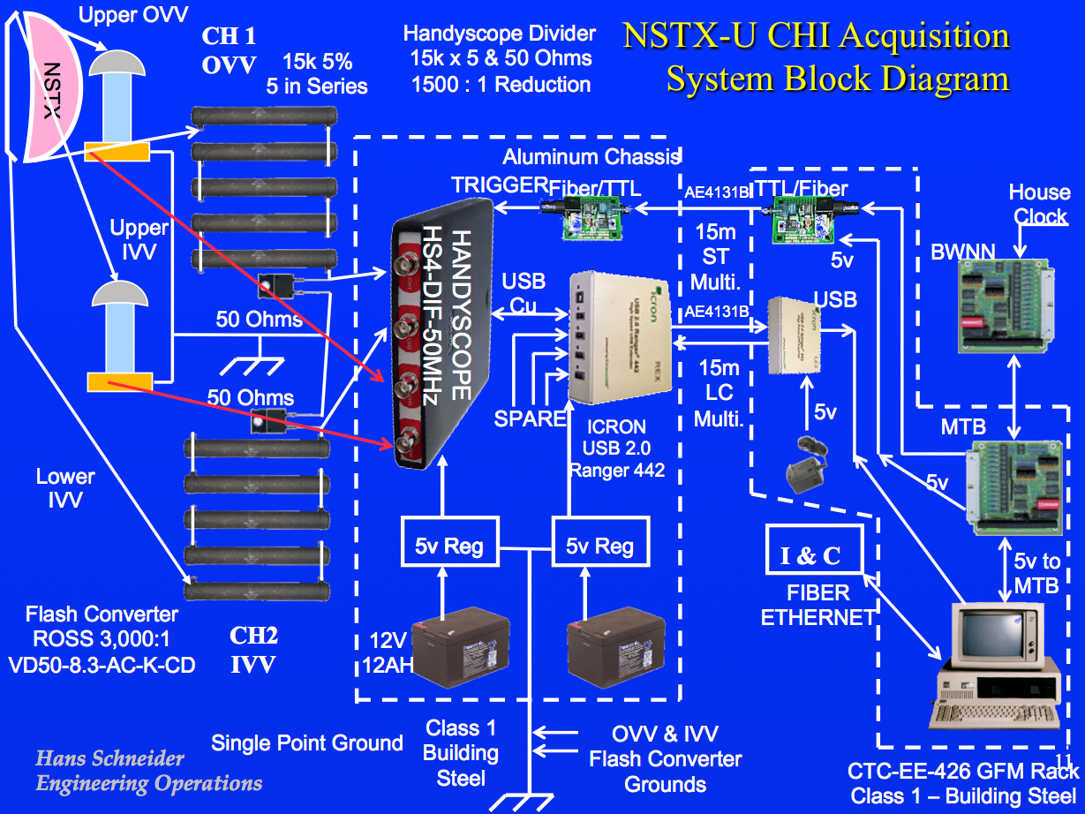
Dual 1 MHz Vessel Voltage Monitors based on Ross Voltage Monitors and Resistive Dividers (H. Schneider)

Slide 16
CHI Injector and Absorber Poloidal Field Coil Parameters
(NSTX and NSTX-U)
Coil | R (cm) | # Turns | L (mH) | R (mΩ) | kA-Turns (min) | kA-Turns (max) | kA.Turns/ms and Voltage (kV)
NSTX
PFAB1 | 43.06 | 48 | 3.93 | 129.7 | -48 | 48 | +/- 4.8 [1 kV]
PFAB2 | 63.18 | 48 | 6.46 | 190.2 | -48 | 48 | +/- 4.8 [1 kV]
PF1B | 30.5 | 32 | 0.673 | 3.15 | 0 | +320 | +19 [2 kV]
PF2L | 80 | 28 | 1.98 | 7.32 | -560 | +560 | +/- 25.3 [2 kV]
NSTX-U
PF1AU,L | 32.4 | 64 | 2.03 | 8.93 | -460 | 1172 | 56.2 [2 kV]
PF1BU,L | 40.4 | 32 | 1.14 | 9.19 | -192 | 416 | +45.8 [2 kV]
PF1CU,L | 55.05 | 20 | 0.72 | 4.49 | -100 | 318 | +41.1 [2 kV]
PF2L | 80 | 28 | 1.98 | 7.32 | -308 | 420 | +25.3 [2 kV]
Injector coil is positioned much closer to CHI gap (R = 57-61.6 cm) in NSTX-U
Absorber buffer coils have much higher current slew rates

Slide 17
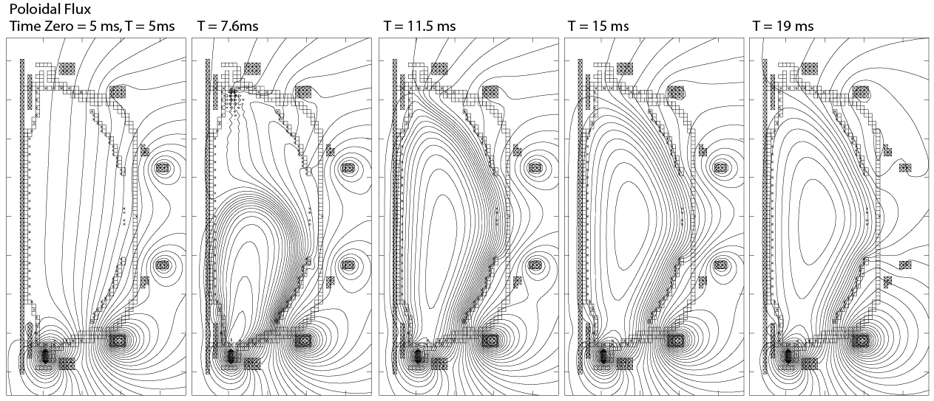
Initial CHI Start-up Scenario in NSTX-U
(TSC Simulations in NSTX-U Geometry – Static Coil Currents)
- Initial Transient CHI discharges in NSTX-U will start with low levels of current in the Primary PF1CL injector coil
- CHI discharge will be grown into a magnetic well suitable for the final CHI plasma equilibrium
- Poloidal flux evolution (shown above) is for for constant (in time) coil current values of:
- PF1CL (2 kA, Max available 15 kA), PF1AL (-0.4 kA), PF2L (-0.35 kA), PF3L (-0.5 kA),
- PF5 (-0.15 kA), PF3U (-0.07 kA), and Zero current in the other coils
- Absorber arc suppression may require low levels of current in the PF1CU coil

Slide 18
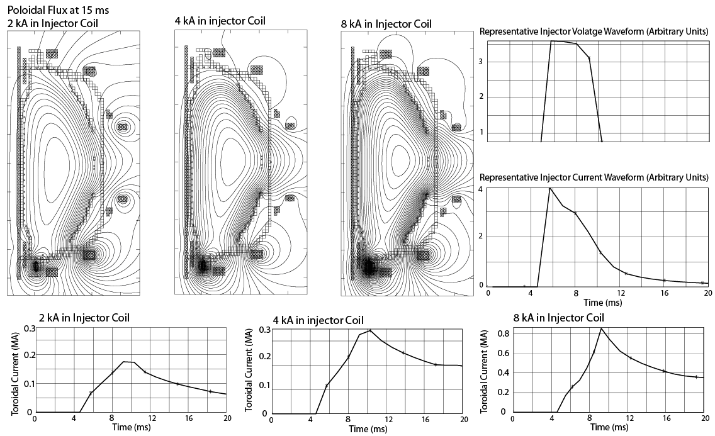
CHI Produced Toroidal Current Increases with Increasing Levels of Current in the CHI Injector Coil (NSTX-U)

Slide 19
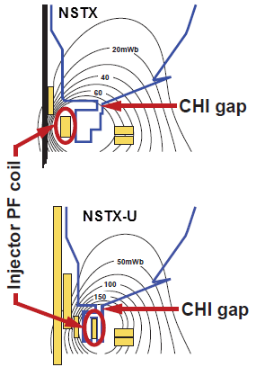
CHI Start-up to ~0.4MA is Projected for NSTX-U, and Projects to ~20% Start-up Current in Next-step STs
Parameters | NSTX | NSTX-U | ST-FNSF
Major Radius [m] | 0.86 | 0.93 | 1.2
Minor Radius [m] | 0.66 | 0.62 | 0.80
B_{T} [T] | 0.55 | 1.0 | 2.2
Toroidal Flux [Wb] | 2.5 | 3.9 | 15.8
Plasma current [MA] | 1 | 2 | 10
Projected Start-up Current (MA) | 0.2 | 0.4 | 2.0
Poloidal Flux (Wb) | 0.04 | 0.08 | 0.53
Injector Flux [Wb] | 0.047 | 0.1 | 0.66
Injector flux in NSTX-U is ~ 2.5 times higher than in NSTX → supports increased CHI current

Slide 20
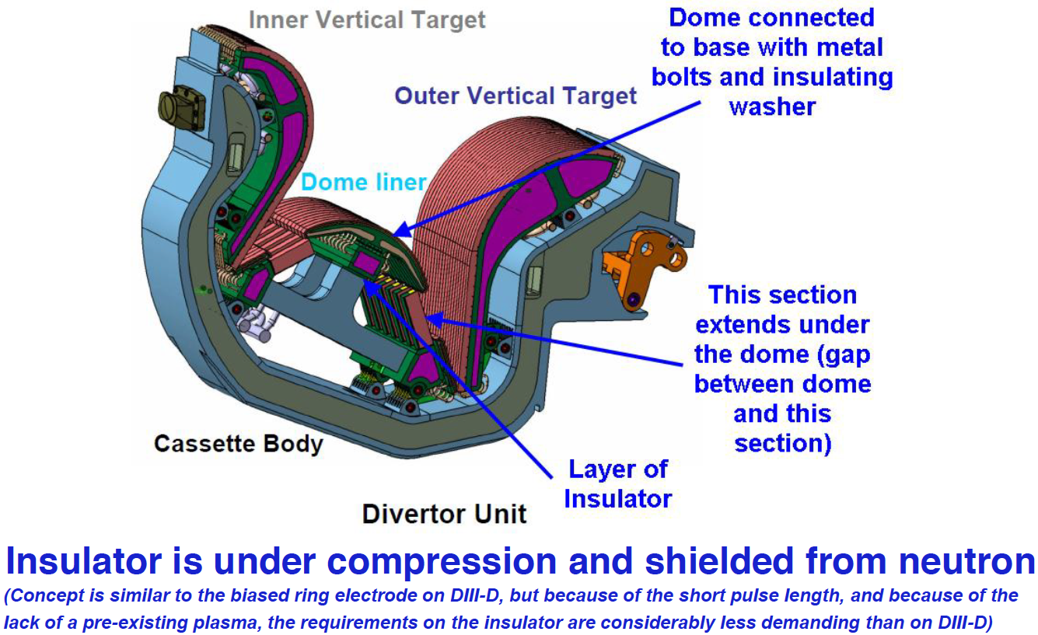
Example of CHI Insulator Installation in a Reactor
(In ITER, the Dome Region would be Insulated from the Vessel)

Slide 21
Requirements for the CHI Insulator are Less Demanding than the Insulation Requirements for a Mineral Insulated Solenoid
Insulator Resistance > 1 Ohm
Resistance to be maintained only during the plasma start-up phase (<30 ms in duration)
The actual high-voltage phase < plasma start-up phase
During the plasma start-up phase, there is no pre-existing plasma that can short out the insulator (and CHI current path is controlled by pre-programmed vacuum field line pattern)
After the high-voltage phase, insulator could be shorted-out, if necessary

Slide 22
Because the Required Insulator Resistance is very low (few times the plasma impedance) other possibilities exist
Layers of thin resistive metal coated with insulating layers
Powdered, weakly bonded, insulator sandwiched between two metal plates
The HIT-Si device used an insulator spray to achieve insulation in a plasma environment in an more complicated vessel geometry
…. Other possibilities (including conventional insulator technology currently planned for next step machines to insulate PF coils and other components)
Insulator could be hidden behind metallic structure as on NSTX-U

Slide 23
NSTX-U will Develop Full Non-inductive Start-up and Current Ramp-up in support of FNSF and next step Tokamaks
0.3MA current generation in NSTX validates capability of CHI for high current generation in a ST (>400 kA projected for NSTX-U)
TSC Simulations for NSTX-U geometry suggest Transient CHI start-up may be more efficient due to improved injector coil positioning
Successful coupling of CHI started discharges to inductive ramp-up & transition to an H-mode in NSTX demonstrates compatibility with high-performance plasma operation
CHI start-up has produced the type of plasmas required for non-inductive ramp-up and sustainment (low internal inductance, low density)
Favorable scaling with increasing machine size (from two machines of vastly different size, HIT-II and NSTX and in TSC simulations)
NSTX-U is well equipped with new capabilities to study full non-inductive start-up and current ramp-up
  - 2x Higher TF, 1MW ECH, Second Tangential NBI for CD, 2x higher CHI voltage, >2.5x more injector flux, Improved upper divertor coils

