Slide 1




NSTX-U
Supported by
National Spherical Torus Upgrade Project: Status and Plans
Culham Sci Ctr
U St. Andrews
York U
Chubu U
Fukui U
Hiroshima U
Hyogo U
Kyoto U
Kyushu U
Kyushu Tokai U
NIFS
Niigata U
U Tokyo
JAEA
Tsukuba U
Hebrew U
Ioffe Inst
RRC Kurchatov Inst
TRINITI
NFRI
KAIST
POSTECH
SNU
ASIPP
ENEA, Frascati
CEA, Cadarache
IPP, Jülich
IPP, Garching
ASCR, Czech Rep
Columbia U
CompX
General Atomics
FIU
INL
Johns Hopkins U
LANL
LLNL
Lodestar
MIT
Nova Photonics
New York U
ORNL
PPPL
Princeton U
Purdue U
SNL
Think Tank, Inc.
UC Davis
UC Irvine
UCLA
UCSD
U Colorado
U Illinois
U Maryland
U Rochester
U Washington
U Wisconsin
Masayuki Ono
for the NSTX-U Team
17th International Spherical Torus Workshop
University of York, September 16 - 19, 2013

Slide 2
Talk Outline
NSTX Upgrade Project and Operational Preparation Status
NSTX-U Facility / Diagnostic Five Year Plans
Summary

Slide 3
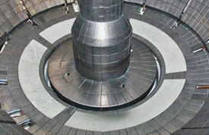
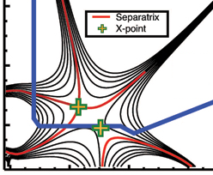

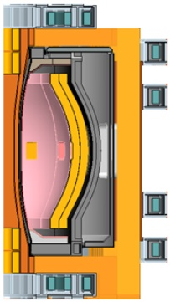
NSTX Upgrade Mission Elements
Advance ST as candidate for Fusion Nuclear Science Facility (FNSF)
Develop solutions for the plasma-material interface challenge
Explore unique ST parameter regimes to advance predictive capability - for ITER and beyond
Develop ST as fusion energy system
ST-FNSF
Lithium
“Snowflake”
ITER
ST Pilot Plant

Slide 4
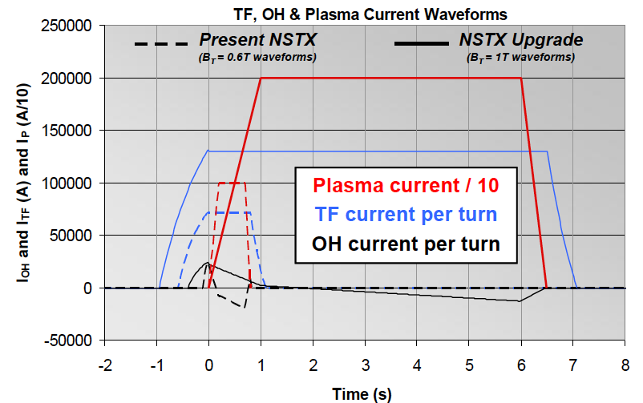


Substantial Increase in NSTX-U Device / Plasma Performance
To provide data base to support ST-FNSF designs and ITER operations
Previous
center-stack
New
center-stack
TF OD = 20cm
TF OD = 40cm
NSTX
 | R₀ (m) | A_{min} | I_{p}(MA) | B_{T} (T) | T_{TF}(s) | R_{CS} (m) | R_{OB} (m) | OH flux (Wb)
NSTX | 0.854 | 1.28 | 1 | 0.55 | 1 | 0.185 | 1.574 | 0.75
NSTX-U | 0.934 | 1.5 | 2 | 1 | 6.5 | 0.315 | 1.574 | 2.1
~ X 10 increase in nτT from NSTX
NSTX-U average plasma pressure ∝ B_{T0}² β_{T} (T²%) ~ TFTR, JET
Present NBI
New 2nd NBI

Slide 5
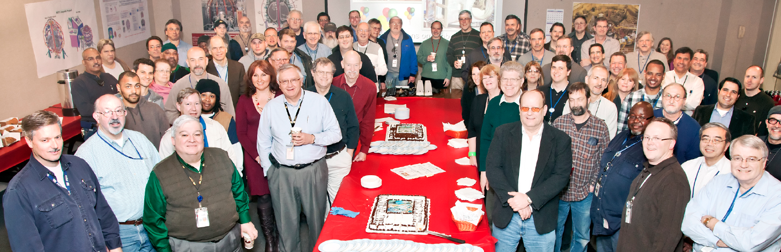
NSTX Upgrade Project Progress Overview
R. Strykowsky, E. Perry, T. Stevenson, L. Dudek, S. Langish, T. Egebo, M. Williams and the NSTXU Project Team
New Center Stack Project Scope
2nd NBI Project Scope
Decontaminate TFTR beamline
Refurbish for reuse
Relocate pump duct, 22 racks and numerous diagnostics to make room in the NSTX Test Cell
Install new port on vacuum vessel to accommodate NB2
Move NB2 to the NSTX Test Cell
Install power, water, cryo and controls
Inner TF bundle
TF Flex bus
OH coil
Inner PF coils
Enhance outer TF supports
Enhance PF supports
Reinforce umbrella structure
New umbrella lids
Power systems
I&C, Services, Coil protection
Center stack
Structure
Ancillary Sys
5

Slide 6
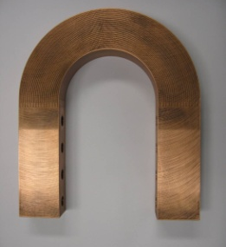
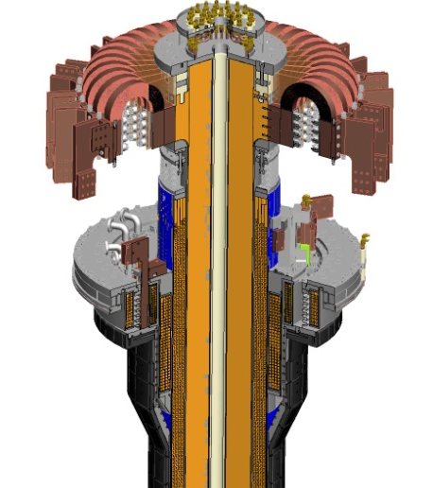
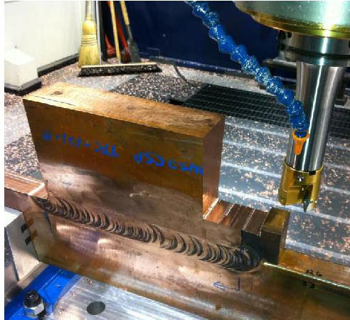
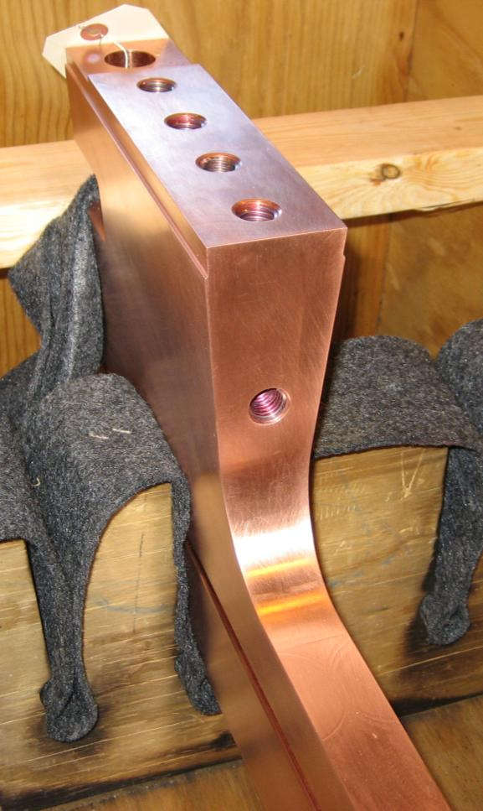
Improved Center-Stack Design to Handle Increased Forces
Identical 36 TF Bars and Innovative Flex-Bus Design
TF cooling lines
Electric Discharge Machining Cuts
TF flex-bus
Tested for
300 k cycles
TF Coil
Friction stir weld joint
CHI bus
PF Coil 1c
PF Coil 1b
PF Coil 1a
OH Coil
CS Casing

Slide 7
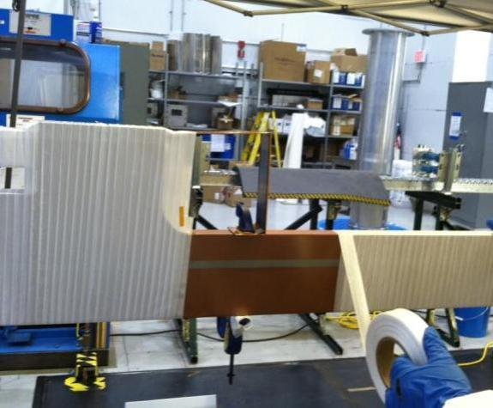
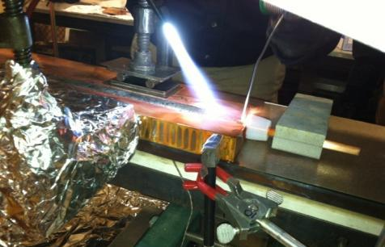
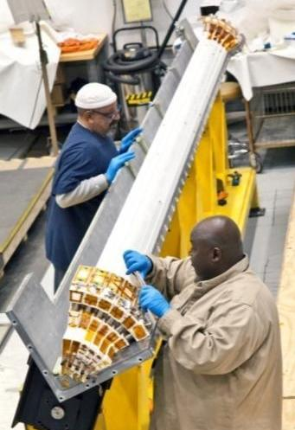
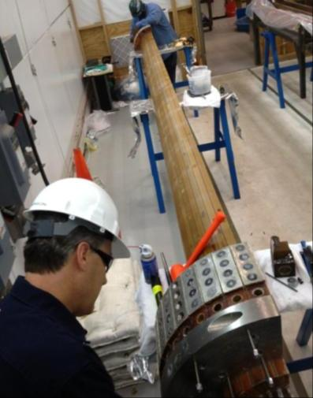
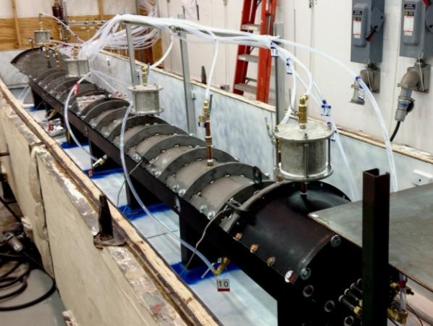
Center Stack Fabrication & Assembly Proceeding Well
Innovative manufacturing techniques developed
Cooling tube soldered with resin-based flux into inner TF conductor
Conductor being wrapped with fiberglass insulation
Insulated conductor being placed into mold
Assembled TF mold ready for Vacuum Pressure Impregnation with CTD-425
Three Quadrants successfully VPI’d !

Slide 8
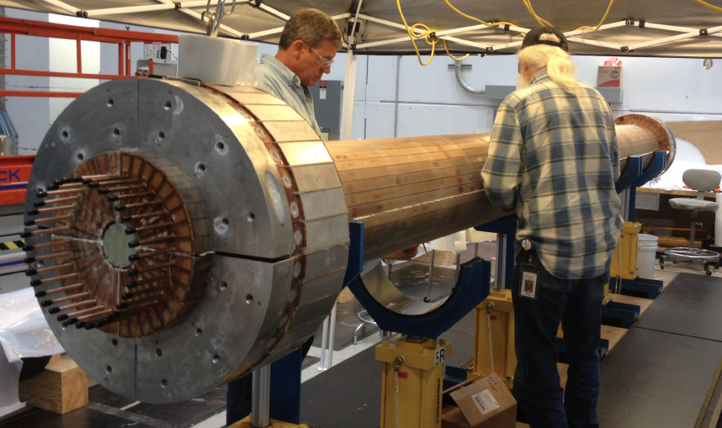
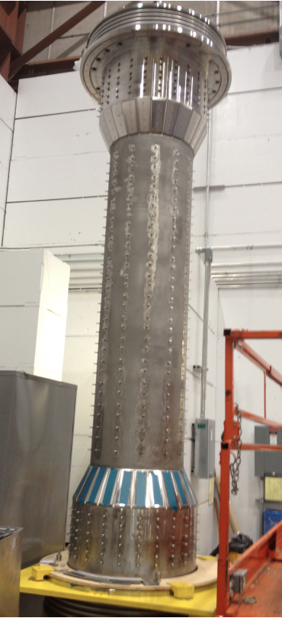
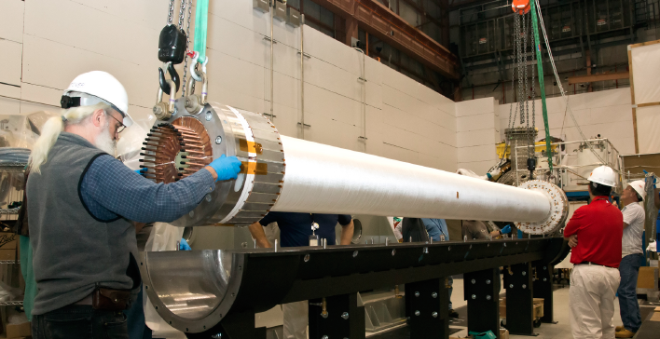
Center Stack Is Coming Together
TF Bundle is nearing completion
Four TF quadrants were combined into a full TF bundle
Center-Stack Casing with tile studs
TF bundle with ground wrapping lowered into VPI mold

Slide 9
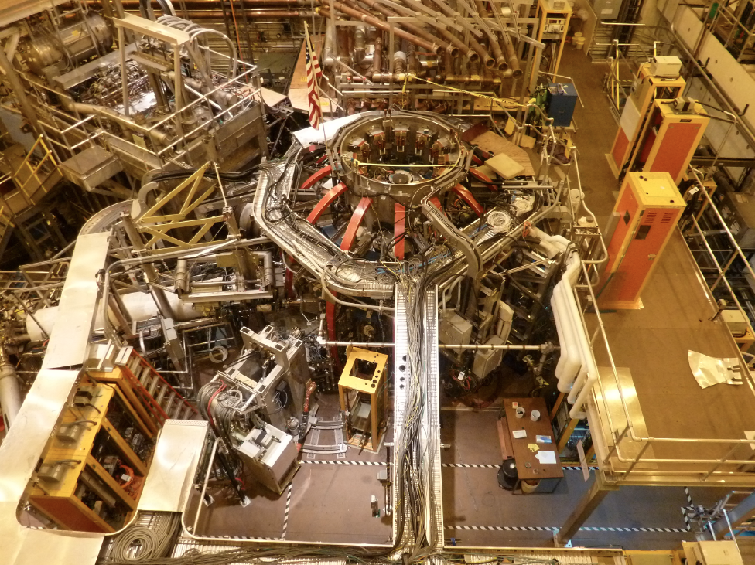
Aerial View of the NSTX Test Cell (Oct. 2011)
Beginning of the NSTX Upgrade Construction Activities
HHFW
System
1st NBI
NSTX
Pumping Duct

Slide 10
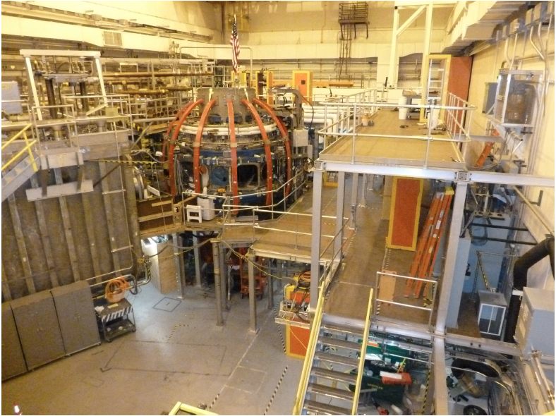
Aerial View of the NSTX Test Cell (Feb. 2012)
Space for the 2nd NBI cleared and 3rd floor platform added
HHFW
System
NSTX
1st NBI

Slide 11
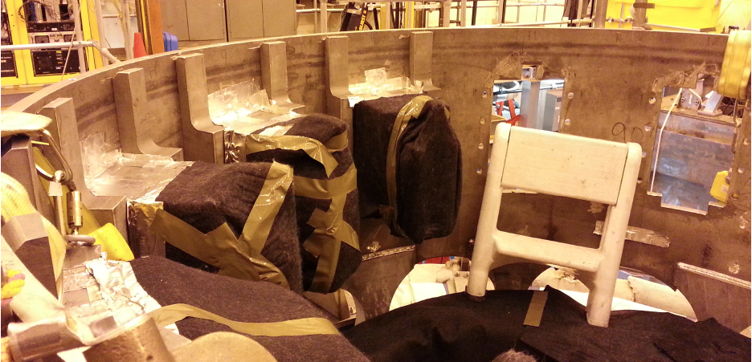
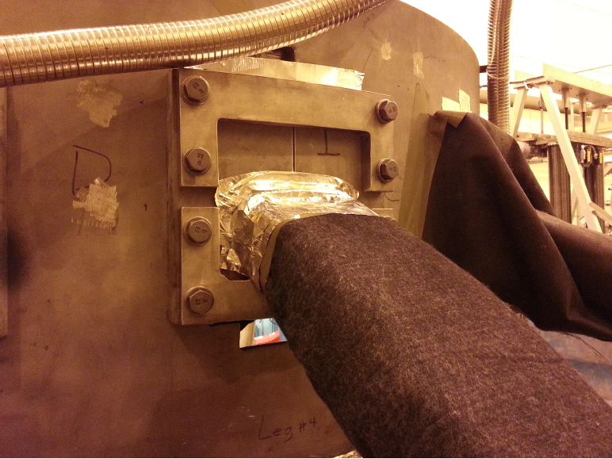
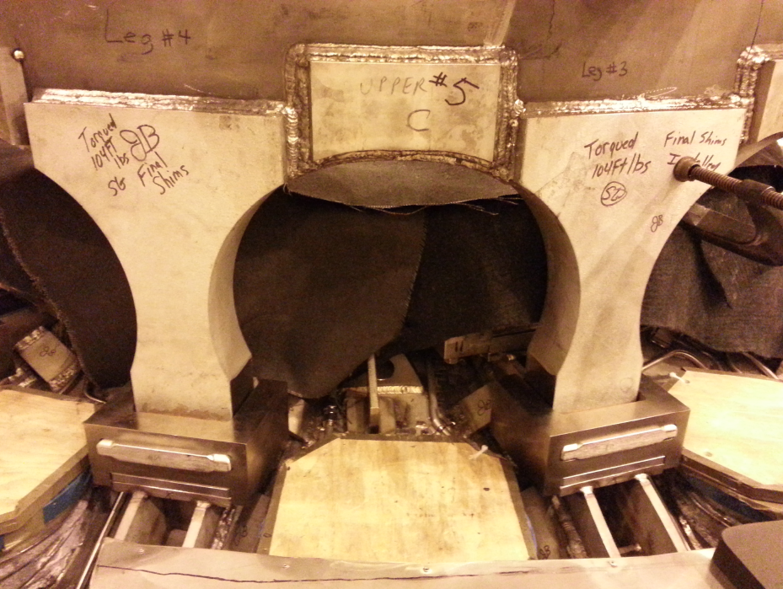
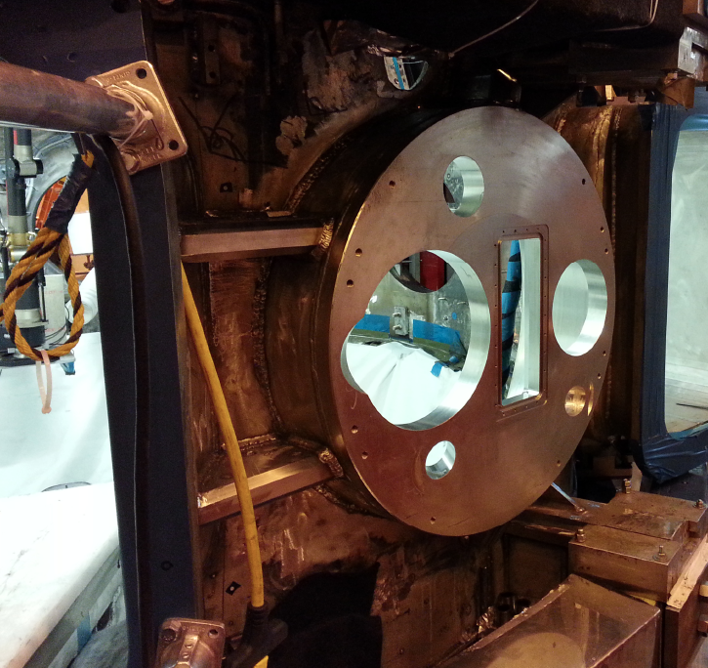
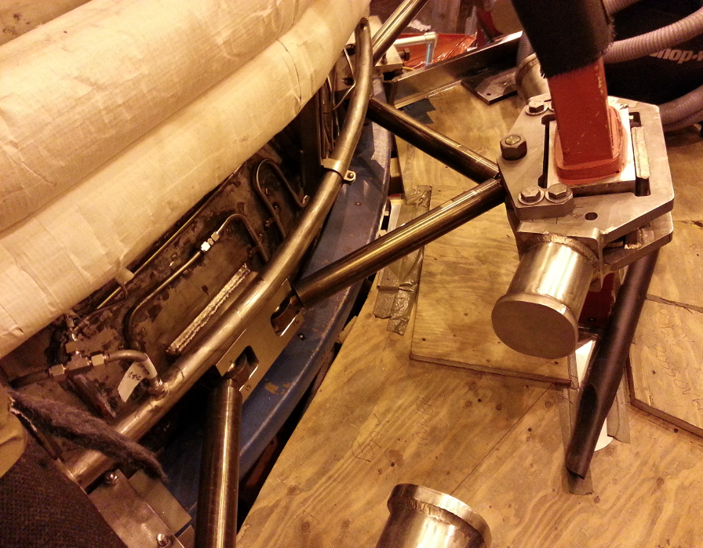
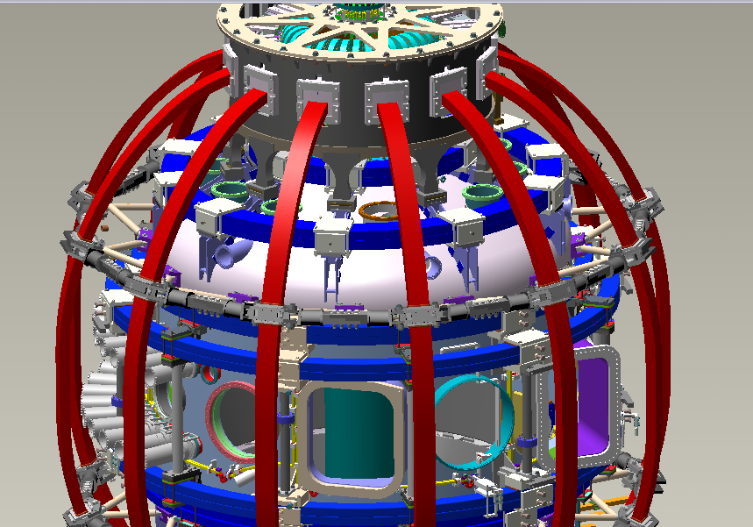
Support Structural and Vacuum Vessel Upgrades
Must handle 4 x higher electromagnetic loads
Upper Al Block Internal Reinforcements
Upper Al Block External Reinforcements
Upper Umbrella Arch Reinforcements
Bay-L Cap
TF-VV Clevis &TF Outer Leg Support
See back-up slides 44 for more detail

Slide 12
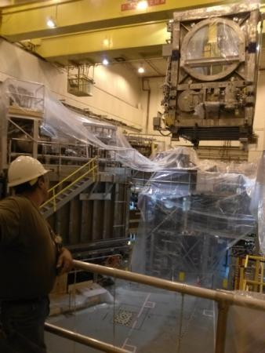
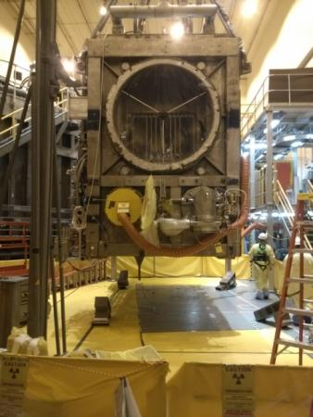
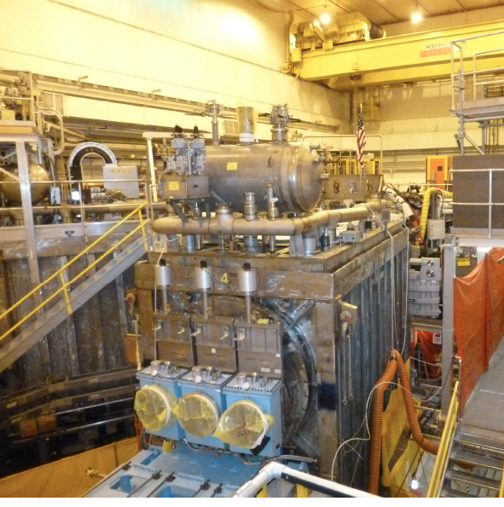
Relocation of the 2nd NBI beam line box from the TFTR test cell into the NSTX-U Test Cell Complete.
TFTR NBI beam box and components successfully tritium decontaminated.
Beam Box being lifted over NSTX
Beam Box placed in its final location and aligned
Beam Box being populated with components

Slide 13
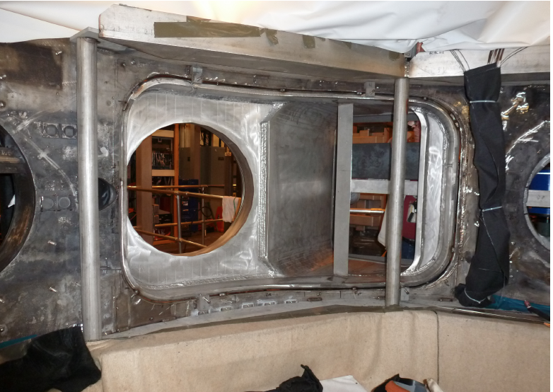
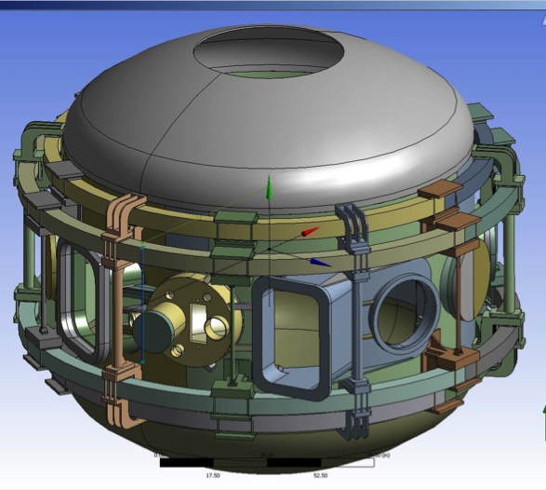
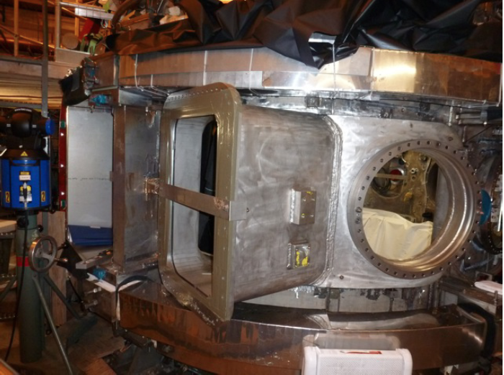
Highly Tangential 2nd NBI Enabled by JK-Cap
Outer Wall Radius Moved Outward to Avoid Beam Clipping
Interior View of Bay J-K
Exterior View of Bay J-K
JK cap

Slide 14
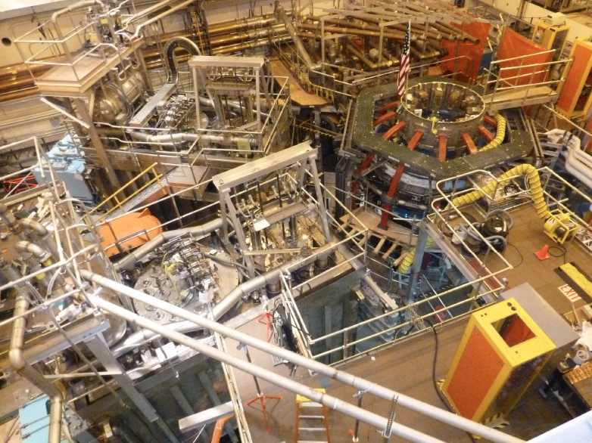
Aerial View of the NSTX-U Test Cell (Aug. 2013)
HHFW
System
1st NBI
NSTX-U
10
2nd NBI

Slide 15
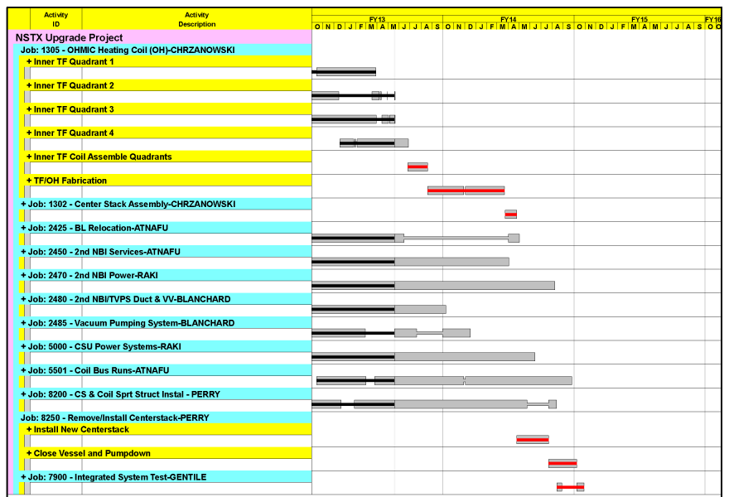
Project on Track for October 2013 Completion
Critical path through the centerstack fabrication and installation
Key Operations Milestones
Begin Diagnostic Installation – August 1st, 2013
Complete in-vessel construction work October 1st 2013.
Complete Diagnostic installation & calibration – December 1st, 2013
Rough Pump down – January 1st, 2014
Forecast Finish November 2014
CD-4 Finish September 2015
Activity Certification Committee (ACC) and start-up planning underway

Slide 16
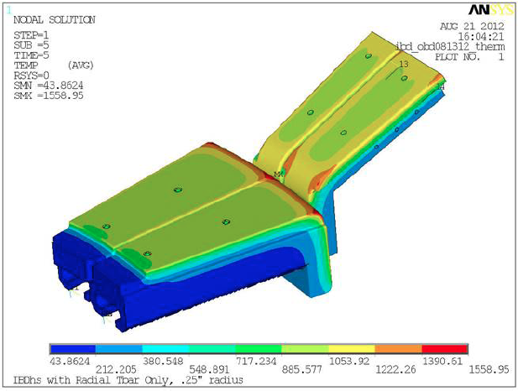
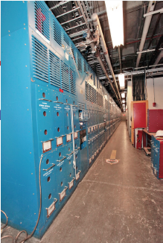
Engineering and Research Operations Activities
In Preparation for the NSTX-U Operations
  • Improving the PFC geometry in the vicinity of the CHI gap to protect the vessel and coils due to ~ 10x higher divertor heat loads
New gap overhung tiles to provides necessary protection. Gap tiles being fabricated by the vendor.
Improved Tile Design
  • Replacing electronics that control rectifiers - The new Firing Generator (FG) will deliver firing pulses with greater resolution, precision, and repeatability, critical for the new 8-parallel, 130kA TF system configuration.
Transrex AC/DC Convertors
More than half of the 68 FG production units have now undergone power testing in rectifiers, and test results for all units have been identical, giving us confidence that we can rely on bench testing for the remaining ones. Power testing will continue to confirm current balancing on multiple rectifiers. Target completion date of Nov. 2013.

Slide 17
NSTX-U Plasma Control System Upgrade
Enables real time up-down symmetric divertor control
NSTX-U PF Coil Power System Upgrade
The first-year power supply capabilities of NSTX-Upgrade will yield considerable experimental flexibility, via up-down symmetric PF-1C coils
By powering upper and lower PF-1A & PF-1C coils, it will be possible to generate up-down symmetric snowflake divertors
The new configuration should provide better control for the CHI absorber region.
Plasma Control System Upgrade
Analog Inputs
Coil Currents
Power Supplies
Magnetics
(including upgrades)
Neutral Beams
(1st and 2nd BLs)
Gas Injection
Vacuum
Rotation data
Pitch angle data
Sample rate: 5 → 20 KHz
Added 32 channels
PC Links replaced with much faster “Firing Generator” Serial Links
FPDP: 1 → 4 links
Analog Inputs
416 channels
PC Links
Power Supplies
(inc. 3 new coils)
Neutral Beams
(including new BL)
Gas Injection
Real-Time
Computer
New computer: cores: 8 → 32
Digital Inputs
12 words
FPDP
FPDP
Digital Outputs
Time Stamp
micro seconds
Analog Outputs

Slide 18
NSTX-U diagnostics to be installed during first 2 years
Half of NSTX-U Diagnostics Are Led by Collaborators
MHD/Magnetics/Reconstruction
  Magnetics for equilibrium reconstruction
  Halo current detectors
  High-n and high-frequency Mirnov arrays
  Locked-mode detectors
  RWM sensors
Profile Diagnostics
  MPTS (42 ch, 60 Hz)
  T-CHERS: T_{i}(R), V_{φ}(r), n_{C}(R), n_{Li}(R), (51 ch)
  P-CHERS: V_{θ}(r) (71 ch)
  MSE-CIF (18 ch)
  MSE-LIF (20 ch)
  ME-SXR (40 ch)
  Midplane tangential bolometer array (16 ch)
Turbulence/Modes Diagnostics
  Poloidal Microwave high-k scattering
  Beam Emission Spectroscopy (48 ch)
  Microwave Reflectometer,
  Microwave Polarimeter
  Ultra-soft x-ray arrays – multi-color
Energetic Particle Diagnostics
  Fast Ion D_{α} profile measurement (perp + tang)
  Solid-State neutral particle analyzer
  Fast lost-ion probe (energy/pitch angle resolving)
  Neutron measurements
Edge Divertor Physics
  Gas-puff Imaging (500kHz)
  Langmuir probe array
  Edge Rotation Diagnostics (T_{i}, V_{φ}, V_{pol})
  1-D CCD H_{α} cameras (divertor, midplane)
  2-D divertor fast visible camera
  Metal foil divertor bolometer
  AXUV-based Divertor Bolometer
  IR cameras (30Hz) (3)
  Fast IR camera (two color)
  Tile temperature thermocouple array
  Divertor fast eroding thermocouple
  Dust detector
  Edge Deposition Monitors
  Scrape-off layer reflectometer
  Edge neutral pressure gauges
  Material Analysis and Particle Probe
  Divertor VUV Spectrometer
Plasma Monitoring
  FIReTIP interferometer
  Fast visible cameras
  Visible bremsstrahlung radiometer
  Visible and UV survey spectrometers
  VUV transmission grating spectrometer
  Visible filterscopes (hydrogen & impurity lines)
  Wall coupon analysis
New capability, Enhanced capability

Slide 19
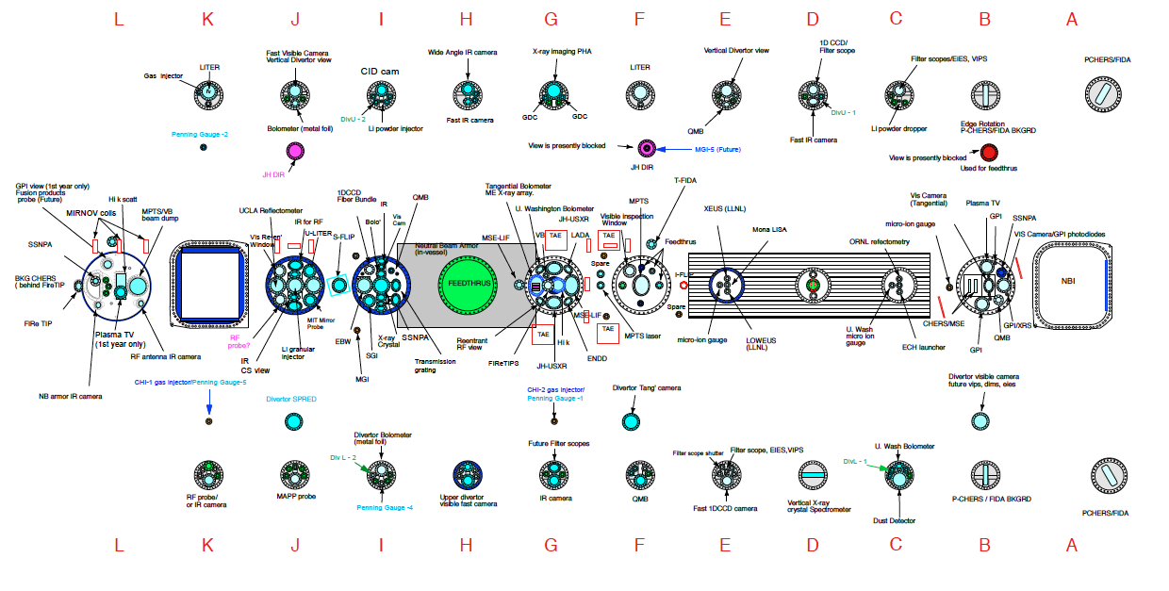
NSTX-U facility/diagnostics port assignment
Port flanges designed and being procured

Slide 20
Formulating Strategy Toward Full NSTX-U Parameters
After CD-4, the plasma operation could enter quickly into new regimes
 | NSTX (Max.) | Year 1 NSTX-U Operations (2015) | Year 2 NSTX-U Operations (2016) | Year 3 NSTX-U Operations (2017) | Ultimate Goal
I_{P} [MA] | 1.2 | ~1.6 | 2.0 | 2.0 | 2.0
B_{T} [T] | 0.55 | ~0.8 | 1.0 | 1.0 | 1.0
Allowed TF I²t [MA²s] | 7.3 | 80 | 120 | 160 | 160
I_{P} Flat-Top at max. allowed I²t, I_{P}, and B_{T} [s] | ~0.4 | ~3.5 | ~3 | 5 | 5
1st year goal: operating points with forces up to ½ the way between NSTX and NSTX-U, ½ the design-point heating of any coil
  Will permit up to ~5 second operation at B_{T}~0.65
2nd year goal: Full field and current, but still limiting the coil heating
  Will revisit year 2 parameters once year 1 data has been accumulated
3rd year goal: Full capability

Slide 21
Talk Outline
NSTX Upgrade Project and Operational Preparation Status
NSTX-U Facility / Diagnostic Five Year Plans
Summary

Slide 22


5 year plan tools with 5YP base funding
2014 | 2015 | 2016 | 2017 | 2018
Upgrade Outage
1.5 → 2 MA, 1s → 5s
Run Weeks:
16
14
14
16
Cryo-pump, high-Z tile row on cryo-baffle, and partial NCC would be installed in-vessel during ~1 year outage between FY2016 and FY2017
  NSTX-U would operate 1st half of FY2016 and 2nd half of FY2017
New
center-stack
Start-up and Ramp-up
Upgraded CHI for ~0.5MA
up to 0.5 MA plasma gun
0.5-1 MA CHI
1 MW ECH/EBW
Boundary Physics
Lower divertor cryo-pump
Divertor Thomson
Materials and PFCs
High-Z tile row on lower OBD
High-Z tile row on cryo-baffle
High-Z PFC diagnostics
All high-Z PFCs
Priority scope
Liquid
metals / lithium
Upward
LiTER
LLD using bakeable cryo-baffle
Flowing Li divertor
or limiter module
Incremental scope
Li granule injector
MGI disruption mitigation
Partial NCC
NCC SPA upgrade
MHD
Enhanced MHD sensors
Transport & Turbulence
δB polarimetry
DBS, PCI, or other intermediate-k
High k_{θ}
Waves and Energetic Particles
HHFW limiter upgrade
HHFW straps to excite EHO
2nd NBI
1 coil AE antenna
4 coil AE antenna
Charged fusion product, neutron-collimator
Scenarios and Control
Establish control of:
Control integration, optimization
n_{e}
q_{min}
Divertor P_{rad}
Snowflake
Rotation

Slide 23
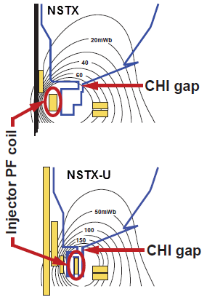
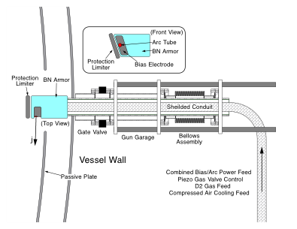
Solenoid-free Start-up
High priority goal for NSTX-U in support of FNSF
CHI Start-Up
PEGASUS Point Source
• Inj. Flux in NSTX-U is about 2.5 times higher than in NSTX
• NSTX-U coil insulation greatly enhanced for higher voltage ~ 3 kV operation
PEGASUS Plasma Gun
U. Washington
U. Wisconsin
Non-Inductive Start-up Systems Design for Post-Upgrade Operations
• CHI will start with the present 2 kV capability then enhanced to ~ 3 kV higher voltage as needed.
• PEGASUS gun start-up producing exciting results Ip ~ 160 kA. The PEGASUS gun concept is technically flexible to implement on NSTX once fully developed. High current gun for the NSTX-U will be developed utilizing the PEGASUS facility in collaboration with University of Wisconsin.

Slide 24
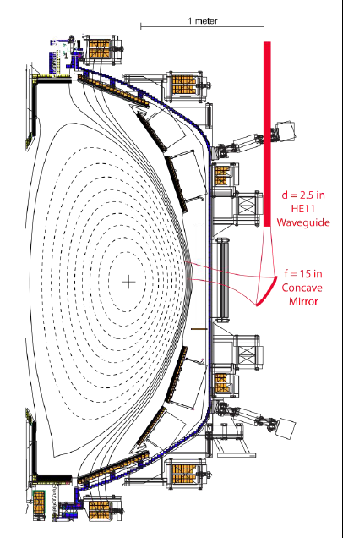
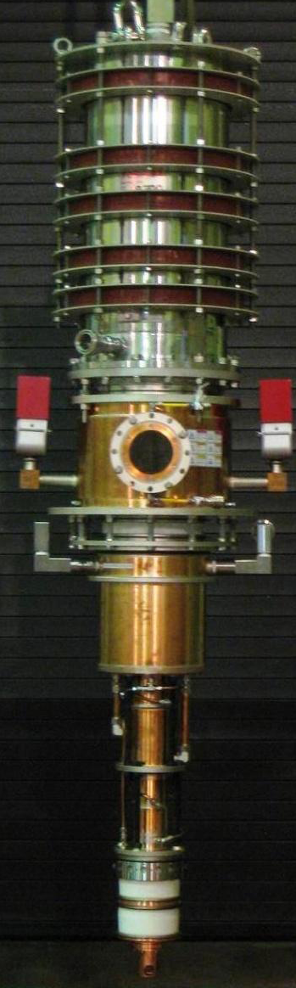
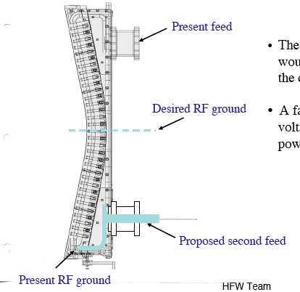
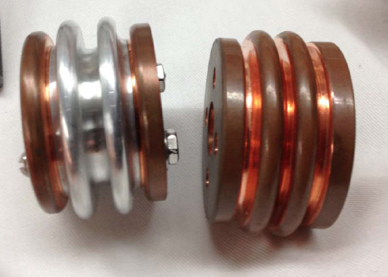
Strengthen HHFW Antenna Feeds for Disruption Load
A MW-Class 28 GHz ECH System for Non-Inductive Operation
New Compliant Antenna Feeds
Will allow HHFW antenna feedthroughs to tolerate 2 MA disruptions
28 GHz, 1.5 MW Tsukuba Gyrotron
C-Mod antenna electroformed compliant section
28 GHz ECH/EBWH waveguide and mirror concept
Successful CDR conducted, prototype feeds being procured.
Feeds to be tested in the RF test-stand before FDR, installation in spring 2014.
• Start MW-class ECH/EBW system conceptual design for non-inductive operations (MOU with Tsukuba University).
Tsukuba U and MIT

Slide 25
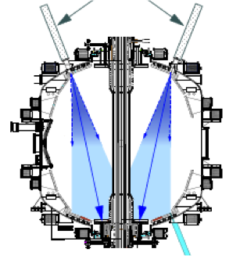
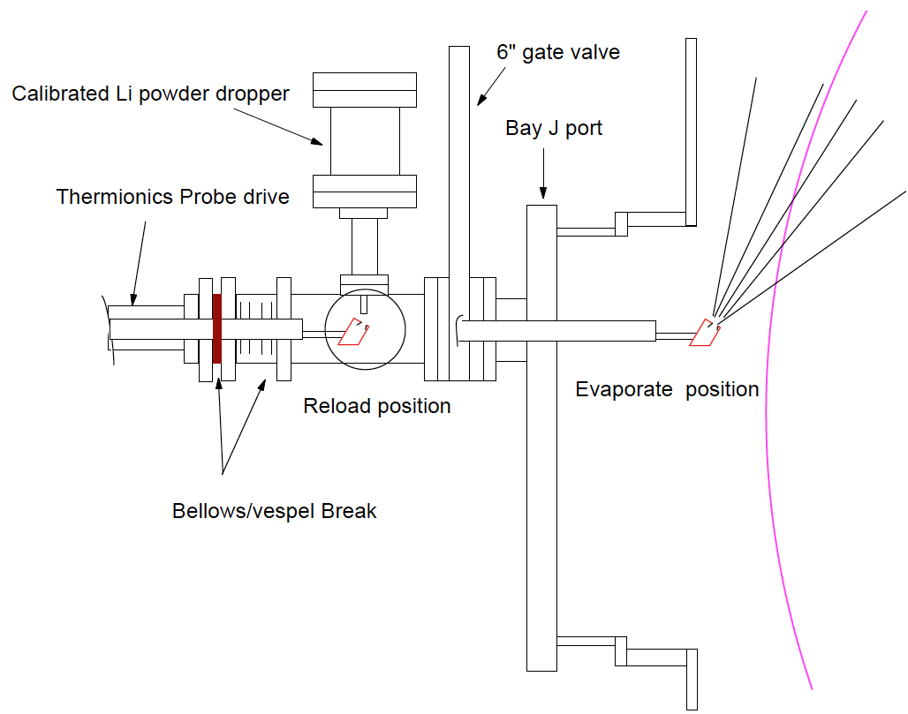
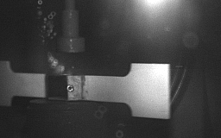
NSTX-U Lithium Capability During Initial Two Years
Lithium Evaporators and Granular Injector
Existing LITERS
New Upward Evaporating LITER
• Upward Evaporating LITER to increase Li coverage for increased plasma performance
NSTX-U lithium granular injector
for ELM pacing
• High frequency ELM pacing with a relatively simple tool.
• ELM pacing successfully demonstrated on EAST (D. Mansfield, IAEA 2012)
Granule Reservoir
Struck Granule Horizontally
Redirected at 70 m/s
t = 800 μs

Slide 26
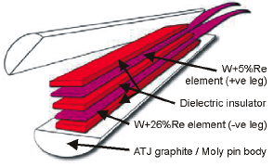
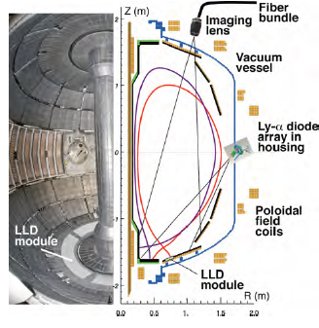
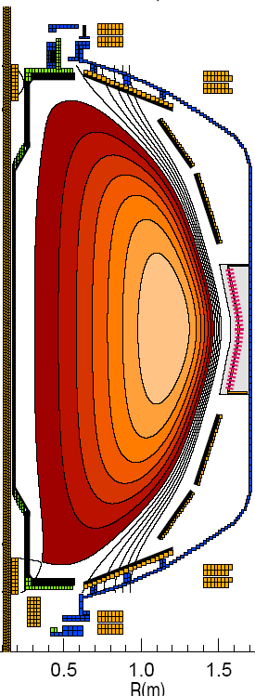
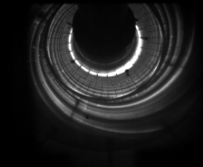
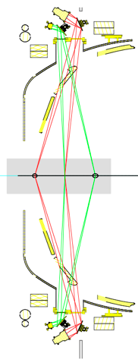




Baseline Capability for PMI Research
Supporting divertor and lithium research
Divertor fast eroding thermocouples
Two fast 2D visible and IR cameras with full divertor coverage
Divertor Imaging
Spectrometer
ORNL
LLNL, ORNL, UT-K
LLNL
Li I
  Lithium CHERS
ORNL
C II
Divertor fast pressure gauges
MAPP probe for between-shots surface analysis
Dual-band fast IR Camera
(see back-up slides # 53 and 54)
Purdue U.
Notes:
With the NSTX PAC recommendation, we have been increasing the LLD diagnsotic capabilities including lithium CHEERS, PMI probe, Lyman Alpha LLD recycling diode array, three view divertor bolometer, and two color fast IR divertor camera.

Slide 27


Boundary Facility Capability Evolution
NSTX-U will have very high divertor heat flux capability of ~ 40 MW/m²
2015
2016
2017
2018
C
BN
Li
High-Z
Lower
OBD
high-Z row of tiles
Cryo + high-Z FW and OBD
+ liquid Li divertor (LLD)
Cryo + high-Z FW and OBD
PFCs
High-Z tile row
Cryo-pump
Bakeable cryo-baffle for liquid Li
NSTX Moly Tiles
ORNL

Slide 28
New MHD and Plasma Control Tools for NSTX-U
Sustain β_{N} and Understand MHD Behavior Near Ideal Limit
Partial NCC option (2 x 6 odd parity)
Full NCC
Existing
RWM
coils
Non-axisymmetric Control Coils (NCC)
Columbia U., GA
• NCC can provide expanded RWM, NTV, RMP, and EF physics studies with more flexible field spectrum (n ≤ 6, or n ≤ 3 depending on set).
• 2nd 3-channel Switching Power Amplifier (SPA) commissioned in July 2011 to power 6 independent currents in existing midplane RWM and NCC coils.
• An extended MHD sensor set to measure theoretically predicted poloidal mode structure and to improve mode control.
• A Real-Time Velocity (RTV) diagnostic in a new plasma rotation control system for active instability avoidance by controlling rotation profile.
• Multi-poloidal location massive gas injector system will be implemented.

Slide 29





Transport and Turbulence
BES together with high-k to provide comprehensive turbulence diagnostic
Modes
0.1
1
k⊥(cm⁻¹)
10
100
μTEARING
ITG/TEM
ETG
BES, pol
BES
BES, Polarimeter
μwave Scattering
48 ch BES available for NSTX-U
(24 ch BES available in 2011)
New high-k scattering system for allowing
2-D k spectrum
Optical fibers
UCD
Neutral Beam
field lines
red-shited
Dα emission
High throughput collection optics
U. Wisconsin
A 288 GHz polarimetry system for magnetic fluctuation measurements is being tested on DIII-D.
UCLA
Notes:
Here is an overview of the NSTX facility operation and upgrade plan for FY 10-12. We plan to run 14 run weeks in each of fiscal year. We will conduct one extra ARRA week this year using the carry over from last fiscal year. For incremental, we propose to run up to 6 run weeks each in FY 11 and 12. We have a very strong set of upgrade becoming available this year . In FY 11, our base upgrade activities are either supported by ARRA funding or by the collaborators. Our base upgrade resources will be mostly devoted to the preparation for the major upgrade outage planned in FY 13-14 to install a new center-stack and the 2nd NBI which will be described by Ron Strykowsky our upgrade project manager.

Slide 30

Energetic Particle Research Capabilities
For NBI fast ion transport and current drive physics
FIDA Views
Fast Ion D-Alpha Diagnostics
UCI
• Vertical FIDA system measures trapped or barely passing (co-going) particles.
• New tangential FIDA system measures co-passing fast ions
• Both FIDA systems have time resolution of 10 ms, spatial resolution ≈ 5 cm and energy resolution ≈ 10 keV.
Vertical
Tangential
FY 2013 - 14 Energetic Particle Conceptual Design and Diagnostic Upgrade
  Solid State-NPA enhancement
  Charged Fusion Product Array
  Proto-type active TAE antenna
UCI
FIU
5-turn radial active TAE antenna installed in 2011

Slide 31
Optimized NSTX-U Five Year Plan Has been Developed
Exciting Opportunities and Challenges Ahead
• NSTX Upgrade provides significant advance in ST plasma performance
  A new center-stack to enable 1T, 2 MA, 5 sec operation
  2nd NBI for doubling the heating power and efficient current drive for fully non-inductive operation
  High power density and innovative divertor solutions for world leading PMI research
• NSTX upgrade outage activities are progressing well
  NSTX operations technical staff were shifted to the Upgrade Project tasks.
  NSTX Upgrade Project is thus far progressing on budget and on schedule.
  Diagnostics were being reinstalled on NSTX-U.
  NSTX-U operational preparation activities are starting.
• Exciting 5 Year Plan (FY 2014 – 18) has been developed
  Aiming to provide necessary data base for FNSF design and construction.
  Strong contribution to toroidal physics, ITER, and fusion energy development.

