Slide 1

ST-FNSF Mission and Performance Dependence on Device Size
J. Menard¹
T. Brown¹, J. Canik², L. El-Guebaly³, S. Gerhardt¹, A. Jaber³, S. Kaye¹,
E. Meier⁴, L. Mynsberge³, C. Neumeyer¹, M. Ono¹, R. Raman⁵, S. Sabbagh⁶,
V. Soukhanovskii⁴, P. Titus¹, G. Voss⁷, R. Woolley¹, A. Zolfaghari¹
¹Princeton Plasma Physics Laboratory, Princeton, NJ 08543
²Oak Ridge National Laboratory, Oak Ridge, TN, USA
³University of Wisconsin, Madison, WI, USA
⁴Lawrence Livermore National Laboratory, Livermore, CA, USA
⁵University of Washington, Seattle, WA, USA
⁶Columbia University, New York, NY, USA
⁷Culham Centre for Fusion Energy, Abingdon, Oxfordshire, UK
17th International Spherical Torus Workshop
University of York
16-19 September 2013
This work supported by the US DOE Contract No. DE-AC02-09CH11466

Slide 2
Outline
Motivation for study
Physics basis for operating points
Performance vs. device size
Tritium breeding ratio calculations
Divertor poloidal field coil layout and design
Power exhaust calculations
Maintenance strategies
Summary

Slide 3
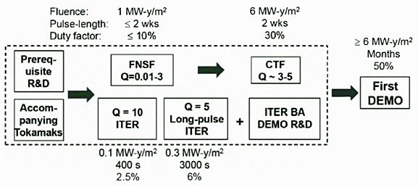
Successful operation of upgraded STs (NSTX-U/MAST-U) could provide basis for design, operation of ST-based FNSF
Fusion Nuclear Science Facility (FNSF) mission:
  Provide continuous fusion neutron source to develop knowledge-base for materials and components, tritium fuel cycle, power extraction
FNSF → CTF would complement ITER path to DEMO
M. Peng et al., IEEE/NPSS Paper S04A-2 - 24th SOFE Conf. (2011)
Studying wide range of ST-FNSF configurations to identify advantageous features, incorporate into improved ST design
Investigating performance vs. device size
  Require: W_{neutron} ≥ 1 MW/m², test area ≥ 10 m², volume ≥ 5 m³
M. Abdou et al. Fus. Technol. 29 (1996) 1

Slide 4
Outline
Motivation for study
Physics basis for operating points
Performance vs. device size
Tritium breeding ratio calculations
Divertor poloidal field coil layout and design
Power exhaust calculations
Maintenance strategies
Summary

Slide 5
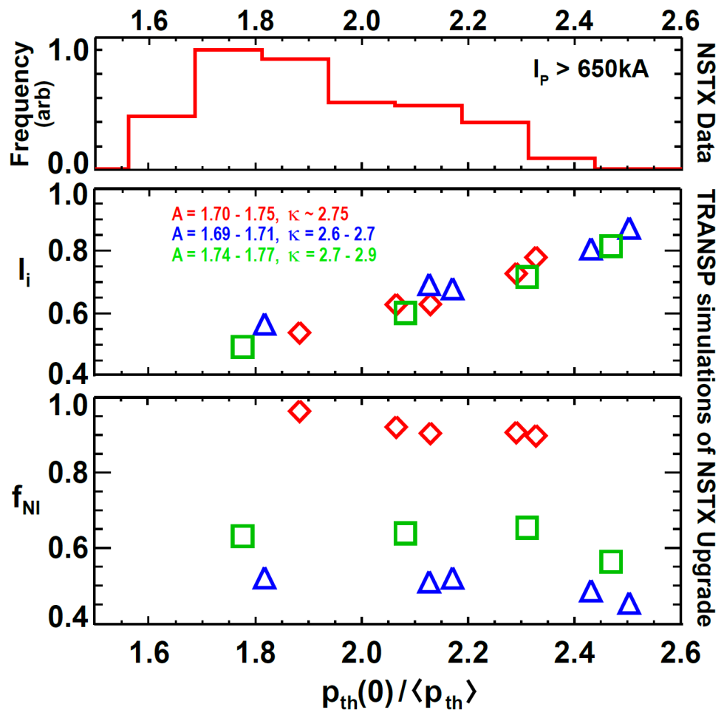
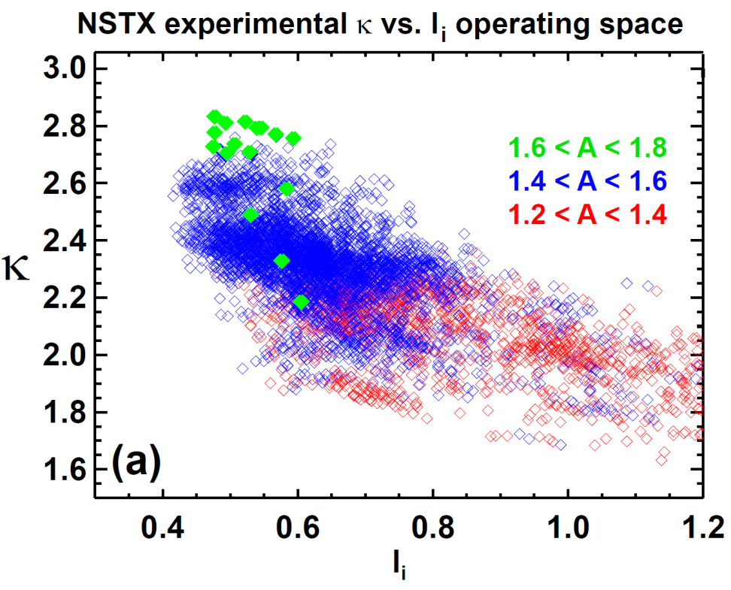
ST-FNSF equilibrium inductance, elongation based on values achieved/anticipated in NSTX/NSTX-U
Most probable NSTX thermal pressure peaking ~ 1.7 – 2.2
  If similar in NSTX-U/FNSF → full non-inductive l_{i} ~ 0.45 – 0.7 (BS + NBI)
NSTX A=1.7, l_{i} = 0.45 – 0.7 plasmas can operate stably at κ ~ 2.7 – 2.9
  Expect to improve n=0 control in NSTX-U
  Anticipate κ → 3 possible in NSTX-U/FNSF

Slide 6
ST-FNSF free-boundary elongation is reduced with increasing l_{i} to match NSTX/NSTX-U trends
ST-FNSF plasma boundaries
ST-FNSF equilibrium κ versus l_{i}

Slide 7
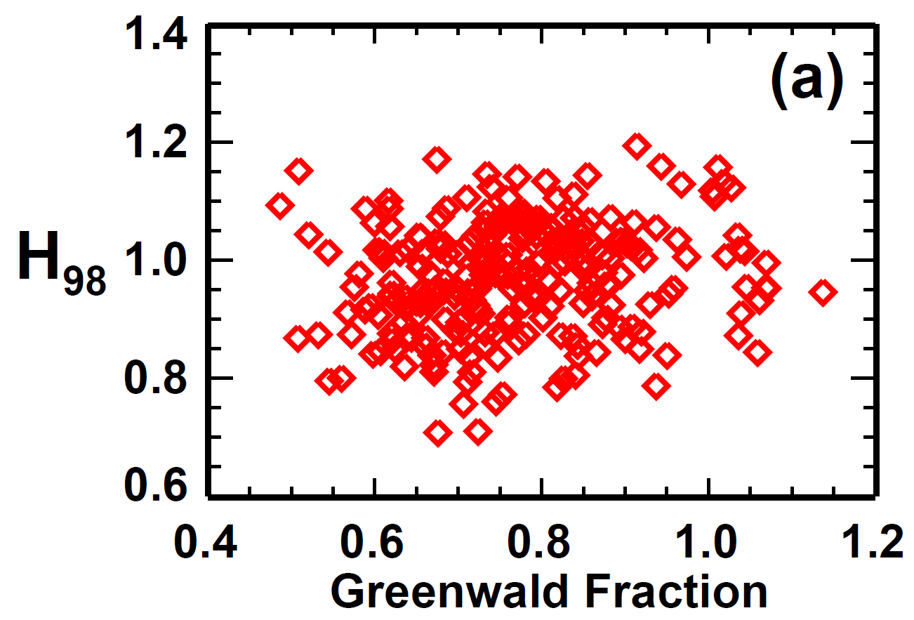
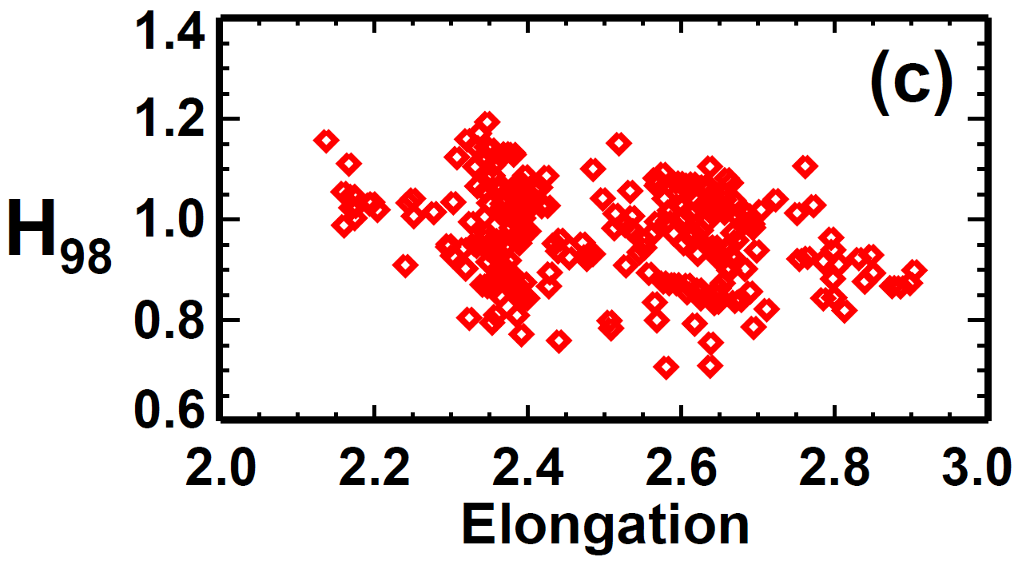
ST-FNSF operating point of f_{Greenwald} = 0.8, H_{98y,2}=1.2 chosen to be at/near values anticipated for NSTX-U
H_{98y,2} → 1.2 accessed for a range of Greenwald fractions in NSTX
  However, much more research needs to be carried out in NSTX-U to determine if H = 1.2 can be achieved reliably
  Note: H_{98y,2} ~ 1 would require much higher P_{aux} (~1.8×)
Need to assess feasibility of access to H_{98y,2} ~ 1.2 at κ ~ 2.7-2.9 in NSTX-U

Slide 8
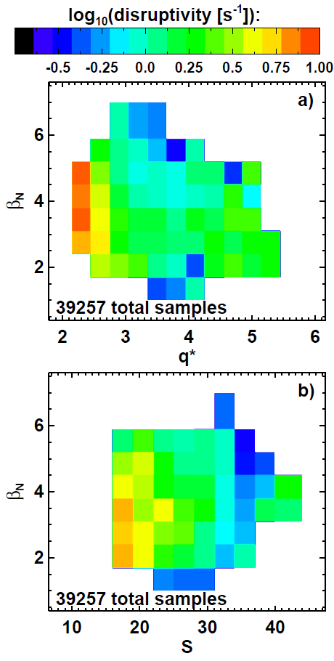
NSTX disruptivity data informs FNSF operating point with respect to global stability
Increased disruptivity for q* < 2.7
  Significantly increased for q* < 2.5
Lower disruptivity for β_{N} = 4-6 compared to lower β_{N}
  Higher β_{N} increases f_{BS}, broadens J profile, elevates q_{min}
  Operation above no-wall limit aided by:
    NBI co-rotation
    Close-fitting conducting wall
    Active error-field and RWM control
Strong shaping also important
  S ≡ q₉₅ I_{P}/aB_{T}
  S > 30 provides strongest stabilization
  S > 22-25 good stability
  S < 22 unfavorable

Slide 9
Outline
Motivation for study
Physics basis for operating points
Performance vs. device size
Tritium breeding ratio calculations
Divertor poloidal field coil layout and design
Power exhaust calculations
Maintenance strategies
Summary

Slide 10
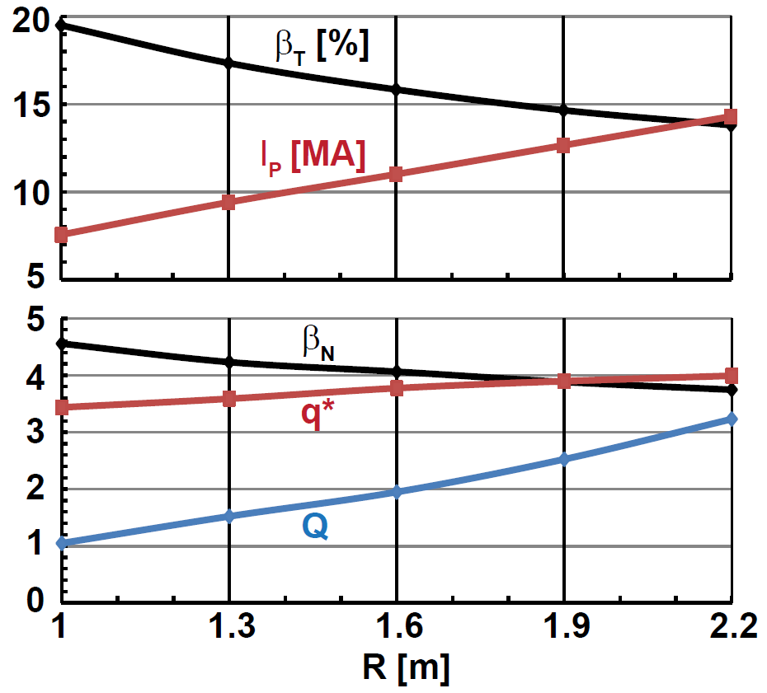
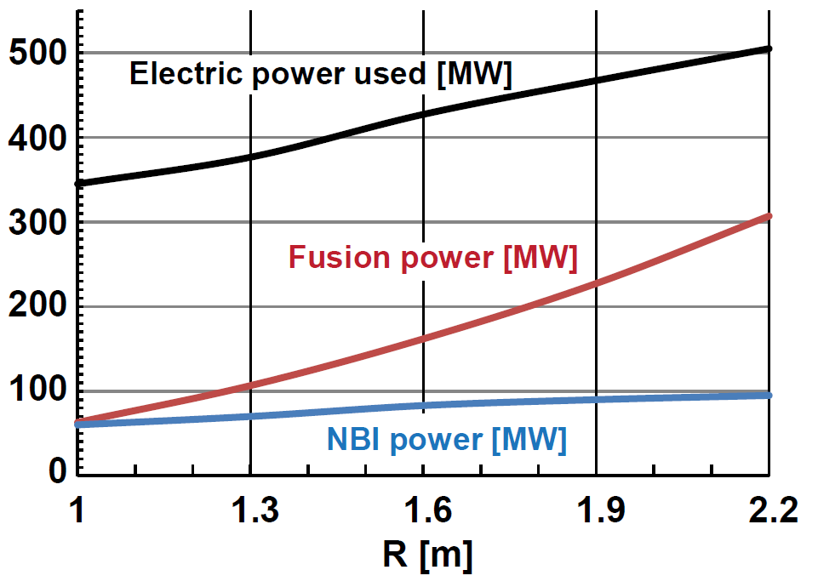
Increased device size provides modest increase in stability, but significantly increases T consumption
Scan R = 1m → 2.2m (smallest FNSF → pilot plant with Q_{eng} ~ 1)
Fixed average neutron wall loading = 1MW/m²
B_{T} = 3T, A=1.7, κ=3, H₉₈ = 1.2, f_{Greenwald} = 0.8
100% non-inductive: f_{BS} = 75-85% + NNBI-CD (E_{NBI}=0.5MeV JT60-SA design)
Larger R lowers β_{T} & β_{N}, increases q*
Comparable/higher β_{T} and β_{N} values already sustained in NSTX
Q = 1 → 3, P_{fusion} = 60MW → 300MW → 5× increase in T consumption

Slide 11
Beyond neutron wall loading and T breeding, FNSF study is also tracking electrical efficiency Q_{eng}
Electricity produced
Electricity consumed
η_{th} = thermal conversion efficiency
η_{aux} = injected power wall plug efficiency
Q = fusion power / auxiliary power
M_{n} = neutron energy multiplier
P_{n} = neutron power from fusion
P_{α} = alpha power from fusion
P_{aux} = injected power (heat + CD + control)
P_{pump} = coolant pumping power
P_{sub} = subsystems power
P_{coils} = power lost in coils (Cu)
P_{control} = power used in plasma or plant control that is not included in P_{inj}
P_{extra} = P_{pump} + P_{sub} + P_{coils} + P_{control}
Note: blanket and auxiliary heating and current-drive efficiency + fusion gain largely determine Q_{eng}
    FNSF assumptions (from Pilot study):
    M_{n} = 1.1
    P_{pump} = 0.03×P_{th}
    P_{sub} + P_{control} = 0.04×P_{th}
    η_{aux} = 0.4 (presently unrealistically high)
    η_{CD} = I_{CD}R₀n_{e}/P_{CD} = 0.3 × 10²⁰A/Wm²
For more details see J. Menard, et al., Nucl. Fusion 51 (2011) 103014

Slide 12
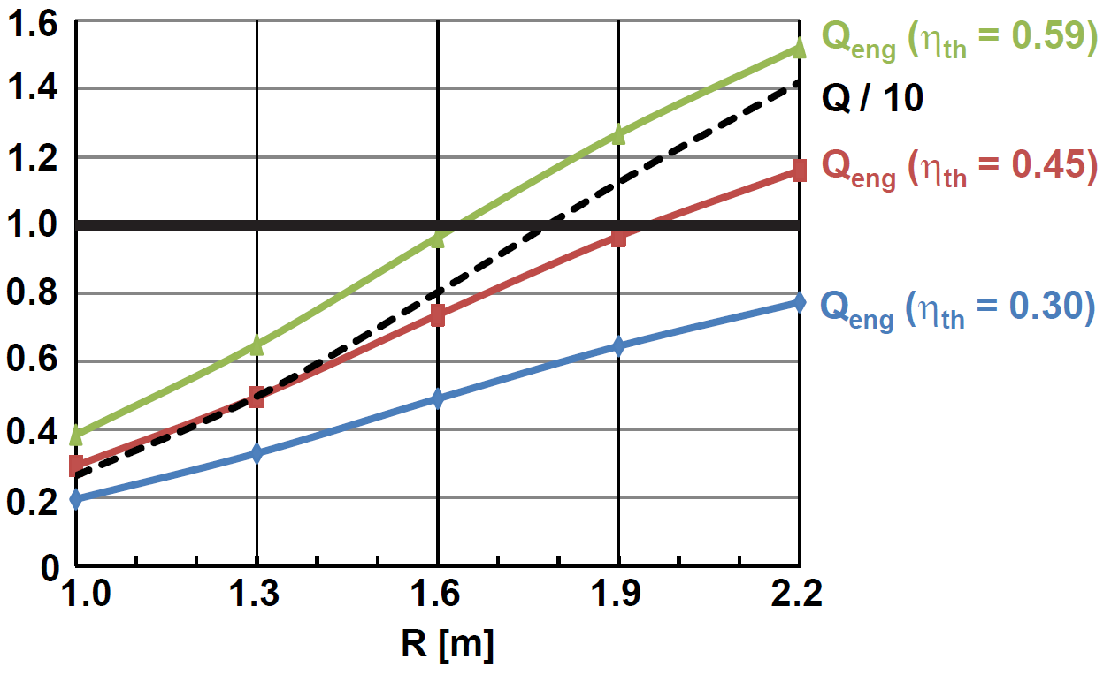
High performance scenarios can access increased neutron wall loading and Q_{eng} > 1 at large R
Decrease B_{T} = 3T → 2.6T, increase H₉₈ = 1.2 → 1.5
Fix β_{N} = 6, β_{T} = 35%, q* = 2.5, f_{Greenwald} varies: 0.66 to 0.47
P_{electric} produced
P_{electric} consumed
Q_{eng} ≡
Note: Outboard PF coils are superconducting
Size scan: Q increases from 3 (R=1m) to 14 (R=2.2m)
Average neutron wall loading increases from 1.8 to 3 MW/m² (not shown)
Smallest ST for Q_{eng} ~ 1 is R=1.6m → requires very efficient blankets

Slide 13
Outline
Motivation for study
Physics basis for operating points
Performance vs. device size
Tritium breeding ratio calculations
Divertor poloidal field coil layout and design
Power exhaust calculations
Maintenance strategies
Summary

Slide 14
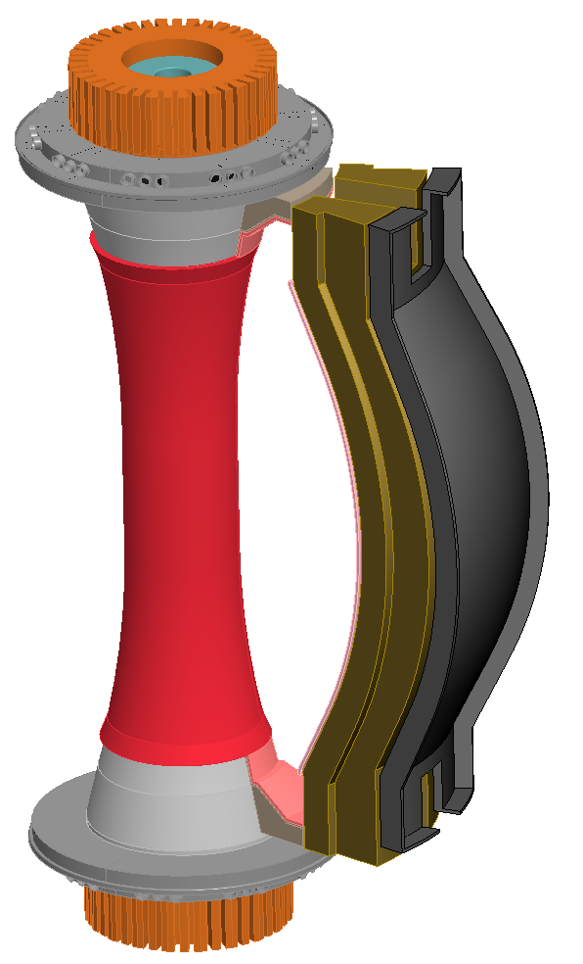
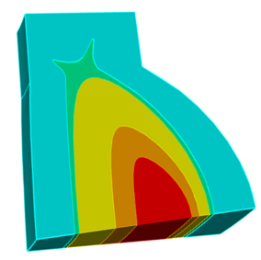
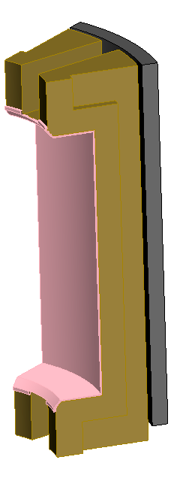
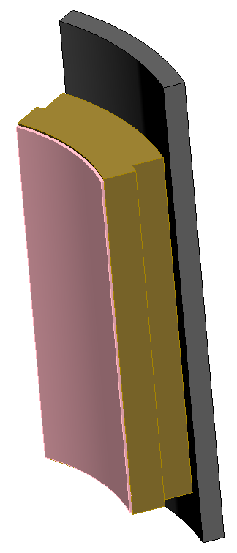
Cost of T and need to demonstrate self-sufficiency motivate analysis of tritium breeding ratio (TBR)
Example costs of T w/o breeding at $0.1B/kg for R=1 → 1.6m
  FNS mission: 1MWy/m² $0.33B → $0.9B
  Component testing: 6MWy/m² $2B → $5.4B
Implications:
  TBR << 1 likely affordable for FNS mission with R ~ 1m
  Component testing arguably requires TBR approaching 1 for all R
Performed initial analysis of R=1.6m FNSF using conformal and straight blankets, ARIES-ST neutron source profiles:
5%
32%
Neutron Source
63%

Slide 15
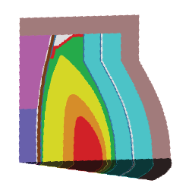
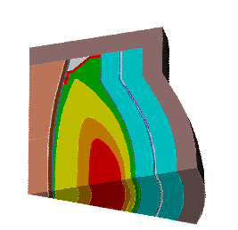
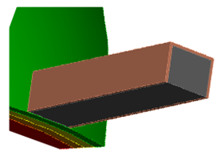

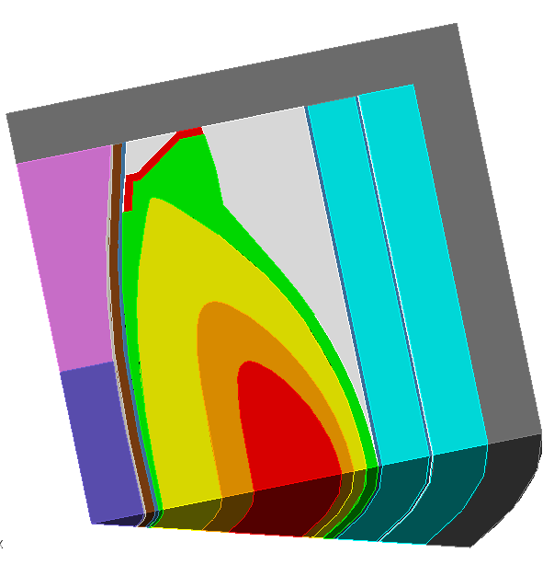
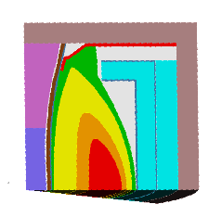
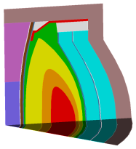
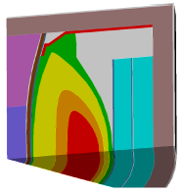
R=1.6m TBR calculations highlight importance of shells, penetrations, and top/bottom blankets
Extended
conformal blanket
+ 3cm thick stabilizing shell
Extended conformal + 3cm shell + NBI
NBI penetration at midplane
Stabilizing
shell
TBR = 1.02
10 NBI penetrations
TBR = 1.1
TBR = 1.07
Extended
straight blanket
Straight blanket
with flat top
Conformal blanket
Straight blanket
TBR = 1.046
TBR = 1.0
TBR = 0.8
TBR = 1.047

Slide 16
Outline
Motivation for study
Physics basis for operating points
Performance vs. device size
Tritium breeding ratio calculations
Divertor poloidal field coil layout and design
Power exhaust calculations
Maintenance strategies
Summary

Slide 17
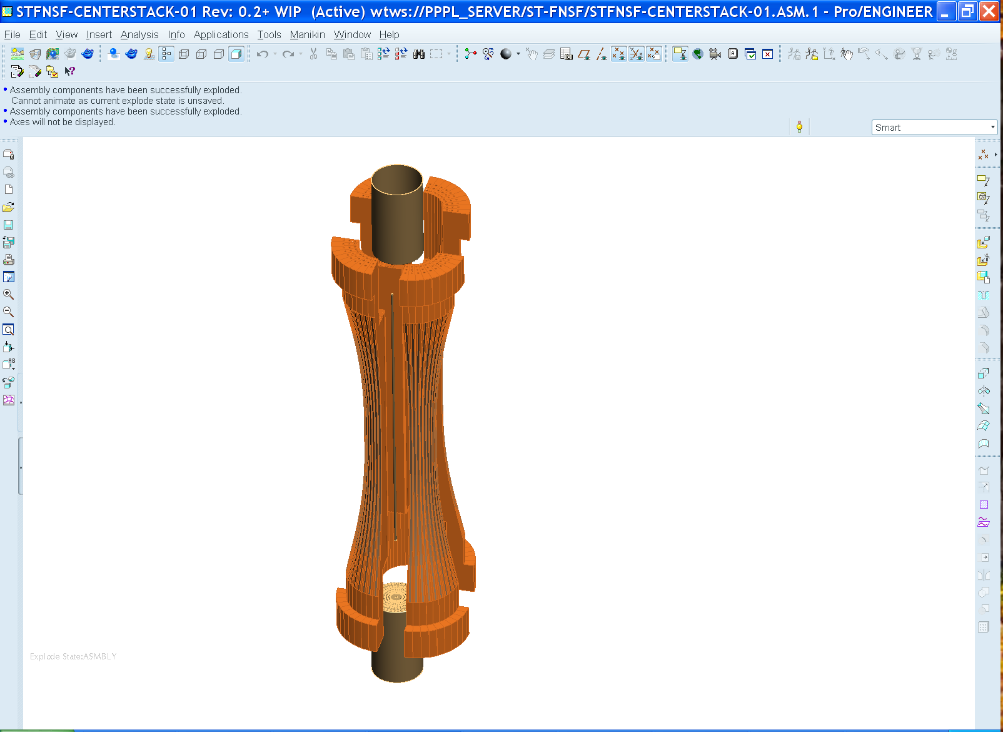
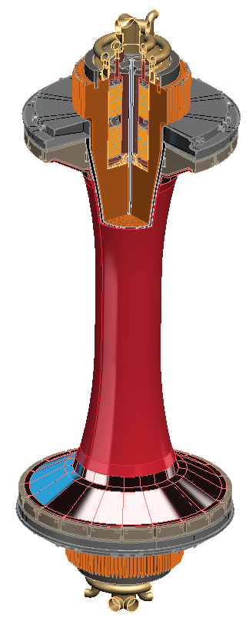
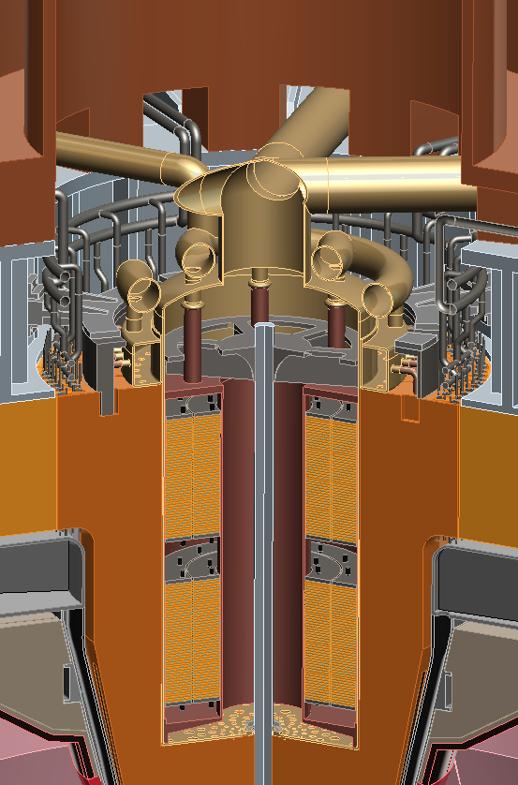
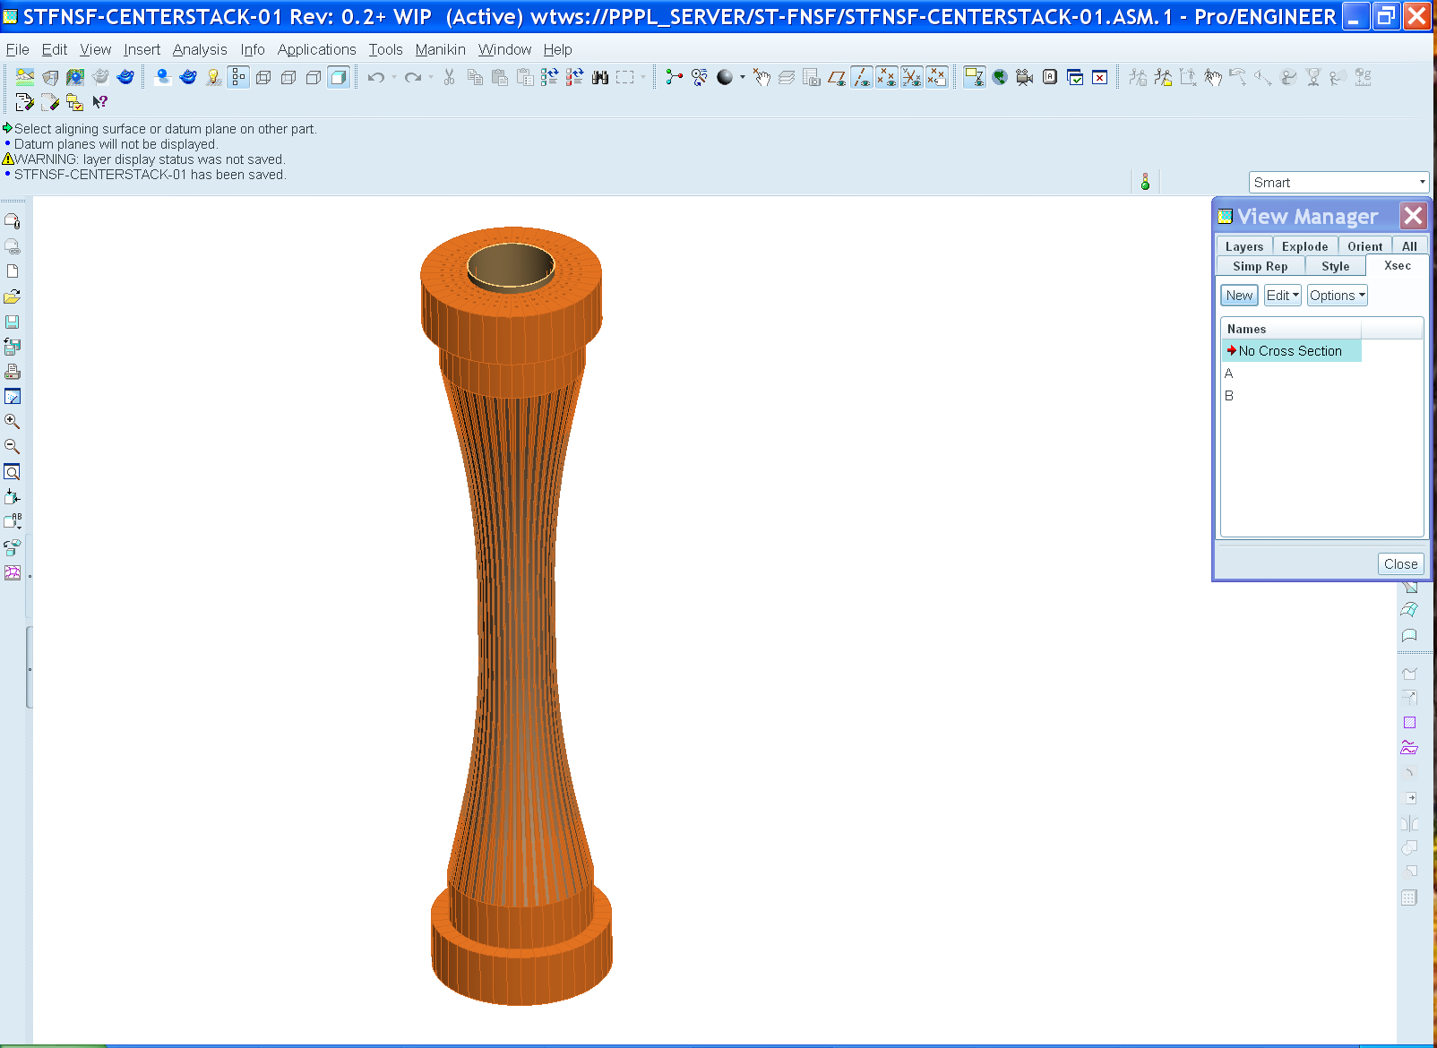
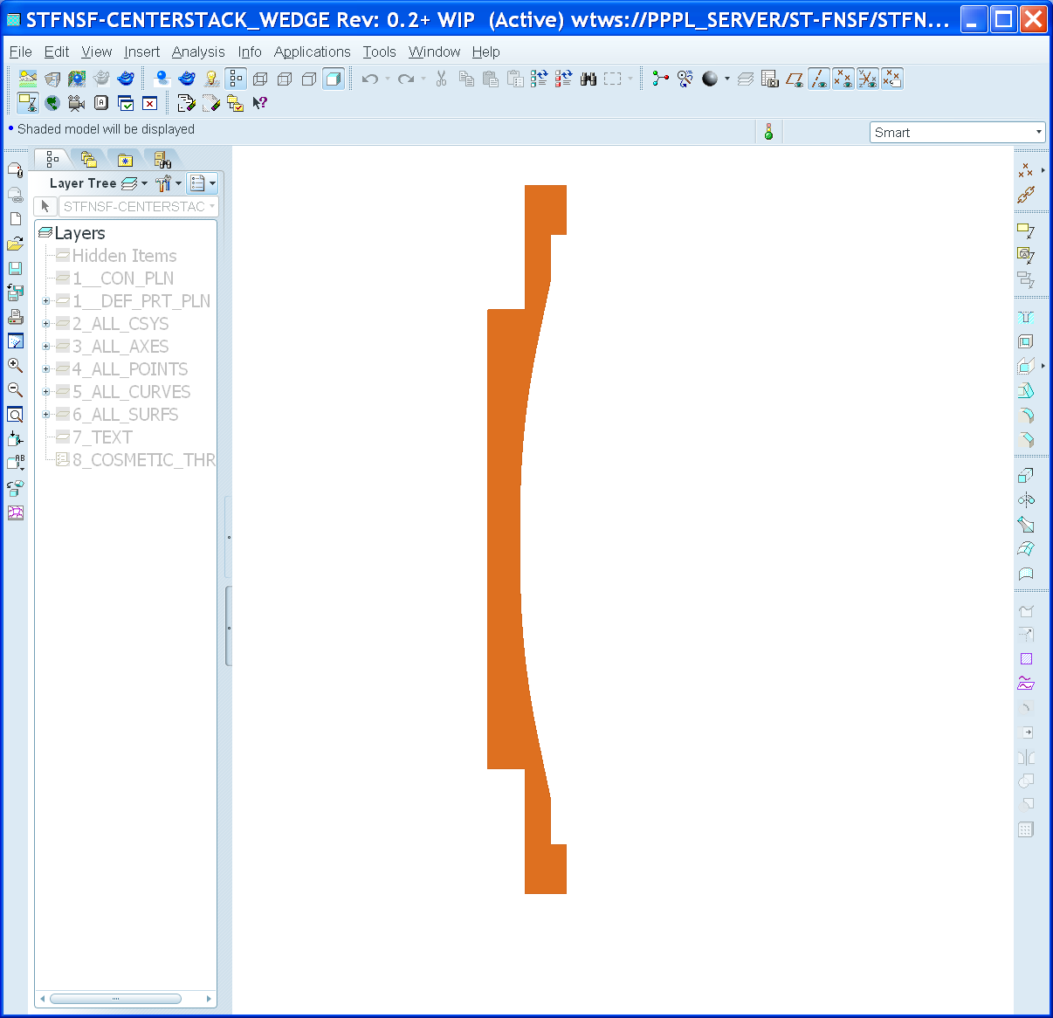
FNSF center-stack can build upon NSTX-U design, incorporate NSTX stability results
Like NSTX-U, use TF wedge segments (but brazed/pressed-fit together)
  Coolant paths: gun-drilled holes or NSTX-U-like grooves in wedge + welded tube
Bitter-plate divertor PF magnets in ends of TF enable high triangularity
  NSTX data: High δ > 0.55 and shaping S ≡ q₉₅I_{P}/aB_{T} > 25 minimizes disruptivity
  Neutronics: MgO insulation can withstand lifetime (6 FPY) radiation dose

Slide 18
Outline
Motivation for study
Physics basis for operating points
Performance vs. device size
Tritium breeding ratio calculations
Divertor poloidal field coil layout and design
Power exhaust calculations
Maintenance strategies
Summary

Slide 19
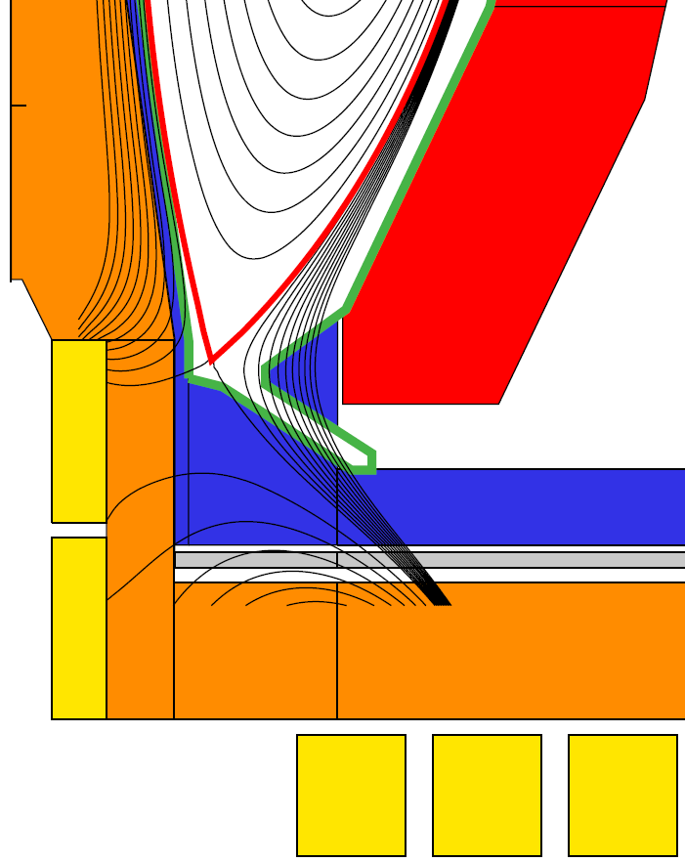
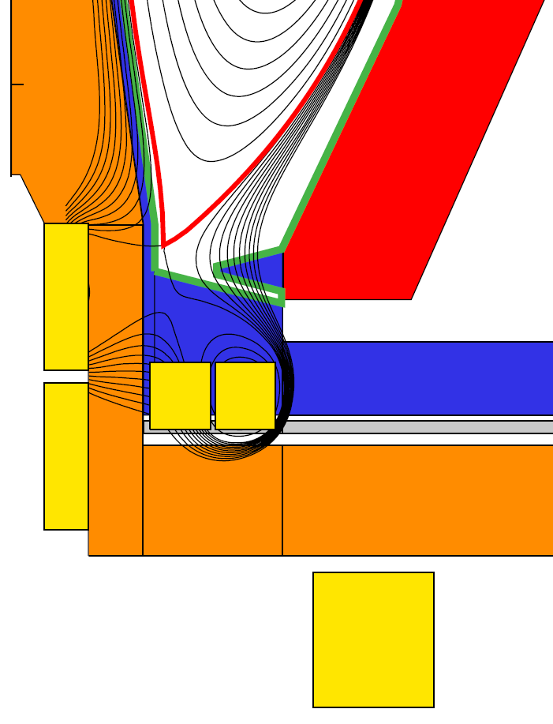
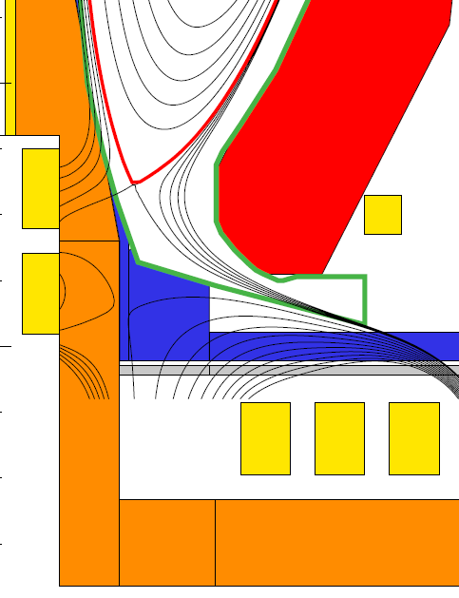
Divertor PF coil configurations identified to achieve high δ, maintain peak divertor heat flux ≤ 10MW/m²
Field-line angle of incidence at strike-point = 1˚
Conventional
Snowflake
Super-X
q_{peak} ~ 10MW/m²
Flux expansion = 15-25
1/sin(θ_{plate}) = 2-3
R_{strike} = 1.15m, δ_{x} ~ 0.55
q_{peak} ~ 10MW/m²
Flux expansion = 40-60
1/sin(θ_{plate}) = 1-1.5
R_{strike} = 1.05m, δ_{x} ~ 0.62
q_{peak} ~ 3MW/m²
Flux expansion = 2
1/sin(θ_{plate}) = 15
R_{strike} = 2.6m, δ_{x} ~ 0.56

Slide 20
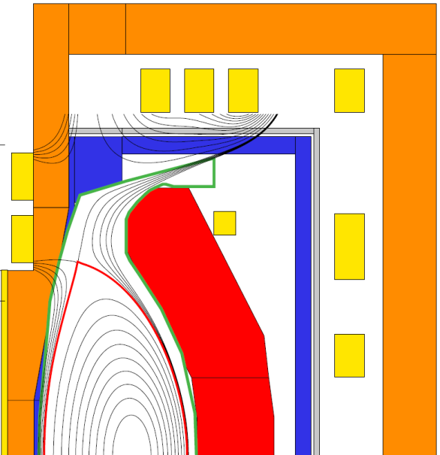
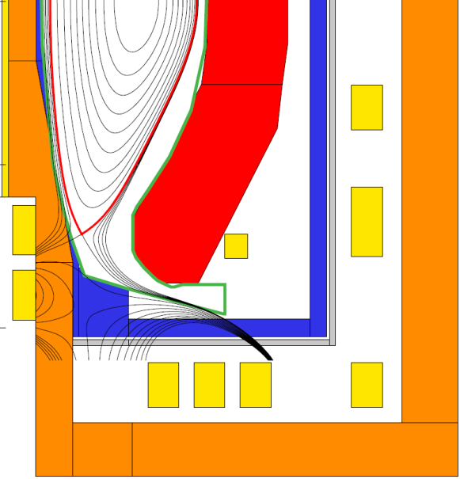
Combined super-X + snowflake divertor configuration has many attractive features
Outboard PF coils shielded by blankets → can be SC
l_{i} = 0.82 κ = 2.55
Increased strike-point radius to reduce B and q||, further increase line-length
Strike-point PFCs shielded by blankets
2nd X-point/snowflake lowers B_{P}, increases line-length
Possible location for T breeding to increase TBR
PF coil design supports wide range of l_{i} values (0.4 – 0.8) with fixed strike-point location/region and controllable B-field angle of incidence (0.5-5˚)
Normally conducting PF coil features:
Divertor coils in TF coil ends for equilibrium, high δ
In-vessel coils not-required for shaping – will be used for vertical control (to be studied in future)
l_{i} = 0.40 κ = 3.0

Slide 21
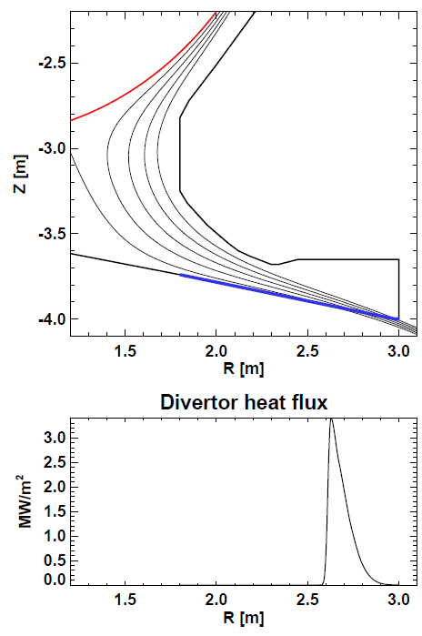
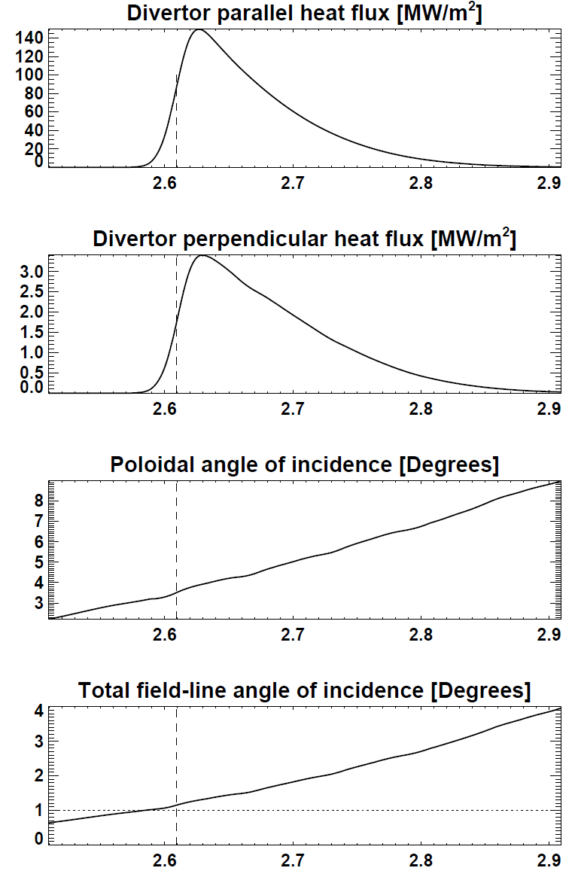
Super-X → ~3× reduction in q_{peak}: 10 → 3MW/m² for fixed radiation fraction and angle of incidence

Slide 22
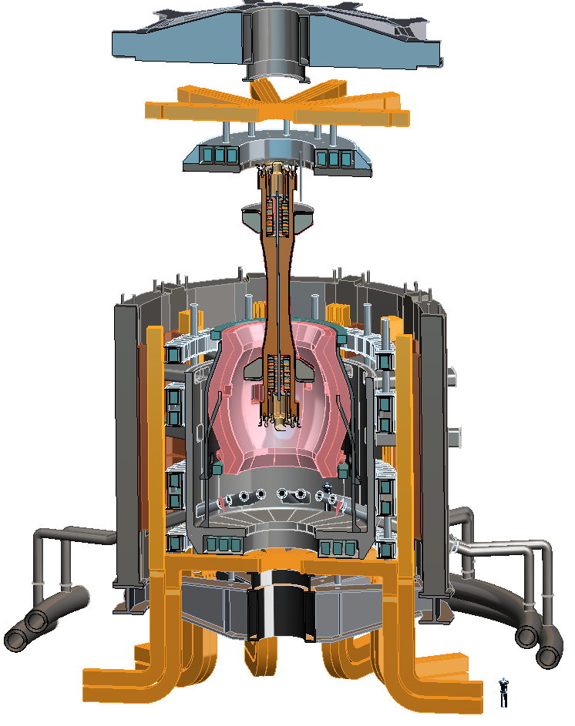
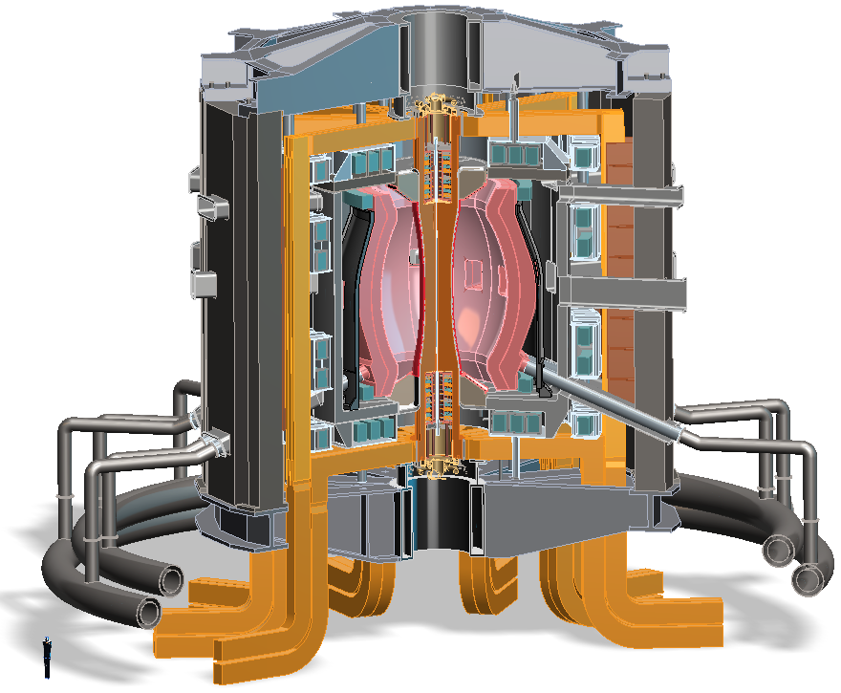
R=1.6 device configuration with Super-X
Design features
Vertical maintenance approach
S/C PF coils housed in VV upper lid
S/C PF coils pairs located in common cryostat
VV outer shell expanded to add shield material
S/C PF coils housed in VV lower shell structure
Angled DCLL concentric lines to external header
Reshaped TF leads

Slide 23
Summary
Present STs (NSTX, MAST) providing preliminary physics basis for ST-FNSF performance studies
  Upgraded devices will provide more extensive and definitive basis
Neutron wall loading of 1MW/m² feasible for range of major radii for β and H₉₈ values at/near values already achieved
  High wall loading and/or pilot-level performance require β_{N} ~ 6 and H₉₈ ~ 1.5 which are at/near maximum values attained in present STs
TBR near 1 possible if top/bottom neutron losses minimized
  TBR ≥ 1 may only be possible for R ≥ 1.6m – under active investigation
Divertor PF coils in ends of TF bundle enable high δ, shaping
Conventional, snowflake, super-X divertors investigated, PF coils incorporated to reduce peak heat flux << 10MW/m²
Vertical maintenance strategies for either full and/or toroidally segmented blankets being investigated

Slide 24
Future work
Physics basis for operating points
  Perform sensitivity study of achievable performance vs. baseline configuration assumptions: A, κ, H_{98y,2}, ST vs. tokamak τ_{E} scaling
  TRANSP calculations of NBI heating, current drive, neutron production
Performance vs. device size
  Could/should overall machine configuration change at smaller R?
    Example questions: could/should vessel take more load?
  Is there sufficient shielding for divertor PF coils at smaller R?
Tritium breeding ratio calculations
  Extend calculations to smaller R
  Include 3D effects and final machine layout
Maintenance strategies
  Assess space/lift requirements above machine for vertical maintenance

Slide 25
Backup

Slide 26
Boundary shape parameters vs. internal inductance
A = 1.8→1.7 at higher l_{i}
High δ = 0.5-0.6 maintained
κ reduced at higher l_{i}
Negative squareness at low l_{i}

Slide 27
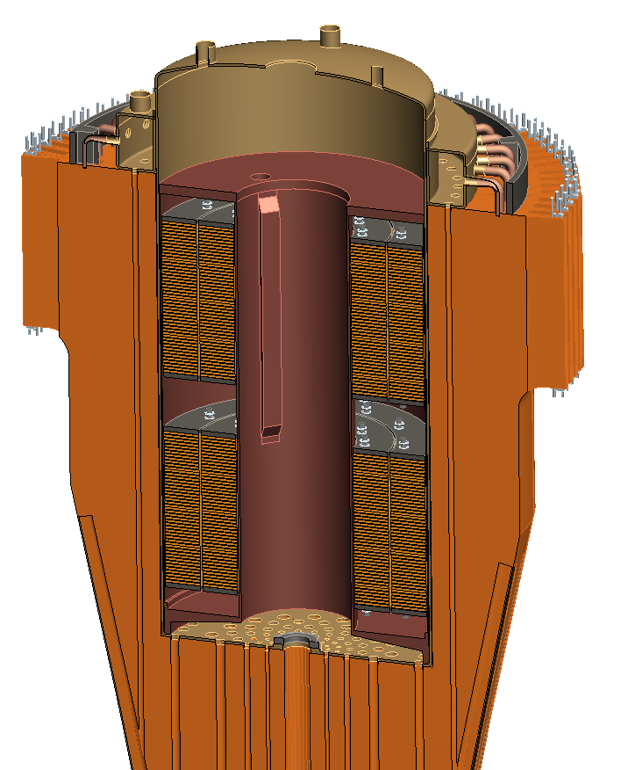
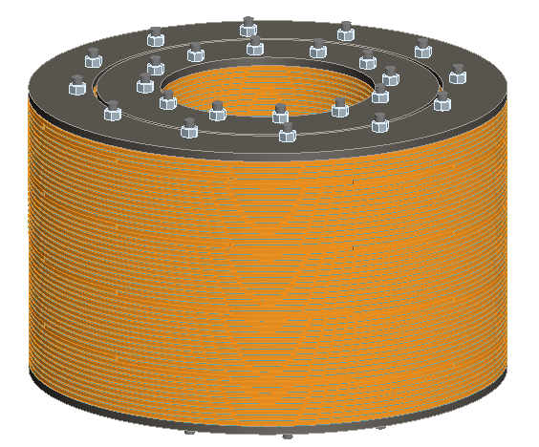
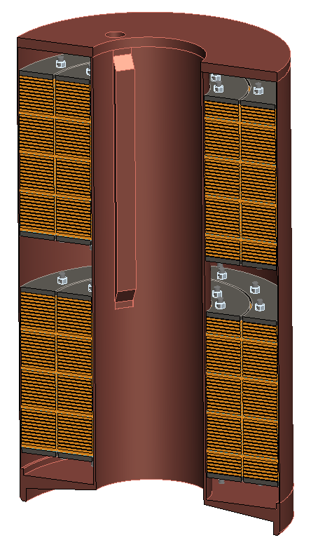
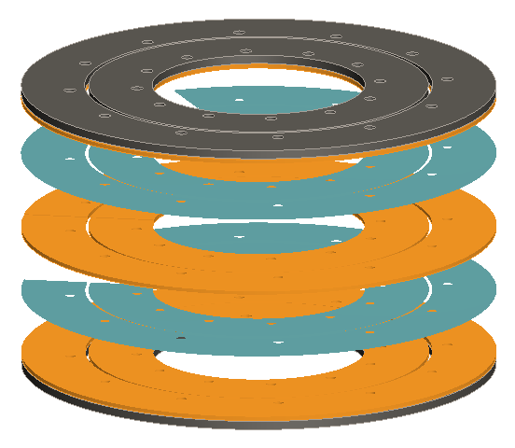
Bitter coil insert for divertor coils in ends of TF
Insulator
Glidcop plates

Slide 28
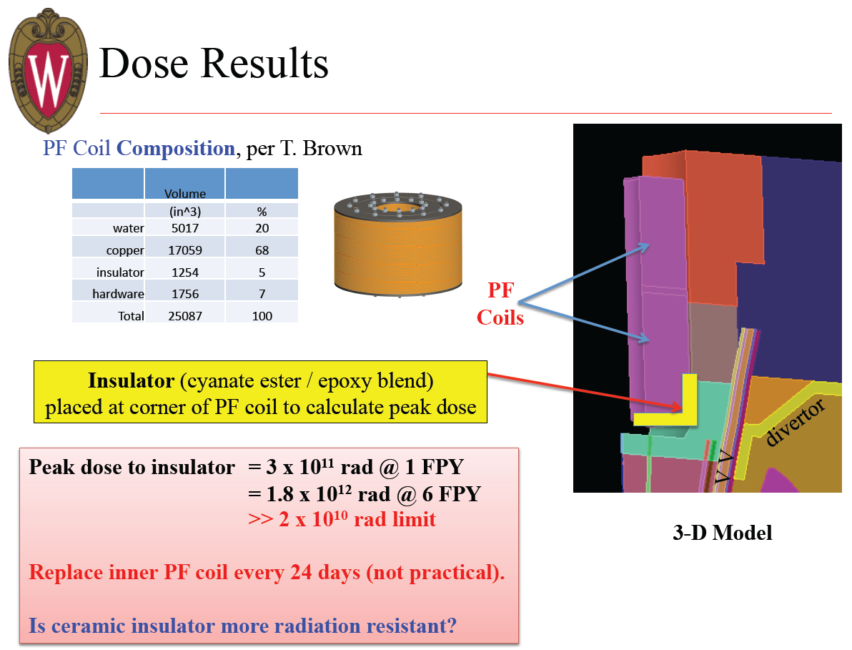
Neutronics analysis indicates organic insulator for divertor PF coils unacceptable

Slide 29
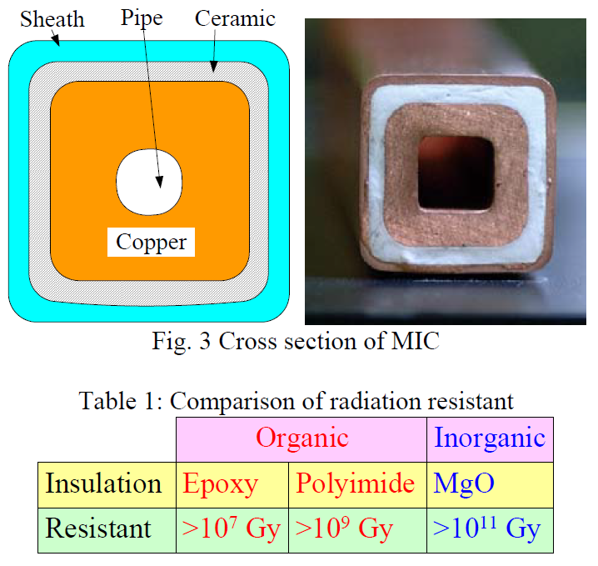
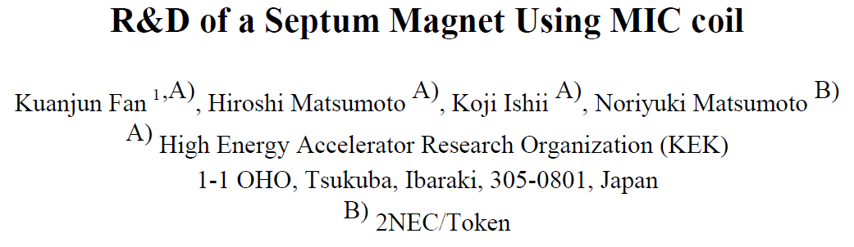
MgO insulation appears to have good radiation resistance for divertor PF coils
UW analysis of divertor PFs
  1.8x10¹² rad = 1.8x10¹⁰ Gy at 6FPY for P_{fus} = 160MW
Pilot mission for R=1.6m:
  P_{fus} = 420MW vs. 160MW → 2.6x higher → 4.7x10¹⁰ Gy
  Even for Pilot mission, dose is < limit of 10¹¹ Gy
Limiting factor may be Cu
Need to analyze CS lifetime
Revisit option for multi-turn TF and small OH solenoid

