Slide 1
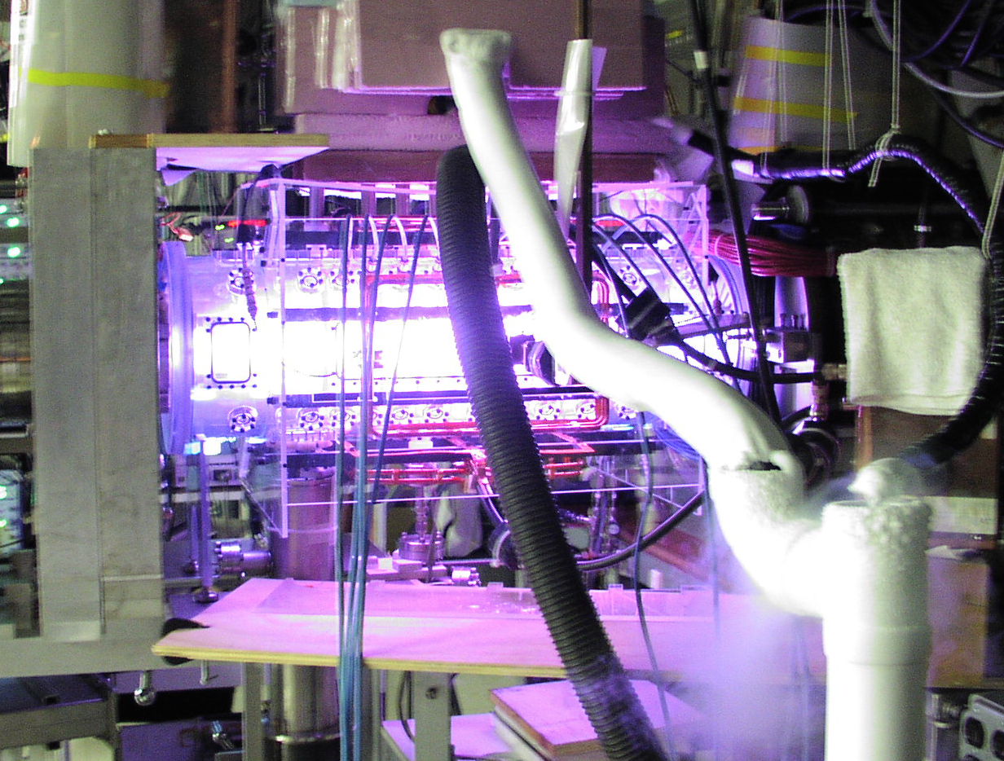

Long-pulse operation of the PFRC-2 device
S.A. Cohen, B. Berlinger, C. Brunkhorst, M.E. Edwards, P. Jandovitz, J. Matteucci, C.E. Myers, and C. Swanson
Princeton Plasma Physics Laboratory, Princeton University, Princeton, NJ
Hi-T Superconducting FCs
r_{s} to 7 cm
T_{e} to 400 eV
τ_{d} to 250 ms
p
PFRC-2 device at PPPL

Slide 2
Take-away points
Research aimed at small (1-10 MW), clean, fusion reactors
for niche applications.
Flux conservation is critically important.
Wall (PMI) interactions should be minimized.
Separatrix should be well away from wall.
Fueling techniques critically important.
Stable discharge durations (250 ms) exceed 10⁵ τ_{Alfven}.
Rotating interchange modes stabilized by gas puffing.

Slide 3
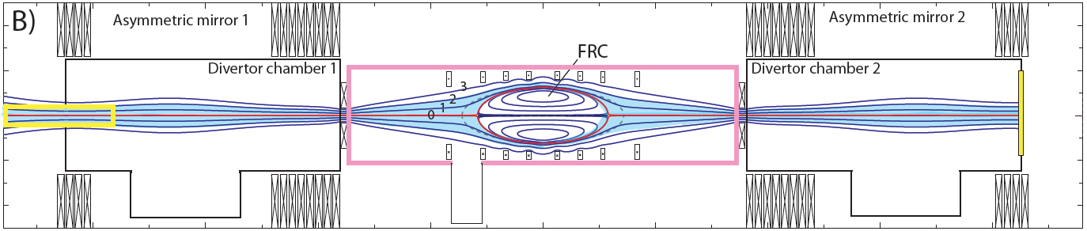
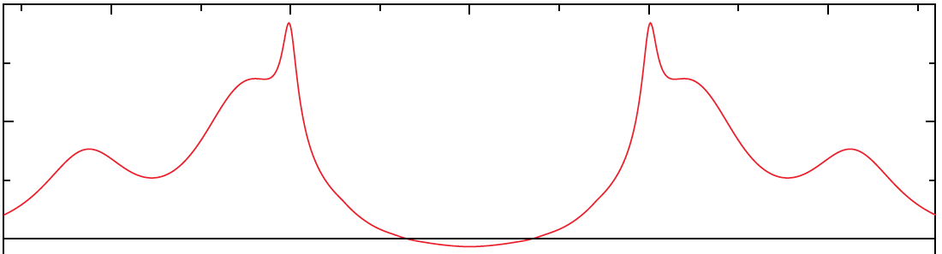
Outline
Long pulse: to 250 ms
Superconducting flux conservers (Hi-T SC FCs)
RMF_{o} heating of the PFRC-2
Gas puffing: refueling
The PFRC-2
X ray
Hα
Hi-T SC FCs
RMF
X ray
μ-wave
Gas puff
B_{z}
An FRC embedded in an axisymmetric tandem mirror

Slide 4
Why long pulse – what is long pulse?
RF times scales
LHD
Tilt
Interchange
Instability time scales
CD/Inductive time scales
Energy time scales
Ash exhaust/reactor time scales
PMI
PFRC-2

Slide 5

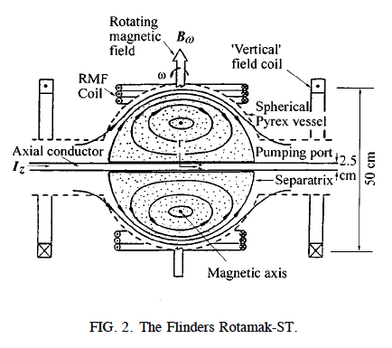
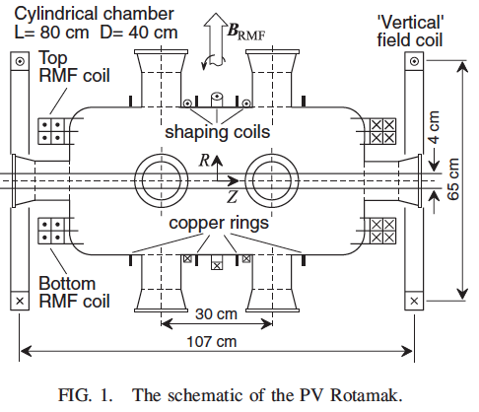
Other long-pulse FRCs
1988 ANS (J. Plasma Phys. 40, 127) t = 15 ms
1989 Flinders (Pl. Phys. Cont. Fus. 32, 575) t = 50 ms
1991 Flinders (Rev. Sci. Instr. 62, 1787) t = 40 ms
1995 Flinders (Pl. Phys. Cont. Fus. 37, 209) t = 50 ms
2009 Prairie View (PRL 102, 255004) t = 40 ms
2015 TriAlpha (Nature 6, 6897) t = 7-15 ms
No flux conservers

Slide 6
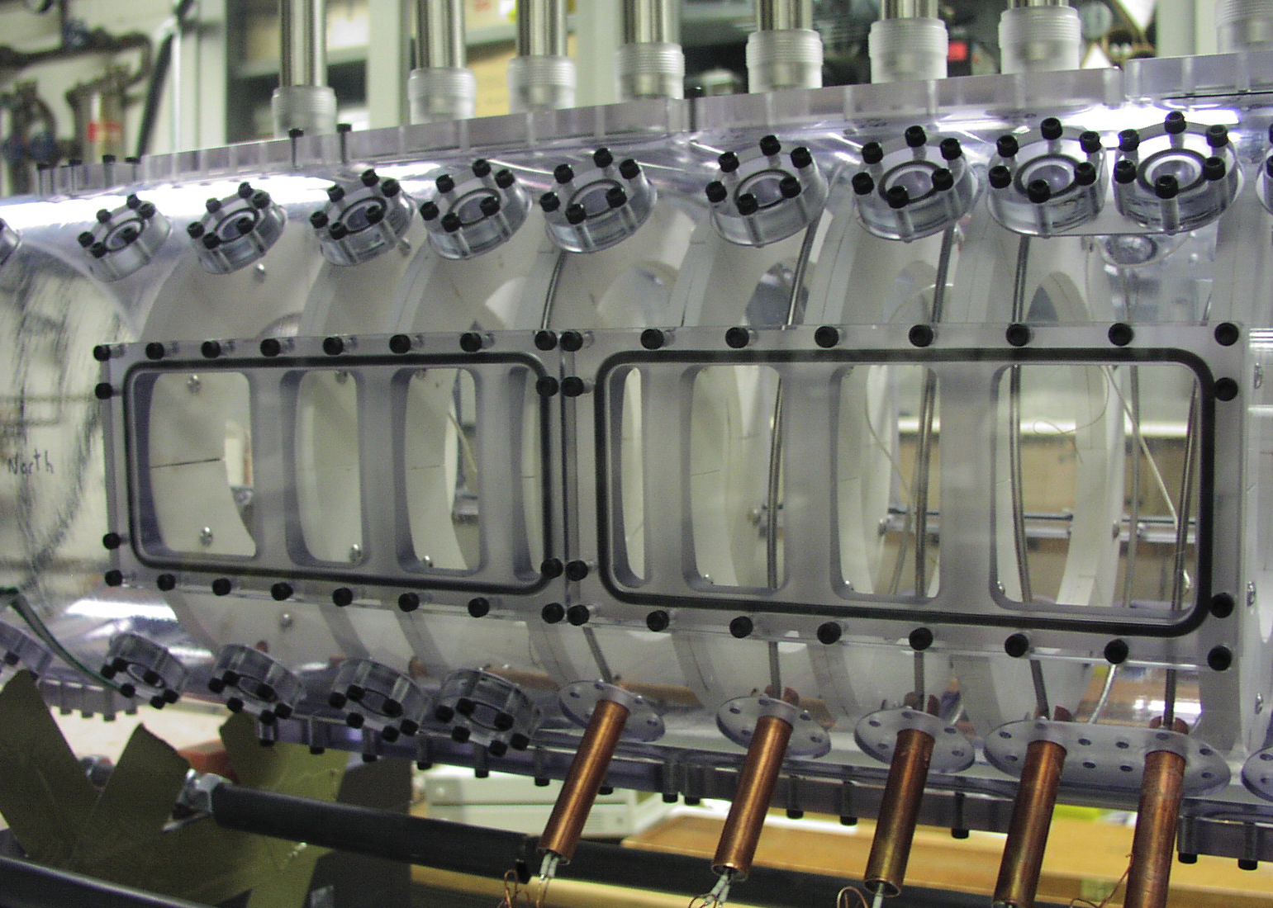
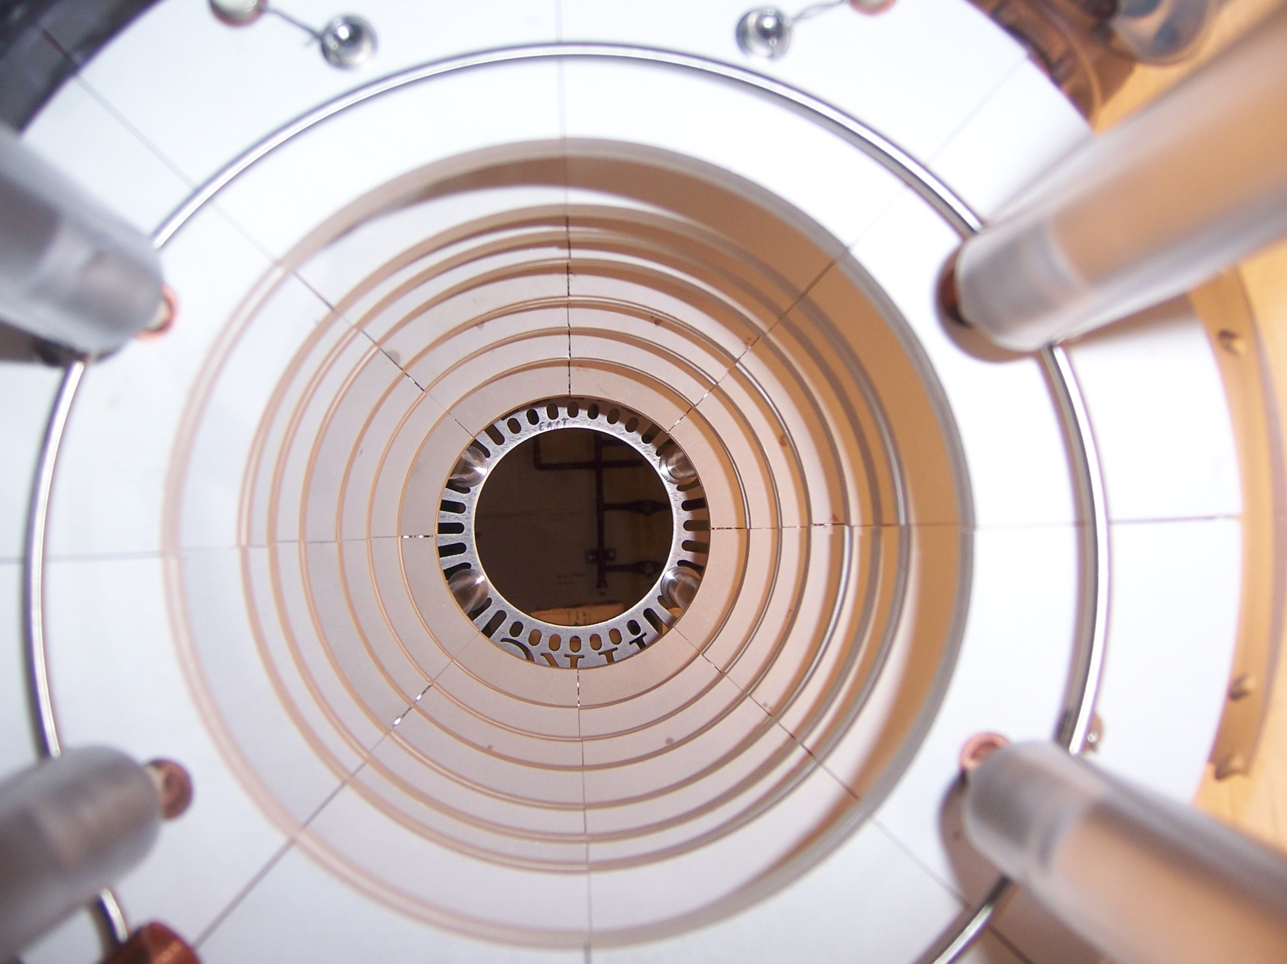
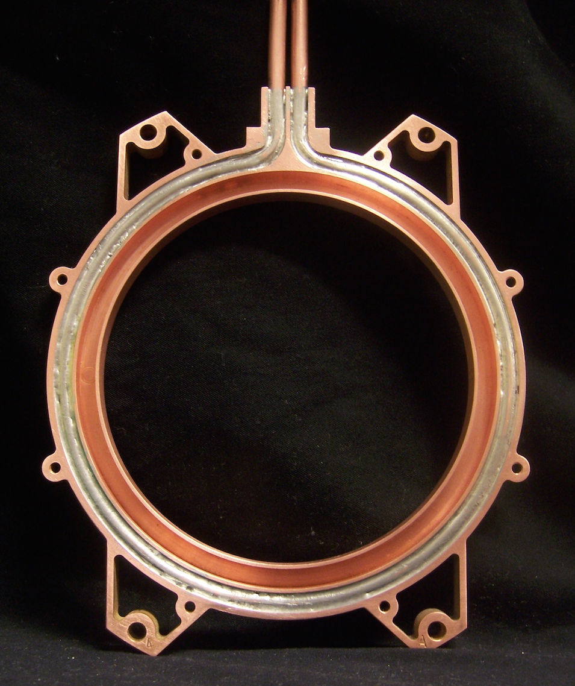
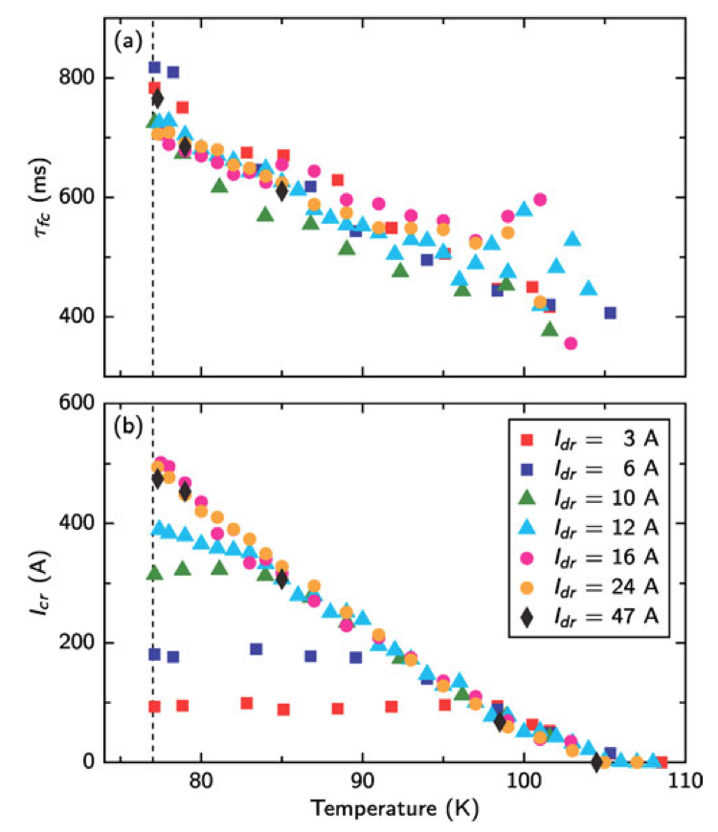
High-Temperature Superconductor FCs

Slide 7
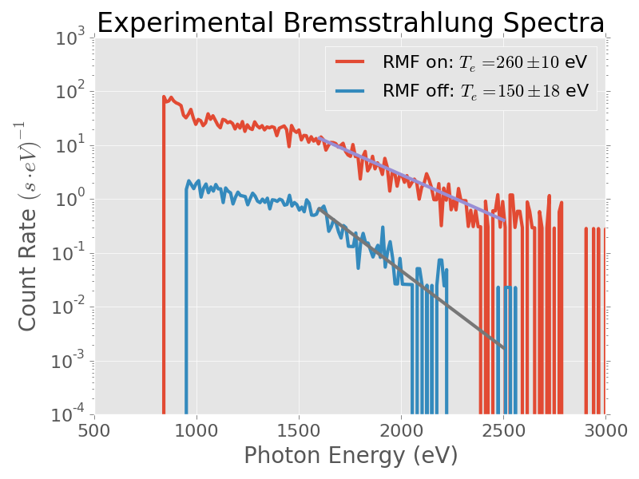
RMF_{o} heating of the PFRC-2
Characteristics
  Frequency = 8.025 MHz
  Odd parity
  P_{forward} to 25 kW (200 kW); P_{reflected} ~ ¼%
  P_{absorbed} ~ 35-75% P_{f}
  Duty factor 1%
Predicted benefits
  Closed field lines
    Matteucci poster
  Electron heating
    Jandovitz poster
  Ion heating (ω_{RMF}~ω_{ci})
  Plasma stabilization
    Swanson poster

Slide 8
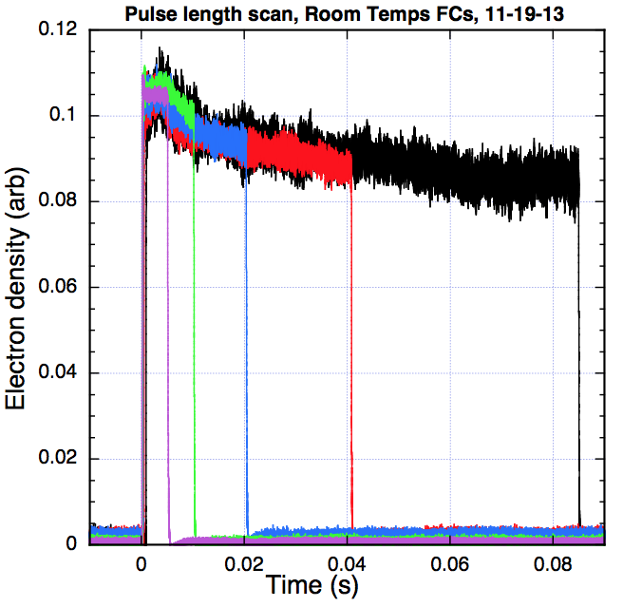
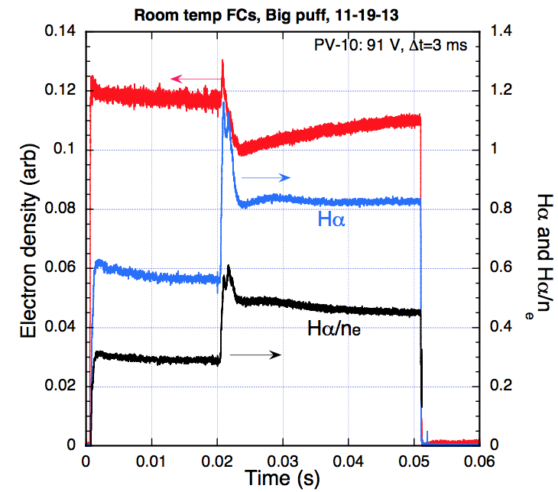
n_{e} behavior with room-temperature FCs
2e12/cc
Prefill H₂
~ 2e13/cc
Gas puff
P_{f} ~ 10 kW, I_{H} = 100 A
Density stays ~constant throughout pulse.
Gas puff only increases n_{e} briefly.
Temporary reduction in n_{e} fluctuations.
Midplane H_{α} rises, stays high long after gas puff.
  Recycling off room temperature FCs (τ_{FC}~ 3 ms @ 70F)

Slide 9
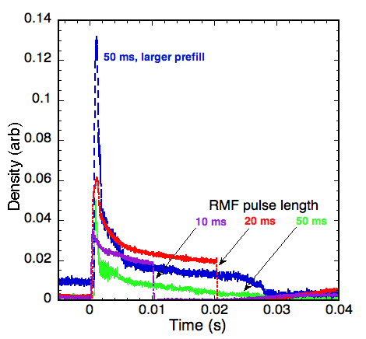
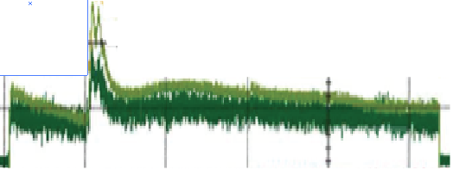
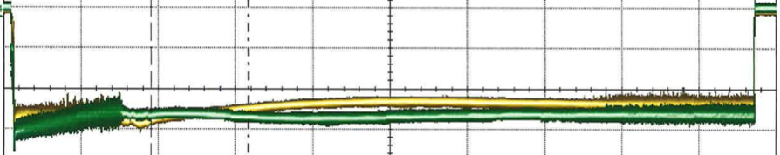
  Behavior with SC FCs at LN2 temperature: (τ_{FC} ~ 1 s)
Pulse length scan
Gas puff!
0 10 20 30 40 50
Time ( ms)
Hα
Density rapidly decays
Absorbed RMF power
Fluctuations suppressed longer
Density flattop from 2 ms gas puff persists for 10s to 100s ms

Slide 10
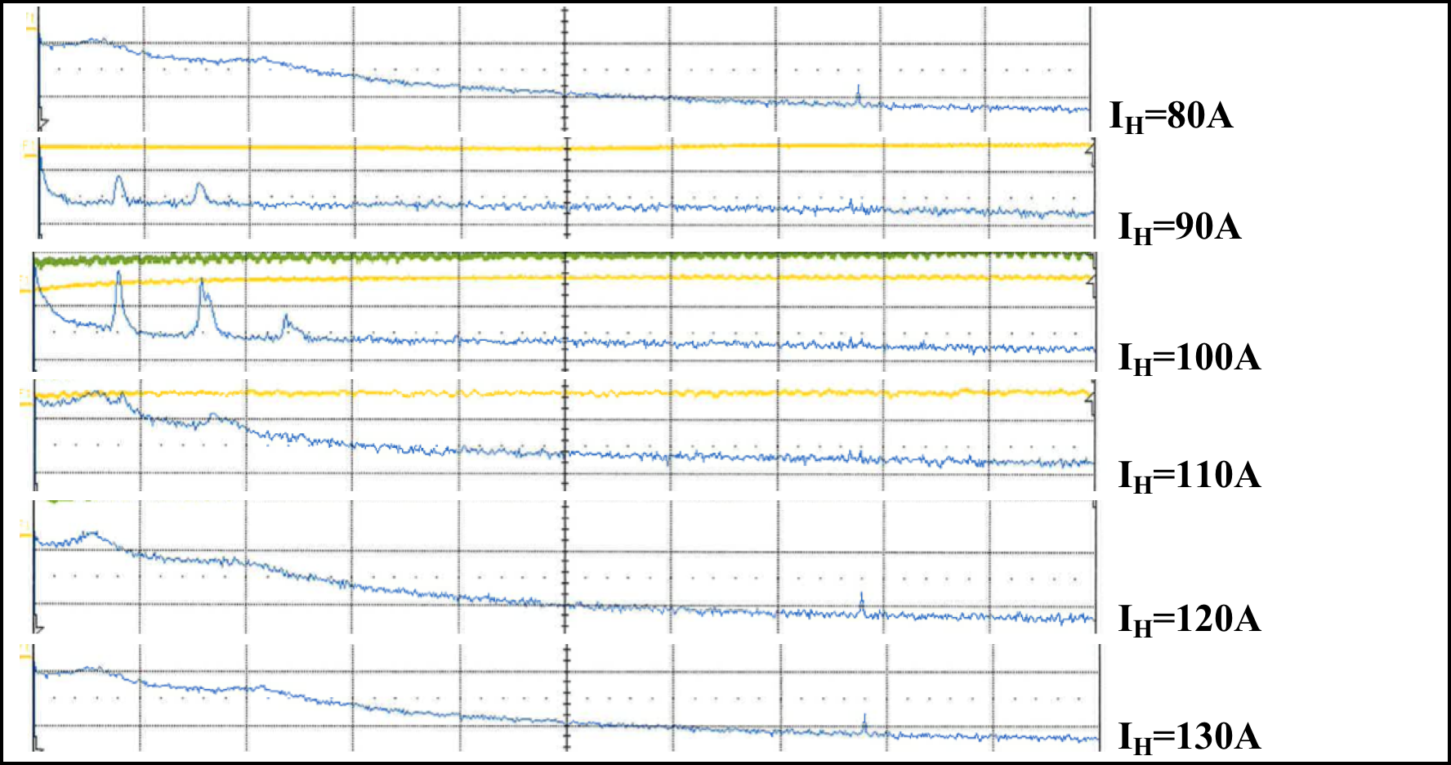
Behavior n_{e} fluctuations with SC FCs (LN2)
10 kHz/div, p_{o} = 0.66 mT, P_{f} =8 kW

Slide 11
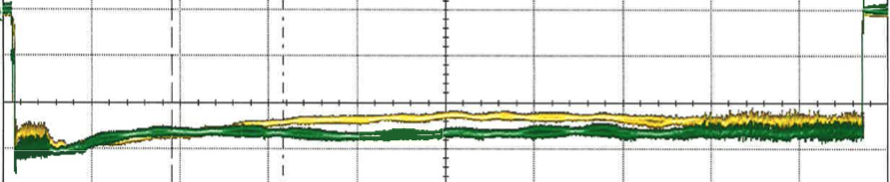
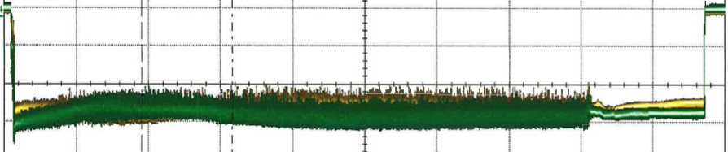
Effect of gas-puff-time on n_{e} with SC FCs (LN2)
t₀ = 0.1 ms
2 ms
7 ms
20 ms
40 ms
Line –average density
Absorbed RMF power
Injecting too early decreases density plateau duration

Slide 12

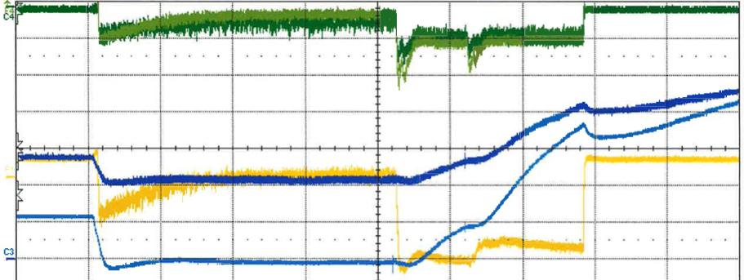
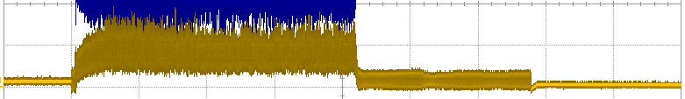
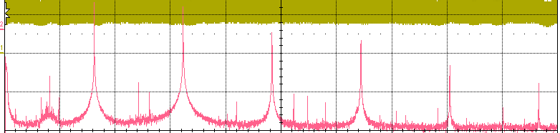

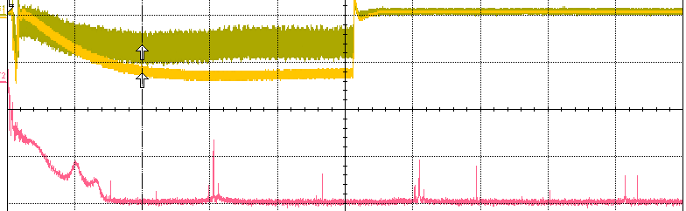
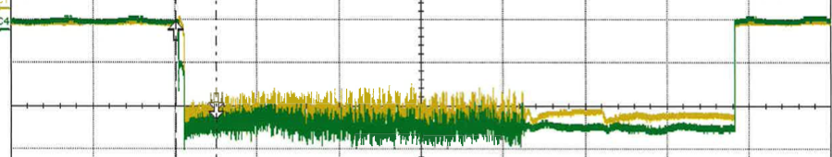
Effects of gas puffs in end cell
3e-5T
-P_{end cell}
P_{f} = 10 kW; I_{H} = 130 A
n_{e}
Initial pump out of end cell.
Gas puff raises pressure in end cell
Hα
0 20 40 60 ms
For this case Hα increases.
Gas puff stifles ion flow to paddle.
3e17 H⁺/s
Paddle current
5MHz/div
P_{a}
200kHz/div
Biased Paddle

Slide 13
Working model of density behavior
RMF efficiently ionizes central cell gas in < 0.2 ms.
With Hi-T SC FCs, plasma flows into end cells until density in central cell falls, increasing RMF penetration ~ T^{5/4}/n^{1/2}.
Good heating occurs, promoting full RMF penetration.
Current drive & re-distribution: FRC forms
L/R|_{cl}~ 2 ms while L/R|_{anom}~ 20 μs
Confinement improved because FRC formed.
Subsequent gas puff penetrates low-density FRC plasma, is ionized throughout, and decorates the already established FRC field pattern.
Long pulses, via SC FCs, were necessary to see this wall-influenced behavior.

Slide 14
Open questions (immediate)
Profile effects
  Is density increase due to axial contraction or improved confinement?
  Full n_{e}, T_{e}, T_{i} profiles
  Separatrix
  SOL parameters, including flows
The role of hydrogen implantation in the walls
Ion-electron drag
CD efficiency
Higher field, higher power: ion heating

Slide 15
Summary: Long-pulse RC discharges
Flux conservation is critically important.
Wall (PMI) interactions should be minimized.
Separatrix should be well away from wall.
Gas fueling technique has been essential.
Stable discharge durations exceed 10⁵ τ_{Alfven}.
Rotating interchange modes stabilized by gas puffing.
A posteriori, surprising long-pulse behavior justifies our decision to built Hi-T SC FCs.
Niche applications
  Spacecraft propulsion (planetary defense, exploration)
  Forward deployment
  Distributed power grid

Slide 16
Additional slides

Slide 17


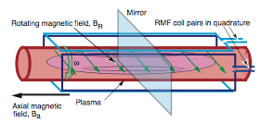
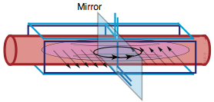
What is odd parity? Symmetry under mirror reflection
Even
Odd

Slide 18
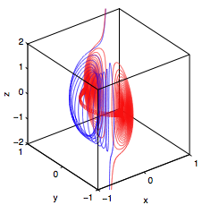
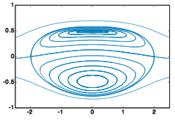
Closed vs open field lines
Open field lines are ones that intersect a material object or leave the device.
Even parity Odd parity
Better confinement

Slide 19
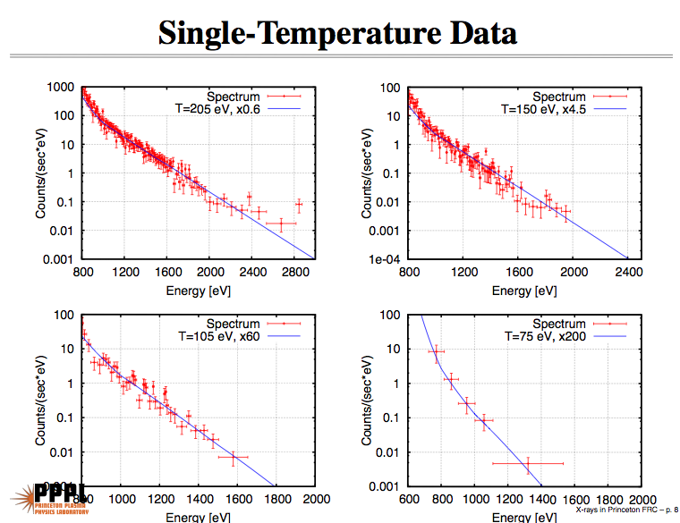
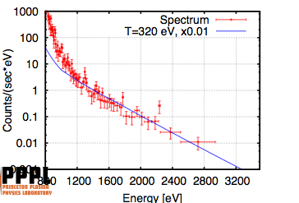
Closed field lines work – higher T_{e}

Slide 20
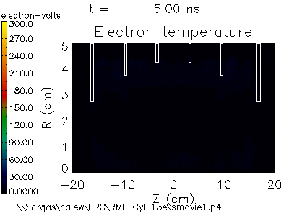
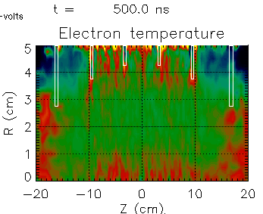
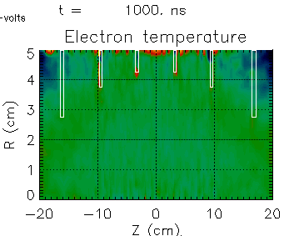
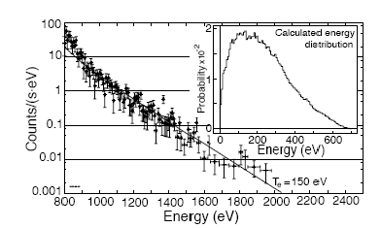
1. RMF_{o} electron heating- Lsp (PIC) code
Fully self consistent, fully electromagnetic
LSP simulation between 120 and 150 eV Maxwellian, but with broader energy tail
PFRC Data showing 150-eV electron temperature
Welch and Cohen (2010)
Roach and Cohen (2007)

Slide 21
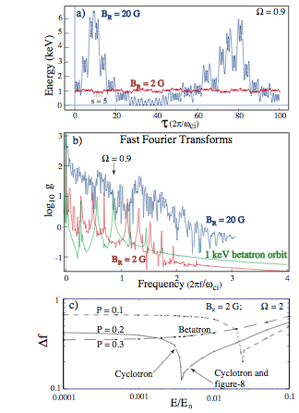
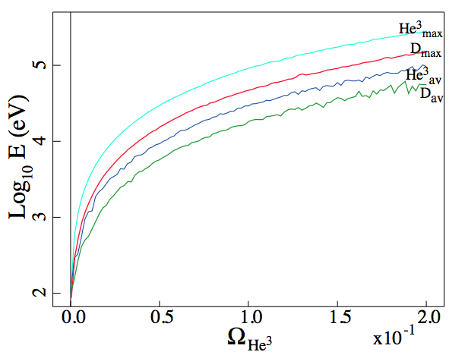
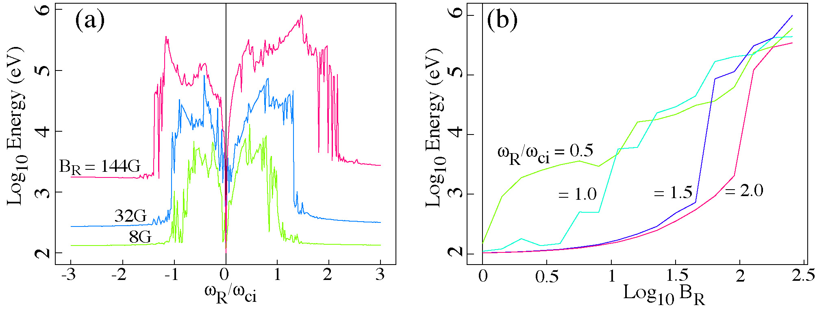
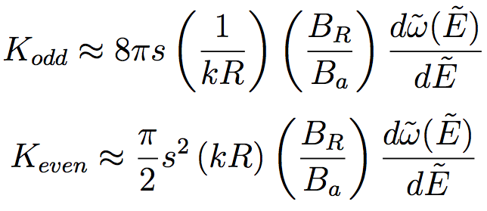
Predicted ion heating: r = 10 cm, κ = 5, B_{e} = 20 kG
B_{R} = 128 G
Ion heating (Ω = ω_{R}/ω_{ci})
Threshold
Saturation
Heating to temperatures relevant for aneutronic fuels
0.1 < |ω_{R}/ω_{ci}| < 2
B_{R}/B_{a} < 0.01
Gradient in heating efficiency may allow tuning for isotopes
Cohen and Glasser (PRL 2000)
Cohen, Landsman, Glasser (PoP 2007)

Slide 22
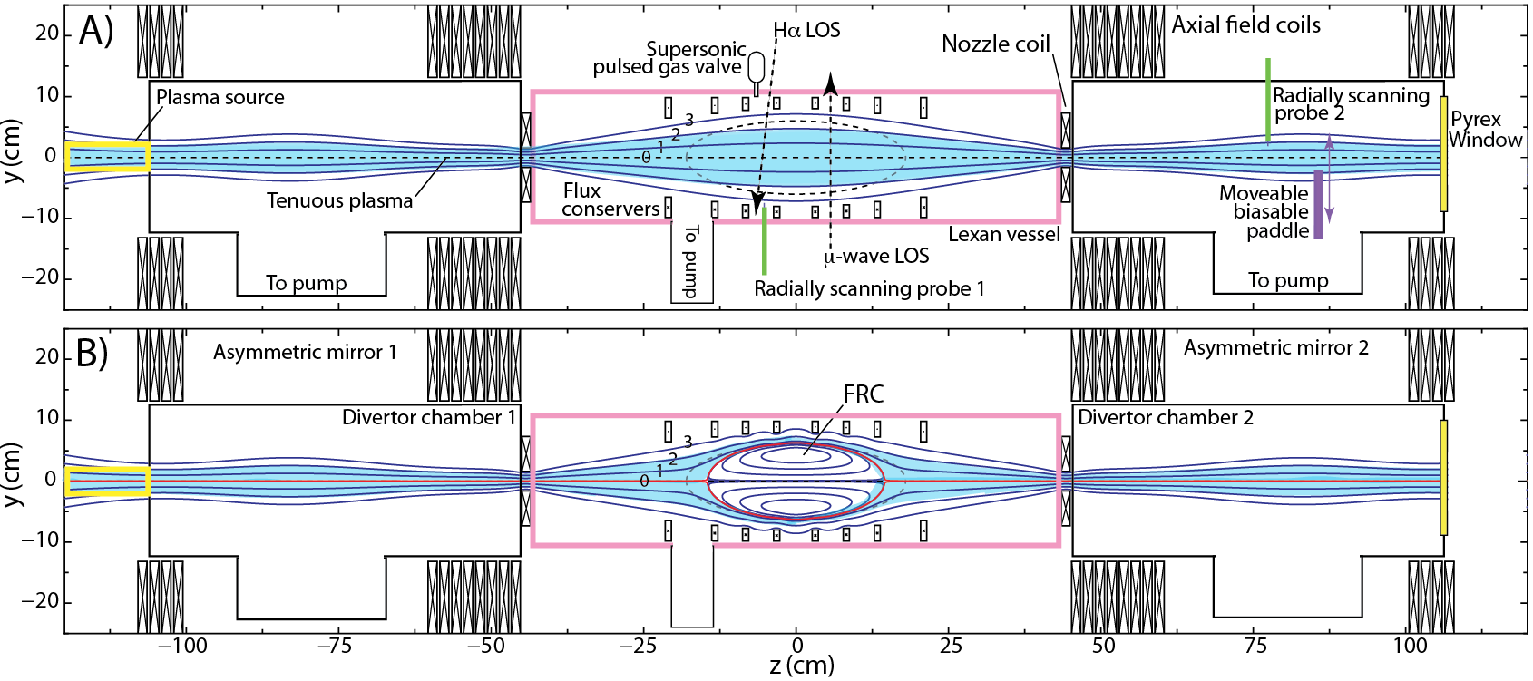
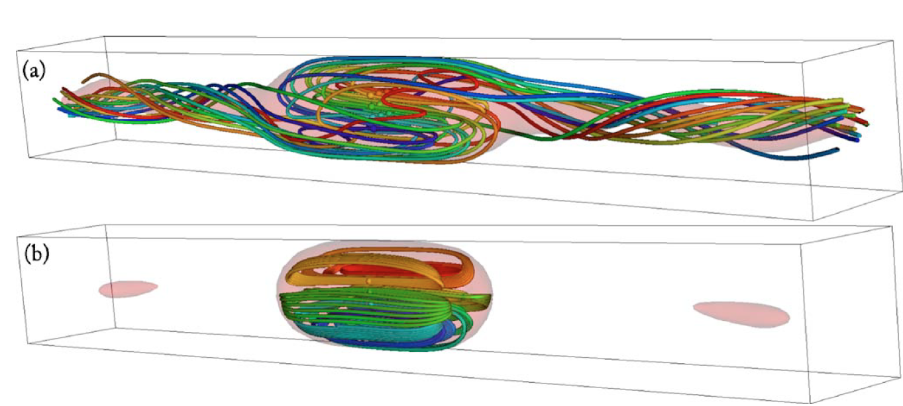
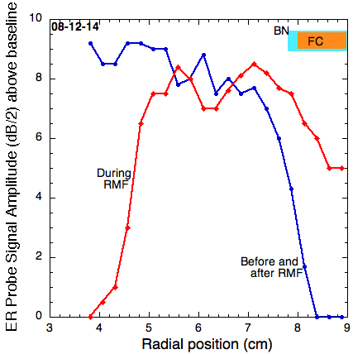
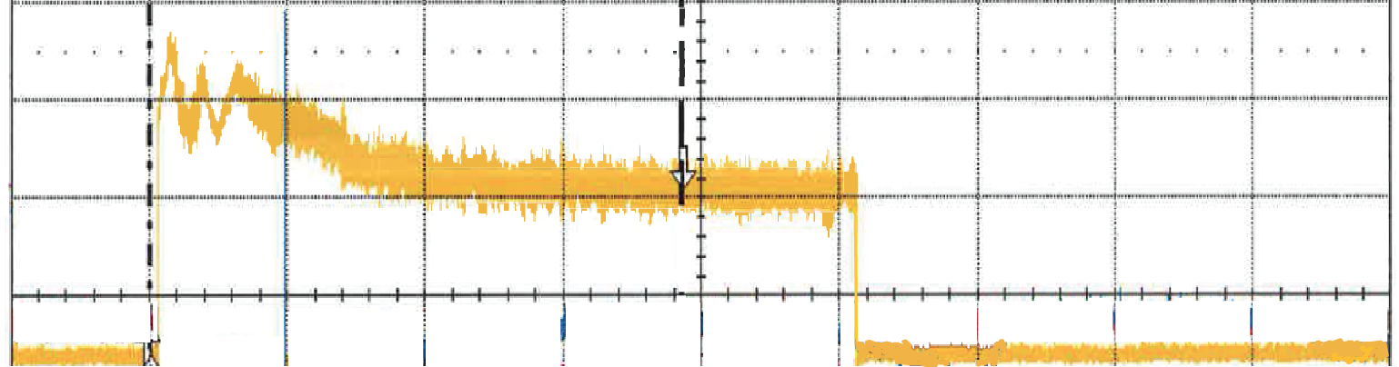
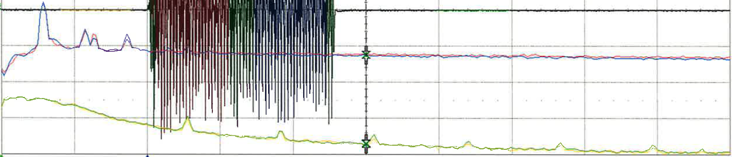
Evidence for closed field lines
1st Goal: to close field lines, form a separatrix and improve confinement
Even parity
Milroy
Odd parity
250 ms long pulse
τ ~ 10⁵ τ_{A}
Fluctuation spectrum
measured by probe
Separatrix

Slide 23
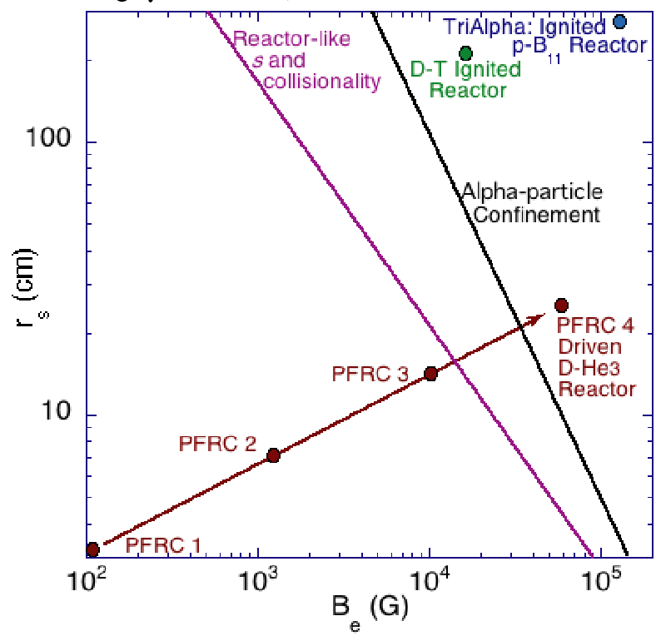
FRC options: The size-field plane
ITER
Instability problems
Choices
Fuel
Beta
Configuration
Heating method
Nature
τ_{E}
Size
Stability
Fusion power
FRCs
Compressed
Helion

