Slide 1
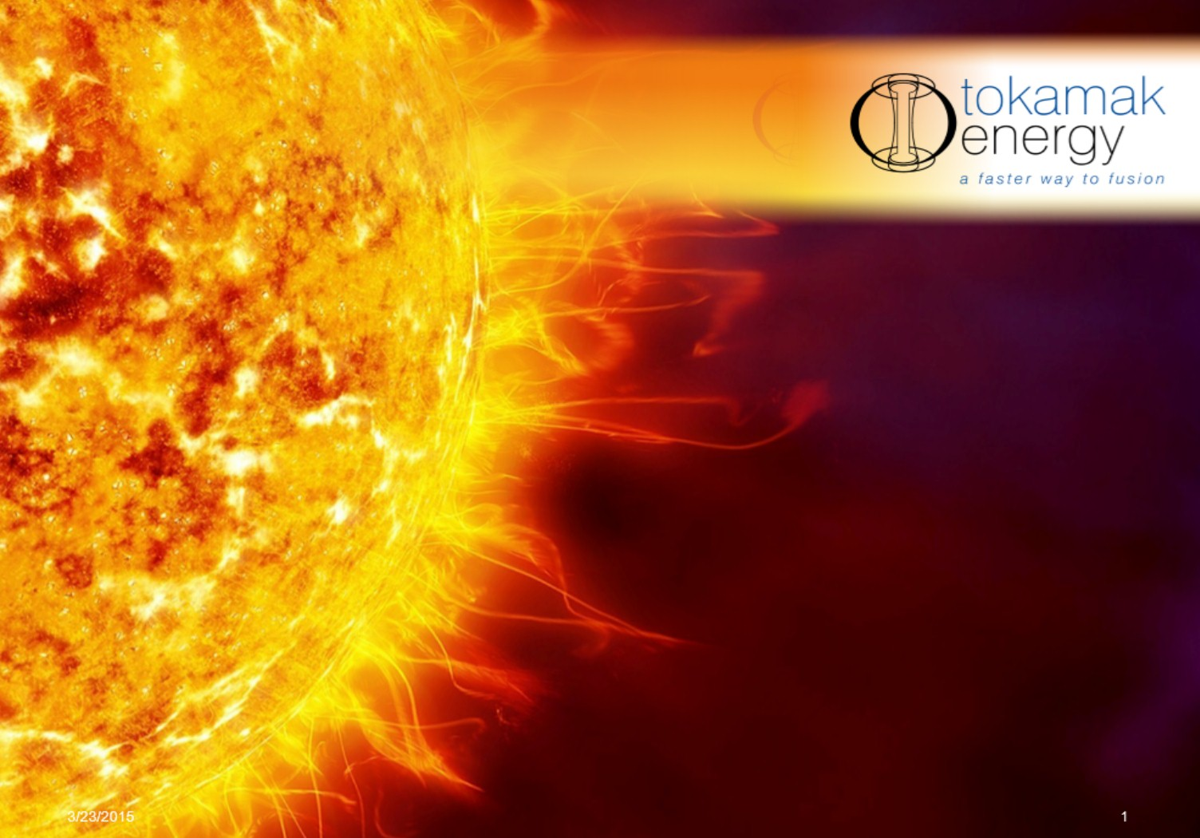
Merging/compression plasma formation in Spherical Tokamaks
Mikhail Gryaznevich
18th International Spherical Torus Workshop (ISTW 2015) 3 – 6 November 2015, Princeton US

Slide 2
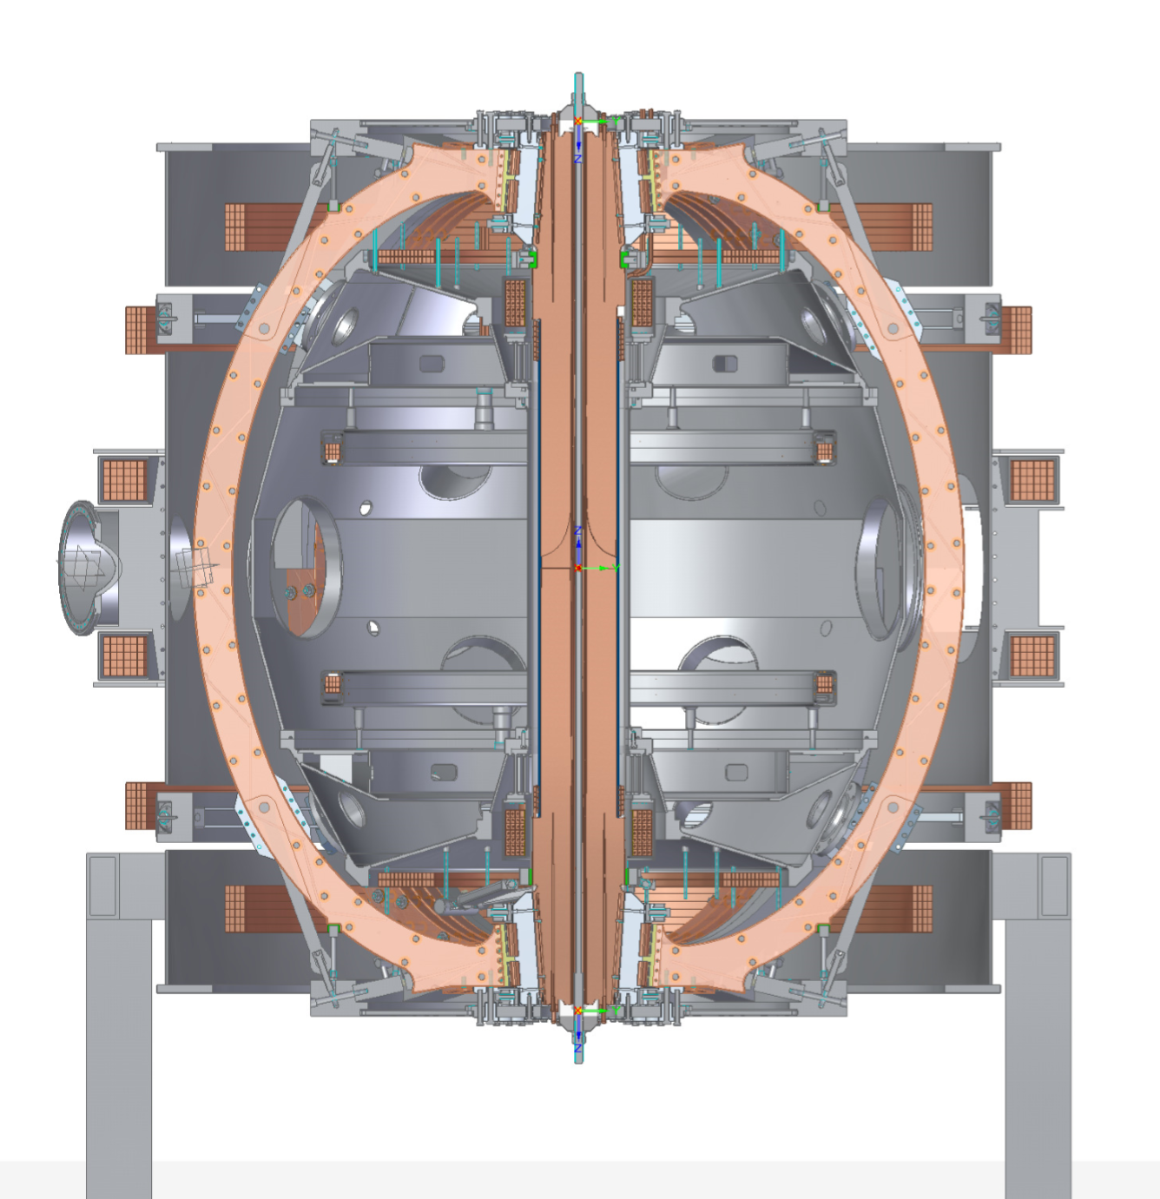
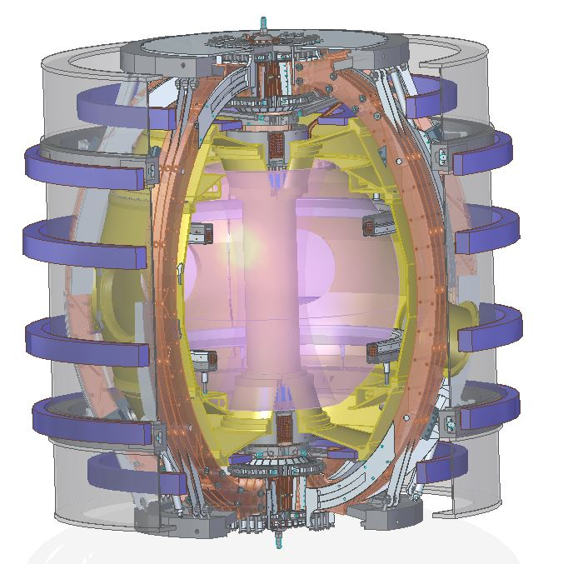
Plasma formation in ST40
ST40: 3T/2MA, water or LN2 cooled copper magnet; R₀=0.4 - 0.6m, R/a = 1.6-1.8, k~2.5, DND, NBI and EBW/ECRH/RF heating at Phase II
ST40 has, like START&MAST, in-vessel merging-compression coils and only small solenoid

Slide 3
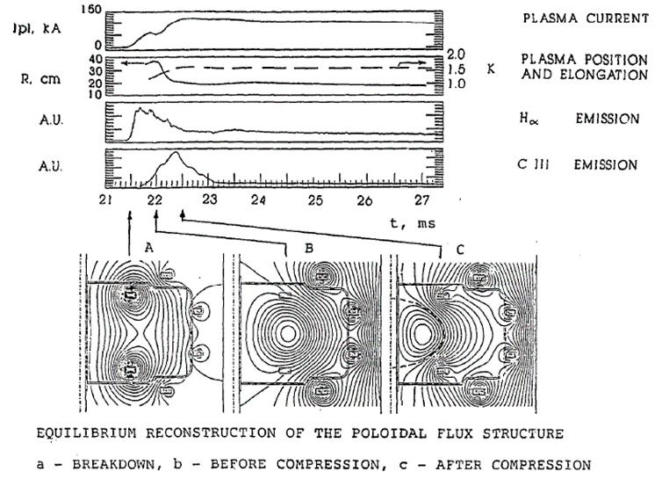
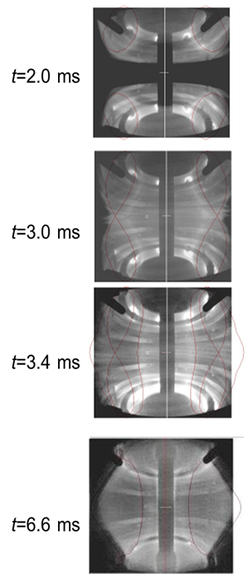
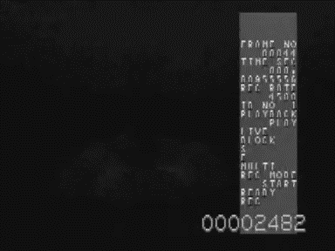
Merging-compression plasma formation
First used on START, at Culham, in 1991. Successfully applied on MAST to achieve first plasma in 1998. Recently studied in detail on MAST, UTST etc.
START
3 stages:
- plasma around coils
- merging (reconnection)
- compression
MAST
Plasma currents 200-500kA without CS assistance

Slide 4
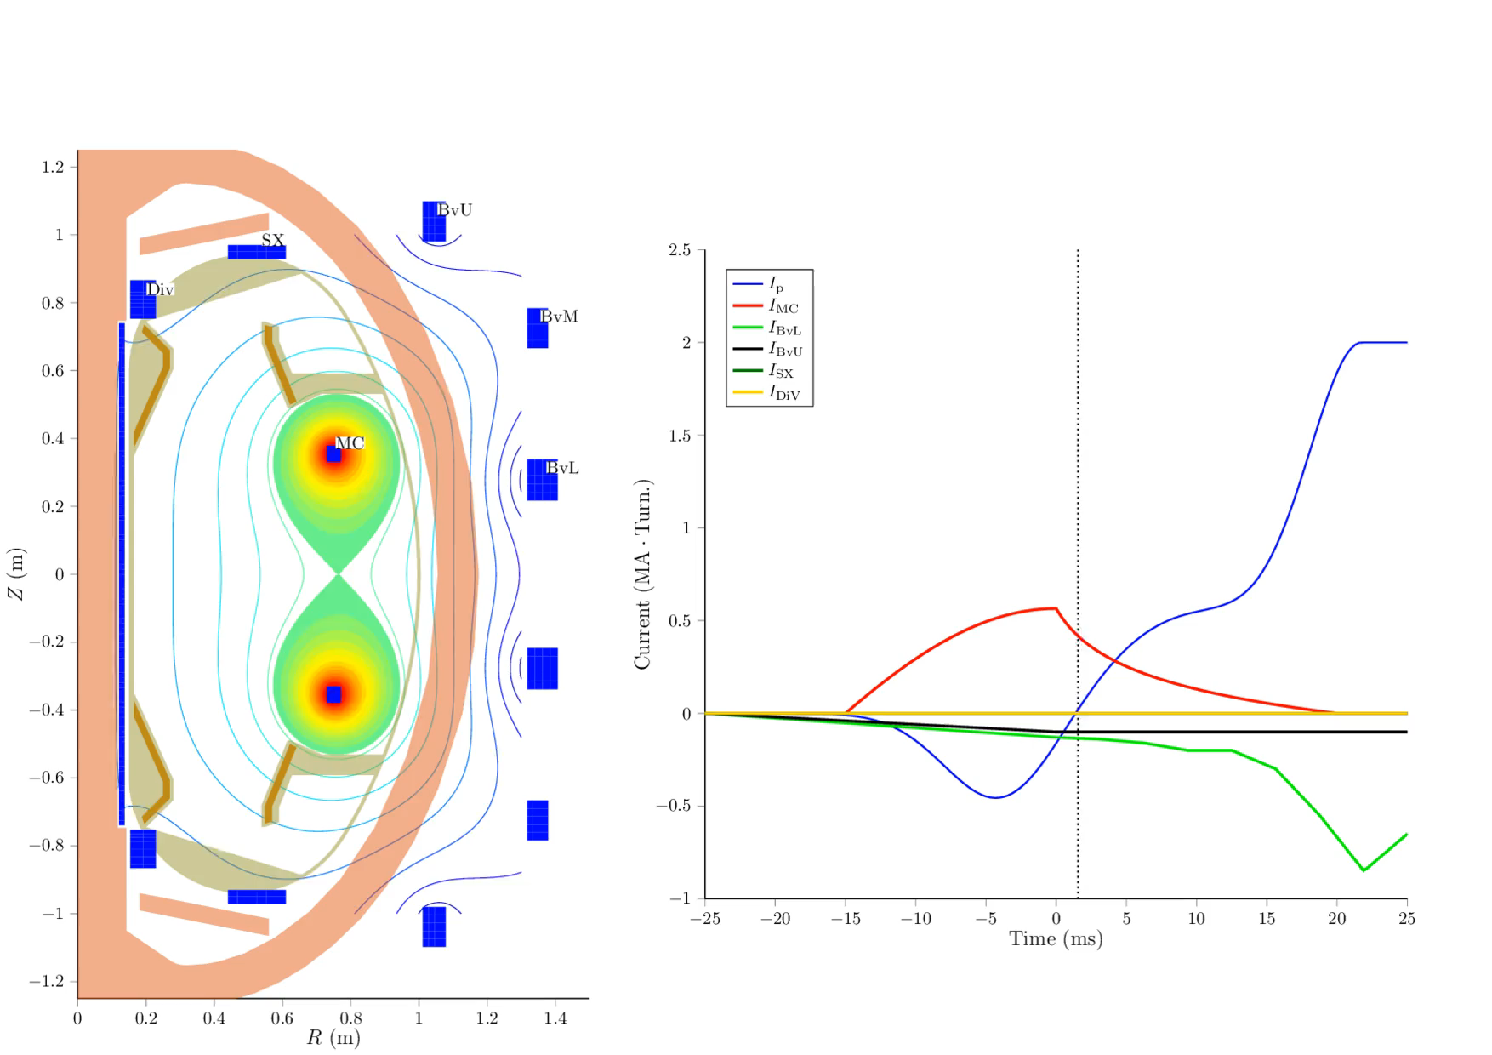
Merging-compression in ST40
First stage – merging and compression

Slide 5
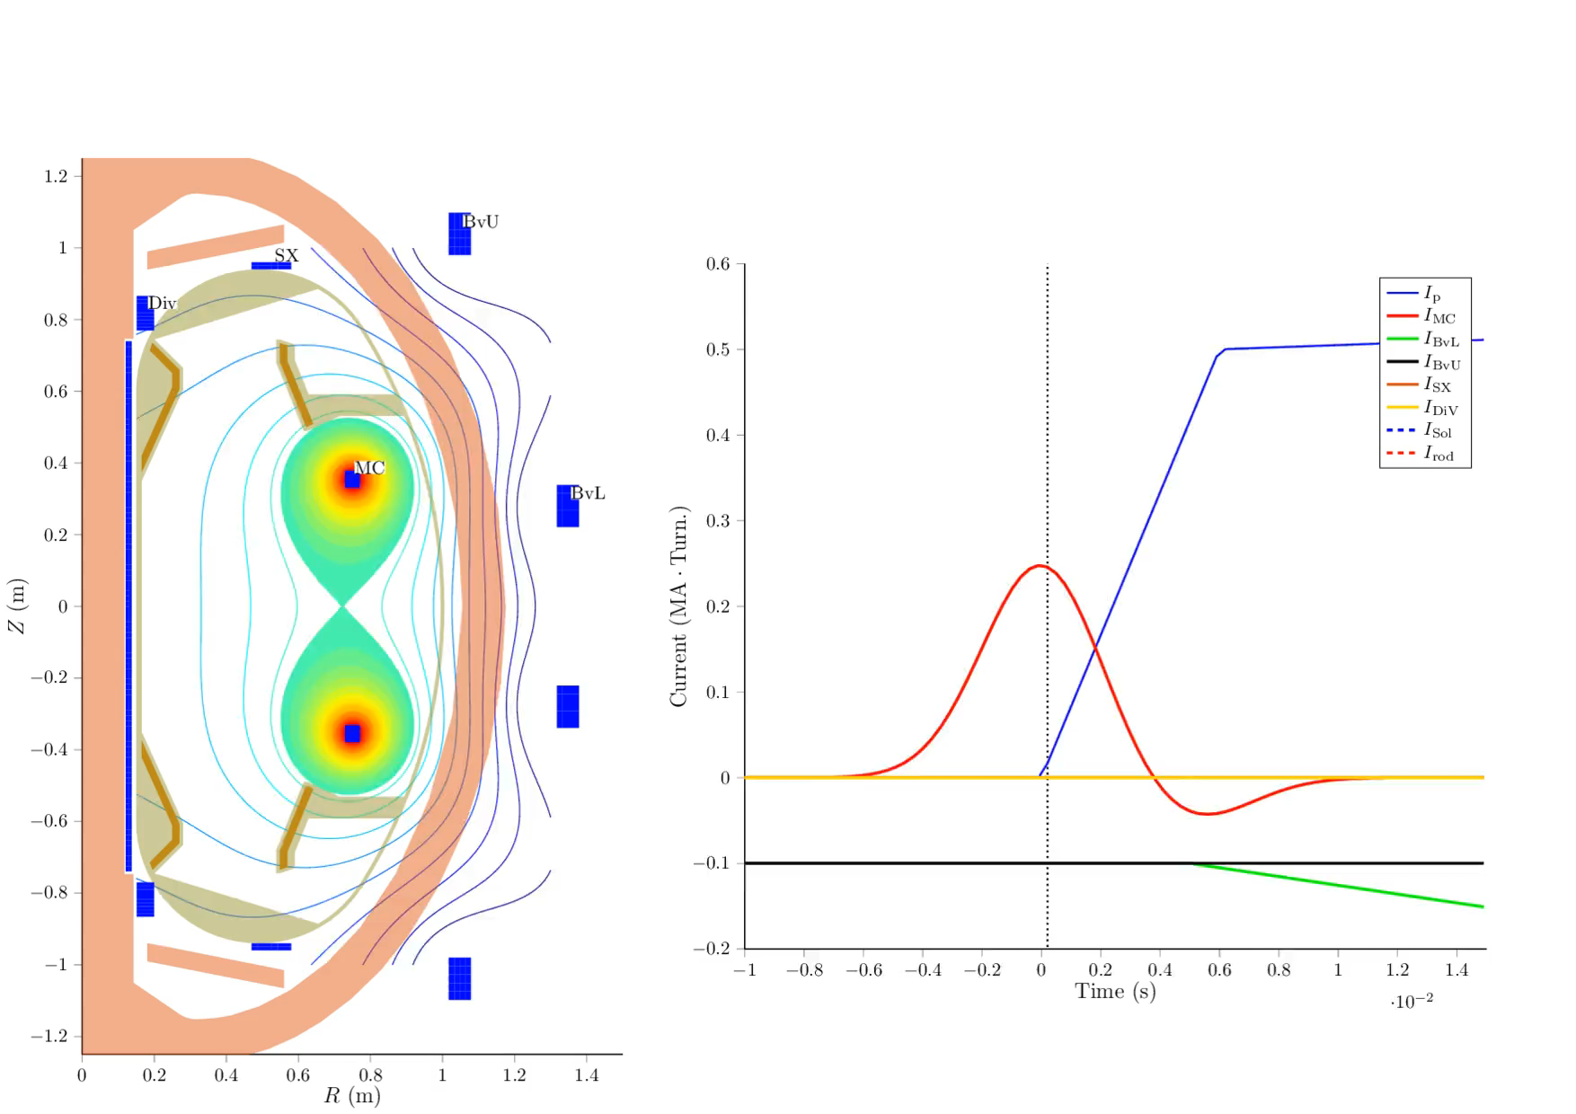
Merging-compression in ST40
Second stage – DND formation

Slide 6
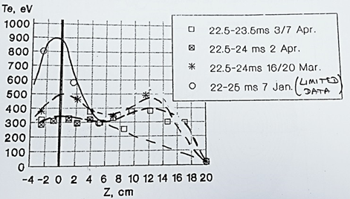
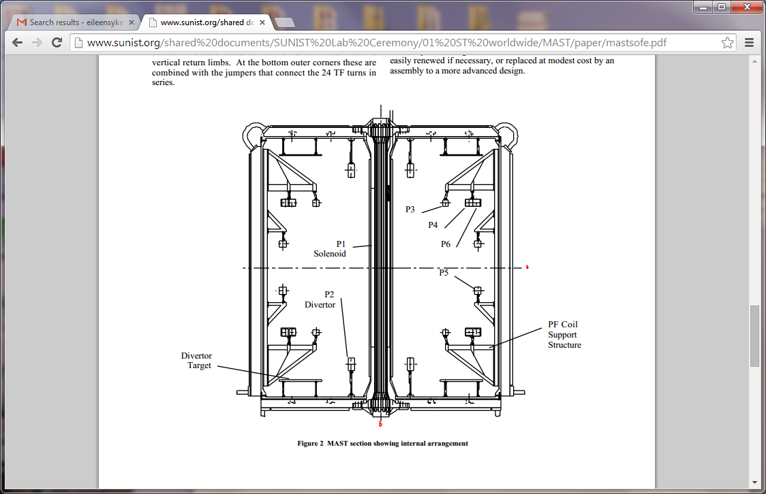
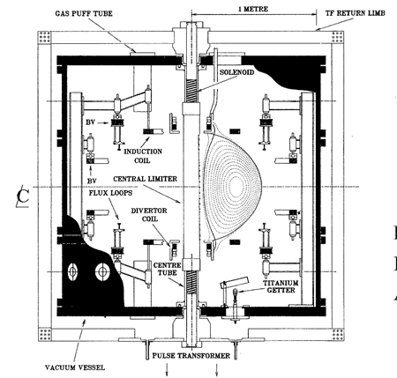
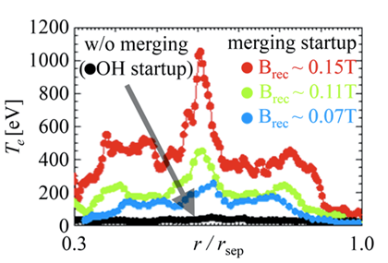



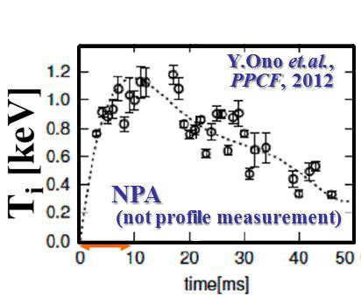
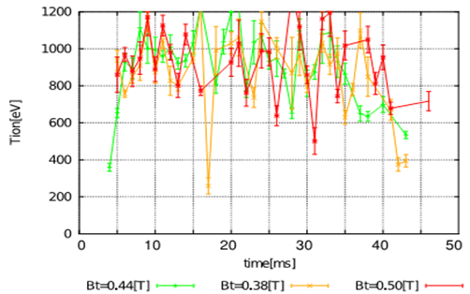
Merging-compression plasma formation
M/c on START, ST40 and MAST, same scale. ST40 plasma footprint shown in blue in all pictures:
START, SiLi data
MAST, TS data
START
ST40
MAST
START and ST40 are similar in geometry
ST40 has more compression
MAST, NPA data
START and MAST demonstrated 1keV temperatures

Slide 7
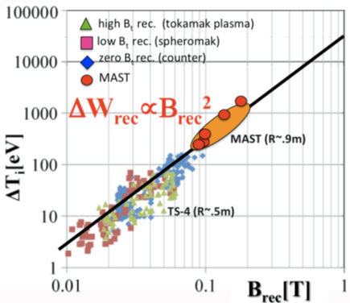
Merging-compression plasma formation
ST40 Phase 1 (2016) objective:
  - Demonstration of merging/compression plasma formation and achievement of high performance already during formation phase
Why this may be exciting:
Ignition conditions, ST40 ops range @3T
Reconnection theory has been developed in astrophysics in 60-70th
According to theory that predicts heating due to reconnection ~ B², and experimental data from START, MAST and Japanese devices, plasma in ST40 should show ignition parameters (nTτ) with temperatures ~10 keV
Reconnection scaling predicts 10keV in ST40

Slide 8
Predictions based on START and MAST data
M/C performance:
Plasma energy increases ~ (R_{P3} I_{P3})²
ST40: R_{P3}=0.75m, I_{P3}=600kAt,
I_{pl} ~ 750 kA before compression
ST40
ST40
W ~ 20kJ – without compression, as on MAST, so ~ 40kJ in ST40 with compression
Plasma current increases linearly with I_{P3}
MAST
ST40
I_{pl}~ 1MA before compression
Difference in W_{e} and W_{tot} could be partly attributed to ion heating
Plasma current increases with TF
Results from START and MAST are encouraging

Slide 9
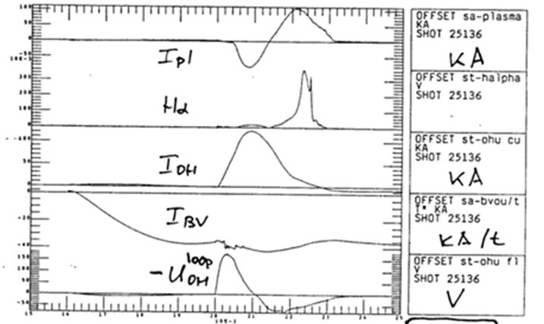
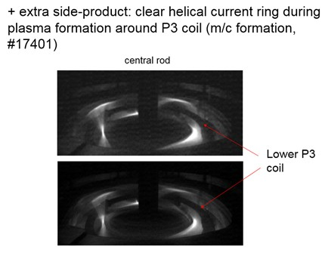
Stage One: plasma rings around P3 coils
Two plasma rings are formed around in-vessel (P3) coils when current in these coils rapidly changes. Duration of this stage – from few to tens of ms.
Plasma rings merge when current in P3 coils decreases.
Plasma in these rings is more like “levetron” plasma, equilibrium is supported by combination of TF and P3 current. Applied vertical field plays little role!
positive I_{pl}, merging
negative I_{pl}, no merging
I_{P3}
P3 coil
Indeed, plasma around coils has clear 3D structure (MAST)
START: applied BV does not affect plasma current in rings
Magnetic energy of two rings converts into kinetic during reconnection, so high initial current is needed

Slide 10
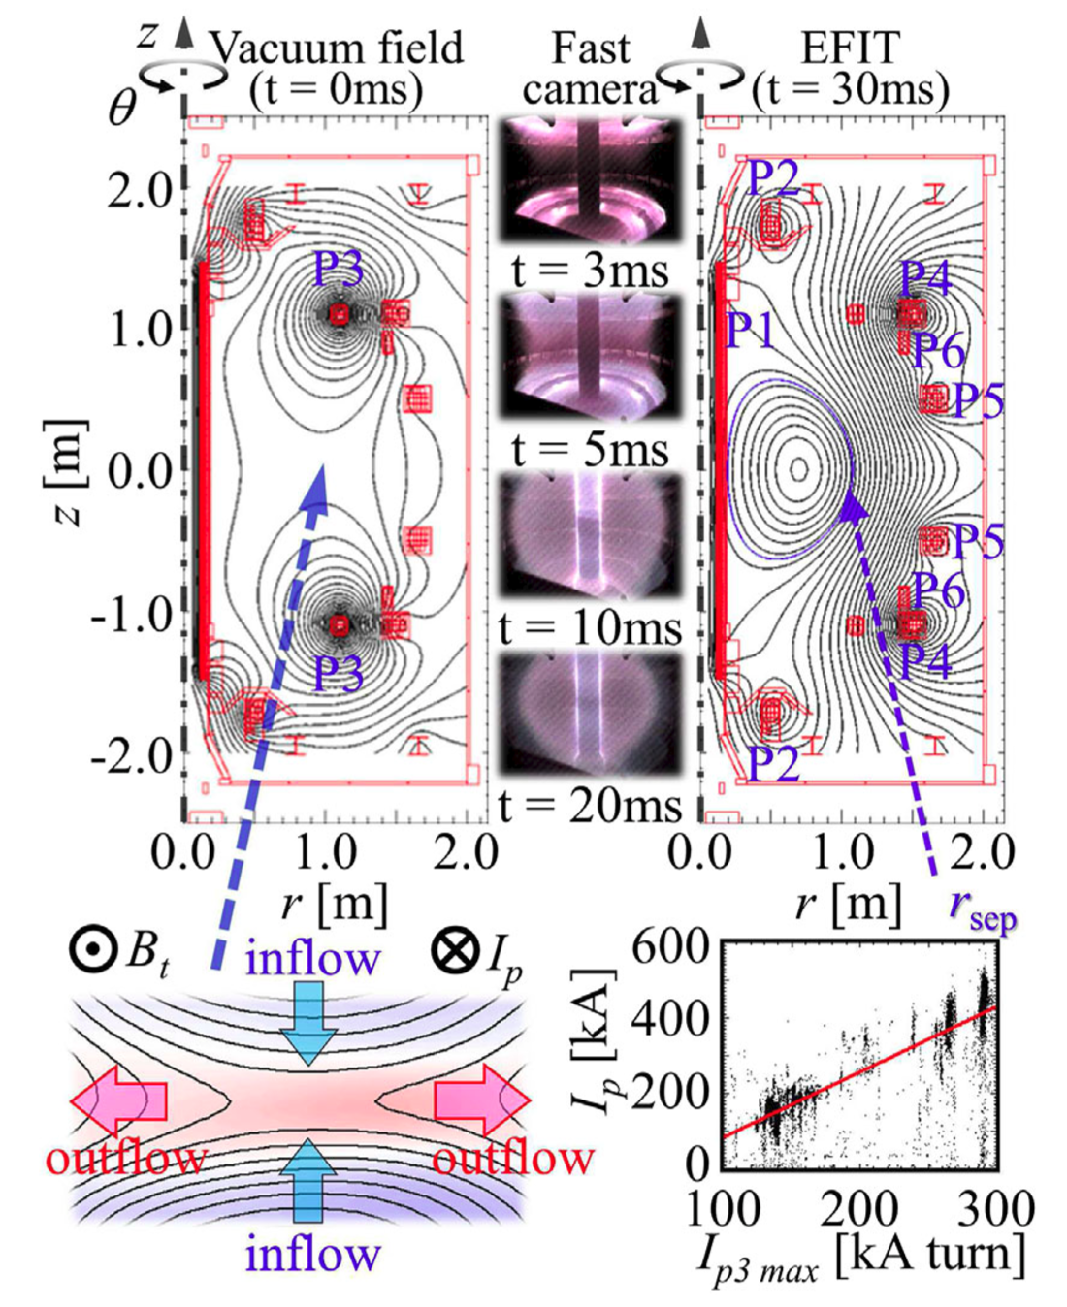
Stage Two: merging
Magnetic energy of two plasma rings is converted via magnetic reconnection, when plasma rings merge, into kinetic energy of the final single torus plasma.
Theory predicts that up to 90% of the poloidal magnetic energy can be converted into kinetic energy, mainly going into ions.
Magnetic energy released by reconnection (8-15MW estimated on MAST) may both heat the plasma and drive plasma flows – the latter may also dissipate to provide further heating (slow shock model).
Current sheet formed at X-point provides anomalously high electron heating. 2D detailed TS measurements on MAST confirm formation of the current sheet.
Tanabe et al, PRL November 2015
Efficient heating of ions and electrons

Slide 11
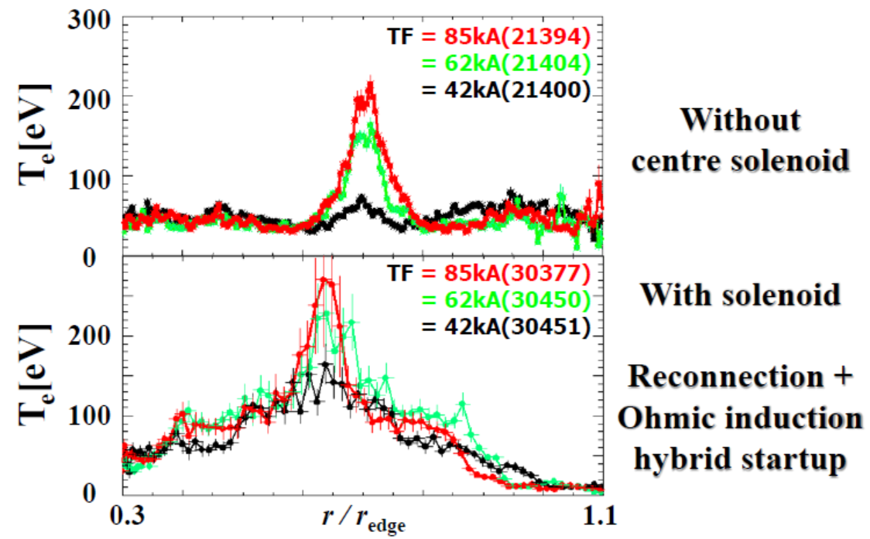
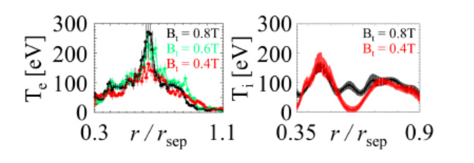
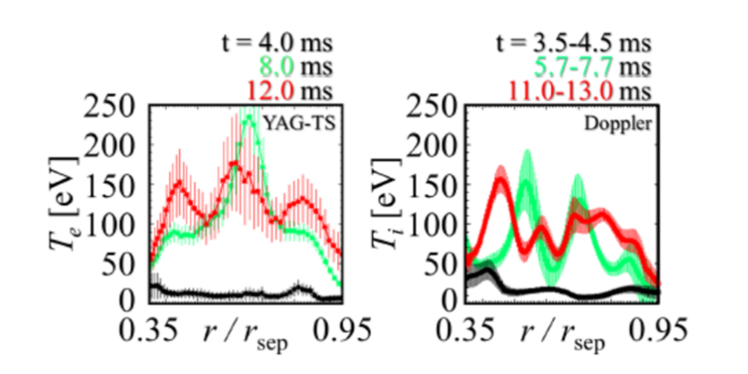
Stage Two: heating due to merging
Electron heating inside current sheet hot spot is enhanced with TF on MAST
Adding loop voltage from central solenoid helps to form “shoulders” outside hot spot
However, ions heating from reconnection does not depend on TF (as predicted)
Evolution after merging is set by exchange between ions and electrons. This explains “triple-peak” profiles formation. τ^{E}_{ei} ~ 4 – 10 ms
Temperature evolution is very complicated

Slide 12
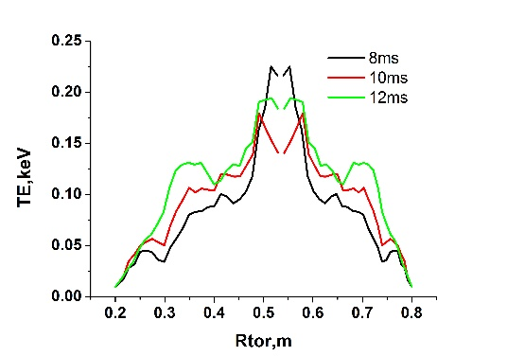
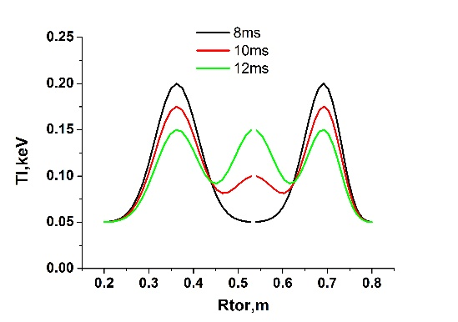
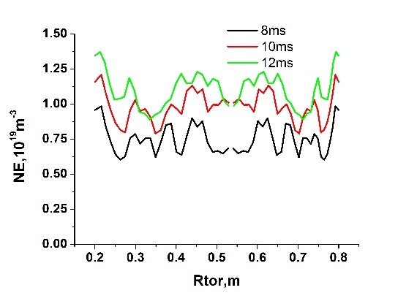
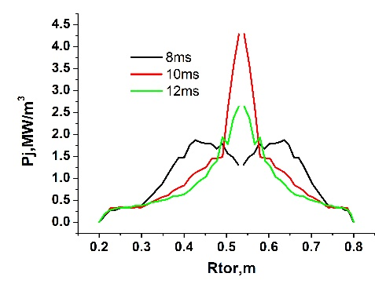
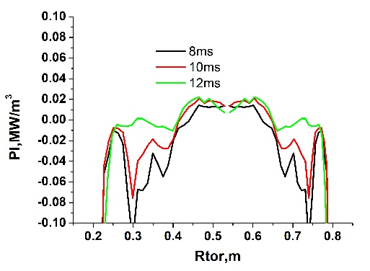
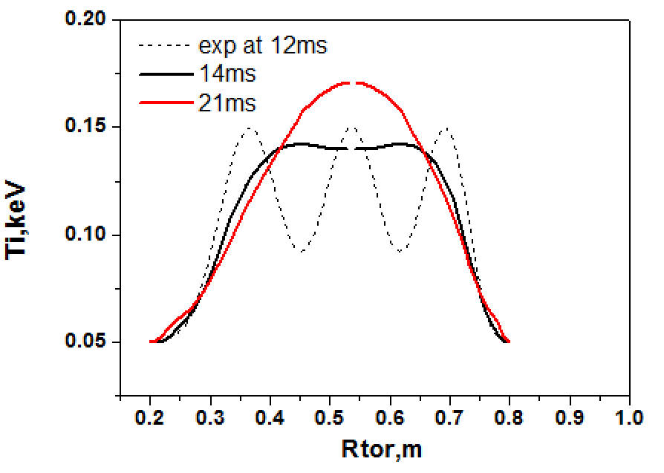
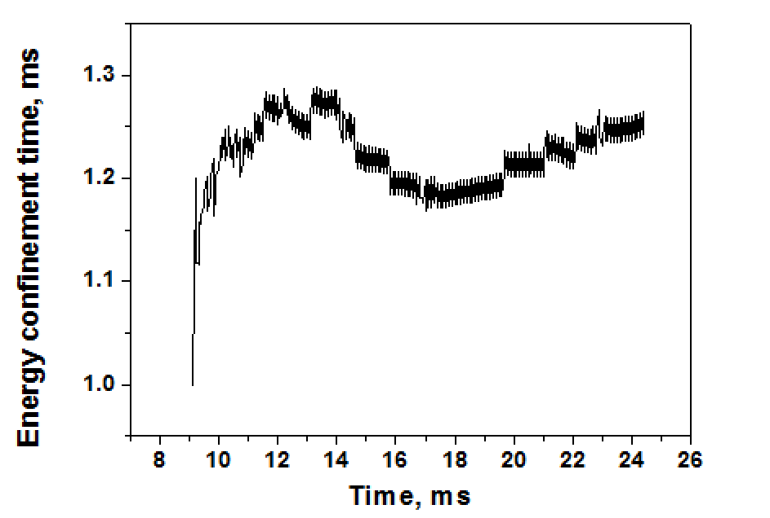
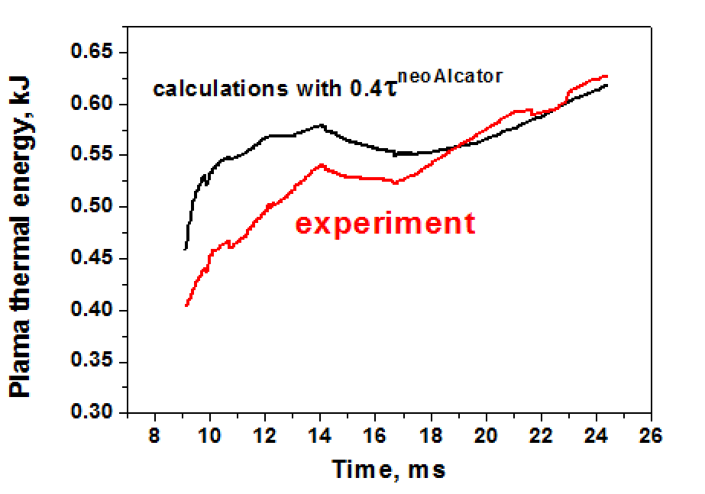
Understanding of post-merging phase
ASTRA modelling of post-merging phase has been performed using experimental data from MAST ##21374-21380 & ##30367-30380
MAST experiment: transport model adjusted to fit experimental profiles
ASTRA modelling: electron heating, ion heating, T_{i} evolution
Confinement did not degraded during post-merging evolution (experiment)
Neo-Alcator scaling is in good agreement with experiment, so can be used for predictions of ST40 m/c
MAST experiment
Model validation
3-peak profiles naturally evolve to “normal plasma”

Slide 13
Stage Three: compression
Adiabatic compression along major radius has been investigated in detail on ATC, TUMAN-3, TFTR, T-13.
Confinement time, calculated using ASTRA validated on well-diagnosed m/c plasmas on MAST, exceeds 10ms, so compression may be not too fast.
Detailed studies of compression on START show doubling of the plasma current when major radius changes from 40cm to 20cm, confirming I_{pl}~1/R rule.
Vertical position control may be an issue during compression (as observed on ATC). However as compression is relatively slow, feedback system should provide an efficient position control.
ST40 is aiming at several keV temperatures and MA-level plasma currents to be achieved using merging-compression
Adiabatic compression may double plasma current

Slide 14
CONCLUSIONS
“two merging STs with B=1-3T, n=10²⁰m⁻³ will be transformed into an ST with T»20keV within reconnection time.” Y. Ono, et al,“Direct Access to Burning Spherical Tokamak Experiment by Pulsed High-Power Heating of Magnetic Reconnection”, 20th IAEA Fusion Energy Conference 2004.
“We, Japan-UK merging team are now planning to produce two merging STs with B_{rec} > 0.4 T to heat ions over 5keV (alpha-heating region) without using any additional heating.” Y. Ono et al, PoP 2015.
First plasma in ST40 is expected in 2016

Slide 15
Back-up slides
First plasma in ST40 is expected in 2016

Slide 16
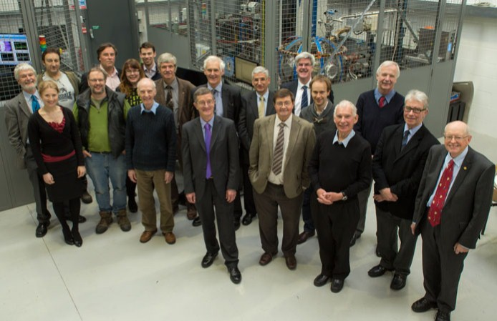
Who are we?
Founded 2009
Tokamak Energy Ltd is a private company funded by private investors, it is based at Culham, UK

Slide 17
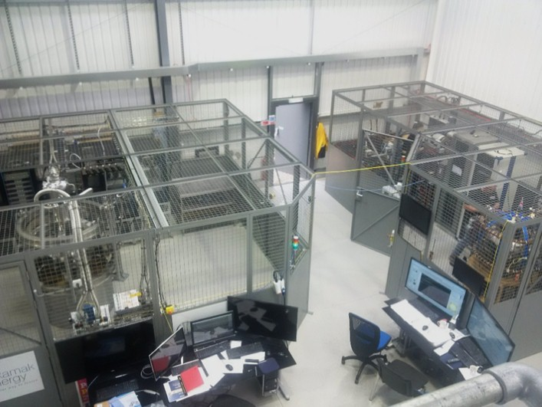
Who are we?
Two small tokamaks are operating at TE Ltd Milton Park site: Cu ST25 and full-HTS ST

Slide 18
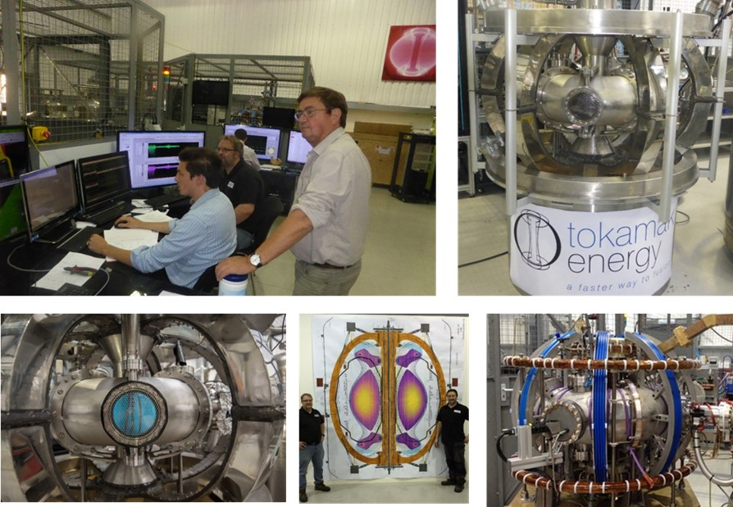
Tokamak Energy Tokamak Engineering Centre
Two small tokamaks are operating at TE Milton Park site, third tokamak under construction, 3T/2MA ST40

Slide 19
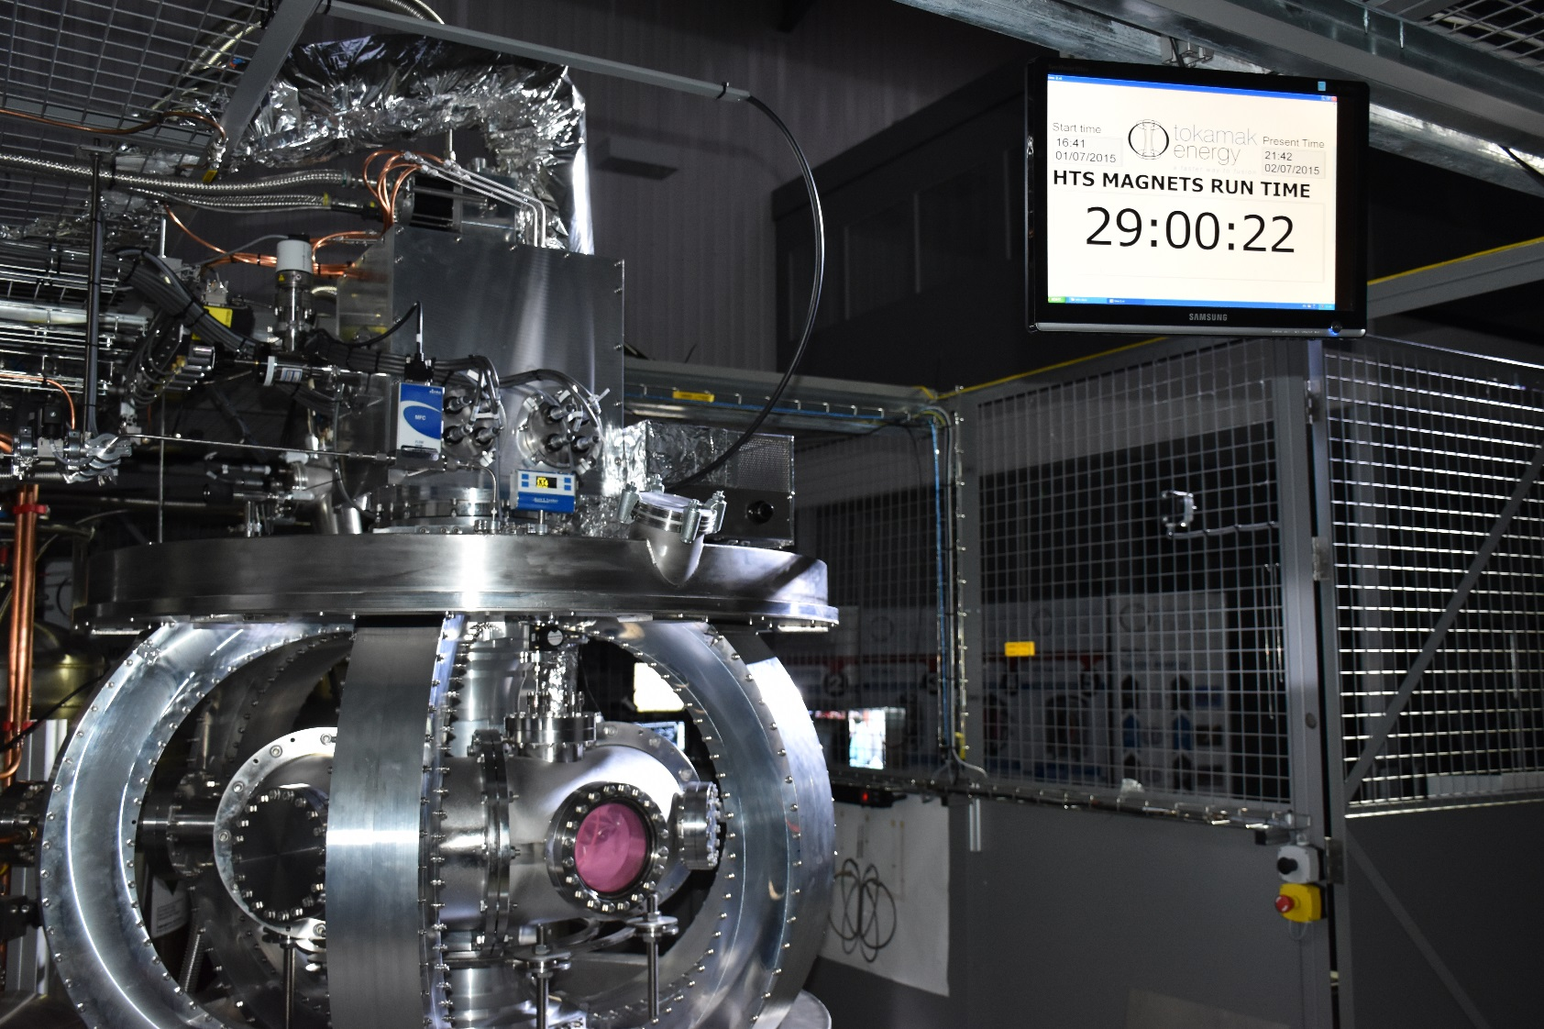
ST25(HTS): world’s first all-HTS tokamak
Summer 2015, 29h RF discharge, now with cool head.

Slide 20
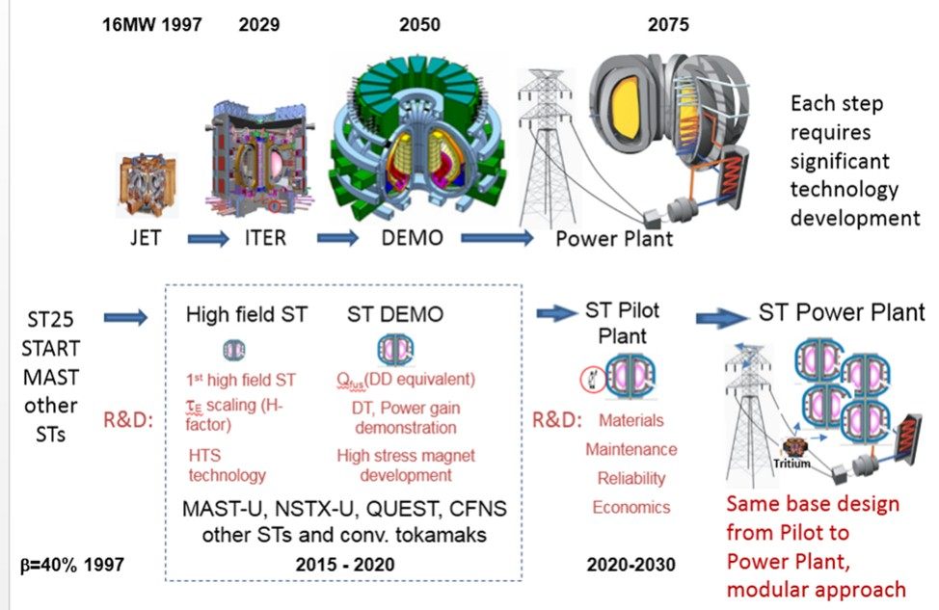
What is our goal? TE Path to Fusion
Our goal is demonstration of electricity production in a fusion reactor based on high field ST

Slide 21
TE Path to Fusion, why compact high field ST?
“Apparently the high beta potential of the ST is so great that the physics of this device will not determine its size”.
Ron Stambaugh, “THE SPHERICAL TOKAMAK PATH TO FUSION POWER”, FUSION TECHNOLOGY VOL. 33 JAN. 1998
See also A Costley et al, “ On the power and size of tokamak pilot plants and reactors”, Nuclear Fusion 55 (2015) 033001
High field ST reactor path has been proposed in 90th

Slide 22
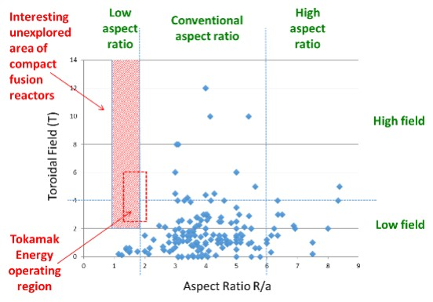
Why we are building ST40?
High field in ST is a real challenge! That is why we need to build it.

Slide 23
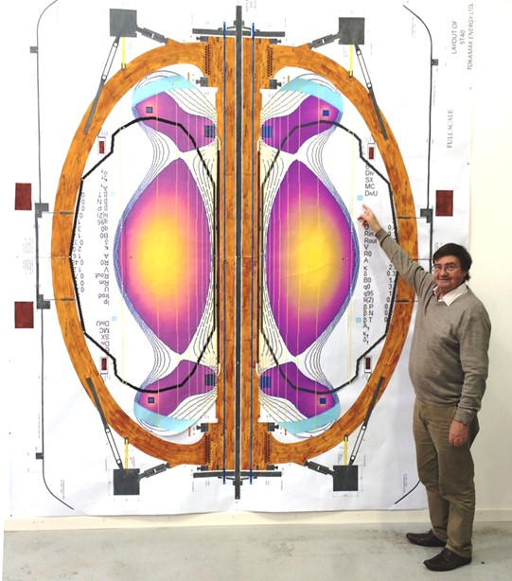
ST40 project
Main features:
High toroidal field up to 3T, water or LN2 cooled copper magnet
Plasma major radius 0.4 -0.6m, R/a = 1.6-1.8
Moderate elongation (κ~2.5) and triangularity (δ~0.3), DND
Plasma current up to 2MA, merging/compression plasma formation
NBI and EBW/ECRH heating
Possibility of DT ops
To be constructed in 2016 at Milton Park TE Ltd site

