Slide 1



M. Inomoto, K. Yamasaki, T. Ushiki, X. Guo, N. Kawakami,
T. Sugawara, K. Matsuyama, A. Sato, K. Noma, Y. Fukai,
H. Yamanaka, R. Tamura, A. Kuwahata, H. Tanabe, Y. Ono,
T.I. Tsujimura¹, S. Kamio¹, T. Yamada²
18th International ST Workshop
Center-Solenoid-Free Merging Startup of STs by Outer PF Coils in UTST
*Results appear in Inomoto, et al., NF 2015
The University of Tokyo, ¹NIFS, ²Kyushu University
Supported by JSPS A3 Foresight Program “Innovative Tokamak Plasma Startup and Current Drive in Spherical Torus” and Grants-in-Aids for Scientific Research 15H05750, 15K14279, 26287143, 25820434.

Slide 2
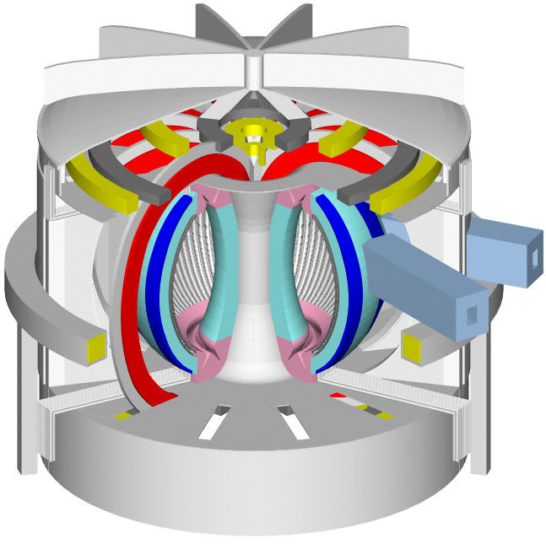
Motivation
For future ST reactor, the Center-Solenoid (CS) coil, which is the most powerful method to initiate tokamak discharge, to ramp-up plasma current, to provide initial heating, and to sustain for a long period, should be removed, or at least downsized.
Alternatives:
  Waves
  Helicity Injection
  Outer Poloidal Field (PF) Coils (inductive)
    IN-VESSEL PF Coils (START, MAST. TS-3, TS-4, ST40)
    EX-VESSEL PF Coils (UTST)
VECTOR
ST reactor without CS
(S. Nishio)

Slide 3
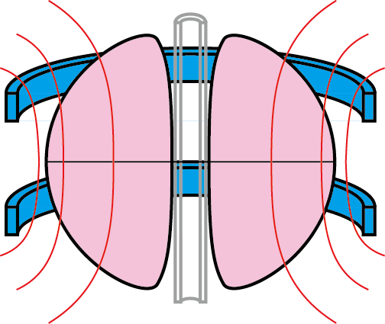
Ex-vessel Outer PF Coil :
Advantages and disadvantages
〇 Simple breakdown mechanism similar to Ohmic discharge.
〇 No occupation in center stack or first wall surface.
× Lower flux efficiency than CS/In-vessel PF coils.
× Short pulse length: incapable of sustaining plasma current.
◎ Favorable if they unite with existing equilibrium coils or MHD control coils!
Electric field is supplied by the change of magnetic flux INSIDE the vacuum vessel
× Difficult to achieve high electron temperature or density only by Ex-vessel Outer-PF-Coil.
Need to be combined with other heating / fueling method. In UTST, merging technique is employed.

Slide 4
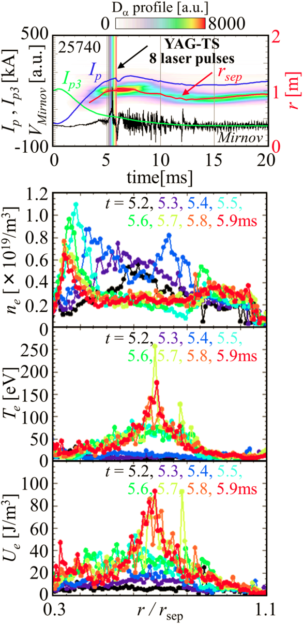
ST merging method
Tanabe, et al., PRL 2015
Downstream ion heating during merging has been intensively investigated in TS-3 and TS-4 experiments (Ono, this workshop).
Recent merging experiment in MAST showed electron heating at X point and density increase in downstream (Tanabe, this workshop).
Several keVs of reconnection heating is expected in the coming ST40 and TS-U devices (Gryaznevich, Ono, this workshop) .
From the scaling, merging of two STs with total current of 200 kA possibly provides good target plasma for NB H/CD in UTST.

Slide 5
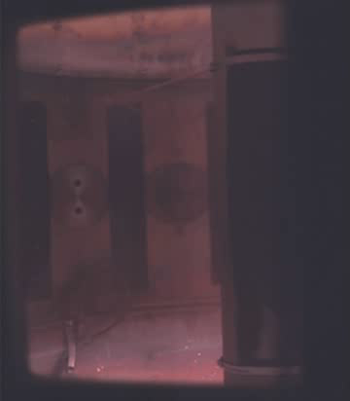
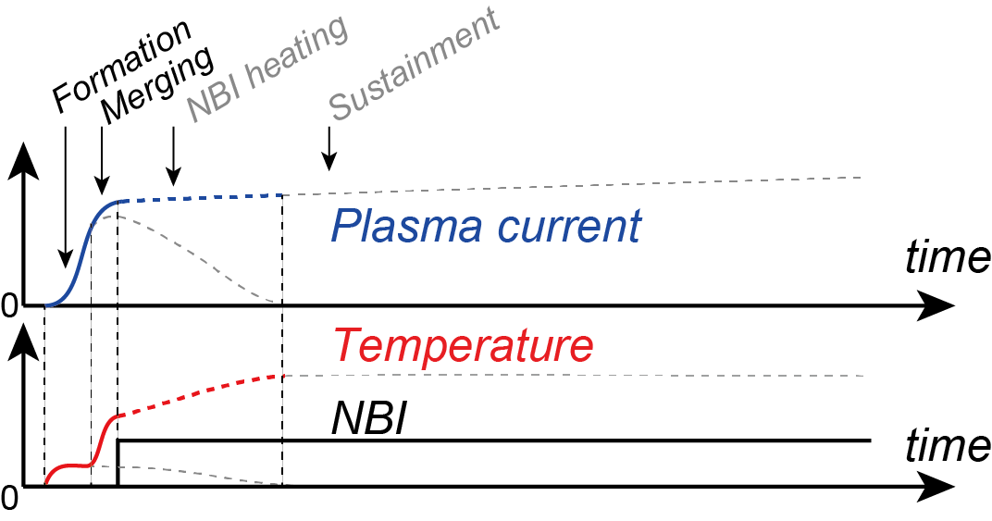
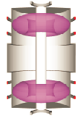
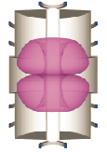
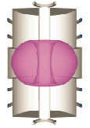
Goal of UTST research
Demonstrate dynamic formation of target plasma for NBI by Outer-PF-coil and merging startup,
NBCD/BS
reconnection
Vis. emission during merging in UTST (400kfps)
NBI

Slide 6
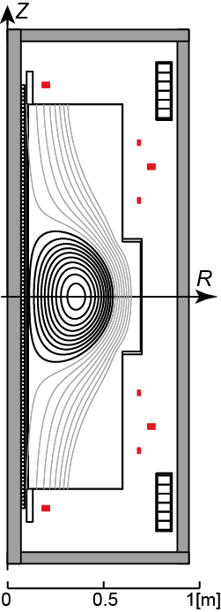
UTST specifications
UTST is operational since 2007 with continuous upgrade.
Highly elongated vacuum vessel provides room to form two initial STs separately in the top and bottom sections.
UTST Outer-PF-Coil and Merging startup
R ~ 0.35 m
a ~ 0.24 m
A ~ 1.5
B_{t0} < 0.25T
I_{p} 200 kA (planned) / < 80 kA (achieved)
n_{e, max} > 1e20 m⁻³ (planned, achieved for a short time)
Main diagnostics : YAG TS, visible light spectroscopy, Internal pickup coils

Slide 7
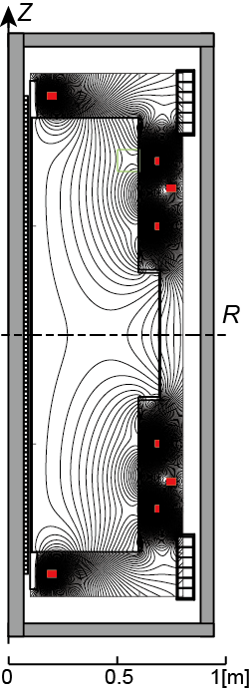
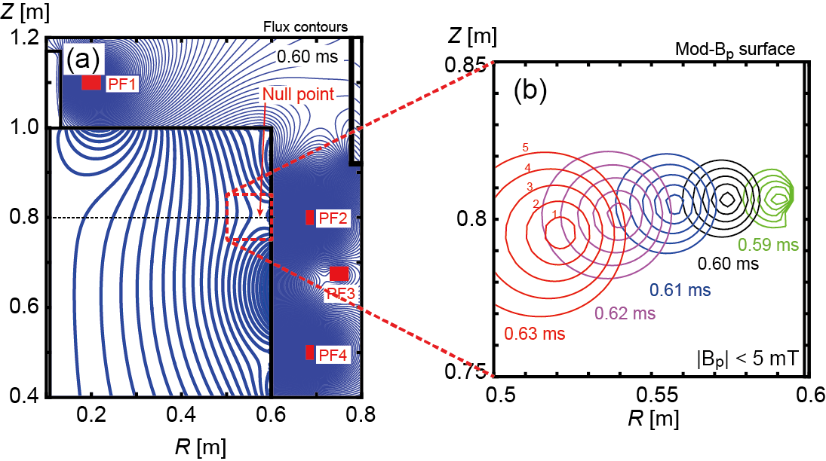
Outer-PF-Coil Startup
How to form null points?
Null points are formed by combination of PF coil and eddy currents, leading to avalanche of ionization and effective current drive during ST start-up phase.
Null point is not steady but changes its location and shape in tens of microsecs.
Null point formed outboard side
FEM calculation of eddy current
Weak- B_{p} region of |B_{p}| < 5mT satisfies the Lloyd’s criteria of E_{t} B_{t} /B_{p} > 1kV/m (E_{t} ~ 40 V/m and B_{t ,null} ~ 0.14 T in UTST).

Slide 8
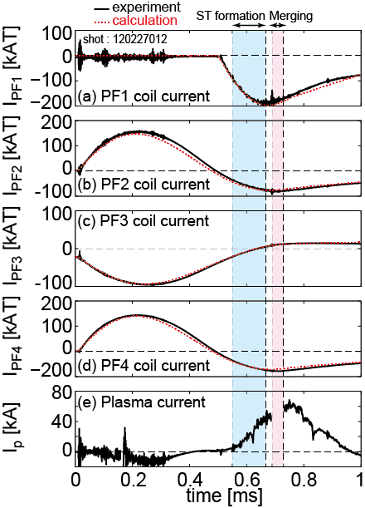
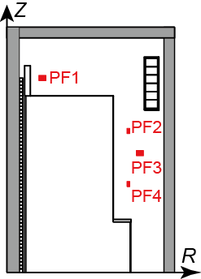
Outer-PF-Coil Startup
Typical waveform of outer-PF start-up
UTST CS-free discharge scheme
  1. Slow TF current and slow PF3 bias current are applied and then the gas is preionized (not shown).
  2. Two pairs of PF coils (PF2 and 4) are energized by capacitor banks to drive oscillating currents with peak current of ~150 kAT and period of ~1 ms. Plasma discharge is initiated in the ramp-down phase of the PF coil currents.
  3. Finally, PF1 coils are energized to push the formed two STs towards the center of the device.

Slide 9
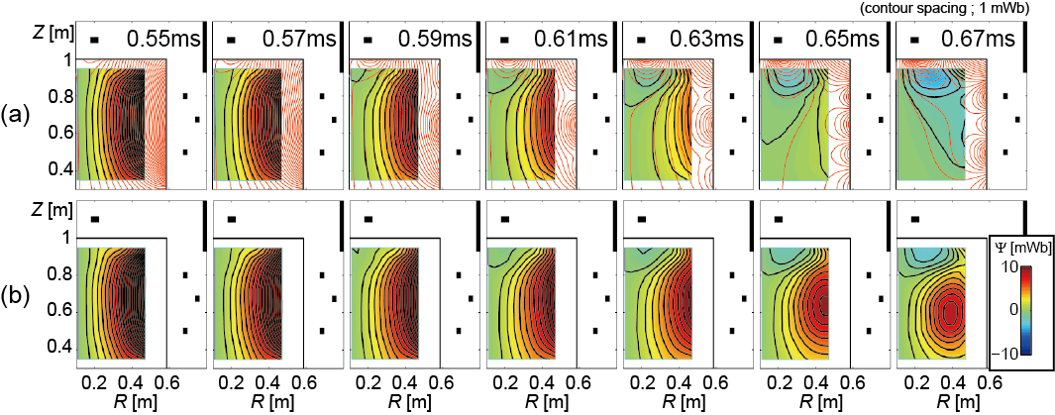
Outer-PF-Coil Startup
Magnetic field during breakdown
Direct measurement by internal probe array
Vacuum
Plasma
Deformation of the flux surfaces from the vacuum case, i.e., initiation of the plasma current
Finally a tokamak plasma with closed flux surface is formed. Since this initial tokamak has larger major radius and smaller minor radius than the final one, its aspect ratio is about 2.

Slide 10
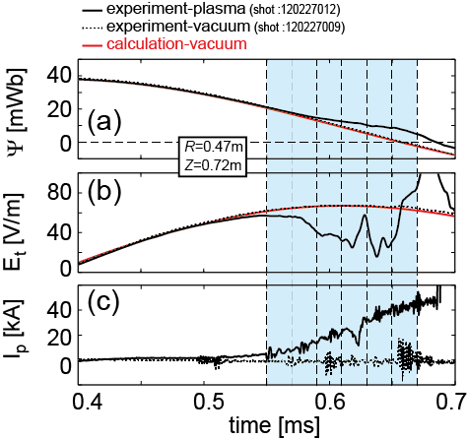
Outer-PF-Coil Startup
Breakdown details
The flux waveform in the plasma discharge case began to diverge from the vacuum case at 0.59ms
→ effective current drive took place just after the null point formation.
Though small reduction of the electric field, i.e. generation of weakly-ionized plasma, was initiated at much earlier timing of 0.5ms when the electric field exceeded ~ 40 V/m, sharp decrease of electric field was also observed near the null point formation timing (0.58 ms).
0.59ms
0.5ms
0.58ms
Formation of null point could drastically extend the electron connection length, leading to avalanche of ionization and final breakdown.

Slide 11
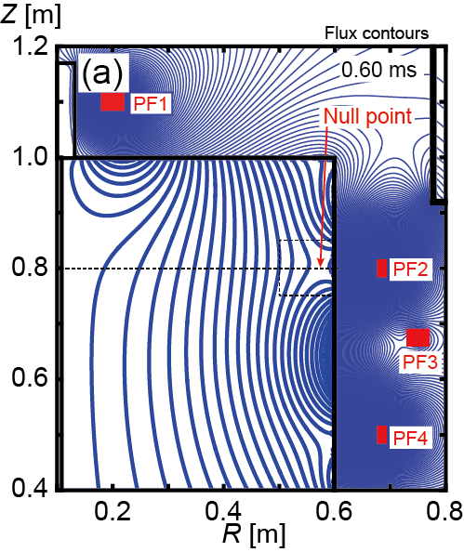
Outer-PF-Coil Startup
Flux utilization efficiency
Total flux induced by outer PF coils
~ 550 mWb
Maximal flux induced inside the vessel
~ 56 mWb (~ 10% efficiency)
Note : if there were no conducting vessel wall, efficiency due to coil geometry increased to 35 %.
16mWb
550mWb
56mWb
Maximal flux induced at the null point
~16 mWb (~ 30% efficiency)
UTST eddy current calculation
Total 3% of the flux utilization efficiency is awfully lower than that of CS coil.
Thin vacuum vessel still prevent outer-coil-flux to penetrate. Longer pulse duration of coil current is required for higher efficiency.

Slide 12
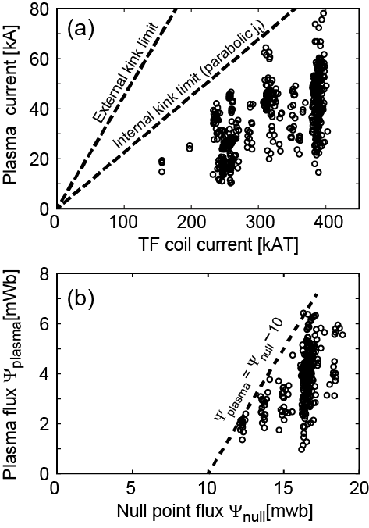
Outer-PF-Coil Startup
UTST discharge conditions
High plasma current (< 80 kA) was achieved in high TF case.
  The achieved plasma current was close to the internal kink limit because of the weak TF at the null point near the outer wall.
The maximal poloidal magnetic flux contained in an initial ST was about 6 mWb, while the induced flux at the null point reached 16 mWb.
  About 10 mWb of vacuum flux was consumed during breakdown and closed flux surface formation.

Slide 13
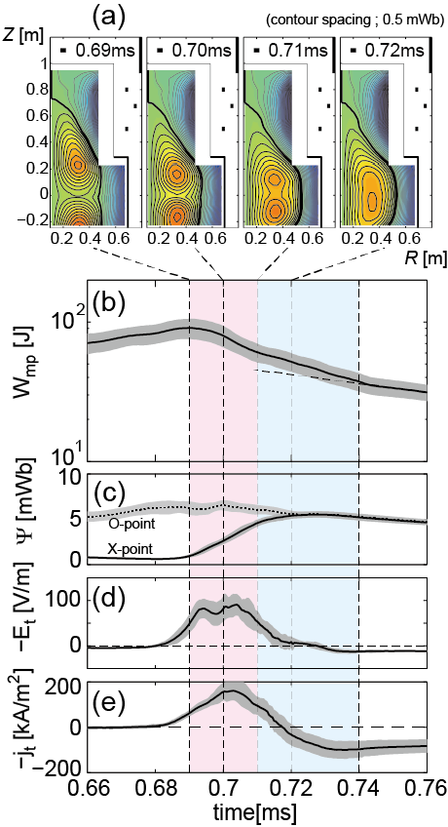
Merging
Well-controlled ST Merging established
All poloidal fluxes contained in the initial STs were reconnected within 30 μs.
Abrupt decay of the poloidal magnetic energy was observed in the initial 20 μs of the merging period. Then, intermediate decay phase lasted about 30 μs.
Finally the ST plasma reached a quasi-stationary state with smaller, but finite, decay rate because no additional heating power input was provided after the formation and merging phase.
Considering this residual power loss, about 30 J from the initial poloidal magnetic energy of 100 J was consumed during merging.

Slide 14
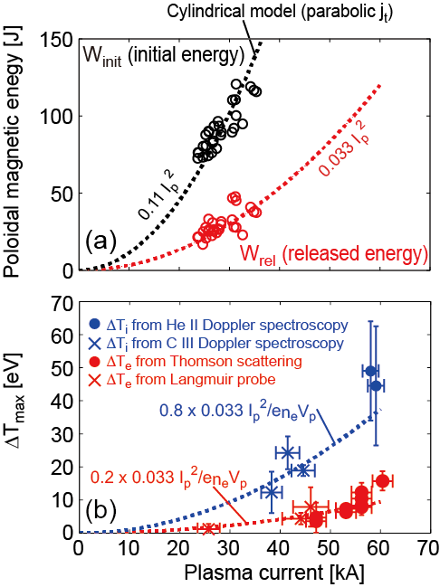
Merging
Merging heating scaling
Initial magnetic energy was proportional to I_{p}² as expected from a simple model.
30 % of the initial magnetic energy was constantly released during merging.
Maximal ΔT_{i} was comparable to the volume-averaged temperature increase estimated from 80 % of the released energy, and maximal ΔT_{e} comparable to that given by 20 % of the released energy.
From this scaling, merging of STs with total current of 200 kA is predicted to provide enough electron heating.

Slide 15
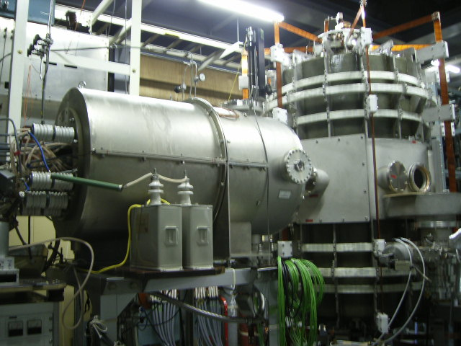
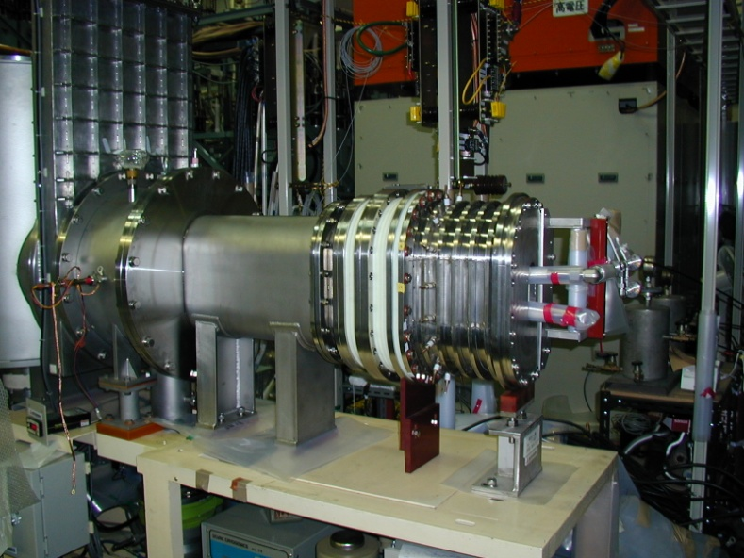
Summary & Future Plans
Center-solenoid-free merging start-up of ST plasmas was successfully demonstrated in UTST plasma merging device by using outer PF coils, but still in low current regime (< 80 kA).
Improvement of formation process required for larger plasma current (> 200 kA) and reconnection heating power (>100 eV).
CT injection for additional (backup) fueling
NBI #1 application and #2 installation
CT injector from Nihon U.
(Shibata, Edo, Asai)
25keV/0.5MW
25keV/1MW

Slide 16
Thanks for your kind attention

Slide 17
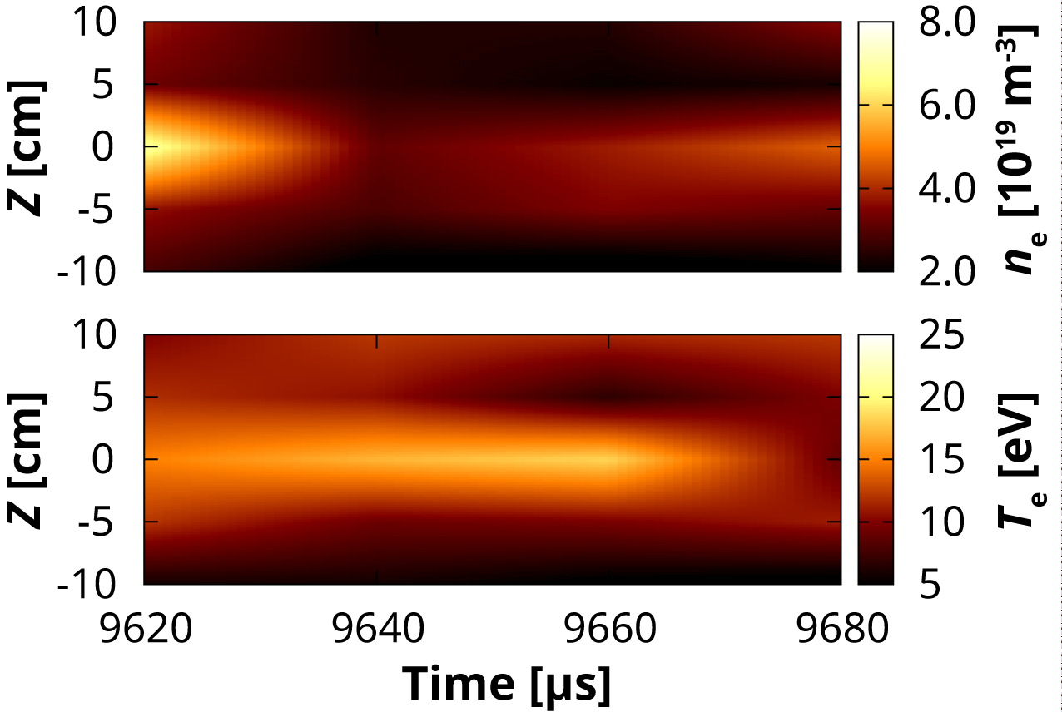
n_{e}/T_{e} evolutions after merging
T. Sugawara

Slide 18
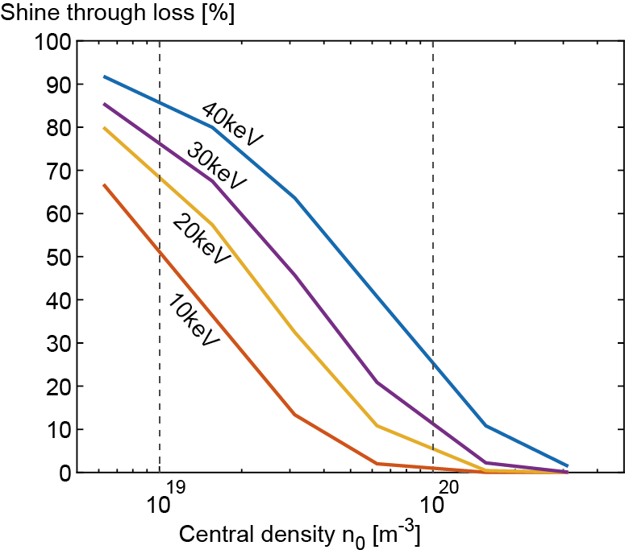
Required parameters for NBI
Tangential injection of 20keV H⁰ beam on UTST midplane (R=35cm) requires peak density of n₀~1x10²⁰ m⁻³ for sufficient ionization.
UTST equilibrium with I_{p}~200 kA well confines co-injected 25keV hydrogen beam.
Electron temperature T_{e}>100 eV is necessary for sustainment with 1MW NBI.

Slide 19
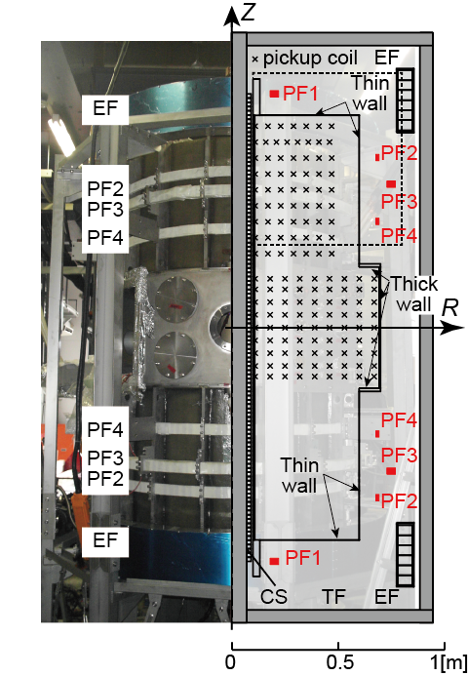
UTST specs
Coils | Z [m] | R [m] | N
PF1 | ±1.1 | 0.2 | 8
PF2 | ±0.8 | 0.685 | 3
PF3 | ±0.675 | 0.75 | 8
PF4 | ±0.5 | 0.685 | 3
EF | ±1.05 | 0.815 | 200
CS | −1.1<Z<1.1 | 0.0835 | 110×4
TF | NA | 1.0 | 16
 | Typ. in UTST
R | ~ 0.35 m
a | ~ 0.24 m
A | ~1.5
B_{t0} | < 0.25 T
 | Diagnostics
B | Pickup coils
dB/dt | Pickup coils (HF)
n_{e} | Thomson scattering / Langmuir probe
T_{e} | Thomson scattering / Langmuir probe
T_{i} | Doppler spectroscopy
emission | SBD, PMT, AXUV
f(v_{e//}) | Energy analyzer
Rating voltage and capacitance | Connection
16 kV / 1.58 mF | Upper PF2 & PF4
16 kV / 1.58 mF | Lower PF2 & PF4
5 kV / 18.8 mF | Upper & Lower PF3
10 kV / 0.85 mF | Upper & Lower PF1
4 kV / 1.2 mF x2 | Washer guns
0.3 kV / 10 F | EF
10 kV / 20 mF | CS
3.3 kV / 100 mF | TF
NBIs | Energy and current
#1 | 25 kV / 20 A
#2 | (25 kV / 40 A)

