Slide 1
Field-Aligned SOL Losses of HHFW Power and RF Rectification in the Divertor of NSTX
R. J. Perkins¹, J. C. Hosea¹, M. A. Jaworski¹, J.-W. Ahn², A Diallo¹, R. E. Bell¹, N. Bertelli¹,
S. Gerhardt¹, T. K. Gray², G. J. Kramer¹, B. P. LeBlanc¹, A. McLean³, C. K. Phillips¹,
M. Podestà¹, L. Roquemore¹, S. Sabbagh⁴, G. Taylor¹ and J. R. Wilson¹
1 Princeton Plasma Physics Laboratory
2 Oak Ridge National Laboratory
3 Lawrence Livermore National Laboratory
4 Columbia University
November 5, 2015

Slide 2
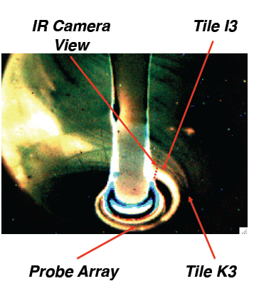
Significant loss of HHFW power to the divertor
along SOL field lines; possibly due to RF rectification
Up to 60% of coupled power is not reaching the core
Hot spirals form on upper & lower divertor during RF
Heat flux up to 2 MW/m² (for 1.8 MW coupled P_{RF})
RF rectification could be converting HHFW power to heat flux
Requires RF fields in divertor region
Could be general to ICRF systems
Divertor diagnostics respond strongly to RF when under spiral

Slide 3
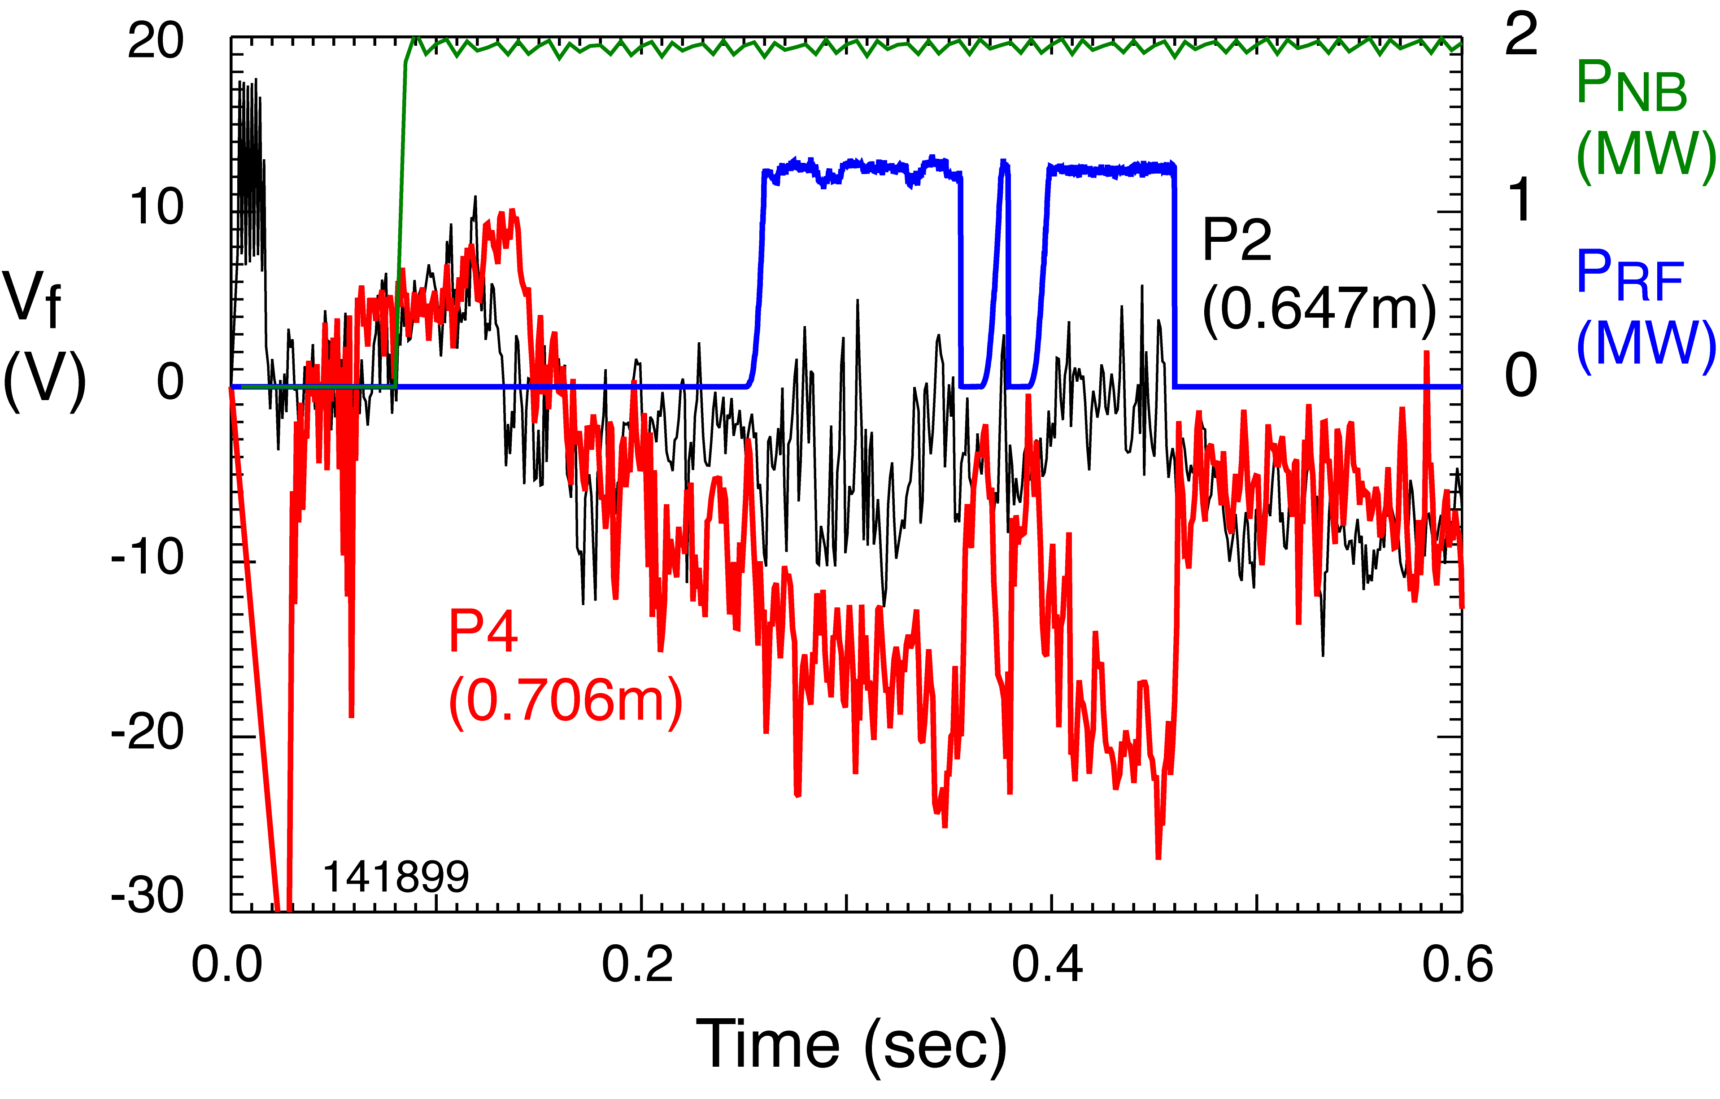
HHFW strongly affects floating potential when probe is under spiral
Probe P4 floating potential (red plot) responds strongly to RF
Probe P2 has much weaker response (black plot)
RF-induced effects are localized to spiral
Similarly, tile currents increase under spiral

Slide 4
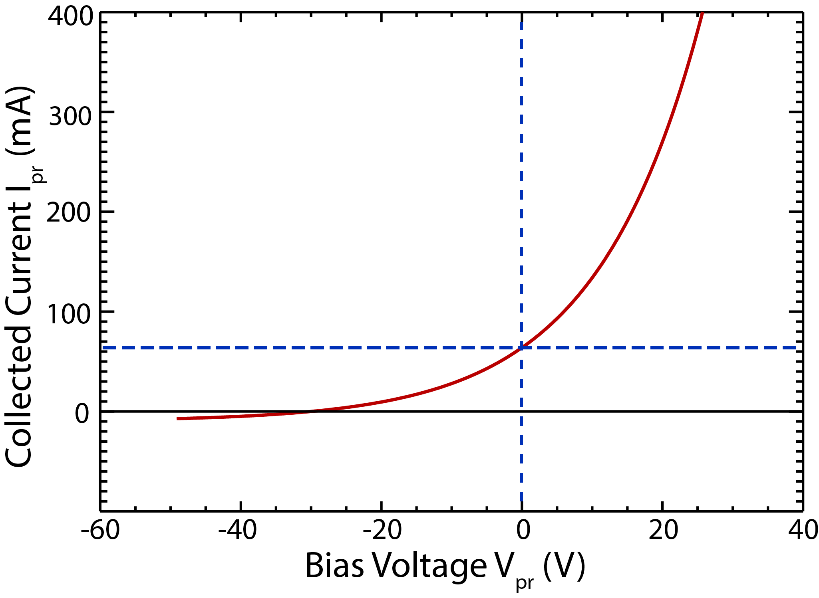
RF rectification is an phenomena due to non-linear IV characteristic of probe/surface
IV characteristic of probe (or divertor tile) is nonlinear
Exponential for Maxwellian distribution

Slide 5
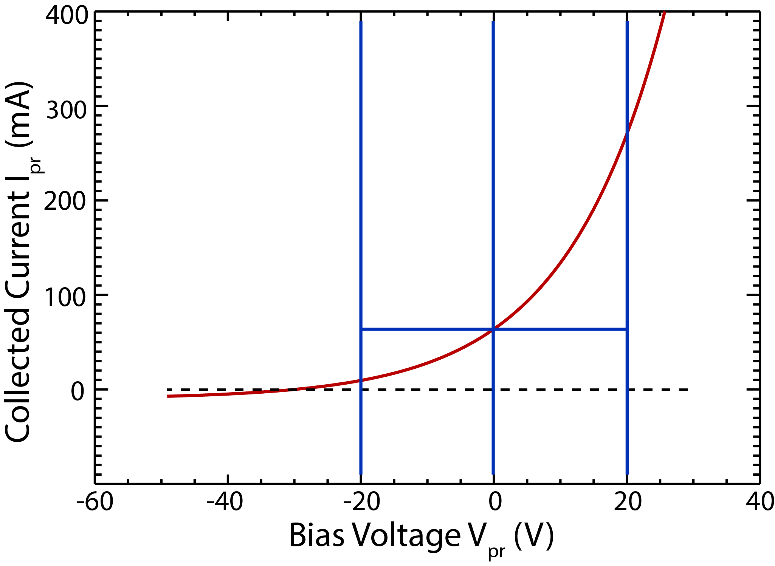
RF rectification is an phenomena due to non-linear IV characteristic of probe/surface
IV characteristic of probe (or divertor tile) is nonlinear
Exponential for Maxwellian distribution
Adding an oscillating potential produces non-zero average of collected current
V_{RF}

Slide 6
RF increases electron current New floating potential depressed
Equation for current collected at bias V

Slide 7
RF increases electron current New floating potential depressed
Equation for current collected at bias V
Add RF potential and average over an RF cycle

Slide 8
RF increases electron current New floating potential depressed
Equation for current collected at bias V
Add RF potential and average over an RF cycle
New floating potential V_{flRF}
A. Boschi and F. Magistrelli, Nuovo Cimento 29 487 (1963 )

Slide 9
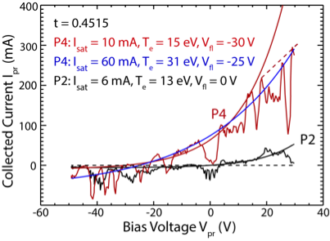
Langmuir probe IV characteristics altered by RF spiral
Probe 4 (under spiral, red curve) characteristic altered by HHFW
Could be a ~ 30 V shift in floating potential due to RF rectification
However, could be ~ 16 eV of plasma heating
Divertor turbulence prevents accurate determination

Slide 10
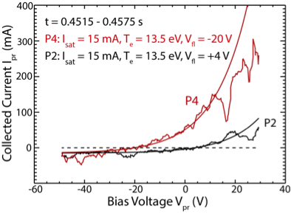
Averaging sweeps smooths turbulence, allows better fitting
Assume RF rectification
Fit both characteristics with exponentials with same T_{e} and n_{e}
Departure from exponential at higher bias expected for oblique magnetic fields
Change in floating potential: 24 V
Estimated V_{RF}: 44 V

Slide 11
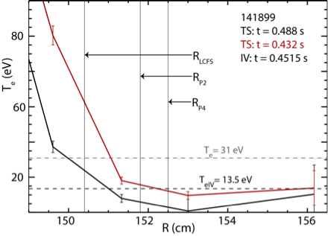
Midplane T_{e} measurements support RF rectification hypothesis
Thomson Scattering provides T_{e} profile at midplane
Assuming RF rectification: T_{e} = 13.5 eV,
Decent agreement with TS
Assuming plasma heating: T_{e} = 31 eV
Much larger than TS measurements
R. J. Perkins et al., Phys. Plasma 22, 042506 (2015)

Slide 12
Heat flux to surface consists of ion and electron contributions
Ion energy flux from sheath voltage drop
Ion thermal flux
Electron
thermal flux
P. Stangeby “The plasma boundary of magnetic fusion devices,” Ch. 2

Slide 13
Adding RF increases heat flux (at same bias) due to increased electron current
Ion energy flux from sheath voltage drop
Ion thermal flux
Electron
thermal flux
Add RF potential and average over an RF cycle

Slide 14
Adding RF increases heat flux (at same bias) due to increased electron current
Electron current without RF
Electron current with RF

Slide 15
Adding RF increases heat flux (at same bias) due to increased electron current
Add RF potential and average over an RF cycle
V_{RF} ~ 44 V → ΔQ_{RF} = 0.1 MW/m²

Slide 16
Comparison of Q_{RF} prediction by RF rectification to heat flux measured by IR camera is currently difficult
Heat flux profiles obtained at Bay I
Langmuir probes located at Bay B
150º of toroidal separation
Strong toroidal variations in spiral intensity

Slide 17
Rough extrapolations suggest RF-rectification prediction is plausible, but better data is needed
δQ = Q_{RF} – Q_{noRF} reveals different spiral passes across Bay I
Probe radius closest to second spiral pass
Subtract off estimate of plasma exhaust from second peak
Estimate 0.3 MW/m² from heat flux profile
Larger than prediction from V_{RF} but does not account for spiral variation
Heat Flux Profile at Bay I
Probe Radius
R. J. Perkins et al., Phys. Plasma 22, 042506 (2015)

Slide 18
Improved diagnostics on NSTX-U will allow for definitive comparisons
New radial array of divertor Langmuir probes
Located at Bay I where most intense part of spiral is anticipated to fall
Probe electronics will detect RF (30 MHz) component of signal
Direct measurement of V_{RF}
ORNL is providing a wide-angle IR view of divertor
Obtain heat flux measurement at probe location
Will perform a dedicated power scan
Determine scaling of measured heat flux and V_{RF}
Determine if RF-rectification predictions of heat flux are accurate

Slide 19
Conclusions
SOL losses of HHFW power are significant for NSTX
Possibly a fast-wave propagation effect that is more apparent in ST geometry
RF rectification is a likely explanation for changes to floating potential and currents
RF rectification can potentially explain the spiral heat flux
Potentially the long sought mechanism converting HHFW power to heat flux to outer divertor
Current predictions are in the right range, but better data is needed
Experiments and diagnostics upgrades on NSTX-U will allow for more a definitive comparison

