Slide 1
Studies of NSTX L and H-mode Plasmas with Global Gyrokinetic Simulation
Y. Ren¹
W. Wang¹, W. Guttenfelder¹, S.M. Kaye¹, S. Ethier¹, J. Ruiz-Ruiz², R.E. Bell¹, B.P. LeBlanc¹, E. Mazzucato¹, D.R. Smith³, C.W. Domier⁴, H. Yuh⁵ and the NSTX-U Team
1. PPPL 2. MIT 3. UW-Madison 4. UC-Davis 5. Nova Photonics
18th International Spherical Torus Workshop
and 2015 US-Japan Workshop on ST Plasmas
Princeton, NJ, USA
November 3rd - 6th, 2015

Slide 2
Why are Global Effects Important?
Global effects are considered to be important for STs
Local assumption of flux tube simulations based on ρ*->0
Large ρ* of STs due to weaker toroidal field compared to conventional tokamaks (ρ* ~ 0.01 for NSTX)
Global effects, e.g. profile variation, requiring global GK codes
Study of global effects are important for achieving predictive capability for future STs
Need to validate first principle model for developing reduced transport model with global effects
Serious validation efforts, applying global GK codes to ST plasmas, are still lacking

Slide 3
Outline
GYROKINETIC TOKAMAK SIMULATION (GTS) code
Global GTS simulations of NSTX L and H-mode plasmas
NSTX RF-heated L-mode plasmas
Fast response of electron-scale turbulence to RF cessation
NSTX H-mode plasmas
Density gradient stabilization of electron-scale turbulence

Slide 4
GTS - a Global Gyrokinetic Code with Robust Capability to Simulate Turbulence & Transport for Tokamak Experiments
$δf$PIC code solving modern GK equation in conservative form
New, improved weight scheme ensuring phase space incompressibility
Full geometry, global simulation (without local ballooning approximation)
Real space field solvers with field-line-following mesh
Retains all toroidal modes allowed by resolution and full channels of nonlinear energy couplings
Enable to treat modes with low-n, with finite k||, (e.g., shear flow mode)
Fully kinetic electrons (both trapped and untrapped electron dynamics)
Linearized Fokker-Plank operator with particle, momentum and energy conservation for i-i and e-e collisions; Lorentz operator for e-i collisions
Include neoclassical physics self-consistently in turbulence simulations
Significant impact on some important transport & confinement issues (bootstrap current, poloidal flow, GAMs and particle transport, etc.)
Applied to wide experiments for various physics studies:
NSTX/U, DIII-D, C-MOD, KSTAR and ASDEX-U

Slide 5
NSTX RF-heated L-mode plasmas with fast response of electron-scale turbulence to RF cessation

Slide 6
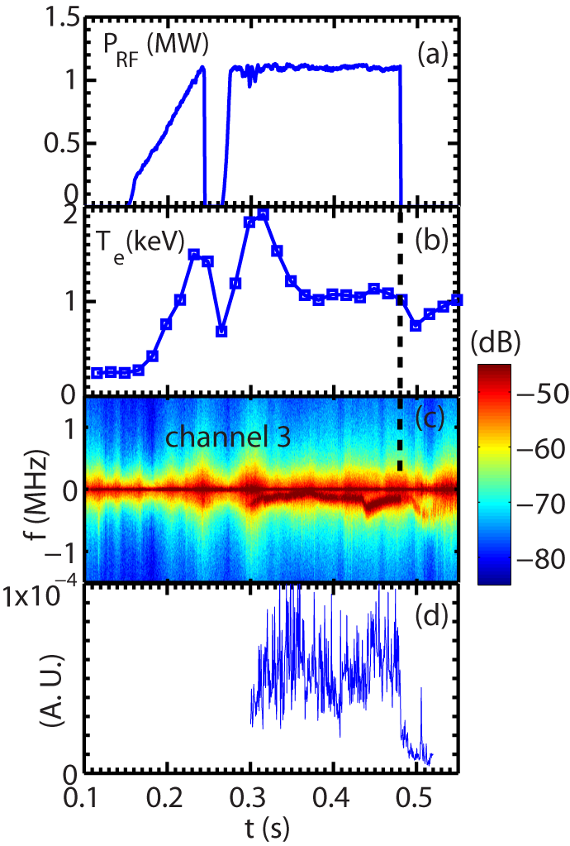
Measured Turbulence Frequency Spectral Power Shows a Significant Drop Following the RF Cessation
Drop in turbulence frequency spectral power at the time of RF cessation
The drop happens in 0.5 to 1 ms
Electron heat flux decreases by about a factor of 2 after the RF cessation
Shot=140301
RF-heated L-mode plasma with
B_{T} =5.5 kG and I_{p}=300 kA
A sudden drop in spectral power
Ren et al., accepted by PoP

Slide 7
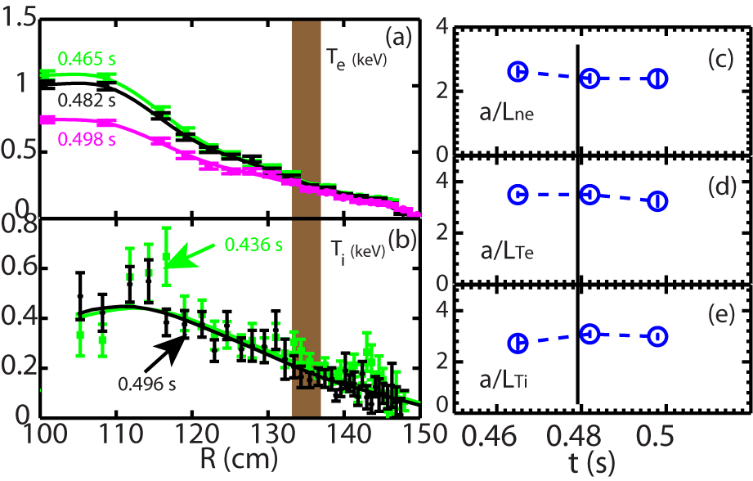
What Causes the Sudden Drop of Electron-scale Turbulence?
High-k measurement region
Equilibrium quantities not expected to change significantly on the time scale on which the turbulence changes (0.5-1 ms)
Energy confinement time~ 10 ms
<15% variation in equilibrium quantities in the high-k measurement region
Time of the RF cessation

Slide 8
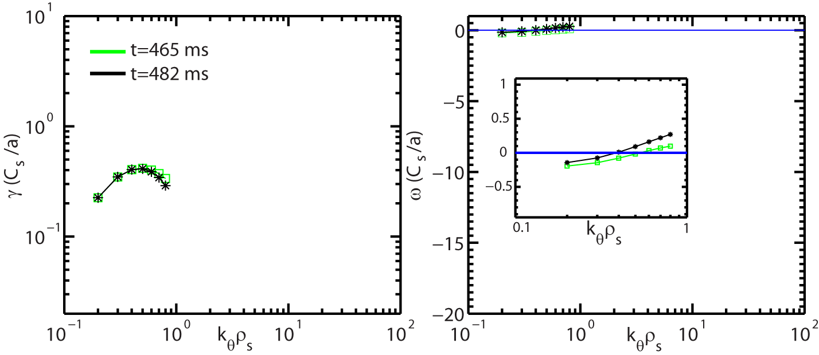
Changes in Linear Growth Rate Cannot Explain the Observed Significant Drop in High-k Turbulence
Ion scale modes are ITG/TEM hybrid
Growth rate similar before and after the RF cessation
R=135 cm
After the RF cessation
Ion direction
Electron direction
ExB shearing rate
Stability Analysis was performed with the GS2 code (Kotschenreuther et al., 1995)

Slide 9
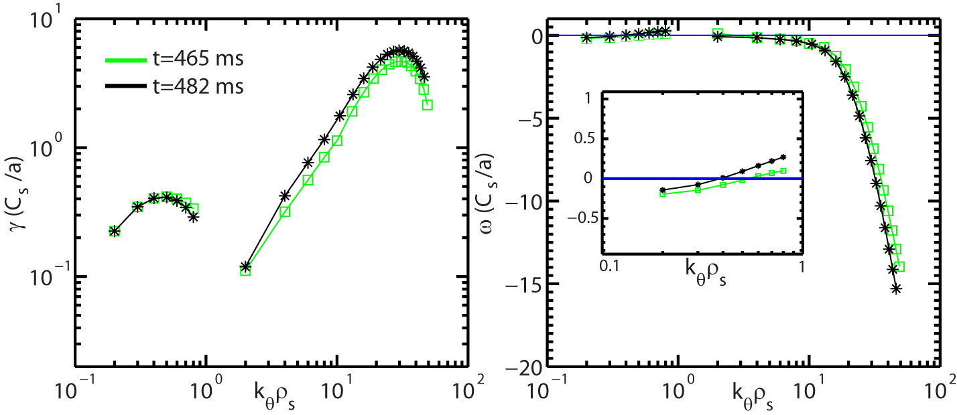
Changes in Linear Growth Rate Cannot Explain the Observed Significant Drop in High-k Turbulence
Ion scale modes are ITG/TEM hybrid
Growth rate similar before and after the RF cessation
ETG mode maximum growth rates show small increase from t=465 to 482 ms
Inconsistent with the drop in the measure high-k spectral power
After the RF cessation
Ion direction
Electron direction
ExB shearing rate
Stability Analysis was performed with the GS2 code (Kotschenreuther et al., 1995)

Slide 10
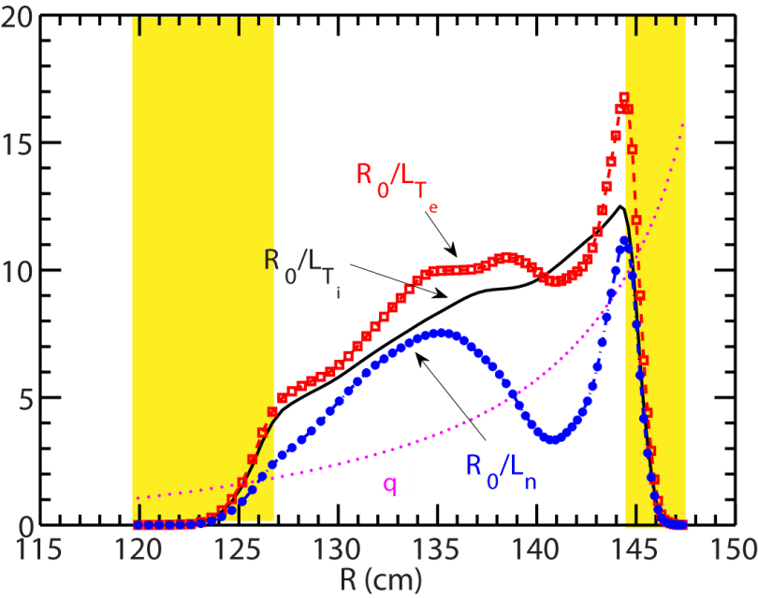
Are Global Effects Able to Explain the Observation?
Global effects, e.g. profile variation, may be important
Turbulence could spread from one region to another
GTS simulations are carried out with experimental equilibria
Linear local GS2 simulations help determine the radial domain for GTS simulations
Focus on ion-scale turbulence, since ExB shear is weak
High-k measurement region R=133~137 cm

Slide 11
Robust Ion-scale Turbulence is Seen
t=465 ms
$$δΦ$$
Strong ion-scale turbulence generated
ExB shear is weak without strong NBI
Turbulence propagates in the electron diamagnetic direction

Slide 12
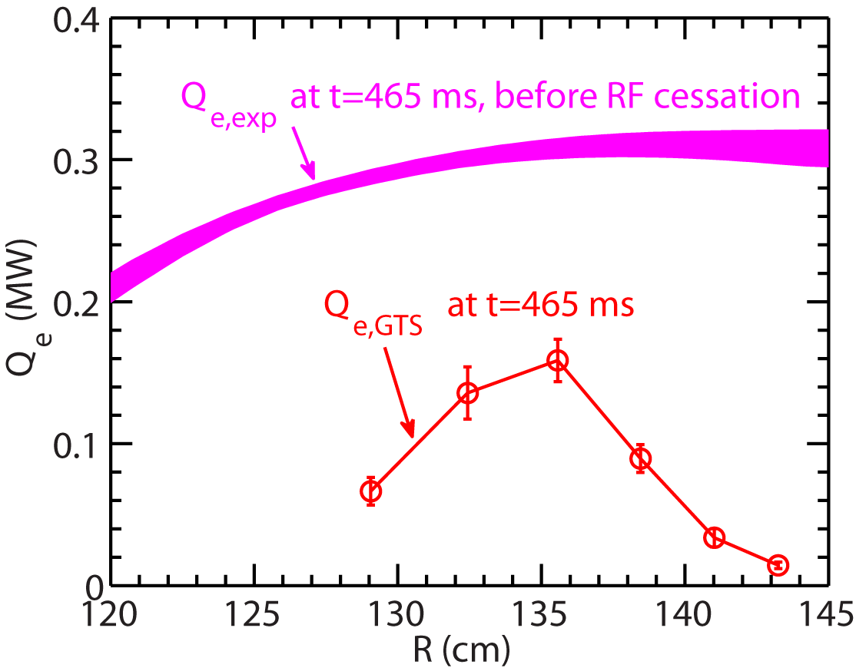
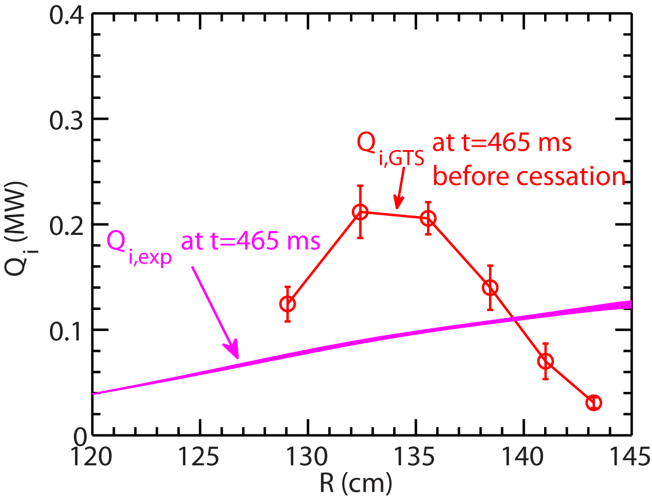
Electron Energy Flux from GTS is Significantly Less than Experimental Value with RF Heating
Ion energy flux is over-predicted
Experimental values from TRANSP+TORIC analysis
Electron energy flux
Ion energy flux

Slide 13
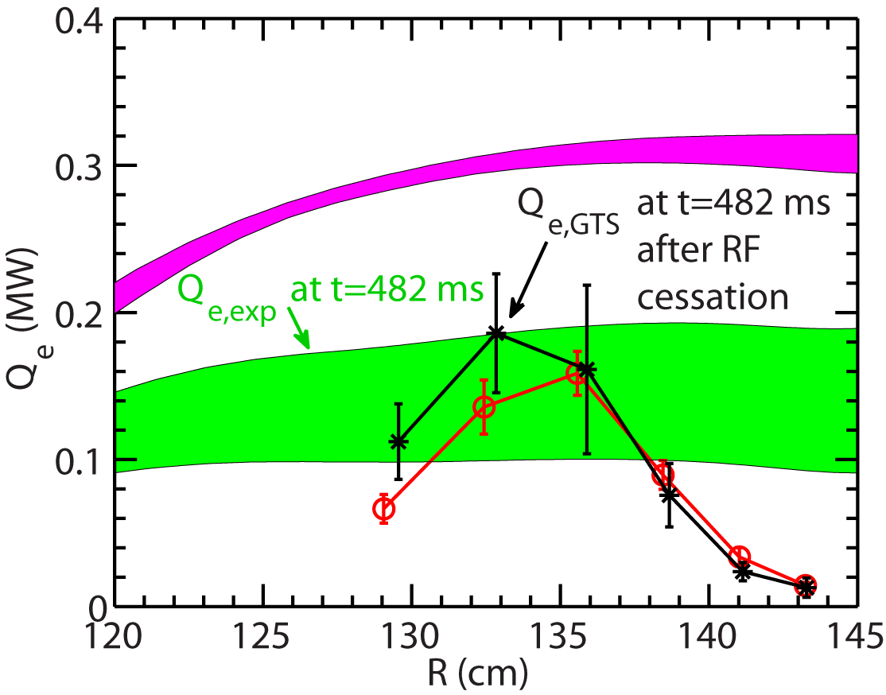
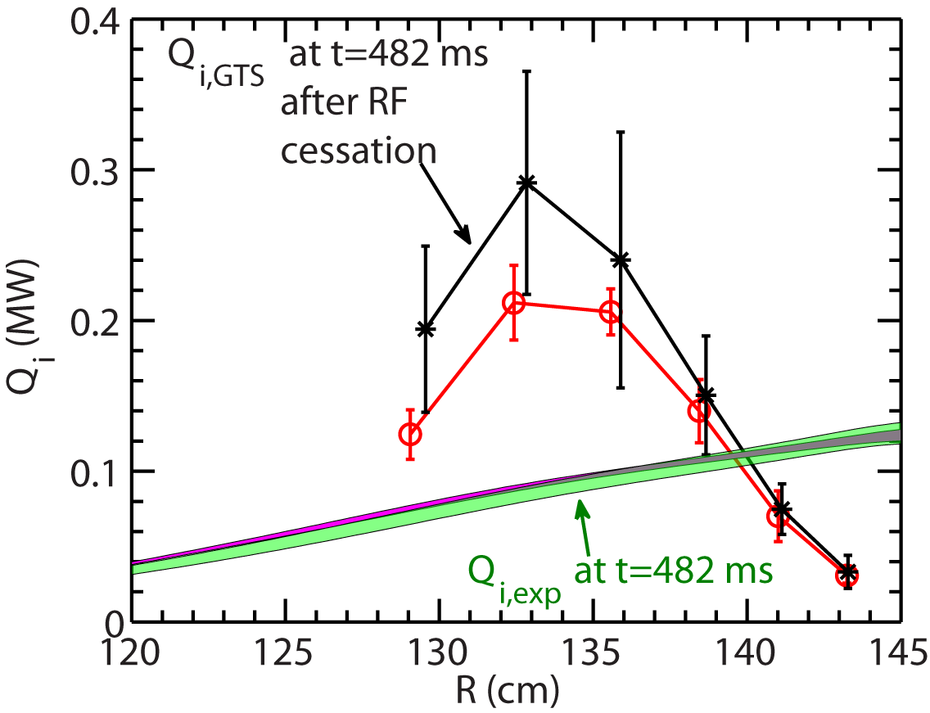
Similar Energy Fluxes from GTS are Seen before and after the RF cessation
Consistent with observed small change in equilibrium profiles
Electron energy flux matches experimental value after the RF cessation but not before
Ion energy flux is over-predicted for both cases
Electron energy flux
Ion energy flux

Slide 14
Gradient-driven Gyrokinetic Models have Difficulty Explaining Experimental Observations
Turbulence decreases on 0.5 -1 ms time scale; About a factor of 2 decrease in Â_{e} after the RF cessation
Equilibrium profiles not expected to vary significantly on 0.5 – 1 ms time scale (much smaller than confinement time ~ 10 ms)
<15% variation in equilibrium quantities in the high-k measurement region are found before and right after the RF cessation (over 17 ms)
Local and global gyrokinetic simulations using experimental profiles are unable to explain observed change in turbulence and electron thermal transport
Nonlocal flux-driven mechanism may be important (S.-I Itoh and K. Itoh, Sci. Rep. 2012)

Slide 15
NSTX H-mode plasmas with
density gradient stabilization of electron-scale turbulence

Slide 16
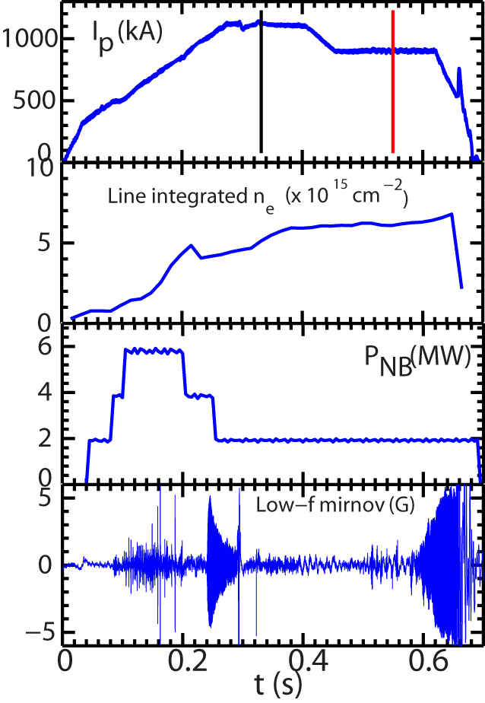
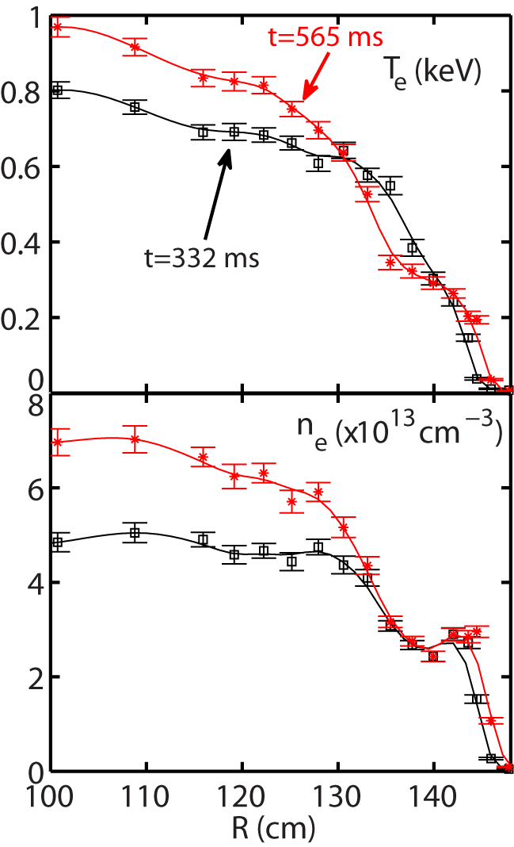
Current Ramp-down in NSTX H-mode Plasma Leads to Core Density Gradient Increase
Shot=141767
NBI-heated H-mode plasma with
B_{T} =5.5 kG
Ruiz-Ruiz et al., submitted to PoP

Slide 17
Current Ramp-down in NSTX H-mode Plasma Leads to Core Density Gradient Increase
Shot=141767
ETG turbulence suppressed by large density gradient
See Ruiz-Ruiz’s poster P1-10
Is ion-scale turbulence driving thermal transport?
Here, we focus on ion-scale GTS simulations and thermal transport
NBI-heated H-mode plasma with
B_{T} =5.5 kG
Ruiz-Ruiz et al., submitted to PoP

Slide 18
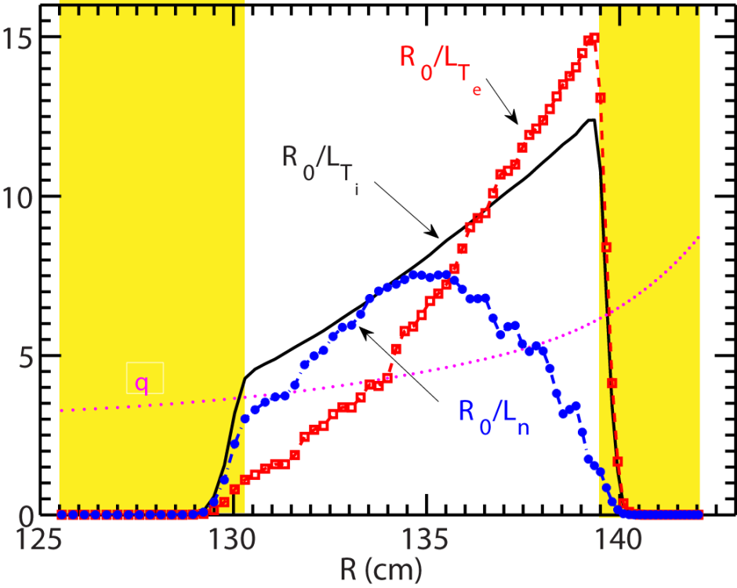
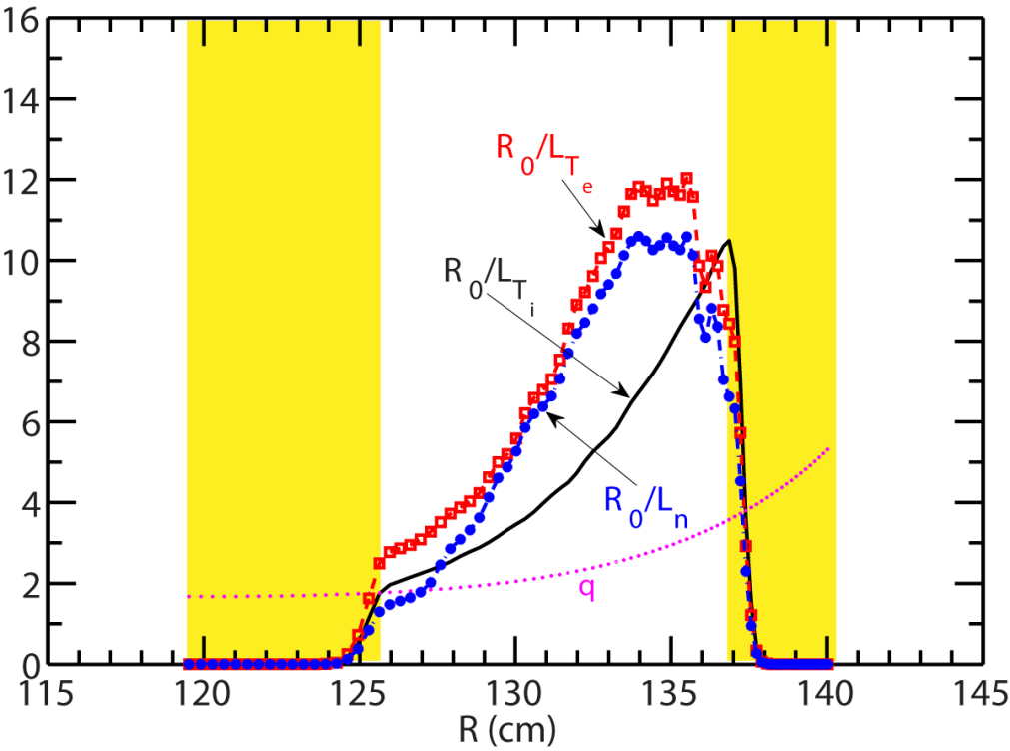
GTS Simulation Domains are Chosen to Have Significant Gradients
Both electron temperature and density gradients are significantly larger at t=565 ms than at t=332 ms
t= 332 ms
t= 565 ms

Slide 19
Robust Ion-scale Turbulence is Seen at t=332 ms
t=332 ms
$$δΦ$$
Strong ion-scale turbulence generated
ExB shear is turned on from the beginning of the simulation
Turbulence propagates in the ion diamagnetic direction, due to toroidal rotation

Slide 20
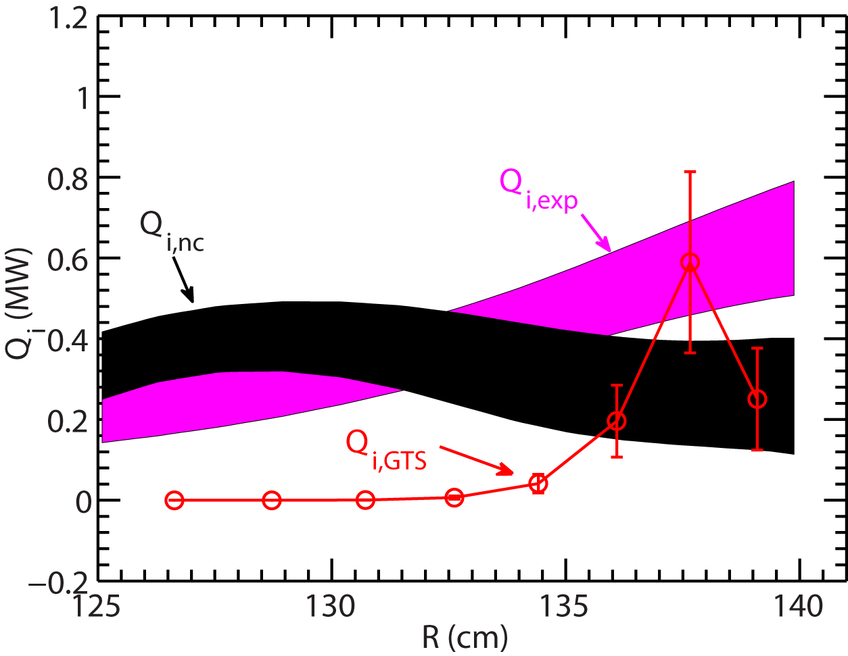
Ion Energy Flux from GTS is in Agreement with Experiment at t=332 ms
t=332 ms
Ion energy flux from ion-scale turbulence contributes significantly at R>135 cm
Neoclassical ion thermal transport is important further in the core of the plasma
Neoclassical ion thermal transport from NCLASS

Slide 21
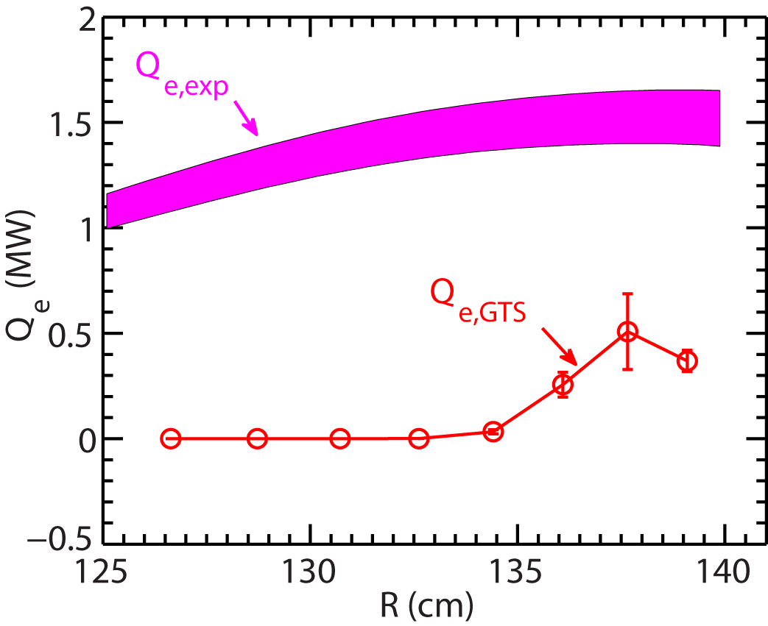
Electron Thermal Transport is Significantly Under-predicted by GTS at t=332 ms
t=332 ms
Electron energy flux from GTS is only significant at R>135 cm
Much smaller than experimental electron thermal transport
Contribution from ETG and electromagnetic effects may be important

Slide 22
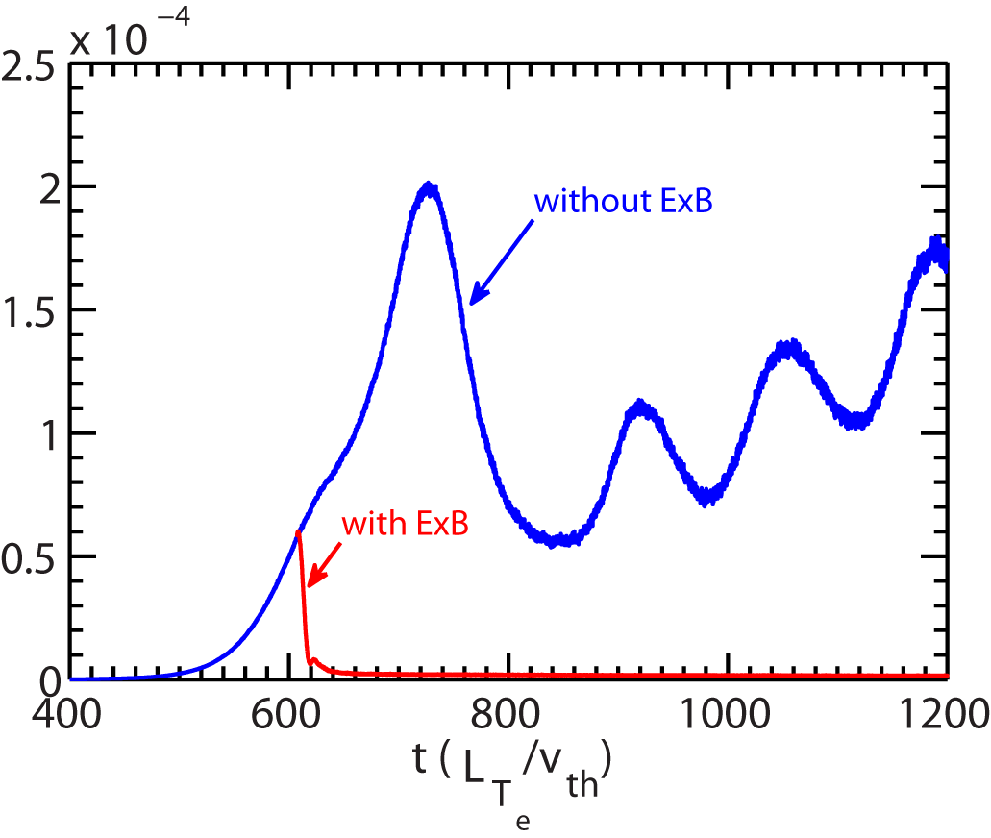
Ion-scale Turbulence is Robustly Suppressed in GTS Simulation for t=565 ms
t=565 ms, R=134.5 cm
Turbulence is suppressed after ExB shear is turned on at t~600
No turbulence growth if ExB shear is turned on at the beginning of the simulation

Slide 23
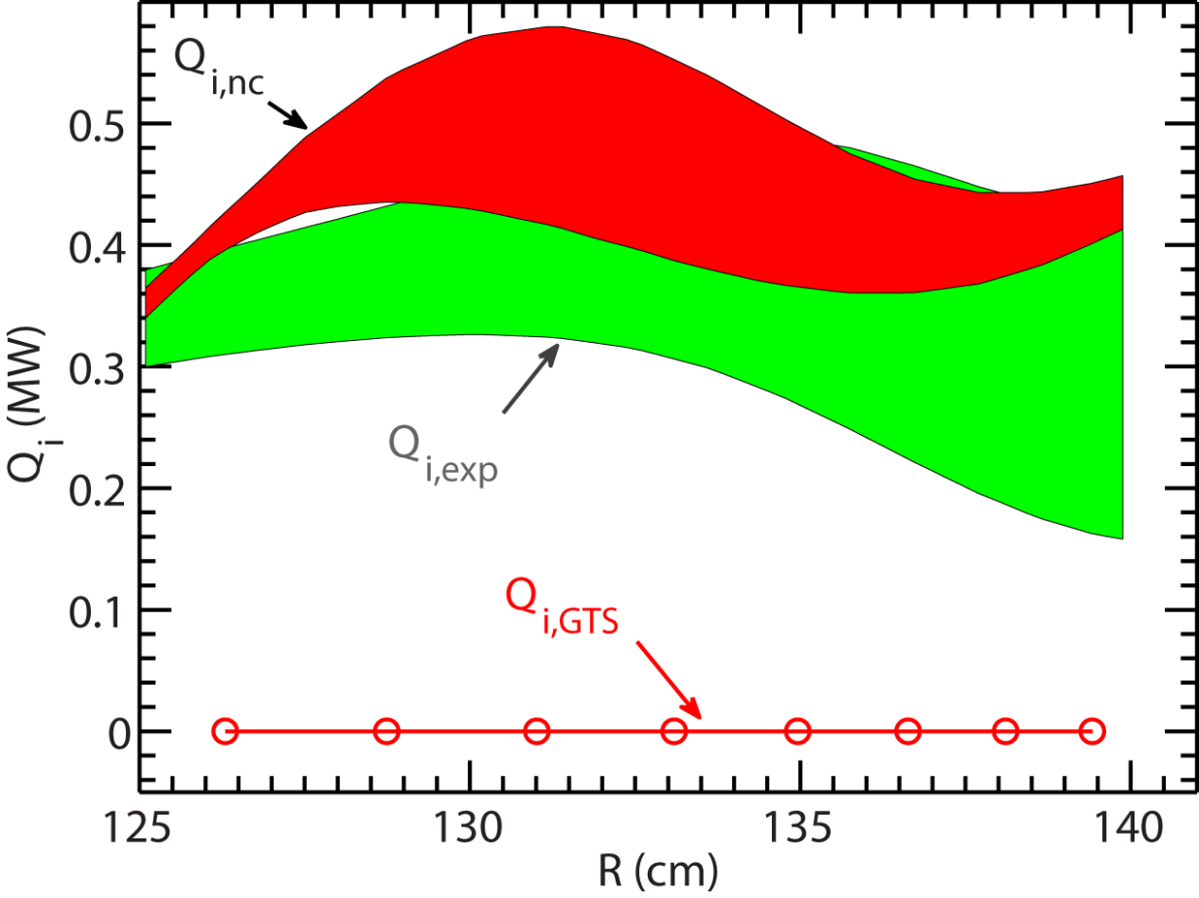
Ion Energy Flux from GTS is Still in Agreement with Experiment at t=565 ms
Neoclassical ion thermal transport is comparable to experimental ion thermal transport level
Neoclassical ion thermal transport from NCLASS
ETG is significantly suppressed by density gradient (see poster P1-10)
Electromagnetic effects may be important
t=565 ms

Slide 24
Summary
We have started to make serious efforts to validate global gyrokinetic simulations with NSTX experiments
Global gyrokinetic simulations with GTS have helped identify the possible importance of nonlocal flux-driven mechanics in electron thermal transport in NSTX RF-heated L-mode plasmas
Global ion-scale gyrokinetic simulations with GTS for a NSTX NBI-heated H-mode plasma showed nice agreement with experiment in ion thermal transport but not in electron thermal transport

Slide 25
Backup slides

Slide 26
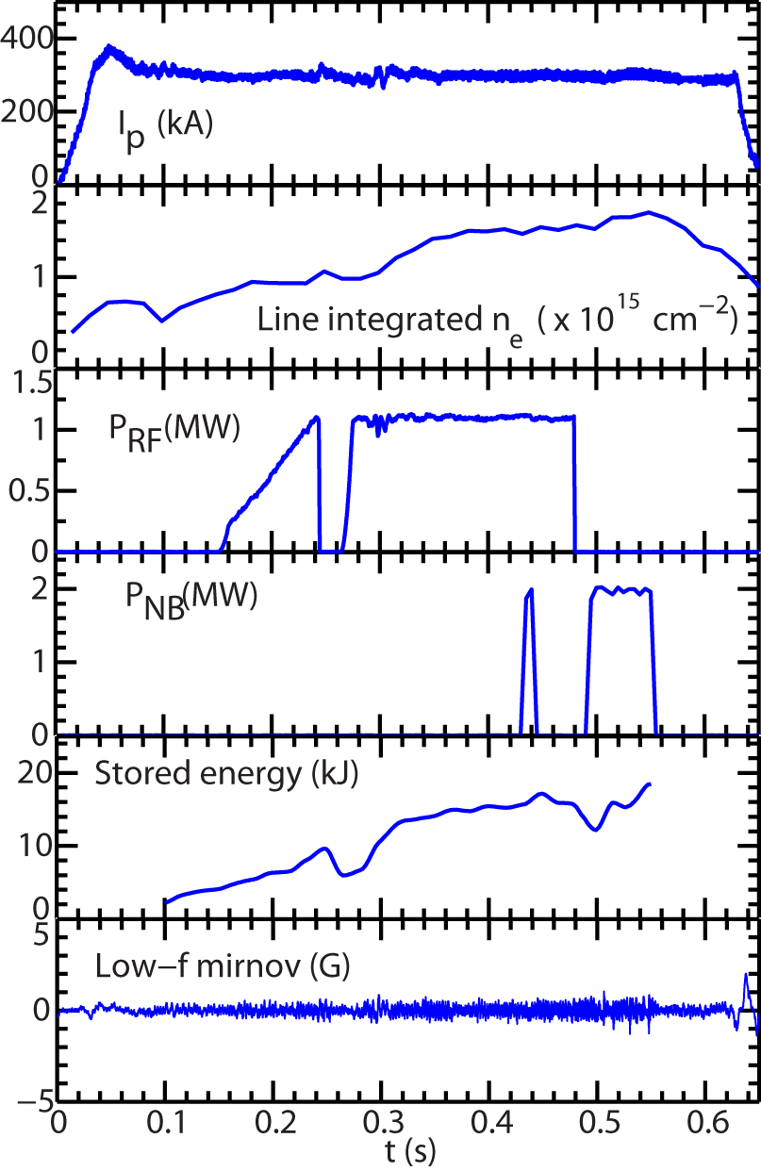
Fast Response of Electron-scale Turbulence to RF Cessation was Observed in a Set of NSTX L-mode Plasmas
Shot=140301
RF-heated L-mode plasma with
B_{T} =5.5 kG
Time range of interest:
around the RF cessation at t=479.6 ms

Slide 27
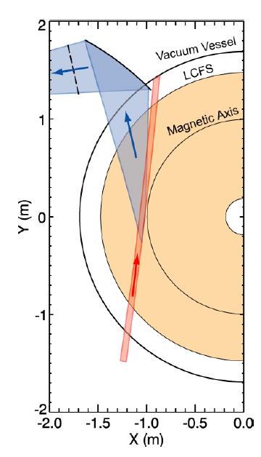
High-k Microwave Scattering System is Used to Measure High-k Turbulence
280 GHz microwave is launched as the probe beam.
Coherent scattering by plasma density fluctuations occurs when the three-wave coupling condition is satisfied:
Bragg condition determines k_{p}:
k_{p}=2k_{i}sin(θ_{s}/2)
The scattered light has a frequency of:
ω_{s}=ω_{p}+ω_{i}
with ω_{s} and ω_{i} >> ω_{p}
The scattering system characteristics are:
Frequency bandwidth: 5 MHz
Heterodyne receiver: Wave propagation direction resolved
Measurement: k_{r} spectrum
Wavenumber resolution: 0.7 cm⁻¹ (2/a with a ≈ 3 cm)
Wavenumber range (k_{r}): 5-30 cm⁻¹ (~5-30 )
Radial resolution: ±2 cm
Tangential resolution: 5-15 cm
Radial range: R=106 – 144 cm
Minimal detectable density fluctuation:
Spherical mirror
Scattered light
k_{s}
k_{p}
k_{p}
=
+
k_{i}
θ_{s}
k_{s}
k_{i}
2a
Probe beam
Probe beam
D.R. Smith, PhD thesis, 2009

Slide 28
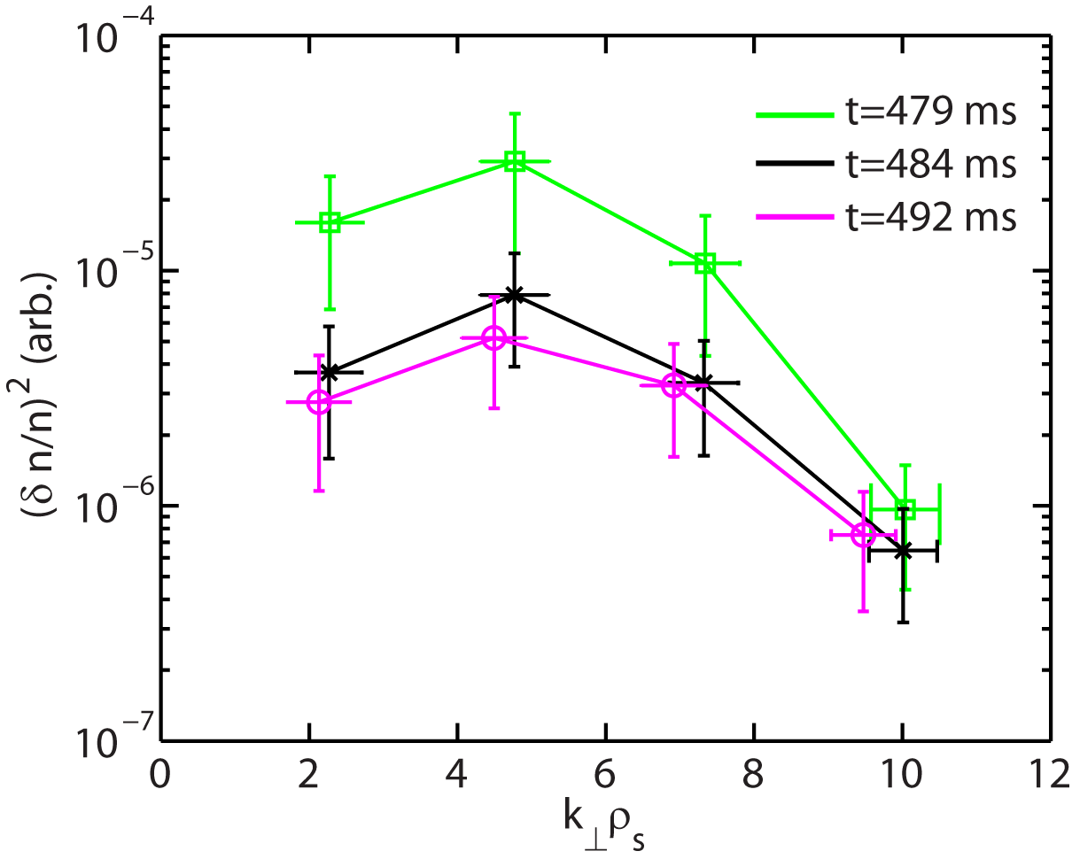
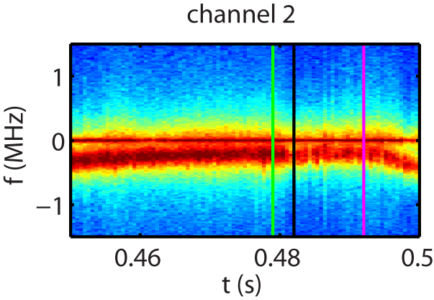
Turbulence Wavenumber Spectra Show Significant Reduction in Smaller Wavenumbers, k┴ρ_{s} <9-10
Up to a factor of 7 drop in wavenumber spectral power right after the RF cessation
At the RF cessation
Time of the RF cessation, t=479.6 ms
Right after the RF cessation

Slide 29
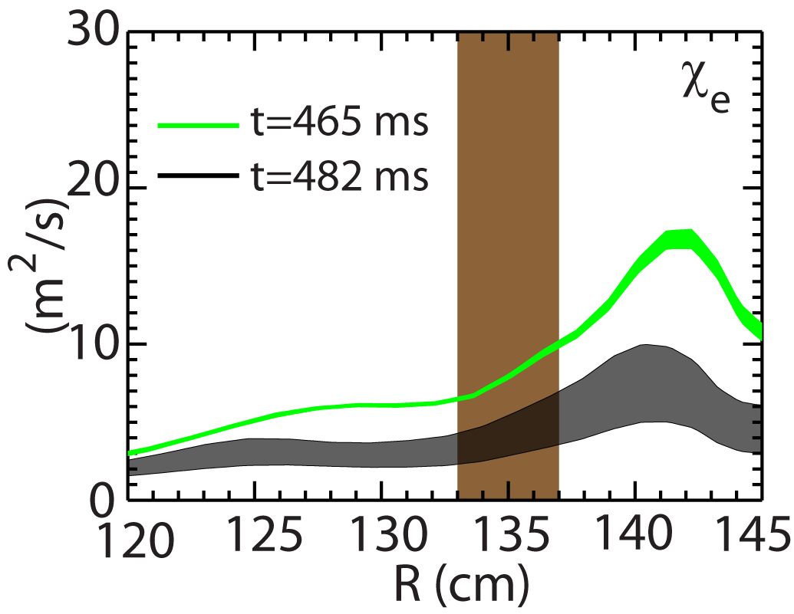
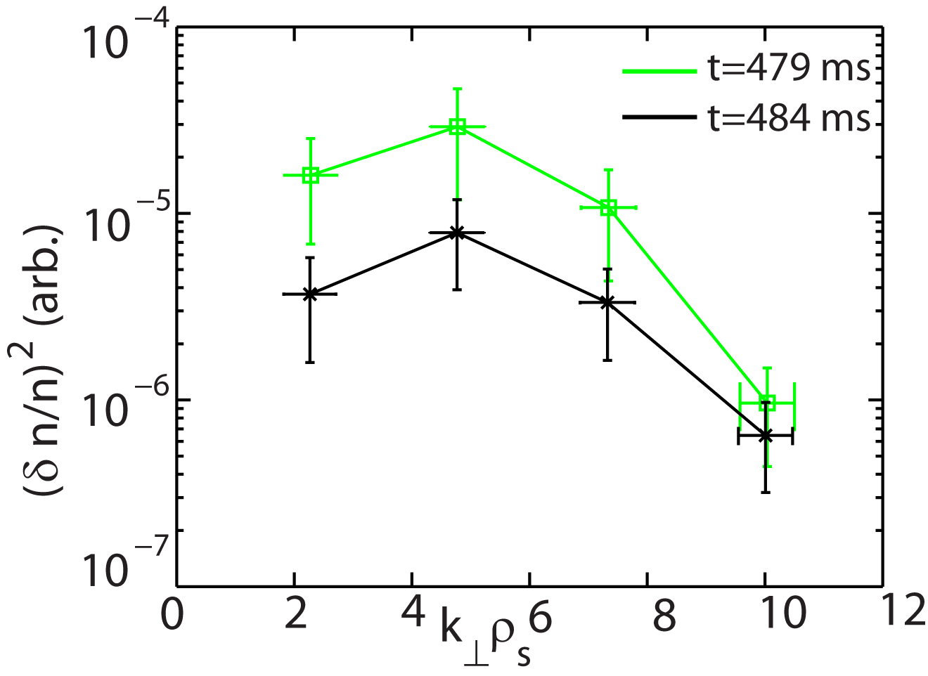
Turbulence Wavenumber Spectral Power is Correlated with Electron Thermal Diffusivity
About a factor of 2 decrease in electron thermal diffusivity after the RF cessation
Correlated with the decrease in turbulence wavenumber spectral power
High-k measurement region
After the RF cessation
After the RF cessation
From TRANSP analysis with TORIC

Slide 30
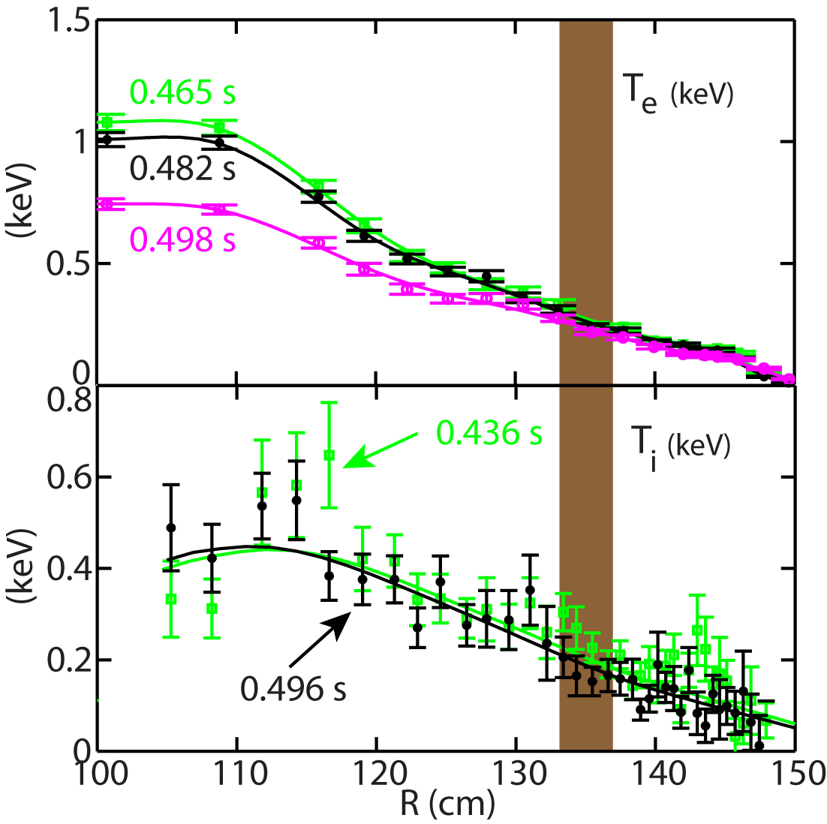
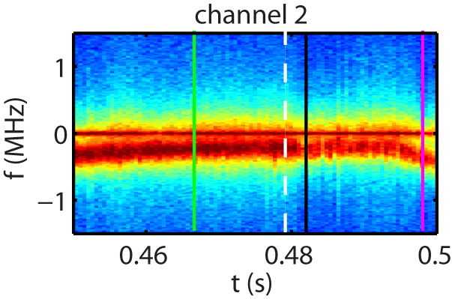
T_{e} and Ti Profile Changes are Small across the RF Cessation
One Thomson measurement point is at t=482 ms, right after the drop of high-k turbulence
T_{i} profile is measured by CHERS
High-k measurement region r/a~ 0.57-0.63
Time of the RF cessation

Slide 31
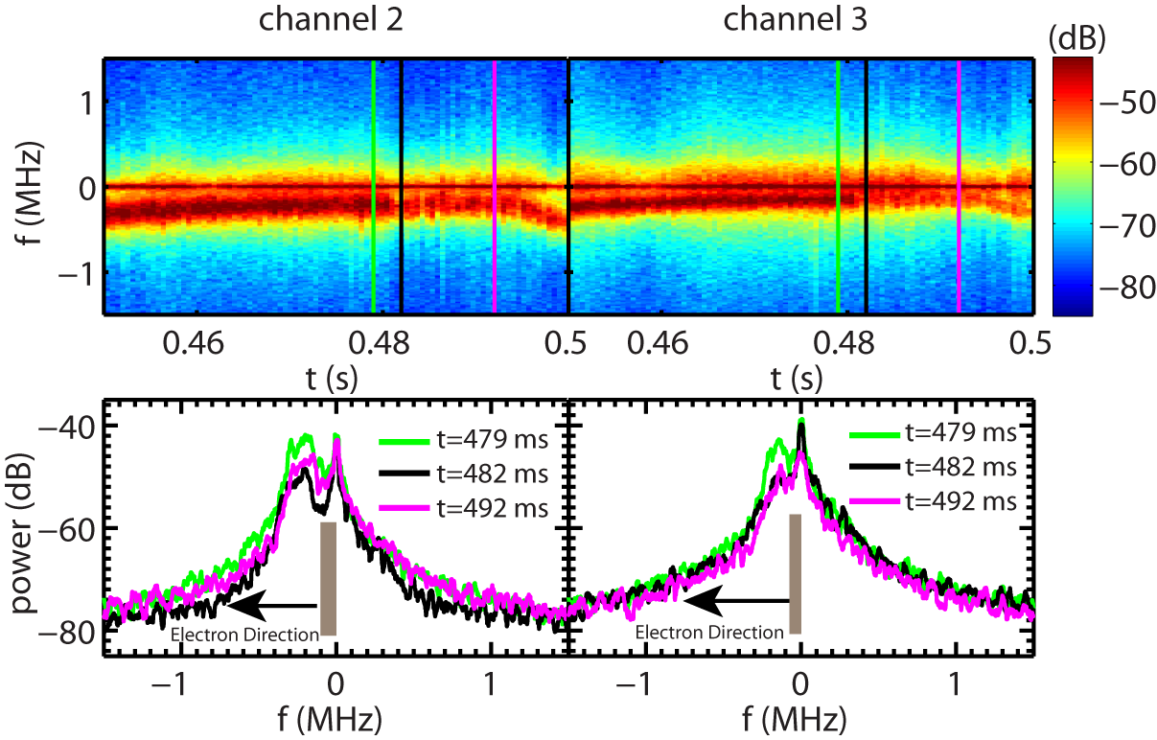
A Time Delay between the Drop in Spectral Power and RF Cessation Indicates a Causal Relationship
Time of the RF cessation, t=479.6 ms
Spectral power decreases within 0.5 - 1 ms and the delay time is about 1-2 ms
Turbulence propagates in electron diamagnetic direction

Slide 32
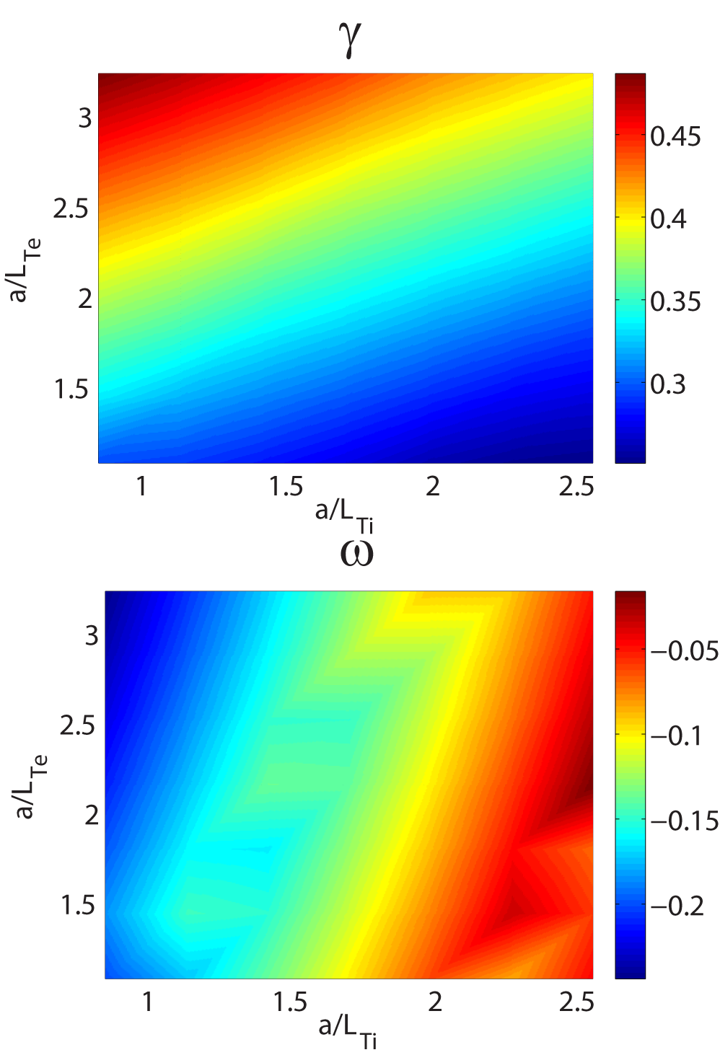
ITG/TEM and ETG Modes are Robustly Unstable
t=465 ms, r/a=0.6
T_{e} and T_{i} gradients are scanned with ¯’ fixed
The ion-scale modes are driven by both electron and ion temperature gradients
a/L_{Te,exp}=3.6
a/L_{Ti,exp}= 2.83
ETG modes critical a/L_{Te} is determined to be 2.1 (a/L_{Te,exp}=3.6) from T_{e} gradient scan
max

Slide 33
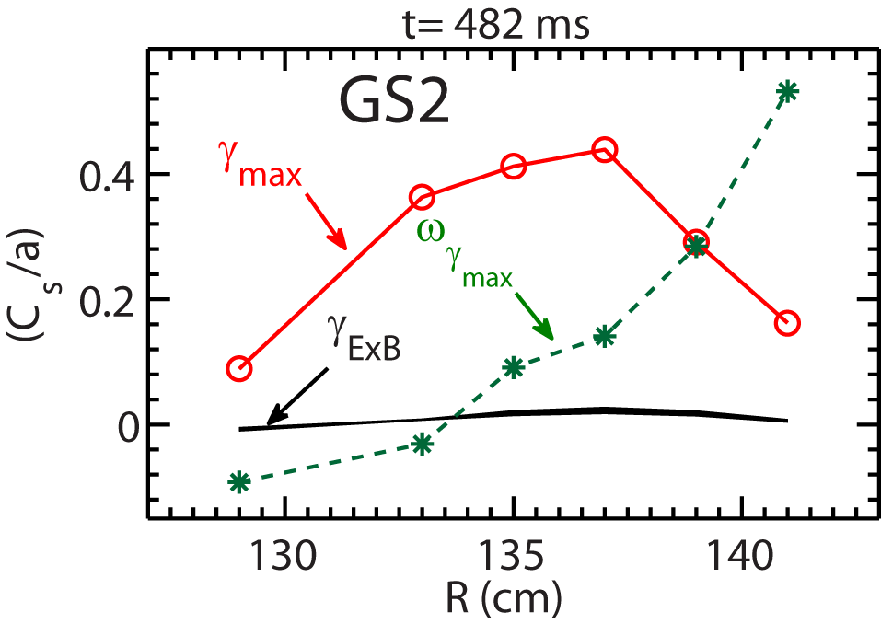
Are Global Effects Able to Explain the Observation?
Global effects, e.g. profile variation, may be important
Global simulations with experimental profiles before and after the RF cessation
GTS simulations are carried out with experimental equilibria
Linear local GS2 simulations help determine the radial domain for GTS simulations
Focus on ion-scale turbulence, since ExB shear is weak

Slide 34
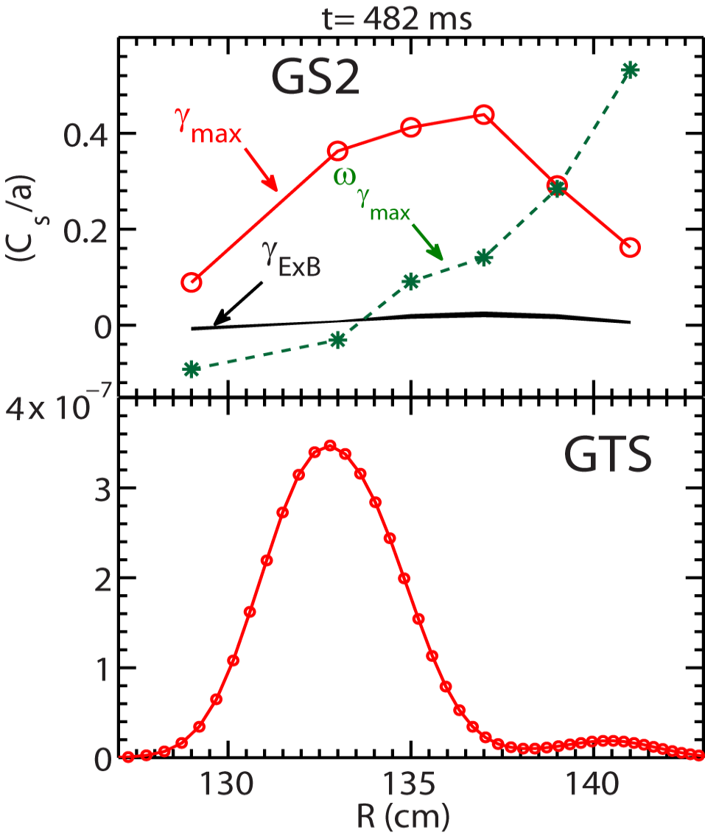
Are Global Effects Able to Explain the Observation?
Global effects, e.g. profile variation, may be important
Turbulence can spread from one region to another
Reasonable linear growth phase seen in the GTS simulation
ExB shear is turned on from the beginning
Linear phase

Slide 35
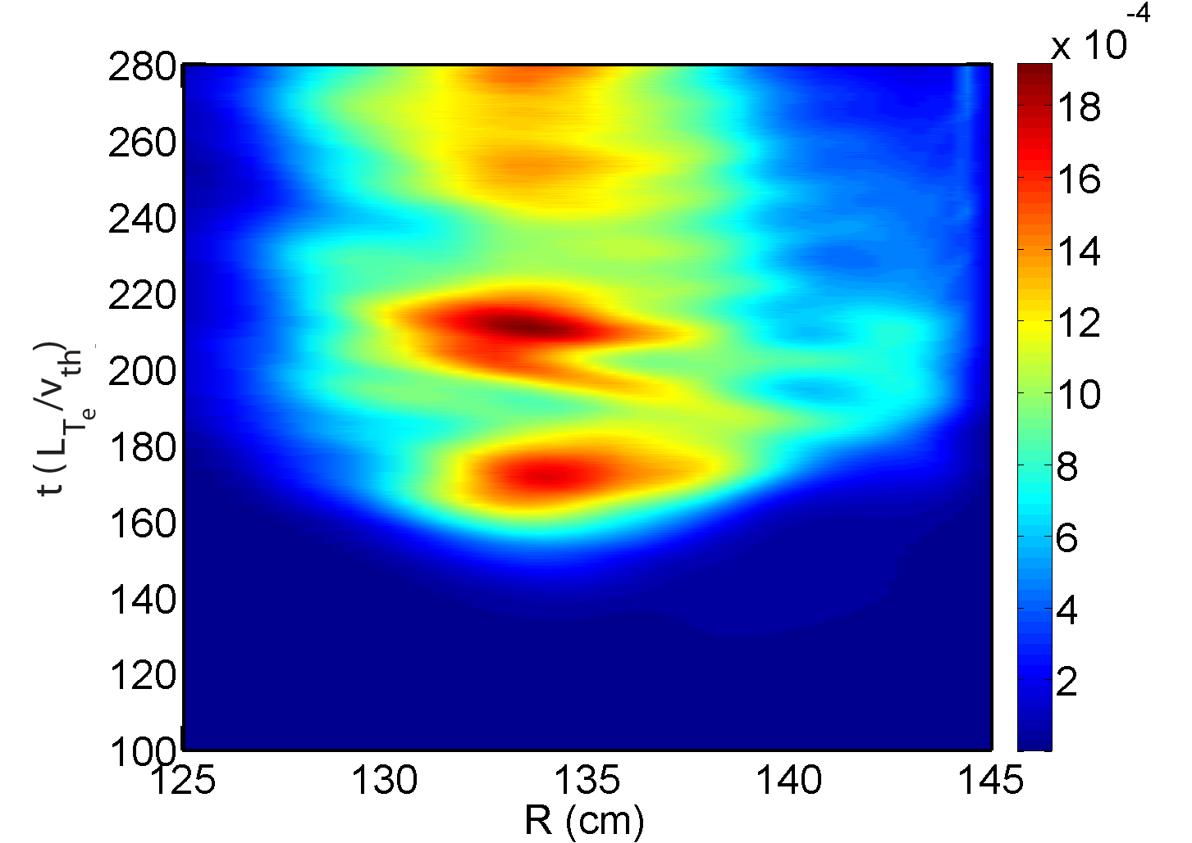
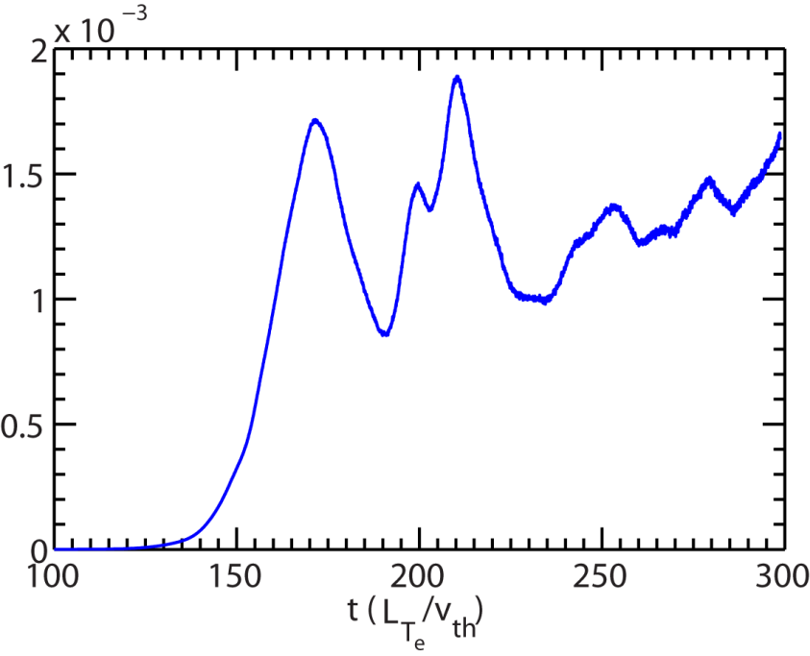
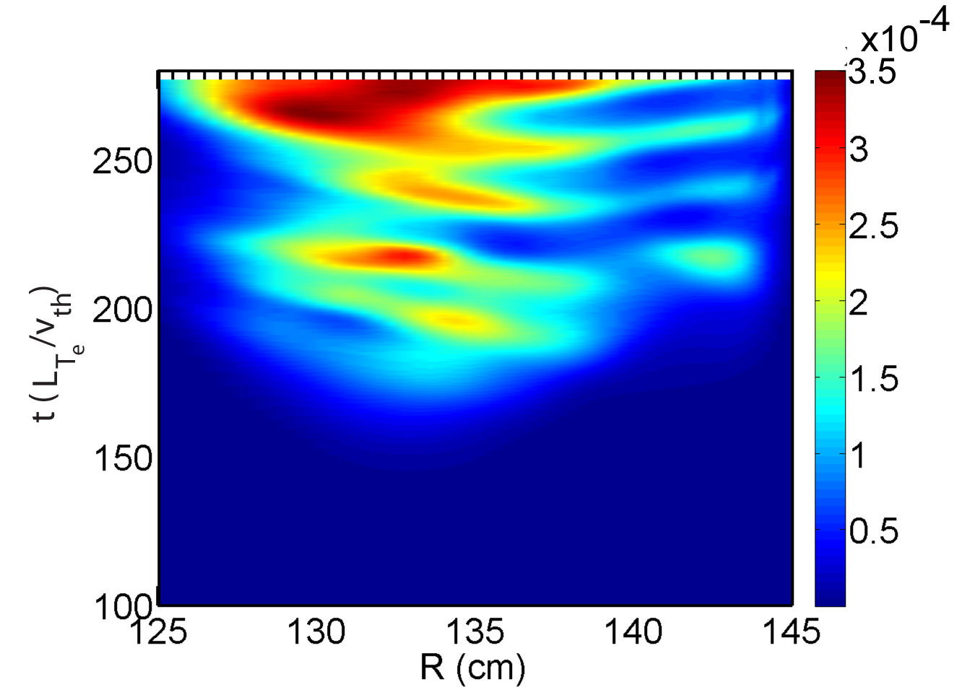
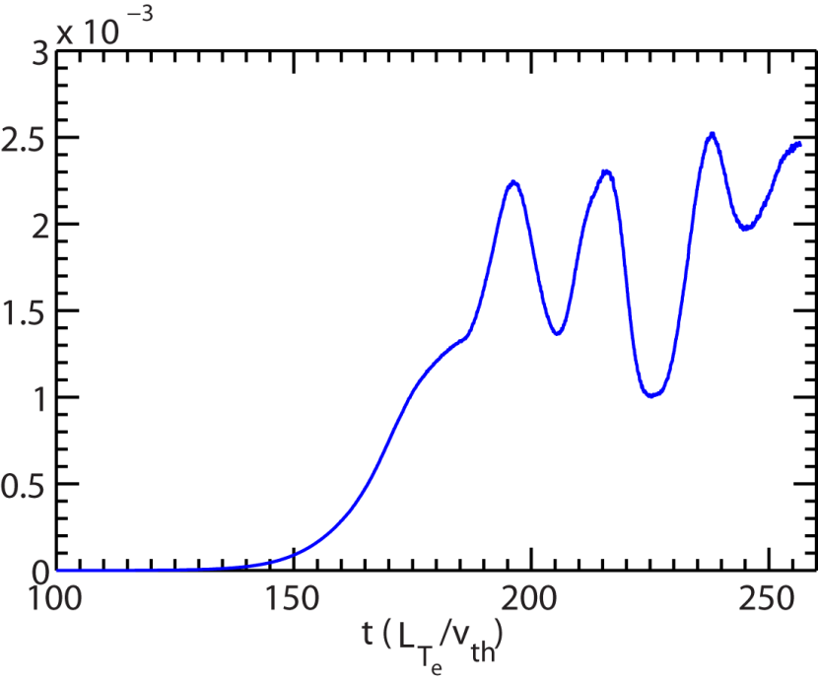
Similar Turbulence Intensity is Found before and after the RF Cessation
R=134 cm
Before RF cessation (t=465 ms)
After the RF cessation (t=482 ms)

Slide 36
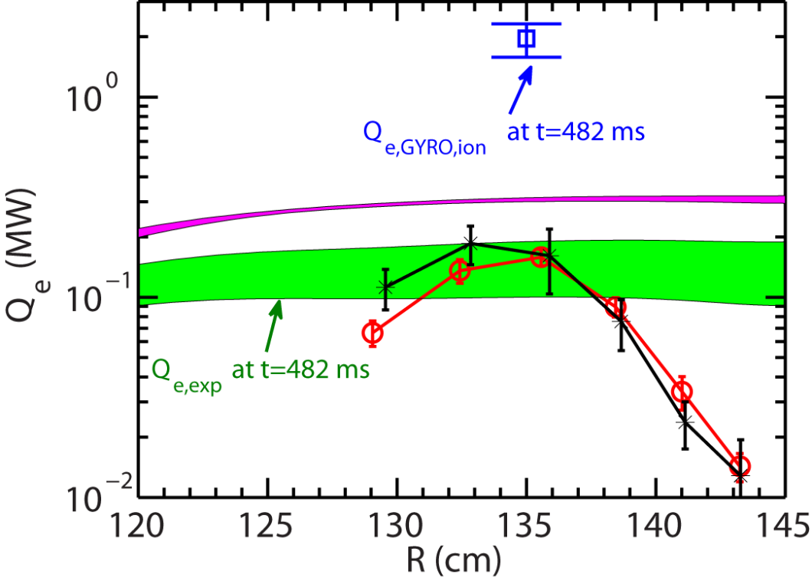
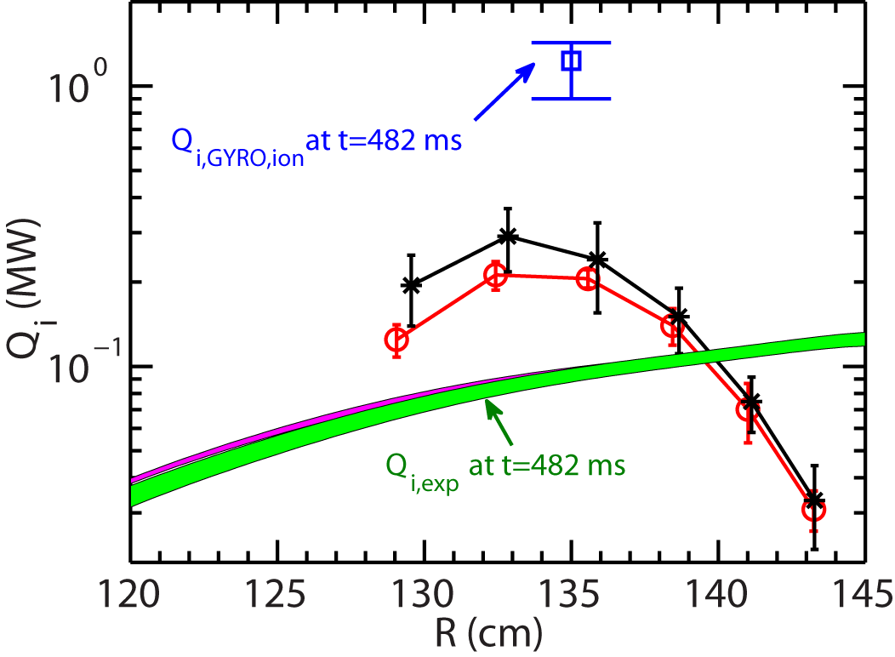
Energy Fluxes from Local Nonlinear Ion-scale GYRO Simulations are Significantly Higher
Local nonlinear ion-scale GYRO simulations were carried out for R=135 cm
T_{e} and T_{i} gradients varied by $±$25% to assess profile stiffness
Weak stiffness is seen
Electron energy flux
Ion energy flux

Slide 37
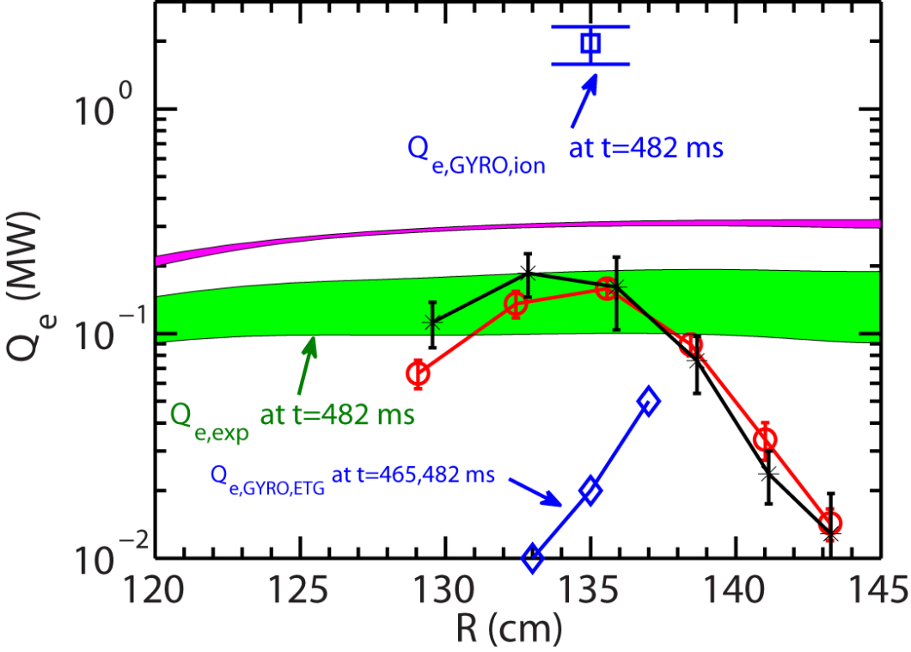
Electron Energy Fluxes from Local Nonlinear ETG GYRO Simulations are Small before and after the RF Cessation
Electron energy fluxes from ETG turbulence have large variation vs radial location
Electron energy flux

Slide 38
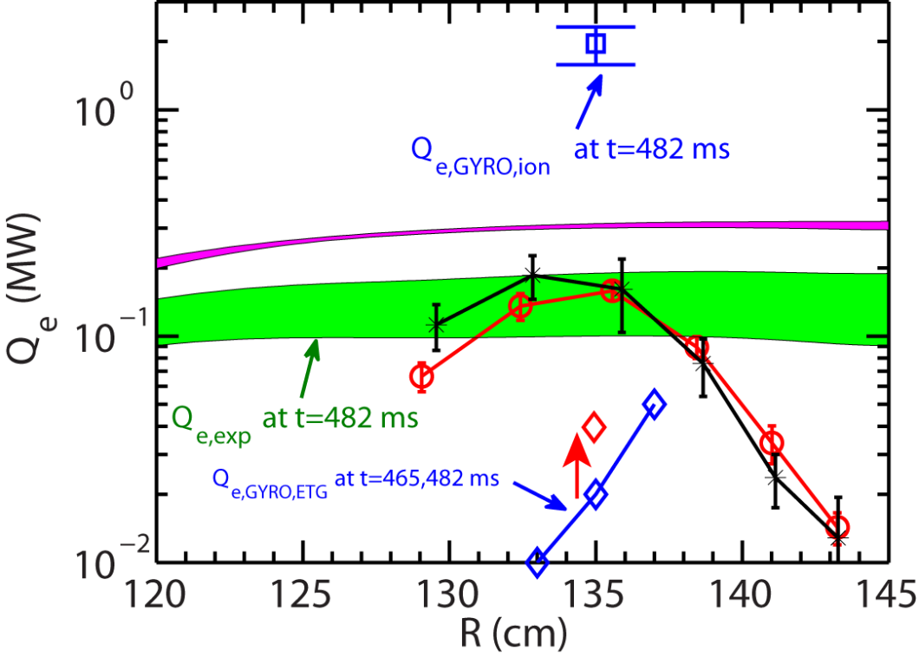
Electron Energy Fluxes from Local Nonlinear ETG GYRO Simulations are Smaller than Experiment
Electron energy fluxes from ETG turbulence have large variation vs radial location
Energy flux from 0.02 MW to 0.04 MW with a 25% increase in T_{e} gradient
Electron energy flux

Slide 39
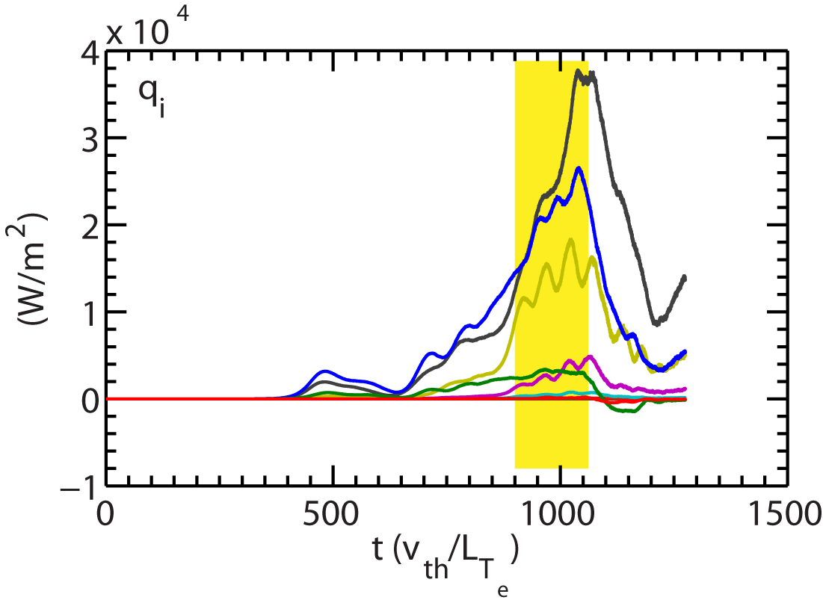
Simulation Quantities are Averaged Over a Quasi-steady Period
t=332 ms
Energy flux drops after significant interaction with boundary in the simulation

