Slide 1
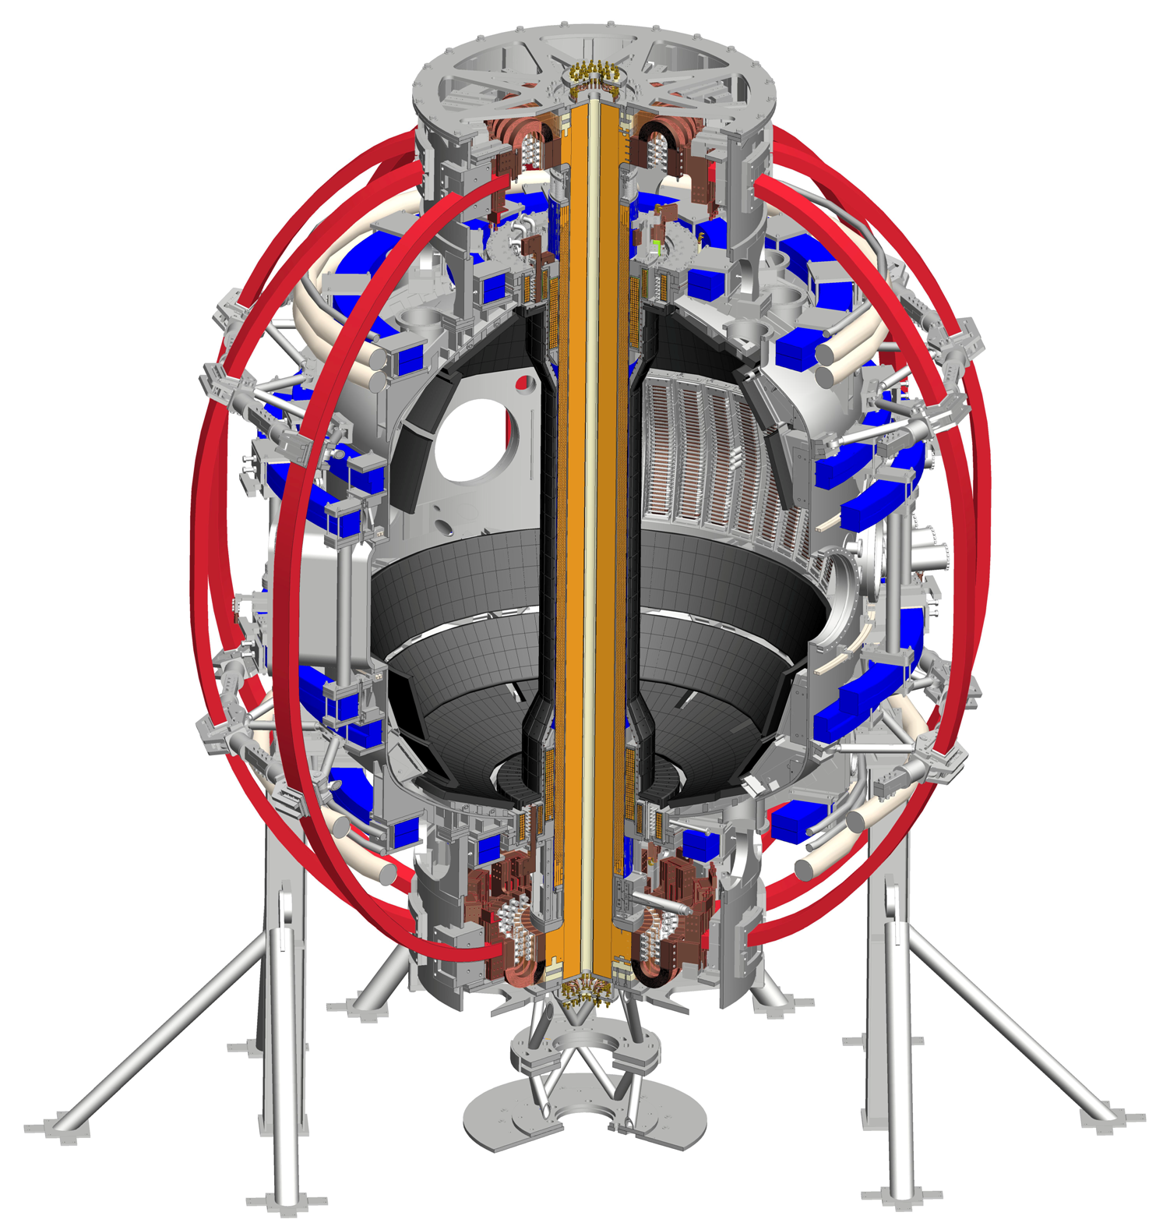
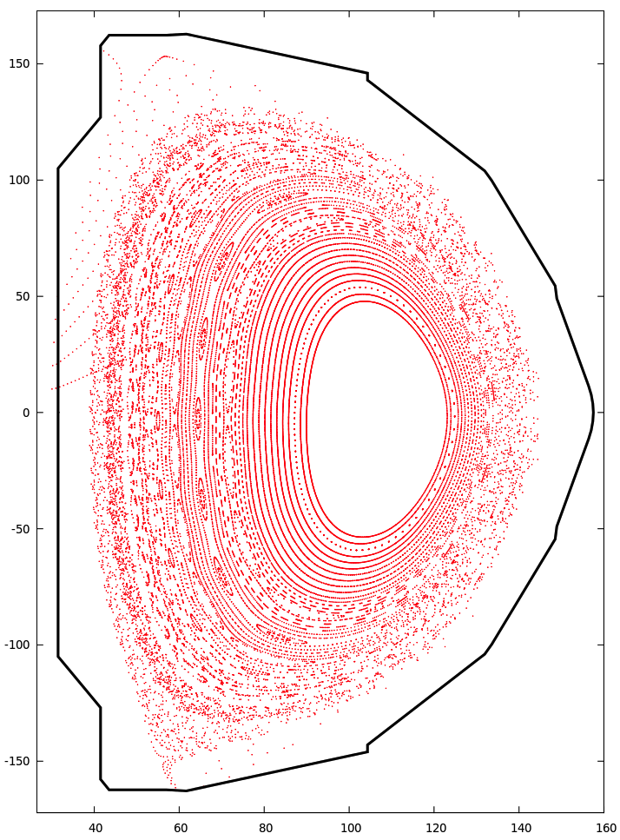
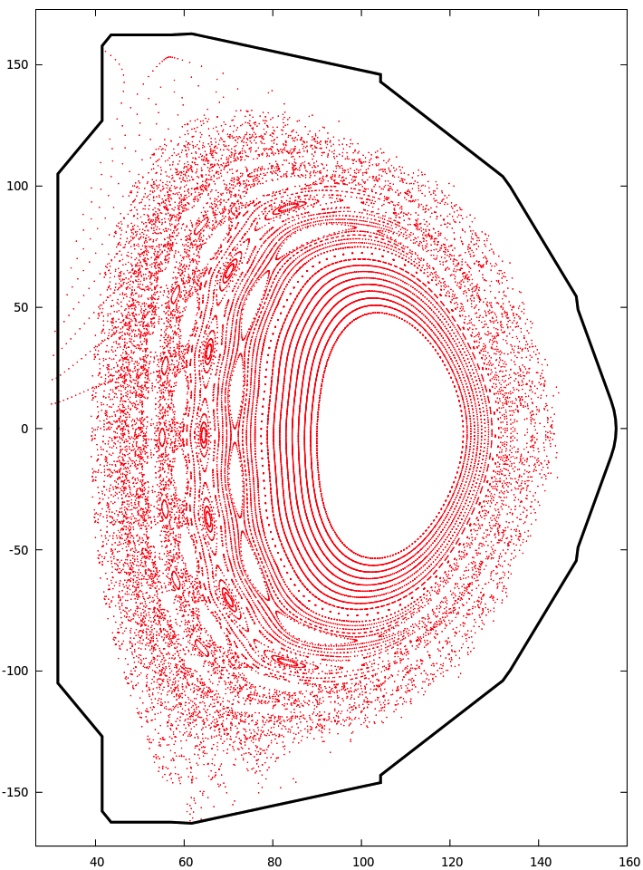
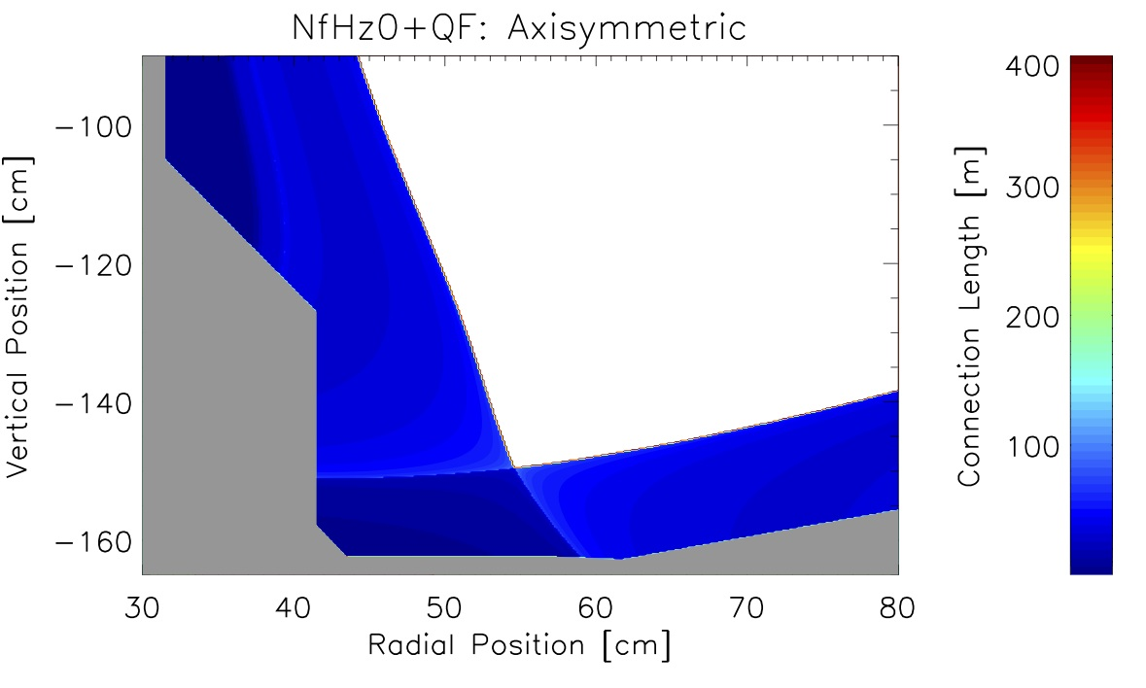
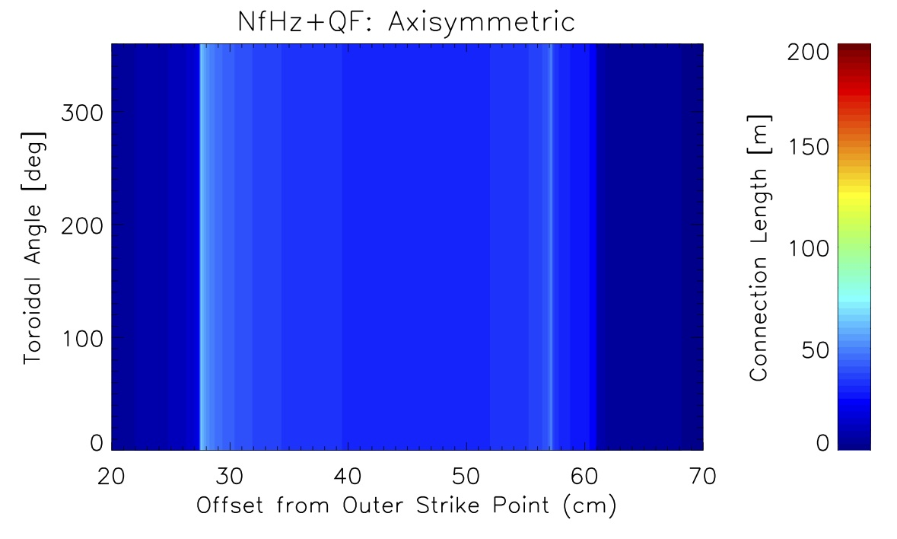
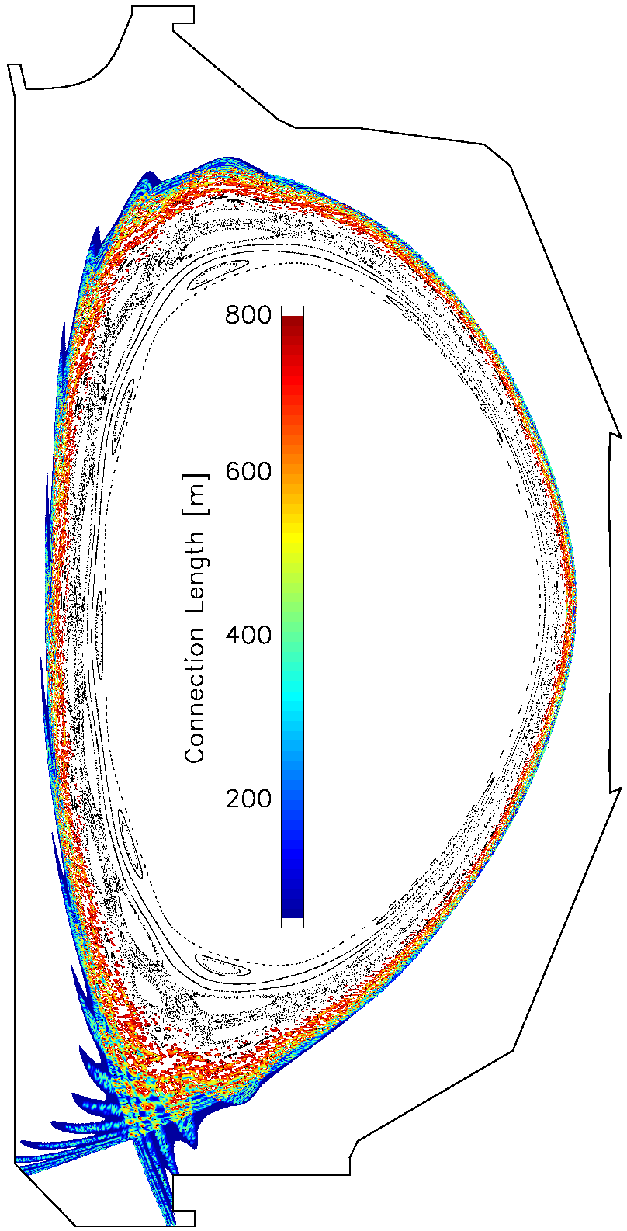
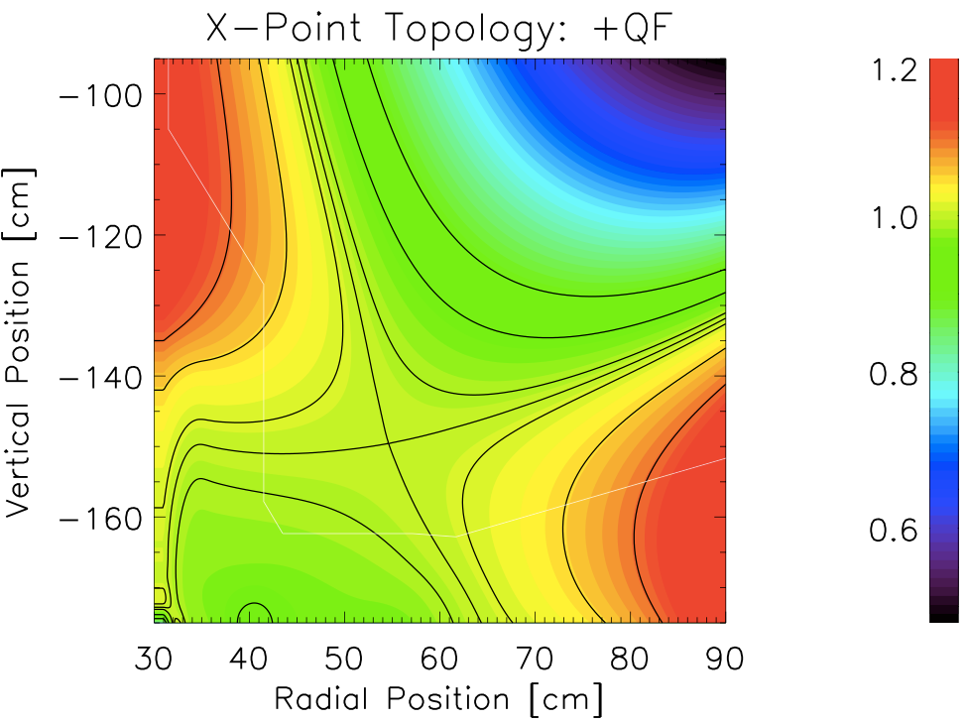
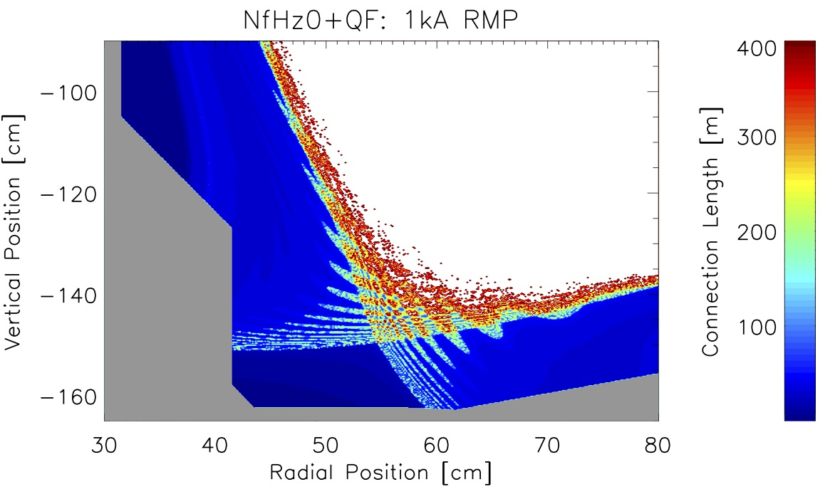
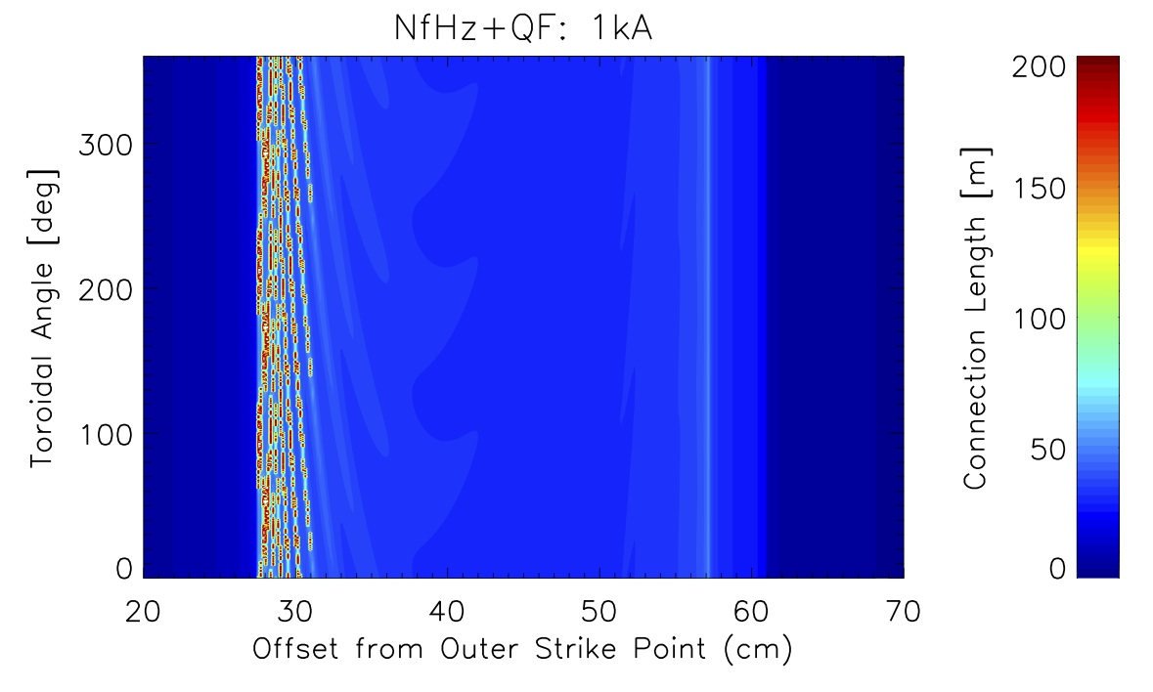
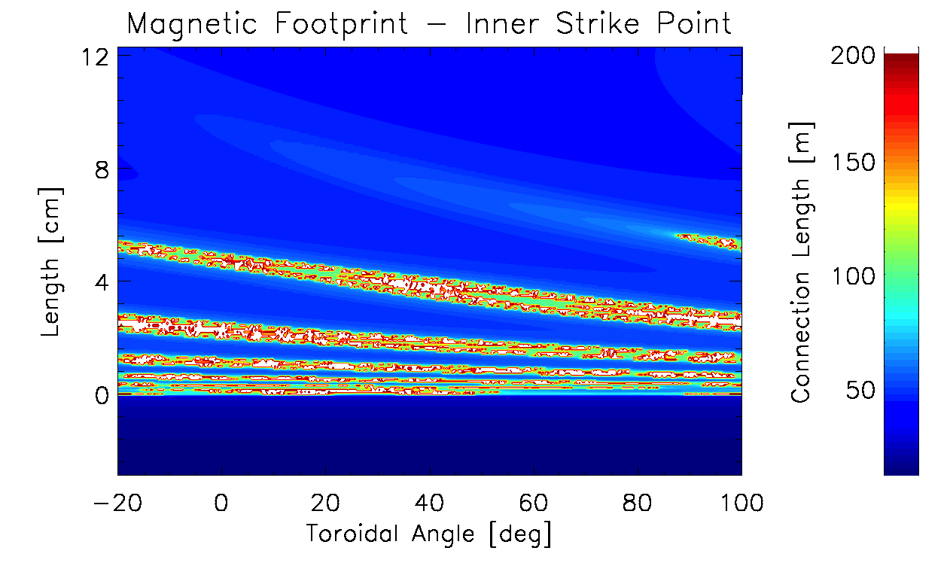
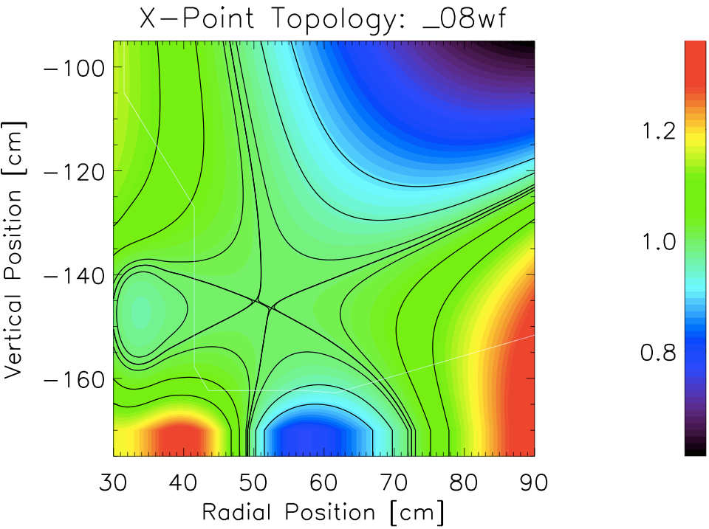
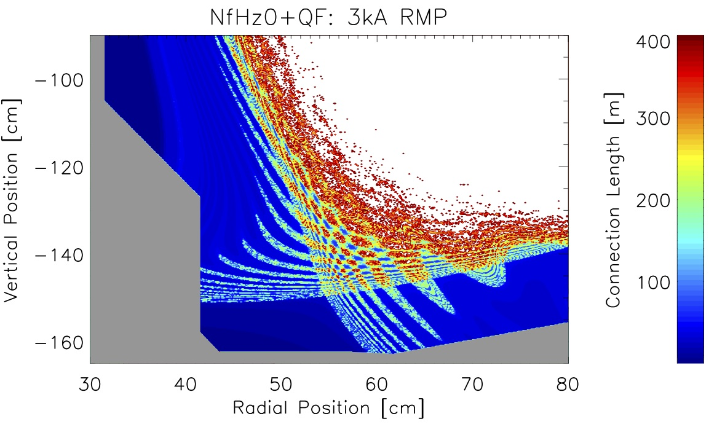
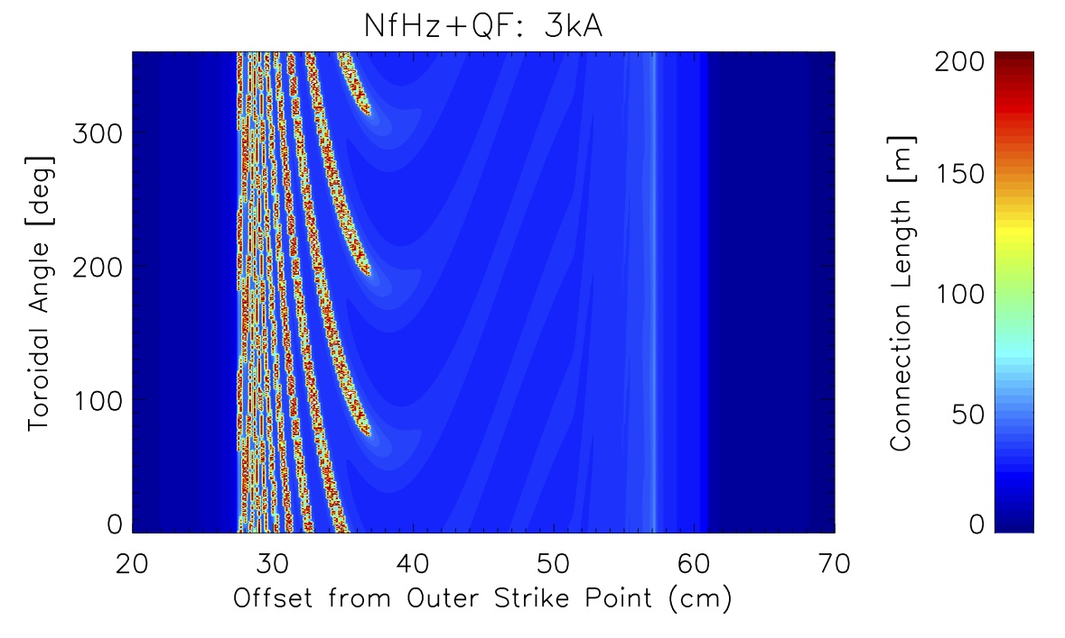
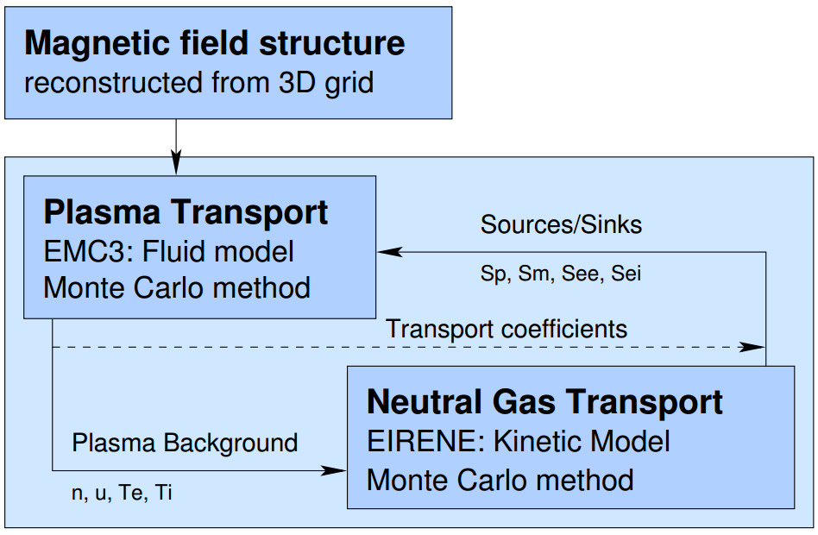
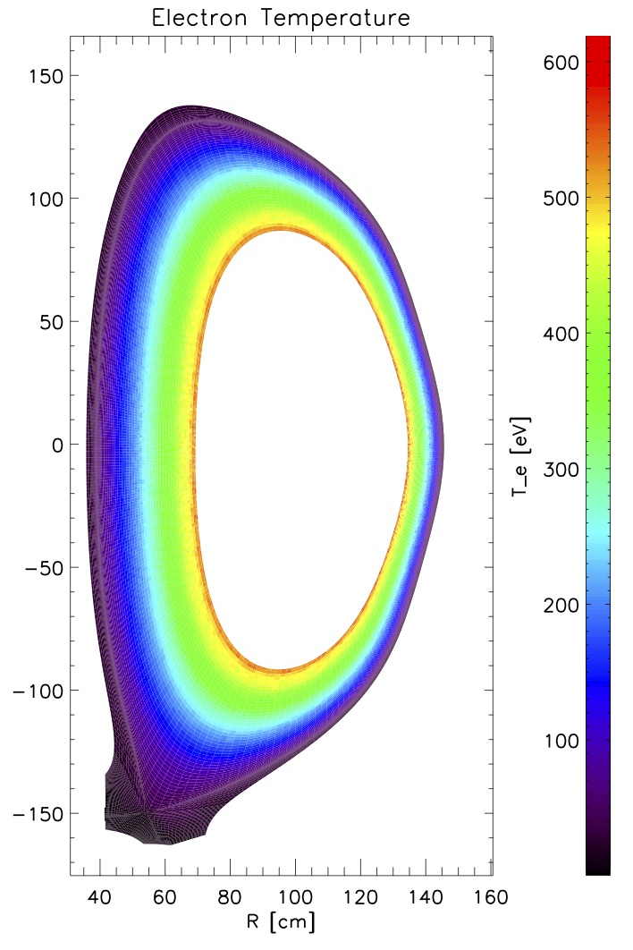
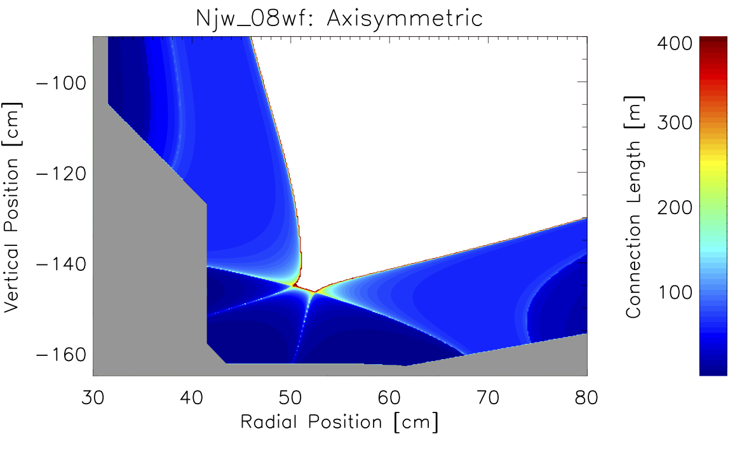
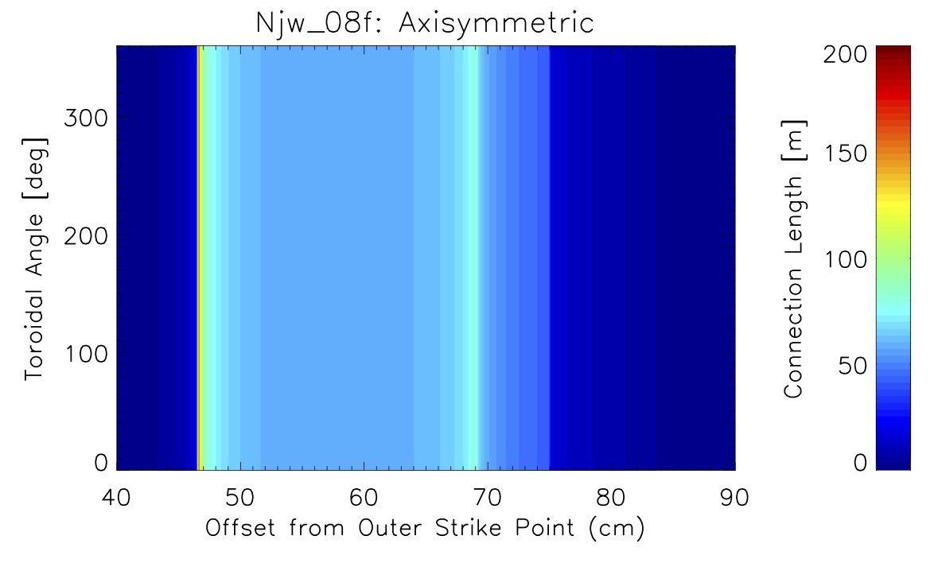
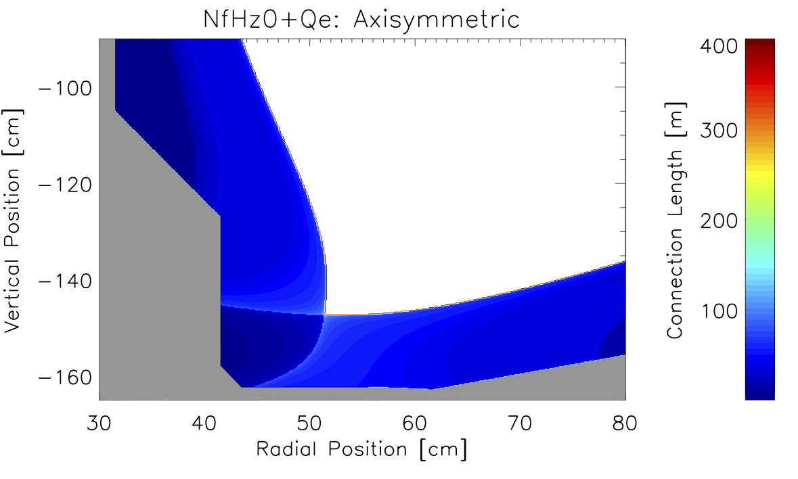
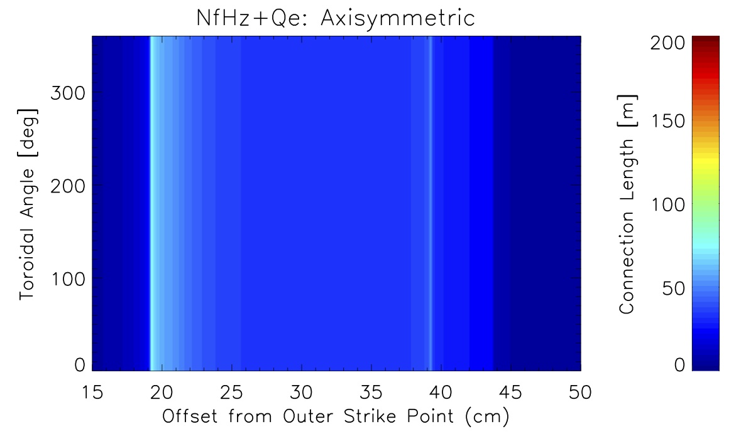
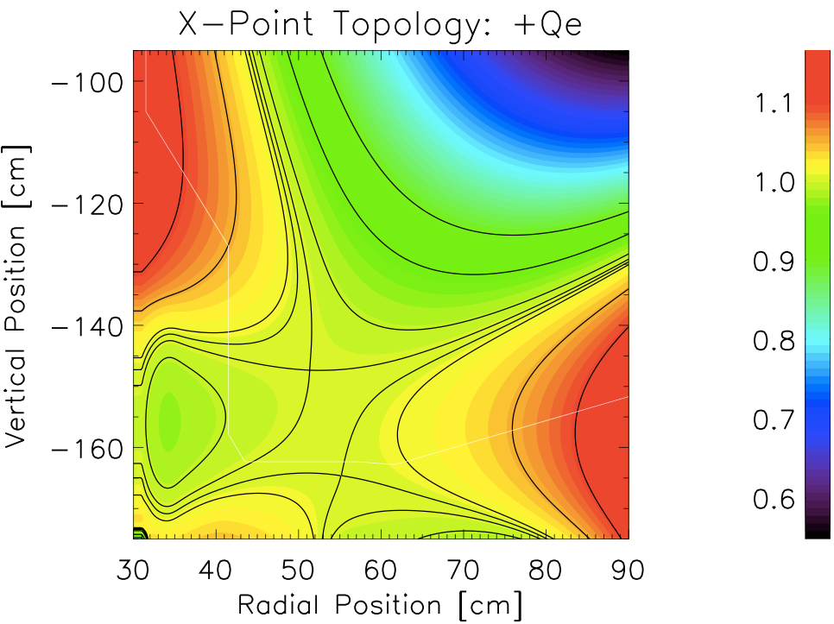
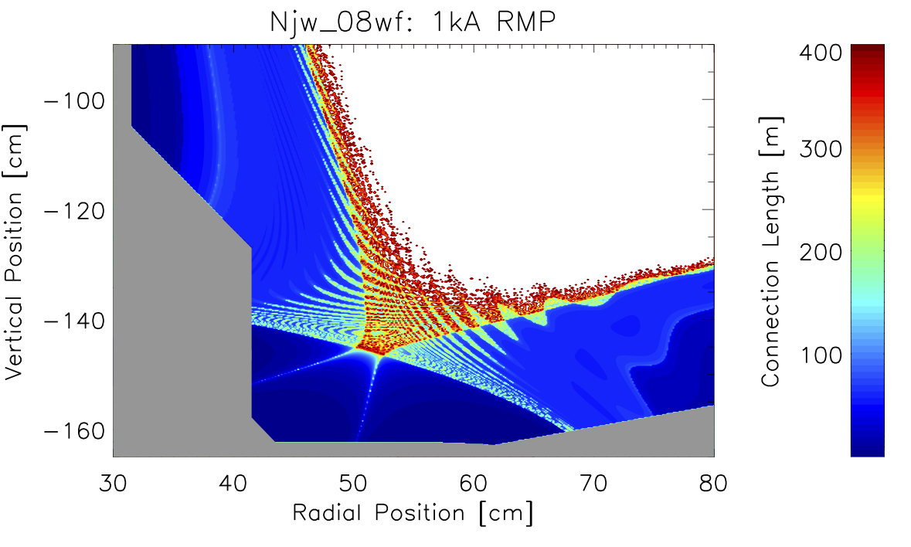
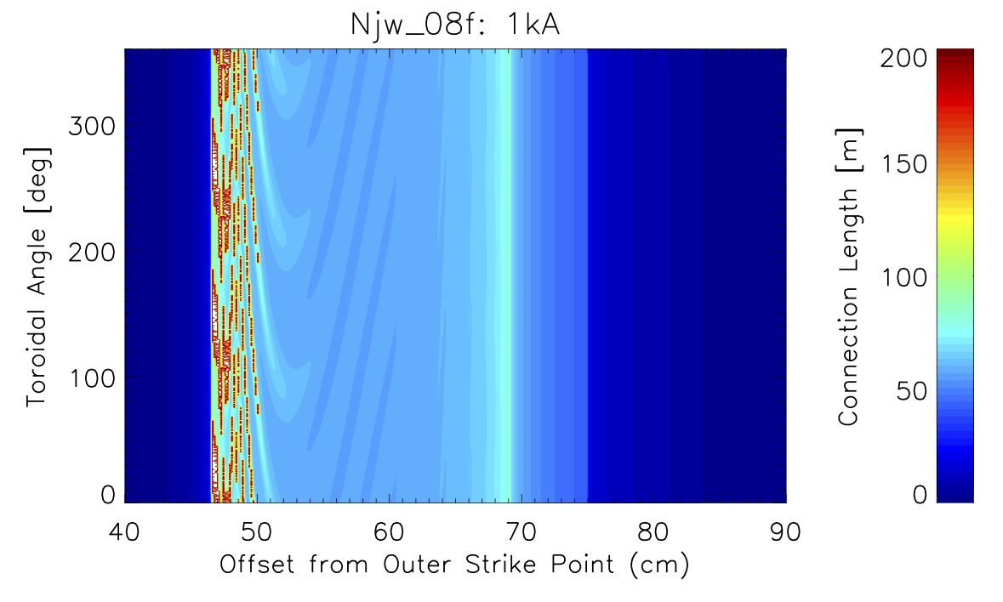
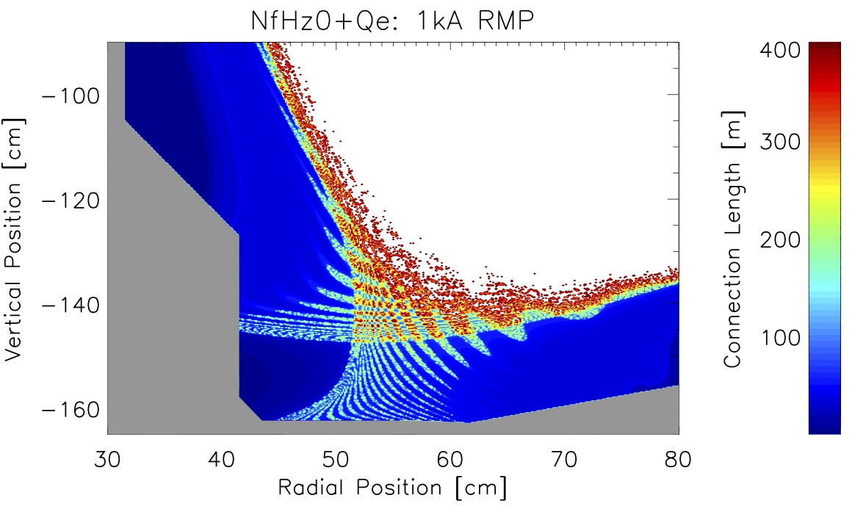
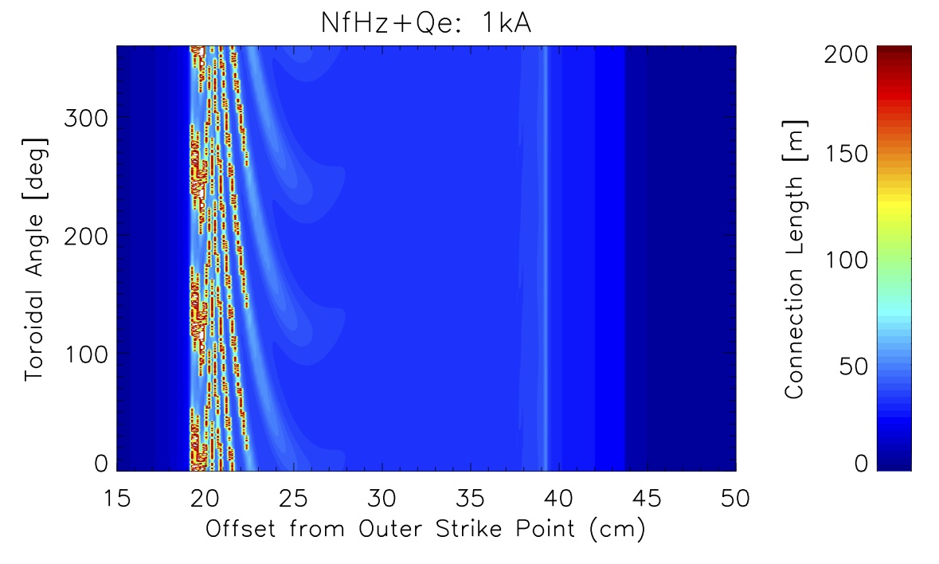
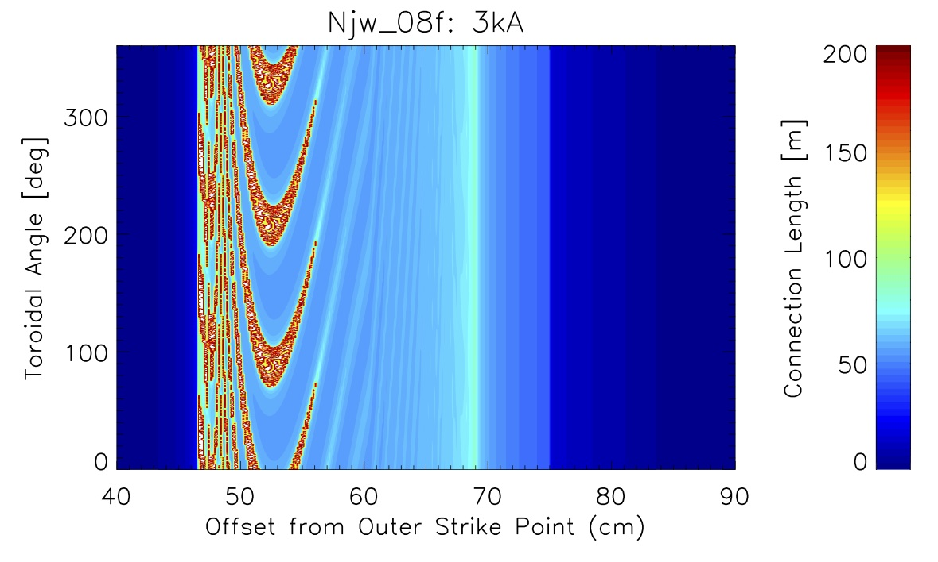
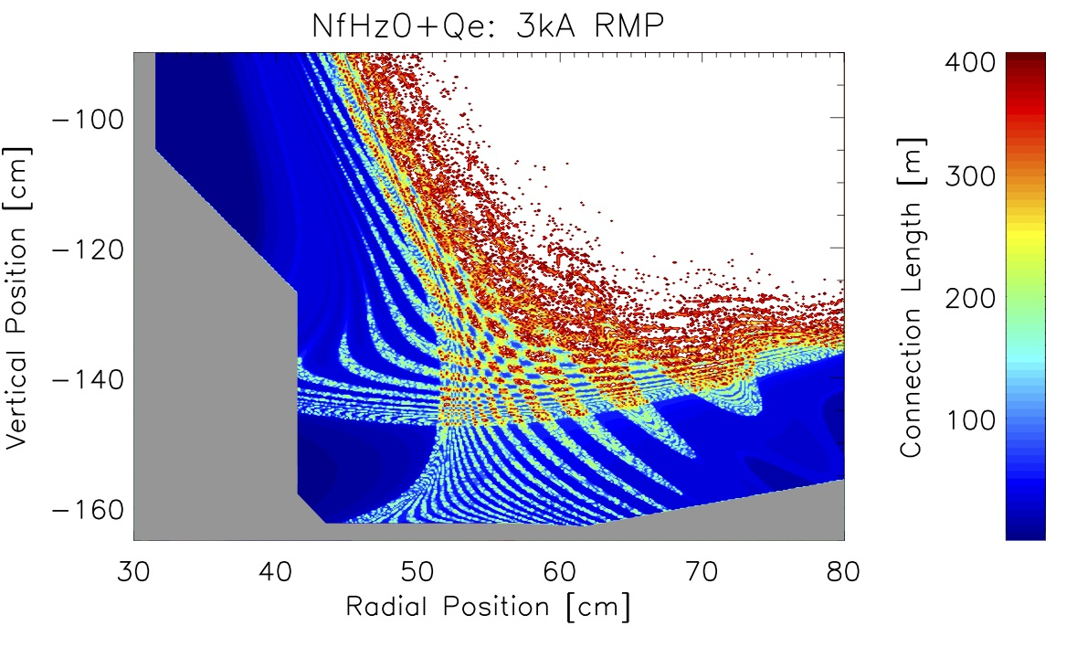
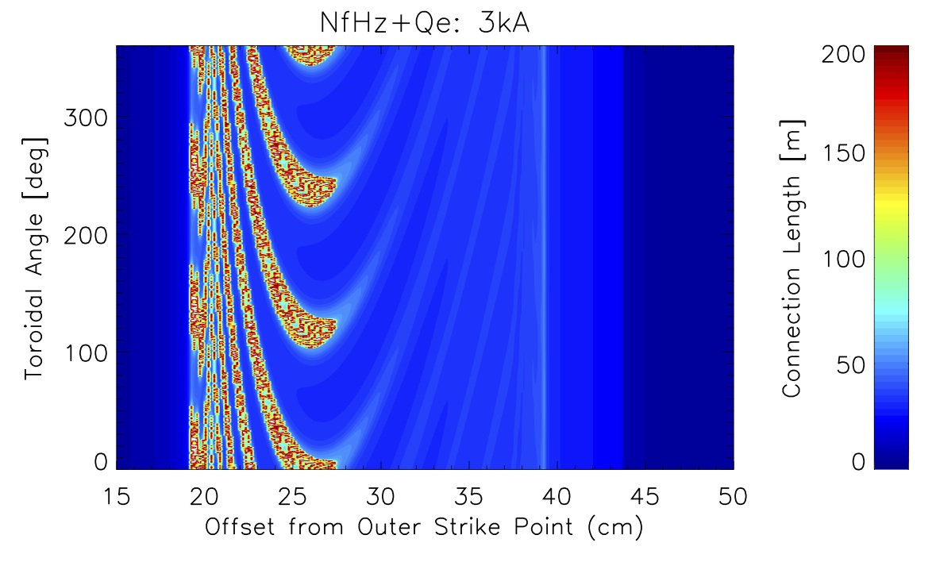
Comparing the Magnetic Divertor Topology and Transport with Resonant Magnetic Perturbation Fields in High and Low Aspect Ratio Tokamaks
¹University of Wisconsin-Madison, Madison, WI, USA ²Princeton Plasma Physics Laboratory, Princeton, NJ, USA ³General Atomics, San Diego, CA, USA ⁴Lawrence Livermore National Laboratory, Livermore, CA, USA
I. Waters¹, H. Frerichs¹, O. Schmitz¹, J.-W. Ahn², G. Canal³, T.E. Evans³, V. Soukhanovskii⁴
Introduction
There is ongoing research into Advanced Divertor configurations at both high and low aspect ratio tokamaks
Simultaneous studies are ongoing into the effects of Resonant Magnetic Perturbations (RMPs) on divertor heat loads, particle exhaust, and impurity screening
Given the use of RMPs for edge localized mode and density control, need to understand how RMPs will behave with Advanced Divertors
A comparison between these effects in low and high aspect ratio tokamaks will help facilitate applications of modeling and experiments in one class of tokamaks to designs of the other
Advanced Divertors
Divertor Configuration has been critical for the progress in tokamaks towards better:
Power Exhaust
D/T/He Pumping
Impurity Screening
Significant challenges with scaling towards ITER and DEMO
Deposited Power/Area
Heat Flux
ELM Control
Resonant Magnetic Perturbations
Resonant Magnetic Perturbations (RMPs) are used to create island chains along flux surfaces which can break up into chaotic regions when islands overlap:
These can control damaging ELMs and prevent high transient heat loads against the first wall
RMPs may also impact particle exhaust and transport in the edge plasma
Here we study the effects of the NSTX-U n=3 RMP fields
Different currents in the RMP coils create varying sizes of chaotic regions
ADVANCED DIVERTORS use alternate magnetic topologies to mitigate these issues
Multiple standard divertors
Multiple X-Points
Higher order null X-Points
NSTX-U: Image Credit PPPL
Credit: Soukhanovskii, V. LLNL-PRES-663440 Edge Coordinating Committee Fall 2014 Technical Meeting
Magnetic Configurations
Three comparative configurations:
Standard Divertor (+QF)
Near Exact Snowflake (_08wf)
Snowflake Minus (+Qe)
Connection Lengths
Longer connection lengths (L_{C}):
Impact High Recycling regimes
Impact divertor target densities
Higher densities near divertor targets can facilitate pump out of exhaust, and impurities
RMP’s lead to helical lobes at the inner and outer strike points with varying degrees of bending as the RMP current is increased in all three cases
Formation of fine mesh of helical structures
RMPs applied to near exact snowflake shows perturbation in primary divertor legs
‘Boomerang’ shaped bending of inner strike point
Snowflake minus configuration shows flux expansion along the outer strike point
Standard Divertor
Poincare plots show the effect of the application of the n=3 RMP perturbation on the +QF Standard Divertor configuration. A) (Left) shows the effect of a 1kA RMP coil current whereas b) (Right) shows the larger effects of a stronger 3 kA RMP coil current. In both cases the formation of island chains, chaotic regions, and closed flux surfaces of the confined region can be seen.
Helical lobes form as RMPs are applied
Normalized Poloidal Flux
EMC3-EIRENE
Coupled 3D plasma fluid and kinetic neutral transport code
The user defines a number of boundary conditions and transport assumptions:
Edge Input Power
Core Plasma Density or Fueling Rates
Perpendicular Heat and Particle Transport Coefficients
An iterative procedure is used to obtain a self-consistent solution of the non-linear and coupled plasma-neutral gas problem
Standard Divertor with single X-Point
Magnitude of lobes increases with increasing RMP strength
Connection length plots of DIII-D with n=3, 4kA coil current RMPs applied. (Left) 2D Poloidal cut of the full device volume with Poincare plot. (Above) Magnetic footprint of the inner strike point of this standard divertor configuration. Credit H. Frerichs et. al. 2010, Nuclear Fusion Vol. 50, Num. 3
Normalized Poloidal Flux
Near Exact Snowflake
Comparison With DIII-D (R/a=2.7)
With DIII-D we have a comparison case of a more traditional tokamak aspect ratio, with similar shaping and RMP fields to NSTX-U [n=3, RMP Coil Current =4kA]
Both cases exhibit:
Helical lobes
Mesh of helical lobes from overlapping of the perturbed invariant manifolds
Bending of strike lines in magnetic footprint
NSTX-U differs in:
More helical lobes and more closely spaced together
Greater degree of bending along strike lines
Finer mesh of lobe structures near the x-point(s)
Snowflake Minus
Increasing RMP Strength
Advanced Divertors with multiple X-Points
Multiple helical lobes form along outer strike point
Normalized Poloidal Flux
EMC3-EIRENE can be used to investigate a number of plasma, neutral, and impurity parameters throughout the edge volume including ion and electron temperatures throughout the volume (Electron temperature plot shown right).
Perturbations don’t affect secondary divertor legs in Snowflake
Acknowledgments: This work is funded by the Department of Energy under grant DE-SC0012315, DE-FC02-04ER54698 and by startup funds of the Department of Engineering Physics at the University of Wisconsin-Madison.
Flux expansion along outer strike point
Above: Equilibrium plots of the three modeled divertor configurations showing surfaces of constant poloidal magnetic flux normalized to the separatrix.
Results of L_{c} plots motivates further study of helical lobe topology and detailed modeling of fueling, exhaust, and neutral particle transport dynamics in Advanced Divertors with RMPs.
Plots show connection lengths (L_{C}) of the three analyzed equilibria. Poloidal cut is shown in the left columns with projection on inner divertor targets in the right column.
Boomerang shapes along inner strike point

