Slide 1

Study on solenoid-free start-up utilizing outer PF coils with the help of pre-ionization via direct XB MC from LFS in VEST
Hyunyeong Lee, J. G. Jo, S.C. Kim and Y. S. Hwang
Department of Nuclear Engineering Seoul National University
ISTW 2017
September 19th, 2017
NUPLEX, Dept. of Nuclear, Seoul National University,
San 56-1, Shillim-dong, Gwanak-gu, Seoul 151-742, Korea
brbbebbero@snu.ac.kr

Slide 2
Contents
Introduction
  Trapped particle configuration in VEST & KSTAR
  Closed flux surface formation
  Solenoid free start-up using outer PF coils
Formation of Closed Flux Surface
Solenoid free start-up in VEST
  Collisional EBW heating in pre-ionization plasma
  Feasibility of EBW collisionless heating
  0D power balance model
4. Summary & conclusion

Slide 3
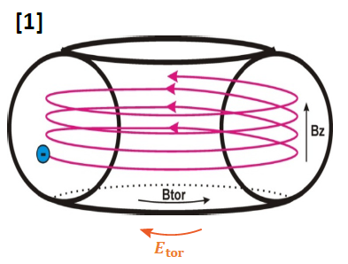
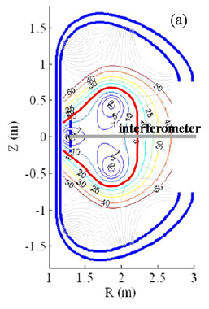


Introduction
Inductive Startup based on Townsend avalanche
[2]
Start-up in fusion devices : inductive & non-inductive (RF, Helicity)
The existing inductive start-up scenario – based on Townsend avalanche
  Long connection length with low vertical field – Field null configuration
[3]
The empirical condition for reliable start-up – Lloyd condition
[4]
  Relaxation with ECH pre-ionization
[1] Jan Stockel, “Plasma start-up in tokamaks”, WS(2010)
[2] Y.S. Bae, et. al., NF 49 022001 (2009)
[3] R. Yoshino, et. al., PPCF 39 205 (1997)
[4] Tanga, A. el. al., “Tokamak Start-up” 159 (1986)

Slide 4
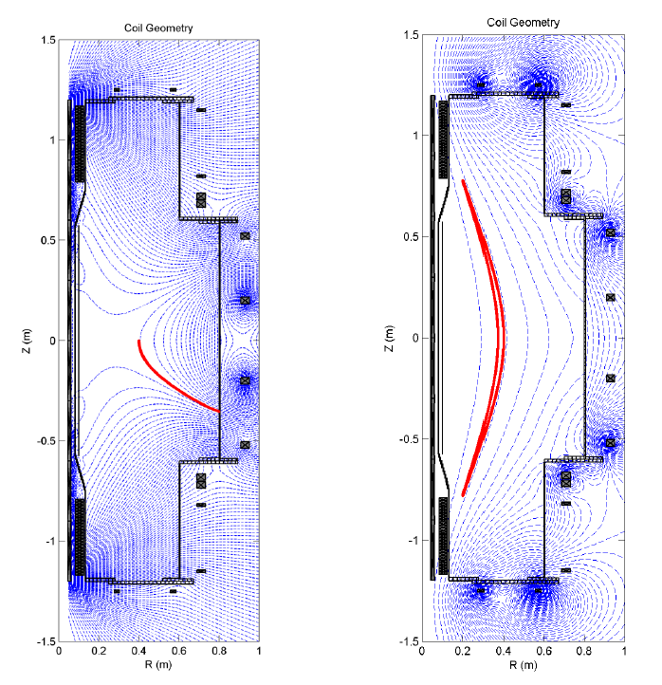
Introduction
Trapped Particle Configuration (TPC) in VEST
(a)
(b)
(a) Field null configuration
  Long connection length
  Requirement of transition time for stable decay index
(b) TPC configuration [5]
  Short connection length
  Enhancement of particle confinement
  Intrinsically stable decay index
Efficient plasma start-up with TPC in VEST
  Fast plasma current formation
  Expanded operation condition
[5] Y.H. An, et. al., NF 57 016001 (2017)
이런 현상이 ST 뿐만 아니라 토카막에서도 적용 가능함 KSTAR 이정원

Slide 5
Introduction
TPC in KSTAR
The start-up experiment utilizing TPC has been demonstrated in KSTAR [6].
  TPC structure formed at R < 2.0 m
  2nd ECR ~ 1.65 m, on TPC structure
  Reliable start-up with wider operation than FNC
2nd ECR
[6] J. W. Lee, et. al., FEC EX/P4-14 (2016)

Slide 6
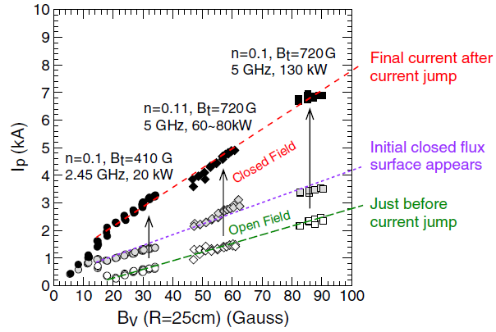
Introduction
What makes CFS formation?
[7]
  The current jump occurs when the field structure changes from open field to CFS [7].
  What does induce the successful CFS formation and start-up not in FNC but TPC?
    The correlation between enhancement of particle, vertical field and electric field from inductive method
  The quantitative analysis is necessary to understand the mechanism of CFS formation with those relations.
  All the fusion devices using inductive method for start-up has the common problem.
[7] T. Yoshinaga, et. Al., PRL 96 125005 (2006)

Slide 7
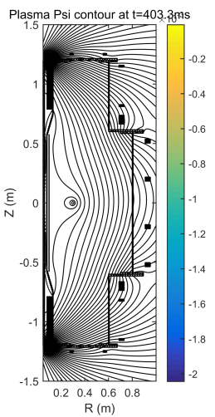
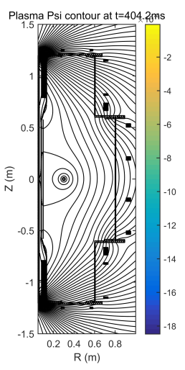
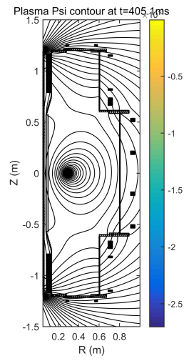
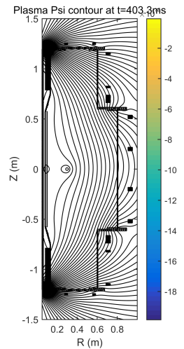
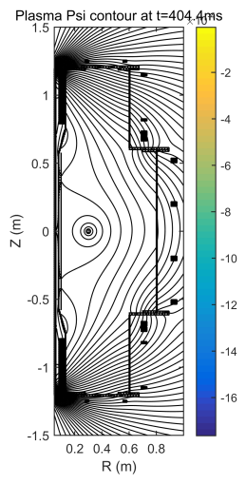
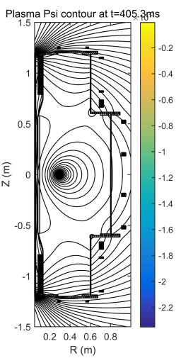
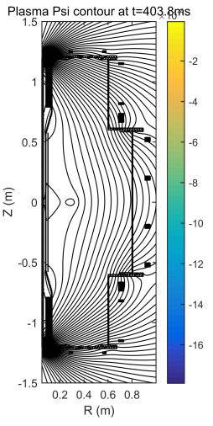

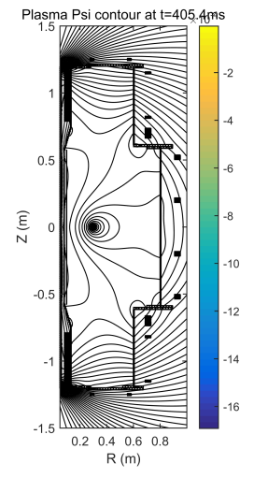
Formation of Closed Flux Surface
CFS formation with decreasing B_{v} along ECH Power
TPC using only central solenoid
  Decreasing B_{v} sustaining TPC
  V_{loop} is supplied continuously after 400 ms
Earlier I_{p} initiation with larger ECH
What determines the timing of CFS formation and plasma current initiation?
  Decreasing B_{v} & Pre-ionization

Slide 8
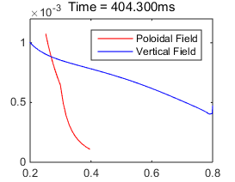
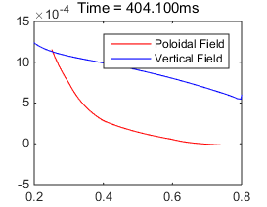
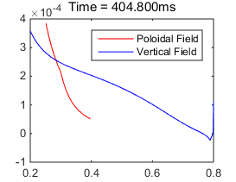
Formation of Closed Flux Surface
Model for CFS formation
ECH 4 kW
Lower resistivity with larger ECH power makes possible faster I_{p} initiation
ECH 6 kW
ECH 2 kW
The model for CFS formation
  The poloidal field from plasma current along resistivity of pre-ionization
  CFS formation : the time when the poloidal field overcomes the decreasing vertical field
  The timing of CFS formation is well reproduced in experimental results.

Slide 9
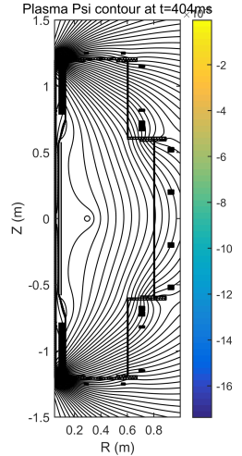
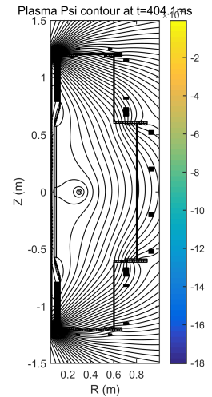
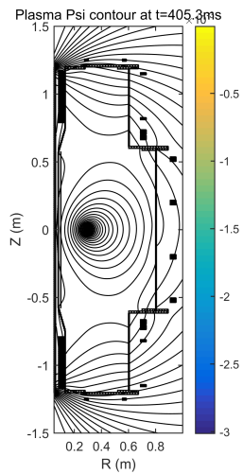
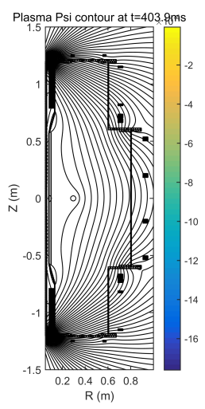


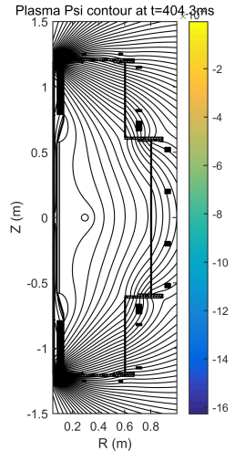
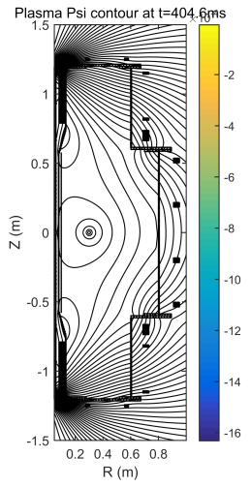
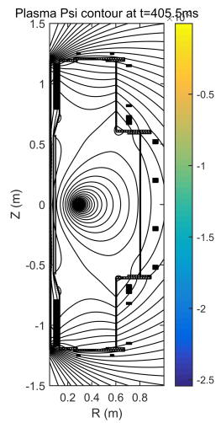
Formation of Closed Flux Surface
CFS formation with decreasing B_{v} along B_{t}
The plasma current initiates differently along the toroidal field.
Resistivity profile changes along B_{t}

Slide 10
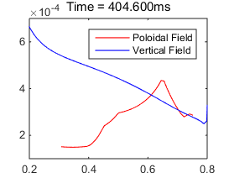
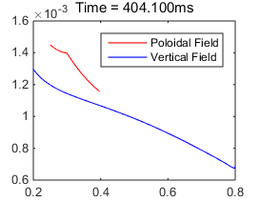
Formation of Closed Flux Surface
CFS Formation along B_{t}
The CFS formation occurs the different timing and location due to the different profile of resistivity and toroidal field as shown in CFS formation model.
In case of 0.5 kG and 0.7 kG, the plasma current initiates simultaneously near inboard side which has strong electric field and low resistivity.
In case of 1 kG, the plasma current initiates near outboard region at the vertical field ~ 5 G
B₀ ~ 1 kG
B₀ ~ 0.5 kG
B₀ ~ 0.7 kG
It is possible that CFS formation occurs any position and timing if appropriate electric field and resistivity for I_{p} ramp-up exists in the specific position to overcome the vertical field.

Slide 11
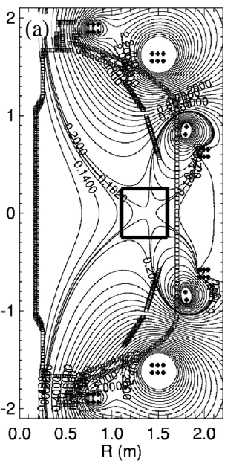
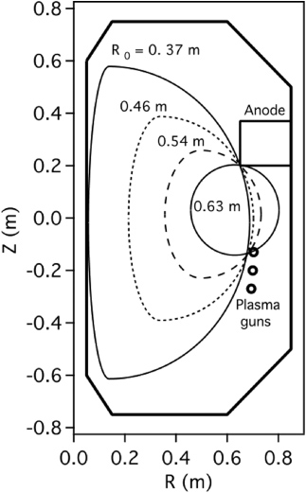
Solenoid free start-up in VEST
Solenoid free start-up using outer PF coils
Solenoid free start-up using outer PF
  Ohmic flux from outer PF coils for equilibrium
  Flux from decrease of external inductance
Solenoid free start-up in NSTX [8]
  The failure of CFS formation
    Difficult for sustaining FNC
    Shortage of pre-ionization
  The importance of effective CFS formation near outboard
Solenoid free start-up in PEGASUS [9]
  CFS formation near outboard with Local Helicity injection (LHI)
  Plasma current evolution with aid of flux from external inductance
[8]
[9]
[8] W. Choe, et. al., NF 45 1463-1473 (2005)
[9] D. J. Battaglia, et. Al., NF 51 073029 (2011)

Slide 12
Solenoid free start-up in VEST
Collisional EBW assisted Pre-ionization plasma
B₀ ~ 1 kG
Enhancement of pre-ionization under TPC with EBW collisional damping
  Tunneling the evanescent layer : the wavelength of injected X wave is relatively longer than the distance between UHR and cutoff
  The generation of steep density gradient near UHR along ECH power
  Direct XB mode conversion
  The over dense plasma with help of EBW collisional damping
  The pre-ionization plasma with low resistivity near outboard region
Solenoid free startup scheme utilizing outer PF coils is suggested with low resistivity near outboard side to form CFS easily

Slide 13
Solenoid free start-up in VEST
Calculation of Pre-ionization Plasma Resistivity
Resistivity Calculation
  Total resistivity is the sum of electron-neutral collision and electron-ion collision (Spitzer)
  Average electron velocity : v_{e}(T_{e})
  Momentum transfer cross section : σ_{m}(T_{e}) [10]
TPC 6 kW
TPC 6+10 kW
[13] J. S. Yoon, et. Al., JPCRD 37 913 (2008)

Slide 14
Solenoid free start-up in VEST
Resistivity calculation for successful SF startup
T_{e} Dominant
n_{e} Dominant
CFS formation near outboard
  The low resistivity of TPC 6 kW & 16 kW does not form CFS
  The poloidal field generated from plasma current overcomes the vertical field when the resistivity is under 1.0E-5
Threshold resistivity 1.0 E-5
Resistivity with TPC 16 kW
Resistivity with TPC 6 kW
It is necessary to make pre-ionization plasma with low resistivity
  Electron temperature dominant region
  EBW collisionless heating near outboard region

Slide 15
Solenoid free start-up in VEST
Feasibility of Collisionless EBW heating
  Boronization (impurity removal) and plasma with high electron temperature
  No change along the electron density profile with additional MW – no collisional damping
  The electron temperature rises near 3rd harmonics – the first position after mode conversion
  Feasibility of EBW Collisionless heating of pre-ionization plasma for low resistivity

Slide 16






Solenoid free start-up in VEST
0D Power balance model
The plasma current evolution will be predicted with 0D power balance model by PEGASUS [11]
0D power balance model for VEST solenoid free start-up
  Source from PF coil : Experimental result
  Source from external inductance : decrease of L_{ext}, shape change(ɛ, κ)
Source
PF coil
Source
External
Inductance
Loss
Internal
Inductance
Loss
Resistive
Dissipation
[12]
[11] J. L. Barr, et. Al., 57th APS (2015)
[12] S.P. Hirshman, et. Al., PF 29 790 (1986)

Slide 17
Solenoid free start-up in VEST
Solenoid free startup scenario in VEST
Initial condition
  Pre-ionization for CFS formation
  The plasma current increases rapidly in the lower resistivity plasma
  Plasma moves inward with decreasing external inductance
    Help of external inductive flux
Decrease of resistive dissipation along the resistivity

Slide 18
Conclusion
  The starting position and timing of plasma current initiation is determined by CFS formation quantitatively and it is applicable for inductive start-up of all fusion devices based on tokamak.
  Direct XB mode conversion and tunneling the evanescent layer from low field side injection is occurred near UHR due to relatively long wavelength of 2.45 GHz microwave and the over dense plasma is generated near outboard region by mode converted EBW collisional damping.
  CFS formation near outboard is essential for reliable solenoid free startup and EBW collisionless heating is necessary for increasing electron temperature to make threshold resistivity under 1.0e-5.
  The successful solenoid free startup is confirmed by 0D power balance model with help of external inductance flux and decreasing resistive dissipation.

