Slide 1
Profile measurements of ion temperature and toroidal rotation velocity from optical emission spectroscopy in VEST
19th International Spherical Torus Workshop
Yoosung Kim, Yue-Jiang Shi, Jae-young Jang, Kyoung-Jae Chung, and Y.S. Hwang
2017.09.19

Slide 2
Contents
Introduction
Experiment setup
Calibration
Spectral inversion and Phantom test
Preliminary result in Ohmic plasma
Summary

Slide 3
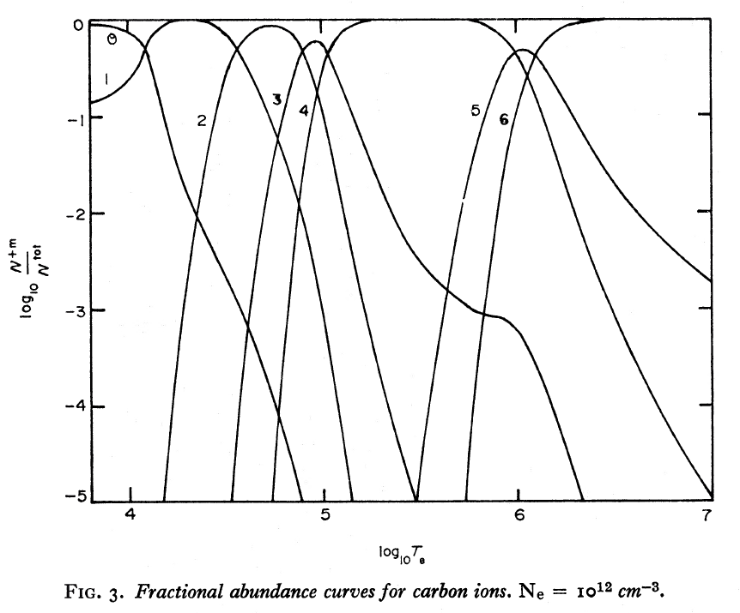
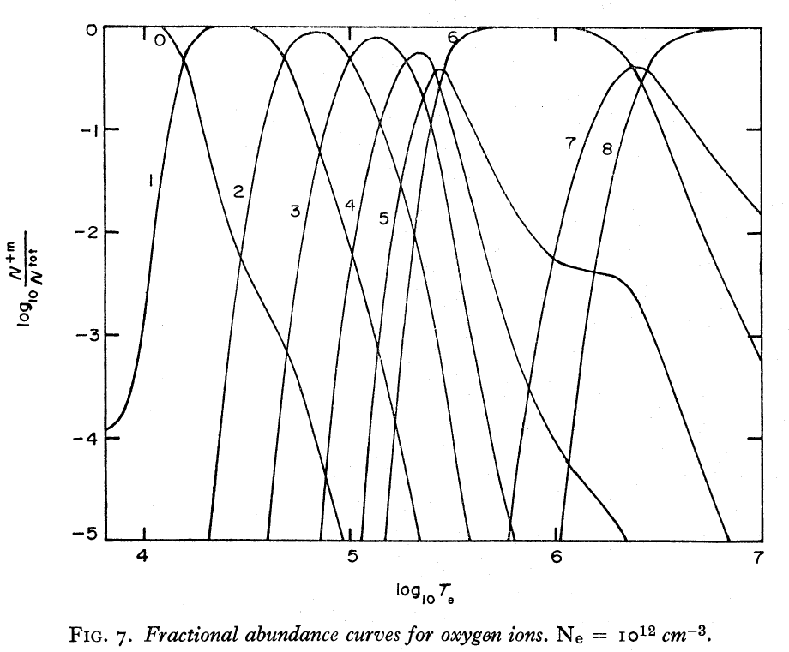
Introduction
$$i$$
$$∆λ_{shift}$$
Spectral shape → rotation and temperature
Line shift : rotation
Line broadening : ion temperature
$$j$$
$$∆λ_{D}^{}$$
Z*
$$λ_{0}$$
$$λ_{shift}$$
Passive emission spectroscopy in visible range
CIII – 464.74 nm
OII – 464.90 nm
Fractional abundance of carbon and oxygen at n_{e}=10¹⁸m⁻³
Characteristics
Without neutral beam
Wide measurement range for VEST → intermediate to edge region cf. 10 eV < T_{e} < 200 eV in VEST
Carbon
Oxygen
Difficulties
Line integrated spectra → inversion process to obtain local properties
Te $<$ 30 eV
Te $<$ 20 eV
H. P. Summers, Monthly Notices of the Royal Astronomical Society 158.3 (1972)

Slide 4
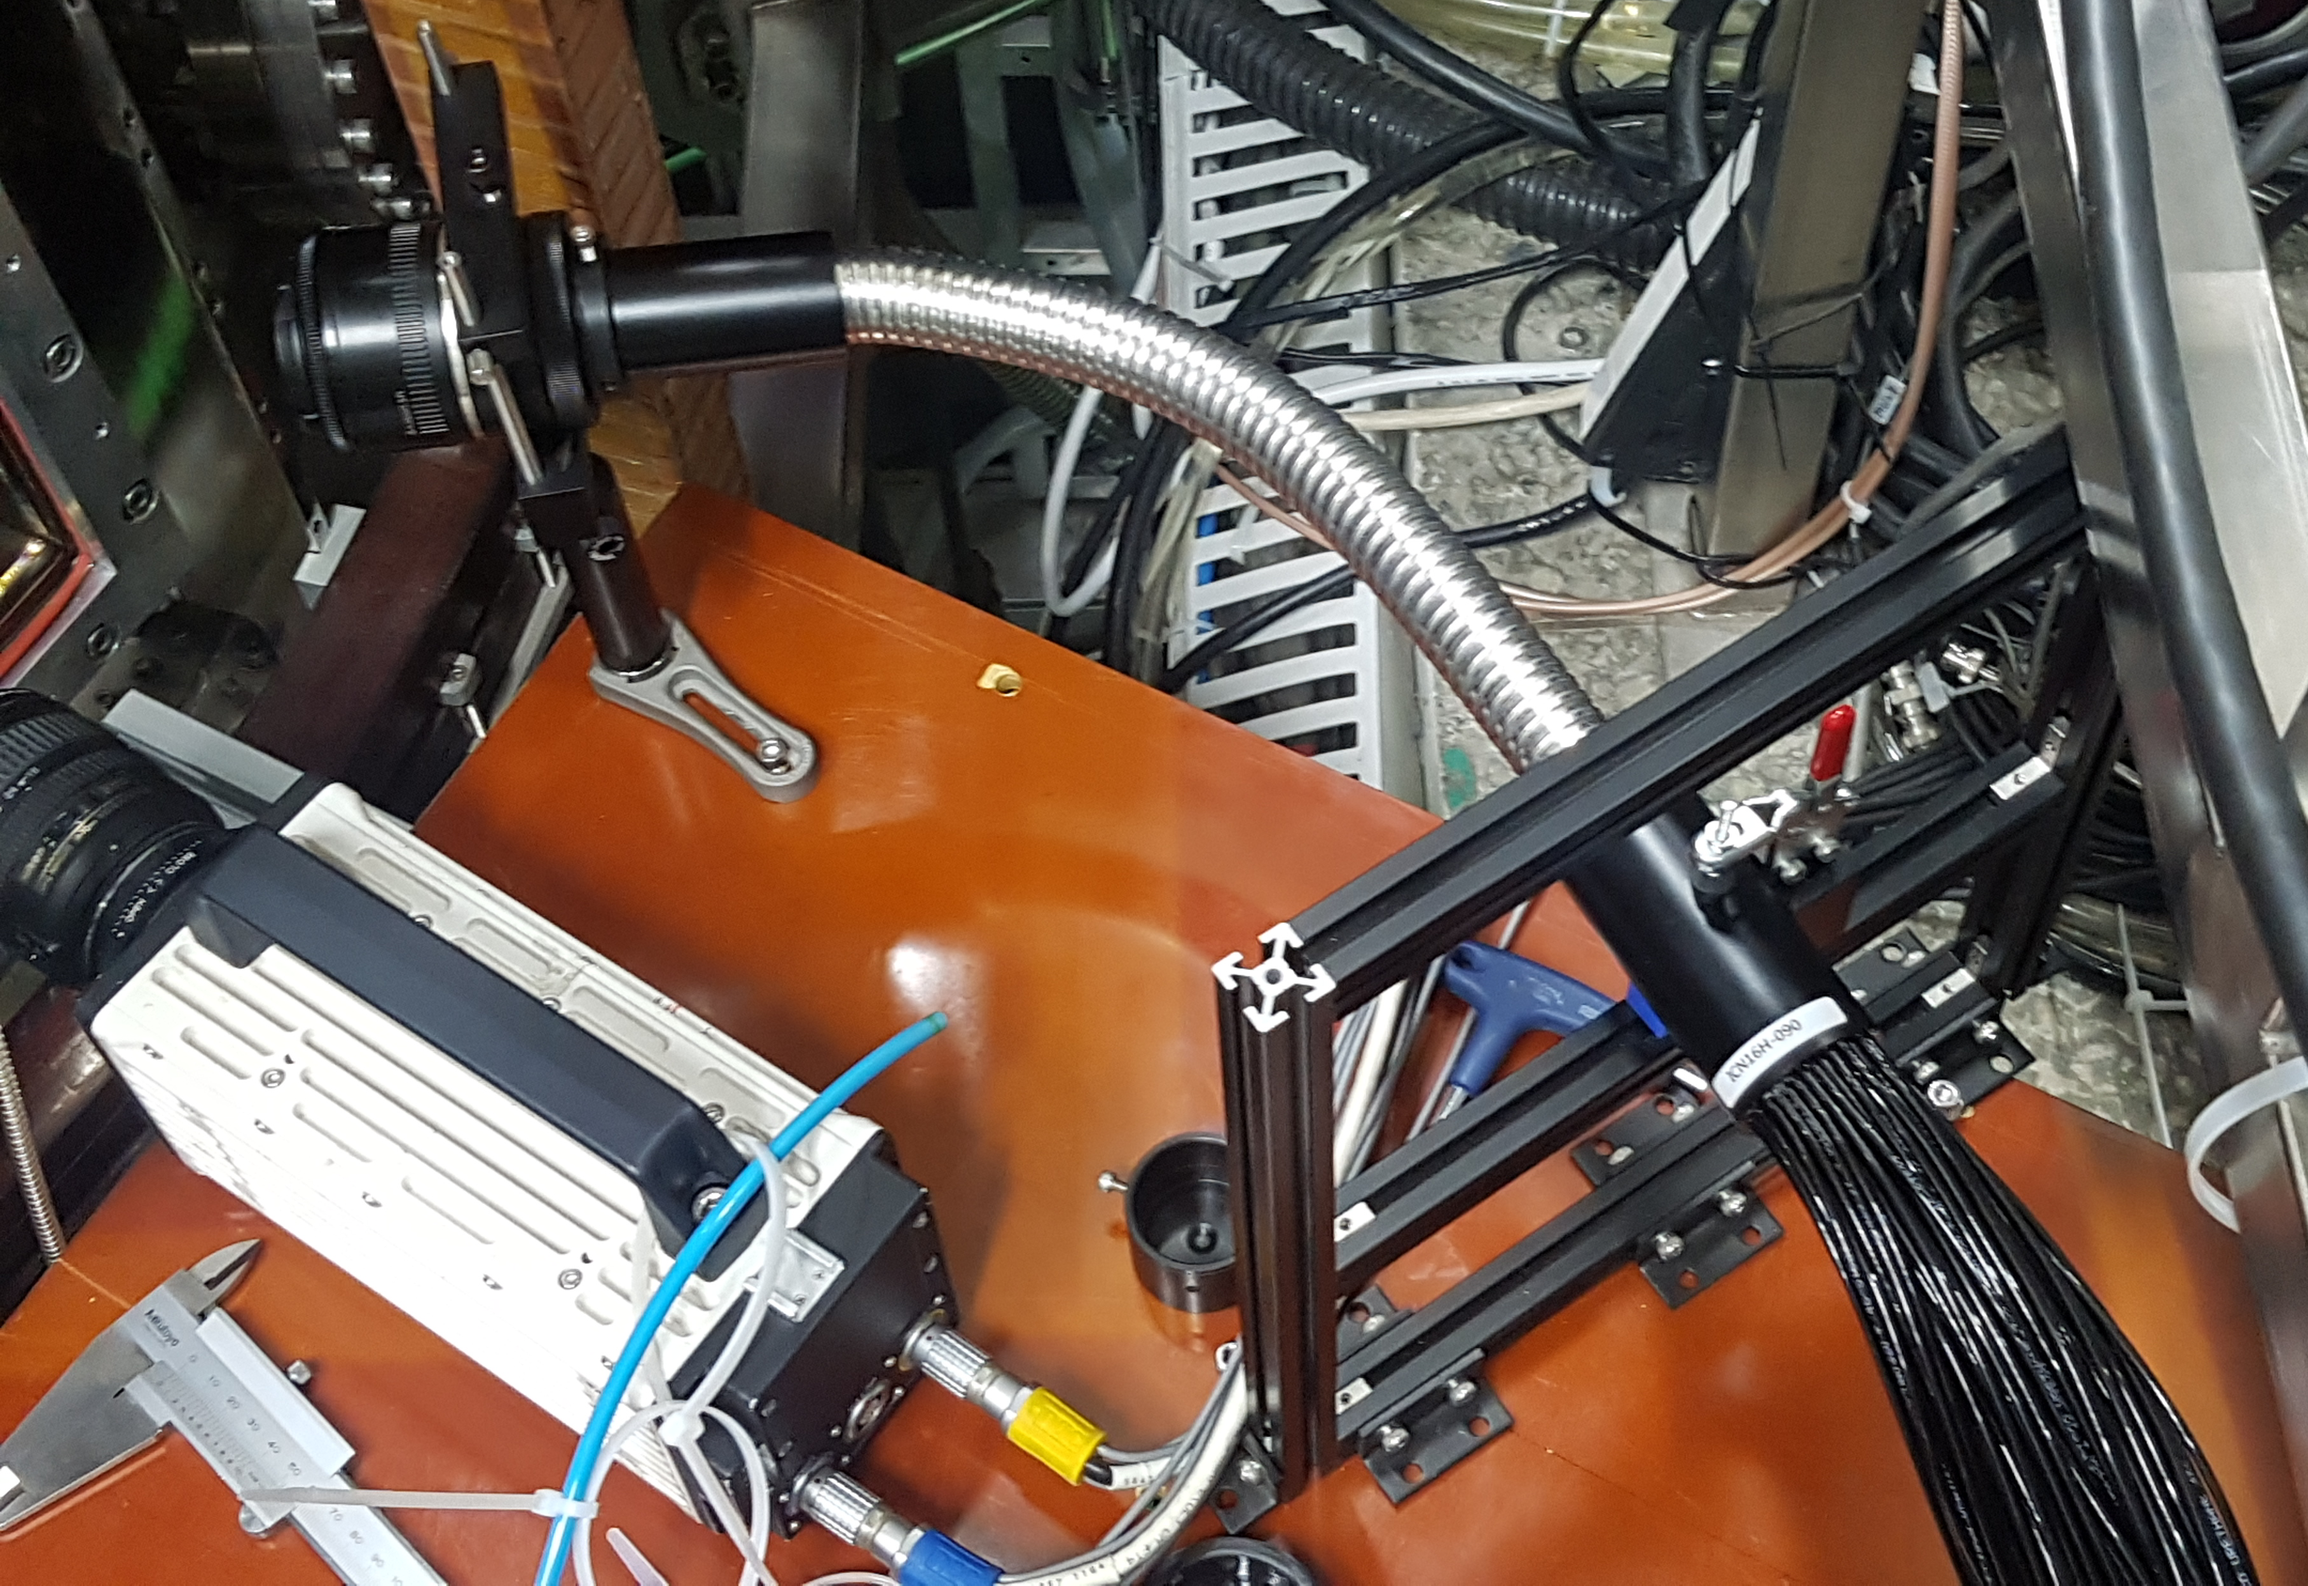
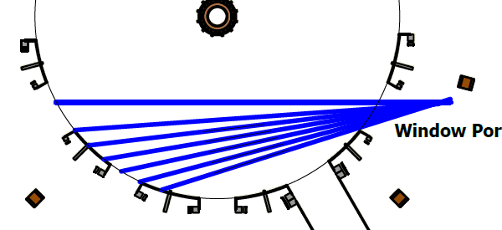
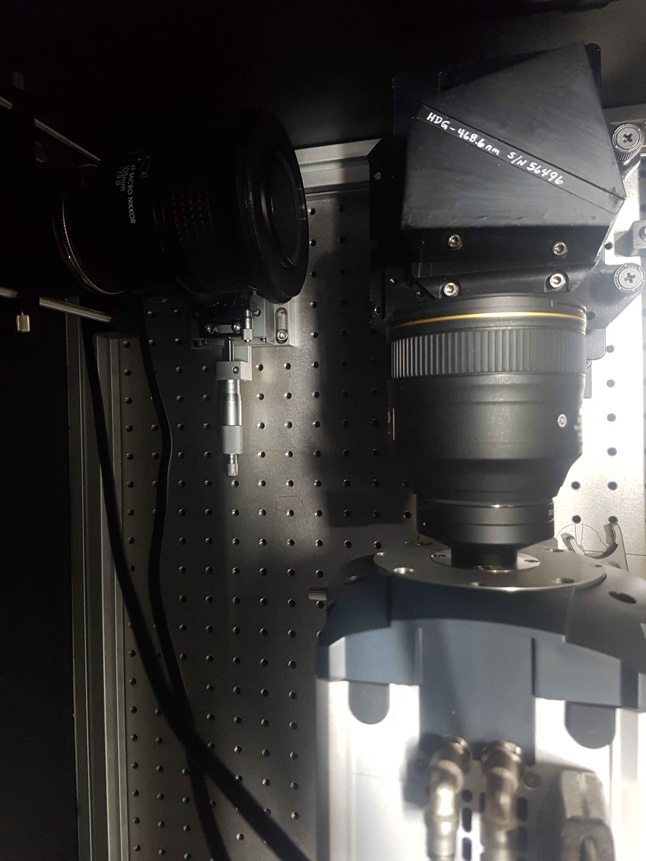
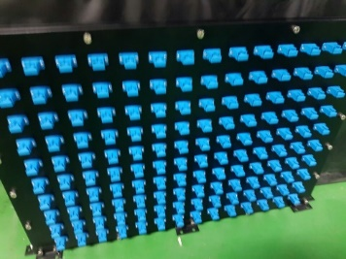
Experiment Setup
Collecting part
Canon 50 mm f/1.8
Fiber array : 35(radial) x 4(vertical)
Spectrometer
Transmission grating (HDG : Kaiser Optical Systems, inc.)
Spatial channel : 7 channel
Dispersion : 0.013 nm/pixel
Detector : EMCCD (Andor iXonUltra888)
Temporal resolution : 2 ms with binning (1.4 ms exposure + 0.6 ms readout)
35 (radial)
4개
Core (R=0.38 m)
Edge (R=0.65 m)
105 mm
f/14
HDG
Slit
$$⋯$$
$$⋯$$
CCD
140 channel
7 channel
85 mm
f/1.4

Slide 5
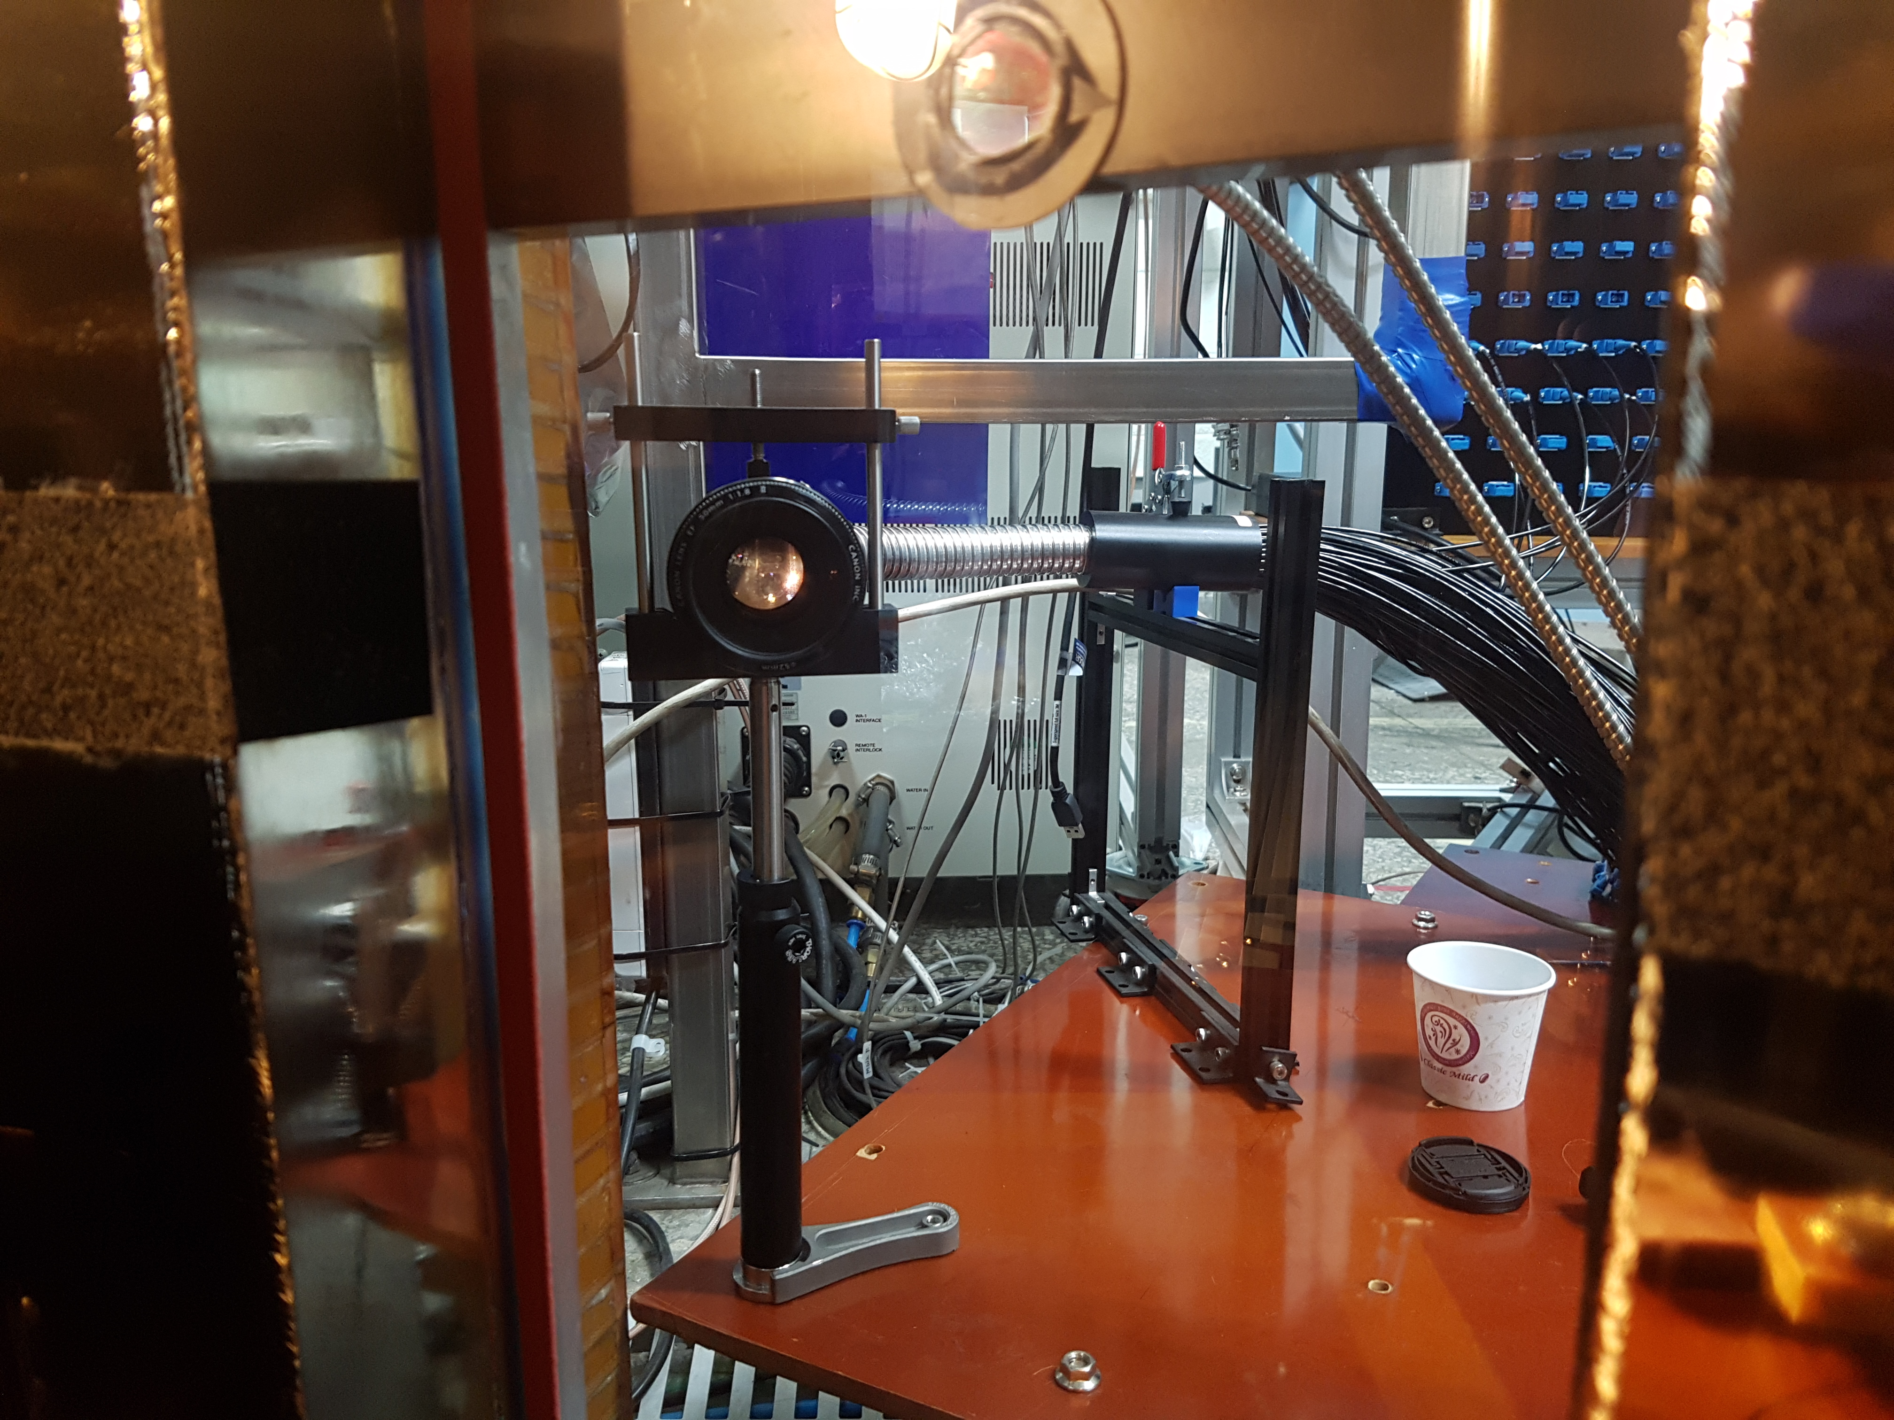
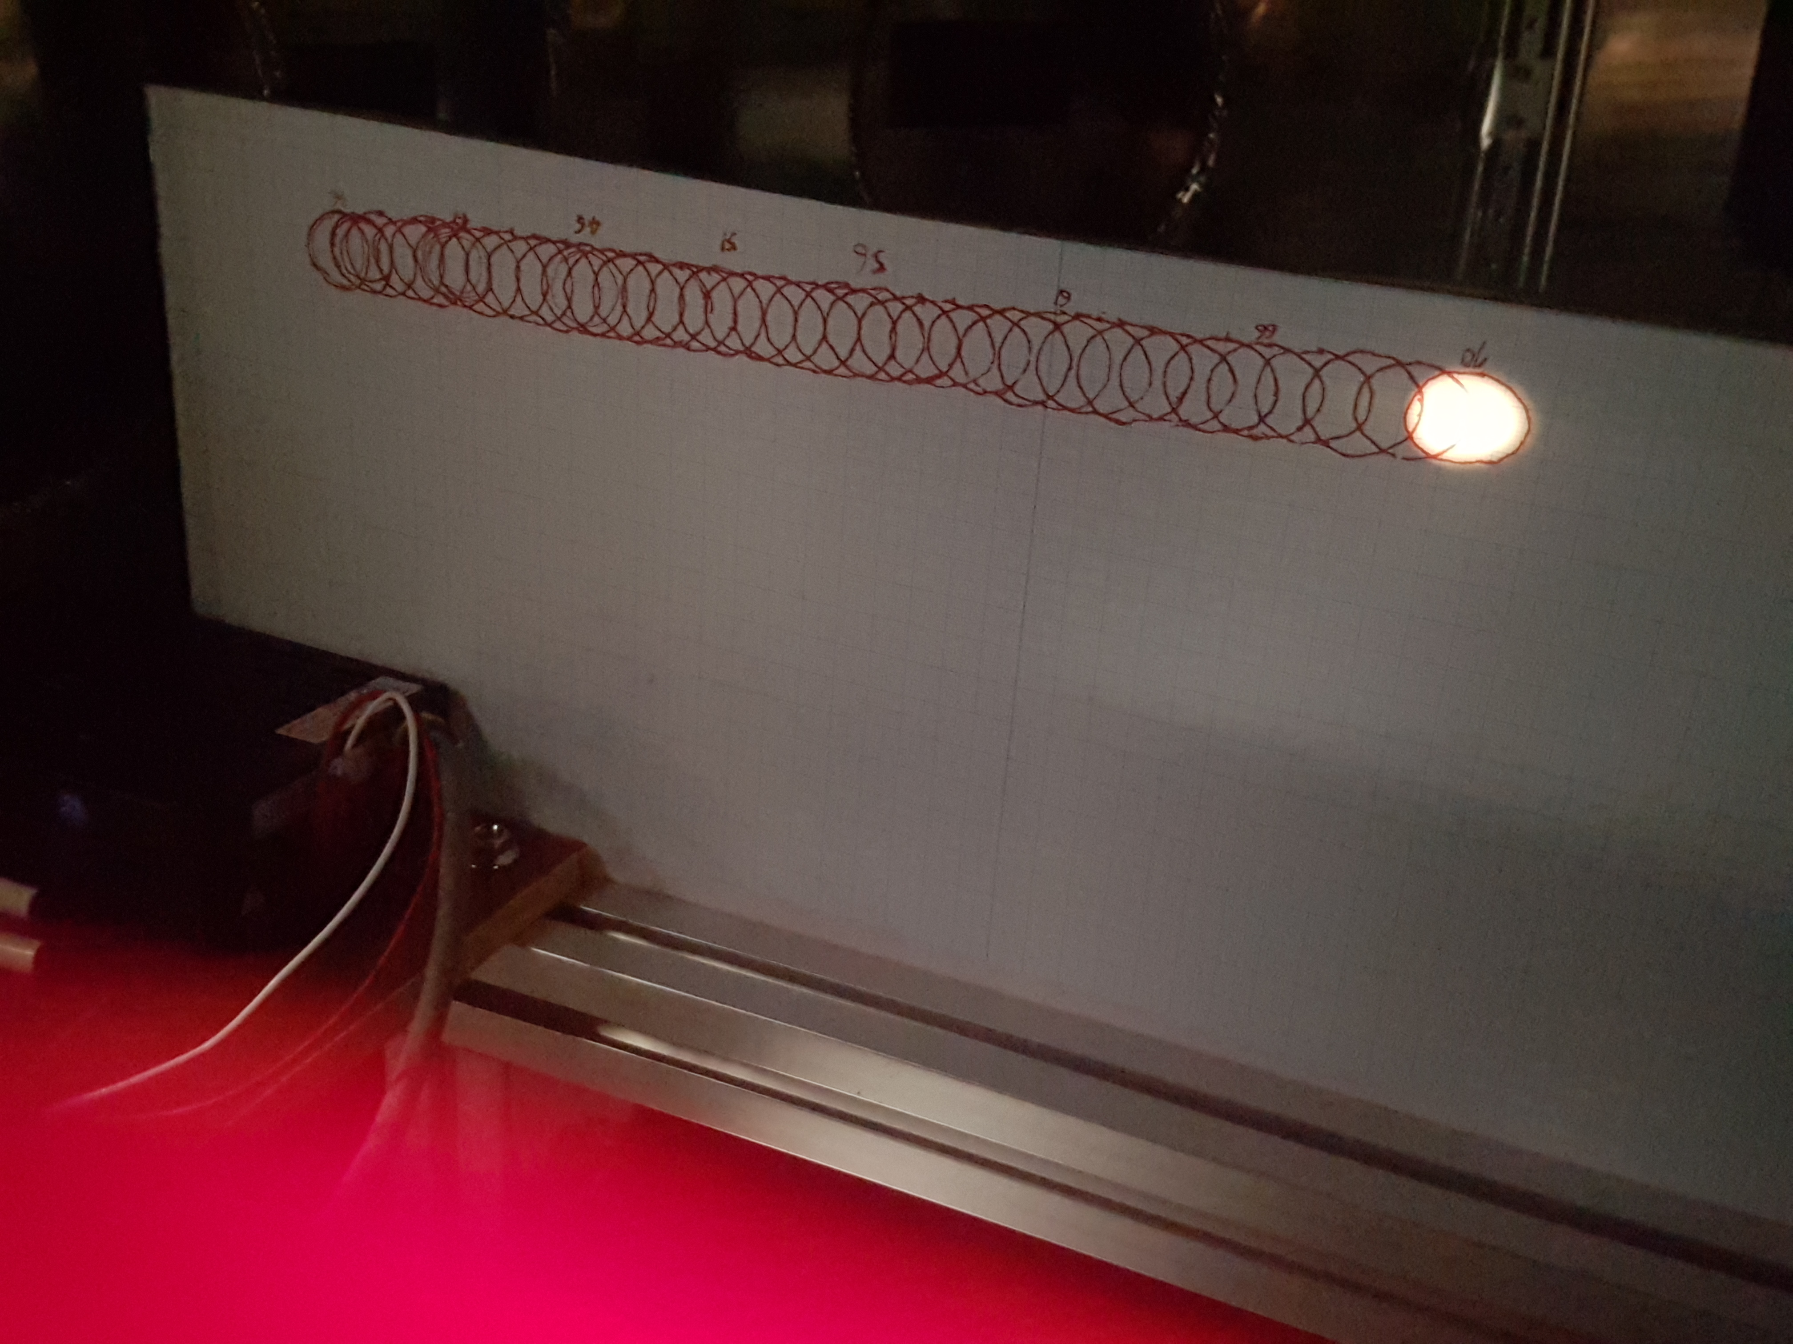
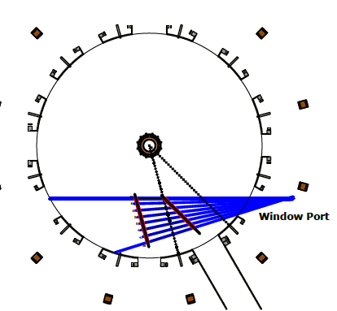
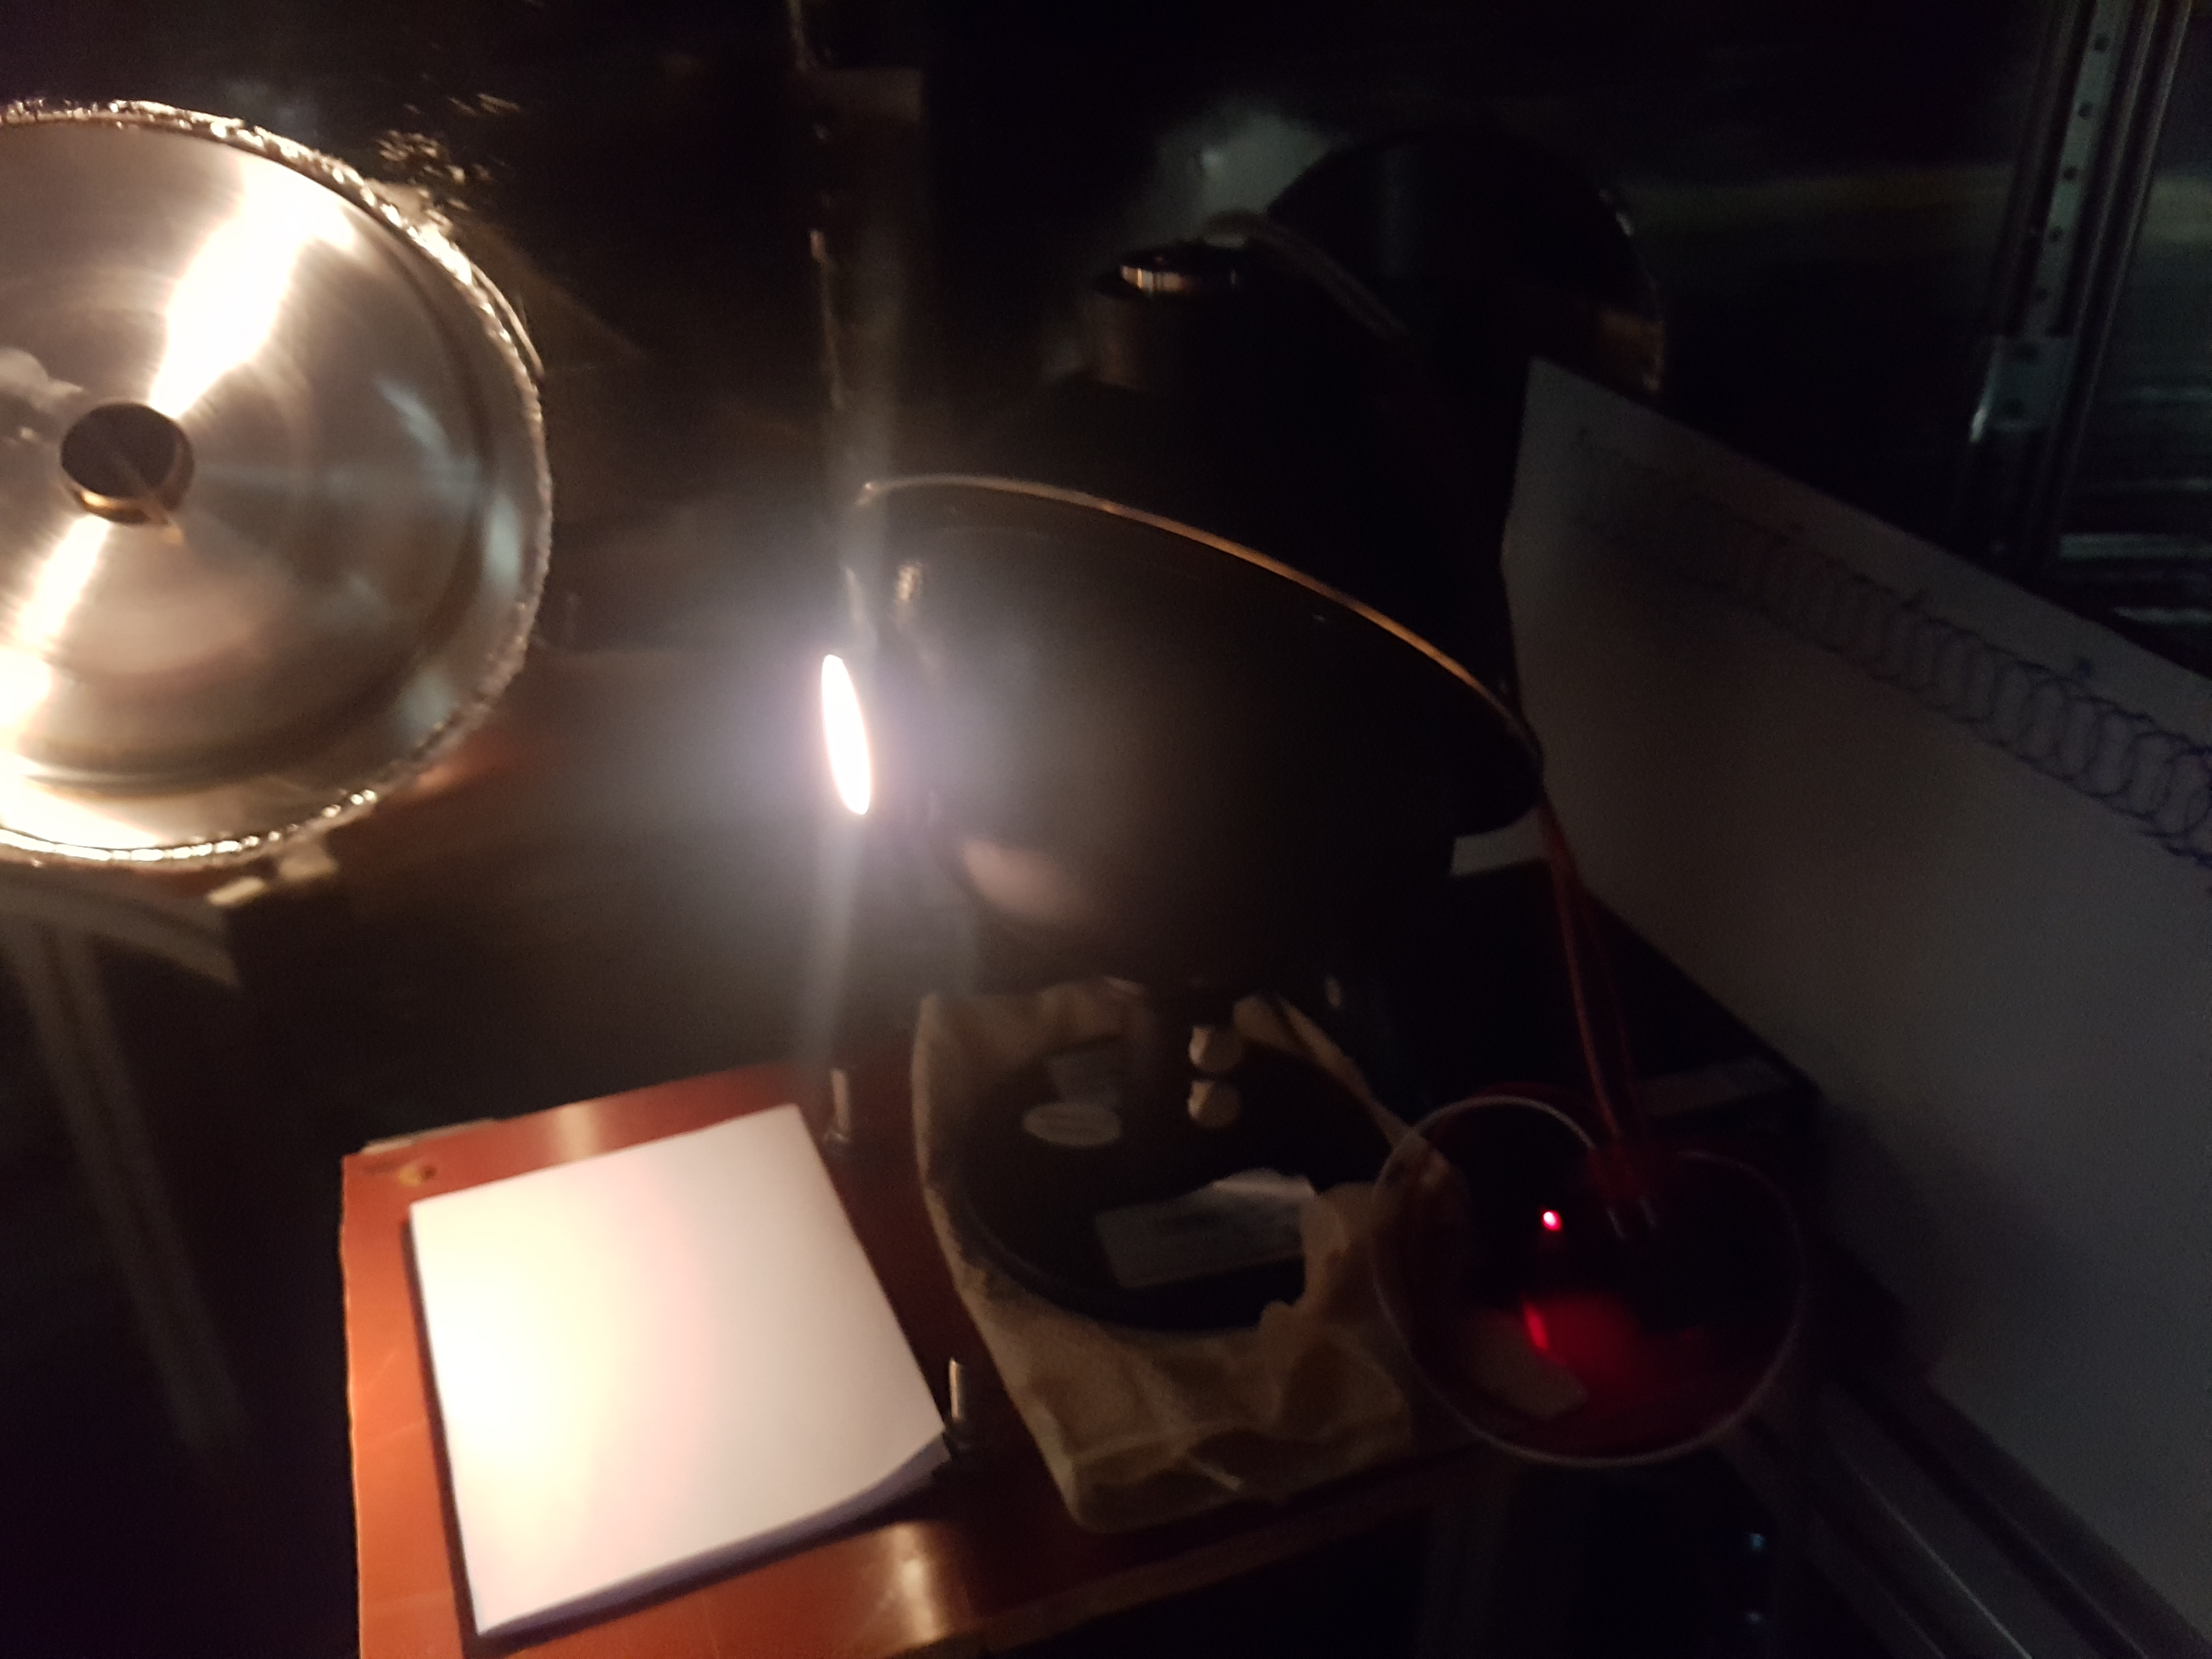
Spatial & Intensity Calibration
Spatial calibration
Spatial calibration
Check the specific measurement point
Two spatial point measurement
Intensity calibration
Intensity calibration with wavelength
Spatial channel to channel sensitivity
Image size = 20-25 mm
Intensity calibration with integrating sphere
R=377-653 mm
Position 1
Position 2
At 465 nm

Slide 6
Wavelength calibration
Xe lamp image
Ch1
Image curvature
→ Short f and large f/#
Ch2
Cubic spline
Calibration with Xe discharge lamp
Wavelength calibration
Instrument broadening
Wavelength calibration
Cubic polynomial fitting
$λ(x)$ = A₀+A₁$x$+ A₂$x^{2}$+A₃$x^{3}$
$x$ : pixel number
A_{i} : fitting coefficient (i=0, 1, 2, 3)
Ch3
Ch4
469.10 nm
Ch5
473.42 nm
Ch6
462.43 nm
467.12 nm
469.70 nm
Ch7
Horizontal pixel → wavelength
After calibration
Wavelength(nm) | Transition
462.4276 | $$5p^{5}\left({{}_{}^{2}P}_{3/2}^{o}\right)6s^{2}{\left[3/2\right]}_{2}^{o} \\ −5p^{5}\left({{}_{}^{2}P}_{3/2}^{o}\right)7p^{2}{\left[3/2\right]}_{2}^{}$$
467.1226 | $$5p^{5}\left({{}_{}^{2}P}_{3/2}^{o}\right)6s^{2}{\left[3/2\right]}_{2}^{o} \\ −5p^{5}\left({{}_{}^{2}P}_{3/2}^{o}\right)7p^{2}{\left[3/2\right]}_{3}^{}$$
469.0972 | $$5p^{5}\left({{}_{}^{2}P}_{3/2}^{o}\right)6s^{2}{\left[3/2\right]}_{2}^{o} \\ −5p^{5}\left({{}_{}^{2}P}_{3/2}^{o}\right)6p^{2}{\left[3/2\right]}_{1}^{}$$
469.7021 | $$5p^{5}\left({{}_{}^{2}P}_{3/2}^{o}\right)6s^{2}{\left[3/2\right]}_{2}^{o} \\ −5p^{5}\left({{}_{}^{2}P}_{3/2}^{o}\right)7p^{2}{\left[5/2\right]}_{2}^{}$$
473.4152 | $$5p^{5}\left({{}_{}^{2}P}_{3/2}^{o}\right)6s^{2}{\left[3/2\right]}_{2}^{o} \\ −5p^{5}\left({{}_{}^{2}P}_{3/2}^{o}\right)6p^{2}{\left[3/2\right]}_{2}^{}$$
Kramida, A., Ralchenko, Yu., Reader, J., and NIST ASD Team (2015). NIST Atomic Spectra Database (ver. 5.3), [Online].

Slide 7
Necessity of Spectral Inversion
Plasma
boundary
Each spatial point,
Different rotation velocity and ion temperature → different wavelength shift and broadening
Position 3
$$λ_{0}$$
Measurement
Line of sight
Position 1
$$λ_{}$$
$$λ_{0}$$
$$λ_{}$$
Line integrated spectrum!!
$$λ_{}$$
To obtain the local properties
Need to inversion process
Spectral inversion
Intensity (emissivity)
Profile shape (broadening & shift)
Position 2
$$λ_{0}$$
$$λ_{}$$

Slide 8
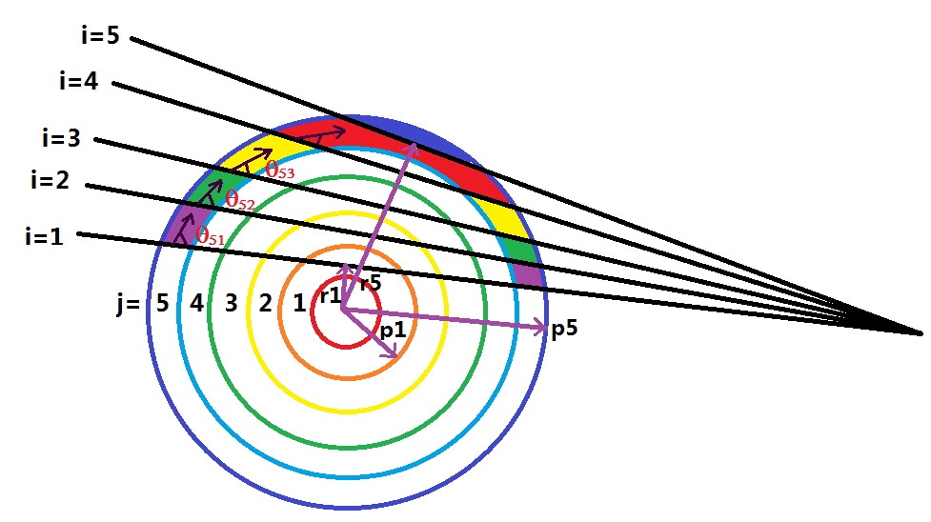
Inversion Method
L₅₅
Intensity inversion
$$E_{j}=\sum_{i}{L_{ji}^{−1}B_{i} }$$
Where
$B_{i}$ : Line integrated emissivity
$E_{i}$ : Local emissivity
Rotation inversion
Where
$u_{i}^{Line}$ : Line integrated velocity
$v_{j}$ : Local velocity
$$v_{j}=\frac{E_{j}v_{j}}{E_{j}}=\frac{\sum_{i}{M_{ji}^{−1}B_{i}u_{i}^{Line}}}{\sum_{i}{L_{ji}^{−1}B_{i}}}$$
$L_{ij}$ : Length of an intersection b/w sightline i and emitting zone j
$M_{ij}=L_{ij}cosθ_{ij}$
Local property
$E_{j}$, $v_{j}^{}$, $T_{j}^{}$
Temperature inversion
Instrument broadening
Line integrated parameter
$B_{i}$, $u_{i}^{Line}$, $T_{i}^{Line}$
$$T_{j}=\frac{\sum_{i}{L_{ji}^{−1}B_{i}T_{i}^{Line}}}{E_{j}}−\frac{m}{k}\frac{\sum_{i}{L_{ji}^{−1}\sum_{k}{L_{ik}^{}E_{k}{\left(v_{k}cosθ_{ik}−u_{i}^{Line}\right)}^{2}}}}{E_{j}}−\frac{\sum_{i}{L_{ji}^{−1}\sum_{k}{L_{ik}^{}T_{k}^{inst}E_{k}}}}{E_{j}}$$
Where
$T_{i}^{Line}$ : Temperature from line integrated spectrum
$T_{j}$ : Local temperature
R.E. Bell, Rev.Sci.Instrum 68 1273 (1997)
I. Condrea et al., Phys. Plasmas 7 3641 (2000)
Y.J. Shi et al., Rev.Sci.Instrum 83 10D717 (2012)

Slide 9
Phantom Test
Line integrated spectra
Phantom test is conducted to confirm the uncertainties of spectral inversion
Phantom profile (emissivity, $v_{T}, T_{i}$)
Hollow, Center-peaked, flat emission profile
Parabolic $v_{T} and T_{i}$ profile as function of R
$$E\left(R\right), v_{T}\left(R\right) , T_{i}(R)$$
ch7
ch6
Collecting optics
Estimate the line-integrated spectra
Assume toroidal symmetry
7 line of sight (Experiment setup)
ch5
ch4
ch3
ch2
ch1
Conduct spectral inversion
Obtain local properties from line-integrated phantom spectra
Noise sensitivity test (10% error)
7 channel measurement
→ Smooth cubic spline interpolation and extrapolation
Comparison
Compare inverted profile with phantom profile

Slide 10
Phantom Test Result
Case1. Hollow emission profile
Case2. Flat emission profile
Case3. Center-peaked profile

Slide 11
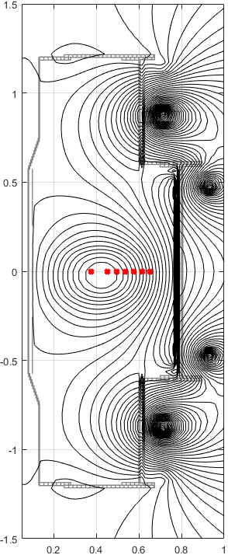
Line-integrated spectra in Ohmic discharge
#17474 305 ms
R=0.38 m
R=0.45 m
R=0.50 m
R=0.54 m
ch7
ch1
R=0.58 m
R=0.62 m
Interference line
R=0.65 m
Strong passive emission is located in near 465 nm
CIII triplet (3s³S-3p³P) : 464.742, 465.025, 465.15 nm
OII (3s⁴P-3p⁴D) – 464.91 nm
Comparison of two passive emission CIII and OII
For the boundary condition
Emissivity=0 at R=0.76 m (Limiter position)

Slide 12
Emissivity profile of CIII and OII
Smoothed cubic spline interpolation is used in line-integrated emissivity
Profile shape
Line integrated emissivity : Flat
Local emissivity : Hollow
Emission peak location
CIII & OII emission peak is in near 0.6 m
CIII peak is more shifted to the core than OII peak
Measurement range for v_{T}, T_{i}
R > ~ 0.55 m

Slide 13
v_{T}, T_{i} profile in VEST Ohmic discharge
Co current
Instrument temperature For C, T_{inst}~38 eV For O, T_{inst}~51 eV
Counter current
Toroidal rotation and ion temperature of CIII and OII is measured by passive emission
Toroidal rotation in counter current direction is observed in the edge region (R>0.6 m → r/a >0.65)
Ion temperature is about 25-40 eV in the intermediate range in VEST Ohmic discharge

Slide 14
Summary
Toroidal rotation and ion temperature profile is measured from the passive emission with OII, CIII lines.
7 channel spectroscopy system is installed and calibrated to measure the toroidal rotation and ion temperature profile.
Spectral inversion is conducted to extract the toroidal rotation and ion temperature as well as local emissivity.
Toroidal rotation is in counter current direction observed in the edge region in the VEST Ohmic plasma.
Ion temperature in the intermediate region is about 25-40 eV.

Slide 15
Future work
Hardware improvement
Image curvature correction → curved entrance slit (R.E.Bell RSI 2004)
Increase the number of line of sight (especially edge region)
Preparation of active beam diagnostic → CES/BES combined system
Data analysis
Uncertainty analysis for emissivity, rotation, and temperature
Experiment
Passive emission spectroscopy with high charge state emission (candidates : OV-650.0 nm, BV 494.4 nm, CVI-529.1 nm)
Rotation and ion temperature profile change in heating NB injection
CVI T_{e}>~30 eV
OV : T_{e} <~150 eV

Slide 16
Thank you

Slide 17
Back up – Photo emission coefficient
Local emissivity
Photo emission coefficient (from CR model)
$$ε_{ij}(r)=n_{Z}\left(r\right)n_{e}(r)PEC(T_{e},n_{e})$$
Electron impact excitation
N_{e}=10¹⁸m⁻³
H. P. Summers, Monthly Notices of the Royal Astronomical Society 158.3 (1972)
OPEN-ADAS http://open.adas.ac.uk

Slide 18
Back up – Error propagation
$${\left(ΔE_{i}^{}\right)}^{2}=\sum_{j}{{\left(L_{ij}^{−1}{ΔB}_{j}\right)}^{2}}$$
$${\left(Δv_{i}^{}\right)}^{2}=v_{i}^{2}{\left(\frac{ΔE_{i}^{}}{E_{i}}\right)}^{2}+\sum_{j}{\frac{{\left(M_{ij}^{−1}{Δ(B}_{j}u_{j})\right)}^{2}}{E_{i}^{2}}}$$
$${\left(ΔT_{j}^{}\right)}^{2}=T_{i}^{2}{\left(\frac{ΔE_{i}^{}}{E_{i}}\right)}^{2}+⋯$$

Slide 19
