Slide 1
Overview of Versatile Experiment Spherical Torus (VEST)
Y.S. Hwang, and VEST team
September 19, 2017
CARFRE and CATS
Dept. of Nuclear Engineering
Seoul National University
ISTW 2017, Sept. 18-22 2017, Seoul National Univ., Seoul, Korea

Slide 2
Outline
Versatile Experiment Spherical Torus (VEST)
Device and discharge status
Start-up experiments
Low loop voltage start-up using trapped particle configuration
EC/EBW heating for pre-ionization
Solenoid-free start-up from outboard with outside PF coils
Studies for Advanced Tokamak
Research directions for high-beta and high-bootstrap STs
Preparation of long-pulse ohmic discharges
Preparation for heating and current drive systems
Preparation of profile diagnostics
Long-term Research Plans
Summary

Slide 3
VEST device and Machine status
VEST device and
Machine status

Slide 4
VEST (Versatile Experiment Spherical Torus)
Objectives
Basic research on a compact, high-β ST (Spherical Torus)
with elongated chamber in partial solenoid configuration
Study on innovative start-up, non-inductive H&CD, high β and innovative divertor concept, etc
Specifications
 | Present | Future
Toroidal B Field [T] | 0.1 | 0.3
Major Radius [m] | 0.45 | 0.4
Minor Radius [m] | 0.33 | 0.3
Aspect Ratio | >1.36 | >1.33
Plasma Current [kA] | ~100 kA | 300
Elongation | ~1.6 | ~2
Safety factor, q_{a} | ~6 | ~5

Slide 5
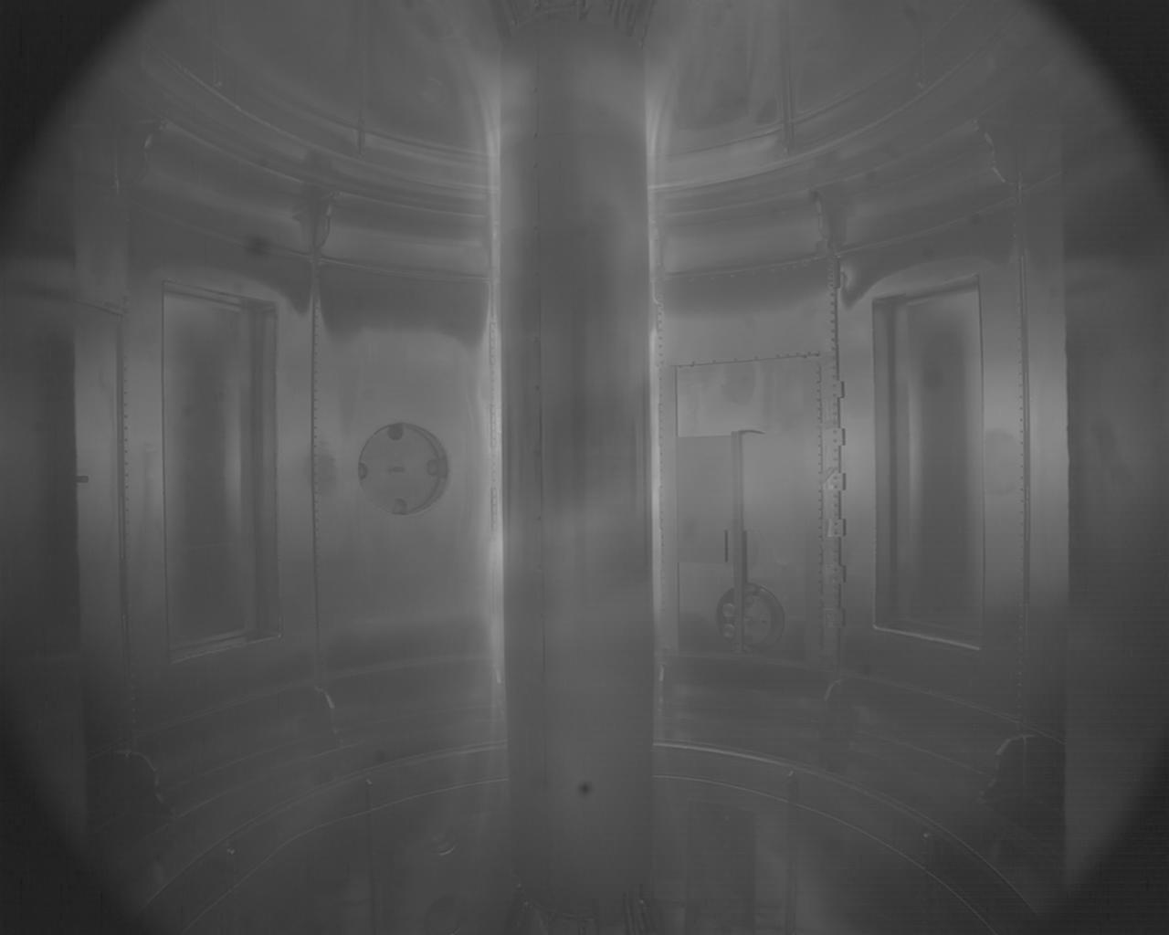
History of VEST Discharges
#2946: First plasma (Jan. 2013)
#10508: Hydrogen glow discharge cleaning (Nov. 2014) I_{p} of ~70 kA with duration of ~10 ms
#14945: Boronization with He GDC (Mar. 2016) Maximum I_{p} of ~100 kA
#16942: Long pulse with coil power supply upgrade (May. 2017)

Slide 6
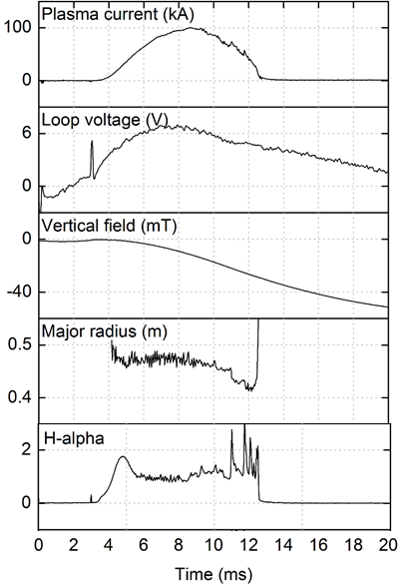
VEST Discharge Status : 100kA with Boronization (#14945)
EC-assisted OH discharge
Plasma current 100 kA
Hydrogen plasma with Boroination
Tungsten & Graphite (inboard) limiter
Equilibrium parameters
R=0.45m/a=0.33m (A=1.36)
Elongation: 1.6 – 2.5
Edge safety factor: ~ 7
Limited discharge length
Fast ramp-up
→ Require large Bv in the beginning
Wall eddy current
→ Limited time response of Bv

Slide 7
VEST Discharge Status : 100kA with Boronization (#14945)
Kinetic plasma parameters from magnetics
Spitzer temperature*: < 300 eV (average)
Diamagnetic flux → Stored energy (perpendicular) < 1.2 kJ
Estimated plasma density: < 3×10¹⁹ m⁻³ (average)
# Greenwald density limit: ~3×10¹⁹ m⁻³
*Z_{σ} = 3 / trapped particle fraction 90%
Diamagnetic flux measurement
TF current filtering method
Error bar 1 mWb
Parameters
Poloidal beta ~ 0.6 (paramagnetic)
Stored energy < 1.2 kJ
Ohmic heating < 400 kW

Slide 8
Start-up Experiments
Start-up Experiments

Slide 9
Start-up experiments Trapped Particle Configuration (TPC)
Efficient and robust tokamak start-up demonstrated at VEST and KSTAR
Mirror like magnetic field configuration
Enhanced particle confinement
Inherently stable decay index structure
Y. An et al., Nucl. Fusion 57 016001 (2017)
Jeongwon Lee et al 2017 Nucl. Fusion in press https://doi.org/10.1088/1741-4326/aa8511
Notes:
These devices are not typical tokamaks. Field null formation is used almost all tokamaks, not only above mentioned tokamaks.

Slide 10
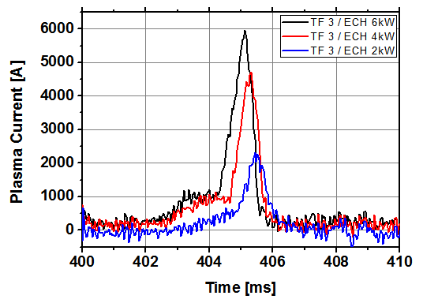
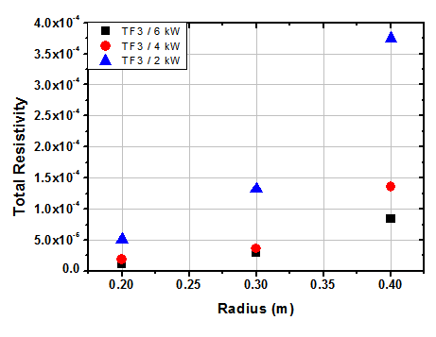
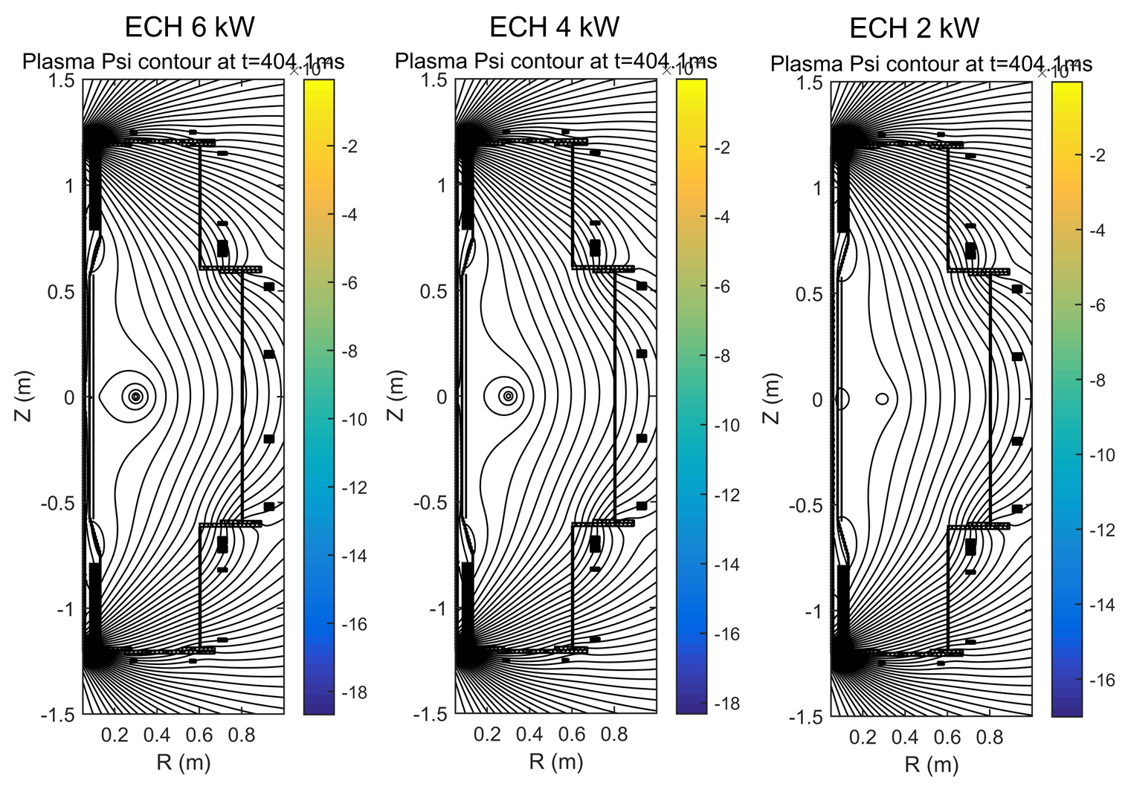
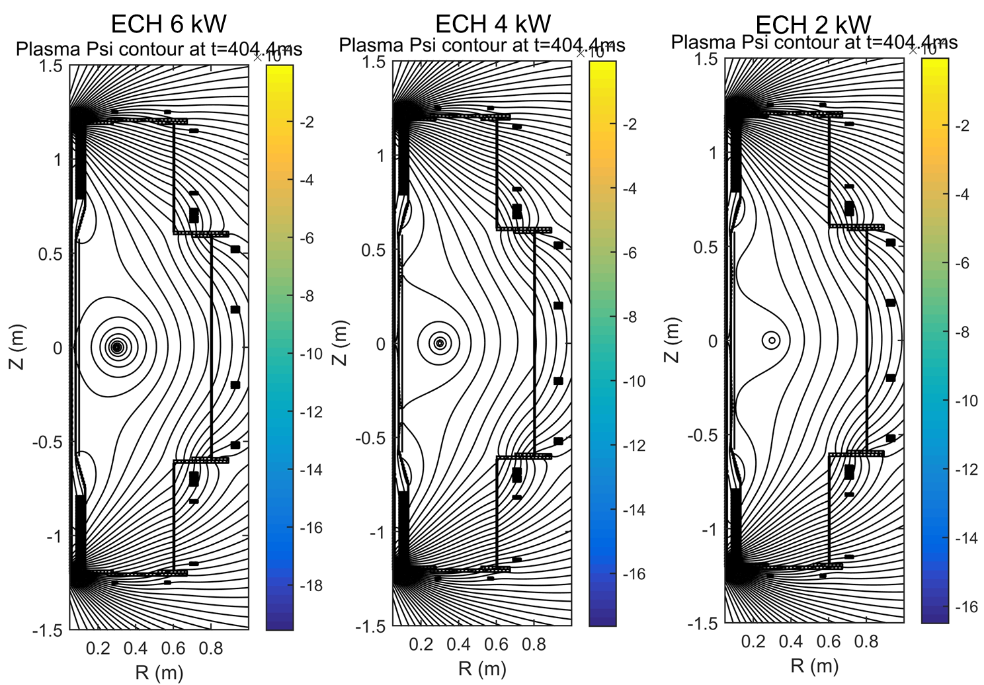
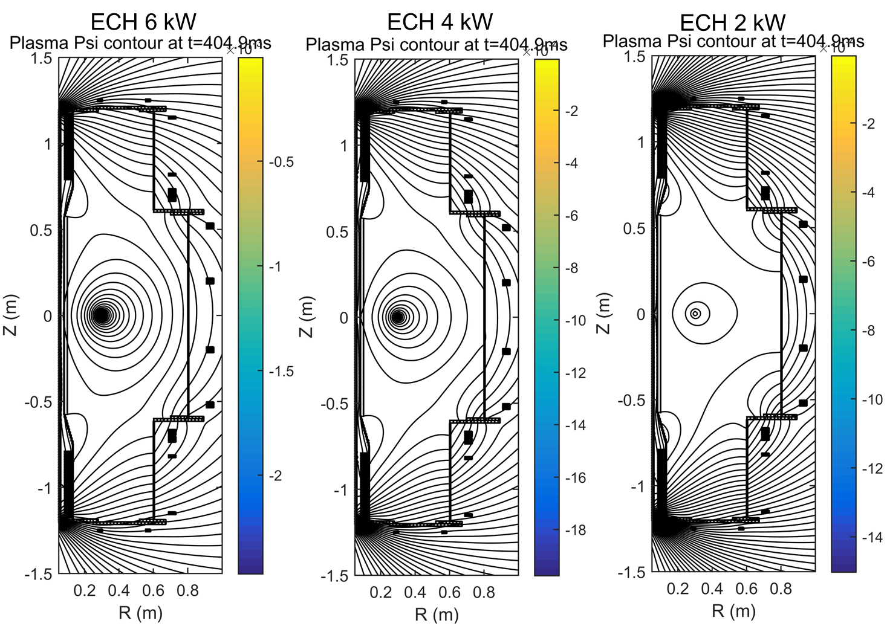
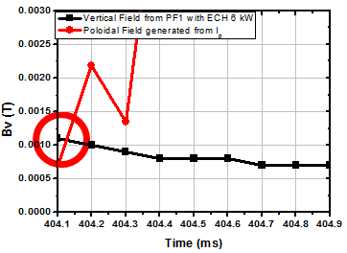
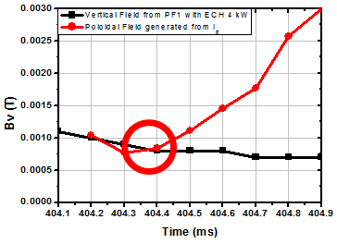
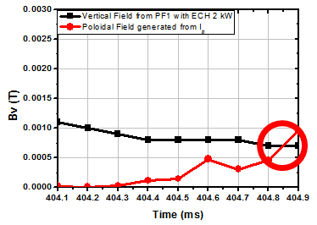
Start-up Experiment in VEST Closed Flux Surface Formation for Successful Start-up in TPC
H.Y. Lee
Successful ohmic start-up at low loop voltage in TPC depends on vertical field strength
Smaller resistivity initiate higher initial current to form sufficient size of closed flux surface
Threshold vertical field strength for successful inductive start-up

Slide 11
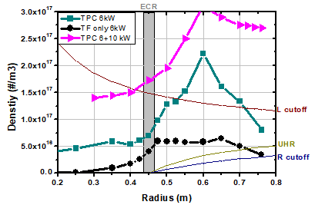
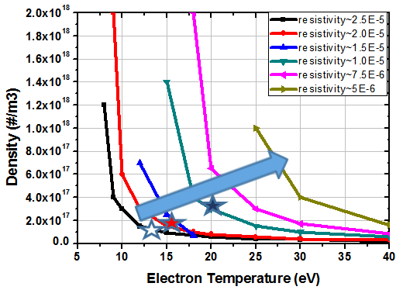
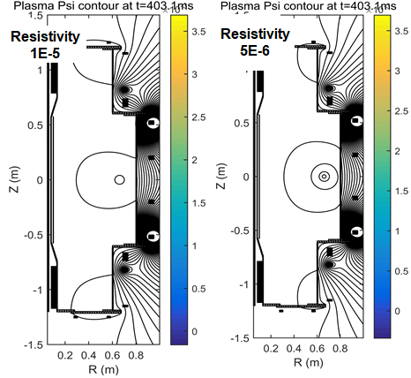
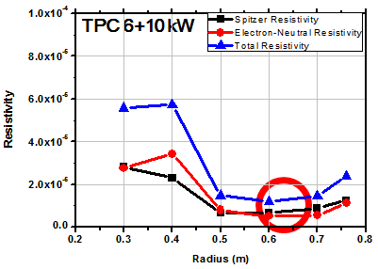
Start-up Experiment in VEST Solenoid-free Start-up from Outboard with Outer Poloidal Field Coils
No closed flux surfaces with up to 16 kW due to their high resistivity of > 1.0 E-5.
In the case of the resistivity of less than 1.0 E-5, the closed flux surface may be formed.
Once current column is formed, inward moving current can grow with decreasing external inductance
H.Y. Lee
To reach target resistivity, higher ECH power of ~30kW may be needed to have sufficient density and temperature in the pre-ionization phase.

Slide 12
Preparation for Advanced Tokamak Studies
Studies for Advanced Tokamak

Slide 13
Preparation for Advanced Tokamak Studies Scopes of Advanced Tokamak Studies in VEST
Fusion reactor requires
high beta (or Q) and high bootstrap current
Simultaneously
Alpha heating dominant (high Q)
→ Centrally peaked pressure profile
High Bootstrap current fraction (high f_{b})
→ Hollow current density profile (low li)
Confinement and Stability?
Profile diagnostics
High power neutral beam heating
Current density profile control
Bootstrap/EBW/LHFW

Slide 14
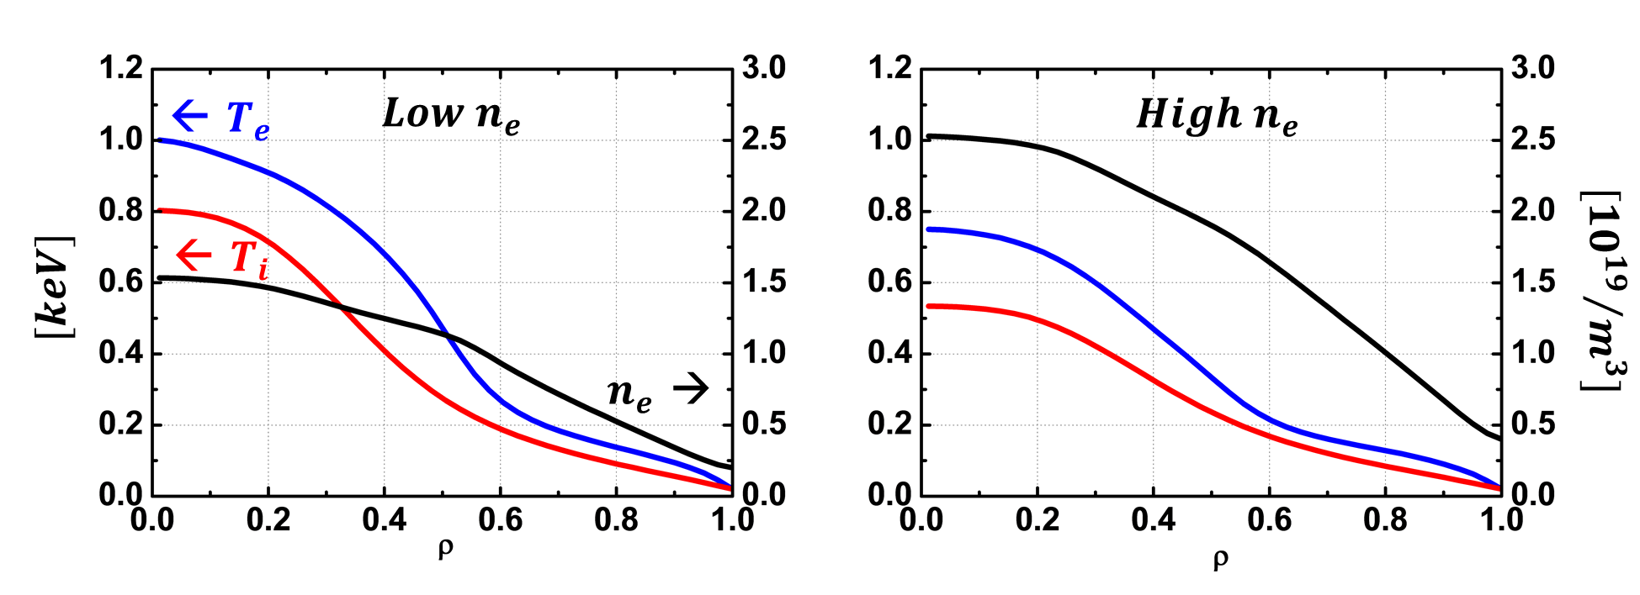
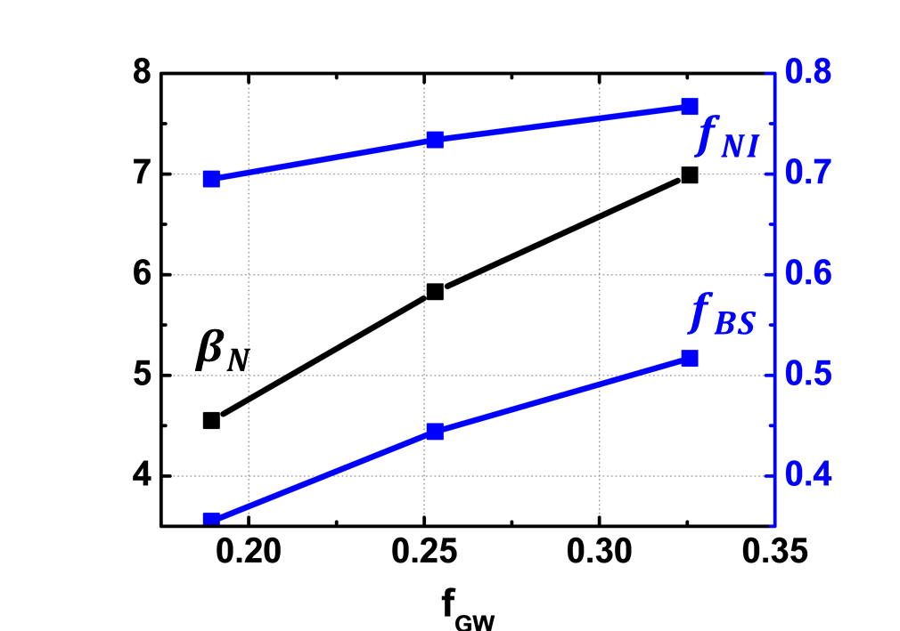
Preparation for Advanced Tokamak Studies Simulations for the VEST Advanced Tokamak Scenario
C.Y. Lee
The integrated modeling system constructed.
ASTRA+TGLF and NEO for heat & particle transport: Valid even in low aspect ratio tokamak
The steady state solution of beam discharges showing that $T_{e0}\sim 0.8 keV$, $T_{i0}\sim 0.5 keV$ can be achieved with considering beam heating & fueling simultaneously.
$β_{N}\sim 7$, $f_{BS}\sim 0.5$, $f_{NI}\sim 0.75$

Slide 15
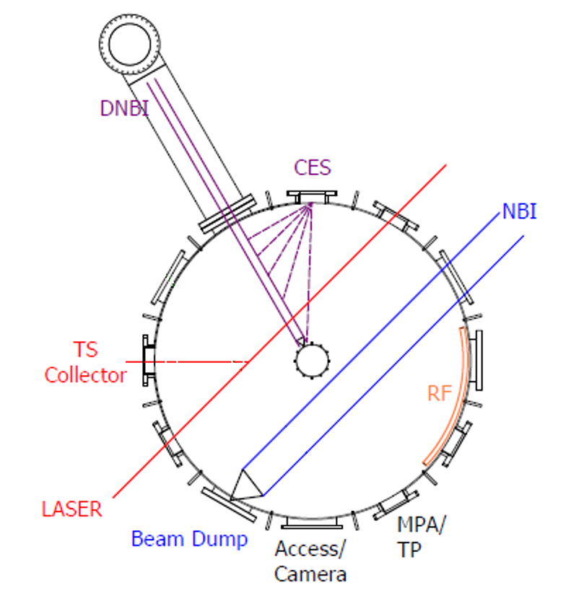
Preparation for Advanced Tokamak Studies Diagnostics, Heating and Current Drive Systems in VEST
Profile Diagnostic Systems
Heating and Current Drive Systems
Magnetics and Spectroscopy
Neutral Beam Injection System
with ~500kW at 15keV
from KAERI
Interferometer
Interferometry
with 94GHz, multi-channel
from SNU/UNIST
Low Hybrid Fast Wave H/CD
with ~10kW at 500MHz
from KAERI/KAPRA/KWU
Thomson Scattering
with Nd:YAG laser
from SNU/NFRI/JNU/SogangU
Electron Cyclotron/Bernstein Wave H/CD
with ~30kW at 2.45GHz
from SNU/KAPRA
ECH

Slide 16
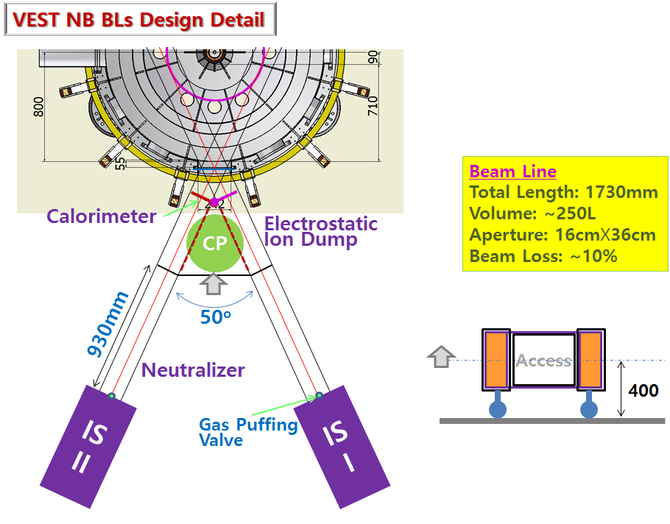
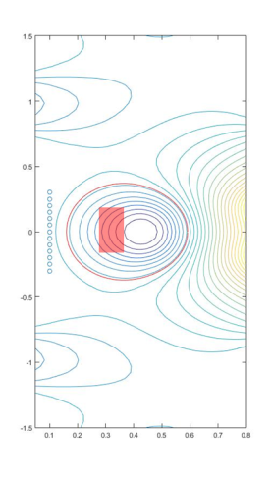
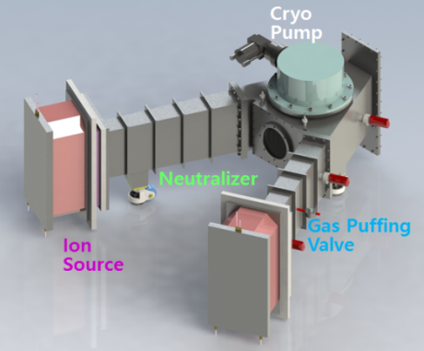
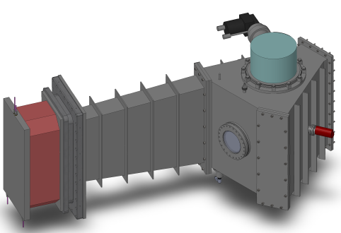
High power central heating High Power NBI System : Dual Beam to Single Beam
NBI beam loss calculation with NUBEAM code
Beam at 20keV
Too large orbit loss for counter-injection
→ Dual beam to single beam
Large shine through loss even for co-injection
→ Require high plasma density

Slide 17
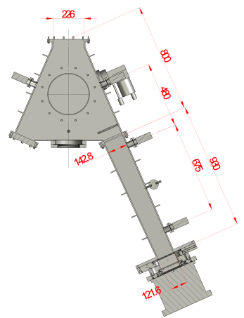
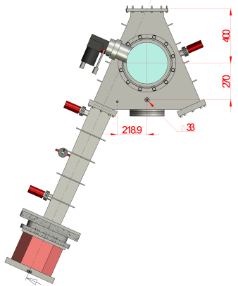
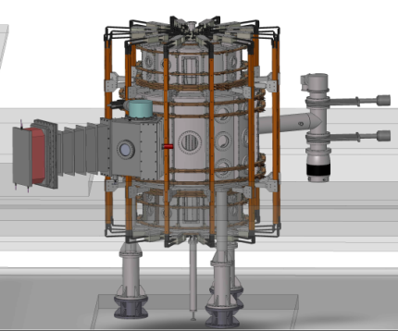
High power central heating High Power NBI System : System Design
Beam power density at beamline
Calculated by BTR code
Focusing beam profile calculation
3.1 m
Max Power
: 32.72 MW/m²
0.7m
Max Power
: 28.12 MW/m²
2.6 m
Max Power
: 35.16 MW/m²
1.8 m
Max Power
: 36.16 MW/m²
1.4 m
Max Power
: 32.77 MW/m²
3D beam line design
Slit beam focusing
Defl. angle, # of slits
- 2 degree 29
- 1 degree 3
0 degree 13
1 degree 3
2 degree 29

Slide 18
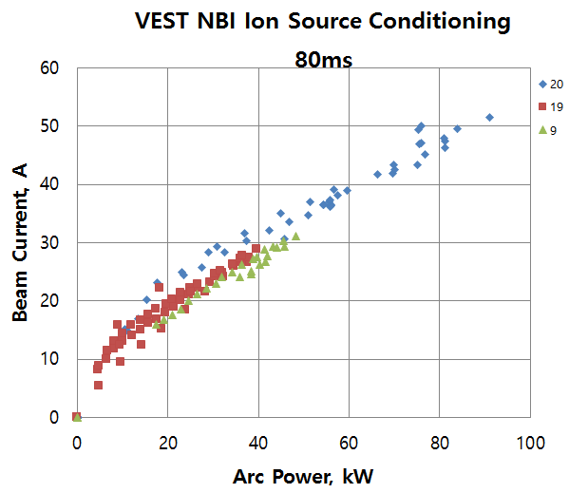
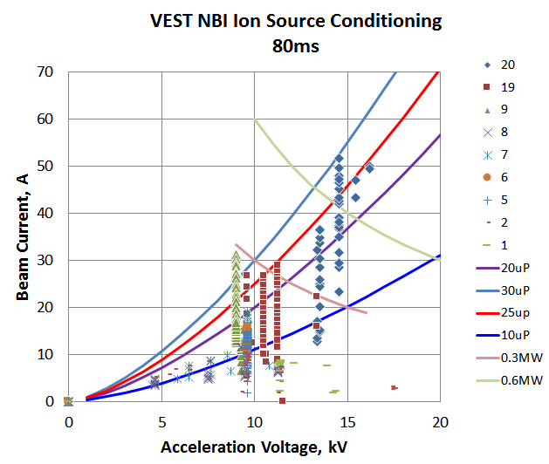
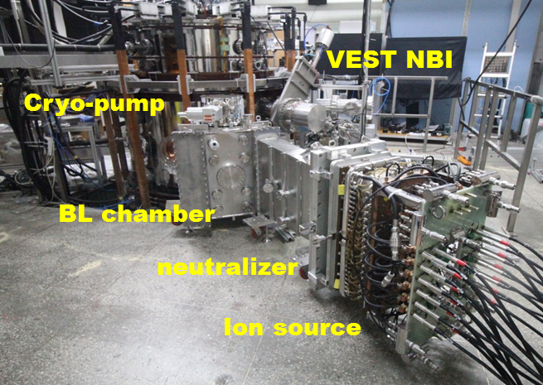
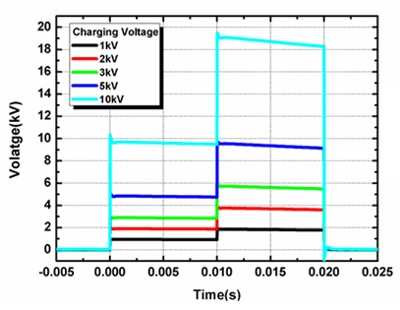
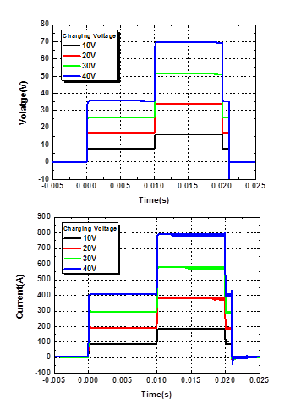
High power central heating High Power NBI System : Ion Source Test, installation
B.K. Jung
Neutral beam injector
Co-directional
Design power: 500 kW
Ion source test completed
750 kW at 15 keV
300 kW at 10 keV
Two-step beam energy PS

Slide 19
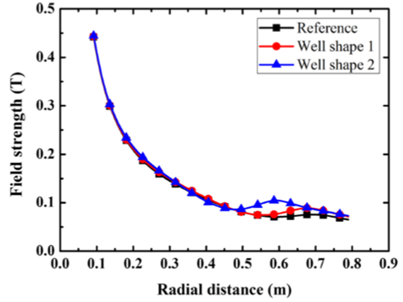
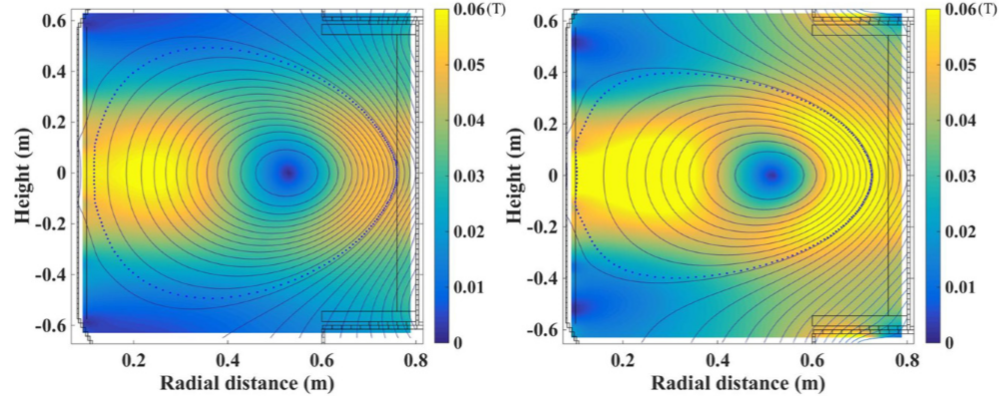
High power central heating Reduced Beam Loss with Magnetic Well Formation
Well shape 1
Well shape 2
 | well shape 1 | well shape 1 | well shape 2 | well shape 2
Beam energy ($E_{b}$) | 20 keV | 25 keV | 20 keV | 25 keV
$I_{p}$($kA$) | $$80$$ | $$80$$ | $$80$$ | $$80$$
$n_{0}$ ($10^{13}/cm^{3})$ | $$1$$ | $$1$$ | $$1$$ | $$1$$
Injection angle ($φ$) | $$40°$$ | $$45°$$ | $$30°$$ | $$35°$$
Shine through ($R_{s}$) | $$30→27\%$$ | $$35→37\%$$ | $$30\%$$ | $$38\%$$
Orbit loss | $$30→16 \%$$ | $$60→12\%$$ | $$7\%$$ | $$6\%$$
Total beam loss | $$66→43\%$$ | $$95→49\%$$ | $$37\%$$ | $$44\%$$
S.K. Kim et al., Nucl. Fusion 56 106006 (2016)
(NUBEAM, Optimized injection condition for VEST)

Slide 20
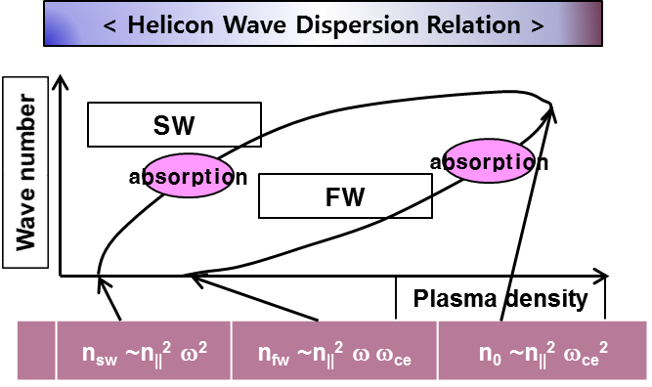
Current density profile control Core Heating and Current Drive with LHFW
For high density plasma in fusion reactor
Slow wave branch of LHW
→ Absorbed at the edge region
Fast wave branch of LHW
→ Possible absorption at the core region
Proof of principle for current drive scheme
by fast wave branch of LHW in VEST
S.H. Kim (KAERI)

Slide 21
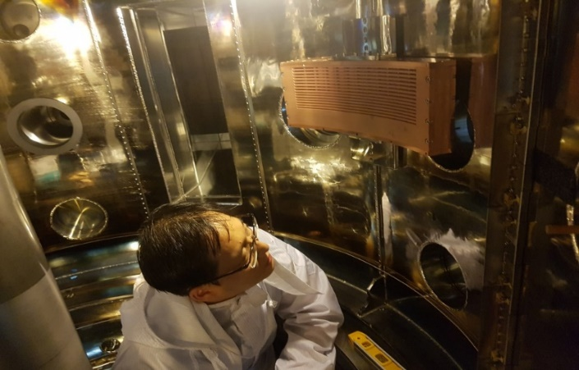
Current density profile control LHFW H/CD Coupling simulation and experiment
In collaboration with KAERI and Kwangwoon Univ.
E_{y}
LH Fast Wave
Good core accessibility
Efficient plasma coupling of combline antenna
Hardware
UHF Klystron, Combline antenna
N|| = 3-5 / 470~510 MHz
S.H. Kim/J.G. Jo
Notes:
These devices are not typical tokamaks. Field null formation is used almost all tokamaks, not only above mentioned tokamaks.

Slide 22
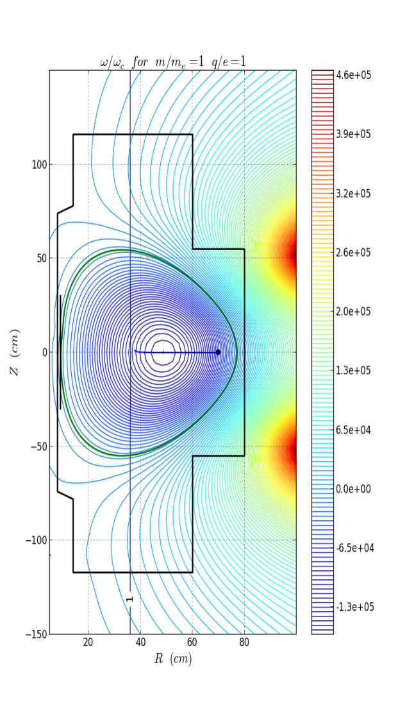
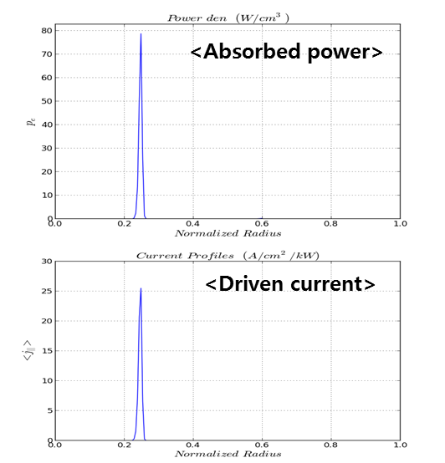
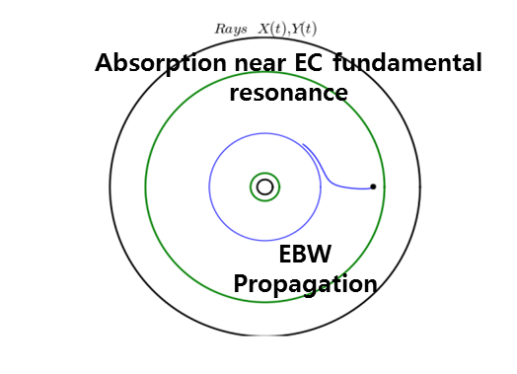
Current density profile control EBW Heating and Current Drive with XB Mode Conversion
► Core heating and current drive with XB mode conversion
GENRAY, CQL3D, mode conversion codes are used
Perpendicular, LFS, X-mode injection
Short distance between R(X) cut-off and UHR
High XB mode conversion efficiency with low n||
Good central heating and current drive expected
ECR
Absorption near EC fundamental resonance
EBW
propagation
S.H. Kim

Slide 23
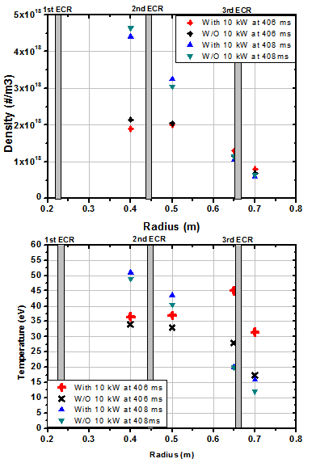
Current density profile control EBW Heating with XB Mode Conversion
EBW heating (6kW cw+10kW pulse at 402ms) on Ohmic plasmas
Boronization (impurity removal) and higher plasma current (higher electron temperature)
No change along the electron density profile with additional MW – no collisional damping
Electron temperature rises two times near 3rd harmonics ECR resonance : the first resonance position after EBW mode conversion
H.Y. Lee

Slide 24
Preparation for Advanced Tokamak Studies VEST Diagnostic Systems
Diagnostic Method |  | Purpose | Remarks
Magnetic Diagnostics | Rogowski Coil | Plasma current & eddy current | 3 out-vessel & in-vessel coils
 | Pick-up Coil & Flux Loop | B_{z}, B_{r} & Loop voltage, flux | 56 pick-up coils 9 loops
 | Magnetic Probe Array | B_{z}, B_{r} measurement inside plasma | Movable single array
Probes | Electrostatic Probe | Radial profile of T_{e}, n_{e} | 2 Triple Probes Mach probe
Optical Diagnostics | Fast CCD camera | Visible Image | 20kHz
 | H_{α} monitoring | H_{α} | H_{α} filter+ Photodiode
 | Impurity monitoring | O & C lines | Spectrometer
 | Interferometry | Line averaged n_{e} | 94GHz, multi-channel
 | Reflectometry | Radial profile of n_{e} | Edge density profile
 | EBE radiometer | Core, edge T_{e} | BX mode conversion
 | Charge Exchange Spectroscopy | Rotation and T_{i} | DNB
 | Thomson Scattering | T_{e}, n_{e} profile | Nd:YAG laser

Slide 25
Profile diagnostics Movable Magnetic Probe Array System
Equilibrium reconstruction with internal probe data
Direct derivation of J_{T}(R)
w/o vertical displacement
Plasma degradation ~ 10%
J.H. Yang et al., Rev. Sci. Instrum. 83 10D721 (2012)
J.H. Yang et al., Rev. Sci. Instrum. 85 11D809 (2014)

Slide 26
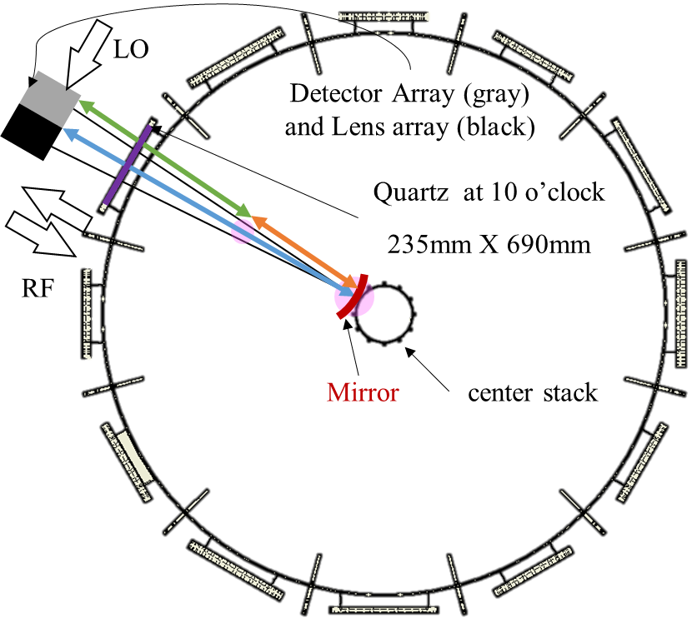
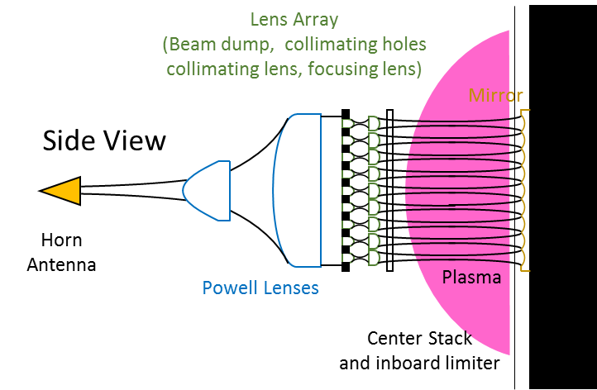
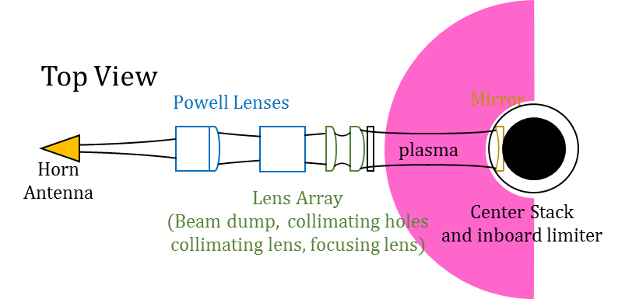
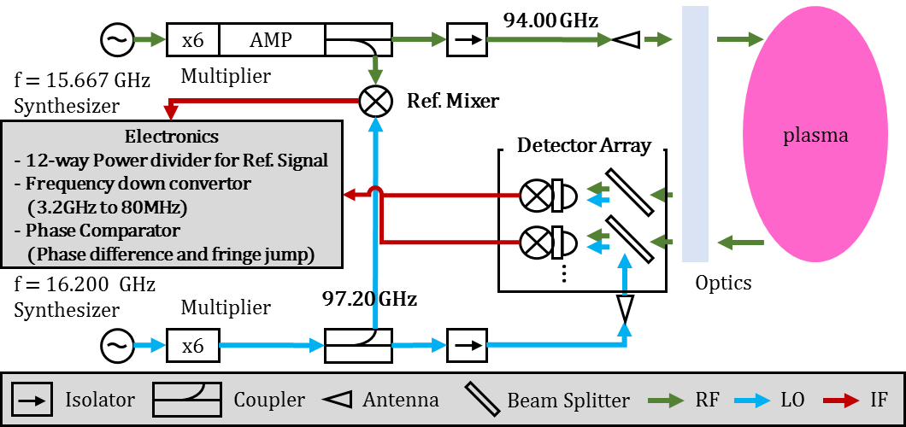
Profile diagnostics 94 GHz Multi-channel Interferometer
In collaboration with UNIST and KNU
Microwave system with heterodyne interferometer
3.2 GHz IF (avoid EC noise)
EC 2.45 GHz
Single chord → multi-chord
J.I. Wang

Slide 27
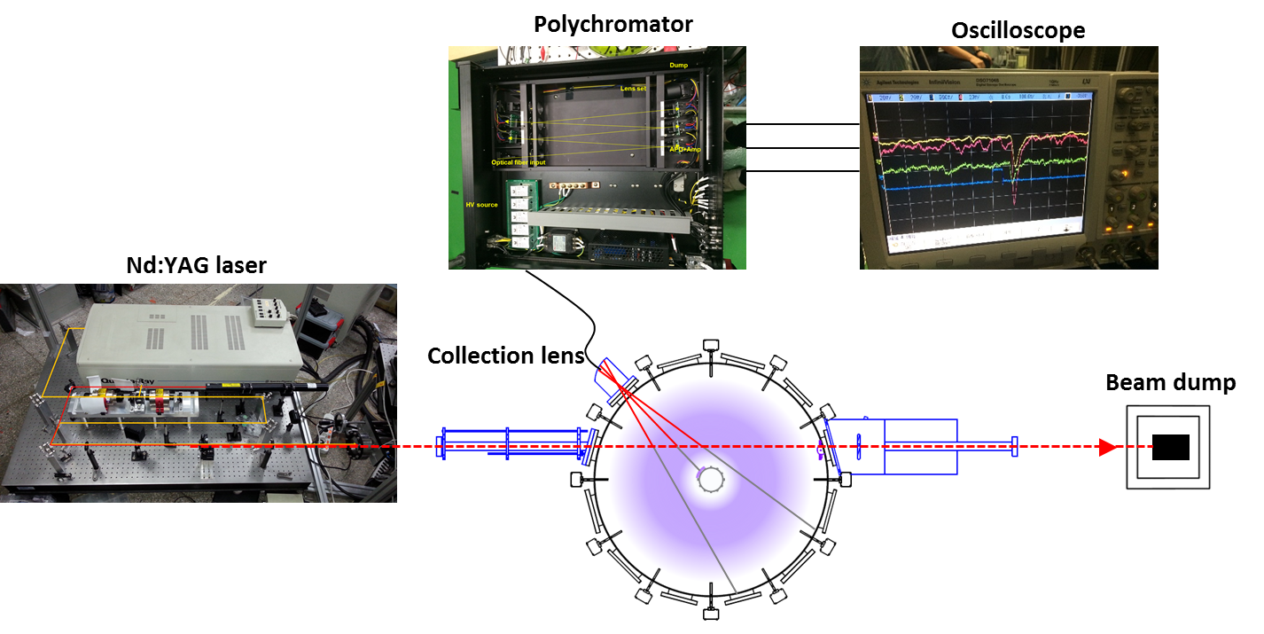
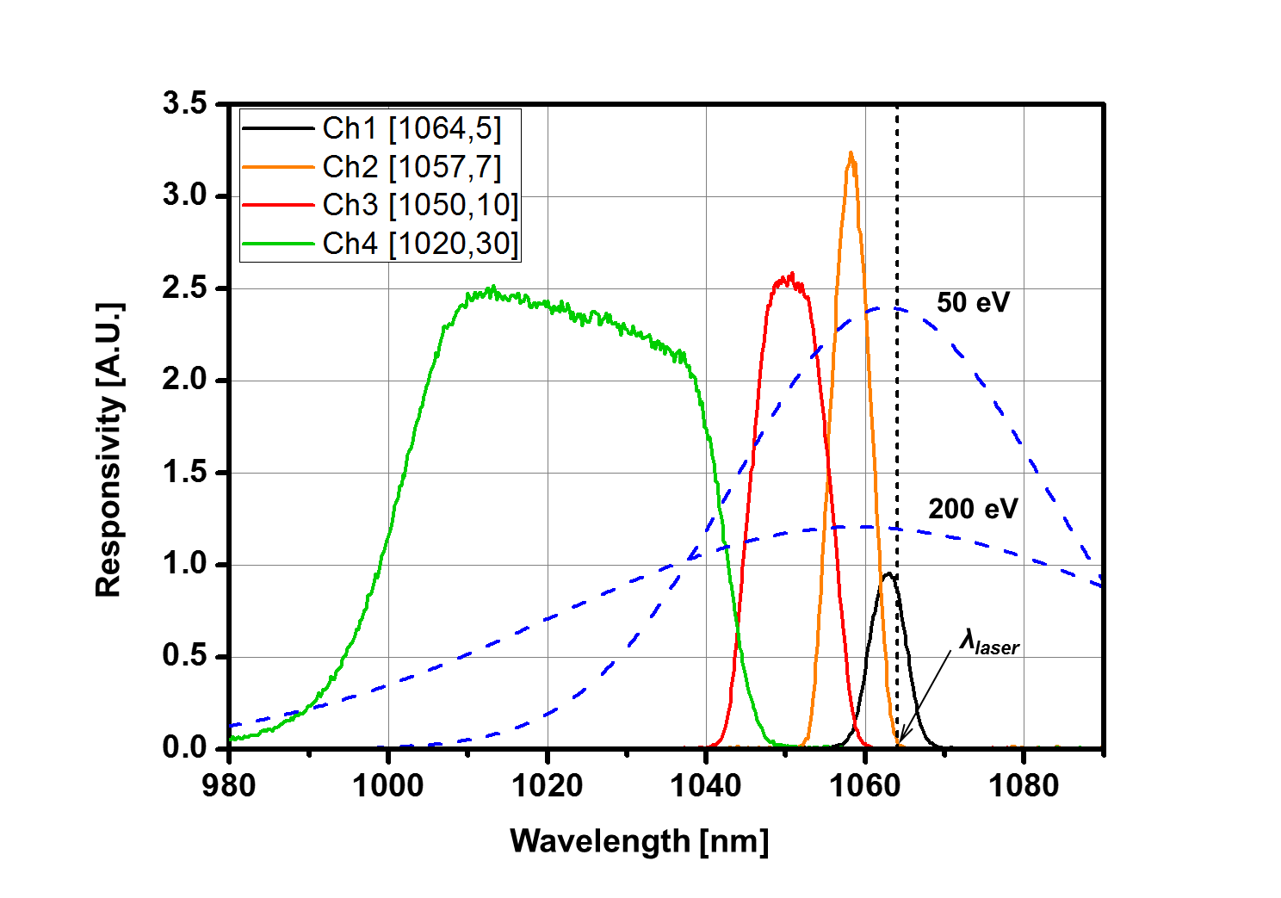
Profile diagnostics Thomson Scattering System
In collaboration with
Y.G. Kim/D.Y. Kim
Measurement target
n_{e}: > 5×10¹⁸ m⁻³
T_{e}: 10-500 eV
core plasma
Laser: 0.65 J/pulse, 1064 nm
Collection solid angle: ~50 msr
Scattering length: ~5 mm
Filter polychromator: 4 channels
Schematic of the TS system
Expected signal level [V]
(calibration: Rayleigh scattering)
Spectral Response
of the polychromator

Slide 28
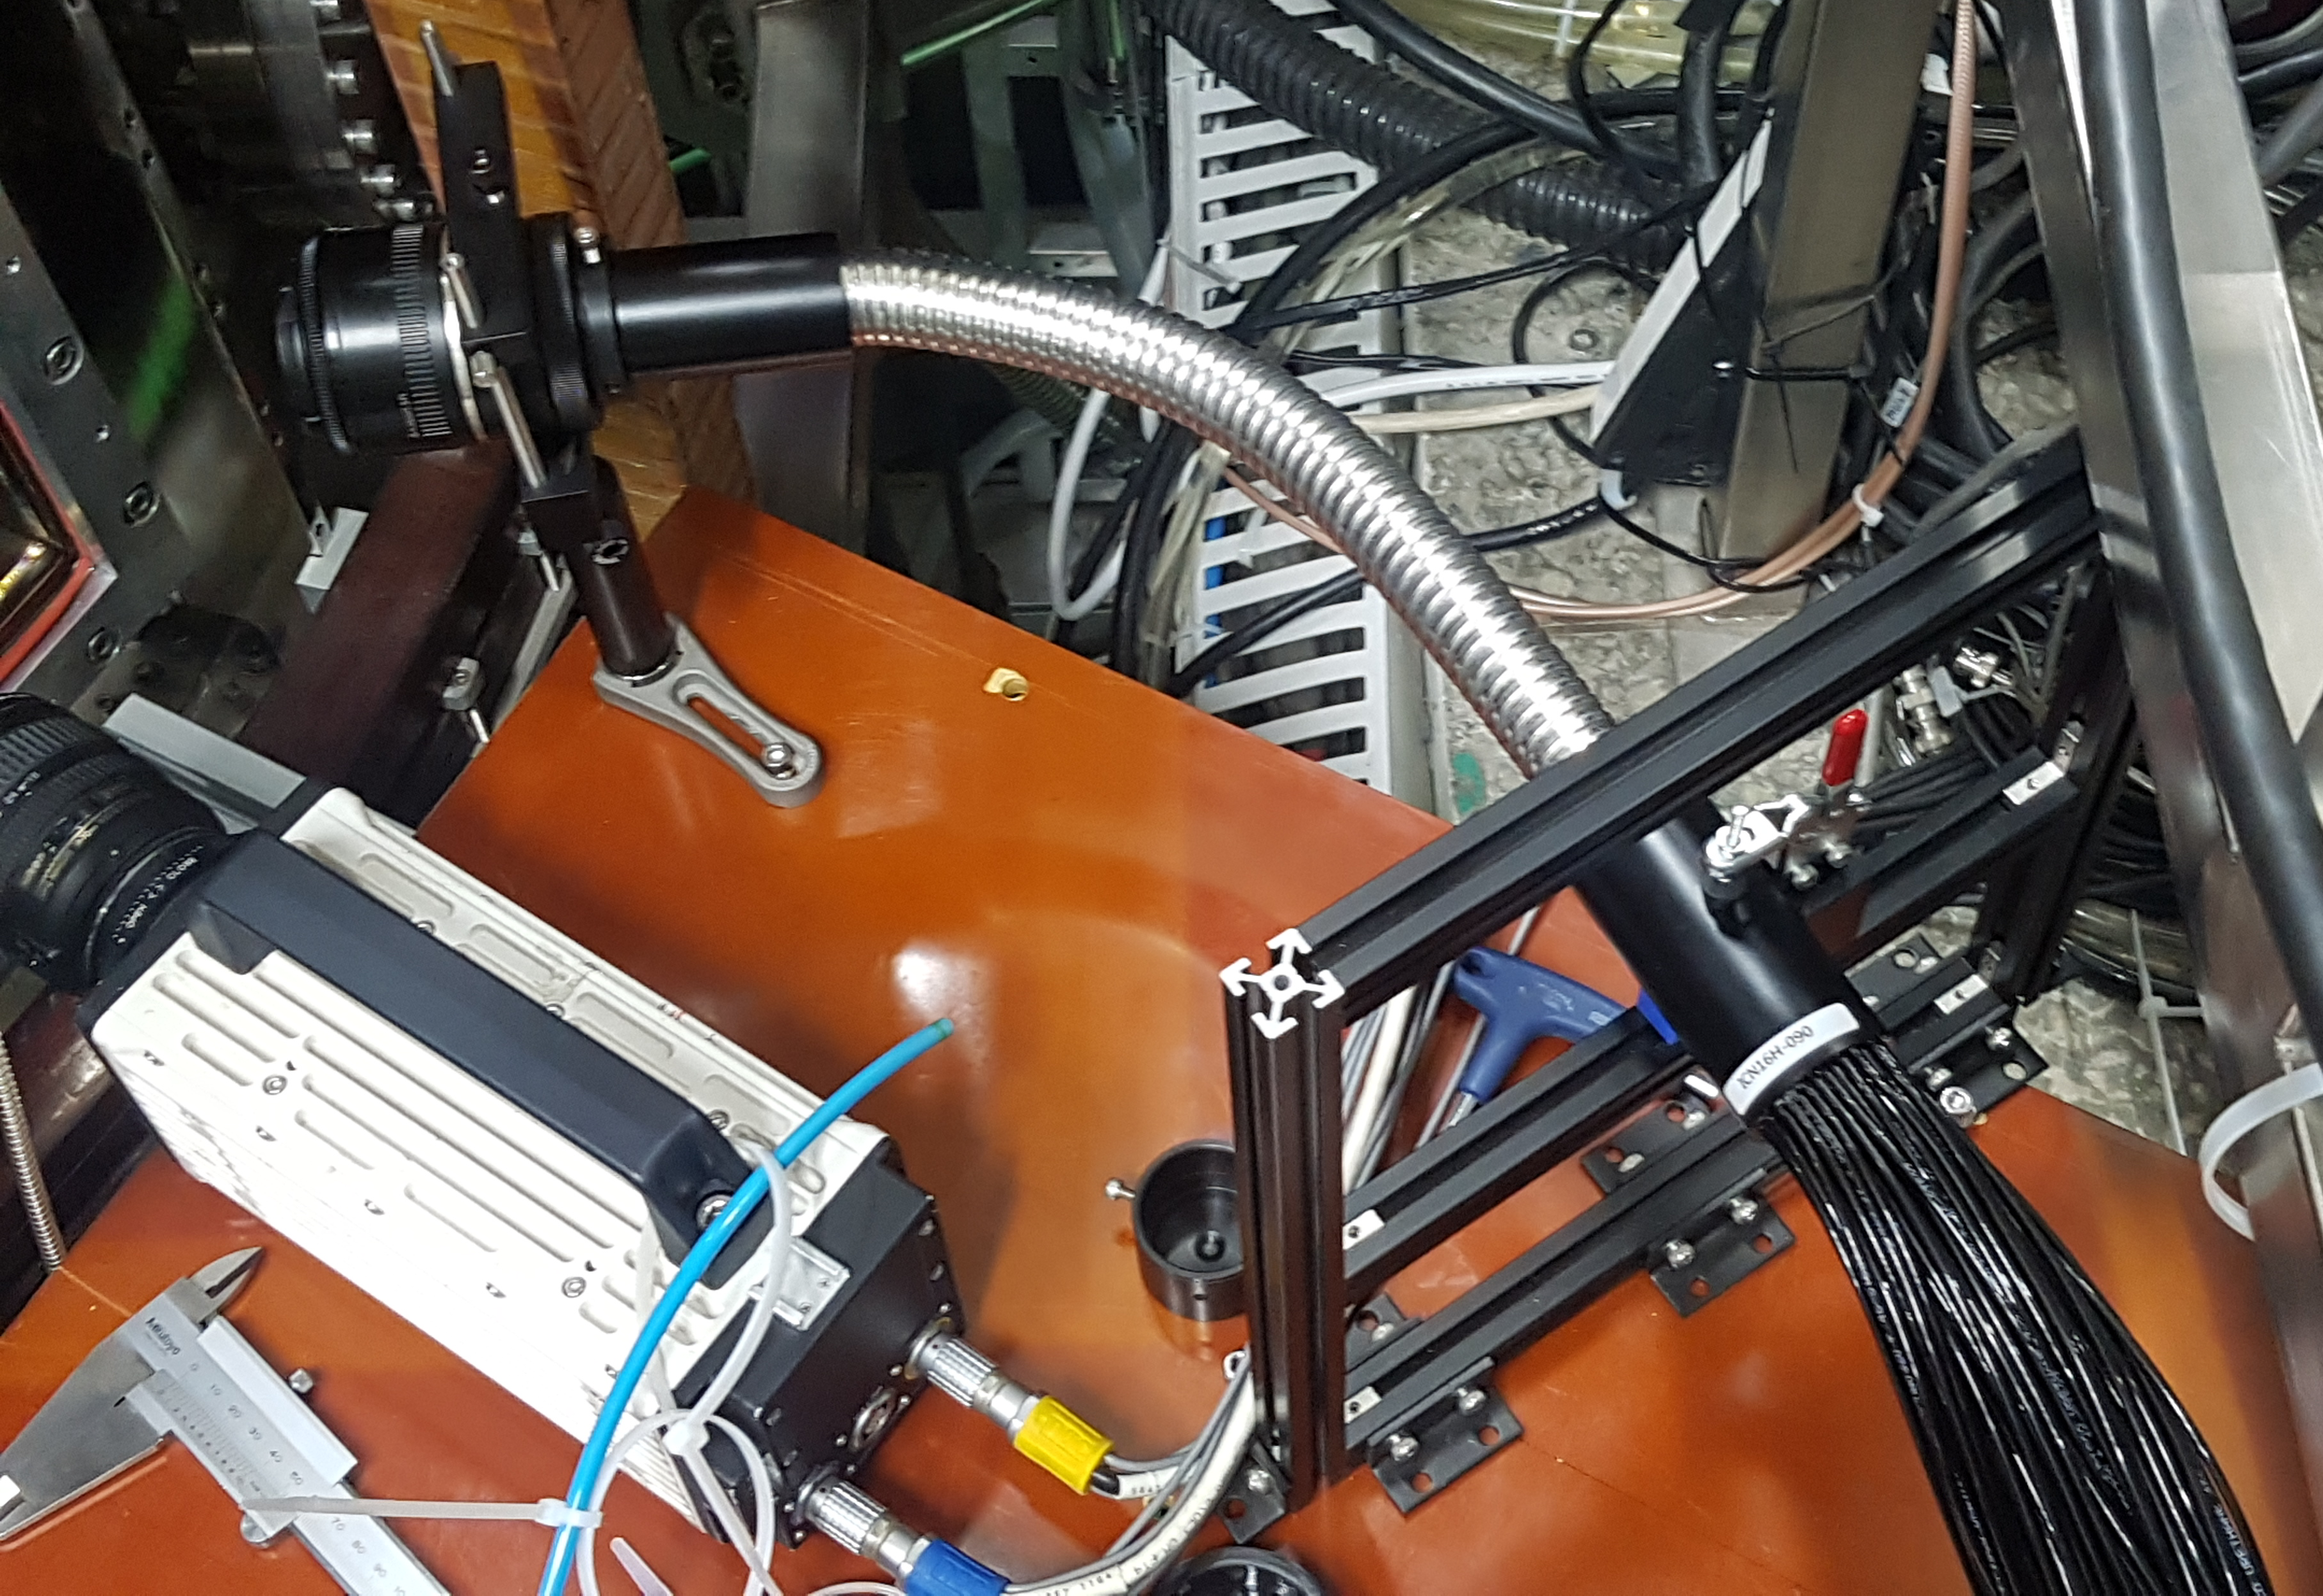
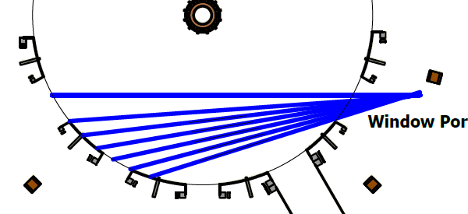
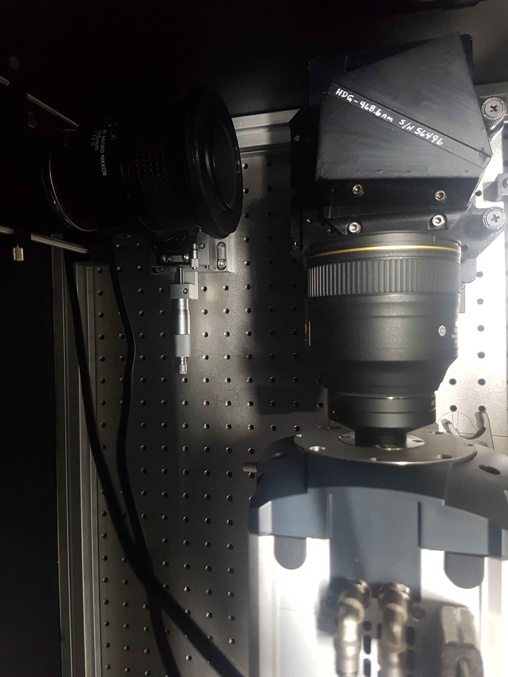
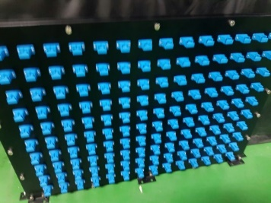
Profile diagnostics Visible optical spectroscopy
Y.S. Kim
Measurement quantities : $T_{i}$, $v_{T}$, $n_{Z}$
Passive emission spectroscopy
CIII line (3s3S-3p3P) – 464.74 nm
Line-integrated spectra → spectral inversion
Specification
Detection range : 0.38 m< R <0.65 m
Spatial resolution : 20-22 mm
Temporal resolution : 2 ms/frame
CES/BES combined system is in preparation
35 (radial)
4개
Core (R=0.38 m)
Edge (R=0.65 m)
105 mm
f/14
HDG
Slit
$$⋯$$
$$⋯$$
CCD
140 channel
7 channel
85 mm
f/1.4

Slide 29
Summary
VEST has achieved successful ohmic operation with plasma currents of up to ~100 kA, elongation of ~ 2 and safety factor of ~6 with efficient ECH pre-ionization.
Efficient start-up method is developed with TPC(Trapped particle configuration) and EBW heating.
Enhanced pre-ionization and stable equilibrium field with TPC improves start-up with low loop voltage, low ECH power, and wider pressure window.
Solenoid-free start-up may be developed by utilizing efficient pre-ionization at outboard with EBW heating.
EBW heating with direct XB mode conversion from LFS launching by generating over-dense plasma.
Preparation for the study of Advanced Tokamak is progressing
VEST Advanced Tokamak scenario is simulated with transport codes.
High power (>500 kW) NBI system has been developed and installed.
EBW/LHFW heating and current drive experiments are under preparation.
Profile diagnostics are under preparation
Reactor-relevant fusion research by developing both AT scenario and innovative divertor concept will be continued.

Slide 30
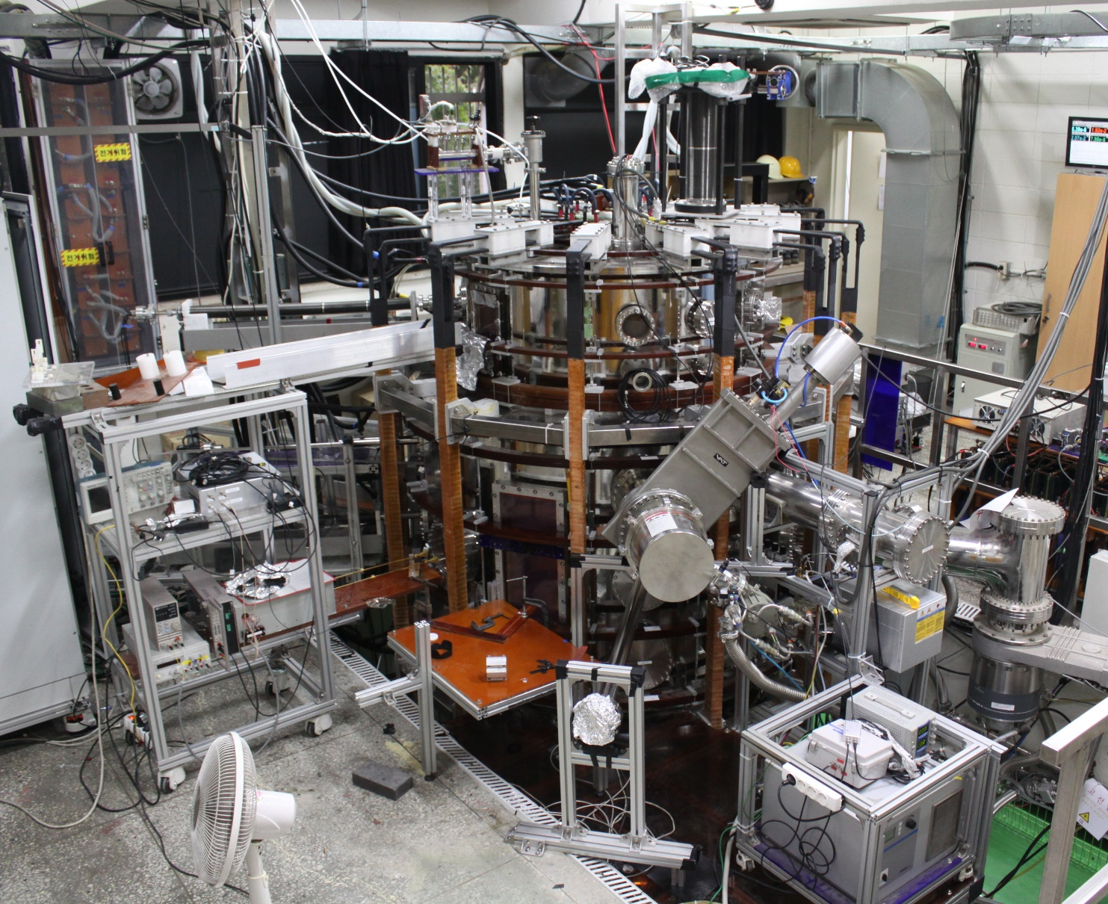
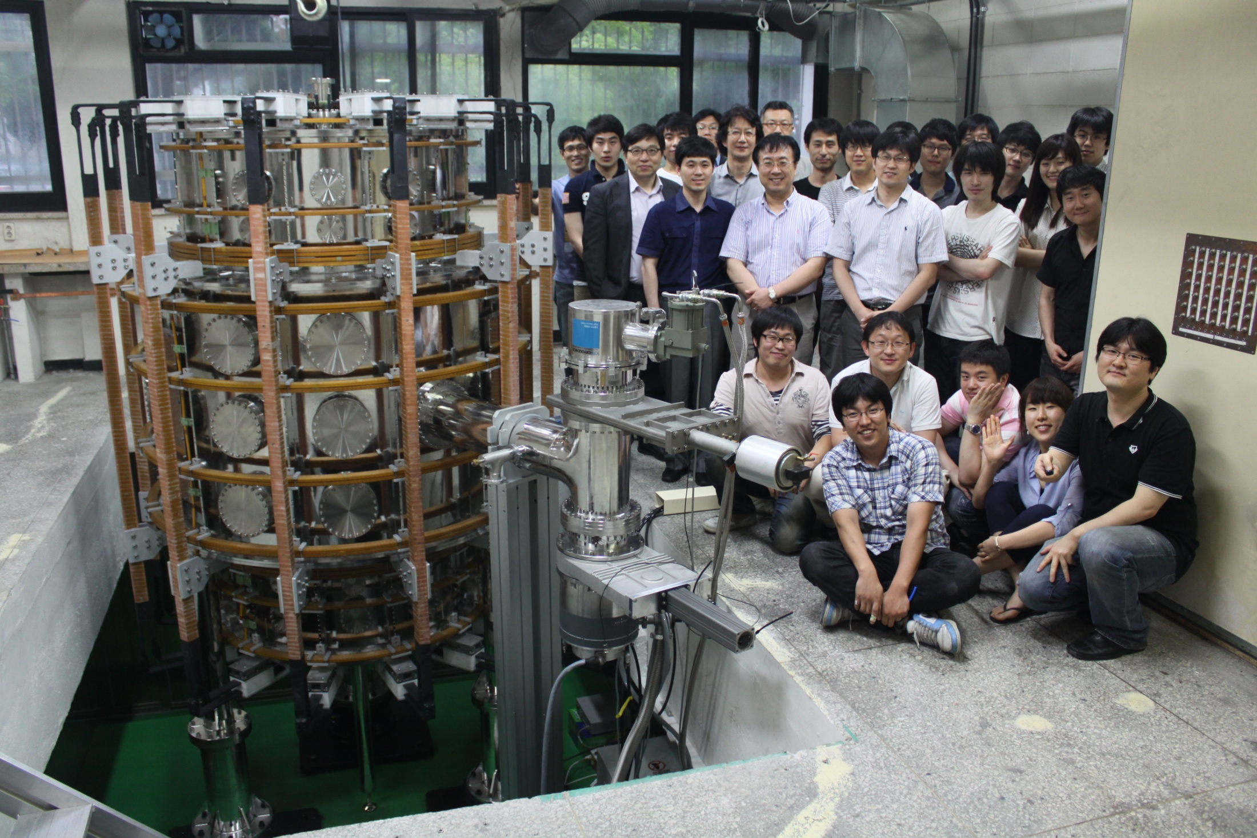
Thank you for your attention !

Slide 31
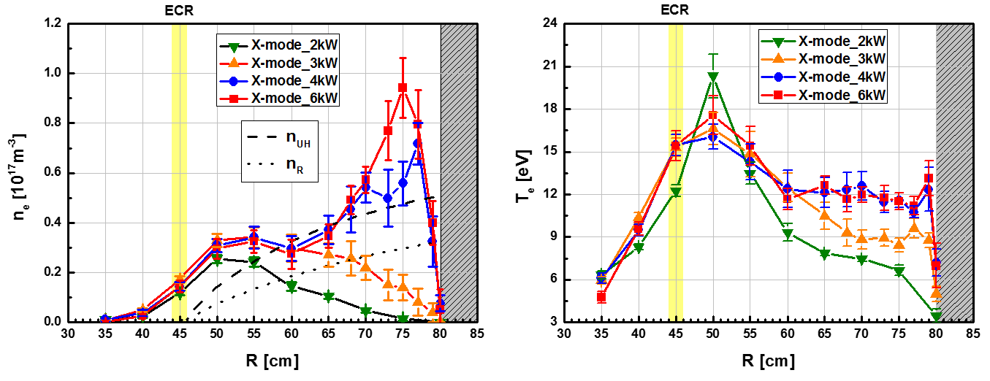
Start-up experiments in VEST Pre-ionization with Low-Field-Side Launch EC/EBW Heating
LFS perpendicular injection of ECW 10 kW
Over-dense plasma (X-wave tunneling)
Parametric decay with mode conversion
High density with collisional heating near UHR
J.G. Jo et al., Phys. Plasmas 24 012103 (2017)
TPC configuration for Pre-ionization
Higher density plasma with broad density profile
Different density profile with B_{t} strength
Low TF (Bo ~ 0.5 kG)
High TF (Bo ~ 1 kG)
Notes:
These devices are not typical tokamaks. Field null formation is used almost all tokamaks, not only above mentioned tokamaks.

Slide 32
Preparation for Advanced Tokamak Studies Discharge Improvement with Boronization
With great help from Dr. S.H. Hong (NFRI)
Boronization during Helium Glow discharge cleaning
Carborane (C₂B₁₀H₁₂) is used for non-toxic boronization
Water concentration recovery slowed down (RGA)
Oxygen atom line emission (777.0 nm) reduced by 3 fold
High density expected: More prefill gas (H_{α} line emission)
Helium flow (MFC 2.0 sccm)
Caborane oven (baked 50°C)
Diaphragm valve
Top flange (CF 6 inch)

Slide 33
Start-up Experiment in VEST
Robust and Reliable TPC Start-up Applied to KSTAR Successfully
Earlier plasma colomn formation than field null
Feasibility study of TPC in KSTAR
Even though low mirror ratio than ST, achieving efficient start-up with TPC
2nd harmonic delay of 20 ms and ECH plasma density of 4x10¹⁸ m⁻²
I_{p} formation with low E_{t} less than 0.2 V/m
Jeongwon Lee et al 2017 Nucl. Fusion in press https://doi.org/10.1088/1741-4326/aa8511

Slide 34
DC Helicity Injection DC Helicity Injection Start-up
J.Y. Park
400.4 ms
401 ms
402 ms
403 ms
Lower Gun Location
R = 0.25 m
Z = - 0.804 m
Magnetic Field Structure
Stacking ratio, G = 7 ~ 8
Multiplication, M = ~ 16
The Electron Gun for DC Helicity Injection
High current electron beam based on arc discharge w/ washer stacks
Low impurity
A toroidal current of up to ~20 kA has been generated by the electron gun
Increased multiplication factor confirmed as current streams reconnect
Very dynamic states of current sheet observed
The electron gun

Slide 35
Future Research Plans
Long-term Research Plans
Reactor-relevant Advance Tokamak research
AT scenario for high beta and steady-state operation
Innovative divertor to handle long-pulse high-performance operation
Energetic particle transport …

Slide 36
Preparation for Advanced Tokamak Studies Simulations for the VEST Advanced Tokamak Scenario
C.Y. Lee
1-D transport simulation
NBI heating with NUBEAM code
(Density and equilibriums are given.)
1D integrated modelling with ASTRA code with TGLF module
(Density profile is given.)
L-mode (edge at r=0.9) and H-mode cases are compared
0-D system code analysis
Low toroidal field 0.1 T
High beta N 7
Plasma current 80 kA
Non-inductive 100%
Bootstrap fraction 80%
Required NB power 500 kW

Slide 37
Preparation for Advanced Tokamak Studies Simulations for the VEST Advanced Tokamak Scenario
C.Y. Lee
Total power loss is calculated using NUBEAM simulations in various conditions ($I_{P}=100 kA$)
Total loss ( $n_{e0}=2∗{10}^{19}{ m}^{−3})$
$$E_{beam}$$ | R = 35 cm | R = 40 cm
$$10keV$$ | 27% | 33%
$$20keV$$ | 43% | 70%
$P_{e}, P_{i}$ at 15$°$ injection
Heating power ($MW/m^{3})$
$$(n_{e0}=2∗{10}^{19} m^{−3})$$
$$r/a$$
Based on the result, R = 35 cm equilibrium is chosen for better NBI power absorption.
15 degree of the injection angle is chosen considering both power loss and engineering issue in VEST and its heating power profiles are calculated.

