Slide 1

Next-Step Low-Aspect-Ratio Tokamaks Using High-Temperature Superconductors and Liquid Metal Plasma Facing Components*
J. Menard, T. Brown, M. Jaworski,
R. Maingi, R. Majeski, Y. Zhai
International Spherical Torus Workshop - 2017
Seoul National University, Seoul, South Korea
September 19-22, 2017
*Work Supported by U.S.D.O.E. Contract No. DE-AC02-09CH11466

Slide 2
Possible missions for next-steps
Integrate high-performance, steady-state, exhaust
  Divertor test-tokamak - DTT
Fusion-relevant neutron wall loading
  Γ_{n} ~ 1-2MW/m², fluence: ≥ 6MW-yr/m²
Tritium self-sufficiency
  Tritium breeding ratio TBR ≥ 1
Electrical self-sufficiency
  Q_{eng} = P_{electric} / P_{consumed} ~ 1
Large net electricity generation
  Q_{eng} >> 1, P_{electric} = 0.5-1 GWe
This talk will discuss PPPL-led studies of how low-A “spherical” tokamaks could fulfill these missions

Slide 3
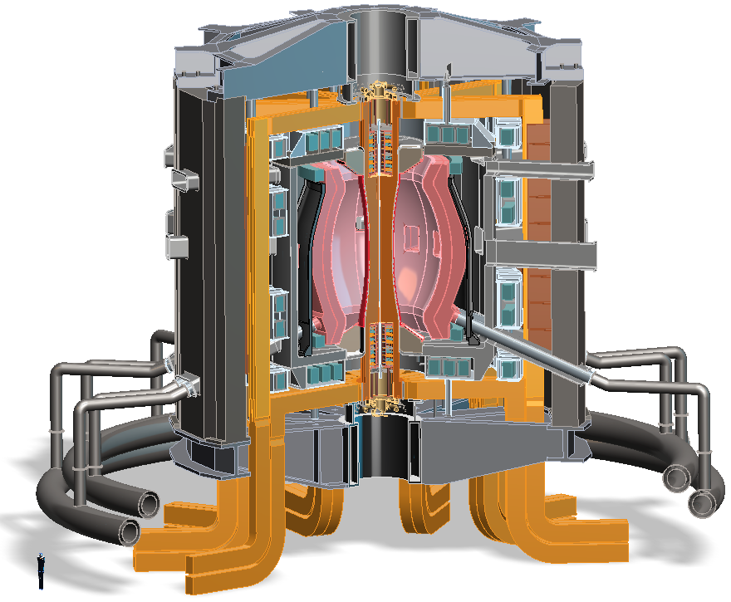
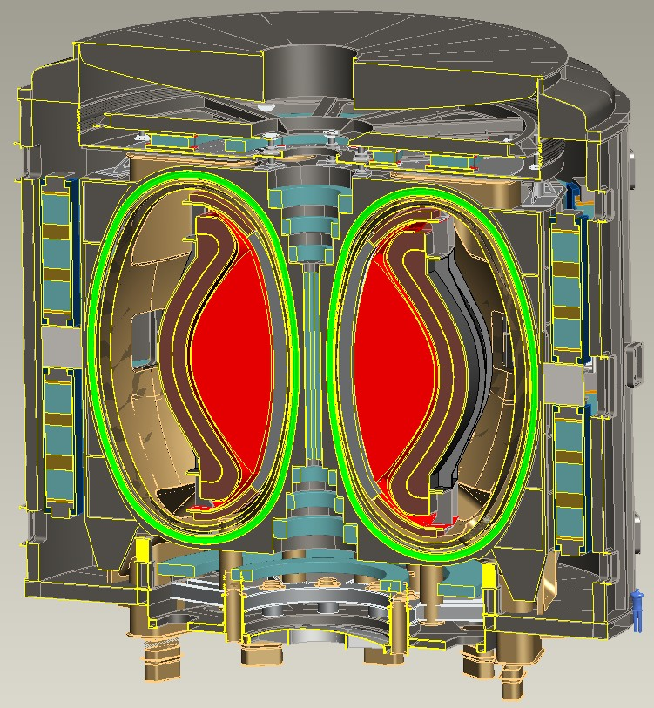
Recent design studies show ST potentially attractive as
Fusion Nuclear Science Facility (FNSF) and Pilot Plant
FNSF: Provide neutron fluence for material/component R&D (+ T self-sufficiency?)
Pilot Plant: Electrical self-sufficiency: Q_{eng} = P_{elec} / P_{consumed} ≥ 1 (+ FNSF mission?)
FNSF with copper TF coils
A=1.7, R₀ = 1.7m, κ_{x} = 2.7, B_{T}=3T
Fluence = 6MWy/m², TBR ~ 1
FNSF / Pilot Plant with HTS TF coils
A=2, R₀ = 3m, κ_{x} = 2.5, B_{T} = 4T
6MWy/m², TBR ~ 1, Q_{eng} ~ 1
Designs integrate ST higher κ , β_{N} and advanced divertors (+ HTS TF for Pilot Plant)
J.E. Menard, et al., Nucl. Fusion 56 (2016) 106023

Slide 4
Possible missions for next-steps
Integrate high-performance, steady-state, exhaust
  Divertor test-tokamak - DTT
Fusion-relevant neutron wall loading
  Γ_{n} ~ 1-2MW/m², fluence: ≥ 6MW-yr/m²
Tritium self-sufficiency
  Tritium breeding ratio TBR ≥ 1
Electrical self-sufficiency
  Q_{eng} = P_{electric} / P_{consumed} ~ 1
Large net electricity generation
  Q_{eng} >> 1, P_{electric} = 0.5-1 GWe
2015-2016:
HTS TF
R = 3m
A=1.6-4
“Pilot Plant”

Slide 5
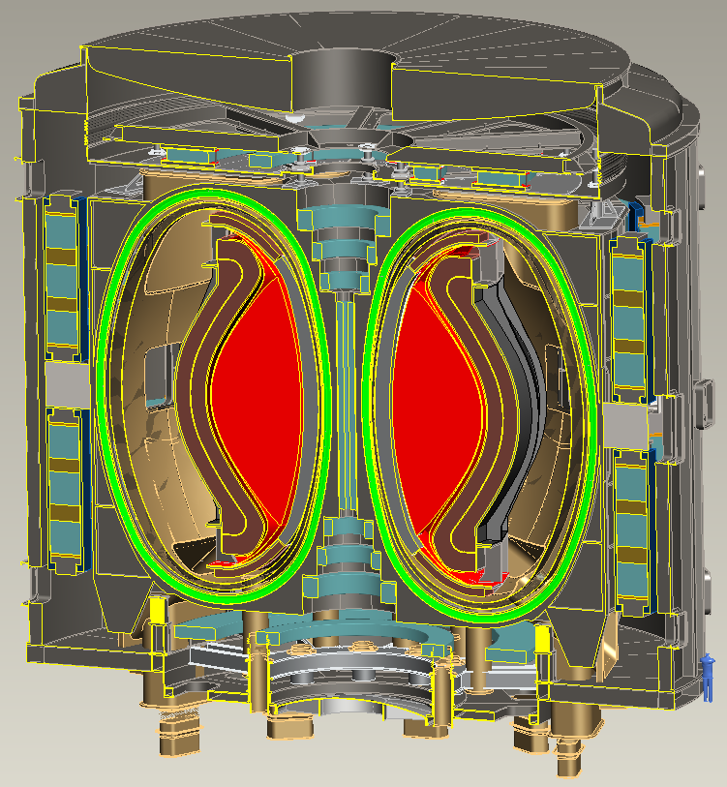
A=2, R₀ = 3m HTS-TF FNSF / Pilot Plant
B_{T} = 4T, I_{P} = 12.5MA
κ = 2.5, δ = 0.55
β_{N} = 4.2, β_{T} = 9%
H₉₈ = 1.8, H_{Petty-08} = 1.3
f_{gw} = 0.80, f_{BS} = 0.76
Startup I_{P} (OH) ~ 2MA
J_{WP} = 70MA/m²
B_{T-max} = 17.5T
No joints in TF
Vertical maintenance
P_{fusion} = 520 MW
P_{NBI} = 50 MW, E_{NBI} = 0.5MeV
Q_{DT} = 10.4
Q_{eng} = 1.35
P_{net} = 73 MW
⟨W_{n}⟩ = 1.3 MW/m²
Peak n-flux = 2.4 MW/m²
Peak n-fluence = 7 MWy/m²
Cryostat volume ~ 1/3 of ITER

Slide 6
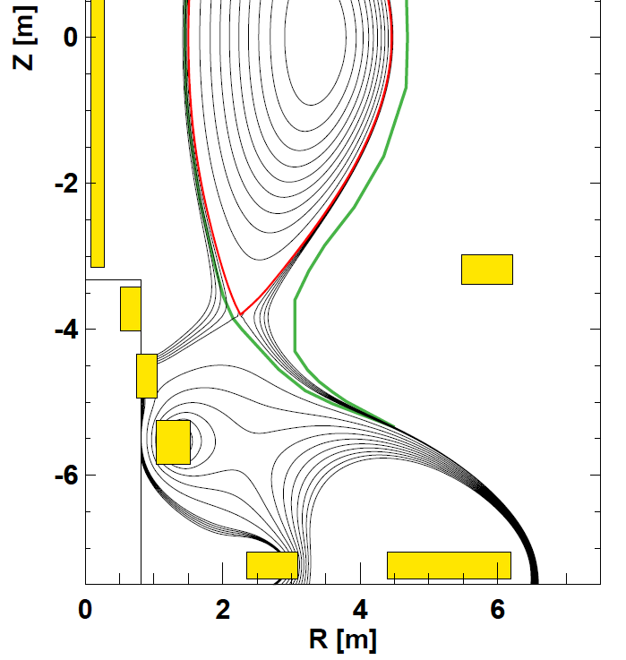
Base-design Pilot uses long-leg / deep-V slot divertor
PF coils outside TF
Increase strike-point radius ~2× to reduce q|| and peak heat flux
Divertor PFCs in region of reduced neutron flux
Narrow divertor aperture for increased TBR
More space for breeding at top/bottom of device

Slide 7
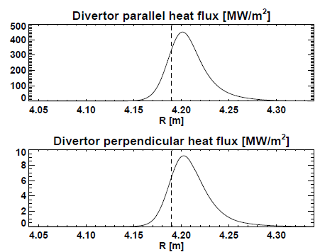
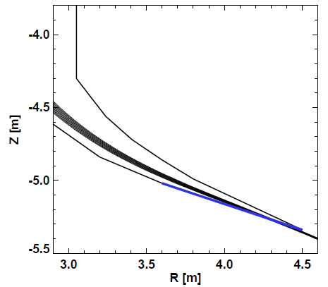
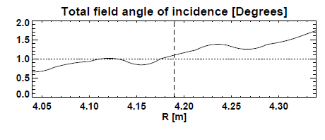
Long-leg / Super-X aids heat flux reduction
A=2 HTS TF FNSF/Pilot
λ_{q} ~ 1mm, assume S ≈ λ_{q} (closed divertor)
(T. Eich NF 2013)
(Partial) detachment likely reduces peak q⊥ by further factor of 2-7

Slide 8
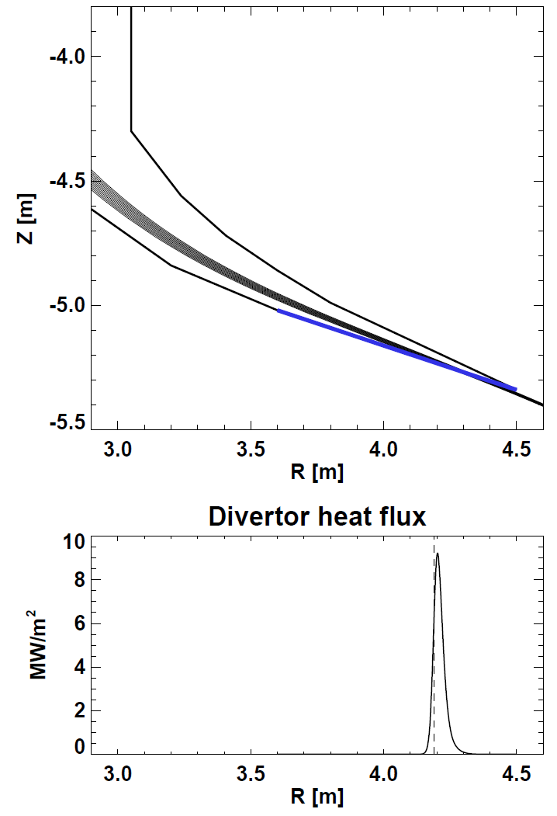
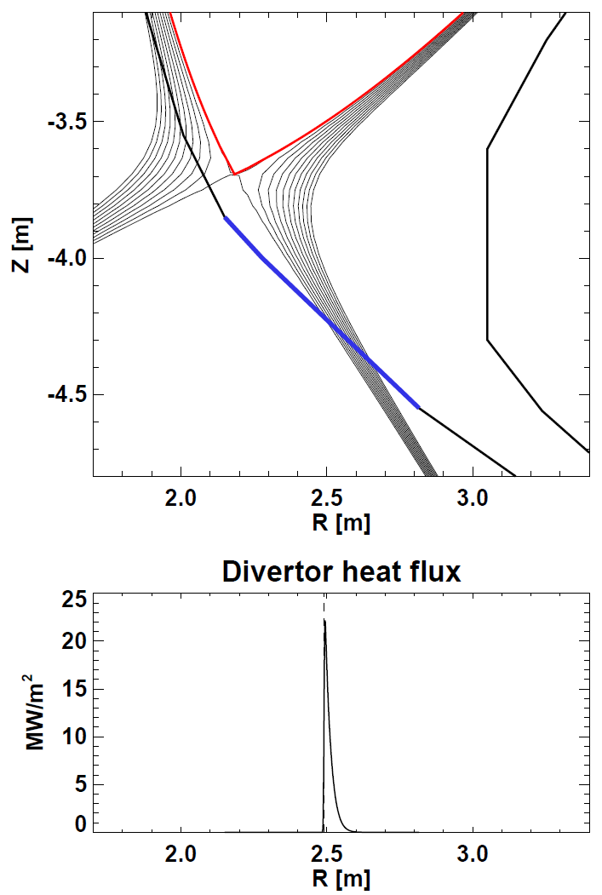
Another option: Liquid metal (LM) divertor w/ shorter outer leg P_{div} = 9 → 21MW/m² for R_{strike} = 4.2m → 2.5m
Long-leg / Super-X
Shorter leg LM divertor
Geometry also compatible with
“vapor box” concepts (Ono / Goldston)

Slide 9
Why (flowing) liquid metals in divertor?
Replenish divertor material lost to steady-state, transient erosion (ELMs, control excursions)
  Potentially more resilient to disruptions (?)
First-wall erosion materials will very likely end up in divertor → need active dust removal
Dissipate higher heat fluxes than is possible with solids → widens divertor design space
Lithium H/D/T pumping may increase energy confinement → important for compact Pilots
  ELMs suppressed by Li in NSTX, EAST

Slide 10
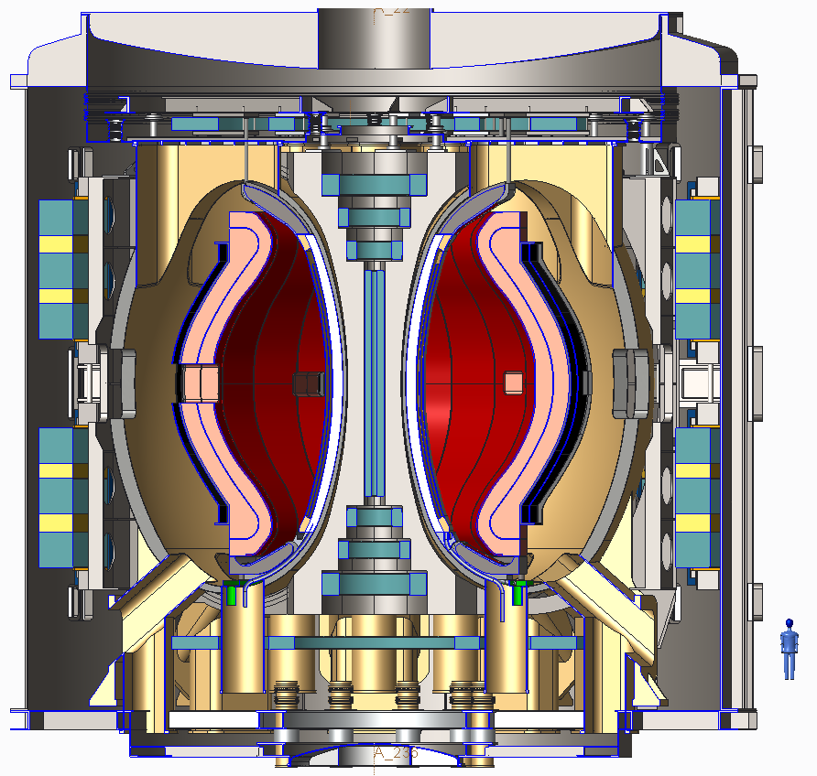
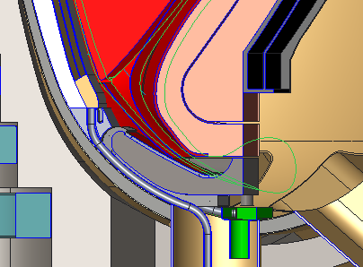
HTS ST-FNSF design with Li flow on divertor and inboard surfaces
Double null liquid metal divertor system
Li flows from upper divertor down the inboard wall, exiting just after the lower inboard divertor.
Separate Li cooling of lower divertor
Thickness = 5-10 mm, flow speed ~5-10 m/s (see Dick Majeski for more details)

Slide 11
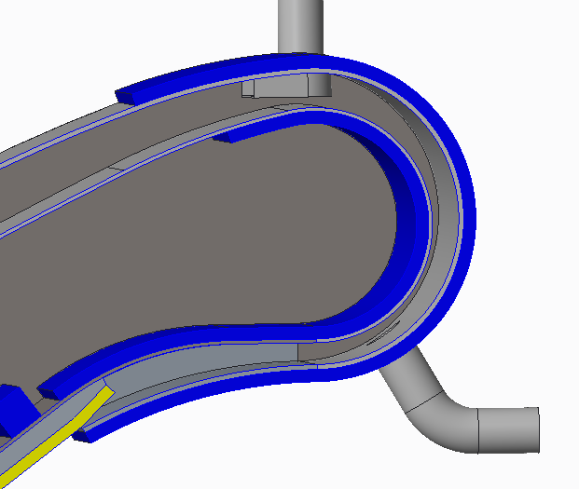
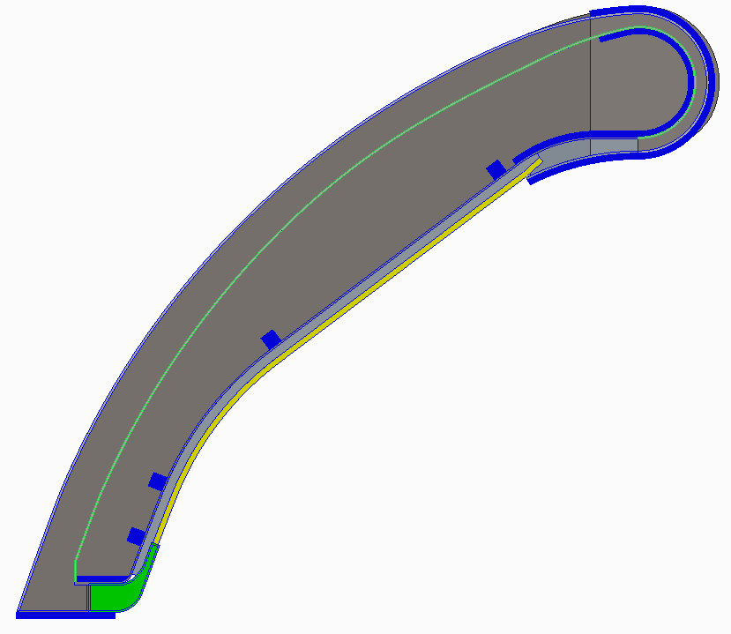
Basic liquid metal divertor concept
Li supply
Plates (in blue) provide
J x B pump electrodes
Li flow direction
J x B pumping to high-field side nozzle
Heat exchanger in reservoir

Slide 12
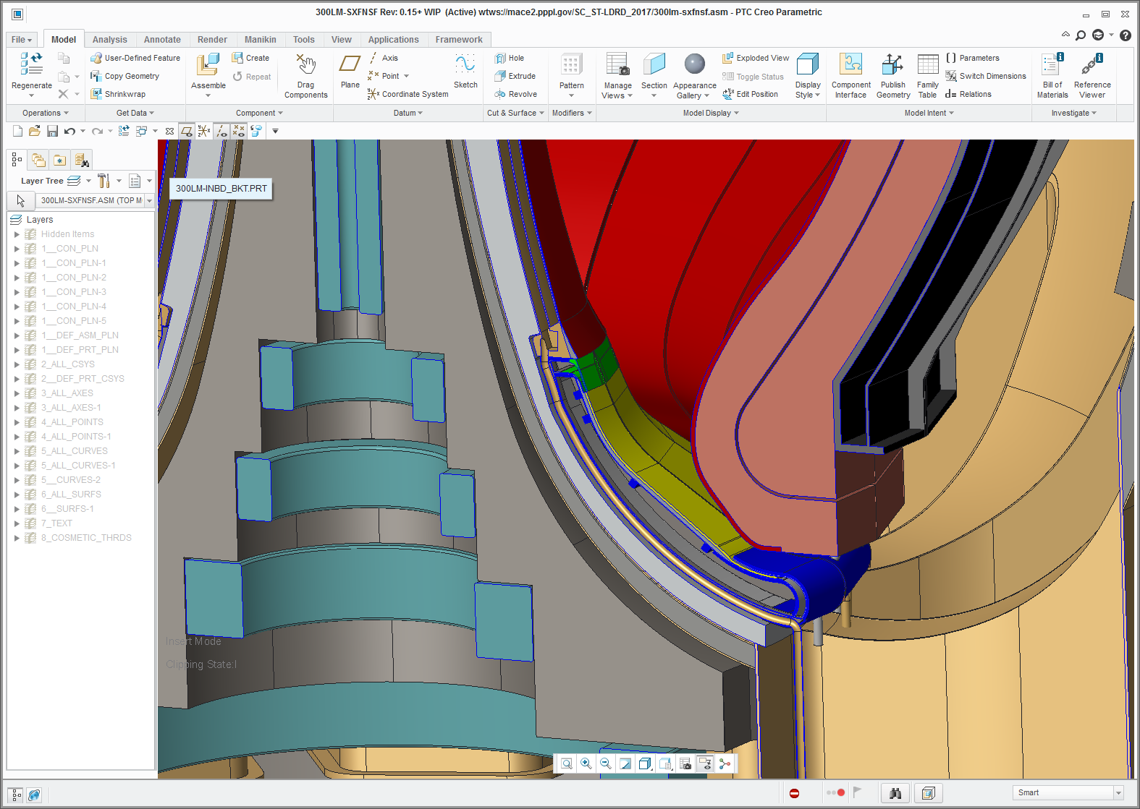
Concepts with LM flow only in divertors
Space for inboard blanket piping

Slide 13
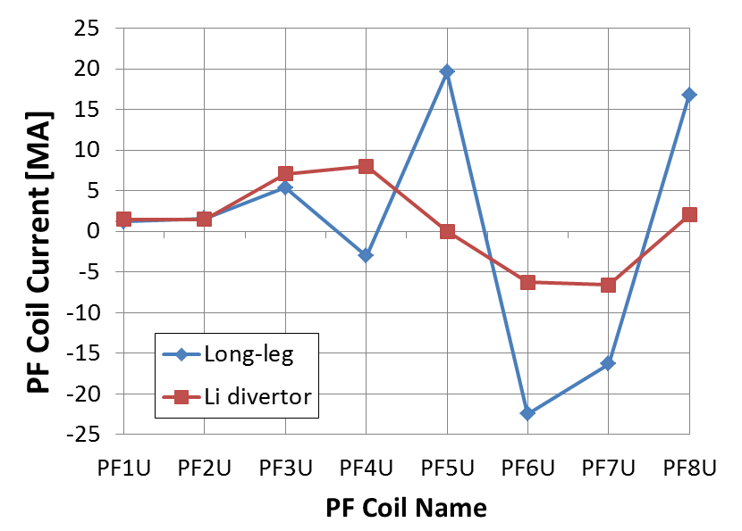
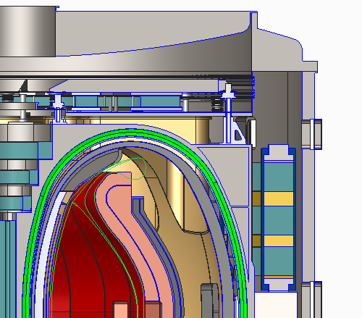
Benefits of shorter-leg LM high-heat-flux divertor:
Significantly reduce outboard PF coil current
  Reduced PF size, force, structure
Eliminate separate upper cryo-stat (for PF5U)
4
5
3
2
6
1
7
8
Li wall pumping could help increase H-factor

Slide 14
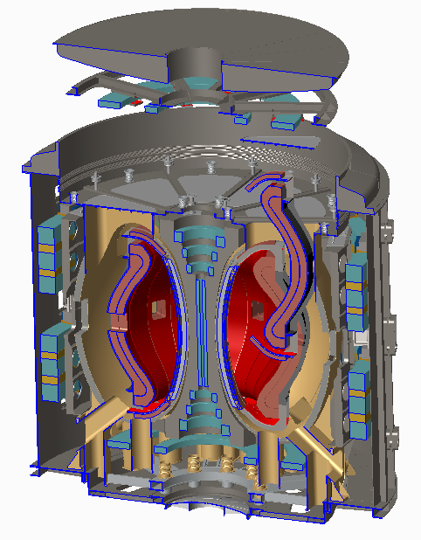
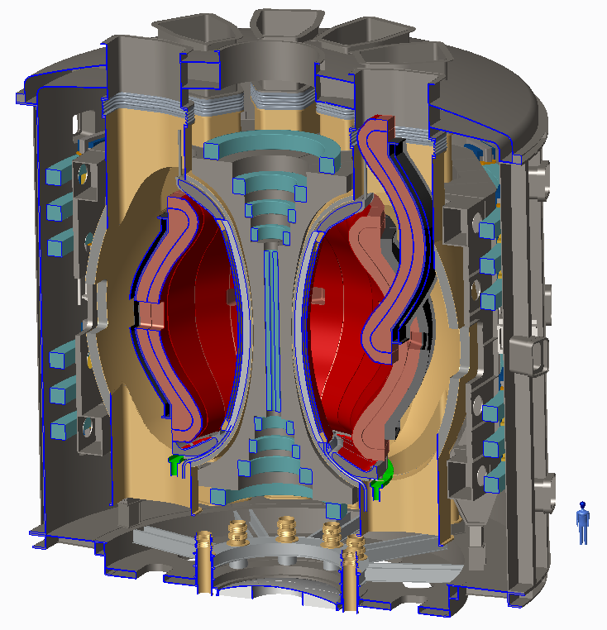
Comparison of long vs. shorter-leg divertor Pilots:
Simplify vertical maintenance
Reduce outboard PF currents → can use LTS PF coils
3m HTS ST-FNSF with
long-leg/Super-X divertor
3m HTS ST-FNSF with Liquid Metal divertor

Slide 15
Possible missions for next-steps
Integrate high-performance, steady-state, exhaust
  Divertor test-tokamak (DTT) emphasizing liquid metals
Fusion-relevant neutron wall loading
  Γ_{n} ~ 1-2MW/m², fluence: ≥ 6MW-yr/m²
Tritium self-sufficiency
  Tritium breeding ratio TBR ≥ 1
Electrical self-sufficiency
  Q_{eng} = P_{electric} / P_{consumed} ~ 1
Large net electricity generation
  Q_{eng} >> 1, P_{electric} = 0.5-1 GWe

Slide 16
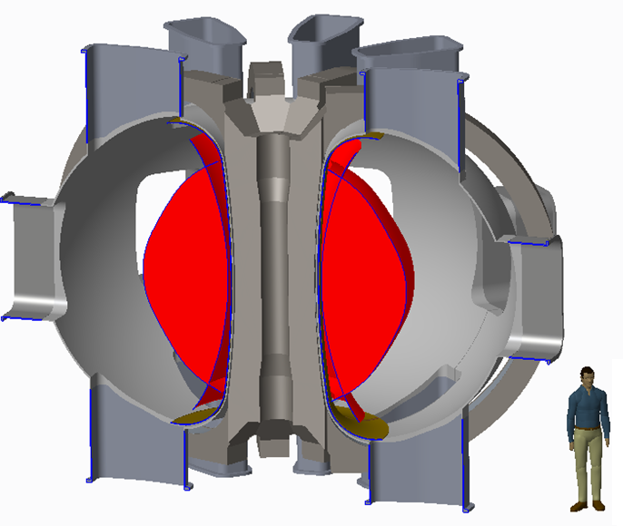
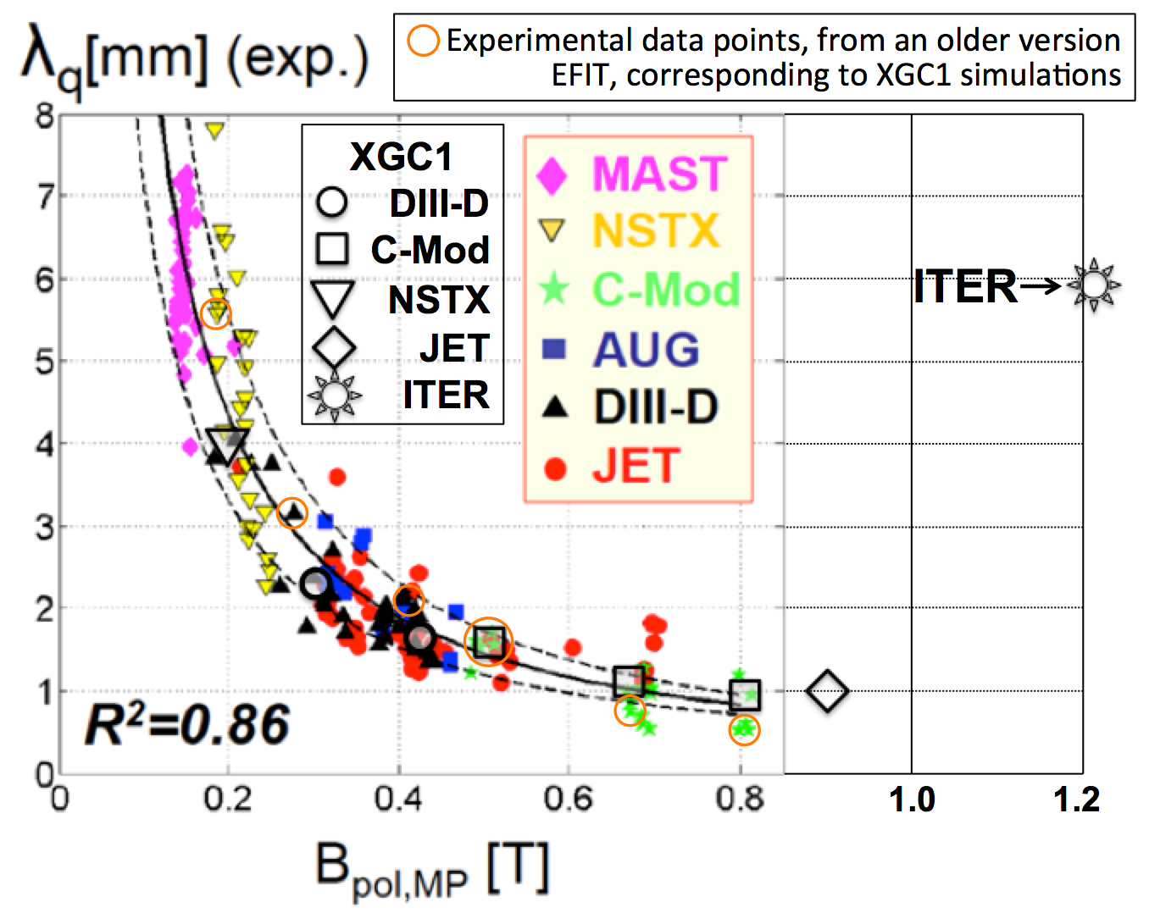
Beginning to assess smaller dedicated low-A HTS tokamak for liquid metal divertor development
R = 1.2m, A = 2.3, κ = 2.1
B_{T} = 4-5T, P_{NBI} = 35MW
H₉₈ = 0.8-1.6, β_{N} = 2-4, full non-inductive
I_{P} = 1.5-3.4MA, B_{P} = 0.35-0.8T
Vary T_{wall} = 20-500ºC, P/S ~ 1MW/m²
λ_{q} →1-2mm, access q⊥ ≥ 20MW/m²
Concept for vessel + TF coil cases
TF: REBCO, likely CORC
CS coil insert possibilities:
    YBCO pancakes (needs insulation scheme for flux-swing)
    Bi-2212 solenoids
Physics bifurcation

Slide 17
Summary
Developed self-consistent low-A FNSFs / Pilot Plants
  Long-leg and/or liquid metal (LM) divertors, T self-sufficient, only ex-vessel TF and PF coils, vertical maintenance
Compact Pilot Plants achievable by combining improved stability of low-A + advanced magnets
  Optimal aspect ratio will be informed by upcoming NSTX-U and MAST-U results and REBCO TF magnet R&D
Liquid metal divertors for high heat flux could simplify cryostat, reduce coil currents/forces
  Higher confinement from liquid Li would also be beneficial
Exploring lower-A toroidal configurations to test liquid-metal divertors under DEMO-relevant conditions

Slide 18
Backup slides

Slide 19
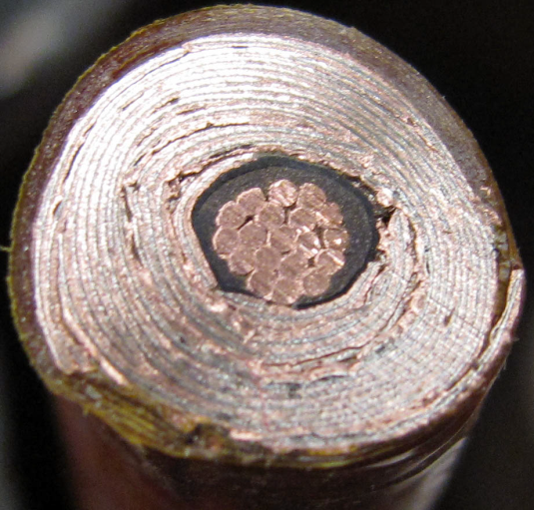
HTS cables using REBCO tapes achieving high winding pack current density at high field
10 mm
Conductor on Round Core Cables (CORC)
J_{WP} ~ 70MA/m² 19T
6 mm
10 mm
7 kA CORC (4.2K, 19 T) cable
Base cable: 50 tapes YBCO Tapes with 38 μm substrate (Van Der Laan, HTS4Fusion, 2015)
7 mm
Base Conductor
He Gas Cooled
8kA,
J_{WP} ~ 160MA/m²
Higher J_{cable} HTS cable concepts under development:
Copper
7 mm
SS conductor jacket for strength

Slide 20
What is optimal A for HTS FNSF / Pilot Plant?
P_{fus} / V ~ ε(β_{N} κ B_{T} )⁴ at fixed bootstrap fraction
β_{N} and κ increase at lower aspect ratio
B_{T} decreases at lower A – depends strongly on:
  Inboard shielding, HTS allowable field and current density
Approach:
Fix plasma major radius and heating power (50MW)
  R₀ = 3m – smallest size for Q_{eng} > 1 and high fluence
Apply magnet & plasma constraints (see backup)
  HTS strain: 0.3%, β_{N}: n=1 no-wall, κ: 0.95×limit, f_{GW} = 0.8
Vary aspect ratio from A = 1.6 to 4
Vary HTS current density, peak field
  Also scan inboard shielding thickness (not shown)
Compute Q_{DT}, Q_{eng}, and required H₉₈ (unconstrained)

Slide 21
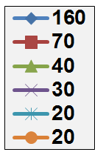
High TF winding-pack current density required to access highest B_{T} at lower A
19T: Present CORC HTS limit
J_{WP} [MA/m²]
12T: ITER-like TF coil limit
(Nb₃Sn, 11.8T)
Coil structure sized to maintain ≤ 0.3% strain on winding pack for all cases shown here

Slide 22
High current density HTS cable motivates consideration of low-A tokamak pilot plants
J_{WP} [MA/m²]
ITER-like TF constraints:
  J_{WP}=20MA/m², B_{max} ≤ 12T
  P_{fusion} ≤ 130MW
  P_{net} < -90MW
J_{WP} ~ 30MA/m², B_{max} ≤ 19T
  P_{fusion} ~ 400MW
  Small P_{net} at A=2.2-3.5
J_{WP} ≥ 70MA/m²,B_{max} ≤ 19T
  P_{fusion} ~500-600MW
  P_{net} = 80-100MW at A=1.9-2.3
(12T)
A ~ 2 attractive at high J_{WP}

Slide 23
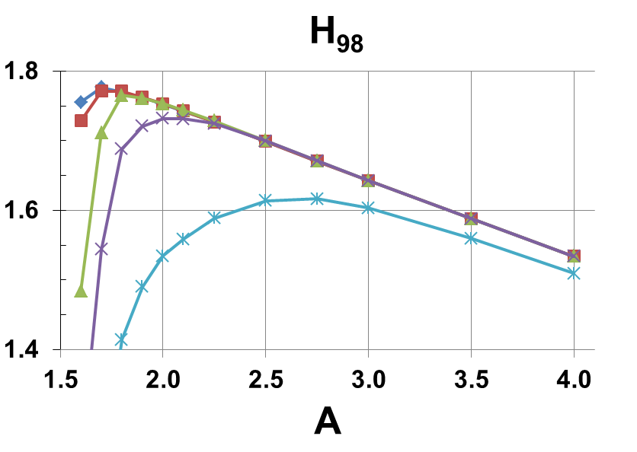
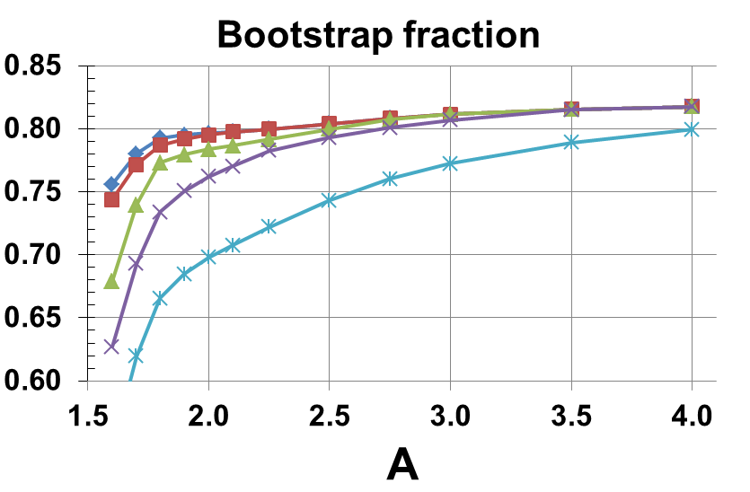
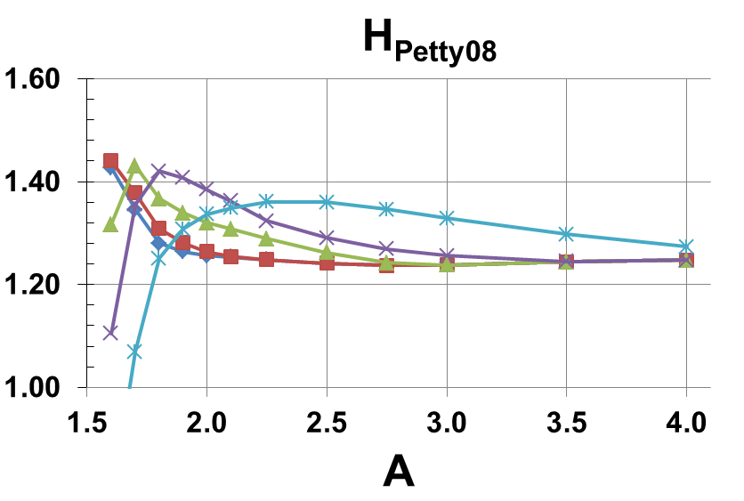
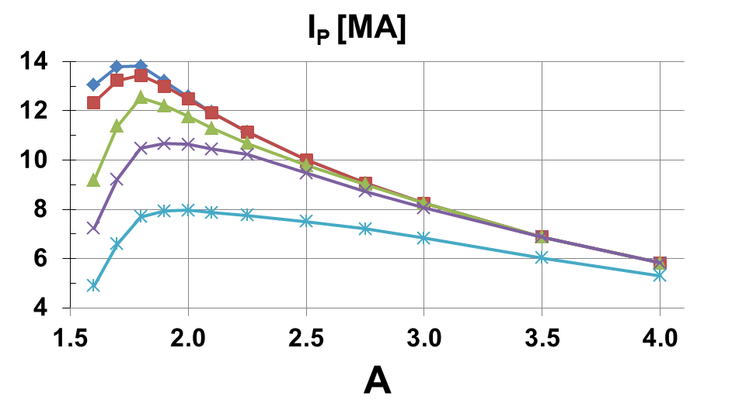
A ≥ 2 pilot plant scenarios have elevated H > 1, f_{BS} ~ 80%, I_{P} = 6-12MA
J_{WP} [MA/m²]

Slide 24
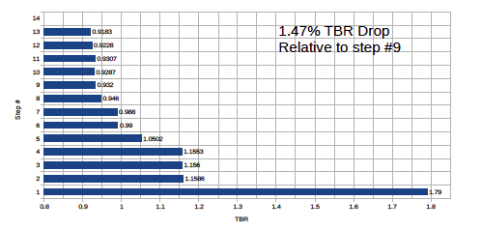

Breeding calculations for A=2, R=3 Pilot Plant
1.04
Outboard TBR ~ 0.92
Step 1- Infinite media of LiPb
Step 2- LiPb confined to OB FW/blanket
Step 3- Assembly gaps added
Step 4- Homogeneous mixture of blanket in upper and lower ends of OB blanket
Step 5- FW material added
Step 6- Side, back, and front walls added
Step 7- Cooling channels added
Step 8- SiC FCI added
Step 9- Stabilizing shells added
Step 10- MTM only inserted (TBR relative to Step #9)
Step 11- 4 TBMs only inserted (TBR relative to Step #9)
Step 12- 4 NBIs only inserted (TBR relative to Step #9)
Step 13- all MTM, 4 TBMs, and 4 NBIs inserted
Step 14 – include inboard breeding blanket
Thin inboard blanket (10 cm) provides TBR = 1.04

Slide 25
Comparison of low-A FNSF / Pilot Plants

Slide 26
Comparison of low-A FNSF / Pilot Plants

Slide 27
Backup slides
HTS TF FNSF / Pilot

Slide 28
Plasma constraints
Fix plasma major radius at R₀ = 3m
  Chosen to be large enough to allow space for HTS neutron shield and access Q_{eng} > 1 for range of A
Inboard plasma / FW gap = 4cm
Use ε-dependent κ(ε), β_{N} (ε) (see next slide)
Greenwald fraction = 0.8
q* not constrained
  q* is better ε-invariant than q₉₅ for current limit
  Want to operate with q* > 3 to reduce disruptivity
0.5 MeV NNBI for heating/CD – fixed P_{NBI} = 50MW
H_{98y2} adjusted to achieve full non-inductive CD

Slide 29
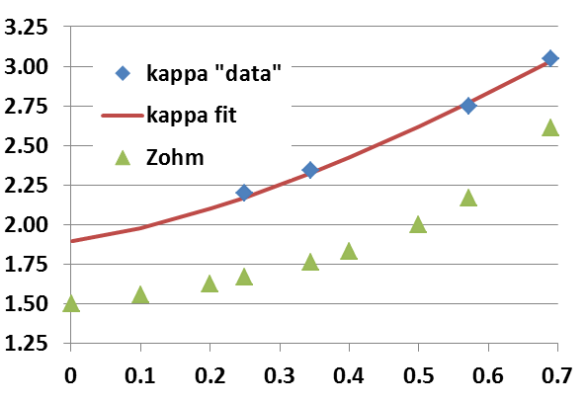
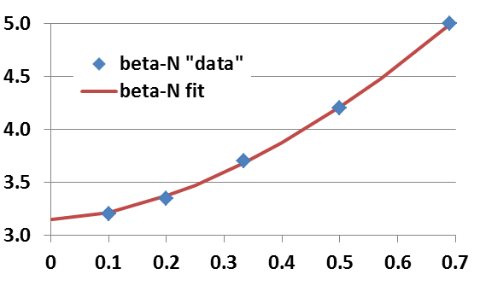
Aspect ratio dependence of limits: κ(ε), β_{N}(ε)
Pilot study uses 0.95×κ value shown here:
NSTX data at low-A
  Also NSTX-U/ST-FNSF modelling
DIII-D, ARIES-AT for higher A
  κ → 1.9 for A → ∞
Profile-optimized no-wall stability limit at f_{BS} ≈ 50%
  Menard PoP 2004
β_{N} → 3.1 for A → ∞
β_{T} ∝ A^{-1/2} (1+κ²) β_{N}² / f_{BS}
→ P_{fus} ∝ ε [κ(ε) β_{N}(ε) B_{T}(ε)]⁴
ε = A⁻¹

Slide 30
Engineering constraints
Magnet constraints
  Maximum stress in TF magnet structure = 0.66 GPa
  HTS tape/cable strain limit 0.3% (equivalent to 0.4 GPa)
  Winding pack current density (CORC 2015) 70 MA/m²
  OH at small R → higher solenoid flux swing for higher A
Shielding / blankets
  HTS fluence limit: 3.5x10²² n/m²
  Shield:10x n-shielding factor per 15-16cm WC for HTS TF
  Include inboard & outboard breeder thickness for TBR ~ 1
    “Effective shield thickness” includes shield + DCLL blanket
Electrical system efficiency assumptions:
  30% wall plug efficiency for H&CD - typical of NNBI
  ≥ 45% thermal conversion efficiency - typical of DCLL
    Also include pumping, controls, other sub-systems
    See Pilot Plant NF 2011 paper for more details

Slide 31
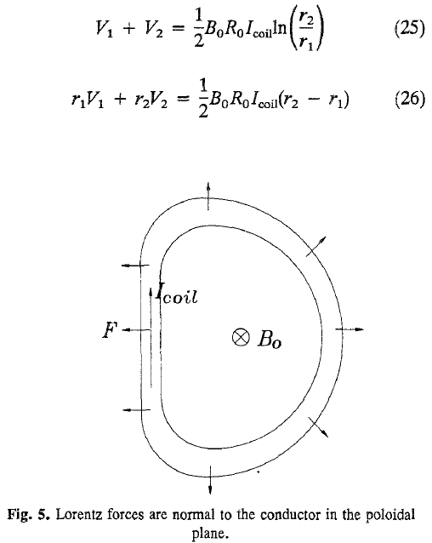
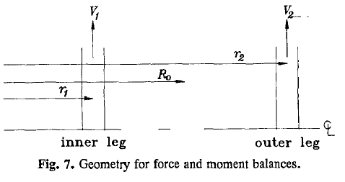
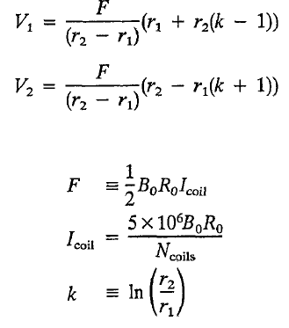
Simplified TF magnet design equations
From J. Schwartz, Journal of Fusion Energy, Vol. 11, No. 1, 1992

Slide 32
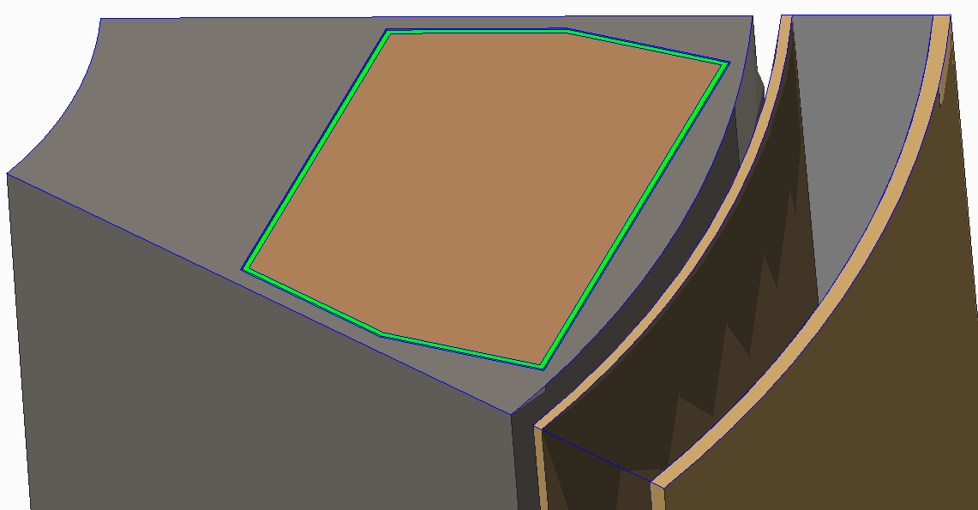
A=2, R₀ = 3m device TF inboard leg showing
allocated space for case and winding
Current per coil: 6 MA
Winding Cd: 35.9 MA/m²
0.167 m² winding area

Slide 33
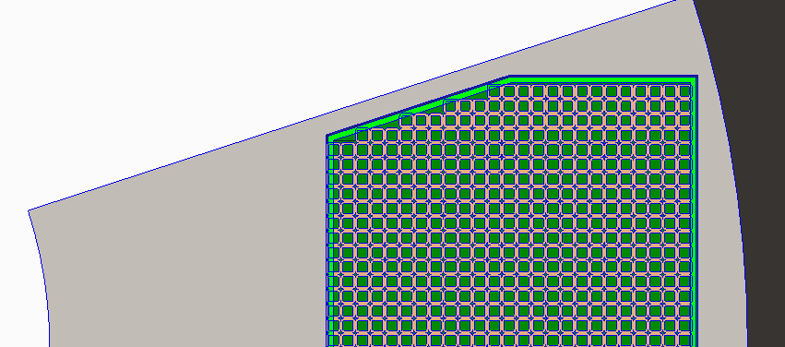
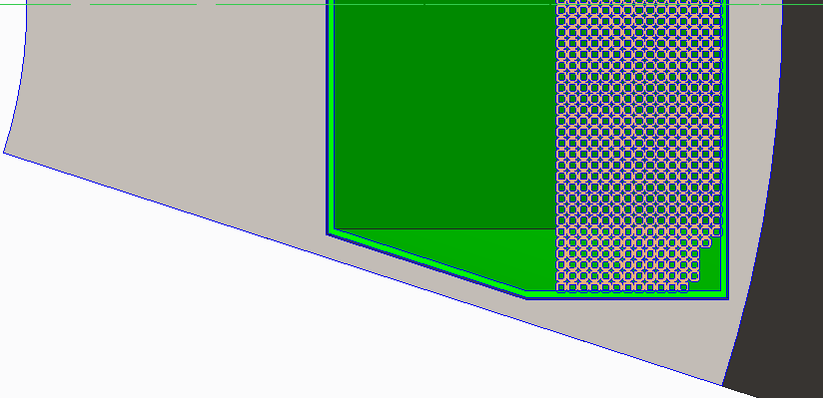
CORC Conductor – Achieved now
857 turns @ 7 kA
(848 turns shown; a few additional turns required)
10 mm
10 mm
6 mm
Base Conductor – Helium Gas Cooled
7 mm
Copper
7 mm
750 turns @ 8 kA
(750 turns shown)
SS conductor jacket for strength

Slide 34
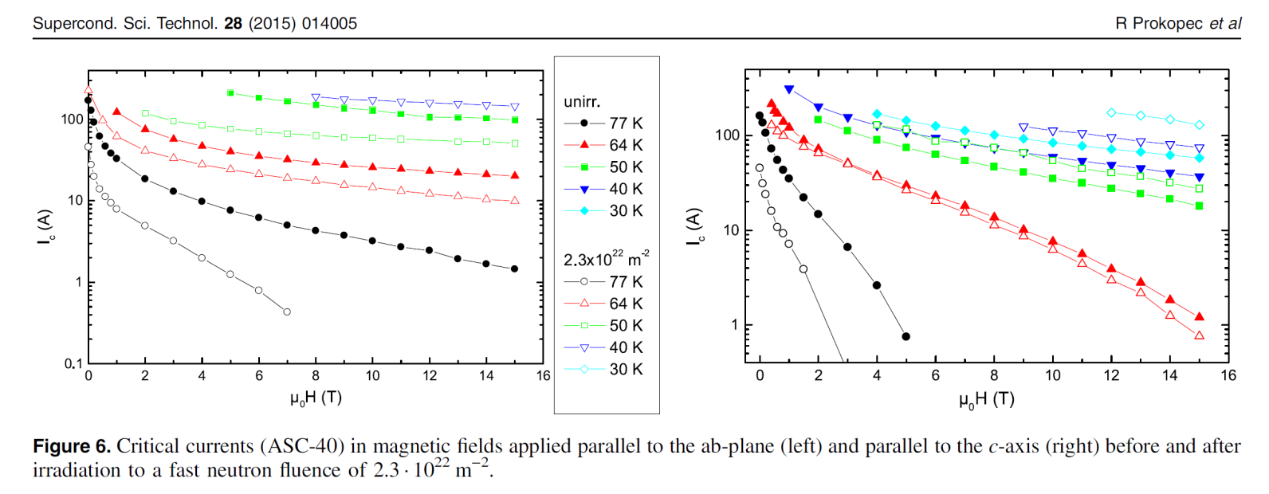
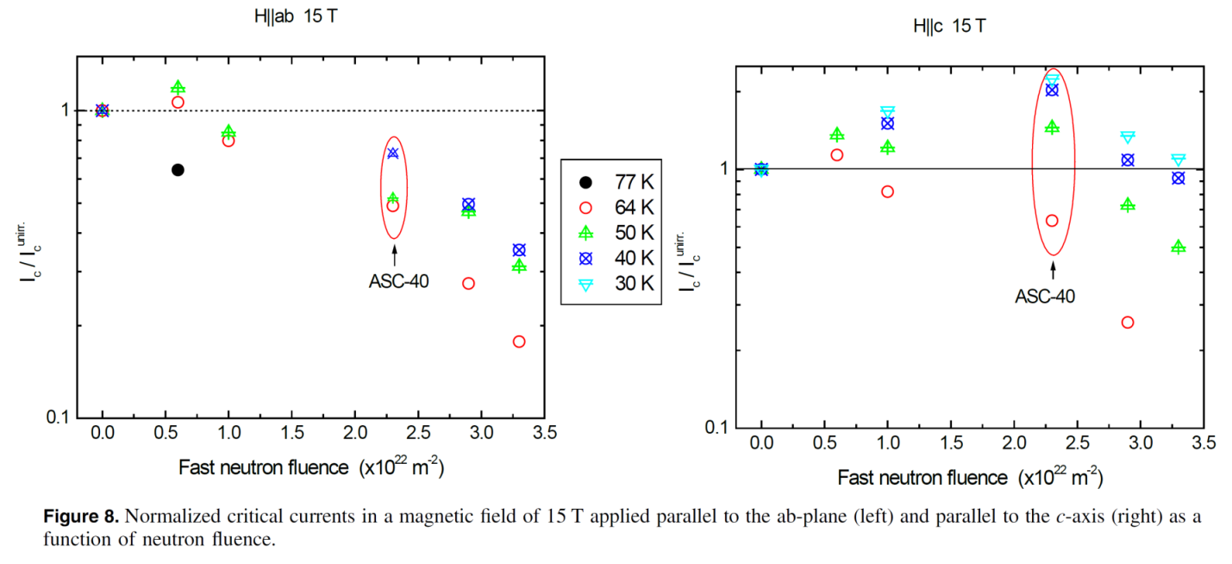
HTS performance vs. field and fast neutron fluence

Slide 35
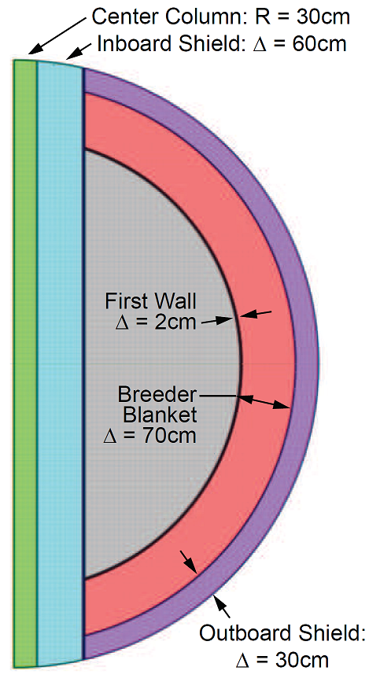
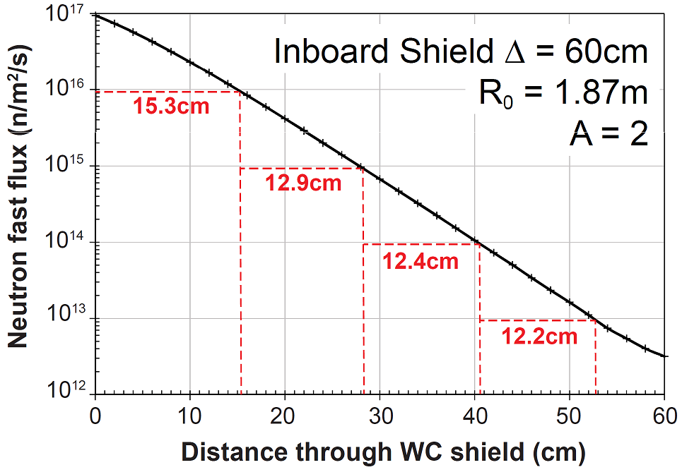

Neutronics analysis for HTS TF shielding

Slide 36
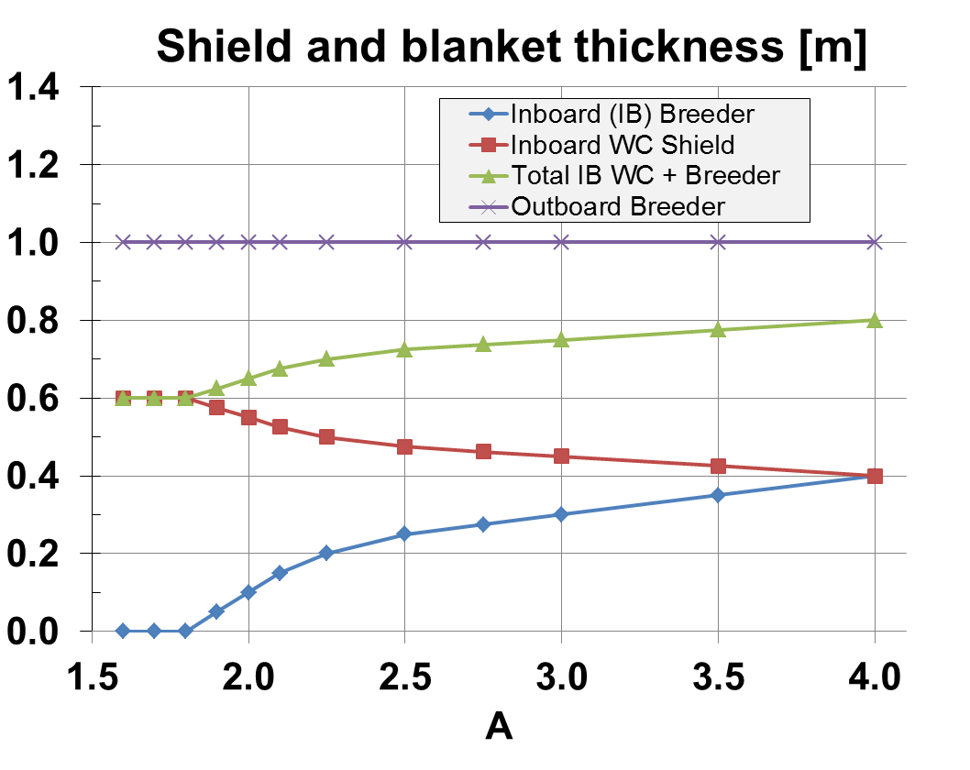
Breeding blanket thickness model

Slide 37
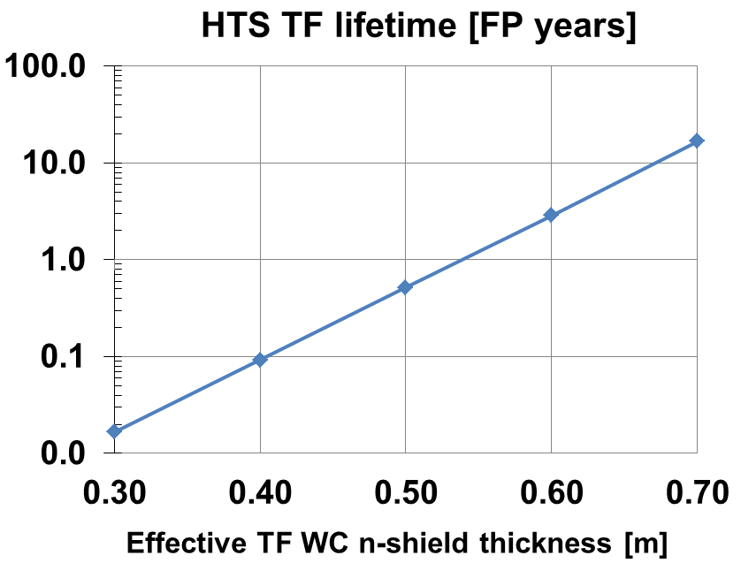
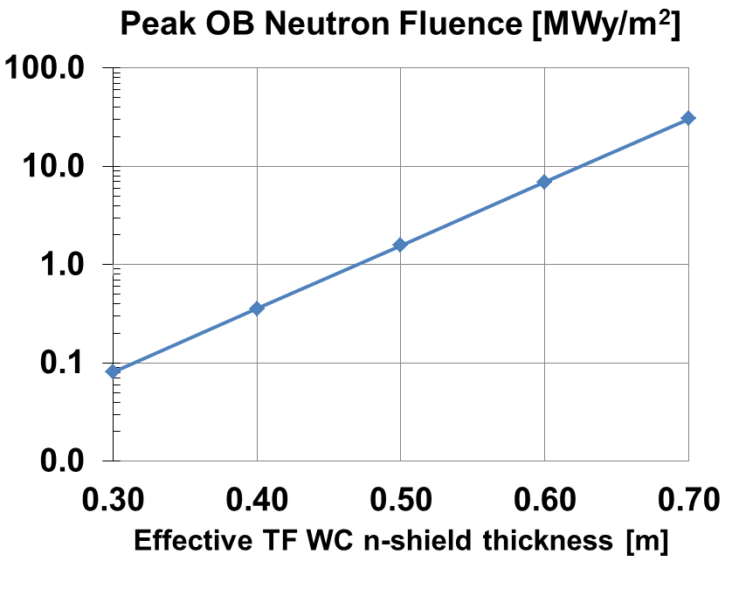
HTS TF lifetime is very strong function of inboard shielding thickness
Inboard shield + blanket equivalent to 60cm WC →
3FPY → 6-7MWy/m² → fulfill FNSF requirement

Slide 38
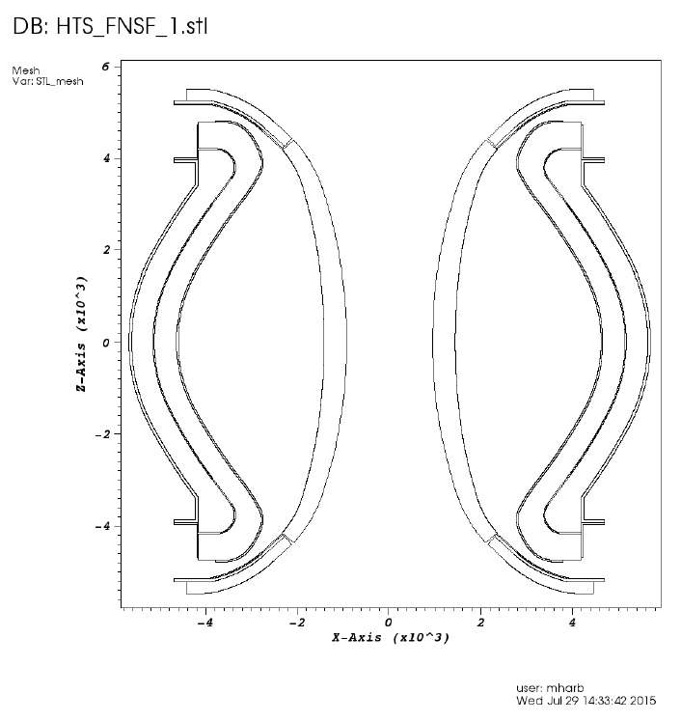
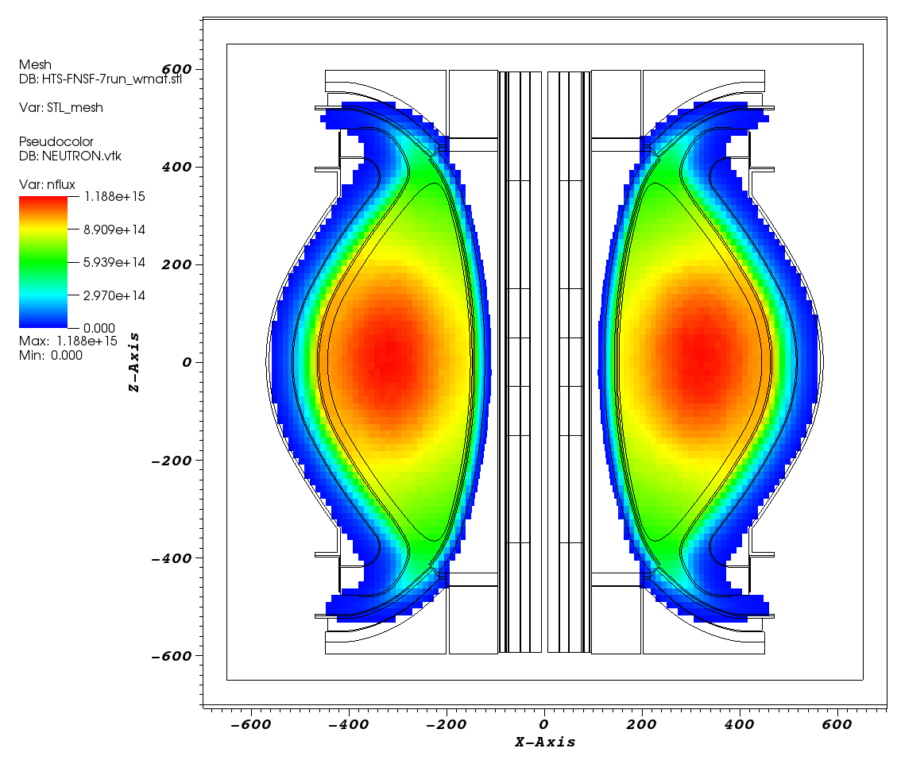
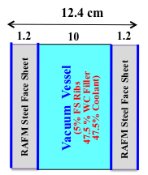
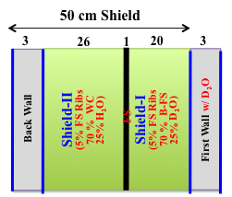
3-D Neutronics Model
Simple CAD Model outlining components (from T. Brown):
  10 cm IB modules
  20 cm OB modules
R-Z neutron source
IB shield and VV optimization and composition by UW.
OB blanket internals and composition by UW
Detailed CAD of blanket by UW
UW DAGMC code couples CAD to 3D MCNP neutronics code.

Slide 39
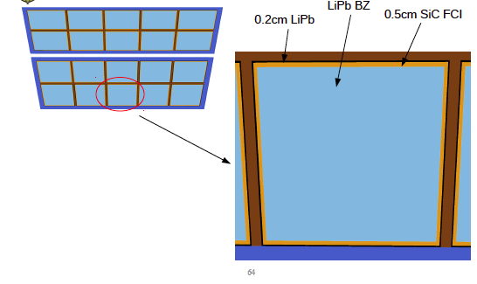
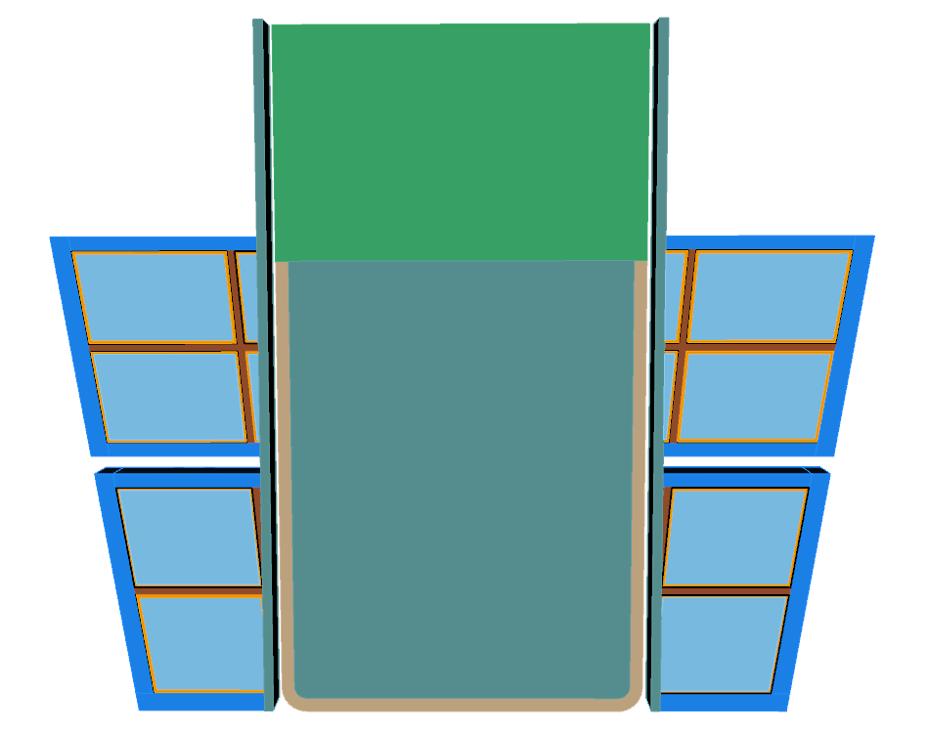
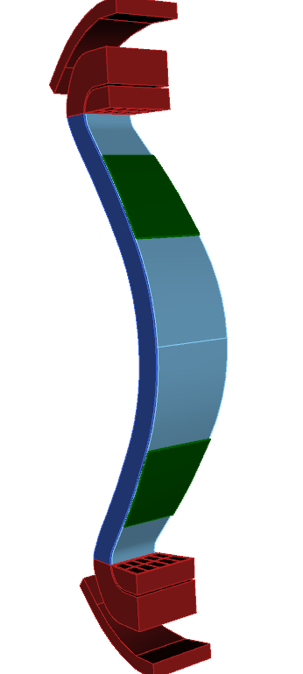
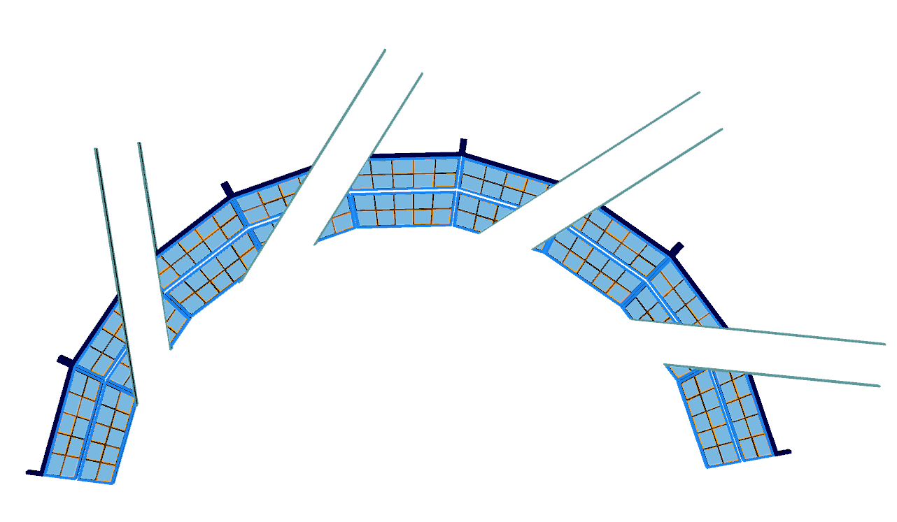

CAD Geometry of OB Blanket with Ports
Detailed Blanket Internals
MTM
Stabilizing
Shells
4 NBIs
TBM

Slide 40

Lower-A maximizes TF magnet utilization
Eff. shield
thickness:
0.3m
0.4m
0.5m
0.6m
0.7m

Slide 41

A = 2.5-3 maximizes blanket utilization

Slide 42


Need inboard breeding for TBR > 1 at A=2
TBR
Required TBR = 1.04
(4% margin)
Outboard TBR ~ 0.92
10cm IB shield sufficient for TBR > 1.04

