Slide 1
Secondary ELM filaments in MAST
S. Elmore, J Harrison, A Kirk, N Walkden and the MAST Team

Slide 2
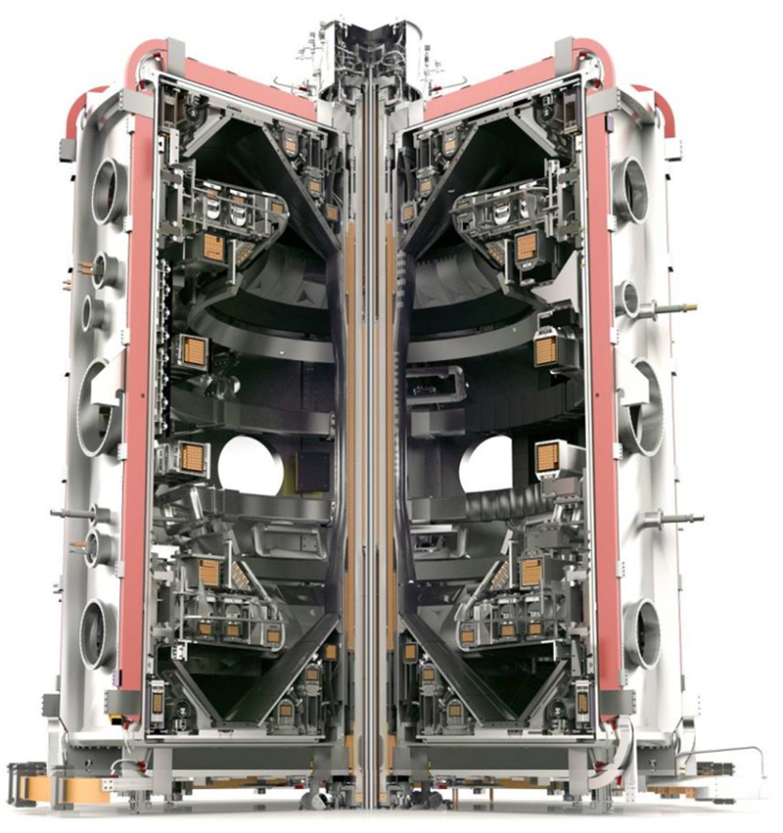
Introduction
Secondary ELMs occur following the first 50-200µs and have been seen on tokamaks such as NSTX[1]
Not routinely seen on MAST but were identified during high time resolution ELM ion temperature measurements
The hypothesis is that they occur when sufficient interaction with PFCs results in neutrals
Unlike in MAST, MAST-U will have more in-vessel structures for the closed divertor
  interaction with PFCs is almost guaranteed during ELMs
Close fitting structures around X-point location
[1] Maqueda R et al 2009 JNM

Slide 3
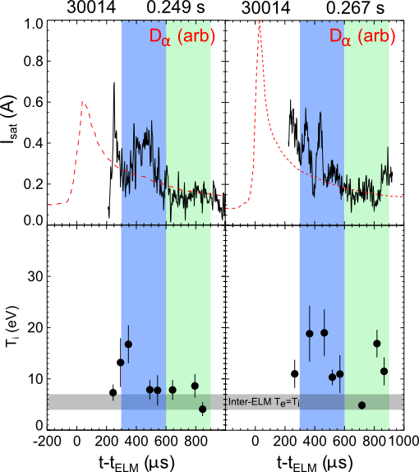
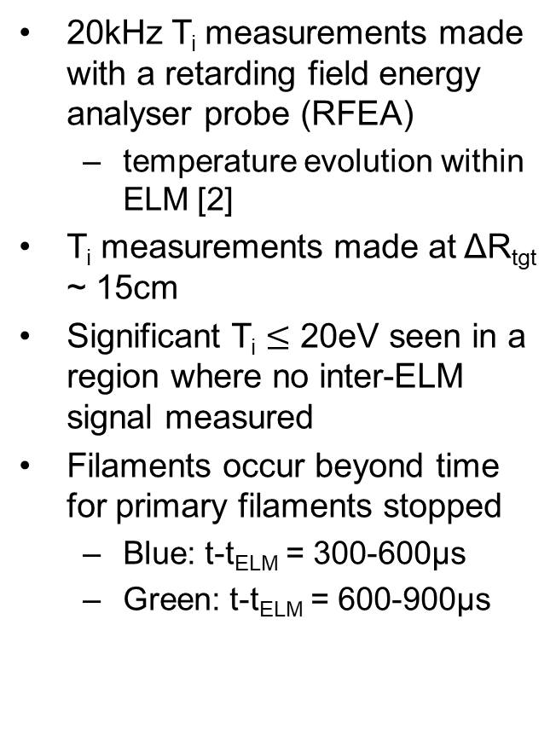
Secondary Filaments on MAST
20kHz T_{i} measurements made with a retarding field energy analyser probe (RFEA)
  temperature evolution within ELM [2]
T_{i} measurements made at ΔR_{tgt} ~ 15cm
Significant T_{i} $≤$ 20eV seen in a region where no inter-ELM signal measured
Filaments occur beyond time for primary filaments stopped
  Blue: t-t_{ELM} = 300-600µs
  Green: t-t_{ELM} = 600-900µs
[2] Elmore S et al 2016 PPCF

Slide 4
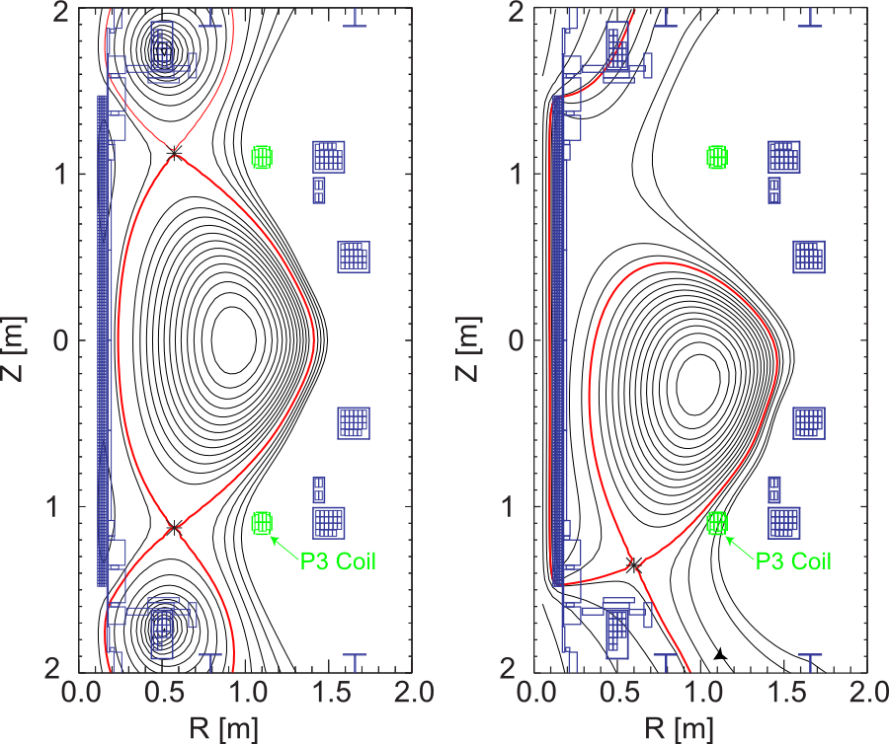
When do secondary filaments occur in MAST?
Comparisons between LSN and DND
  LSN operates closer to PFC
  Strong plasma interaction with the in-vessel poloidal coil
Propose that secondary filaments occurred due to the interaction with PFC
  May be what effects the edge transport causing secondary instability [1]
Investigate similar ELMs in these specific scenarios to give plasma-wall gap ‘scan’
[1] Maqueda R et al 2009 JNM

Slide 5
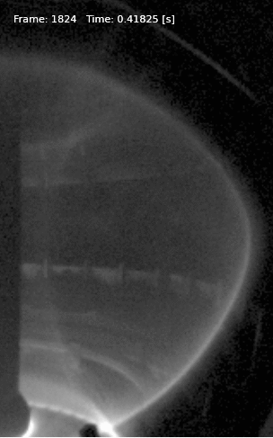
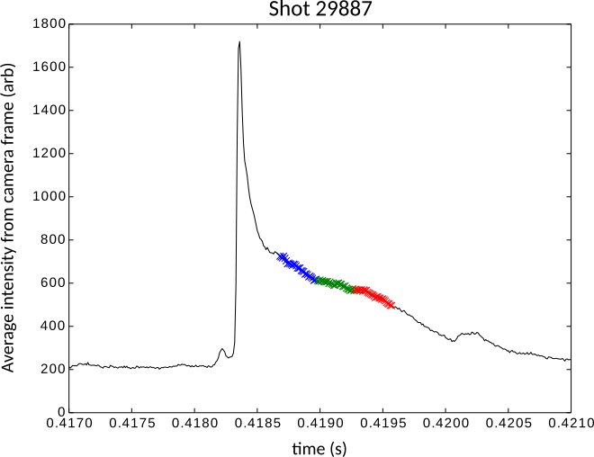
Diagnostics for identifying secondary filaments
Analysis using target arrays of Langmuir probes
  Use LP measurements of I_{sat} to identify presence of filaments
  Use database of similar ELMs to build up I_{sat} target profiles using probe array
  Analyse time windows of 300µs after t_{ELM}

Slide 6
Diagnostics for identifying secondary filaments
Visible camera with fast frame rate operated at 90-100kHz
  Midplane view of plasma allows identification of filaments beyond ψ_{N} = 1
  Fast frame rate ~10µs can resolve filaments
  Statistical analysis on 300µs time windows to match LP analysis

Slide 7
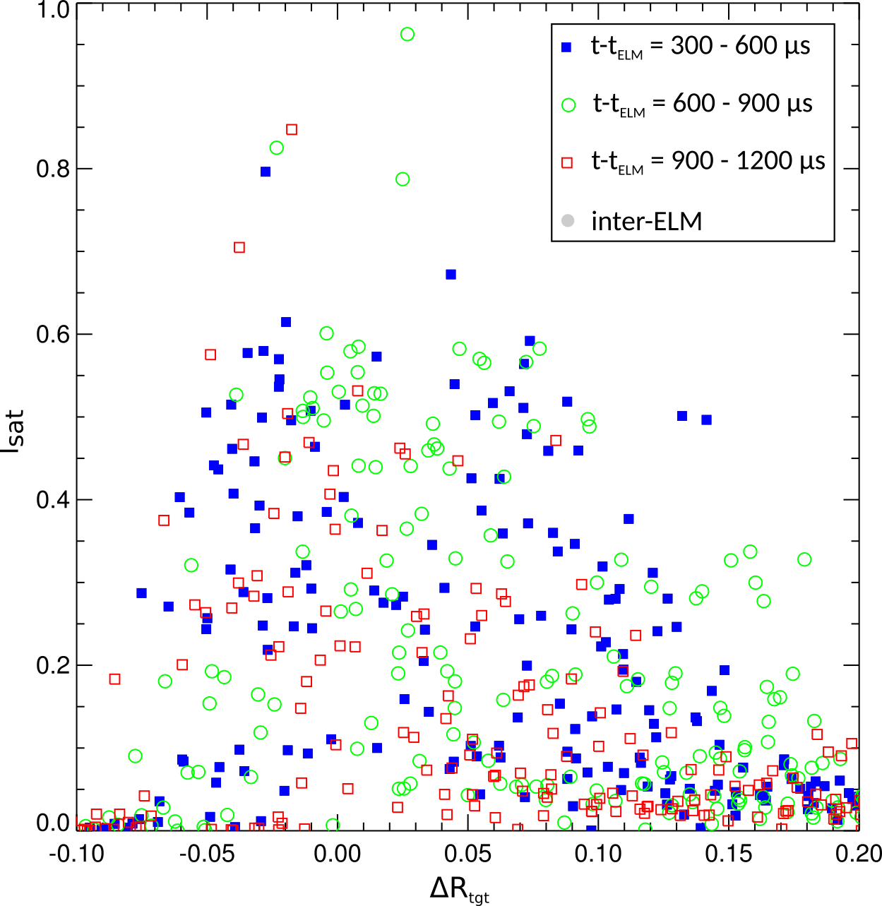
LSN Type I ELM filaments
LSN type I ELMy H-mode
  Same scenario as RFEA measurements (I_{P} = 600kA)
I_{sat} measured along divertor target
Filaments clearly seen at target consistent with RFEA
  ΔR_{tgt} > 15cm
I_{sat} filaments signals high at large radius until t-t_{ELM} ~ 1ms
At t-t_{ELM} = 900-1200µs still large I_{sat} fluctuations up to ΔR_{tgt} = 10cm

Slide 8
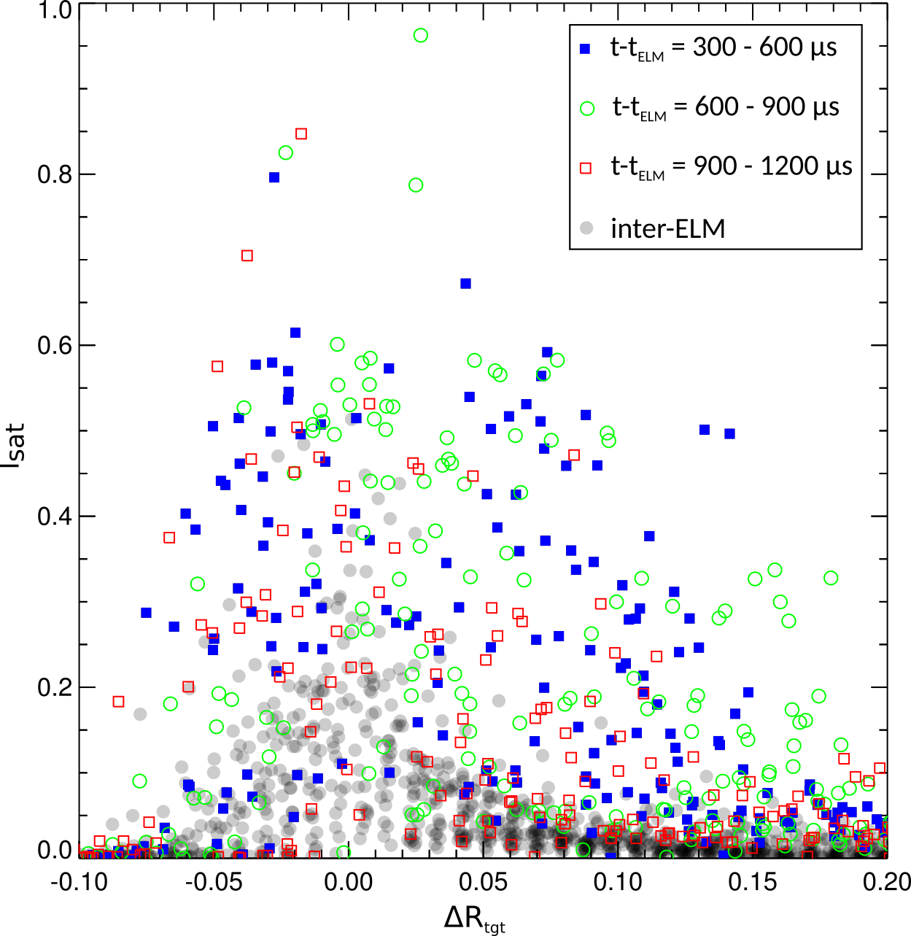
LSN Type I ELM filaments
LSN type I ELMy H-mode
  Same scenario as RFEA measurements (I_{P} = 600kA)
I_{sat} measured along divertor target
Filaments clearly seen at target consistent with RFEA
  ΔR_{tgt} > 15cm
I_{sat} filaments signals high at large radius until t-t_{ELM} ~ 1ms
At t-t_{ELM} = 900-1200µs still large I_{sat} fluctuations up to ΔR_{tgt} = 10cm
Inter-ELM is equivalent to t-t_{ELM} > 1.5ms

Slide 9
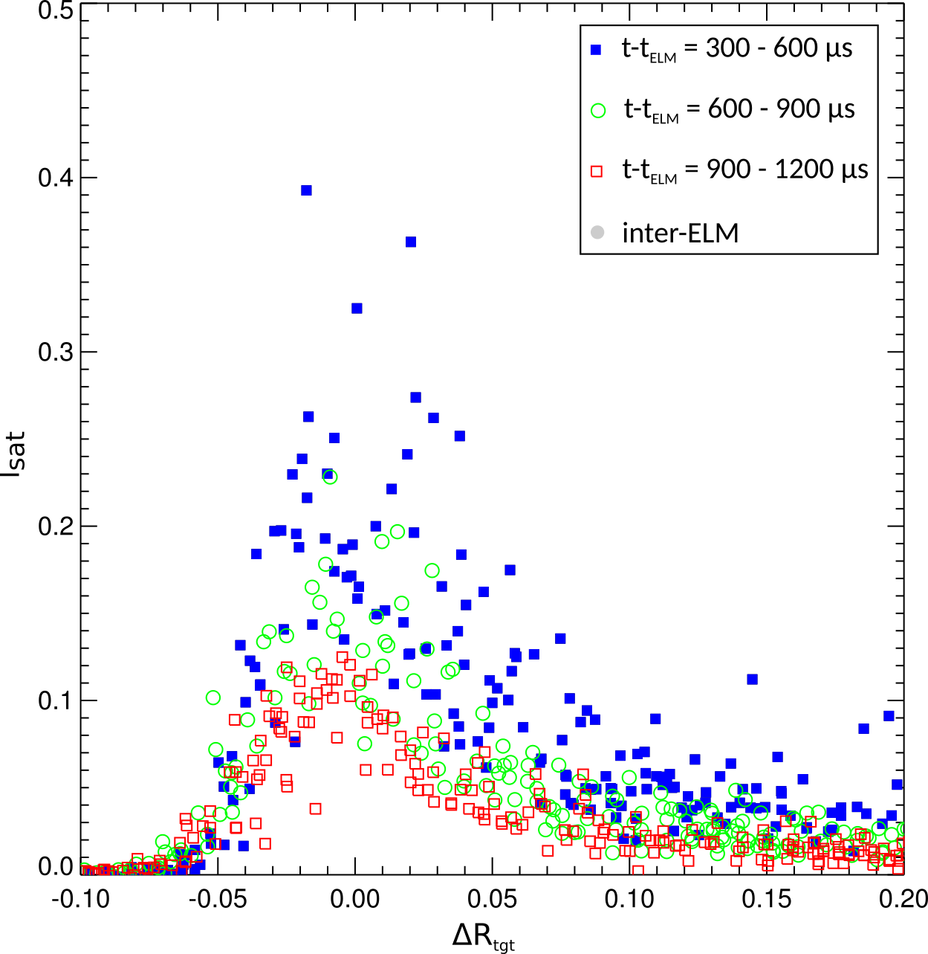
DND Type I ELM filaments
DND type I ELMy H-mode
  Magnetic equilibrium means LCFS is further from PFCs
Secondary filaments do exist after DND type I ELMs
I_{sat} due to filaments reduces across target profile
  t-t_{ELM} = 900 – 1200µs:
    I_{sat} is close to level of inter-ELM SOL
Camera data will be used to show if any interaction with PFCs in this case
Inter-ELM is equivalent to t-t_{ELM} > 1.5ms

Slide 10
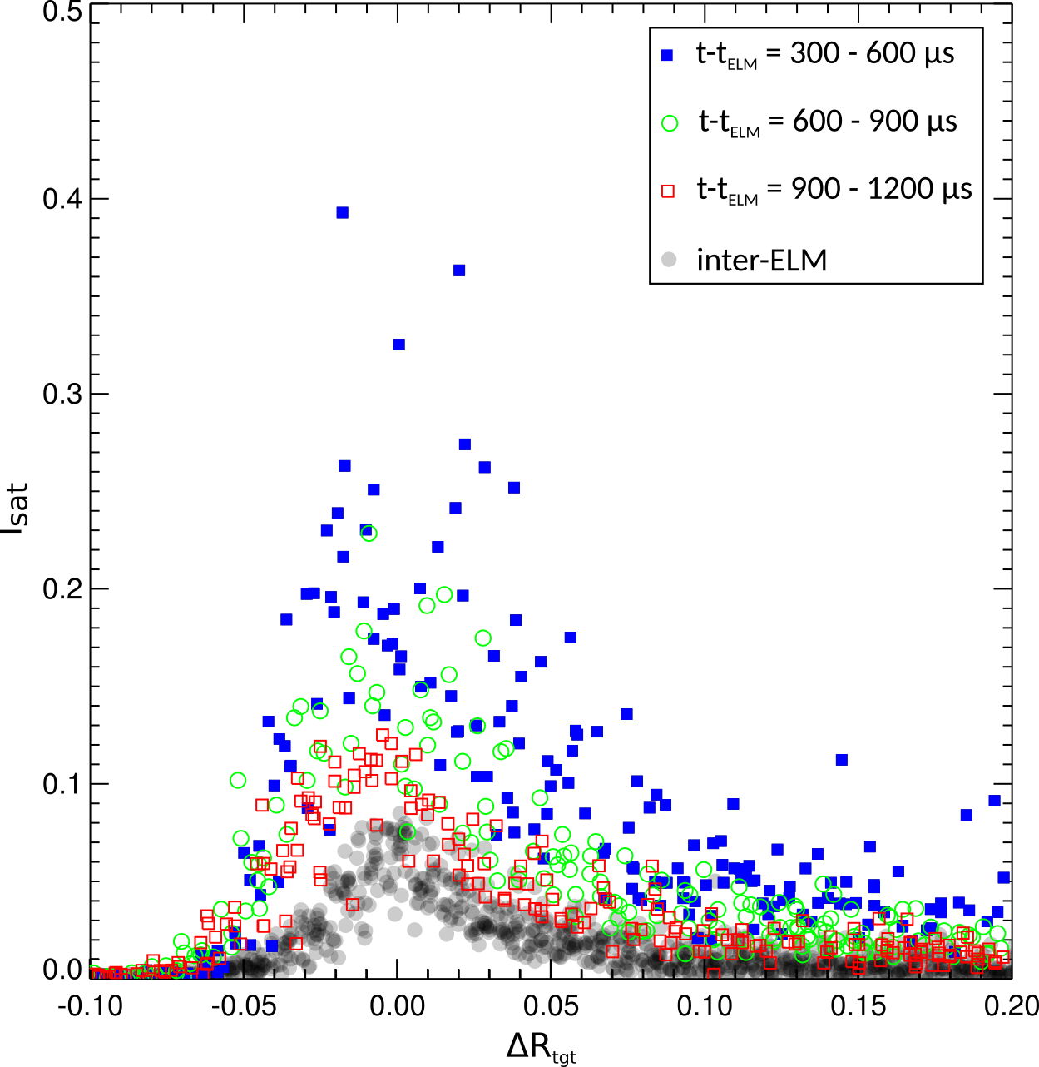
DND Type I ELM filaments
DND type I ELMy H-mode
  Magnetic equilibrium means LCFS is further from PFCs
Secondary filaments do exist after DND type I ELMs
I_{sat} due to filaments reduces across target profile
  t-t_{ELM} = 900 – 1200µs:
    I_{sat} is close to level of inter-ELM SOL
Camera data will be used to show if any interaction with PFCs in this case
Inter-ELM is equivalent to t-t_{ELM} > 1.5ms

Slide 11
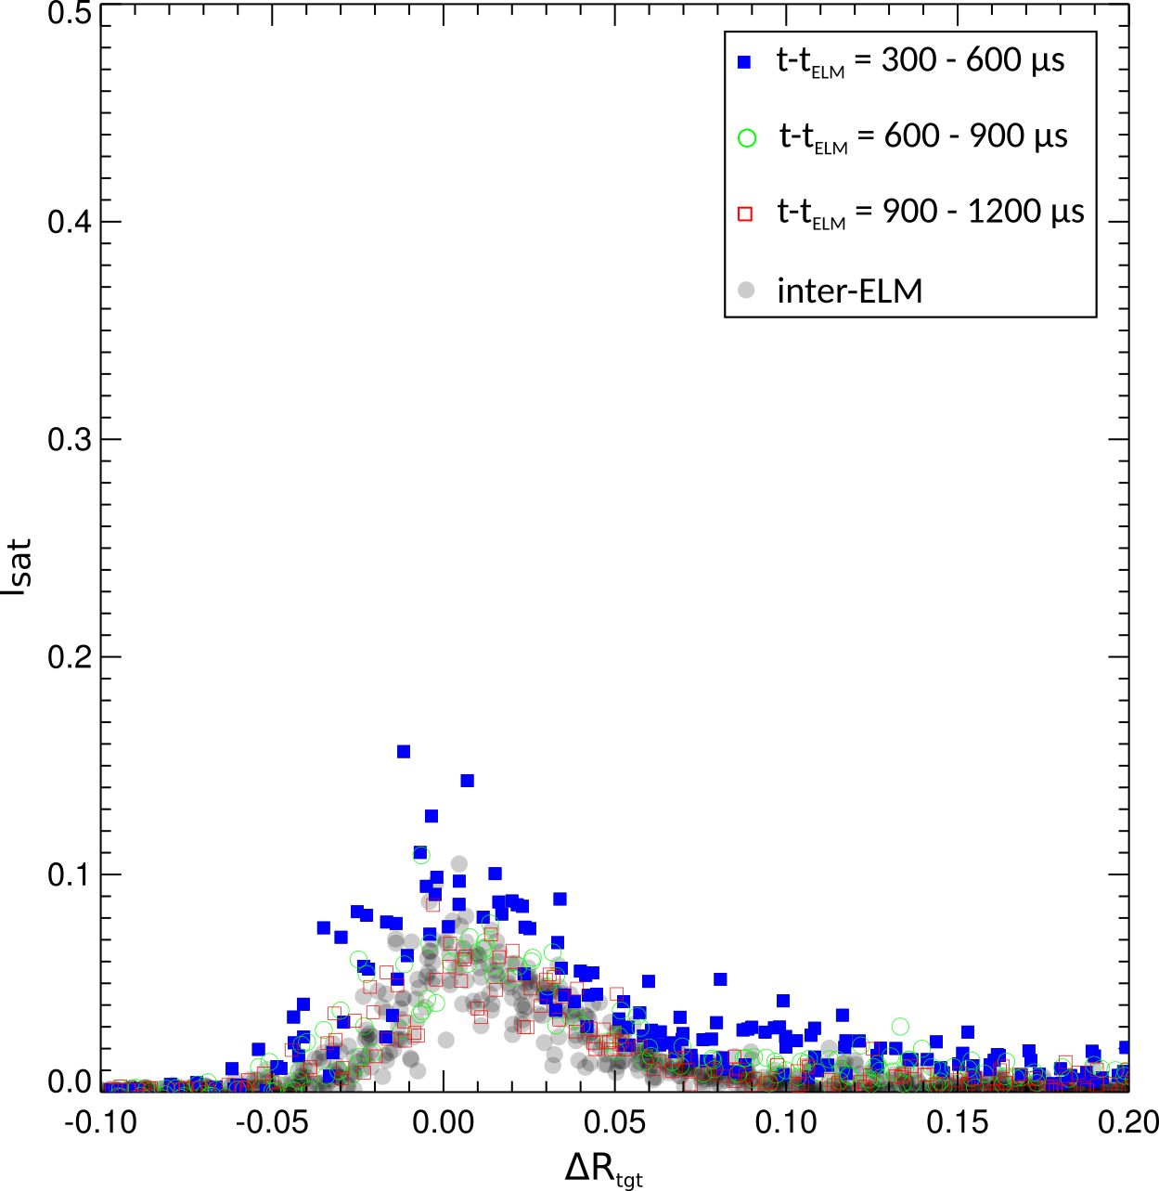
DND Small Type I ELM filaments
Same DND plasma scenario
  ΔW smaller than previous set of type I ELMs
Same t-t_{ELM} windows as previous analysis
  I_{sat} signal almost overlays inter-ELM measurements
During t-t_{ELM} = 300-600µs higher I_{sat} indicative of small filamentary behaviour
  low compared to previously studied secondary filaments
Inter-ELM is equivalent to t-t_{ELM} > 1.5ms

Slide 12
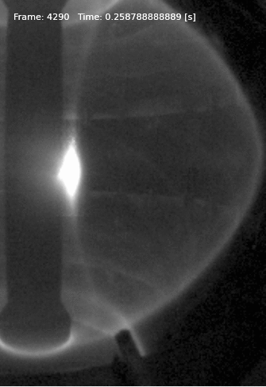
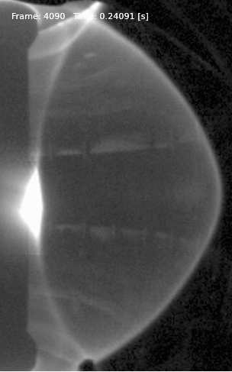
Fast camera data of ELMs
LSN Type I ELM
DND Type I ELM
DND Small Type I ELM
Notes:
Interaction
Turbulent filaments
How long they continue

Slide 13
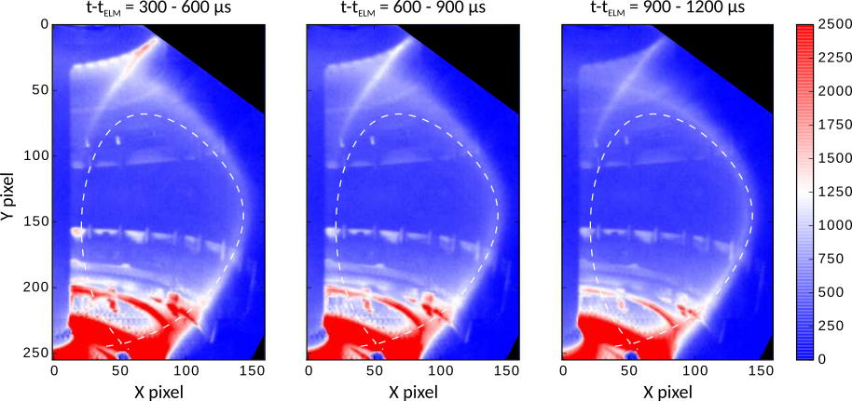
LSN Type I ELMs
Mean
LCFS
Average intensity of all frames in time window following set of ELMs occurring at t_{ELM}
Strong plasma interaction seen in all three time windows on the lower P3 coil

Slide 14
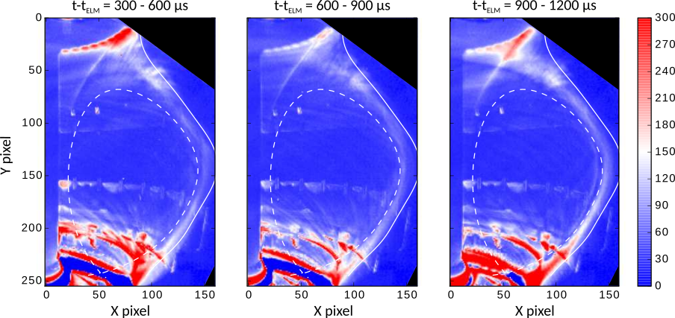
LSN Type I ELMs
Standard deviation
ψ_{N} = 1.4
Strong plasma interaction seen in all three time windows on the lower P3 coil can
Filamentary behaviour visible beyond ψ_{N} = 1 continuing for each time window analysed
Filaments extend out to beyond ψ_{N} = 1.4

Slide 15
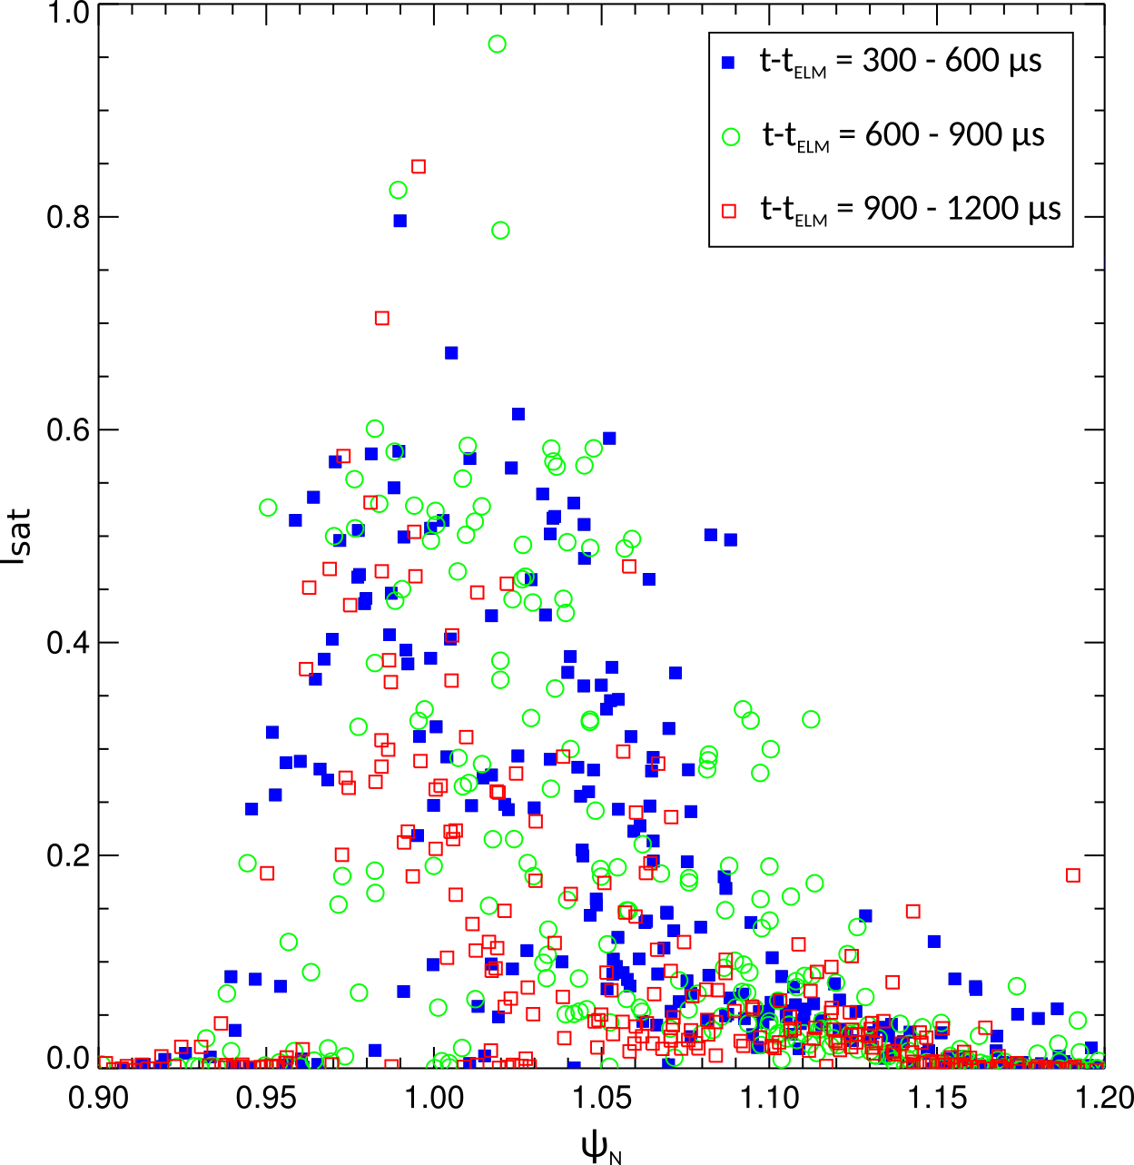
LSN Type I ELMs
Standard deviation
ψ_{N} = 1.4
Filamentary behaviour visible beyond ψ_{N} = 1 continuing for each time window analysed
Filaments extend out to beyond ψ_{N} = 1.4

Slide 16
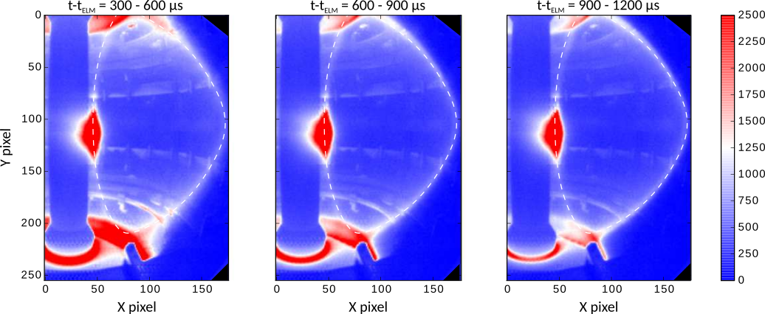
DND Type I ELMs
Mean
LCFS
Average intensity of all frames in time window following set of ELMs occurring at t_{ELM}
Plasma interaction seen in first time window on the upper and lower P3 coil
Likely that the presence of secondary filaments in this magnetic configuration is due to plasma interaction with PFCs

Slide 17
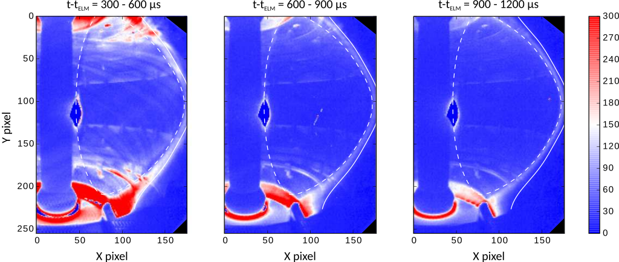
DND Type I ELMs
Standard deviation
ψ_{N} = 1.4
Plasma interaction on the PFCs visible in first time window
Filamentary behaviour visible beyond ψ_{N} = 1
Filamentary indications reduce with increasing t-t_{ELM}
Filaments extend out to beyond ψ_{N} = 1.4

Slide 18
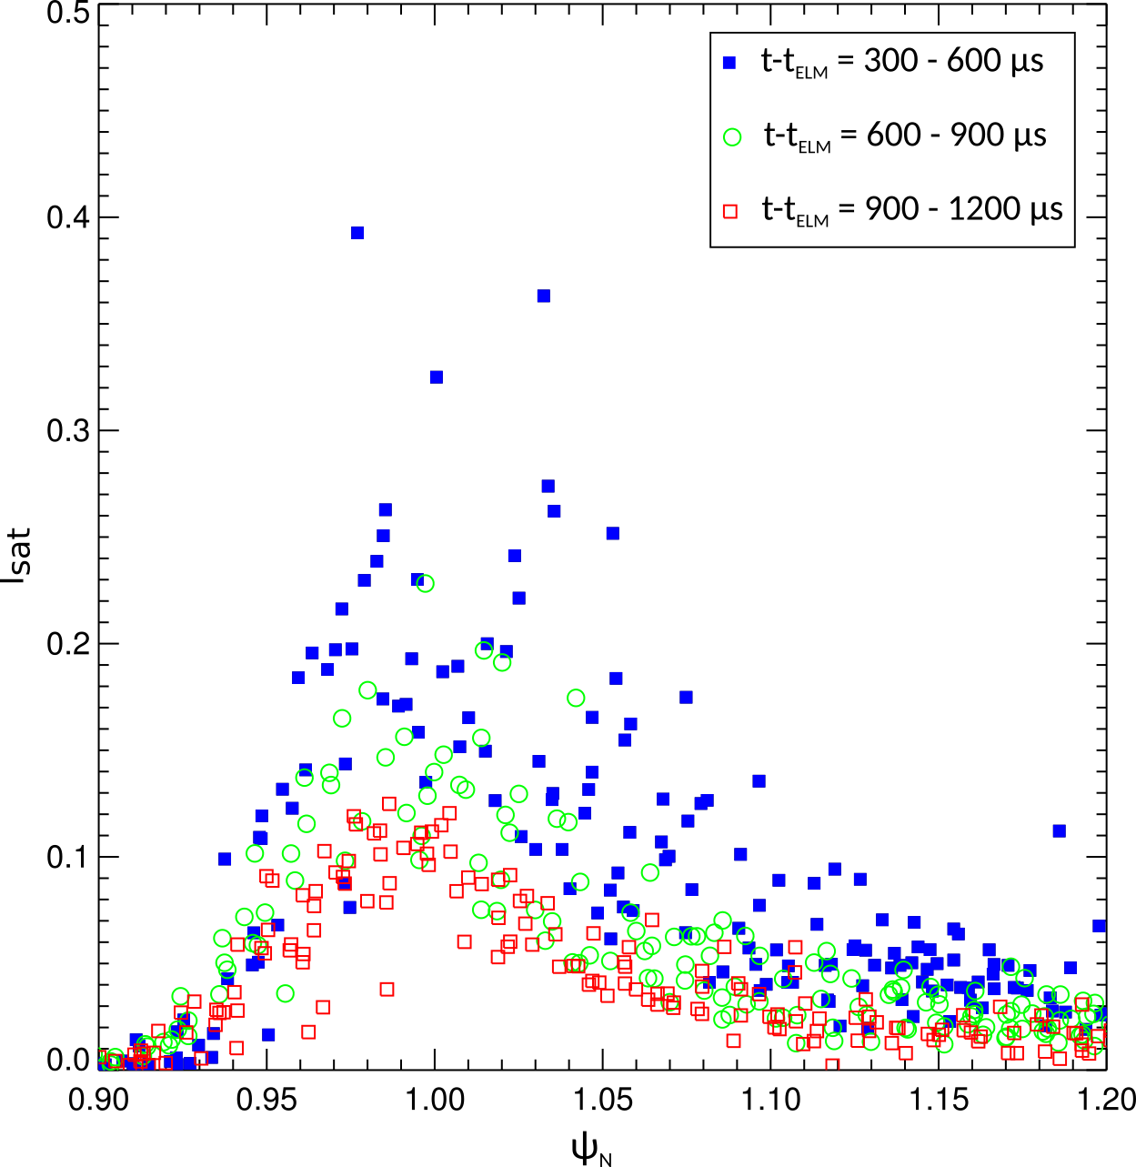
DND Type I ELMs
Standard deviation
Filamentary indications reduce with increasing t-t_{ELM}
Filaments extend out to beyond ψ_{N} = 1.4

Slide 19
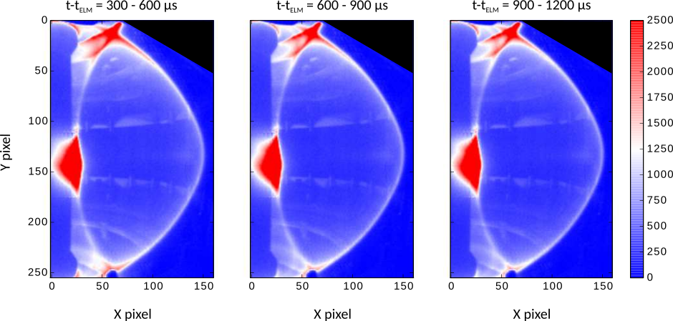
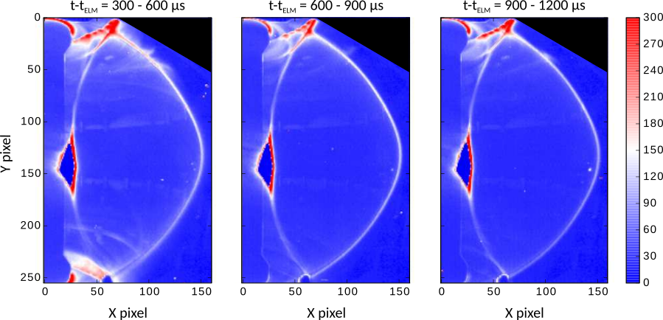
Small Type I ELMs in DND
Mean
Plasma interaction on the PFCs not visible
Little or no filamentary behaviour can be seen
Small filamentary activity close to ψ_{N} = 1 only visible up to t-t_{ELM} = 600µs
LCFS
Standard deviation

Slide 20
Implications for MAST-U
With MAST-U in-vessel structures for closed divertor expect all ELMs to interact with PFCs
Power from secondary filaments not significant issue compared to primary ELM filaments but some consequences
Increased turbulence for prolonged periods following an ELM
  effect H-mode pedestal recovery
In detached H-mode plasmas expect strike point to reattach due to primary ELM
  prolonged periods of secondary filaments may delay getting back into detachment
In MAST-U will investigate optimum scenario by altering X-point position and flux through divertor throat
  Monitor with LPs in nose and divertor tiles operated in I_{sat} mode
  Several fast cameras available to study the turbulence and filamentary structures

Slide 21
Conclusions
Secondary filaments have been identified on MAST and are seen to occur following plasma interaction with PFCs
Assumption is that neutrals from the plasma-surface interaction effect the edge transport and enhance the turbulence
  Further study required to understand the relationship between plasma-surface interaction and the secondary filament instability
Secondary filaments have been measured at the divertor target in MAST by LPs in LSN and DND with type I ELMs
  Measured up to ΔR_{tgt} = 20cm persisting for > 1ms after ELM
Fast camera data from a midplane view of the plasma confirmed plasma interaction with in vessel coils occurred in cases with secondary filaments
  Turbulent filamentary behaviour seem for more than 1.2ms after an ELM event extending to ψ_{N} = 1.4

