Slide 1
Plasma Response, Density Control, and Neutral Fueling: EMC3-EIRENE Analysis of the Edge Plasmas at MAST
I. Waters¹, H. Frerichs¹, R. Akers², Y. Feng³, K. Flesch¹, A. Kirk², D. Ryan^{2, 4}, O. Schmitz¹, A. Thornton²
¹University of Wisconsin, Madison, WI, USA
²Culham Centre for Fusion Energy, Abingdon, UK
³Max-Planck-Institut für Plasmaphysik, Greifswald, Germany
⁴York Plasma Institute, Department of Physics, University of York, UK
Acknowledgments: This work is funded by the Department of Energy under grant DE-SC0012315 and has been carried out within the framework of the EUROfusion Consortium.
19th International Spherical Tokamak Workshop-Seoul, South Korea

Slide 2
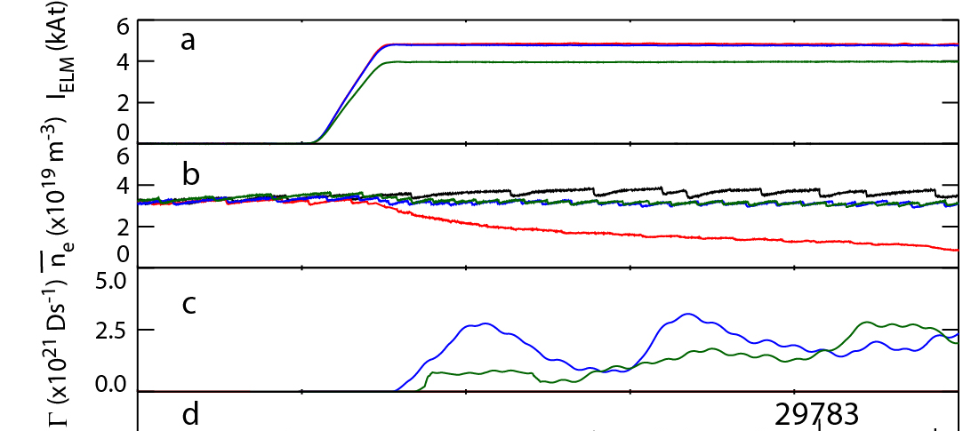
Motivation: Density Pump-Out at MAST
Range of H-Mode and L-Mode discharges show density pump-out with Resonant Magnetic Perturbations (RMP)
Dependent on RMP phasing and configuration
Courtesy: A. Kirk
What is the result of fueling? What is from exhaust?
See: A. Kirk et. al Nucl. Fusion 55 (2015) 043011

Slide 3
Outline
Numerical tools for studying edge plasma:
  EMC3-EIRENE
  MARS-F
Evaluate with a multi-reservoir particle balance
Find that in simulations of MAST the observed pump out is a result of changes to confinement and fueling

Slide 4
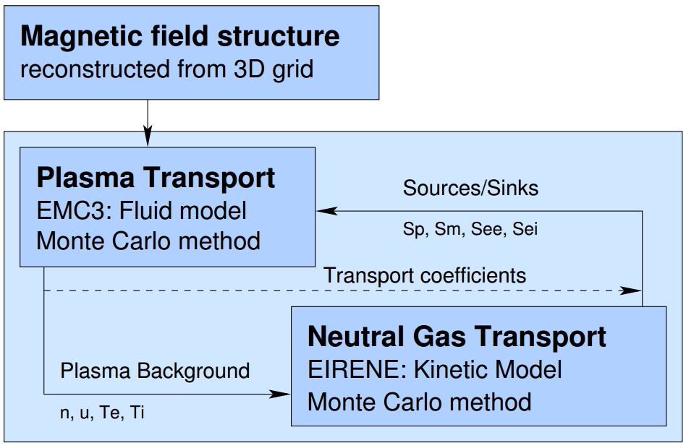
EMC3-EIRENE* for Edge Modeling
3D Edge Transport Model for Plasma
3D Neutral Particle Transport Model
  Together enable studies of 3D impacts on exhaust (plasma) and fueling (neutrals)
Highly flexible:
  Advanced divertors
  Cross machine studies
Courtesy: H. Frerichs
*Y. Feng et. al Plasma Phys. Control. Fusion 59 034006 (2017)

Slide 5
Plasma Response and MARS-F
MARS-F: Linear, Single Fluid, Resistive MHD Code [Y. Q. Liu, et al 2000 Phys. Of Plasmas 7 3681]
Plasma response effects are critical
In particular for pump-out studies at MAST in general (and this discharge in particular) want to include the “edge-peeling response” [Y. Q. Liu et al 2011 Nucl. Fusion 51 083002]
  Resulting fields can be found with MARS-F and incorporated into EMC3-EIRENE!

Slide 6
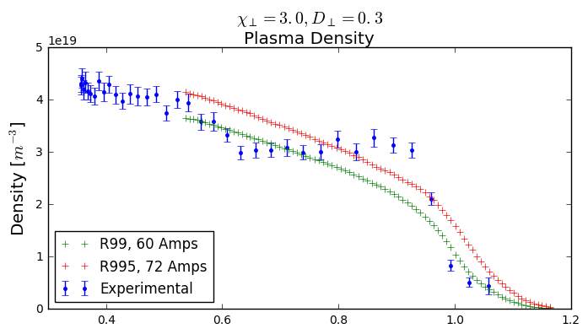
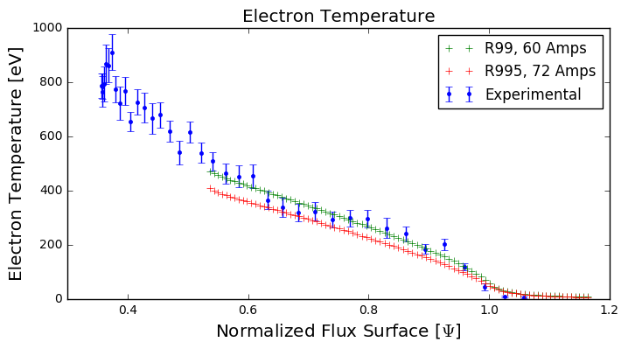
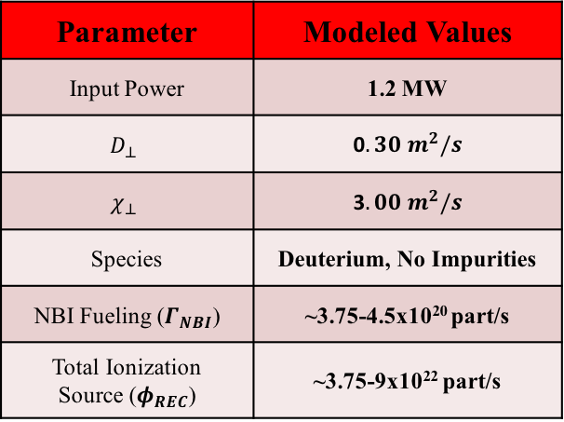
EMC3-EIRENE Simulations of MAST #30322
Chose parameters based on comparing axisymmetric case with experiment:
Parameter | Modeled Values
Input Power | 1.2 MW
$$D_{⊥}$$ | 0$.30 m^{2}/s$
$$χ_{⊥}$$ | 3$.00 m^{2}/s$
Species | Deuterium, No Impurities
NBI Fueling ($Γ_{NBI}$) | ~3.75-4.5x10²⁰ part/s
Total Ionization Source ($φ_{REC}$) | ~3.75-9x10²² part/s

Slide 7




Axisymmetric
Vacuum RMP
Apply an n=6 Vacuum RMP field
Fix global fueling input terms to get comparable solutions
$$Γ_{NBI}$$
n [cm⁻³]
n [cm⁻³]
$Γ_{NBI}$ = 3.75 x 10²⁰ ion/s
$φ_{REC}$ = 3.75 x 10²² ion/s
$$φ_{REC}$$

Slide 8
Axisymmetric
Vacuum RMP
Edge-Peeling RMP
n [cm⁻³]

Slide 9
See Pump-Out in Midplane Profiles of Density
Density recovers with Edge-Peeling response
Extreme pump-out in Vacuum RMP case

Slide 10



Evaluate 3D Simulation with a Multi-Reservoir Particle Balance
Breakdown where we’re having an impact on confinement
Accounts for Exhaust and Fueling
Define an Edge Reservoir
$$ψ=0.6$$
Core
$$\frac{dN_{EDGE}}{dt}=−\frac{N_{EDGE}}{τ_{EDGE}}+f_{EDGE}φ_{REC}+f_{CORE}φ_{REC}+Γ_{NBI}$$
Edge
$$Γ_{EDGE}$$
SOL
$$τ_{EDGE}=\frac{N_{EDGE}}{Γ_{EDGE}}$$

Slide 11
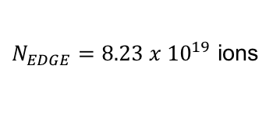
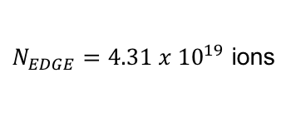
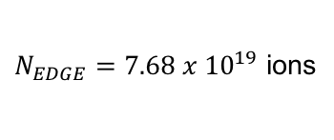
Axisymmetric
Vacuum RMP
Edge-Peeling RMP
n [cm⁻³]
$N_{EDGE}=8.23 x {10}^{19}$ ions
$N_{EDGE}=4.31 x{ 10}^{19}$ ions
$N_{EDGE}=7.68 x{ 10}^{19}$ ions
47.5 % Decrease!!!
6.6% Decrease

Slide 12
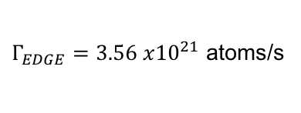
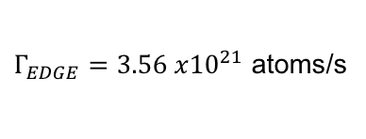
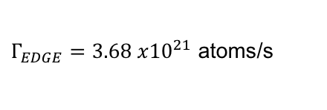
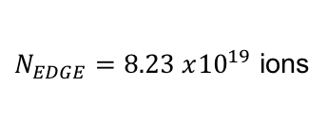
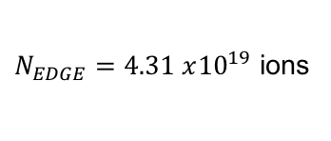
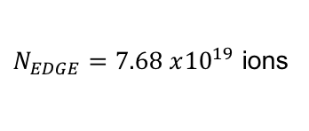
Axisymmetric
Vacuum RMP
Edge-Peeling RMP
n [cm⁻³]
$N_{EDGE}=8.23 x{10}^{19}$ ions
$N_{EDGE}=4.31 x{10}^{19}$ ions
$N_{EDGE}=7.68 x{10}^{19}$ ions
$Γ_{EDGE}=3.56 x{10}^{21}$ atoms/s
$Γ_{EDGE}=3.56 x{10}^{21}$ atoms/s
$Γ_{EDGE}=3.68 x{10}^{21}$ atoms/s
0.0% Decrease
3.6% Increase

Slide 13
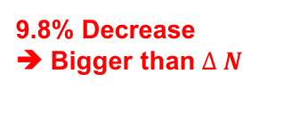



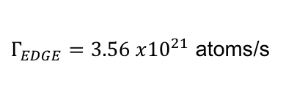
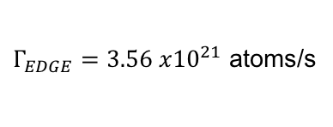
Axisymmetric
Vacuum RMP
Edge-Peeling RMP
n [cm⁻³]
$N_{EDGE}=8.23 x{10}^{19}$ ions
$N_{EDGE}=4.31 x{10}^{19}$ ions
$N_{EDGE}=7.68 x{10}^{19}$ ions
$Γ_{EDGE}=3.56 x{10}^{21}$ atoms/s
$Γ_{EDGE}=3.56 x{10}^{21}$ atoms/s
$Γ_{EDGE}=3.68 x{10}^{21}$ atoms/s
$τ_{EDGE}=$ 23.1 ms
$τ_{EDGE}=$ 12.1 ms
$τ_{EDGE}=$ 20.8 ms
47.6 % Decrease
9.8% Decrease
➔ Bigger than $∆ N$

Slide 14
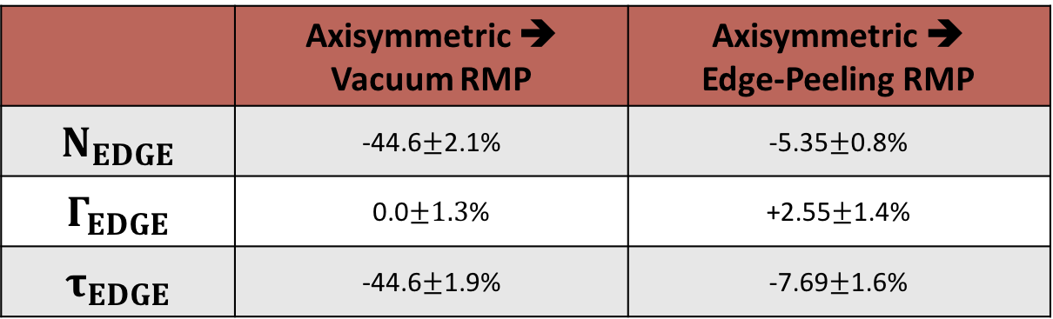
Average Change Across Fueling Scan Shows Consistently Enhanced Fueling in Edge-Peeling RMP
Completed scan across fueling parameters
  ➔ 3 Recycling Coefficients, 2 NBI Fueling Rates
  Table shows averages and standard-dev across fueling scan
 | Axisymmetric ➔ Vacuum RMP | Axisymmetric ➔ Edge-Peeling RMP
$$N_{EDGE}$$ | -44.6$±$2.1% | -5.35$±$0.8%
$$Γ_{EDGE}$$ | 0.0$±1.3$% | +2.55$±$1.4%
$$τ_{EDGE}$$ | -44.6$±$1.9% | -7.69$±$1.6%
Edge-Peeling RMP combined impact of
exhaust and fueling
Vacuum-RMP dominated by exhaust

Slide 15
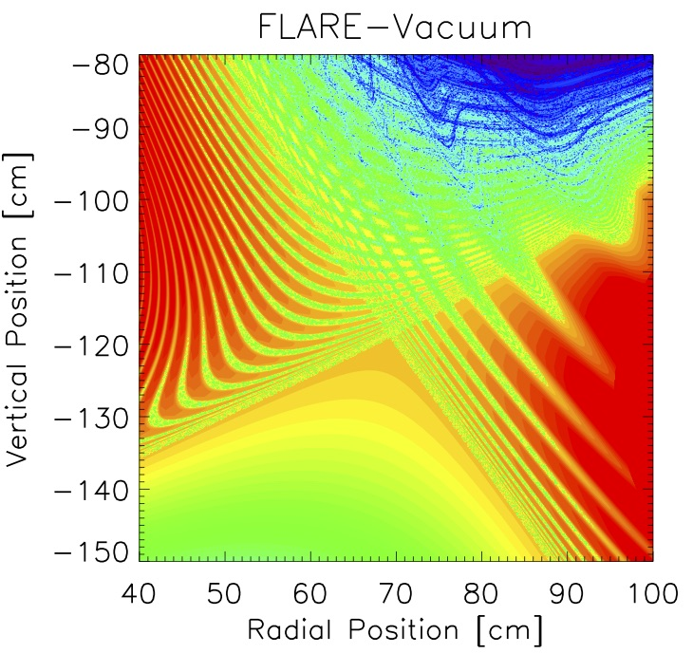
Parallel Connection Between Edge and SOL Allow Parallel Flows
Vacuum RMP
Edge-Peeling RMP

Slide 16
Edge Flows Drive Loss in Confinement
Axisymmetric
Vacuum RMP
Edge-Peeling RMP
Flow [M]
Broadly aligns with simulations of traditional aspect ratio tokamaks:
H. Frerichs et al 2015 Phys. Of Plas. 22 072508
O. Schmitz et al 2016 Nucl. Fusion 56 066008

Slide 17
Changing SOL Structure Impacts Fueling to Edge
Edge-Peeling
Response
Axisymmetric
3D SOL impacts penetration of neutrals inside nominal separatrix
  Depending on extent / temperature / structure of lobes this can shield or enhance penetration
Investigation of impact on neutral energy and neutral distribution ongoing
S_{p}[ln(Amps/cm3)]

Slide 18
Changing SOL Structure Impacts Fueling to Edge
Edge-Peeling
H⁰ Density
Edge-Peeling
Electron Temperature
3D SOL impacts penetration of neutrals inside nominal separatrix
  Depending on extent / temperature / structure of lobes this can shield or enhance penetration
Investigation of impact on neutral energy and neutral distribution ongoing
H Density [Atoms/cm³]
T_{e} [eV]

Slide 19
Bottom Line
Successfully incorporated MARS-F results into EMC3-EIRENE simulations
Simulated a range of fueling scenarios: Consistent Density Pump-Out with RMP Fields Applied
Consistent loss of confinement, in the edge-peeling response case Mitigated by Enhanced Edge Fueling
Root cause of fueling enhancement currently under investigation
Ongoing work to quantitatively link simulation with experimental measurements

Slide 20
Backup

Slide 21
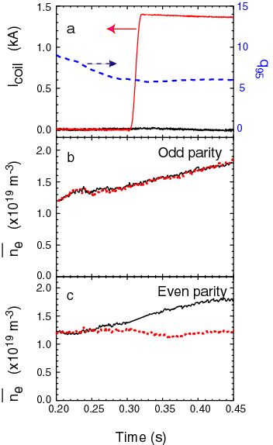
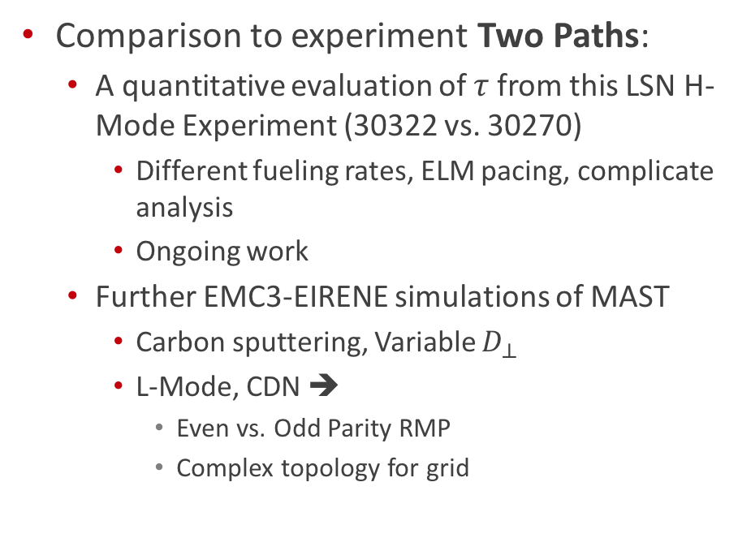
Next Steps
Comparison to experiment Two Paths:
  A quantitative evaluation of $τ$from this LSN H-Mode Experiment (30322 vs. 30270)
    Different fueling rates, ELM pacing, complicate analysis
    Ongoing work
  Further EMC3-EIRENE simulations of MAST
    Carbon sputtering, Variable $D_{⊥}$
    L-Mode, CDN ➔
      Even vs. Odd Parity RMP
      Complex topology for grid
Courtesy: A. Kirk

Slide 22
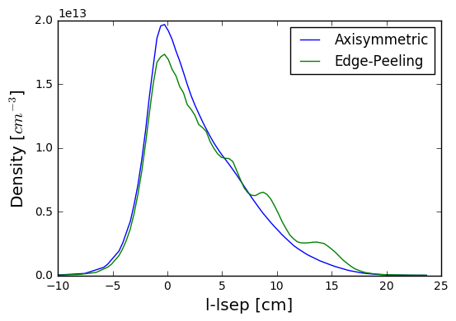
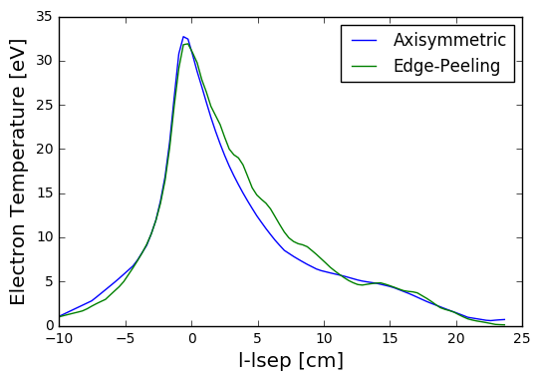
Divertor Conditions: Axi vs. Edge-Peeling
Ion Density
Electron Temperature

Slide 23
Outer Leg Neutral Hydrogen: Along Sep. vs. Across
Edge-Peeling
Response
Look ‘up’ the outer divertor leg at the neutral hydrogen density
  Divertor conditions could be impacting neutral mean free paths

Slide 24
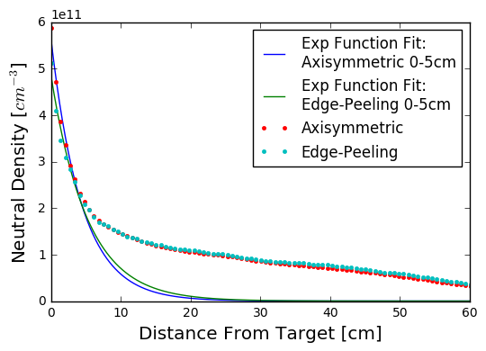
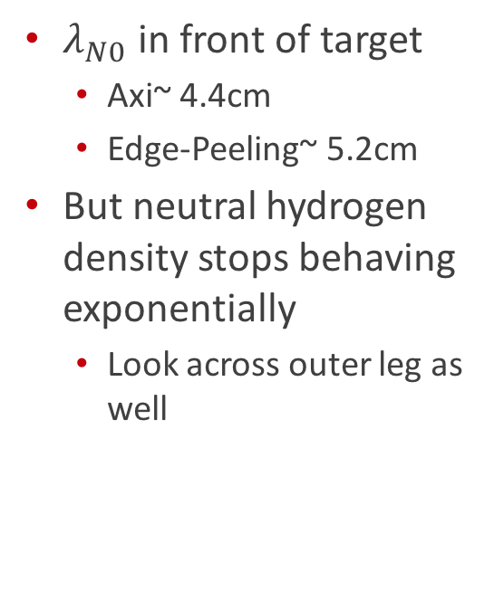

Examine $λ_{N0}$ lengths Up Separatrix
$λ_{N0}$ in front of target
  Axi~ 4.4cm
  Edge-Peeling~ 5.2cm
But neutral hydrogen density stops behaving exponentially
  Look across outer leg as well

Slide 25
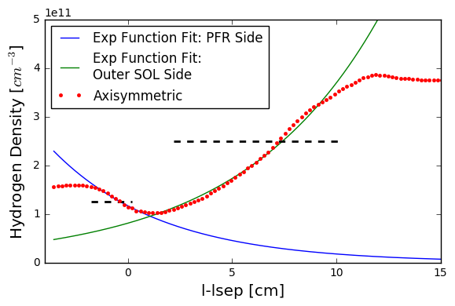

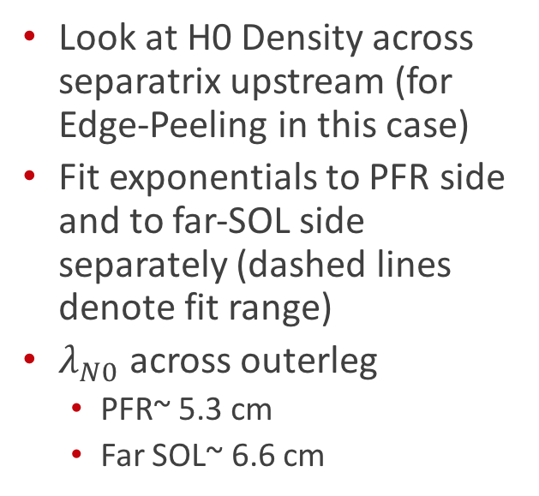
Examine $λ_{N0}$ Lengths Across Separatrix
Look at H0 Density across separatrix upstream (for Edge-Peeling in this case)
Fit exponentials to PFR side and to far-SOL side separately (dashed lines denote fit range)
$λ_{N0}$ across outerleg
  PFR~ 5.3 cm
  Far SOL~ 6.6 cm
H0 Density upstream dominated by neutrals from PFR, and/or far SOL, not direct neutrals from near OSP

Slide 26
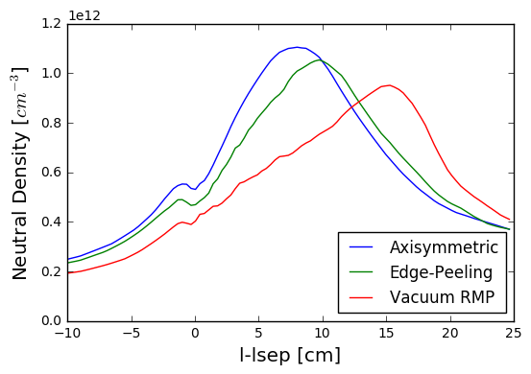
Neutral Hydrogen Density Pushed Outward in Edge-Peeling Response, but also in Vacuum RMP
Neutral Density Divertor Profile

Slide 27
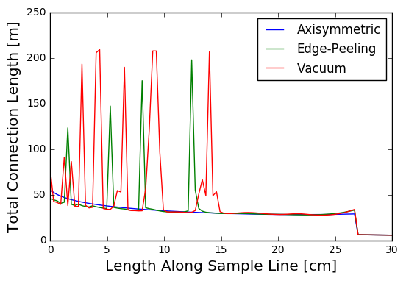
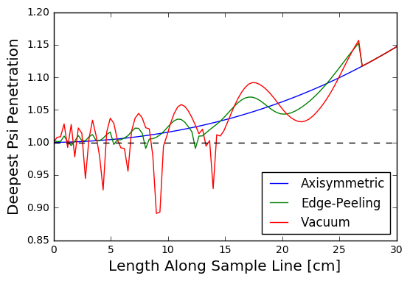
Connection Length and Psi-Penetration
Enhanced L_{c} cools plasma
Enhanced Psi-Penetration Opens SOL to hot interior plasma in Vacuum but not Edge-Peeling
Response in Te sensitive to fueling scenario
Notes:
lobecut_psiPenetration.png

Slide 28
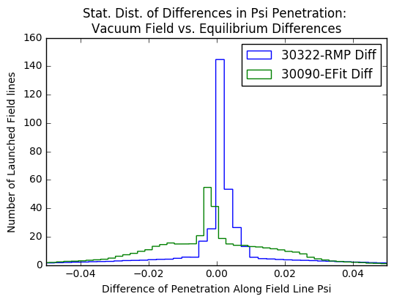
Backup: MARS-F Vacuum Fields Benchmarking
Quantitative comparison:

Slide 29
Tau SOL

Slide 30
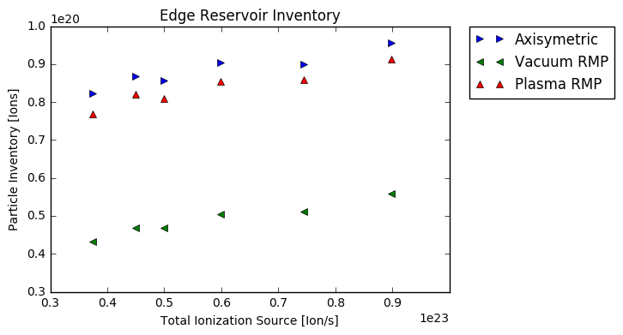

Significant Over Prediction of Density Pump-Out in Edge ($0.6<ψ<1.0$) with Vacuum RMP Fields
Consistent decrease in edge inventory across fueling scenarios

Slide 31
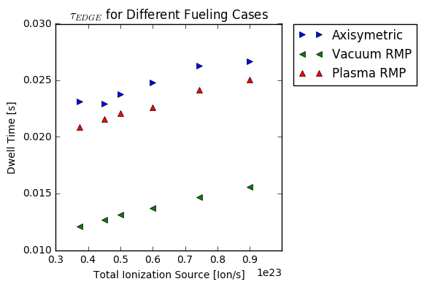
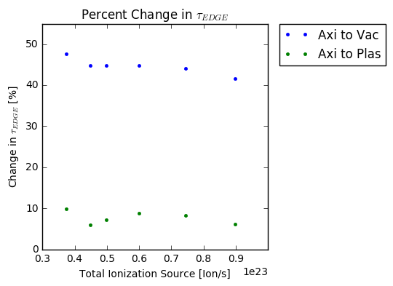

3D-Fields Lead to 5-10% Decrease in $τ_{EDGE}$
Vacuum RMP fields over predict confinement loss
Direct impact of the 3D-Fields ONLY
  No breakdown in H-mode barrier, irrespective of ELM pacing

Slide 32
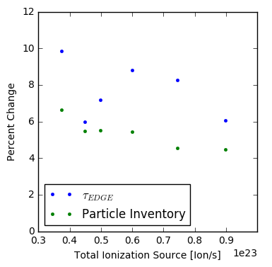

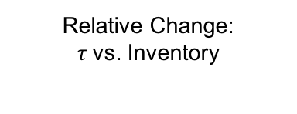
Change in $τ_{EDGE}$ and in Particle Inventory Do NOT align ➔ Fueling Changes Playing a Role
Relative Change:
$τ$vs. Inventory

Slide 33
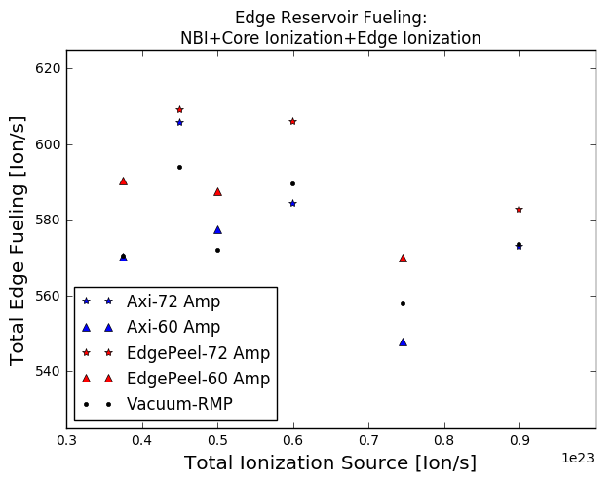
Change in Edge Fueling Across all Scenarios
Edge-Peeling response has consistently higher edge fueling than Axisymmetric and Vacuum RMP
Vacuum RMP fueling scenario dependent on whether it has higher or lower fueling than Axisymmetric

Slide 34

Experimental Analysis [PhD Student K. Flesch]
Experimental particle balance interpreting MAST results:
Uses $D_{α},$ S/XB coefficients, Neutral Puffing Rates, Assumptions about MAST device
G P Maddison et al 2006 Plasma Phys. Control. Fusion 48 71

