Slide 1
MAST Upgrade – Progress & Plans
19th International Spherical Tokamak Workshop, Seoul, Sept. 2017
Brian Lloyd
CCFE

Slide 2
Outline
MAST history
MAST Upgrade design features
Project progress
Planned research programme
Additional enhancements
Summary

Slide 3
MAST - history
2000 MAST physics programme started
2003-04 Installed new centre column & divertors
2003-08 Neutral beam heating system upgraded
2007-08 Installed ELM control coils & major diagnostic upgrades e.g.
- Thomson scattering (with the University of York)
- Motional Stark Effect measurements
2010-11 Installed additional ELM control coils, upgraded plasma & neutral beam control systems & diagnostics e.g.
- Beam Emission Spectroscopy (with RMKI Hungary)
- Neutron camera (with Uppsala Univ.)
- Fast Ion D-alpha (FIDA)
- Synthetic Aperture Microwave Imaging (with York U.)
2013 Proton detector (FIU & PPPL), Doppler Backscattering (UCLA) and coherence imaging systems (ANU, Durham University) installed
2013-17 Major device upgrade
MAST history

Slide 4
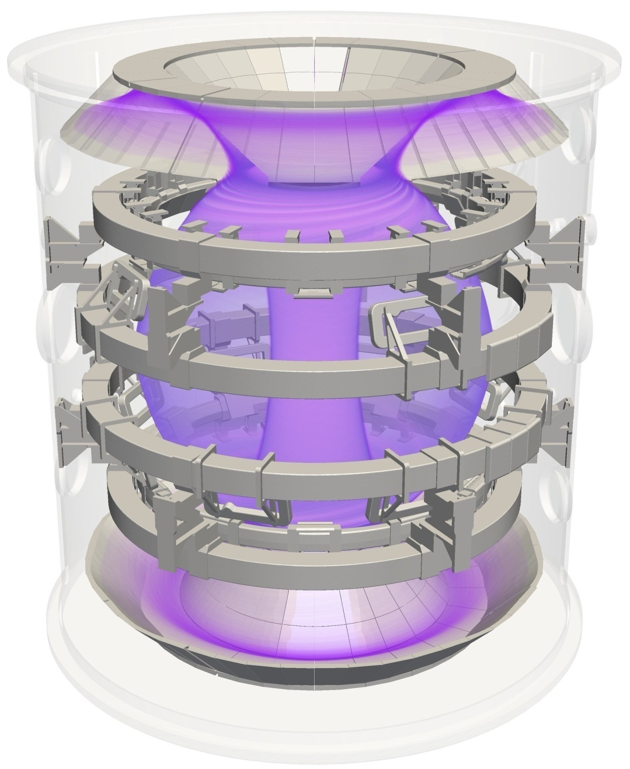
MAST Upgrade
MAST Upgrade has 3 primary objectives:
Test a range of novel exhaust concepts including the Super-X divertor
Contribute to the ITER/DEMO physics base to improve predictive capability
Explore the physics viability of an ST– based Component Test Facility
MAST Upgrade Design Features

Slide 5
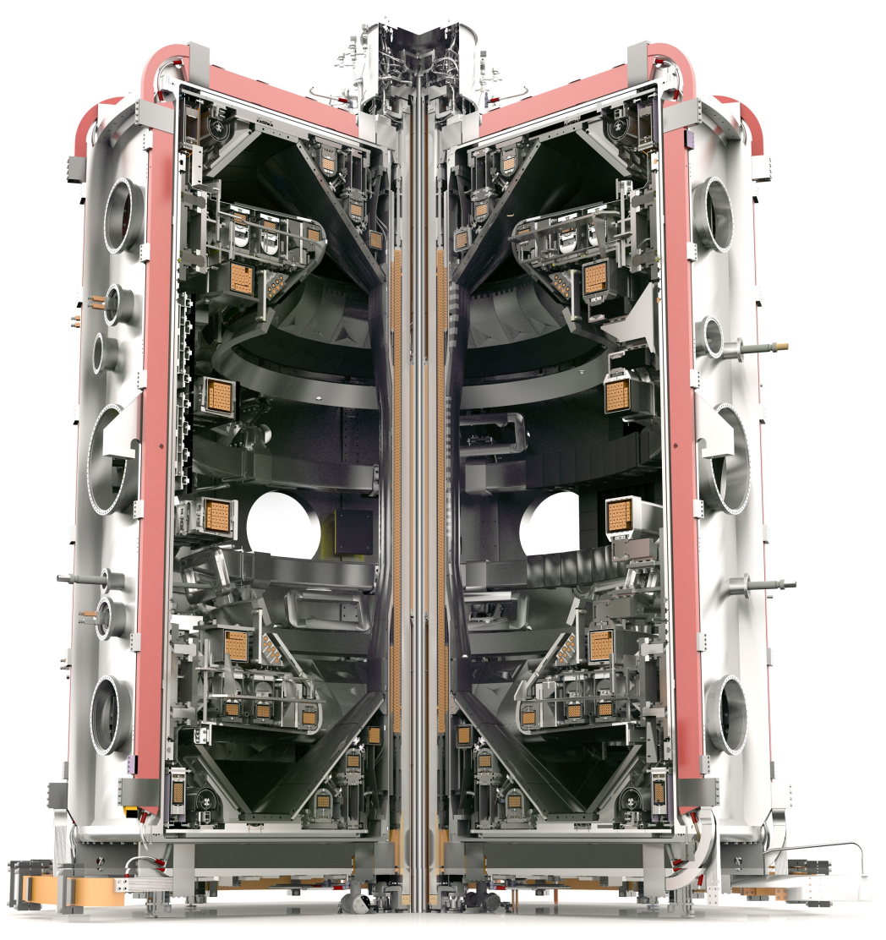
MAST Upgrade in 2017
New centre column incl. solenoid
- up to 50% higher toroidal field, plasma current up to 2MA
- pulse length up to 5s
19 new poloidal field coils
- better shape control, higher κ, δ
- allows advanced divertor configurations, e.g. Super-X, snowflake
Closed divertor with super-X capability & cryopump
- lower main chamber neutral pressure
Off-axis NBI and beamline improvements
- adaptable beam geometry (better profile control)
New diagnostics
MAST Upgrade Design Features

Slide 6
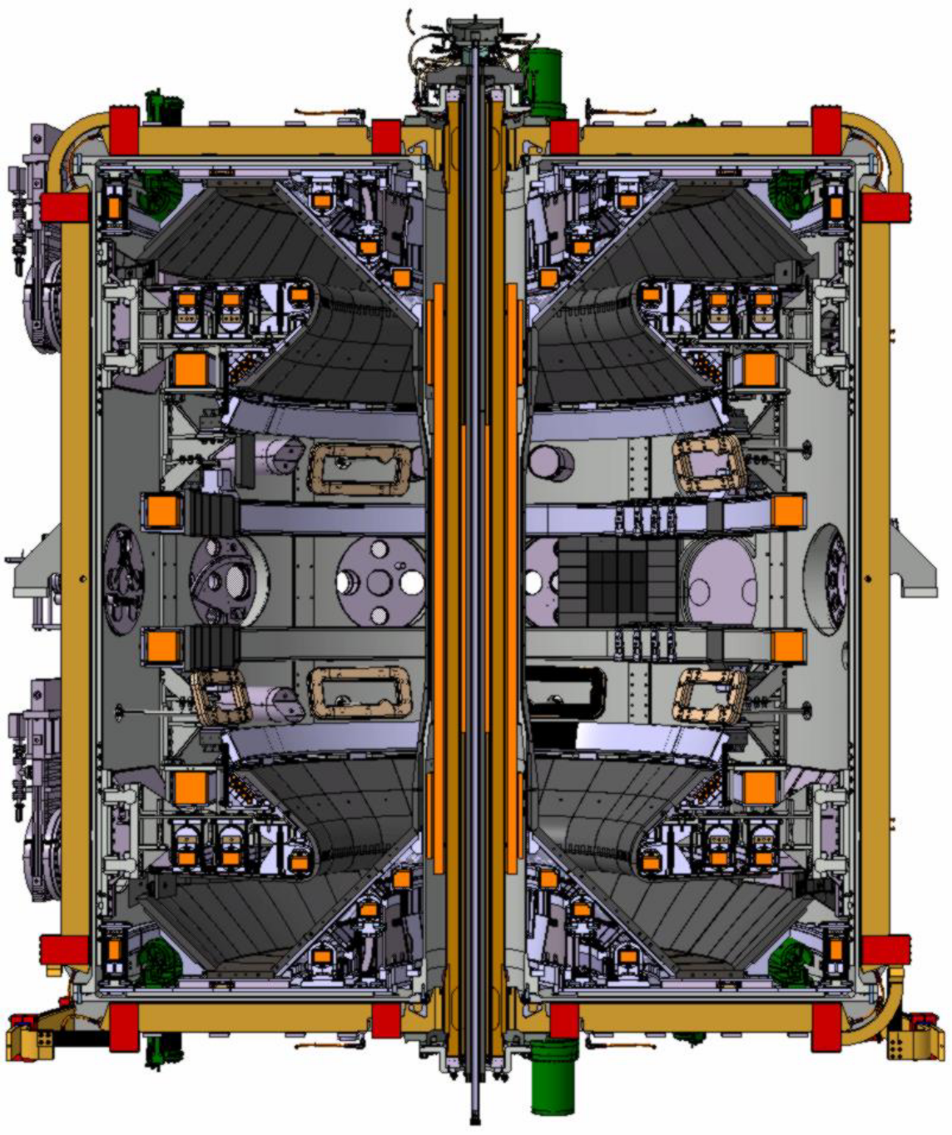
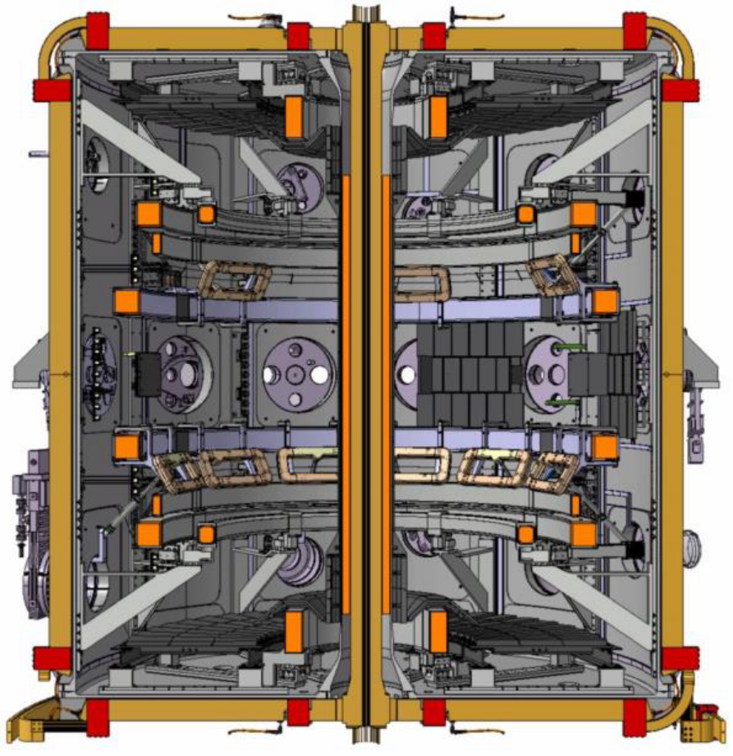
MAST-U Parameters
Parameter / System | Upgrade
Toroidal Field | Increased from 0.5 to 0.8T (at R = 0.8m)
Plasma Current | Increased from 1MA to 2MA
Pulse Length | Increased from 0.5 to 5s
In-vessel Coils | Increased from 10 to 20
Ex-vessel PF Coils | Increased from 1 to 4
NBI injection | 2 on-axis beams reconfigured to 1 on-axis, 1 off-axis
RMP coils | Two rows of 4 + 8 in-vessel coils
Divertor | Fully reconfigured for advanced divertor configurations
MAST
MAST-U
=> Result, 90% of the Load Assembly is new (only vacuum vessel and a few coils re-used)
MAST Upgrade
MAST Upgrade Design Features

Slide 7
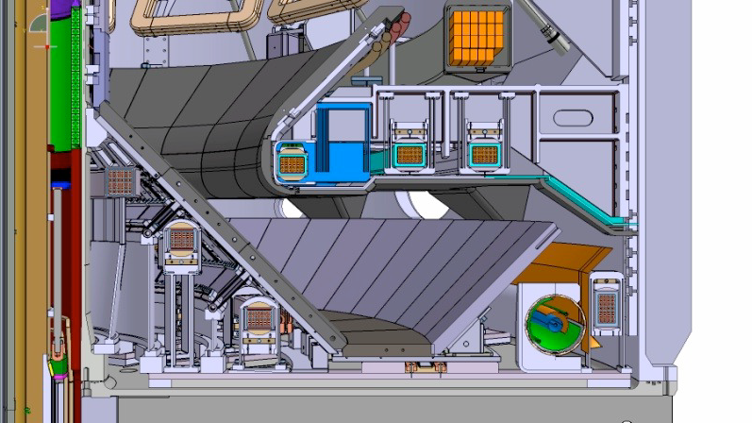
MAST Upgrade Divertor
Closed divertor with very flexible PF coil set
P6
P4
Divertor nose
PX
D6
D7
DP
D1
Gas baffle
D2
D5
D3
Cryopump
MAST Upgrade
MAST Upgrade Design Features

Slide 8
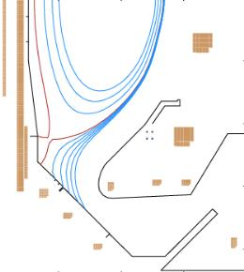
Divertor Configurations in MAST-U
MAST Upgrade has considerable flexibility for studying conventional and alternative divertor configurations
Vertical Target
Low R_{T}
X-divertor
Inner Leg Super-X
Snowflake
Super-X
MAST Upgrade
MAST Upgrade Design Features

Slide 9
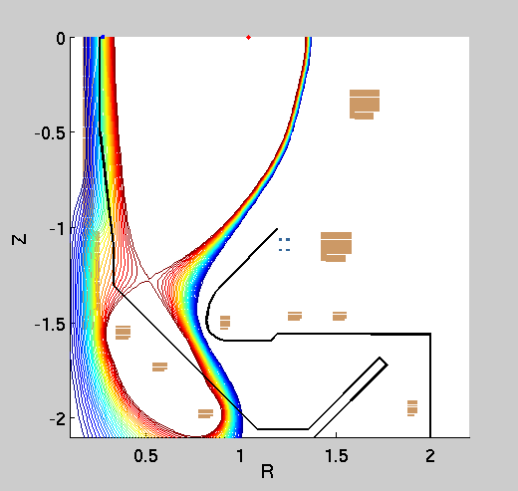
Control of Divertor Configuration
Can smoothly change from conventional to Super-X whilst keeping same core plasma
MAST Upgrade Design Features

Slide 10
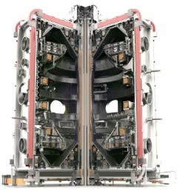
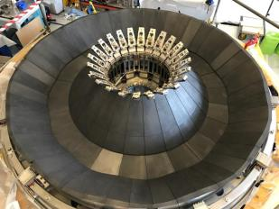
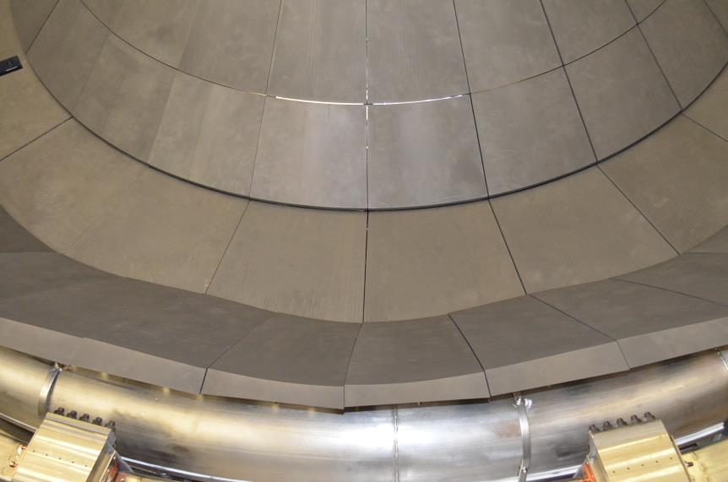
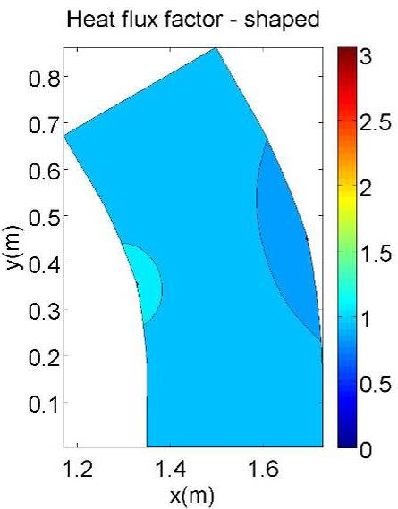
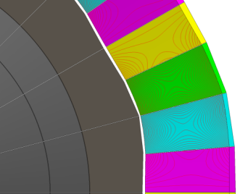
Divertor - impact of TF ripple
TF Ripple:
Challenge:
TF ripple leads to factor 3 variation of heat flux on super-X target
Angling tiles only doesn’t help much.
Solution:
Shaping brings variations within ±6%
MAST Upgrade Design Features

Slide 11
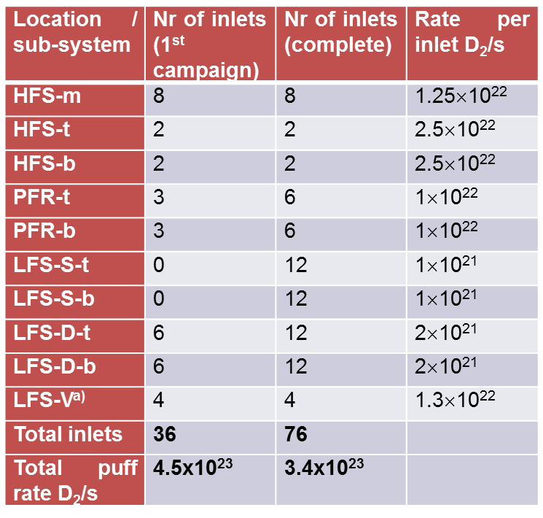
Gas Fuelling Capability
Gas fuelling capability
Significant capacity
Each location can be used to inject main ion species or impurities
HFS-m
LFS-V
HFS-t/b
*
PFR-t/b
*
LFS-D t/b
*
LFS-S t/b
*
*
*
Two inlets per piezo valve
MAST Upgrade Design Features

Slide 12
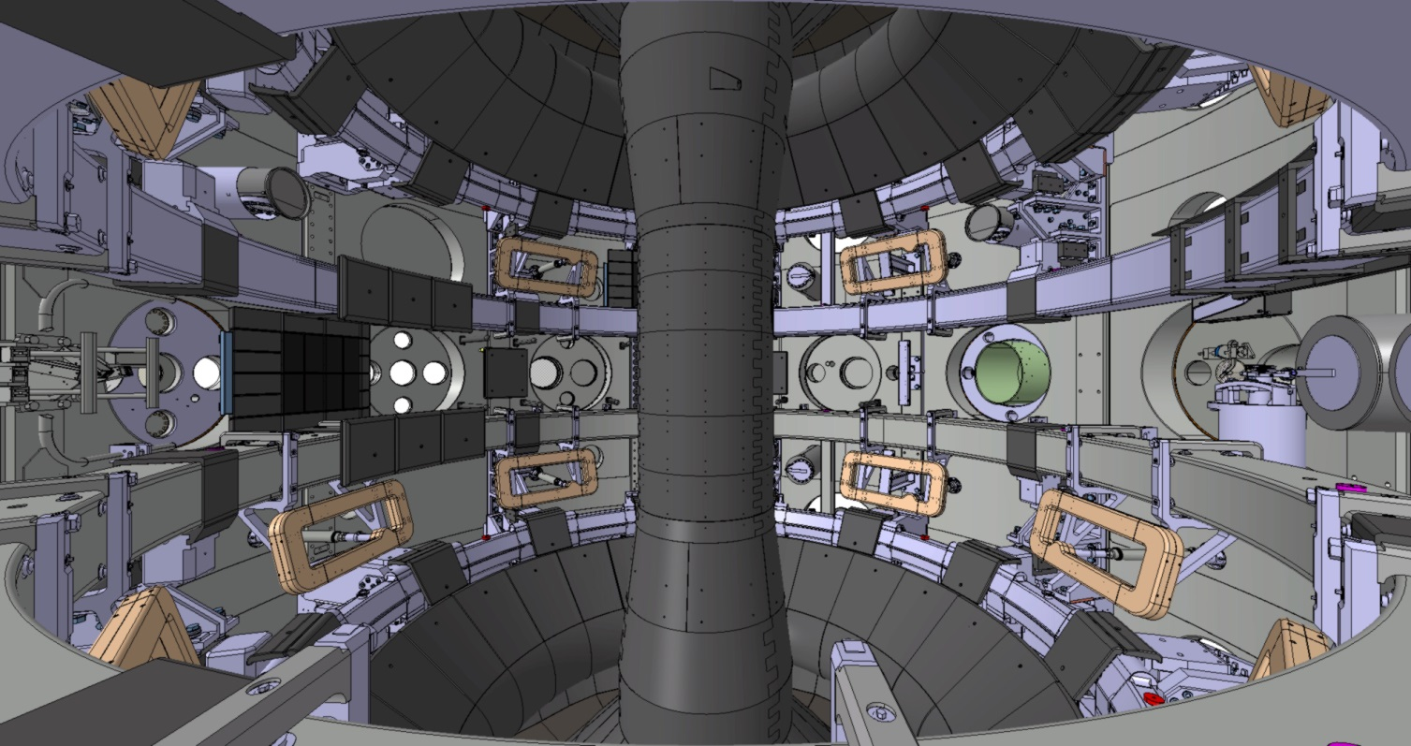
ELM Control & Error Field Correction
MAST Upgrade is equipped with internal and external coils for applying RMPs or error field correction
External coils also available for n=1 error field correction, internal RMP coils can be used for n=2 correction
Upper row of RMP coils can apply perturbations up to n=2, lower row can apply up to n=4
RMP coils
MAST Upgrade Design Features

Slide 13
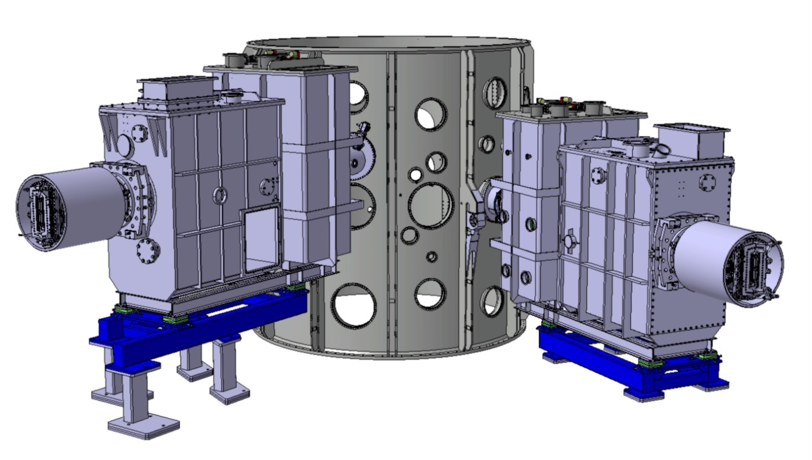
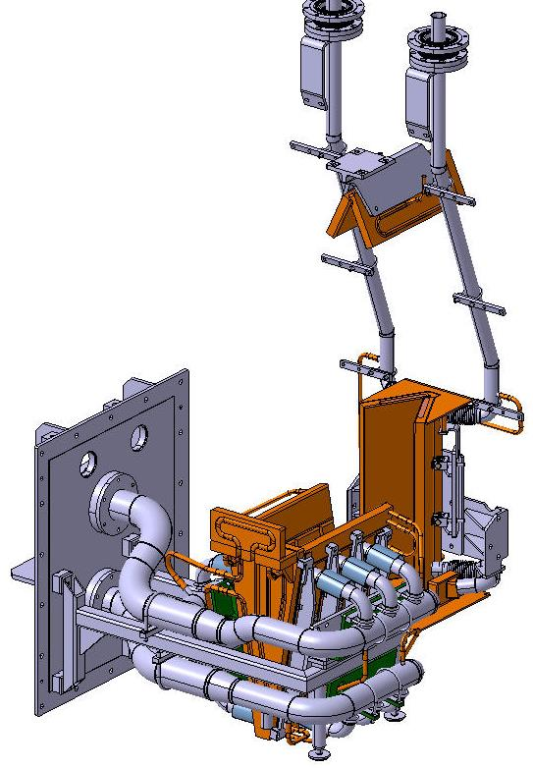
Neutral Beam Heating in MAST Upgrade
Residual Ion Dump
3rd Energy Ion Dump
2x 2.5MW PINI sources will be available initially
1 on-axis beam (Z = 0.0, R_{tan} = 0.7m)
1 off-axis beam (Z = 0.65m, R_{tan} = 0.8m)
Combination of on and off axis heating allow for control over the heating, current and fast ion profiles
½ Energy Ion Dump
Full Energy Ion Dump
New beamline components to increase pulse length capability to 5s
MAST Upgrade Design Features

Slide 14
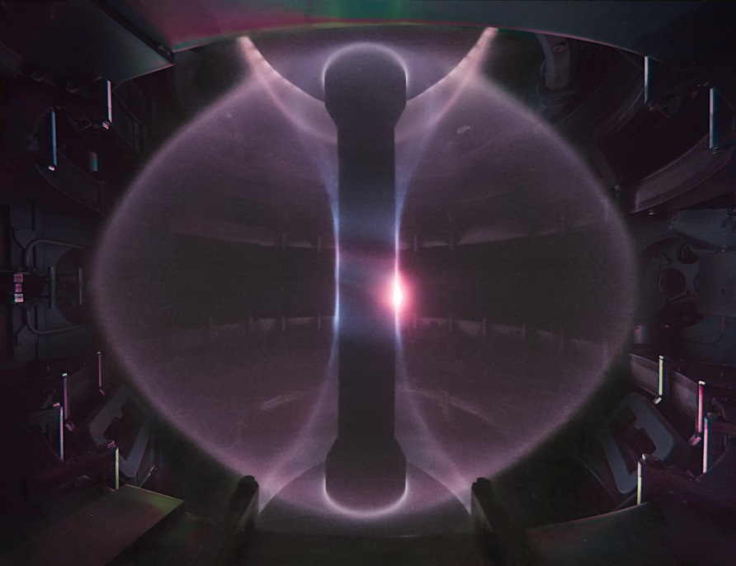
MAST Upgrade Diagnostics
MAST-U will retain and extend the extensive suite of MAST diagnostics e.g.
  130 point, ~1cm resolution Thomson scattering
  Extensive beam spectroscopy
    Charge-exchange recombination spectroscopy
    Motional Stark Effect
    Fast Ion D_{α}
  Wide-angle high speed imaging
  SAMI
  Upgraded Beam Emission Spectroscopy System
  Neutron camera
  etc
Divertor diagnostics will be significantly extended and enhanced
MAST Upgrade Design Features

Slide 15
Diagnostics Overview
MAST Upgrade Design Features

Slide 16
Diagnostics Overview
MAST Upgrade Design Features

Slide 17
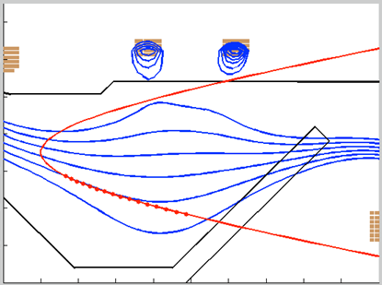
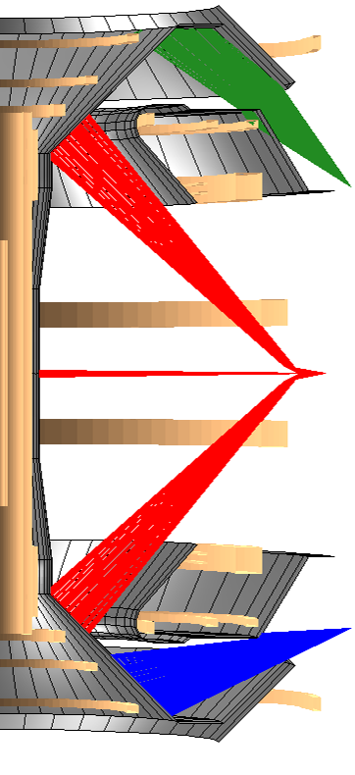
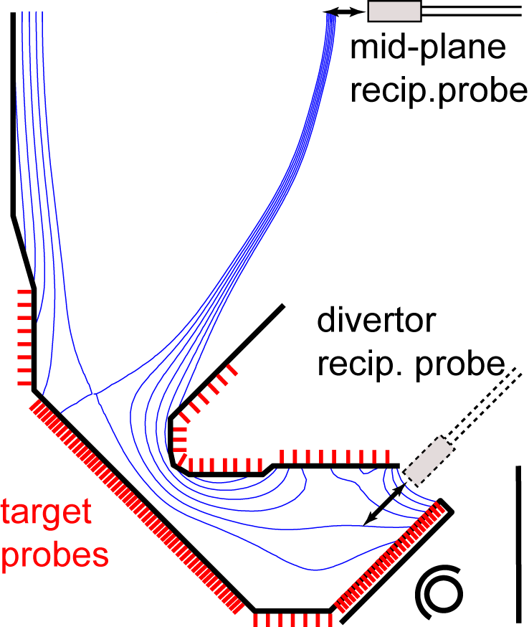
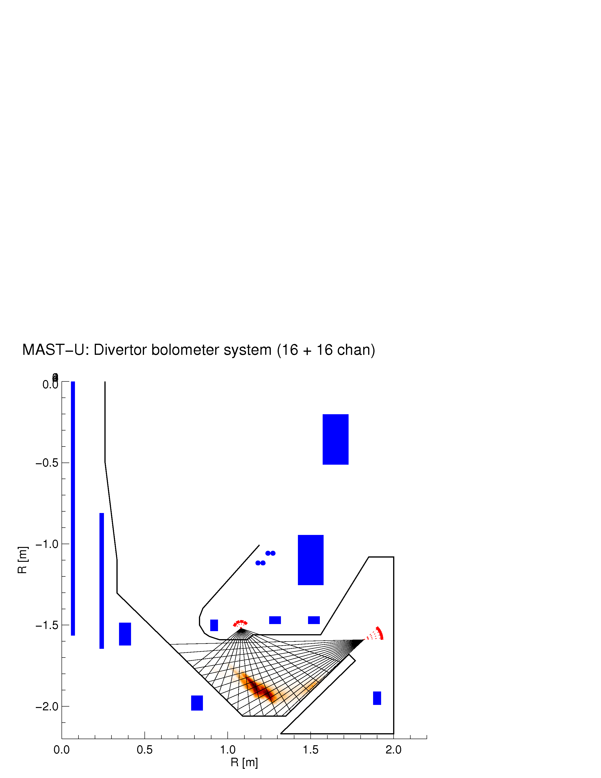
New Divertor Diagnostics
Divertor Thomson scattering
Spectroscopy
core
system
Infra red views of PFCs
Others, especially
Coherence imaging (flows)
> 400 pick-up coils
Divertor science facility
radiation
from SOLPS
Bolometer arrays for divertor
> 800 Langmuir probes
MAST Upgrade
MAST Upgrade Design Features

Slide 18
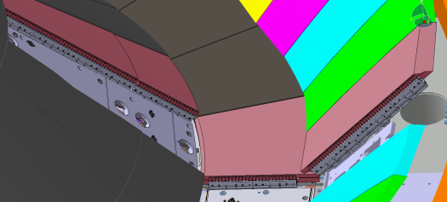
Langmuir Probes
The divertors are equipped with a total of 858 Langmuir probes
10mm spacing
Covering all possible outer strike point locations in both upper and lower divertors at 2 toroidal locations
Up to 640 probes can be monitored
Mid-plane reciprocating probe with heads to measure:
T_{i} profiles (RFEA)
Flow profiles (Mach probe & Gundestrup probe)
Plasma potential profiles (ball-pen probe)
Divertor reciprocating probe
MAST Upgrade Design Features

Slide 19
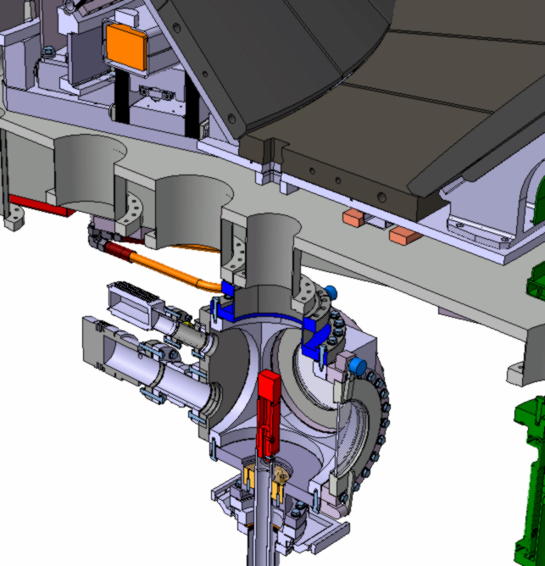

Divertor Science Facility
  Divertor Science Facility (similar to DIMES)
  Allows for the introduction of electrical probes, materials samples, etc into the lower divertor chamber
MAST Upgrade Design Features

Slide 20
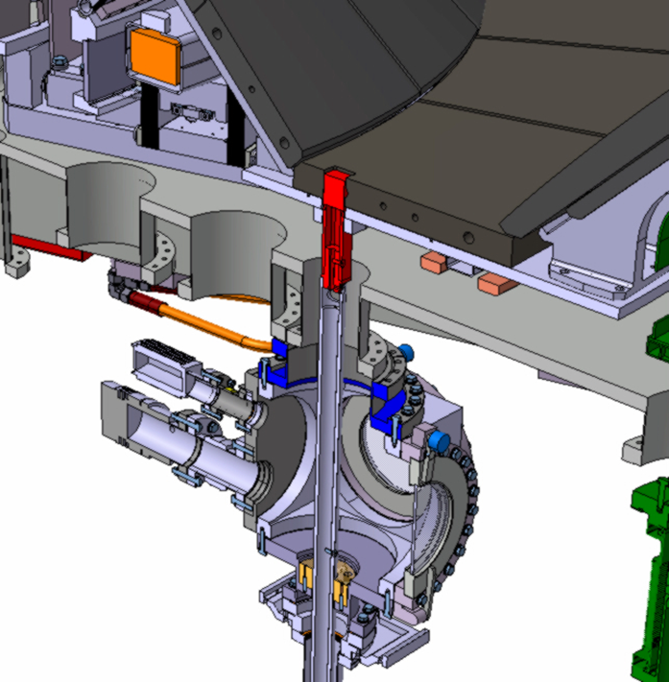
Divertor Science Facility
  Divertor Science Facility (similar to DIMES)
  Allows for the introduction of electrical probes, materials samples, etc into the lower divertor chamber
MAST Upgrade Design Features

Slide 21
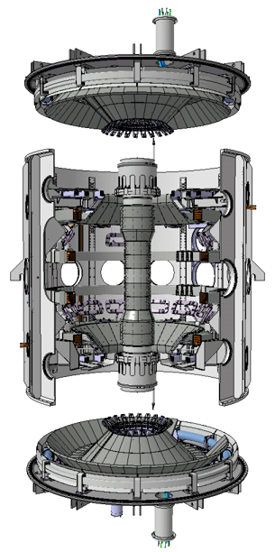
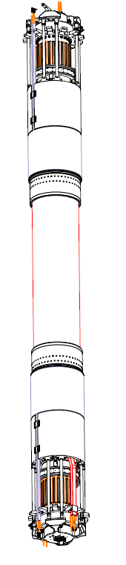

MAST Upgrade Load Assembly
MAST-U Load Assembly - Modular Construction
Upper End Plate
Upper Cassette
Outer Cylinder
=
+
Centre Tube
Centre Column
Lower Cassette
Lower End Plate
Construction Progress

Slide 22
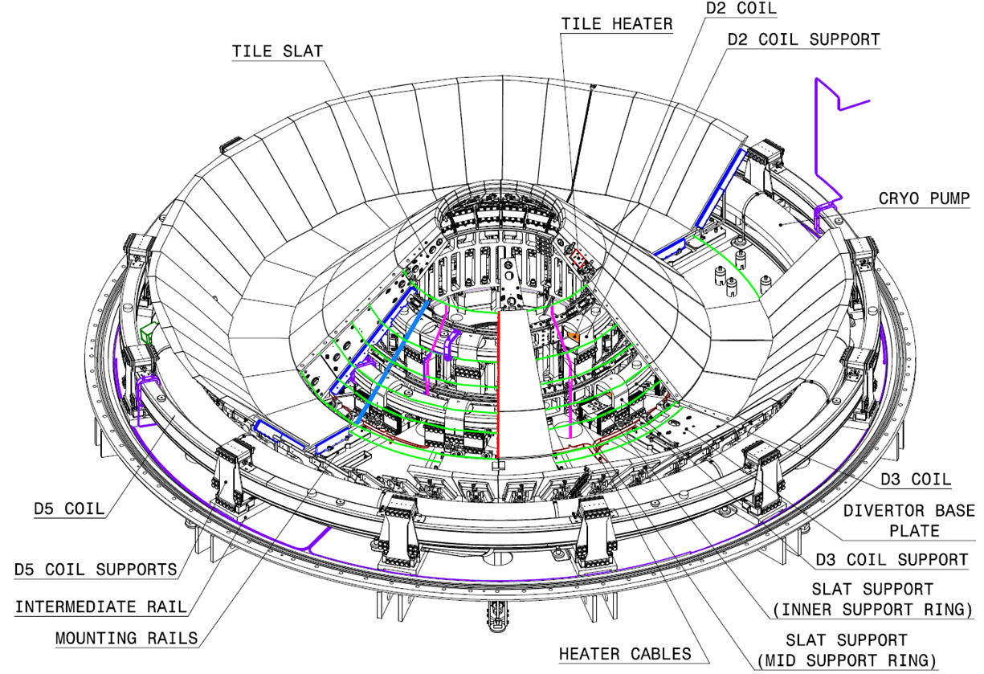
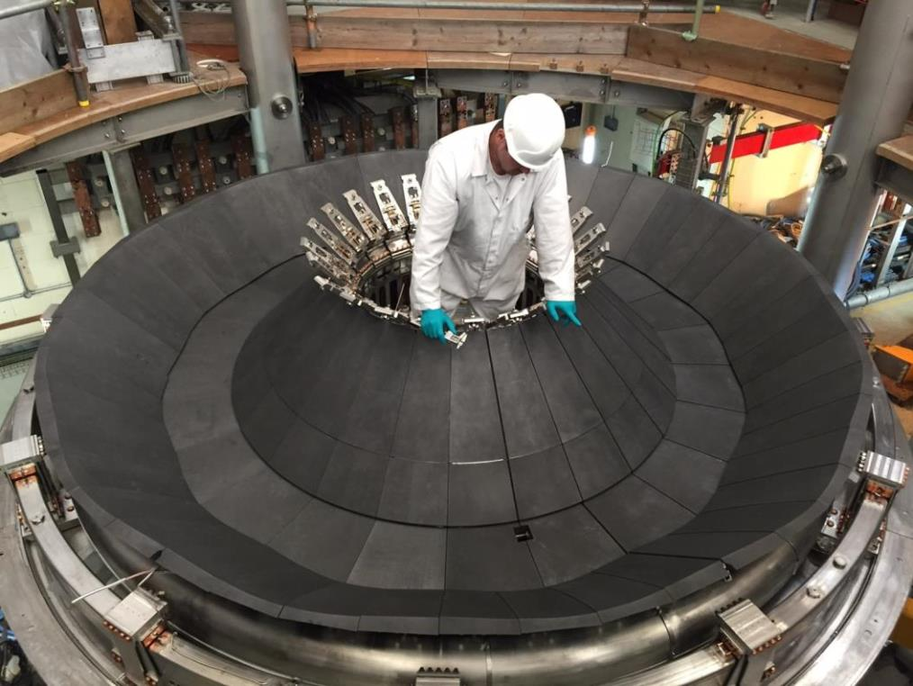
End Plate Construction
May 2016
Construction Progress

Slide 23
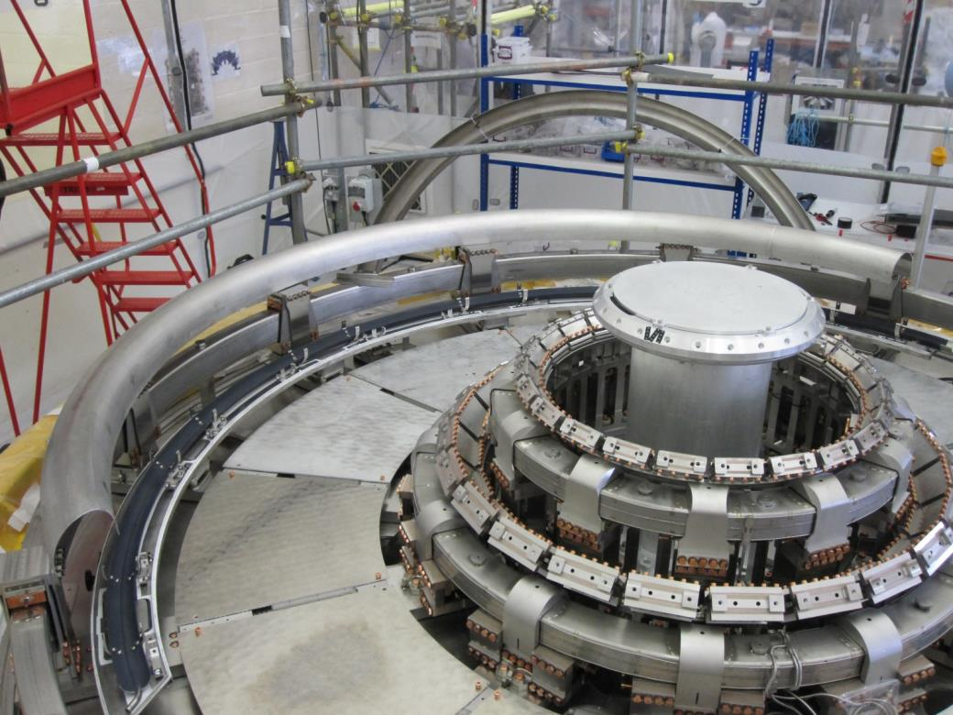
End Plate Construction
Particle shield
Cryopump
Construction Progress

Slide 24
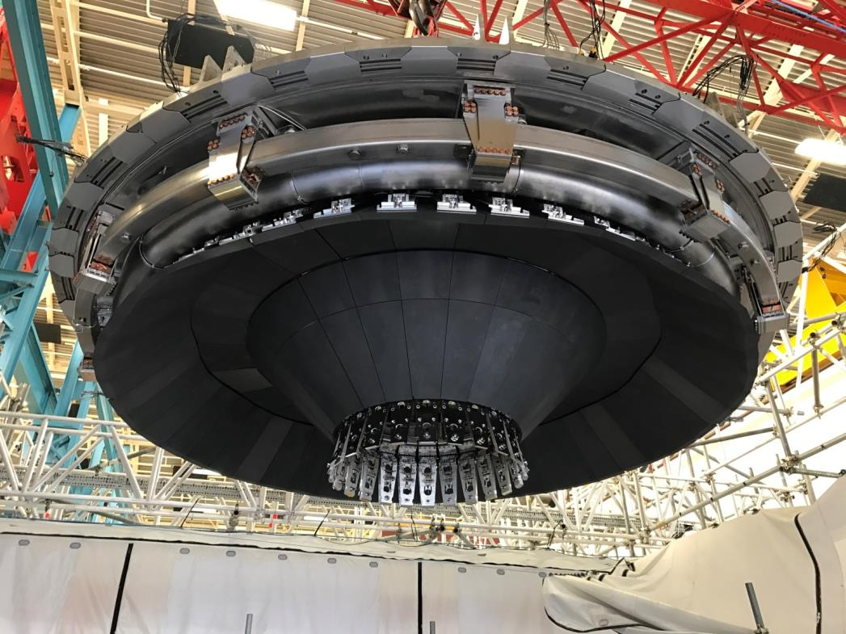
Upper End Plate Installation – Nov 2016
Construction Progress

Slide 25
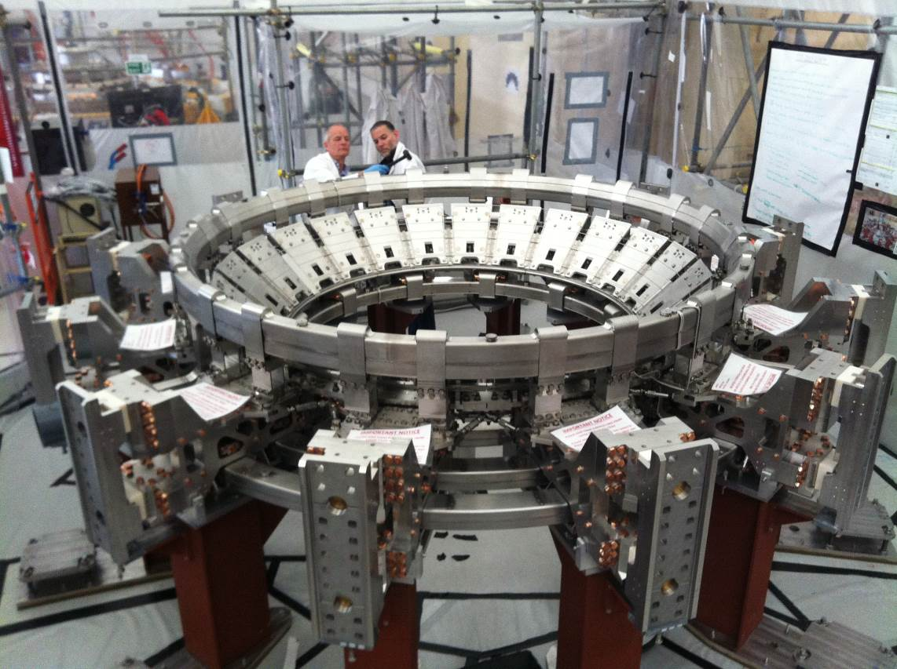
Lower Cassette Construction
P5 & P4
lower
P6
Main cassette structure
DP
Construction Progress

Slide 26
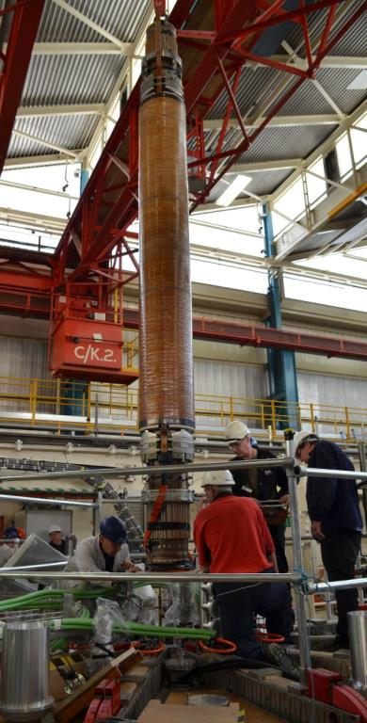
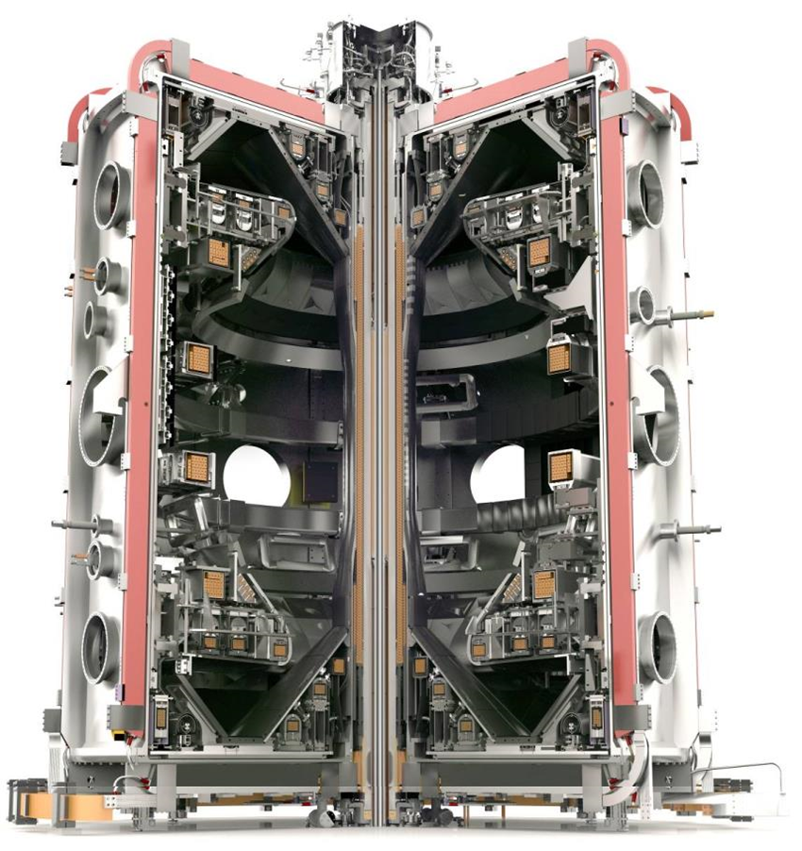
Centre Column Installation – Mar 2017
Construction Progress

Slide 27
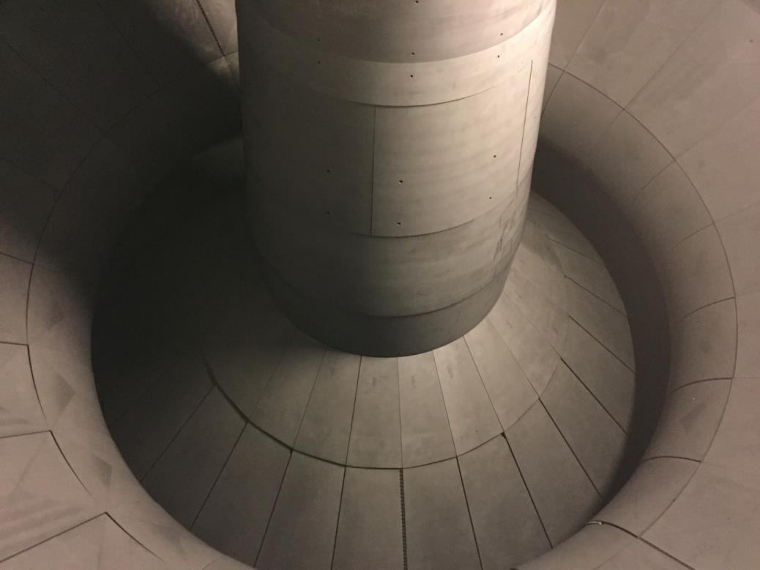
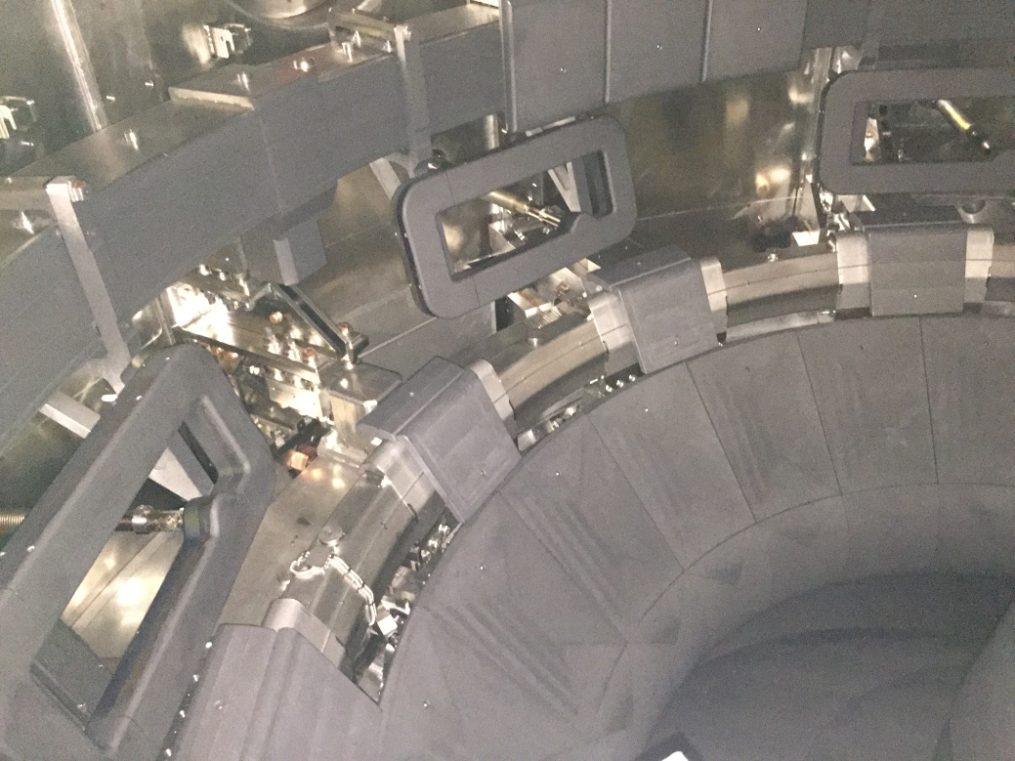
In-vessel Views – April 2017
View of centre column & lower divertor
12 ELM coils installed (8 lower, 4 upper)
Construction Progress

Slide 28
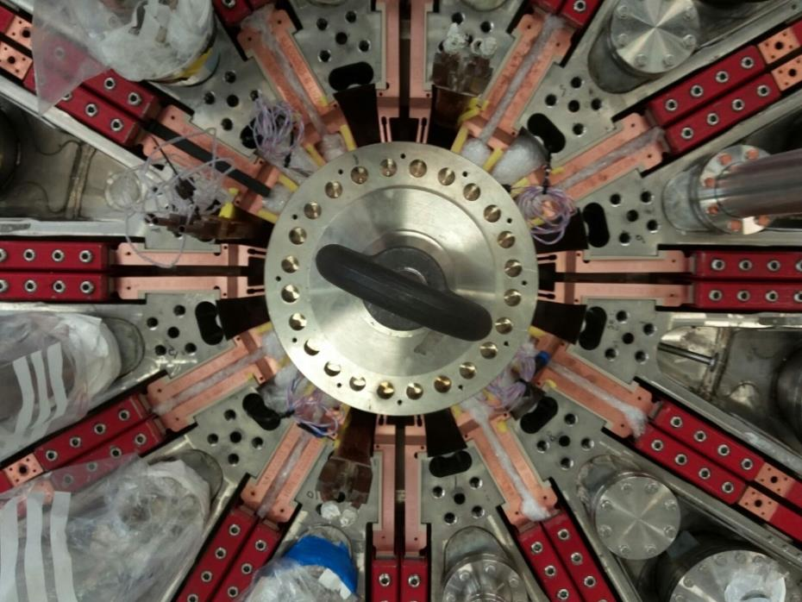
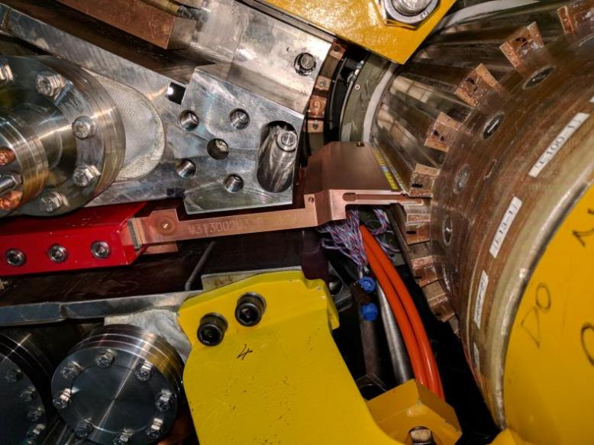
TF Sliding Joints – July 2017
TF sliding joints installed and tested July 2017
Construction Progress

Slide 29
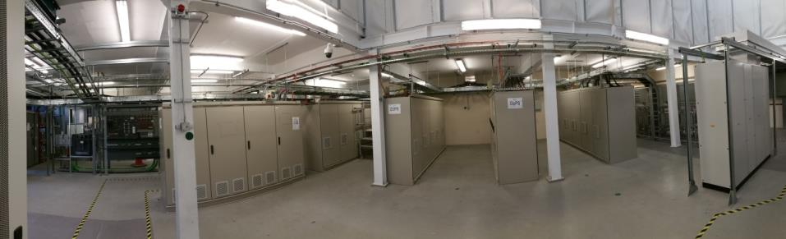
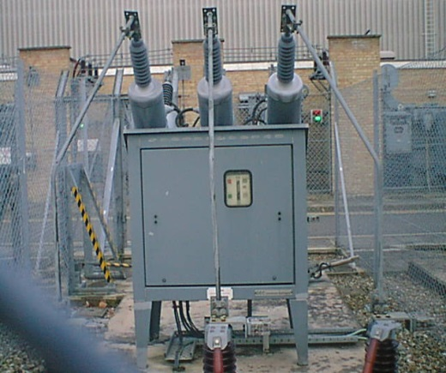
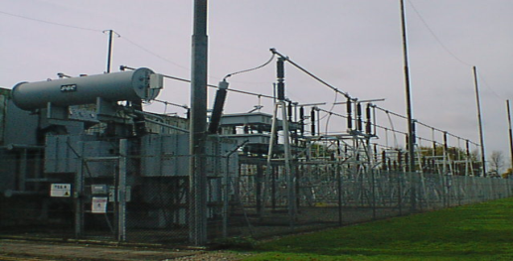
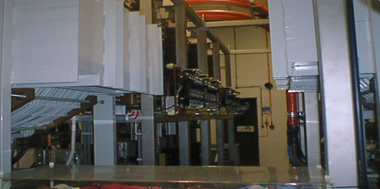
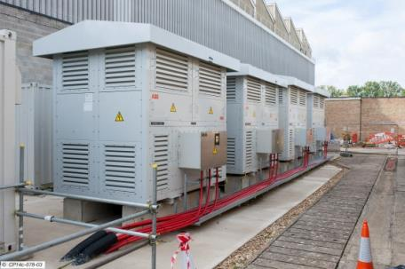
Power Supplies
Divertor Coil Power Supplies
Poloidal Field
Power Supplies
HVPS
LVPS
TF Coil Power Supplies
Solenoid Power Supplies
Construction Progress

Slide 30
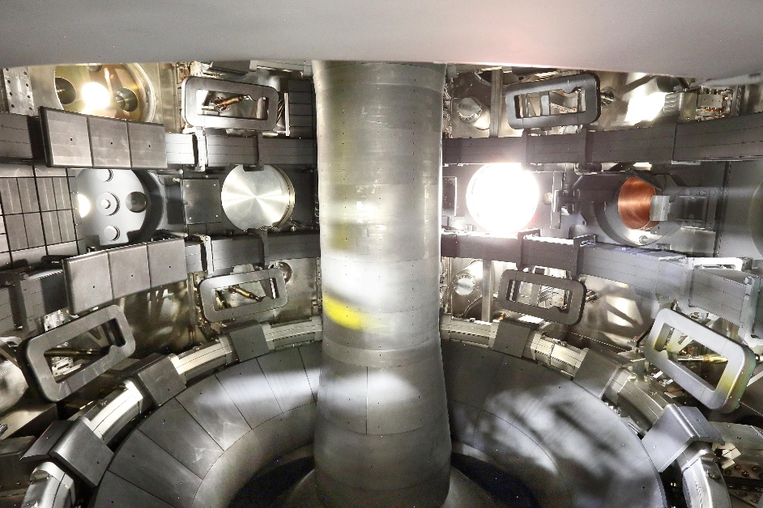
Latest Timeline
M/c now under vacuum again
Aiming to conduct high temperature bake by Christmas
First plasma – Spring 2018
First physics campaign – 2nd half of 2018
Construction Progress

Slide 31
Physics Priorities
The high-level themes of the first physics campaign are:
  Understanding the effect of divertor magnetic configuration on SOL transport, power and particle losses and loads to divertor PFCs
  Understanding the role of divertor configuration on plasma performance, including H-mode access and pedestal parameters
  Validation of the MAST Upgrade design concept, e.g. neutral baffling, power deposition to divertor PFCs
  Developing scenario performance towards long pulse, including error field correction and RMPs for ELM control
  Exploring fast ion confinement, heating and current drive
Planned Research Programme

Slide 32
First Physics Campaign
Proposals by Topic Area
Received: 79 proposals requesting 1500 shots
Andrew Kirk/James Harrison MAST Research Forum April 2017
Planned Research Programme

Slide 33
EUROfusion MST Programme
EUROfusion Medium Sized Tokamak (MST) programme
MAST-U is part of the EUROfusion MST programme, along with ASDEX Upgrade and TCV
40 proposals received, showing a strong interest from European collaborators. The requested number of pulses was 3 times those available
Shot prioritisation was discussed at the General Planning Meeting held in November 2016 in Garching at which MAST-U was included for the first time
Planned Research Programme

Slide 34
Additional Information
MST1 wiki page on MAST Upgrade:
http://users.euro-fusion.org/iterphysicswiki/index.php/WPMST1_2014_MAST-U
MAST Upgrade users page (requires EUROfusion login credentials):
https://users.mastu.ukaea.uk
MAST Upgrade research plan:
http://www.ccfe.ac.uk/assets/documents/other/MAST-U_RP_v3.pdf
or contact:
Andrew Kirk (programme leader): andrew.kirk@ukaea.uk
Andrew Thornton (session leading & scenarios): andrew.thornton@ukaea.uk
Richard Martin (diagnostics): richard.martin@ukaea.uk
Planned Research Programme

Slide 35
MAST-U Enhancements 2017-22
In October 2015, EUROfusion issued a call for proposals to address specific gaps in the EU Plasma Exhaust (PEX) strategy.
CCFE submitted a proposal addressing some of these gaps via the study of conventional and alternative divertor geometries in MAST-U and received approval for a phased approach in April 2017.
Phase 1: Divertor diagnostics, cryoplant, fuelling, plasma control
Phase 2: Increased NBI power
Phase 2 is dependent on demonstrating that Super-X works and that additional NBI power is necessary.
The PEX enhancements will provide additional capability to characterize and understand plasma exhaust in both conventional and advanced (e.g. super-X) divertor configurations including validation of predictive models for designing future devices and developing further divertor improvements.
Additional enhancements

Slide 36
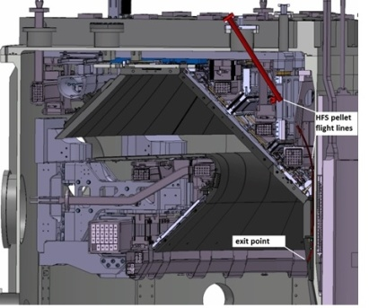
MAST-U Enhancements 2017-22
Additional planned enhancements over the next 5 years
Cryoplant
Divertor particle control
Installation target dates:
2019 Diagnostics & fuelling
2020 Cryoplant
2021 Double beam box
Double NBI Box
10MW auxiliary heating
Flexible Fuelling
HFPI + 48 gas valves
Upgraded control
New RFPS and software
Extra diagnostics
X-pointThomson scattering
RT Langmuir probes
Multiple extra IR cameras
2 fast visible cameras
Additional enhancements

Slide 37
MAST-U Enhancements 2017-22
Parameter | MAST-U First Campaigns | MAST-U after enhancements
R / a (m) | 0.7 / 0.5 | 0.7/ 0.5
Divertor PFC material | Carbon (graphite) | Carbon (graphite)
B_{φ} (0.8m) | 0.8 | 0.8
Max I_{p} (MA) | 2.0 | 2.0
Max elongation | 2.5 | 2.5
Max triangularity | 0.6 | 0.6
Divertor | Closed, unpumped | Closed, cryo-pumped
Configurations | DN, Super-X, Snowflake, SN | DN, Super-X, Snowflake, SN
Pulse length | Up to 5s | Up to 5s
NBI heating power | 5MW | 10MW
NBI geometry | 1 on axis, 1 off axis | 2 on axis, 2 off axis
Fuelling | Gas Injection | Gas Injection + High Frequency Pellet Injector
+ further enhancements to diagnostics and control capability
Additional enhancements

Slide 38
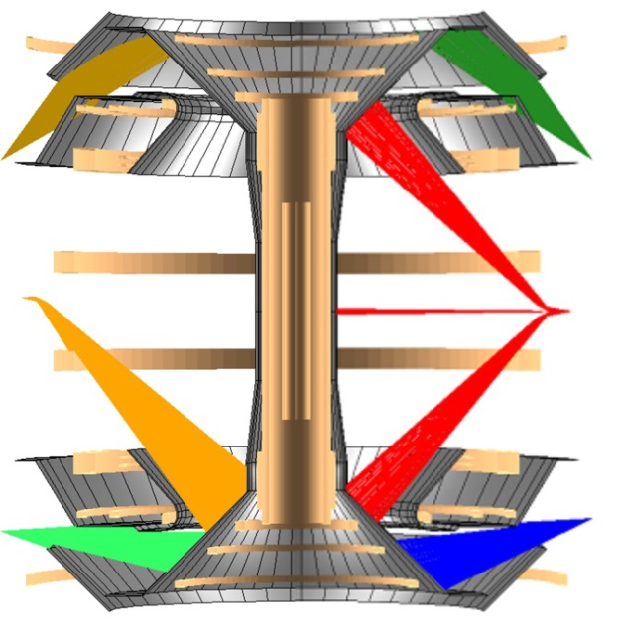
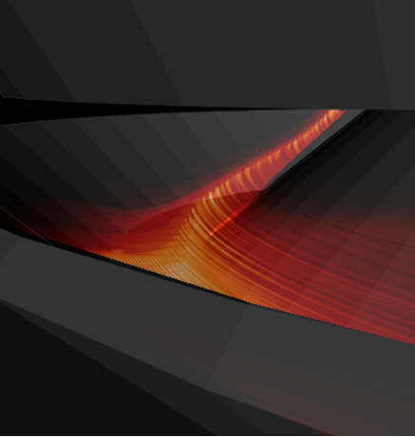
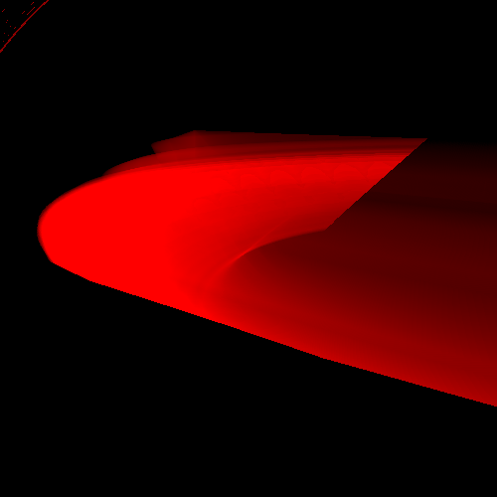


Enhanced Divertor Diagnostics
IR coverage of all strike points
X-point Thomson scattering
Improved fast imaging of filaments
IR Imaging bolometer & AXUV diodes
Dα
C II
C III
Improved multi-spectral imaging
Additional enhancements

Slide 39
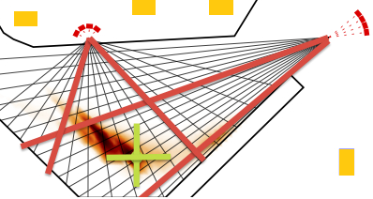
Detachment Control
Upgraded control hardware to control divertor detachment with multiple input sensors:
  Thomson scattering (mid-plane & divertor – n_{e}, T_{e}),
  CO₂ interferometer (mid-plane ∫n_{e}.dl),
  Fast ionization gauges (mid-plane & divertor p₀)
  Langmuir probes (divertor j⁺_{sat}, j_{SOL})
  Bolometry (radiation)
  Real-time readout of spectroscopy and cameras
Feasibility of locating radiating region with bolometers and FPGAs for feedback control has been demonstrated
Very flexible gas fuelling system allows injection of D₂ and impurities from different locations
Cryopumping essential to exhaust seeded impurities
Additional enhancements

Slide 40
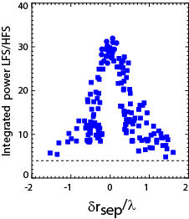
Vertical Control
On MAST-U δ_{r,sep} will be controlled to ~2mm accuracy in core scope
Real-time IR cameras and Langmuir probes together with a model-based controller using FPGAs driving a new switching RFA to control power balance
But for DEMO relevance need to control δ_{r,sep} to fraction of relevant power heat flux length λ_{q}
MAST
P_{LFS}/P_{HFS} reduces by factor of 2 for δr_{sep} ~ 0.5 λ
For MAST this means control of ~ 3-5 mm
For DEMO need to be able to control δr_{sep}~0.3 - 0.5 mm
Vertical position control will be upgraded to give this precision and investigate suitability of control schemes based on power deposited to the divertor
We will investigate effect of divertor geometry on control criterion
Additional enhancements

Slide 41
KPIs for 3rd and 4th NBI
Key performance indicators
To show that the Super-X works:
KPI#1 For similar conditions, demonstrate that the target heat loads decrease by more than a factor of 2 when moving from a conventional to a super-X divertor configuration.
To justify the need for extra heating power:
KPI#2 Demonstrate achievement of 3.5 MW with beam boxes 1 and 2.
KPI#3: At high power (≥ 3.5MW), demonstrate that the divertor is detached down to low densities. (~ 0.5 n_{GW}).
KPI#4: Detailed Design Review for Double Beam Box completed and approved by EUROfusion.
Additional enhancements

Slide 42
Summary
MAST Upgrade is an exciting new facility. Construction is now close to completion and the vessel is under vacuum
One of its primary objectives is to test a range of novel exhaust concepts e.g. super-X, snowflake
Planning is well underway for the first physics campaign in 2018 which will include a EUROfusion MST component
A project to implement a second wave of major enhancements has started. These include a cryoplant, pellet injector, upgraded control systems, new diagnostics and a double beam box to increase the installed NBI power to 10MW.
A large number of international collaborators and UK universities are already involved in the programme. New participants are welcome.
Summary

Slide 43
MAST Upgrade in 2017
Increased TF
Improved confinement
New Solenoid
Greater I_{p}, pulse duration
19 New PF Coils
Improved shaping
Super-X Divertor
Improved power handling
Off-Axis NBI
Improved profile control
MAST Upgrade Design Features

