Slide 1
2017. 09. 20.
Hoam Faculty House, Seoul National University
Study on MHD Activity
during Ohmic Plasma Operation in VEST
J.H. Yang¹, S.C. Kim¹, and Y.S. Hwang¹*
¹Seoul National University, Korea

Slide 2
Contents
Introduction
  VEST Ohmic discharge
  Previous works on MHD activity during Ohmic discharge
Equilibrium reconstruction
  Special features of VEST equilibrium reconstruction
  Sensitivity test
  Internal magnetic probe
  Current density profile reconstruction
Study of MHD activity: Comparison to safety factor profile
Summary and future work

Slide 3
VEST Ohmic Discharge
I_{P} (kA)
EC-assisted startup & boronized wall
  Pre-ionization: R ~ 0.46 m (2.45 GHz EC)
  Trapped particle configuration
  Boronization / He glow discharge cleaning
Best shot: plasma current ~ 100 kA
  MHD activity during ramp-up
  Runaway electron production / IRE
  Analysis in terms of equilibrium (q profile)
dB/dt (T/s)
R (m) | 0.39 | I_{P} (kA) | 96.7
a (m) | 0.28 | B_{t} (T) | 0.10
A = R / a | 1.39 | l_{i} | 0.67
κ | 1.58 | q_{a} | 6.11
R (m)
a (m)
Equilibrium reconstruction at t = 5.0 ms

Slide 4
MHD Activity during Ramp-up Limits Plasma Performance
I.H. Hutchinson (1976) / R.S. Granetz et al. (1979)
  Anomalous resistivity: Fast current penetration leading to disruption / rational q surface important
M. Ono et al. (1997) / G.D. Garstka et al. (2003)
  Soft X-ray array / soft X-ray constrained equilibrium reconstruction
  Internal resistive MHD modes associated with low m/n ~ 1-3 surfaces
Study effect of safety factor / current density profiles on MHD activities → Equilibrium reconstruction
VEST shots 14721-17571
I_{P} (10⁵ A)
I_{P} = I_{TF}
I_{P} = 0.5I_{TF}
I_{TF} (10⁵ A)

Slide 5
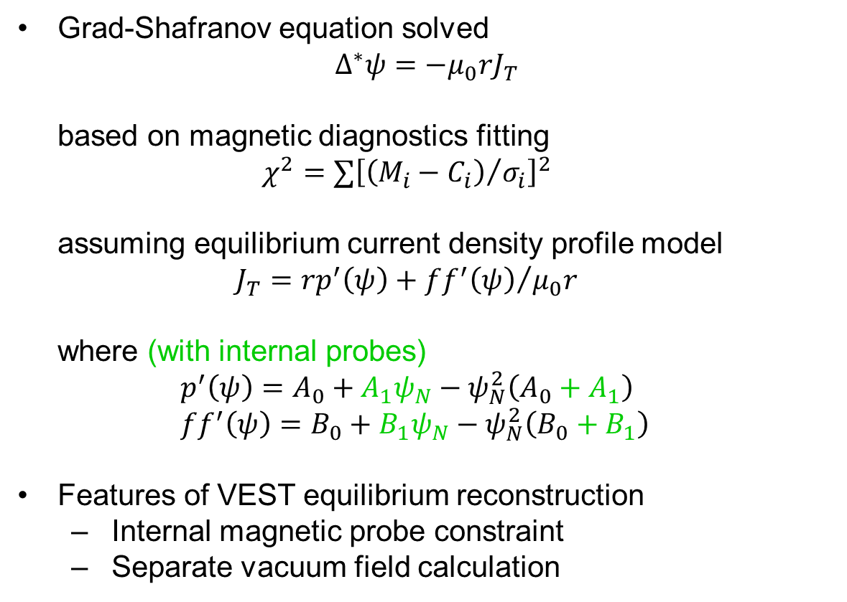
Equilibrium Reconstruction
Grad-Shafranov equation solved
$∆^{∗}ψ=−μ_{0}rJ_{T}$
based on magnetic diagnostics fitting
$$χ^{2}=∑{\left[{\left(M_{i}−C_{i}\right)}/{σ_{i}}\right]}^{2}$$
assuming equilibrium current density profile model
$$J_{T}=rp^{′}\left(ψ\right)+{ff^{′}\left(ψ\right)}/{μ_{0}r}$$
where (with internal probes)
$$p^{′}\left(ψ\right)=A_{0}+A_{1}ψ_{N}−ψ_{N}^{2}\left(A_{0}+A_{1}\right) \\ ff^{′}\left(ψ\right)=B_{0}+B_{1}ψ_{N}−ψ_{N}^{2}\left(B_{0}+B_{1}\right)$$
Features of VEST equilibrium reconstruction
  Internal magnetic probe constraint
  Separate vacuum field calculation

Slide 6
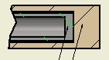
Internal Magnetic Probe for Additional Constraints
Reaches R > 0.35 m: ~ 10% degradation of plasma current (10 mm diameter)
Compensation of
toroidal field crosstalk
SUS 1/4 inch
Alumina 10 mm
Operation test (low plasma current discharge)

Slide 7
Separate Vacuum Field Calculation
Eddy current I_{eddy} ~ 250 kA (> I_{P}) in VEST
  Walls close to the plasma (low aspect ratio)
Coarse grid distorts vacuum field: Fine grid needed
  Over 400+ elements: Too many for magnetics fitting
Plasma breakdown site
FL 10
Midplane
Inboard
Partial solenoid
Unconventional structures
Wall eddy current (kA)
Measurement
Grid 1 (Coarse)
Grid 2 (Fine)
Plotted all 483 elements
Time (s)

Slide 8
Equilibrium Reconstruction Quality
Accumulative equilibrium reconstruction
  Random error ±10% added to measurements
  Accumulated 48 reconstructed equilibriums
  Post-process to get MHD parameters / fit to normal distribution
Error bar: Shape parameters 10% / profile parameters 20% without information inside the plasma
  Internal magnetic probe constraint required
b = b .* (1 + 0.2 * (rand(size(b)) – 0.5));
relative error = st.dev / mean
fit to normal distribution
R | 0.008 | q₀ | 0.183
a | 0.011 | q_{a} | 0.037
δ | 0.121 | l_{i} | 0.040
κ | 0.011 | L_{t} | 0.019
5σ
5σ
max. error bar: ±18%
R (m)
q₀
Sample: Shot 15311
Excluded internal magnetic probe data
0.39
0.8
0.36
0.1

Slide 9
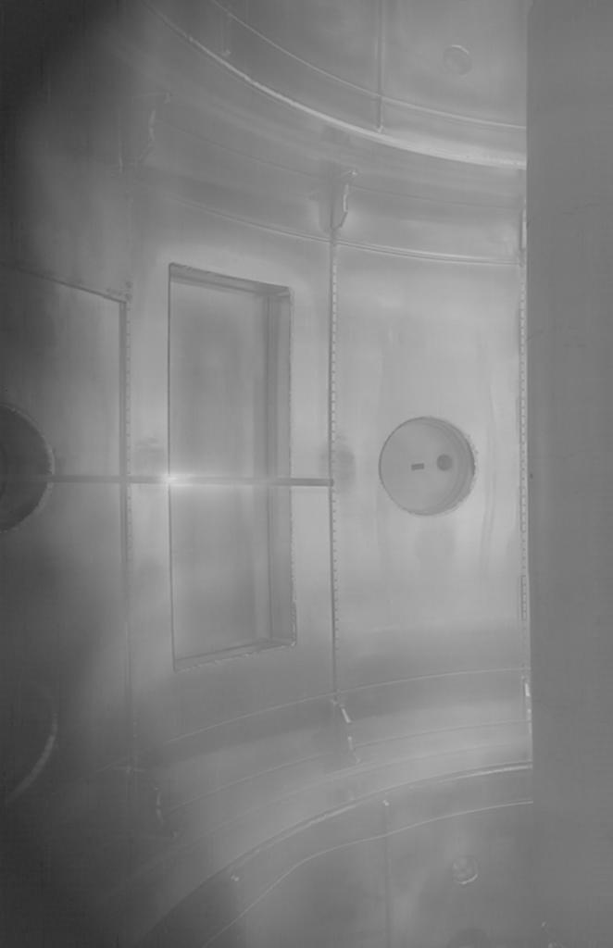
Current Density Profile Reconstruction Quality
J_{T} (A/cm²)
Dashed: 5.4 ms
Full line: 6.2 ms
Additional constraint → more unknowns used
Reconstructed vs. measured current density profile
  Plasma centered above midplane
  Sensor position may be off-midplane
  Plasma perturbed by the sensors (~ 10%)
Direct deduction
(4.4 / 5.2 ms)
R (m)
Shot 15305 – 15311 (radial scan)
Total plasma current: ~ 70 kA
Boronized wall
EC pre-ionization
Plasma current (measurement)
(max. I_{P} – min. I_{P}) / mean I_{P} = 10%
VEST typically shows a very good shot to shot reproducibility

Slide 10
Equilibrium Reconstruction Results
I_{P} (kA)
Low current for internal magnetic probe ~ 70 kA
  More current profile parameters (2 → 4)
  Faster ramp-up: Lower internal inductance
MHD activity is observed as always
  dB/dt from outboard midplane Mirnov coils
  Numerical filter applied at 1 kHz
  DAQ sampling: 25 kS/s
dB/dt (T/s)
R (m)
cf. if V_{T} = 10 km/s, V_{T} / 2πR ~ 4 kHz in VEST
a (m)
R (m) | 0.38 | I_{P} (kA) | 67.0
a (m) | 0.27 | B_{t} (T) | 0.06
A = R / a | 1.41 | l_{i} | 0.38
κ | 1.93 | q_{a} | 6.97
q₉₅ / 10
li
Equilibrium reconstruction at t = 5.2 ms

Slide 11
MHD Activity and Safety Factor Profile
Nearly zero shear during current ramp-up (hollow current profile, 4.4 ms)
As discharge evolves, current profile is relaxed (5.2 ms)
  Positive shear throughout minor radius
  MHD activity is decreased
I_{P} (kA)
4.4 ms
5.2 ms
Dashed: 4.4 ms
Full line: 5.2 ms
Current density (A/cm²)
dB/dt (T/s)
Safety factor
4.4 ms
5.2 ms
ψ_{N} (normalized flux)

Slide 12
Summary and Future Work
MHD activity is observed during Ohmic plasma operation in VEST
Equilibrium reconstruction code has been developed for current profile diagnostics
  Internal magnetic probe is used as an additional constraint
  Vacuum field calculated separately
Safety factor profile evolution has shown the relevance of magnetic shear to MHD activity
  Change from zero to positive shear is coincident with decrease of MHD activity
Future work will focus on the identification of instability source
  Improved profile reconstruction using diamagnetic flux constraint
  Mode number analysis

