Slide 1
Overview of recent progress on plasma current start-up and long-duration plasma maintenance in QUEST
Kazuaki Hanada¹, Hiroshi Idei¹, Naoaki Yoshida¹, Makoto Hasegawa¹, Kazuo Nakamura¹, Hideki Zushi¹, Akihide Fujisawa¹, Yoshihiko Nagashima¹, Takumi Onchi¹, Kengo Kuroda¹, O. Watanabe¹, Shoji Kawasaki¹, Aki Higashijima¹, Takahiro Nagata¹, Shun Shimabukuro¹, Atsushi Fukuyama², Osamu Mitarai³, Yuichi Takase⁴, Roger Raman⁵, and Masayuki Ono⁶.
¹ Research Institute for Applied Mechanics, Kyushu University, Kasuga 816-8580, Japan: ² Kyoto University, Japan: ³ Tokai University, Japan: ⁴ The University of Tokyo, Japan: ⁵ The University of Washington, USA: ⁶ Princeton Plasma Physics Laboratory, USA
Acknowledgement：
K. Mishra^{a, h} T. Kariya^{b}, M. Yunokiª, S. Kojimaª, A. Ejiri^{c}, N. Matsumoto^{c}, T.I. Tsujimura^{d}, S. Kubo^{d}, H. Ohwadaª, K. Yamasaki^{e}, R. Yonedaª, G. Taylor^{g}, N. Bertelli^{g} , T. Hondaª,
Z. Wangª, A. Kuzmin^{d}, I. Takagi^{f}, T. Hirata^{f}, Y. Oya^{i}, M. Miyamoto^{j} , K.Tokunaga^{e}
^{e} IGES., Kyushu University : ^{b} PRC, University of Tsukuba, : ^{C} Univ. of Tokyo, ^{d} NIFS : ª RIAM, Kyushu University,
^{f} Kyoto Univ. : ^{g} PPPL, USA: ^{h} IPR, India

Slide 2
Outline
Introduction of QUEST
Introduction of 28GHz RF system
Recent progress on RF non-inductive plasma current start-up
Recent progress on coaxial helicity injection (CHI) for plasma start-up
Plasma control for steady state operation (SSO)
Recent progress on particle balance research
Summary

Slide 3
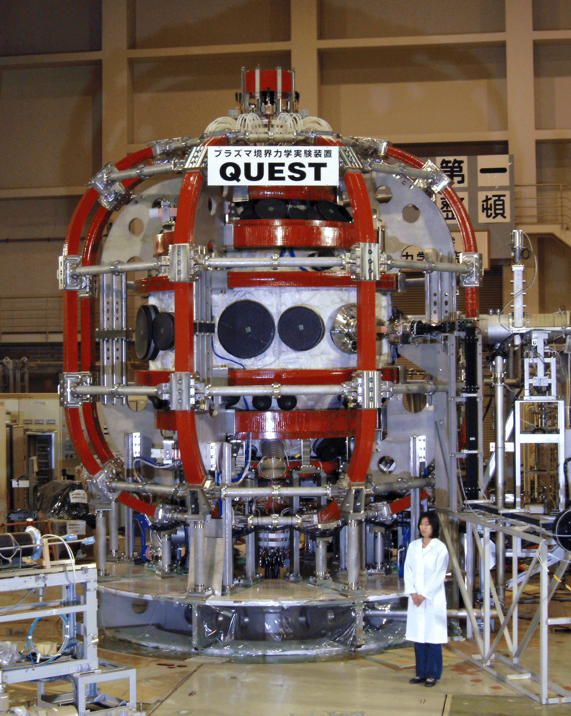
Introduction of QUEST
QUEST (Q-shu University Experiment with Steady-State Spherical Tokamak)
Height : ～6.6 m
Width : 5 m
Vessel Radius : 1.4 m
Vessel Height : 2.8 m
Vessel Volume: 13.5m³
Toroidal field: <0.25T@0.64m
Plasma heating source
2.45GHz : <50kW, CW
8.2GHz : <200kW, CW
8.56GHz : <250kW, CW in preparation
28GHz : <400kW, several sec
OH : 0.2 Vs unipolar operation

Slide 4
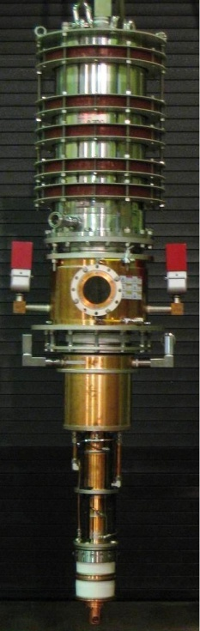
The 28GHz Gyrotron has been Developed in Tsukuba Univ.
28 GHz gyrotron has been developed for Gamma-10/PDX projects at Tsukuba
University.
Design Parameters
From T. Kariya
28GHz 1MW 1s Gyrotorn for PRC(Tsukuba)
Frequency 28GHz Output Power 1MW Pulse Width 1s Output Efficiency 35% (W/O CPD) Beam Voltage 80kV Beam Current 40A MIG triode Cavity Oscillation mode TE_{8,3} Built-in Mode Converter with Output mode Gaussian like Output Window Sapphire Single Disk Aperture diameter 112mm Collector W/O CPD Sweeping coils
Kyushu Univ. HVPS
75 kV / 25 A =>
max. 0.4 MW
Va
Commercial PS
+
MOSFET SW.

Slide 5
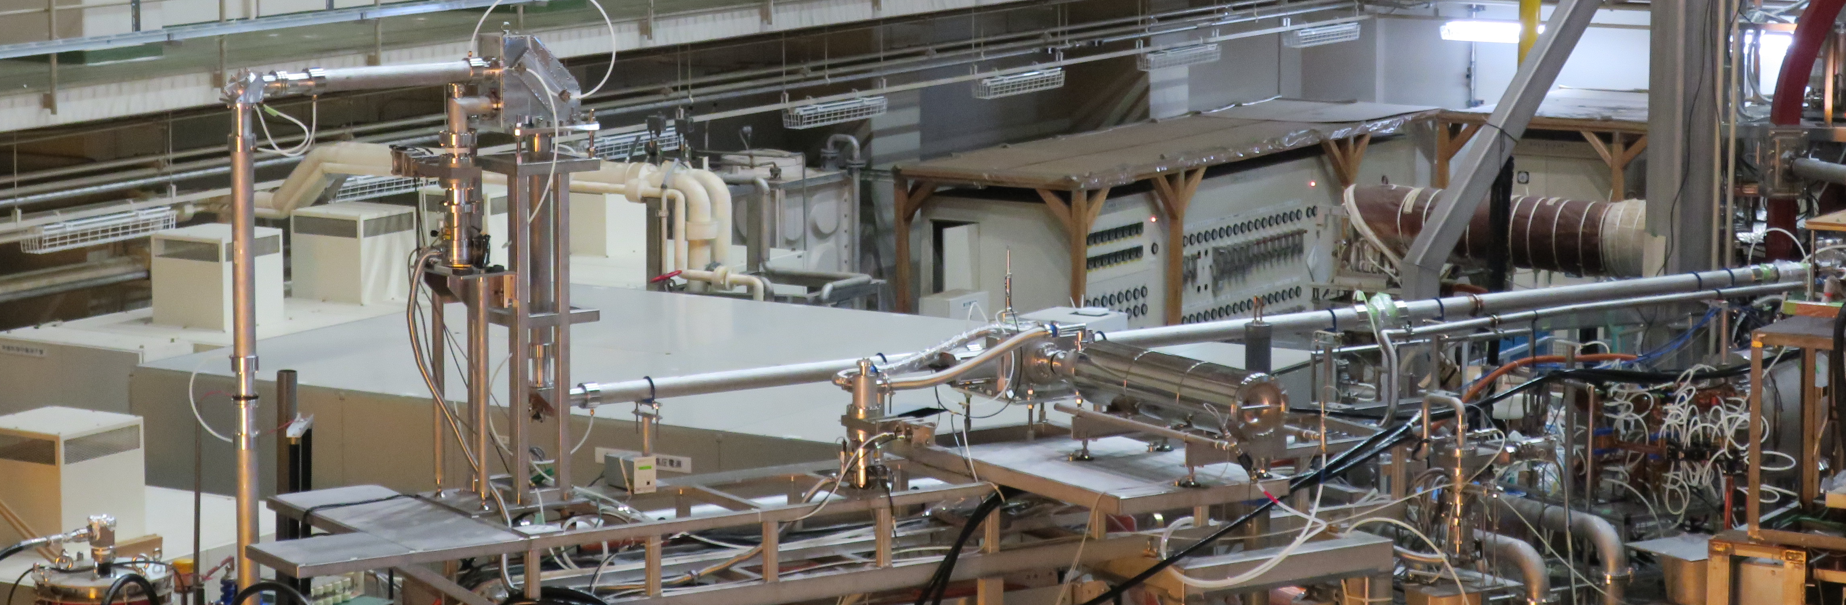
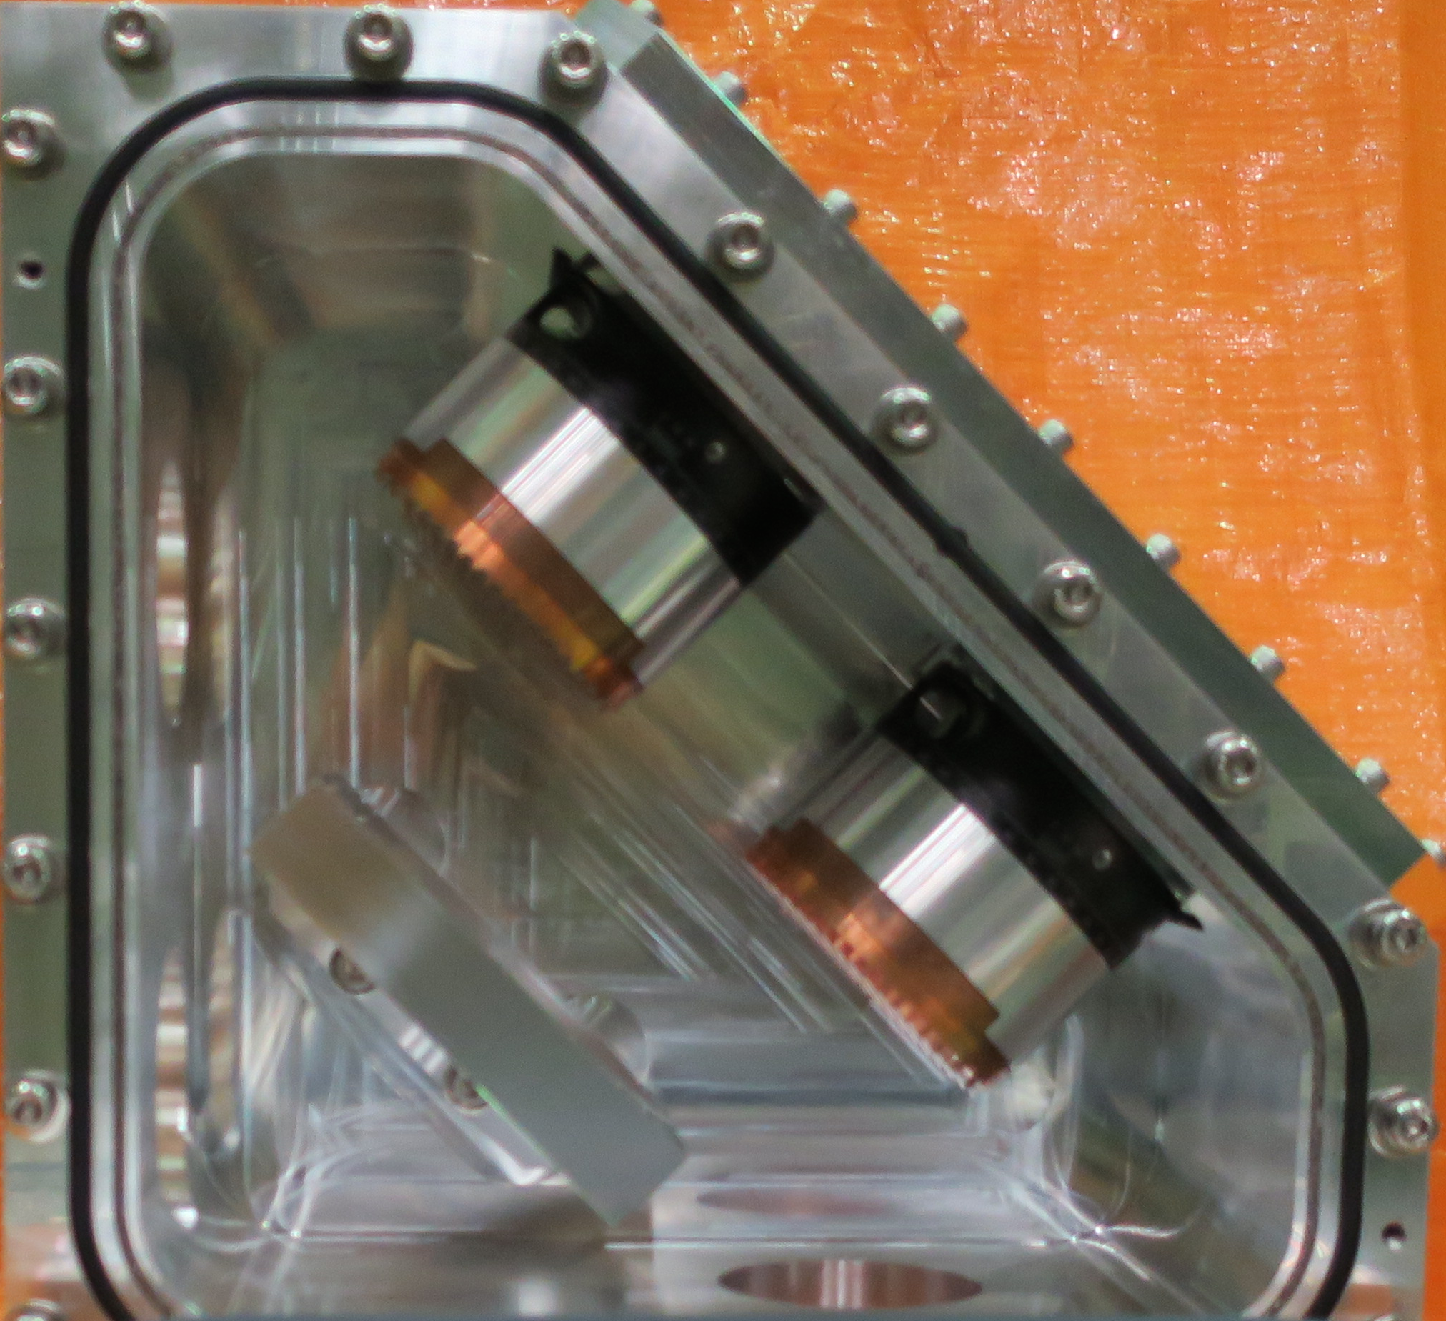
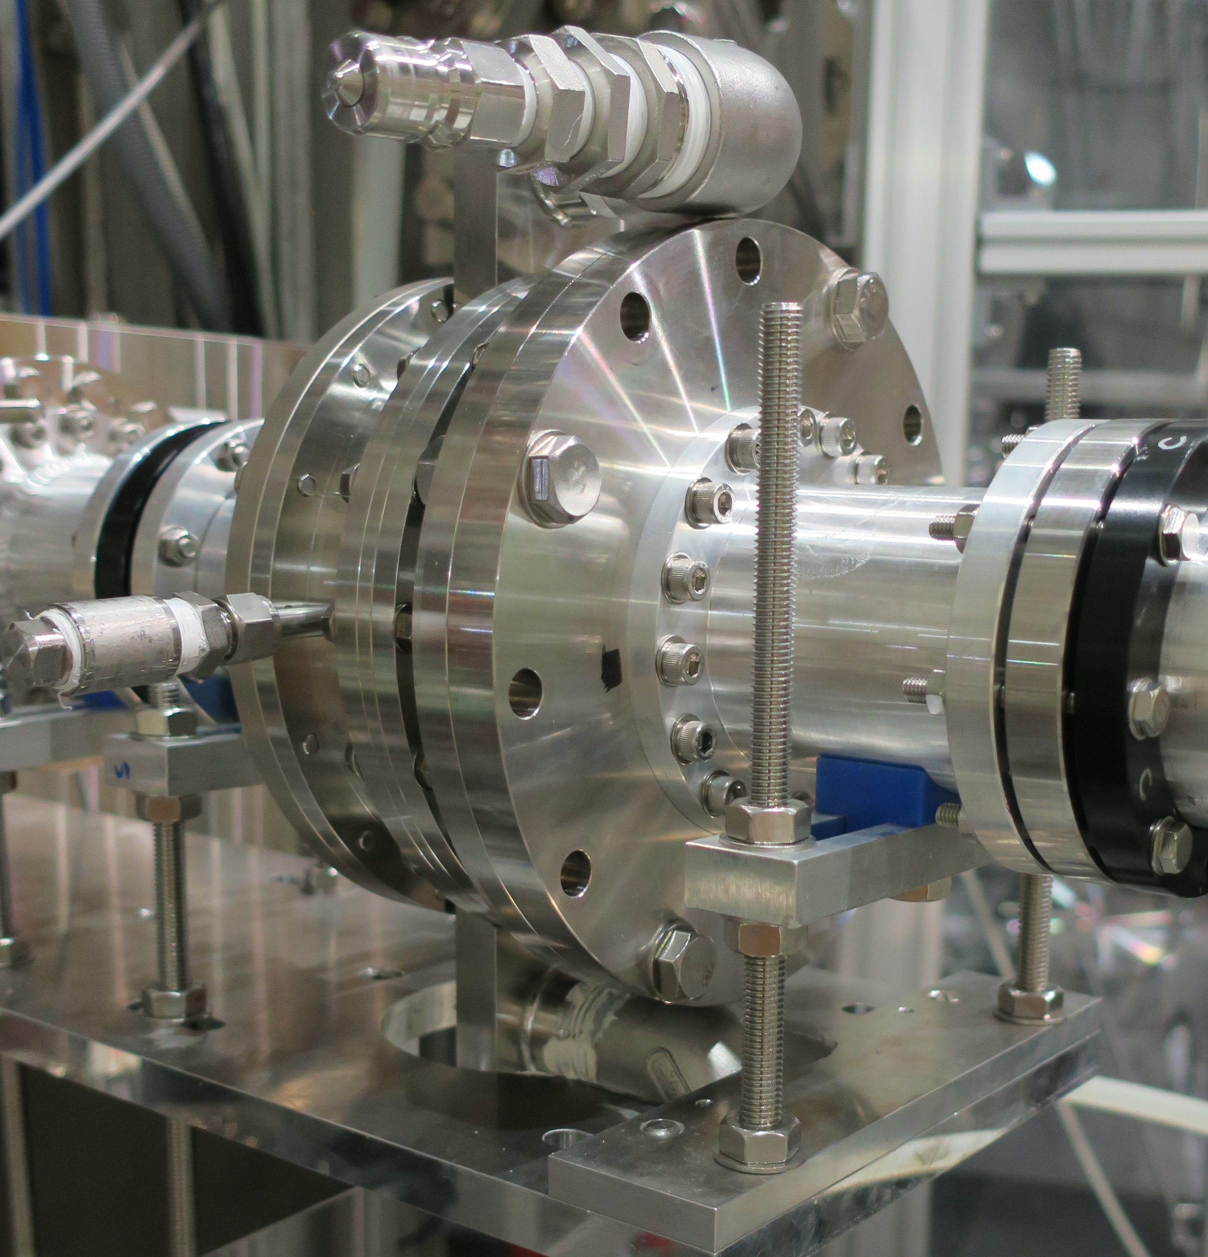
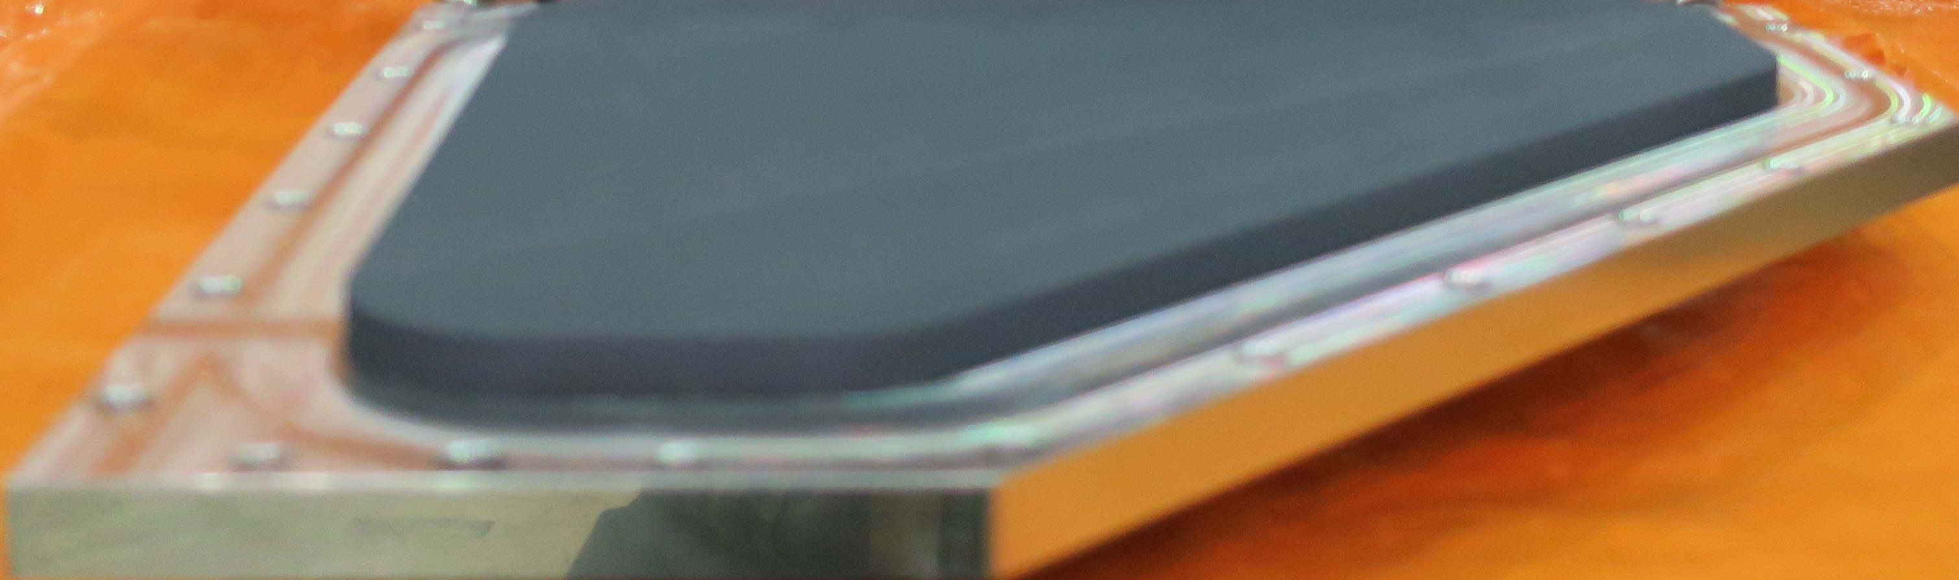
New Transmission Line
(collaborated with NIFS and Tsukuba University)
QO Polarizer System
For CW Operation
Double
Disk Window
WG Switch
TMP
Gyrotron
Arc Sensors
TMP
DL
λ/4
polarizer
2.5-inch CC WG
with Water-cooling Jacket
SS pipe
λ/8
polarizer
Water
Viton
O-ring
Ti02 Coating
Absorber

Slide 6
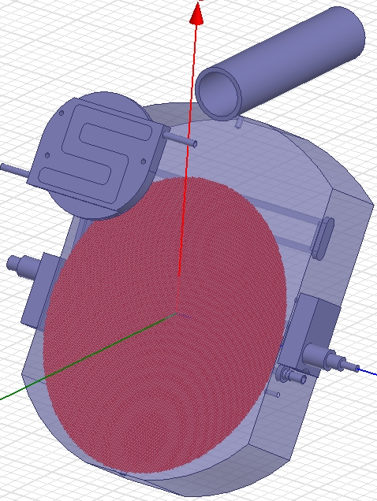
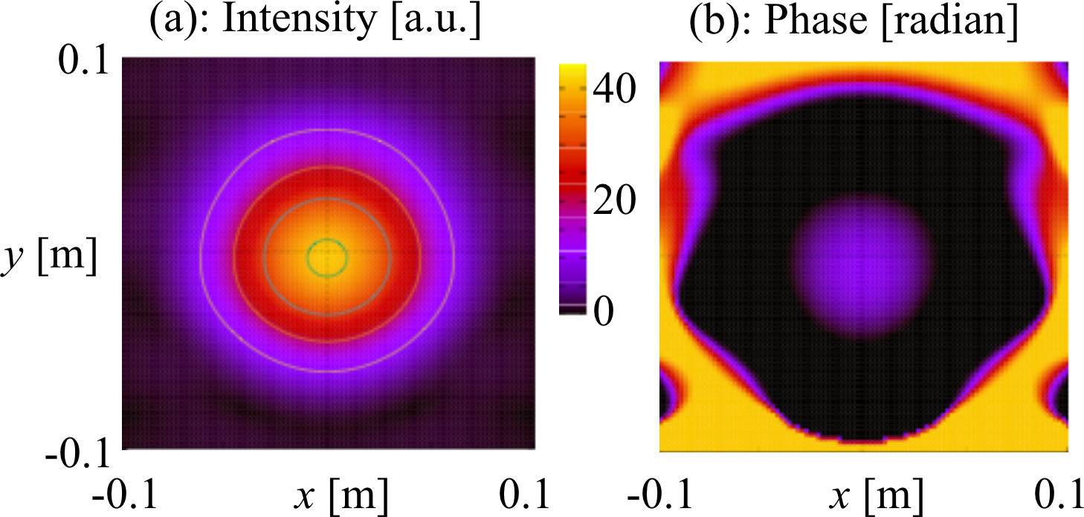
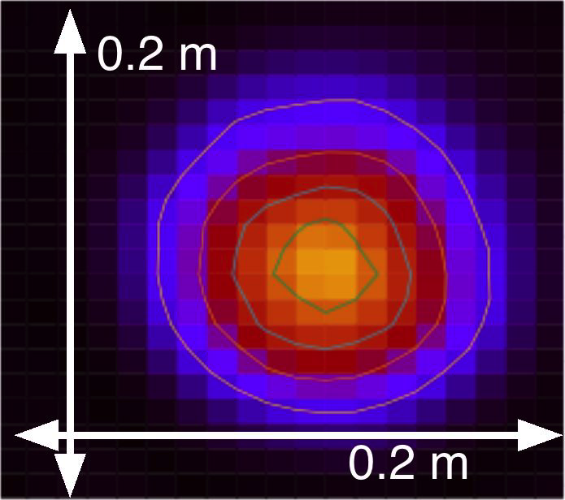
Beam Focusing could be checked in a cold test.
The irradiant HE11 beam was converted to Gaussian
beam and expanded at the 1st mirror. The mirror
was designed on the phase surfaces to be matched
between the incident HE11 and output Gaussian
beams using a developed Kirchhoff integral code.
The 2nd large mirror sharply focused the expanded
Gaussian beam to a narrow beam with a 5-cm waist
size at the ECR layer.
Full Wave
Simulation
Full wave simulation
at the ECR layer for
a launching beam
from a 2.5-inch CC WG.
Low power
test results

Slide 7
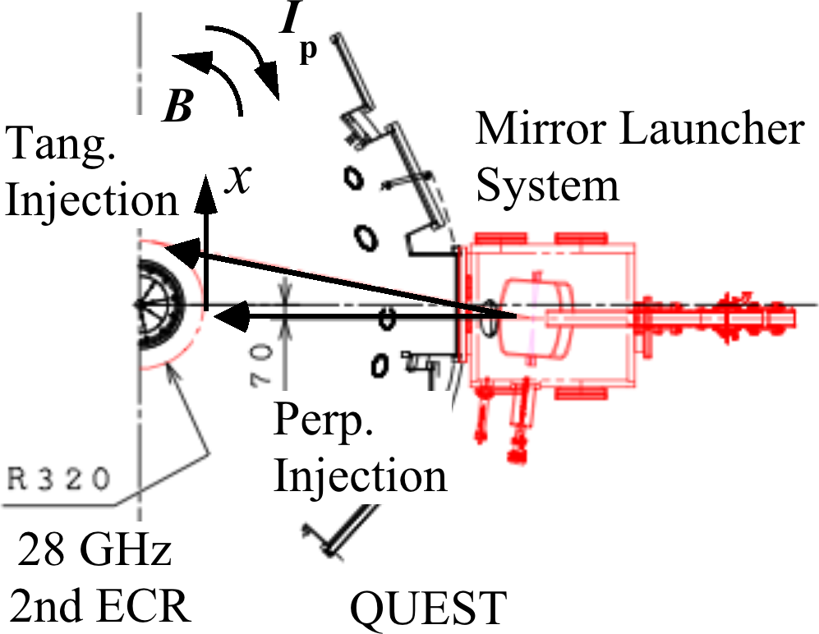
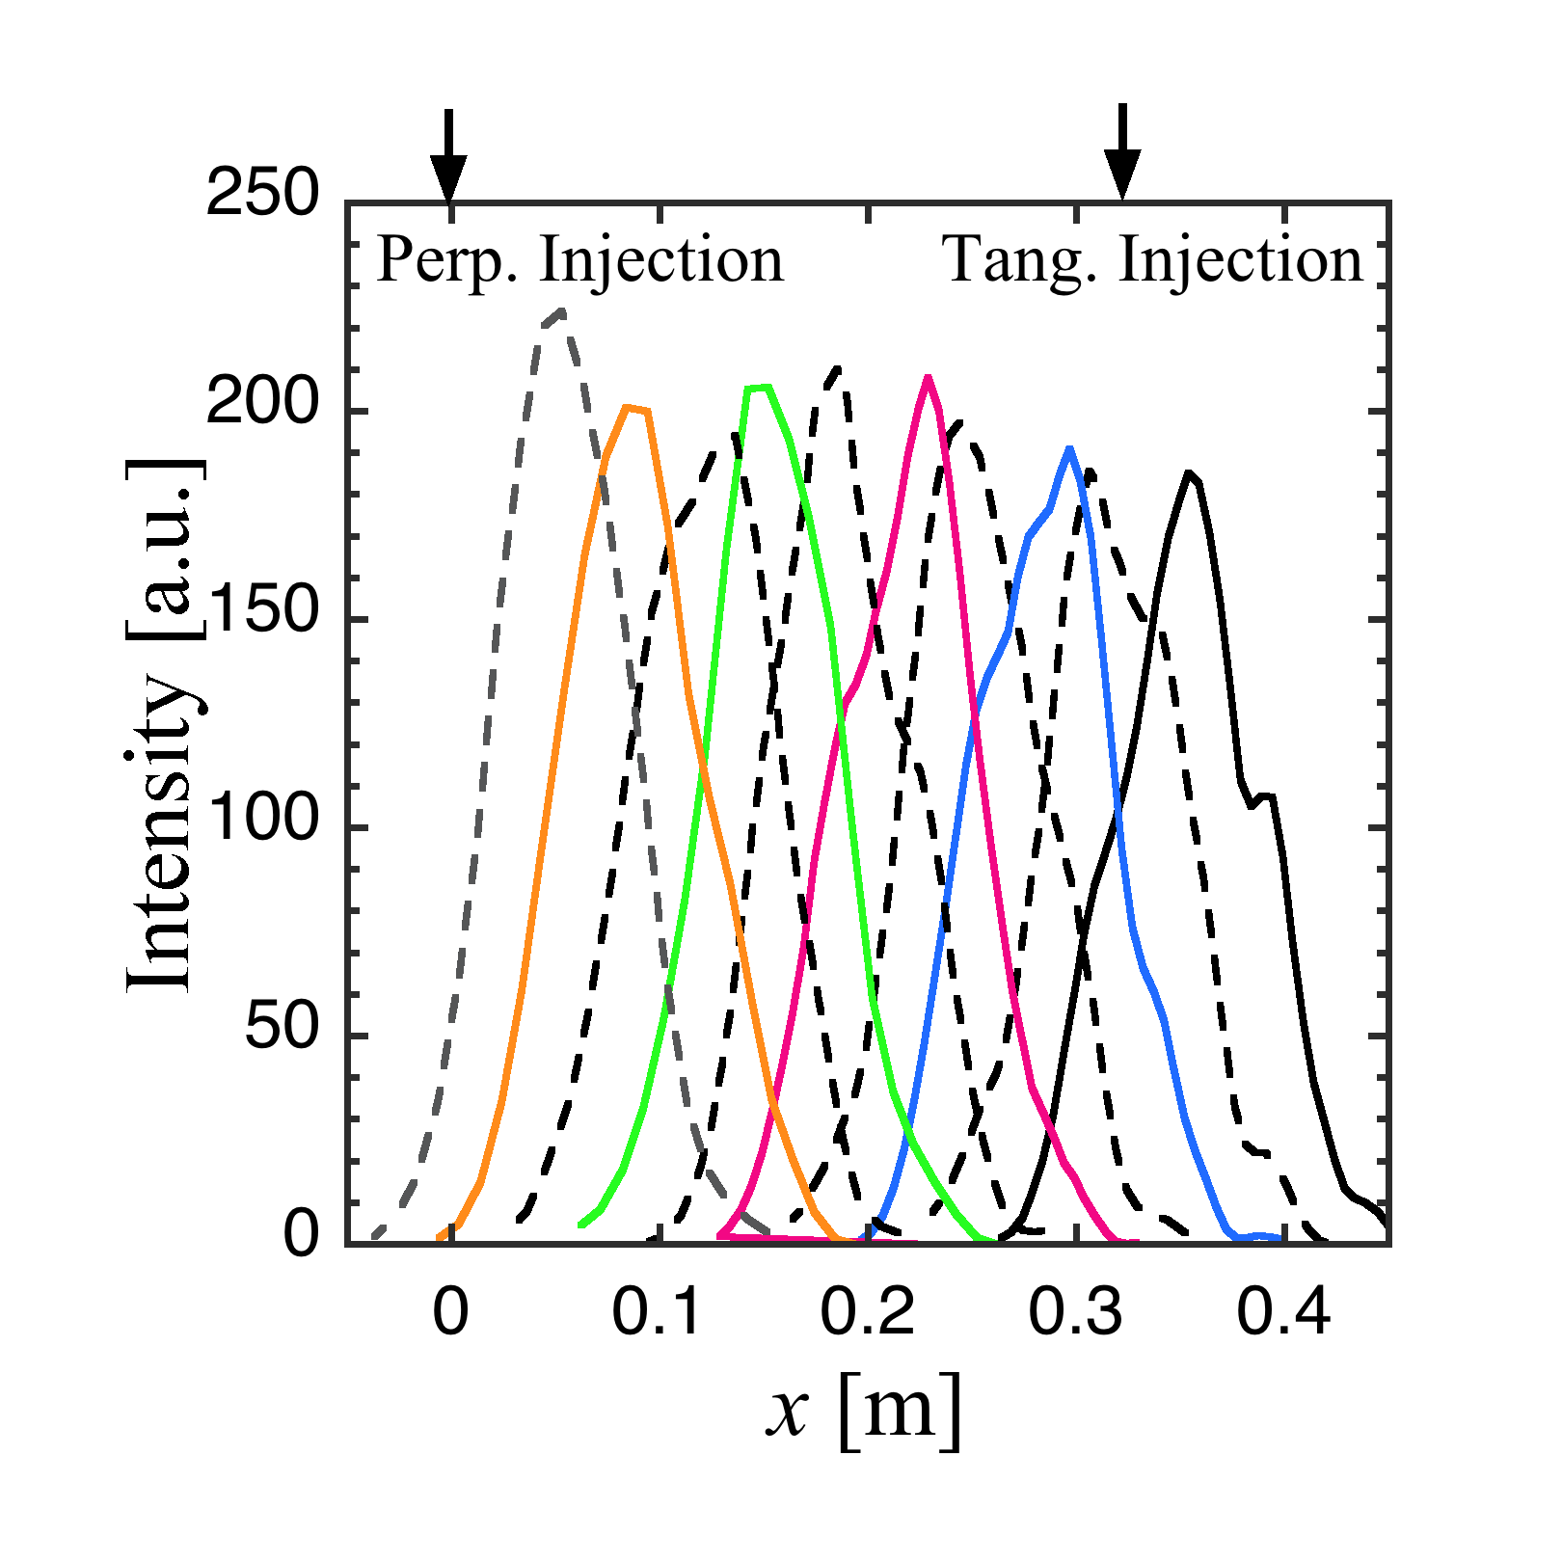
Beam Steering could be demonstrated.
CC WG
1st Convex Mirror
Full Wave
Simulation
2nd Focusing
Mirror
The beam can be steered mainly in the
toroidal direction to have the refractive
parallel index N// from 0 to 1.
Low power
test results

Slide 8
Summary of 2017 Spring/Summer Campaign
Pulse duration
Plasma current
3600sec ＥＣＲ
ＥＣＲ
#35682 86.4kA

Slide 9
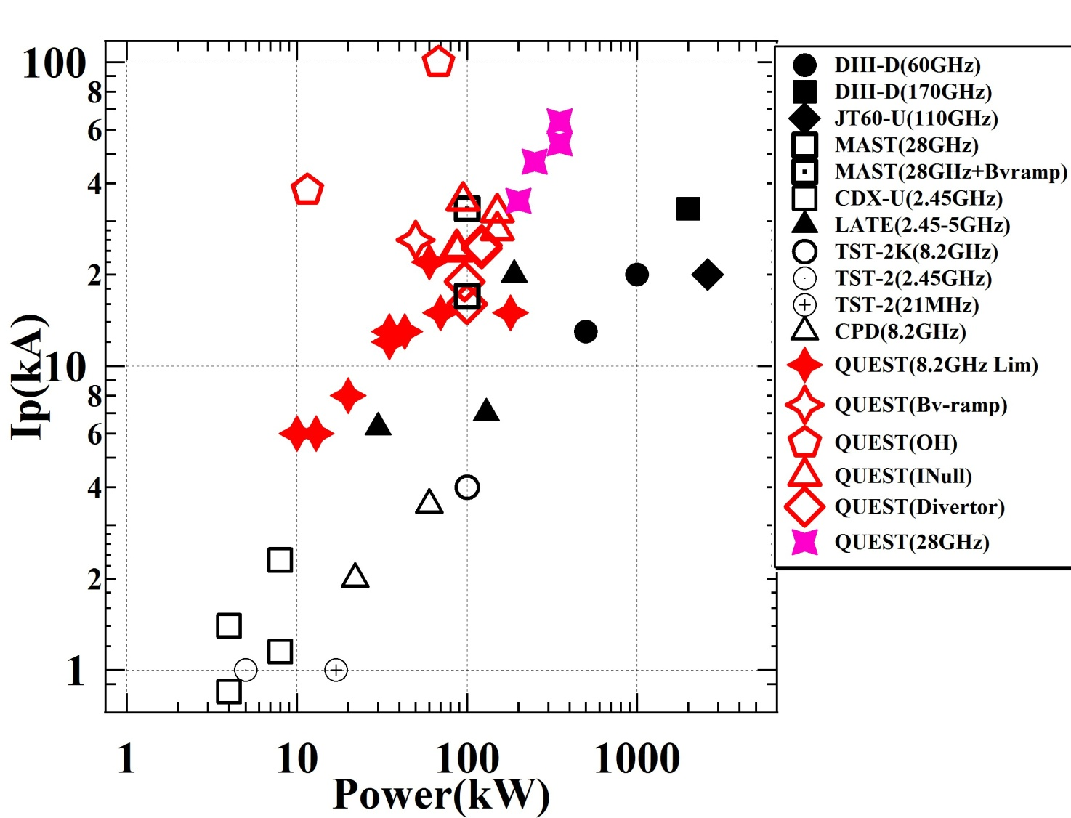
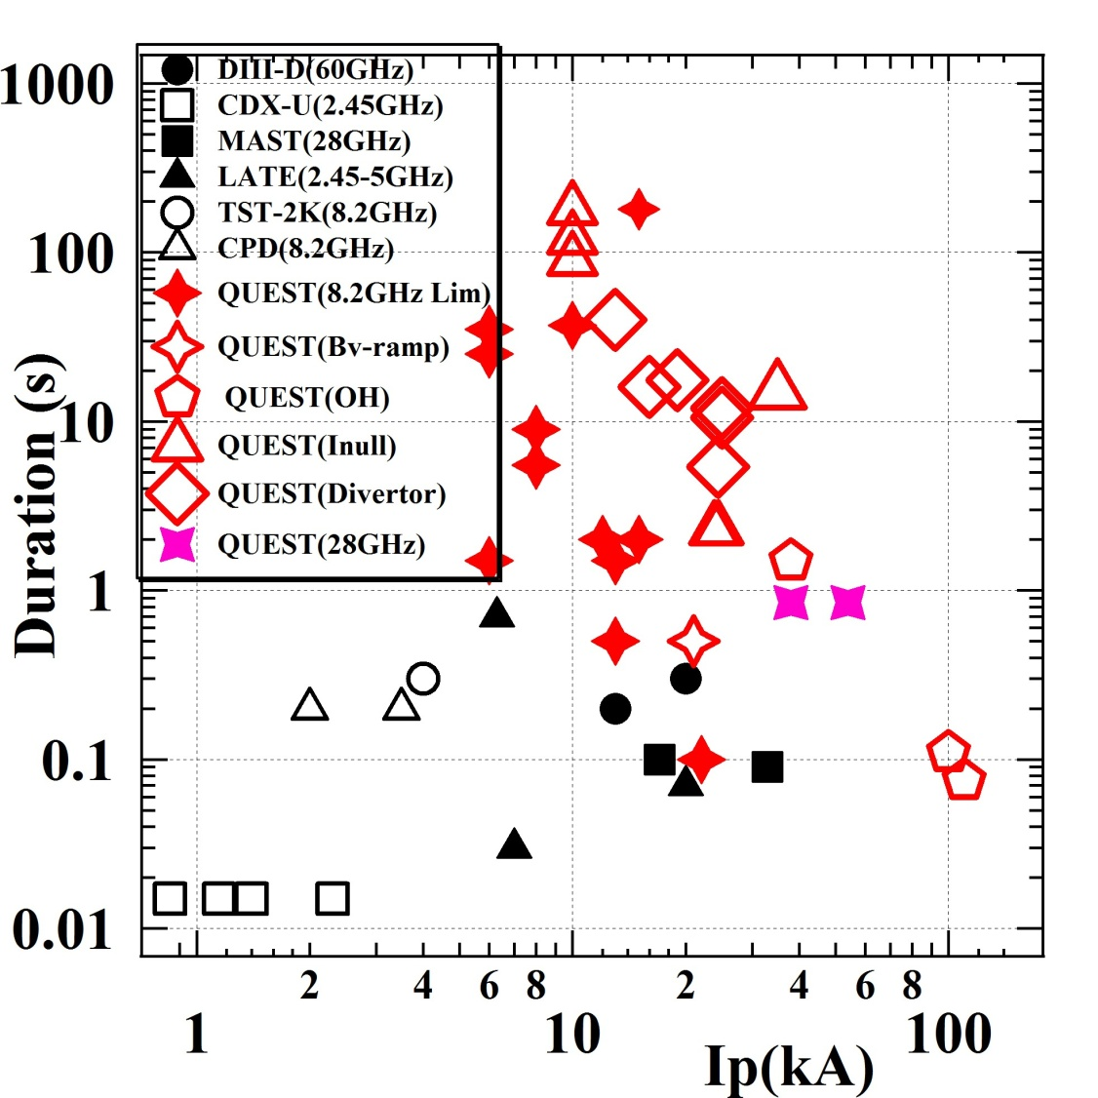
Present Operation regime and target in QUEST
Target

Slide 10
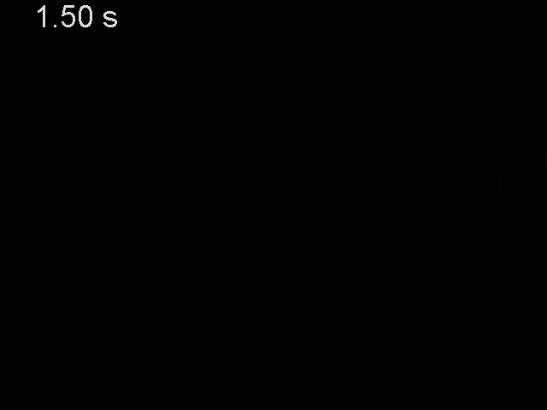
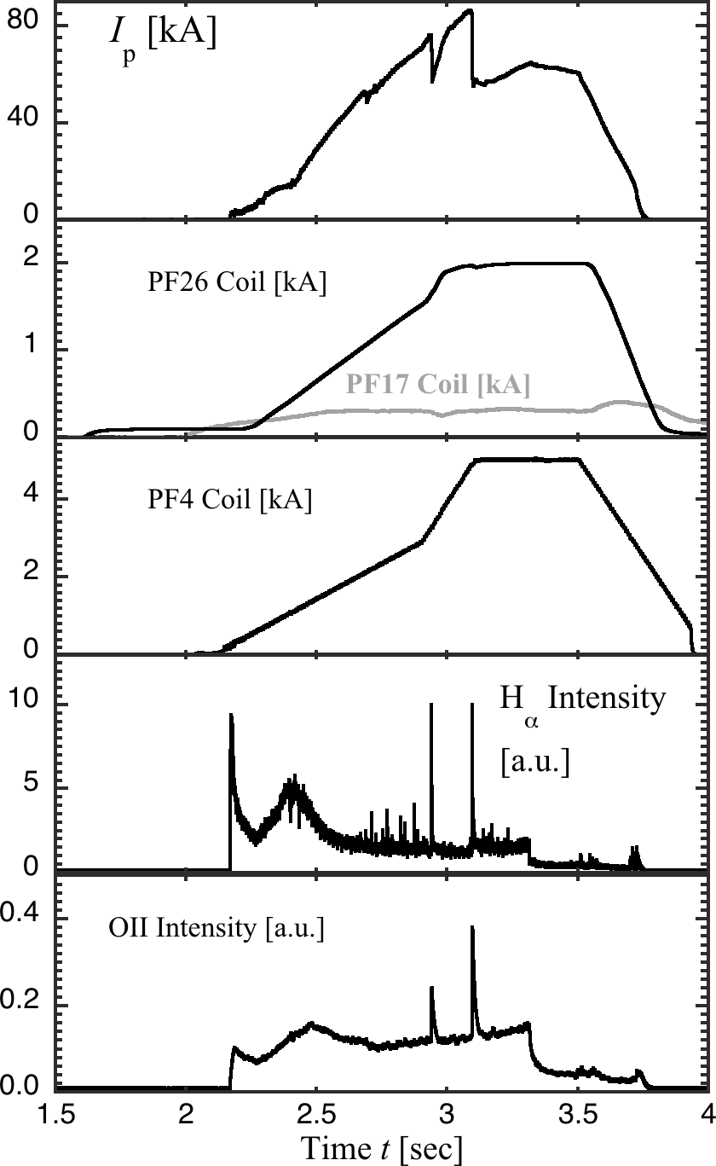
Visible camera image of I_{p} Ramp-up Exp. with the 28GHz ECH
28 GHz 250 kW

Slide 11
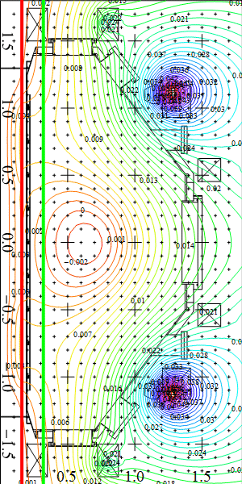
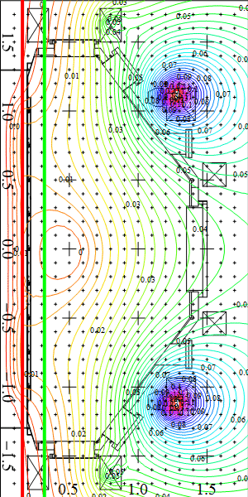
Plasma current rapidly increased with HX connts of more than 40keV
PF26:0.59kA
PF352:0.22kA
PF4(1-2A-3-CC1):1.3kA
Ip=-15kA
Transition

Slide 12
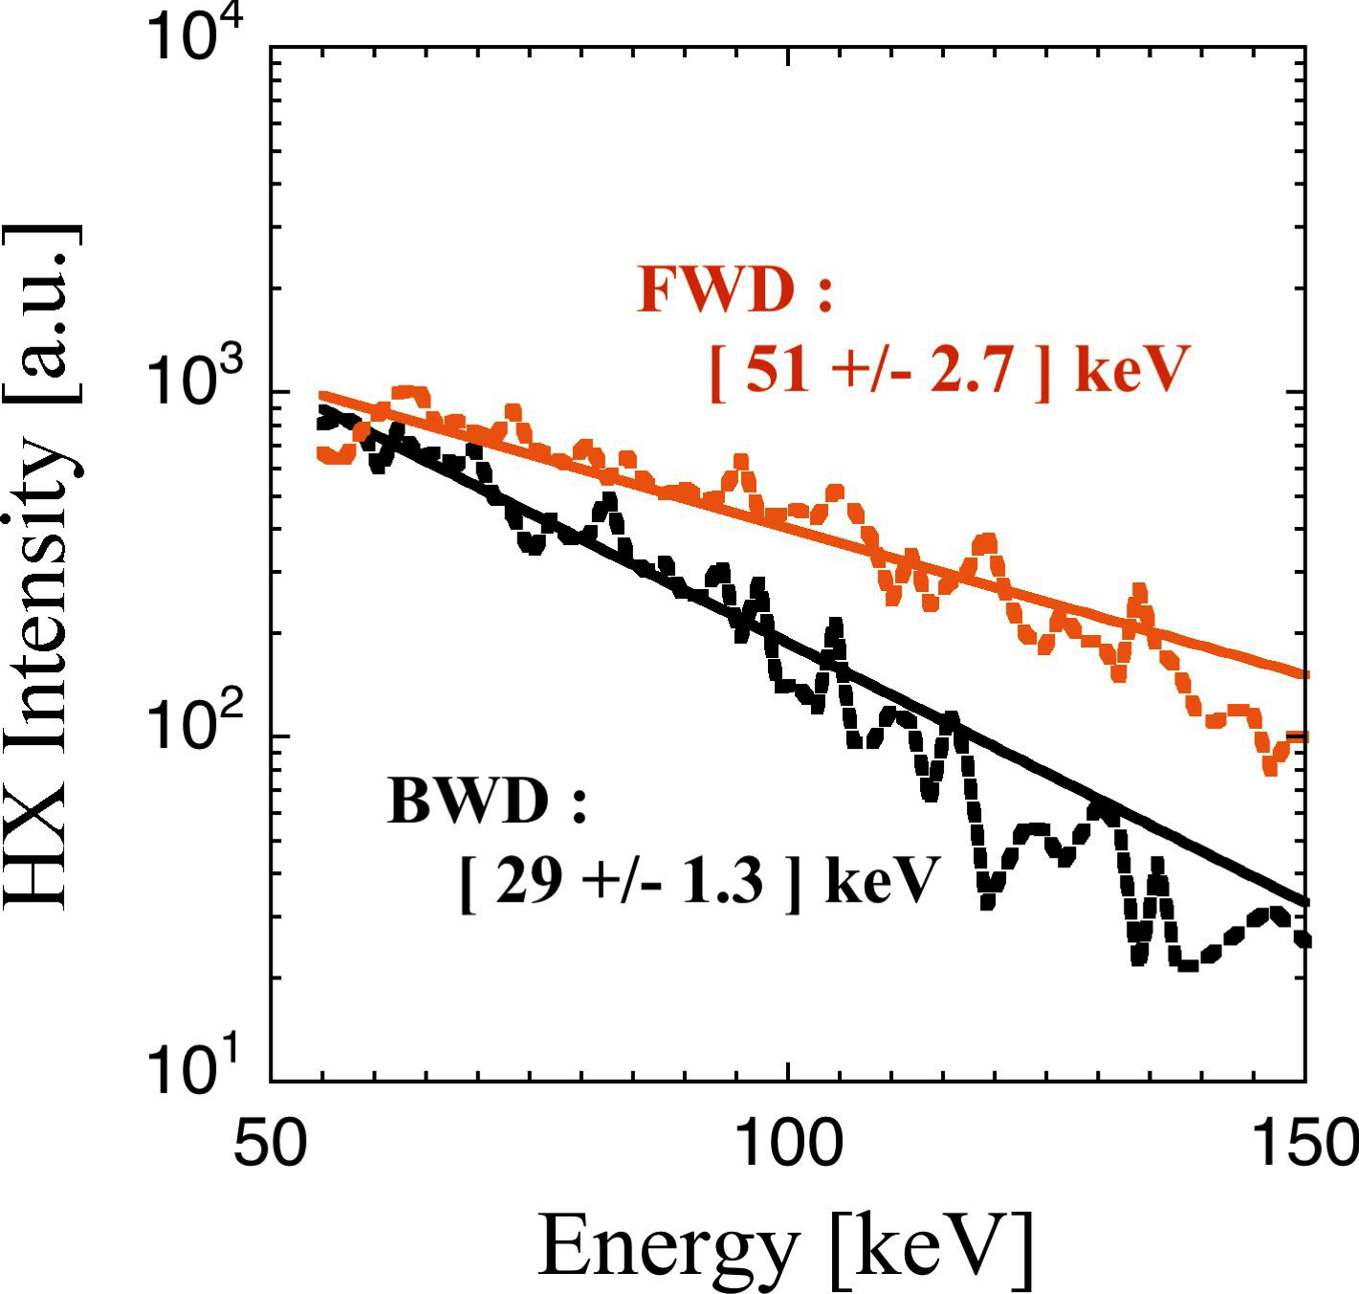
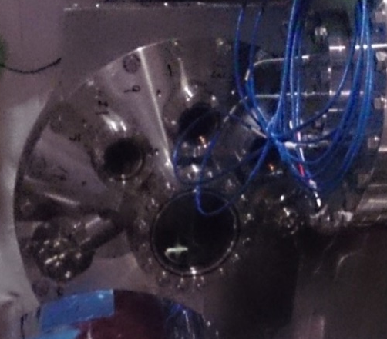
HX measurement indicates presence of energetic electons during current ramp-up.
28GHzRF 2nd
Resonance layer
(R ≈ 320 mm)
I_{p}
e⁻
FWD
QUEST
TOP VIEW
Detector (CdTe)
BWD

Slide 13
Making an strong gas puff from the center stack prevented from plasma current start up.
Gas puff

Slide 14
Injected RF is much easier to couple with higher temperature electron around 2nd harmonic ECR. But single path absorption cannot be expected.
The first path absorption of 17 % can be expected, when density is 1 x 10¹⁷m⁻³.
The first path absorption is almost proportional to Te.
Calculated results by ＧＥＮＲＡＹ
Ｘ mode oblique injection N//~0.8
Calculated single path absorption is approximately proportional to electron temperature and density when the Ray trajectory of 28GHz does not inflect.
We assume Bulk: 1×10¹⁸ m⁻³, 10eV
Tail: 1×10¹⁶ m⁻³, 100keV.
Density 10⁻²; Temperature 10⁴ leads to 10² absorption.
The first path absorption is almost proportional to ne except near cut-off density (3 x 10¹⁸m⁻³).
When the energetic electron is present in the target plasma, injected RF is likely to deposit on energetic electrons even in the multi-reflection dominant condition.

Slide 15
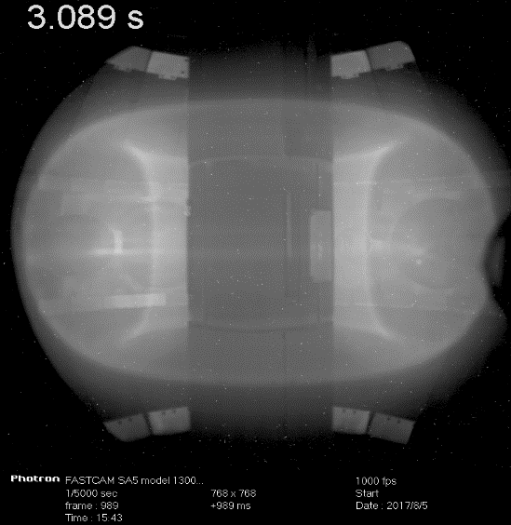
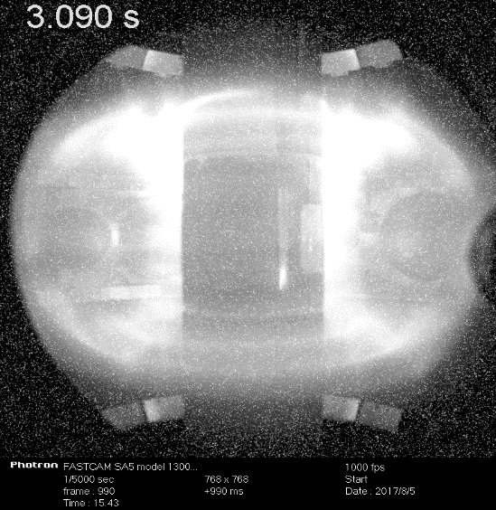
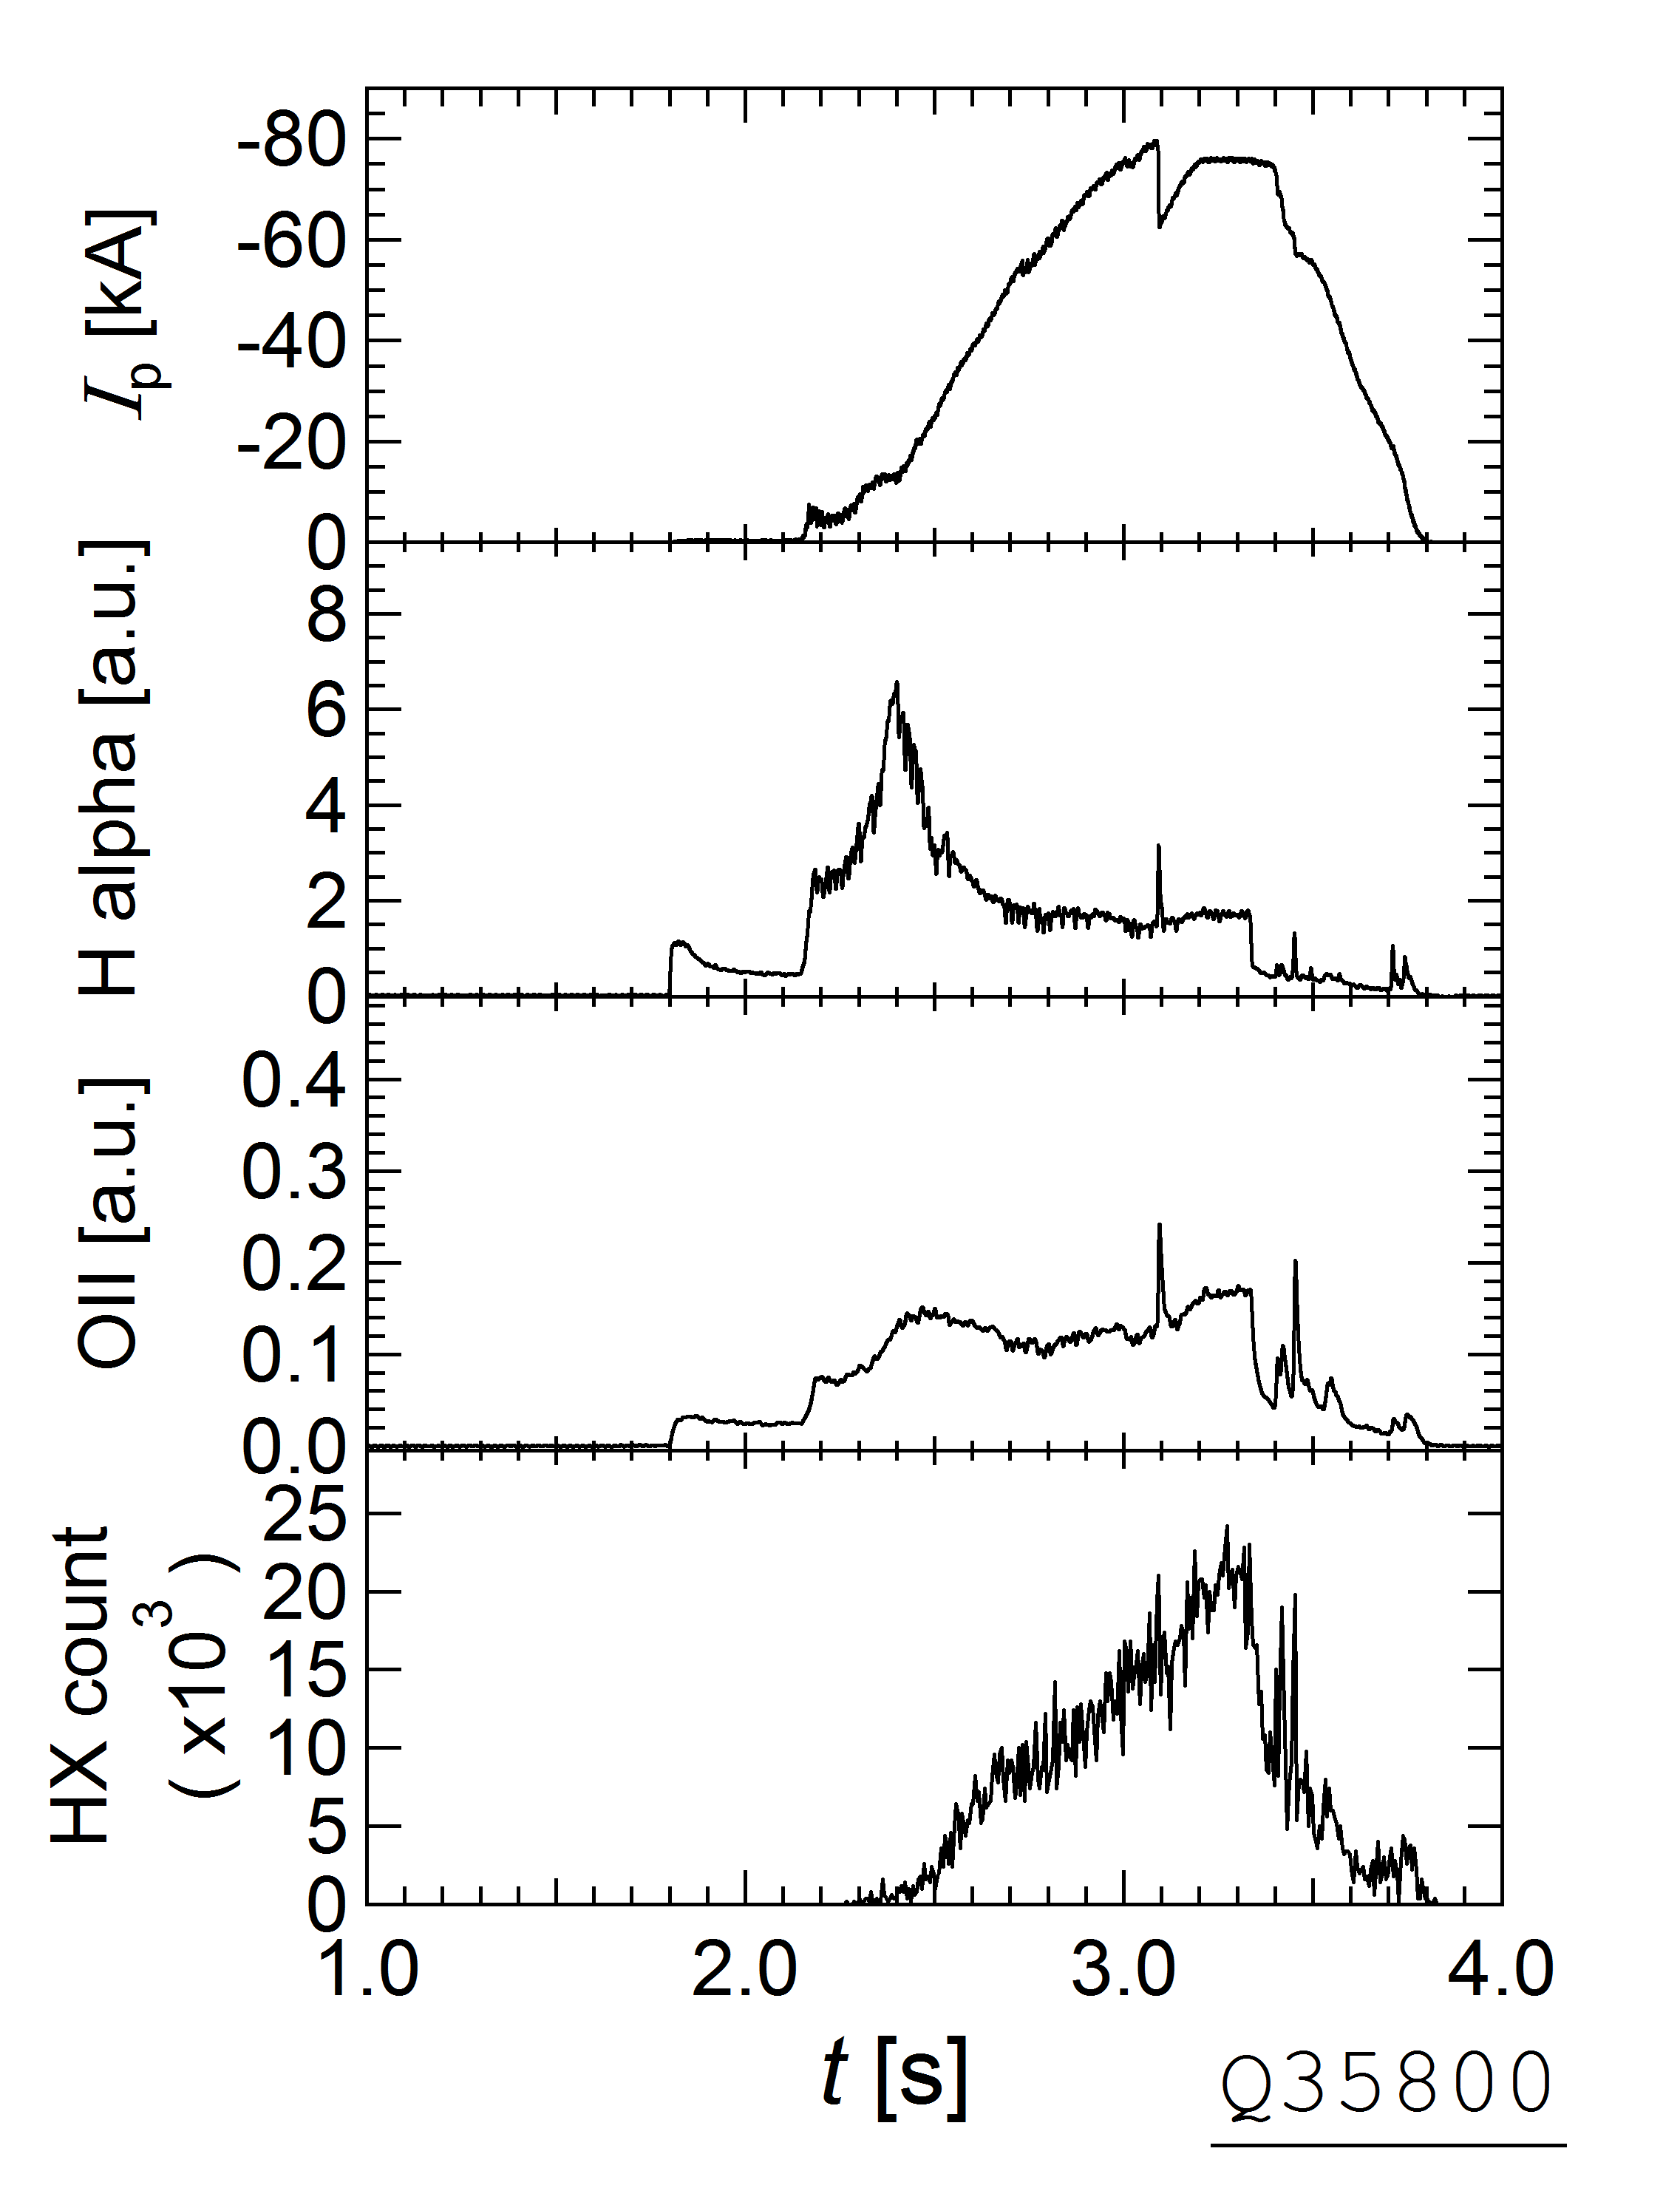
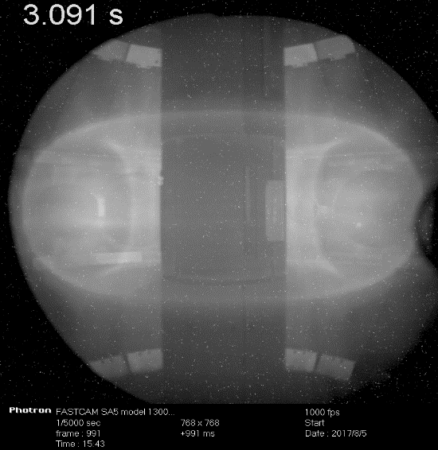
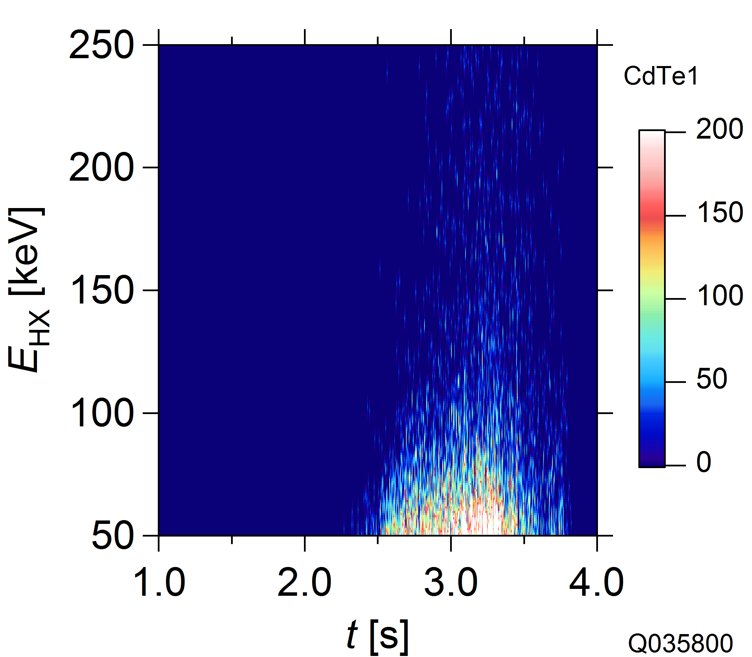
Spike of Ip prevented from increasing Ip
8.2
28
3.09 s
3.09 s

Slide 16
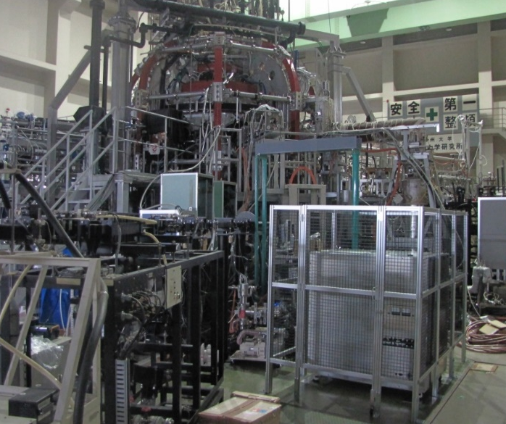
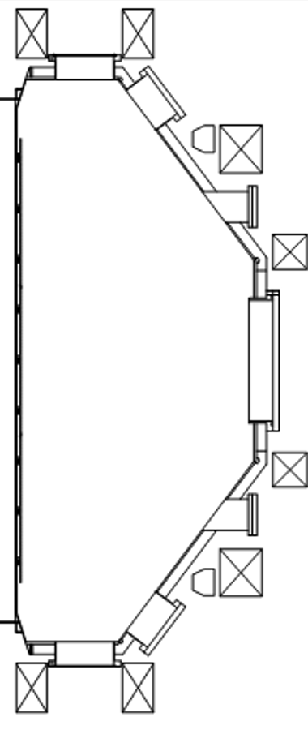
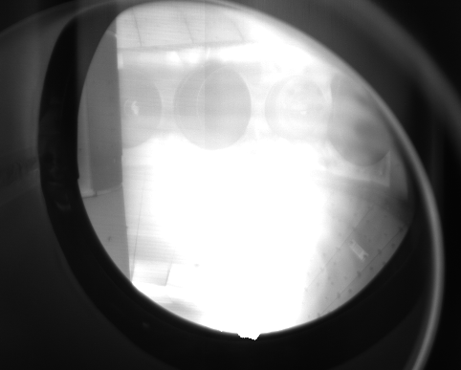
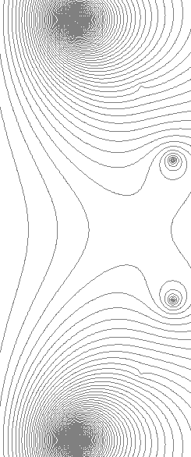
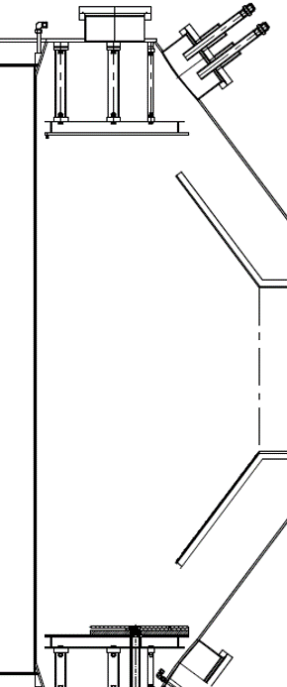
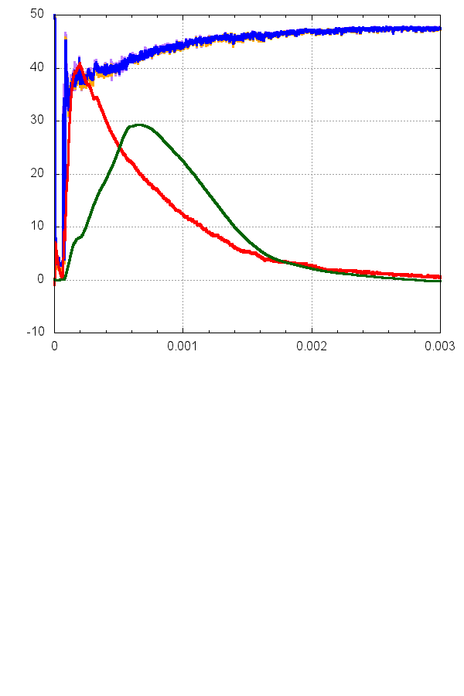
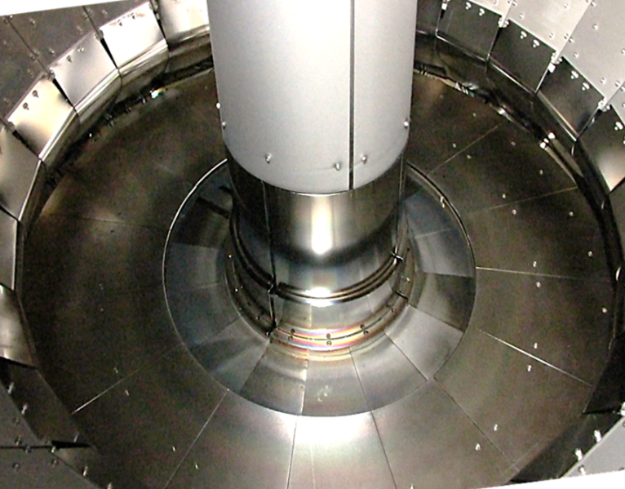
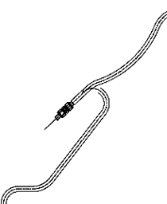
Progress of CHI experiment project in QUEST
Introduced CHI systems
Result of first CHI experiment
PF3-1
PF3-2
QUEST
PF2
CHI Capacitor Bank Power supply
CHI
Electrodes
PF1
Ground
(Conducted to vessel)
CHI electrodes
0
50
Bias
(Isolated to vessel)
PF7
Electrode voltage
-0.4
40
Injector current
-0.8
30
PF6
CHI Ground
Electrode
[kV]
-1.2
Toroidal current
20
[kA]
CHI
Gas injector
CHI Bias
Electrode
-1.6
10
PF5-1
PF5-2
Cramic
Break
-2.0
0
− Capacitor +
Bank
Lower
End-plate
-2.4
-10
0
1
[ms]
2
3

Slide 17
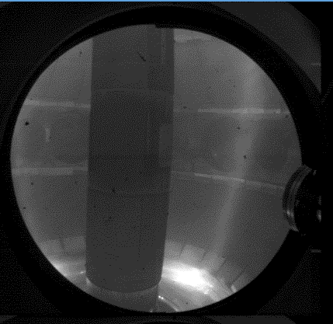
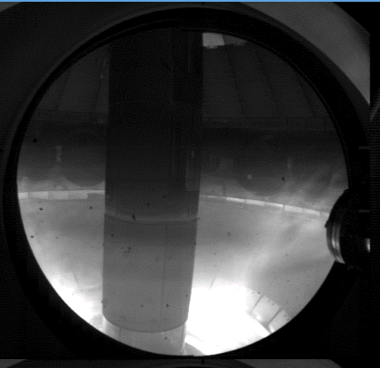
Progress of CHI experiment project in QUEST
2.
3.
4.
・In the PF configuration of the picture 2
The plasma evolved up to the top wall and the toroidal current increased up to 48kA.
However, this configuration is not suitable for attaining flux closure.
・In the PF configurations of the picture 3 and 4
In picture 3, current path is to the outer anode plate as expected.
As toroidal current increases, the discharge appears to contact the upper wall plates,
as shown in picture 4.
Improved diagnostics, vertical field control, and performance of capacitor bank to be implemented in future to improve plasma evolution.

Slide 18
Plan of high field side injection of 8.2GHz for EBW plasma current start-up to make higher density plasma
Presented by Mr. Hatem in this conference

Slide 19
Main target of SSO on QUEST is particle balance
Tokamaks operating long pulses have to overcome and control several plasma-core and plasma-wall interaction time scales
MHD
ITER pulses
400s – 3000s
E. conf
Heat loads
JT-60SA
100s
LHD
48m
TRIAM-1M
5h16m
Part + Imp
QUEST
2h14m
Cur. Diff.
Retention
JET
10s
Erosion/deposition
10⁻³ | 10⁻² | 10⁻¹ | 1 | 10¹ | 10² | 10³ | 10⁴ | 10⁵
[s]

Slide 20
Recent progress on SSO in QUEST
SSO is the most important issue to realize fusion power plant. Particle balance including tritium retention is crucial, but few experiments were executed.
Hot wall since 2015

Slide 21
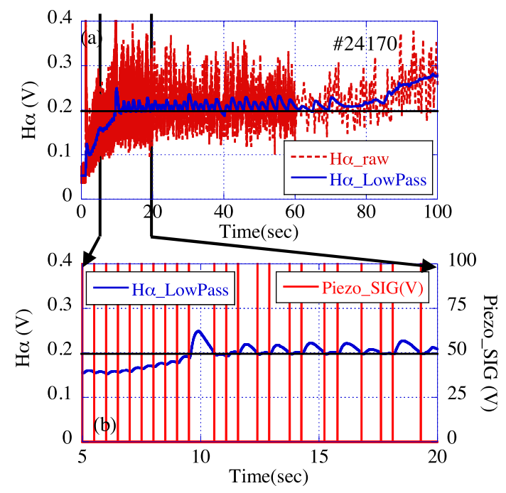
Particle fueling feed-back control for SSO
--- Two types of actuators can be used for feed-back control referring to Ha signal. ---
Piezo valve control by changing the duty of repetitive gas puff.
Total H Flux to the wall is expected to be proportional to Hα signal level.
When Ha level is kept constant, change of wall pumping rate must be caused by net emission of H₂.
Mass flow control by changing the flow rate of fueling with PID loop
Maximum fueling rate
Gas puff:
q_{fuel} = 2.0×10²¹ Hs⁻¹
Mass-flow:
q_{fuel} = 1.7×10¹⁹ Hs⁻¹
M. Hasegawa, et al., Fusion Engineering and Design, 112 (2016) 699-702
Fig. 5. Gas fueling control with monitoring Hα. (a) Hα signal filtered by a digital low-pass filter (solid line) and raw signal (dashed line), (b) Hα signal widened by time and the voltage applied to the piezo valve.
Hα signal is kept at the target value
by decreasing the flow rate gradually.

Slide 22
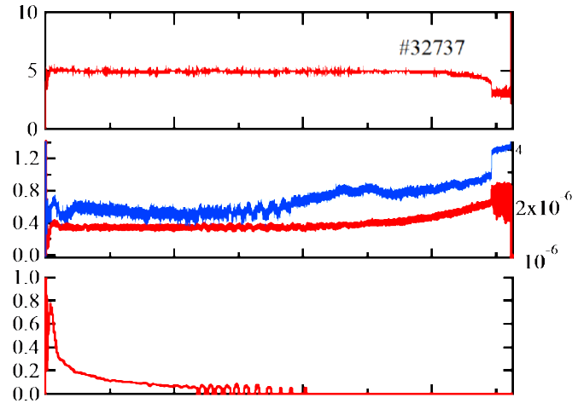
Plasma discharge of 1hour 55min
Phase I
Phase II
Phase III
Gas fueling is feed-back controlled with mass flow controller to keep Hα constant.
Temperatures of hot wall and vessel wall are kept 120℃ constant.
Plasma current is measured with hall sensors.
Ip_{hall} (kA)
Hα (a.u.)
H₂ pressure (Pa)
Fueling rate is decreased gradually to keep Hα constant, and it finally become zero.
After that, Hα increases gradually, and finally plasma discharge is terminated spontaneously.
H₂ flux (ml/min)
0
2000
4000
6000
Time (sec)

Slide 23
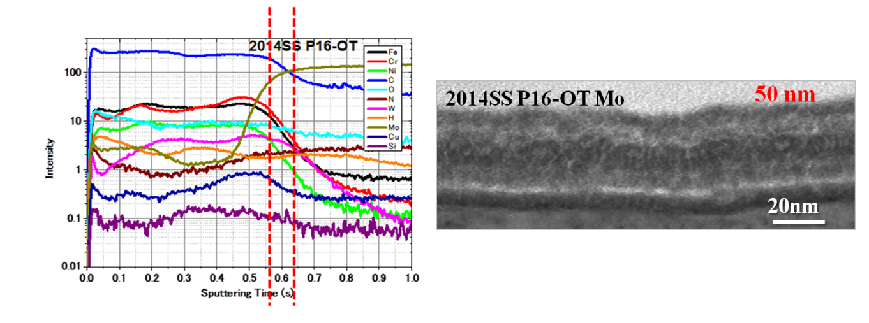
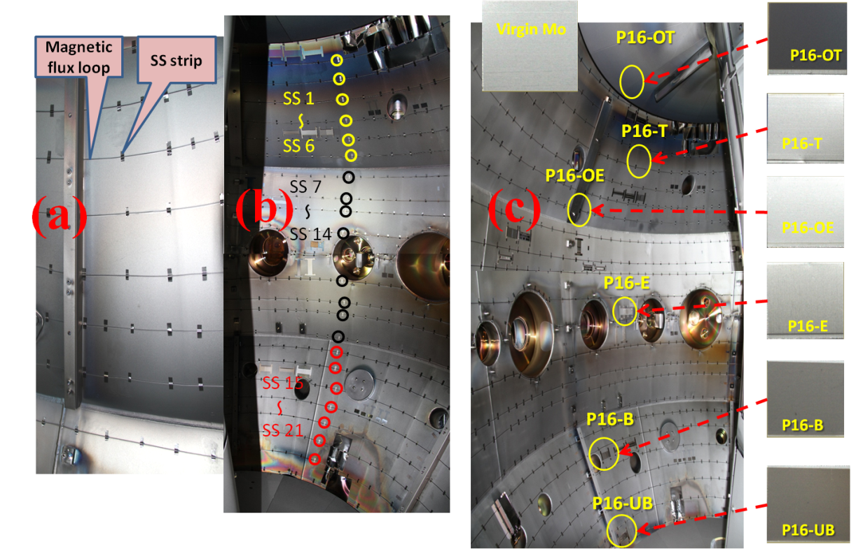
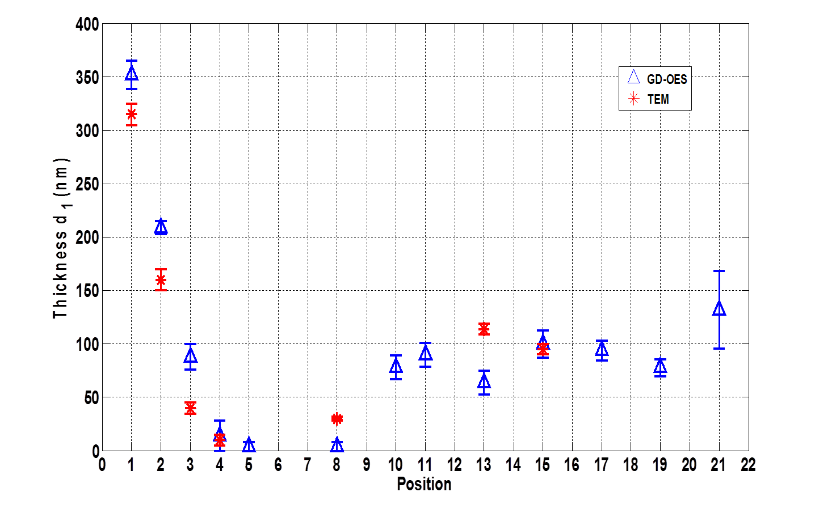
Investigation of Plasma facing wall with TEM, Ellipsomerty and Colormetry
Photo of inner vessel and specimen for TEM and Ellipsometry before installation of the hot wall
Component and thickness of plasma-induced thin film on the surface
Thickness distribution
Top
Bottom
100nm
Published to RSI, Z.Wang et al.

Slide 24







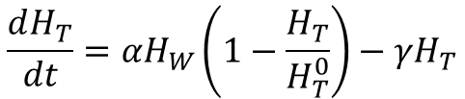




A wall model with hydrogen barrier (HB) is proposed
In this model, H atoms don’t move from deposition layer to SUS substrate and vice versa due to high chemical potential.
H_{w} and H_{T} are total numbers of H atoms in deposition layer.
$$\frac{d\left(H_{W}+H_{T}\right)}{dt}=Γ_{in} S−\frac{k}{S d_{R}^{2}}H_{W}^{2}$$
Release due to recombination
Influx to the deposition layer
$$\frac{dH_{T}}{dt}=αH_{W}\left(1−\frac{H_{T}}{H_{T}^{0}}\right)−γH_{T}$$
Trapping
De-trapping
$H_{W}$ :the number of H dissolved in wall material
$H_{T}$ :the number of H trapped in defects
$H_{T}^{0}$ :the upper-limit number of $H_{T}$
$Γ_{in}$ :net influx per unit area into wall material
$S$ : surface area
Distance from wall surface
$k$ : surface recombination coefficient of H atoms
26th IAEA Fusion Energy Conference, EX/P4-49, K. Hanada, et. al.
To be published in Nuclear Fusion, K.Hanada, et. al.
$d_{R}$ : thickness of deposition layer
$α$ : H trapping rate
$γ$ : H de-trapping rate
Advanced Fusion Research Center

Slide 25
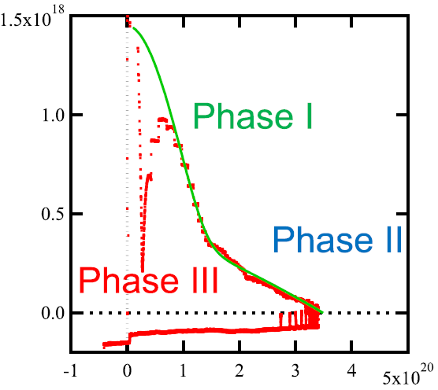
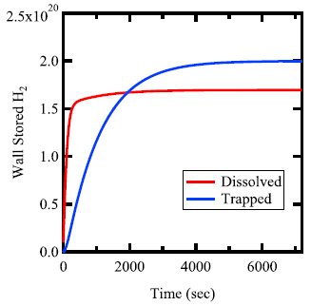
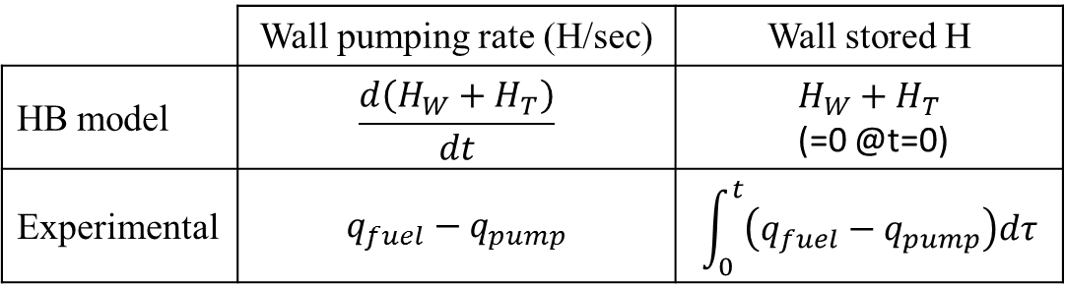
Comparison between experimental results and HB model
 | Wall pumping rate (H/sec) | Wall stored H
HB model | $$\frac{d\left(H_{W}+H_{T}\right)}{dt}$$ | $$H_{W}+H_{T}$$ (=0 @t=0)
Experimental | $$q_{fuel}−q_{pump}$$ | $$\int_{0}^{t}{\left(q_{fuel}−q_{pump}\right)dτ}$$
HB model
Phase I
The wall-stored H gradually increase with the decrease of wall pumping rate.
In phase III, wall release starts with the decrease of wall stored H.
Total
Wall pumping (H₂/s)
Ionization
Phase II
CX
Phase III
Wall stored H

Slide 26
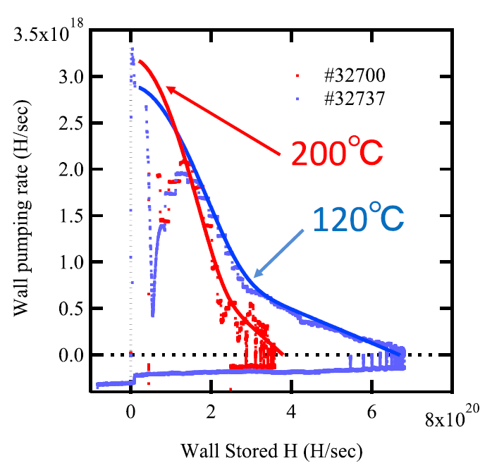
Hot wall can modify wall pumping rate and H recycling rate

Slide 27
Future Plans
Hot wall + water cooling
SSO of more than 100kA plasmas
CW 28 GHz system

Slide 28
Summary
The plasma current start-up without fundamental ECR could be demonstrated by 28 GHz microwave injection on QUEST. The plasma current up to 86 kA could be achieved with 250kW injection (0.35A/W) which is in large part responsible for the improvement of transmission line.
Coaxial helicity injection has been executed and reliable plasma breakdown could be observed. Toroidal current of up to 48 kA could be achieved, but closed flux surface was formed.
High field Injection of 8.2 GHz is planning to excite EBW effectively.
Feedback control of Hα is effective to achieve long duration discharge and three phases of particle balance could be observed.
Plasma-induced film on the surface of plasma facing wall has been investigated and the film Plays an essential role in particle balance.
Hydrogen barrier model is proposed to explain the progress on particle balance in the long duration discharge. In phase I and II, the model could express the progression.
The Hot wall has the possibility to control the wall pumping and the hydrogen recycling.

Slide 30
HB model agrees well with experimental results, excluding Phase III.
The number of trapped particles is saturated with longer time constant.
HB model
Phase I
Wall pumping (H₂/s)
Phase II
The wall-stored H gradually increase with the decrease of wall pumping rate.
In phase III, wall release starts with the decrease of wall stored H.
Phase III
Wall stored H

Slide 31
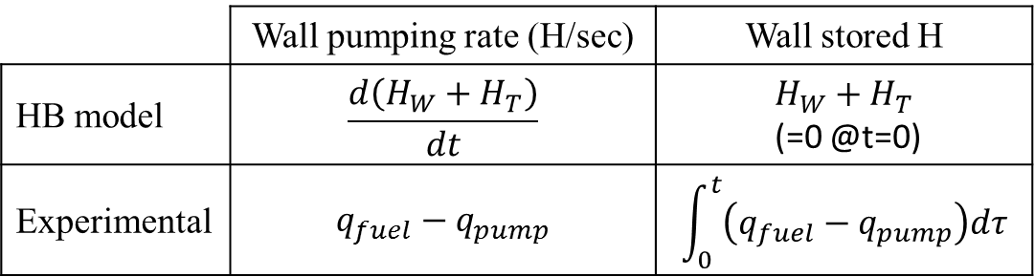
Comparison between experimental results and HB model
 | Wall pumping rate (H/sec) | Wall stored H
HB model | $$\frac{d\left(H_{W}+H_{T}\right)}{dt}$$ | $$H_{W}+H_{T}$$ (=0 @t=0)
Experimental | $$q_{fuel}−q_{pump}$$ | $$\int_{0}^{t}{\left(q_{fuel}−q_{pump}\right)dτ}$$
HB model
Phase I
Total H Flux to the wall is expected to be proportional to Hα signal level.
When Ha level is kept constant, change of wall pumping rate must be caused by net emission of H₂.
Total
Wall pumping (H₂/s)
Ionization
Phase II
CX
Phase III
Wall stored H

Slide 32
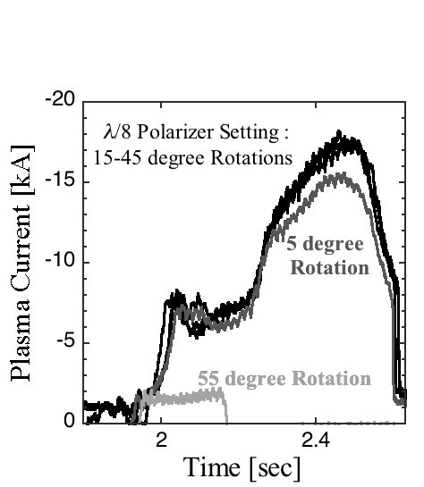
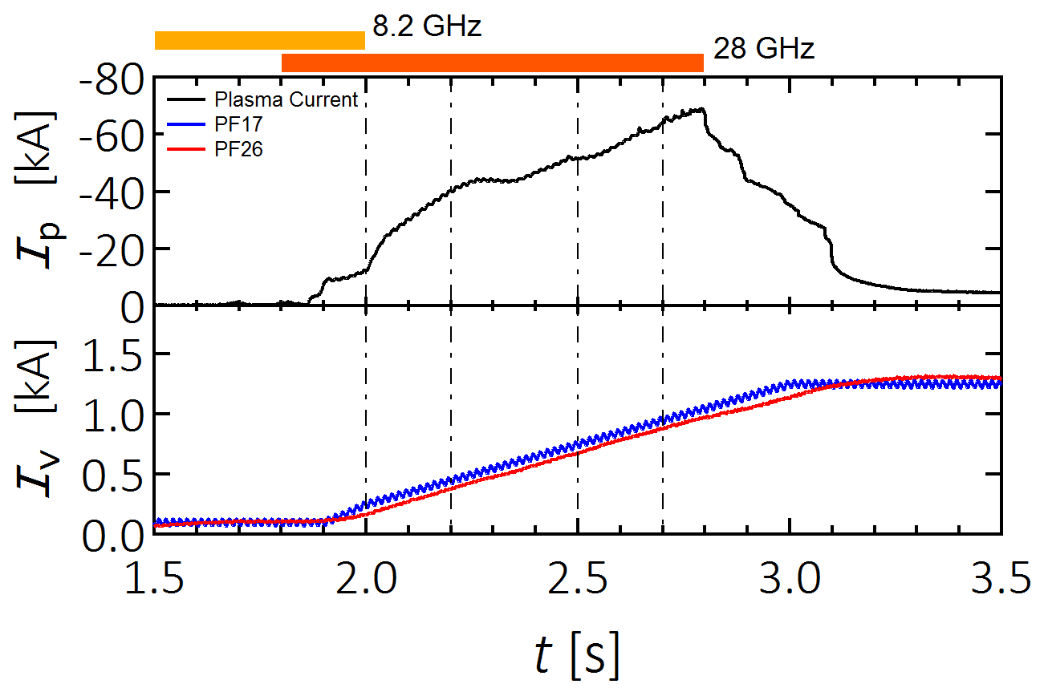
Incident polarization scan indicates single path absorption was dominant.
High non-inductive Ip of 70 kA has been
achieved using a new 28 GHz launcher.
Incident Polarization Scanning

Slide 33
The same operation of human-conducted control gave rise to complete different plasma start-up. The plasma start-up was quite sensitive to hydrogen recycling from the center stack.
Standard operation
After strong gas puff

Slide 34
2nd ECR 28GHz Plasma start-up(#35713)（九大提供）

Slide 35
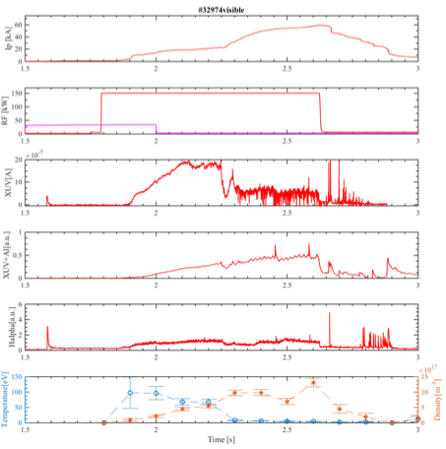
Transition from bulk heating to tail heating was observed in the early phase of plasma start-up. （九大、東大提供）
After the transition
Rapid Ip ramp-up was observed.
Bulk electron temperature was significantly reduced from 100 eV to 5 eV.
Electron density of 1 x 10¹⁸ m⁻³ was not so different.
AXUV and Ha signals were significantly reduced.
XUV with an aluminum filter of 0.4 μm in thickness signal did not become altered so much.
HXR signals beyond 40keV was enhanced.

Slide 36
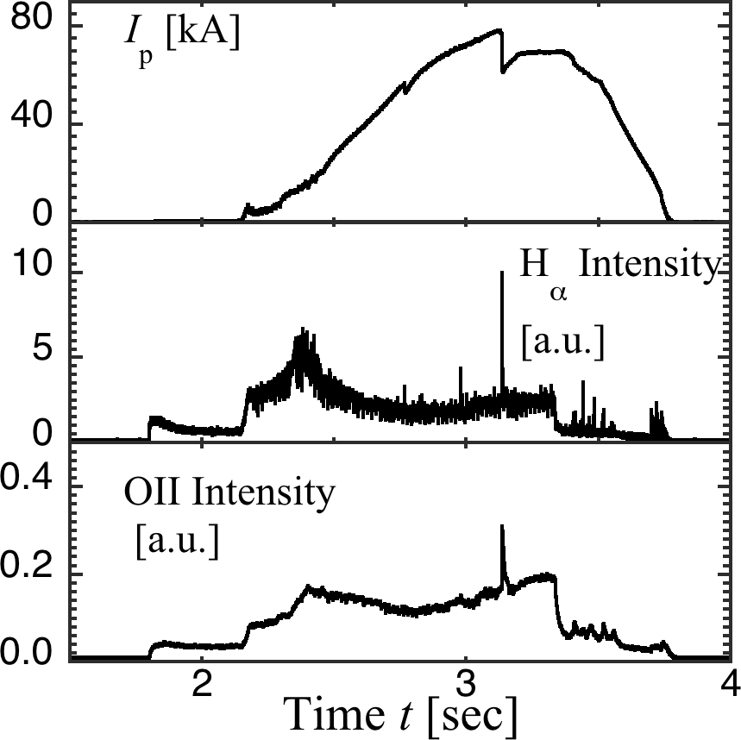
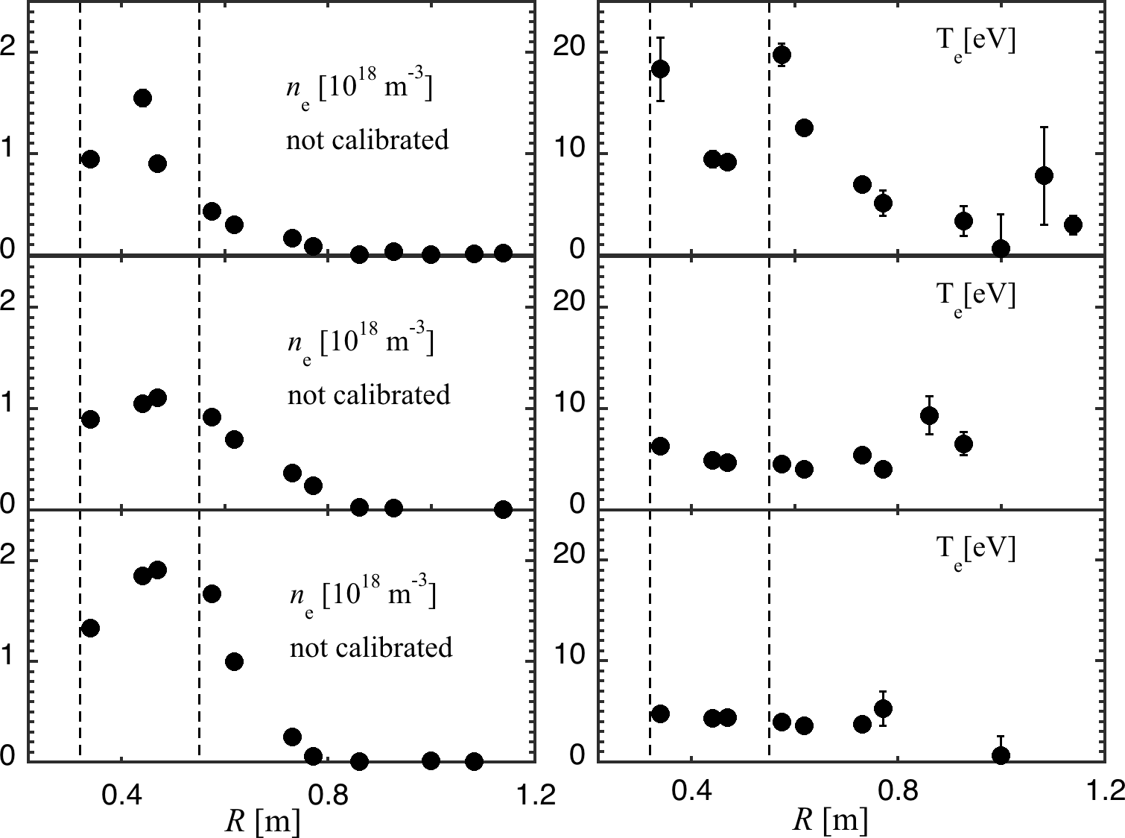
TS Diagnostics（東大提供）
2nd ECR
for 28 GHz
1st ECR
for 8,2 GHz
2nd ECR
for 28 GHz
1st ECR
for 8,2 GHz
HX
t = 2.4 s
t = 2.9 s
Before the HX built-up,
Te peaks were observed near
the ECR layers, while Te deceased
after the HX built-up.
The plasma current was ramped up
with the HX built-up.
t = 3.3 s

Slide 37



Resonance condition at high field side of 2nd ECR layer is satisfied by bi-directional drifting electrons, but …
A
LFS of 2nd ECR
Pperp/mc
2nd ECR R=0.32m
Energy=25, 50, 100keV
Resonance curve
B
N//=0.78
R=0.35m
B
Co direction of
Plasma current
A
Area is wide.
Ppara/mc
Pitch Angle
CNT direction of
Plasma current
C
A
B
1m
keV

Slide 38


Resonance condition in the low field side is satisfied by only CNT drifting electrons, when single path absorption is dominant. It is expected to make a current drive originally intended.
A
Drifting CNT-direction
LFS of 2nd ECR
Pperp/mc
2nd ECR R=0.32m
Energy=25, 50, 100keV
Resonance curve
B
N//=0.78
R=0.35m
Co direction of
Plasma current
A
Area is wide.
Ppara/mc
B
Pitch Angle
CNT direction of
Plasma current
Drifting CNT-direction
A
B
1m
keV

Slide 39
Injected RF is much easier to couple with higher temperature electron around 2nd harmonic ECR. But single path absorption cannot be expected.
The first path absorption of 17 % can be expected, when density is 1 x 10¹⁷m⁻³.
The first path absorption is almost proportional to Te.
Calculated results by ＧＥＮＲＡＹ
Ｘ mode oblique injection N//~0.8
Calculated single path absorption is approximately proportional to electron temperature and density when the Ray trajectory of 28GHz does not inflect.
We assume Bulk: 1×10¹⁸ m⁻³, 10eV
Tail: 1×10¹⁶ m⁻³, 100keV.
Density 10⁻²; Temperature 10⁴ leads to 10² absorption.
The first path absorption is almost proportional to ne except near cut-off density (3 x 10¹⁸m⁻³).
When the energetic electron is present in the target plasma, injected RF is likely to deposit on energetic electrons even in the multi-reflection dominant condition.

Slide 40
Equilibrium calculation also indicates the plasma shrinking before the transition.
PF26:0.59kA
PF352:0.22kA
PF4(1-2A-3-CC1):1.3kA
Ip=-15kA
Transition

Slide 41





Plasma was shrinking before transition and detached from the center stack. It is expected to produce less PWI and reduce hydrogen emission from the wall.
142
157
151
156
154
155

Slide 42
Modelling of the transition with estimation of Life time of energetic electron
QUEST@R=0.64m
200μs
3keV
τ_{e}
Collision time
Ip (kA)
100μs
Ip (kA)
τ_{e}
10keV
When the plasma is shrinking into high field side, τ// is constant. The collision time between neutral with energetic electron is approximately several 10 μm [1]. Therefore the collision may prevent from production of energetic electrons.
100μs
Ip (kA)
50keV
τ_{e}
[1] D.Sengupta, et al. Pramana, 11, 661 (1978)
Ip (kA)

Slide 43


2nd Transmission Line for Local ECHCD
(NIFS及び九大提供）
Polarization control to
excite X-mode in the
oblique injection
X-mode Injection
for 2nd ECHCD
Launcher
with a
focusing
mirror
λ/4
polarizer
λ/8
polarizer
Beam focusing to obtain
a narrow beam

Slide 44


W-Be壁の導入により静的吸蔵から動的吸蔵へ
JET ILW
S. Brezinsek et al Nucl. Fusion 53 (2013) 083023
V. Philipps et al, J. Nucl. Matr. 438 (2013) S1067–1071
W-Be壁(ILW)の導入により放電終了時の重水素放出が促進されて、トリチウムの長期吸蔵による放射化レベルは激減した。一方放電中の重水素放出（動的吸蔵）の影響はより顕著になった。

Slide 45
The same operation of human-conducted control gave rise to complete different plasma start-up. The plasma start-up was quite sensitive to hydrogen recycling from the center stack.
Standard operation
After strong gas puff

Slide 46
Making an strong gas puff from the center stack prevented from plasma current start up.
Gas puff

Slide 47
Modelling of the transition with estimation of Life time of energetic electron
QUEST@R=0.64m
200μs
3keV
τ_{e}
Collision time
Ip (kA)
100μs
Ip (kA)
τ_{e}
10keV
When the plasma is shrinking into high field side, τ// is constant. The collision time between neutral with energetic electron is approximately several 10 μm [1]. Therefore the collision may prevent from production of energetic electrons.
100μs
Ip (kA)
50keV
τ_{e}
[1] D.Sengupta, et al. Pramana, 11, 661 (1978)
Ip (kA)

Slide 48
Plasma was shrinking before transition and detached from the center stack. It is expected to produce less PWI and reduce hydrogen emission from the wall.
142
157
151
156
154
155

Slide 49
Equilibrium calculation also indicates the plasma shrinking before the transition.
PF26:0.59kA
PF352:0.22kA
PF4(1-2A-3-CC1):1.3kA
Ip=-15kA
Transition

Slide 50
Incident polarization scan indicates single path absorption was dominant.
High non-inductive Ip of 70 kA has been
achieved using a new 28 GHz launcher.
Incident Polarization Scanning

Slide 51
3rd Transmission Line
（筑波大学、NIFS、九大提供）
QO Polarizer System
For CW Operation
Double
Disk Window
WG Switch
TMP
Gyrotron
Arc Sensors
TMP
DL
2.5-inch CC WG
with Water-cooling Jacket
For CW Operation
SS pipe
Water
Viton
O-ring
Viton
O-ring

Slide 52
Beam Steering（九大提供）
CC WG
1st Convex Mirror
Full Wave
Simulation
2nd Focusing
Mirror
The beam can be steered mainly in the
toroidal direction to have the refractive
parallel index N// from 0 to 1.
Low power
test results

Slide 53
Beam Focusing（九大提供）
The irradiant HE11 beam was converted to Gaussian
beam and expanded at the 1st mirror. The mirror
was designed on the phase surfaces to be matched
between the incident HE11 and output Gaussian
beams using a developed Kirchhoff integral code.
The 2nd large mirror sharply focused the expanded
Gaussian beam to a narrow beam with a 5-cm waist
size at the ECR layer.
Full Wave
Simulation
Full wave simulation
at the ECR layer for
a launching beam
from a 2.5-inch CC WG.
Low power
test results

Slide 54

Heater of the hot wall was off during long duration discharge
Locations of thermocouple
Jun. 30, 2017
Total heater powers to keep 120 ℃ without plasma are about 5 kW in vessel wall, and less 1 kW in hot wall.
Temperatures of most parts increase up in the same way due to the plasma radiation.
Heater power of hot wall becomes zero because of the increase of hot wall temperature.
Heater power of vessel wall decreases gradually.
Plasma discharge
with 35 kW RF
Vessel wall
Hot wall

Slide 55


Cooling function for vacuum vessel wall
Temperature of vacuum vessel has to be kept under 150℃ to protect diagnostics and plasma-heating devices.
Water cooling channels are installed at the ribs of vacuum vessel and vacuum ports.

Slide 56


Cooling function for hot walls
3D view of one section HCP
Cross section of heating-cooling channels
High
Low
~50mm
Two water cooling channels are prepared, which are connected to the panel with appropriate SUS316L plates (thickness and distance).
This provides two different thermal resistances to the panel, and the cooling capacity will be adjusted with the combination of cooling channels.
Sheath heater profile (Red)
Cooling capacity: H water < L water < H&L water

Slide 57
HX measurements
28GHzRF 2nd
Resonance layer
(R ≈ 320 mm)
I_{p}
e⁻
FWD
QUEST
TOP VIEW
Detector (CdTe)
BWD

Slide 58
Fast camera images at I_{p} drop
8.2
28
3.09 s
3.09 s

