Slide 1
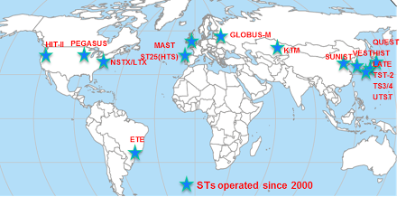
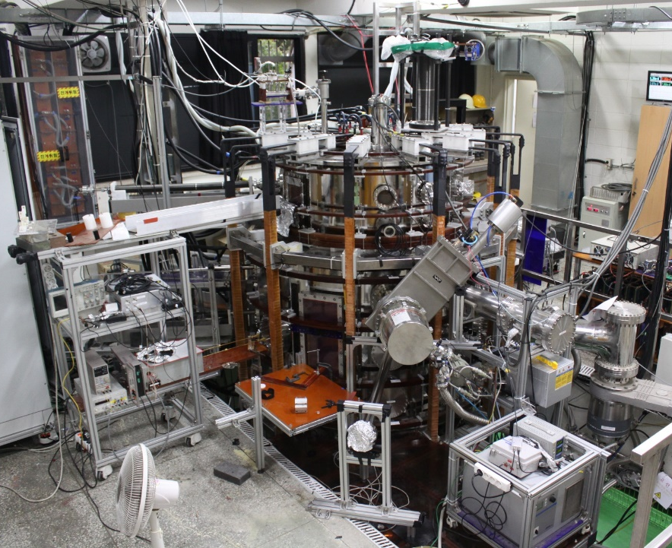
19th International Spherical Torus Workshop (ISTW 2017) will be held at Seoul National University, 18-22 September 2017
Previous ISTWs were held in Oak Ridge (1994), Princeton (1995), Culham (1996), St. Petersburg (1997), Tokyo (1998), Seattle (1999), Sao Jose dos Campos (2001), Princeton (2002), Culham (2003), Kyoto (2004), St. Petersburg (2005), Chengdu (2006), Fukuoka (2007), Frascati (2008), Madison (2009), Toki (2011), York (2013), and Princeton (2015).

Slide 2
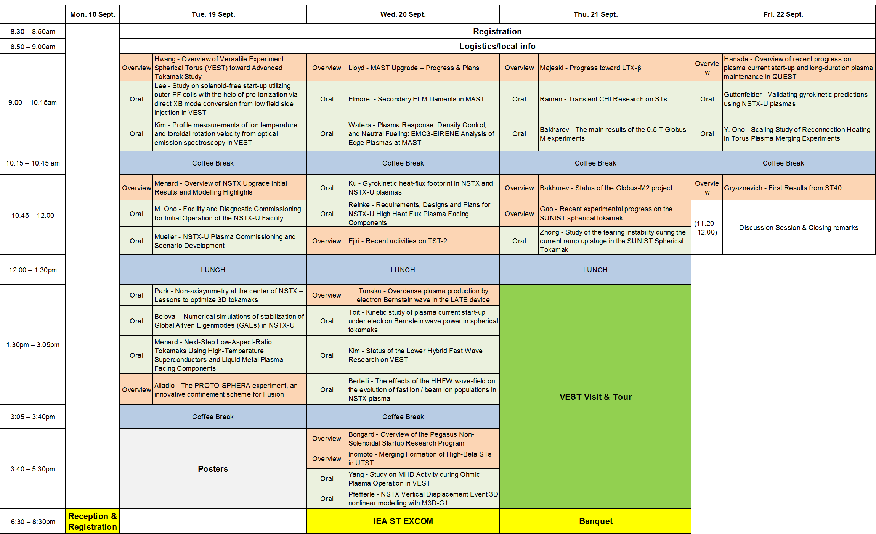
Program at a Glance
Presentations:
Overview 13
Oral 21
Poster 20
Participants:
8 countries
66 participants (31+35)

Slide 3
Program (Tuesday, Sept. 19, 2017)
Session 1 Chair: J. Menard
09:00 – 09:35 Overview of Versatile Experiment Spherical Torus (VEST) toward Advanced Tokamak Study, Y.S. Hwang (SNU, Korea)
09:35 – 09:55 Study on solenoid-free start-up utilizing outer PF coils with the help of pre-ionization via direct XB mode conversion
from low field side injection in VEST, H.Y. Lee (SNU, Korea)
09:55 – 10:15 Profile measurements of ion temperature and toroidal rotation velocity from optical emission spectroscopy in VEST,
Y.S. Kim (SNU, Korea)
10:15 – 10:45 Coffee Break
Session 2 Chair: F. Alladio
10:45 – 11:20 Overview of NSTX Upgrade Initial Results and Modelling Highlights, J. Menard (PPPL, USA)
11:20 – 11:40 Facility and Diagnostic Commissioning for Initial Operation of the NSTX-U Facility, M. Ono (PPPL, USA)
11:40 – 12:00 NSTX-U Plasma Commissioning and Scenario Development, D. Muller (PPPL, USA)
12:00 – 13:30 Lunch
Session 3 Chair: T. S. Hahm
13:30 – 13:50 Non-axisymmetry at the center of NSTX – Lessons to optimize 3D tokamaks, J.K. Park (PPPL, USA)
13:50 – 14:10 Numerical simulations of stabilization of Global Alfven Eigenmodes (GAEs) in NSTX-U, E. Belova (PPPL, USA)
14:10 – 14:30 Next-Step Low-Aspect-Ratio Tokamaks Using High-Temperature Superconductors and Liquid Metal Plasma
Facing Components, J. Menard (PPPL, USA)
14:30 – 15:05 The PROTO-SPHERA experiment, an innovative confinement scheme for Fusion, F. Alladio (ENEA, Italy)
15:05 – 15:30 Coffee Break
15:30 – 17:30 Poster Session Chairs: A. Ejiri/M. Bongard

Slide 4
Program (Wednesday, Sept. 20, 2017)
Session 4 Chair: M. Inomoto
09:00 – 09:35 MAST Upgrade – Progress & Plans, B. Lloyd (UKAEA, UK)
09:35 – 09:55 Secondary ELM filaments in MAST, S. Elmore (UKAEA, UK)
09:55 – 10:15 Plasma Response, Density Control, and Neutral Fueling: EMC3-EIRENE Analysis of Edge Plasmas at MAST,
I. Waters (Univ. of Wisconsin-Madison, USA)
10:15 – 10:45 Coffee Break
Session 5 Chair: N. N. Bakharev
10:45 – 11:05 Gyrokinetic heat-flux footprint in NSTX and NSTX-U plasmas, S. Ku (PPPL, USA)
11:05 – 11:25 Requirements, Designs and Plans for NSTX-U High Heat Flux Plasma Facing Components , M. L. Reinke (ORNL, USA)
11:25 – 12:00 Recent activities on TST-2 , A. Ejiri (Univ. Tokyo, Japan)
12:00 – 13:30 Lunch
Session 6 Chair: M. Ono
13:30 – 14:05 Overdense plasma production by electron Bernstein wave in the LATE device, H. Tanaka (Kyoto Univ., Japan)
14:05 – 14:25 Kinetic study of plasma current start-up under electron Bernstein wave power in spherical tokamaks, E.J. du Toit (York Univ., UK)
14:25 – 14:45 Status of the Lower Hybrid Fast Wave Research on VEST, S. H. Kim (KAERI, Korea)
14:45 – 15:05 The effects of the HHFW wave-field on the evolution of fast ion / beam ion populations in NSTX plasma, N. Bertelli (PPPL, USA)
15:05 – 15:40 Coffee Break
Session 7 Chair: : B. Lloyd
15:40 – 16:15 Overview of the Pegasus Non-Solenoidal Startup Research Program , M. Bongard (Univ. of Wisconsin-Madison, USA)
16:15 – 16:50 Merging Formation of High-Beta STs in UTST, M. Inomoto (Tokyo Univ., Japan)
16:50 – 17:10 Study on MHD Activity during Ohmic Plasma Operation in VEST, J. H. Yang (SNU, Korea)
17:10 – 17:30 NSTX Vertical Displacement Event 3D nonlinear modelling with M3D-C1, D. Pfefferlé (PPPL, USA)

Slide 5
Program (Thursday, Sept. 21, 2017)
Session 8 Chair: Z. Gao
09:00 – 09:35 Progress toward LTX-β, R. Majeski (PPPL, USA)
09:35 – 09:55 Transient CHI Research on STs, R. Raman (PPPL, USA)
09:55 – 10:15 The main results of the 0.5 T Globus-M experiments, N. N. Bakharev (Ioffe institute, RF)
10:15 – 10:45 Coffee Break
Session 9 Chair: H. Tanaka
10:45 – 11:20 Status of the Globus-M2 project, N. N. Bakharev (Ioffe institute, RF)
11:20 – 11:55 Recent experimental progress on the SUNIST spherical tokamak , Z. Gao (Tsinghua Univ., China)
11:55 – 12:15 Study of the tearing instability during the current ramp up stage in the SUNIST Spherical Tokamak,
H. Zhong (Tsinghua Univ., China)
12:05 – 13:35 Lunch
13:35 – 18:30 VEST Visit & Tour
18:30 – 20:30 Banquet

Slide 6
Program (Friday, Sept. 22, 2017)
Session 10 Chair: M. Gryaznevich
09:00 – 09:35 Overview of recent progress on plasma current start-up and long-duration plasma maintenance in QUEST,
K. Hanada (Kyushu Univ., Japan)
09:35 – 09:55 Validating gyrokinetic predictions using NSTX-U plasmas , W. Guttenfelder (PPPL, USA)
09:55 – 10:15 Scaling Study of Reconnection Heating in Torus Plasma Merging Experiments , Y. Ono (Tokyo Univ., Japan)
10:15 – 10:45 Coffee Break
Session 11 Chair: Y. S. Hwang
10:45 – 11:20 First Results from ST40 , M. Gryaznevich (Tokamak Energy, UK)
11:20 – 12:00 Discussion Session & Closing Remarks
Best Poster Award
Chairs: Prof. Ejiri and Dr. Bongard
Recipients: S.C. Hong and Y.G. Kim
Next ISTW 2019 where?
Previous ISTWs : Oak Ridge (1994), Princeton (1995), Culham (1996), St. Petersburg (1997), Tokyo (1998), Seattle (1999), Sao Jose dos Campos (2001), Princeton (2002), Culham (2003), Kyoto (2004), St. Petersburg (2005), Chengdu (2006), Fukuoka (2007), Frascati (2008), Madison (2009), Toki (2011), York (2013), Princeton (2015) and Seoul(2017).

