Slide 1
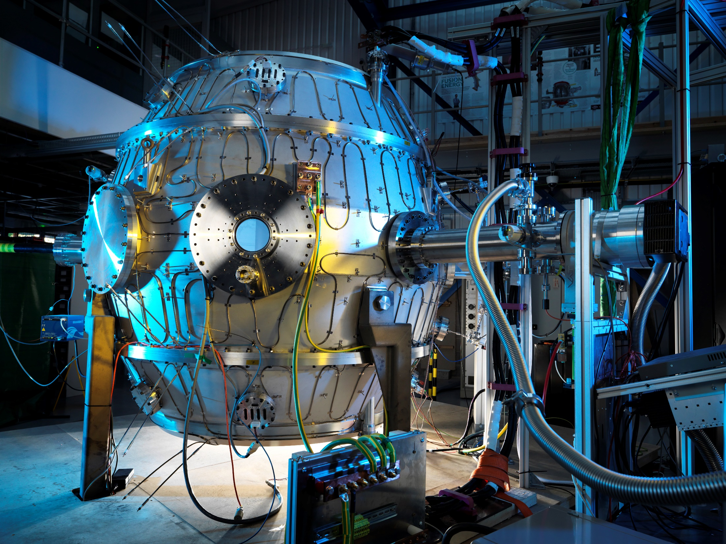

First Results from ST40
M Gryaznevich for the Tokamak Energy Team

Slide 2
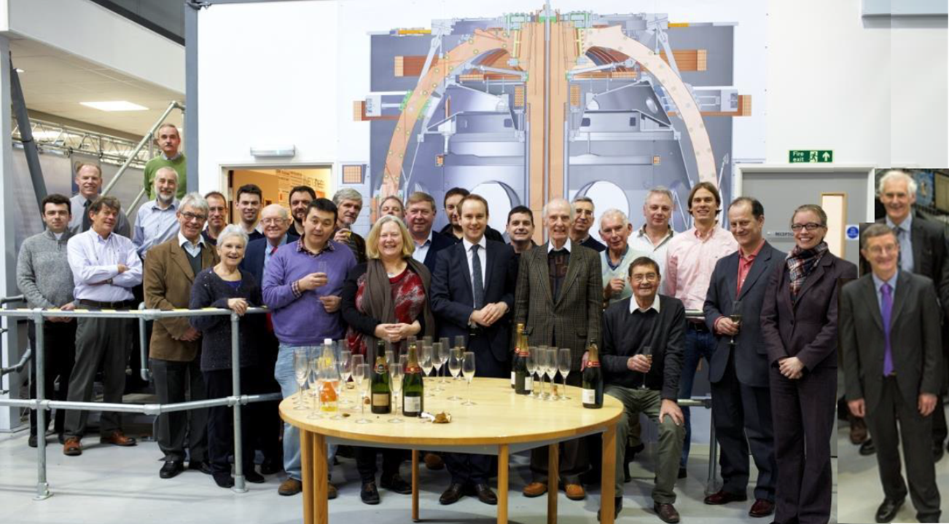
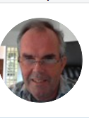
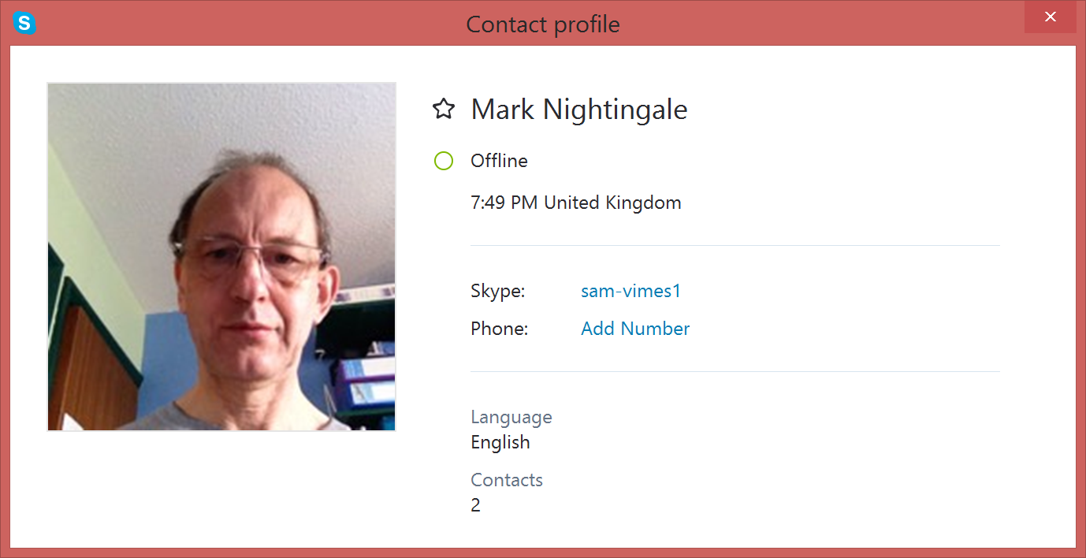
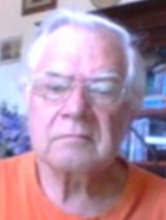
Tokamak Energy Ltd. 80+ staff in 2017
P Thomas
M Nightingale
P Noonan
V Shevchenko
V Chuyanov
M Gryaznevich
C Windsor
J Hunt
J Lister
J Connor
J Hugill
P Buxton
D Kingham
A Costley
A Sykes
Notes:
This is our Team. You might find some familiar faces (our founders Alan and Mikhail). Photo taken in Alan Sykes’ retirement party (early spring if I remember correctly). Already out of date. Scale model of ST40 on the background.

Slide 3
Tokamak Energy Program
Demonstrate scientific viability of ST path to Fusion
Develop HTS technology towards commercial viability
Combine STs and HTS in a series of engineering prototypes
ST25 Cu
ST40 Cu
ST25 HTS
Test coils
ST40 magnet
ST150~200
HTS engineering
Other engineering (Divertor, shielding, power conversion, breeding …. )

Slide 4
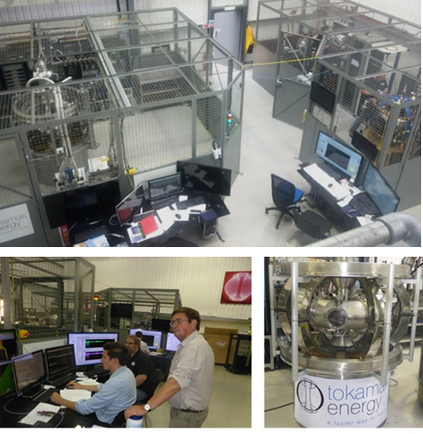
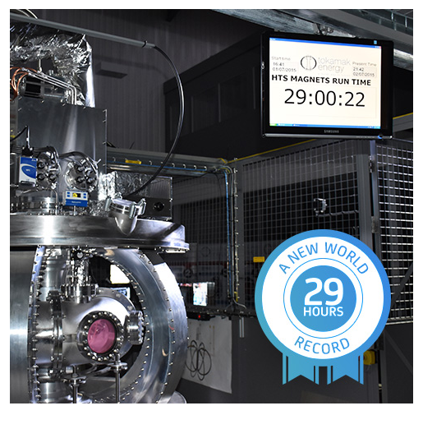
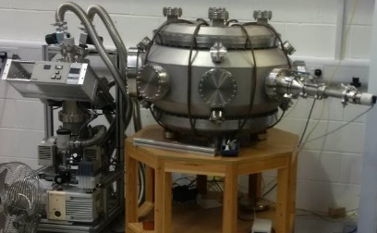
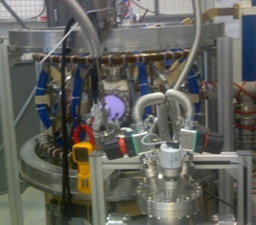
Tokamak Energy small devices
Demonstrated full-HTS tokamak for the first time
YBCO 20⁰K operation – 6 limb 3D cryostat

Slide 5
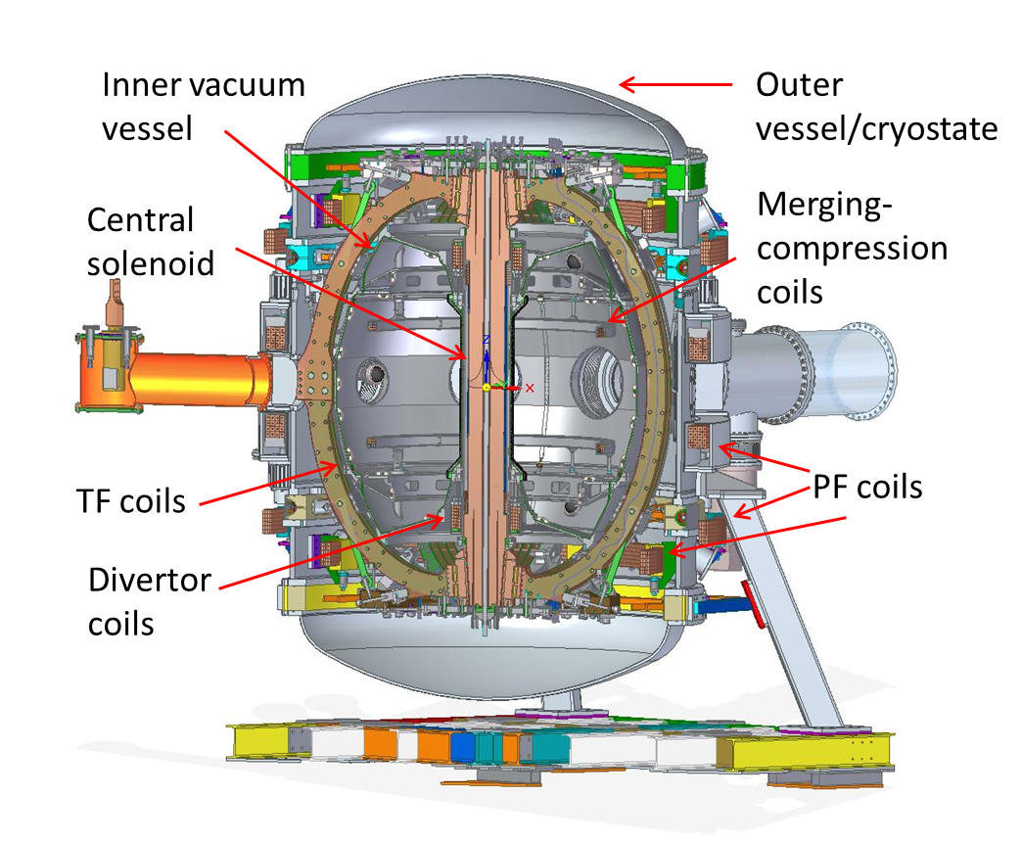
ST40: 3T, 2MA Cu Coils
Main features:
High toroidal field up to 3T, LN2 cooled copper magnet
Plasma major radius 0.4 - 0.6m, R/a = 1.6 - 1.8
Moderate elongation (k ~ 2.5) and triangularity (δ ~ 0.3), DND
LN2 cooled passive plates
Plasma current up to 2MA (3?)
Pulse duration 1-10 sec
2MW NBI + EBW/EC (2MW?);
Li conditioning, (Li divertor?)
Possibility of DT ops, metal wall
m/c plasma formation
Notes:
Just to give you a quick view, here’s ST40. 3T, 2MA spherical tokamak that we’re currently building. I’ll go further into details later, but first let me show you the outline of my presentation.

Slide 6
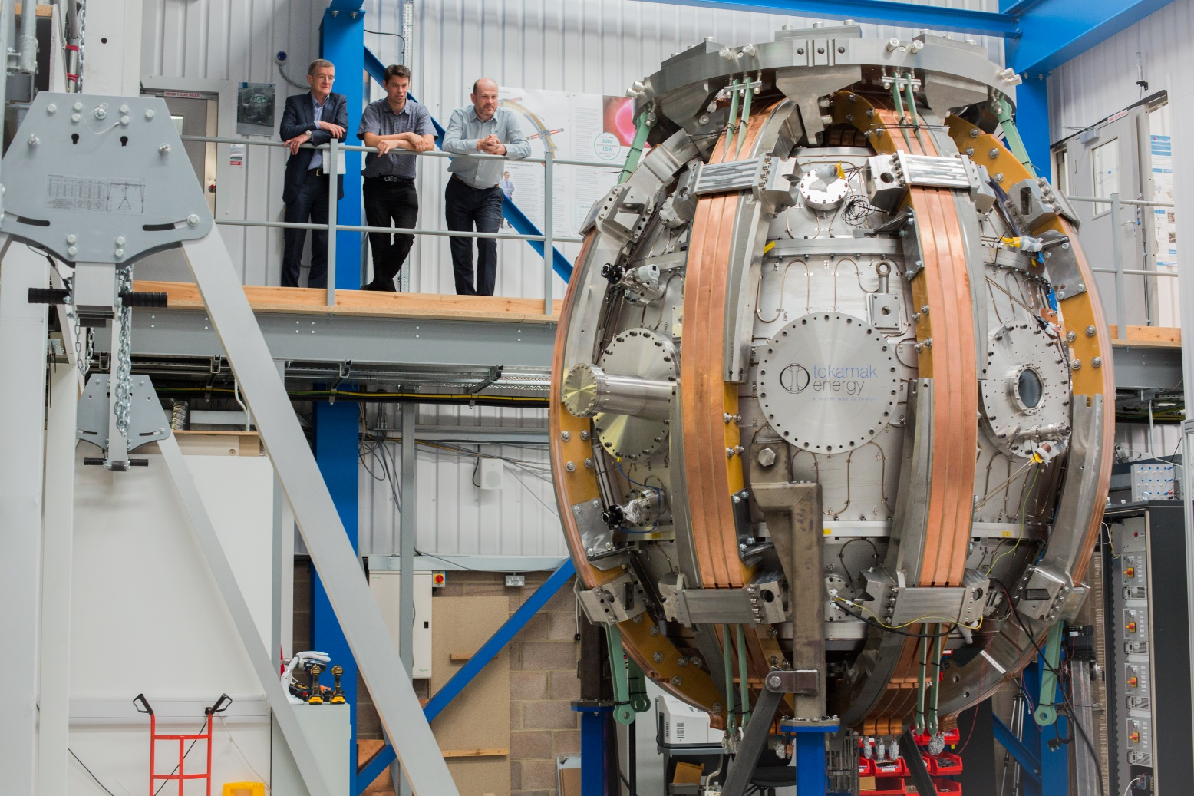
ST40 TF Coil Trial Fit
TF coils installed, contacts resistivity measured. Power tests in September – November 2017, physics operations in December.

Slide 7
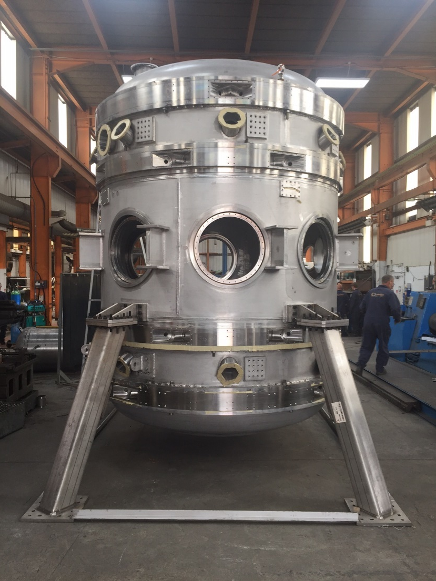
ST40 Outer vessel (cryostat)
Main PF coils installed on central section of Outer vessel (cryostat)

Slide 8
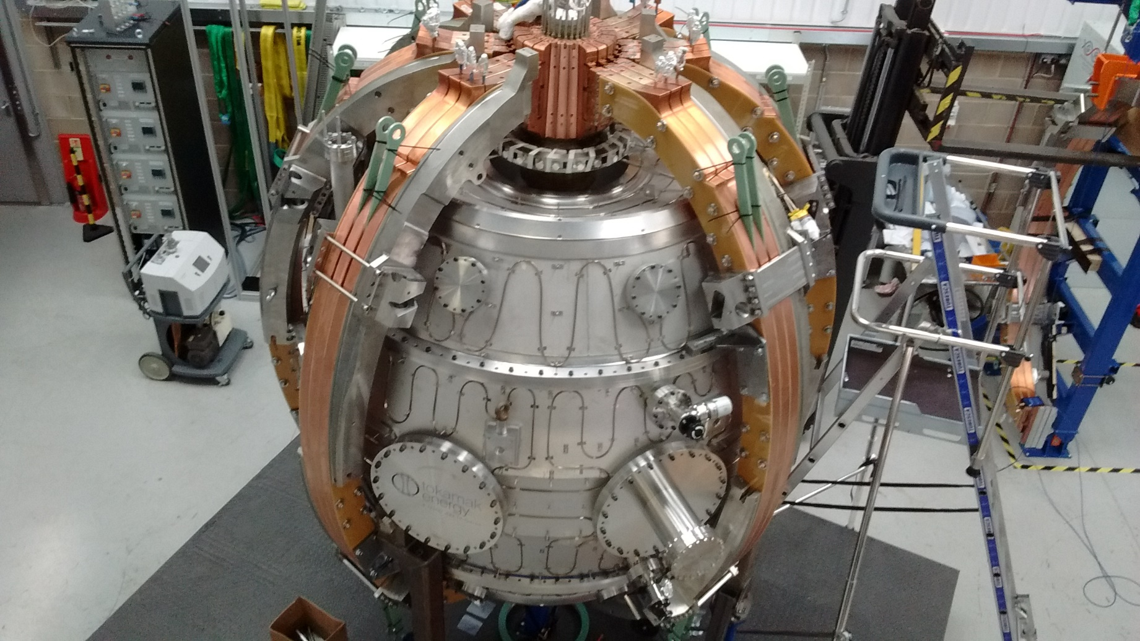
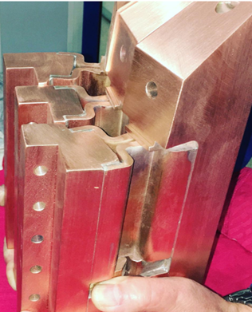
ST40 TF Coil Detail
Lapped contacts
Flexible couplings

Slide 9
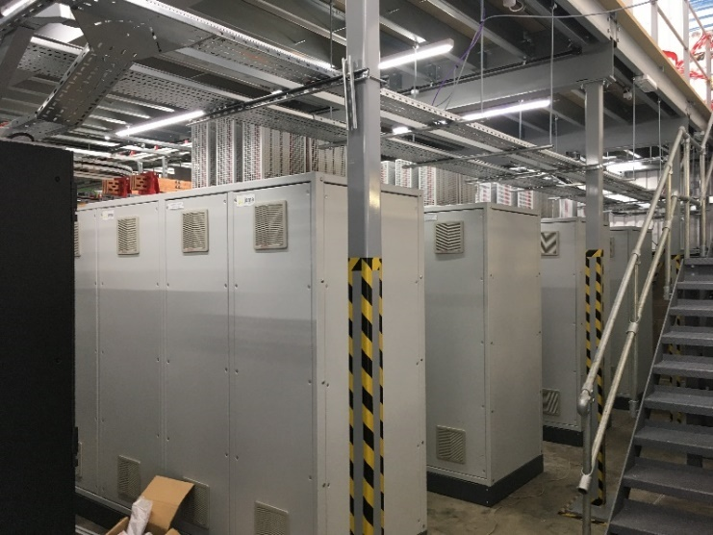
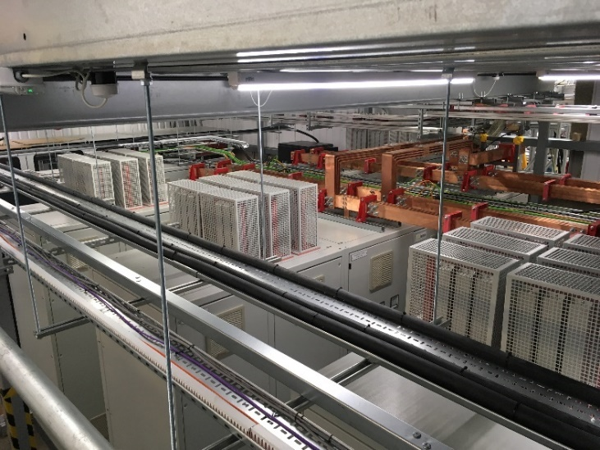
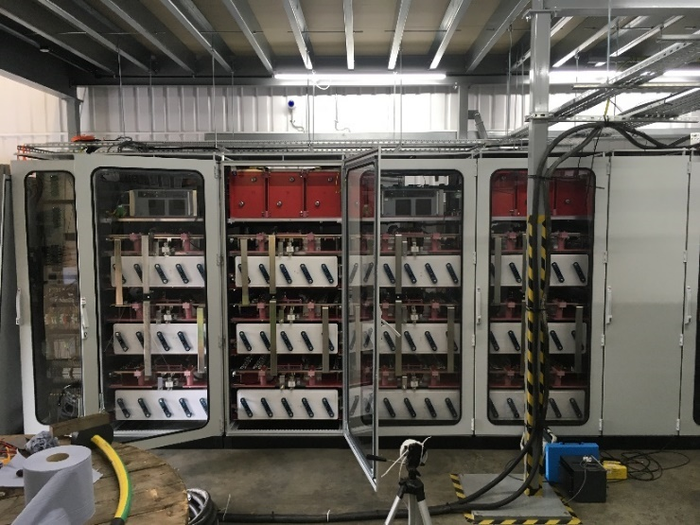
First power supplies in place
ST40 power supply units (PSUs) based on ultracapacitors
TF first to arrive (70 MJ), installed and tested
To be expanded to 250kA and 175MJ to provide B_{t}=3T
MC p/s commissioned
“The final Test pulse has been successfully fired into the BvL coils at 26500 Amps” Thursday 21 Sept 2017.
Notes:
TF: 400V

Slide 10
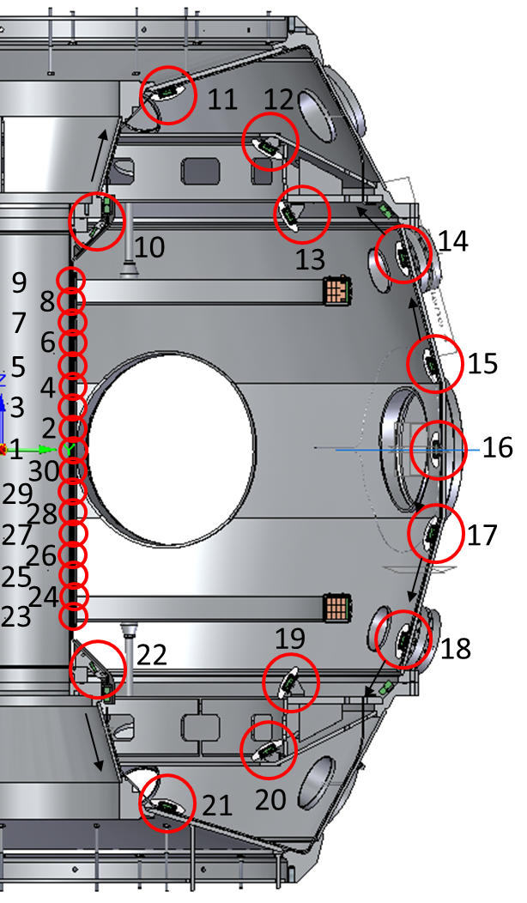
Diagnostics
Machine monitoring: vacuum, mass spectrometer, fast ion gauge, thermocouples, position monitoring, TF joint testing
Magnetics: Bp&Bt probes, flux loops, Rogowski coils, saddle loops, diamagnetic loops
Cameras: Fast high resolution visible (500&80 fps), IR

Slide 11
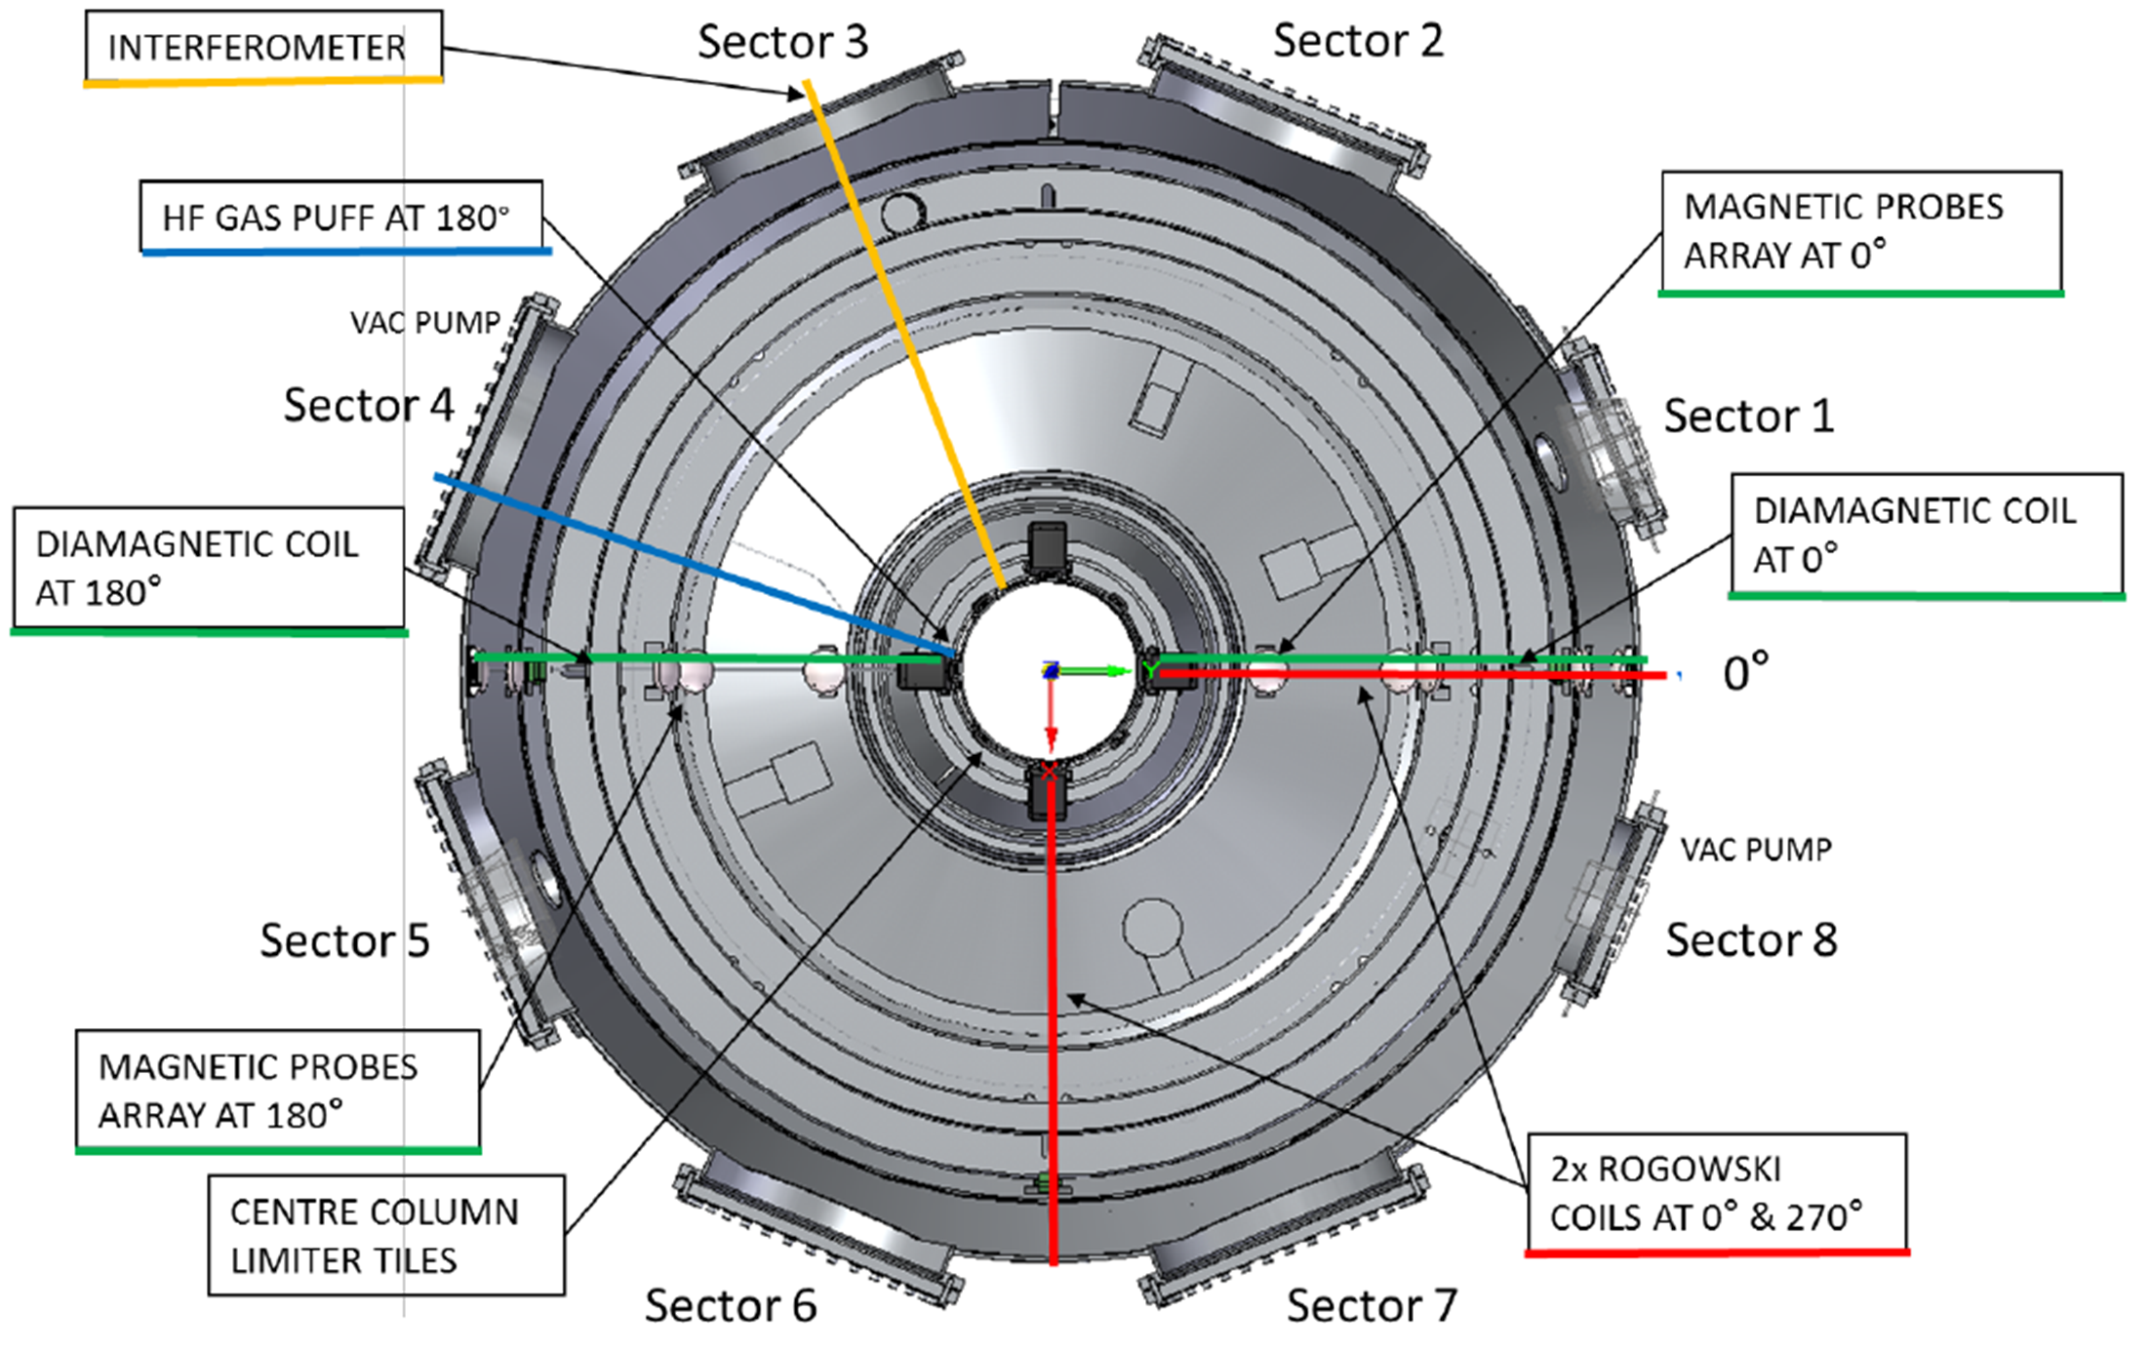
Diagnostics
Multifoil X-ray camera (4x3x20 channels), UV/visible spectrometer with impurity Doppler, dual colour NIR interferometer vertical & horisontal chords, ECE Doppler radiometer, hard X-ray spectrometer, micro-balance probes
Planned: interferometer (195 μm, 2 chords), NPA, multi-channel TS, neutron spectrometer, Langmuir probes

Slide 12
ST40
First Results

Slide 13
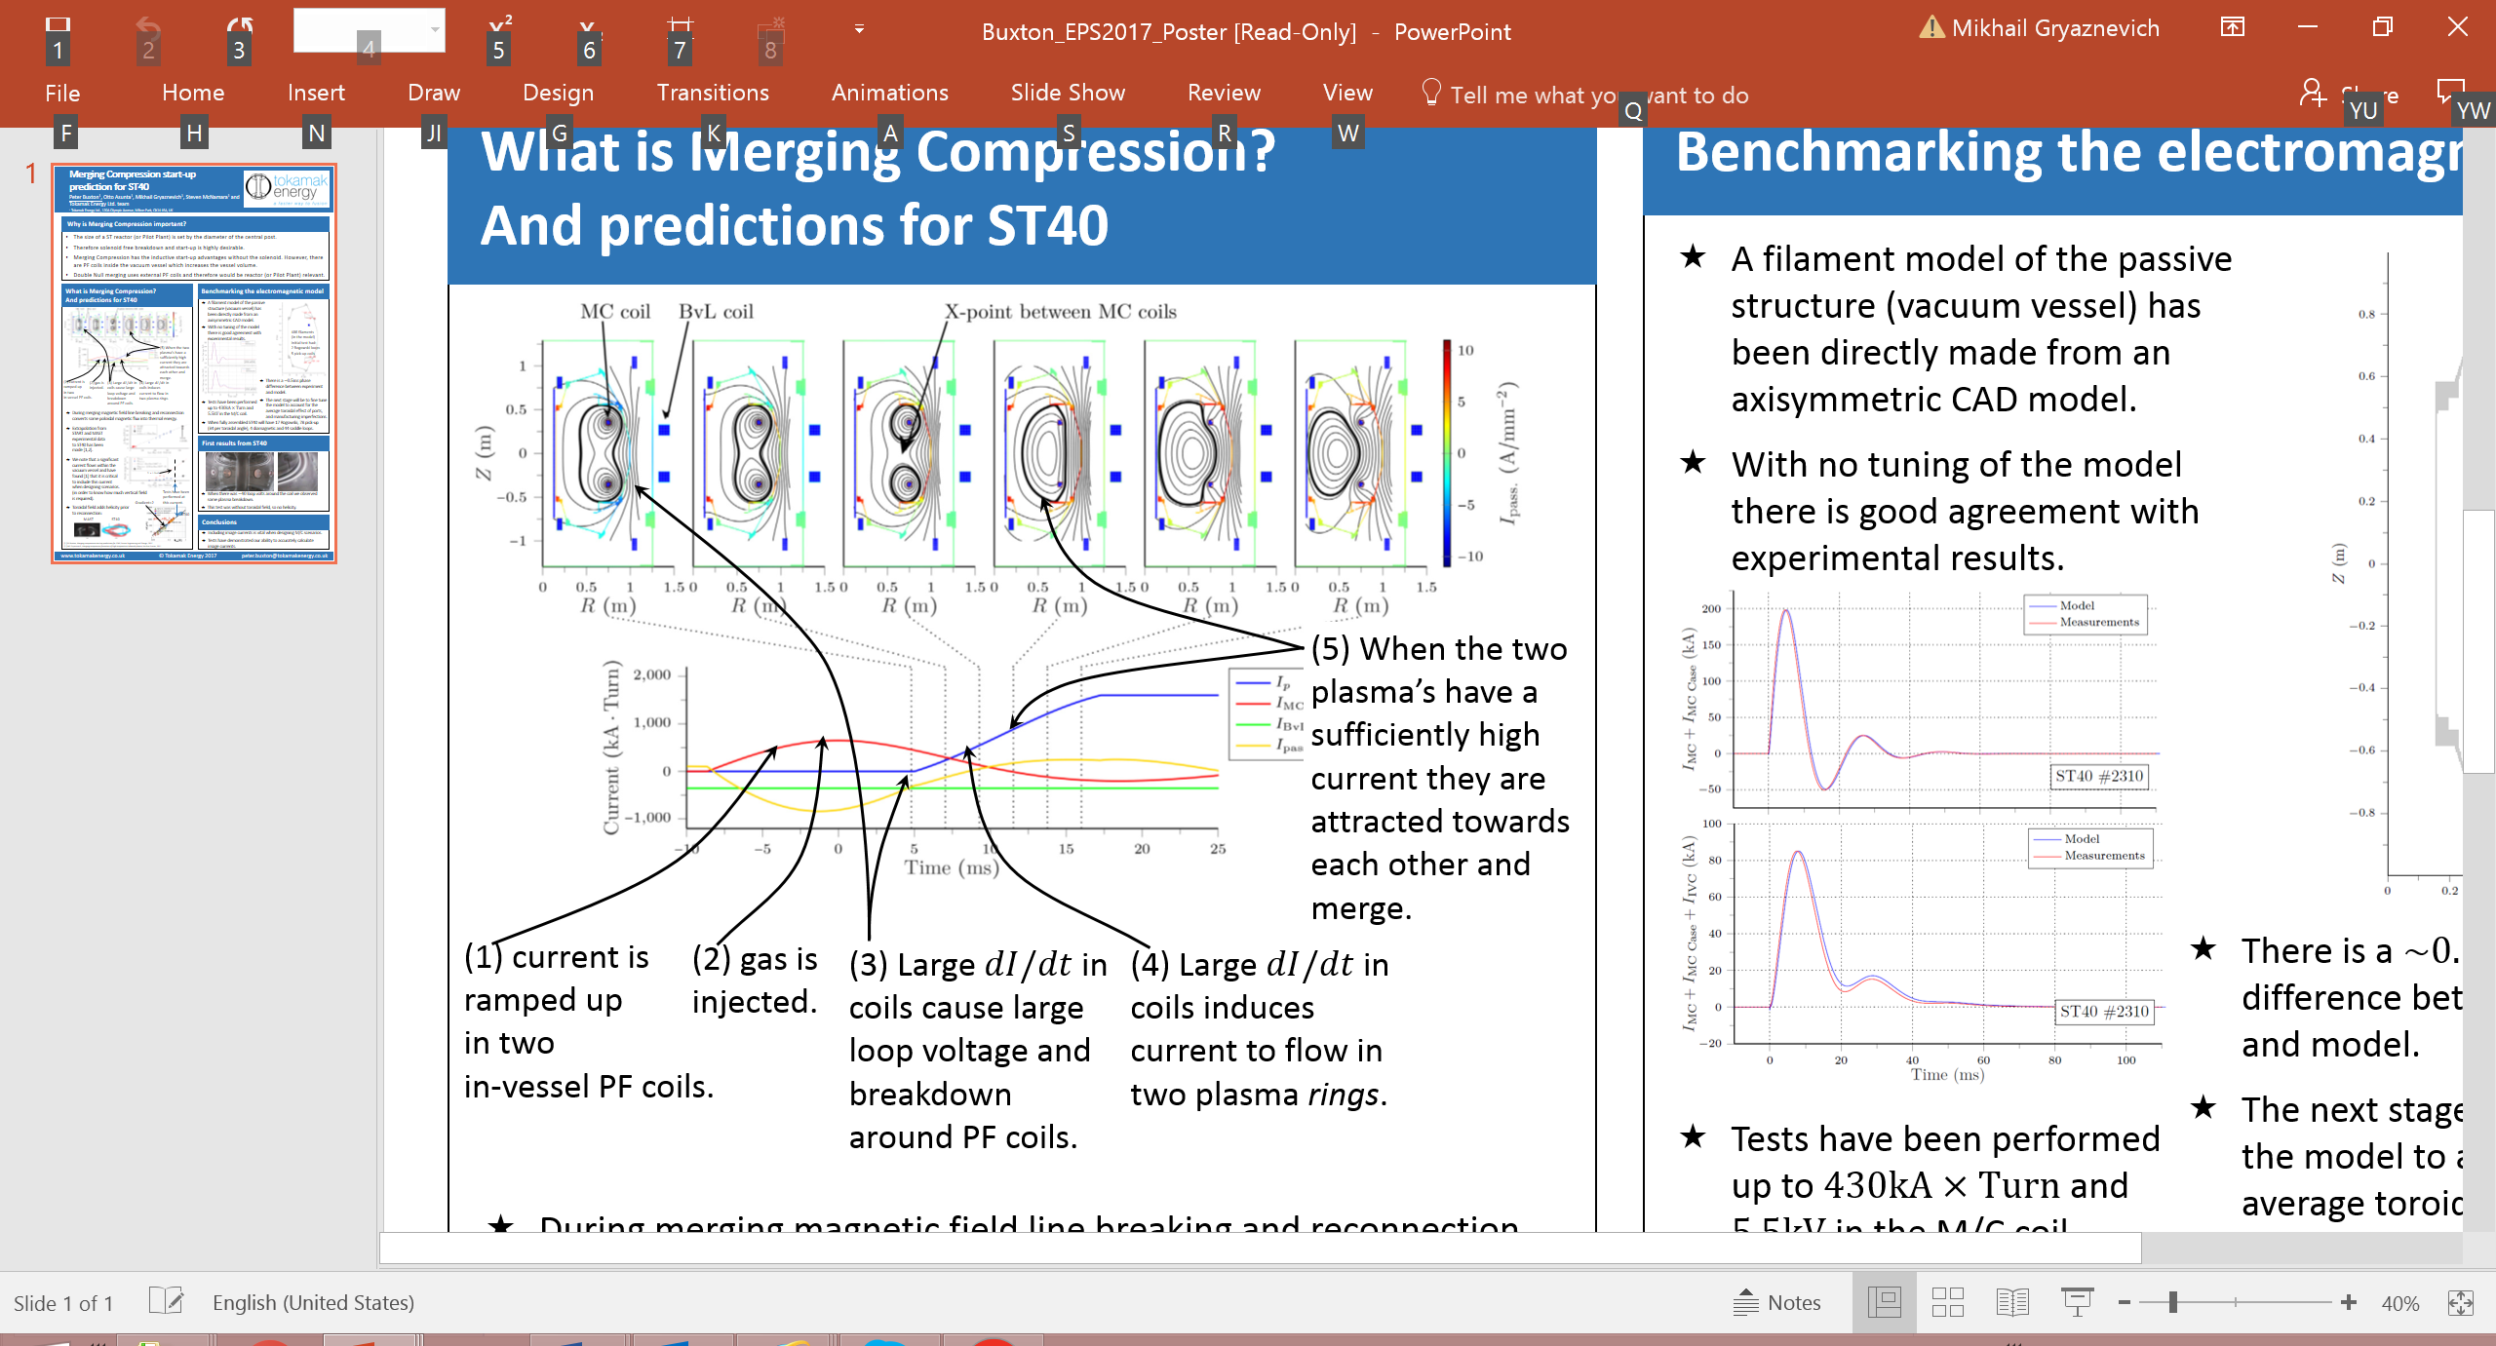
Merging-compression start-up
Total eddy currents
Notes:
Induced current in the vessel up to 0.8MA

Slide 14
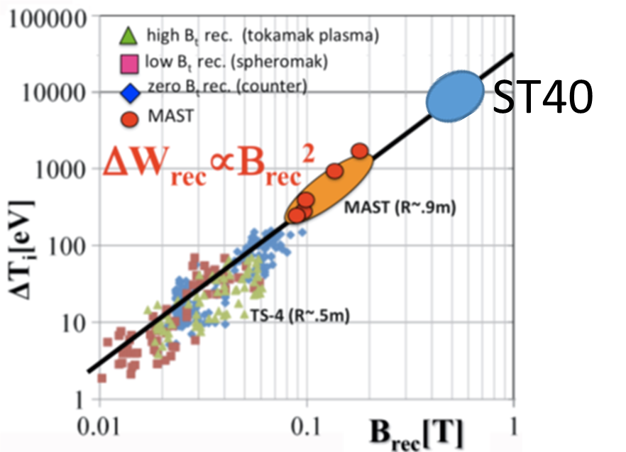
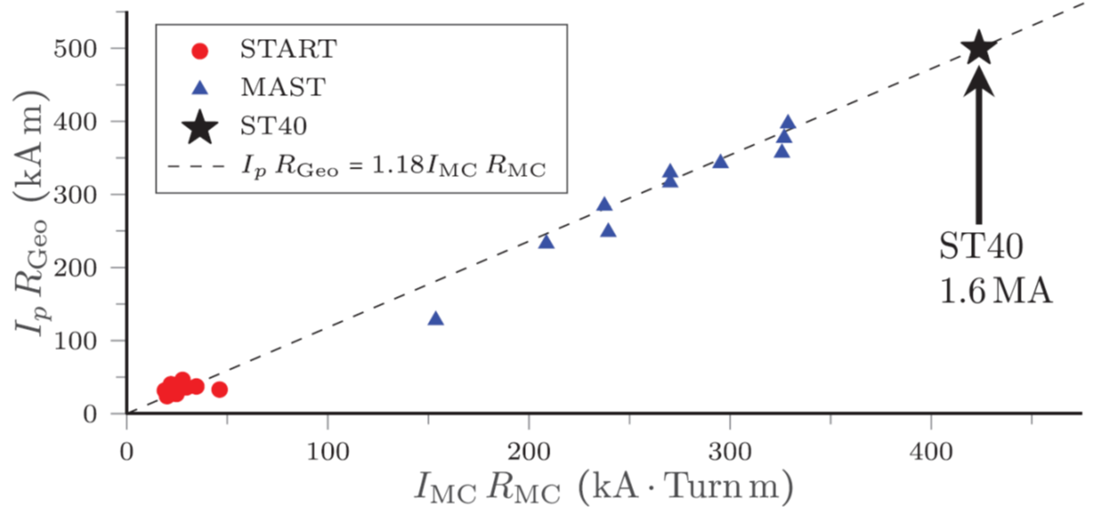
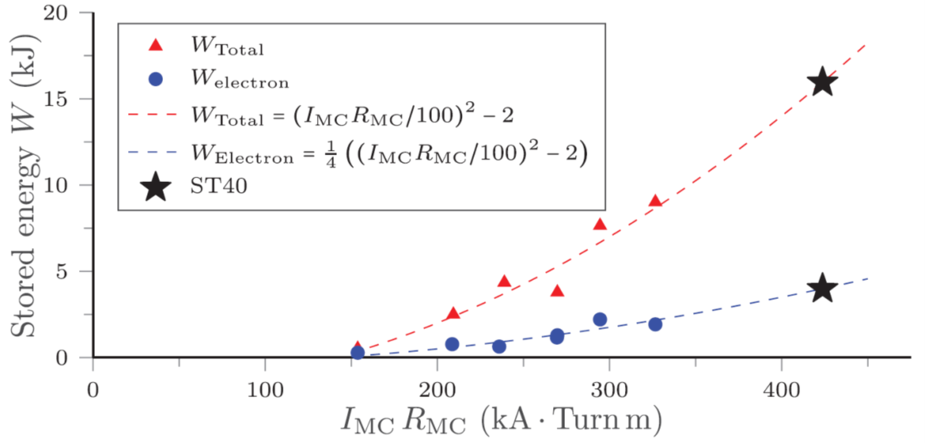
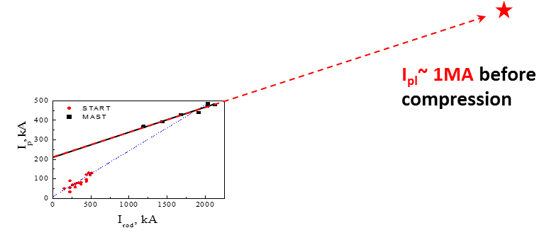
Merging-compression, basics
During merging magnetic field line breaking and reconnection converts some poloidal magnetic flux into thermal energy.
According to theory, and experimental data from START, MAST, Pegasus and several Japanese devices, heating due to reconnection is ~ B², so plasma in ST40 should show ignition parameters (nTτ) with temperatures ~10 keV
Extrapolation from MAST/START:
P3 coil current achieved
Plasma current increases linearly with I_{P3}
T_{e,i}~1keV
Plasma current increases with TF
Thermal energy in electrons and ions indeed increases ~ B², MAST
Notes:
Induced current in the vessel up to 0.8MA

Slide 15
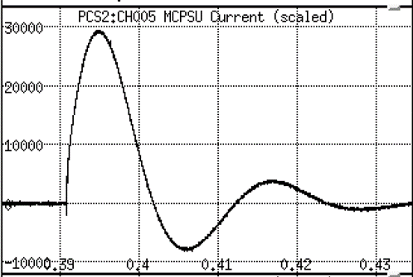
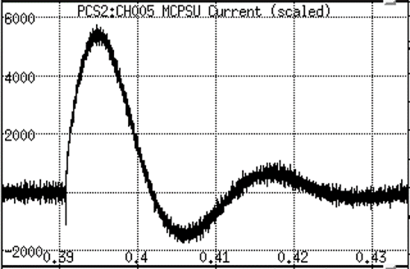
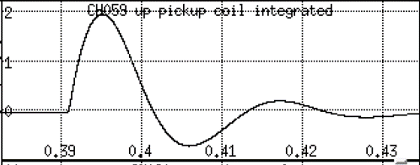
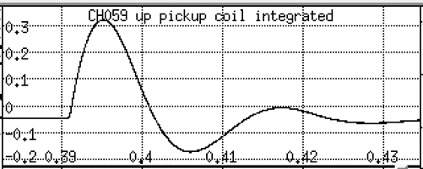
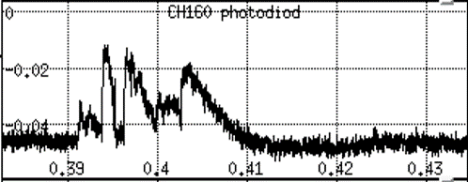
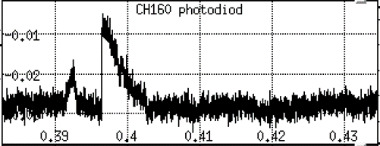
Merging-compression, first tests
First tests of plasma formation around m/c coils
- Plasma around m/c coil was formed during GDC in He
- 530kAt in m/c coils have been demonstrated (300kAt on MAST)
Main traces for
#2434 (5.5kV, 330kAt) and
#2453 (1kV, 57.5kAt):
m/c coil (P3) current
Internal pick-up coil, integrated
Photodiode
Note that b/d happens when GDC is terminated by applied field. However, without support of GDC b/d never happened, so pre-ionization is essential
Notes:
Induced current in the vessel up to 0.8MA

Slide 16
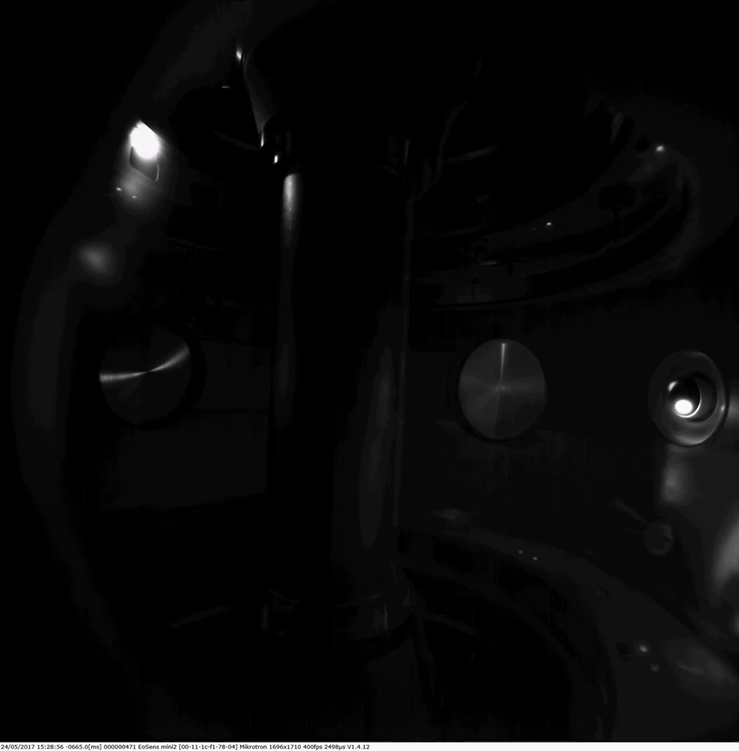
Merging-compression, first tests
GDC
Plasma around m/c coil
Notes:
Induced current in the vessel up to 0.8MA

Slide 17
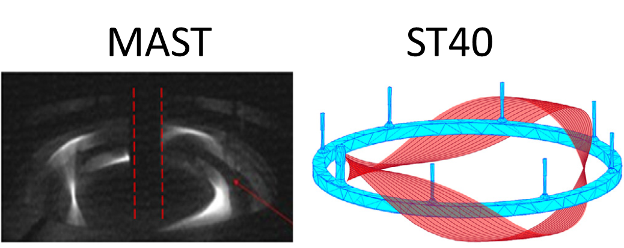
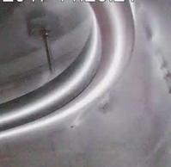
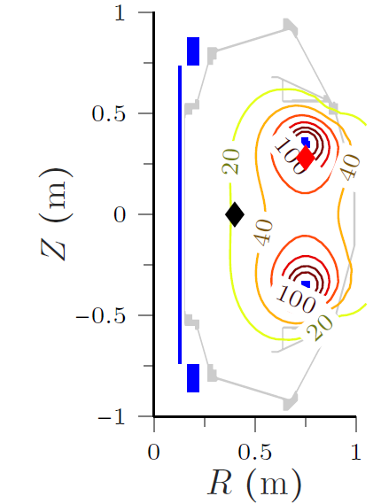
Merging-compression, analysis
Clear b/d around coil is seen at ~ 40V of toroidal loop voltage, measured with a loop outside IVC and ~60 V at the coil
b/d happens in absence of TF due to high loop voltage (100V) generated by m/c coil
However, there is no evidence of filaments/arcs at the coil to be helical, as on MAST, so no self-generated TF can be suggested (plasma is cold).
Notes:
Induced current in the vessel up to 0.8MA

Slide 18
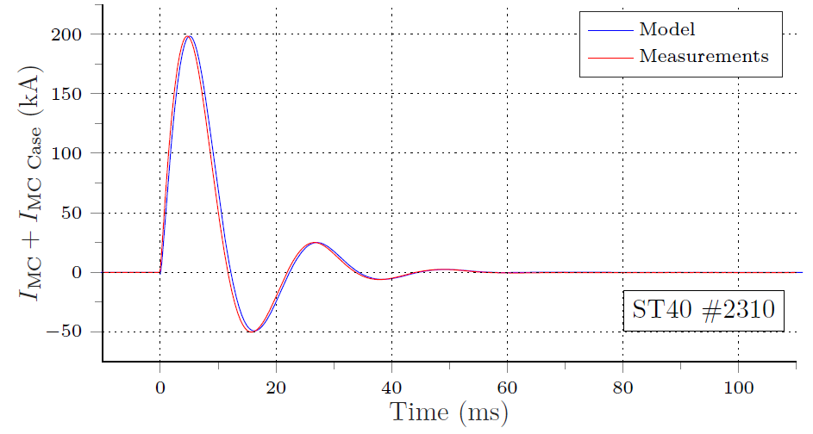
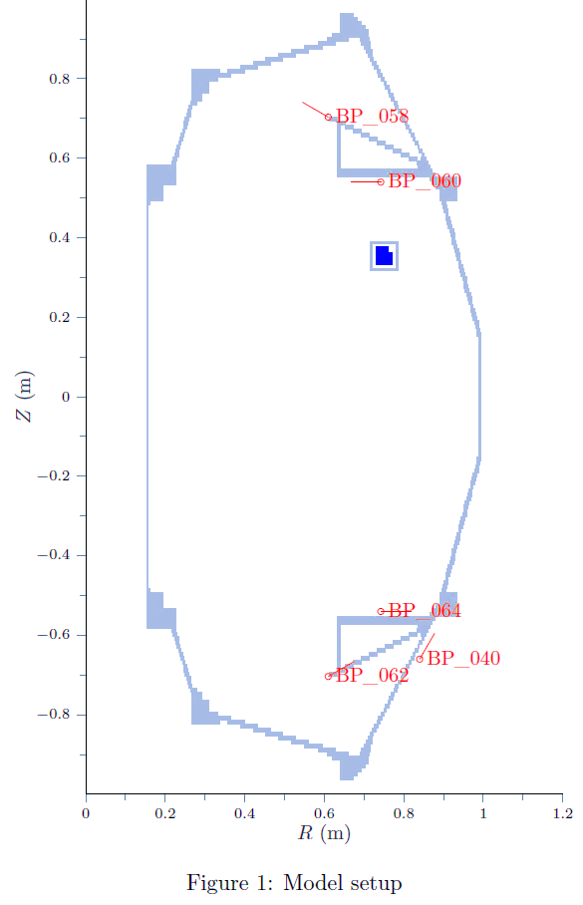
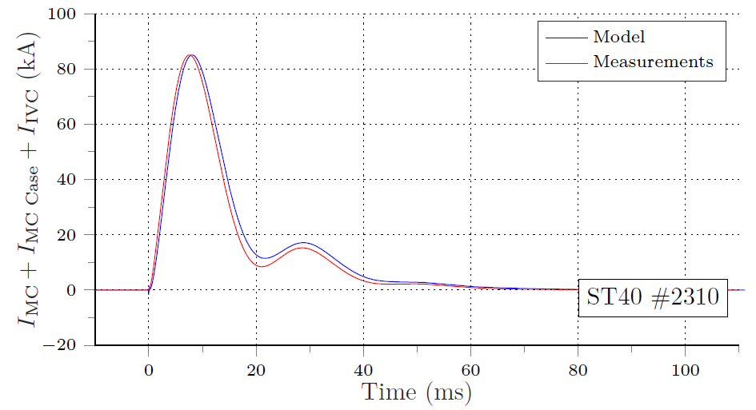
Validation of vessel currents model
It is critical to include image currents when designing scenarios.
Benchmarking of image currents model with experiment, #2310 :
Good agreement, results are important for disruption/VDE studies, so for design of the new IVC

Slide 19
Physics
Predictions of performance for D-T operations
Vertical stability
Divertor concept

Slide 20
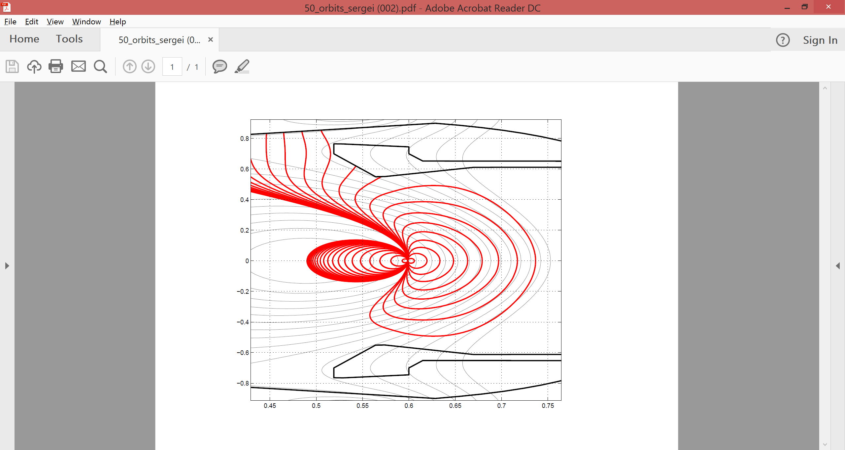
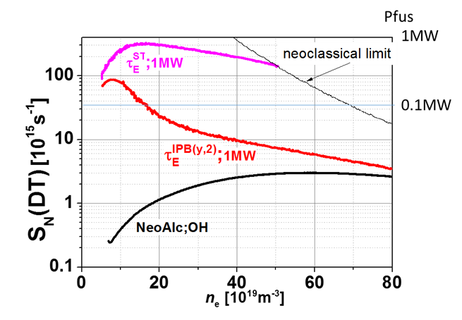
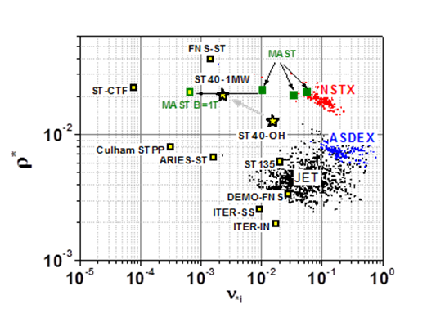


Performance predictions, ASTRA, ASCOT
ASCOT simulations suggest that 1MW 140keV D NBI into pure D-T plasma (50:50) in 3T/2MA scenario will produce 677kW of thermal fusion and 480kW from beam-plasma reactions (for T_{e}(0)=5.7keV, T_{i}(0)= =11.0keV, n_{e}(0)=10²⁰m⁻³)
ST40 can approach Q_{fus} ~ 1 with P_{fus} ~ 1MW if ST scalings work at low ν*
Confinement of alphas is not so bad (>50%) even at 2MA in ST40 (NF 54 (2014) 104005)
ASCOT GC run for 50 equipitched 3.5MeV alphas started at ρ_{pol}=0.5 at the outer midplane in ST40 3T/2MA (A Salmi)

Slide 21
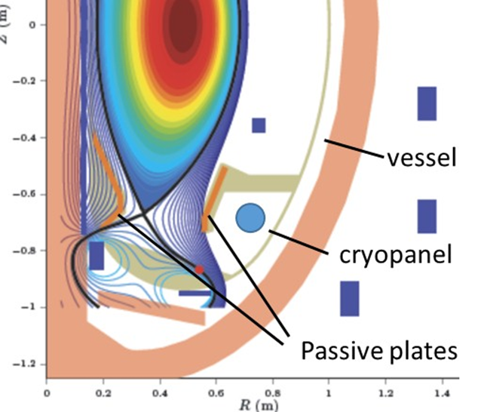
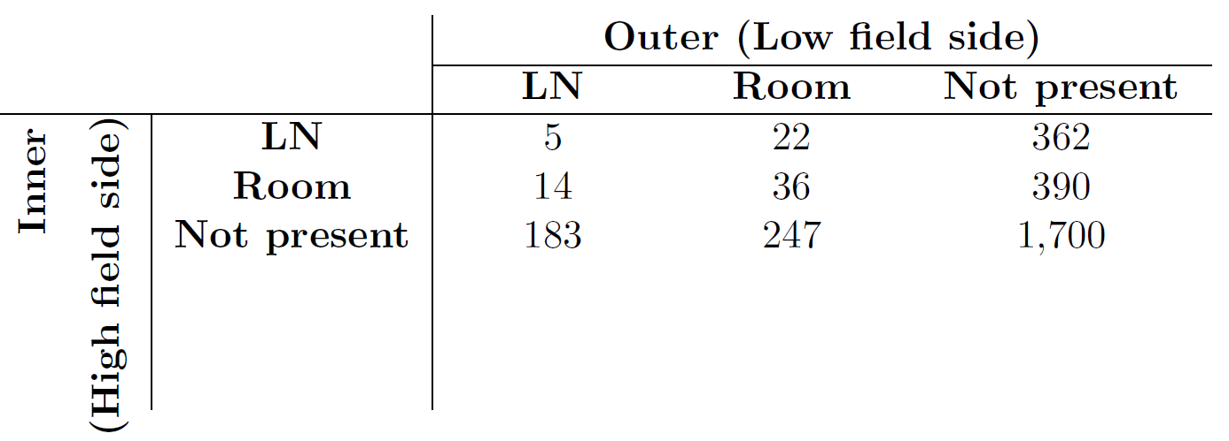
Vertical Stability
It was found that VDE growth rate is very sensitive to position of passive plates (KINX simulations, S Medvedev) and to resistivity of passive plates
We will have LN2 cooled passive plates with position optimized using KINX simulations
KINX simulations are in good agreement with FIESTA+RZIP results:
Vertical instability growth rates (γ) with several different passive stabilisation configurations, s⁻¹.
ST40 divertor layout

Slide 22
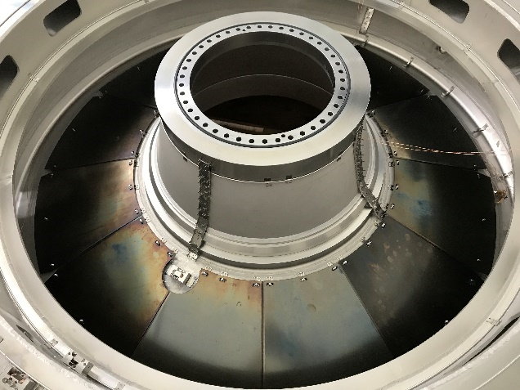
Divertor Concept
Several options for divertor have been considered, including liquid Li divertor (FED, 89 2014 2937). Mo divertor plates installed for now.
Simulations show that ST40 divertor does not require water cooling and divertor loads are moderate
Cryopumping objective: keep n_{neutral} < n_{target} ~ 10²⁰ m⁻³ in the gas box to avoid penetration in the chamber and interference with plasma
Target power load estimated with Eich formula:
  - According to NSTX scaling: λ_{q} ~ 1 cm in ST40 with I_{p} = 1MA
- According to JET & ASDEX scaling: S ~ λ_{q}/4 (worst case)
- Assumption: P_{IT}= 0.1P_{heat} & P_{OT}= 0.9P_{heat}
Peak heat flux density q┴IT = 1 MW.m⁻² & q┴OT = 5 MW.m⁻²
Angle of incidence on target ~ 3º
Mo divertor for Phase 1 ST40 operations
For 10 s pulse, interface CFC/316L SS temperature ~ 100ºC (semi-infinite model with T_{surf} = 2∆tq┴ / (ρC_{p}Kπ)^{0.5} ) if CFC is used for final option

Slide 23
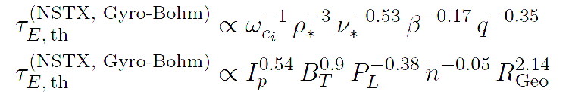
ST-40 domain of operation
Scailings used:
For L-H transition: P_{LH} = 0.072n₂₀^{0.7}B_{t}^{0.7}S^{0.9}(Z_{eff}/2)^{0.7}F(A)^{0.5}
with F(A) = 0.1A/f(A) and f(A) = 1 - [2/(1+A)]^{0.5} [Takizuka NF 2004]
For L-I transition: P_{LI} ~ 1.5-2.5x10²¹n_{e}S [Hubbard NF 2016]
→ “Improved mode” with H-mode confinement of energy and L-mode confinement of particles (τ_{P} ~ τ_{E})
→ Reactor relevant: density control, low impurity and no ELMs
For confinement time [ITER Physics basis NF 1999 & P Buxton]:
τ_{E}⁹⁸ = 0.0562I_{p}^{0.93}B_{t}^{0.15}n₁₉^{0.41}P^{-0.69}R^{1.97}A^{-0.58}κ^{0.78}M^{0.19}
For pedestal energy scaling [Cordey NF 2003]:
W_{ped} = α0.000643I_{p}^{1.58}R^{1.08}P^{0.42}n_{e}^{-0.08}B_{t}^{0.06} κ^{1.81}A^{2.13}m^{0.2}F_{q}^{2.09}
with F_{q} = q₉₅/(5κa²B_{t}/(RI_{p})) and α ~ 0.5 calibrated on C-mod data
For pedestal pressure and temperature:
p_{eped} = p_{iped} = W_{ped}/(3x0.92V_{p}) and T_{eped} = T_{iped} = p_{eped}/(en_{ped})

Slide 24
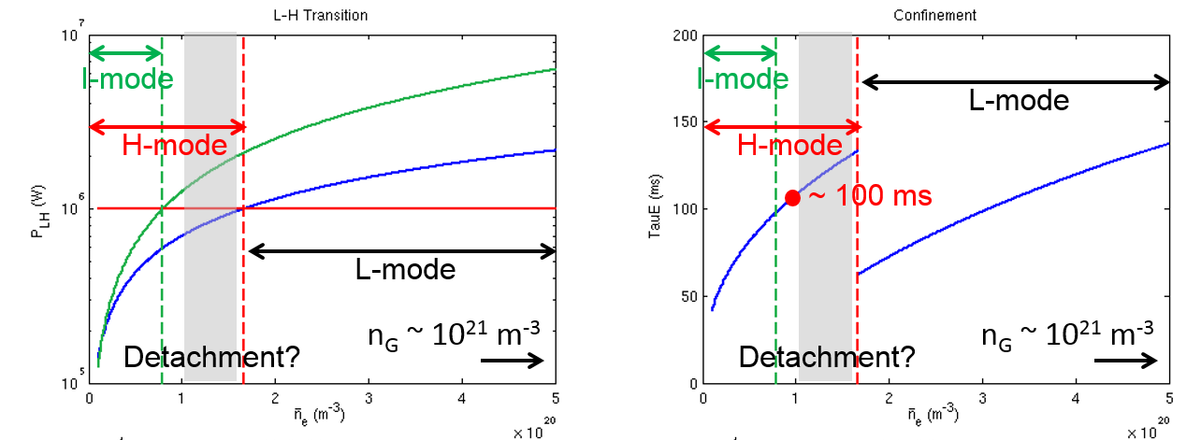
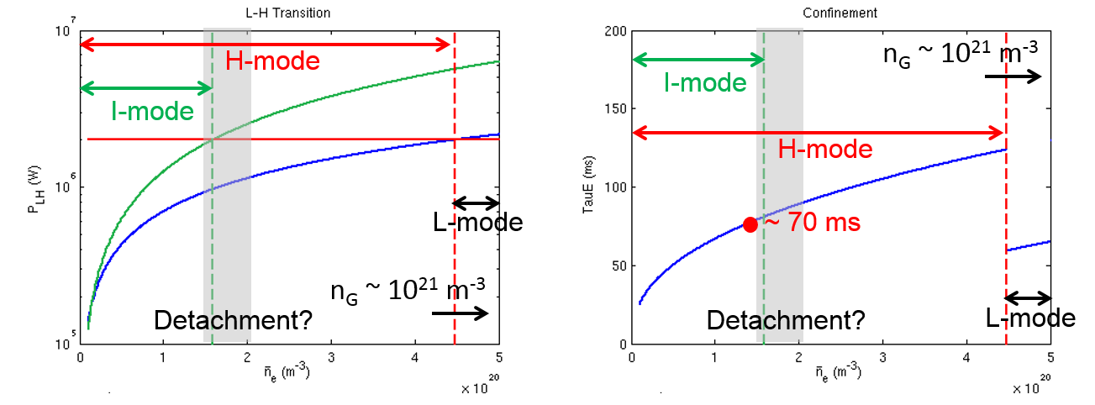
ST-40 domain of operation
P_{NBI}=1MW
P_{NBI}=2MW
• T_{ped} should be high for a hot ion DT scenario (Li conditioning?)
“Low” n_{ped} of 0.5 – 1x10²⁰ m⁻³ should allow T_{ped} = 1 – 2 keV and should keep us away from detachment (Li conditioning, cryo-panel?)

Slide 25
Fueling, pumping, retention
Fueling is governed by τ_{P} and retention
If τ_{P} ~ 8 – 9 τ_{E} in H-mode the plasma can be 100% fueled by NBI
If τ_{P} ~ τ_{E} like in L or I-mode, puffing or PI (proposed) will be necessary to control the density and can by as high as ~ 3.5x10²² s⁻¹ (accounting for 70% dynamic retention and inner wall fueling efficiency of ~ 10%)
Estimation of tritium retention and needs:
In H-mode with τ_{P} >> τ_{E} :
→ For ~ 100 DT pulses of 1s two possibilities can be considered:
→ If T is recycle we need only ~ 41 mg
→ If T is not recycled we need ~ 125 mg
If τ_{P} ~ τ_{E} (possibly L or I-mode):
→ if T is recycled we need ~ 3 g
→ If T is not recycled we need ~ 8.5 g
We should develop a hot ion H-mode scenario requiring very little or no puffing to keep our needs for T around ~ 100 mg (regulations!)

Slide 26
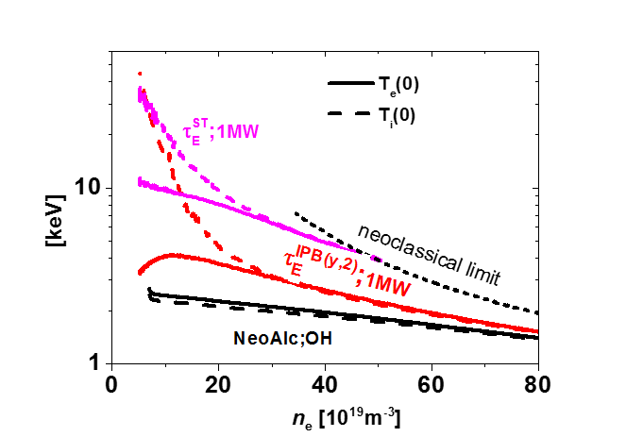
Hot ion mode in ST40
NBI heated H-mode plasmas in NSTX and MAST generally have a higher ion temperature compared to the electron temperature, even though a higher fraction of the NBI power (~60%–70%) is estimated to flow into electrons.
But ST40 has an advantage of 10 times lower ion neoclassic heat conductivity over MAST and NSTX, so high ion temperatures expected
ASTRA: 1 MW additionally heated plasma
Main assumption of ion neoclassic heat transport at low collisionality can be confirmed in ST40 in 1 MW externally heated plasma
High ion temperature at low collisionality may be possible even for pessimistic confinement predictions

Slide 27
Summary of ST40 objectives
Main engineering objective:
- to demonstrate feasibility of high-field ST
Main physics objective:
- to demonstrate advantages of high field in ST, aiming at 10 keV-range plasma temperatures
Main objectives of possible upgrades:
- demonstration of efficient production of neutrons
- demonstration of Q_{fus}~1 with upgraded NBI system in DD equivalent and with DT subject to site availability and tritium licence.
ST40 will be the first high field Spherical Tokamak
Necessary step on the way to steady-state ST reactor module

Slide 28
Future plans
Move to new site (several options considered, incl. Culham)
ST40:
  Add divertor and LN cooled Cu vertical stabilization plates, and satisfy the requirements for tritium operation
  Neutral beam injection (NBI): 2 systems under consideration, one to assist start-up (already during Phase 1), one for heating during flat-top in DD
  2MW 2gyrotrons ECRH/EBW project started
  Likewise for pellet injector
Following test magnet programme, prototype HTS TF magnet
Conceptual design of Fusion Demonstration device has started (see poster by S McNamara) and will be completed early next summer.
Notes:
Short pulse Japanese beam for start-up. JET tritium plant to be closer to us than JET.
Minimal shielding of the centre post.

Slide 29
Back-up slides

Slide 30
ST40 long and short term plans
Short term plans, 2017
- TF trial assembly, contact resistance measurements, m/c coil (P3) tests up to 600kAt
- BVL tests on outer OVC belt
- low TF (0.3T) m/c plasma formation experiments
Longer term plans, 2018 Q2-3
- 1.2T m/c coils tests and m/c formation optimisation
- m/c optimization and 100M degrees attempt
Longer term plans, 2018 Q4
- 3T DND ops, H beam into D (AIST/RFX NB)

Slide 31
Modular Fusion Power Plants
Based on CoE ⇨ compelling arguments for fusion plants based on:
Spherical Tokamaks
~100% bootstrap current to reduce recirculating power
High beta operating point to reduce capital cost
Confinement has potential for ignited operation at moderate P_{fus}
High Temperature Superconductors
20K operation to reduce recirculating power for refrigeration
High critical field (>20T) at reasonable J ⇒ high P_{fus} relative to size
Fusion Power Modules
Reduced capital cost of modules due to “series manufacture”
100% availability with reserve module to maximise revenue
Shared services and CD systems further reduce capital cost.

Slide 32
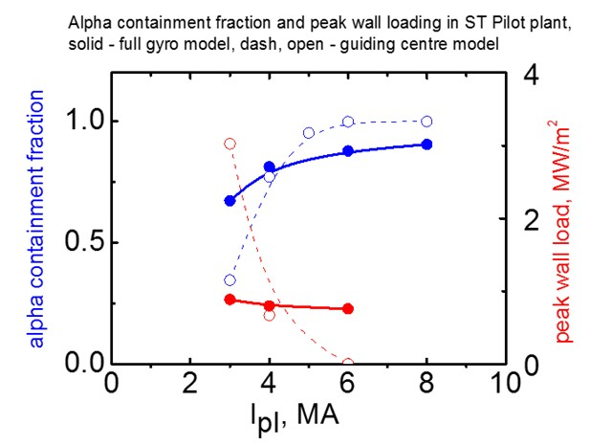
α-particles containment & wall load in ST Pilot plant
Monte-Carlo Beam Deposition Code NFREYA and Fast Ion Fokker-Planck Code FIFPC, comparison with guiding centre model
Full-orbit simulations show possibility of reducing I_{p} in compact ST reactor

Slide 33
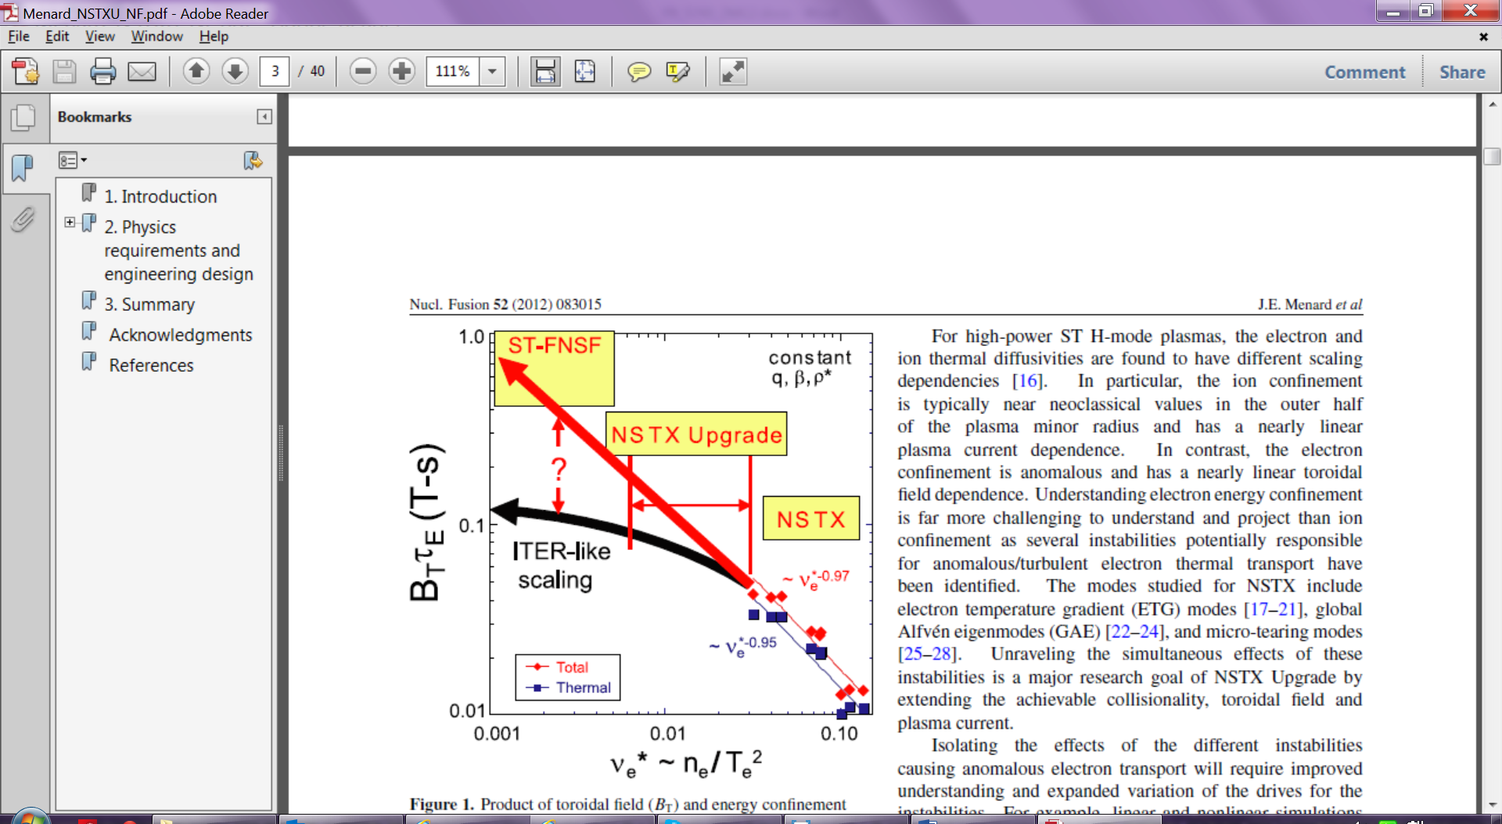
ST40 in parameter space
Electron neoclassical limit for ST40
ST40
H_{NSTX}=1
ST40 plasma can be a test for collisionality confinement scalings
τ_{E}~ν*-0.8
ρ*_{ST40}= ρ*_{MAST}
β_{ST40}= β_{MAST}
ST40
H_{ITER}=1
MAST
MAST
IPB(y,2) : Bτ_{E,th} ∝ (ν*)^{0.01}(ρ*)^{-2.73}β^{-0.88}A^{-0.74}q⁻³
MAST : Bτ_{E,th} ∝ (ν*)^{-0.82}(ρ*)^{-2.5to-3}β^{-0.5to0}q^{-0.85}

Slide 34
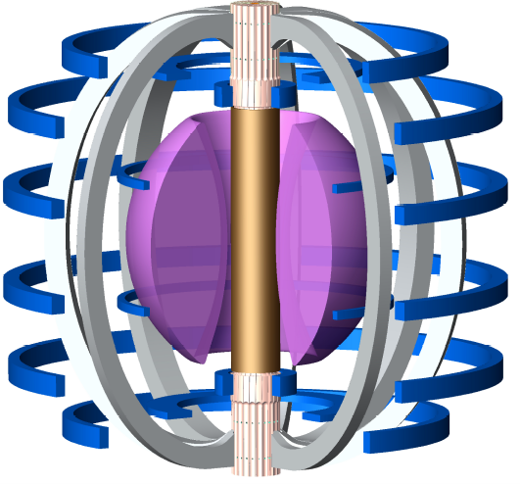
HTS key technologies
REBCO conductors
I_{C} surface
Boundary resistance
Tape construction
Quality / variability
Quench protection
Current sharing
Detection
Dump
~100 kA cable design
AC losses
% copper content
Cooling
Joints
Size, shape, position
Heatload - many or few ?
Mechanical design
PF / TF coil locations
Forces
Demountable coils ?
I_{C} degradation
Neutron damage
Thermal cycling
Mechanical
Fatigue
Cryogenics
Neutron heating
Joint heating
Suspension
Vacuum vessel
Power supplies
Current leads
Dump circuits
Cold rectification ?

Slide 35


Operating Range for FPD

