Slide 1
NSTX-U CAD Integration Meeting
Dimensional Control Working Group Overview
M. Mardenfeld
October 4, 2017
Dimensional Control Google Drive
NSTX-U Eng > WBS 1.1 > Sys Eng & Integration> Dimensional Control
https://drive.google.com/open?id=0B9yOrU8Z_IpZWVdnNkFaMTJhR1U

Slide 2
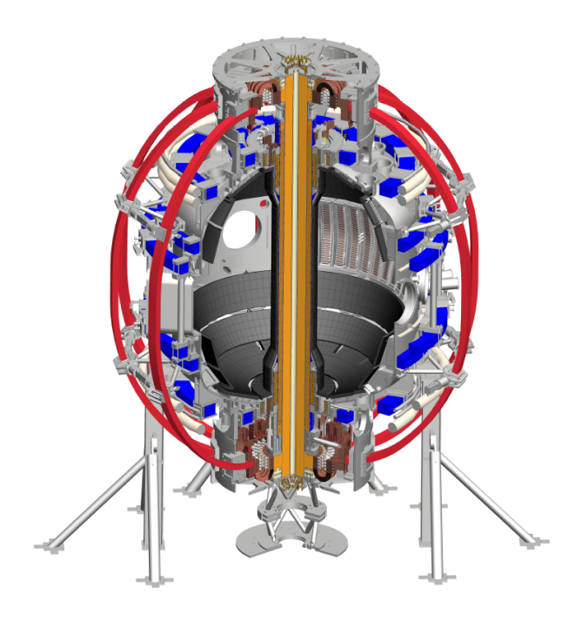
What is the need Dimensional Control should fill?
The relative locations and orientations of some components have a heightening impact on the ability to achieve high level machine goals
Driving Concerns
Physics Desired Magnetic Topology
PFC/Plasma Interface and Heat Flux
Net Structural Loads
Mechanical Assembly and Fit Up
“Location Critical Components”
OH/TF Bundle
PF4/5
OBD
NSTX-U is a system of systems, and their interfaces and configuration requirements need to be coordinated in a considered way which minimizes project risk
CS Casing
Main 47” Vessel Flange
IBD PFCs
CS Support Pedestal
PF1A/B
etc…

Slide 3
Scope of Dimensional Control Working Group
Define achievable alignment requirements and tolerances which are mutually acceptable for all “Location Critical Components” and machine performance.
Be a forum for interfacing between critical hardware and key stakeholders
Define a plan for verifying a subset of these tolerances in the as built machine
Resolve issues related to position, alignment, and orientation.
Provide recommendations for sequencing and assembly choices where the group determines the criticality of assembly requires a specific holistic plan
(Identify and Coordinate the needs for metrology measurements related to “Location Critical Components” and store results)
(Provide longer term ownership for Dimensional Control concerns and be a resource to the rest of the NSTX-U team during operations and future modifications to NSTX-U)

Slide 4
Sample Dimensional Control Breakout
(Radial CS Build)
Realistically allocating space and alignment requirements is the primary immediate need….
Allowable Deviation of Incident Plasma Heat Flux from Nominal Angle of Incidence
TF/OH Bundle Position/Geometry
PFC Position/Geometry
(Total Allowance)
TF Rogowski Thickness
Microtherm
Tile Size
Installation Clearance
Tile to Tile Step Height
CS Casing Position/Geometry
Tile Angular Orientation
PFC Position/Geometry
At Risk Performance
(If all components built with worst case tolerances)
Tile Shaping
Dimensional Control Working Group Scope
Individual System Scope

Slide 5
Proposed Workflow for Dimensional Control
Identify:
Location Critical Components
Key Interfaces
Recommend Assembly and Installation sequences where necessary
Perform Trade Studies on tolerable dimensional deviations
Field Error
Mechanical Fit Up
Component Tolerances
Load Impacts
Etc.
Check against machine requirements which are above the individual system level
Track metrology data in a central repository
Individual Systems Identify Impacts
Design
Cost
Schedule
Performance
Develop plan for verifying as installed condition of critical components (as necessary)
Apportion Total Acceptable Deviation into Allowances for each System
Identify additional configuration control concerns and needs and forward to responsible parties

Slide 6
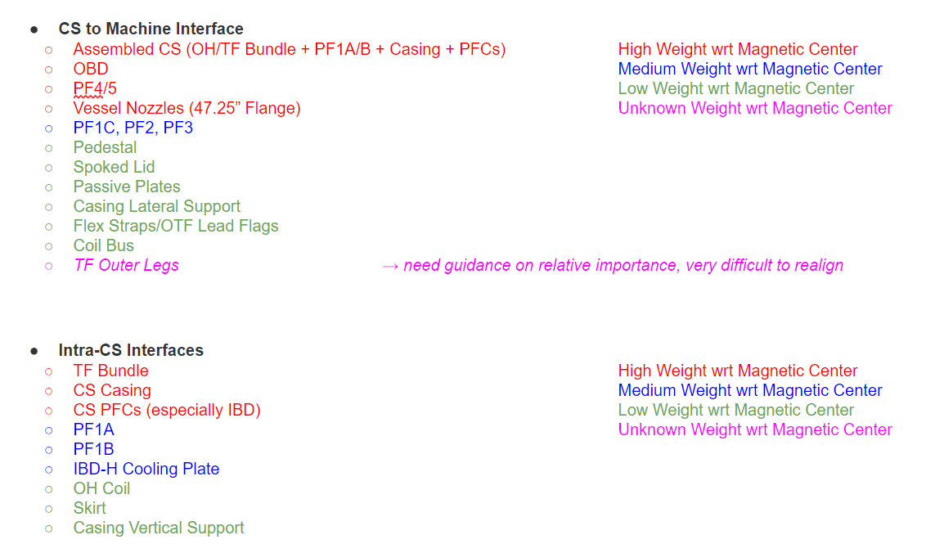
Working List of Location Critical Components
(2017-10-3)

Slide 7
WIP Proposal for Definition of Magnetic Center
(2017-10-3)

