Slide 1
Scoping for PCS heat flux control
Dan Boyer¹, Pat Vail², Matt Reinke³
PFC working group meeting
May 2018
¹PPPL,
²Princeton U.,
³ORNL

Slide 2
Control of heat flux to PFCs expected to be important part of commissioning/operating NSTX-U at high power
Other activities will define engineering limits of PFCs and monitoring requirements
Validated models are expected to become available for use in real-time prediction of heat flux
Likely to feed into existing ‘shutdown handler’ system to avoid exceeding pre-determined thresholds
It is expected that, at least over some operational range, active control of the heat flux will be used to avoid exceeding thresholds for as long as possible, e.g., to achieve 5s 10MW discharges
Operations guidance from PFC working group will determine final requirements for active control, but we can begin scoping

Slide 3
Goals of present scoping activity
Develop mechanism for simulating control for arbitrary plasma equilibria from EFIT or TRANSP
Control algorithm for simultaneous control of heat flux related quantities defined in PFCR-MEMO-017-01
Mechanism for generating GEQDSK files from output of simulations for further heat load analysis
Feasibility study for two cases and assessment of impact on control of other shape parameters

Slide 4
Mechanism for simulating control
NSTX-U TOKSYS tools being developed by Pat Vail
EFIT description of conducting structures, magnetics
Linear and nonlinear models of shape evolution in response to coil voltage changes
Modeling approaches
Fixed plasma: Vacuum response with fixed current distribution from reference equilibrium
Rigid plasma: Linearized response assuming equilibrium current distribution
Non-rigid plasma: Linearization formed from perturbed solutions of G.S. equation
Time-varying linear: Update linearization at points during simulation (e.g., ramp-up studies)
Nonlinear simulation: Solve G.S. equation at each step, or linearize at many points during simulation

Slide 5
Setting up simulation
Reading in reference equilibrium
Assuming non-inductive, I_{vv,eq}=0, I_{OH,eq}=0 for now, will add OH swing in later iterations
Can read in EFIT GEQDSK and AEQDSK data
TRANSP can generate GEQDSK – need to make AEQDSK files or mimic the data
Matlab script for generating model linearized around reference
Model implemented in Simulink along with necessary control algorithms
Matlab script for setting up control parameters

Slide 6
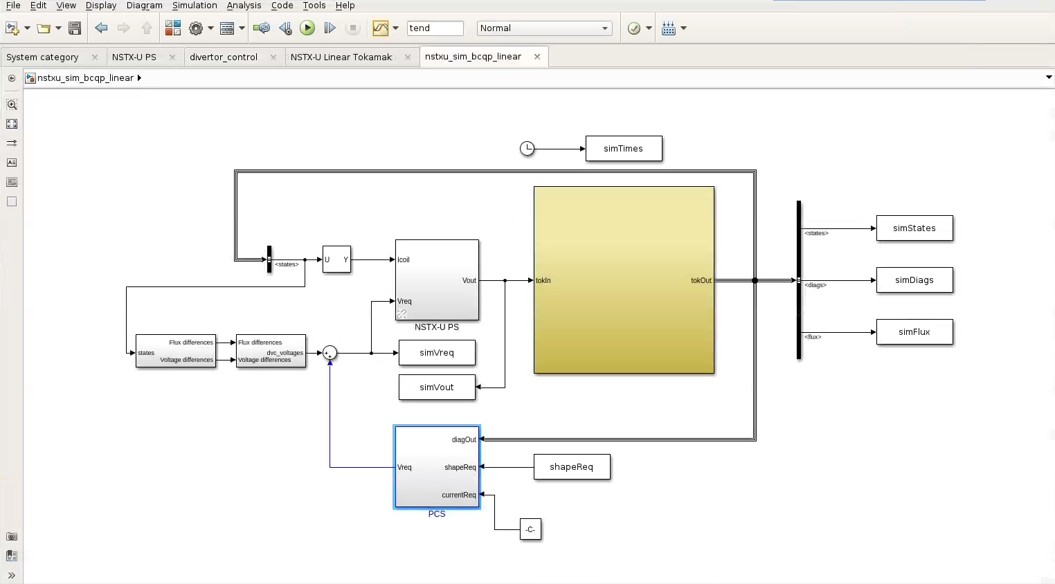
Simulink model
Run simulation
Power supply model
Vertical control
Plasma model
Shape control

Slide 7
Simulation mechanism on-going work
Validate plasma models, begin using non-rigid model
Include more sophisticated power supply model (only using a delay at the moment)
Read in equilibria from TRANSP, write out GEQDSK
Related functions exist but need to put them together and debug
Include option for OH swing in simulations
Once control prototyping is complete, can connect models to PCS for PCS-in-the-loop simulations

Slide 8
Control system goals
New algorithm needed to simultaneously control:
dr_{sep}/λ_{q}: Assuming λ_{q} is not a function of shaping parameters, this is equivalent to controlling dr_{sep}
Inner and outer strike point locations: NSTX-U commissioned X-point RZ control and X-point Z + outer strike point R control. Need to enable sweeping (triangle wave)
Up for discussion – Other waveform shapes for sweeping, how to select sweep amplitude, frequency, inner/outer phasing
Average angle of incidence or normal field between strike point and a nearby point: I think the latter can be achieved by controlling flux difference between nearby point and strike point. Angle of incidence most important in toroidal direction, may be best to control with small toroidal field changes.
Up for discussion – how should targets be defined? Maximize wetted area, constrained by tile edge limitations? Does this quantity need to stay fixed during strike point sweeps or just within some limits? Could we just sweep faster through points that have higher normal field?
Outer boundary: midplane outer gap, upper/lower outer gaps
Inner gap: Previously indirectly controlled through variation of X-point location, upper/lower outer gaps

Slide 9
Angle of incidence, normal field, or flux difference?
From
PFCR-MEMO-004-01
Angle of incidence
Normal field
Integrating normal field over divertor just outside S.P. -> flux difference.
Control flux difference and monitor predicted angle of incidence?
Optimal control scheme could minimize normal field or heat flux and enforce constraints on angle of incidence.

Slide 10
Feedback control approach
Outer boundary: SISO ISOFLUX control
dr_{sep}: Adjust upper/lower outer boundary target points to achieve target dr_{sep}
Strike points and ‘flux expansion’ points: Constrained model-based optimization of divertor coil currents (constrained by current limits for now, planning to eventually include limits on outputs, coil forces)
Optimization weights flux errors at target points, could include weights on X-point errors, or affect on inner gap, triangularity, etc.
Constraints on outputs could include limits on angle of incidence, avoiding introducing rogue X-points
Inner gap control:
Not sure yet – may need to optimize sweep to minimize impact on inner gap

Slide 11
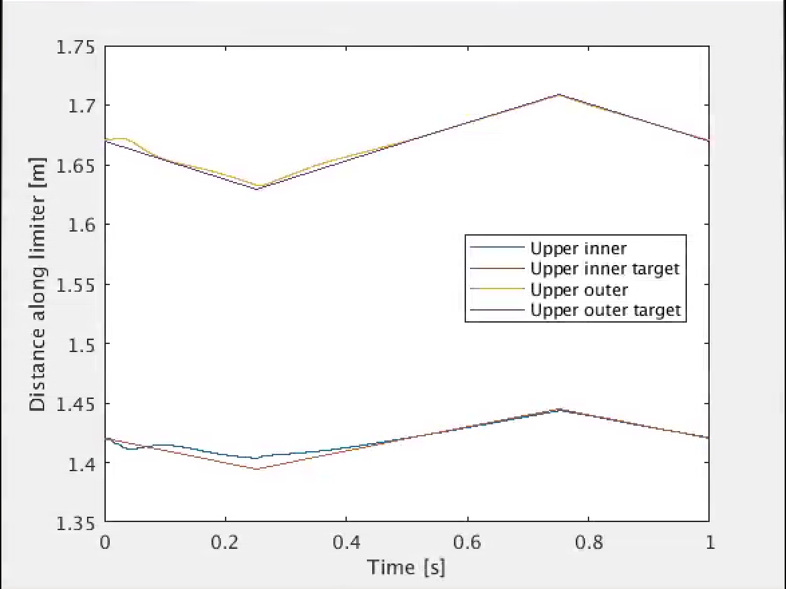
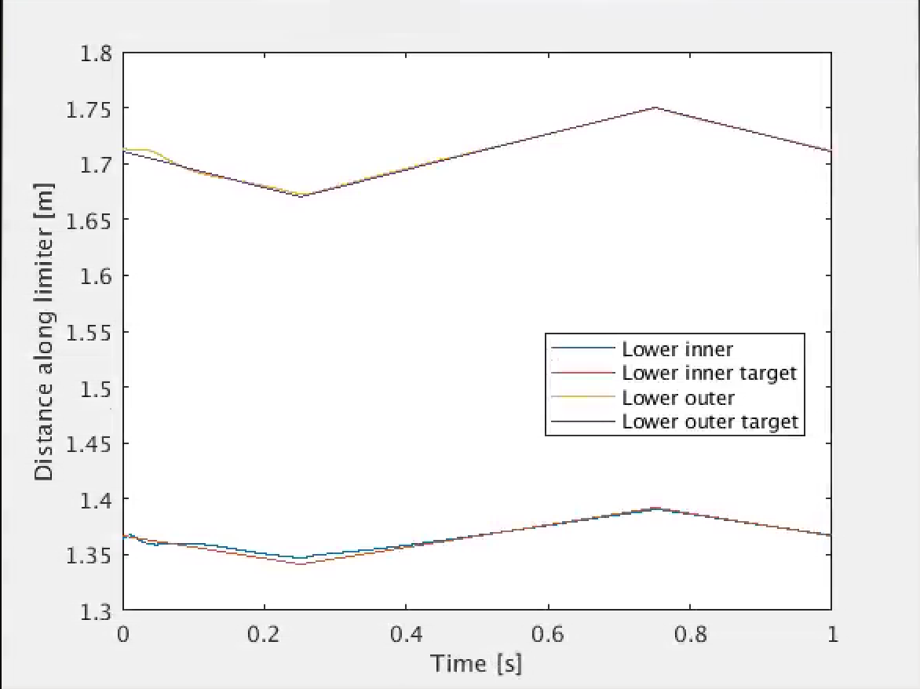
Initial test: strike point location tracking
Modeled around 204118 at t=0.7s
Controller designed with same model – not a good test of robustness to uncertainties
Sweep frequency defined in memo from Matt, magnitude and phase adjusted to reduce impact on shape
Tracking improves on second oscillation

Slide 12
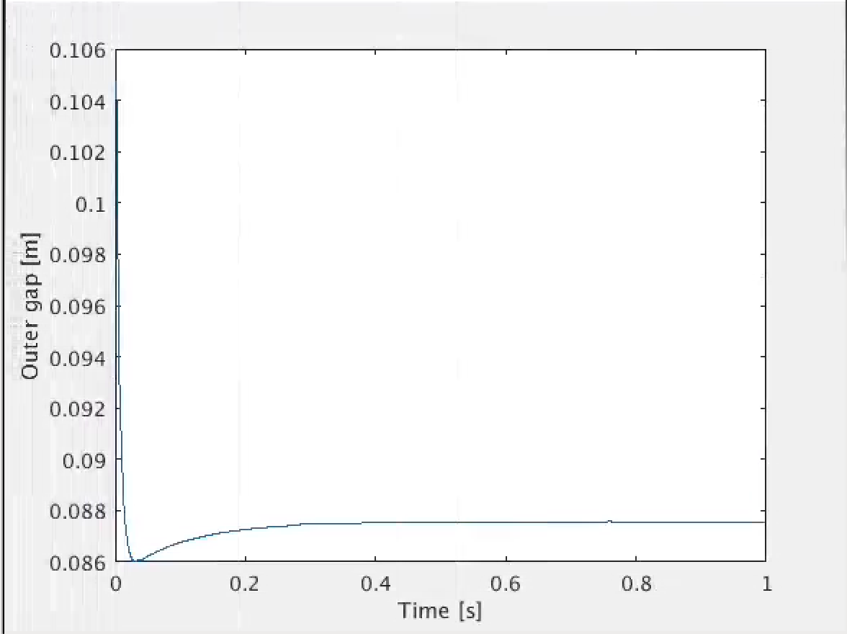
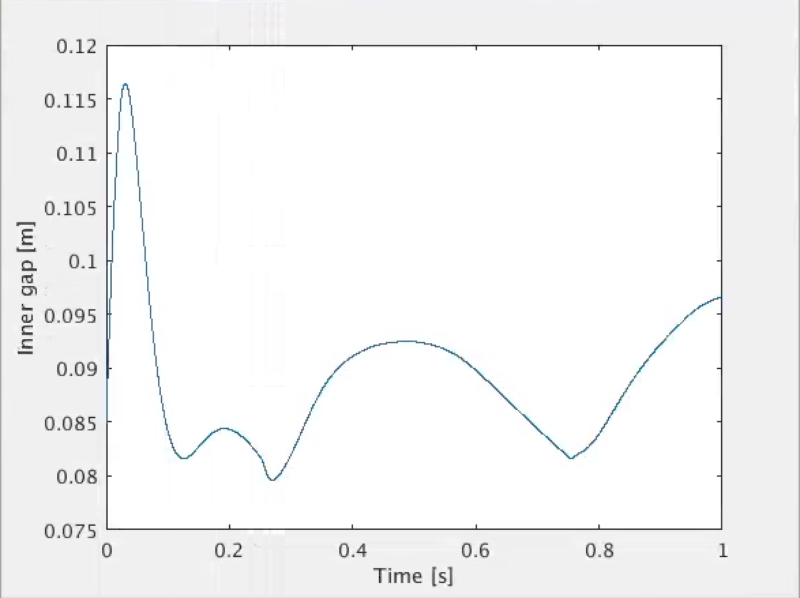
Initial test: impact on outer/inner gap
Outer gap not really impacted at all
Inner gap was changing by ~10cm with initial phasing of sweep. Switching phase and adjusting magnitude helped but could be optimized further.
Will need to avoid control inducing phase shift to avoid introducing large inner gap changes during sweeps

Slide 13
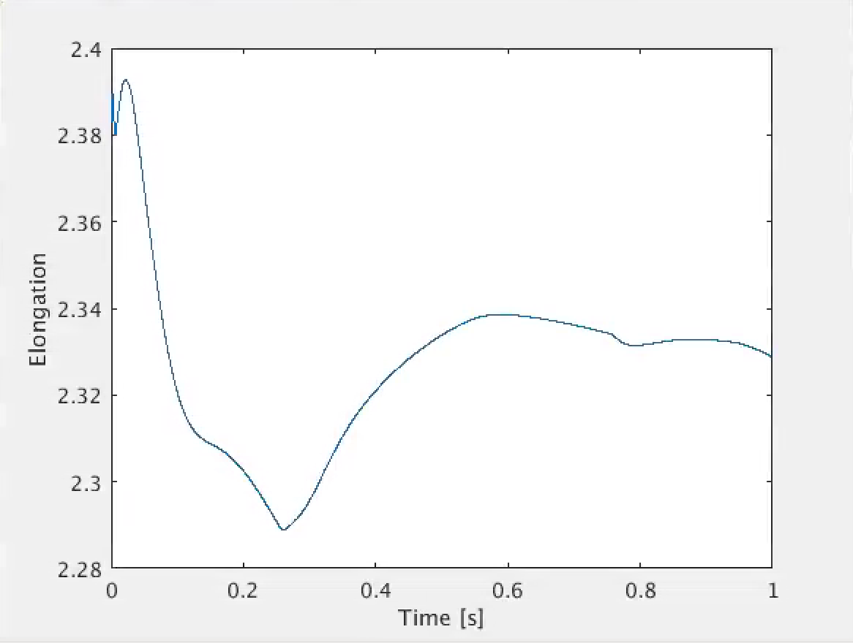
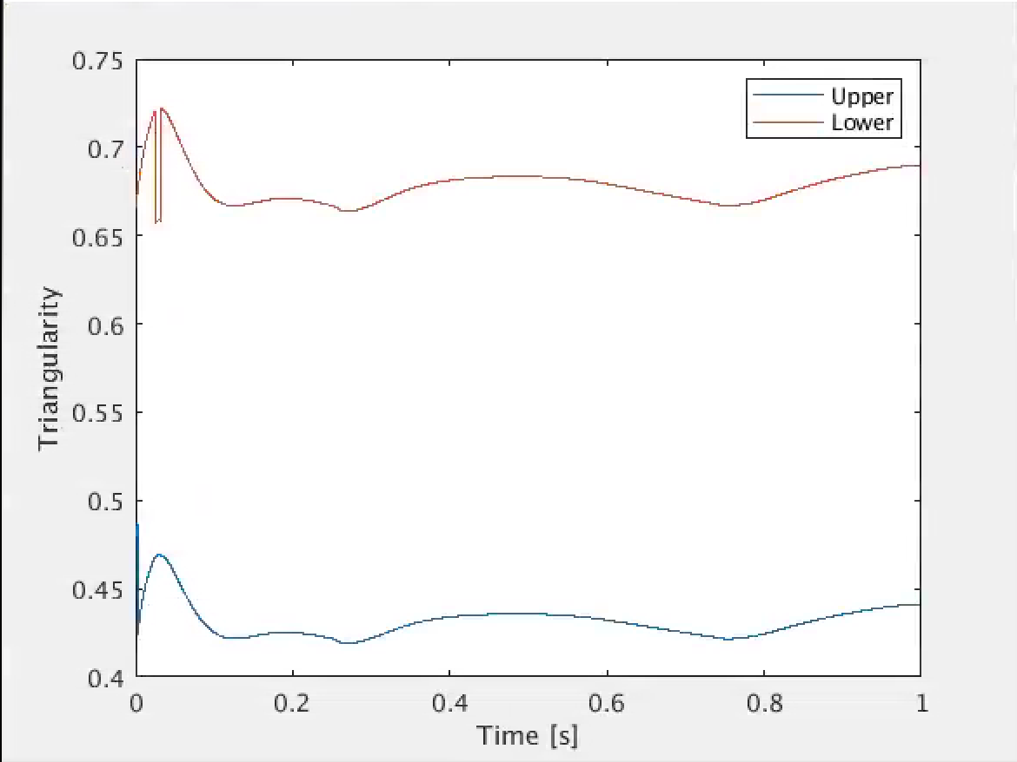
Initial test: Impact on elongation and triangularity
On second oscillation, not much impact on elongation
Fairly small oscillations in triangularity
Sweep design tool should minimize this impact and control should avoid introducing phase shifts

Slide 14
Possible deliverable: Offline (+real-time) sweep design tool
Input: equilibrium and heating power
Model: Linearized shape response model, Eich heat-flux model, tile temperature rise model -> options for this?
Process: Optimize sweep magnitude, frequency, phasing
minimize weighted combination of
Shape parameters
Possible shot length – target shot length
Tile temperature
Constrained within
Current limits, voltage limits
Angle of incidence limits, temperature/heat flux limits
Output: GEQDSK for further analysis,
Targets, current and voltage feedforward waveforms for PCS

Slide 15
Next steps for control design
Increase sweep frequency
Optimize gains and control approach to achieve good tracking without extreme gains (reduce noise sensitivity)
Add constraints on angle of incidence, decide how to choose targets for flux expansion (just rely on offline sweep design tool?)
Scope real-time version of sweep design tool
Real-time tile temperature prediction
Adjust target sweeping based on changes to the shot
Predict time remaining – suggest changes to heating, etc.
Add option to run feedback test to sweep design tool

