Slide 1
Sweeping Study Update
S.P Gerhardt
PFC WG Meeting
6/14/2017

Slide 2
About the Study
The PFC requirements presently allow for sweeping the ISP & OSP, simultaneously, to mitigate large heat fluxes in standard DN divertor cases.
Vague Plan
Develop equilibria for a range of sweeping scenarios
Assess what shape parameters change under various sweeping scenarios
Computer heat fluxes all the cases.
Assemble the heat flux profiles in an oscillatory manner as a surrogate for sweeping.
Computer “smeared” heat fluxes and compare to out present tile designs.

Slide 3
Method #1
Scans of elongation and triangularity in small increments
Fixed squareness request

Slide 4
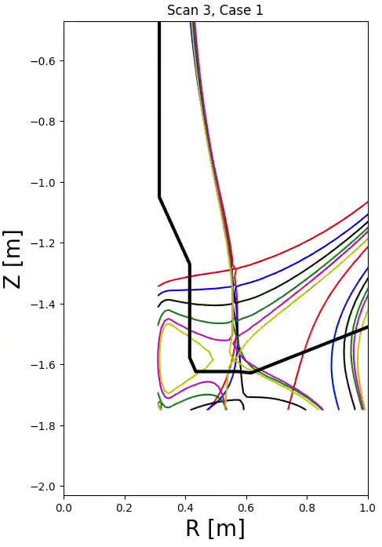
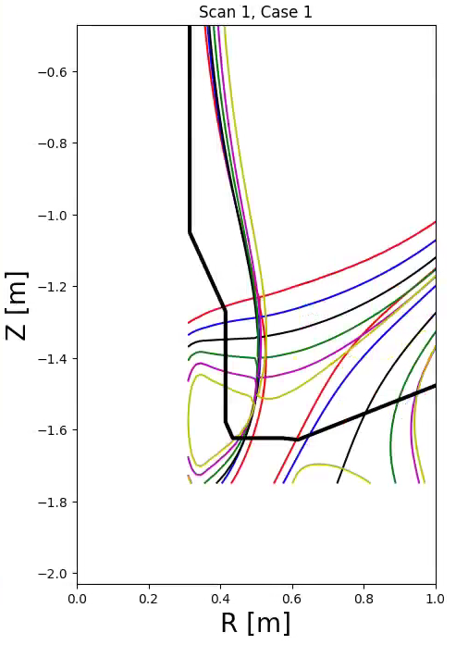
Elongation Scans at Fixed Triangularity and Squareness ISP Scans
κ Scan, higher δ, with -1c, I_{OH}=0
κ scan, reduced δ, with -1c, I_{OH}=0

Slide 5
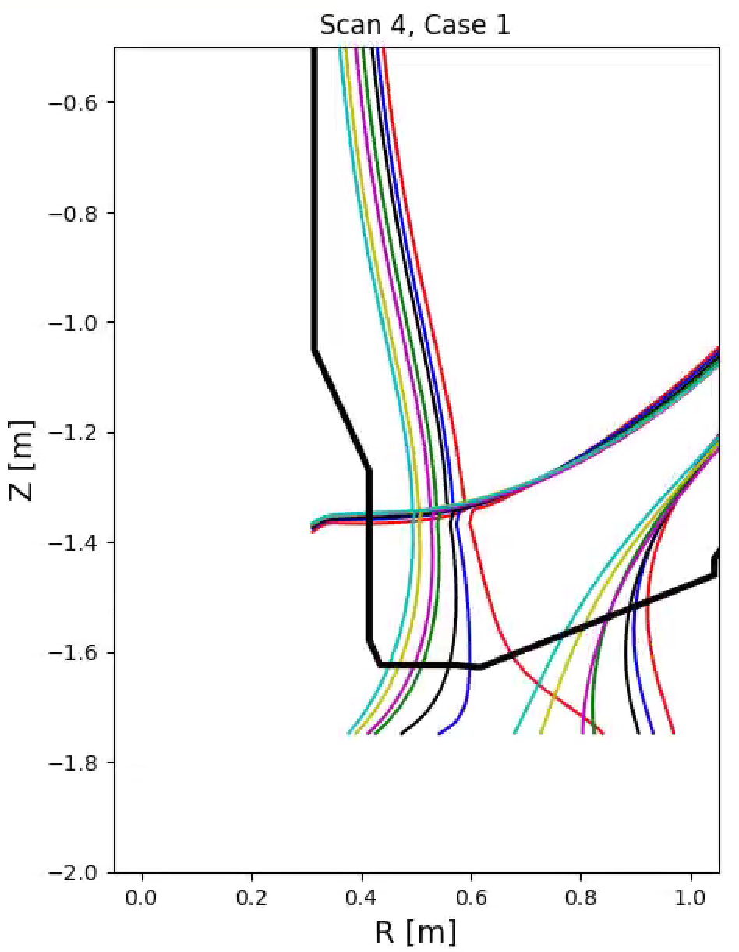
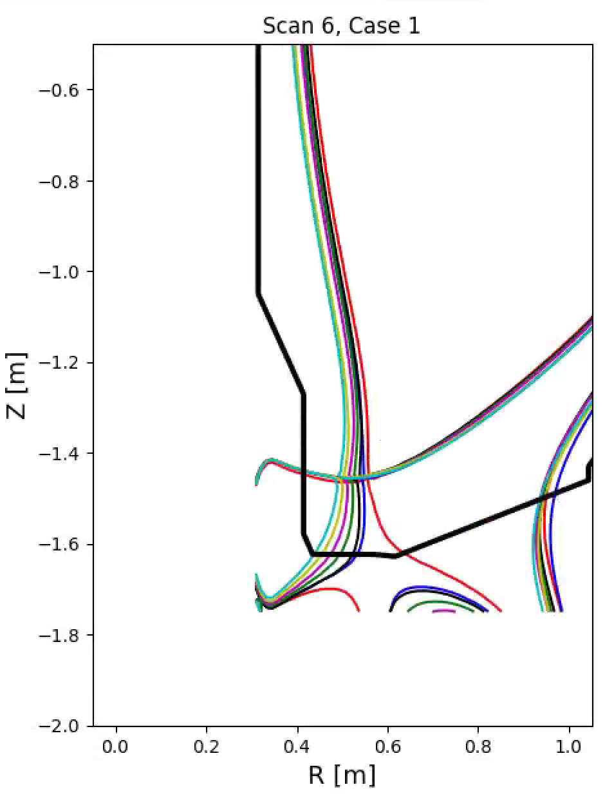
Triangularity Scans at Fixed Elongation and Squareness OSP Scans
δ Scan, lower κ, with -1c, I_{OH}=0
δ scan, higher κ, with -1c, I_{OH}=0

Slide 6
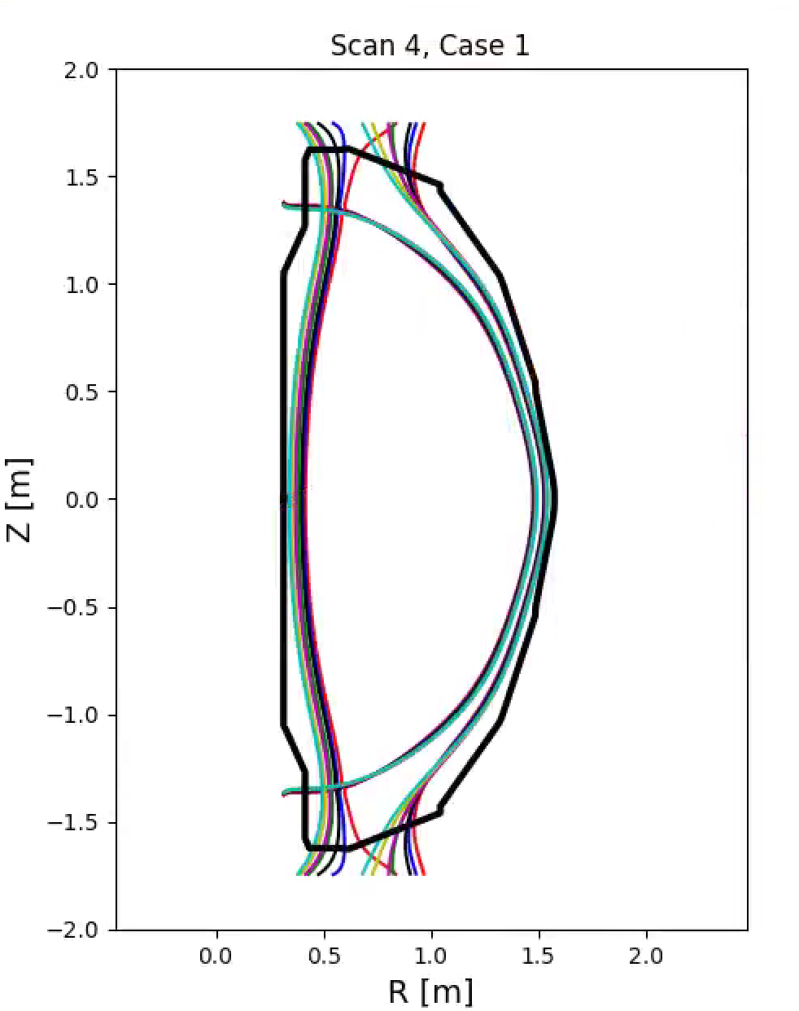
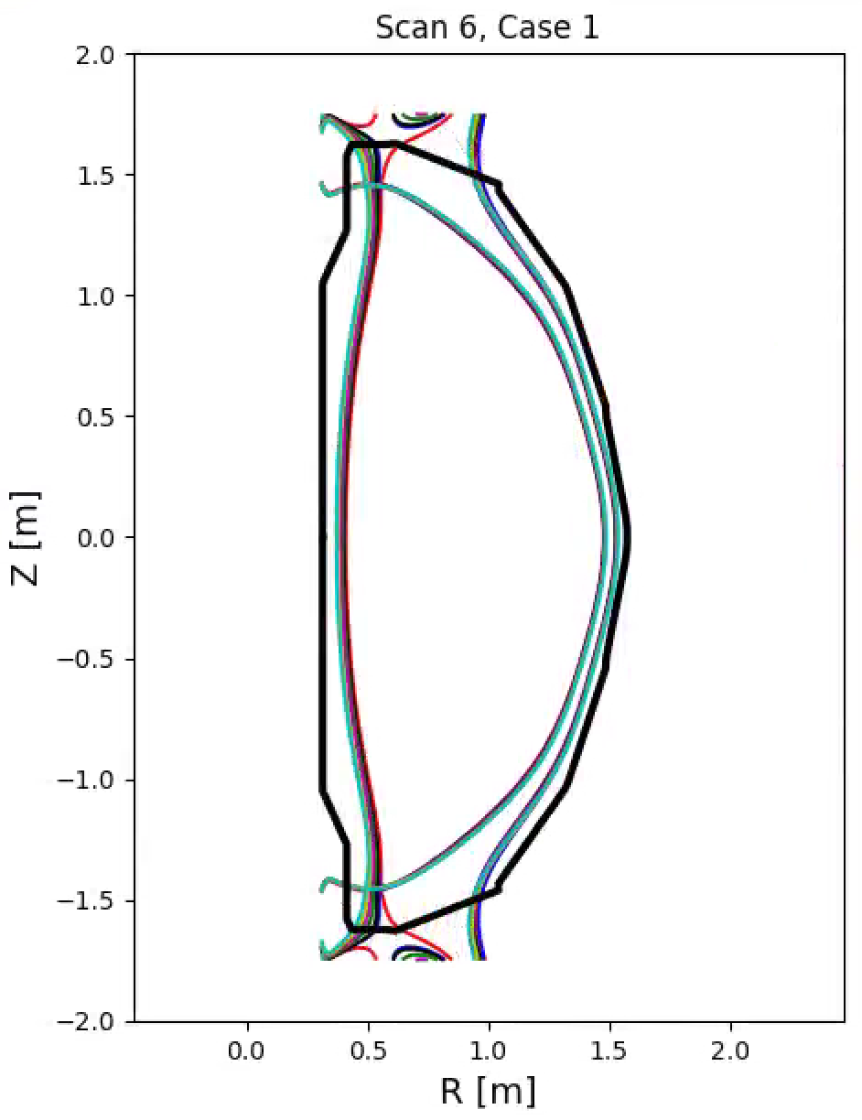
Triangularity Scans at Fixed Elongation and Squareness OSP Scans
δ Scan, lower κ, with -1c, I_{OH}=0
δ scan, higher κ, with -1c, I_{OH}=0

Slide 7
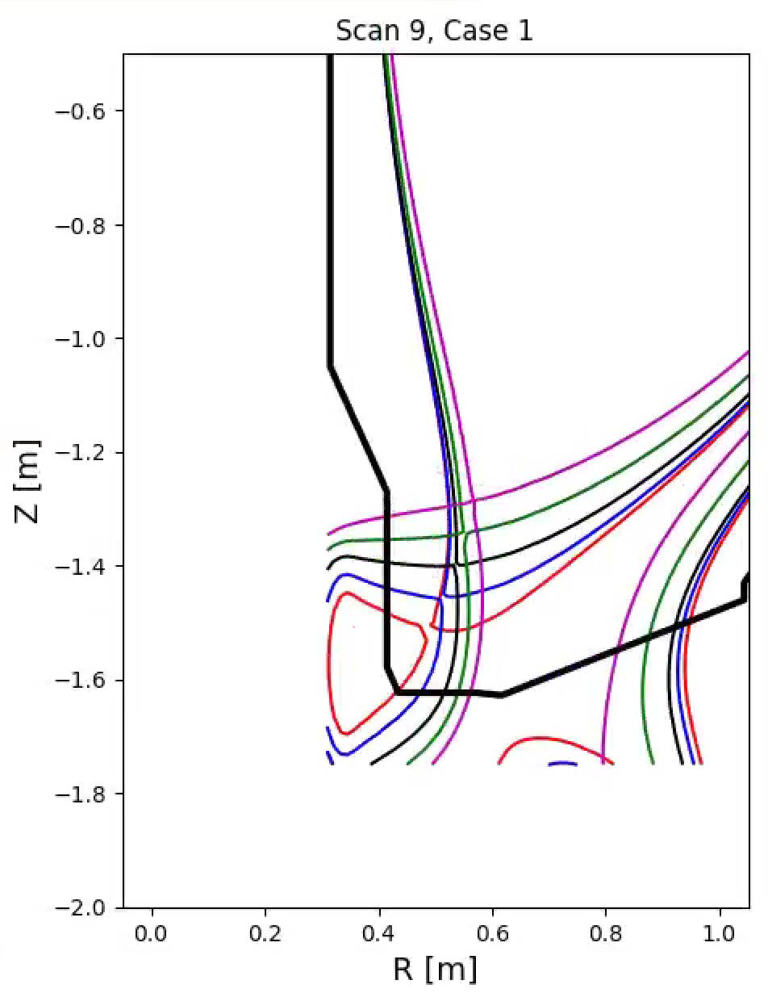
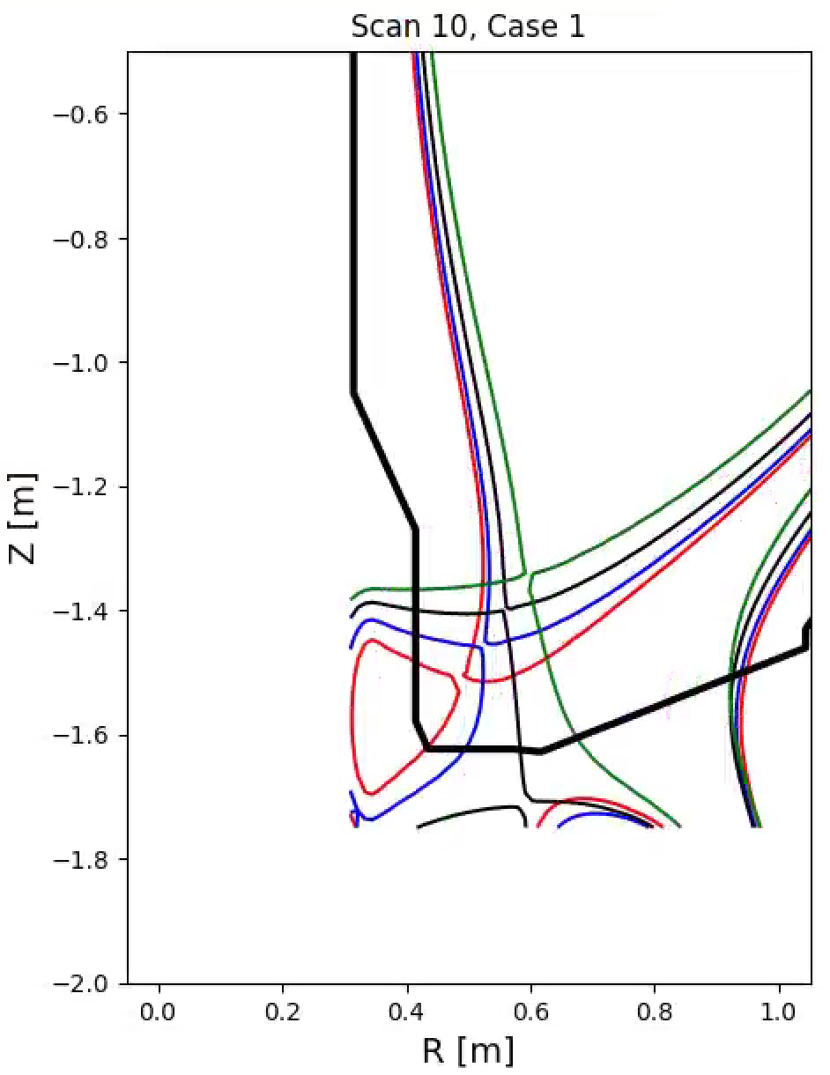
Scan κ and δ Simultaneously to Vary Both the ISP and OSP

Slide 8
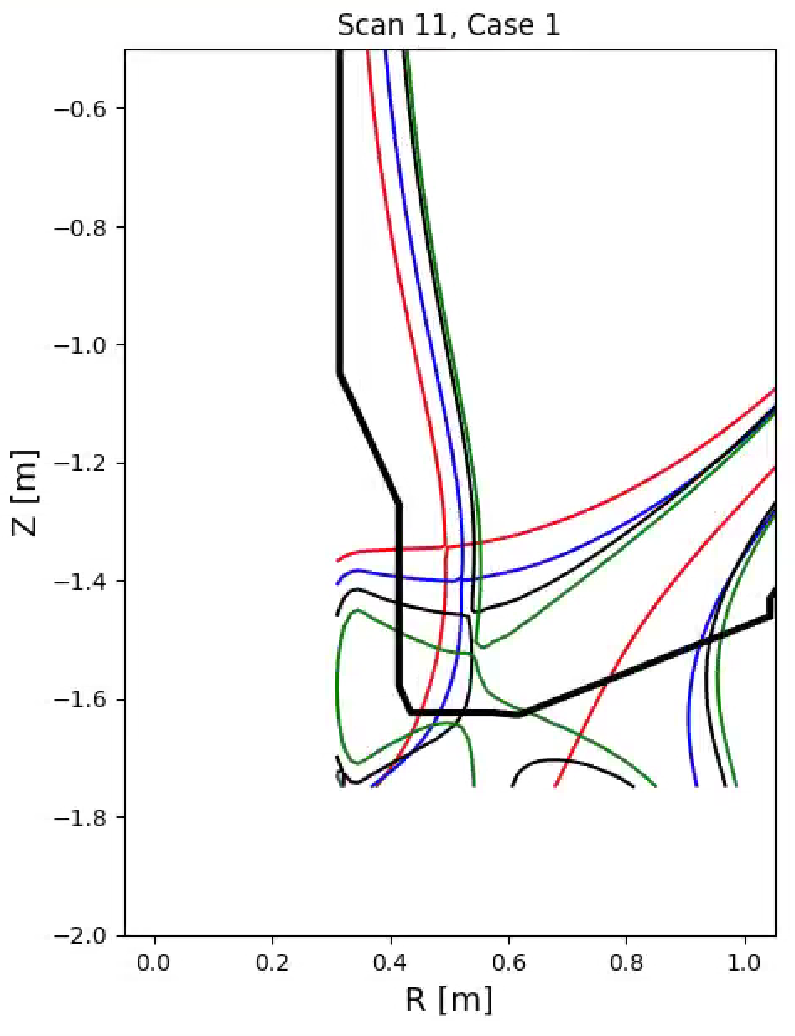
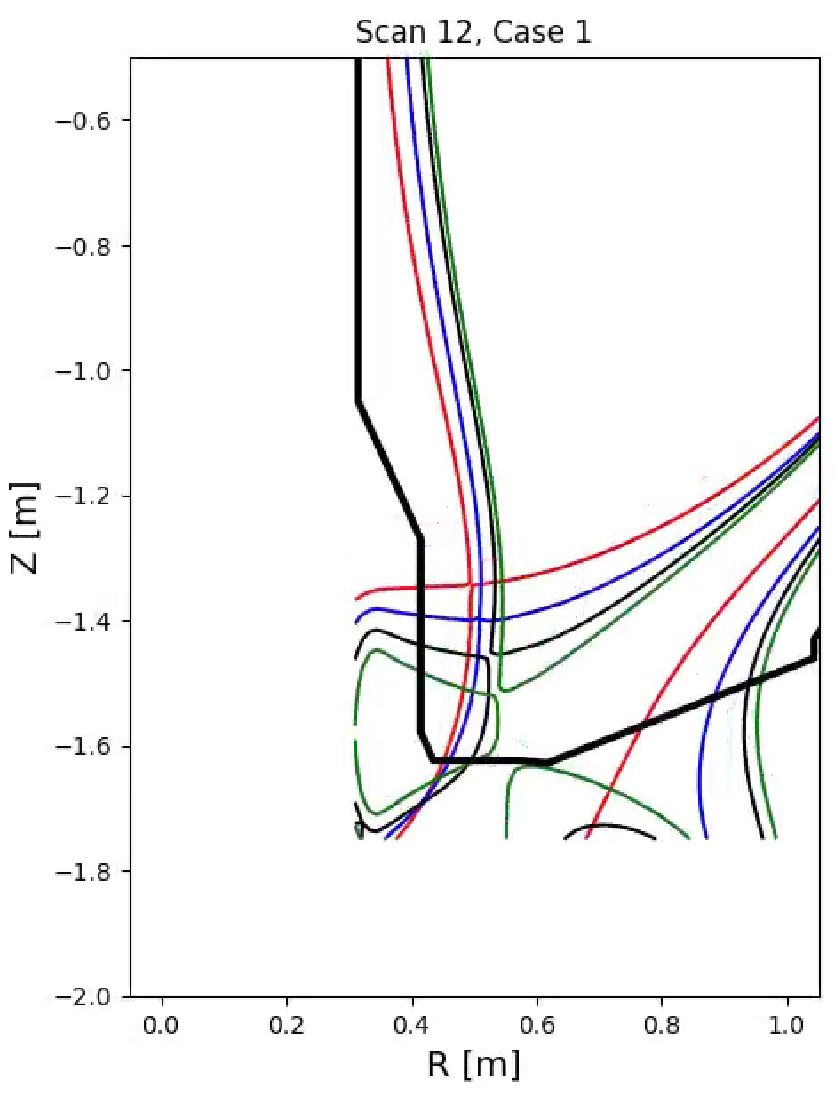
Can Also Scan δ and κ in Opposite Phase

Slide 9
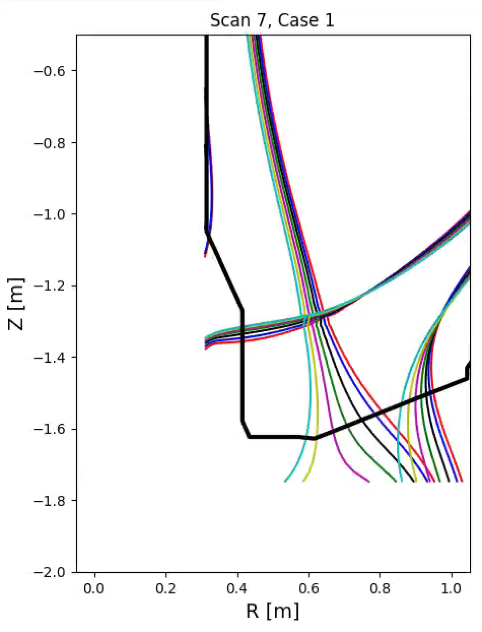
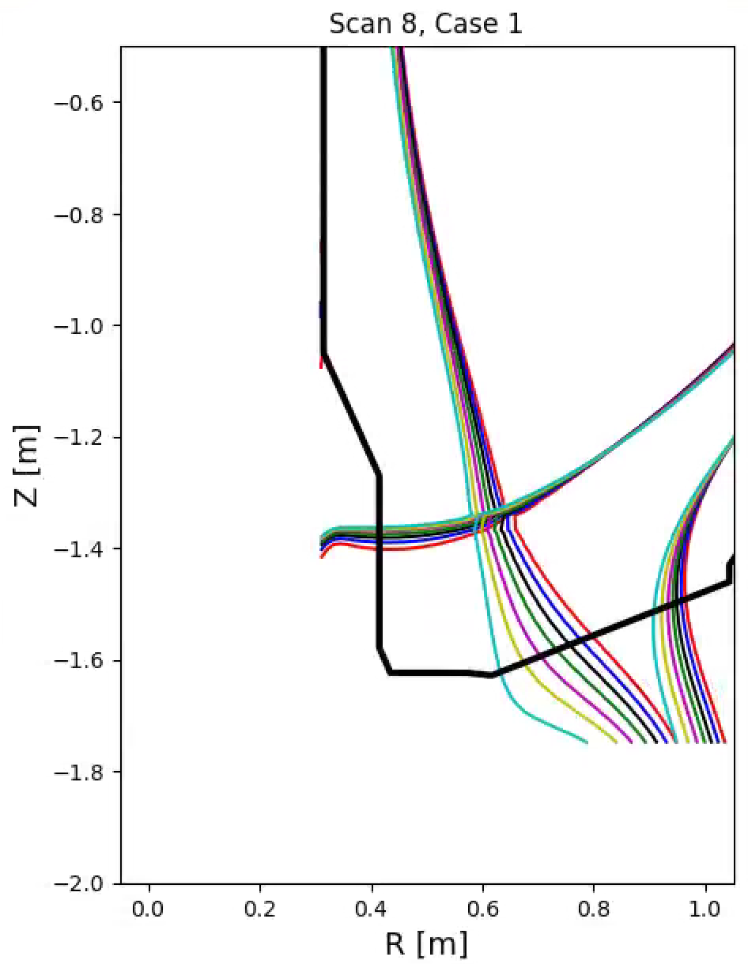
Triangularity Scans for Cases on the OBD
Small changes in δ can scan the OSP for low-δ cases

Slide 10
Scan 2
I did not like the X-Point moving so much
Instead, allow the boundary to “breathe” while keeping the X-point more fixed.

Slide 11
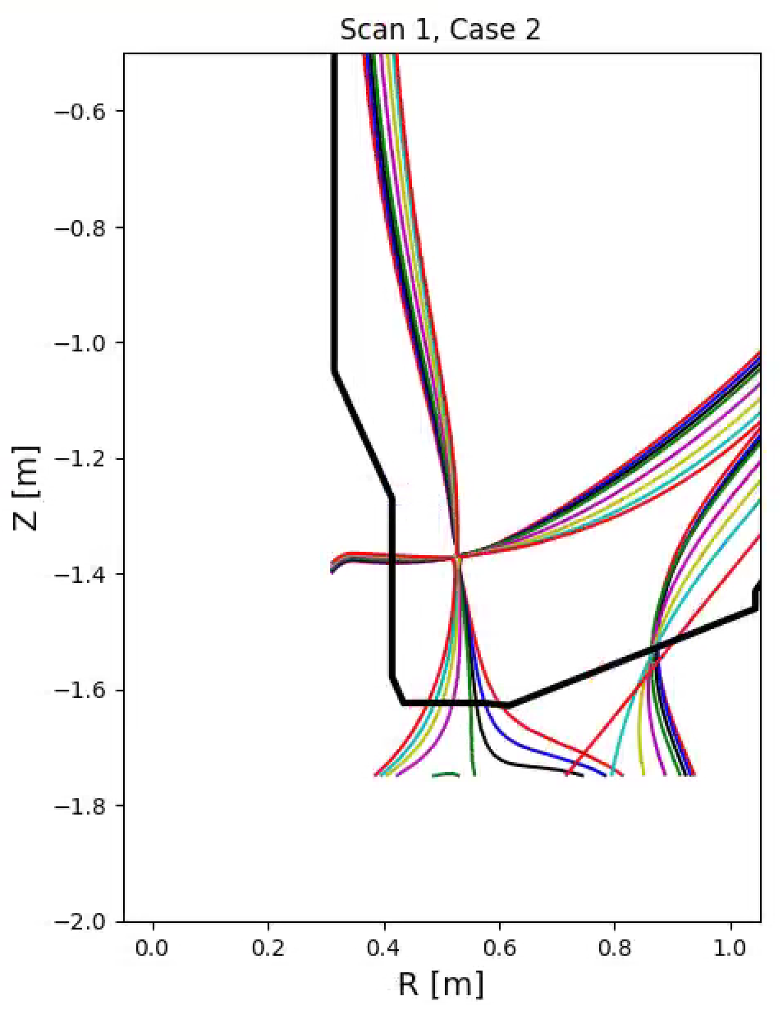
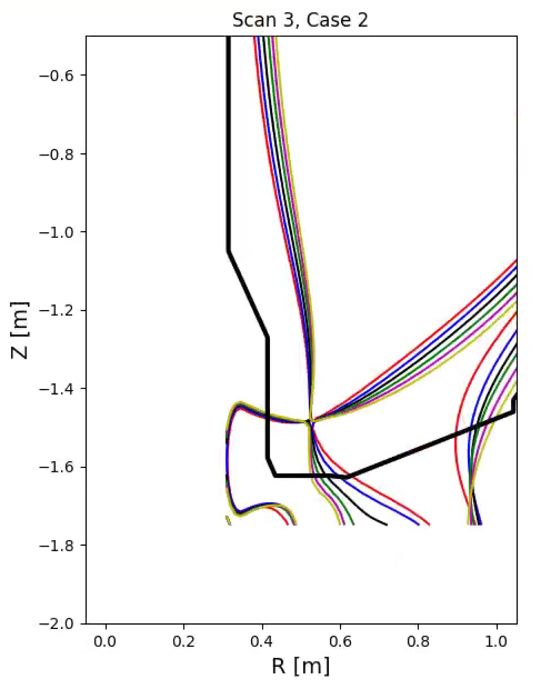
Scan Squareness at Fixed Elongation Results in an OSP Scan
ζ Scan, lower κ, with -1c, I_{OH}=0
ζ scan, higher κ, with -1c, I_{OH}=0

Slide 12
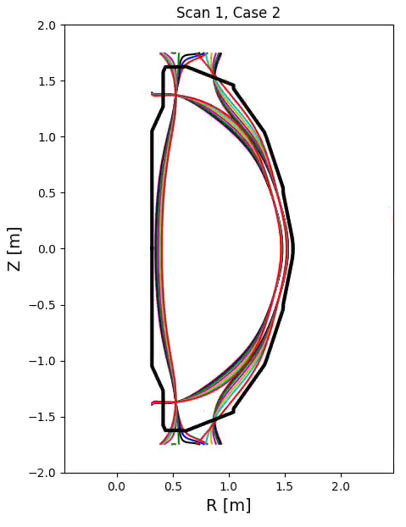
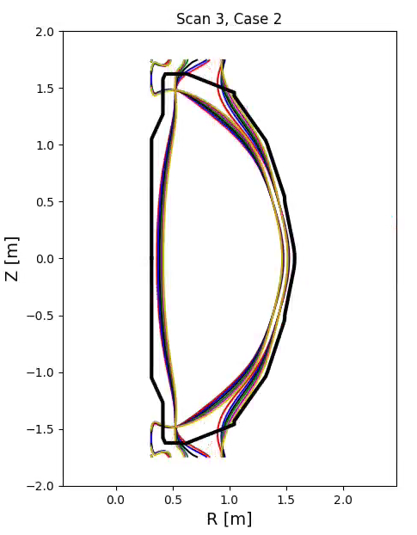
Scan Squareness at Fixed Elongation Results in an OSP Scan
ζ Scan, lower κ, with -1c, I_{OH}=0
ζ scan, higher κ, with -1c, I_{OH}=0

Slide 13
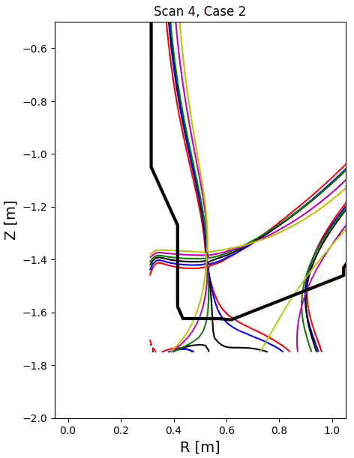
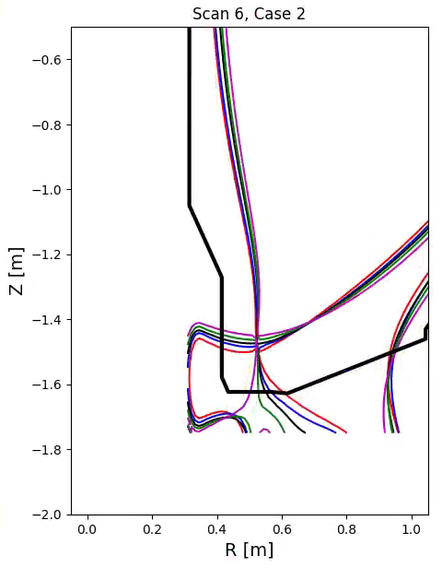
Scan Kappa and Squareness Scans both SPs
κ & ζ scan, with -1c, I_{OH}=0
κ & ζ scan, with -1c, I_{OH}=0

Slide 14
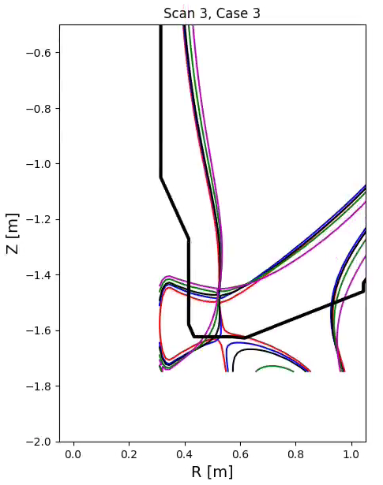
Use of -1c in Can Change the Details Upshot: The details of the Control Law will Matter
κ & ζ scan, with -1c, I_{OH}=0
κ & ζ scan, no -1c, I_{OH}=0

Slide 15
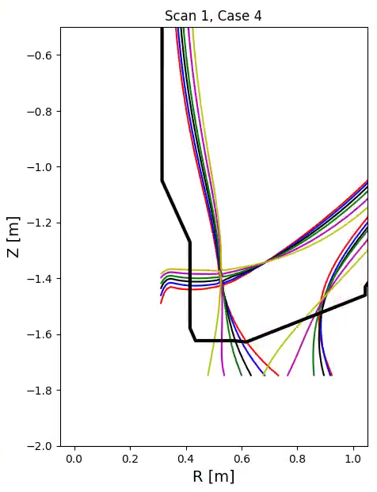
Also Studied Impact of I_{OH}=24kA Same Range of κ, Adjusted ζ Request
κ & ζ scan, with -1c, I_{OH}=0
κ & ζ scan, with -1c, I_{OH}=-24 kA

Slide 16
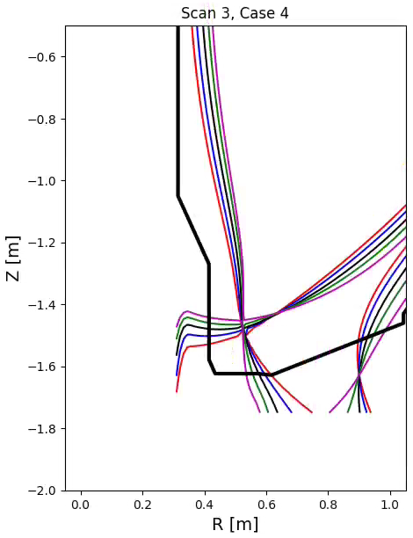
Also Studied Impact of I_{OH}=24kA Same Range of κ, Adjusted ζ Request
κ & ζ scan, with -1c, I_{OH}=0
κ & ζ scan, with -1c, I_{OH}=-24 kA

Slide 17
Observations
Details like the OH state and how the -1c is used can impact the range of OSP sweep.
It is possible to trade off X-point radial motion and outer squareness when scanning the OSP
For a low X-point (high κ), can get odd behavior as the flux lines break to transition around PF-2, have secondary X-points come and go.

