Slide 1




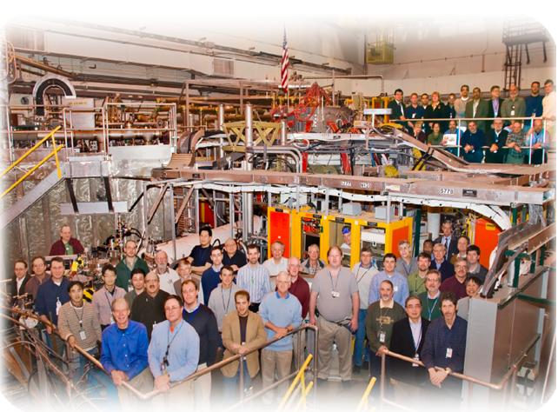

Supported by
XP 1001 - Recycling and pumping studies
with LLD module
College W&M
Colorado Sch Mines
Columbia U
CompX
General Atomics
INEL
Johns Hopkins U
LANL
LLNL
Lodestar
MIT
Nova Photonics
New York U
Old Dominion U
ORNL
PPPL
PSI
Princeton U
Purdue U
SNL
Think Tank, Inc.
UC Davis
UC Irvine
UCLA
UCSD
U Colorado
U Illinois
U Maryland
U Rochester
U Washington
U Wisconsin
Culham Sci Ctr
U St. Andrews
York U
Chubu U
Fukui U
Hiroshima U
Hyogo U
Kyoto U
Kyushu U
Kyushu Tokai U
NIFS
Niigata U
U Tokyo
JAEA
Hebrew U
Ioffe Inst
RRC Kurchatov Inst
TRINITI
KBSI
KAIST
POSTECH
ASIPP
ENEA, Frascati
CEA, Cadarache
IPP, Jülich
IPP, Garching
ASCR, Czech Rep
U Quebec
V. A. Soukhanovskii, M. Jaworski, J. Kallman,
H. W. Kugel, R. Maingi, R. Raman, and NSTX Team
NSTX Team Review
Princeton, NJ
19 March 2010

Slide 2
A consistent research plan of LLD studies is emerging…
XMP (Plasma start-up)
XP 1000 “LLD characterization” (H. W. Kugel et al.)
XP 1001 “Pumping and recycling with LLD”
(V. A. Soukhanovskii et al.) - this talk
XP 1057 “Deuterium retention with LLD” (C. H. Skinner et al.) - next talk
  Discharge-integrated and long-term retention, gas balance, detailed surface physics and chemistry using the sample probe
XP 100? “Edge and pedestal studies with LLD” (R. Maingi et al.)
XP 100? “Survey of physics with LLD” (S. Gerhardt et al)
…

Slide 3
LLD pumping demonstration in XP 1000
(H. W. Kugel et al.) is a prerequisite to this XP
XP 1000 “LLD characterization”
  Crude strike point scan (R_{OSP}=0.5, 0.63 m; if warranted, 0.75, 0.35 m)
  Two fueling scenarios - HFS and SGI
  Two input power levels - 2-3 MW and 4-6 MW
  Comparison between “cold” and “warm” (~ 220 C) LLD
Anticipated deliverables from XP 1000
  Demonstration of reduced ion density / inventory with “warm” LLD
    Did LLD fully wet and operate as expected?
  Data on LLD thermal regime
    LLD steady-state heating? Heating due to plasma interaction?
  Data on LLD impurity handling
    Is Li, C, Fe, Mo sputtering a problem?
  Data on LITER evaporation requirements (rate, frequency)
    LITER between shots? Every few shots?

Slide 4
XP 1001 aims at extending XP 1000 results to wider parameter range enabling trend studies and comparison with models
Study neutral and ion fluxes and particle balance as functions of
  Proximity to strike point (essentially, divertor ion flux and LLD temperature convoluted together)
  Steady-state core ion density (n_{d} ~ 1-6 x 10¹⁹ m⁻³)
    Use SGI fueling to vary core density
  Response of SOL and/or divertor density to source perturbation
    Use SGI and divertor gas puffs, measure “pump-out” times
  Steady-state LLD temperature
    Use heaters and/or helium system to vary LLD temperature
    Possibly, use plasma heating to increase LLD temperature
Based on above measurements, infer LLD particle pumping characteristics using models
  “Simple” 0D particle balance for electrons and ions
  2D fluid models

Slide 5
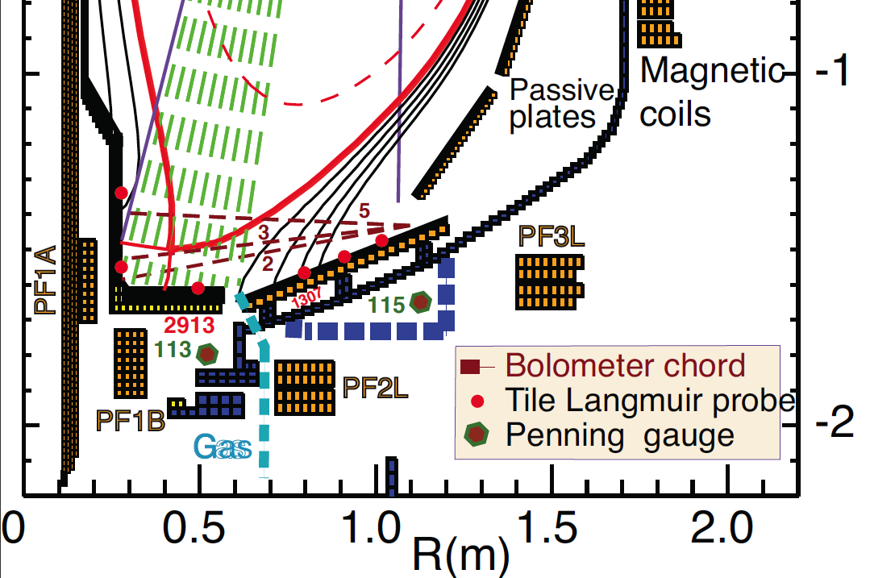
Multiple diagnostic measurements will be analyzed
Diagnostic set for LLD pumping studies
  Spectroscopy
    LADA
    Filtered cameras
    VIPS2 and DIMS
    Filterscopes
  Neutral pressure gauges
  Tile Langmuir probes
    “Super tile” array
    Existing probes
  Midplane diagnostics
    Thomson scattering and CHERS systems
    FIReTIP, reflectometry
    Fast probe (?)

Slide 6
XP 1001 would also produce good scans and data for pedestal, SOL and divertor studies
Effect of LLD on SOL / divertor transport
  Impurity sources
  What can we say about parallel heat transport?
    T_{e} gradients?
  What can we say about radial ion and impurity transport?
    Use GPI to characterize blob velocity and size
Effect on pedestal
  Relate (n_{e}, p_{e}) pedestal structure (height and width) and collisionality to recycling measurements and pumping (e.g., via Mahdavi model)
  Further quantify ion transport vs source effect
  Keep outer gap 10 cm

Slide 7
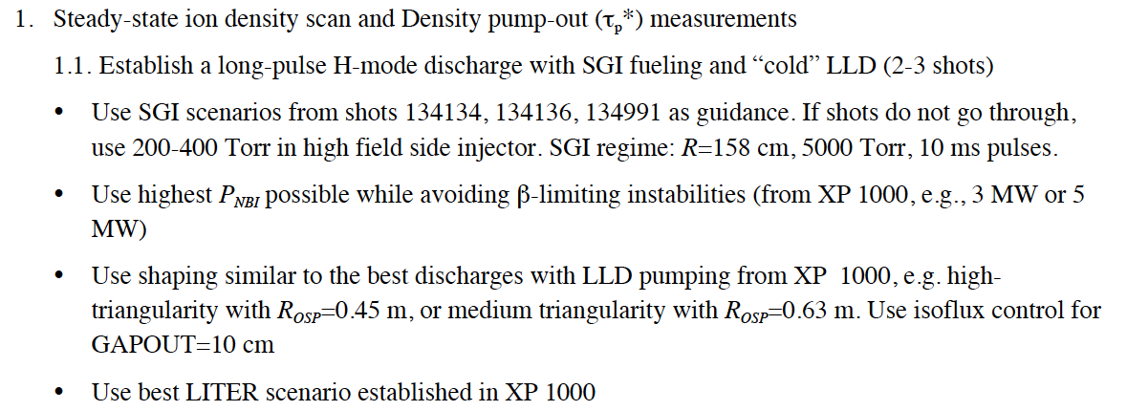
Run plan

Slide 8
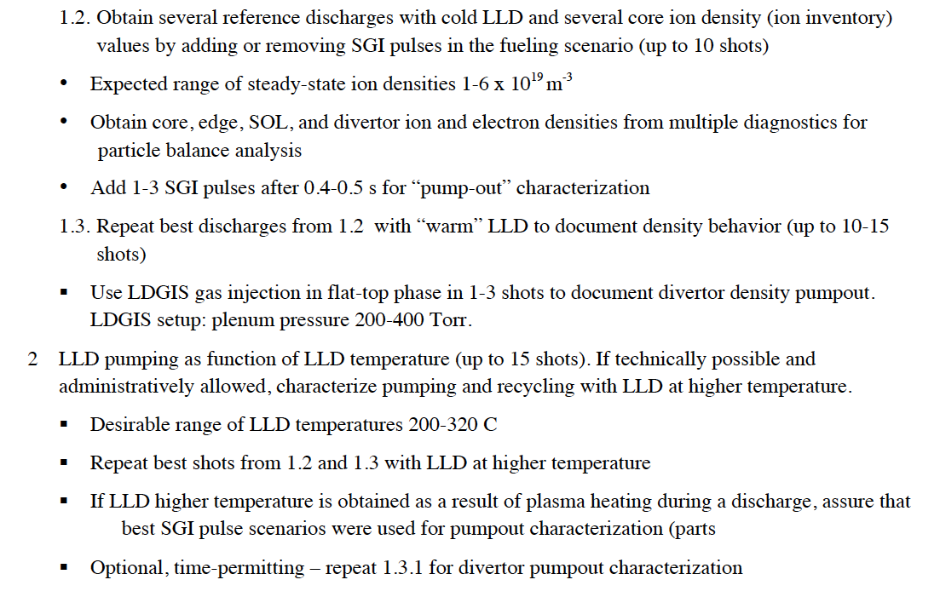
Run plan (cont.)

Slide 9
Backup

Slide 10
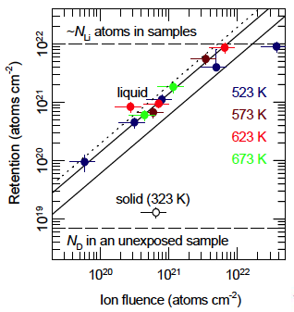
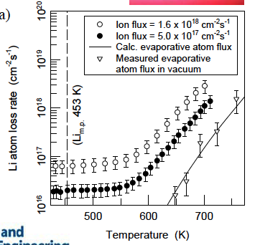
Liquid lithium ability to “pump” D depends on temperature and ion fluence and greatly exceeds that of solid lithium
R. Doerner, M. Baldwin, UCSD
2002 Nucl. Fusion 42 1318

Slide 11
Understanding of lithium coatings and LLD for density control and pumping is emerging
Cryo-pumping (e.g., DIII-D experience)
  Calibrated pumping rate ☺
  Demonstrated density control ☺
  Compatibility with radiative divertor ☺
  Significant in-vessel hardware modifications ☹
  Inflexibility in plasma shaping due to the need of proximity to strike point ☹
Lithium coatings on graphite PFCs (NSTX LITER experience)
  Flexibility in plasma shaping ☺ (LLD..?)
  Large area pumping
  Need for operational scenario development for each pumping and fueling rate ☹
    Due to complex dynamic behavior of lithium coating
    LLD: + need to satisfy thermal regime requirements
  Multiple side effects (good and bad) on plasma core and edge
    E.g., improved confinement, ELM stability, impurity transport, etc ☺ ☹

Slide 12
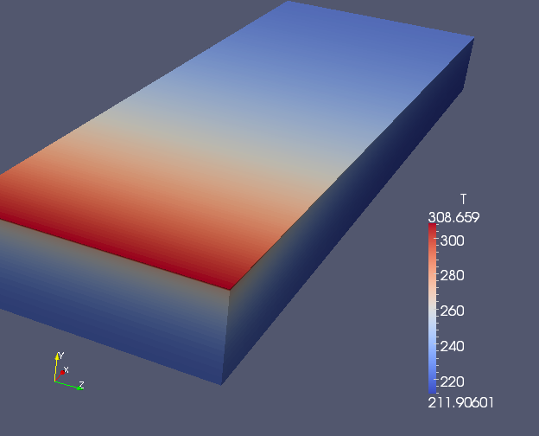
Uncertainty in thermal LLD regime will be clarified in XP 1000 and through modeling
Only ¾ of LLD can be heated to 220-250 C using heaters
Possibility of steady-state heating with helium system TBD
All three thermal models (Zakharov (PPPL), Nygren (SNL), Jaworski (PPPL)) show substantial LLD heating in a 1 s long 2-4 MW NBI discharge
  Based on realistic measured divertor heat fluxes
  Include thermal conduction in layered LLD material (Mo, SS, Cu)
  Jaworski’s calculations shown here
  (more in backup slides)

Slide 13
Recycling fluxes and coefficients will be measured as functions of LLD regime in this XP
Define recycling as R_{local}=Γ_{i}^{out} / Γ_{i}^{in}
  Ion flux into LLD Γ_{i}^{in} is measured by Langmuir Probes (combined PPPL / UIUC effort)
  Ion outflux Γ_{i}^{out} into SOL plasma can be estimated from measured D flux and S/XB (ionizations/photon) coefficient from ADAS
    Need absolutely calibrated D photon flux (D-alpha cameras, LADA)
    Need molecular emission measurements (e.g., Fulcher bands) to include contributions from molecules (DIMS)
Recycling measurements are useful for UEDGE / Degas 2 modeling
  calculation constraints
  infer a global picture of LLD performance (pumping, etc)

Slide 14
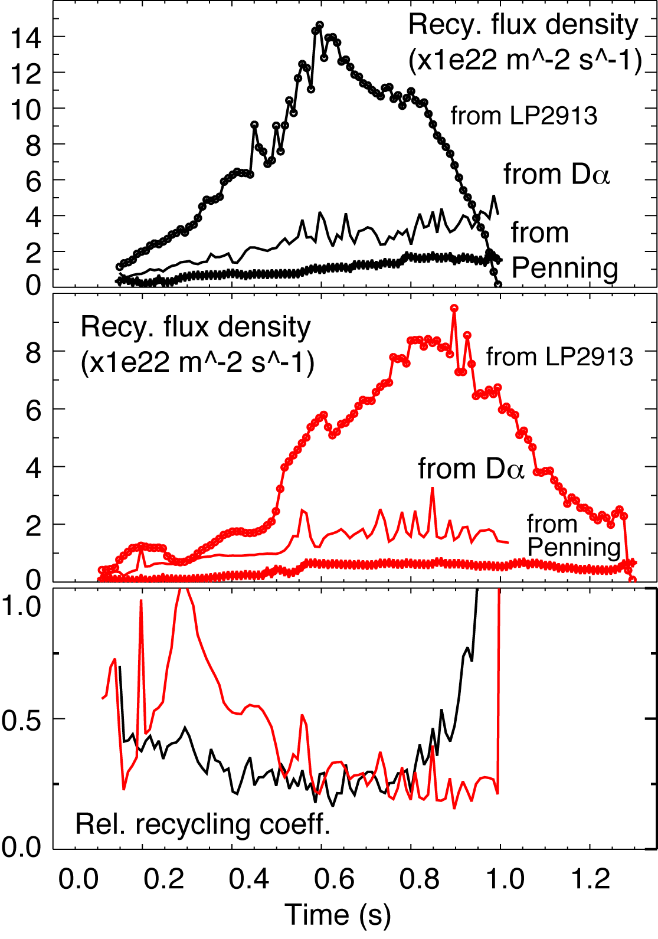
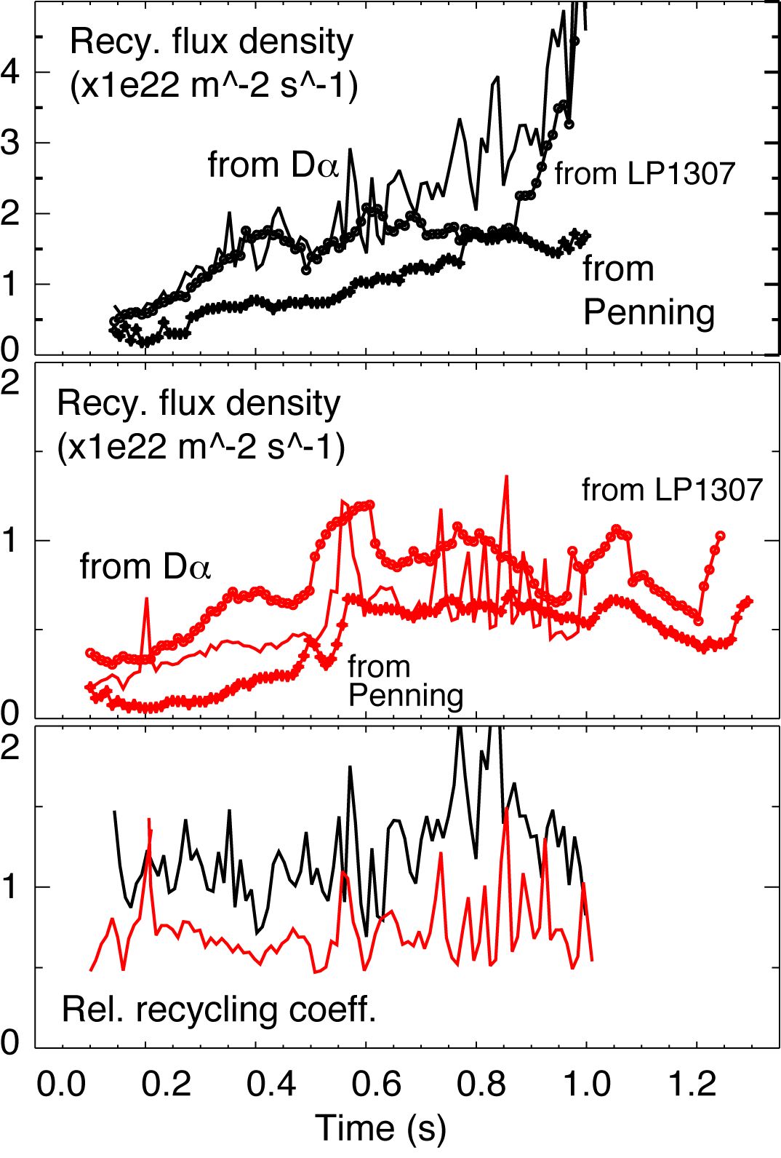
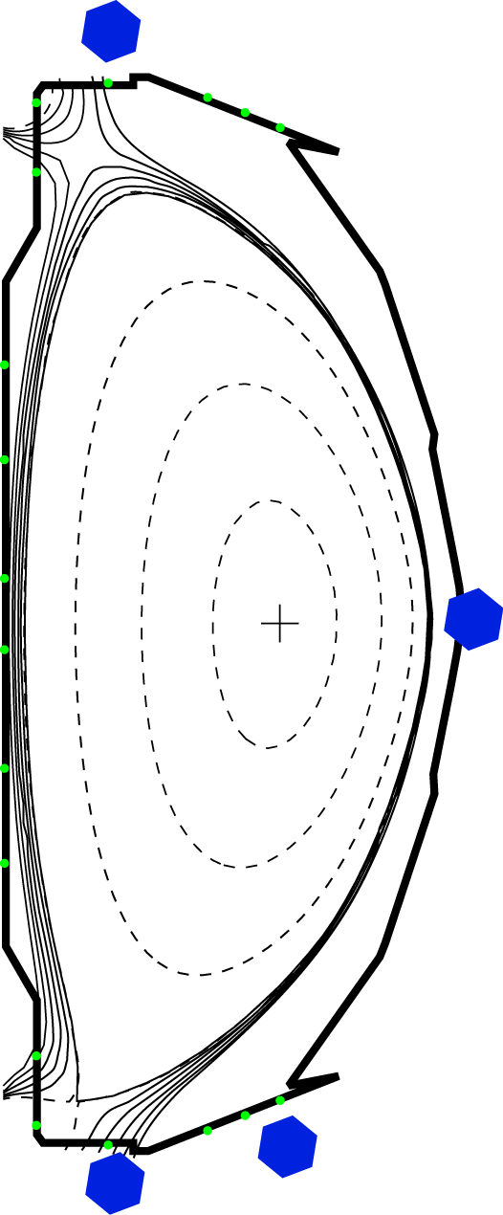
Local relative recycling coefficient measurements in LITER experiments showed reduction of R with lithium
No lithium (129013)
190 mg Lithium (129061)
Strike point region R Far SOL R
shows complex pattern clearly reduced

Slide 15
XP aims at LLD pumping characterization based on measured particle balance and models
0D Particle balance models
  Wall inventory model for pumping
  “Simple” τ_{p}* model
    Global τ_{p}* to understand LLD pumping
    Local SOL τ_{p}* as LLD pumping metric
  More sophisticated τ_{p}* model of core+SOL (R. Maingi - predictions for LLD pumping)
1D models (e.g., Onion Skin Model OEDGE)
2D multi-fluid models (e.g., UEDGE, SOLPS) to estimate pumping
  May include DEGAS 2 for neutrals, lithium PSI and transport
Kinetic models (plasma, neutrals)

Slide 16
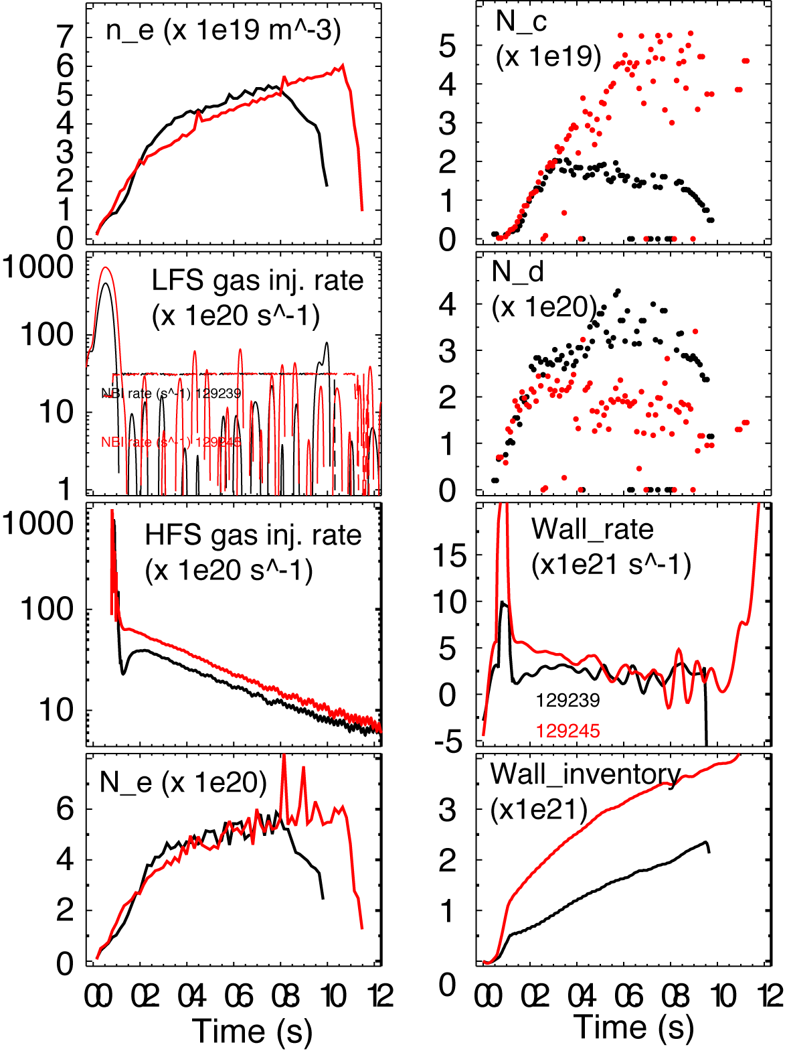
Particle balance models show wall pumping in LITER experiments
Lithium pumping is characterized by an increased “wall” loading rate and “wall” inventory
Need to improve model for ion inventory only
Particle balance equation for wall loading

Slide 17
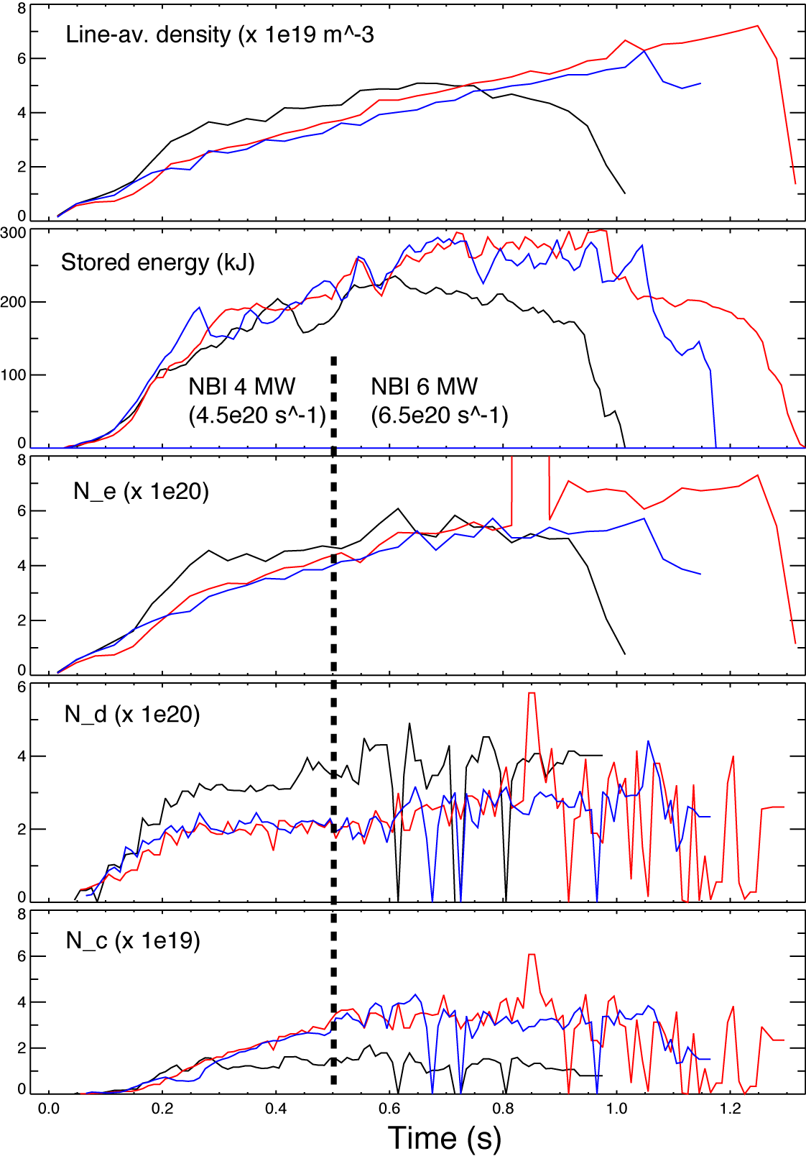

Particle balance models show lithium pumping and τ_{p}* reduction in LITER experiments
Particle balance model
“Steady-state” τ_{p}* estimated to be
  ~ 250 ms w/ LITER
  ~ 300-350 ms w/o LITER
  HFS fueling 20-30 T-l/s
  Interestingly, same ion
  inventory with more lithium albeit lowered recycling
No lithium (129013)
190 mg Lithium (129061)
600 mg lithium (129064)

Slide 18
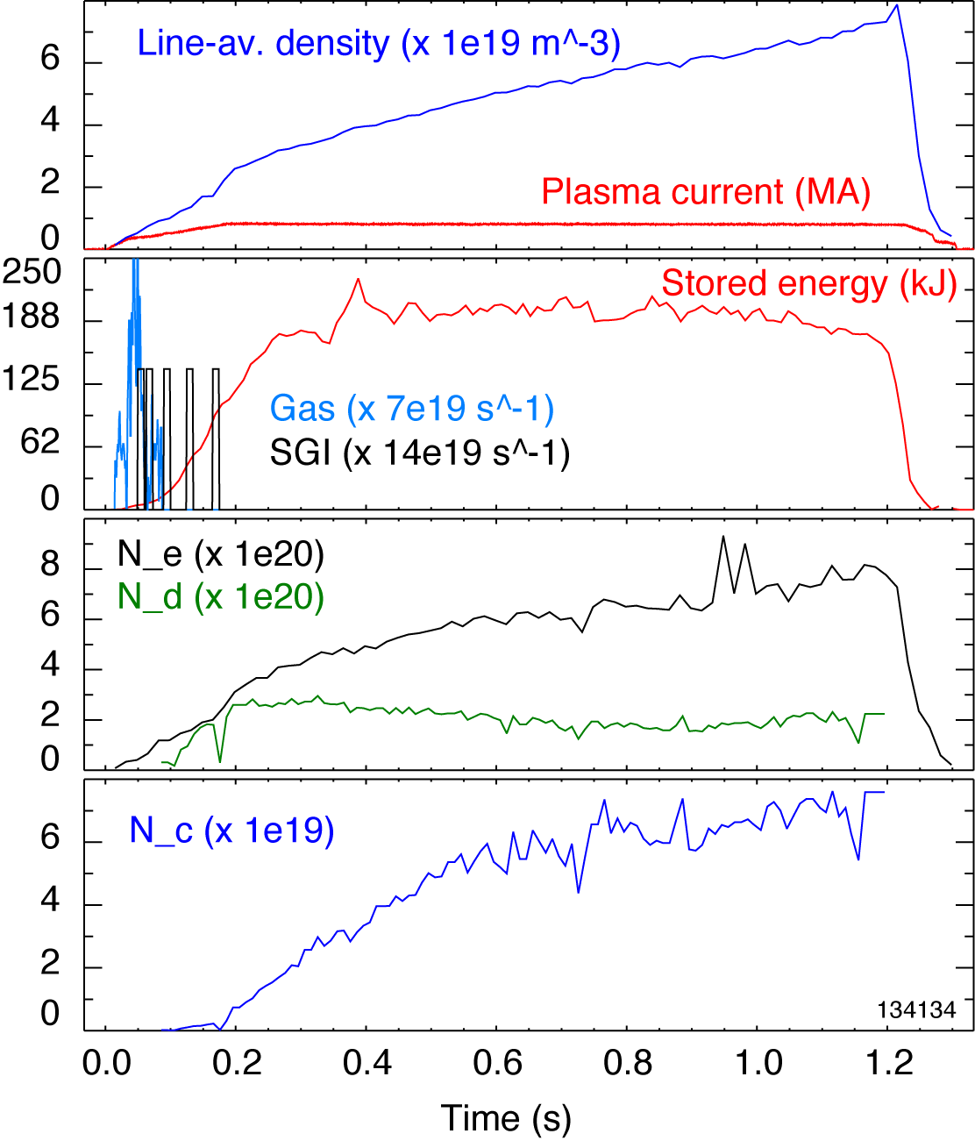
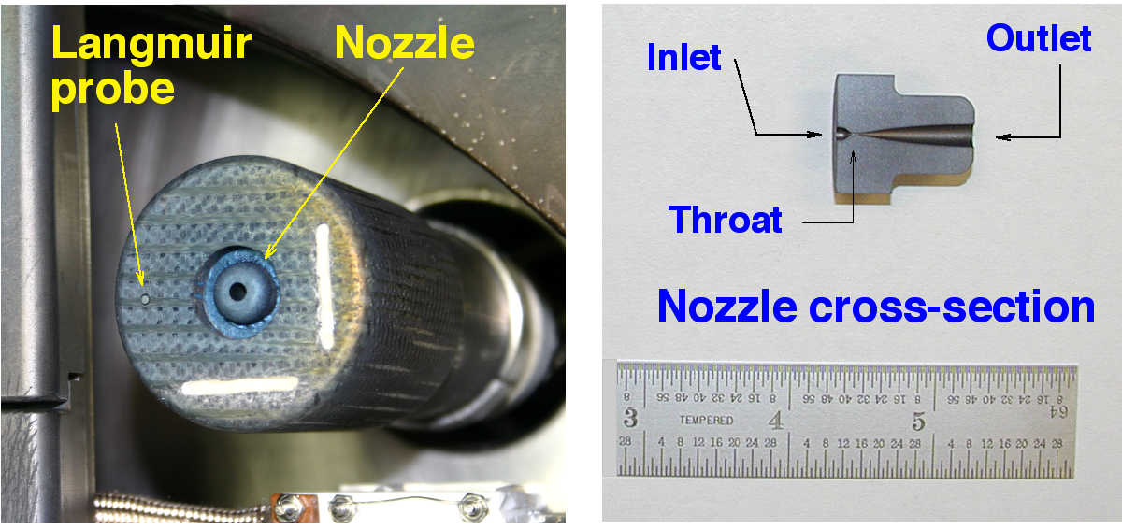
SGI fueling will be used to produce controlled steady-state ion density in XP 1001
Used SGI-only fueling
LITER rate 6-9 mg/min
Ion density nearly constant
N_{i} also nearly constant, while N_{e} is rising due to carbon
τ_{p}* estimated to be 0.3-0.4 s

Slide 19
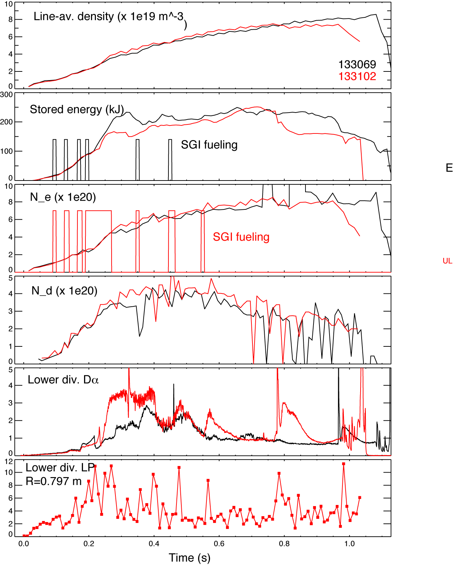
SGI singular gas pulses will be used to measure “pump-out” (edge “ τ_{p}* “ )
Measure dynamic SOL density response to singular flat-top SGI pulses (“pumpout”) at various LLD temperatures, plasma densities
  Use FIReTIP channel 7 (R_{tang} ~ 150 cm) at midplane (n_{e})
  Use divertor Langmuir probes (Γ_{i}, n_{e})
  Use neutral pressure gauges (Γ_{n,} n₀)
Example - Two shots compared
  14 mg/min Li evaporation, 10 min clock cycle
  HFS at 700 Torr + SGI
  Higher SGI and lower SGI fueling rate
Accordingly, higher N_{e}, N_{d} and lower N_{e} , N_{d} obtained
  Carbon inventory the same (not shown)
Divertor D_{α} and Langmuir Probe I_{sat} correlated with SGI pulses, showed density pump-out

Slide 20
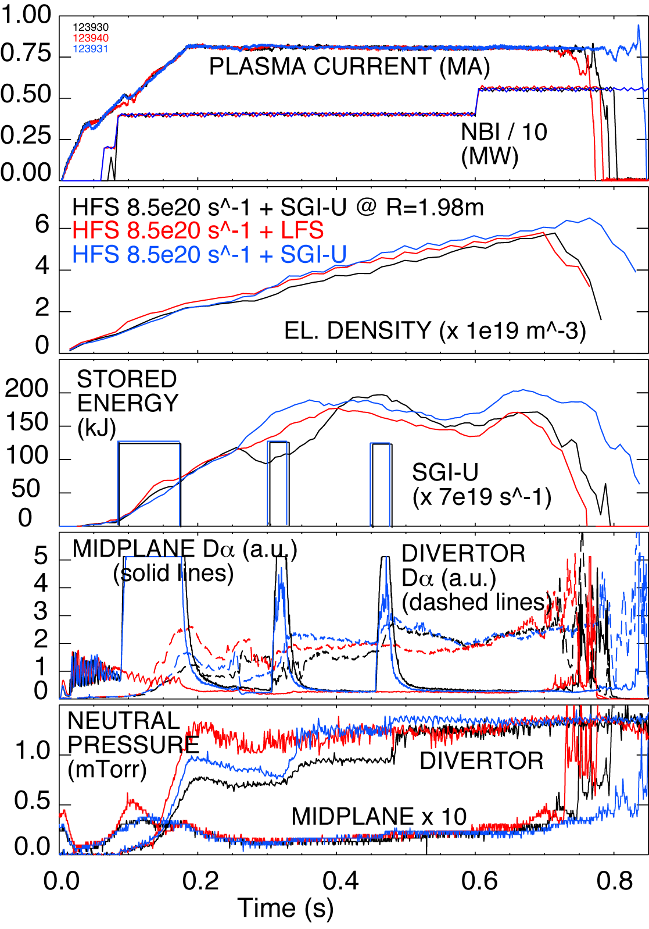
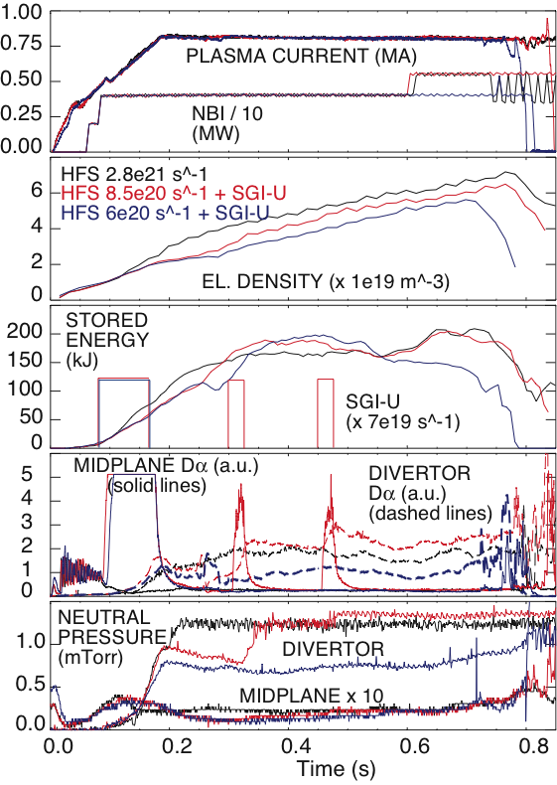
Discharges without lithium conditioning never showed pump-out with SGI singular gas pulses

Slide 21
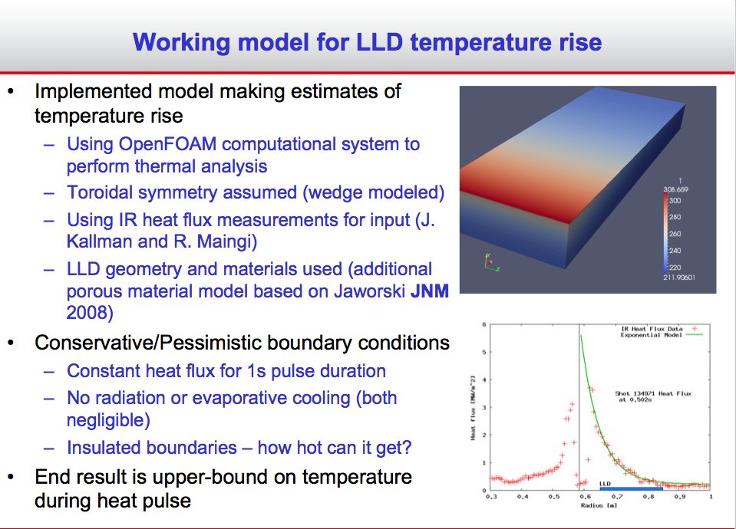
Details of LLD thermal regime calculations by M. Jaworski (1)

Slide 22
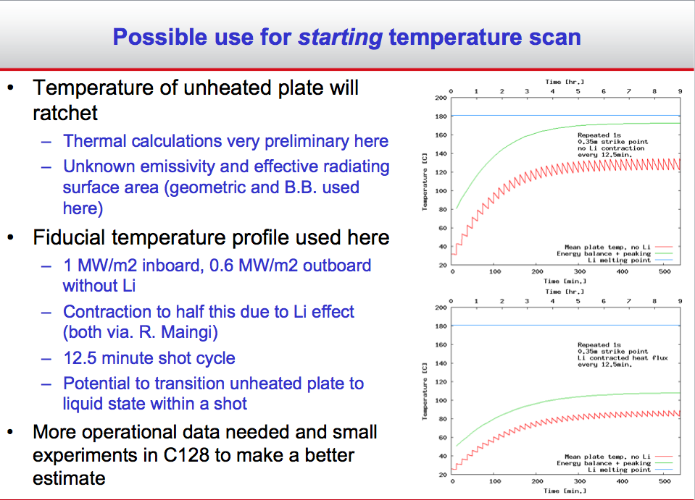
Details of LLD thermal regime calculations by M. Jaworski (2)

Slide 23
Summary of APS 2009 poster “Modifications in SOL and divertor conditions with lithium coatings…” by V. A. Soukhanovskii et al.
Evaporative lithium coatings on carbon PFCs modify divertor and SOL sources
  Lower divertor, upper divertor and inner wall recycling was reduced by up to 50 %
  Local recycling coefficients reduced on inner wall and far SOL, remained similar in the outer strike point region
  Lower divertor carbon source from physical sputtering also reduced
  Divertor lithium influx increased, however, lithium was retained in divertor
SOL transport regime changes from high-recycling to sheath-limited
  Apparently small parallel T_{e} gradient
  Detached inner divertor re-attaches, X-point MARFEs disappear
Pedestal and core confinement improvement leads to
  Reduction of ion inventory (density) by up to 50 % due to surface pumping
  Effective screening of lithium from core plasma
  Carbon and high-Z impurity accumulation
  P_{rad} increases in the core, P_{SOL} significantly reduces

Slide 24
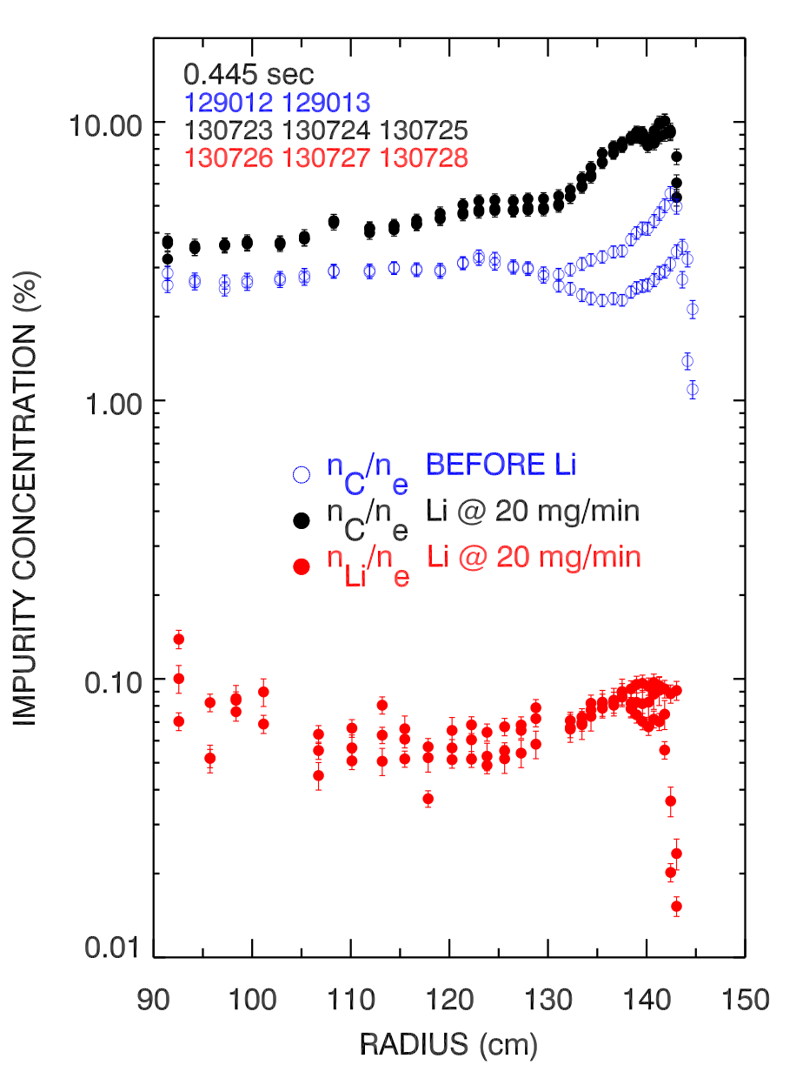
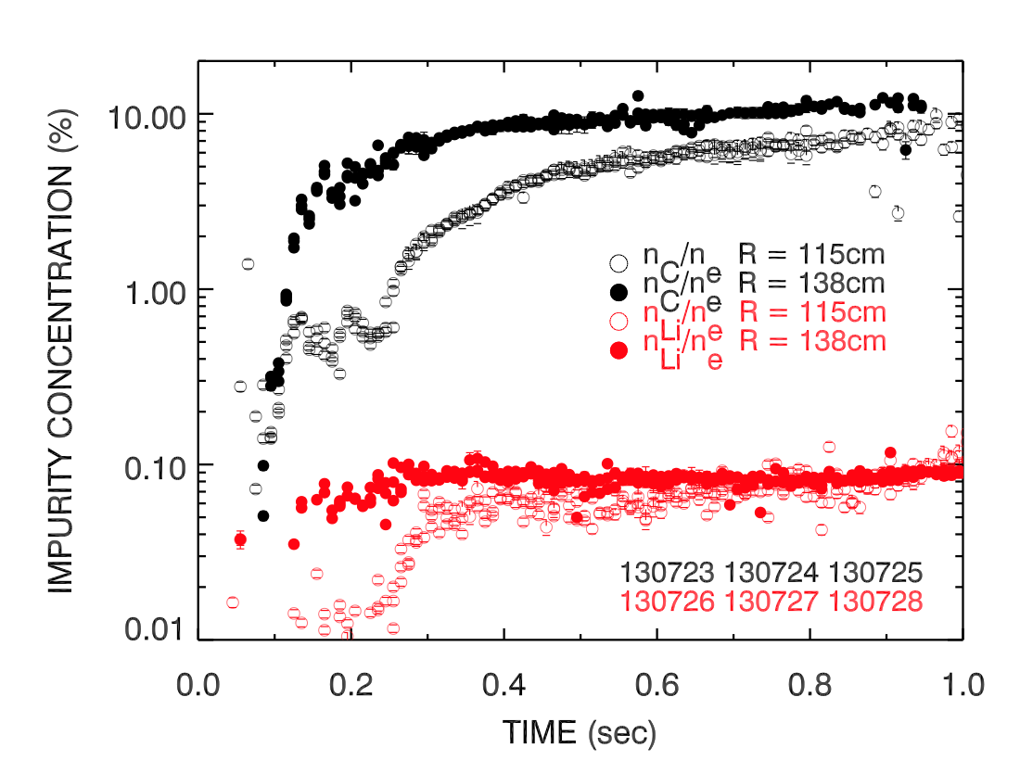
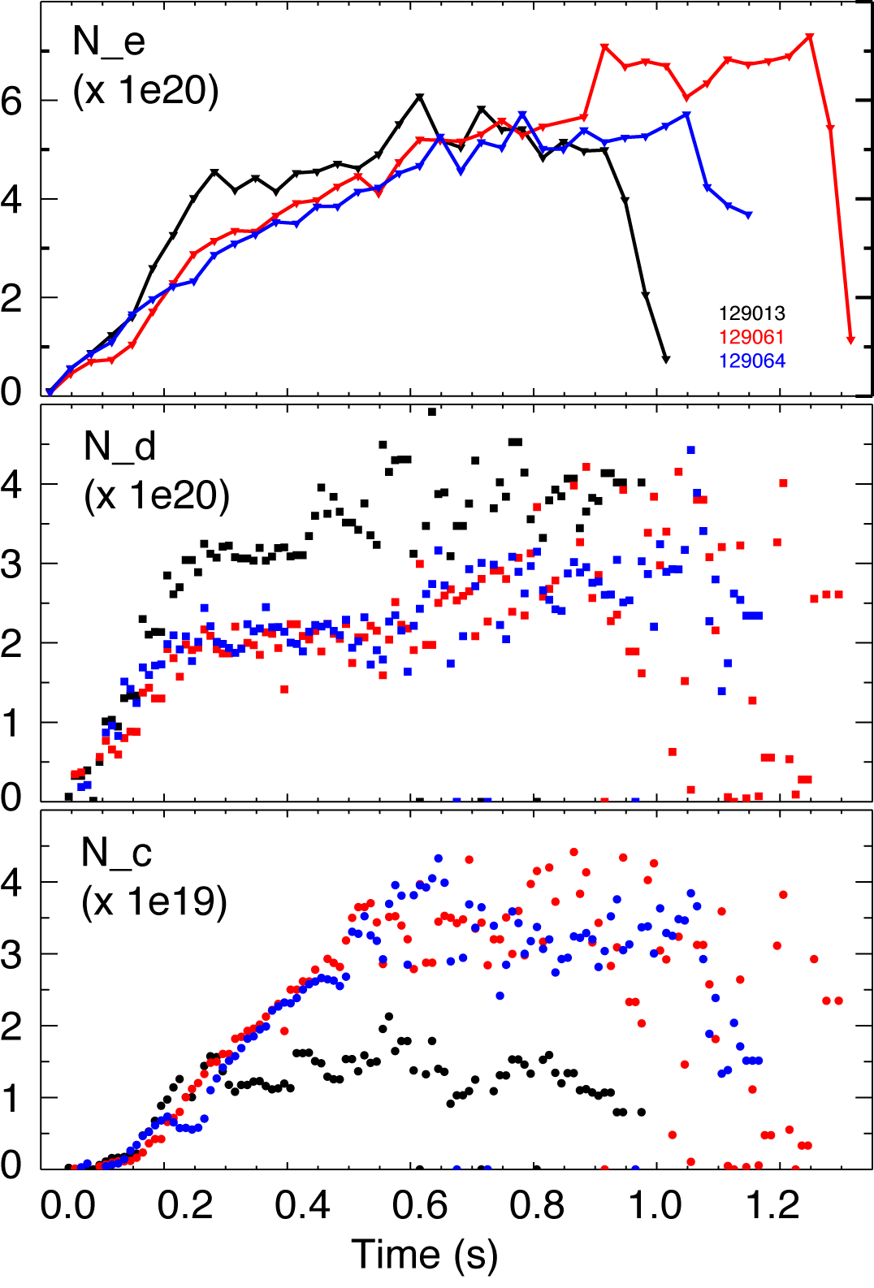
Ion inventory is well controlled in discharges with lithium, core carbon accumulates, lithium is screened out
ion
Impurity density profiles from CHERS
  C VI, n = 8-7 transition, 529.1 nm
  Li III, n = 7-5 transition, 516.7 nm
Lithium concentration much lower than carbon concentration
  n_{C}/n_{Li} ~ 100
Carbon increases with Li evaporation
No lithium (129013)
190 mg Lithium (129061)
600 mg lithium (129064)

