Slide 1


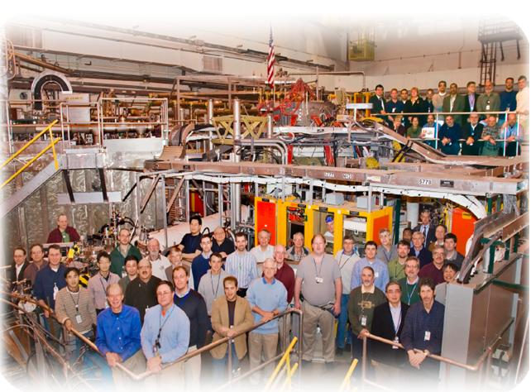

NSTX
Supported by
Is there any confinement degradation going to NSTX-Upgrade Elongation and Aspect Ratio?
(XP-1103)
College W&M
Colorado Sch Mines
Columbia U
CompX
General Atomics
INL
Johns Hopkins U
LANL
LLNL
Lodestar
MIT
Nova Photonics
New York U
Old Dominion U
ORNL
PPPL
PSI
Princeton U
Purdue U
SNL
Think Tank, Inc.
UC Davis
UC Irvine
UCLA
UCSD
U Colorado
U Illinois
U Maryland
U Rochester
U Washington
U Wisconsin
Stefan Gerhardt,…
Culham Sci Ctr
U St. Andrews
York U
Chubu U
Fukui U
Hiroshima U
Hyogo U
Kyoto U
Kyushu U
Kyushu Tokai U
NIFS
Niigata U
U Tokyo
JAEA
Hebrew U
Ioffe Inst
RRC Kurchatov Inst
TRINITI
KBSI
KAIST
POSTECH
ASIPP
ENEA, Frascati
CEA, Cadarache
IPP, Jülich
IPP, Garching
ASCR, Czech Rep
U Quebec
NSTX Team Review

Slide 2
Big Picture Description
Aspect (A) ratio and elongation (κ) are the lowest order shape parameters in a tokamak…and their impact on the ST is the focus of R11-2.
NSTX has a large database of confinement with A<1.55 and κ<2.4.
  NSTX upgrade will run at larger values of both these parameters.
It is hard to scan these parameters independently in NSTX.
  Will be even harder in NSTX-U…this may be the last chance.
Propose to do three scans:
  A scan at fixed κ
  κ scan at fixed A
  Push to very high A and κ
Goals:
  1: Confirm (or not) confinement and current drive assumptions used in Upgrade modeling.
  H₉₈=1 is accessible?
  Ion transport remains neoclassical?
  NUBEAM+Sauter BS+V_{loop} analysis can predict the current profile?
  2: Determine if there is a strong A or κ dependence of the above.
  3: Develop the shapes to be used in further XPs targeting R11-2, JRT, Upgrade support.

Slide 3
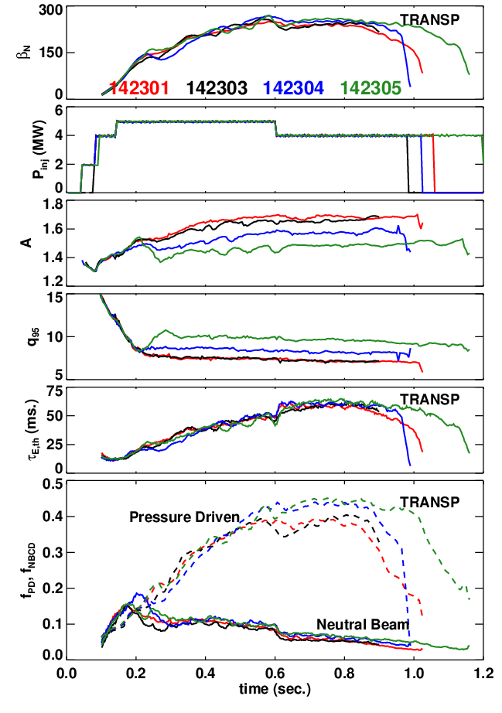
Limited Data Set Last Year Showed a Reduction in Confinement When A & κ Were Increased
I_{P}=900 kA, B_{T}=0.45 T
Some drop in β_{N} at higher A (for fixed P_{inj}).
Big hit in q₉₅. (10->7.5)
Confinement is degraded by ~10%.
  H from 1.02 to 0.85.
T_{e} is a bit lower, which hurts the NBCD.
Data collected at the end of the run, when machine performance was sub-optimal.

Slide 4
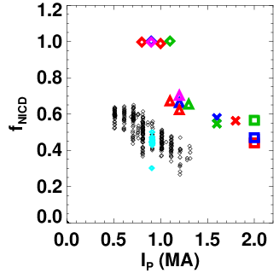
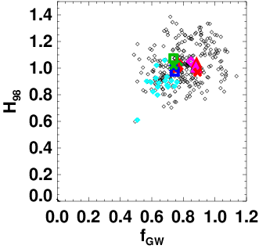
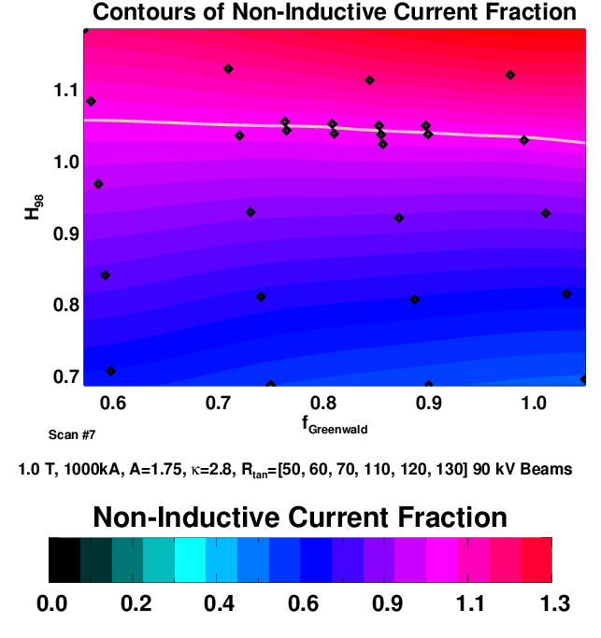
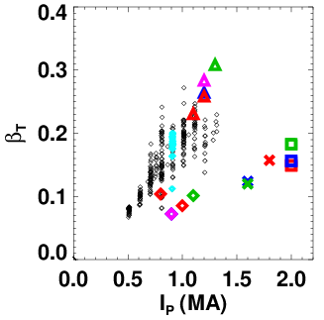
NSTX-U Scenarios Need H~1.0 at Higher A to Meet
Aggressive Scenario Goals
Effect of degraded confinement on NSTX-Upgrade 100% non-inductive scenarios.
Comparisons of Upgrade Scenarios To Existing Data

Slide 5
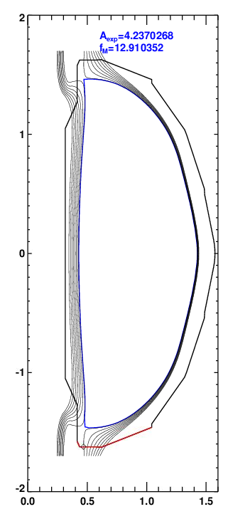
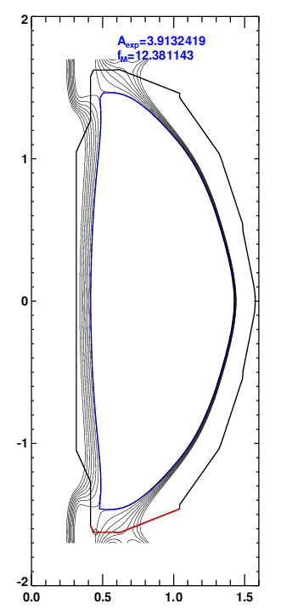
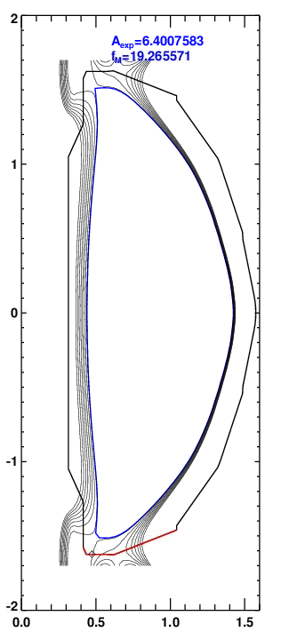
Use of SFD in NSTX-Upgrade Will Mandate High Elongation
DN, κ=2.93
DSFD, κ=2.88, A=1.83
DSFD, κ=3.06, A=1.89
(D)SFD Works Best with Small Top/Bottom Gaps

Slide 6
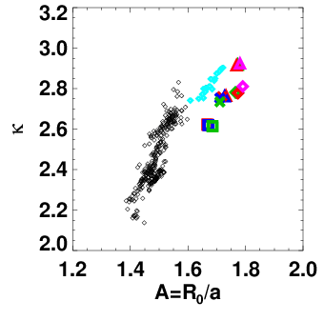
In General, It is Hard to Scan A and κ Independently
Space of aspect ratio and elongation for NSTX and interesting upgrade scenarios.
Space of aspect ratio and elongation for NSTX and some proposed next step devices.

Slide 7
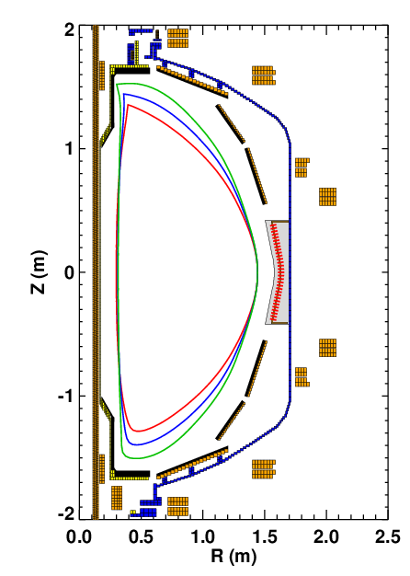
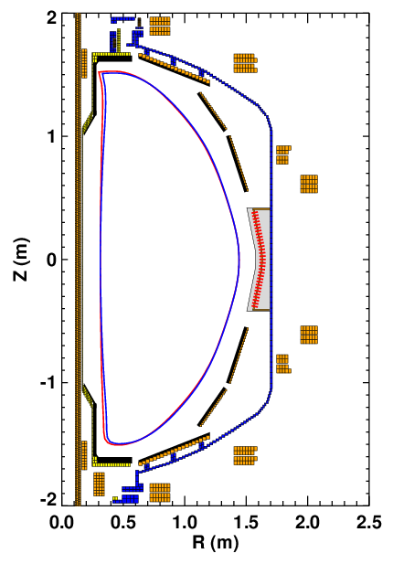
Scan of Kappa At Fixed A.
With Constant I_{P} or Constant q₉₅
Low elongation limit is set by current limit on the PF-1A coil.
  Otherwise the inner gap shrinks
  700 kA plasma need 19.6 kA of PF-1A
Scan of κ at fixed A and I_{P}
A | κ | I_{P} | q₉₅ | I_{PF-1A}
1.56 | 2.66 | 825 | 12.1 | 10.7
1.55 | 2.69 | 700 | 17.9 | 6.3
1.55 | 2.55 | 700 | 13.9 | 11.6
1.52 | 2.3 | 700 | 12.03 | 19.6

Slide 8
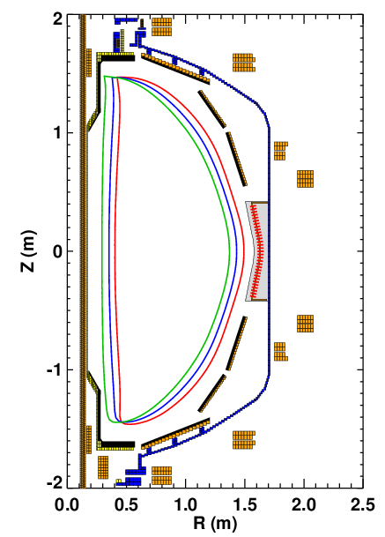
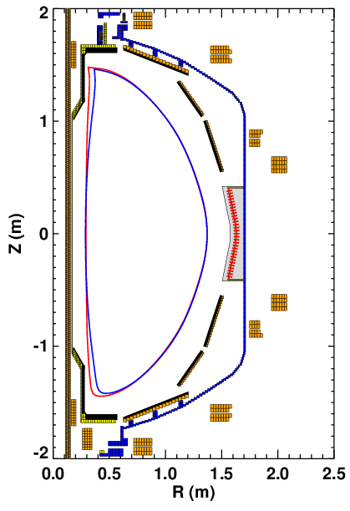
Scan of A at Fixed Kappa
With Constant I_{P} or Constant q₉₅
High aspect ratio limit set by the PF-1A coil current limit.
Scan of A at fixed κ and I_{P}
700 & 1000 kA
A | κ | I_{P} | q₉₅ | I_{PF-1A}
1.53 | 2.64 | 1000 | 9 | 18.9
1.54 | 2.7 | 700 | 18 | 7
1.65 | 2.69 | 700 | 12 | 13.3
1.74 | 2.67 | 700 | 9.5 | 19.6

Slide 9
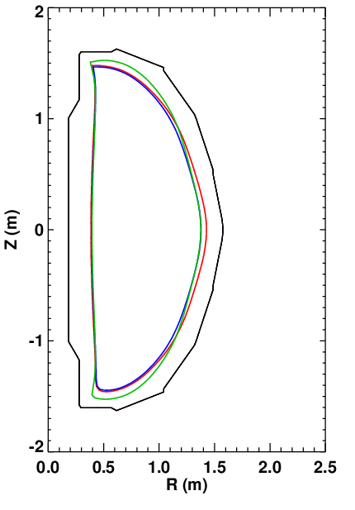
Maximal Aspect Ratio and Kappa Can Be Studied.
Three cases here
  κ=2.8, A=1.75,I_{P}=750 kA shape typical of f_{ni}=1 in NSTX-upgrade. 15 cm outer gap. (Should get this in the other scans)
  κ=2.95, A=1.81, I_{P}=750 kA shape typical of high-β_{T} in NSTX-upgrade. 20 cm outer gap helps elevate q_{min} at high I_{N}.
  κ=3.1, A=1.81, I_{P}=850 kA shape with 20 cm outer gap…a shape approaching the needs of next-step STs. For κ>3, should we minimize the inner or outer gap? Trade aspect ratio against proximity to plates? May get some indication in A scans.

Slide 10
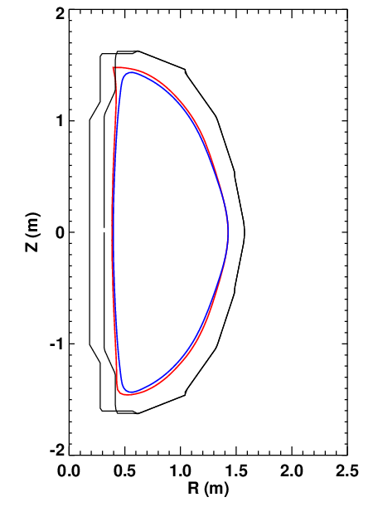
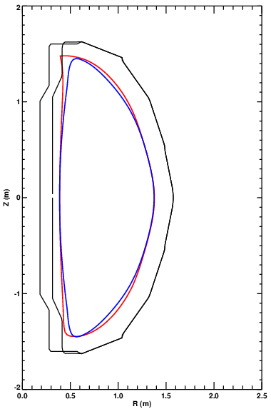
Shapes In Study Are Designed to Mimic Upgrade Scenarios
Proposed Shape NSTX-Upgrade Scenarios
A=1.75
κ=2.8
f_{NI}=1 optimization
A=1.8
κ=2.95
High-β_{T} optimization
Maximize Off Axis NBCD

