Slide 1
Agenda
Motivation & Background for XP-1106
Summary of XMP-77 (n=0 Control Software Checkout)
XP-1106 shot list
Summary of XMP-72 (RWM Control Software Checkout)

Slide 2


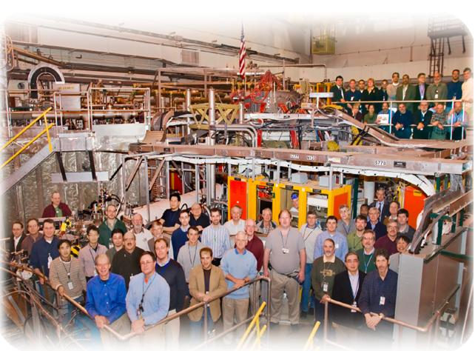

NSTX
Supported by
Development of Improved Vertical Position Control
College W&M
Colorado Sch Mines
Columbia U
CompX
General Atomics
INL
Johns Hopkins U
LANL
LLNL
Lodestar
MIT
Nova Photonics
New York U
Old Dominion U
ORNL
PPPL
PSI
Princeton U
Purdue U
SNL
Think Tank, Inc.
UC Davis
UC Irvine
UCLA
UCSD
U Colorado
U Illinois
U Maryland
U Rochester
U Washington
U Wisconsin
Culham Sci Ctr
U St. Andrews
York U
Chubu U
Fukui U
Hiroshima U
Hyogo U
Kyoto U
Kyushu U
Kyushu Tokai U
NIFS
Niigata U
U Tokyo
JAEA
Hebrew U
Ioffe Inst
RRC Kurchatov Inst
TRINITI
KBSI
KAIST
POSTECH
ASIPP
ENEA, Frascati
CEA, Cadarache
IPP, Jülich
IPP, Garching
ASCR, Czech Rep
U Quebec
NSTX Team Review

Slide 3
Strategy To Improve Vertical Position Control
Improve the detection of small vertical motion.
  “dZ/dt Observer”
Utilize improved observer in optimization of control with PF-3 as the actuator.
Utilize improved observer in optimization of control with the RWM coils as the actuator.
From group review…E. Kolemen examined the problem for improvements to the underlying architecture of the controller.
  Found that there were no simple ways to improve control, due to the somewhat nonstandard coupling of ISOFLUX & Z_{P} control.

Slide 4
Vertical Position Controller is a PD Controller Using Loop Voltages for dZ/dt Measurement
Proportional controller is simply the Isoflux shape control algorithm:
Fast derivative controller is based on the up-down loop voltage difference.
The underlying assumption is that the plasma vertical position can be measured by only 2 loops:
Thesis: Using more/different loop voltages will lead to a better estimation of the plasma position.
  Eliminate n=1 pickup from random loop orientation problems.
  More information for shapes that are distorted.
Proper selection of measurement loops has been emphasized in the literature:
  Ward & Hofmann, Nuclear Fusion 34, 401 (1994)
  Pomphrey, Jardin, and Ward, Nuclear Fusion 29, 465 (1989)
  Albanese, Coccorese, and Rubinacci, Nuclear Fusion 29, 1013 (1989)
  C. Kessel, et al., Nuclear Fusion 41, 953 (2001)

Slide 5
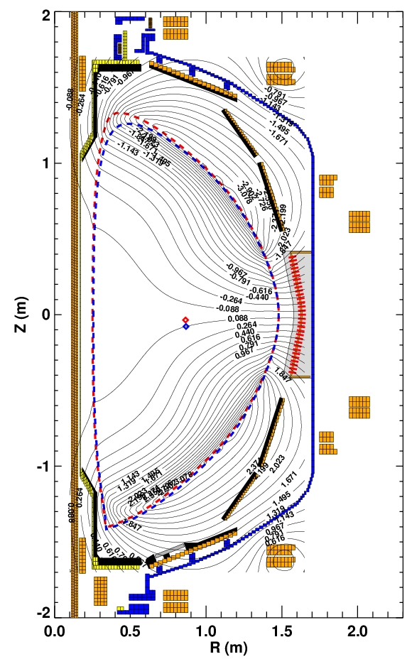
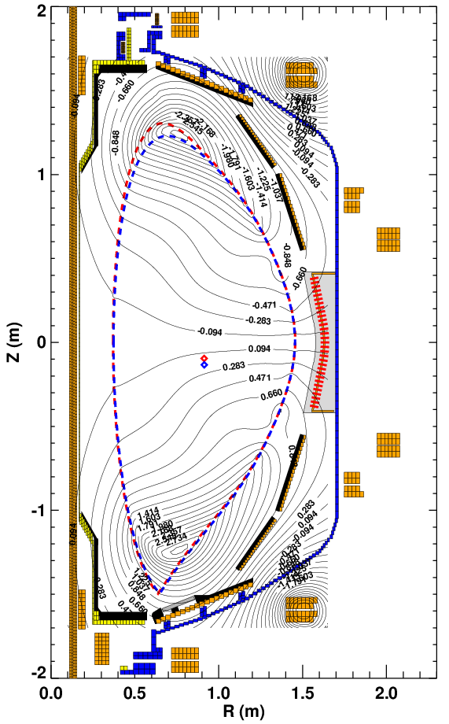
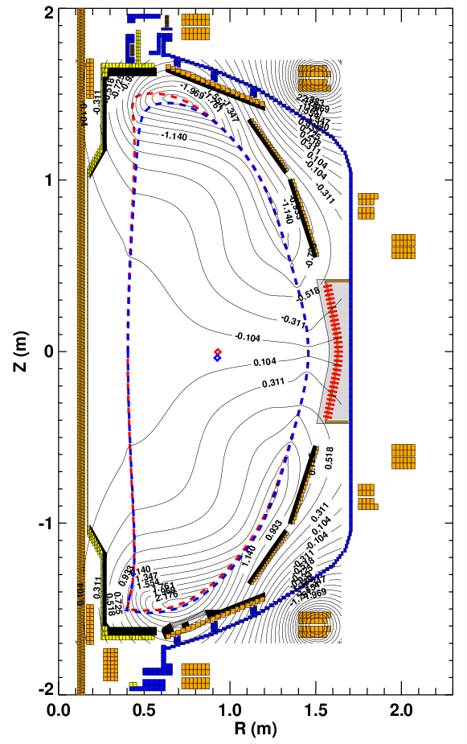
Plasma Equilibrium Determines the Most
Sensitive Loop Pair
Compute pairs of equilibria displaced by 2 cm: ψ₁ and ψ₂
Subtract them from each other (Surrogate for the voltage.): δψ =ψ₁–ψ₂
Compute the expected flux difference: δψ_{UD} =δψ−δψ(z=-z)
No single pair is optimal for detecting vertical motion.

Slide 6
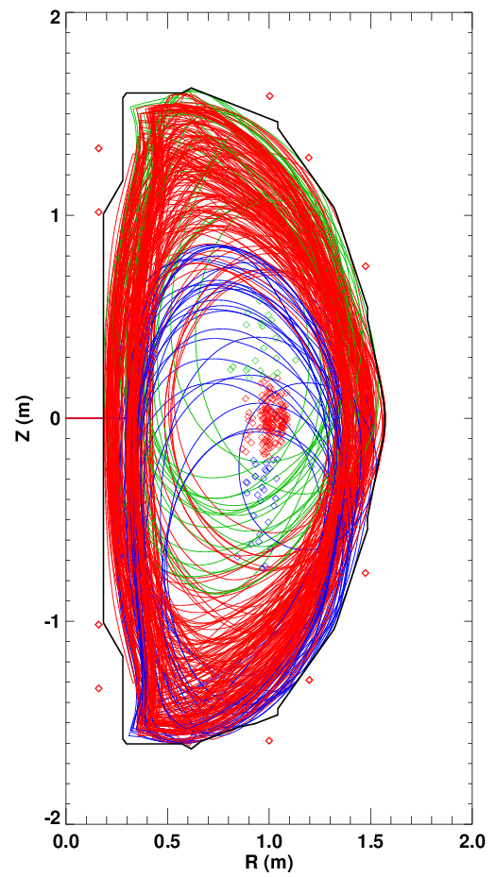
Use a Database of Equilibria to Determine Which Loops are Best For Detecting Vertical Motion
Consider ~590 NSTX equilibria.
  Majority from LRDFIT and EFIT reconstructions.
    Include currents in the passive plates, mode non-rigidity.
  Minority generated with ISOLVER
Computed the flux at the various flux loop locations.
Fit the magnetic axis location to a function:
  Only use equilibria with |Z_{P}|<20 cm
Find coefficients α from:
  linear SVD solution, or
  constrained optimization
    Prevent any single value α from becoming too large.

Slide 7
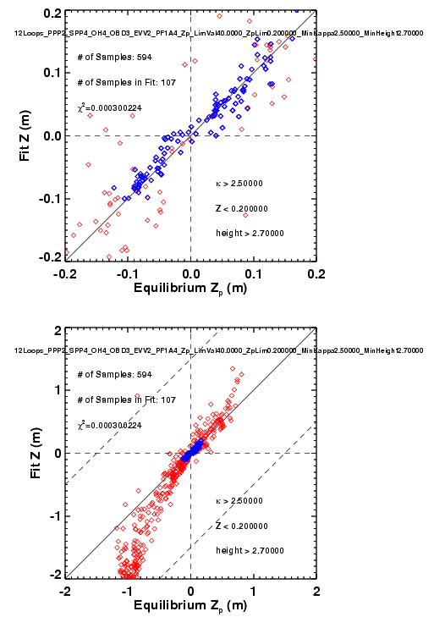
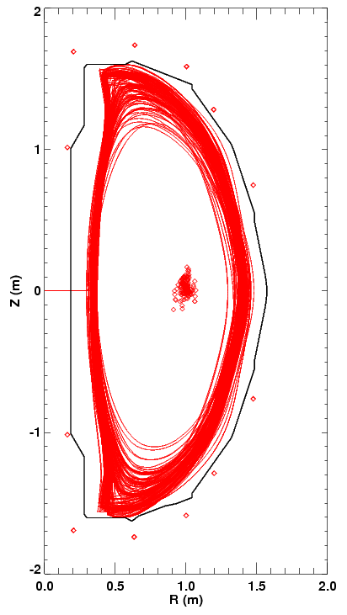
Example: Constrain to Only High Elongation Plasmas

Slide 8
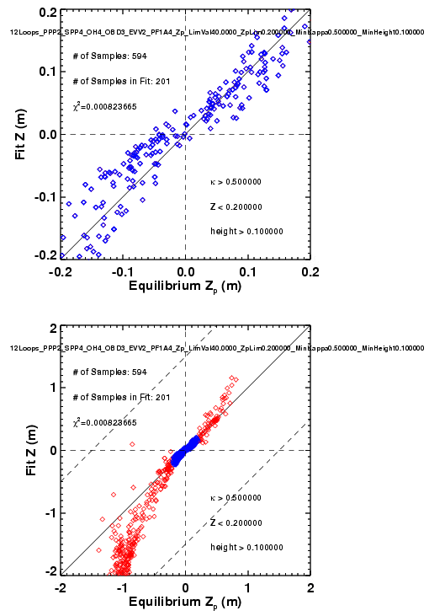
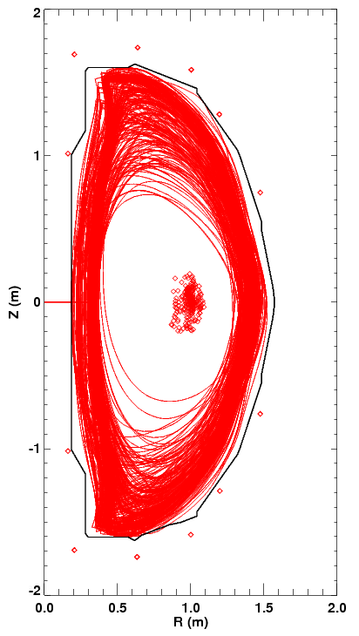
Example: Constrain to Also Sorts of Plasmas

Slide 9
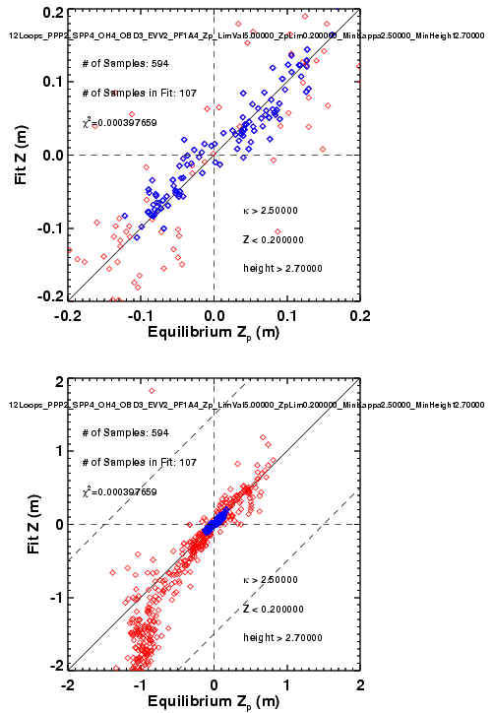
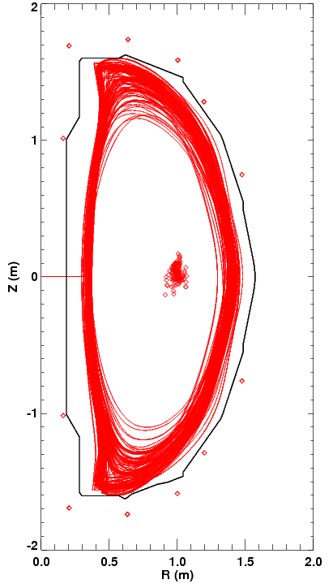
Example: Only High Elongation, But With Limits on the Size of Any Individual Weight

Slide 10
Strategy For Determining Loop Weighing
There is a balance to be struck:
  Linearity: Put all weight on inner flux loops
  Noise immunity: Distribute weight across loops
n=1 pickup (tearing and kink modes) will be stronger in some loop pairs than others.
  Won’t really know this until we see the data.
Will pick final weight coefficients based on actual difference voltage signals.
  Use actual voltage differences (including any noise).
  First use coefficients from previous analysis, compare reconstructed and estimated d(I_{P}Z_{P})/dt (will need fast EFITs/LRDFITs).
  May need to further adjust weights.
  Will require a week or so of operation will all loop voltage differences functioning and data being collected.

Slide 11
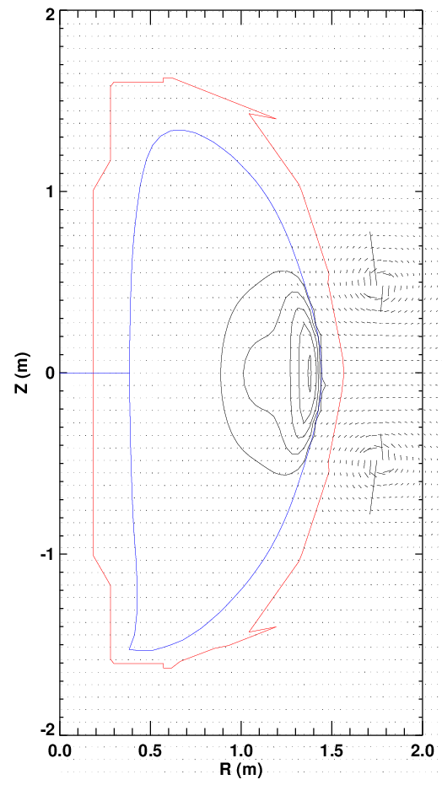
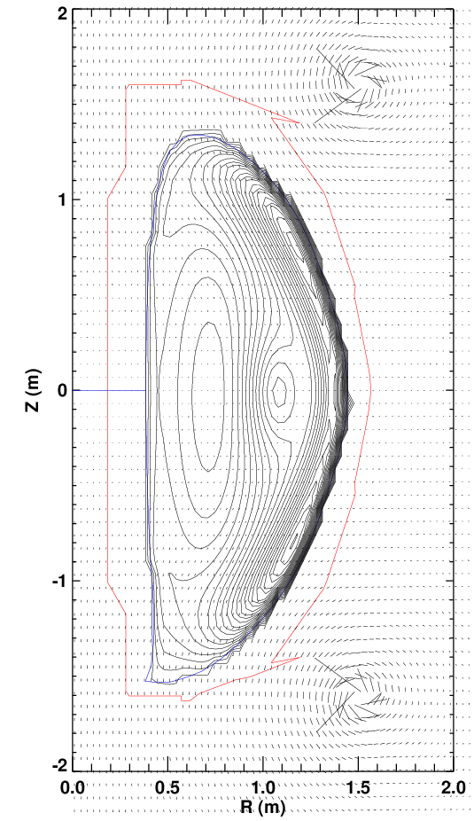
Vertical Position Control May Be Possible With the RWM Coils
Calculate force assuming 1 amp of power supply currents
RWM Coils: F_{Z}=78
PF-3 Coil: F_{Z}=1500
RWM Coils make far less force for the same power supply current.
(ratio is not as bad for lower-elongation plasmas)
However….
SPA are very fast
(0 to 3 kA in 1-2 msec)
2) Latency in that system is smaller
3) RWM coil field may not couple as strongly to the passive plates.

Slide 12
Formulation of the PCS Code
Estimate of d(Z_{P}I_{P})/dt :
Form the SPA current request:
How big should D be?
  Take a 1 MA plasma, moving 10 cm in 10 msec:
    d(Z_{P}I_{P})/dt =1*0.1/0.01=10 MAm/sec
  We want 3000 A of current for this feedback.
    D=3000/10=300 Asec/MAm

Slide 13
Hardware and Software Status
dZ/dt Observer
  Complete specification has been written, implemented in PCS
  Electronics for voltage differences are finished, installed in NTC, and fully cabled in.
  Changes to MDS+ tree for additional channels have been made.
  Offline IDL code written for comparison to archived realtime data.
  Testing is making good progress.
    And has been a good (& painful) learning experience for those involved…
RWM coils for Z_{axis} control.
  Specification has been written.
    Relies on the improved dZ/dt observer for the measurement.
  Code has been implemented as part of the 6 subunit proportional control algorithm.
XMP written for testing of these software changes.

Slide 14
Backup

Slide 15
Note on Gain Equivalences
Present system uses a gain of 80.
  i.e.:
New system will use a formulation:
For observer with PPP2 loops only, α=2.5.
So, equivalent derivative gain is now 80/2.5=32.

Slide 16
Run Plan (I)
Debugging: Compare PCS calculations to identical off-line versions.
XMP (?): Test that system is correctly coupled to the PF-3 coils.
  Switch to new controller formulation (the αs), use the same single loop pair and value of gain (27) that reproduces the old system.
  Show that vertical controller still works.
Day 1: Optimize gains with PF-3 as actuator, new d(I_{P}Z_{P})/dt observer.
  Reload vertically unstable target, A~1.75, κ=2.9. Show a VDE. (3 shots)
    Potential reload is 142301.
    Use divertor gas injection to drive l_{i} up?
  Transition to new d(I_{P}Z_{P})/dt observer, same overall gain. Repeat. (4 shots)
    If no VDE, then increase κ until a VDE occurs.
  Scan control gain for optimum stability. (5 shots)
    (or oscillation develops).
  Contingency, do one of: (5 shots)
    Test a second combination of loops.
      Repeat gain scan
    Use same combination of loops, change the shot and demonstrate benefits.
      For instance, lower-delta target with reduced beam heating.

Slide 17
Run Plan (2nd ½ day, using RWM coils, if necessary)
Turn off PF-3 vertical control and see plasma drift. (3 shots)
  Use fiducial like target
  Shot to reload: 141640
Add n=0 control with RWM coils. (7 shots)
  Scan gain using value 0.5, 1.0, 1.5, 2.0, 2.5
  Stop scan when coil currents become too large, or VDE is stabilized.
If VDE is stabilized, then increase inner gap until instability is achieved. (4 shots)
Test combined PF-3 and RWM coil control to determine the new limit on aspect ratio and l_{i}. (4 shots)

Slide 18
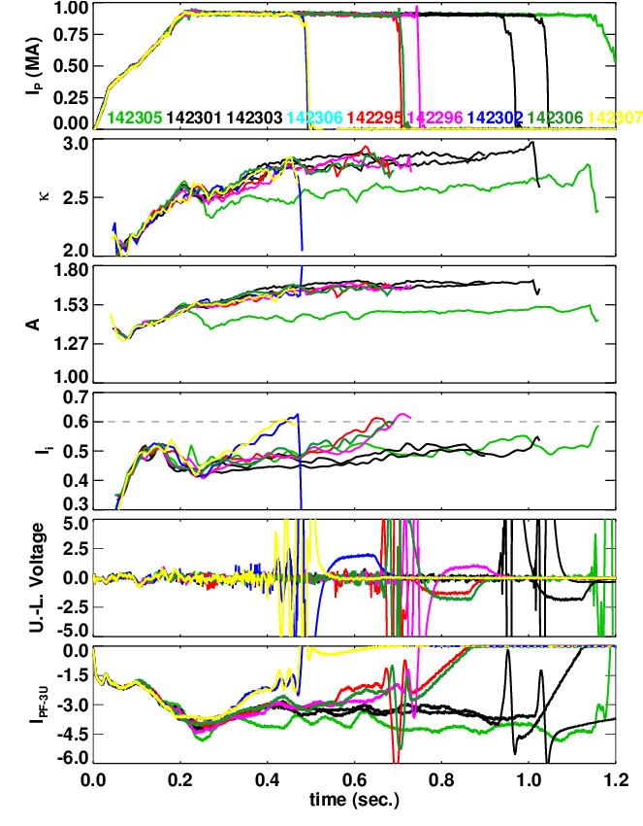
XP in 2010 Showed that Vertical Position Control can be Lost at Higher Aspect Ratio
1 Fiducial (green) and 8 shots at higher aspect ratio.
  Black cases vertically stable, the colored ones have VDEs.
VDE is always triggered when l_{i}=0.6.
  This is not a particularly high value.
  Would preclude use of the scenario for many XPs.
Other instances of vertical stability problems.
  Egemen’s squareness XP.
  Ron Bell’s DIII-D comparison XP.
  After every nearly every locked mode and RWM.
Motivates improvements to the n=0 controller.

Slide 19
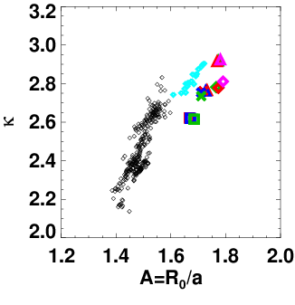
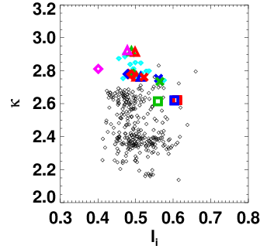
Interesting Scenarios for the Upgrade Will Push Against These Limits
Ask for high-kappa at even larger A.
Ask for high-kappa at values of l_{i} comparable to present values.

Slide 20
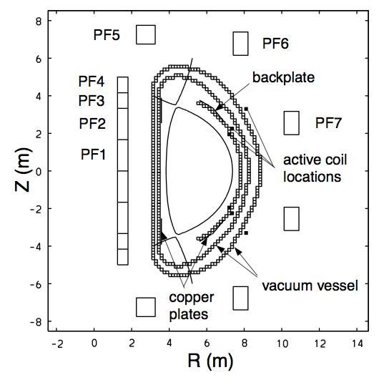
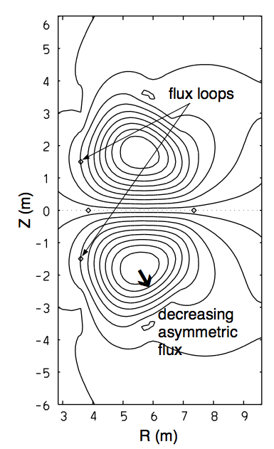
Inboard Side Loops Were Chosen in a Study for ITER Control in Kessel, et al.
Perturbed flux pattern from 10 cm downward shift
s
What is the common perturbed flux pattern for NSTX cases?
C. Kessel, et al., Nuclear Fusion 41, 953 (2001)

Slide 21
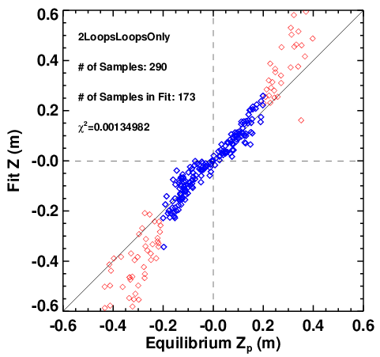
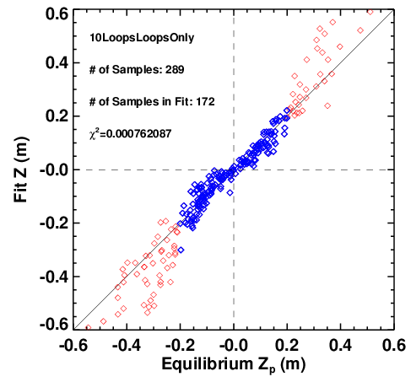
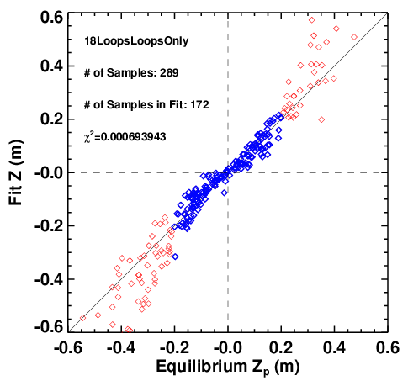
Adding More Loops With Unconstrained Fitting Allows Further Reduction of χ², Keeps Weight on CSC Loops

Slide 22
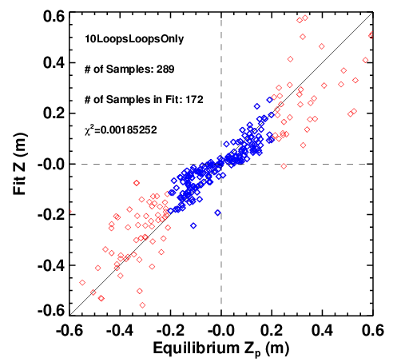
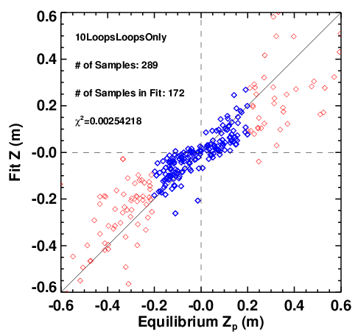
Constrained Optimization Can Balance Sensitivity
Against Linearity
Scan of the maximum allowable weight on a single loop
(40, 5, 2.5)
About 2.5 x better than present system
Study neglects any benefits that might come from elimination n=1 pickup.

Slide 23
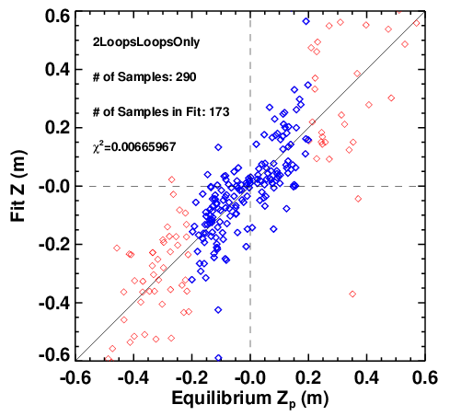
Studies Show That Loops on the Center Column are Most Linear...But Least Sensitive
CSC loops have less relative coupling to plates, are more linear.
  But are much less sensitive (34 vs 2.53).
Compromise between linearity and sensitive has not been discussed in the literature (to my knowledge)
PPP2
OHU4

