Slide 1
Proposal to apply FW heating at 30 MHz on DIII-D
Motivations:
DIII-D is an excellent facility for fast-wave studies, especially for fast-wave & fast-ion physics
  Existing FW system that can be restarted relatively easily
  Excellent neutral beam capability
  Strong physics program in fast ions
  Diagnostic complement is excellent for studying RF effects on heating, fast ion interactions, AE instabilities and transport
30 MHz FW at 1 T on DIII-D would give valued information for NSTX-U operation
  Fast ion damping at 4th deuterium harmonic of the NB ions
  Edge RF power deposition relative to central power deposition
30 MHz FW at 2 T on DIII-D would provide for minority H ICRH
  Heating regime to be employed on ITER
  Should provide strong heating of the core plasma
  ICRH efficiency in ECH generated discharges is of direct importance for predicting performance of this only ion heating technique for ITER

Slide 2
Estimate of Man Days required for restart of FW system at 30 MHz
(Nagy/Greenough)
ABB1 source and the 0-deg antenna to be used
~ 3 MM of engineering/techs from PPPL
Support from Nagy, Brown at GA
Support desired from Horton from ORNL
Physicist effort from Pinsker, Perkins, Hosea
Minor M&S required
< $10 k
Total estimate ~ $100 K + travel
 |  | Labor MD | Duration days
 | Total | 59 | 51
Restart Tasks
ABB Amplifier
1 | FPA Tubes should be pulled and put on ion pumps to determine quality | 4 | 2
2 | Reinstall best tube in ABB1 | 4 | 2
3 | Walkdown all indoor cabinets--clean out as required | 2 | 1
4 | Perform maintenance--filter cleaning etc | 2 | 1
5 | Walkdown power yard, inspect cap bacnks, clean | 2 | 2
6 | Operate test/braker perform maintenance if required | 2 | 1
7 | Turn on water system, check for leaks | 2 | 1
8 | Fill and restart dummy load, do not repair leaks, leave sump in place | 2 | 1
9 | Retune ABB to 30MHz | 2 | 3
Antenna/Transmission Line
1 | Pull coax at antenna, remake 1/4 wave sections for 30HHz or replace with straight line | 2 | 10
2 | Operate tuners, repair if needed | 2 | 3
3 | Reinstall transmission line with bridge support in original position | 2 | 3
4 | Pressurize line check for leaks | 2 | 1
Turn On Sequence
1 | Turn on water system, check for flows and leaks | 2 | 1
2 | Turn on local control power, check that fans and controls work, tube filaments come on | 2 | 1
3 | Set to dummy load | 1 | 1
4 | Check tuning for 30 MHz | 2 | 2
5 | Turn on power yard | 2 | 1
6 | Turn up voltages on both driver and FPA to form caps | 2 | 1
7 | Force a crowbar at low voltage to see that the crowbar operates | 2 | 1
8 | Run low power shots, check for stage tuning and outputs at 30MHz | 2 | 1
9 | Operate system up to high power into dummy load | 2 | 1
10 | With Pit closed, operate into antenna | 2 | 1
11 | Check arc detector viability | 1 | 1
12 | RF sniff line for leakage | 2 | 1
13 | Condition the antenna to 28kV to assess | 2 | 2
14 | Buffer | 5 | 5

Slide 3
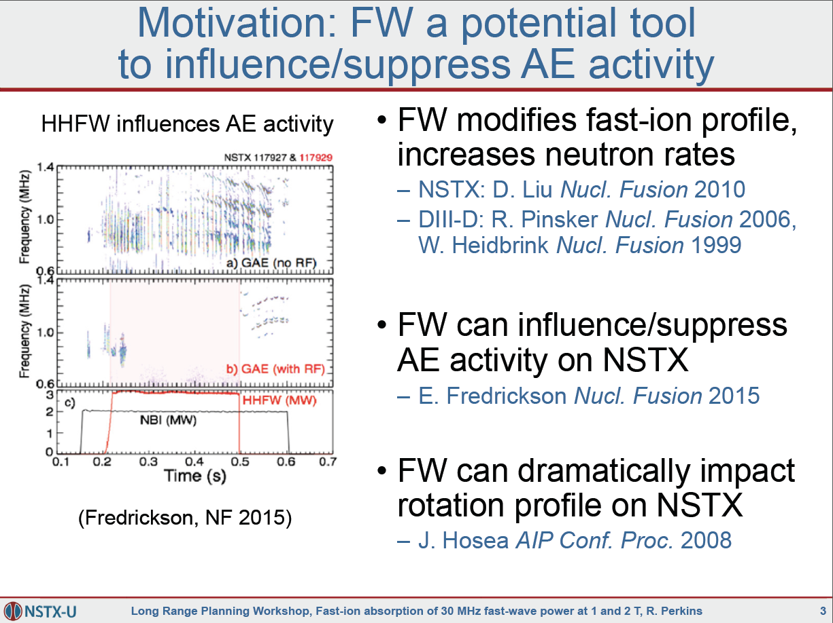
Slide from Perkins presentation at the long range planning workshop showing FW suppression of GAE modes

Slide 4
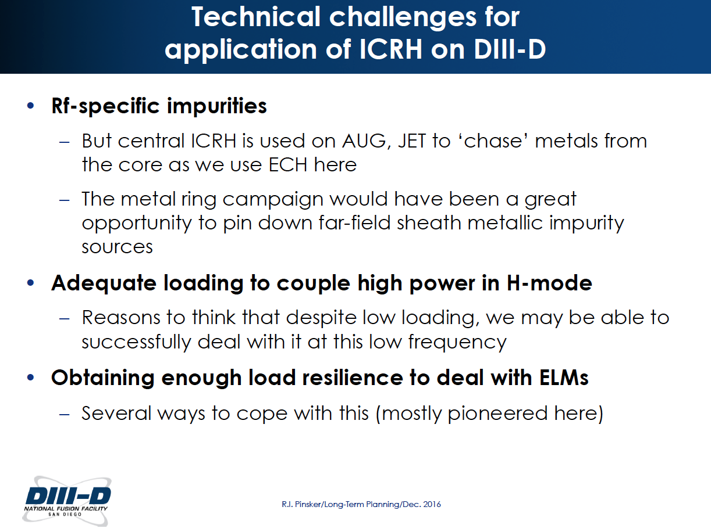
Slide from Pinsker presentation at the long range planning workshop showing ICRH application challenges
The launcher will be kept back away from direct NB ion bombardment to avoid impurity generation at the launcher
A three strap configuration as used on ASDEX-U could be considered

