Slide 1

POWER SYSTEM FOR FUSION RESEARCH
S. Ramakrishnan
PPPL Princeton NJ
01/15/2014
Acknowledgement:
This work supported by the US DOE Contract No. DE-AC02-09CH11466 with Princeton University
The presentation materials are extracts from published papers by PPPL staff - C. Neumeyer , S. Ramakrishnan & others

Slide 2
POWER SYSTEM FOR FUSION RESEARCH
FUSION RESEARCH
FUSION RESEARCH CENTERS IN THE WORLD
FUSION RESEARCH IN PRINCETON
NSTX in Princeton
DCCTs USED IN POWER LOOPS

Slide 3
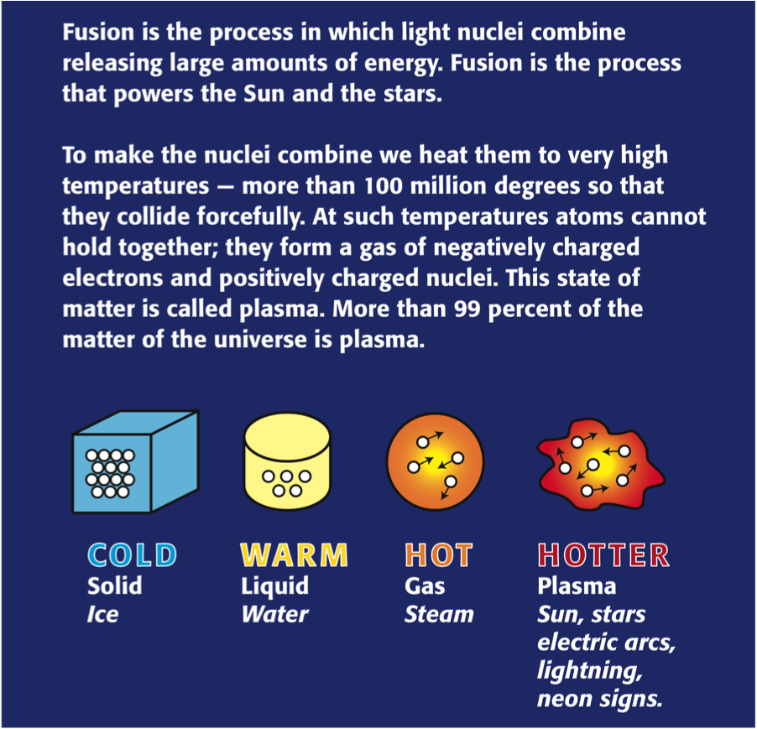
POWER SYSTEM FOR FUSION RESEARCH
What is Fusion
Fusion

Slide 4
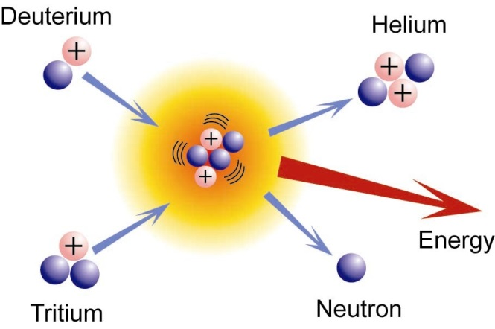

POWER SYSTEM FOR FUSION RESEARCH
FUSION CONCEPTS
Research Started in 1951 in Princeton
  Soon after the H2 bomb test
KEY CONCEPTS
  D-D and D-T reactions
  Plasma heating – Ohmic, Neutral Beam, and RF
  High temperatures needed: plasma
  Fuel unlimited: ²H in seawater
  Little radioactive waste
  Containment
    Magnetic
    Inertial
  Fusion Power Generation unlikely for next couple of decades

Slide 5
Power System for Fusion Research
ADVANTAGES
Abundant Fuel Supply
Deuterium – inexhaustible supply from sea water (1 part/ 6,500 H₂O)
Tritium – produced from Lithium, thousands of years supply
No Risk of Nuclear Accident
No meltdown possible
Large uncontrolled release of energy impossible
No Air Pollution of Greenhouse Gases
Reaction product is Helium
Minimal or No High Level Nuclear Waste
Careful material selection should minimize waste caused by neutron activation

Slide 6
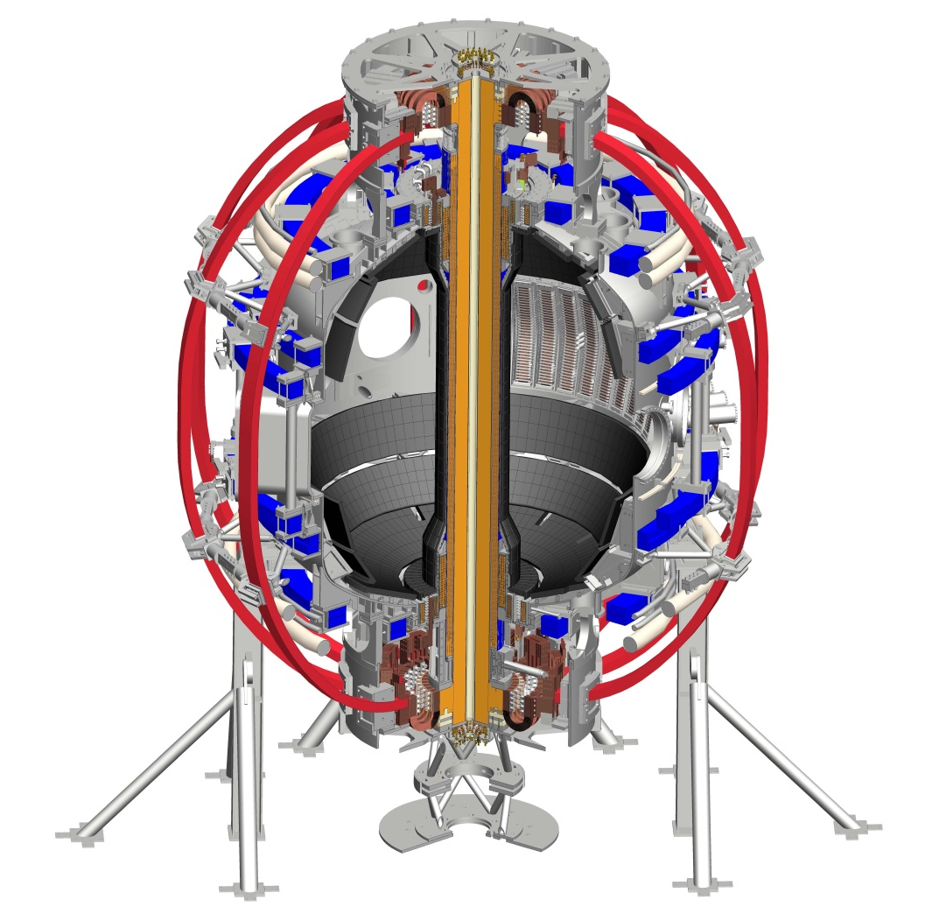
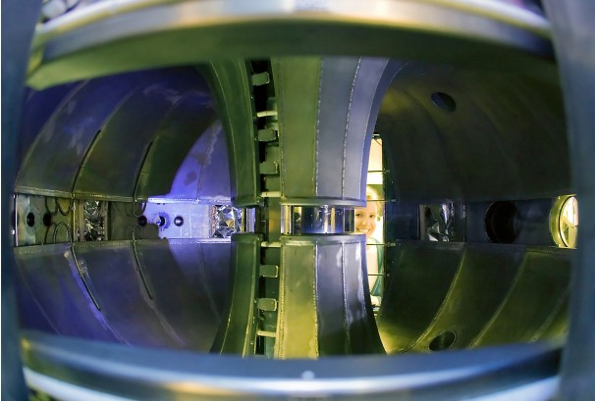
Power System for Fusion Research
National Spherical Torus Experiment in PPPL

Slide 7
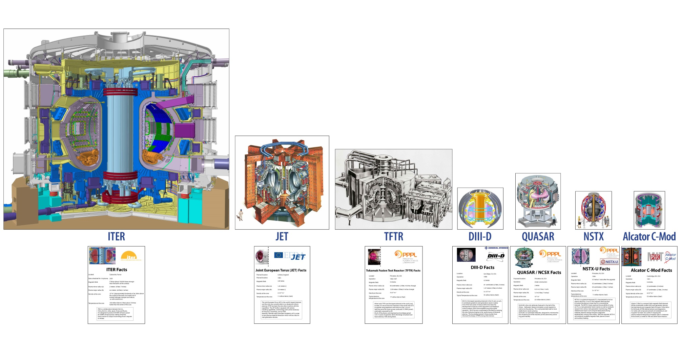
Comparison of Fusion Research Devices in the World

Slide 8
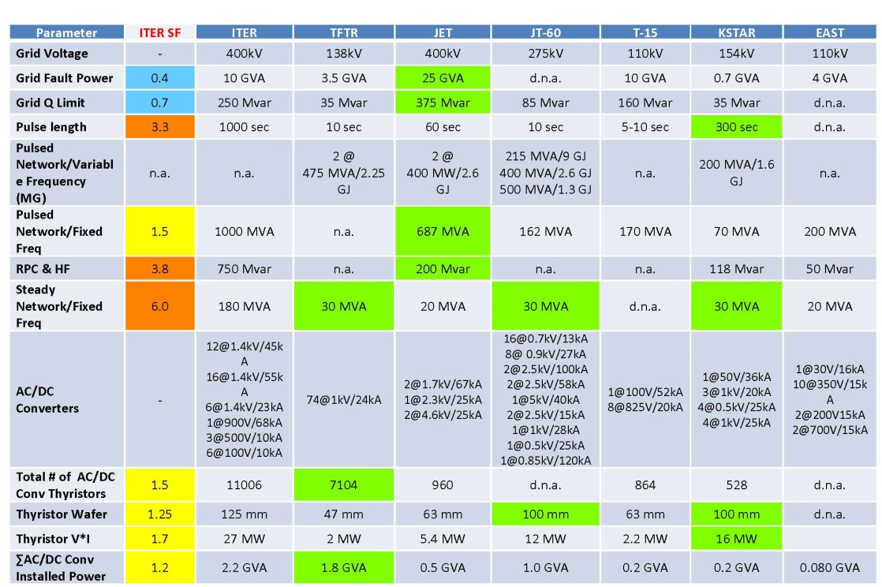
Power System for Fusion Research
Fusion Devices in the World

Slide 9
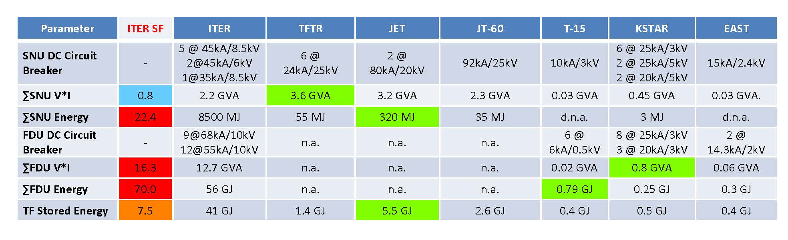
Power System for Fusion Research
Fusion Devices in the World – Contd.
Switching Network Unit (SNU)
Fast Discharge Unit (FDU)

Slide 10
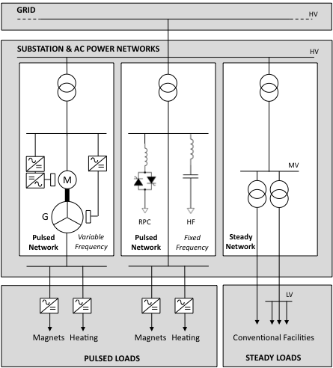
Power System for Fusion Research
Typical AC System
Grid –AC transmission grid provides the input power source.
Pulsed Network/Variable Frequency –receives low level of power from the grid, stores energy between pulses, and delivers a high level of active (P) and reactive power (Q) during pulses, typically using a motor – generator (MG) system with variable frequency output.
Pulsed Network/Fixed Frequency – delivers a high level of P and Q during pulses, directly from the grid. Reactive Power Compensation (RPC) controls net Q and Harmonic Filtering (HF) filters harmonic currents.
Steady Network/Fixed Frequency –receives power from grid and delivers to medium voltage (MV) and low voltage (LV) conventional steady-state facility loads.
Conventional CTs in use for feeders
Protective relays tested for variable frequencies

Slide 11
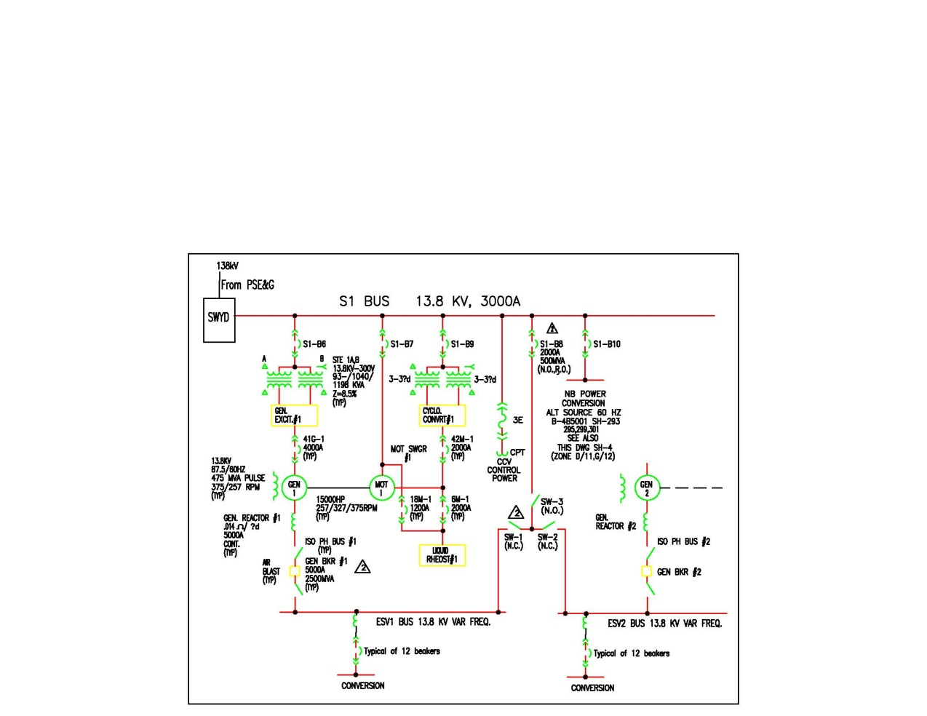
Power System for Fusion Research
Experimental AC System in PPPL Princeton
Same as G1

Slide 12
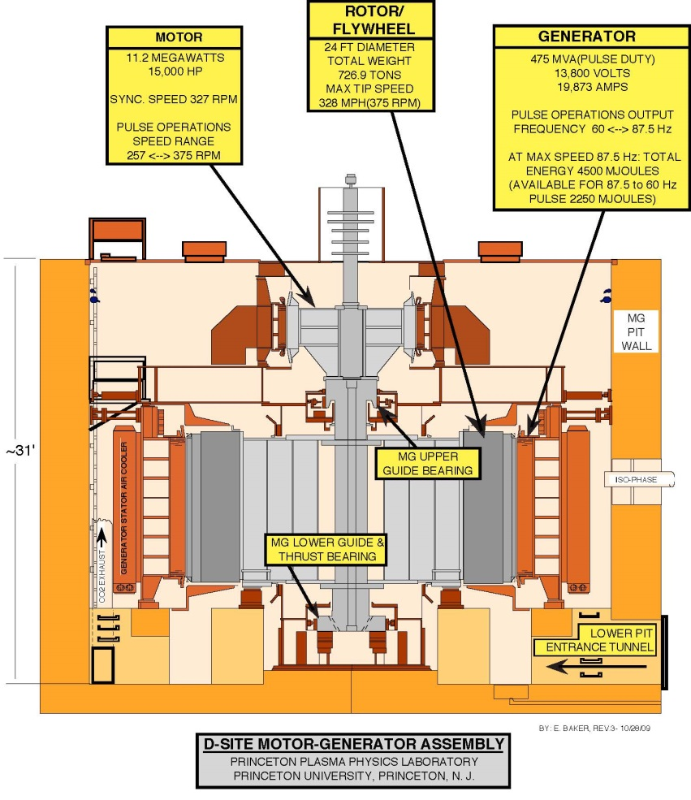
Power System for Fusion Research
PPPL MG – Supplied by GE

Slide 13
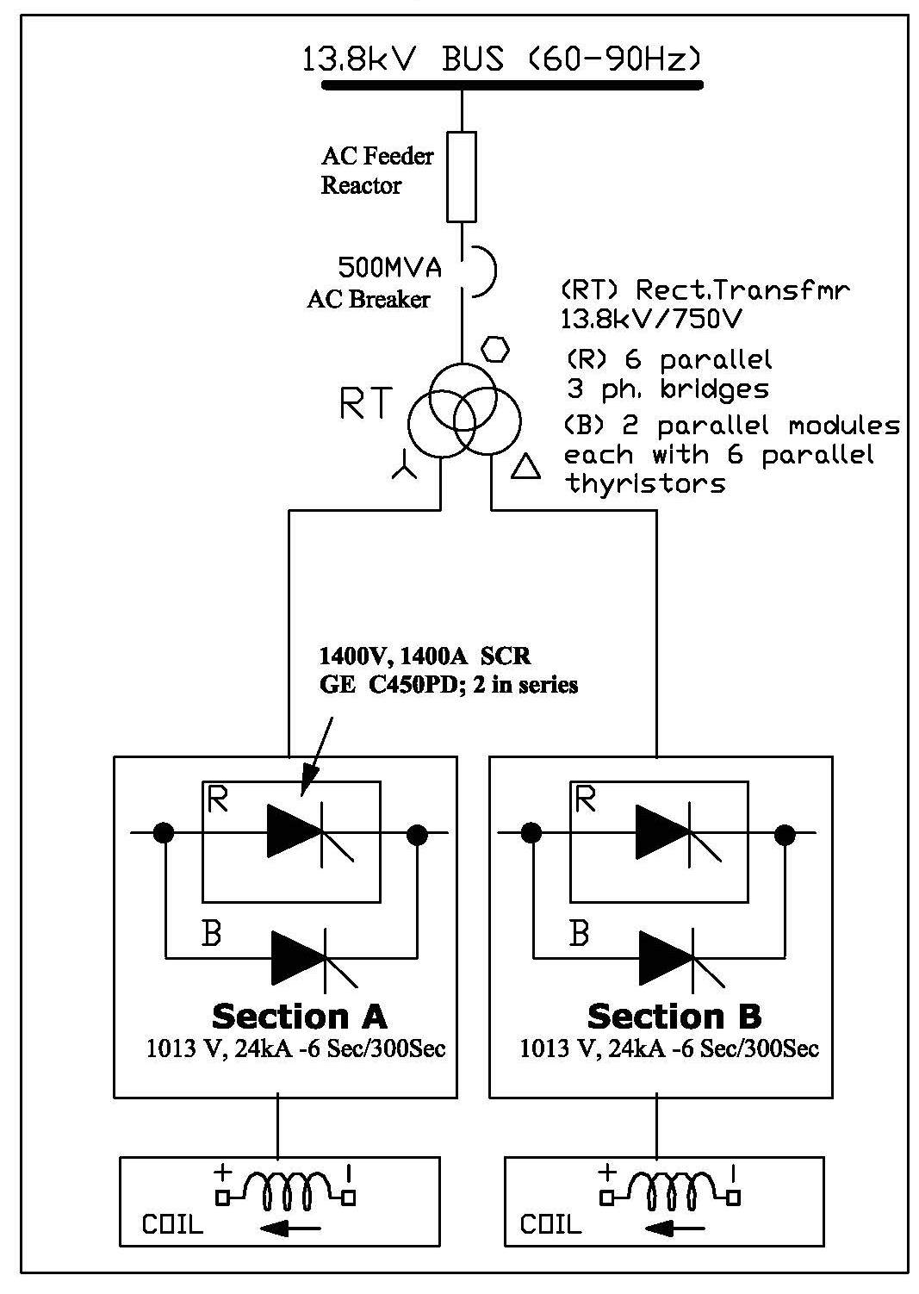
Power System for Fusion Research
Typical Conversion System in PPPL
Three Winding Transformer feed the Rectifiers
  These have polygonal primaries
  Total of 37 Units of this rating
  Effective 24 pulse rectification possible by series/parallel operation
  Conventional CTs on AC side
  DCCTs are typically Hall effect type
  Some fiber DCCTs are also used.
  DCCT accuracy typically 0.1%

Slide 14
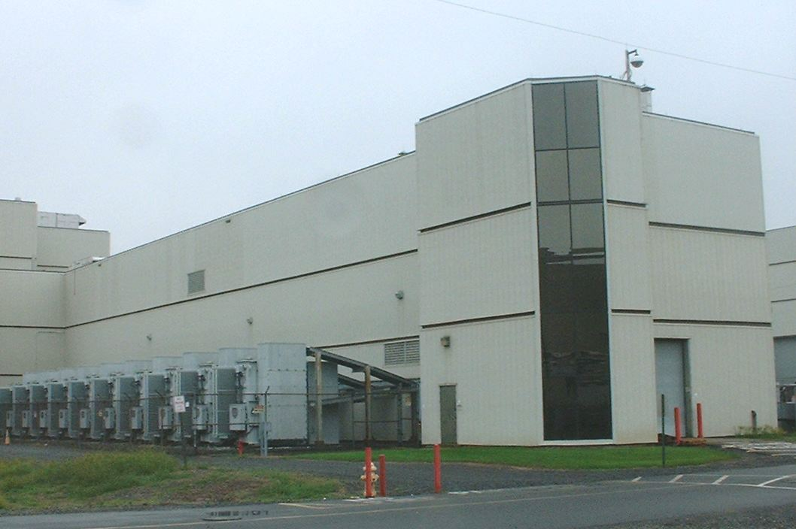
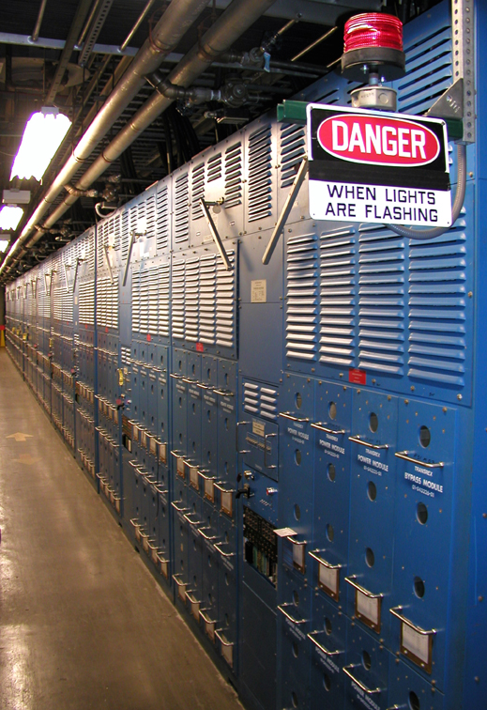
Power System for Fusion Research
PPPL Pwr. Supply Bldg
PPPL Thyristor Rectifiers

Slide 15
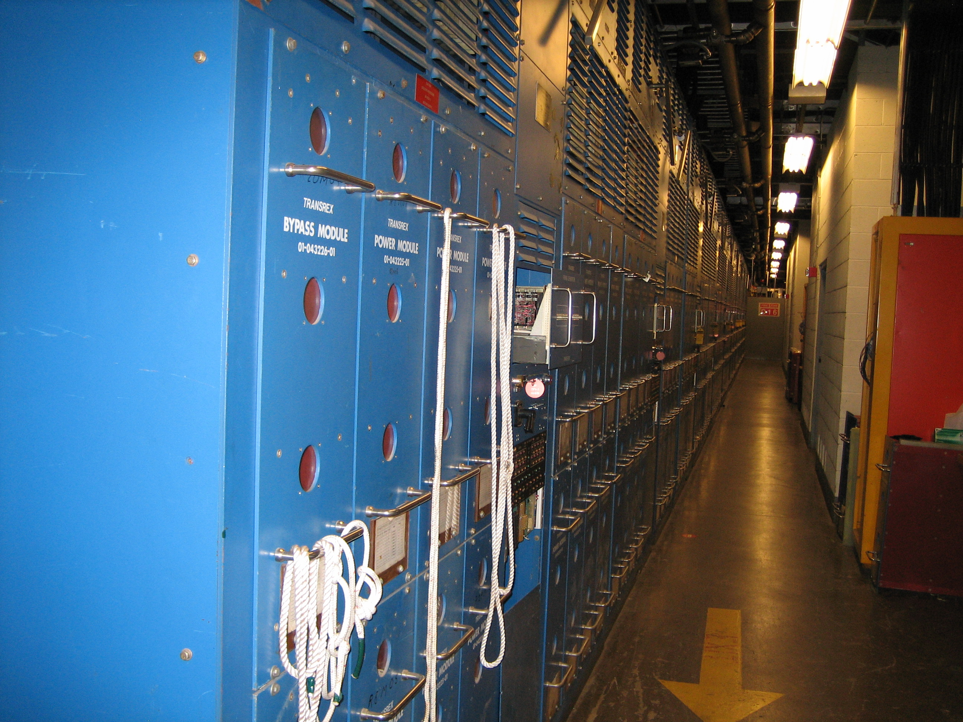
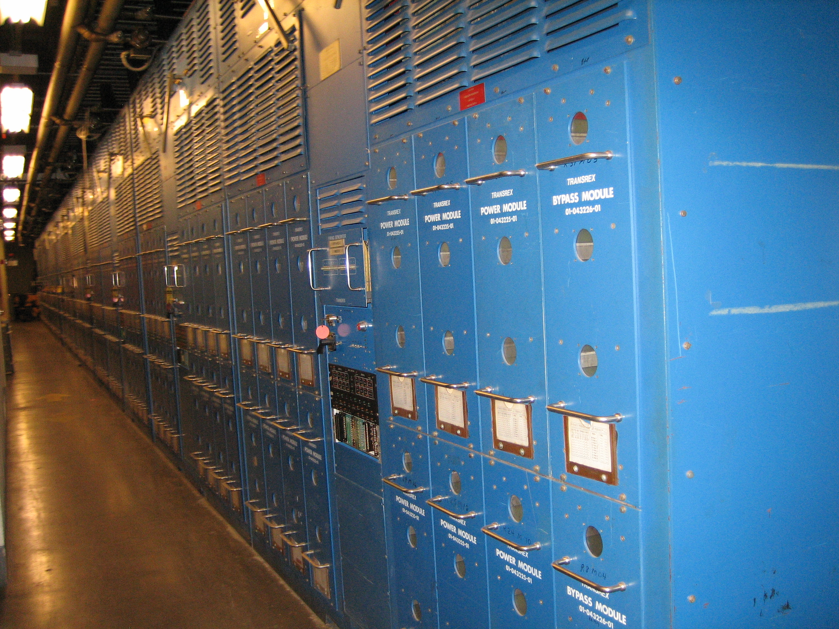
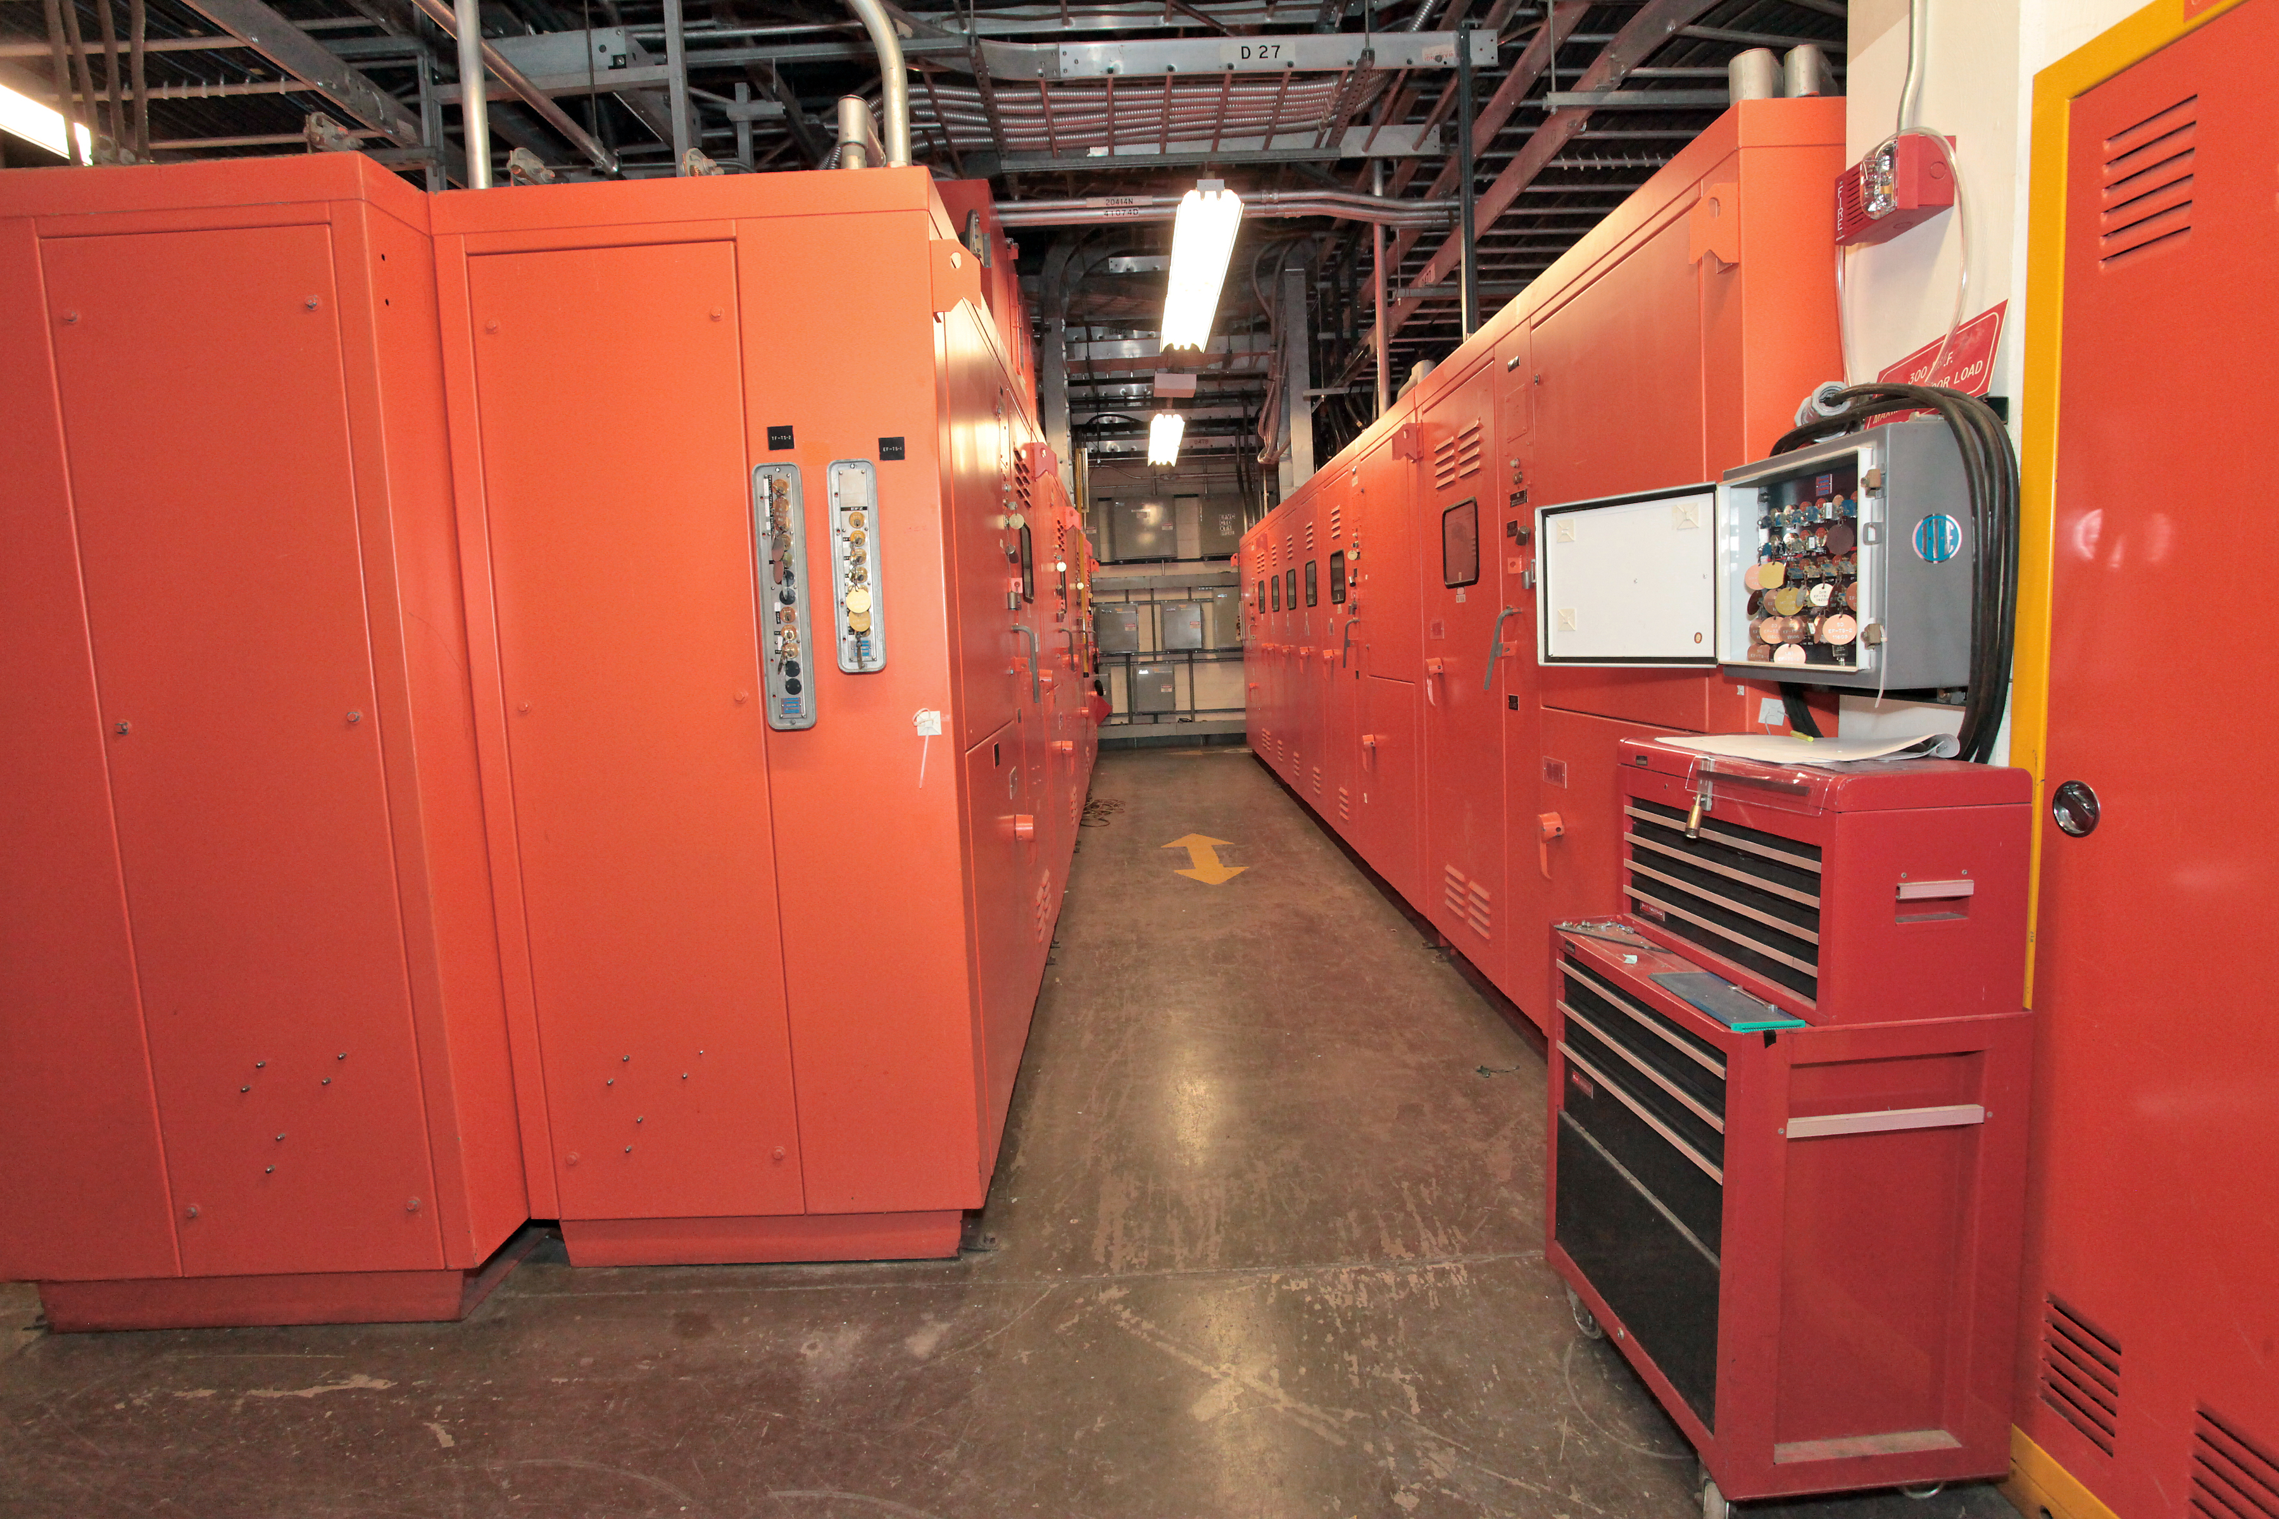
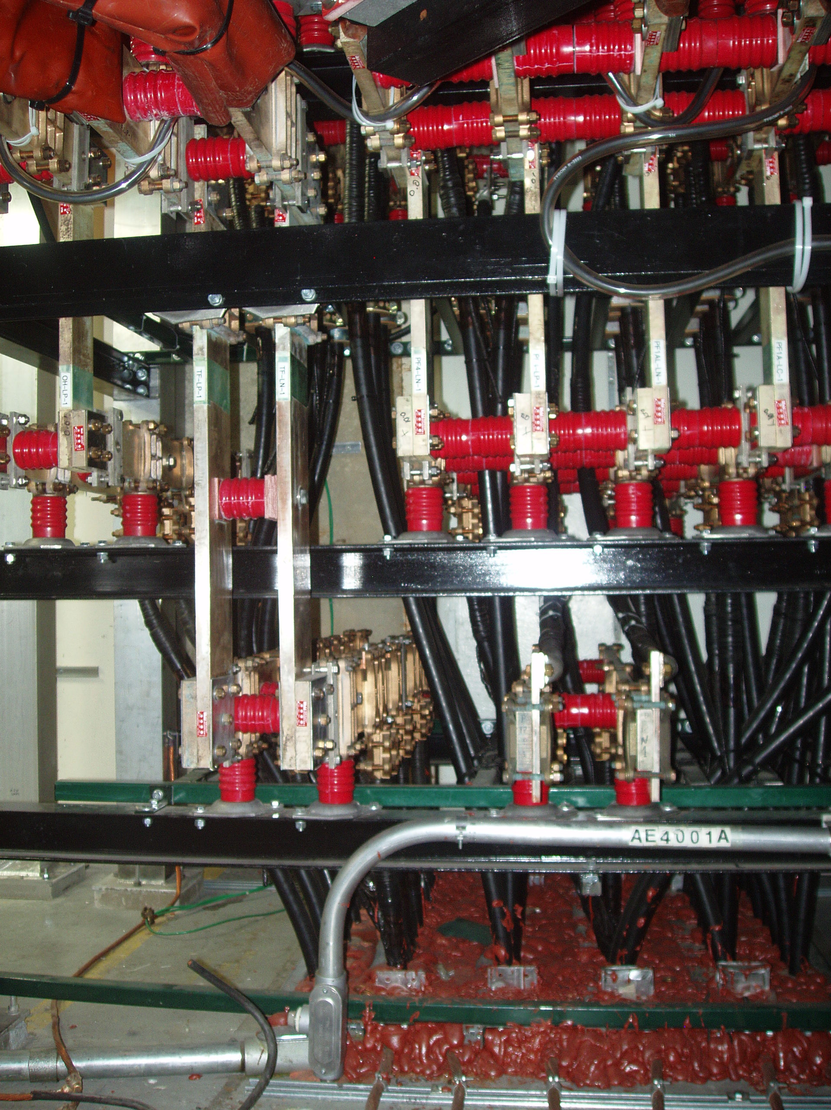
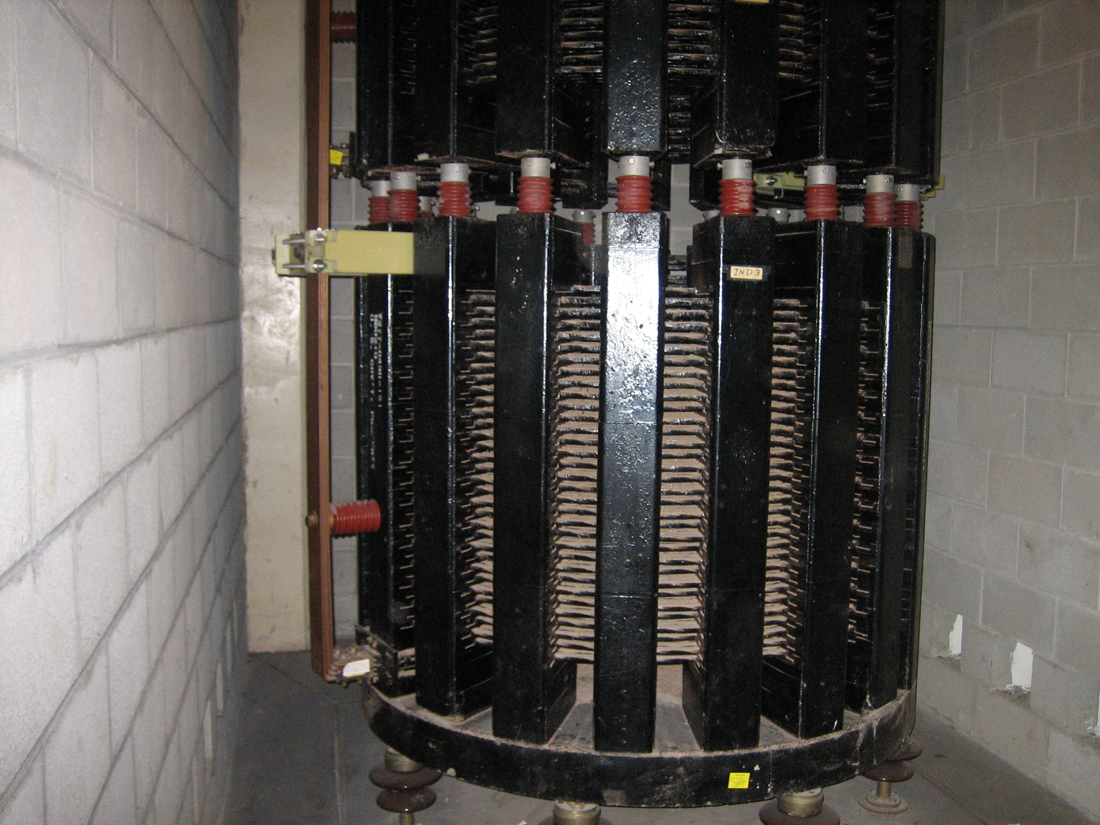
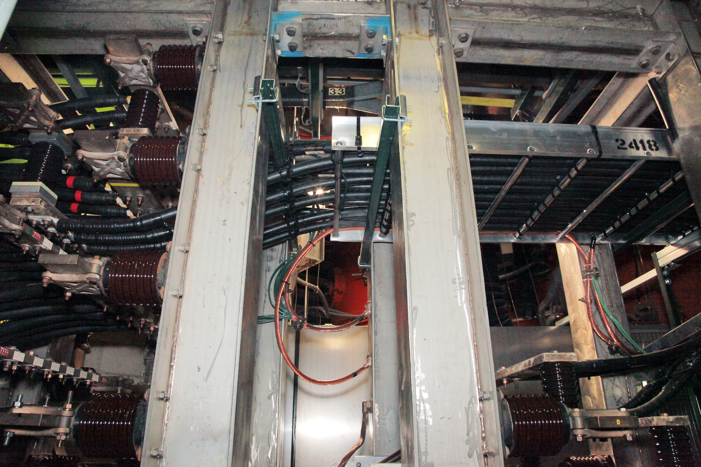
Power System for Fusion Research
Power System Equipment

Slide 16
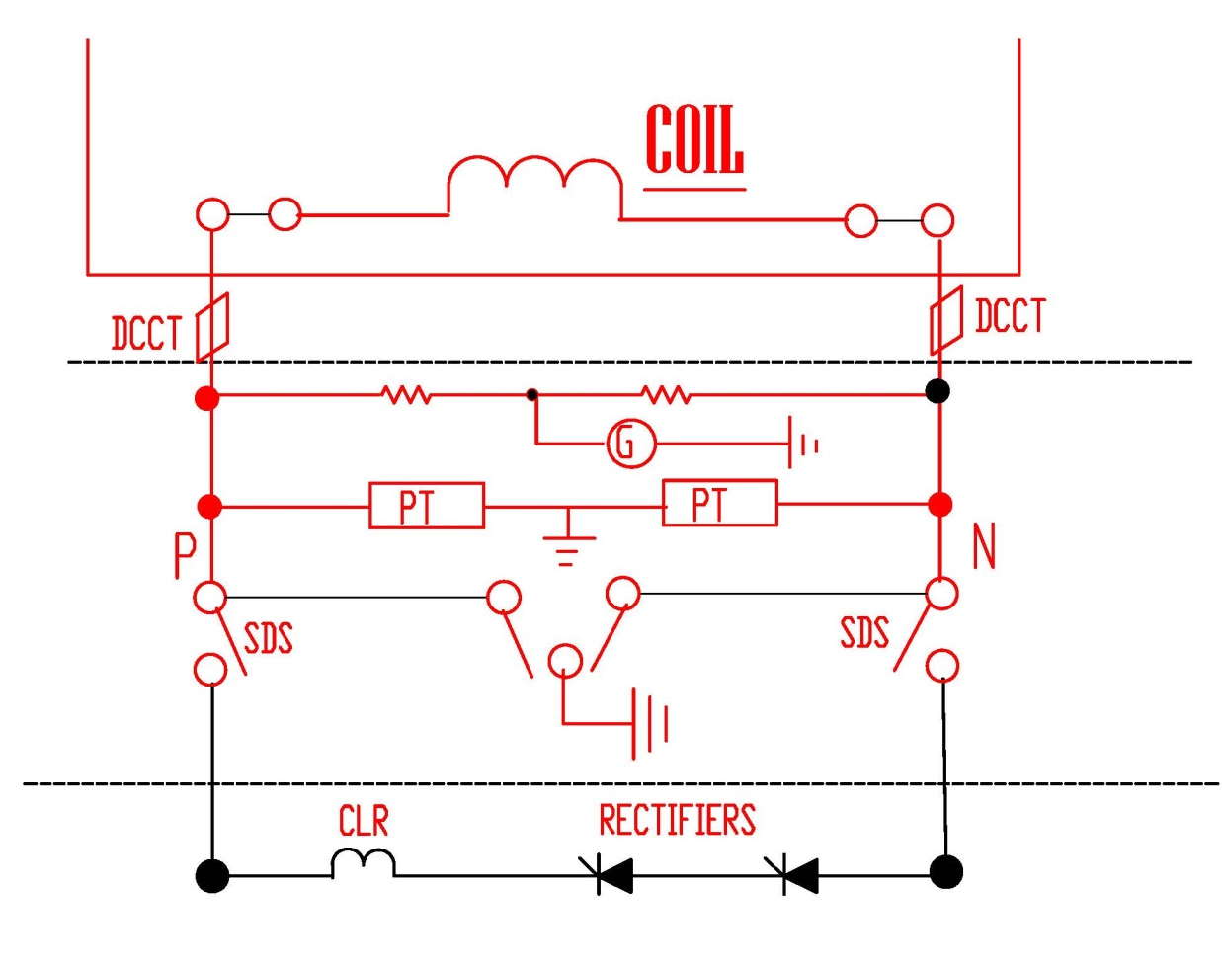
Power System for Fusion Research
TYPICAL COIL CIRCUIT

Slide 17
POWER SYSTEM FOR FUSION RESEARCH
NSTX in PPPL
-The National Spherical Torus Experiment (NSTX) designed & installed in existing facilities at Princeton Plasma Physic Laboratory (PPPL) in 1999.
-Most of the hardware, plant facilities, auxiliary sub-systems, and power systems originally used for Tokamak Fusion Test Reactor (TFTR) have been used with suitable modifications to reflect NSTX needs.
-At present, the NSTX power system is feeding thirteen (13) circuits from the Power converters.
-An upgrade of the NSTX center stack is being executed and will be commissioned in 09/2014. This has a much higher Toroidal Field Current from 71.2kA to 129.8kA, and required major configuration changes including doubling the number of parallel strings of rectifiers along with associated power loop changes. Also, three additional coils are to be installed in the machine.
-The control and protection of the rectifiers have to be replaced to reflect state of the art features to enhance the performance.
The main power supply systems for NSTX upgrade are for the Toroidal Field (TF), Poloidal Fields (PF) with twelve individual circuits), the Ohmic Heating Solenoid (OH) coil circuit, the Coaxial Helicity Injection (CHI) system, and the Resistive Wall Mode Coils (RWM). Table 1 gives the details of the NSTX coil system circuits for the upgrade mode. All the DC power loops are kept floating.
The Coaxial Helicity Injection (CHI) system is retained. For CHI operation, the vacuum vessel is divided into two electrically separate parts. These act as the two electrodes for the CHI. Thus the vessel sections are also required to float during CHI operation.

Slide 18
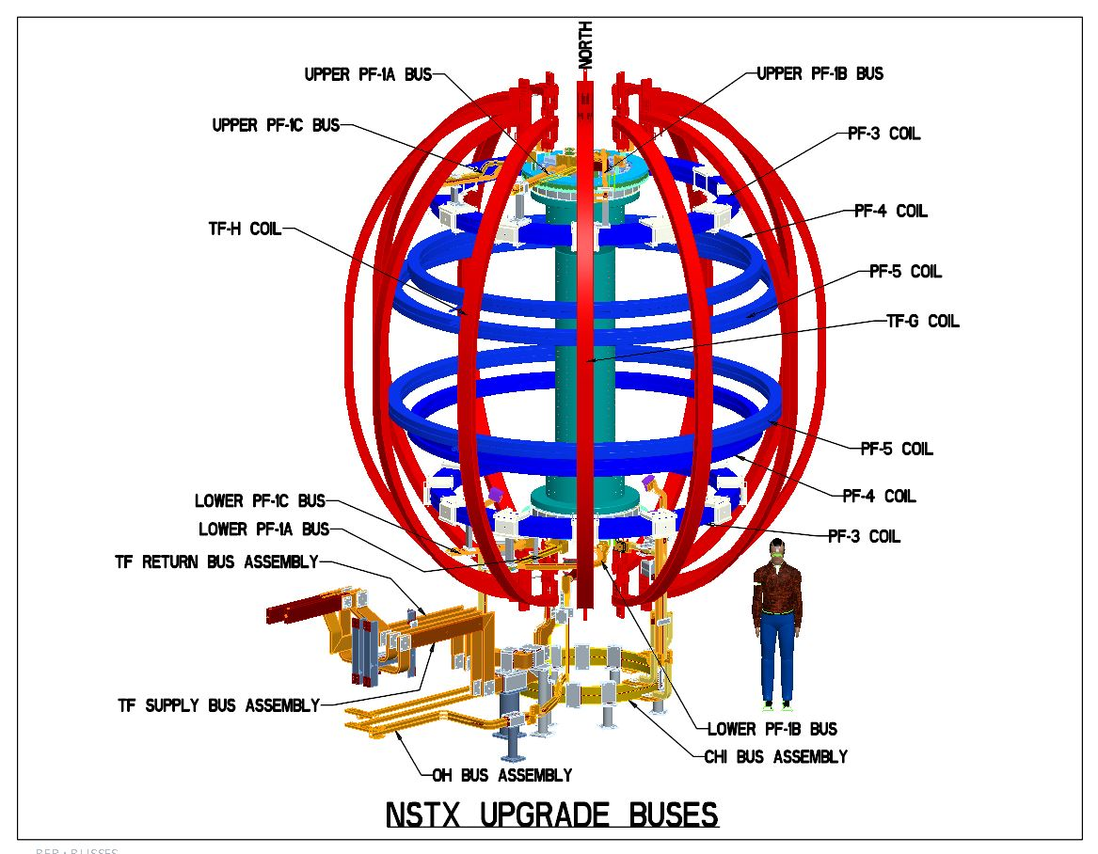
Power System for Fusion Research

Slide 19
POWER SYSTEM FOR FUSION RESEARCH
NSTX-U Coil Circuits

Slide 20
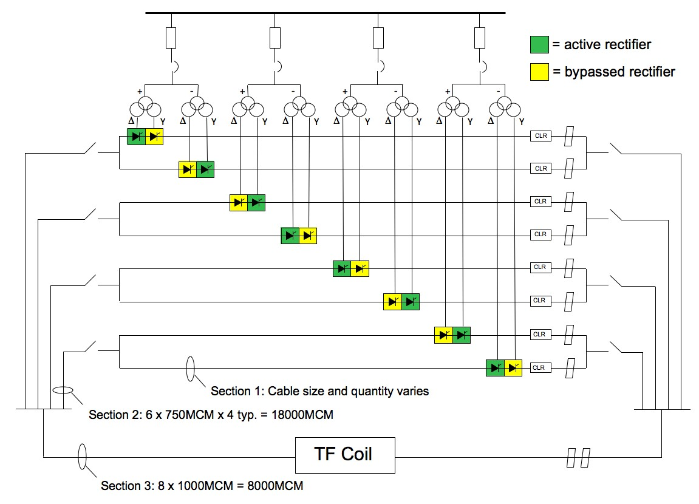
Power System for Fusion Research
TF Circuit
DCCTs in each branch
Hall effect
Fiber DCCTs

Slide 21
POWER SYSTEM FOR FUSION RESEARCH
Seconds
Typical projected current in TF coils
Fiber DCCTs supplied by Dynamp installed

Slide 22
Power System for Fusion Research
DCCTS USED IN PPPL PRINCETON
Different Types of DCCTs used
  Rogowski coils to measure plasma current up to one megamp – Built in-house (3 units)
  Standard shunts with fiber optic transmitters – (4 units – transmitters built in-house)
  Coaxial shunts with fiber transmitters as needed – (6 units were in service for TFTR)
  Misc. dccts
    ADM units supplied originally by Halmar Electronics – total of 30 units
    LEM units – 12 units
  Fiber optic dccts. (Total of 6 units )
  Time response important in some applications

Slide 23
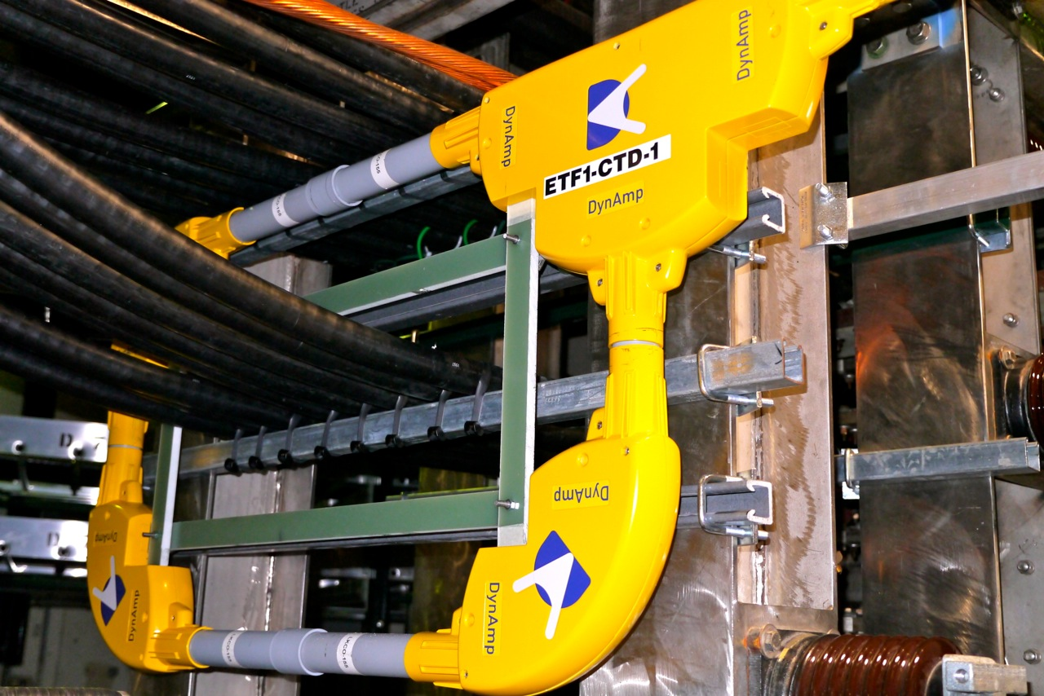
Power System for Fusion Research
+150/-150kA DCCT installed in TF Circuit

Slide 24
POWER SYSTEM FOR FUSION RESEARCH
A unique application of a COSI DCCT
TF pulsed current is 129.8kA for 7.04 seconds every 1200 seconds in the final phase
There are twelve TF bundles each with three turns
Each bundle will have a max. current of 390kA during the pulse
Keeping the above factors in view following is proposed:
  Use a fiber optic current DCCT sensor
  Run the sensor fiber around the machine (at the top or bottom of the machine) such that the sensor fiber is placed in clockwise direction in one bundle and in the anticlockwise direction in the next bundle.
  Thus the resultant current sensed is zero under normal operating condition.
  If a turn to turn fault develops in any one bundle the resultant current will be 130kA as sensed by the fiber. This will initiate a trip.
  See the sketch

Slide 25
Power System for Fusion Research
The COSI fiber DCCT can be used for this application.
Manufacturer of this DCCT is Alstom type A, COSI-CT-F3 – Open Loop
This is +50/-50kA unit with a 50 meters long sensor fiber.
Provide the required loops around the machine as per sketch
Proposed to keep the trip setting around 50Amps (10mV)

Slide 26
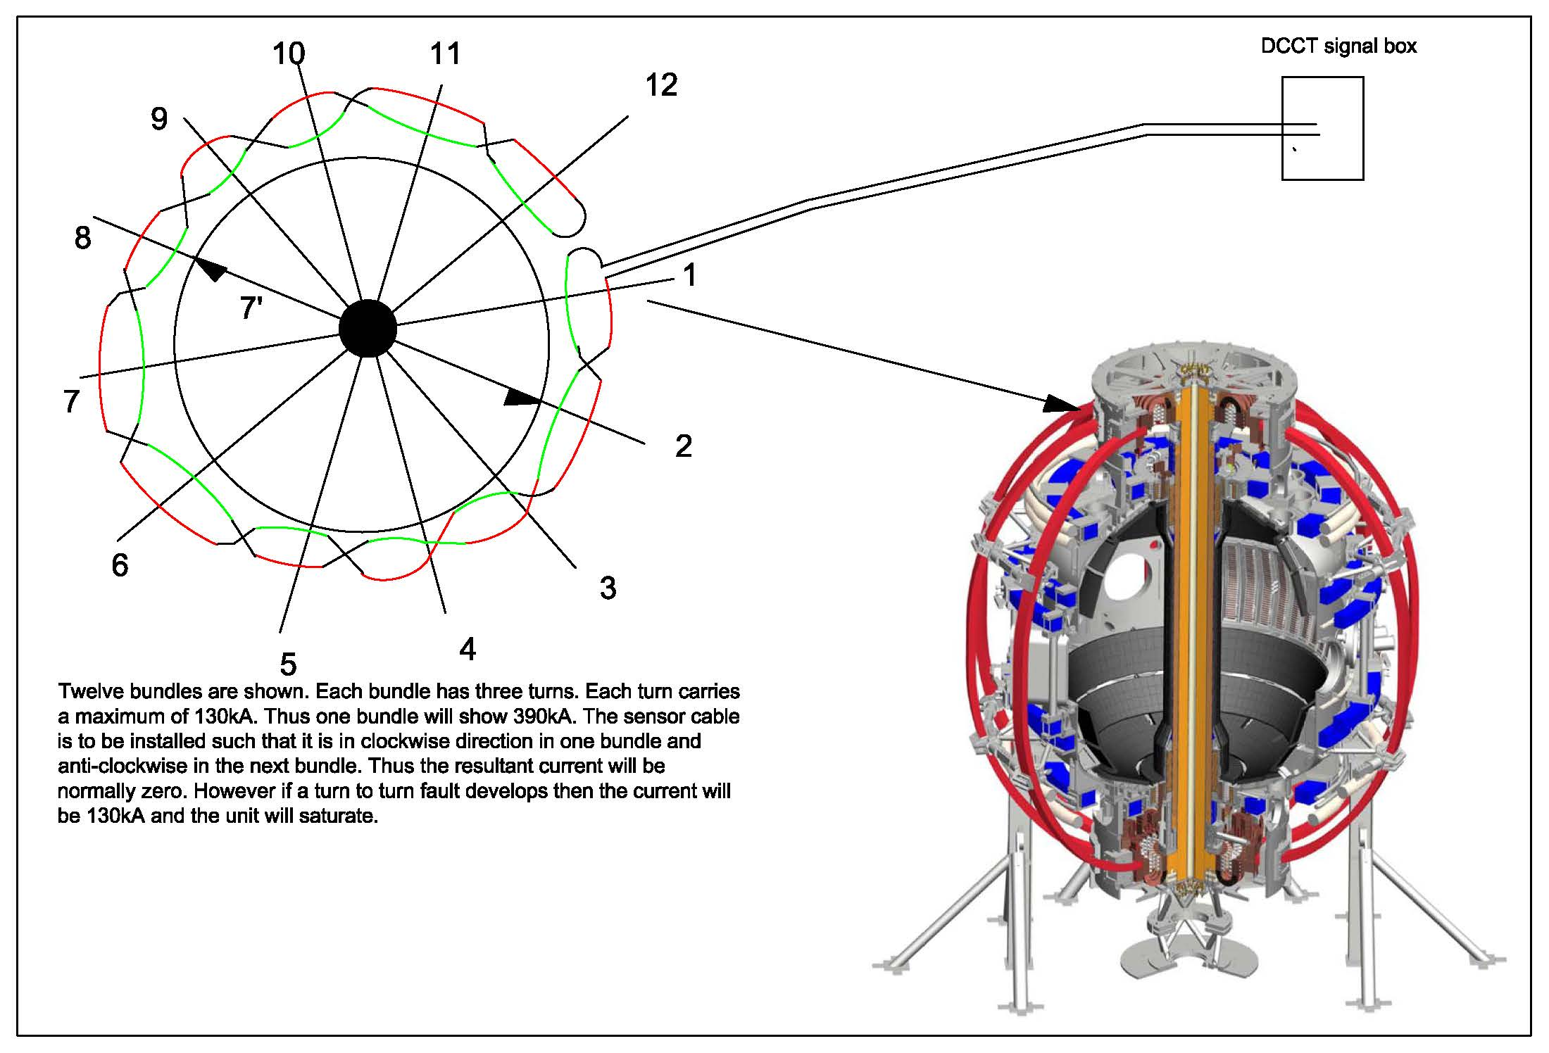
Power System for Fusion Research
Planned turn to turn fault detection

Slide 27
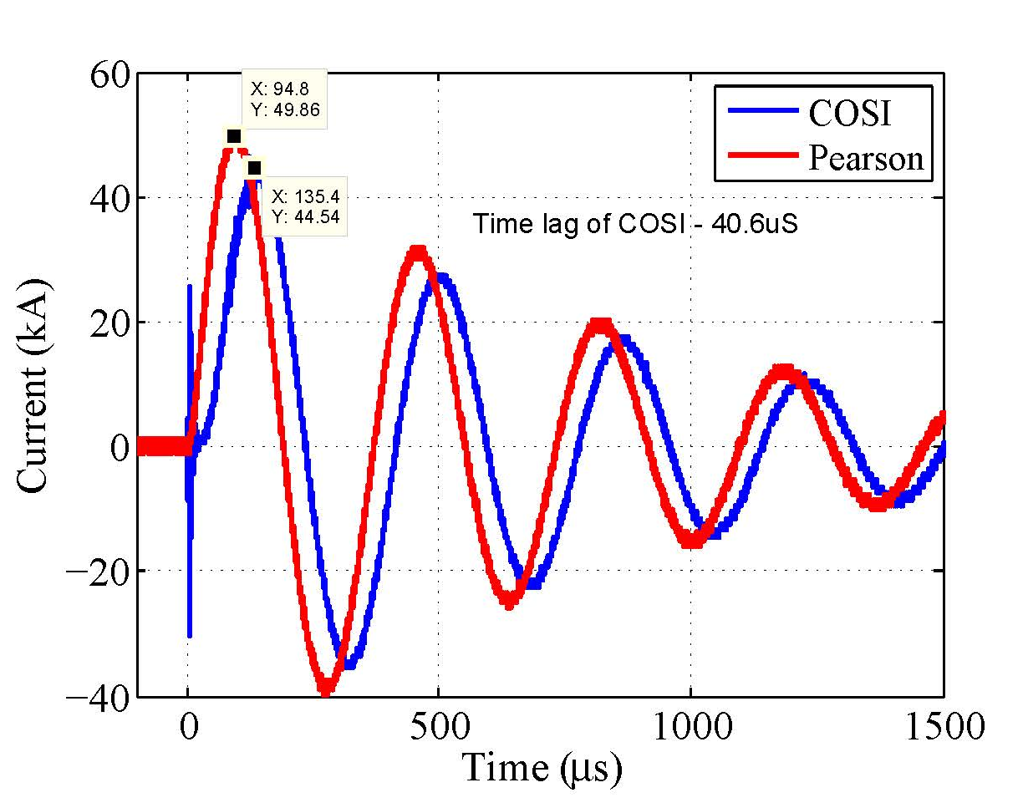
Power System for Fusion Research
Tests on COSI DCCTs in PPPL Princeton
COSI with 50 meter sensor tested in PPPL
Clarifications and support was extended by Jim Blake and others in ALSTOM Phoenix.
Cap banks used for the Experiment
Rate of change of current > 500 Amps / microsecond
Time lag without filters 41us approximately
  Per Jim Blake (Alstom) this is expected.

Slide 28
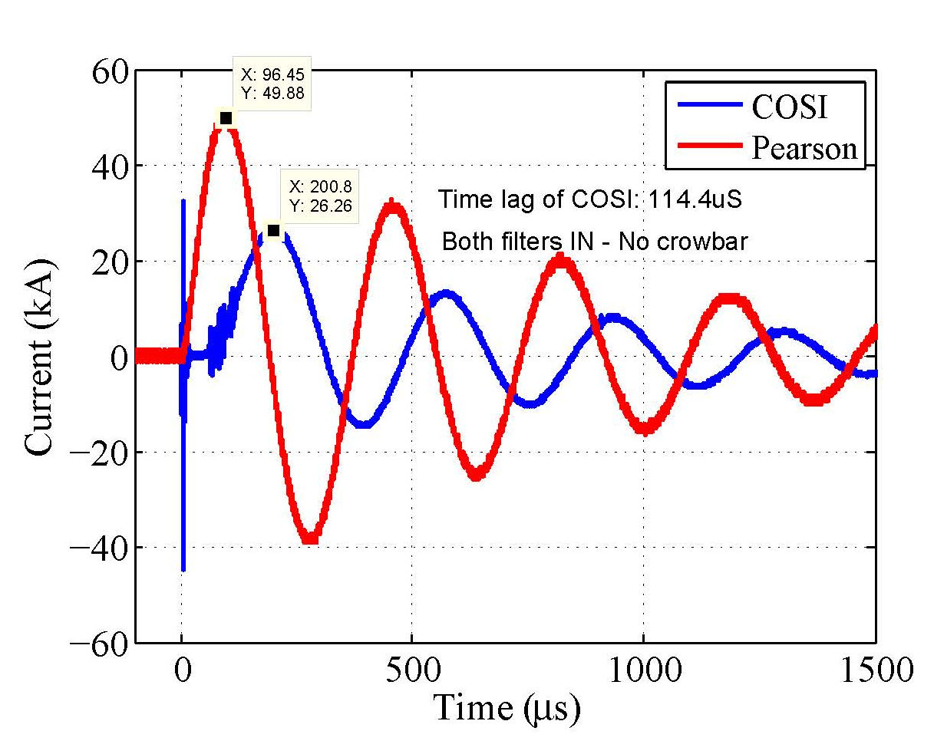
Power System for Fusion Research
COSI Tests in Princeton
Time lag with filter 110us approx.

Slide 29
Power System for Fusion Research
Conclusion
Fusion research principles outlined
International effort to explore fusion for eventual alternative to power
Overview of Fusion research in PPPL
Typical Power systems for Fusion research – AC & DC systems
CTs used in power system
A unique application of COSI in PPPL
COSI tests for time response given

Slide 30
Power System for Fusion Research
Acknowledgement
This work supported by the US DOE Contract No. DE-AC02-09CH11466 with Princeton University
The contents of this presentation are extracts from already published articles and internal reports within PPPL.
References:
1. S. Ramakrishnan et al – “Power System for NSTX upgrade” Symposium on Fusion Engineering 2013.
2. C. Neumeyer et al –” ITER Power Supply Innovations & Advances” Symposium on Fusion Engineering 2013.
3. PPPL internal presentations on Fusion
4. Input from Jim Blake of Alstom on COSI dccts

