Slide 1
PPPL – TE Collaboration
Confidential

Slide 2
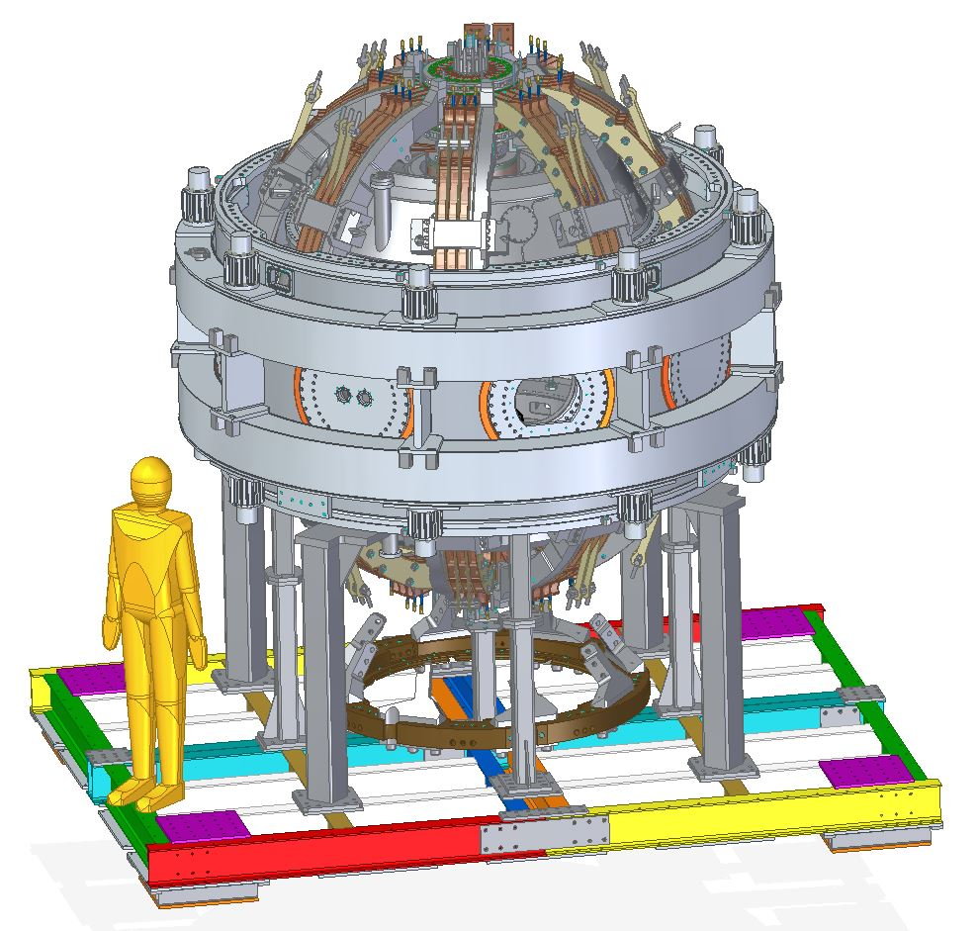
Contents
Tokamak Energy – Who are we?
ST40 – High field ST
ST40 first operations and results
  Merging-compression start-up
  Magnetic reconstruction and camera images
Future of ST40

Slide 3
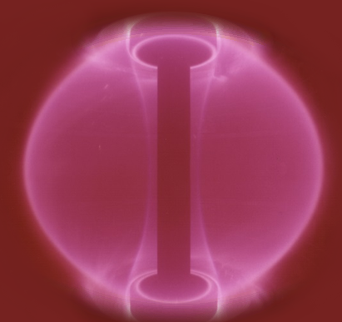
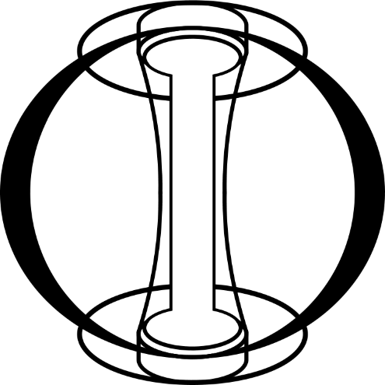
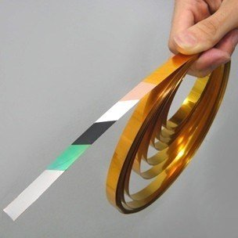
Tokamak Energy Ltd.
Privately funded company, established in 2009 as a spin-off from Culham Centre for Fusion Energy
Team of ~80 staff
Located at Milton Park, Oxfordshire, UK
Spherical tokamaks (STs):
High beta + high bootstrap fraction = high efficiency
High Temperature Superconductors (HTS):
Superconducting in high magnetic field
Compact reactors
Notes:
Combining STs and HTS to examine the possibility of building small fusion reactors.
HTS allows high current density and remains superconducting at high fields → possibility to have 20T on centre column surface.

Slide 4
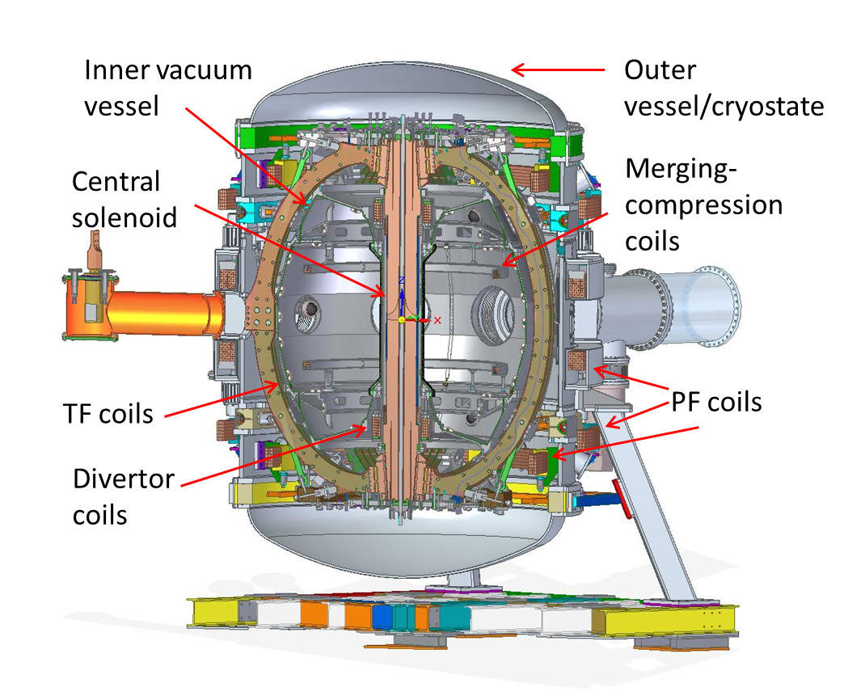
ST40 – High field ST
Design:
B_{t} =3T, I_{p} =2MA, R₀ =0.4-0.6m, R/a=1.6-1.8 κ=2.5
Solenoid-free start-up using merging-compression
2MW of auxiliary heating (NBI / ECRH)
Pulse flat-top length 1s at nominal B_{t}

Slide 5
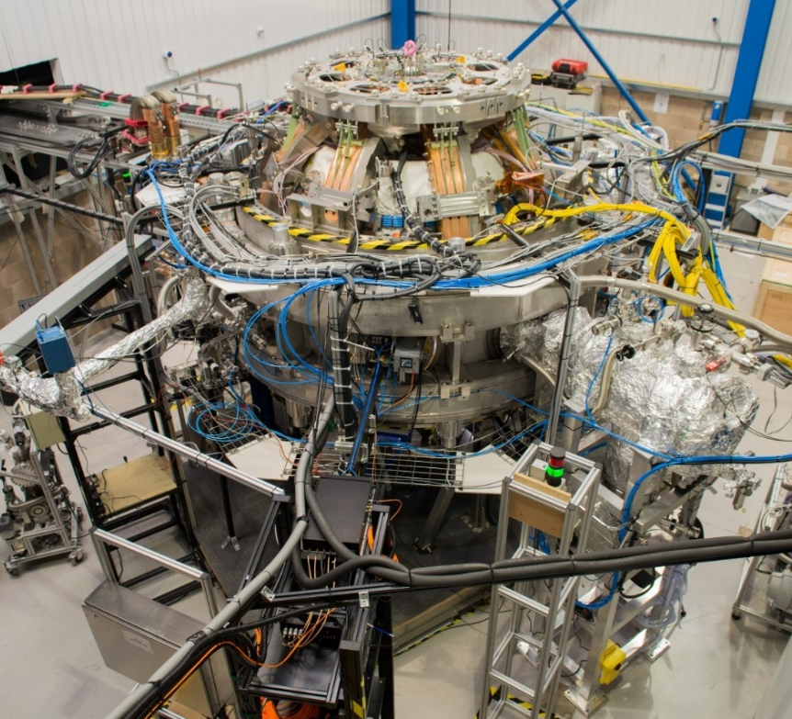
Highlights (thus far)
Assembly in 2017, first plasma 17 January 2018
First experimental campaign completed in June 2018
~700 plasma pulses
I_{p} up to 350kA, B_{T,0}=1T, T_{i} ~1keV, n_{e} above 10²⁰m⁻³
I_{p} flattop up to ~13ms
More to come: solenoid, NBI, more PSUs, plasma control, improved diagnostics, longer pulses, …
Notes:
Start with highlights to whet you appetite

Slide 6
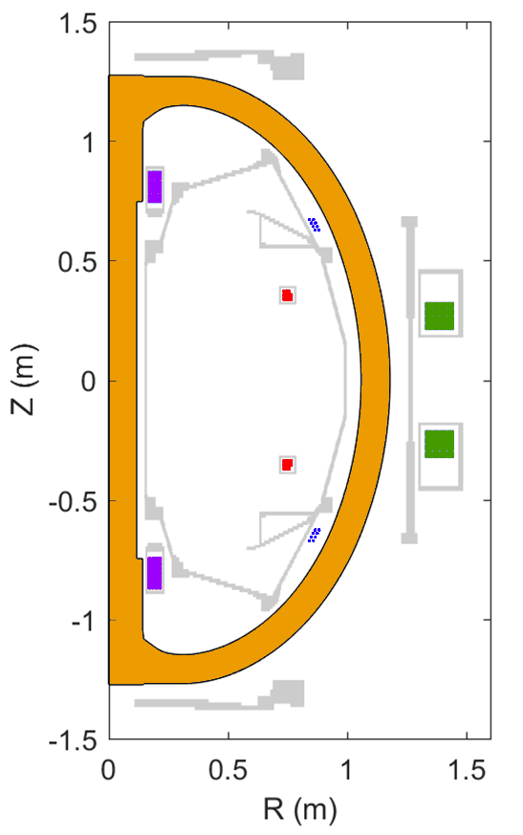
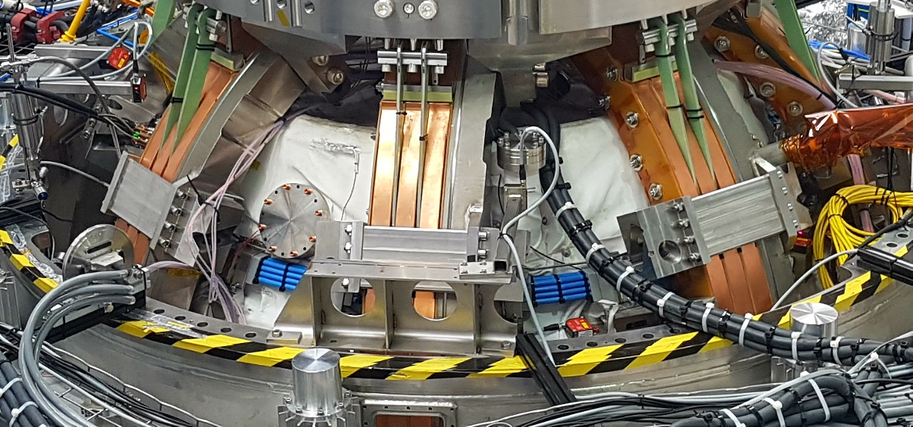
First operations
Coils installed
  TF (24 turns): I_{rod,max} =1725 kA*t → 1T @0.34m
  MC (11 turns)
  BvL (16 turns) and Div (28 turns) in series
  BvU (8 turns): added during campaign
Notes:
Two more pairs of PF coils will be added

Slide 7
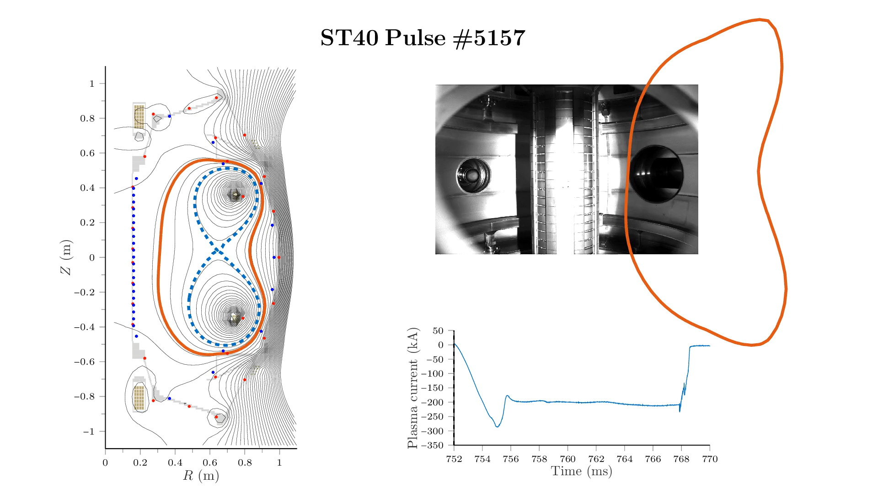
Magnetic reconstruction
Photron camera:
dt=100 μs
t_{integ}=2.5μs
Notes:
During the first operations, this is what we had. Reconstruction of the plasma matches the camera images.
First light is pre-ionization using a flashlamp.
At the moment, fire and forget, next operations: plasma control. Still, without control, we managed to get fairly long flat-tops.
Plasma gets smaller due to high external Bv and decaying image currents. q* ≈ 2 → kink instability limit

Slide 8
Research goals
Extend high field ST physics basis → reduce uncertainty in predicting performance of future STs
  Expand ST τ_{E} database, particularly towards low ν, and confirm favourable scaling with B_{t}
  Evaluate solenoid-free start-up methods, including merging compression (MC) and EBW assisted start-up
  Develop RF heated scenarios with limited or no NB heating
  Test reactor relevant divertor solutions

Slide 9
Upcoming Programmes
Programme | Goals | Comment
Programme 1 Q1 2019: Test readiness for 100M degree plasma temperatures | Demonstrate TEs ability to design, construct and operate a high field spherical tokamak Establish operational procedures Demonstrate diagnostics capabilities and data analysis tools Develop plasma control system | Repeat earlier performance with rebuilt device; fully commissioned PSUs & diagnostics; solenoid.
Programme 2 Q1 2020: 100M degree plasma temperatures | Demonstrate plasma current and position control Optimise beam + solenoid heated regimes Confirm favourable confinement at high field Explore diverted configurations | B_{t,0}=3T; 25ms, 1MW NBI; more PF PSUs to improve plasma control.
Programme 3 Q4 2020: Establish fusion conditions* | Develop operation with highly elongated plasmas Develop and optimise divertor scenario with NB + solenoid heating in DD Validate predictions of improved energy confinement in high field STs and document transport properties Validate SOL width scalings | New IVC with divertor; 2s, 1MW NBI; more PF coils/PSUs to improve plasma control.
*Fusion conditions is defined as central ion temperatures >10keV and densities >10²⁰m⁻³

Slide 10
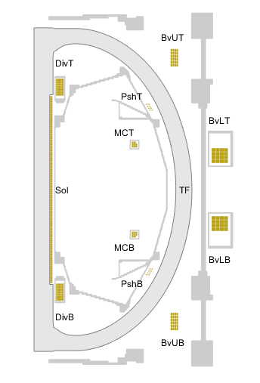
Programme 1 configuration
Coil name | R centre (m) | Z centre (m) | Turns | LN cooled (Y/N)
MC | 0.750 | 0.355 | 11 | N
Div | 0.193 | 0.808 | 28 | N
BvL | 1.386 | 0.268 | 16 | N
BvU | 1.047 | 1.039 | 24 | N
Psh | 0.861 | 0.649 | 8 | N
Sol | 0.130 | 0.000 | 190 | N
TF | N/A | N/A | N/A | N
PSU name | Maximum voltage (V) | Maximum current (kA) | Controllable Duration (ms)
MC | 11000 | 51 | N/A
BvL | 500 | 25 | 0.74
BvU | 500 | 12.5 | 0.33
Psh | 2000 | 20 | N/A
Sol | 1150 | 17.1/11 | 1.1/2.0
TF | 385 | 125 | 0.12 (flat top)

Slide 11
Programme 1 diagnostics
Category | Diagnostic name | Application | Plasma Parameters | Est. time resolution | Sector (Port)
Vis/UV Spectroscopy | Princeton Spectrometer (x1) 50 Chord Spectrometer | Doppler Zeeman splitting Beam Emission Spectroscopy CXRS | <Ti>, Ti(R), <v_{phi}>, v_{phi}(R) ne(R), |B(R)| ni(R) | 1-5ms | 8 (mid)
 | Avantes Spectrometer (x1) Single Chord Spectrometer | Doppler (of multiple lines 200-750nm) Zeeman splitting Beam Emission Spectroscopy Visible Bremsstrahlung Impurity Identification/monitoring | <Ti>, Ti(R), <v_{phi}>, vi(R) ne(R), |B|(R) ni(R) <Zeff> Impurity content | 1-5ms | 8 (mid)
 | Ocean Spectrometer (x1) Survey Spectrometer | Impurity Identification/monitoring | Impurity content | 1-20ms | 3 (upper)
 | Line Emission Monitor (8+4) Spectral Line Diodes | Impurity monitoring | Impurity content | 0.02ms | 8 (mid) / 3 (lower)
X-Ray Spectroscopy | Canberra Spectrometer (x1) X-ray spectrometer | High energy tail bremsstrahlung Impurity Identification/monitoring | <Te> | 10ms | 1 (mid)
 | Crystal X-ray Spectrometer (x1) | Doppler (Fe-XXV) | Ti(R) | 1-10ms | 2 (mid)
 | SXR Tomography (x3) Soft X-ray spectrometer | No filter – Bolometry With filter – Tomography | Radiated power Te(R) | 1-10ms | 2 (lower / mid / upper)
Interferometry | Near-InfraRed interferometer (x1) |  | <ne> | 0.05ms | 3 (mid)
 | Submillimetre interferometer (x2) |  | <ne> | 0.05ms | 3 (mid)
Cameras | Fast Camera (x1) | Visible – monochrome | Boundary shape PFC temperatures | 0.067ms | 5 (mid)
 | H-alfa Camera (x1) | H-alpha – monochrome |  | 1-2ms | 3 (mid)
 | Marketing Camera (x1) | Visible – colour |  | N/A (acquires 1 frame) | 5 (mid)
 | IR Camera (x1) | IR - monochrome |  | 33.3ms | 3 (mid)
Magnetics | Rogowski Coils (x23) | EFIT/PFIT Specplot | Internal plasma parameters MHD modes | 0.01ms | N/A
 | Saddle Loops (13+3+3+3+13+3+3+3) |  |  | 0.01ms | 1/2/3/4/5/6/7/8
 | Flux Loops (x48) |  |  | 0.01ms | N/A
 | BP-Probes (34+1+34+1) |  |  | 0.01ms | 1/3/5/7
 | BT-Probes (2+2+2+2) |  |  | 0.01ms | 1/3/5/7
 | Diamagnetic Loops (2+2) |  |  | 0.01ms | 1/5
DNBI | Diagnostic Neutral Beam (x1) Budker DNBI (100kW/50keV) | Beam Emission Spectroscopy CXRS | (See Avantes and Princeton) | 5ms (beam modulation) | 7 (mid)
ECE Radiometer | ECE Radiometer (x8) |  | <Te> | 0.05ms | 3 (mid)
NPA | Neutral Particle Analyser (x1) |  | Ti (peak – no profile) | 0.01-1ms | 4 (mid)

Slide 12
Programme 2 configuration
Coil name | R centre (m) | Z centre (m) | Turns | LN cooled (Y/N)
MC | 0.750 | 0.355 | 11 | N
Div | 0.193 | 0.808 | 28 | Y
BvU | 1.047 | 1.039 | 24 | N
BvL | 1.386 | 0.268 | 16 | Y
Psh | 0.861 | 0.649 | 8 | N
Sol | 0.130 | 0.000 | 190 | Y
TF | N/A | N/A | N/A | Y
Auxiliary system | Description
RFX NBI | 1MW / 25keV / 30ms
PSU name | Maximum voltage (V) | Maximum current (kA) | Controllable Duration (s)
MC | 11000 | 73 | N/A
Div | 500 | 23 | 2.0
BvL | 500 | 44 | 1.78
BvU (x2) | 500 | 12.5 | 2.0
Psh | 2000 | 20 | N/A
Sol | 1150 | 17.1/11 | 1.1/2.0
TF | 385 | 250 | 1.0 (flat top) TBD (pulse duration)

Slide 13
Programme 3
Major upgrade after Programme 2:
  New inner vacuum chamber (IVC2) – divertor, passive plates, space allocated for EBW and pellet injector,…
  1MW, 55keV, 2.0s HNBI
  Two new pairs of PF coils – capability for 2MA operation, improved shaping, and strike-point control
Final design reviews in early 2019

Slide 14
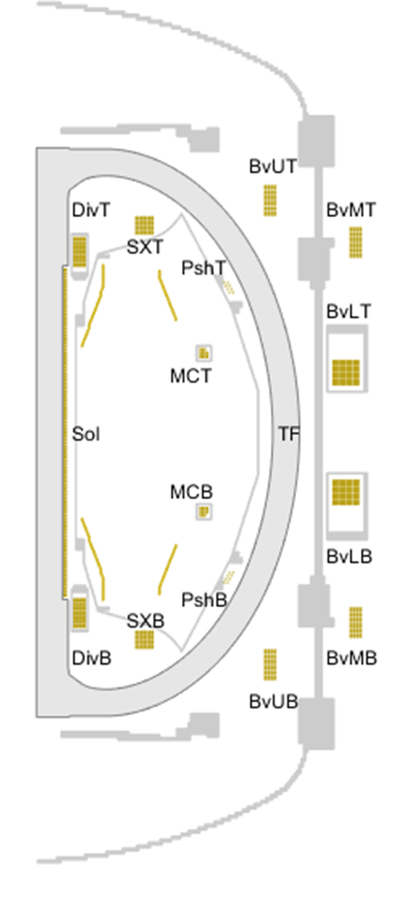
Programme 3 configuration
Coil name | R centre (m) | Z centre (m) | Turns | LN cooled (Y/N)
MC | 0.750 | 0.355 | 11 | N
Div | 0.193 | 0.808 | 28 | Y
BvL | 1.386 | 0.268 | 16 | Y
BvU | 1.047 | 1.039 | 24 | N
BvM
SX
Psh | 0.861 | 0.649 | 8 | N
Sol | 0.130 | 0.000 | 190 | Y
TF | N/A | N/A | N/A | Y
Auxiliary system | Description
RFX NBI | 1MW / 25keV / 30ms
HNBI (Budker) | 1MW / 55keV / 2.0s
PSU name | Maximum voltage (V) | Maximum current (kA) | Controllable Duration (s)
MC | 11000 | 51 | N/A
Div | 500 | 23 | 2.0
BvL | 500 | 44 | 1.78
BvU (x2) | 500 | 12.5 | 2.0
BvM
SX
Psh | 2000 | 20 | N/A
Sol | 1150 | 17.1/11 | 1.1/2.0
TF | 385 | 250 | 1.0 (flat top) TBD (pulse duration)

Slide 15
Collaborations
For impact on Programme 3: now is the time!
IVC2 design on-going – diagnostic requests and recommendations still possible
Physics Programme flexible

Slide 16
Thank you!

Slide 17
Backup slides

Slide 18
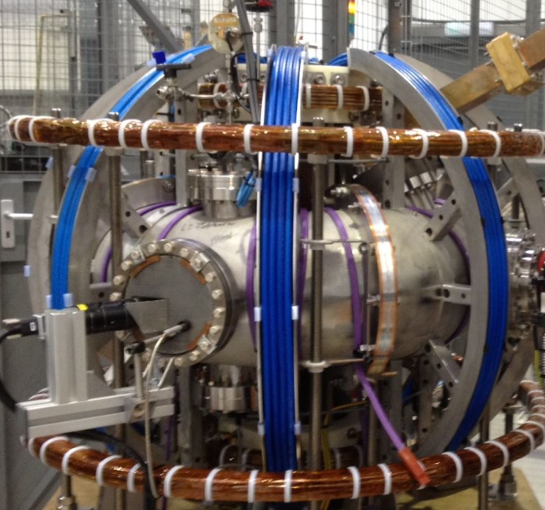
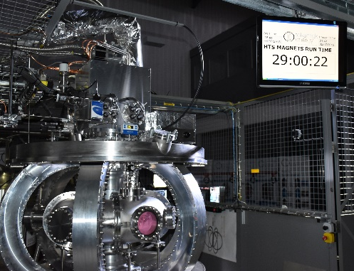

TE Milestones to date
ST25: working prototype with copper magnets achieved several second RF plasmas and
Demonstrated that Tokamak Energy can rapidly build and test working prototypes
ST25 (HTS): first tokamak featuring all high temperature superconducting magnets
Achieved continuous plasma for 29 hours – a new world record
ST40: worlds first high field spherical tokamak
First operations started in January 2018

Slide 19
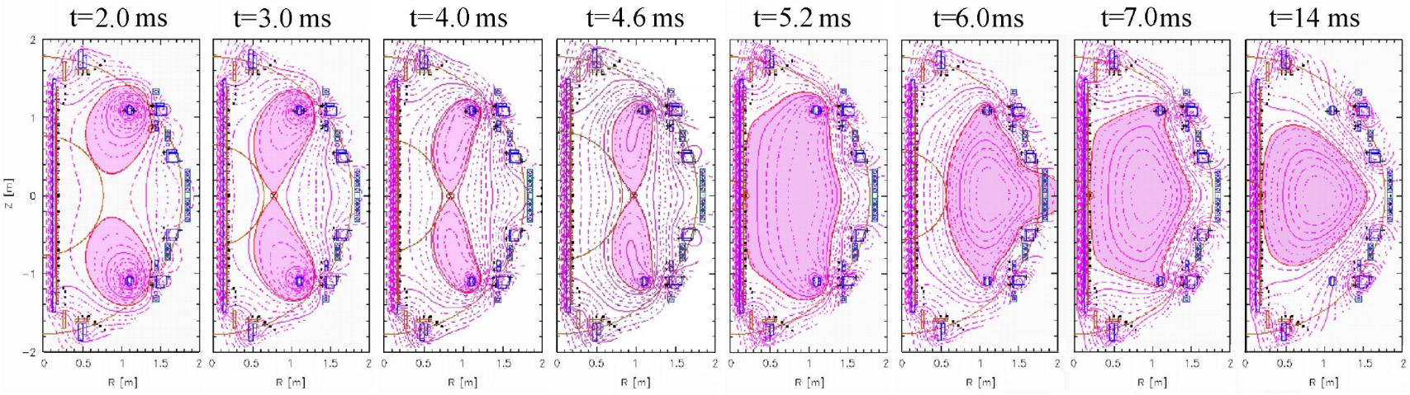
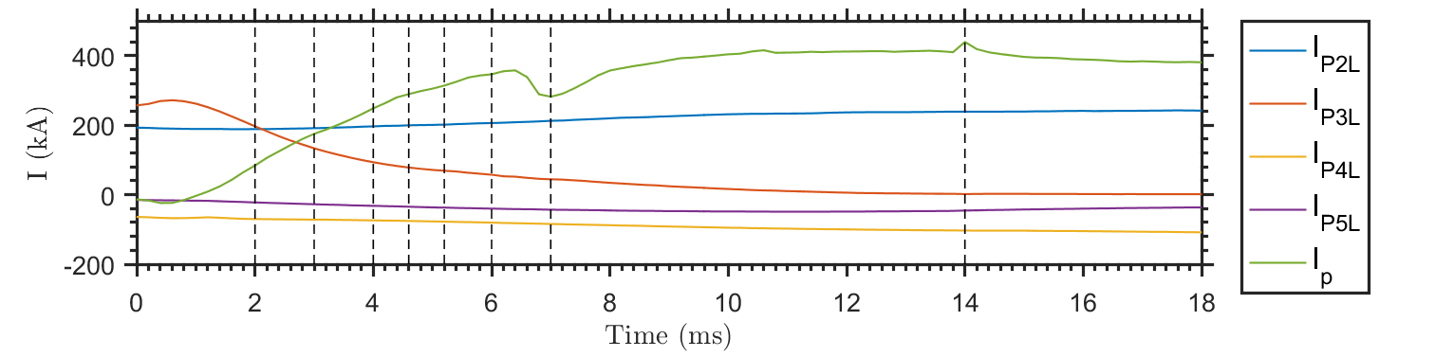
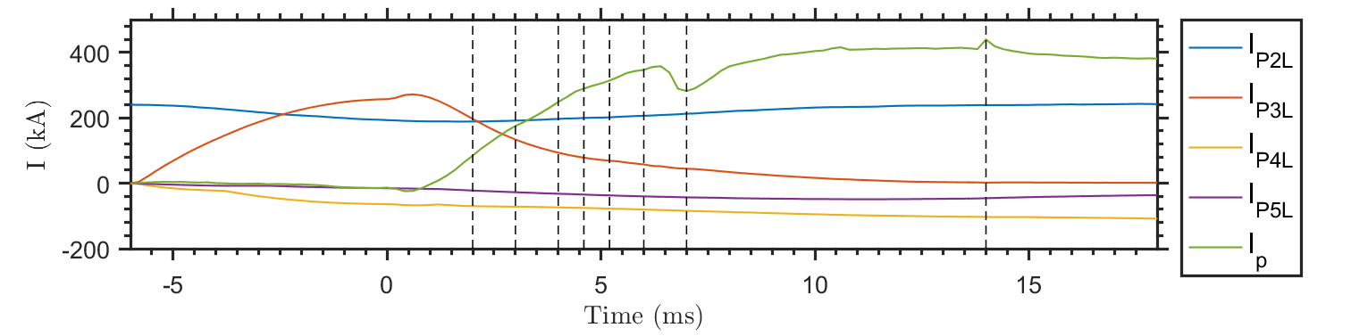
Merging-compression start-up
MAST pulse #14412 [1]
[1] F. Alladio et al., Status and perspectives of MAST start-up in the absence of solenoid flux, 33rd EPS Conference on Plasma Phys. Rome, 19 - 23 June 2006, P-1.095
Notes:
Limited space in ST centre column → Solenoid-free start-up important
Method pioneered in START [1] and MAST [2] at Culham Centre for Fusion Energy by our founders
Converts magnetic energy of two plasma rings into plasma kinetic energy through magnetic reconnection
Current ramped down rapidly in high voltage MC coils to create a plasma around the coils
Compress plasma along major radius R to further increase I_{p} (W=LI²/2=const.)

Slide 20
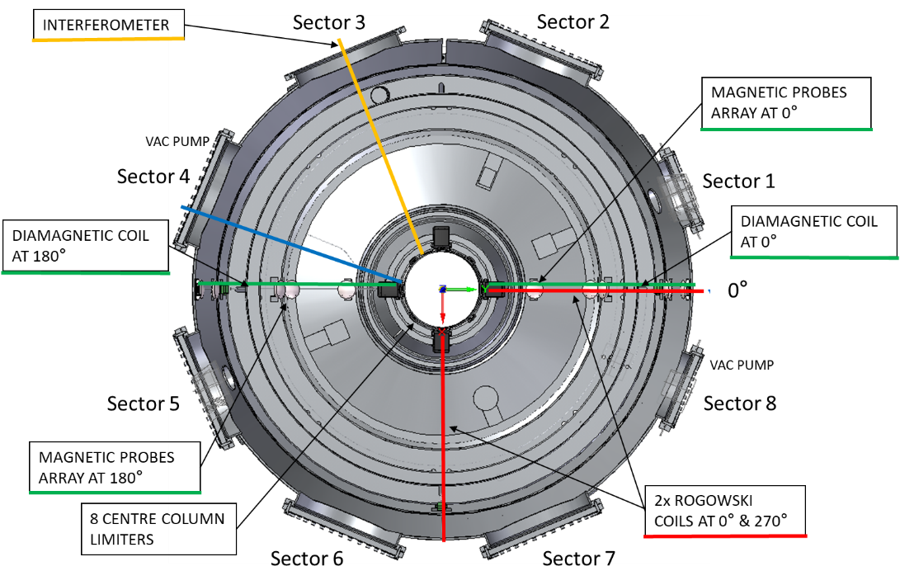
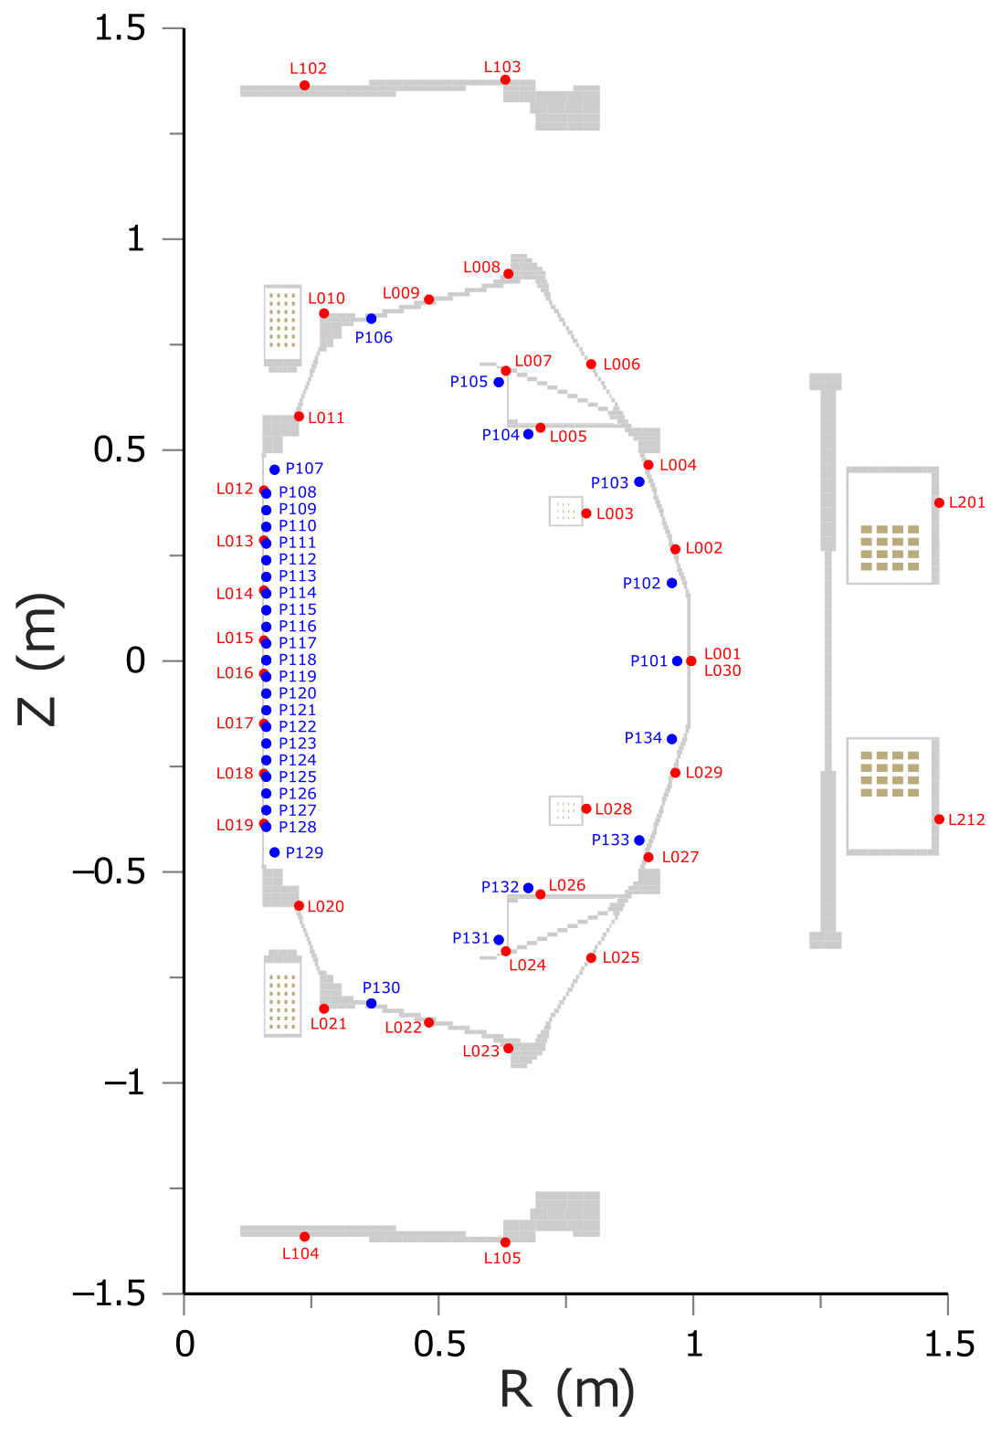
Diagnostics available already
Two fast monochrome cameras
Spectrometer (200-700nm), line diodes
Magnetics: Bp-probes, flux loops, Rogowski coils, diamagnetic loops
NIR interferometer, ECE radiometer

Slide 21
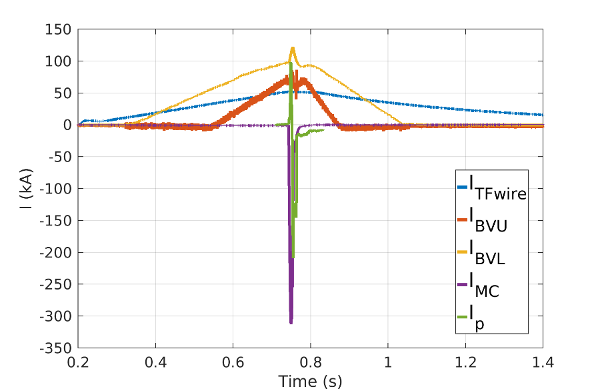
Typical ST40 pulse
ST40 pulse #5118
  PF and TF coils ramped up
  MC PSU fired
  Induced currents in coils partly compensated by the PSUs
  Induced currents in passive structures decay naturally
Full pulse
Notes:
Fast MC swing induces ~1MA into vessel.

Slide 22
Typical ST40 pulse
ST40 pulse #5118
  PF and TF coils ramped up
  MC PSU fired
  Induced currents in coils partly compensated by the PSUs
  Induced currents in passive structures decay naturally
Full pulse

Slide 23
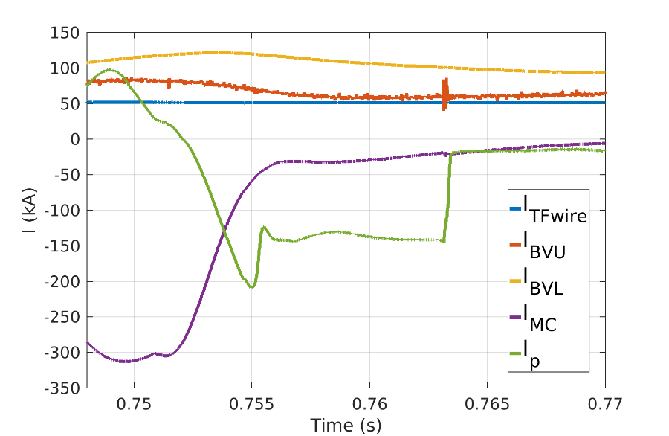
Typical ST40 pulse
ST40 pulse #5118
  PF and TF coils ramped up
  MC PSU fired
  Induced currents in coils partly compensated by the PSUs
  Induced currents in passive structures decay naturally
Zoom in
MC coil
2nd trigger
flat-top
merging-compression
disruption
Notes:
Merging starts before the bottom of the dip
Actually, induced currents are really important during compression…

Slide 24

Magnetic reconstruction
Good match with camera images
Plasma gets smaller due to high external Bv and decaying image currents
Kink safety factor q* ≈ 2 → instability
Longest flat-top durations achieved at highest TF
Highest I_{p} achieved with highest MC coil currents
$$q^{∗}=ε\left(1+κ^{2}\right)πaB_{T,0}/μ_{0}I_{p}$$

Slide 25
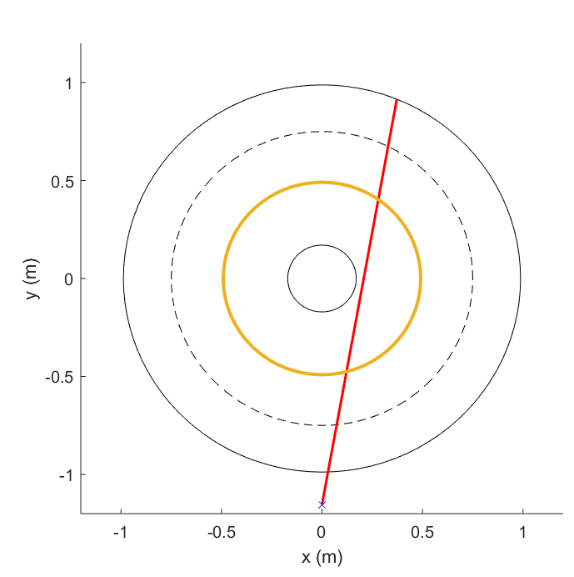
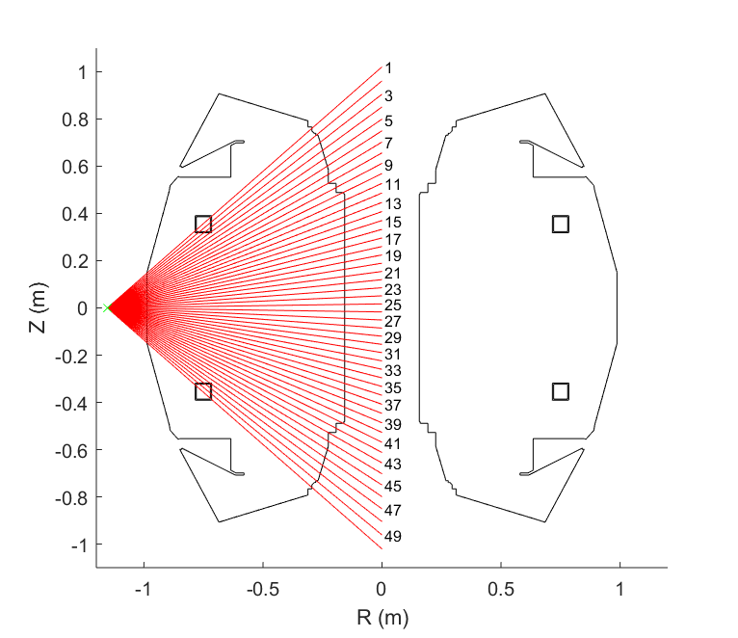
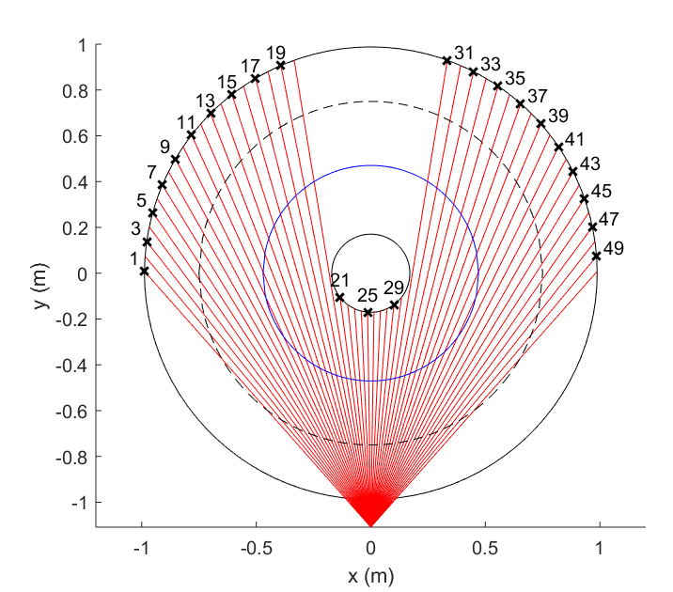
Temperature measurements
Ion Doppler broadening using spectrometer (200-700nm)
50 chords: vertical/horizontal and radial/tangential alignments to rule out effect of rotation
Experiments w/ various lines: CIII (464.74nm), CV (227.09nm), BIV (282.16nm)
vessel
MC coil
LCFS
Spectrometer LoS
Notes:
Precise numbers still a work in progress. Unsuccessfully tried: , CVI (529.05nm), CV (494.4nm), FeXIV (530.29nm)

Slide 26
Temperature measurements
Ion temperature in the range [800,1500] eV
  High, considering no auxiliary heating
  Maximum temperatures up to and even above 2keV measured in presence of transient events (small IREs etc.)
  More data analysis needed
Notes:
Maximum temperatures, up to and even above 2keV, were measured in a presence of transient events (small IREs etc)

Slide 27
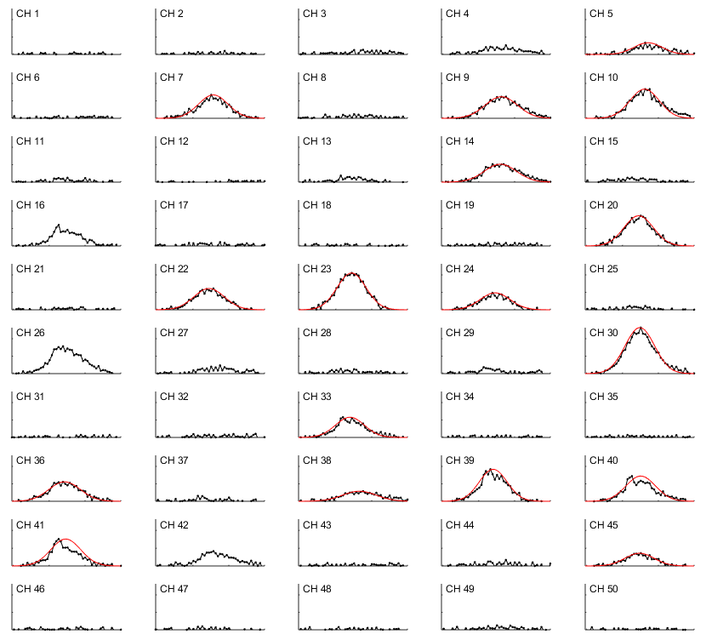
Temperature measurements
Pulses #5079, #5080, #5081 and #5090 combined to improve statistics
Measuring CV line
Spectrometer aligned horizontally

Slide 28
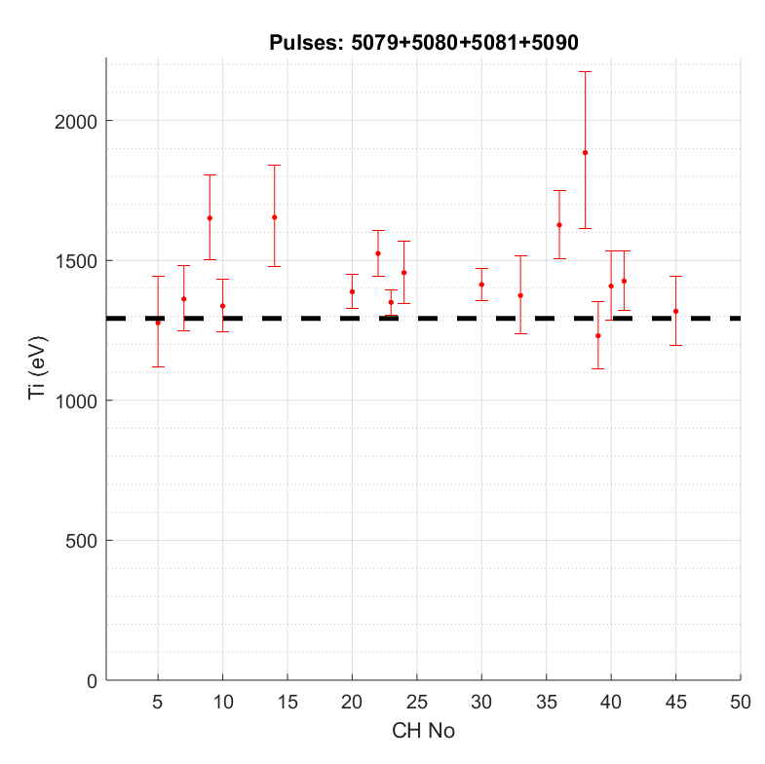
Temperature measurements
Pulses #5079, #5080, #5081 and #5090 combined to improve statistics
15M degrees!
Overall, Ti in the range [800,1500] eV
  Ti_{max} ~2keV in presence of transient events (IREs etc.)
15M deg

Slide 29
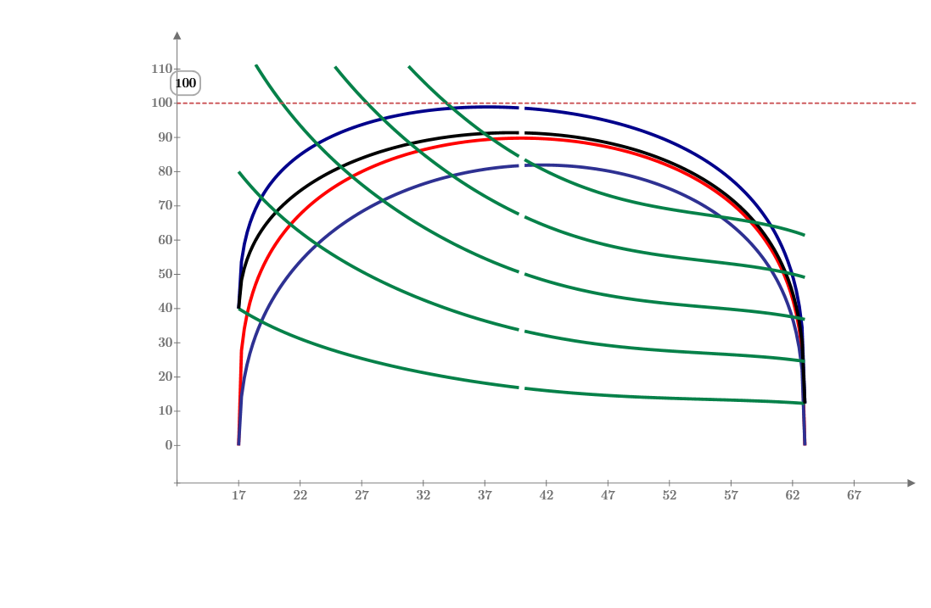
High plasma densities
NIR interferometer: line averaged densities 10²⁰ m⁻³
  Accurate measurements not yet possible due to vibrations
ECE radiometer: n_{e} regularly above 10²⁰ m⁻³ because 3rd harmonic signal (100GHz) is cut off
Radiometer range
Midplane cross-section of plasma cut-offs and resonances for majority of ST40 first operations: n_{e} = 10²⁰ m⁻³, I_{TF} = 50 kA (B_{t,0}=0.6 T)
f_{X-cutoff}
3f_{ce}
Frequency, GHz
2f_{ce}
f_{pe}
f_{ce}
Major Radius, cm
110
100
90
80
70
60
50
40
30
20
10
0
17 22 27 32 37 42 47 52 57 62 67

Slide 30
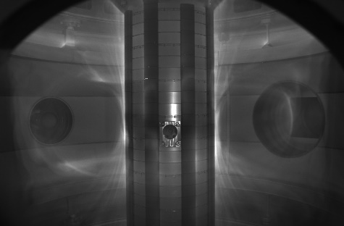
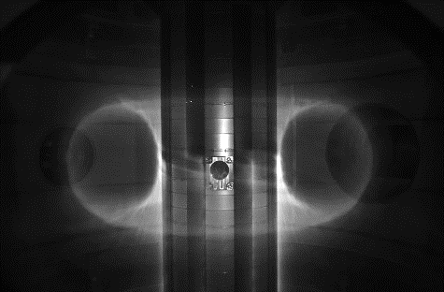
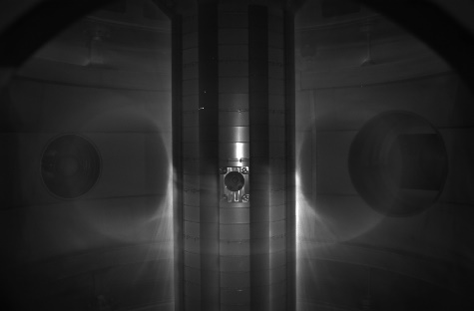
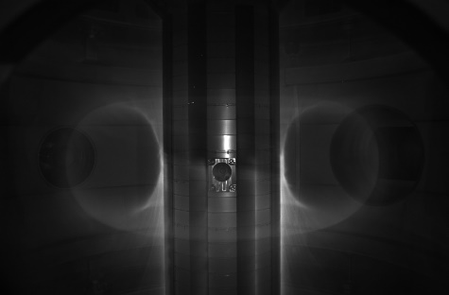
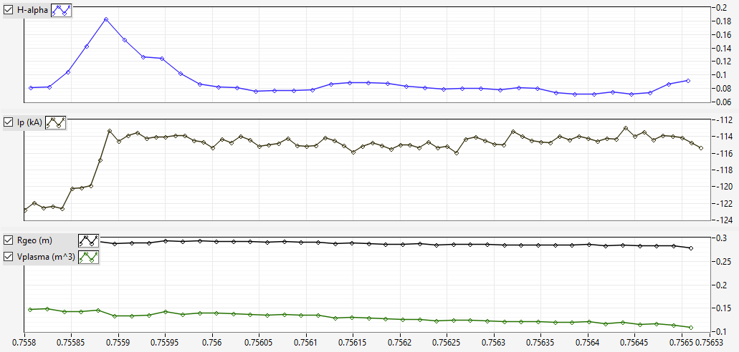
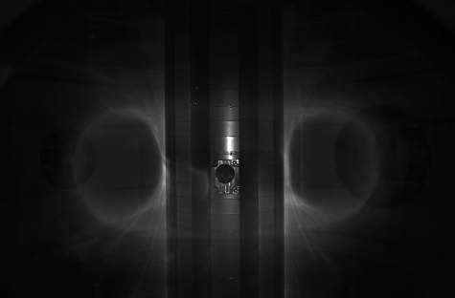
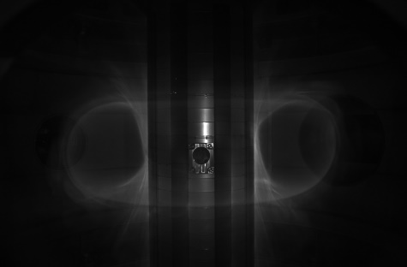
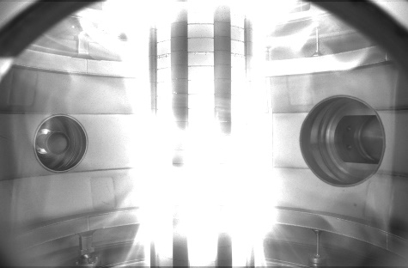
Well-defined plasma edge
ST40 – Pulse #5027 – 756.00 ms
ST40 – Pulse #5027 – 756.10 ms
ST40 – Pulse #5027 – 756.20 ms
ST40 – Pulse #5027 – 756.30 ms
ST40 – Pulse #5027 – 756.40 ms
ST40 – Pulse #5027 – 756.50 ms
ST40 – Pulse #5027 – 756.60 ms
Notes:
Colour adjusted image

Slide 31
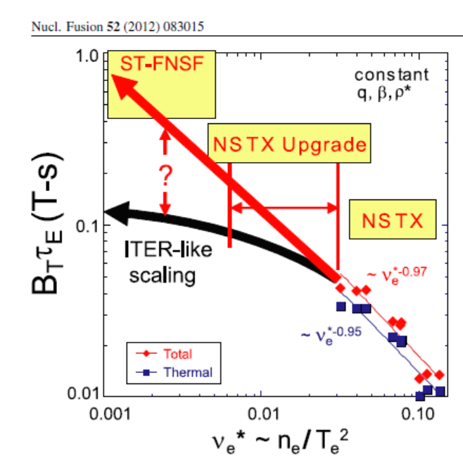
Confinement scalings
Inverse scaling of normalized confinement with ν*
Aim to get to low collisionality
Electron neoclassical limit for ST40
ST40
H_{NSTX}=1
ST40
H_{ITER}=1
MAST
MAST

