Slide 1


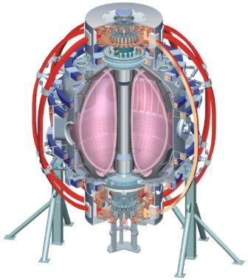

NSTX
Supported by
NSTX Research Program Progress
and Plans Toward 5 Year Plan Goals
J. Menard
NSTX Program Director
For the NSTX Team
Columbia U
CompX
General Atomics
FIU
INL
Johns Hopkins U
LANL
LLNL
Lodestar
MIT
Nova Photonics
New York U
ORNL
PPPL
Princeton U
Purdue U
SNL
Think Tank, Inc.
UC Davis
UC Irvine
UCLA
UCSD
U Colorado
U Illinois
U Maryland
U Rochester
U Washington
U Wisconsin
Culham Sci Ctr
U St. Andrews
York U
Chubu U
Fukui U
Hiroshima U
Hyogo U
Kyoto U
Kyushu U
Kyushu Tokai U
NIFS
Niigata U
U Tokyo
JAEA
Hebrew U
Ioffe Inst
RRC Kurchatov Inst
TRINITI
NFRI
KAIST
POSTECH
ASIPP
ENEA, Frascati
CEA, Cadarache
IPP, Jülich
IPP, Garching
ASCR, Czech Rep
Midterm Review of Major MFE Facilities
Germantown, MD
June 6, 2011

Slide 2
Agenda
J. Menard - Research Program Progress and Plans
  60-70 minutes
M. Ono - Facility Status and Plans (+ NSTX Upgrade)
  30-40 minutes
Discussion with panel
  40-60 minutes

Slide 3
Outline
NSTX mission elements
Changes in program since 5yr plan proposal
Research goals, progress, and plans
Summary
Supplemental slides

Slide 4
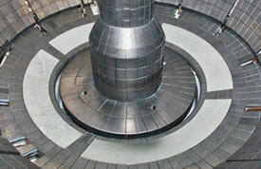
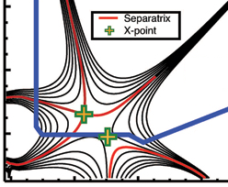
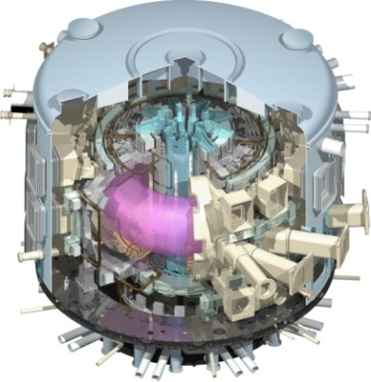
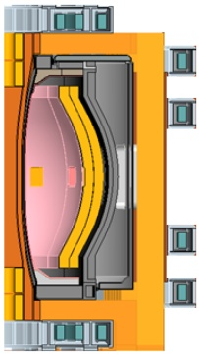
NSTX Mission Elements
Advance ST as candidate for Fusion Nuclear Science Facility (FNSF)
Develop solutions for plasma-material interface
Advance toroidal confinement physics for ITER and beyond
Develop ST as fusion energy system
ST-FNSF
Lithium
“Snowflake”
ITER
ST Pilot Plant

Slide 5
Changes in program since 5 year plan proposal
2009 - ReNeW Thrust 16: Emphasizes developing physics basis of ST for FNSF
2010 - FES vision for next decade: Materials/PMI, FNSF, predictive capability
  Stronger emphasis on FNSF + PMI + diagnostics and validation
  Successful implementation of Upgrade Project highest NSTX priority
ReNeW Thrust 16: “Develop the ST to advance fusion nuclear science”
consists of 7 Thrust Elements:
Develop MA-level plasma current formation and ramp-up
Advance innovative divertor magnetic geometries, first wall solutions
Understand ST confinement and stability at fusion-relevant parameters
Develop stability control techniques for long-pulse, disruption-free ops
Sustain current, control profiles with beams, waves, pumping, fueling
Develop normally-conducting radiation-tolerant magnets for ST applications
Extend ST performance to near-burning-plasma conditions
These elements provide outline for subsequent FY09-13 results and plans

Slide 6
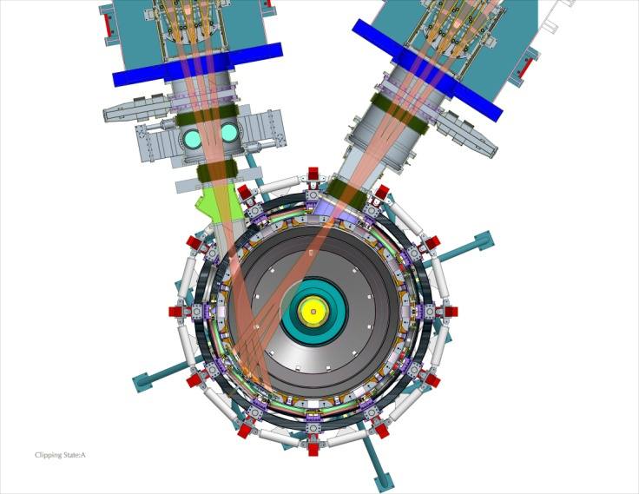
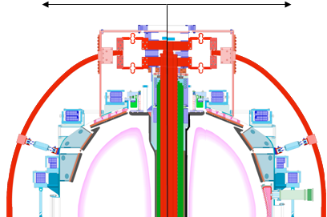
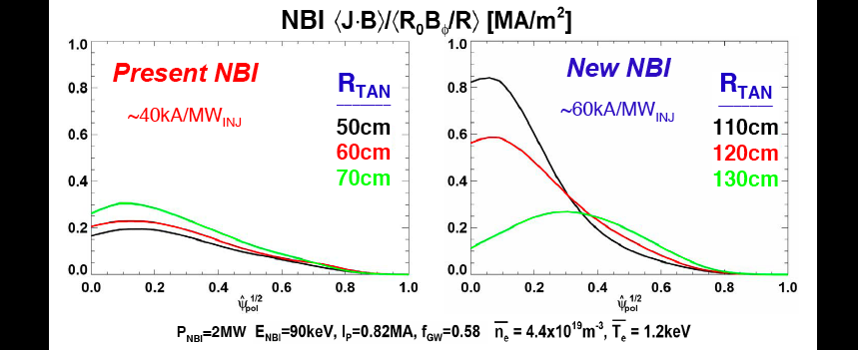
NSTX Upgrade supports ReNeW ST physics thrust elements, bridges device and performance gaps toward ST-FNSF
New center stack for 1T, 2MA, 5s
2nd NBI with 5 MW, 5s at larger R_{Tangency}
R₀ /a = 1.25-1.3 1.5-1.6
Present CS
New CS
2nd NBI
R_{TAN} =
110,120,130cm
Present NBI
R_{TAN} =
50,60,70cm
1.0
I_{P} ≤ 2 MA
NBI current drive profiles [MA/m²]
0.8
New CS
I_{P}=1.4 MA
Present NBI
2nd NBI
B_{T}
[Tesla]
1 MA
0.6
0.4
0.75 MA
Present CS
0.2
1.0
2.0
3.0
4.0
5.0
6.0
7.0
8.0
τ_{Pulse} (sec)
Normalized minor radius
Magnet operation at ~1T (vs. 0.55T):
ν* reduced 3-6x, nTτ up to 10x higher
Up to 2x higher NBI current drive efficiency:
Non-inductive ramp-up, sustainment, J(r) control

Slide 7
Schedule for NSTX Upgrade elements (new CS + 2nd NBI) has changed substantially since 5 year plan proposal
Run-time and Upgrade schedule proposed in 5 year plan:
FY 09
FY 10
FY 11
FY 12
FY 13
FY 14
Run Weeks
15
15
15
15
15
New CS
2nd NBI
Present run-time and Upgrade schedule:
FY 09
FY 10
FY 11
FY 12
FY 13
FY 14
Run Weeks
16
17
4
10
10
New CS + 2nd NBI
More cost effective, faster to implement new CS + 2nd NBI in single outage
  Upgrade project approved, approaching CD-3, highest NSTX priority
Impact on original 5 year plan goals and schedule:
  Higher B_{T} = 1T not available in 2012 – impacts all research planned for 2012
  ECH/EBW deferred due to funding limitations
  Plasma guns deferred due to technical readiness / time constraints
  Less run-time in 2012, no run-time in 2013 → ~3/4 of originally planned run-time

Slide 8
Outline of Topical Areas and Research Goals
(Aligned with NSTX Mission and ReNeW elements)
Solenoid-free Plasma Start-up and Ramp-up
  Develop helicity injection and fast-wave heating for plasma current formation and ramp-up
Lithium and Boundary Physics
  Assess lithium PFCs, develop high-flux-expansion divertors, understand edge transport/stability
Transport and Turbulence
  Measure, understand, predict instabilities responsible for ST transport, project to next-steps
Macroscopic Stability
  Develop predictive capability for accessing, controlling, sustaining very high plasma pressure
Energetic Particle Physics
  Establish predictive capability for fast-ion transport caused by *AE for ST, burning plasma
Wave Heating and Current Drive
  Demonstrate reliable wave heating and CD to enable advanced operating scenarios
Advanced Scenarios and Control
  Establish high-performance integrated scenarios and the necessary control capabilities
ITER Support
  Utilize unique ST/NSTX parameters and capabilities to extend tokamak understanding for ITER
Key for labels used
in this presentation:
Publication or presentation
Collaborating institution
Major award for NSTX researcher
NSTX Research Milestone: R**-*
DOE 3 Facility Joint Research Target: FY** JRT

Slide 9
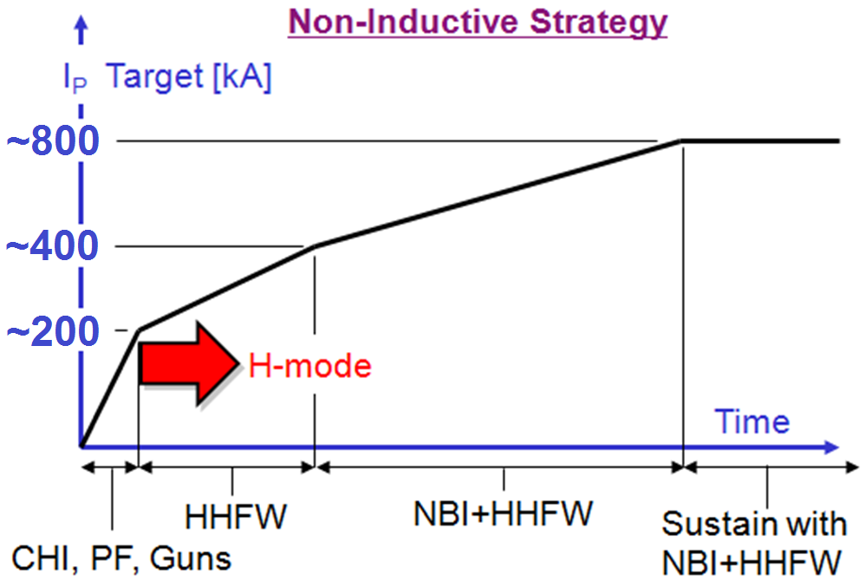
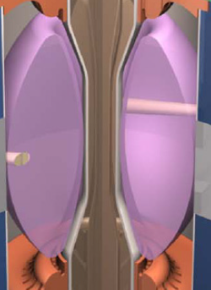
Plasma initiation with small or no transformer is unique challenge for ST-based Fusion Nuclear Science Facility
ST-FNSF has no/small central solenoid
Iron core and/or thin mineral insulated conductor transformer may be able to provide 1-2MA FNSF start-up current
PF: J. Leuer, NF 51 (2011) 063038 on DIII-D - collaboration with DIII-D and MAST
Guns: D. Battaglia, PRL 102 (2009) 225003 on Pegasus – new collaboration with NSTX
D. Gates, FED 86 (2011) 41–44
Y-K.M. Peng, FST 56 (2009) 957
Near-term Goal: ~0.3-0.4MA fully non-inductive start-up with CHI + fast wave
Upgrade Goal: Use NBI current drive to ramp-up from 0.4MA to 0.8-1MA
  More tangential 2nd NBI of upgrade has higher CD efficiency, better confinement at low I_{P}
Upgrade goal is to provide physics basis for non-inductive ramp-up to high performance 100% non-inductive ST plasma → prototype FNSF

Slide 10
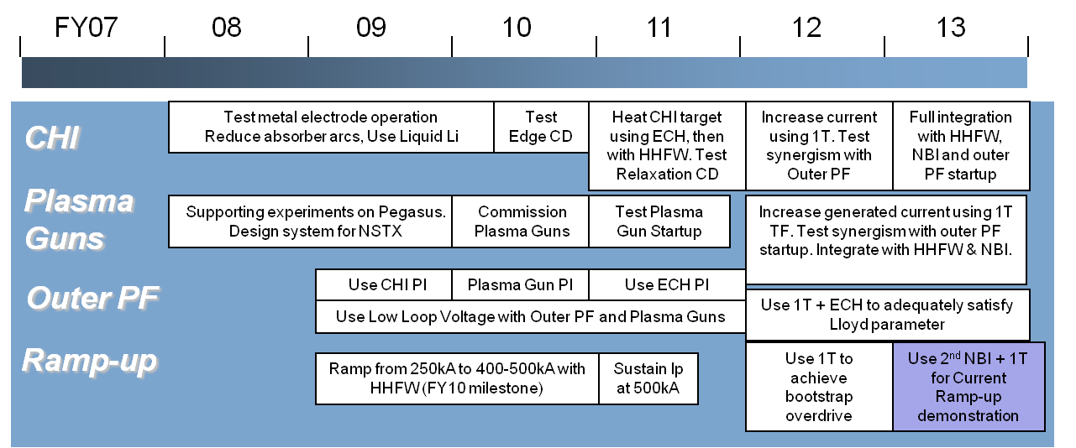
  Solenoid-Free Plasma Start-up and Ramp-up
  ➢ Develop helicity injection and fast-wave heating for plasma current formation and ramp-up
5 year plan
timeline
and goals
Progress and Plans
Gray italics indicates material provided in supplemental section
Coaxial Helicity Injection (CHI)
  Plasma current savings of up to 400kA using CHI start-up preceding inductive ramp-up
  Used CHI absorber coils to reduce/eliminate absorber arcs
  Controlled density, reduced divertor impurities with evaporated lithium
  FY11-12: Test full metallic divertor: LLD Mo outboard + Mo tiles inboard (facility talk)
Plasma guns: deferred – not technically ready
Outer PF: deferred due to cost of ECH, collaborate on DIII-D
HHFW ramp-up: antenna upgraded, utilized 2nd half of 2009 run
  FY10: Heated 300kA ohmic target plasma to 3keV, 70% non-inductive fraction
  FY11-12: Plan to increase power to 3-4MW level for 100% non-inductive, test ramp-up

Slide 11
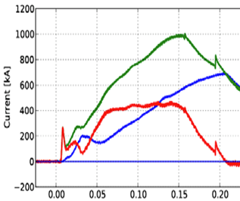
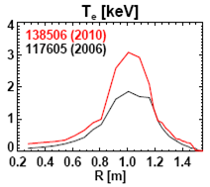
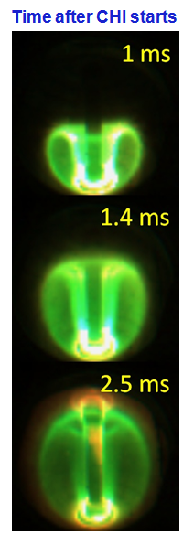
Achieved substantial progress on Coaxial Helicity Injection (CHI) and fast wave heating of low-current plasmas in 2010
    Generated 1MA using 40% less flux than induction-only case
    Low internal inductance (l_{i} ≈ 0.35), and high elongation > 2
    Suitable for advanced scenarios
Achieved high T_{e}(0) ~ 3keV at I_{P}=300kA w/ only 1.4MW HHFW
  - Previous best was T_{e}(0) ~ 1.5keV at twice the RF power
  - Enabled by 2009 antenna upgrades
CHI + OH
OH only
R10-2
138506 (2010)
117605 (2005)
Difference
ORNL
B. Nelson, NF 51 (2011) 06308
R. Raman, APS Invited Talk 2010
R. Raman, PRL 104 (2010) 095003
D. Mueller, EPS Oral (2010)
Time (sec)
Non-inductive fraction ~60-70% with 25-30% from RFCD from high T_{e}(0)
Projects to ~100% NI at P_{RF} = 3-4MW
ΔI_{P} = 400kA vs. 50kA in 2008
Univ. Washington
R12-2: Test higher P_{RF}, HHFW heating of CHI-initiated plasmas
R12-2:

Slide 12
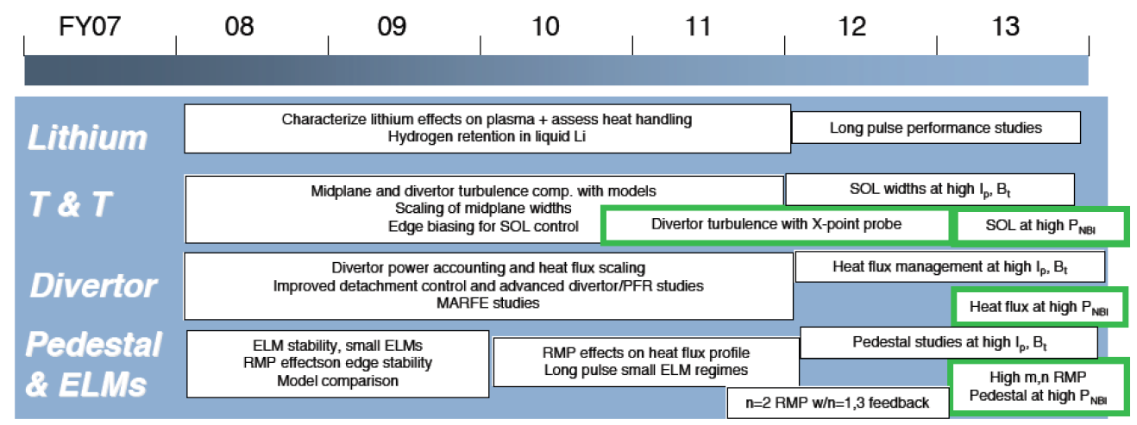
Lithium and Boundary Physics
➢ Assess lithium PFCs, develop high-flux-expansion divertors, understand edge transport/stability
5 year plan
timeline
and goals
Progress and Plans
Gray italics indicates material provided in supplemental section
Lithium Research: Liquid Lithium Divertor (LLD) implemented in FY2010
  LLD extensively tested: D pumping with LLD comparable to solid Li coatings
  No evidence of Mo in plasma from LLD – preparing to test new Mo tiles on inboard divertor
Transport and Turbulence
  Heat flux width scalings determined - comparing to simulation, edge biasing has small effects
Divertor Physics
  Focusing on high-flux-expansion “snowflake” divertor to reduce heat-flux and impurities
  Partial detachment and MARFE studies largely complete, power accounting studies planned
Pedestal and ELMs
  ELM stability modifications from lithium quantified, pedestal structure under study (FY11-12)
  Assessed 3D field effects on pedestal, divertor (ITER section) - comparisons to theory ongoing

Slide 13
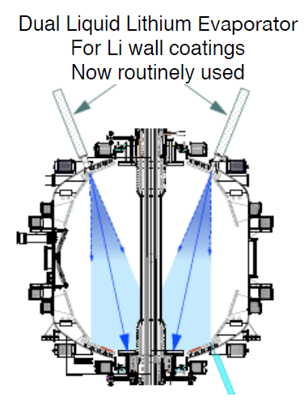
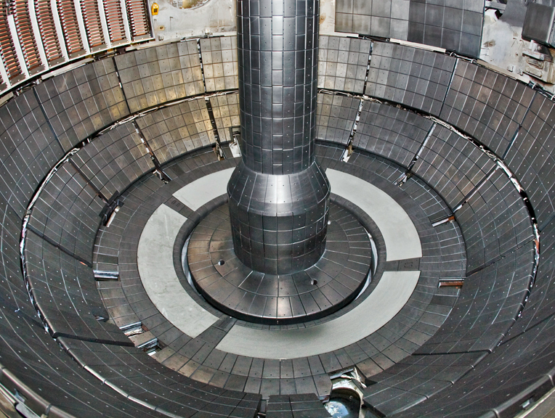
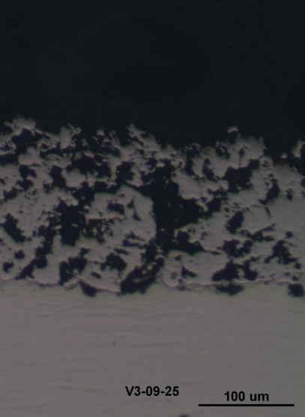
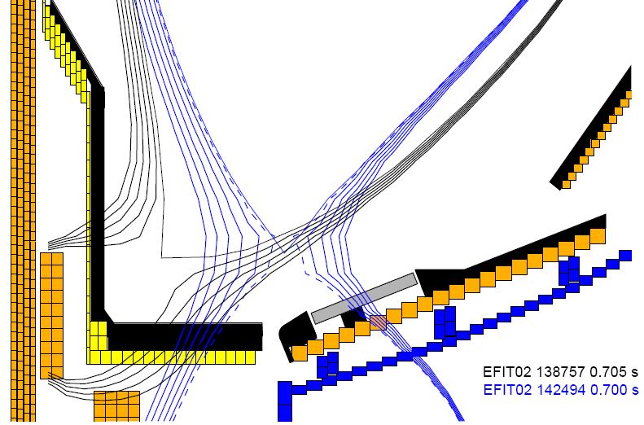
NSTX is a world leader in assessing lithium plasma facing components as a possible PMI solution for magnetic fusion
Solid Li surface coatings: Pump D, increase confinement, stored energy, pulse length, eliminate ELMs, reduce core MHD instabilities
H. Kugel, IAEA FEC 2010 Oral, FTP/3-6Ra
H. Kugel, FED 85 (6) 865-873 (2010)
M. Bell, PPCF 51 (12), (2009) 124054
M. Bell, EPS Invited Talk 2009
D. Mansfield, JNM 390-91, 764-767 (2009)
H. Kugel, JNM 390–391, 1000–1004 (2009)
Liquid Lithium Divertor (LLD) motivation: provide volume D pumping capacity (> solid Li coatings) to provide longer pumping duration + potential for handling high heat flux
JP Allain, NF 51 (2) 023002 (2011)
V. Soukhanovskii, RSI 81 (10) 10D723 (2010)
D. Stotler, Contrib. Plas. Phys. 50 (3-5) 368-373 (2010)
H. Kugel, FED 84 (7-11), 1125-1129 (2009)
R. Nygren, FED 84 (7-11), 1438-1441 (2009)
Sandia, ORNL, Purdue, LLNL
Average Mo porosity: 45%
LLD
Controlled scans of strike-point location:
On inboard divertor
On LLD (outboard divertor)
Li evaporators used to coat lower divertor, LLD
4 heatable LLD plates (Mo on Cu)
Surface temp: 160 – 350+ °C
LLD surface cross section: plasma sprayed porous Mo
FY2010: First LLD tests - filled with 67g Li by evaporation (2x needed to fill porosity)
Brief results summary provided on next slide + more details in supplemental

Slide 14
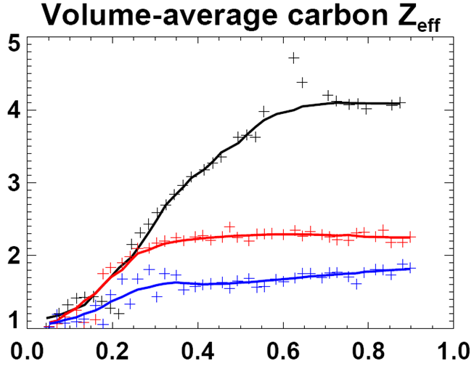

Operation with outer strike-point on Mo LLD (coated with Li) compatible with high plasma performance, low impurities
LLD
(2010-12)
LLD FY2010 results:
R10-2
LLD did not increase global D pumping beyond that achieved with LiTER
  Solid Li on C pumps D quite efficiently
  Liquid Li reacts rapidly w/ background gases (LTX)
  C on LLD may have impacted D pumping
Divertor T_{e} increases when T_{LLD} > T_{Li-melt}
No evidence of Mo from LLD in plasma during normal operation
Operation with strike-point (SP) on LLD reduced core impurities (due to ELMs?)
Mo tiles for upcoming run (2011-12)
SP on inner carbon divertor (no ELMs)
SP on LLD, T_{LLD} < T_{Li-melt}
SP on LLD, T_{LLD} > T_{Li-melt} (+ fueling differences)
  No ELMs, no → small, small → larger
  → High-Z impurities also reduced, β_{N} > 4 sustained
  Need to separate effects of PFC material, ELMs - motivates Mo tiles on inboard divertor → facility talk

Slide 15
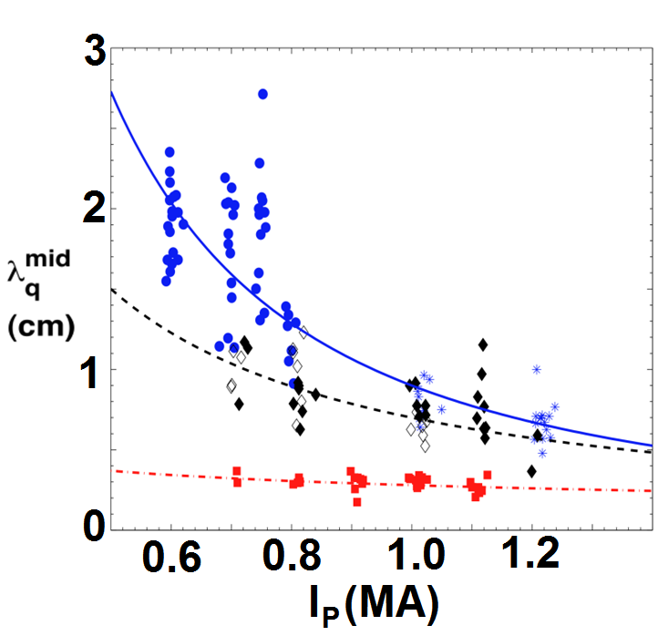
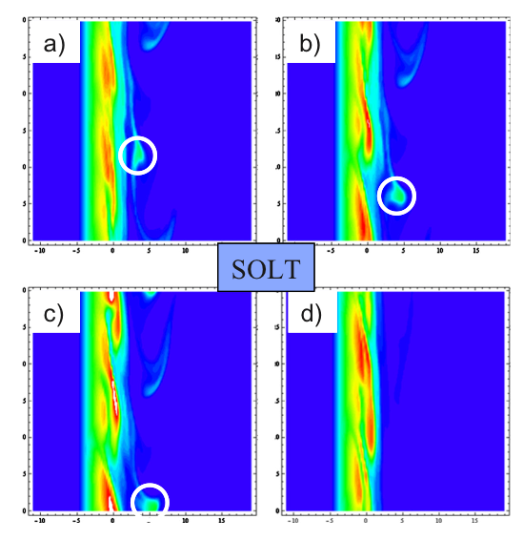
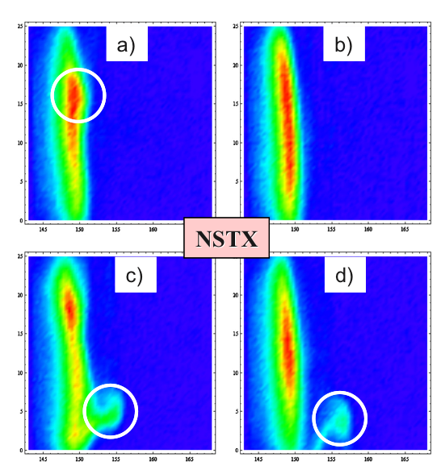
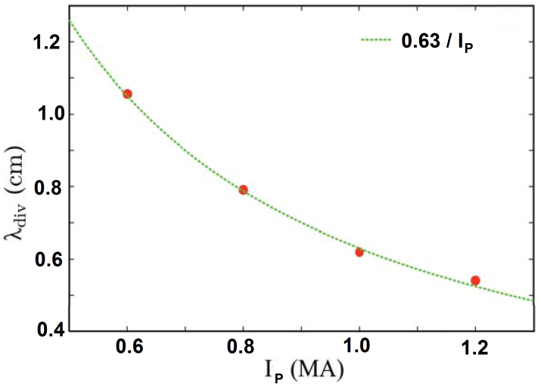
NSTX has contributed strongly to FY11 JRT to characterize and understand divertor heat fluxes
FY10 JRT
0 mg Li: α=1.6
150 mg Li: α=1.1
300 mg Li: α=0.4
Divertor heat flux width λ_{q}^{mid} decreases with increased plasma current I_{P}
  Potentially major implications for ITER
  NSTX: λ_{q}^{mid} further decreases with Li
  Physics mechanisms not yet fully understood
For NSTX-U parameters: λ_{q}^{mid} = 3 ± 0.5 mm
λ_{q}^{mid} ~ I_{p}^{-α}
T. Gray, JNM 2011 – in press
T. Gray, APS 2010
ORNL
Blob formation in SOLT is similar to NSTX Gas Puff Imaging (GPI) diagnostic data
Lodestar
XGC0 kinetic neoclassical consistent with ~ 1/I_{P} scaling
SOLT
NSTX GPI
A. Pankin (Lehigh)
G.-Y. Park (NFRI)
SOLT scaling weaker than 1/I_{P}
J. Myra, PoP 18, 012305 (2011)

Slide 16
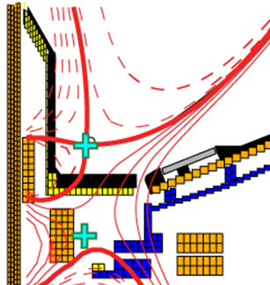
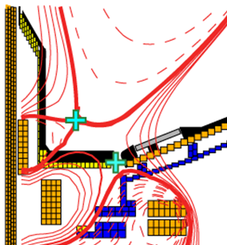
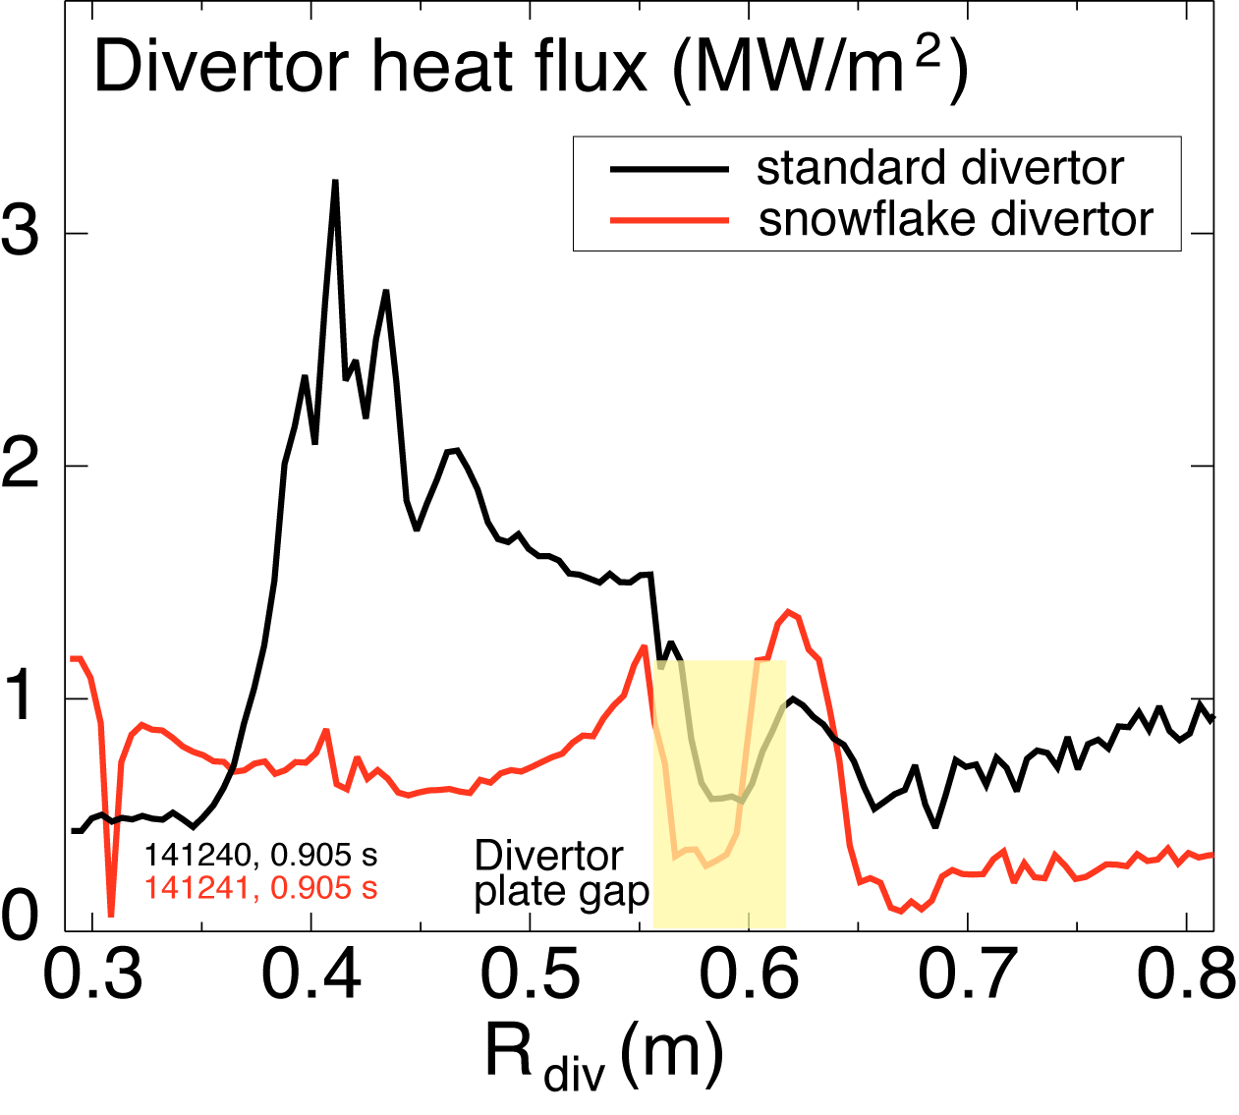
“Snowflake” divertor configuration provides significant divertor heat flux reduction and impurity screening
Standard Divertor
Snowflake Divertor
2nd X-point brought close to limiter boundary in divertor
Higher flux expansion (increased div wetted area)
Higher divertor volume (increased div. losses)
Peak heat flux reduced by 2-3×
Snowflake H-mode τ_{E} similar to standard divertor
Core and pedestal carbon reduced by 50%
Double-null snowflake is baseline divertor in Upgrade to maintain heat flux < 10MW/m² for 2MA, 15MW plasmas
R11-3: Assess control of U/D snowflake, possible synergies with Li, radiation
LLNL
V. Soukhanovskii , NF 51 (1) 012001 (2011)
V. Soukhanovskii , APS Invited 2010
R11-3:
V. Soukhanovskii: DOE Early Career Research Award - 2010

Slide 17
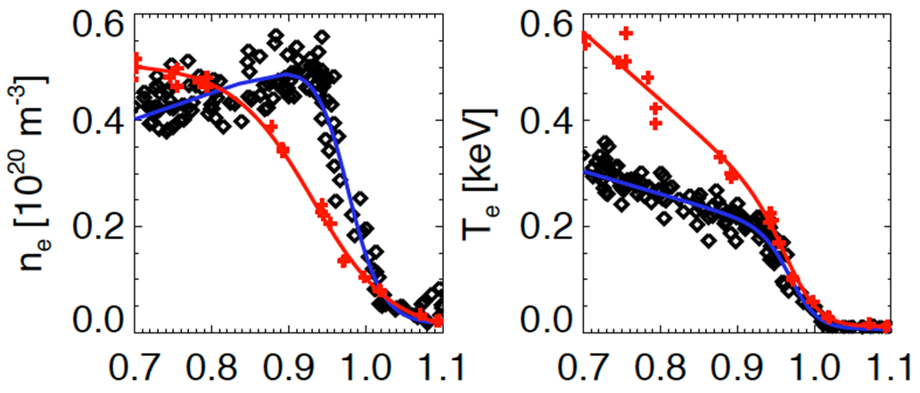

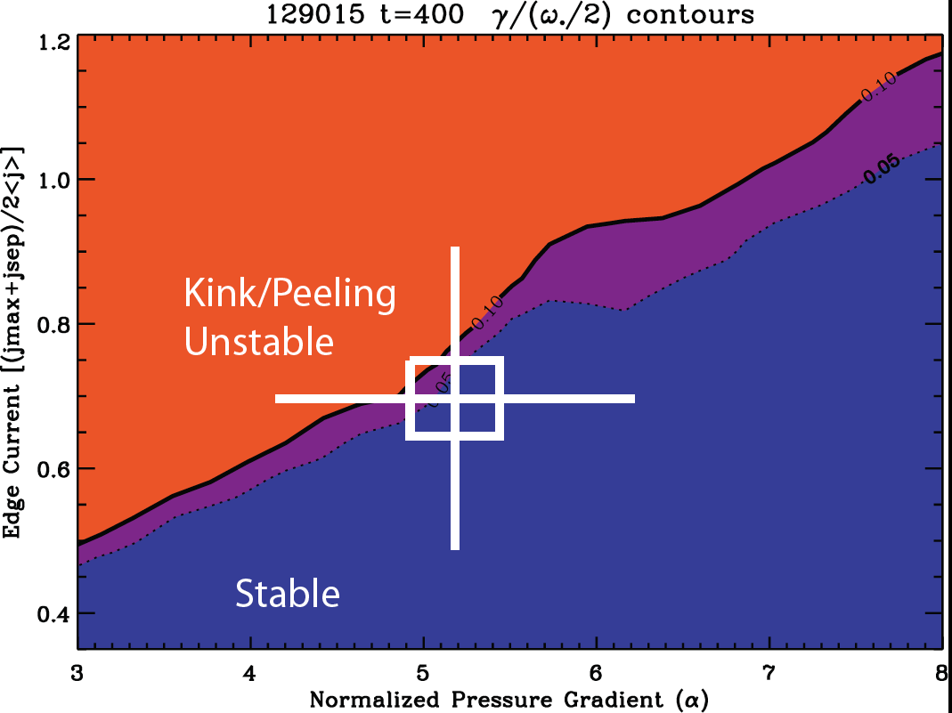
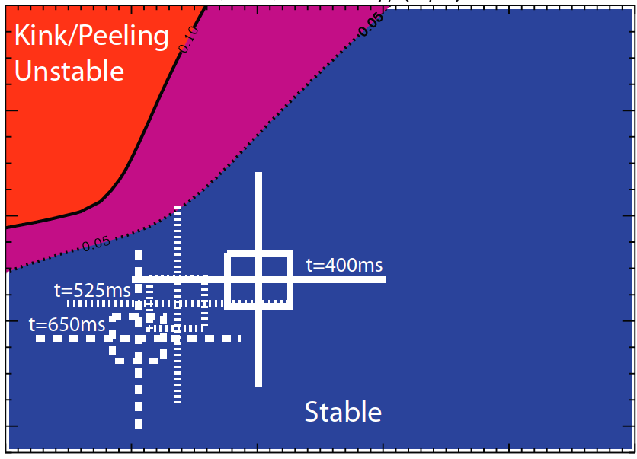
Li wall coatings broaden pedestal profiles, suppress ELMs – consistent with peeling-ballooning theory
  Edge stability calculations (ELITE)
  Colors represent contours of ratio of linear mode growth rate to diamagnetic drift frequency
  Pre-Li discharges close to kink/peeling stability boundary
H-Mode
pedestal
Post Li
Pre- Li
γ_{lin}/(ω*/2)
1.2
0.8
0.4
J. Canik, APS Invited 2010
R. Maingi, IAEA FEC 2010 Oral, EXD/2-2
R. Maingi, APS Invited 2009
R. Maingi, PRL 103 (7), 075001 (2009)
0.1 0.05
0.1 0.05
With Lithium
ORNL, General Atomics
Edge current
[(jmax+jsep)/2<j>]
No Lithium
3 4 5 6 7 8
Normalized Pressure Gradient (α)
3 4 5 6 7 8
Normalized Pressure Gradient (α)

Slide 18
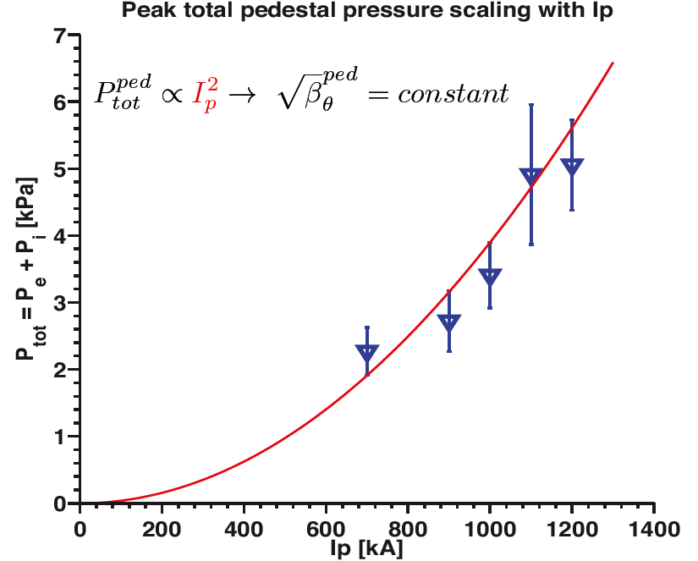
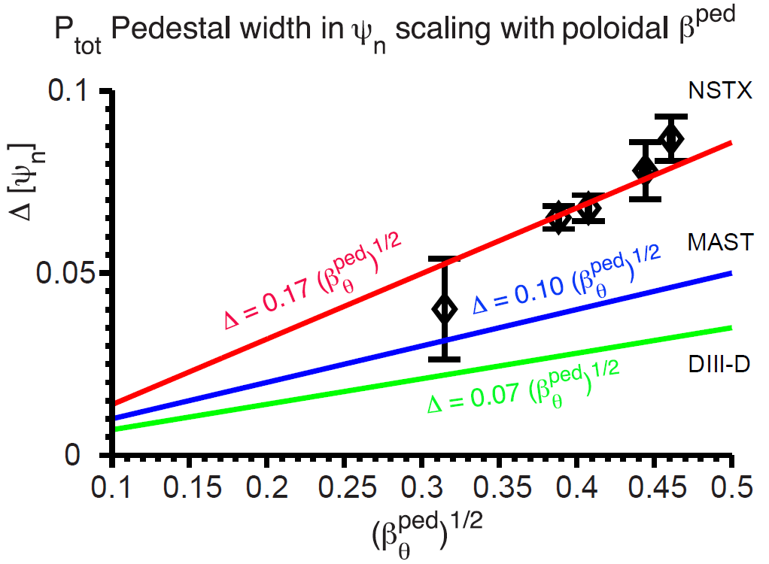
Pedestal structure and underlying MHD/transport mechanisms being elucidated by FY11 JRT effort
FY11 JRT
A. Diallo, submitted to NF (2011)
Pedestal pressure scaling established
  P_{ped} ∝ I_{p}² and increases with triangularity
  Builds up during ELM cycle, saturates at lower I_{p} late in ELM cycle
Establishing pedestal width scaling
  Analysis of pedestal data with peeling-ballooning theory (ELITE) ongoing
  Initial calculations: ELMy discharges are at kink/peeling boundary
Planned research supporting R11-4
  Pedestal transport, turbulence, stability with 3D fields
    Roles of particle and thermal heat transport
R11-4:
ORNL, General Atomics

Slide 19
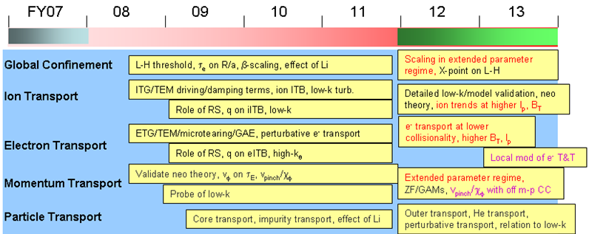
Transport and Turbulence
➢ Measure, understand, predict instabilities responsible for ST transport, project to next-steps
5 year plan
timeline
and goals
Progress and Plans
Gray italics indicates material provided in supplemental section
Global confinement
  Extensive L-H threshold studies performed, tests of effects of A, β, Li on confinement ongoing
Ion transport: BES commissioned FY10 – will be used extensively in FY11-12
Electron transport
  ETG, micro-tearing, GAE, RS eITB experiments and gyro-kinetic modeling performed
Momentum transport
  Poloidal velocity measured, consistent w/ neoclassical - will improve edge resolution (FY11-12 )
  Initial momenum pinch studies completed/published – will revisit with low-k BES data (FY11-12)
Particle transport
  Impurity ion (Ne) transport consistent w/ neoclassical – large edge PS transport from high q
  Beginning to explore D, C, Li transport with kinetic neoclassical transport with XGC-0

Slide 20
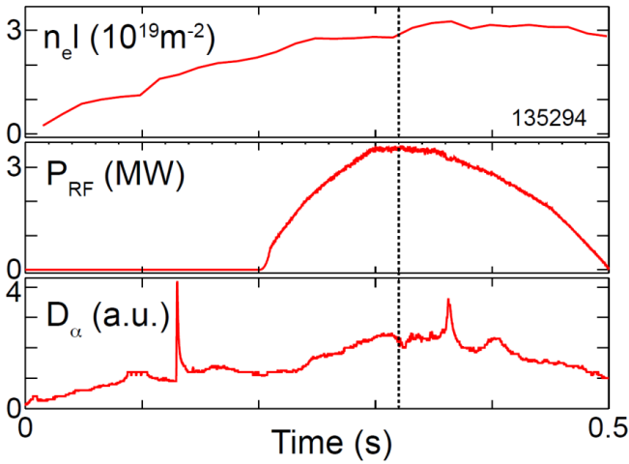
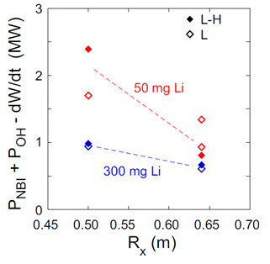
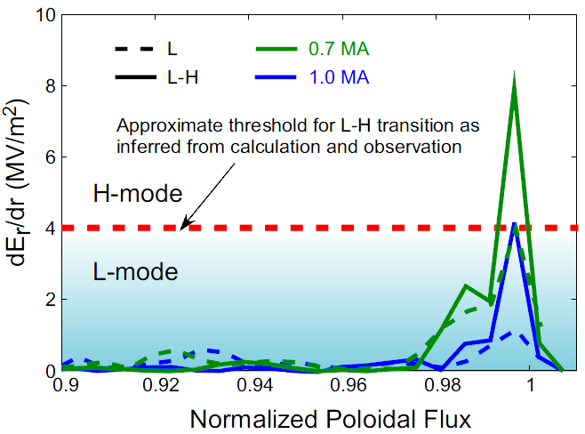
L-H threshold experiments in NSTX have explored a wide range of ITER and ST-relevant issues
Species dependence
  P_{LH} (He) ~ 1.2-1.4 P_{LH} (D): RF-heated
  H_{98y,2} ~1 with no ELMs after L-H transition
Non-axisymmetric field application
  P_{LH} /n_{e} increased ~65% with ~few Gauss n=3 fields
Plasma configuration
  Lower P_{LH} at increased major radius of X-point
Lithium coatings
  P_{LH} /n_{e} decreased by ~35% with lithium coating
  Additive influence for R_{X} , USN vs. LSN
Strong I_{p} dependence (ST effect)
  lower P_{LH} with lower I_{p}
  XGC0 calculations show larger E_{r} shear at lower I_{p}
Role of ion-scale turbulence*
  Beam Emission Spectroscopy now being utilized
R10-3
*More info on turbulence at L-H threshold in supplemental
S. Kaye, submitted to NF 2011
S. Kaye, IAEA FEC 2010 Oral, EXC/2-3Rb
R. Maingi, NF 50 (2010) 064010
ORNL, Univ. Wisconsin

Slide 21
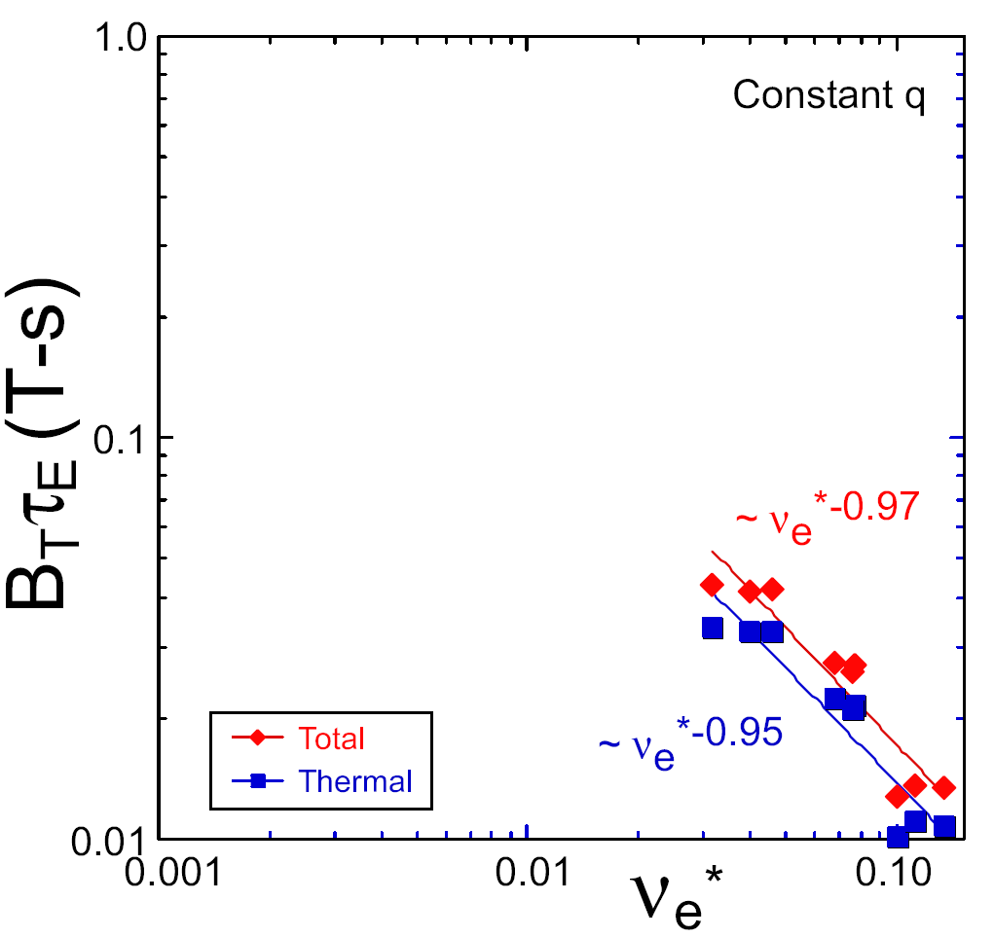
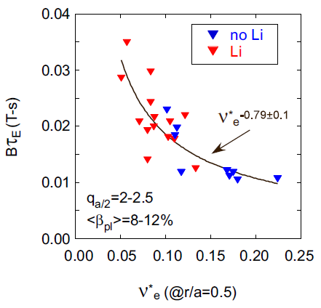
NSTX is continuing to explore the favorable collisionality scaling (∝ 1/ν_{e*}) of ST energy confinement
ST-FNSF
Increased τ_{E} with lithium may be result of reduction in ν_{e}*
constant q, β, ρ∗
NSTX Upgrade
?
NSTX
ITER H-mode scaling
S. Kaye, NF 47 (2007) 499–509
ν_{e}* ∝ n_{e} / T_{e}²
S. Kaye, ITPA TC-1
Expts also show weak β scaling: τ_{E-th} ~ β^{-0.12, -0.25} (no Li, with Li)
  Important for high-β ST and AT scenarios
  Beta scaling strong function of ELM character – Type III ELMs → strong degradation

Slide 22
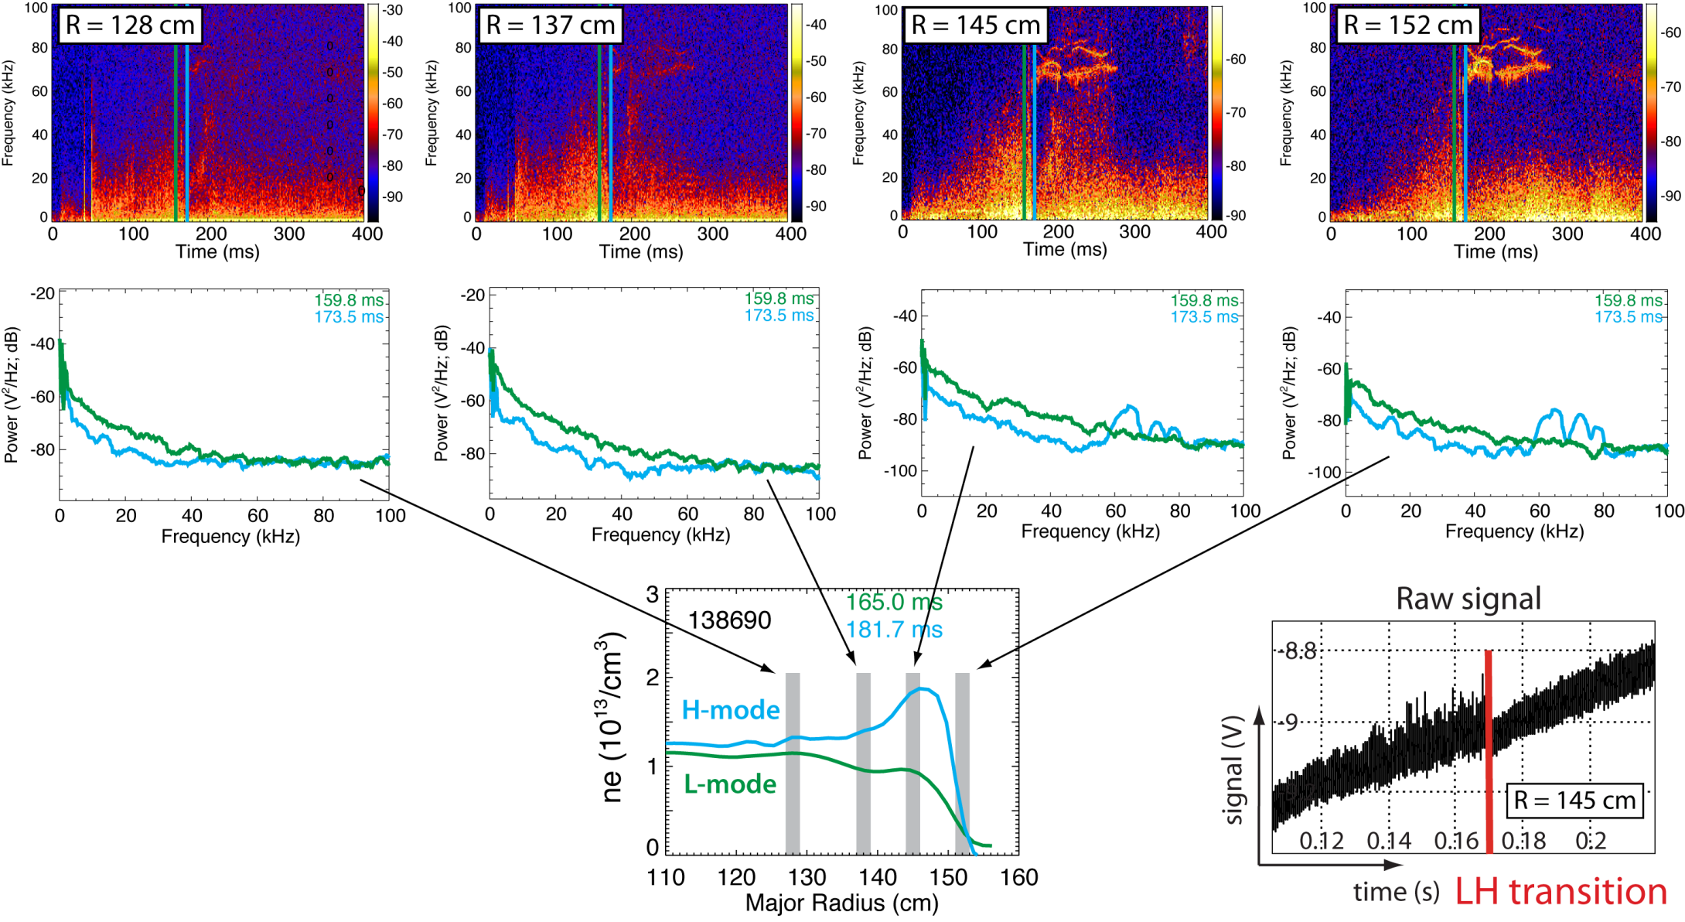
New BES commissioned in 2010: observed decrease in fluctuations at L-H transition from edge to core regions
R11-1, FY12 JRT
Univ. Wisconsin
R. Fonck, G. McKee, D. Smith, and I. Uzun-Kaymak (UW-Madison) and B. Stratton (PPPL)
Notes:
Initial measurements have shown that fluctuations decrease at LH transitions. In the top row you see spectrograms from 4 BES channels located from 128 cm to 152 cm. You can see the radial locations and a density profile in the bottom graph. The blue and green time slices show measured spectra before and after the h-mode transition. In the bottom right you can see the RMS value of the time-series signal decreases at the h-mode transition. Initial measurements have also shown fluctuations increase at the HL back-transition.

Slide 23
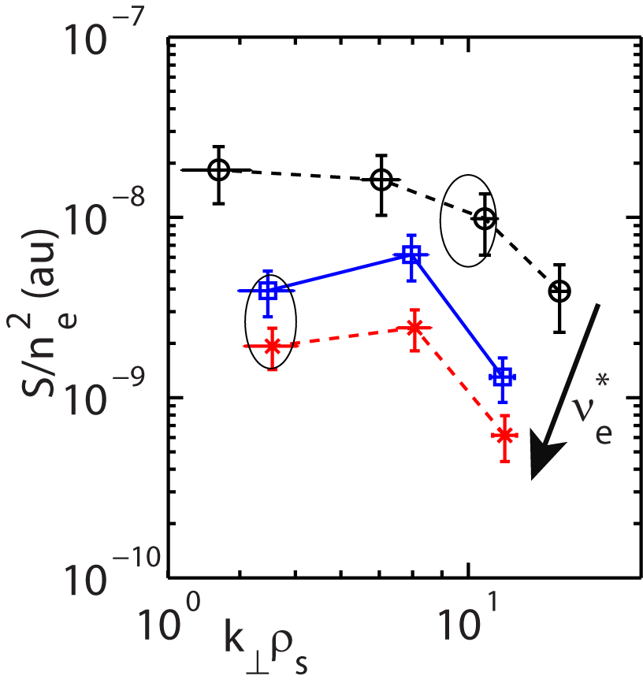
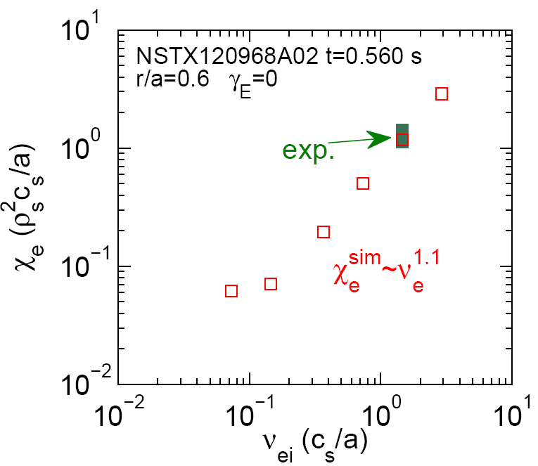
NSTX turbulence measurements and simulations are advancing the understanding of the collisionality scaling of τ_{E}
High-k measurement
High-k scattering measurements show fluctuation levels increase at lower ν_{e}*, β_{e}
Seemingly inconsistent with global confinement scaling from NSTX, MAST
  Pursuing non-linear gyro-kinetic simulations with synthetic diagnostics to interpret results
Y. Ren, PPPL
constant q, β, ρ_{e}*
β_{e} ≈ 3%
General Atomics
Non-linear GYRO simulations of lower-k μ-tearing predict χ_{e} ∝ ν_{e}*
W. Guttenfelder, PRL 106 (2011) 155004
  Predominantly EM turbulence – result of high β
What is role of μ-tearing in ST transport?
R11-1, FY12 JRT: High-k scattering + 2D BES will measure full k-spectrum of fluctuations
R11-1, FY12 JRT:
β_{e} ≈ 9%

Slide 24
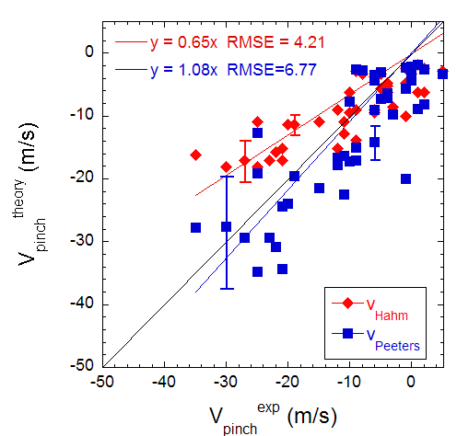
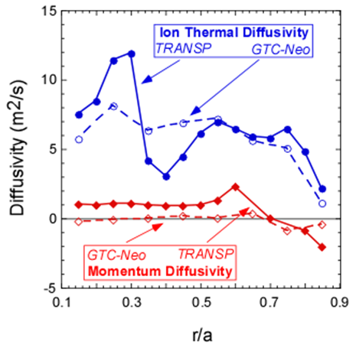
Momentum transport may be best probe of low-k turbulence
In NSTX, χ_{φ}^{ss} < χ_{i}, << χ_{e}
Perturbative momentum transport studies using magnetic braking indicate significant inward pinch
Theory predicts v_{pinch}/χ_{φ} ratio based on low-k turbulence – in agreement w/ expt
Γ_{i,turb} < Γ_{i,neo} while Γ_{φ,turb}>Γ_{φ,neo}
Residual low-k fluctuations predicted to drive anomalous momentum transport
Test with non-linear gyro-kinetic codes + BES
W. Solomon, APS Invited Talk 2010
S. Kaye, NF 49, (2009) 045010
W. Wang, PRL 102, (2009) 035005
R11-1

Slide 25
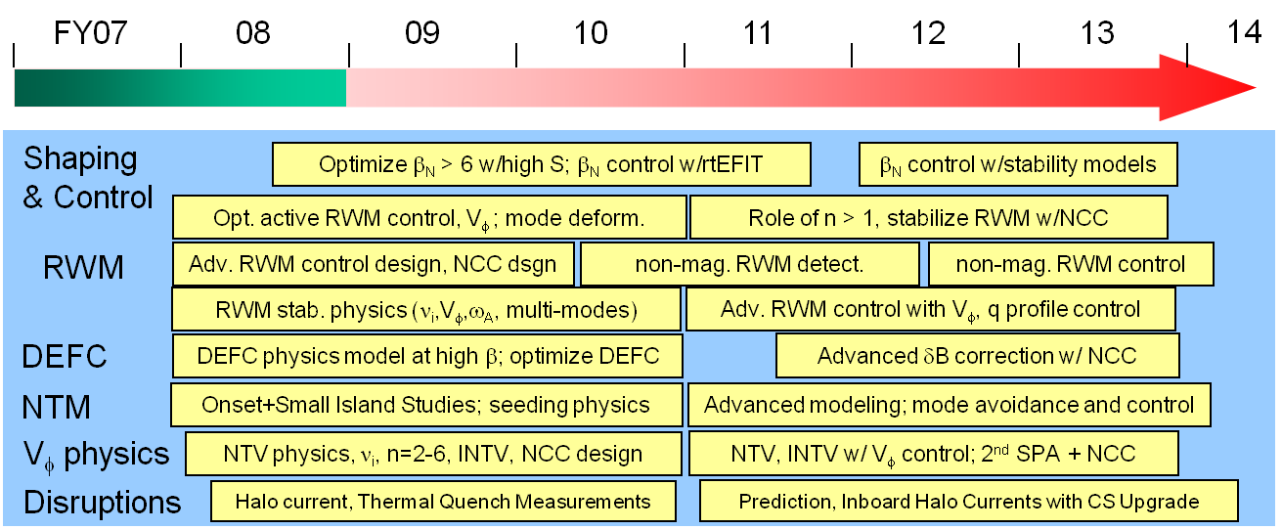
Macroscopic Stability
➢ Develop predictive capability for accessing, controlling, sustaining very high plasma pressure
5 year plan
timeline
and goals
Progress and Plans
Gray italics indicates material provided in supplemental section
Shaping and β control: (see Advanced Scenarios and Control section)
Resistive wall mode (RWM)
  Kinetic resonances found to play key role, advanced state-space controller successfully tested
Dynamic Error Field Correction (DEFC)
  Improved sensor compensation→ feedback on B_{R} component of RFA/RWM (+ B_{P} sensors already used)
Neoclassical Tearing Modes (NTM)
  Marginal island width scales with poloidal ion Larmor radius – joint studies with DIII-D
Toroidal rotation physics: rotation control planned for FY2012
  Incorporated plasma response via 3D perturbed equilibrium, studying (offset) rotation effects
Disruptions:
  Halo currents characterized, thermal quench studies started, mitigation experiments planned

Slide 26
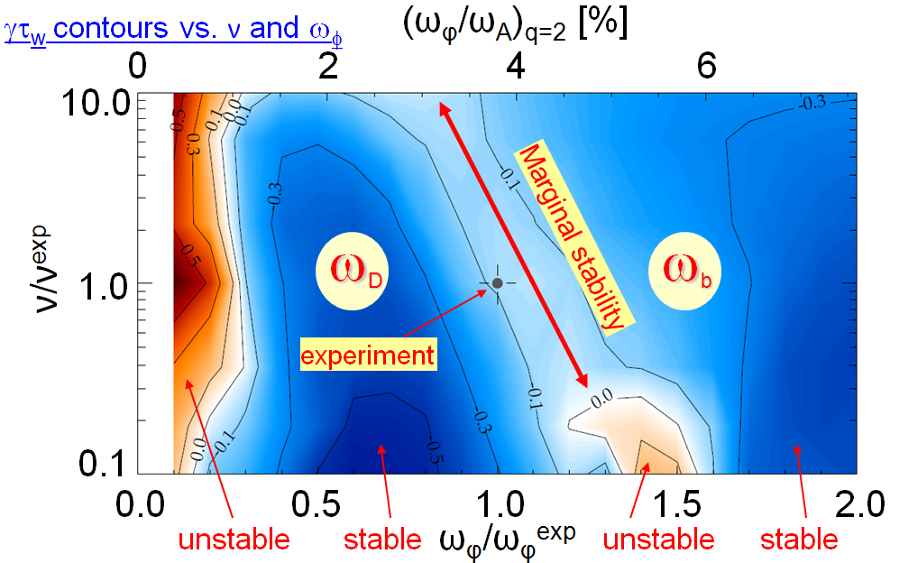
Resistive Wall Mode (RWM) stability depends on thermal kinetic resonances and fast-ion content (R09-1)
R09-1
Calculated growth rate γτ_{w} contours vs
collisionality ν and rotation frequency ω_{φ}
Observe that RWM can be unstable despite significant plasma rotation
MISK code predicts stabilization of RWM from:
  precession drift resonance
  ω_{D} at low rotation
  bounce resonance ω_{b} at high rotation
Plasma marginally unstable at intermediate rotation
(ω_{φ}/ω_{A})_{q=2} [%]
Stability to RWM improves with increased fast ion content
  Developing kinetic damping models for arbitrary fast-ion distributions
  Lower rotation speed required to stabilize RWM at higher FI density
  Important for high-beta ST-FNSF and ITER advanced scenarios
J. Berkery, PRL 106 (2011) 075004
S. Sabbagh, APS Invited Talk 2010
J. Berkery, PRL 104 (2010) 035003
J. Berkery, APS Invited Talk 2009
S. Sabbagh, NF 50 (2010) 025020
Columbia Univ.

Slide 27
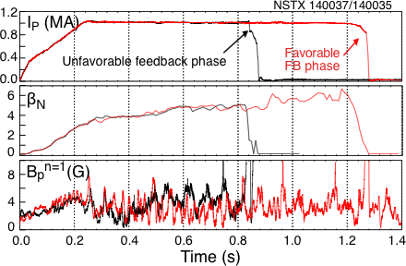
NSTX is first tokamak to implement advanced RWM state-space controller, and has utilized it to sustain high β_{N} (R10-1)
R10-1
Full 3-D model
~3000+ states
State reduction (< 20 states)
RWM
eigenfunction (2 phases, 2 states)
- Device R, L, mutual inductances
Instability B field / plasma response
Modeled sensor response
truncate
State space feedback with 12 states
Controller can compensate for wall currents
  Including mode-induced current
  Examined for ITER
Successful initial experiments
  Suppressed disruption due to n = 1 applied error field
  Best feedback phase produced long pulse, β_{N} = 6.4, β_{N} / l_{i} = 13
O. Katsuro-Hopkins, NF 47 (2007) 1157
S. Sabbagh, APS Invited Talk 2010
S. Sabbagh, IAEA FEC 2010 Oral EXS/5-5
Columbia Univ.

Slide 28
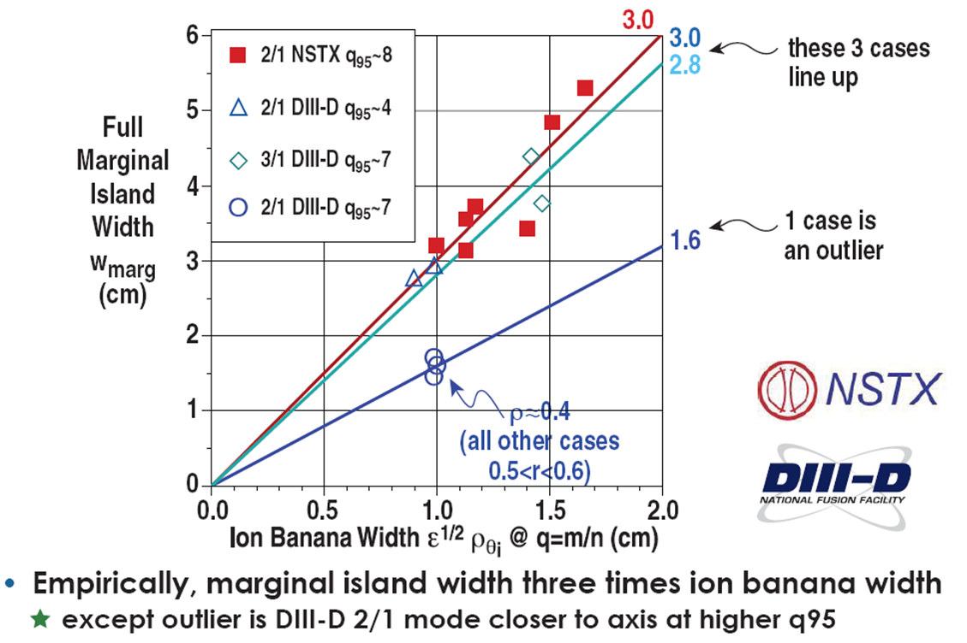
Measure of the marginal island width gives information on small island stabilizing physics
R. La Haye, APS DPP 2010
ITPA MHD 2010 MDC-4
Balance of terms in modified Rutherford equation shows that curvature term dominates over Δ’ for NSTX plasmas; curvature term negligible for DIII-D plasmas
Studying error field threshold scaling for mode locking in H-modes (Buttery; J-K Park)
2011-12 Plans: Extend present mode locking density, and NTV offset rotation studies to low-torque (RF-heated) plasmas

Slide 29
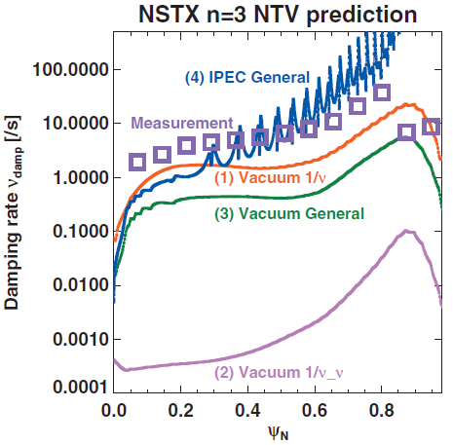
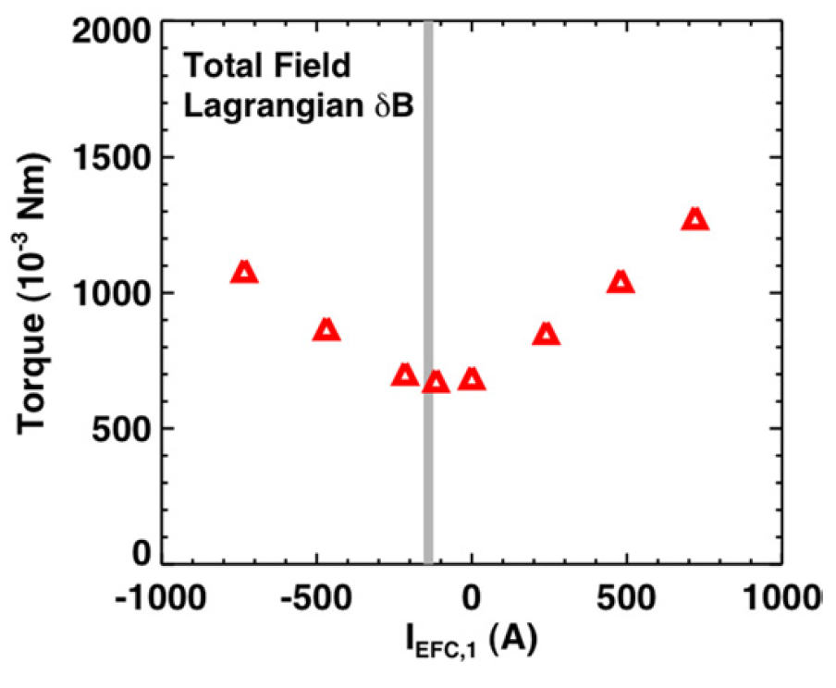
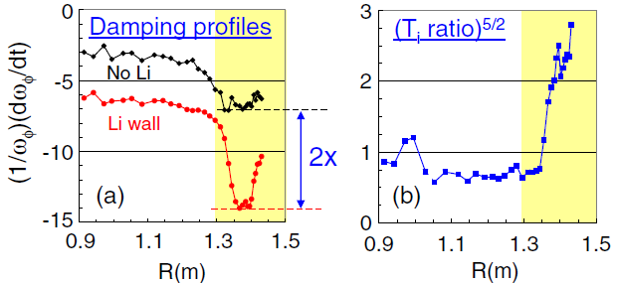
Generalized theory of Neoclassical Toroidal Velocity (NTV) developed, linked to Ideal Perturbed Equilibrium Code (IPEC)
IPEC+NTV rotation damping predictions largely consistent with NSTX and DIII-D data (except for region near plasma edge)
Optimal n=3 error field correction consistent with minimization of predicted NTV torque
J.-K. Park, APS Invited Talk 2010
J.-K. Park, PRL 102, 065002 (2009)
J.-K. Park, PoP 16, 056115 (2009)
S. Gerhardt, PPCF 52 104003 (2010)
J. Menard , NF 50 (4) 045008 (2010)
J.-K. Park: Marshall N. Rosenbluth Outstanding Doctoral Thesis Award - 2010
J.-K. Park: DOE Early Career Research Award - 2010
Damping scales as expected ∝ p_{i} /ν_{i} ~ T_{i}^{5/2}
Increased NTV damping at reduced collisionality, NTV dependence on E×B rotation important for ST-FNSF, ITER
Columbia Univ.
S. Sabbagh, NF 50 (2010) 025020

Slide 30





NSTX is addressing disruption physics for ITER and FNSF
Example: halo current (HC) dynamics
  HC rotation is a key issue for ITER: mechanical resonances could cause significant damage
  NSTX studying parametric dependencies of the n=1 HC magnitude and rotation dynamics
Other key contributions:
  Current quench database physics
  Divertor heat loading with fast dual-band IR
  Fast and slow n=1 control, and rotation profile optimization, for avoidance of disruptive MHD
  2011-12 – New disruption mitigation studies: Optimization of poloidal location of MGI
Contours of halo current flowing into the lower divertor of NSTX
S. Gerhardt, PPPL
ORNL
Columbia University
Univ. Washington
*More info on MGI experimental plans in supplemental

Slide 31

Energetic Particle Physics
➢ Establish predictive capability for fast-ion transport caused by *AE for ST, burning plasma
5 year plan
timeline
and goals
Progress and Plans
Gray italics indicates material provided in supplemental section
Model validation:
  TAE-avalanche induced neutron rate drop modeled successfully using NOVA+ORBIT
  GAE-induced electron transport simulated with GAE model, high-k data, ORBIT calculations
  HYM code (fully kinetic ions) calculations of GAE eigenstructure consistent with experiment
    Sub-cyclotron frequency modes are driven unstable via Doppler-shifted cyclotron resonance
    Simulations show nonlinear saturation of GAEs due to particle trapping
Upcoming experiments will utilize new diagnostics, tools
  BES: preliminary measurements of GAE eigenstructure in 2010 – extend in FY11-12
  New tangential + existing perpendicular fast-ion D_{α} (FIDA) diagnostic for improved f(v)
Active coupling to *AE: HHFW antenna usage deferred
  Dedicated prototype TAE antenna to be commissioned and tested in FY11-12

Slide 32



TAE-avalanche induced neutron rate drop modeled successfully using NOVA and ORBIT codes (R09-2)
R09-2
Toroidal Alfvén Eigenmode (TAE) avalanches in NBI-heated plasmas associated with transient reductions in D-D (beam-target) neutron rate
Fast Ion Profile (E_{λ} = 30-60keV)
UC Irvine
Change in beam-ion profile measured with Fast-ion D_{α} (FIDA)
Modeled using NOVA-K + ORBIT codes
  Mode structure obtained by comparing NOVA calculations w/ reflectometer data
  Fast ion dynamics in the presence of TAEs calculated by guiding-center code ORBIT
IR12-12: Improve predictive capability for TAE/GAE/CAE with self-consistent and advanced codes (M3D-K, HYM, SPIRAL)
A. Bortolon, RSI 81 (2010) 10D728
M. Podestà, PoP 16 (2009) 056104
UCLA
E. Fredrickson, PoP 16 (2009) 122505
M. Podestà, PoP 17 (2010) 122501
IR12-2:
G.-Y. Fu, IAEA-FEC 2010 THW/2-2Rb
E. Fredrickson, IAEA-FEC 2010 EXW/P7-06
N. Gorelenkov, PoP 16 (2009) 056107

Slide 33



Global Alfven Eigenmodes (GAE) candidate to explain high core electron thermal transport rates in NBI-heated H-modes
K. Tritz, APS Invited Talk 2010
N. Gorelenkov, NF 50 (2010) 084012
D. Stutman, PRL 102 (2009) 115002
Johns Hopkins Univ.
GAE model + high-k δn + ORBIT modeling roughly consistent w/ experiment:
+
Also exploring coupling of *AE to other modes:
  GAE/CAE can sometimes trigger TAE (via fast ion redistribution?)
  TAE/EPM can interact with low-freq kink-like modes, impact rotation
UCLA, UC Irvine
E. Fredrcikson, NF (in preparation)
E. Fredrickson, IAEA FEC 2010, EXW/P7-06
M. Podestà, NF 51 (2011) 063035
M. Podestà, IAEA FEC 2010, EXW/P7-23
N. Crocker, PoP 16 (2009) 042513

Slide 34

Wave Heating and Current Drive
➢ Demonstrate reliable wave heating and CD to enable advanced operating scenarios
5 year plan
timeline
and goals
Progress and Plans
Gray italics indicates material provided in supplemental section
HHFW coupling optimization
  HHFW performance summary on next slide
  Fast-ion interaction with HHFW successfully modeled by including finite orbit width effects
  Edge interaction modeling with fully 3D AORSA underway – initial results qualitatively similar to experiment
ECH/EBW coupling and heating studies: deferred due to cost

Slide 35

Antenna upgrades performed in 2009 significantly improved HHFW heating performance
Modifications to antenna described in M. Ono facility presentation
Improvements in performance likely due to a combination of antenna upgrade and Li conditioning:
  Coupled > 4 MW into He L-mode
  Record T_{e}(0) ~ 6.2 keV with P_{RF} ~ 2.7 MW
  Allowed study of L-H and H-L transition
  in He & D with RF (not previously achievable)
  Maintained HHFW coupling through
  L-H transition and during relatively
  large repetitive ELMs during D plasmas (not previously achievable)
  2010: P_{RF} limited to 2MW, apparently from Li-oxide-dust-associated arcs
  Will re-establish 4MW operation in 2011 to support and other experiments
G. Taylor, PoP 17, (2010) 056114
G. Taylor, APS Invited Talk 2009
ORNL, MIT
R12-2

Slide 36

Self-consistent finite-orbit-width (FOW) ORBIT-RF/AORSA improves agreement with FIDA data for NBI+HHFW plasmas
M. Choi , PoP 17, (2010) 056102
HHFW interaction with NBI fast-ion can be significant
There was previously significant disagreement between modeling & FIDA fast-ion profiles
Good agreement between modeling & FIDA has now been achieved by including additional iterations between AORSA & FOW ORBIT-RF
Work has also begun on a full FOW correction to CQL3D which is expected to be completed in late 2011
  P_{NBI} = 1 MW
  P_{RF} = 1 MW
M. Choi, US-Japan RF Workshop, Toba, Japan, February 2011
ORNL, General Atomics, CompX

Slide 37



3-D AORSA full-wave model with 2-D wall boundary predicts large E_{RF} following magnetic field near top & bottom of NSTX
  k_{φ} = -8 m⁻¹
  Center Stack
  Edge RF eigenmode similar to striated structures imaged by visible plasma TV
  k_{φ} = -8 m⁻¹
  HHFW
  Antenna
  E_{RF}
D. L. Green, ORNL
3D AORSA with boundary extended to wall
In addition to RF power coupling to core, AORSA predicts some RF power
propagates just inside LCFS as an edge localized RF eigenmode
Initiated divertor tile current measurements to compare to theory

Slide 38

  Advanced Scenarios and Control
  ➢ Establish high-performance integrated scenarios and the necessary control capabilities
5 year plan
timeline
and goals
Progress and Plans
Gray italics indicates material provided in supplemental section
Scenario development
  Developed range of scenarios with sustained high κ, β_{N}, and bootstrap fraction
  Exploring scenarios for NSTX Upgrade: higher A and elongation, extend in FY11-12
  Extended duration of H-mode scenarios with very high confinement (H₉₈ up to 1.7)
NBI-driven current redistribution from *AE
  During large repeated TAE avalanches, substantial modification of J(r) observed, simulated
Assess, optimize performance vs. n_{e}, lithium
  Need to develop and understand MHD-stable scenarios at low density – FY12 milestone
Increase NBI H-mode non-inductive fraction: requires high P_{RF} - test in FY11-12
ELM control with mid-plane RMP, Li
  Utilized paced 3D fields and vertical jogs to trigger ELMs, reduce impurities, control density
Advanced control
  Implemented: β_{N}, multiple strike-points Planned: MIMO shape, improved n=0, snowflake, rotation

Slide 39


In 2009-10, NSTX demonstrated sustained high-elongation configurations over a range of currents and fields (R09-3)
R09-3
High-β_{T} Long Pulse High-β_{P}
q*=2.8 q*=3.9 q*=4.7
Plasma current
B_{T}=0.44 T
I_{P}=1100 kA
B_{T}=0.38 T
I_{P}=700 kA
B_{T}=0.48 T
I_{P}=700 kA
Poloidal beta
Toroidal beta
κ ~ 2.6-2.7
δ ~ 0.8
Double Null
H₉₈ ≥ 1
Current in central solenoid
Pulse-lengths limited by OH, TF coil heating limits
S. Gerhardt, accepted for publication in NF 2011
S. Gerhardt, IAEA FEC 2010, EXS/P2-8

Slide 40


NSTX is exploring stability impact of higher aspect ratio and elongation, and profiles in preparation for Upgrade, FNSF
A=1.45, κ = 2.4
A=1.65, κ = 2.8
Next-step ST designs assume increased κ = 3-3.5 and A=1.6-1.7
  Maximizes fusion performance of low aspect ratio configurations
NSTX has begun to explore the stability of higher κ and A
  Also exploring how current profile (internal inductance l_{i}) varies with these geometric changes, since elongation depends strongly on l_{i}
R11-2: NSTX scenarios will be systematically extended toward shapes of Upgrade and next-steps
  Assess maximum stable κ, l_{i}, β_{N}
  Optimize RWM stability, control
NSTX-U
limiter
boundary
R11-2
S. Gerhardt, accepted for publication in NF 2011

Slide 41


High confinement H-Mode regime obtained with lithium
High Performance ST-FNSF/Pilot Plant level confinement: H_{98y2} < 1.7
• Very high H_{98y2} < 1.7 is combination of Li confinement improvement and higher pedestal temperature and pressure
• ITER, FNSF fusion performance is highly dependent on pedestal pressure: Q ~ p²
P_{NBI} /10 [MW]
t₁ t₂
separatrix
~3 τ_{E}
EPH
R. Maingi, PRL 105, 135004 (2010)
R. Maingi JNM 390-91, 440-443 (2009)
ORNL
Notes:
41

Slide 42





Toroidal Alfven Eigenmodes (TAE) can strongly modify
NBI current profile – important for FNSF, ITER-AT (R09-2)
R09-2
700 kA High-β_{P} with Rapid TAE Avalanches
Neutrons
All (Neo)classical physics
Discrepancy between reconstruction and total due to large classical J_{NBCD}.
With Impulsive D_{FI}
Reduced J_{NBCD} eliminates discrepancy between reconstruction and total.
Model TAE “avalanches” using spatially and temporally localized fast-ion diffusivity D_{FI}(ψ,t)
  TAE avalanches could impact ST-FNSF scenarios with large fraction of NBI current
  IR12-2: Obtain new tangential FIDA data for M3D-K validation during Upgrade outage
IR12-2
S. Gerhardt, NF 51 (2011) 033004

Slide 43


ELM pacing developed with pulsed non-resonant fields,vertical jogs – useful for controlling impurities
Rapid, Reliable Triggering with Pulsed 3-D Fields
ELM Pacing Via Vertical Jogs
Stored Energy
Electron Density
Radiated Power
D-Alpha
Phase Locked
D-Alpha
n=3 RMP pulses
D-Alpha
Vertical jogging successful despite thick continuous vacuum vessel.
ELMs become phase locked to upward motion
- Reduction in radiated power
- Rapid ELMs lead to smaller per-ELM energy loss
J. Canik, IAEA FEC 2010 Oral, EXC/8-1
J. Canik, NF 50 (2010) 064016
J. Canik, PRL 104 (4), 045001 (2010)
ORNL
S. Gerhardt, NF 50 (2010) 064015

Slide 44
Activities in support of ITER
➢ Utilize unique ST/NSTX parameters and capabilities to extend tokamak understanding for ITER
Active ITPA participation
ITER task agreements:
  Study of error fields using the Ideal Perturbed Equilibrium Code
  Error field measurements in ITER without plasma
Divertor detachment thresholds with 3D fields + gas puffing
Plasma transport and stability response to 3D fields
Gray italics indicates material provided in supplemental section

Slide 45
NSTX Participation in ITPA Joint Experiments and Activities
NSTX typically actively participates in ~25 Joint Experiments/Activities
Advanced Scenarios and Control (5)
  IOS-1.2 Study seeding effects on ITER baseline discharges
  IOS-4.1 Access conditions for advanced inductive scenario with ITER-relevant restrictions
  IOS-4.3 Collisionality scaling of confinement in advanced inductive plasmas
  IOS-5.2 Maintaining ICRH coupling in expected ITER regime
  IOS-6.2 li controller (Ip ramp) with primary voltage/additional heating
Boundary Physics and Lithium Research (16)
  PEP-6 Pedestal structure and ELM stability in DN
  PEP-19 Basic mechanisms of edge transport with resonant magnetic perturbations in toroidal plasma confinement devices
  PEP-23 Quantification of the requirements for ELM suppression by magnetic perturbations from off-midplane coils
  PEP-24 Minimum pellet size for ELM pacing
  PEP-25 Inter-machine comparison of ELM control by magnetic field perturbations from midplane RMP coils
  PEP-26 Critical parameters for achieving L-H transitions
  PEP-27 Pedestal profile evolution following L-H/H-L transition
  PEP-28 Physics of H-mode access with different X-point height
  PEP-29 Vertical jolts/kicks for ELM triggering and control
  PEP-31 Pedestal structure and edge relaxation mechanisms in I-mode
  PEP-32 Access to and exit from H-mode with ELM mitigation at low input power above PLH
  PEP-33 Effects of current ramps on the L-H transition and on the stability and confinement of H-modes at low power above the threshold
  PEP-34 Non-resonant magnetic field driven QH-mode
  DSOL-20 Transient divertor reattachment
  DSOL-21 Introduction of pre-characterized dust for dust transport studies in divertor and SOL
  DSOL-24 Disruption heat loads
Macroscopic Stability (7)
  MDC-1 Disruption mitigation by massive gas jets
  MDC-2 Joint experiments on resistive wall mode physics
  MDC-4 Neoclassical tearing mode physics – aspect ratio comparison
  MDC-12 Non-resonant magnetic braking
  MDC-14 Rotation effects on neoclassical tearing modes
  MDC-15 Disruption database development
  MDC-17 Active disruption avoidance
Transport and Turbulence (11)
  TC-1 Confinement scaling in ELMy H-modes: beta degradation
  TC-2 Hysteresis and access to H-mode with H~1
  TC-4 H-mode transition and confinement dependence on ionic species
  TC-9 Scaling of intrinsic rotation with no external momentum input
  TC-10 Experimental identification of ITG, TEM and ETG turbulence and comparison with codes
  TC-11 He and impurity profiles and transport coefficients
  TC-12 H-mode transport and confinement at low aspect ratio
  TC-14 RF rotation drive
  TC-15 Dependence of momentum and particle pinch on collisionality
  TC-17 rho-star scaling of intrinsic torque
  TC-19 Characteristics of I-mode plasmas
Wave-Particle Interactions (5)
  EP-1 Measurements of damping rate of intermediate toroidal mode number Alfven eigenmodes
  EP-2 Fast ion losses and redistribution from localized AEs
  EP-3 Fast ion transport by small scale turbulence
  EP-4 Effect of dynamical friction (drag) at resonance on nonlinear AE evolution
  EP-6 Fast ion losses and associated heat load from edge perturbations (ELMs and RMPs)

Slide 46



3D fields used for RMP ELM control can cause toroidally asymmetric divertor heat & particle deposition, re-attachment
Distribution of splitting locations from measurement and vacuum field line tracing in good agreement
Low gas
High gas
Increased divertor gas puffing reduces heat-flux peaking and re-establishes divertor detachment
J.-W. Ahn PoP 18 (5) 056108 (2011)
J.-W. Ahn, APS Invited Talk 2010
ORNL
Similar splitting observed previously on DIII-D (T. Evans)

Slide 47

NSTX investigating H-mode pedestal transport,
turbulence, and stability response to 3D fields (R11-4)
R11-4
NSTX provides unique data to understand response to 3D fields for ELM control:
No n=3
With n=3
ELMs stabilized by Li coatings
ELMs triggered by 3D fields, not suppressed
  Profile changes from 3D fields depend on Li, ν*, q₉₅
ORNL
J. Canik, IAEA FEC 2010 Oral, EXC/8-1
J. Canik, NF 50 (2010) 064016
J. Canik, NF 50 (2010) 034012
J. Canik, PRL 104 (4), 045001 (2010)
Will study possible mechanisms for modifying transport
Pedestal turbulence trends: BES, high-k scattering, gas-puff imaging
Transport response: Improved Thomson, impurity injection, edge SXR
Also supports FY11 JRT on H-mode pedestal structure
FY11 JRT

Slide 48
NSTX successfully completed annual research milestones and is prepared to complete upcoming FY11-12 milestones
( blue = completed, red = ongoing/future, green = incremental )
FY2009
FY2010
FY2011
FY2012
Run Weeks:
16
15
4
10
10
4
Transport & Turbulence
Macroscopic Stability
Boundary/Lithium Physics
Waves and Energetic Particles
Solenoid-free start-up, ramp-up
Advanced Scenarios & Control
ITER urgent needs, cross-cutting
Joint Research Targets (3 US facilities):
R11-1
Measure fluctuations responsible for electron, ion, impurity transport
R09-1
R10-1
R11-2
IR12-1
Understand physics of RWM stabilization & control vs. rotation
Assess sustainable β & disruptivity near and above ideal no-wall limit
Assess ST stability dependence on aspect ratio and boundary shaping
Investigate magnetic braking physics and toroidal rotation control at low ν*
R10-3
R11-3
R12-1
Assess H-mode characteristics vs.
collisionality and Li conditioning
Assess very high flux expansion divertor operation
Assess relationship between lithium-conditioned surface composition and plasma behavior
R09-2
R10-2
IR12-2
Study how j(r) is modified by super-Alfvénic ion-driven modes
Characterize HHFW heating, CD, and ramp-up in deuterium H-mode
Assess predictive capability of mode-induced fast-ion transport
R12-2
Assess confinement, heating, and ramp-up of CHI start-up plasmas
R09-3
R12-3
Perform high-elongation wall-stabilized operation at lower n_{e}
Assess access to reduced n_{e} and ν* in high-performance scenarios
R11-4
H-mode ped. transport, turbulence, stability response to 3D fields
FY09 JRT
FY10 JRT
FY11 JRT
FY12 JRT
Particle control and hydrogenic fuel retention
Understanding of divertor heat flux and transport in scrape-off layer
Characterize H-mode
pedestal structure
Understand core transport
and enhance predictive capability

Slide 49
Plans for FY2012-13 analysis and research
Complete analysis and publication of FY2011-12 data
Planning and design studies supporting post-Upgrade ops:
  Start-up: CHI upgrades, point helicity injection (plasma guns)
  Boundary: Divertor cryo-pumps, divertor diagnostics
  Lithium: Additional Mo tiles, next-generation LLD
  Transport, EP: New high-k scattering, assess solid-state NPA
  MHD: 3D-coil physics design for RWM/RMP/TM/EFC/NTV/TAE
  Control: Real-time-MSE for NBI J-profile control, control of heat flux
Develop, write NSTX Upgrade 5 year plan for 2014-18
Update/extend physics design of ST-FNSF
  LDRD to further develop design concepts, utilize NSTX team expertise
  Predictive modeling of start-up, sustainment, transport, stability, divertor
Will rely heavily on NSTX collaborators for 5 year plan preparation, post-Upgrade planning and design, FNSF physics design studies

Slide 50

Planning for FY2013 NSTX collaboration
Solicited, received info on collaboration opportunities
  Enthusiastic response: MAST, LTX, Pegasus, DIII-D, C-Mod, KSTAR, EAST, LHD
  Also gathered info on PPPL NSTX researcher interests and skills
~1/3 time available for collaboration: ~10 FTE/yr for 2-3 yrs
Presently aligning opportunities & skills with needs & goals
  Experienced NSTX researchers can help advance off-site research
  Can also bring back new experiences, ideas to NSTX Upgrade
Example: NSTX-U goal of 100% NICD, high β, q(r) control using 1st + new 2nd NBI
  Collaboration on advanced scenarios, profile control, energetic particles mutually beneficial:
    DIII-D, EAST, KSTAR, MAST
NBI R_{TAN} [cm]
__________________
50, 60, 70, 130
60, 70,120,130
70,110,120,130
Normalized minor radius

Slide 51
Summary: NSTX is contributing strongly to basis of ST-FNSF, advancing PMI solutions, supporting toroidal physics, ITER
NSTX has completed all planned research milestones and produced many additional important results
NSTX has had a very productive 2.5 years
  See M. Ono talk for statistics on publications, invited talks, awards and recognition, facility utilization and diagnostic implementation
Research program has adapted to, aligned with the ReNeW ST thrusts, FES vision: emphasis on FNSF, PMI, validation:
  NSTX Upgrade highest priority, HHFW upgraded to support start-up research
  Lithium/LLD, snowflake, high-Z PFCs contribute to potential PMI solutions
  Drift-kinetic MHD, non-linear gyro-kinetic transport, non-linear *AE/fast-ions
Developed comprehensive research plan for FY11-12 run
  Emphasis on boundary, PMI, transport, MHD, prep for Upgrade
Planning for Upgrade outage period is under way
  Emphasis on post-upgrade operation prep, off-site collaboration

Slide 52
Start-up and Ramp-up Supplemental Slides

Slide 53

Transient CHI: Axisymmetric reconnection leads to formation of closed flux surfaces
Demonstration of closed flux current generation
  Aided by gas and EC-Pi injection from below divertor plate region
Demonstration of coupling to induction (2008)
  Aided by staged capacitor bank capability
CHI for an ST: T.R. Jarboe, Fusion Technology, 15 (1989) 7
Transient CHI: R. Raman, T.R. Jarboe, B.A. Nelson, et al., PRL 90, (2003) 075005-1

Slide 54



Coaxial Helicity Injection (CHI) has Produced Substantial
Flux Savings and Scales Favorably with Size and B_{T}
  Enabling capabilities
  Elimination of arcs in absorber region
  Conditioning of lower divertor
Time after CHI starts
200 kA more current with CHI start-up
  Generated 1MA using 40% less flux than induction- only case
  Hollow T_{e} maintained during ramp
  Low internal inductance (l_{i} ≈ 0.35)
  High elongation
  Suitable startup for advanced scenarios
B.A. Nelson EXW/P2-8

Slide 55


In 2008, low Z impurities limited the ability to ramp-up a CHI discharge with central solenoid
Absorber Coils
CHI exhibits low Z impurities that increase with increasing capacitor energy.
As the discharges grow upwards to fill the vessel absorber arcs occur
  FY2009: Used absorber coils to provide buffer flux and prevent arcs

Slide 56



Absorber Coils Suppressed Arcs in Upper Divertor and Reduced Influx of Oxygen Impurities
FY 2009
With Absorber coils
Without coil
Divertor cleaning and lithium used to produce reference discharge
Buffer field from PF absorber coils prevented contact of plasma with upper divertor
R. Raman, D. Mueller, B.A. Nelson, T.R. Jarboe, et al., PRL 104, (2010) 095003

Slide 57




TSC Simulations Show Increasing Current
Multiplication as TF is Increased (NSTX geometry)
NSTX Experimental result
Measured current
multiplication at 0.5T
TSC simulation
4
2
TSC: Developed by S.C. Jardin
60
20
Current multiplication factors similar to observations in NSTX
Higher toroidal field important as it reduces injector current requirement
Time (ms)
-20 -10 0 10 20
Now starting to use NIMROD code
(in collaboration with Bick Hooper, LLNL)

Slide 58

TSC Simulations Show 600kA CHI Start-up Capability in NSTX as TF is Increased to 1T
Projected closed flux plasma current for NSTX-U is >450 kA [I_{p} = I_{inj}(ψ_{Tor}/ψ_{Pol})]*
  Based on 11 kA injector current
  Current multiplication of 55 (achieved in NSTX)
  Applied voltage ~2x that at 0.5T, further optimization may reduce voltage requirement
Voltage
(kV)
Voltage
(kV)
1.5
1.5
1
1.0
0.5
0.5
600
600
Plasma
current (kA)
Plasma
Current (kA)
Te = 40 eV
Te = 40eV
400
400
200
200
600
600
Plasma
current (kA)
Plasma
Current (kA)
Te = 150 eV
Te = 150eV
400
400
200
200
Consistent with present experimental observations in NSTX that attain >300kA at 0.5T
* T.R. Jarboe, FT (1998)

Slide 59
Lithium Research Supplemental Slides

Slide 60

Solid lithium surface coatings pump D, increase confinement, stored energy, and pulse length, and eliminate ELMs
2009: Lithium evaporation became baseline wall-conditioning tool
H. Kugel, IAEA FEC 2010 Oral, FTP/3-6Ra
H. Kugel, FED 85 (6) 865-873 (2010)
M. Bell, PPCF 51 (12), (2009) 124054
M. Bell, EPS Invited Talk 2009
D. Mansfield, JNM 390-91, 764-767 (2009)
H. Kugel, JNM 390–391, 1000–1004 (2009)
No longer perform between-shot He glow
Typically deposit 50 to 300mg Li between shots

Slide 61

With lithium coating pumping, deuteron inventory is constant or even decreasing, C accumulates, Li saturates
Electron density rises monotonically in lithium induced ELM-free H-mode
Strongly Li-pumped discharges exhibit D inventory pump-out
but C inventory increases
Li inventory increases slowly, remains at very low value
Lithium screening efficiency is high, penetration factor is low: N_{Li} / Γ_{Li} ~ 0.0001
As a result, NSTX is shifting emphasis from D inventory control to C impurity reduction
R. Bell, M. Podestà (PPPL) V. Soukhanovskii (LLNL)

Slide 62

NSTX contributed unique Li data to FY09 joint research milestone on "...particle control and hydrogenic fuel retention in tokamaks”
Edge pressure and wall inventory changes with Li
FY09 JRT
With Li:
  lower edge neutral pressure
  higher wall particle inventory.
Additional D wall inventory is released after discharge.
Pre-Li and with Li NB heated discharge
Retention Summary | Before Li | With Li
Ohmic | 92% | 94% (48 mg Li)
NB heated | 87% | 93% (137 mg Li)
Wall inventory calculated by dynamic particle balance model.
V. Soukhanovskii
C. Skinner, JNM (2011) – in press
Notes:
Here we show a comparison of the edge pressure and wall inventory in matched discharges with and without lithium.
You can see the stored energy increase, and a lower neutral pressure.
Fueling: 132474 = 37 torr-liters during Ip
133110 = 41 torr-liters during Ip
The wall deuterium inventory is calculated by a dynamic particle balance model and is higher with lithium and increases throughout the shot.
However after the discharge the edge pressure promptly increases to equal or exceed the no -Li case. This also has a connection to the surface analysis results which I will show later.
Equation from ‘Soukhanovskii FuelingModelPSI03.pdf’

Slide 63

Gas balance retention measurements correlate with in-situ PMI surface science measurements
GAS BALANCE: | SURFACE ANALYSIS
Retention higher with Li, difference increases with Li concentration | X-ray Photo-electron Spectroscopy shows D atoms are weakly bound in regions near lithium atoms bound to either oxygen or the carbon matrix. Chemical bonding changes with Li concentration.
Additional D retained with Li is released promptly after discharge | Weak D bonding with Li conditioning observed in Thermal Desorption Spectroscopy.
PMI probe
DOE FY09 JRT
Notes:
This summarizes the results obtained from the gas balance measurements and the surface analysis of samples exposed to the NSTX plasmas.
It is clear from the surface analysis that the situation is more complicated than just the chemical binding of D by Li in LiD. The molecular state of Li-O-C-D changes molecular state with increasing lithium dose which is interesting in the light of the differences in retention observed with increasing dose.
The additional D retained with Li was observed to be released promptly after the pulse. At the same time thermal desorption spectroscopy showed an additional low energy D peak with lithium. It seems that the additional retained D may be bound in a relatively weak chemical state and that is why it is promptly released. This is good news for controlling the D inventory in next step machines that utilize Li. The data underlying these results are in the backup slides.

Slide 64
2010: LLD Loaded With Lithium Using LITER
• LITER Deposition Capability
- for LLD-1 to pump NSTX plasma from 7x10¹³ cm⁻³ --> 5 x10¹³ cm⁻³ will require the absorption of 2.4 x 10²⁰ D particles, every particle confinement time (~ 50 ms), for 1000 ms, for a total of 4.8 x 10²¹ D particles absorbed.
- for a 1:1 D/Li ratio requires at least 5.5x10⁻² g of lithium (2 μm).
- present LITER deposition efficiency on to LLD ~ 7% of its total output, then the total lithium need is 0.79 g.
- using two evaporators at 30 mg /min (FY07 typ) will require about 13 min to coat the LLD-1.
- if lower concentration ratio 0.1D/Li is required, then need 7.9 g of lithium (20 μm), or 4 g per LITER, operating at 100 mg/min for 40 min.

Slide 65
Overview and chronology of LLD results and plans
2007-10: LLD designed, implemented with goal of providing 30-50% reductions in n_{e} to enable variations in collisionality and NBI CD fraction
During this time, routine Li evaporator operation successfully implemented
  Deuterium inventory control demonstrated for 1-1.5s, n_{e} / n_{Greenwald} from D⁺ = 0.2-0.4
  Substantial fraction of n_{e} can come from accumulation of C⁶⁺ and high-Z due to lack of ELMs
Decision made to use LiTER to fill/replenish LLD during first year of ops
  Completing and installing LLD + implementing LLD diagnostics consumed available resources
  2010 plan: Develop liquid lithium fill system for LLD during 2010 to utilize in 2011-12
2010 results: LLD did not exhibit D pumping beyond that achieved w/ LiTER
  No Mo observed with strike-point on LLD, core impurities reduced (may be due to low-δ/ELMs)
  Plasma heat can melt Li during shot (re-solidifies after) – minimizes Li reactivity between shots
  Some evidence of divertor T_{e} increase when T_{LLD-surface} > T_{Li-melt} – enhanced local pumping?
LLD technical problems during 2010 run
  Insufficient plate grounding + disruptions → arcing to surrounding tiles and heating and cooling tubes, mechanical damage to plate supports, eventual failure of most electrical heaters
  Insufficient time/resources to restore LLD heating capability → rely on plasma heat to melt Li
2011-12: Improved LLD grounding/supports, added Mo inboard divertor tiles
  Assess pumping/impurities w/ Li + inboard + outboard Mo PFCs → use Mo PFCs in Upgrade?

Slide 66
FY10 Li /LLD operational summary
Rapid startup with Li conditioning and without boronization.
Total of 1.3 kg Li evaporated (2x 2009 level), extensive lithium coverage of PFCs.
Devoted 11 run days, 6 XPs, 452 discharges to LLD commissioning and characterization.
Performed 0.6 run day for increased Li delivery via Li powder injection.
Explored plasma D content and gas balance vs.
  LLD Li fill,
  LLD temperature,
  strike point location,
  fueling,
  divertor gas injection etc…
Porous Mo (LLD) and ATJ samples exposed by PMI probe, retrieved and analyzed.
2-color thermography and high density Langmuir probe array commissioned.

Slide 67
LLD pumping similar above or below Li melting temperature
• Constant deuterium fueling for LLD 100% Li fill conditions, 4 plates air heated.
• As LLD surface temperature transitioned from solid temperatures to the liquid regime,
the plasma electron and deuterium content remain relatively constant.
• Core carbon C6+ content decreased - may be due in part to increased ELMing and
edge turbulence.
• No systematic trend in D-alpha, wall inventory, or ion pumping with a transition
above the Li melting temperature.

Slide 68
Higher local electron temperature during LLD melting sequence despite increased fueling
Langmuir probes indicate increase in near-surface electron temperature during LLD expeiments
  Discharge sequence indicated decreased fueling efficiency during LLD heating (gas increased, N_{e} constant)
  Non-local and classical probe interpretations applied, increase in T_{e} consistent with increase in V_{p}-V_{f} difference
  Temperature rise occurs in hot-electron population of the distribution function
  Observations consistent with plasma-absorbing PFC
Floating and Plasma Potentials
Difference in potentials most strongly correlated with hot-electron energy fraction
Inferred temperature in near-SOL
M.A. Jaworski, ISLA oral, FED submitted

Slide 69


LLD surface was not pure Li
LLD after vent at end of run
60
Radius (cm)
80
LLD surface converted to Li₂CO₃ following vent
LLD edges exhibit evidence of sputtered
graphite from plate to graphite tile (vessel-
ground) arcing.
Acetic acid tests on the LLD after run suggests
that Li does wick into Mo pores and is depleted
from the surface at blackened region.
Reactions with residual gasses also likely
• Carbon, lithium, and deuterium emission extends across LLD surface after overnight Li evaporation.
• No marked change at LLD location

Slide 70



Full metal wall data from LTX shows thin liquid film reacts rapidly with residual/background gasses
LTX is a full high temperature, high Z wall operation of a tokamak
  lithium evaporated into 5 mTorr helium fill to disperse coating.
Deposition rate ~0.75 g/hour/evaporator
  3 hour duration
  est. 1.6 micron average thickness.
Thin liquid lithium coating darkened rapidly
  indicative of reactions with background gases or oxidized substrate
  no visual evidence of metallic surface.
Hot (300 °C) shell with thin lithium coatings does not exhibit reduced recycling
  but strong lithium emission observed
  relevant to NSTX LLD operation.

Slide 71


Lab analysis of NSTX exposed samples (Purdue U.)
Deuterium saturation of Li
XPS O1 spectra for the LLD samples
30 mins D₂ irradiation of Li on:
O1s
Mo001: D₂ on solid Li
Mo002: D₂ on liq. Li deposited cold
Mo202: D₂ on liq. Li deposited hot
Mo201: Sputtered C and D₂ on liq. Li
ATJ203: D₂ on Li on graphite
XPS O1s spectra show changes in surface chemistry with D irradiation of Li deposited on cold / hot / C contaminated Mo and graphite.
Suggests Li on Mo is interacting with D and diffusing into Li.
Modeling by the TBDFT code showed the probability for D to bond to a Li-C complex is 3 x larger than to C

Slide 72



MAPP probe will be installed for FY11-12
MAPP is the first in-vacuo surface analysis diagnostic directly attached to a tokamak, capable of shot-to-shot chemical surface analysis of material samples (solid Li,
liquid Li, Mo etc).
MAPP will enable the correlation of PFC surface chemistry with plasma conditions and point the way to improved plasma performance. (R12-1)
Analysis chamber
Plasma
X-ray source
Electron analyzer with MCP detector
Analysis
Chamber
Focused ion gun
Sample holder with 4 samples
Samples at
analysis position
EFIT02 142512 @ 547 ms

Slide 73

New diagnostics will be used to investigate relationship between Li-conditioned surface composition & plasma behavior (R12-1)
R12-1
JP Allain, JNM 390–391 (2009) 942–946
Chemistry of Li on C/Mo critical, complex, under-diagnosed
Li very chemically active → prompt surface analysis required to characterize the lithiated surface conditions during a shot
An in-situ materials analysis particle probe (MAPP) being installed on NSTX to provide prompt surface analysis
  Ex-vessel but in-vacuo surface analysis within minutes of plasma exposure using state of the art tools
Purdue
Li experiments will utilize MAPP to study:
  Reactions between evaporated Li and PFCs, gases
  Correlation surface composition and plasma behavior, comparisons to lab experiments, modeling
  Characterizations of fueling efficiency, recycling
J.-P. Allain: DOE Early Career Research Award - 2010

Slide 74



Lithium Technology developed for NSTX needs
R&D continuing for LLD performance at high heat flux.
Continuous Li replenishment systems:
Li powder
(50 gm)
Resonating
piezoelectric
disk
(2.25 kHz)
NSTX &
EAST
powder
granules
liquid
Li delivery by:
High heat flux test
~
guide tube
lithium
heated tube
Pedestal
1 mm Spheres
falling @ 500Hz
bellows
False color image of LLD sample during NB exposure
T ≤ 225 °C @ 1.5 MW/m² - 3s. Potential PFC for upgrade
500 Hz Impeller Rotating @ 95 m/s
10 g of molten Li moved 1.1m in vacuum and ejected 7.6 cm from nozzle
Midplane injection for ELM pacing

Slide 75
Boundary Physics Supplemental Slides

Slide 76


Partial divertor detachment (PDD) and associated heat flux reduction achieved with D₂ divertor gas puffing
V.A. Soukhanovskii, Nucl. Fusion 49 (2009) 095025

Slide 77


Snowflake divertor studies inform divertor solutions for NSTX-U, future high power density tokamaks
Progress in snowflake divertor studies
  Magnetic control: snowflake-minus w/ three divertor coils up to 600 ms
  Partial detachment of outer strike point
    q_{pk} reduced from 3-7 to 0.5-1 MW/m² at P_{SOL}~ 3 MW due to increased divertor P_{rad} (up to 50 %) and high flux expansion (increased up to 90 %)
    Core and pedestal carbon concentration reduced by up to x 50 %
  ELM regime modification (no ELMs -> Type I)
  UEDGE modeling commencing
Planned research (R11-3, R12-3)
  Divertor power balance, radiation and turbulence characteristics, pumping with lithium, impurity seeding
  Pedestal structure, P.-B. stability, ELM control
  NSTX-U divertor scenarios
    NSTX-U shaping, upper+lower snowflake

Slide 78


Good H-mode confinement with reduced impurities and outer strike point detachment with snowflake divertor

Slide 79


Pedestal / SOL turbulence measurements and modeling contributing to edge transport and L-H transition studies
Transport and turbulence with lithium
  Turbulence reduction with lithium
    Low-k δn/n in pedestal measured by BES
    δn/n from ~10 % to 1 % from edge reflectometer
    δn/n in pedestal measured by high-k scattering
  UEDGE and SOLPS transport modeling
L-H transition physics
  Edge zonal flow/GAM and turbulence modulation at ~3 kHz preceding L-H transition (from velocimetry of edge turbulence flow speed)
  No systematic changes in poloidal flow shear during ~1 msec just before L-H transition at ±3 cm around separatrix – no clear L-H trigger
FY2011-12 planned research:
  Spatial localization of L-H transition
  Validation of SOLT, GAMs, XGC-1, BOUT simulations using NSTX data
  Effect of 3D fields, SOL currents, X-points on edge transport and ELMs
U. Wisconsin UCLA
No lithium
With lithium
U. Colorado
L-H

Slide 80


NSTX gas fueling locations and turn-off time-scales
τ ~ 0.15 sec
Conventional
Supersonic
(SGI)
τ ~ 0.5 sec
SGI provides efficient, controllable fueling
V. Soukhanovskii, LLNL

Slide 81
SGI fueling results in higher fueling efficiency, lower edge neutral pressure
Comparison between SGI and conv. gas injection was only possible by 1) matching density in 1 MA, 6-4 MW discharges; 2) comparing gas injection rate and total gas inventory
V. Soukhanovskii, LLNL

Slide 82
SGI-only fueling scenario with steady-state ion inventory developed
Obtained good n_{e} and T_{e} profiles (at outer gap ~ 10 cm) to compare SGI and LFS fueling
  Will analyze pedestal height and width in collaboration with ORNL
Developed shoulder and SGI long pulse fueling scenarios
Developed SGI-only fueling scenario with ion density control
  N_{i} constant, while N_{e} is rising due to carbon; LITER at 9 mg/min
Constant N_{i}
V. Soukhanovskii, LLNL

Slide 83
Transport and Turbulence Supplemental Slides

Slide 84
ETG turbulence proposed as possible cause of anomalous electron transport
ETG mode has been identified by comparing linear growth rate and rest frequency of measured fluctuations to linear GS2/GYRO calculations
ETG in e-ITB found to be suppressed by reversed magnetic shear, allows access to supercritical electron temperature gradients
Expt.
(shear = -0.5)
RS
accessible
Rest frequency of peak amplitude mode measured by subtraction of Doppler shift due to plasma rotation
Linear GS2 / GYRO simulations of ETG mode growth rates are consistent with high-k measurements
H. Yuh, PRL 106, 055003 (2011)

Slide 85
Reversed shear suppresses mode growth even at supercritical ETG gradients during e-ITBs
1
Intermittent, short duration bursts of ETG observed during RS phase
Average ETG mode amplitude low, T_{e} gradient well above ETG critical
GYRO simulations indicate non-linear up-shift of critical ETG gradient
A series of large amplitude, closely spaced in time ETG bursts collapse Te profile
Magnetic shear becomes zero/positive due to anomalous current redistribution
T_{e} profile can only be reheated to ETG critical gradient at zero shear
ETG mode amplitude grows to a moderate continuous level
2
3
H. Yuh, PRL 106, 055003 (2011)
1
2
3
ETG mode amplitude
1
1
3
3
2
2

Slide 86


Nonlinear GYRO Simulations of NSTX Reversed Shear Show Strong Up-Shift of Critical Gradient for ETG Turbulence
Non-linear up-shift of critical ETG gradient
Scan in shear and electron temperature gradient for NSTX e-ITB baseline parameters
Nonlinear critical gradient for transport has large up-shift during reversed shear
H. Yuh, PRL 106, 055003 (2011)

Slide 87

Large Density Gradient Induced by an ELM Event
After the ELM event:
  A factor of 4 increase in density gradient
  60% increase in electron temperature gradient
  60 % decrease in ion temperature gradient
  40% increase in T_{i}
  Less than 25% variation in all other equilibrium quantities
No large global MHD mode appears before and right after the ELM event
ELM event
High-k measurement region
Shot=140620
Ren et al., PRL, 106, (2011) 165005

Slide 88




Correlation Found between Reduction of Turbulence Spectral Density and Improvement of Plasma Thermal Confinement
Significant decrease in wavenumber spectral power is observed for modes with longer wavelength,
The spectral power of the large wavenumbers, , is unaffected
Plasma thermal diffusivity is decreased by about a factor of 2 after the ELM event
This increase correlates well with the decrease of the spectral power of the longer wavelength mode
High-k region
Ren et al., PRL, 106, (2011) 165005

Slide 89

Poloidal CHERs detection planes and viewing sightlines
R. Bell, Phys. Plasmas 17, 082507 (2010)
R. Bell, APS Invited Talk 2009

Slide 90



Poloidal velocity dependence on field consistent w/ predicted neoclassical trends, magnitudes differ by ~ factor of 2

Slide 91

Experimental neon diffusivity in agreement with neoclassical models

Slide 92

Core impurity diffusivity can be affected by rotation in NSTX (×10-100 static D_{Neo})

Slide 93


Impurity Transport Studies will Exploit New Diagnostics and Modeling Capabilities (R11-1, 2012 JRT)
Neon diffusivity neoclassical in the core accompanied by some anomalous convection
  Under-resolved at the edge and suffered from low signal
Plasma rotation enhancing core impurity transport without invoking low-k turbulence
New Multi-Energy Soft X-Ray diagnostic in 2010
  ~1 cm resolution; <100 μs response; high SNR; r/a>0.65
STRAHL transport code being used
  Neoclassical calculation embedded
  Up-to-date atomic data
Impurity transport study at plasma edge
  Carbon build up in ELM-free discharges
  Z dependence of impurity transport
  Measure edge turbulence and its relation to impurity transport (BES, High-k, reflectometer etc.)
Neon puff
separatrix

Slide 94

Lithium concentration in plasma core remains very low compared to higher-Z carbon
Quantitative measurements of C⁶⁺, Li³⁺ with charge-exchange recombination spectroscopy
n_{C}/n_{Li} ~ 100
Hollow profiles early for both C and Li fill in as time progresses
Status:
Low lithium core contamination continues to hold true for LLD operation
Favorable result for lithium based divertor concepts
Low level of lithium accumulation consistent with neo-classical theory (C.S. Chang et al.)
A quantitative model still lacking
R = 135cm
118cm
Carbon
180mg lithium
Lithium
180mg lithium
135cm
118cm
No sign of Li accumulation in core
R. E. Bell (PPPL)

Slide 95


Preliminary: XGC0 Kinetic neoclassical transport calculations being used to model, interpret lithium transport
For n_{C}/n_{e}=10%, Li moves outward while C⁶⁺ moves in at ψ_{N} < 1
For n_{C}/n_{e}=5%, Li moves inward at much slower speed than C⁶⁺
C.S. Chang (PPPL) - in collaboration with Kyuho Kim (KAIST) and GY Park (KSTAR now) and the CPES Team
Presented at 2nd International Symposium on Lithium Applications for Fusion Devices - April 27-29, 2011 - PPPL

Slide 96

High-frequency core GAE electromagnetic fluctuations can apparently cause large core electron transport
2 MW
4 MW
6 MW

Slide 97



Measuring micro-tearing turbulence with high-k scattering system
Micro-tearing turbulence has significant density fluctuations
  Very Different 2D k spectrum anisotropy than ETG
  Significant spectral power in large k_{r} (electron-scale) is expected for micro-tearing turbulence
The present high-k system measures mostly k_{r} spectrum and is able to distinguish the different anisotropies
Micro-tearing density fluctuation NSTX H-mode
ETG density fluctuations
NSTX L-mode
GYRO simulations

Slide 98


Preliminary Design of the New
High-k Scattering System for NSTX-Upgrade
The design utilizes the launching port of the present high-k_{r} system and its microwave hardware
Two scattering configurations of the system allow it to measure 2D k spectrum

Slide 99


Ion Transport Typically Found to be Near Neoclassical in H-mode Plasmas
Controls τ_{E} scaling with I_{p}
Linear GS2 calculations indicate possible
suppression of low-k turbulence by ExB shear during H-phase
- Supported by non-linear GTC results
BES range
Neoclassical (r/a=0.5-0.8)
Neoclassical levels determined from GTC-Neo: includes finite banana width effects (non-local)
Need BES to confirm conclusions
χ_{i} routinely anomalous in high density L-modes
(γ_{lin, ITB} > γ_{ExB})
S. Kaye, Nucl. Fusion 47 (2007) 499–509

Slide 100
Macroscopic Stability Supplemental Slides

Slide 101
Use of combined B_{r} + B_{p} RWM sensor n= 1 feedback yields best reduction of n = 1 field amplitude / improved stability
Combination of DC error field correction, n = 1 feedback
  Dedicated scans to optimize B_{r}, B_{p} sensor feedback phase and gain
  n = 3 DC error field correction alone subject to RWM instability
  n = 1 B_{p} sensor fast RWM feedback sustains plasma
  Addition of n = 1 B_{R} sensors in feedback reduce the combined B_{p} + B_{r} n = 1 field to low level (1–2 G)
R10-1
ITPA MDC-17, WG7
+ n = 1 Bp + B_{R} feedback
7
6
5
β_{N}
4
3
n = 3 correction alone
(RWM-induced disruption)
+ n = 1 B_{p} feedback
2
1
0
500
Feedback current (A)
400
300
200
128693
139347
140137
100
0
6
B_{r}^{n = 1} (G)
+ n = 1 B_{p} feedback
5
4
3
2
+ n = 1 B_{p} + B_{R} feedback
1
0
7
(B_{p}+ B_{r})^{n = 1} (G)
6
5
4
3
2
1
0
0.0
0.2
0.4
t (s)
0.6
0.8
1.0

Slide 102
RWM B_{r} sensor n = 1 feedback phase variation shows clear settings for improved feedback when combined with B_{p} sensors
n = 1 B_{R} + B_{p} feedback
(B_{p} gain = 1, B_{R} gain = 1.5)
R10-1
Recent corrections to B_{r} sensors improve measurement of plasma response
  Removed significant direct pickup of time-dependent TF intrinsic error field
  Positive/negative feedback produced at theoretically expected phase values
Adjustment of B_{p} sensor feedback phase from past value further improved control performance
ITPA MDC-17, WG7
6
β_{N}
140124
140125
140126
140127
4
2
0
0.8
0.6
0.4
l_{i}
0.2
0.0
10
ω_{φ}^{~q=2} (kHz)
8
6
B_{r} FB phase = 225º
4
2
0
6
B_{r}^{n = 1} (G)
B_{r} FB phase = 180º
4
2
0
0.0
0.2
0.4
0.6
0.8
1.0
1.2
t (s)
1.4
B_{r} FB phase = 0º
B_{r} FB phase = 90º

Slide 103



RWM feedback using upper/lower B_{p} and B_{R} sensors modeled and compared to experiment
Modeled B_{r} field at sensors and midplane
B_{r} sensors alone
250 degrees
R10-1
Passive growth
ITPA MDC-17, WG7
Radial field (G)
Growth rate (1/s)
B_{r} and B_{p}
sensors
gain 2e5
bottom sensors
midplane
top sensors
DCON, VALEN
codes
B_{r} feedback phase (deg)
Toroidal angle (deg)
Both B_{r}, B_{p} feedback contribute to active control
  B_{r} mode structure and optimal feedback phase agrees with parameters used in experiment
  B_{r} feedback alone provides stabilization for growth times down to ~ 10 ms with optimal gain
  Physics of best feedback phase for B_{p} sensors in low l_{i} plasmas under investigation
    Present analysis mismatches experiment – 3D conducting structure model, plasma response model being investigated
gain 2e5
Growth rate (1/s)
optimal gain

Slide 104

FY11-12: NSTX will contribute to disruption mitigation research
→ optimum Massive Gas Injection (MGI) locations for ITER
Unique capability of NSTX:
Assess benefits of injection into the private flux region & the high-field side region vs. LFS mid-plane
Initial Experiments (FY11):
  - Compare MGI into private flux region to mid-plane and to SOL
  - 100cc plenum at 5000Torr
  - He, Neon & D2
More Detailed Experiments (FY12):
  - Modify plenum size and valve throughput rates
  - Consider other poloidal locations
  - Simultaneous injection from multiple locations to maintain cold edge mantle and reduce poloidal asymmetries
Gas Injection
Gas Injection
1a
1b
1a: Private flux region 1b: lower SOL
2: Conventional mid-plane injection
3: Variation in poloidal location

Slide 105
Plan for Integration of Diagnostics and Resulting Data for MGI Experiments
Thomson scattering, EFIT, neutral pressure gauges
Physics of gas penetration (fraction that penetrates separatrix)
H-alpha array, neutral pressure gauges
System response time (gas trigger time to first detection of injected gas interacting with the plasma edge)
Multi-color Soft X-ray, H-alpha, Ip, EFIT, Thomson scattering, Mirnov coils
Delay in current quench after the gas contacts plasma edge
Rate of current quench and vertical dynamics of the plasma
3-D MHD response to the whole equilibrium and MHD activity Thermal quench evolution & pedestal collapse
Bolometer array- Core radiated power dynamics
Halo current sensors- Dependence on halo current amplitude on gas assimilation (Mitigated vs. beta limit and a VDE disruption)
Two color divertor fast infrared camera and Eroding thermocouples
Spatial distribution of Thermal loads & fast heat flux measurements
Locked mode, RWM mode - n=0 mode detectors - Precursors to disruption
Provide data to groups involved in NIMROD, KPRAD, EIRENE-SOLTPS

Slide 106
Proposed Nonaxisymmetric Control Coil (NCC)
Expand Control Capabilities, Understanding of 3D Effects
Non-axisymmetric control coil (NCC) – at least four applications:
  RWM stabilization (n>1, up to 99% of n=1 with-wall β_{N})
  DEFC with greater poloidal spectrum capability
  ELM control via RMP (n = 6).
  n > 1 propagation, increased V_{φ} control).
  Similar to proposed ITER coil design.
Addition of 2nd SPA power supply unit:
  Feedback on n > 1 RWMs
  Independent upper/lower n=1 feedback, for non-rigid modes.
Design activities continue:
  GA collaboration (T. Evans) computed favorable coil combinations/variations for RMP ELM suppression of NSTX plasmas (2009)
  CU group assessing design for RWM stabilization capabilities compatible with ELM control
Secondary PP option
Primary
PP option
Existing
coils
NCC in front of:
Secondary Plates
Primary Plates
growth rate γ [1/s]
passive
Ideal wall limit
external coils
β_{N}
J. Bialek (Columbia U.)

Slide 107
Energetic Particle Physics Supplemental Slides

Slide 108

Observation of Global Alfven Eigenmodes in NSTX

Slide 109

HYM simulations of GAE mode structure compare favorably with NSTX experimental measurements
1e-02
1e-04
1e-06
1e-08
1e-10

Slide 110
Summary of “Numerical Modeling of
NBI-Driven Sub-Cyclotron Frequency Modes in NSTX”
E. Belova, APS Invited Talk 2010
Self-consistent simulations using the HYM code show that for large injection velocities, and strong anisotropy in the pitch-angle distribution, many Alfven modes can be excited by NBI ions.
Sub-cyclotron frequency modes are driven unstable via Doppler-shifted cyclotron resonance.
Multiple fast ion resonances are seen for each mode (poloidal mode number).
Magnetic mode structure for GAE in NSTX shows significant compressional component at the edge.
Simulations show nonlinear saturation of GAEs due to particle trapping.
Saturation amplitudes and mode structure are comparable with the experimental measurements.
Drift-kinetic electron model has been implemented in the HYM code, and it will be used to study the effects of GAE modes on the electron transport.

Slide 111
Wave Heating and Current Drive Supplemental Slides

Slide 112


NSTX HHFW antenna has well defined spectrum, ideal for studying phase dependence of heating
I_{P}
B
HHFW antenna extends toroidally 90°
RF Power Sources
Decoupler
Elements
5 Port
Cubes
Phase between adjacent straps easily adjusted between Δφ = 0°
to Δφ = 180°
12 Antenna Straps

Slide 113

HHFW double end-fed upgrade was installed in 2009, shifted ground from end to strap center to increase maximum P_{RF}
  Designed to bring system voltage limit with plasma
  (~15 kV) to limit in vacuum
  (~25 kV):
  Increasing P_{RF} ~ 2.8 times
Antenna upgrade was beneficial:
    Reached arc-free P_{RF} ~ 4 MW after a few weeks of operation at the end of 2009 campaign
  In 2008-9, Li wall conditioning was observed to enhance HHFW coupling by decreasing edge density
Original RF Feeds
New Ground
New RF Feeds
Previous Ground

Slide 114



Increased lithium usage in 2010 significantly degraded performance of the upgraded antenna compared to 2009
  In 2010 RF plasma operations started after extensive Li injection, only reached arc-free P_{RF} ~ 1.4 MW; observed copious Li ejections during arcs
    Before run quickly reached stand-off voltage ~ 25 kV during vacuum conditioning
    After extensive Li injection difficult to reach ~ 15 kV in vacuum
    Dust seen during plasmas & inside antenna
  Li coated & cleaned antenna straps after 2010 campaign
  Clouds of dust observed
  during plasmas
  For FY11-12 will return to FY09 Li levels:
      should be okay for HHFW operations
  White dust found
  around antenna straps
Tested prototype ELM/arc discrimination system in 2010:
  Worked well on bench using recorded data, but tripped undesirably 20-30 times during real shot

Slide 115


Progress made in sustaining HHFW heating during I_{p}=300 kA RF-only H-mode plasma; T_{e}(0) = 3keV with only 1.4 MW
Low I_{p} HHFW experiments in 2005 could not maintain P_{RF} during H-mode
Produced sustained RF-only H-mode in 2010:
  Better plasma-antenna gap control than in 2005, due to reduced PCS latency
  Modeling predicts I_{RFCD} ~ 85 kA, I_{Bootstrap}~ 100 kA → f_{NI} ~ 60%
  High f_{NI} enabled by positive feedback between ITB, high T_{e}(0) and RF CD
  f_{NI} ~ 100% requires P_{RF} ~ 3 MW, well below arc-free P_{RF} available in 2009
  No q-profiles for these RF-only plasmas – MSE-LIF will enable this in FY11-12

Slide 116

Adding NBI to P_{RF} = 1.4 MW, I_{p} = 300kA plasma resulted in lower f_{NI} due to RF absorption on fast-ions & higher n_{e}
Density increased during HHFW heating probably due to fast-ion interaction with the antenna
Much lower T_{e}(0) & higher n_{e}(0) than
RF-only H-mode, resulted in I_{RFCD} ~ 20 kA
60% of P_{RF} to electrons, 40% to fast-ions
~ 50% of injected NBI fast-ions are promptly lost at this low current:
  Predict ~ 80% will be confined using
  more tangential 2nd NBI in NSTX-U
I_{Bootstrap} = 60-90 kA, I_{NBICD} = 50-70 kA
f_{NI} ~ 50%

Slide 117



Double-fed HHFW antenna operation improved with time in 2009, but degraded over time in 2010
5
2008: Single-fed antenna
2009: Double-fed antenna
2010: Double-fed antenna
Plasma Conditioning
Experiment
P_{RF}
(MW)
0
128000
130000
134800
135200
139000
141000
Shot Number
Shot Number
Shot Number
Operation spread out evenly over ~ 5 months
Initial plasma conditioning, then majority of time on experiments
Most operation in 2-3 MW range throughout campaign
2009 operation concentrated in last 4 weeks
Majority of time spent on plasma conditioning
Operation in 2.5-4 MW range, improved with time
2010 operation widely separated over ~4 months
Almost all time spent on plasma conditioning
Operation < 3 MW, deteriorated with time

Slide 118

TRANSP-TORIC simulation with no RF coupling losses predicts ~180 kA Bootstrap CD + ~120 kA RFCD
RF coupling efficiency is typically ~ 60% for
H-mode, giving f_{NI} ~ 75%
TRANSP-TORIC RF CD efficiency of ~ 85 kA/MW
GENRAY-ADJ RF CD efficiency ~ 115 kA/MW

Slide 119

Slow fall of P_{RF} results in sustainment of high T_{e}(0) and core electron heating even down to P_{RF} < 1.4 MW
Slow transition to H-mode from L-mode as power is ramped to 3.7MW
During slow ramp down of P_{RF}, the core temperature is maintained and broadened in radius even down to 1.36 MW
Large ELM at even lower power strongly reduces the stored electron energy and marks the transition back to the L-mode
Notes:
119

Slide 120


Divertor tile currents are used to track presence of RF fields (sheath) and driven currents
Bay I
Bay J
Shunt Tiles (x12)
Tiles in row 3 and 4 of divertor plate are instrumented with Rogowski sensors
Bay I and K tiles are in line with “hot” zone for RF edge deposition
Bay K
Tile I3, I4
Tile K3, K4
Notes:
120

Slide 121
Advanced Scenarios and Control Supplemental Slides

Slide 122


β_{N} Controller Implemented Using
NB Modulations and rtEFIT β_{N}
Controller implemented in the General Atomics plasma control system (PCS), implemented at NSTX.
Measure β_{N} in realtime with rtEFIT.
Use PID scheme to determine requested power:
Determination of Gains Using Ziegler-Nichols Method
I_{p}=700 kA, τ_{β}=27, τ_{dead}=14
B_{T}=0.485 T, δβ_{N}=3.2
Constant-β_{N} During I_{P} and B_{T} Scans
n=1 ramps
S. Gerhardt, FST, accepted 2011
Use Ziegler-Nichols method to determine P & I.
  Based on magnitude, delay, and time-scale of the β_{N} response to beam steps.
Convert “analog” requested power to NB modulations.
  Minimum modulation time of 15 msec.

Slide 123

Improvements to the Shape Controller Will Allow Higher Performance Scenarios and Reduce Development Time.
Key issue: individual controllers are “selfish”
  Good control of individual quantities like outer gap or S.P. radius…
  …but bottom or inner gaps go to zero.
ISOFLUX controller produces voltage requests via the “M-Matrix” of weights.
  M is essentially a diagonal matrix for present scenarios.
    Implies that the controllers are ignorant of each other.
More accurate boundary control can be achieved with more complex M-matrix.
    Accounting for controller interactions.
      Important at the number of coils increases.
    Proper weighting of the most important parameters.
      Can be scenario dependent.
Desired physics and operations benefits:
  Better regulation of inner and bottom gaps in high-performance plasmas.
  More rapid development of complex scenarios.
Highly desirable for NSTX-Upgrade, where manual programming of 16 coils, including interactions, will likely be impossible.
Example high-κ shape and control segments
OH leakage flux drives the bottom gap to zero
Coil
Voltages
Segment Errors
General Atomics
M-Matrix
E. Kolemen, PPPL

Slide 124



Control of 4 Strike Points (SP)
Developed To Support LLD Experiments
FY-09 S.P. Control
  Had uncontrolled dr_{sep} ramps when only lower S.P. under control.
FY-10: Optimized 4 S.P. Controller
  Eliminated dr_{sep} ramps.
  Used for initial LLD experiments.
E. Kolemen, NF 50 (2010) 105010
General Atomics

Slide 125





New Capability for Experimental System ID:
Closed Loop Auto-tune with Relay Feedback
Control Output
(PF-2L Coil Voltage)
h
The closed-loop plant response period (P_{u}) & amplitude (A) are used for PID controller tuning.
Multiple advantages to closed loop tuning:
  Single-shot system-ID
    Save experimental time.
  Enable system ID for actuators that can’t be open loop
    e.g. vertical control.
Process Output
(Flux Error at Outer S.P.)
A
P_{u}
E. Kolemen, PPPL

Slide 126



Developing a Better Reatime dZ/dt Estimator For Improved Vertical Control in 2011 & 12
NSTX has historically used the voltage difference between two loops for derivative control on the vertical position.
  Assume that , so that .
  Proportional part of PD controller provided by ISOFLUX.
Use of additional loops can significantly improve the fidelity of the position, and thus velocity, estimate.
Bringing additional loop voltages into PCS for improved dZ/dt measurement
Fit Axis Location to Weighted Sum of Flux Loops:
Best fit of Z_{P} with 2 Loops
Best fit of Z_{P} with 18 Loops
S. Gerhardt, PPPL
>200 Equilibria

Slide 127

Challenge of Snowflake: finding and controlling 2nd X-point
E. Kolemen, PPPL
Locate snowflake centroid & 2nd X-point
Locally expand of the Grad-Shafranov equation in toroidal coordinates:
Keep the 3rd order terms and find the magnetic nulls:
Find coefficients from sample points
Very fast algorithm with good accuracy
Ref. M.A. Makowski & D. Ryutov, “X-Point Tracking Algorithm for the Snowflake Divertor”
M.V. Umansky et al.. “Analysis of geometric variations in high-power tokamak divertors.” LLNL-JRNL-410565.
Snowflake tracking for NSTX:
Red cross is the tracked snowflake centroid
Black crosses are the calculated X-point locations by snowflake tracking algorithm

Slide 128




2011-2012 Run: Rotation Control
Reduced order model for rotation control
Adequate models for torque inputs and time evolution
K. Taira, E., Kolemen, C.W. Rowley, and N.J. Kasdin, Princeton University.
NBI Torque profile prediction:
Model versus data
Rotation time evolution:
Reduced model versus TRANSP data
NTV torque profile: Calculations (Zhu et al.) versus experimental data

Slide 129


Development of Real-Time NB Control
Enables β_{N} and Rotation Control
β_{N} control demonstrated in 2009, optimized in 2010.
Long-term plan to control the rotation profile.
  RWM & EF physics as a function of β and rotation.
  Transport dynamics vs. rotation shear.
  Pedestal stability vs. edge rotation.
  What is the optimal rotation profile for integrated plasma performance?
Use a state-space controller based on a momentum balance model.
  Neutral beams provide torque.
  3-D fields provide braking.
  Different toroidal mode numbers provide different magnetic braking profiles.
    Use 2nd Switching Power Amplifier (SPA) for simultaneous n=1,2 &3 fields.
Developing rt-V_{φ} diagnostic for FY-11.
  Camera has been purchased.
  Is being tested for real-time acquisition.
PCS control algorithm implementation driven by the measurement.
Model Torque Profiles
3-D
Fields
Neutral
Beams
(TRANSP)
Achievable Profiles For Various Values of Control Power
Increasing
Control
Power
K. Taira, E., Kolemen, C.W. Rowley, and N.J. Kasdin, Princeton University.

Slide 130
ITER Support Supplemental Slides

Slide 131



NSTX researchers led ITER Task Agreement on the study of error fields using Ideal Perturbed Equilibrium Code (IPEC)
Inclusion of plasma response (using IPEC) reduces effectiveness of top/bottom EFC
Find RMP coils effective for EFC and NTV reduction
ITER coil geometry represented by each filament, for CS coils (Light Blue), PF coils (Blue), TF coils (Green), EFC coils (Red), RMP coils (Purple).
NTV force density profiles for intrinsic PF4-tilt error and each correction, for Scen2_Burn (Top) and for Scen4_Burn. EFCM+RMPU+RMPL gives the best correction.
Required currents to eliminate worst n=1 error fields
  J. Menard (PPPL-P.I.), J.-K. Park (PPPL-primary author), M.J. Schaffer (GA - contributing author)
  Final Report submitted October 2010
General Atomics

Slide 132

Measurements Outside TF Coil Could Identify
Some Manufacturing and Assembly Defects
Only field errors (m,n ≠ 0) are present outside TF coil envelope
  TF does not affect magnetization of distant ferromagnetic sources
Ripple (n = 18) is dominant near coils but
Higher n components fall off roughly as R^{-n} so
Is there a region where n = 1 is detectable above intrinsic field?
This is outside the cryostat in “open air” where measurements with Hall effect instruments could be made at well defined locations
  M. Bell (PPPL - P.I.), N. Pomphrey (PPPL), A. Boozer (Columbia University)
  Final Report submitted spring 2011
Columbia University

Slide 133

Planned Partial Flux Loops in ITER Can Be Used to Characterize Field Errors from PF Coils
Partial Flux Loops (“saddle” loops) mounted on inside of VV inner wall, span all or part of a VV sector (40° toroidally)
22 loops span poloidal circumference in 6 of 9 VV sectors
Conductor positions are specified to be known to mm accuracy
Change in mutual inductance
for coil axis lateral shift 10mm
0.3
PF1
PF4
PF2
PF5
-0.4
PF3
PF6
Change in mutual inductance (µH)
0.3
CS3U
CS3L
CS2U
CS2L
CS1U
CS1L
-0.4
0
90
180
270
360
Flux loop poloidal angle (deg.)
  M. Bell (PPPL - P.I.), N. Pomphrey (PPPL), A. Boozer (Columbia University)
  Final Report submitted spring 2011
Columbia University

Slide 134
NSTX Upgrade, ST-FNSF/Pilot Supplemental Slides

Slide 135
Access to reduced collisionality is needed to understand underlying causes of ST transport, scaling to next-steps
ST-CTF
Future ST’s are projected to operate at 10-100x lower normalized collisionality ν*
Conventional tokamaks observe weak inverse dependence of confinement on ν*
NSTX observes much stronger scaling vs. ν*
  Does favorable scaling extend to lower ν* ?
  What modes dominate e-transport in ST ?
    Electrostatic or electromagnetic?
constant q, β, ρ∗
NSTX Upgrade
?
ITER-like scaling
ITER Bτ_{E} (e-static g-Bohm) ∝ ρ*⁻³ β⁰ ν*^{-0.14} q^{-1.7}
Petty et al., PoP, Vol. 11 (2004)
Normalized electron collisionality ν_{e}* ∝ n_{e} / T_{e}²
ν* also impacts RWM stability, rotation damping, range of other physics
Higher toroidal field & plasma current enable access to higher temperature
Higher temperature reduces collisionality, but increases equilibration time
Upgrade: Double field and current + 3-5x increase in pulse duration to substantially narrow capability gap → 3-6x decrease in collisionality

Slide 136
Increased auxiliary heating and current drive are needed to fully exploit increased field, current, and pulse duration
Higher heating power to access high temperature and β at low collisionality
  Need additional 4-10MW, depending on confinement scaling
Increased external current drive to access and study 100% non-inductive
  Need 0.25-0.5MA compatible with conditions of ramp-up and sustained plasmas
Upgrade: double neutral beam power + more tangential injection
  More tangential injection → up to 2 times higher efficiency, current profile control
  ITER-level high-heat-flux plasma boundary physics capabilities & challenges
Use 4 of 6 sources
E_{NBI}=90keV, P_{INJ} = 8MW
f_{GW}=0.95
q(r) profile very important for global stability, electron transport, Alfvénic instability behavior
  Variation of mix of NBI tangency radii would enable core q control
R_{TAN} [cm]
__________________
50, 60, 70, 130
60, 70,120,130
70,110,120,130
I_{P} = 725kA, B_{T}=0.55T, β_{N} = 6.2, β_{T} = 14%
H_{98y2} = 1.2, f_{NICD} = 100%, f_{∇p} = 73%
Normalized minor radius

Slide 137




Non-inductive ramp-up to ~0.4MA possible with RF + new CS, ramp-up to ~1MA possible with new CS + more tangential 2nd NBI
Ramp to ~0.4MA with fast wave heating: Extend ramp to 0.8-1MA with 2nd NBI:
High field ≥ 0.5T needed for efficient RF heating
~2s duration needed for ramp-up equilibration
Higher field 0.5→1T projected to increase electron temperature and bootstrap current fraction
Benefits of more tangential injection:
  Increased NBI absorption = 40→80% at low I_{P}
  Current drive efficiency increases: x1.5-2
New CS needed for ~3-5s for ramp-up equilibration
  Higher field 0.5→1T also projected to increase electron temperature and NBI-CD efficiency
TSC Simulations – C. Kessel
Present NBI
More tangential 2nd NBI
Time (s)

Slide 138
NSTX Upgrade reference operating scenarios highlight major research capabilities and needs of Upgrade
Dual NBI capability (P/Δt): 15MW/1.5s, 10MW/5s, 5MW/10s
TF flat-top capability: 1T for 6s, 0.75T for 10s, total OH flux = 2.1Wb
Divertor peak heat flux limit = 10MW/m² for 5s (T_{carbon-tile} ≤ 1200°C)
Plasma carbon Z_{eff} ≤ 2.5 (goal)
2MA operation may require n_{e} / n_{Greenwald} = 0.7 to aid achievement of sufficiently high T_{e} to reduce loop voltage to 0.25V for 5s flat-top
1.5-2MA operation for 5s will require heat-flux mitigation utilizing: U/L power sharing, detachment, and/or snowflake (possibly all three)
This is major goal of Upgrade research program

Slide 139




Some ST FNSF/Pilot design features:
Developing design concepts for ST-based
Fusion Nuclear Science Facility / Pilot Plant
Free-boundary
equilibrium
3D layout
Minimize power losses to access Q_{eng} ~ 1
  Flared TF rod to reduce power: 150-200MW
  Outer PF coils superconducting
Strong shaping for stability, bootstrap current
PF coils in ends of TF rod to produce diverted high δ plasma, protect PF coils
DN divertor for power sharing
  May need snowflake, flowing Li, Super-X, radiation…
500keV NNBI for current drive (JT60-SA)
Vacuum vessel independent of TF legs
Low ripple < 0.25% at plasma boundary
Conformal blankets to maximize TBR
Entire blanket structure removable vertically
Shielding for vessel, TF outer legs, PF coils outside center-stack → lifetime components
Center-stack shielded for 1-2 FPY
CS removal
Blanket removal
Have also begun meeting, sharing ideas with MAST/Culham CTF designers + other collaborators

