Slide 1




NSTX-U
Supported by
NSTX-U Research Plans for FY2013-15
Coll of Wm & Mary
Columbia U
CompX
General Atomics
FIU
INL
Johns Hopkins U
LANL
LLNL
Lodestar
MIT
Lehigh U
Nova Photonics
Old Dominion
ORNL
PPPL
Princeton U
Purdue U
SNL
Think Tank, Inc.
UC Davis
UC Irvine
UCLA
UCSD
U Colorado
U Illinois
U Maryland
U Rochester
U Tennessee
U Tulsa
U Washington
U Wisconsin
X Science LLC
J. Menard, M. Ono - PPPL
For the NSTX-U Research Team
Culham Sci Ctr
York U
Chubu U
Fukui U
Hiroshima U
Hyogo U
Kyoto U
Kyushu U
Kyushu Tokai U
NIFS
Niigata U
U Tokyo
JAEA
Inst for Nucl Res, Kiev
Ioffe Inst
TRINITI
Chonbuk Natl U
NFRI
KAIST
POSTECH
Seoul Natl U
ASIPP
CIEMAT
FOM Inst DIFFER
ENEA, Frascati
CEA, Cadarache
IPP, Jülich
IPP, Garching
ASCR, Czech Rep
FY2015 FES Budget Planning Meeting
Germantown, MD
April 10, 2013

Slide 2
Outline
NSTX-U mission, priorities, FY13-15 overview
FY13-15 research plans
Milestone summary
ITPA contributions
ST-FNSF mission and configuration study
Summary

Slide 3
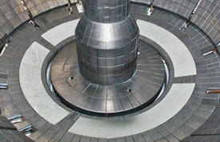
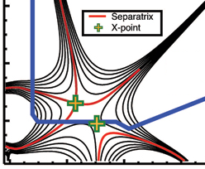
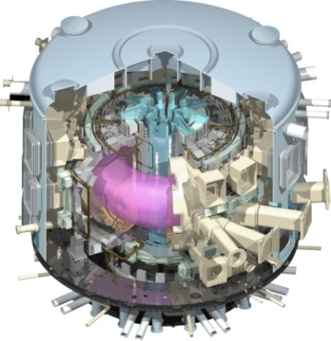
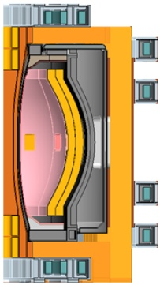
NSTX Upgrade mission elements
Advance ST as candidate for Fusion Nuclear Science Facility (FNSF)
Develop solutions for the plasma-material interface challenge
Explore unique ST parameter regimes to advance predictive capability - for ITER and beyond
Develop ST as fusion energy system
ST-FNSF
Lithium
“Snowflake”
ITER
ST Pilot Plant

Slide 4
FY13-15 planned research supports
5 highest priority goals for NSTX-U 5 year plan:
Demonstrate stationary 100% non-inductive at performance that extrapolates to ≥ 1MW/m² neutron wall loading in FNSF
Access reduced ν* and high-β combined with ability to vary q & rotation to dramatically extend ST plasma understanding
Develop and understand non-inductive start-up/ramp-up
to project to ST-FNSF operation with small or no solenoid
4. Develop and utilize high-flux-expansion “snowflake” divertor
and radiative detachment for mitigating very high heat fluxes
5. Begin to assess high-Z PFCs + liquid lithium to develop high-duty-factor integrated PMI solution for SS-PMI, FNSF, beyond

Slide 5
Overview of FY2013 NSTX-U research activities
Finalizing NSTX-U 5 year plan for FY2014-2018
  Plan to be submitted this month, reviewed next month
  First 2-3 years: prepare for operation, explore new regimes
    High β + lower ν*, higher non-inductive w/ higher B_{T}, I_{P}, 2nd NBI
  Proposed long-term upgrades under consideration:
    Base: divertor cryo, ECH/EBW for start-up, off-midplane 3D coils
    Incremental: convert PFCs to high-Z, implement divertor Thomson
Collaborations supporting NSTX-U, ITER, FNSF
  DIII-D: Snowflake & NTM control, pedestal transport, operations
  MAST: AE* physics, micro-tearing/turbulence, EBW start-up
  EAST: Lithium and high-Z PFCs, long-pulse control, ICRF
  C-Mod: Pedestal structure/turbulence, high-Z PFC studies
  KSTAR: NTV physics, MHD equil/stability, plasma control
  LHD: 3D equilibrium, transport (J-K Park visiting professor)

Slide 6
Overview of FY2014-15 NSTX-U research activities
FY2014
  Transition off-site collaboration/researchers back to NSTX-U
  Finish data analysis, publications from NSTX, collaborations
  Prepare diagnostics, control system, analysis for NSTX-U ops
  Complete CD-4 for NSTX Upgrade Project
FY2015
  Initiate operation, carry out research program for NSTX-U
  Obtain first data at higher field, current, longer pulse:
    Re-establish sustained low l_{i} / high-κ operation above no-wall limit
    Study thermal confinement, pedestal structure, SOL widths
    Assess current-drive and fast-ion instabilities from new 2nd NBI
    Push toward full non-inductive operation, high current operation

Slide 7
FY2013-15 planned research supports
5 highest priority goals for NSTX-U 5 year plan:
Demonstrate stationary 100% non-inductive at performance that extrapolates to ≥ 1MW/m² neutron wall loading in FNSF
Access reduced ν* and high-β combined with ability to vary q & rotation to dramatically extend ST plasma understanding
Develop and understand non-inductive start-up/ramp-up
to project to ST-FNSF operation with small or no solenoid
4. Develop and utilize high-flux-expansion “snowflake” divertor
and radiative detachment for mitigating very high heat fluxes
5. Begin to assess high-Z PFCs + liquid lithium to develop high-duty-factor integrated PMI solution for SS-PMI, FNSF, beyond

Slide 8
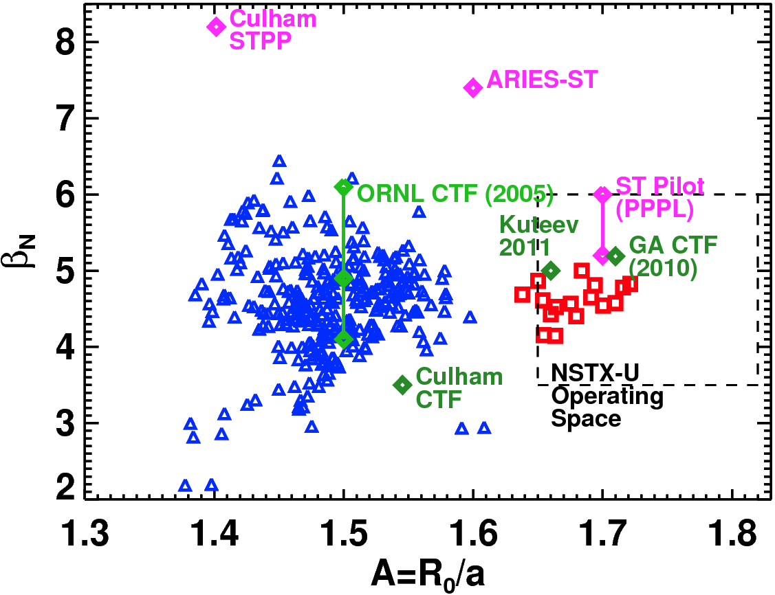
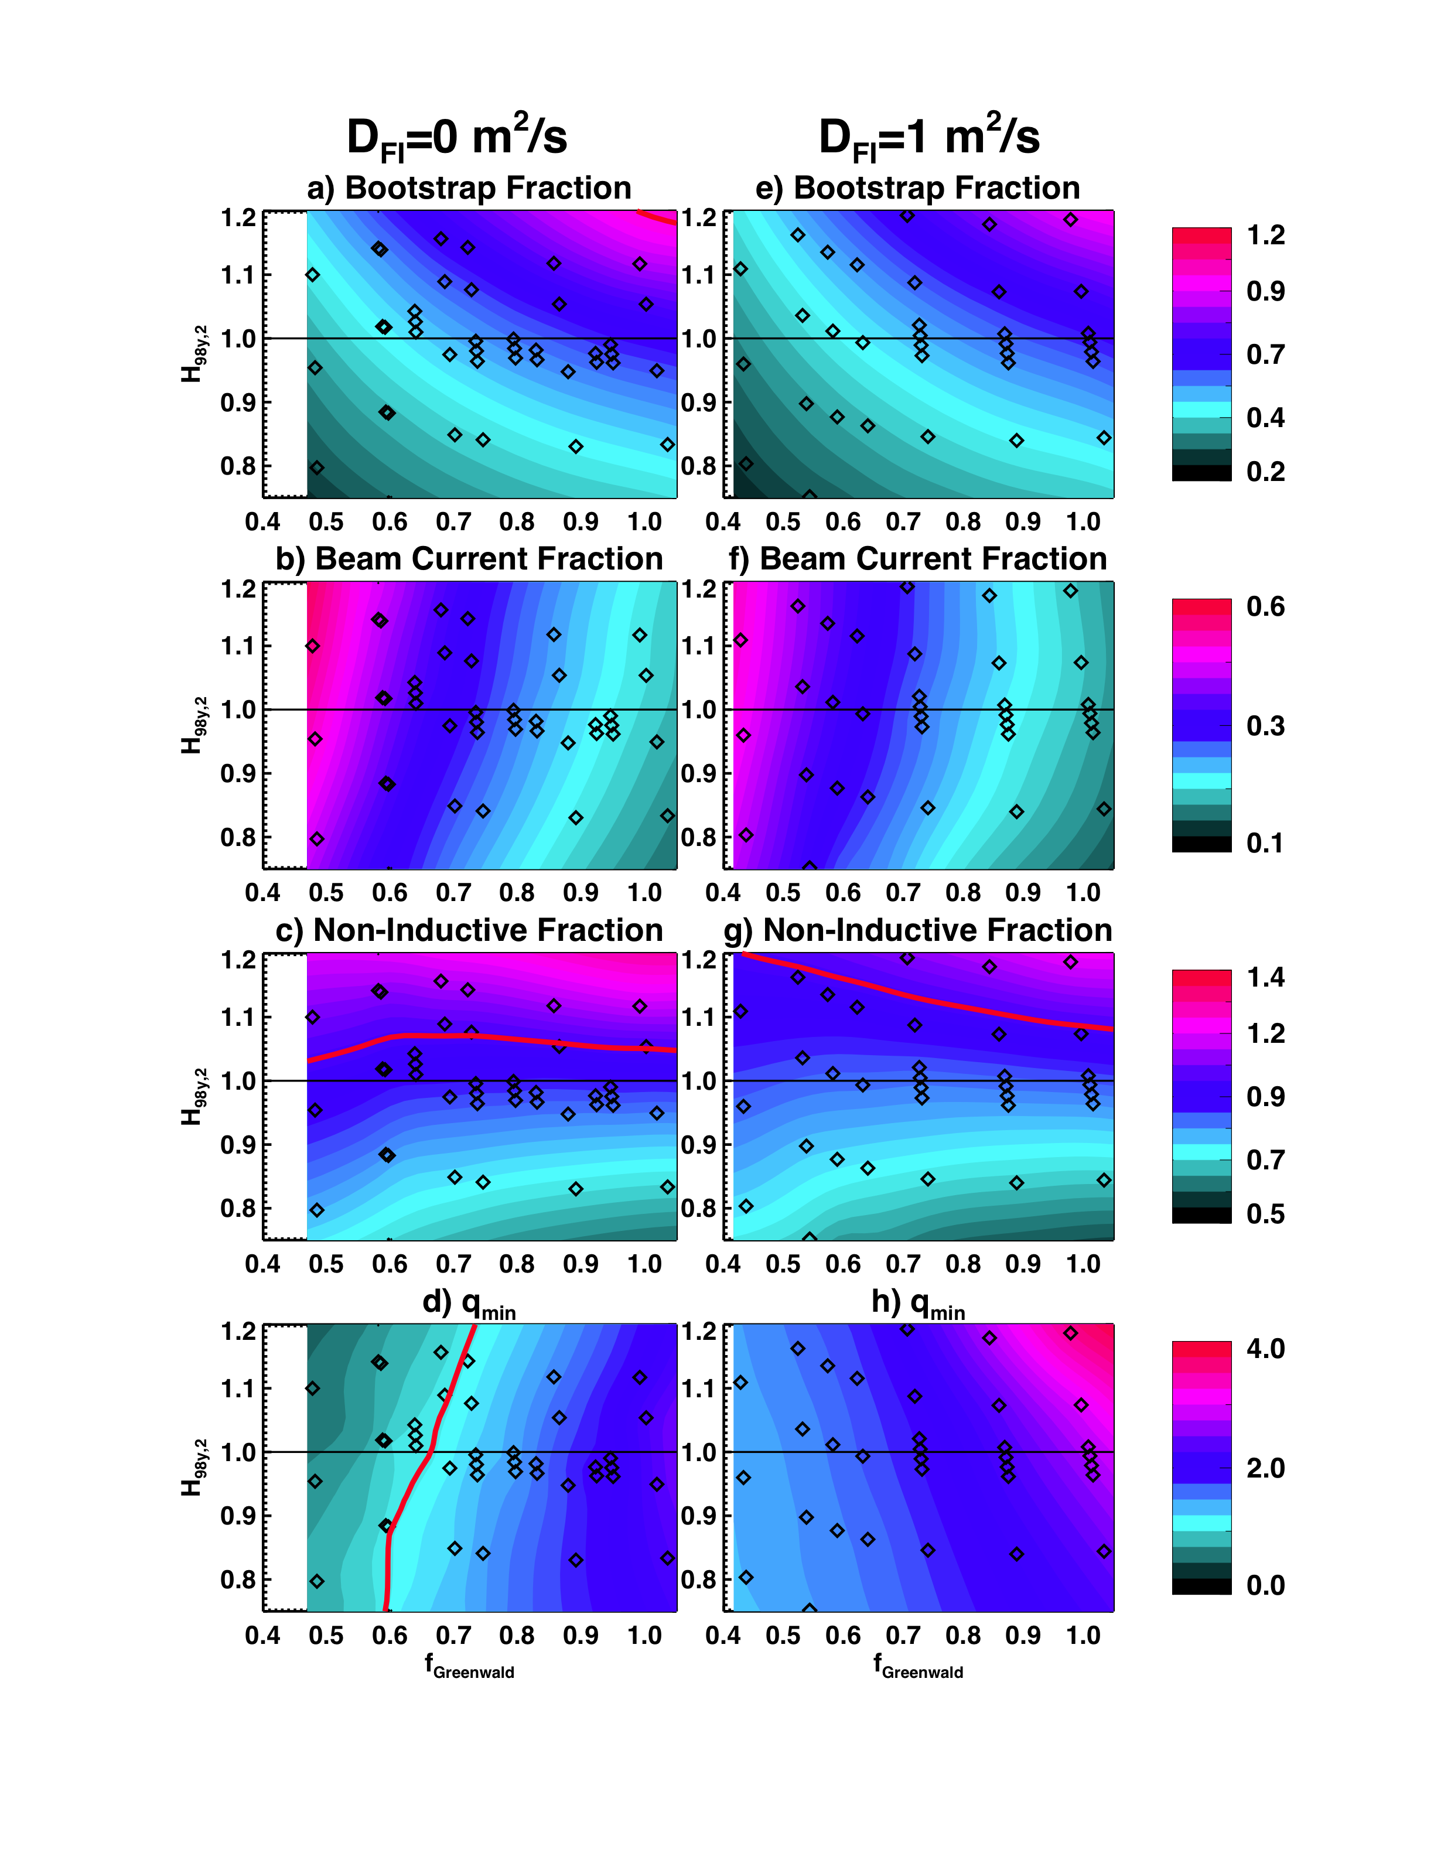
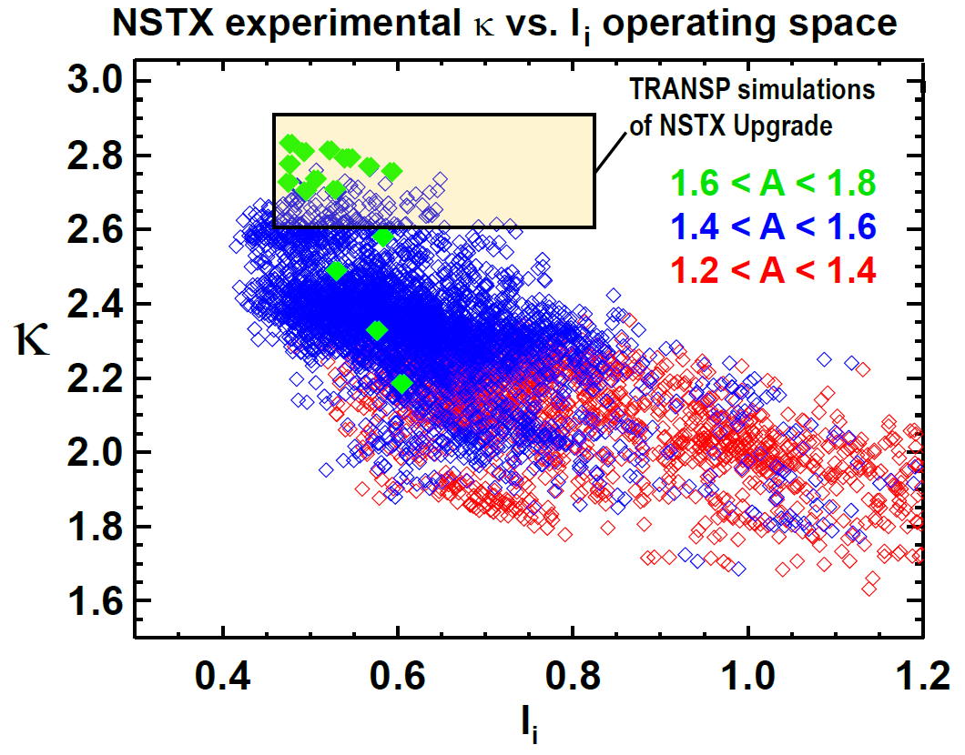
NSTX has already accessed A, β_{N}, κ needed for ST-based FNSF – next step is to access & control 100% non-inductive
NSTX-U TRANSP predictions:
B_{T}=1.0 T, I_{P}=1 MA, P_{inj}=12.6 MW
Contours of Non-Inductive Fraction
Contours of q_{min}

Slide 9
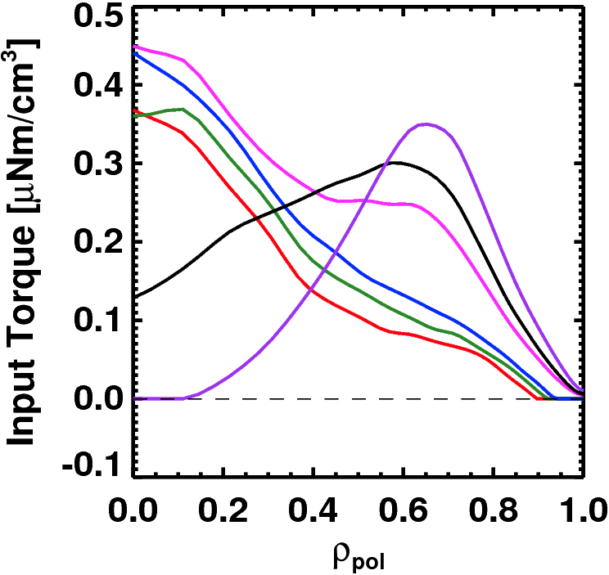
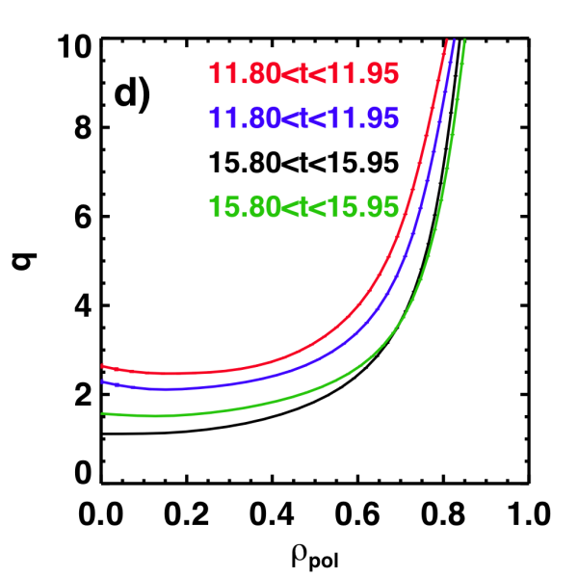
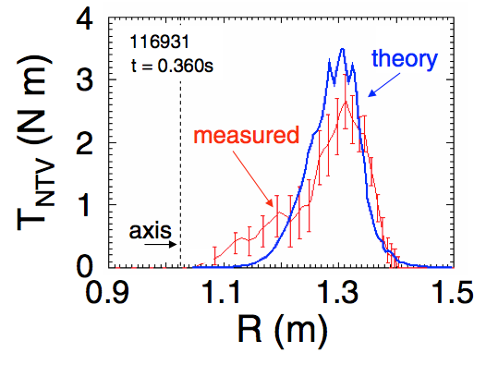
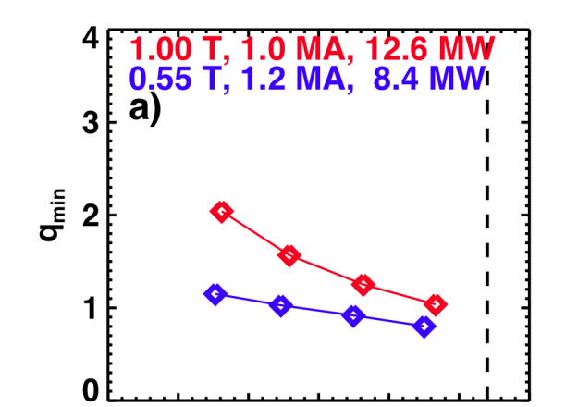
NSTX-U is developing a range of profile control actuators for detailed physics studies, scenario optimization for FNSF
Rotation Profile Actuators
q-Profile Actuators
Torque Profiles From 6 Different NB Sources
Variations in Beam Sources
800 kA Partial Inductive, 87% < f_{NI} < 100%
Largest R_{tan}
800 kA and 1 T
[50,60,70,130] cm
[50,60,120,130] cm
[60,70,110,120] cm
[70,110,120,130] cm
Neutral
Beams
(TRANSP)
Smallest R_{tan}
Measured and Calculated Torque Profiles from 3D Fields
Variations in Outer Gap
(n=3)
Zhu, et al., PRL
R14-3
27 22 17 12 7 2
Outer Gap

Slide 10
Advanced Scenarios and Control Research Plans for FY2013-15:
Develop advanced control algorithms, explore new NSTX-U scenarios
JRT-2013: “Evaluate stationary enhanced confinement regimes without large Edge Localized Modes (ELMs), and to improve understanding of the underlying physical mechanisms that allow increased edge particle transport while maintaining a strong thermal transport barrier” (Led by S. Gerhardt)
FY13-14: Develop and implement advanced control algorithms in preparation for NSTX-U operation
  Snowflake control on DIII-D (PPPL+LLNL+GA)
  J profile control using on/off-axis 2nd NBI (PPPL + Lehigh)
    Implement rt-MSE (Nova Photonics) in rt-EFIT for q-profile reconstruction
  Rotation control: 2nd NBI deposition flexibility + 3D fields/NTV
FY14-15: Re-establish NSTX-U control and plasma scenarios
FY15: Assess new 2nd NBI current-drive vs. R_{TAN}, n_{e}, outer gap
  Push toward 100% non-inductive operation at higher B_{T}, P_{NBI}
FY15: Explore scenarios (τ_{E}, l_{i}, MHD) at up to 60% higher I_{P}, B_{T}
R14-3
R15-3

Slide 11
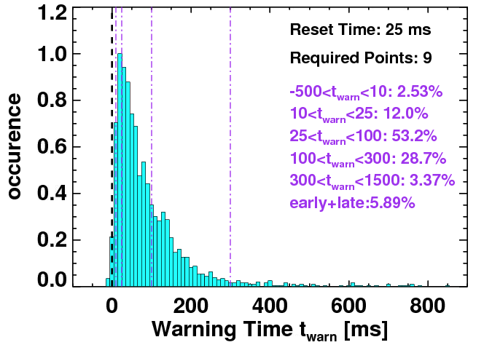
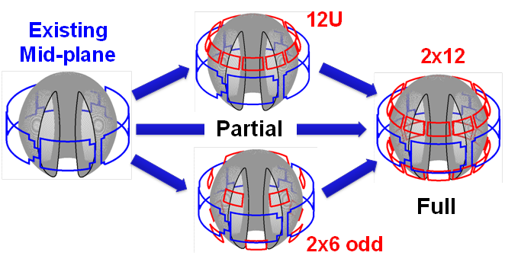
NSTX is making leading contributions to high-β_{N} & disruption warning research, assessing possible 3D coil upgrades
n=1 MHD spectroscopy: high β_{N} can be more stable → important for advanced scenarios
Resonant Field
Amplification (G/G)
Developing disruption warning algorithms
  Based on sensors + physics-based variables
  < 4% missed, 3% false positives
  ITER requires 95-98% prediction success
  Will assess applicability/extension to ITER through ITPA Joint Activity, and for ST-FNSF
Neutron emission
RWM growth
Model locking
V_{loop}, v_{φ}, τ_{E}
dZ/dt
f_{p}, l_{i}
Identified several off-midplane 3D coil sets favorable for profile, mode control
False positives

Slide 12
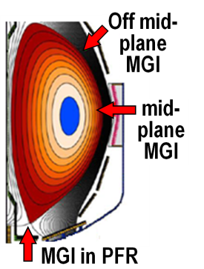
Macroscopic Stability Research Plans for FY2013-15:
Advance disruption warning and 3D coil design, re-establish high-β ops
FY13-14: Complete compilation of NSTX disruption database and precursor ID for disruption characterization and prediction
  Prepare real-time disruption warning algorithms for NSTX-U
FY13-14: Complete physics design of new Non-axisymmetric Control Coils (NCC) for RWM, TM, RMP, EFC, NTV/v_{φ} control
FY14: Understand/model low-density/ramp-up disruptions in NSTX in preparation for low ν* operation in NSTX-U scenarios
  Leverage DIII-D, KSTAR, MAST collaborations
R13-4
R14-1
FY15: Re-establish n=1-3 error-field correction, RWM control, minimize rotation damping, sustain operation above no-wall stability limit
FY15: Test poloidal dependence of Massive Gas Injection (outboard vs. private flux region)
  Longer-term goal: trigger mitigation via real-time warning

Slide 13
FY2013-15 planned research supports
5 highest priority goals for NSTX-U 5 year plan:
Demonstrate stationary 100% non-inductive at performance that extrapolates to ≥ 1MW/m² neutron wall loading in FNSF
Access reduced ν* and high-β combined with ability to vary q & rotation to dramatically extend ST plasma understanding
Develop and understand non-inductive start-up/ramp-up
to project to ST-FNSF operation with small or no solenoid
4. Develop and utilize high-flux-expansion “snowflake” divertor
and radiative detachment for mitigating very high heat fluxes
5. Begin to assess high-Z PFCs + liquid lithium to develop high-duty-factor integrated PMI solution for SS-PMI, FNSF, beyond

Slide 14
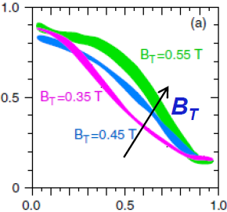
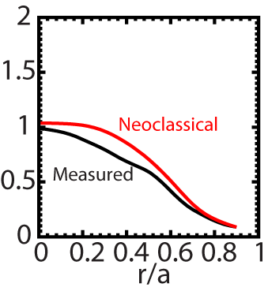
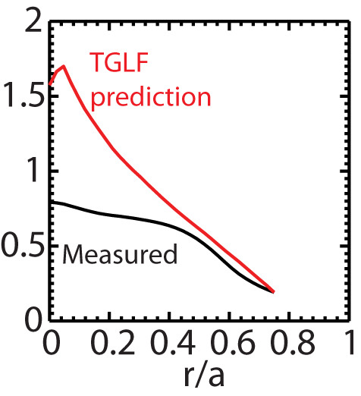
Beginning to test/utilize transport models to predict NSTX temperature profiles, identify possible missing physics
NSTX H-modes showed broadening of T_{e} profile as B_{T} was increased
  Similar broadening trend observed with increased lithium deposition
  B_{T}τ_{E} scales as ~1/ν* in both datasets
T_{e} (keV)
r/a
Utilizing neoclassical + drift wave models to simulate NSTX T_{i} and T_{e} profiles (collaboration with GA)
  Need model for pedestal χ
  Discrepancy in core T_{e} prediction for beam-heated H-modes
T_{i} (keV)
T_{e} (keV)
Over-prediction of core T_{e} in NSTX may be due to transport from GAE/CAE modes not included in gyro-Landau-fluid model

Slide 15
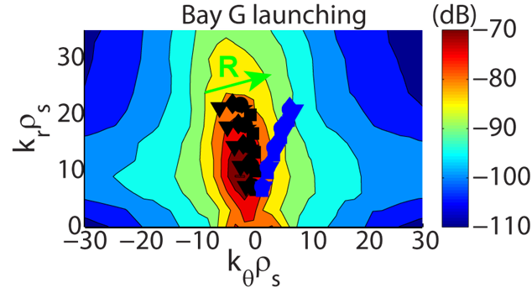
Transport and Turbulence Research Plans for FY2013-15:
Complete turbulence diagnostic design, obtain first τ_{E} data at higher B_{T}, I_{P}
FY13: Complete integrated physics and optical design of the new high-k FIR scattering system for ETG turbulence
  Measure k_{r} & k_{θ} to study turbulence anisotropy
R13-1
FY13-14: Investigate micro-tearing on MAST by varying relevant parameters (β, ν, Z_{eff}) and using BES diagnostics
FY13-15: Develop model χ_{e, AE} using measured CAE/GAE mode structures and ORBIT simulations (w/ EP group)
FY14-15: Develop and validate reduced transport models using ST data + linear and non-linear gyro-kinetic simulations
FY15: Extend ST confinement scalings and understanding with up to 60% increase in B_{T} and I_{P} (higher in later years)
  Measure low-k δn (BES w/ increased edge channel count), 1st polarimetry data
R15-1

Slide 16
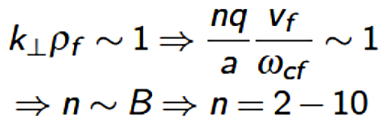
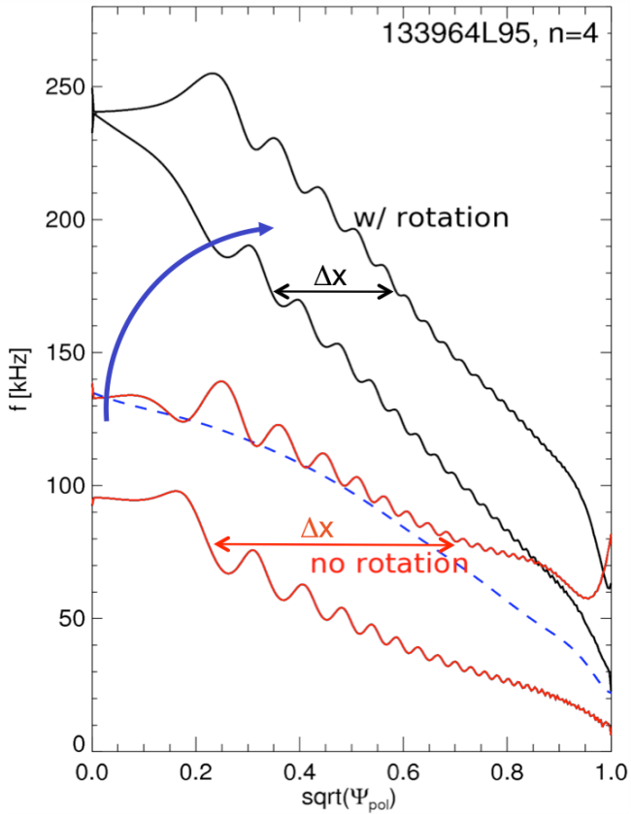
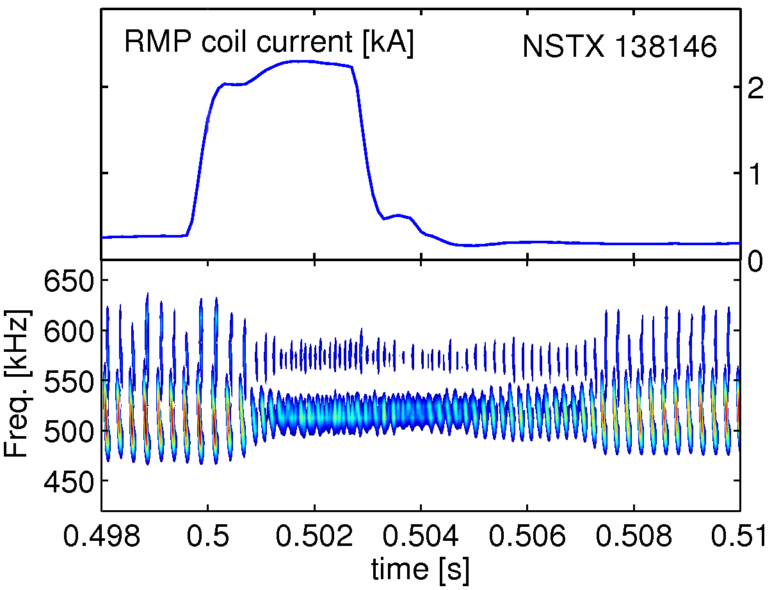
Developing improved energetic particle simulation tools and understanding utilizing NSTX data for NSTX-U, ITER, FNSF
Expect mode-number up-shift at higher B
  B will be up to 2x higher in NSTX-U vs. NSTX
  Broad spectrum possible from large v_{fast} / v_{Alfvén}
Plasma rotation & associated Doppler shift can significantly alter radial gap width
  NSTX-U rotation expected to be 2-4x higher
  Consistent treatment of rotation crucial for correct computation of both drive and damping
    Implementing rotation effects in NOVA-K
Many competing influences on AE stability:
  Destabilizing effects: higher β_{fast}, more tangential injection and resonance with passing ions
  Stabilizing: Large R_{TAN} → broader fast-ion density
  3D fields: direct transport, also thru rotation profile
GAE activity

Slide 17
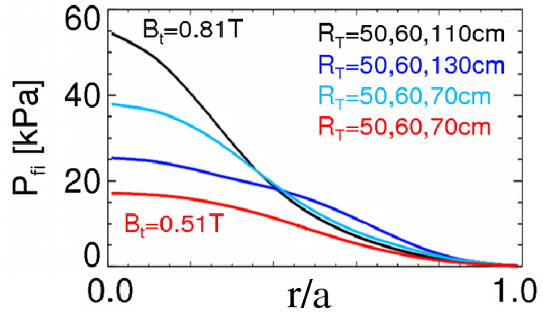
Energetic Particle Physics Research Plans for FY2013-15:
Develop full + reduced models of fast-ion x-port, characterize new 2nd NBI
FY13: Collaborate with MAST and DIII-D on AE experiments to provide data for reduced fast-ion transport models
FY13-14: Develop reduced model for AE-induced fast ion losses – needed for NBICD in STs/ATs/ITER
FY13-14: Contribute to development of reduced model of electron thermal transport from CAE/GAE
FY14: Finalize design/implementation of prototype AE antenna and of upgraded ssNPA diagnostic
R14-2
FY15: Measure fast-ion (FI) density profiles, confinement, current drive, AE stability with new 2nd NBI
R15-2

Slide 18
FY2013-15 planned research supports
5 highest priority goals for NSTX-U 5 year plan:
Demonstrate stationary 100% non-inductive at performance that extrapolates to ≥ 1MW/m² neutron wall loading in FNSF
Access reduced ν* and high-β combined with ability to vary q & rotation to dramatically extend ST plasma understanding
Develop and understand non-inductive start-up/ramp-up
to project to ST-FNSF operation with small or no solenoid
4. Develop and utilize high-flux-expansion “snowflake” divertor
and radiative detachment for mitigating very high heat fluxes
5. Begin to assess high-Z PFCs + liquid lithium to develop high-duty-factor integrated PMI solution for SS-PMI, FNSF, beyond

Slide 19
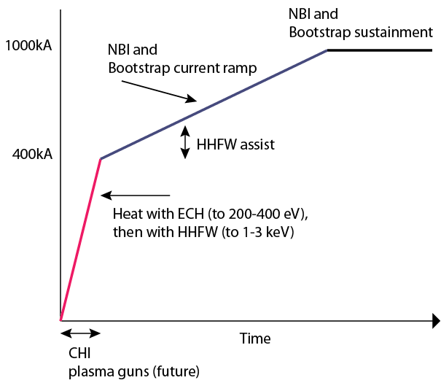
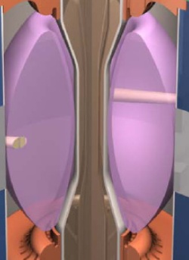
Plasma initiation with small or no transformer is unique challenge for ST-based Fusion Nuclear Science Facility
NSTX-U Non-Inductive Strategy:
ST-FNSF has no/small central solenoid
NSTX-U 5 year plan goal:
  Generate ~0.4MA closed-flux start-up current with helicity injection
  Heat CHI with ECH and/or fast wave, ramp 0.4MA to 0.8-1MA with NBI

Slide 20

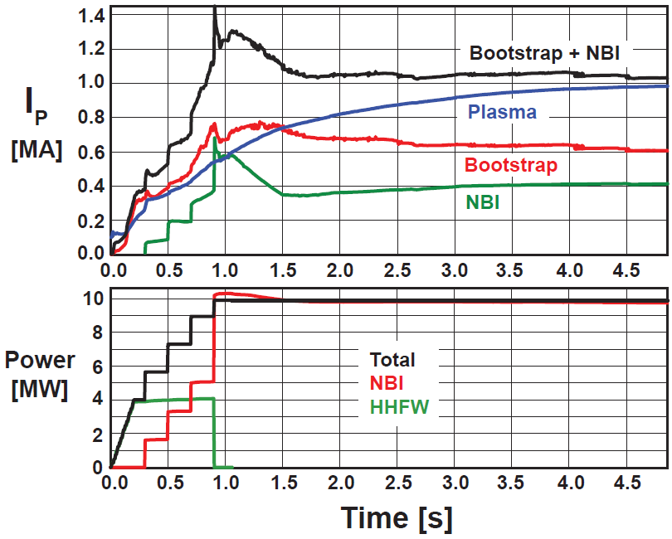
Simulations support non-inductive start-up/ramp-up strategy
TSC code successfully simulates CHI I_{P} ~200kA achieved in NSTX
TRANSP: NSTX-U more tangential NBI → 3-4x higher CD at low I_{P} (0.4MA)
  1.5-2x higher CD efficiency, 2x higher absorption
TSC: non-inductive ramp-up from 0.4MA to 1MA possible w/ BS + NBI
1.0 ms
1.6 ms
2.7 ms
2
1
Z (m)
0
-1
-2
0
1
2
0
1
2
0
1
2
R (m)
R (m)
R (m)
TSC + tools included in 5 year plan support CHI I_{P} → 400kA in NSTX-U
  2.5 x higher injector flux (scales with I_{P})
  Higher B_{T} = 1T (increases current multiplication)
  > 2kV CHI voltage (increases flux injection)
  1MW 28GHz ECH (increases T_{e})
But, RF heating (ECH and/or HHFW) of CHI likely required to couple to NBI

Slide 21
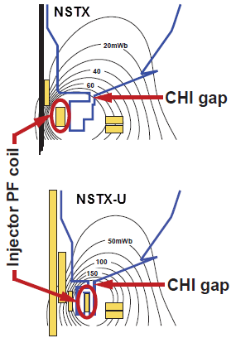
Solenoid-Free Start-up and Ramp-up Research Plans for FY2013-15:
Simulate CHI start-up/ramp-up, prepare CHI for NSTX-U
FY13: Model CHI start-up → ECH+HHFW+NBI ramp-up scenarios using the NSTX-U vessel + coil geometry
  Extend TSC simulations to include time-evolving TRANSP NBI current-drive and coupling/ramp-up of low-I_{P} plasmas
FY13-14: Complete design of upgraded capacitor bank and diagnostics for NSTX-U, implement CHI gap tiles
FY13-14: Finish CHI design study for QUEST, possibly implement CHI
FY15: Establish NSTX-U CHI, assess impact of new injector, gap, higher B_{T}
FY15: First tests of NBI ramp-up using new 2nd NBI
IR15-2

Slide 22
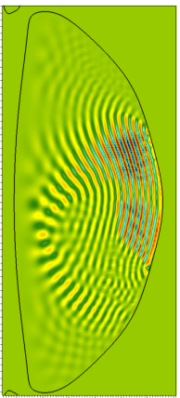
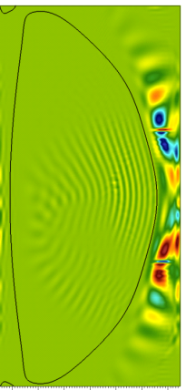
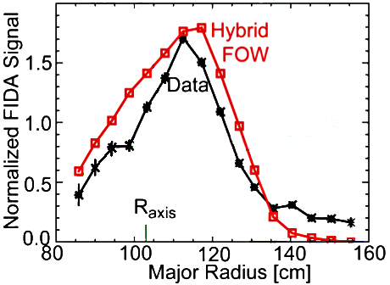
Developing and validating advanced fast-wave simulations supporting NSTX-U non-inductive start-up and ITER ICRF
AORSA simulations for NSTX-U:
  Edge power losses often observed in NSTX
  SOL profiles and antenna model can strongly influence edge wave-fields & power deposition
  40-50% of FW power predicted to be absorbed by thermal & fast ions for antenna using heating phasing (k_{φ} = 13 m⁻¹)
CQL3D Fokker-Planck simulations:
  Full-orbit “Hybrid” finite orbit width version of
  code now shows good agreement with NSTX fast ion diagnostic (FIDA) data
  Future: simulate and interpret NSTX-U data
At full field, NSTX-U will operate in an ion-cyclotron-harmonic regime similar to ITER ½-field pre-activation phase
Without SOL
With SOL
1
1
Z
0
0
[m]
-
1
-
1
0.4 1.6
0.4 1.6
R [m]
R [m]
AORSA Re(E||) simulations for 30 MHz FW
n_{φ} = 12 heating in NSTX-U w/ B_{T}(0) = 1T
NSTX NBI +
HHFW

Slide 23
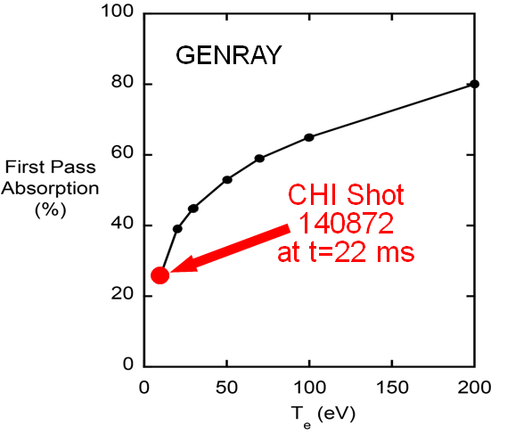
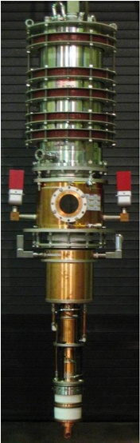
Wave Physics Research Plans for FY2013-15:
Prepare ECH/EBW design, simulate & develop reliable FW H-mode
FY13: Extend HHFW coupling / heating calculations to higher I_{P}, B_{T} NSTX-U equilibria – emphasis on fast-ion interactions
FY13: Collaborate with MAST on EBW start-up
FY13-14: Complete physics design of 1MW/28GHz ECH/EBW system for NSTX-U. Design goals:
  ECH to heat CHI plasma to form target for HHFW/NBI+BS I_{P} ramp-up
  EBW H&CD for start-up, sustainment
R13-3
FY14: Collaborate on EAST to develop/guide reliable ICRF-heated H-mode scenarios for NSTX-U, ITER
FY15: Assess, optimize HHFW coupling and heating at higher B_{T} and I_{P} and support low-I_{P} heating for non-inductive ramp-up
IR15-2

Slide 24
FY2013-15 planned research supports
5 highest priority goals for NSTX-U 5 year plan:
Demonstrate stationary 100% non-inductive at performance that extrapolates to ≥ 1MW/m² neutron wall loading in FNSF
Access reduced ν* and high-β combined with ability to vary q & rotation to dramatically extend ST plasma understanding
Develop and understand non-inductive start-up/ramp-up
to project to ST-FNSF operation with small or no solenoid
4. Develop and utilize high-flux-expansion “snowflake” divertor
and radiative detachment for mitigating very high heat fluxes
5. Begin to assess high-Z PFCs + liquid lithium to develop high-duty-factor integrated PMI solution for SS-PMI, FNSF, beyond

Slide 25
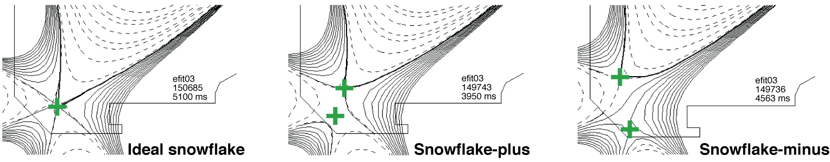
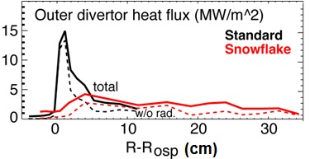
Snowflake divertor results + simulations project to favorable particle and power exhaust control in NSTX-U, next-steps
Snowflake on DIII-D (GA+LLNL+PPPL collaboration) extended 2-3x reduction in q_{peak} to 3s duration
NSTX-U divertor cryo projections: f_{G} ≤ 0.5 for wide range of I_{P} (λ_{SOL})
  Standard/snowflake: 0.6/0.7 to 1.5/2MA
  Maintain q_{peak} ≤ 10MW/m²
Multi-fluid edge transport model (UEDGE) predicts factor of ~5 reduction in NSTX-U peak heat flux
  Geometry + impurity radiation (4% C)

Slide 26
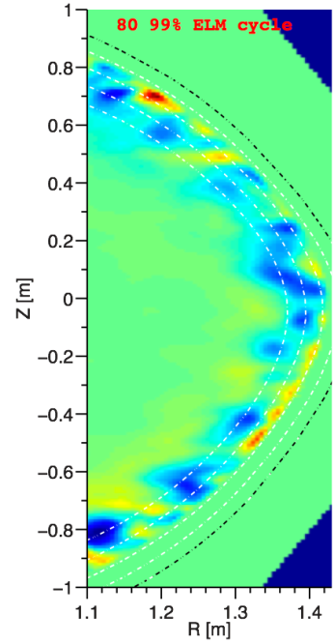
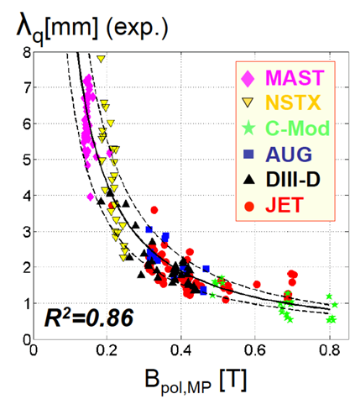
Boundary Physics Research Plans for FY2013-15:
Advance snowflake, cryo, pedestal, SOL studies, extend to higher B_{T}, I_{P}
FY13: Complete modeling of synergy of snowflake with detachment in NSTX and NSTX-U, extend to FNSF
FY13-14: Complete NSTX-U cryo-pump physics design, integrate w/ detached snowflake
FY13-14: Continue/complete collaborations on pedestal and SOL transport (DIII-D, C-Mod) to improve edge predictive capability
  NSTX: Measured ion-scale correlation lengths at pedestal top consistent with XGC1 predictions
    Low-k turbulence consistent with ITG and/or KBM
  XGC0 and 1 also being utilized to understand L→H threshold, QH-mode edge transport in DIII-D
139047
FY15: Measure pedestal structure, SOL width, ELM types, snowflake performance at up to 60% higher current, field, 2× higher P_{NBI}
R15-1 IR15-1

Slide 27
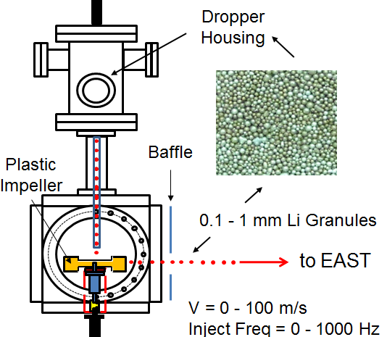
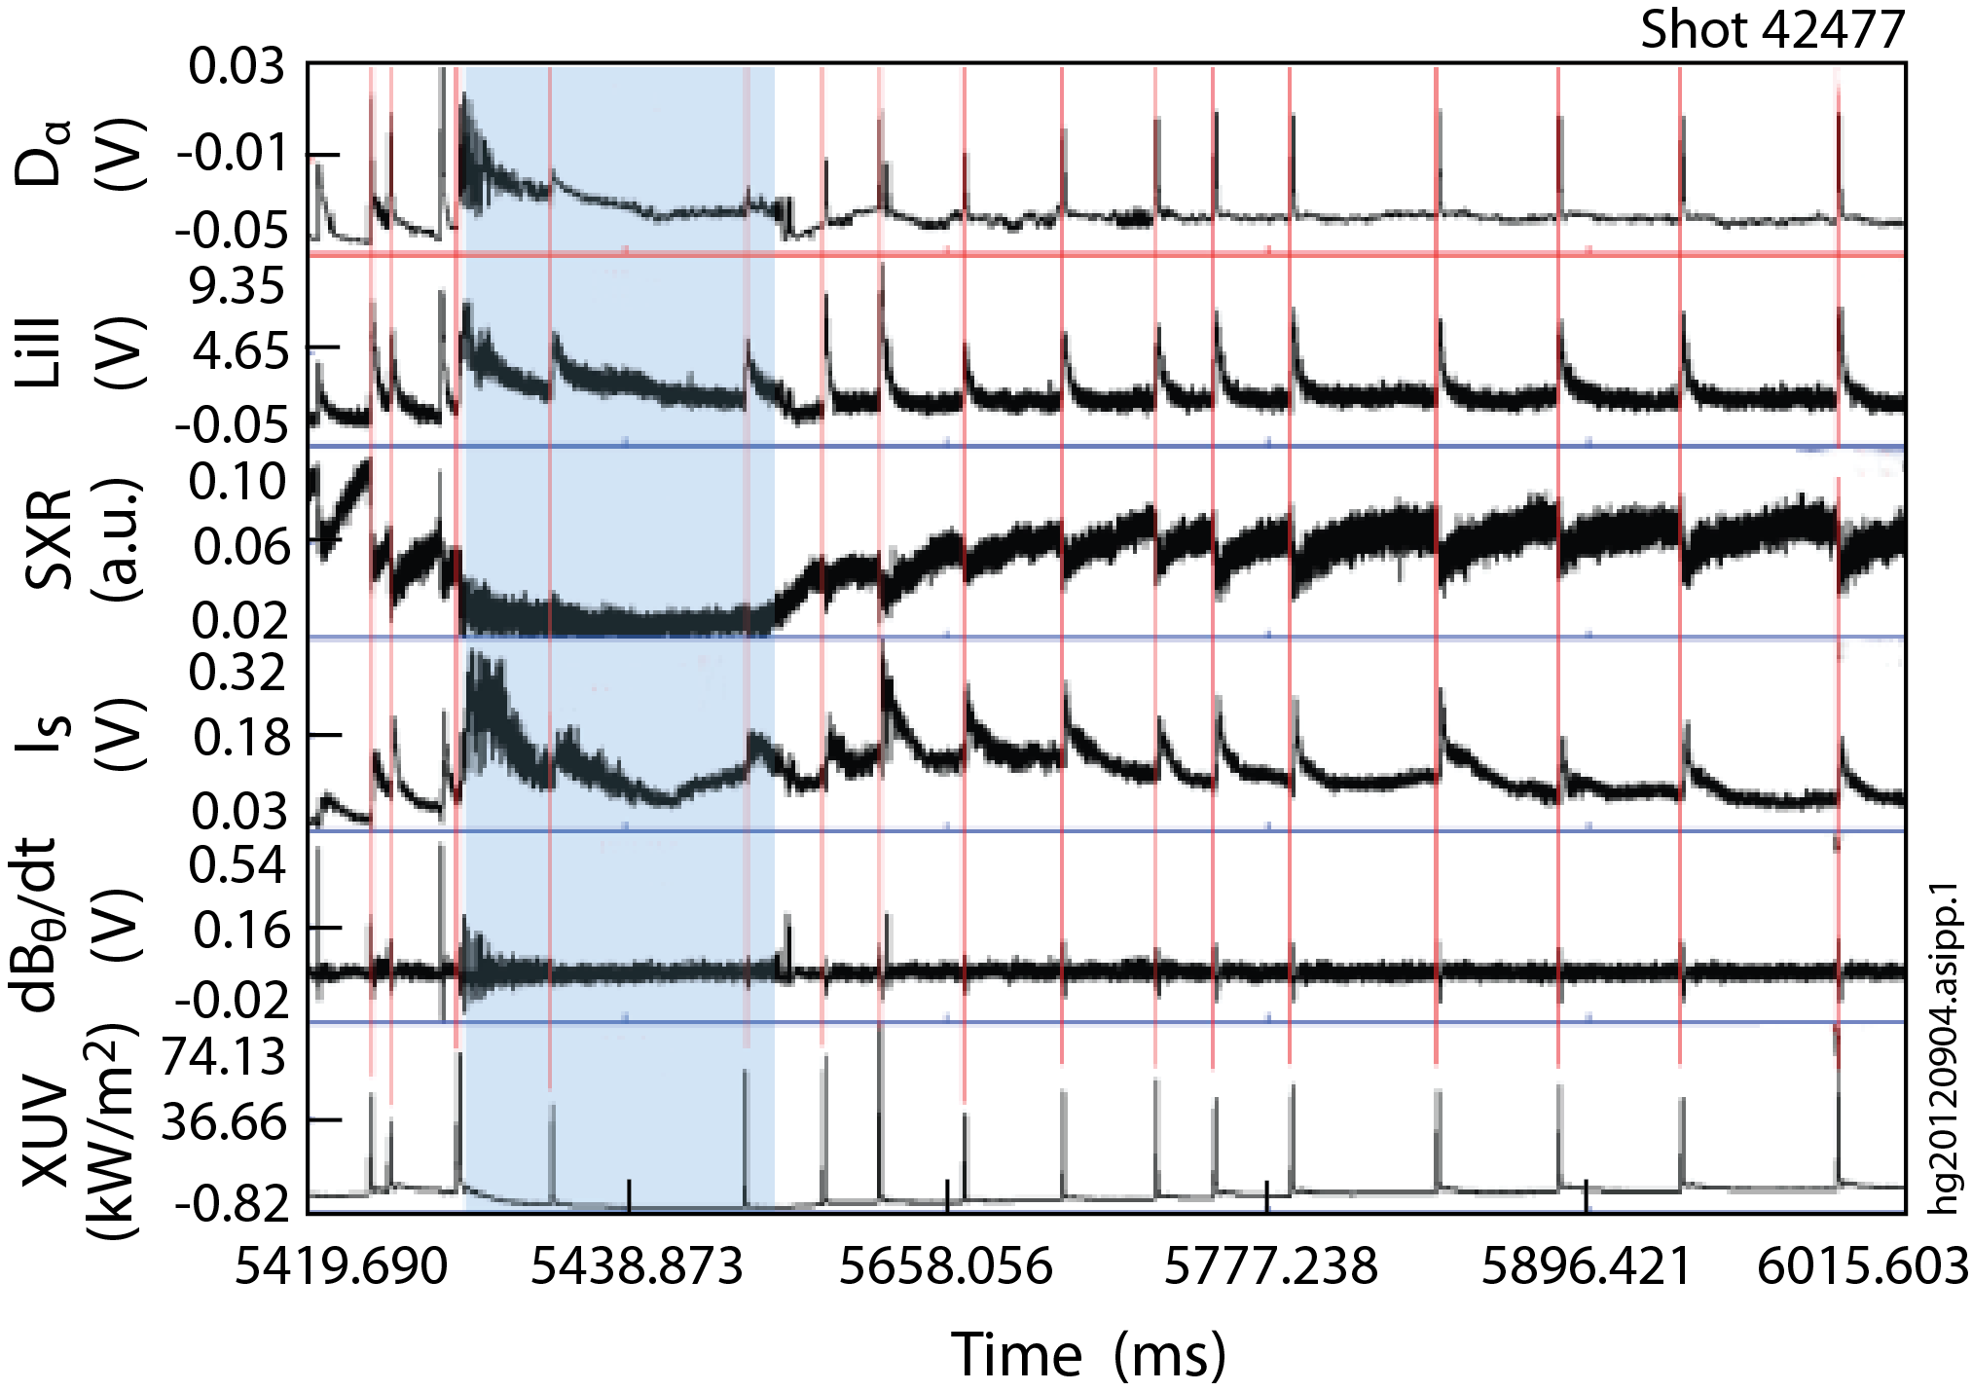
Lithium Granule Injector (LGI) is promising tool for pedestal/ELM control and scenario optimization
Successful EAST collaboration
  Demonstrated LGI ELM-pacing at 25 Hz with nearly 100% triggering reliability
  Capable of up to 1 kHz injection
LGI will be tested on NSTX-U for high-frequency ELM pacing
  Possible density control technique:
    Combine Li coatings for D pumping with LGI for ELM-expulsion of carbon
  Goal: reduce Z_{eff} to ~2-2.5
  Injection of Li granules could also potentially replenish PFC Li coatings
JET/ITER: potentially interested in testing Be granules for ELM pacing
EAST data

Slide 28
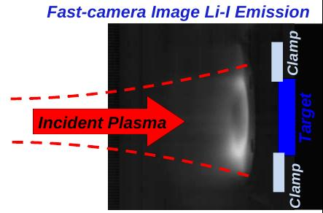
Materials and Plasma Facing Components Plans for FY2013-15:
Advance Li understanding/technology, support NSTX-U wall conditioning
FY13: Study Li-conditioned surface composition and plasma behavior using Materials Analysis and Particle Probe (MAPP – Purdue collaboration) on LTX in-prep for NSTX-U
FY13-14: Develop Li-coating tools for upper PFCs of NSTX-U to increase Li coverage of C, D pumping, thermal confinement
FY14: EAST collaboration: assess particle/impurity control w/ triggered ELMs, cryo-pumping, lithiumization, high-Z PFCs
FY15: Test LGI, Li coating dependence/evolution in NSTX-U
R13-2
FY13-15: Lab-based R&D for advanced Li PFCs
  Study Li on metal substrates, response to plasma power and particle fluxes (MAGNUM-PSI)
  High-heat-flux high-Z PFC design (TZM or W lamellae)
  Flowing Li loop tests
  Develop capillary-restrained gas-cooled Li PFC

Slide 29
Outline
NSTX-U mission
FY13-15 research overview and plans
Milestone summary
ITPA contributions
ST-FNSF mission and configuration study
Summary

Slide 30
Administration FY13 request-level funding would greatly limit run-time in FY15, and limit field and current near NSTX levels
FY2013
FY2014
FY2015
Expt. Run Weeks:
0
0
0-6
Macroscopic Stability
R14-1
Assess access to reduced density
and ν* in high-performance scenarios (with ASC, BP TSGs)
Transport and Turbulence
R13-1
Perform integrated physics+optical design of new high-k_{θ} FIR system
R15-1
Assess H-mode τ_{E}, pedestal, SOL characteristics at higher B_{T}, I_{P}, P_{NBI} (with BP, M&P, ASC, WEP TSGs)
Boundary
Physics
MG weld repair likely required to access B_{T} and I_{P} significantly above NSTX levels
R13-2
Materials & PFCs
Assess relationship between lithium-conditioned surface composition and plasma behavior
R14-2
R15-2
Waves+Energetic Particles
Perform physics design of ECH & EBW system for plasma start-up & current drive in advanced scenarios
Assess reduced models for *AE mode-induced fast-ion transport
Assess effects of NBI injection on fast-ion f(v) and NBI-CD profile (with SFSU, MS, ASC TSGs)
Solenoid-free Start-up/ramp-up
R13-3
R14-3
Adv. Scenarios and Control
Assess advanced control techniques for sustained high performance (with MS, BP TSGs)
R15-3
Develop physics+operational tools for high-performance discharges (with CC, ASC, MS, BP, M&P TSGs)
R13-4
ITER Needs + Cross-cutting
Identify disruption precursors and disruption mitigation & avoidance techniques for NSTX-U and ITER
Joint Research Target
Stationary regimes w/o large ELMs, improve understanding of increased edge particle transport
Quantify plasma response to non-axisymmetric (3D) magnetic fields in tokamaks
TBD

Slide 31
+15% above Administration FY13 request-level provides run-time and field + current to exploit new Upgrade capabilities
FY2013
FY2014
FY2015
Expt. Run Weeks:
0
0
16
Macroscopic Stability
R14-1
Assess access to reduced density
and ν* in high-performance scenarios (with ASC, BP TSGs)
Transport and Turbulence
R13-1
Perform integrated physics+optical design of new high-k_{θ} FIR system
R15-1
Assess H-mode τ_{E}, pedestal, SOL characteristics at higher B_{T}, I_{P}, P_{NBI} (with BP, M&P, ASC, WEP TSGs)
Boundary
Physics
R13-2
Materials & PFCs
Assess relationship between lithium-conditioned surface composition and plasma behavior
R14-2
R15-2
Waves+Energetic Particles
Perform physics design of ECH & EBW system for plasma start-up & current drive in advanced scenarios
Assess reduced models for *AE mode-induced fast-ion transport
Assess effects of NBI injection on fast-ion f(v) and NBI-CD profile (with SFSU, MS, ASC TSGs)
Solenoid-free Start-up/ramp-up
R13-3
R14-3
Adv. Scenarios and Control
Assess advanced control techniques for sustained high performance (with MS, BP TSGs)
R15-3
Develop physics+operational tools for high-performance discharges (with CC, ASC, MS, BP, M&P TSGs)
R13-4
ITER Needs + Cross-cutting
Identify disruption precursors and disruption mitigation & avoidance techniques for NSTX-U and ITER
Joint Research Target
Stationary regimes w/o large ELMs, improve understanding of increased edge particle transport
Quantify plasma response to non-axisymmetric (3D) magnetic fields in tokamaks
TBD

Slide 32
accelerates snowflake + start-up/ramp-up research for FNSF, fully utilizes facility during 1st year of ops
Full operation case
FY2013
FY2014
FY2015
Expt. Run Weeks:
0
0
14
20
Macroscopic Stability
R14-1
Assess access to reduced density
and ν* in high-performance scenarios (with ASC, BP TSGs)
Transport and Turbulence
R13-1
Perform integrated physics+optical design of new high-k_{θ} FIR system
R15-1
Assess H-mode τ_{E}, pedestal, SOL characteristics at higher B_{T}, I_{P}, P_{NBI} (with BP, M&P, ASC, WEP TSGs)
Boundary
Physics
Develop snowflake configuration, study edge and divertor properties
(with ASC, TT, MP)
R13-2
Materials & PFCs
Assess relationship between lithium-conditioned surface composition and plasma behavior
IR15-1
R14-2
R15-2
Waves+Energetic Particles
Perform physics design of ECH & EBW system for plasma start-up & current drive in advanced scenarios
Assess reduced models for *AE mode-induced fast-ion transport
Assess effects of NBI injection on fast-ion f(v) and NBI-CD profile (with SFSU, MS, ASC TSGs)
Solenoid-free Start-up/ramp-up
R13-3
Assess CHI & low-I_{P} FW heating at higher B_{T}, test NBI+BS I_{P} ramp-up (with WEP, ASC TSGs)
R14-3
IR15-2
Adv. Scenarios and Control
Assess advanced control techniques for sustained high performance (with MS, BP TSGs)
R15-3
Develop physics+operational tools for high-performance discharges (with CC, ASC, MS, BP, M&P TSGs)
R13-4
ITER Needs + Cross-cutting
Identify disruption precursors and disruption mitigation & avoidance techniques for NSTX-U and ITER
Joint Research Target
Stationary regimes w/o large ELMs, improve understanding of increased edge particle transport
Quantify plasma response to non-axisymmetric (3D) magnetic fields in tokamaks
TBD

Slide 33
Outline
NSTX-U mission
FY13-15 research overview and plans
Milestone summary
ITPA contributions
ST-FNSF mission and configuration study
Summary

Slide 34
NSTX-U team continuing to strongly support ITER through participation in ITPA joint experiments and activities
Pedestal/Edge Physics and DIVSOL
DSOL-24 | Disruption heat loads | PEP-27 | Pedestal profile evolution following L-H/H-L transition
PEP-6 | Pedestal structure and ELM stability in DN | PEP-29 | Vertical jolts/kicks for ELM triggering and control
PEP-19 | Basic mechanisms of edge transport with RMP | PEP-34 | ELM energy losses and their dimensionless scaling
Energetic Particles
EP-2 | Fast ion losses and redistribution from localized Aes | EP-6 | Fast ion losses and associated heat loads from edge perturbations
Integrated Operating Scenarios
IOS-3.2 | Define access conditions to get to SS sceanrio | IOS-4.3 | Collisionality scaling of confinement in advanced inductive regime
IOS-4.1 | Access conditions for advanced inductive scenario | IOS-5.2 | Maintaining ICRH coupling in expected ITER regime
MHD
MDC-2 | Joint experiments on resistive wall mode physics | MDC-17 | Active disruption avoidance
MDC-8 | Current drive prevention/stabilization of NTMs | MDC-18 | Evaluation of axisymmetric control aspects
MDC-15 | Disruption database development
Transport and Confinement
TC-9 | Scaling of intrinsic rotation with no external momentum input | TC-15 | Dependence of momentum and particle pinch on collisionality
TC-10 | Exptl id of ITG, TEM and ETG turbulence and comparison with codes | TC-17 | ρ∗ scaling of the edge intrinsic torque
TC-11 | He and impurity profiles and transport coefficients | TC-24 | Impact of RMP on transport and confinement
TC-12 | H-mode transport and confinement at low aspect ratio

Slide 35
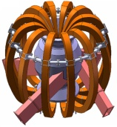
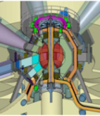
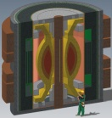
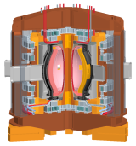
NSTX/ST researchers contributing to LDRD-funded study of Mission and Configuration of an ST-FNSF
Overarching goal of study:
  Determine optimal mission, performance, size
Goals of study:
  Review existing designs, ID advantageous features, improve configuration
  Key considerations for configuration:
    T self-sufficiency
    Maintainability, upgradeability, overall flexibility
    Key components: coils, divertors, shields, blankets, ports
  Develop self-consistent assessment + configuration for use by community
FY2013 progress:
  Developing/comparing configurations with range of sizes: R=2.2, 1.6, 1.0m
  Assessing impact of different divertors: conventional, snowflake, super-X
  May be minimum device size required (R~1.5-1.6m) for TBR > 1 with DCLL
    Preliminary: breeding in divertor and/or centerstack first-wall/shield may be required
Russia
Culham
UT Austin
ORNL
PPPL

Slide 36
Summary: NSTX-U FY2013-15 research plan strongly supports FES 10-year vision elements
ITER research
  Leading contributions to non-linear AE* dynamics, fast-ion transport, disruption warning, response to 3D δB, RWM control
Control science, plasma-wall interactions, FNSF
  Prepare NSTX-U to extend high-β + high-non-inductive scenarios to full non-inductive operation with advanced control
  Provide critical data on SOL-widths and turbulence, novel snowflake divertors, Li-based PFCs – all for high power density
  NSTX + Upgrade will provide critical confinement, stability, and sustainment data for assessing ST as potential FNSF
Validated predictive capability
  Will access new & unique high-β + low-ν* regime, exploit wide variation of rotation, q, fast-ion drive to test leading models
Incremental funding needed to fully utilize NSTX-U capabilities during FY15

Slide 37
Backup Slides

Slide 38
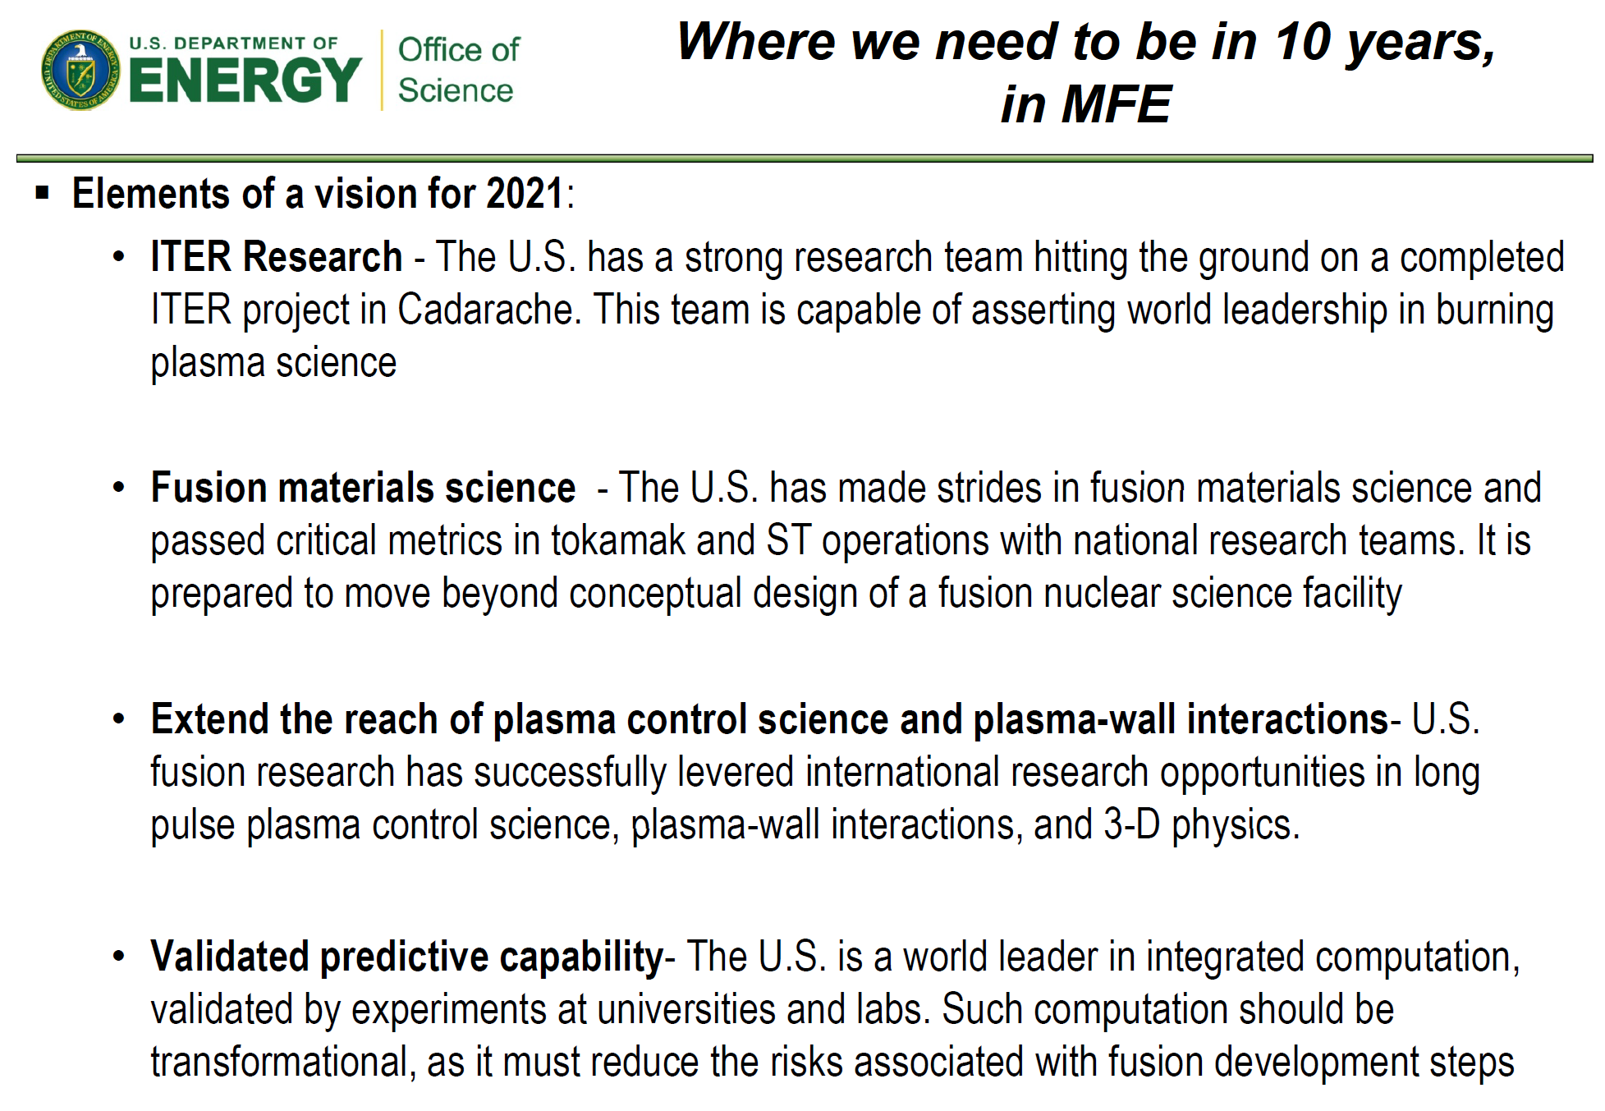
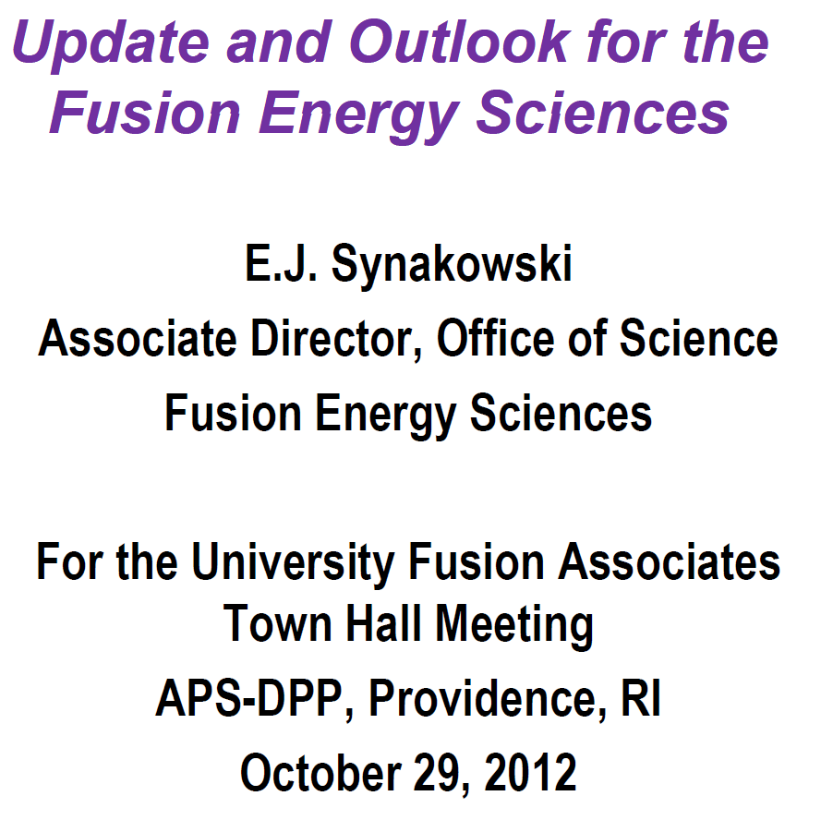
FES 10 year vision elements for U.S. fusion research
38

Slide 39
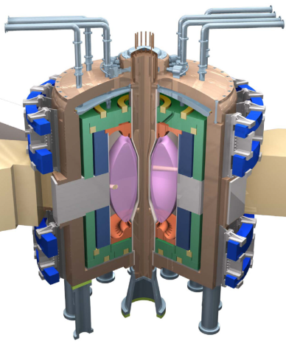
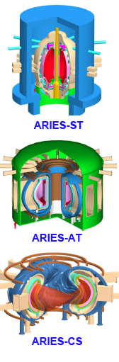
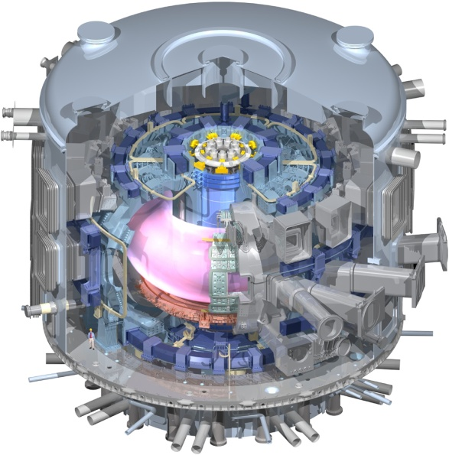
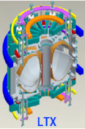
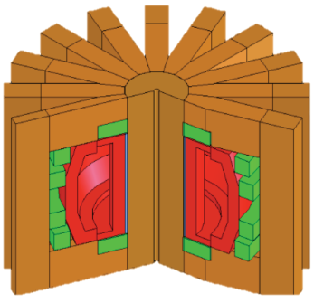
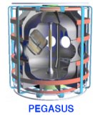







STs and planned NSTX-U program support and accelerate wide range of development paths toward fusion energy
Extend Predictive Capability
  Non-linear Alfvén modes, fast-ion dynamics
  Electron gyro-scale turbulence at low ν*
  High β, rotation, shaping, for MHD, transport
Burning Plasma Physics - ITER
Fusion Nuclear Science Facility
Pilot Plant or DEMO
FNSF-ST
LTX
ARIES-ST
PEGASUS
NSTX-U
STs Narrow Gaps to Pilot/DEMO:
FNSF-AT
Goal: 100% non-inductive + high β
Plasma-Material Interface Research
  Strong heating + smaller R → high P/R, P/S
  Novel solutions: snowflake, liquid metals, Super-X (MAST-U), hot high-Z walls (QUEST)
Steady-State, Plasma-Material Interface R&D
ARIES-AT
Fusion Nuclear Science Facility
  High neutron wall loading
  Potentially smaller size, cost
  Smaller T consumption
  Accessible / maintainable
EAST
JT-60SA
NHTX
VULCAN
ARIES-CS
KSTAR
W7-X, LHD
QUASAR

Slide 40




NSTX Upgrade will address critical plasma confinement and sustainment questions by exploiting 2 new capabilities
Previous
center-stack
New
center-stack
ST-FNSF
constant q, β, ρ∗
2x higher B_{T} and I_{P} increases T, reduces ν* toward ST-FNSF to better understand confinement
  Provides 5x longer pulses for profile equilibration, NBI ramp-up
NSTX Upgrade
?
ITER-like scaling
TF OD = 20cm
TF OD = 40cm
Normalized e-collisionality ν_{e}* ∝ n_{e} / T_{e}²
I_{P}=0.95MA, H_{98y2}=1.2, β_{N}=5, β_{T} = 10%
B_{T} = 1T, P_{NBI} = 10MW, P_{RF} = 4MW
  2x higher CD efficiency from larger tangency radius R_{TAN}
100% non-inductive CD with q(r) profile controllable by:
  tangency radius, density, position
n
e
/
n
Greenwald
0.95
0.72
R_{TAN} [cm]
__________________
50, 60, 70, 130
60, 70,120,130
70,110,120,130
Present NBI
New 2nd NBI
J. Menard, et al., Nucl. Fusion 52 (2012) 083015

Slide 41





NSTX Upgrade will access next factor of two increase in performance to bridge gaps to next-step STs
Low-A
Power Plants
Parameter | NSTX | NSTX Upgrade | Plasma Material Interface Facility | Fusion Nuclear Science Facility | Pilot Plant
Major Radius R₀ [m] | 0.86 | 0.94 | 1.0 | 1.3 | 1.6 – 2.2
Aspect Ratio R₀ / a | ≥ 1.3 | ≥ 1.5 | ≥ 1.8 | ≥ 1.5 | ≥ 1.7
Plasma Current [MA] | 1 | 2 | 3 – 4 | 4 – 10 | 11 – 18
Toroidal Field [T] | 0.5 | 1 | 2 | 2 – 3 | 2.4 – 3
Auxiliary Power [MW] | ≤ 8 | ≤ 19* | 30 – 50 | 22 – 45 | 50 – 85
P/R [MW/m] | 10 | 20 | 30 – 50 | 30 – 60 | 70 – 90
P/S [MW/m²] | 0.2 | 0.4-0.6 | 0.7 – 1.2 | 0.6 – 1.2 | 0.7 – 0.9
Fusion Gain Q |  |  |  | 1 – 2 | 2 – 10
ARIES-ST (A=1.6)
JUST (A=1.8)
VECTOR (A=2.3)
* Includes 4MW of high-harmonic fast-wave (HHFW) heating power
Non-inductive start-up, ramp-up, sustainment
Confinement scaling (esp. electron transport)
Stability and steady-state control
Divertor solutions for mitigating high heat flux
Key issues to resolve for next-step STs

Slide 42
5 year plan goal: access performance levels of next-steps, approach Pilot-Plant regimes
Requirements for tokamak / ST next-steps:
1.0
Bootstrap fraction
0.9
ST-Pilot
Full non-inductive (NI) current drive for steady-state operation
  ST requires NI start-up/ramp-up
High confinement to minimize auxiliary heating, device size
Sustained high β to minimize magnet size, forces, power
Divertor/first-wall survival with intense power/particle fluxes
f_{BS}
0.8
ST-PMI
ST-FNSF
0.7
NSTX-U
0.6
0.5
2.0
Normalized Confinement
1.8
ST-Pilot
H_{98y2}
1.6
1.4
ST-FNSF
NSTX-U
ST-PMI
1.2
1.0
8.0
Normalized Beta
β_{N}
7.0
ST-Pilot
6.0
NSTX-U
5.0
ST-PMI
ST-FNSF
4.0
3.0
1.0
ST-PMI
ST-FNSF
ST-Pilot
P/S
0.8
0.6
NSTX-U
[MW/m²]
0.4
0.2
0.0
Power exhaust challenge

Slide 43


Non-inductive ramp-up from ~0.4MA to ~1MA projected to be possible with new CS + more tangential 2nd NBI
More tangential NBI provides 3-4x higher CD at low I_{P}:
  2x higher absorption (40→80%) at low I_{P} = 0.4MA
    Now modeling coupling to 0.2-0.3MA (TRANSP)
  1.5-2x higher current drive efficiency
TSC simulation of non-inductive ramp-up from initial CHI target
  - Simulations now being improved to use TRANSP/NUBEAM loop within TSC
  Experimental challenges:
    Maximum NBI power in low l_{i} CHI plasma
Present NBI
More tangential 2nd NBI
R. Raman, F. Poli, C.E. Kessel, S.C. Jardin

Slide 44


5 year plan tools with 5YP base funding
(FY2012 + 2.5% inflation)
2014 | 2015 | 2016 | 2017 | 2018
Upgrade Outage
1.5 → 2 MA, 1s → 5s
Run Weeks:
16
14
14
16
Cryo-pump, high-Z tile row on cryo-baffle, and partial NCC would be installed in-vessel during ~1 year outage between FY2016 and FY2017
  NSTX-U would operate 1st half of FY2016 and 2nd half of FY2017
New
center-stack
Start-up and Ramp-up
Upgraded CHI for ~0.5MA
up to 0.5 MA plasma gun
1 MW ECH/EBW
Boundary Physics
Lower divertor cryo-pump
High-Z PFC diagnostics
Materials and PFCs
High-Z tile row on lower OBD
High-Z tile row on cryo-baffle
Full high-Z lower OBD
Liquid
metals / lithium
Upward
LiTER
LLD using bakeable cryo-baffle
Li granule injector
MHD
MGI disruption mitigation
Partial NCC
Enhanced MHD sensors
Transport & Turbulence
δB polarimetry
High k_{θ}
Waves and Energetic Particles
Charged fusion product
2nd NBI
1 coil AE antenna
4 coil AE antenna
Scenarios and Control
Establish control of:
Snowflake
n_{e}
Rotation
q_{min}
Divertor P_{rad}

Slide 45
NSTX-U internal component staging supports goal to assess compatibility of high τ_{E} and β + 100% NICD with metallic PFCs
Base budget case
Nominal 2014-18 5 year plan steps for implementation of cryo-pump + high-Z PFCs + LLD
2015
2016
2017
2018-19
2021
2022-23
All
high-Z FW + divertors
+ flowing LLD module
C
BN
Li
High-Z
Cryo +
full lower
outboard high-Z divertor
Cryo + high-Z FW and OBD
+ liquid Li divertor (LLD)
Lower
OBD
high-Z row of tiles
Cryo + U+L OBD
high-Z rows of tiles
High-Z tile row
Cryo-pump
Bakeable cryo-baffle for liquid Li
Flowing Li module

Slide 46
NSTX-U internal component staging supports goal to assess compatibility of high τ_{E} and β + 100% NICD with metallic PFCs
Incremental budget case
Nominal 2014-18 5 year plan steps for implementation of cryo-pump + high-Z PFCs + LLD
2015
2016
2017
2018
2019-20
Cryo-pump
2021
Upper cryo + all
high-Z & higher-T PFCs
+ full toroidal LLD
Cryo + high-Z FW and OBD
+ liquid Li divertor (LLD)
All
high-Z FW + divertors
+ flowing LLD module
C
BN
Li
High-Z
Lower
OBD
high-Z row of tiles
Cryo + high-Z FW and OBD
PFCs
High-Z tile row
Cryo-pump
Bakeable cryo-baffle for liquid Li
Flowing liquid Li divertor (LLD) module
Full toroidal flowing Li

