Slide 1




NSTX-U
Supported by
NSTX Project Plans for FY2013-15
Culham Sci Ctr
U St. Andrews
York U
Chubu U
Fukui U
Hiroshima U
Hyogo U
Kyoto U
Kyushu U
Kyushu Tokai U
NIFS
Niigata U
U Tokyo
JAEA
Tsukuba U
Hebrew U
Ioffe Inst
RRC Kurchatov Inst
TRINITI
NFRI
KAIST
POSTECH
SNU
ASIPP
ENEA, Frascati
CEA, Cadarache
IPP, Jülich
IPP, Garching
ASCR, Czech Rep
Columbia U
CompX
General Atomics
FIU
INL
Johns Hopkins U
LANL
LLNL
Lodestar
MIT
Nova Photonics
New York U
ORNL
PPPL
Princeton U
Purdue U
SNL
Think Tank, Inc.
UC Davis
UC Irvine
UCLA
UCSD
U Colorado
U Illinois
U Maryland
U Rochester
U Washington
U Wisconsin
Masa Ono and Jon Menard
for the NSTX-U Team
FWP 2015 Budget Planning Meeting
Germantown, April 10, 2013

Slide 2
Talk Outline
FY 2012-13 Operations Summary and Status
FY2013-15 Facility / Diagnostic / Operations Plans
Budget
Summary
Back-up Slides: NSTX-U Facility and Diagnostic Enhancement Detail

Slide 3
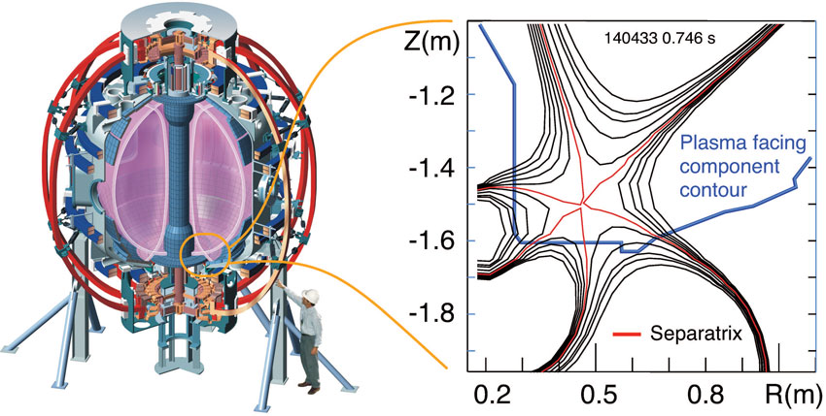
NSTX-U Research Team Has Been Scientifically Productive
Very Active in Scientific Conferences, Publications, and Collaborations
NSTX “Snow-flake Divertor” team won the R&D 100 Award for 2012! Also featured in Oct. 2012 FES Science Highlights
NSTX well represented at PSI, High Temperature Plasma Diagnostic, and EPS meetings.
Strong presentations at the IAEA. Most IAEA Presentations (30) given by the NSTX-Team. Prominent contributions to the post-deadline IAEA papers.
Image courtesy of Vlad Soukhanovskii
The National Spherical Torus Experiment Device at Princeton Plasma Physics Laboratory (left), and a schematic of magnetic field lines in the snowflake divertor configuration (right).
Strong presence at fall APS with 63 presentations. Three NSTX APS-DPP press releases are available on the web.
All of the FY 2012 milestones completed on schedule.
Significant collaboration research contributions are being made in diverse science areas by the NSTX-U research team. A summary is available on the web: http://nstx.pppl.gov/DragNDrop/Collaboration/
NSTX-U research team published 56 papers in refereed journals in 2012.

Slide 4
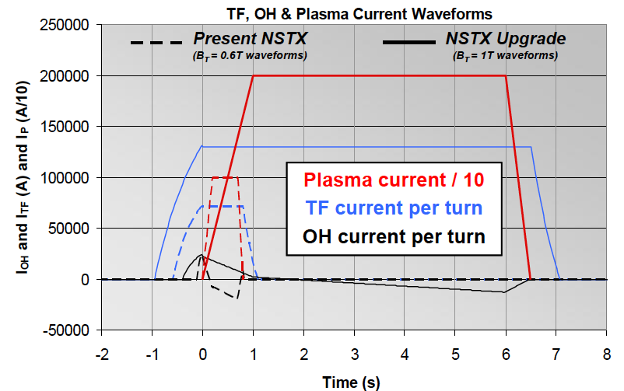
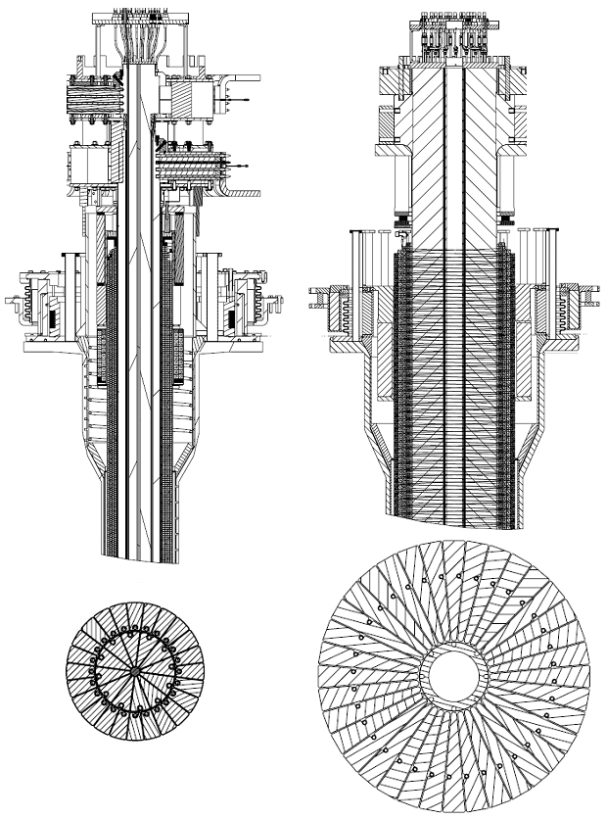
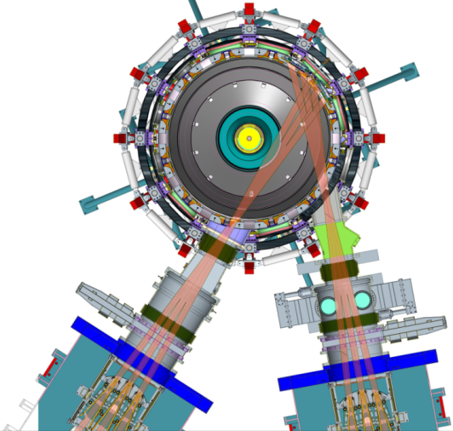
Substantial Increase in NSTX-U Device / Plasma Performance
Higher performance requires facility / infrastructure enhancements
Previous
center-stack
New
center-stack
TF OD = 20cm
TF OD = 40cm
NSTX
 | R₀ (m) | A_{min} | I_{p} (MA) | B_{T} (T) | T_{TF} (s) | R_{CS} (m) | R_{OB} (m) | OH flux (Wb)
NSTX | 0.854 | 1.28 | 1 | 0.55 | 1 | 0.185 | 1.574 | 0.75
NSTX-U | 0.934 | 1.5 | 2 | 1 | 6.5 | 0.315 | 1.574 | 2.1
Present NBI
New 2nd NBI

Slide 5
Engineering and Research Operations Activities
In Preparation for the NSTX-U Operations
Upgrading the Plasma Control System (PCS) for NSTX-U.
  Upgrading to new 32-core computer.
  Switching to 64 bit real-time Linux with advanced debugging tools.
  Upgrading shape-control codes for new divertor coils, gas injector controls for new/additional injectors, additional physics algorithms
  Improving the real-time data-stream.
  Assisting with development of a new Digital Coil Protection System (DCPS).
Upgrading HHFW antenna feedthroughs for higher disruption forces.
Boundary Physics Operations
  Improving the PFC geometry in the vicinity of the CHI gap to protect the vessel and coils.
  Developing an upgraded Boronization system.
  Developing lithium technologies (granule injector, upward LITER).
Diagnostic Upgrades
  Fabricating new port covers to support high-priority diagnostics.
  Installing additional, redundant magnetic sensors.
  Upgrading diagnostics: Bolometry (PPPL), ssNPAs, spectroscopy (collaborators)
Physics & Engineering Operations
  Replacing electronics that control & protect rectifiers.
  Upgrading the poloidal field coil supplies to support up-down symmetric snowflake divertors.
  Developing PF null/breakdown scenario w/ new CS.

Slide 6
NSTX-U diagnostics to be installed during first 2 years
Half of NSTX-U Diagnostics Led by Collaborators
MHD/Magnetics/Reconstruction
  Magnetics for equilibrium reconstruction
  Halo current detectors
  High-n and high-frequency Mirnov arrays
  Locked-mode detectors
  RWM sensors
Profile Diagnostics
  MPTS (42 ch, 60 Hz)
  T-CHERS: T_{i}(R), V_{φ}(r), n_{C}(R), n_{Li}(R), (51 ch)
  P-CHERS: V_{θ}(r) (71 ch)
  MSE-CIF (18 ch)
  MSE-LIF (20 ch)
  ME-SXR (40 ch)
  Midplane tangential bolometer array (16 ch)
Turbulence/Modes Diagnostics
  Poloidal Microwave high-k scattering
  Beam Emission Spectroscopy (48 ch)
  Microwave Reflectometer,
  Microwave Polarimeter
  Ultra-soft x-ray arrays – multi-color
Energetic Particle Diagnostics
  Fast Ion D_{α} profile measurement (perp + tang)
  Solid-State neutral particle analyzer
  Fast lost-ion probe (energy/pitch angle resolving)
  Neutron measurements
  Neutral particle analyzer (single channel)
Edge Divertor Physics
  Gas-puff Imaging (500kHz)
  Langmuir probe array
  Edge Rotation Diagnostics (T_{i}, V_{φ}, V_{pol})
  1-D CCD H_{α} cameras (divertor, midplane)
  2-D divertor fast visible camera
  Metal foil divertor bolometer
  AXUV-based Divertor Bolometer
  IR cameras (30Hz) (3)
  Fast IR camera (two color)
  Tile temperature thermocouple array
  Divertor fast eroding thermocouple
  Dust detector
  Edge Deposition Monitors
  Scrape-off layer reflectometer
  Edge neutral pressure gauges
  Material Analysis and Particle Probe
  Divertor VUV Spectrometer
Plasma Monitoring
  FIReTIP interferometer
  Fast visible cameras
  Visible bremsstrahlung radiometer
  Visible and UV survey spectrometers
  VUV transmission grating spectrometer
  Visible filterscopes (hydrogen & impurity lines)
  Wall coupon analysis
New capability

Slide 7
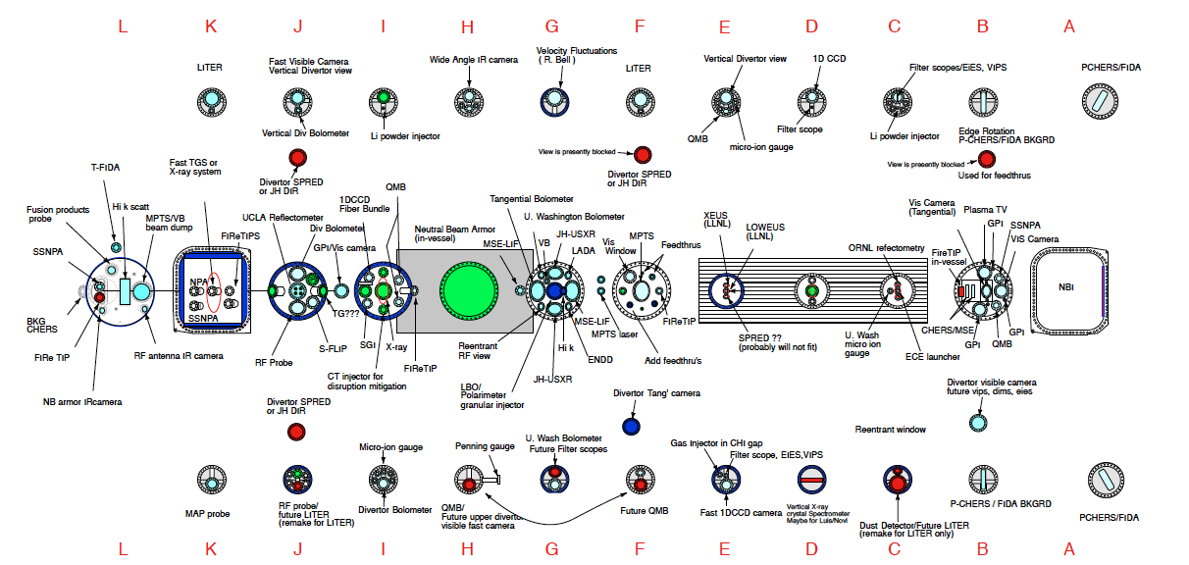
NSTX-U facility/diagnostics port assignment
Port flanges designed and ordered

Slide 8
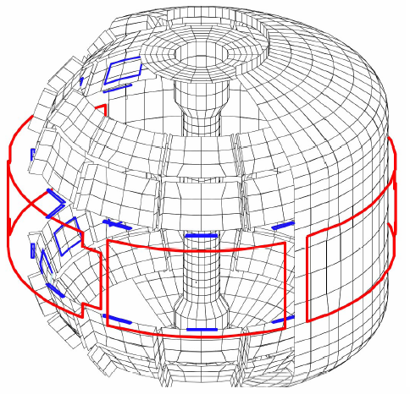
New MHD and Plasma Control Tools Available for NSTX-U
Sustain β_{N} and Understand MHD Behavior Near Ideal Limit
Copper passive
conductor plates
SS Vacuum
Vessel
2nd 3-channel Switching Power Amplifier (SPA) commissioned in July 2011 powers independent currents in six EFC/RWM coils for simultaneous control of n = 1, 2, 3 field harmonics
• RWM spectrum dependence
• Rotation and beta effects on NTMs
• Response to 3D fields for EFC, ELM and Neoclassical Toroidal Viscosity physics
• Disruption physics
B_{R}
B_{P} sensor
6 ex-vessel midplane control coils
• A Real-Time Velocity (RTV) diagnostic (commissioned in 2011) to be incorporated into the plasma control system for feedback control of the plasma rotation profile using the NBI and non-resonant magnetic braking as the actuators.
• A new Plasma Control System (PCS) platform with increased capabilities (e.g., 64-bit operating system) to support increased NSTX-U rt-control requirements.
• Disruption mitigation system with massive gas injection at multiple poloidal location.

Slide 9
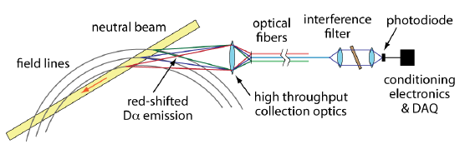
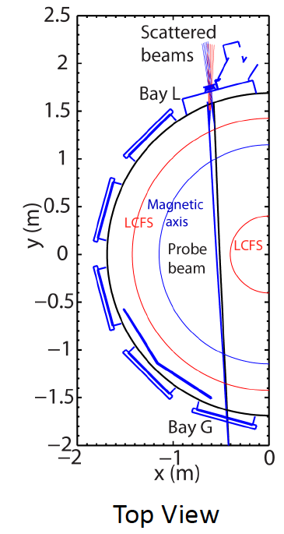
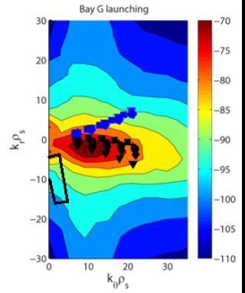
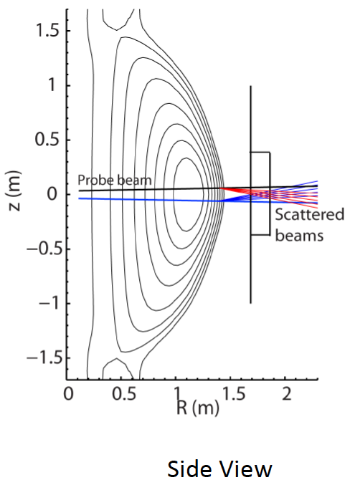
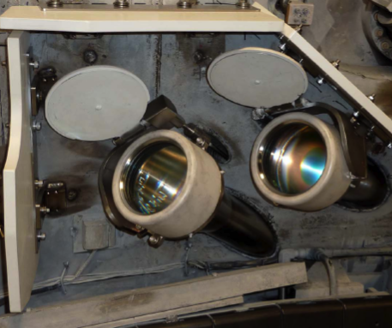
Transport and Turbulence
BES together with high-k to provide comprehensive turbulence diagnostic
Modes
0.1
1
k⊥(cm⁻¹)
10
100
μTEARING
ITG/TEM
ETG
BES, pol
BES
BES, Polarimeter
μwave Scattering
48 ch BES available for NSTX-U
(24 ch BES available in 2011)
New high-k scattering system for allowing
2-D k spectrum
Optical fibers
UCD
Neutral Beam
field lines
red-shited
Dα emission
High throughput collection optics
U. Wisconsin
A 288 GHz polarimetry system for magnetic fluctuation measurements is being tested on DIII-D.
UCLA
Notes:
Here is an overview of the NSTX facility operation and upgrade plan for FY 10-12. We plan to run 14 run weeks in each of fiscal year. We will conduct one extra ARRA week this year using the carry over from last fiscal year. For incremental, we propose to run up to 6 run weeks each in FY 11 and 12. We have a very strong set of upgrade becoming available this year . In FY 11, our base upgrade activities are either supported by ARRA funding or by the collaborators. Our base upgrade resources will be mostly devoted to the preparation for the major upgrade outage planned in FY 13-14 to install a new center-stack and the 2nd NBI which will be described by Ron Strykowsky our upgrade project manager.

Slide 10
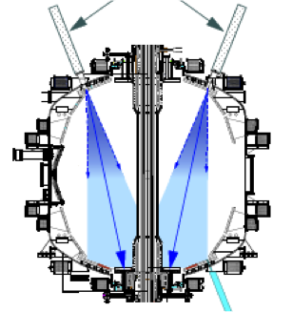
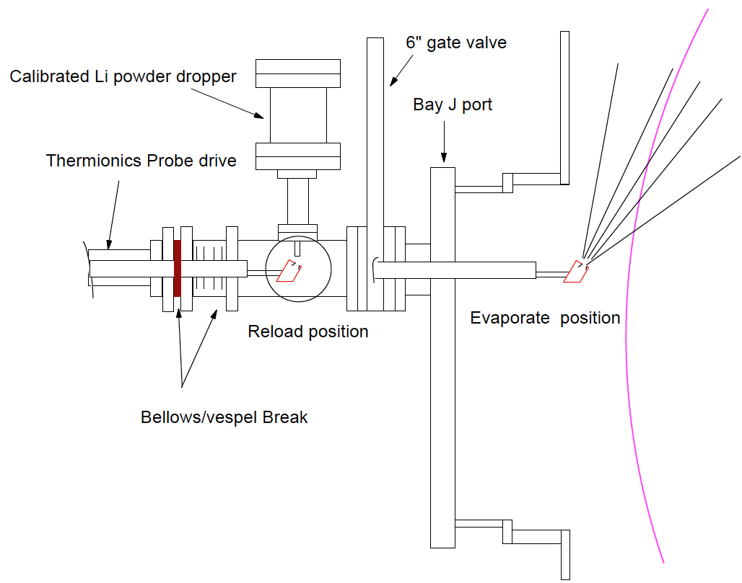
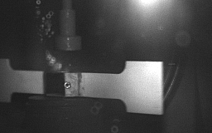
NSTX-U Lithium Capability During Initial Two Years
Lithium Evaporators and Granular Injector
Existing LITERS
New Upward Evaporating LITER
LLD
LLD
• Upward Evaporating LITER to increase Li coverage for increased plasma performance
NSTX-U lithium granular injector
for ELM pacing
• High frequency ELM pacing with a relatively simple tool.
• ELM pacing successfully demonstrated on EAST (D. Mansfield, IAEA 2012)
Granule Reservoir
Struck Granule Horizontally
Redirected at 70 m/s
t = 800 μs

Slide 11
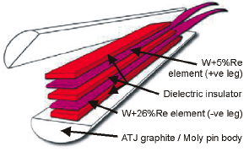
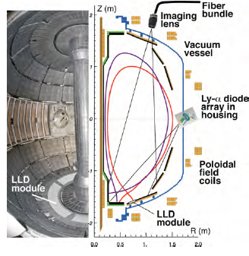
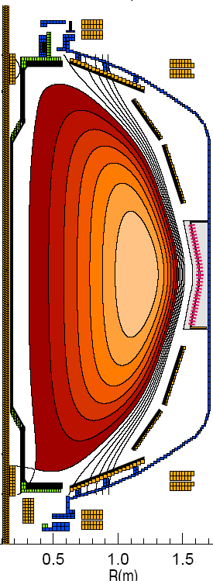
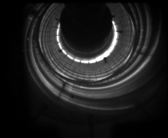
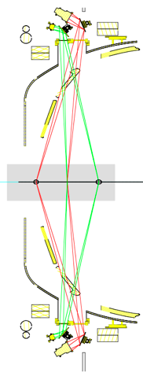
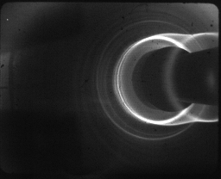
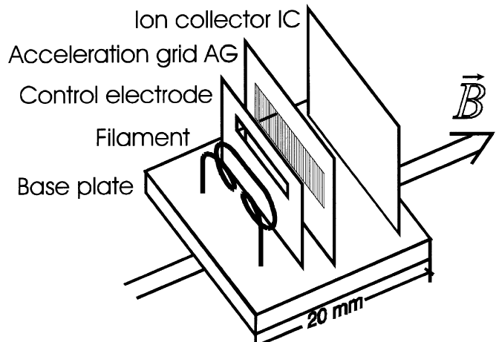
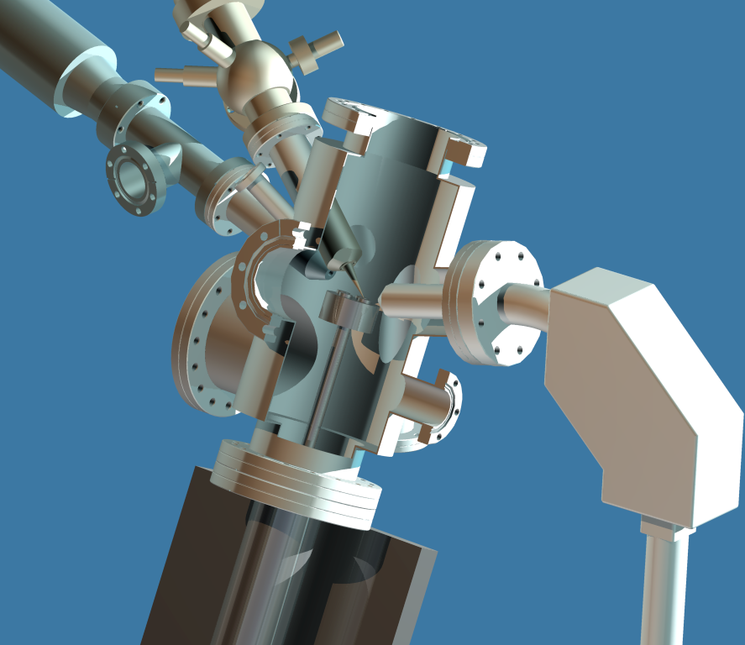
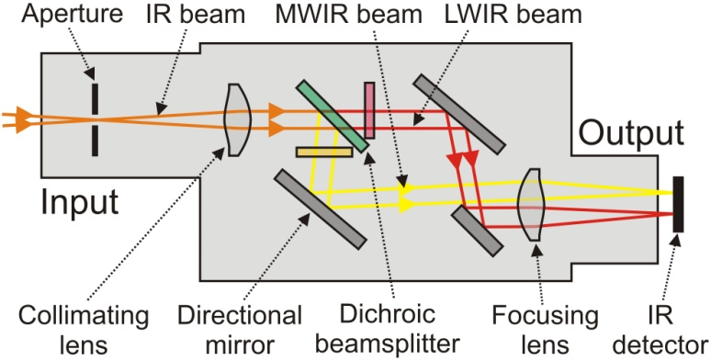
Enhanced Capability for PMI Research
Multi-Institutional Contributions
Divertor fast eroding thermocouples
Two fast 2D visible and IR cameras with full divertor coverage
Divertor Imaging
Spectrometer
ORNL
LLNL, ORNL, UT-K
LLNL
Li I
  Lithium CHERS
ORNL
C II
Divertor fast pressure gauges
MAPP probe for between-shots surface analysis
Dual-band fast IR Camera
Purdue U.
Notes:
With the NSTX PAC recommendation, we have been increasing the LLD diagnsotic capabilities including lithium CHEERS, PMI probe, Lyman Alpha LLD recycling diode array, three view divertor bolometer, and two color fast IR divertor camera.

Slide 12
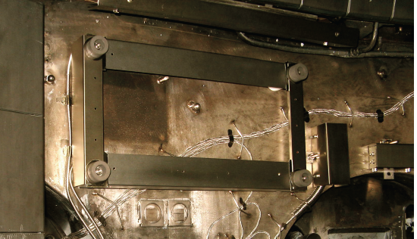
Energetic Particle Research Capabilities
For NBI fast ion transport and current drive physics
Fast Ion D-Alpha Diagnostics
FIDA Views
UCI
• A vertical FIDA system measures fast ions with small pitch, corresponding to trapped or barely passing (co-going) particles.
• A new tangential FIDA system measures co-passing fast ions with pitch ~0.4 at the magnetic axis up to 1 at the plasma edge.
• Both FIDA systems have time resolution of 10 ms, spatial resolution ≈5 cm and energy resolution ≈10 keV.
Vertical
Tangential
FY 2013 - 14 Energetic Particle Conceptual Design and Diagnostic Upgrade
  SS-NPA enhancement due to removal of scanning NPA
  Proto-type active TAE antenna
UCI
5-turn radial active TAE antenna installed in 2011

Slide 13
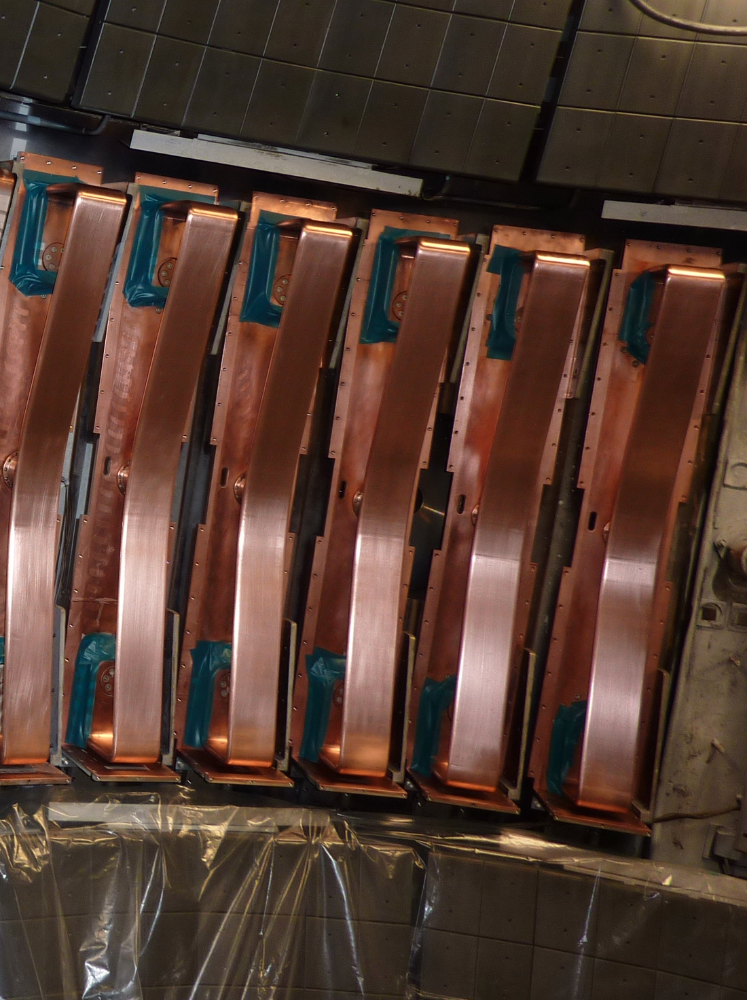
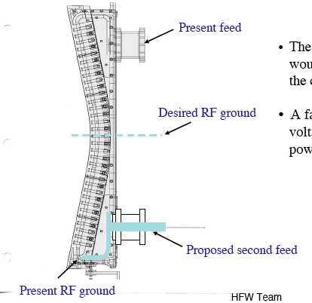
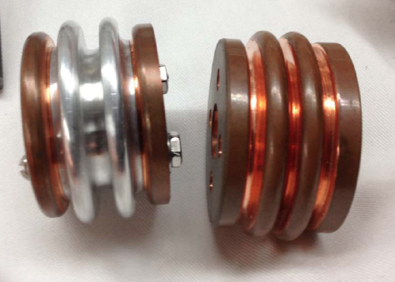
HHFW Antenna Refurbishment
To Withstand 4x Higher Disruption Loads
Double Feed Antenna
• HHFW power system to undergo structural enhancement against disruption loads in the feedthru area
A compliant section being designed
Photo courtesy of C-Mod Group
• FY 2013-2014 – Perform necessary modification
• FY 2014-2015 – Start MW-class ECH/EBW engineering design for non-inductive operations (US-Japan)

Slide 14
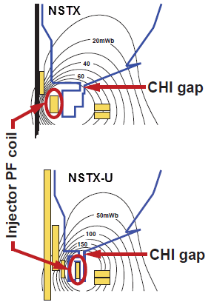
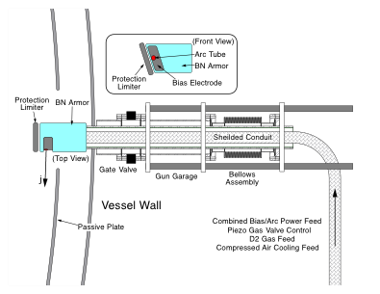
Solenoid-free Start-up
High priority goal for NSTX-U in support of FNSF
CHI Start-Up
Point Source Being Developed
• Inj. Flux in NSTX-U is about 2.5 times higher than in NSTX
• NSTX-U coil insulation greatly enhanced for higher voltage ~ 3 kV operation
PEGASUS Plasma Gun
U. Washington
U. Wisconsin
FY 2013-15 Non-Inductive Start-up Systems Design for Post-Upgrade Operations
• CHI will start with the present 2 kV capability then enhanced to ~ 3 kV higher voltage as needed.
• PEGASUS gun start-up producing exciting results Ip ~ 160 kA. The PEGASUS gun concept is technically flexible to implement on NSTX-U once fully developed. High current gun for the NSTX-U will be developed utilizing the PEGASUS facility in collaboration with University of Wisconsin.

Slide 15
Plans to Rapidly Recover Physics Operations Capabilities
NSTX-U Operations Team Similar to NSTX
Plasma Operations with:
I_{p}<=1.0 MA, B_{T}<=0.5
Develop:
Breakdown and current ramp scenarios
Shape & position control
Reliable H-mode
Diagnostic operations
Continue to add diagnostic & control capabilities while initiating physics experiments.
ISTP:
(Integrated Systems Test Procedure)
Establishes facility in state of readiness for operations.
I_{p}<=1.5-1.6 MA
B_{T}<=0.75-0.8
~September 2014
ISTP-1 & CD-4 Prep
CD-4
(I)
MPTS
Calib.
Bake
Out
CD-4
(II)
Operations
Commissioning
Phys. Ops
ISTP-2
Phys.
Ops
~ 1 Month
Rayleigh/Raman Scattering for n_{e} & T_{e} calibrations.
ISTP-2
Required to increase the field and current for later research phase
Attempt 50 kA CD-4 plasma before bake-out. If water in vessel prevents success, then repeat.

Slide 16
Formulating Strategy Toward Full NSTX-U Parameters
After CD-4, the plasma operation could enter quickly into new regimes
 | NSTX | Year 1 NSTX-U Operations | Year 2 NSTX-U Operations | Year 3 NSTX-U Operations | Ultimate Goal
I_{P} [MA] | 1.4 | ~1.6 | 2.0 | 2.0 | 2.0
B_{T} [T] | 0.55 | ~0.8 | 1.0 | 1.0 | 1.0
Allowed TF I²t [MA²s] | 7.3 | 80 | 120 | 160 | 160
I_{P} Flat-Top at max. allowed I²t, I_{P}, and B_{T} [s] | ~0.7 | ~3.5 | ~3 | 5 | 5
1st year goal: operating points with forces up to ½ the way between NSTX and NSTX-U, ½ the design-point heating of any coil
  Will permit up to ~5 second operation at B_{T}~0.65
2nd year goal: Full field and current*, but still limiting the coil heating
  Will revisit year 2 parameters once year 1 data has been accumulated
3rd year goal: Full capability
* Requires motor generator weld crack repair

Slide 17
NSTX FY 2015 FWP Budget Summary ($M)
Base budget adversely impacts NSTX-U research operation
 | FY2012 | FY2013 |  | FY2014 |  | FY2015
Budget Cases | BA | BA | Incr | Base | 15% Incr | Warm Shutdown | Base | 15% Incr | Optimal
Run Weeks | 0 | 0 | 0 | 0 | 0 | 0 | 0 - 6 | 16 | 20
Facility Ops | $13.21 | $8.82 | $9.91 | $8.44 | $12.18 | $20.48 | $23.38 | $25.89 | $26.79
Facility Enhancements | $0.30 | $0.80 | $1.72 | $0.04 | $0.71 | $0.00 | $0.00 | $1.75 | $5.01
CS & 2nd NBI | $20.50 | $22.80 | $22.80 | $23.17 | $23.17 | $3.79 | $3.79 | $3.79 | $3.79
Facility Total | $34.01 | $32.42 | $34.43 | $31.65 | $36.06 | $24.27 | $27.17 | $31.43 | $35.59
PPPL Research | $10.48 | $7.62 | $8.96 | $8.50 | $10.80 | $11.50 | $12.63 | $13.62 | $14.10
Collab Diag Interf | $0.40 | $0.25 | $0.44 | $0.2 | $0.60 | $0.30 | $0.60 | $0.70 | $0.80
Collaborations | $6.10 | $5.86 | $5.86 | $5.80 | $6.40 | $5.80 | $5.80 | $6.60 | $7.26
Science Total | $16.98 | $13.73 | $15.26 | $14.55 | $17.60 | $17.90 | $19.03 | $20.92 | $22.16
NSTX-U Total | $50.99 | $46.15 | $49.69 | $46.20 | $53.86 | $41.87 | $46.20 | $52.35 | $57.75
• President's base budget results in significant loss of operations and research staff and delays NSTX-U full research operation by ~ one year to FY 2016.
• FY 2014 and 2015 incremental case is equivalent to inflation adjusted FY 2012 budget case and it will restore the staff and the NSTX-U operation start to FY 2015.
• Optimal scenario will enable full NSTX-U operation and implementation of the five year plan major facility and diagnostic enhancements.
• Warm shutdown scenario completes CD-4 and put the NSTX-U facility in warm shut down mode with essential operations and research staff to enable rapid restart of the plasma operation.

Slide 18
NSTX-U FY 2015 FWP Manpower Summary
Base budget adversely impacts NSTX-U research operation
 | FY 2010 | FY 2011 | FY 2012 | FY 2013 |  | FY2014 |  | FY 2015
 | Actual | Actual | Actual | Base | Incrementals | Base | Incrementals | Warm SD | Base | Incrementals | Optimum
Run Weeks | 15 | 4 | 0 | 0 | 0 | 0 | 0 | 0 | 0-6 | 16 | 20
Science | 36.2 | 36.1 | 29.7 | 25.9 | 28.7 | 22.6 | 31.3 | 27.9 | 32.6 | 36.8 | 39.3
Operations | 71.1 | 78.03 | 36.7 | 29.5 | 37.2 | 21.5 | 42.3 | 58.6 | 65.3 | 72.2 | 74.2
Upgrade Project | 29 | 25.9 | 69.3 | 70.3 | 70.3 | 73.4 | 73.4 | 11.9 | 11.9 | 11.9 | 11.9
Other Upgrades | 13.3 | 7.8 | 0.8 | 0 | 0 | 0 | 0 | 0 | 0 | 8.5 | 18.3
Total FTEs | 149.6 | 147.83 | 136.5 | 125.7 | 136.2 | 117.5 | 147 | 98.4 | 109.8 | 129.4 | 143.7
Science FTEs
Operations FTEs
FY10 FY11 FY12 FY13 FY14 FY15
FY10 FY11 FY12 FY13 FY14 FY15
CD-4
CD-4
FY13 - FY15 base case delays the NSTX-U full research start to FY 2016 due to severe loss of operations and research staff.

Slide 19
NSTX-U FY 2015 FWP Manpower Summary
Incremental budget enables timely research operation
 | FY 2010 | FY 2011 | FY 2012 | FY 2013 |  | FY2014 |  | FY 2015
 | Actual | Actual | Actual | Base | Incrementals | Base | Incrementals | Warm SD | Base | Incrementals | Optimum
Run Weeks | 15 | 4 | 0 | 0 | 0 | 0 | 0 | 0 | 0-6 | 16 | 20
Science | 36.2 | 36.1 | 29.7 | 25.9 | 28.7 | 22.6 | 31.3 | 27.9 | 32.6 | 36.8 | 39.3
Operations | 71.1 | 78.03 | 36.7 | 29.5 | 37.2 | 21.5 | 42.3 | 58.6 | 65.3 | 72.2 | 74.2
Upgrade Project | 29 | 25.9 | 69.3 | 70.3 | 70.3 | 73.4 | 73.4 | 11.9 | 11.9 | 11.9 | 11.9
Other Upgrades | 13.3 | 7.8 | 0.8 | 0 | 0 | 0 | 0 | 0 | 0 | 8.5 | 18.3
Total FTEs | 149.6 | 147.83 | 136.5 | 125.7 | 136.2 | 117.5 | 147 | 98.4 | 109.8 | 129.4 | 143.7
Science FTEs
Operations FTEs
Optimum
Optimum
Incremental
Incremental
FY10 FY11 FY12 FY13 FY14 FY15
FY10 FY11 FY12 FY13 FY14 FY15
CD-4
CD-4
FY13 - FY15 increment preserves operations and research staff needed to enable NSTX-U full research operation start in FY 2015 after CD-4.

Slide 20
Incremental Funding Summary ($M)
Enabling NSTX-U Operations and Enhancements
 | FY13I | FY14I | FY15I
Research Staff | $1.1 | $2.1 | $1.0
Increased Collaborator Funding |  | $0.6 | $0.8
MG Operations | $0.2 | $0.4
HHFW Engineering | $0.3 | $0.9 | $0.2
Diagnostic Support | $0.2 | $0.3 | $0.1
Central I&C and DAS | $0.1 | $0.4 | $0.2
Continue-FG/SAD-II/MPTS | $0.3
MG Weld Repair |  | $0.8
Integrators/Digitizer Upgrades | $0.1 | $0.3
TMB System | $0.1 | $0.3
PSRTC (PCS Backup) | $0.1 | $0.2
Lithium Engineering Support | $0.1 | $0.2
D-Site AC Power Equip | $0.1 | $0.1 | $0.1
Fault Detector/HCS I/O Interface | $0.7 | $0.6
Central I&C H/W Improvements |  | $0.2
Plasma Operations Support |  | $0.3 | $1.7
5 year Plan-Facility & Diagnostic Upgrades |  |  | $1.8
Reserves e.g., Spares/Overtime |  |  | $0.5
Total | $3.4 | $7.6 | $6.3
Increment per Year ($46.2M Base) | 7.4% | 16.5% | 13.6%
Incremental Cases – FY2013 +7.5%; FY2014 & 2015 +15%:
Preserve essential operations and research staff to resume operations in FY2015 (PPPL and national collaborators).
Restores facility enhancements necessary for reliable NSTX-U operation.
Allows NSTX-U to be operated at its full capability.
Increase the NSTX-U plasma operation run weeks from 0-6 to 16 run weeks.
Start preparation for the NSTX-U five year plan facility and diagnostic tools.
Optimum Cases:
Enables full NSTX-U operations.
Enables initiation of the major five year plan facility/diagnostic enhancements

Slide 21
Optimized Plan Being Developed for FY 2013–15
Exciting Opportunities and Challenges Ahead
• NSTX upgrade outage activities are going well
  Researchers are working productively on data analysis, collaboration, next five year plan and preparation for the NSTX-U operation.
  NSTX operations technical staff are working on the Upgrade Project tasks in FY 2013 – 14.
  Upgrade project progressing on cost and on schedule.
• Exciting NSTX-U research plan being developed
  Provide new solutions to the plasma-material interface.
  Provide necessary data base for FNSF design and construction.
  Strong contribution to toroidal physics, ITER, and fusion energy development.
• FY 2014 / FY 2015 base budget guidance will delay the NSTX-U research operations start date
  FY 2013 presidential budget is~ $ 5 M lower than FY 2012 budget which results in severe loss of essential operation and research personnel.
  Continuing flat budget for FY 2014 and FY 2015 will delay the NSTX-U research grade plasmas by ~ 1 year into FY 2016 due to lack of personnel.
  Incremental funding restores the budget to the FY 2012 level and enables timely start of the NSTX-U research operations in FY 2015.
21

Slide 22
Back-up Slides

Slide 23
Operations Activities Designed to Fit in the Existing NSTX-U Project Schedule
NSTX research operations activities conducted in coordination with Upgrade project.
Time | Activity
Summer-Fall, 2013 | Diagnostic Reinstallations/Calibrations In Parallel with Construction Activities
Dec. 2013 – March, 2014 | Close Machine (w/o CS), Leak Checking, Prep. for CS installation.
April-May, 2014 | CS Installation
June, 2014 | Final Calibrations, Particularly Those Diagnostics Requiring CS for Calibration
July-Sept., 2014 | Run Prep, Internal and DOE Readiness Reviews, Integrated Systems Testing, First plasma

Slide 24
NSTX-U Operations Staff and Resource Needs
Much of the core operations staff unchanged
While the facility capability is significantly enhanced, the core operation team and research staff however are similar for NSTX and NSTX-U. For example, the control improvements enable the NBI operations by the same number of operators.
Main Changes:
• Additional HP (Health Physics) technician to support higher level of radiation activation and tritium levels in the NSTX-U test cell.
• Additional software engineer to support plasma control system due to much greater plasma control system requirements for NSTX-U.
• Increased consumables (electricity, liquid helium, liquid nitrogen, SF6, etc.) due to the addition of 2nd NBI and increased magnet system power loads (x 2 higher field and x 5 pulse length) which increases the cost of incremental operating week by ~ $50k from ~ $200k/week to ~ $250k/week.

Slide 25
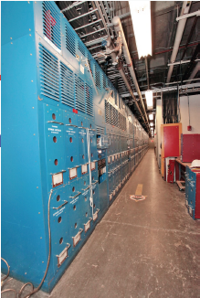
Transrex AC/DC Convertors of the NSTX FCPC
Upgrading of Firing Generators and Fault Detectors
Transrex AC/DC Convertors of the NSTX Field Coil Power conversion System (FCPC) provide a pulsed power capability of 1800 MVA for 6 seconds. The modular converter concept of 74 identical (with a paired sections A & B), electrically isolated 6-pulse “power supply sections” was originally used on TFTR, and then adapted to NSTX.
  Many parts from 1984 are nearing end-of-life due to age and wear, replacement parts are rare or unavailable, and that performance can be improved using more modern equipment.
  Precise control of thyrister firing angles by the FCPC firing generators becomes more critical for the new 8-parallel, 130kA TF system configuration.
  Ability to separately control the “A” and “B” sections of each power supply unit allows for more efficient utilization of the 74 available sections.
  The new Firing Generator (FG) will deliver firing pulses with greater resolution, precision, and repeatability, and can receive and process separate commands to the A and B sections
Status:
The prototype FG has been fully tested in a Transrex rectifier, and production units are being fabricated.
The new Fault Detector (FD) provides improved external interface compatible with the NSTX-U data acquisition system.
The FD prototype has been completed in conjunction with the new FG in a Transrex rectifier.

Slide 26
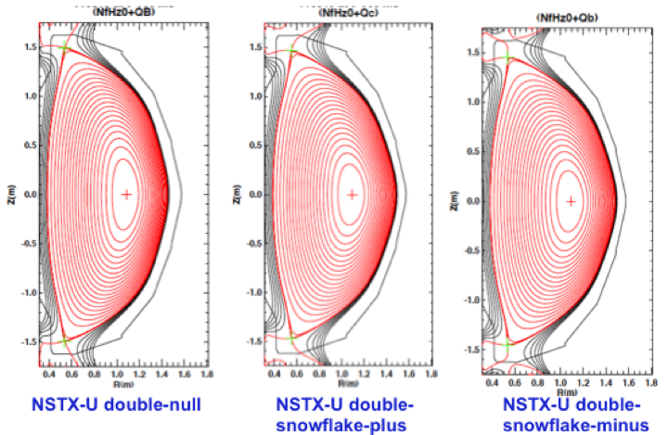
NSTX-U PF Coil Power System Upgrade
Enables up-down symmetric divertor operations
The first-year power supply capabilities of NSTX-Upgrade will yield considerable experimental flexibility, namely, up-down symmetric PF-1C coils compared to only at the bottom.
By powering the PF-1A & PF-1C coils, it will be possible to generate up-down symmetric snowflake divertors
  Capability did not exist in NSTX.
  Bipolar PF-1C allows easy comparison between snowflake and standard divertors.
The new configuration should provide better control for the CHI absorber region.
Longer-term, upgrades to the power supply systems may add considerable new capability:
  - The PF-2 coils may be upgraded to bipolar operations. This will allow those coils to either create the snowflake divertor or to control the lower plasma-wall gap in the high-triangularity shapes, without changes to the power supply links.
  - The PF-1B coil, which will not be powered during initial upgrade operations, may be important for maintaining a steady snowflake divertor through the full OH swing.

Slide 27
NSTX-U Plasma Control System Upgrade
Migration to more modern computer for real-time applications
Sample rate: 5 → 20 KHz
Added 32 channels
PC Links replaced with much faster “Firing Generator” Serial Links
Analog Inputs
Coil Currents
Power Supplies
Magnetics
(including upgrades)
Neutral Beams
(1st and 2nd BLs)
Gas Injection
Vacuum
Rotation data
Pitch angle data
FPDP: 1 → 4 links
Analog Inputs
416 channels
PC Links
Power Supplies
(inc. 3 new coils)
Neutral Beams
(including new BL)
Gas Injection
Real-Time
Computer
Digital Inputs
12 words
FPDP
FPDP
Digital Outputs
Time Stamp
micro seconds
Analog Outputs
Hardware Upgrades
New computer: cores: 8 → 32
Commercial Linux Real-Time operating system & advanced real-time debug tools.
New quad-port fiber optic FPDP I/O boards.
Software Upgrades
Ported PPPL code and GA PCS to 64-bit.
Generate commands for new firing generators .
Coil Protection (DCPS) functions incorporated in PSRTC.
Numerous new control algorithms.
PCS algorithms re-written using GA format.
PSRTC to be re-written.
Physics Algorithms For Development Once Hardware/Software Infrastructure is Complete
Modified shape control
Snowflake Control
Dud Detection & Soft Landings
Rotation, Current, β_{N}
SGI and density control
new diagnostic algorithms
A second instance of this real-time computer will be acquired before operation providing a backup for NSTX-U operations and allowing parallel testing of control code during NSTX-U operations.

Slide 28
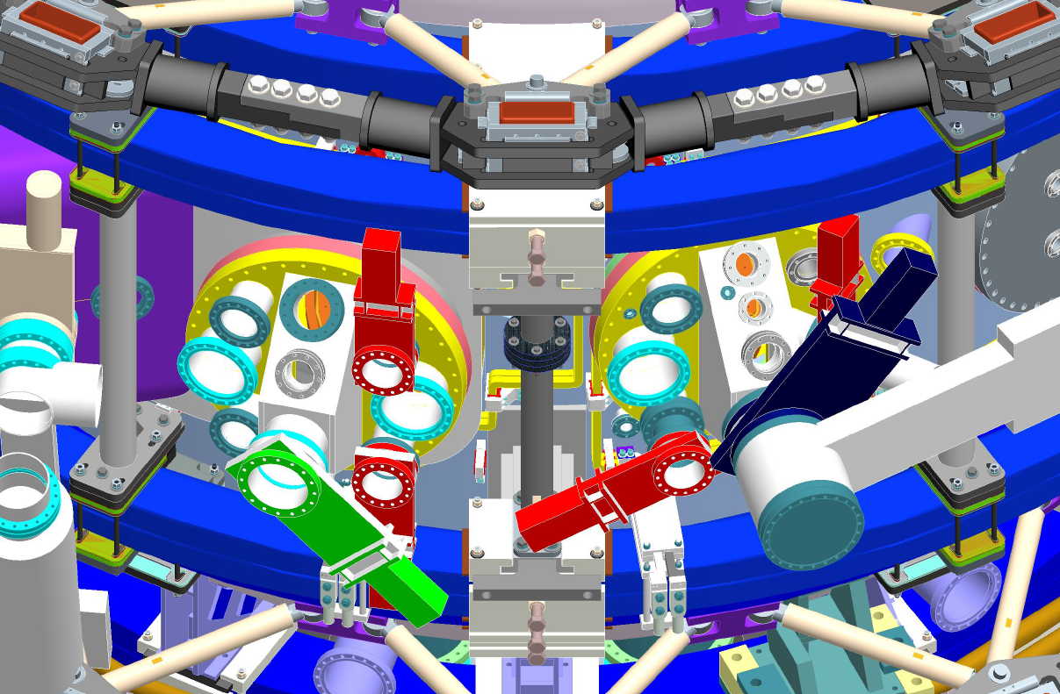
Detailed facility/diagnostics port design developed Example of Bay I and J Configuration for Day 1
UCLA polarimeter
IR camera
IR divertor view
Upward-Liter
1D CCD
Visible fast camera
ORNL IR CS view
Bolometer
LLNL Re-entrant
Visible window
Transmission Grating
UCLA
reflectometer
RF Probe
QMB
Li Granular Injector
Bolometer
IR CS view
Visible fast camera
Laser Blow-off
Edge Microwave
Imaging Diagnostic
SGI
IR camera
ORNL IR
divertor view

Slide 29
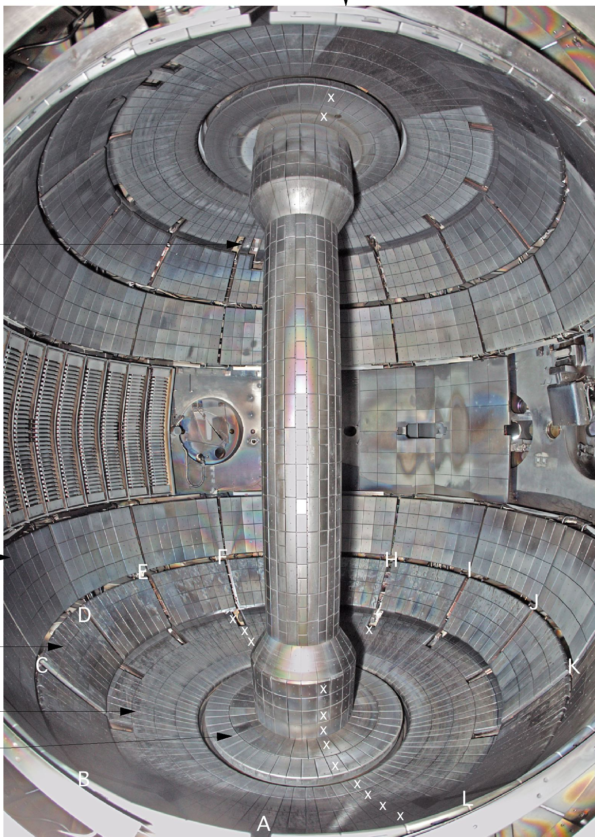
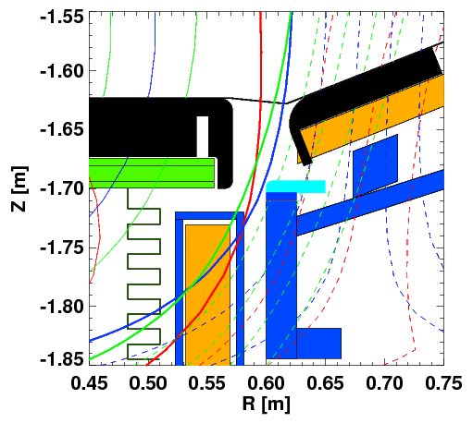
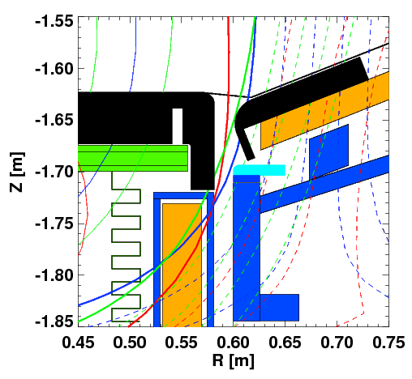
Day-1 Plasma Facing Component
Improved gap tiles to protect PF1C and Exposed SS surfaces
NSTX-U plasma operation may increase the gap area thermal loading by ~ x 10
Existing Tile Design
New Gap Overhung Tiles to Provide Necessary Protection
Preliminary design completed
5 MW/m² for 5 sec tolerable with ATJ but not with Poco TM
ATJ graphite tile material secured
CHI Gap
Center Stack
Secondary Passive Plates
PF 1C
HHFW
Antenna
NBI Armor
Improved Tile Design
Primary Passive Plates
CHI Gap
CHI Gap
In-board
Divertor
PF 1C
Out-board
Divertor

Slide 30
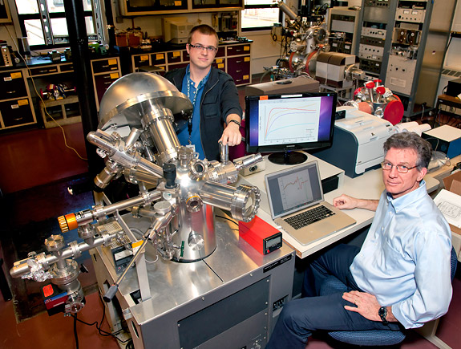
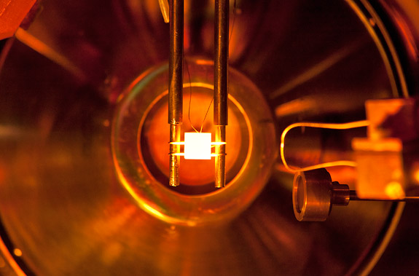
Surface Analysis Facilities to Elucidate Plasma-Surface Interactions
PPPL Collaboration with B. Koel et al., Princeton University
The Surface Science and Technology Laboratory (SSTL) with three surface analysis systems and an ultrahigh vacuum deposition chamber.
The Surface Imaging and Microanalysis Laboratory (SIML) with a Thermo VG Scientific Microlab 310-F High Performance Field Emission Auger and Multi-technique Surface Microanalysis Instrument.
Recently solid lithium and Li coated TZM were examined using X-ray photoelectron spectroscopy (XPS), temperature programmed desorption (TPD), and Auger electron spectroscopy (AES) in ultrahigh vacuum conditions and after exposure to trace gases. - Determined that lithiated PFC surfaces in tokamaks will be oxidized in about 100 s depending on the tokamak vacuum conditions. (C. H. Skinner et al., PSI_20 submitted to J. Nucl. Mater. )
X-ray photo-electron spectroscopy
Lithium coated TZM being examined by TPD and AES.

Slide 31
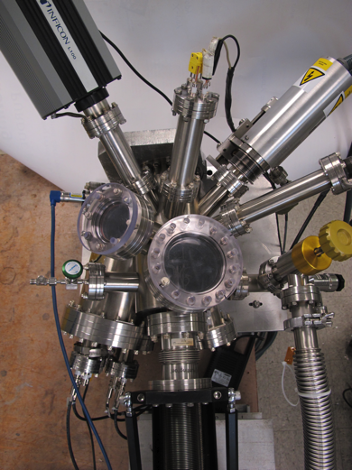
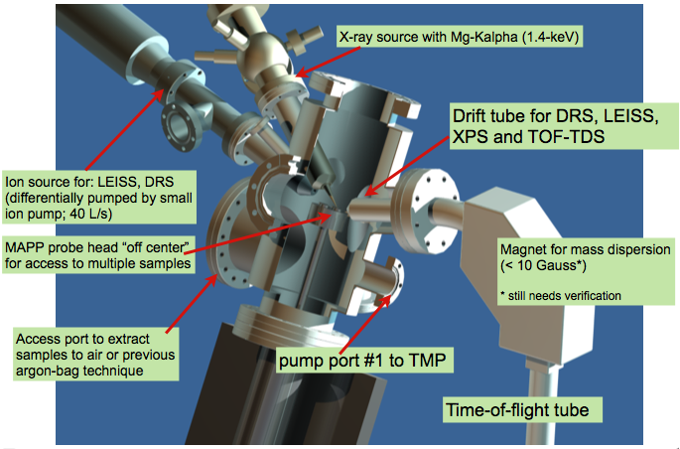
Materials Analysis and Particle Probe – MAPP –
to relate PFC surface conditions and plasma behavior in “real time”
PFC analysis after run is difficult to relate to plasma behavior
  Reflects cumulative effect of multiple evaporations and surface compound formation
  Hard to determine determine surface conditions during any specific discharge
MAPP provides in-situ and between-shots solution
  PFC sample can be exposed during shot and withdrawn for between-shots analysis
MAPP chamber showing diagnostics for sample analysis
MAPP will be tested on LTX during outage
J.P. Allain (Purdue), R. Kaita, et al.,

Slide 32
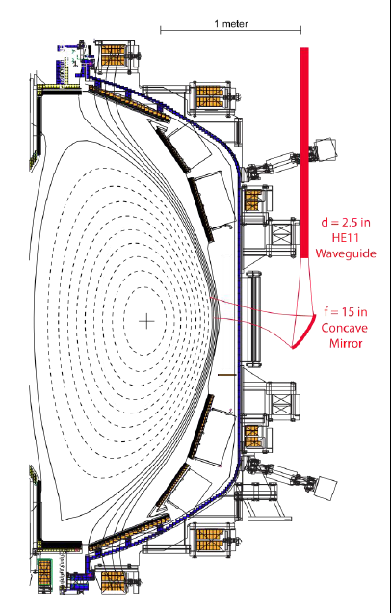
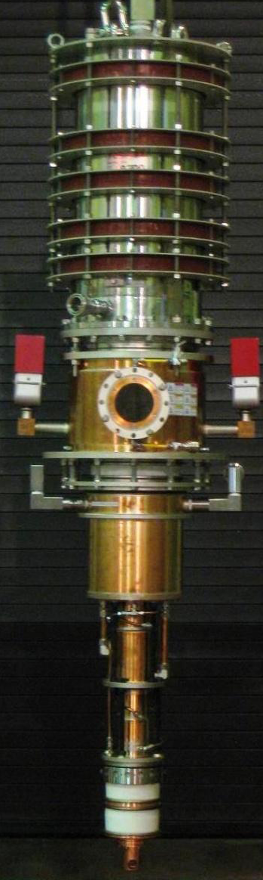
A MW-Class ECH/EBW System for Non-Inductive Operations
To bridge the temperature gap between CHI and HHFW
28 GHz, 1 – 2 MW
Tsukuba Gyrotron
28 GHz ECH/EBWH waveguide and mirror concept
• FY 2014-15 - Start MW-class ECH/EBW system design for non-inductive start-up and CD operations (US-Japan)
• FY 2016-17 – Implement the ECH/EBW system utilizing the NBI infrastructure

Slide 33
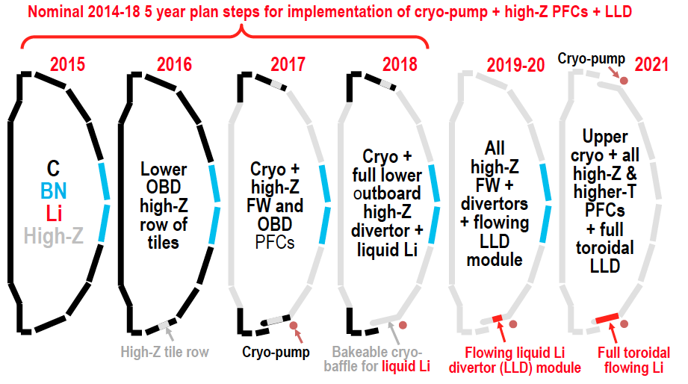
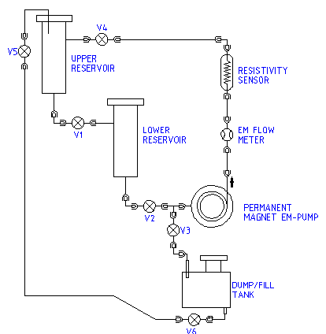
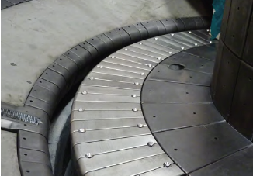
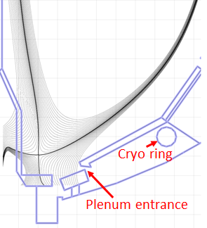
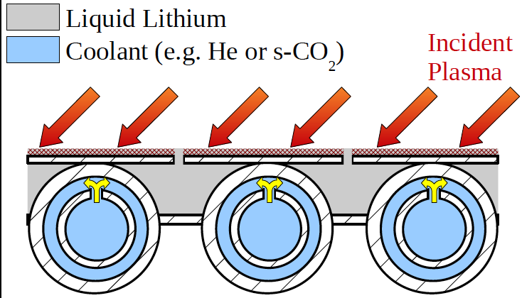
Boundary Physics Evolution
High-Z PFC, Cryo-pump, and flowing LLD
Flowing LL Test Loop
NSTX Moly Tiles
A Possible LLD Module
• For FY 12-14, advanced divertor upgrade conceptual design work will commence for the five year plan – e.g., moly-based PFCs, liquid lithium divertor, and closed divertor with cryo-pump.

Slide 34
New MHD and Plasma Control Tools for NSTX-U
Sustain β_{N} and Understand MHD Behavior Near Ideal Limit
Full toroidal NCC array (2 x 12)
Partial toroidal NCC array (2 x 6)
Partial NCC
Full NCC
Existing
RWM
coils
• NCC can provide various NTV, RMP, and EF selectivity with flexibility of field spectrum (n ≤ 6 for full and n≤ 3 for partial) as synergy with the existing EFC/RWM system.
• 2nd 3-channel Switching Power Amplifier (SPA) commissioned in July 2011 powers independent currents in existing EFC/RWM and NCC coils.
• A Real-Time Velocity (RTV) diagnostic will be incorporated into the plasma control system for feedback control of the plasma rotation profile.
• Multi-poloidal location massive gas injector system will be implemented.

