Slide 1




NSTX-U
Supported by
NSTX-U Research Plans for FY2015-17
Coll of Wm & Mary
Columbia U
CompX
General Atomics
FIU
INL
Johns Hopkins U
LANL
LLNL
Lodestar
MIT
Lehigh U
Nova Photonics
Old Dominion
ORNL
PPPL
Princeton U
Purdue U
SNL
Think Tank, Inc.
UC Davis
UC Irvine
UCLA
UCSD
U Colorado
U Illinois
U Maryland
U Rochester
U Tennessee
U Tulsa
U Washington
U Wisconsin
X Science LLC
J. Menard, M. Ono - PPPL
For the NSTX-U Research Team
Culham Sci Ctr
York U
Chubu U
Fukui U
Hiroshima U
Hyogo U
Kyoto U
Kyushu U
Kyushu Tokai U
NIFS
Niigata U
U Tokyo
JAEA
Inst for Nucl Res, Kiev
Ioffe Inst
TRINITI
Chonbuk Natl U
NFRI
KAIST
POSTECH
Seoul Natl U
ASIPP
CIEMAT
FOM Inst DIFFER
ENEA, Frascati
CEA, Cadarache
IPP, Jülich
IPP, Garching
ASCR, Czech Rep
FY2017 FES Budget Planning Meeting
Germantown, MD
March 24, 2015

Slide 2
Outline
NSTX-U mission, priorities, FY15-17 overview
FY15-17 research plans
Milestone summary
ITPA contributions
ST-FNSF study highlights
Summary

Slide 3

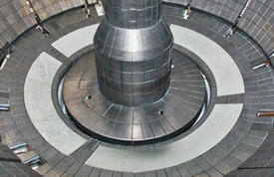
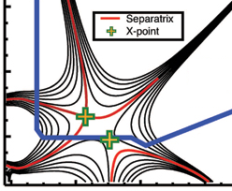
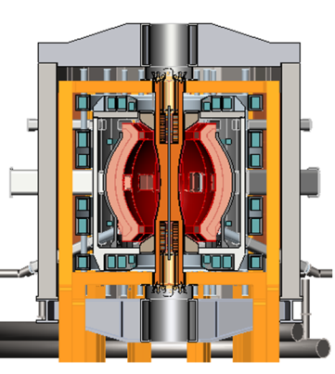
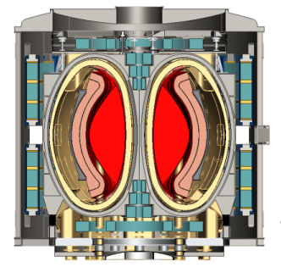
NSTX Upgrade mission elements
ITER
Explore unique ST parameter regimes to advance predictive capability - for ITER and beyond
Develop solutions for the plasma-material interface (PMI) challenge
Advance ST as candidate for Fusion Nuclear Science Facility (FNSF)
Develop ST as fusion energy system
Lithium
“Snowflake”
ST-FNSF/Pilot

Slide 4
FY15-17 planned research supports
5 highest priority goals of NSTX-U 5 year plan:
Mission Elements and 5 Year Plan 5 Highest Priorities
Explore unique ST parameter regimes to advance predictive capability - for ITER and beyond
  Reduced ν* + high-β + varied q and rotation to extend understanding
Develop solutions for PMI challenge
  High-flux-expansion snowflake/X + radiative detachment
  Assess high-Z PFCs + liquid Li as integrated PMI solution
Advance ST for FNSF
  100% non-inductive sustainment at FNSF normalized performance
  Develop and understand non-inductive start-up, ramp-up/overdrive

Slide 5
NSTX-U 5 year plan: Develop physics/scenario understanding needed to assess ST viability as FNSF/DEMO, support ITER
2015 | 2016 | 2017 | 2018 | 2019 | 2020
Max B_{T} [T], I_{P} [MA]
0.8, 1.6
1, 2
Structural force
and coil heating
limit fractions
0.5, 0.5
1.0, 0.75
1.0, 1.0
Nominal τ_{pulse} [s]
1 – 2
2 – 4
4 – 5
Sustained β_{N}
3 – 5
4 – 6
NCC
5 – 6
ν* / ν* (NSTX)
0.6
0.4
Cryo
0.3 – 0.2
0.2 – 0.1
Inform choice
of FNSF/DEMO
aspect ratio
and divertor
Non-inductive
fraction (Δt ≥ τ_{CR})
70 – 90%
80 – 110%
90 – 120%
100 – 140%
NBI+BS I_{P} ramp-up: initial → final [MA]
0.6 → 0.8
0.5 → 0.9
0.4 → 1.0
CHI closed-flux
current [MA]
0.15 – 0.2
0.2 – 0.3
ECH / EBW
0.3 – 0.5
0.4 – 0.6
P_{heat} [MW] with
q_{peak} < 10MW/m²
8
10
15
20
Divertor heat-flux control
Snowflake and radiative divertor exhaust location
Lower
Lower or Upper
Lower + Upper
Cryo: access lowest ν*, compare to Li
ECH / EBW: bridge T_{e} gap from start-up to ramp-up
Off-midplane non-axisymmetric control coils (NCC): rotation profile control (NTV), sustain high β_{N}

Slide 6
10 year goal: Integrate high-performance core + metal walls
5 year goal: Establish core physics/scenarios for ST
2015-2019
2020-2024
Establish ST physics / scenarios:
High-performance + metal walls
Non-inductive start-up, ramp-up
Confinement vs. β , collisionality
Sustain high β with advanced control
Mitigate high heat fluxes
Test high-Z divertor, Li vapor shielding
Convert all PFCs from C to high-Z
Static → flowing Li divertor module(s), full toroidal flowing Li divertor, high T_{wall}
5s → 10-20s for PFC/LM equilibration
Assess ST with high-Z, high-Z + Li
Inform choice of
FNSF configuration:
Inform choice of FNSF / DEMO
plasma facing materials:
Lower A or higher A?
Standard, snowflake, Super-X (MAST-U)?
High-Z acceptable? or need high-Z + Li?
Assess for both divertor and first-wall

Slide 7
NSTX-U Research Team Has Been Scientifically Productive
Very Active in Scientific Conferences, Publications, and Collaborations
Strong APS meeting participation in the fall 2014: 1 ST review talk, 5 invited talks, 44 additional presentations. Three NSTX APS-DPP press releases available on the web.
Significant collaboration research contributions are being made in diverse science areas by the NSTX-U research team.
On-going active research collaboration particularly with DIII-D and C-Mod. Several activities resulted in 2014 IAEA papers.
Strong NSTX-U and ST-FNSF related engineering / technology presentations at the 2014 PSI, SOFE and TOFE meetings.
All of the FY 2014 milestones were completed on schedule
54 refereed publications for CY 2014
NSTX-U will host next International ST workshop - November 2015

Slide 8
Partnering with PPPL theory to enhance NSTX-U modeling supporting high-priority research areas
Energetic particle research:
  Use the HYM, NOVA-K codes code (fully kinetic ions and drift and kinetic electrons) to study CAE, GAE, KAW eﬀects on energy ﬂuxes and electron transport
  M3D-K nonlinear multi-mode TAE studies leading to avalanche production
  Extend TAE quasi-linear model to calculate fast-ion diffusion in NSTX-U
Transport:
  Implement E-M effects in global GTS (for core) and XGC-1 (for edge) to enable studies of micro-tearing in NSTX/NSTX-U
  Comparative study of role of collisionality in transport in NSTX and DIII-D
Stability:
  VDE and beta-limit disruptions using M3D/M3D-C1
  Use stellarator tools for 3D equilibrium and coil optimization for proposed NSTX-U off-midplane non-axisymmetric control coils (NCC)
  Halo current diagnostic planning, future implementation and measurements
8

Slide 9
Overview of FY2014-15 NSTX-U research activities
Collaborations supporting NSTX-U, ITER, FNSF
  DIII-D: Snowflake/detachment control, core transport
  C-Mod: Boundary - pedestal structure/KBM, high-Z PFCs
  KSTAR: MHD - NTV physics, kink stability, plasma control
  York/MAST: Synthetic aperture μ-wave imaging (DBS, BXO)
Prepare for NSTX-U operation
  Finish data analysis, publications from NSTX, collaborations
  Physics ←→ engineering design of facility enhancements:
    Row of high-Z tiles on outboard divertor
    Lower divertor cryo-pump
    Non-axisymmetric control coil (NCC) specification
    ECH/EBW for start-up/ramp-up
  Prepare diagnostics, control system, analysis for NSTX-U ops

Slide 10
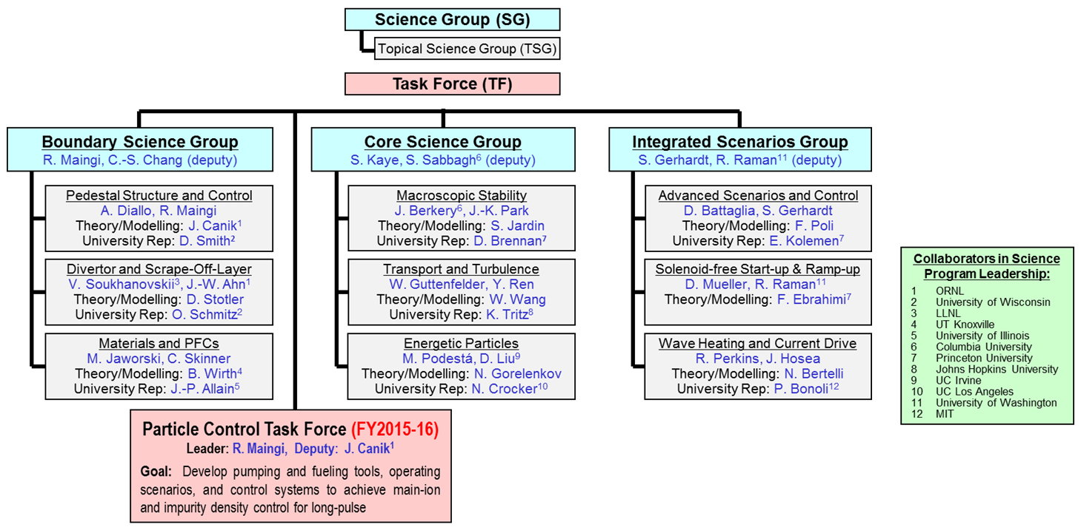
New NSTX-U Science organizational structure for 2015:
3 Science Groups, 9 Topical Science Groups, 1 Task Force
Each TSG will have a leader, deputy, theory rep, and at least 1 university rep to enhance university participation
12 collaborating institutions engaged in NSTX-U science program leadership

Slide 11
Operations goals for first 2 run-months of FY15
Machine Commissioning ~1 month (run weeks 1-4)
  Develop basic breakdown, current ramp, shape/position control, diverted plasmas, H-mode access, basic fuelling optimizations
  Goal: 1 MA, 0.5 T, NBI-heated H-mode (i.e. ~NSTX fiducial levels)
  Diagnostic commissioning
  Boronized PFCs
  Mostly eXperimental Machine Proposals (XMPs)
1st Month of Science Campaign (run weeks 5-8)
  Boronized PFCs, possibly begin lithium coatings
  Operations and basic profile diagnostics, neutron rate,…
  Operation up to 1.4 MA and 0.65 T, 2 seconds
  6 beam sources up to 90 kV
  HHFW available for commissioning
  Begin early critical XPs

Slide 12
Overview of FY2015-17 NSTX-U research activities
FY2015
  Obtain first data at 60% higher field/current, 2-3× longer pulse:
    Re-establish sustained low l_{i} / high-κ operation above no-wall limit
    Study thermal confinement, pedestal structure, SOL widths
    Assess current-drive, fast-ion instabilities from new 2nd NBI
FY2016
  Extend NSTX-U performance to full field, current (1T, 2MA)
    Assess divertor heat flux mitigation, confinement at full parameters
  Access full non-inductive, test small current over-drive
  First data with 2D high-k scattering, high-Z tiles
FY2017
  Study low-Z and high-Z impurity transport
  Assess causes of core electron thermal transport (micro-instability vs. *AE)
  Test advanced q profile and rotation profile control
  Assess CHI plasma current start-up performance

Slide 13
FY15-17 planned research supports
5 highest priority goals of NSTX-U 5 year plan:
Purple boxes indicate Research milestone year and number in this presentation and FWP
R1#-#
Explore unique ST parameter regimes to advance predictive capability - for ITER and beyond
  Reduced ν* + high-β + varied q and rotation to extend understanding
Develop solutions for PMI challenge
  High-flux-expansion snowflake/X + radiative detachment
  Assess high-Z PFCs + liquid Li as integrated PMI solution
Advance ST for FNSF
  100% non-inductive sustainment at FNSF normalized performance
  Develop and understand non-inductive start-up, ramp-up/overdrive

Slide 14
FY15-17 planned research supports
5 highest priority goals of NSTX-U 5 year plan:
Core Science
Macroscopic Stability
Transport and Turbulence
Energetic Particles
Explore unique ST parameter regimes to advance predictive capability - for ITER and beyond
  Reduced ν* + high-β + varied q and rotation to extend understanding
Develop solutions for PMI challenge
  High-flux-expansion snowflake/X + radiative detachment
  Assess high-Z PFCs + liquid Li as integrated PMI solution
Advance ST for FNSF
  100% non-inductive sustainment at FNSF normalized performance
  Develop and understand non-inductive start-up, ramp-up/overdrive

Slide 15
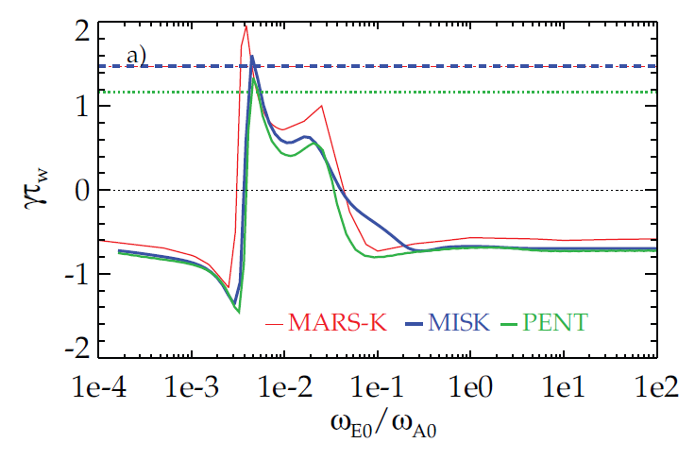
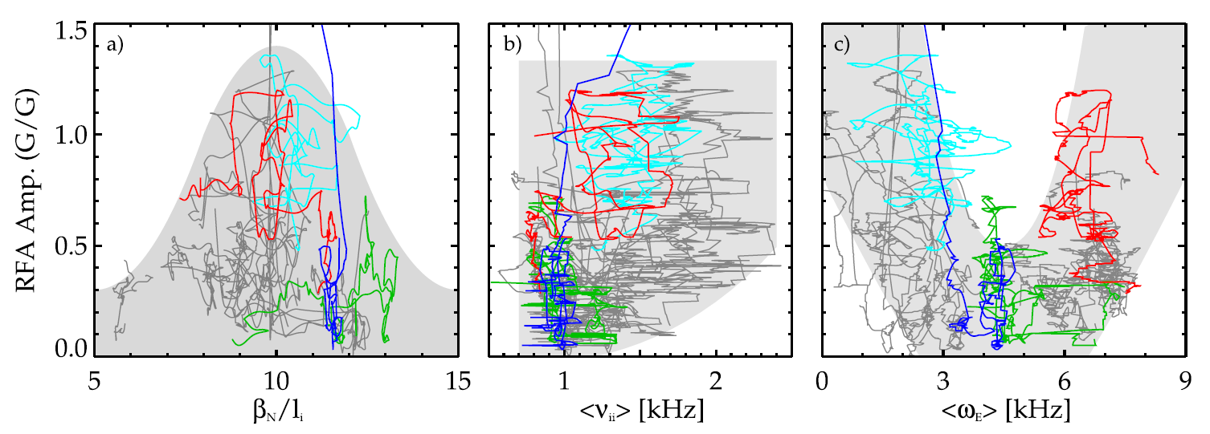
  Kinetic stability theory and comparison to NSTX is setting the stage for practical use in NSTX-U for disruption avoidance
  Moving kinetic RWM stability theory from successful theory/experiment comparison to actual implementation
Instability measure (RFA) vs. exp. ω_{E} for NSTX
Growth rate vs. ω_{E} for ITER case
    MISK (perturbative) benchmarked with other leading codes
    A simplified model based on these results will be implemented in NSTX-U disruption avoidance algorithm
  Ideal Wall Mode destabilization by rotational shear vs. stabilization by kinetic effects explained with MARS-K
    Also may help explain low-density/ramp-up disruptions in NSTX in prep for low ν operation (fast ions important)
PRL 2014
β_{N}
exp

Slide 16
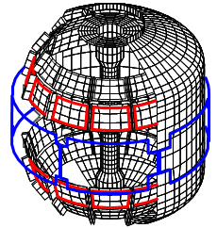
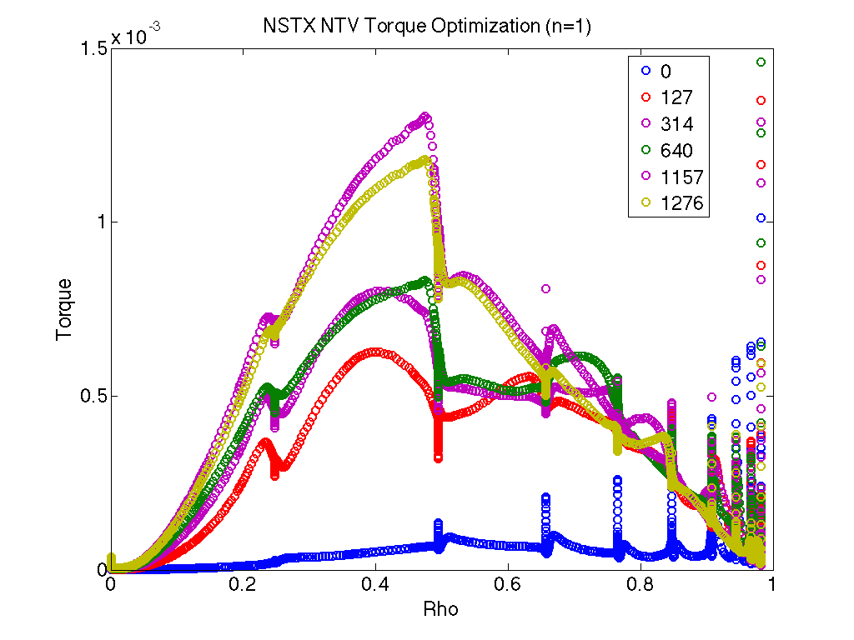
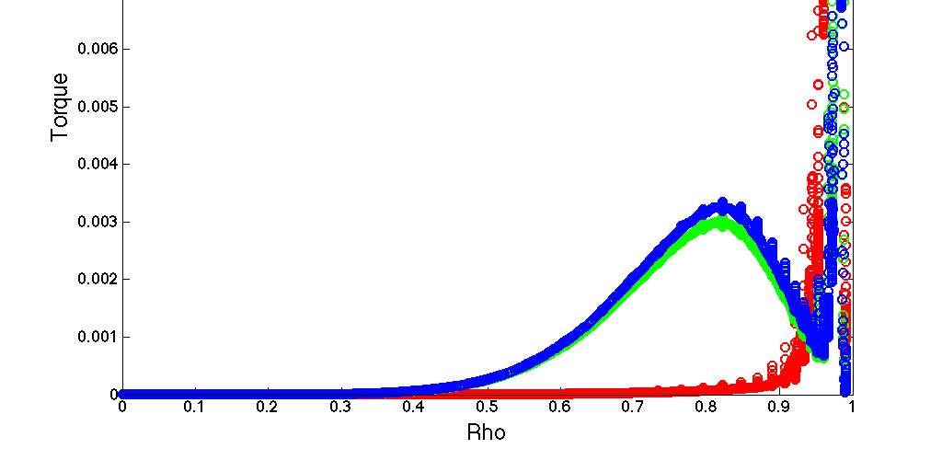
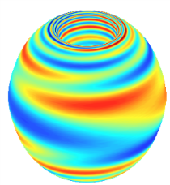
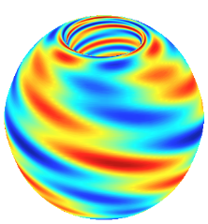
  Non-axisymmetric control coils (NCC) (incremental) will enhance physics studies and control
NCC designed with multiple physics metrics for:
error field, RWM, rotation control by NTV, RMP
  Analysis updated with IPEC-PENT and more NSTX-U targets
NCC design (on passive plates)
Existing coils
Utilizing stellarator optimization tools for NCC design
  The IPECOPT code developed (from STELLOPT) to optimize IPEC equilibrium for core and edge NTV Torque
PPPL Theory Partnership, JRT-14
Examples of initial IPECOPT NTV torque profile localization optimization
n=1
n=3
Torque
Iteration count
Optimized for 0.5<Ψ<0.9
Optimized for core
Rho
Rho

Slide 17
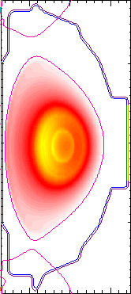
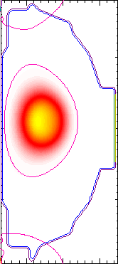
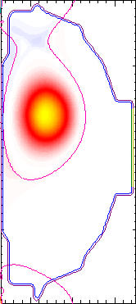
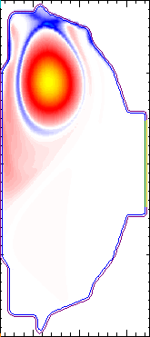
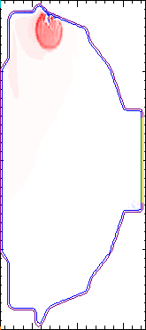
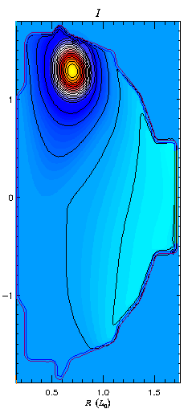
Simulations of VDEs have begun using M3D-C¹
Initial simulations from 2D low resolution calculation
  Benchmark against earlier TSC results
New capability is finite thickness wall
Note halo currents
Toroidal Current Density Evolution
(a)
(b)
(c)
(d)
(e)
Future work: Extend to 3D and realistic η to compute non-axisymmetric halo current distribution for validation against experimental measurements
Jardin

Slide 18
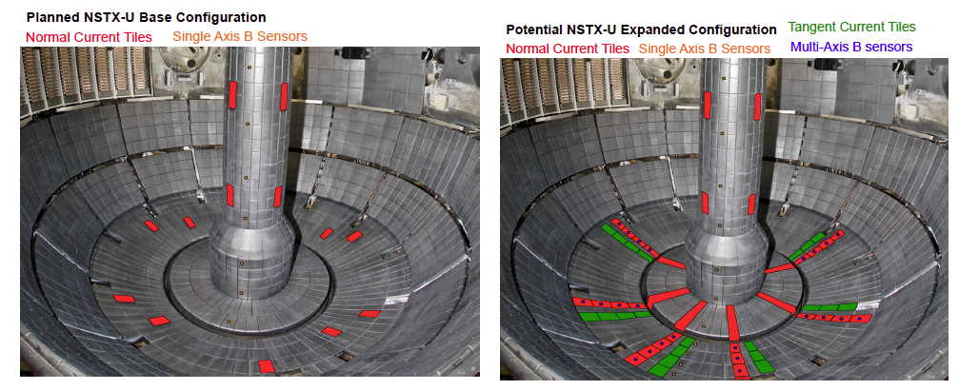
Halo current diagnostic upgrade planned
Definition of expanded configuration in progress
  Experimental post-doc hired for magnetics/disruptions/halo currents
  Hiring theory post-doc for modeling support (NSTX-U/theory partnership)

Slide 19
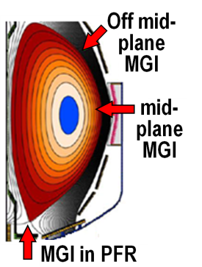
Macroscopic Stability Research Plans for FY2015-17:
Complete 3D coil design, re-establish high-β ops, assess MGI and halos
FY15: Finalize NCC coil specs for engineering design
  Re-establish n=1-3 error-field correction, RWM control, minimize EF rotation damping, sustain operation above no-wall limit
  Test poloidal dependence of Massive Gas Injection (outboard vs. private flux region)
FY16: Contribute unique MGI data (low-A, injector location) for mitigation + warning, prediction
  Assess mitigation triggering via real-time warning in NSTX-U
R15-3
JRT-2016
First data from upgraded halo diagnostics
FY17: Control of current and rotation profiles to improve global stability limits and extend high performance operation
R17-3

Slide 20
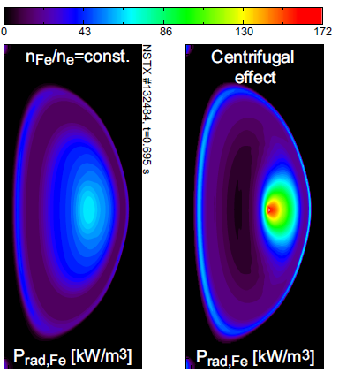

NSTX-U will study low- and high-Z impurity transport to assess potentially strong rotation effects
Will investigate if high-Z transport follows neoclassical including centrifugal effects
  Use 2nd NBI + NTV to vary rotation
Investigate particle transport using edge neutral measurement (D_{α} from MSE, BES; D_{β} camera) + DEGAS2 calculations
  Assess perturbative capability using TS, ME-SXR
  Perturbative particle transport measurements led on MAST in 2013 (Ren) – analysis ongoing
f₀=28 kHz
(M_{D,0}=0.56)
Collaboration with CCFE
Delgado-Aparicio, HTPD (2014)
Impurity transport studies: gas-puff (Ne, Ar), laser blow off (Ca, Mo, W – FY16, LLNL/JHU) and several diagnostic enhancements:
  Survey x-ray spectrometers (LLNL)
  XCIS: V_{ϕ,Z}, T_{Z}, n_{Z} (Ca, Ar, Mo, W) (PPPL)
  1D tangential mid-plane + 2D poloidal bolometers (PPPL)

Slide 21
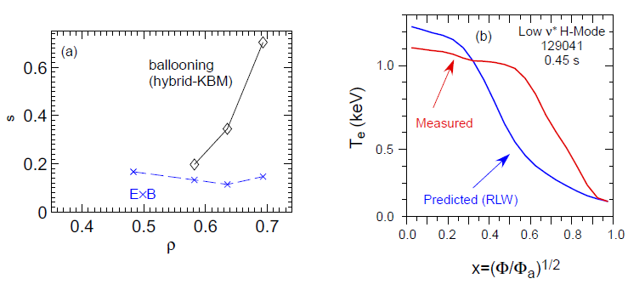
Testing reduced χ_{e} models for micro-tearing turbulence
ST providing unique access to high-β electromagnetic effects
Microtearing (MT) instability dominant in high-collisionality H-modes
T_{e} predictions using Rebut-Lallia-Watkins (1988) microtearing model show agreement
  Poor agreement for lower ν* discharges
  Will test physics-based TGLF transport model in FY15 (GA)
Beginning to investigate global EM effects (ρ*=ρ_{s}/a~1/120)
high-ν* H-mode
low-ν* H-mode
Microtearing
KBM
ExB
ρ
ρ
0
.
8
)
Measured
V
e
k
Predicted
(
0
.
e
4
T
Ad-hoc χ_{e}
20-30 m²/s
(GAE proxy)
Collaboration with UC-Boulder, GEM (Chowdhury),
EM in XGC1 (Lang, Ku) & GTS (Startsev, Wang) in FY15 (PPPL-Theory)
χ_{e} (RLW)
0
.
0
0
.
0
0
.
2
0
.
4
0
.
6
0
.
8
1
.
0
ρ
Kaye (2014)
ρ
No drift wave instability predicted near axis – influence of GAE/CAE?

Slide 22
Large inferred anomalous core electron transport in presence of CAE/GAEs
Observation of high frequency CAE/GAE modes in plasma core associated with flattening of T_{e} profile (Stutman et al., Tritz et al.)
  High level of transport (10-100 m²/s) inferred assuming classical beam physics
BES spectra show mode amplitudes peaking from R=115 to 120 cm (r/a~0.2 to 0.3), in region of enhanced transport
CAE/GAE
~δn amplitude of 738 kHZ CAE/GAE
Stutman
Smith
Is enhanced transport the full picture?

Slide 23
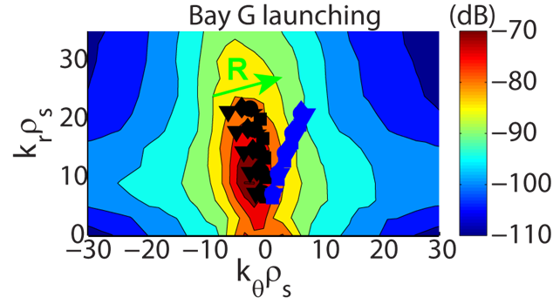
Transport and Turbulence Research Plans for FY2015-17:
Develop reduced χ_{e} models, first τ_{E} data at higher B_{T}, I_{P} + turbulence
FY15: Extend ST confinement scalings and understanding with up to 60% increase in B_{T} and I_{P}
  Measure low-k δn (BES w/ increased edge channel count), 1st polarimetry data
FY15-16: Develop and validate reduced transport models using ST data + linear and non-linear gyro-kinetic simulations
FY16: Extend confinement studies to full B_{T}, I_{P} → 2-3× lower ν*
R15-1
Initial utilization of new high-k FIR scattering system for ETG turbulence
  Measure k_{r} & k_{θ} to study turbulence anisotropy
Incremental: Study turbulence vs. ν*, rotation, q with high-k + BES + polarimetry
IR16-1
FY17: Assess impurity sources, edge/core impurity transport
  Utilize new laser blow-off system (LLNL) for edge impurity injection
R17-1

Slide 24
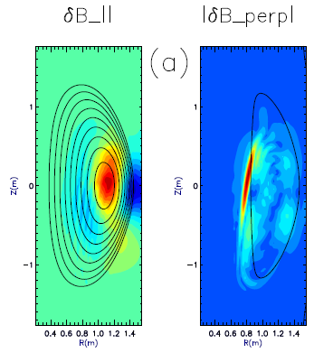
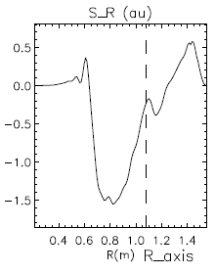
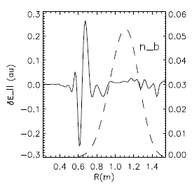
Investigating coupling of CAEs to kinetic Alfvén waves (KAW) as additional energy “loss” mechanism
GAE/CAEs cause large χ_{e} through stochastic orbits [Gorelenkov, NF 2010]
CAEs also couple to KAW - Poynting flux redistributes fast ion energy near mid-radius, E|| resistively dissipates energy to thermal electrons
  P_{CAE→KAW}~0.4 MW from QL estimate + experimental mode amplitudes (Belova,IAEA 2014)
  P_{e,NBI}~1.7 MW for ρ<0.3, NBI power deposited on core electrons
Radial Poynting flux
⟨E×B⟩_{R}
CAE
(n=8)
KAW
Up to 25% of electron heating power transferred to KAW off-axis?
~ρ_{beam}
E. Belova – HYM code
(PPPL Theory)
ω_{A}(R,Z)=ω_{CAE}

Slide 25
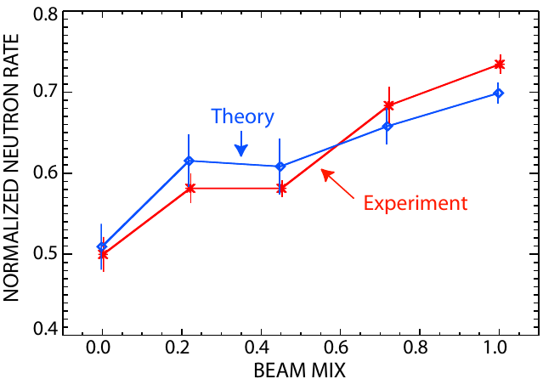
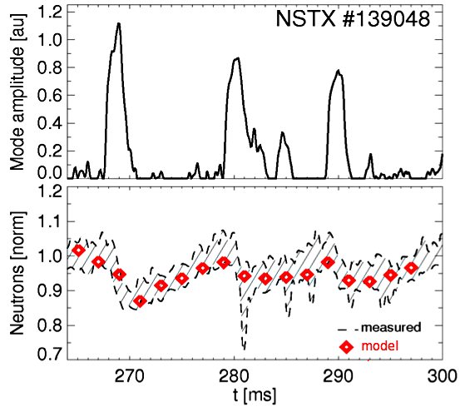
Validated reduced models for EP transport; extend validation beyond present DIII-D collaboration
“Critical Gradient” 1.5D model predicts relaxed fast ion profiles for given instabilities
Being validated on DIII-D, NSTX → NSTX-U
Motivates 2D, more accurate quasi-linear model
  Improve treatment of resonances in velocity space
  Working towards inclusion in TRANSP
Promising tool for ITER predictions
Validation of CGM on DIII-D
W. Heidbrink, N. Gorelenkov, NF 2013
on-axis off-axis
N. Gorelenkov, APS 2012
New “kick” model being implemented in NUBEAM/TRANSP for low-f AEs (μ conserved)
  Uses a probability distribution p(ΔE,ΔP_{ζ}|P_{ζ},E,μ) to model phase-space kicks by instabilities
  Provides detailed evolution of F_{nb}(P_{ζ},E,μ), hence accurate estimates for NB-driven current
Can handle multiple instabilities with arbitrary, time-varying mode amplitude
Initial validation with stand-alone NUBEAM successful for TAEs, kink-like modes on NSTX
M. Podestà, PPCF 2014

Slide 26
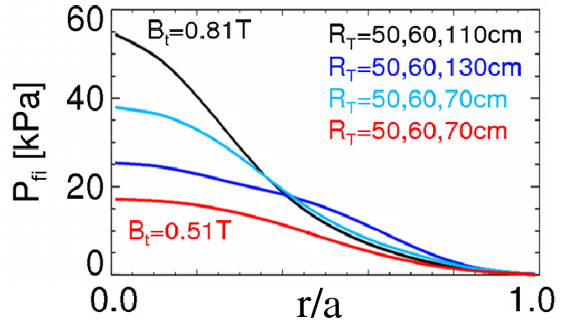
Energetic Particle Physics Research Plans for FY2015-17:
Develop full + reduced fast-ion transport models, characterize new 2nd NBI
FY15: Measure fast-ion (FI) density profiles, confinement, current drive, AE stability
R15-2
  Exploit new 2nd NBI and higher B_{T}, access to reduced v_{fast} / v_{A}
Complete reduced model for AE-induced fast ion losses in TRANSP
  Needed for NBICD in STs/ATs/ITER
FY15-16: Develop model χ_{e, AE} using measured CAE/GAE mode structures and HYM/ORBIT simulations (w/ T&T group)
FY17: Assess role of fast-ion driven instabilities versus micro-turbulence in plasma thermal energy transport
  Joint milestone between transport / energetic particle groups
R17-2

Slide 27
FY15-17 planned research supports
5 highest priority goals of NSTX-U 5 year plan:
Explore unique ST parameter regimes to advance predictive capability - for ITER and beyond
  Reduced ν* + high-β + varied q and rotation to extend understanding
Develop solutions for PMI challenge
  High-flux-expansion snowflake/X + radiative detachment
  Assess high-Z PFCs + liquid Li as integrated PMI solution
Advance ST for FNSF
  100% non-inductive sustainment at FNSF normalized performance
  Develop and understand non-inductive start-up, ramp-up/overdrive
Boundary Science
Pedestal
Divertor / SOL
Materials and PFCs

Slide 28
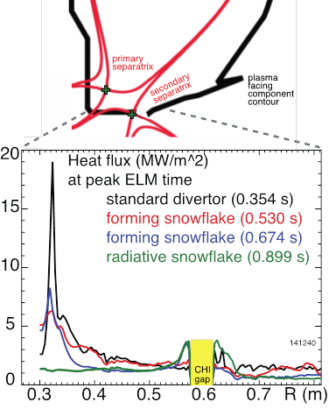
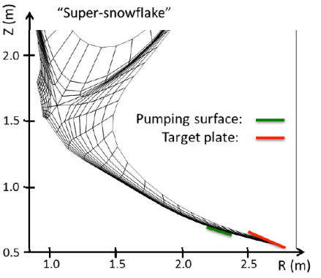
Modeling of radiative snowflake being performed in preparation for NSTX-U operation and design of ST-FNSF
ELM heat deposition from fast thermography
  A_{wet} decreases during Type-I and III ELMs
  A_{wet} decrease leads to q_{peak} increase with increase of ELM energy loss – mitigation needed (e.g., with rad. snowflake)
UEDGE modeling of ST-FNSF divertor
  Nitrogen-seeded tilted-plate and long-legged snowflake divertor provided 3x reduction in heat flux from ≤ 25 MW/m²
    NSTX-like transport χ_{i,e}= 2-4 m²/s
    P_{SOL}=30 MW, 4% nitrogen, R=1 (saturated metal plate)

Slide 29
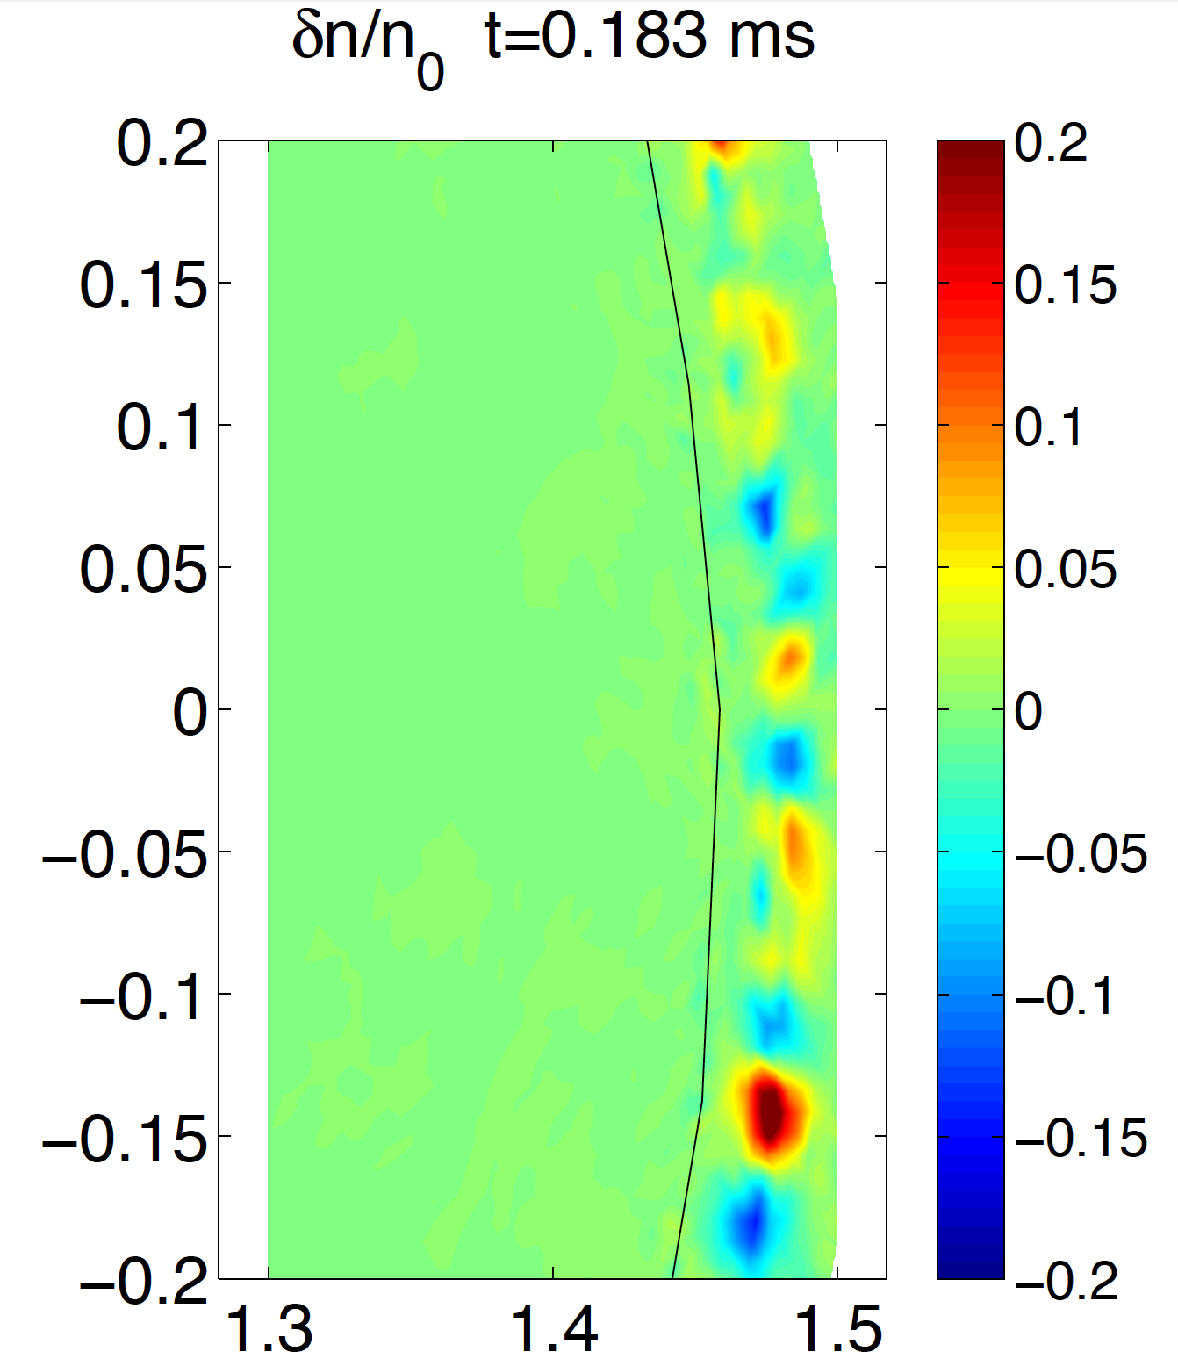
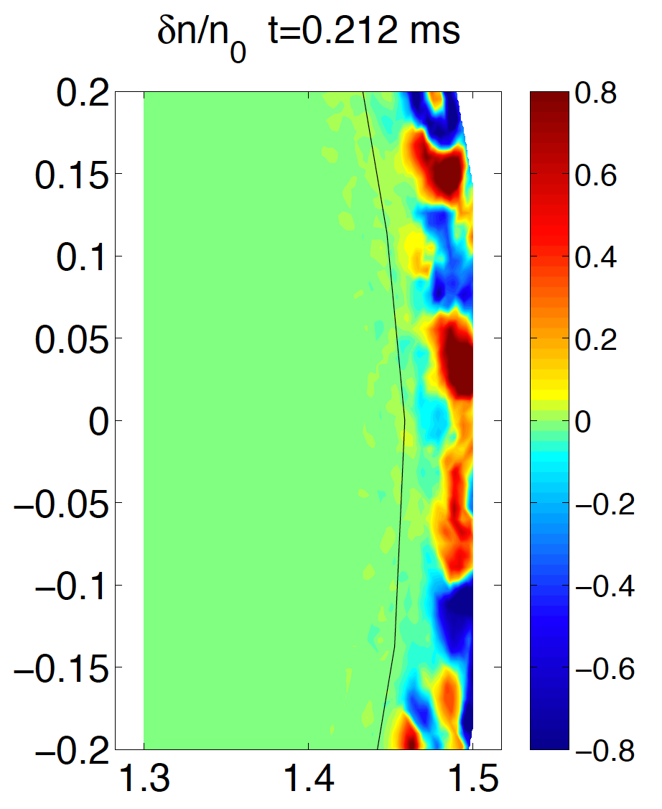
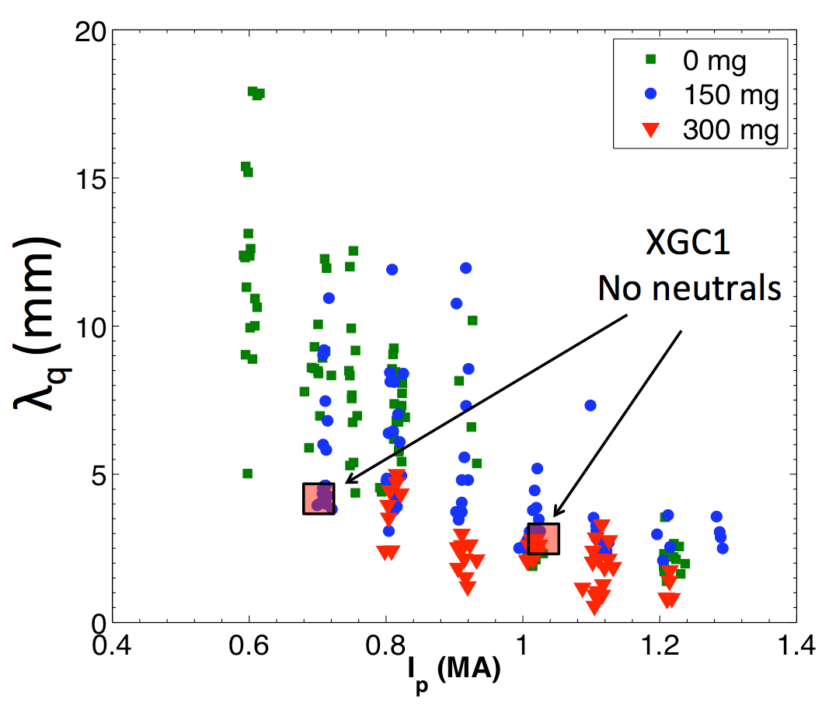
Collisionless XGC1 simulations indicate that the SOL heat flux width is set primarily by neoclassical processes
XGC1 (collisionless) predicts “blob” related turbulence
  Blobs stronger in SOL than in pedestal
  Stronger at higher I_{p}
Blobs do not appear to widen the heat load width above the neoclassical width (~Δ_{banana} ~1/I_{p} from XGC0)
Predicted variation of I_{p}^{-0.8} is consistent with observation (for 300 mg Li dep.)
300 mg Li deposition
λ_{q,mid} (mm)
I_{p} = 0.7 MA
I_{p} = 1.0 MA
Future Work: Extend to finite collisionality and recycling to determine effect on SOL λ_{q}

Slide 30
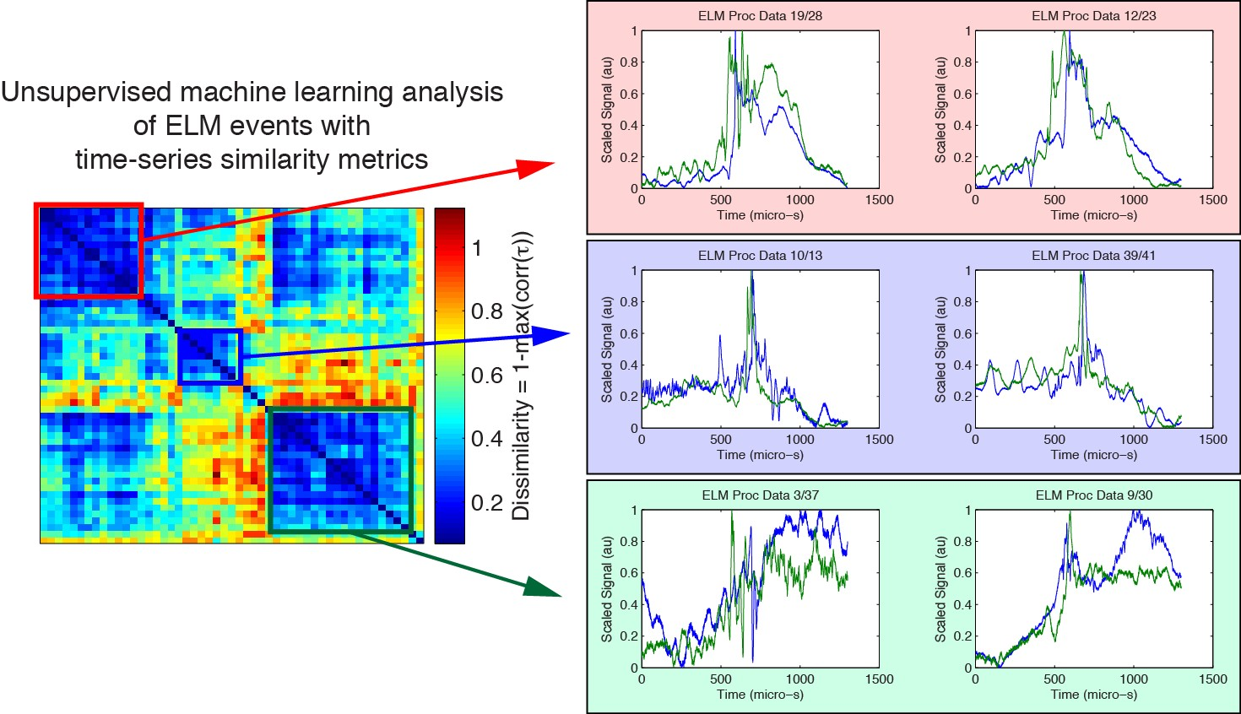
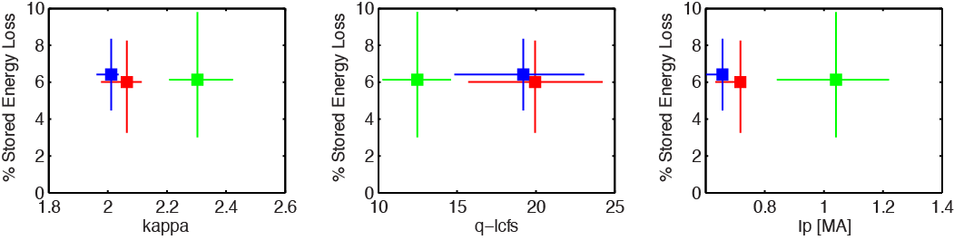
NSTX BES measurements used to identify 2 or 3
ELM groups with distinct nonlinear evolution patterns
Smith (UW)
NSTX ELM groups occur in distinct regions of parameter space:

Slide 31
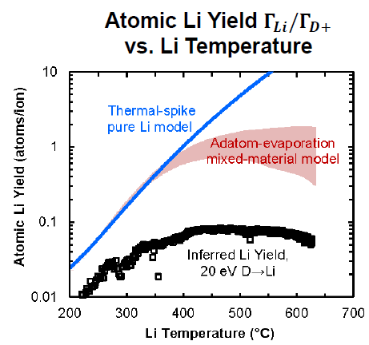
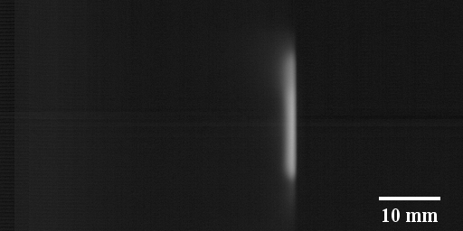
Magnum-PSI experiments on high-temperature Li show strongly reduced erosion and stable cloud production
Gross erosion measured spectroscopically in divertor-like plasma
  Neon plasma reproduces Langmuir Law
  Deuterium suppresses erosion
Reduced gross erosion and strong re-deposition result in 10× longer lifetime of 1 micron coating
  Consistent with Li trapping in pre-sheath
  Pre-sheath scale length consistent with neutral Li emission region (~3mm)
Abrams, PSI 2014
Neutral Li emission, t=2.5s
Incident Plasma
Target
Jaworski, PSI 2014

Slide 32
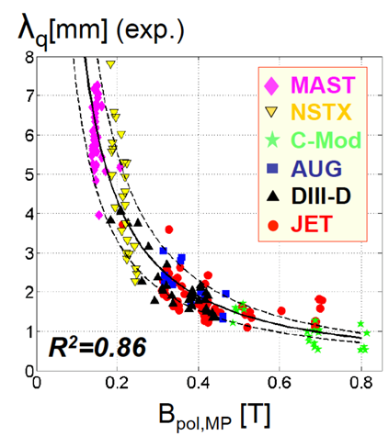
Boundary Science Research Plans for FY2015-17:
Advance snowflake, cryo, pedestal, SOL studies, extend to higher B_{T}, I_{P}
FY15: Measure pedestal structure, SOL width, ELM types, snowflake performance at up to 60% higher I_{P}, B_{T}, 2× higher P_{NBI}
Lithium granule injector (LGI) ELM triggering for impurity control, Li coating performance in NSTX-U - compare to EAST/DIII-D results
R15-1
EAST: assess long-pulse particle/impurity control with triggered ELMs, cryo-pumping, lithiumization, high-Z PFCs
FY16: Increase I_{P} → 2MA → test snowflake, detachment, PFCs with q|| up to 4-5× higher than NSTX
Assess high-Z + lithium coated PFC performance with 1 row of high-Z tiles on outboard divertor (at large R)
FY17 (incremental): Investigate power/momentum balance for high density divertor operation (vapor shielding baseline)
R16-1
R16-2
IR17-1

Slide 33
FY15-17 planned research supports
5 highest priority goals of NSTX-U 5 year plan:
Explore unique ST parameter regimes to advance predictive capability - for ITER and beyond
  Reduced ν* + high-β + varied q and rotation to extend understanding
Develop solutions for PMI challenge
  High-flux-expansion snowflake/X + radiative detachment
  Assess high-Z PFCs + liquid Li as integrated PMI solution
Advance ST for FNSF
  100% non-inductive sustainment at FNSF normalized performance
  Develop and understand non-inductive start-up, ramp-up/overdrive
Integrated Scenarios
Adv. scenarios and control
Start-up
Wave heating and CD

Slide 34
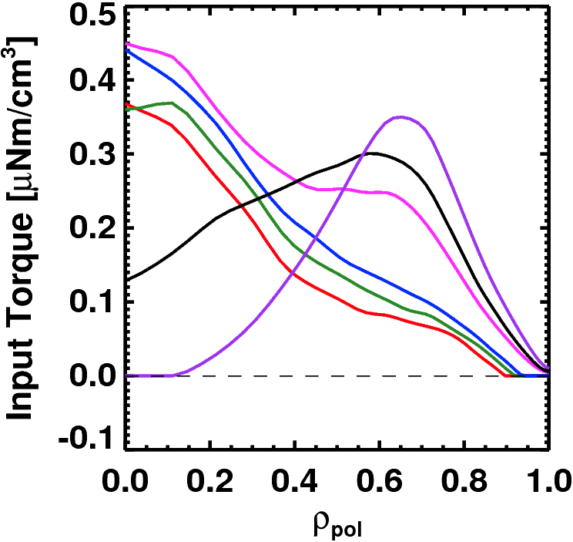
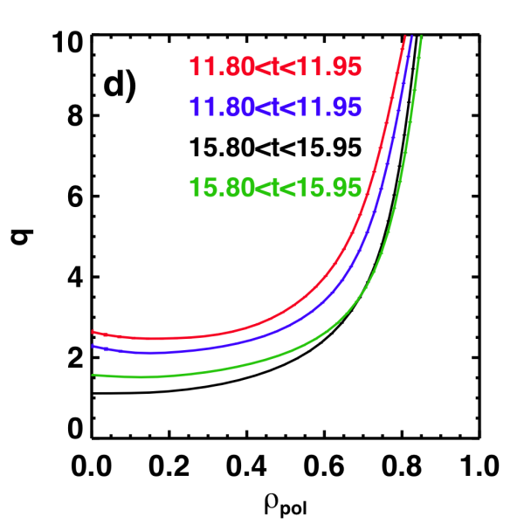
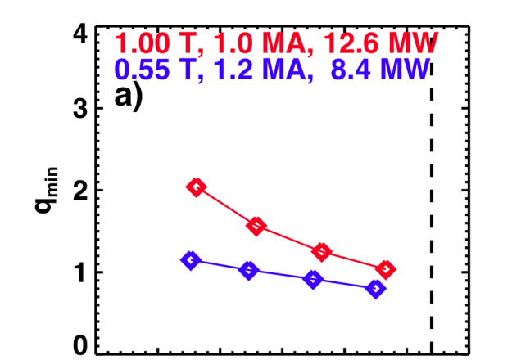
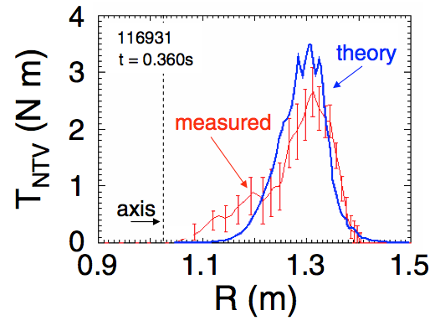
NSTX-U is developing a range of profile control actuators for detailed physics studies, scenario optimization for FNSF
q-Profile Actuators
Rotation Profile Actuators
Variations in Beam Sources
800 kA Partial Inductive, 87% < f_{NI} < 100%
Torque Profiles From 6 Different NB Sources
Largest R_{tan}
800 kA and 1 T
[50,60,70,130] cm
[50,60,120,130] cm
[60,70,110,120] cm
[70,110,120,130] cm
Neutral
Beams
(TRANSP)
Smallest R_{tan}
Measured and Calculated Torque Profiles from 3D Fields
Variations in Outer Gap
(n=3)
27 22 17 12 7 2
Zhu, et al., PRL
Outer Gap

Slide 35
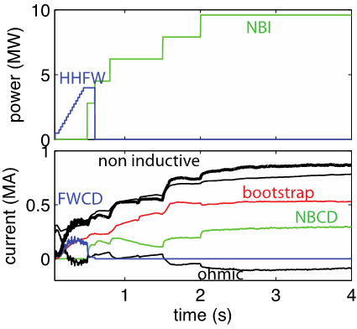
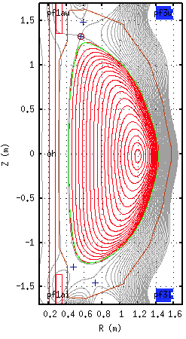
Free-boundary TRANSP now being used routinely to model NSTX-U non-inductive ramp-up (+ other scenarios)
First ramp-up modelling with self-consistent NBI → 2nd NB line can ramp-up current from HHFW-heated plasma and sustain stationary 900kA
ISOLVER equilbrium
t = 3.5s
κ~2.50
δ~0.75
HHFW used at t < 0.5 to ramp to ~400kA and heat target plasma
Final state: n_{e,lin} = 8x10¹⁹ m⁻² → ~900kA non-inductive, ~60% bootstrap
β_{T}~7%, β_{P}~6%, β_{FAST} / β_{TOT}~0.25-0.35, H₉₈~1.2 (τ₉₈~70ms)

Slide 36
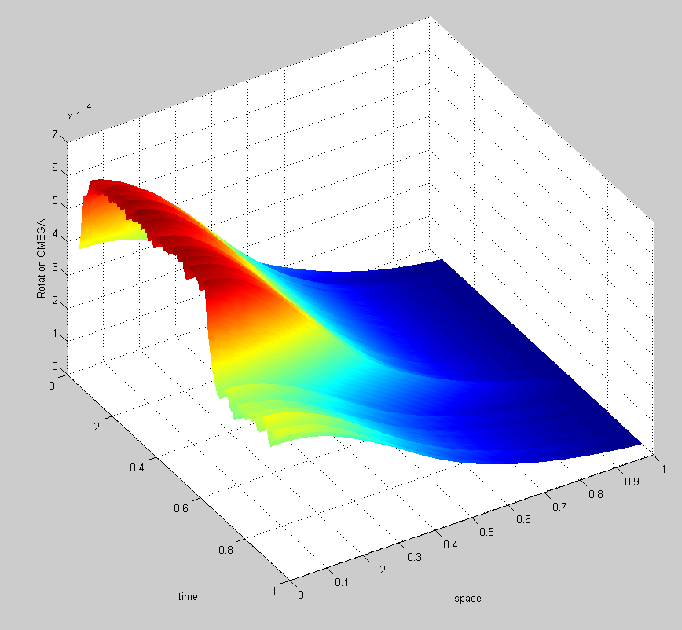
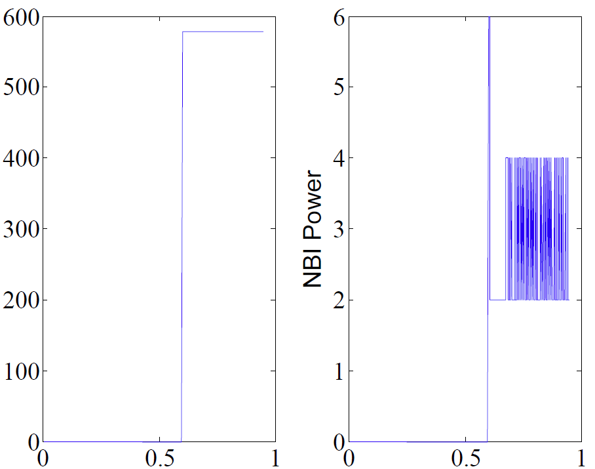
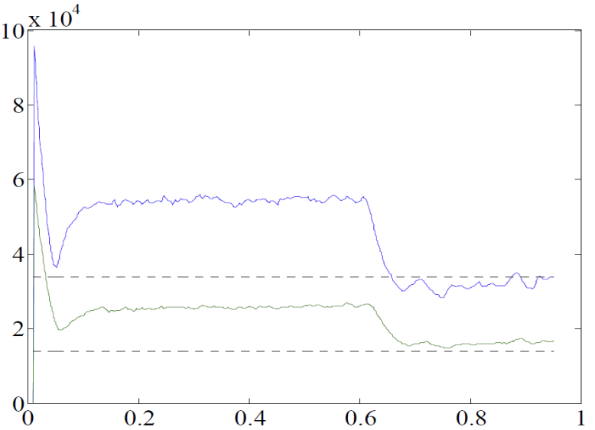
TRANSP used for simulating toroidal rotation control using NBI and magnetic braking (NTV) as actuators
3D coil current and NBI power (actuators)
3D Coil Current (A)
NBI power (MW)
feedback on
Plasma rotation (rad/s)
t (s)
t (s)
Rotation evolution vs. desired
rotation setpoints
feedback on
t (s)
Plasma rotation (rad/s)
Normalized radius
desired ω_{φ} (#1)
desired ω_{φ} (#2)
This case uses pre-programmed 3D coil current and NBI feedback
t (s)

Slide 37
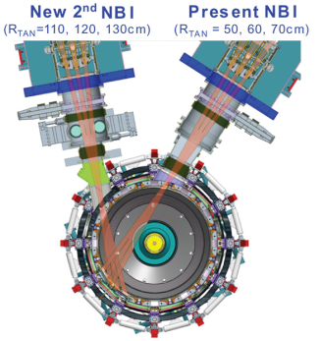
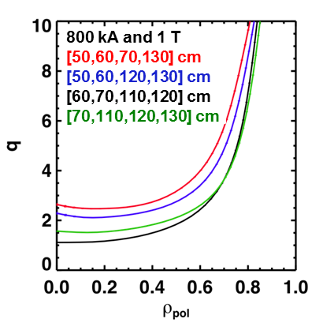


Advanced Scenarios and Control Research Plans for FY2015-17:
Implement advanced controls, explore high non-inductive & I_{P} scenarios
FY15: Re-establish NSTX-U control and plasma scenarios
  Vertical/shape control, NBI beta feedback control, EF/RWM control
Assess new 2nd NBI current-drive vs. R_{TAN}, n_{e}, outer gap
  Push toward 100% non-inductive at higher B_{T}, P_{NBI}
  Quantify impact of broadened J(r), p(r) on confinement, stability
Explore scenarios (τ_{E}, l_{i}, MHD) at up to 60% higher I_{P}, B_{T}
FY16: Explore scenarios at full I_{P} and B_{T} capability of NSTX-U
  Goal: Access 100% non-inductive, test small I_{P} overdrive
FY17: Control of current and rotation profiles to improve global stability limits and extend high performance operation
R15-3
JRT-2015
R16-3
R17-3

Slide 38


Plasma initiation with small or no transformer is unique challenge for ST-based Fusion Nuclear Science Facility
NSTX-U Non-Inductive Strategy:
ST-FNSF has no/small central solenoid
NSTX-U 5 year plan goal:
  Generate ~0.4MA closed-flux start-up current with helicity injection
  Heat CHI with ECH and/or fast wave, ramp 0.4MA to 0.8-1MA with NBI

Slide 39



TSC code successfully used to interpret NSTX, now using to optimize NSTX-U coil currents for CHI operation
Favorable PF coil current evolution for NSTX-U transient CHI identified:
  Initiate CHI with PF1C injector coil
  Grow CHI plasma into magnetic well
  Provide buffer flux with PF1CU (absorber coil)
  PF1AL, PF2L, PF3L adjusted as needed to reduce/optimize injector currents
NSTX-U Vessel Geometry, 100 eV
CHI generated toroidal current increases approximately linearly with injector flux as expected

Slide 40


NIMROD simulations suggest Transient CHI has resemblance to 2D Sweet Parker-type reconnection
With reduction of injector voltage & current a toroidal E-field is generated in the injector region
  E_{toroidal} X B_{poloidal} drift brings oppositely directed field lines closer and cause reconnection generating closed flux
Direction of plasma flows
In Injector Region only
Elongated Sweet-Parker-type current sheet forms in injector region
Higher-n modes/MHD not strongly impacting 2D reconnection and closed-flux current generation
Current
sheet
F. Ebrahimi, et al., PoP (2013)
F. Ebrahimi, et al., PoP (2014)

Slide 41




CHI current sheet unstable → formation of plasmoids → merging
NSTX may provide first lab observation of plasmoids - relevant to astrophysics
Possible NSTX plasmoids during CHI
Ebrahimi and Raman – submitted to PRL (2015)

Slide 42

Solenoid-Free Start-up and Ramp-up Research Plans for FY2015-17:
Prepare CHI for NSTX-U, assess CHI/NBI start-up/ramp-up
FY15: Establish NSTX-U CHI, assess impact of new injector, gap, higher B_{T}
FY15-16: Initial tests of small NBI+BS overdrive ramp-up using new 2nd NBI and higher B_{T}
FY17: Assess transient CHI current start-up potential in NSTX-U
  Characterize maximum start-up current vs. injector flux, CHI voltage, toroidal field, high-power ECH (if available – incremental)
  Study reconnection region and plasmoid instabilities with improved cameras/imaging
R17-4

Slide 43



Wave Physics Research Plans for FY2015-17:
Finalize ECH/EBW design, simulate & develop reliable FW H-mode
FY15: Support 1MW/28GHz ECH/EBW engineering design
  ECH to heat CHI, form target for HHFW/NBI
  EBW H&CD for start-up, sustainment
FY16: Assess fast-wave SOL losses and core thermal and fast ion interactions at increased B_{T}, I_{P}
FY17: Utilize ECH/EBW (incremental) for non-inductive start-up studies – couple to CHI → HHFW heating → NBI ramp-up
R16-2
AORSA modeling:
higher B → lower SOL losses
N. Bertelli

Slide 44
Outline
NSTX-U mission, priorities, FY15-17 overview
FY14-16 research plans
Milestone summary
ITPA contributions
ST-FNSF configuration study
Summary

Slide 45
Administration FY2016 request-level provides run-time and full field + current to exploit most new Upgrade capabilities
FY2015
FY2016
FY2017
Run Weeks:
12
14
14
R15-1
R16-1
R17-1
Boundary Science
+ Particle Control
Assess H-mode confinement, pedestal, SOL characteristics at higher B_{T}, I_{P}, P_{NBI}
Assess scaling, mitigation of steady-state, transient heat-fluxes w/ advanced divertor operation at high power density
Assess impurity sources and edge and core impurity transport
R16-2
Assess high-Z divertor PFC performance and impact on operating scenarios
Core Science
R15-2
R17-2
Assess effects of NBI injection on fast-ion f(v) and NBI-CD profile
Assess role of fast-ion driven instabilities versus micro-turbulence in plasma thermal energy transport
R16-3
R17-3
R15-3
Assess fast-wave SOL losses, core thermal and fast ion interactions at increased field and current
Control of current and rotation profiles to improve global stability limits and extend high performance operation
Integrated Scenarios
Develop physics + operational tools for high-performance: κ, δ, β, EF/RWM
R16-4
R17-4
Develop high-non-inductive fraction NBI H-modes for sustainment and ramp-up
Assess transient CHI current start-up potential in NSTX-U
FES 3 Facility Joint Research Target (JRT)
NSTX-U leads JRT
C-Mod leads JRT
DIII-D leads JRT
Quantify impact of broadened J(r) and p(r) on tokamak confinement, stability
Assess disruption mitigation, initial
tests of real-time warning, prediction
TBD

Slide 46
accelerates transport and divertor research, strongly utilizes facility, supports 5YP enhancements
Incremental
FY2015
FY2016
FY2017
Run Weeks:
12
14
16
14
16
R15-1
R16-1
R17-1
Boundary Science
+ Particle Control
Assess H-mode confinement, pedestal, SOL characteristics at higher B_{T}, I_{P}, P_{NBI}
Assess scaling, mitigation of steady-state, transient heat-fluxes w/ advanced divertor operation at high power density
Assess impurity sources and edge and core impurity transport
R16-2
IR17-1
Assess high-Z divertor PFC performance and impact on operating scenarios
Investigation of power and momentum balance for high density and impurity fraction divertor operation
R15-2
IR16-1
R17-2
Core Science
Assess effects of NBI injection on fast-ion f(v) and NBI-CD profile
Assess confinement and local transport and turbulence at low ν* with full confinement and diagnostic capabilities
Assess role of fast-ion driven instabilities versus micro-turbulence in plasma thermal energy transport
R16-3
R17-3
R15-3
Assess fast-wave SOL losses, core thermal and fast ion interactions at increased field and current
Control of current and rotation profiles to improve global stability limits and extend high performance operation
Integrated Scenarios
Develop physics + operational tools for high-performance: κ, δ, β, EF/RWM
R16-4
R17-4
Develop high-non-inductive fraction NBI H-modes for sustainment and ramp-up
Assess transient CHI current start-up potential in NSTX-U
FES 3 Facility Joint Research Target (JRT)
NSTX-U leads JRT
C-Mod leads JRT
DIII-D leads JRT
Quantify impact of broadened J(r) and p(r) on tokamak confinement, stability
Assess disruption mitigation, initial
tests of real-time warning, prediction
TBD

Slide 47
Outline
NSTX-U mission, priorities, FY14-16 overview
FY14-16 research plans
Milestone summary
ITPA contributions
ST-FNSF mission and configuration study
Summary

Slide 48
Supporting ITER through ITPA participation
Representatives in every Task Group, leadership in several:
  R. Maingi: chair of Pedestal and Edge Physics TG
  S. Sabbagh: Leads WG on RWM code benchmarking, RWM stability & control
Active in 31 JEX/JACs with many contributors from NSTX-U
Pedestal, Scrape-Off Layer, Divertor
PEP-26 | Critical edge parameters for achieving L-H transitions | PEP-37 | Effect of low-Z impurity on pedestal and global confinement
PEP-28 | Physics of H-mode access with different X-point height | DSOL-31 | Leading edge power loading and monoblock shaping
PEP-29 | Vertical jolts/kicks for ELM triggering and control | DSOL-34 | Far-SOL fluxes and link to detachment
PEP-30 | ELM control by pellet pacing in ITER-like conditions | DSOL-35 | In-out divertor ELM energy density asymmetries
PEP-31 | Pedestal structure and edge relaxation mechanisms in I-mode
Energetic Particles
EP-6 | Fast ion losses + associated heat loads from edge perturbations (ELMs, RMPs)
Integrated Operating Scenarios
IOS-1.2 | Divertor heat flux reduction in ITER baseline scenario | IOS-3.3 | Core confinement for q(0)=2
IOS-1.3 | Operation near P_{LH} | IOS-5.2 | Maintaining ICRH coupling in expected ITER regime
IOS-2.1 | Compare helium H-modes in different devices
Macroscopic Stability and Control
MDC-1 | Disruption mitigation by massive gas jets | MDC-18 | Evaluation of axisymmetric control aspects
MDC-8 | Current drive prevention/stabilization of NTMs | MDC-19 | Error field control at low plasma rotation
MDC-15 | Disruption database development | MDC-21 | Global mode stabilization physics and control
MDC-17 | Active disruption avoidance | MDC-22 | Disruption prediction for ITER
Transport and Turbulence
TC-9 | Scaling of intrinsic plasma rotation with no external momentum input | TC-15 | Dependence of momentum and particle pinch on collisionality
TC-10 | Experimental ID of ITG, TEM, ETG turbulence and comparison with codes | TC-17 | ρ* scaling of intrinsic torque
TC-11 | He and impurity profiles and transport coefficients | TC-19 | Characteristics of I-mode plasmas
TC-14 | RF rotation drive | TC-24 | Impact of resonant magnetic perturb. on transport, confinement
Maingi (chair), Ahn, Canik, Chang, Diallo, Goldston, Jaworski
Fredrickson, Fu, Gorelenkov, Heidbrink, Kramer, Podestá
Gerhardt, Kessel, Poli, Gates, Boyer
Sabbagh, Berkery, Jardin, Park, Zakharov, Gerhardt, Menard
Kaye (previous chair), Ren, Guttenfelder, McKee/Smith
48

Slide 49



NSTX-U / U.S. ST researchers led LDRD-funded study of Mission and Configuration of an ST-FNSF
FY2014 / Final Results:
  Identified coil configuration compatible with:
    Breeding in CS end region + vertical maintenance
    Ex-vessel PF coils on outboard, can be S/C, support range of l_{i} and β_{N}
    Divertor power exhaust: q_{peak} ~ 3-5MW/m², partially detached
  p, J_{BS}(r) important for l_{i} / κ / PF coils – assess in NSTX-U
  Carried out free-boundary TRANSP simulations for NNBI+BS current drive, fusion performance, neutronics
  Tritium breeding ratio (TBR) ~ 1 requires large enough R₀ and breeding blankets near top + bottom of centerstack
Blanket regions
R₀ = 1.7m
TBR ~ 1
R₀ = 1m
TBR ~ 0.9
Breeding at back of blanket important for tangential NBI ducts

Slide 50
Outline
NSTX-U mission, priorities, FY14-16 overview
FY14-16 research plans
Milestone summary
ITPA contributions
ST-FNSF mission and configuration study
Summary

Slide 51
NSTX-U program well-aligned with priorities of upcoming FES workshops
Plasma material interactions
  Scrape off layer / divertor physics
  PMI and long pulse divertor simulators
  Engineering innovations for plasma exhaust
  Plasma core-edge integration
Transients
  Disruption prediction, avoidance, mitigation
  ELM suppression with RMP
  Naturally ELM-free operation
  ELM pacing
Integrated Simulations
  Disruption prevention, avoidance, mitigation
  Plasma boundary (Ped, SOL, PMI)
  Whole device modeling
Plasma science frontiers
NSTX-U contributions:
  Low-A, advanced divertors
  MAPP + surface science
  Liquid metal PFCs
  Long-term NSTX-U goal
  Kinetic MHD, PCS, MGI
  NCC RMP (incremental)
  Li-wall scenarios, EPH
  Granule injector, 3D fields
  Kinetic MHD codes
  XGC, UEDGE, Walldyn, …
  TRANSP, control models
  EM turbulence, plasmoids

Slide 52
Summary: NSTX-U FY2015-17 research plan strongly supports FES vision, scientific organization
Foundations
  Expect transport, stability discoveries in new high-β + low-ν* regime
  Core: Non-linear AE* / fast-ion dynamics, disruptions, response to 3D δB
  Boundary: SOL-widths & turbulence, advanced divertors, Li-based PFCs
Long-Pulse
  PMI: EAST collaboration: long-pulse performance of high-Z, liquid metals
  FNSF: NSTX-U provides critical data on confinement, stability, sustainment
High-Power
  Robust Control: Goal: high-β + full non-inductive, disruption avoidance
Incremental funding needed to fully utilize NSTX-U
facility and implement 5YP facility enhancements

Slide 53
Backup Slides

Slide 54







NSTX Upgrade will access next factor of two increase in performance to bridge gaps to next-step STs
Low-A
Power Plants
Parameter | NSTX | NSTX Upgrade | Plasma Material Interface Facility | Fusion Nuclear Science Facility | Pilot Plant
Major Radius R₀ [m] | 0.86 | 0.94 | 1.0 | 1.3 | 1.6 – 2.2
Aspect Ratio R₀ / a | ≥ 1.3 | ≥ 1.5 | ≥ 1.8 | ≥ 1.5 | ≥ 1.7
Plasma Current [MA] | 1 | 2 | 3 – 4 | 4 – 10 | 11 – 18
Toroidal Field [T] | 0.5 | 1 | 2 | 2 – 3 | 2.4 – 3
Auxiliary Power [MW] | ≤ 8 | ≤ 19* | 30 – 50 | 22 – 45 | 50 – 85
P/R [MW/m] | 10 | 20 | 30 – 50 | 30 – 60 | 70 – 90
P/S [MW/m²] | 0.2 | 0.4-0.6 | 0.7 – 1.2 | 0.6 – 1.2 | 0.7 – 0.9
Fusion Gain Q |  |  |  | 1 – 2 | 2 – 10
ARIES-ST (A=1.6)
JUST (A=1.8)
VECTOR (A=2.3)
* Includes 4MW of high-harmonic fast-wave (HHFW) heating power
Non-inductive start-up, ramp-up, sustainment
Confinement scaling (esp. electron transport)
Stability and steady-state control
Divertor solutions for mitigating high heat flux
Key issues to resolve for next-step STs

Slide 55



Supporting ITER through massive gas injection (MGI) research for disruption mitigation
MGI research will assess gas penetration efficiency at different poloidal locations
NSTX-U researchers successfully tested, will utilize pulsed-induction MGI valves
Same design as is being developed for ITER
Builds on designs used on JET and TEXTOR
Eliminates magnetic material in valve that can saturate in external magnetic field
Sub-ms opening time → well suited for MGI
Can operate at very high pressure (5-10kTorr)
Discharging small capacitor through a pancake coil (in solenoid chamber) induces image currents on conducting (non-magnetic) piston, which causes it open on a sub ms time scale
Predictive capability: Modeling using DEGAS-2 is quantifying the gas penetration past the SOL for NSTX-U
1
NSTX-U can offer new insight by:
  Reducing the amount of gas
  Injecting gas into the private flux and lower x-point regions of divertor to determine if these are more desirable locations for MGI
R. Raman (University of Washington)

Slide 56
Joint NSTX/Theory Partnership Aimed at Understanding ITER-Relevant Halo Current Physics
Dynamics of the halo currents and forces are critical for ITER
  Particular concern: the halo current asymmetry magnitude and its rotation
Key physics questions being addressed:
  The role of boundary conditions (v_{N}=0, or not) in determining halo/hiro currents
  The role of model assumptions (sharp boundary vs. diffuse halo currents)
  Halo current distributions in arbitrary conducting structures
Possible diagnostics fall into four areas:
  Shunt tiles of the type previous implemented on NSTX
    Limited array of shunt tiles will be present for first run
  Novel diagnostic tiles to assess currents flowing along tile surfaces
  3-axis magnetic sensors in the divertor to assess local forces and non-axisymmetries
  Poloidal arrays of magnetic sensors to enable measurements of the “I_{P} asymmetry” as in JET

Slide 57


Lithium Granule Injector (LGI) is newly demonstrated tool for pedestal/ELM control and scenario optimization
Successful EAST and DIII-D demonstrations / collaborations
  Capable of up to 0.5 kHz injection
LGI will be tested on NSTX-U for high-frequency ELM pacing
  Possible density control technique:
    Combine Li coatings for D pumping with LGI for ELM-expulsion of carbon
  Goal: reduce Z_{eff} to ~2-2.5
  Injection of Li granules could also potentially replenish PFC Li coatings
ASDEX-U/JET/ITER: potentially interested in testing B/Be granules for ELM pacing
EAST data

Slide 58




Improving model estimates of energy transport due to Alfvén eigenmodes
Assumed GAE, CAE mode structures, amplitude, polarity used previously to model χ_{e,EP} from ORBIT modeling (Gorelenkov, 2010; Tritz, 2012)
Measured n, ω, δn + dispersion allow distinction of GAE, CAE
HYM simulations predict both GAE and CAE
  E.g, counter propagating GAE frequencies consistent, mode structure shows some discrepancies
  Measured displacements used to estimate CAE→KAW power channeling, P_{CAE→KAW}~γ(δB)², δB~ξ
Crocker, NF (2013)
Will use measured mode structures, amplitude, polarity in ORBIT simulations to model χ_{e,EP} in FY14-16 (Crocker, UCLA)
GAEs
CAEs
n=7
f_{exp} = 520 kHz
f_{sim} = 510 kHz
n=6
f_{exp} = 560 kHz
f_{sim} = 590 kHz
Will test additional physics in HYM simulations in FY14-16
(E. Belova, PPPL Theory)
FY17+ goal of fully nonlinear, self-consistent HYM predictions of χ_{e,EP} and P_{CAE→KAW}
Crocker, IAEA (2014)

Slide 59


Developing scheme to compute fast ion redistribution from
*AE in NUBEAM/TRANSP using probabilistic methods
Methodology:
Supports R(14-2)
M. Podestá

Slide 60
Momentum transport predictions being used to help constrain theory
#1
#2
#3
#4
#5
high β H-modes (r/a~0.7)
Coriolis pinch (#2) for ITG generally describes conventional aspect ratio results
  Microtearing (MT) & kinetic ballooning modes (KBM) predicted in NSTX H-modes, calculated pinch is inconsistent
Simulation challenges at high β motivated analysis in low β L-modes
  Nonlinear simulations with E×B shear (#4) predict weak pinch, even for low β ITG
  Led perturbative L-mode experiments at MAST using 3D δB fields (2013) – analysis ongoing
Investigating finite-ρ* effects for momentum transport in low-β L-mode
  Global GTS, GYRO & XGC1 (δf) simulations predict inward directed residual stress (#5) in absence of flow (u=u′=γ_{E}=0)
Kaye (2009)
RV_{ϕ}/χ_{ϕ} (experiment)
KBM
k_{θ}ρ_{s}<0.4
Investigating centrifugal effects (#3) in FY14, collaboration with U-Bayreuth, GKW (Buccholz)
RV_{ϕ}/χ_{ϕ} (QL simulations)
ITG in low β NSTX L-mode
Collaboration with CCFE
Inward directed residual stress
Ongoing global benchmark in FY14-15
Notes:
If residual stress important, will need to revisit experimental analysis

Slide 61





Strong flow shear can destabilize Kelvin-Helmholtz (K-H) instability in NSTX (Wang, TTF 2014)
K-H instability expected for |ML_{n}/L_{ω}|>1 from linear analytic theory (Catto, 1973; Garbet, 1999)
K-H identified in global electrostatic ITG simulations for NSTX low β L-mode (Ren, 2013)
  Mostly unstable K-H modes have finite k|| (shifted away from nq=m)
K-H/ITG + neoclassical close to experiment χ_{i}
  χ_{e} underpredicted
  ETG possibly important
GTS code
nq=m
Nonlinear ETG simulations to be run in FY14-15 to investigate contribution in NSTX L-modes

Slide 62
5 year plan goal: access performance levels of next-steps, approach Pilot-Plant regimes
Requirements for tokamak / ST next-steps:
1.0
Bootstrap fraction
0.9
ST-Pilot
Full non-inductive (NI) current drive for steady-state operation
  ST requires NI start-up/ramp-up
High confinement to minimize auxiliary heating, device size
Sustained high β to minimize magnet size, forces, power
Divertor/first-wall survival with intense power/particle fluxes
f_{BS}
0.8
ST-PMI
ST-FNSF
0.7
NSTX-U
0.6
0.5
2.0
Normalized Confinement
1.8
ST-Pilot
H_{98y2}
1.6
1.4
ST-FNSF
NSTX-U
ST-PMI
1.2
1.0
8.0
Normalized Beta
β_{N}
7.0
ST-Pilot
6.0
NSTX-U
5.0
ST-PMI
ST-FNSF
4.0
3.0
1.0
ST-PMI
ST-FNSF
ST-Pilot
P/S
0.8
0.6
NSTX-U
[MW/m²]
0.4
0.2
0.0
Power exhaust challenge

Slide 63



NSTX has already accessed A, β_{N}, κ needed for ST-based FNSF – next step is to access & control 100% non-inductive
NSTX-U TRANSP predictions:
B_{T}=1.0 T, I_{P}=1 MA, P_{inj}=12.6 MW
Contours of Non-Inductive Fraction
Contours of q_{min}

Slide 64


Non-inductive ramp-up from ~0.4MA to ~1MA projected to be possible with new CS + more tangential 2nd NBI
More tangential NBI provides 3-4x higher CD at low I_{P}:
  2x higher absorption (40→80%) at low I_{P} = 0.4MA
    Now modeling coupling to 0.2-0.3MA (TRANSP)
  1.5-2x higher current drive efficiency
TSC simulation of non-inductive ramp-up from initial CHI target
  - Simulations now being improved to use TRANSP/NUBEAM loop within TSC
  Experimental challenges:
    Maximum NBI power in low l_{i} CHI plasma
Present NBI
More tangential 2nd NBI
R. Raman, F. Poli, C.E. Kessel, S.C. Jardin

Slide 65

AORSA predicts RF field amplitude in SOL increases when Fast-Wave cut-off is “open” in front of antenna
E_{tot} for n_{φ} = -21, Δφ = -150º (for NSTX Shot# 130608)
[N. Bertelli, et al., accepted for publication in Nuclear Fusion (June 2014)]

Slide 66

ECH is a game changer for non-inductive ramp-up
ECH heats low temperature plasma to 1keV in 30ms
  However, accessibility limited to low density (but compatible with CHI)

Slide 67

ECH creates flat-top temperature conditions
When combined with EC, lowest phasing most favorable
  Half power needed to drive 400kA compared to w/o EC

Slide 68

EC+HHFW sustain broad current profiles
Start with EC+HHFW at lowest phasing
Increase phasing and transition to NBI phase
  Lower HHFW power needed!

