Slide 1

NSTX-U Facility and Diagnostic Plans for FY 2016- 2018
Masa Ono and J. Menard
FWP 2018 Budget Planning Meeting
April 13, 2016

Slide 2
Presentation Outline
Facility Operations Status and Plan
Facility Enhancement Status and Plan
Facility Milestones and Budget
Summary

Slide 3
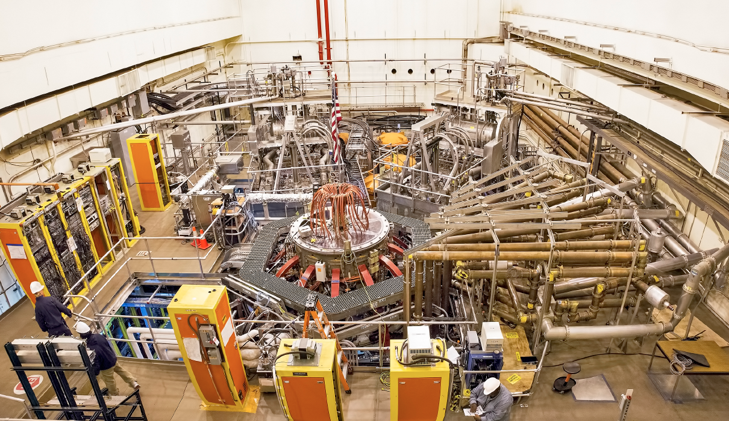
NSTX-U Facility Is Now Operational
Upgrade Project Completed on Schedule and Cost
2nd NBI
1st NBI
HHFW System
NSTX-U
All six NBI sources are now operational, supporting high performance H-mode experiments

Slide 4
Latest run plan schedule for 2016
~ 7.2 run week to date, goal is to operate 18 run weeks
Outage
Completed Plasma Operations
Planned Plasma Operations
Want as much data as possible for IAEA synopses/meeting, APS-2016
December 2015: 0.4 run weeks (XMP)
January 2016 (3 weeks): 2 run weeks (H-mode), PAC-37
Two week maintenance: NBI T-line repair, Argon purge system, LITER, Diagnostics
• February – March (4 weeks): 2.4 run weeks (routine H-mode)
Two week maintenance: BN piece recovery, NBI Auto/transformer/T-line repair, LGI, MGI, Diagnostics
March – April: (3 weeks) 2.4 run weeks (high power H-mode)
Two week maintenance: BPM, NBI LHe refrigeration turbine regeneration, LGI, MGI, Diagnostics
April – July 10.8 run weeks to complete FY16 run with extended run days
August: Start outage: install high-k, high-Z tiles, …
Resume operations winter 2017 for FY17: ~ 16 run weeks
4

Slide 5
NSTX-U device performance progression
1st year: Limit forces to ½ way between NSTX and NSTX-U, and ½ of the design-point heating of any coil
  Presently operating at B_{T} ~ 0.65T
  Increase to B_{T} ~ 0.8T after completing engineering analysis
2nd year goal: Full field and current, coil heating to ¾ of limit
3rd year goal: Full capability
Parameter | NSTX (Max.) | Year 1 NSTX-U Operations | Year 2 NSTX-U Operations | Year 3 NSTX-U Operations | NSTX-U Ultimate Goal
I_{P} [MA] | 1.2 | ~1.6 | 2.0 | 2.0 | 2.0
B_{T} [T] | 0.55 | ~0.8 (0.65) | 1.0 | 1.0 | 1.0
Allowed TF I²t [MA²s] | 7.3 | 80 | 120 | 160 | 160
I_{P} Flat-Top at max. allowed I²t, I_{P}, and B_{T} [s] | ~0.4 | ~3.5 | ~3 | 5 | 5
5

Slide 6
Presentation Outline
Facility Operations Status and Plan
Facility Enhancement Status and Plan
Facility Milestones and Budget
Summary

Slide 7
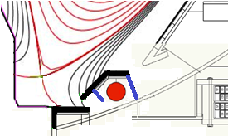
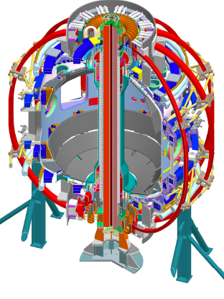
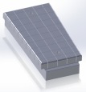
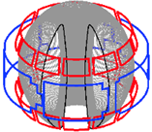
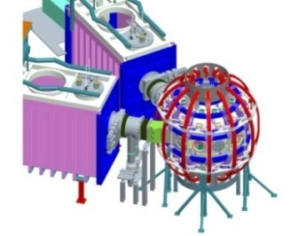
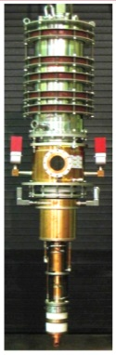
Five Year Facility Enhancement Plan (green – ongoing)
Incremental enables 5 year plan enhancements including NCC, ECH
Fiscal Year:
2015 | 2016 | 2017 | 2018 | 2019
Major enhancements:
Base funding
incremental funding
Upgrade Outage
1.5 → 2 MA, 1s → 5s
Run Weeks:
18
16
12-16
10-12
New
center-stack
Pulse-burst MPTS
Lower divertor cryo-pump
Boundary Science
+ Particle Control
High-Z tile row on lower OBD
Boronization
High-Z PFC diagnostics
Li granule injector
Scanning MLP
Upward
LiTER
Graphite CHI/Lower Bullnose
LiTER
APD-based GPI
MAPP
Resistive
Bolometer
MGI disruption mitigation
XICS
Off-midplane 3D coils (NCC)
Upgraded halo sensors
Core Science
sß
Enhanced MHD sensors
42 ch MPTS
Laser blow-off
CPS δB diag.
DBS, PCI, or other intermediate-k
48 ch BES
High k_{θ}
MSE/LIF
Charged fusion product
Neutron collimator
4 coil AE antenna
Establish control of:
Rotation
q_{min}
HHFW limiter upgrade
Snowflake
Integrated Scenarios
FIReTIP
n_{e}
Divertor P_{rad}
2nd NBI
1 MW ECH/EBW
Upgraded CHI for ~0.5MA
0.5-1 MA CHI
up to 1 MA plasma gun
7

Slide 8
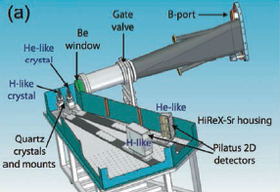
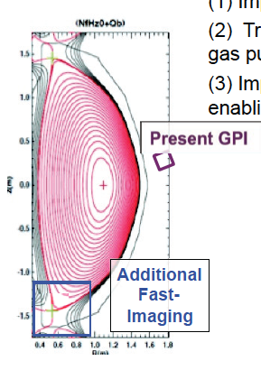
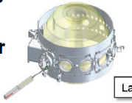
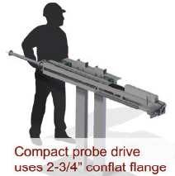
MIT PSFC Complements Well Existing NSTX-U Capabilities
Discussions Started on Various Diagnostic Implementations
MIT will enhance NSTX-U GPI systems
X-ray Imaging Crystal Spectroscopy
Avalanche-PhotoDiode (APD)-based GPI
MIT is developing a next generation, servo-driven, compact scanning MLP system

Slide 9
Five Year Facility Enhancement Plan (green – ongoing)
Incremental enables 5 year plan enhancements including NCC, ECH
Fiscal Year:
2015 | 2016 | 2017 | 2018 | 2019
Major enhancements:
Base funding
incremental funding
Upgrade Outage
1.5 → 2 MA, 1s → 5s
Run Weeks:
18
16
12-16
10-12
New
center-stack
Pulse-burst MPTS
Lower divertor cryo-pump
Boundary Science
+ Particle Control
High-Z tile row on lower OBD
Boronization
High-Z PFC diagnostics
Li granule injector
Scanning MLP
Upward
LiTER
Graphite CHI/Lower Bullnose
LiTER
APD-based GPI
MAPP
Resistive
Bolometer
MGI disruption mitigation
XICS
Off-midplane 3D coils (NCC)
Upgraded halo sensors
Core Science
sß
Enhanced MHD sensors
42 ch MPTS
Laser blow-off
CPS δB diag.
DBS, PCI, or other intermediate-k
48 ch BES
High k_{θ}
MSE/LIF
Charged fusion product
Neutron collimator
4 coil AE antenna
Establish control of:
Rotation
q_{min}
HHFW limiter upgrade
Snowflake
Integrated Scenarios
FIReTIP
n_{e}
Divertor P_{rad}
2nd NBI
1 MW ECH/EBW
Upgraded CHI for ~0.5MA
0.5-1 MA CHI
up to 1 MA plasma gun
9

Slide 10
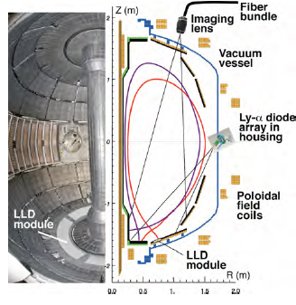
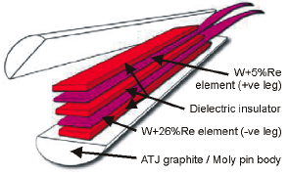
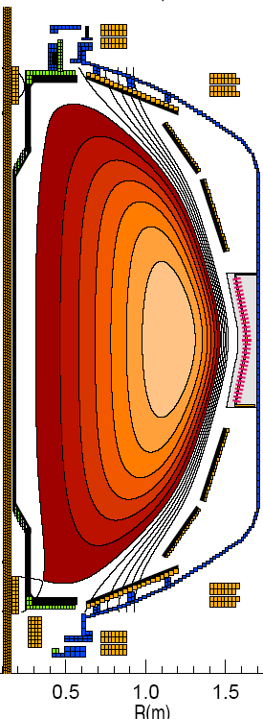
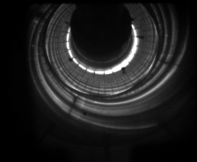
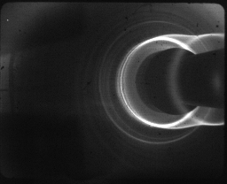
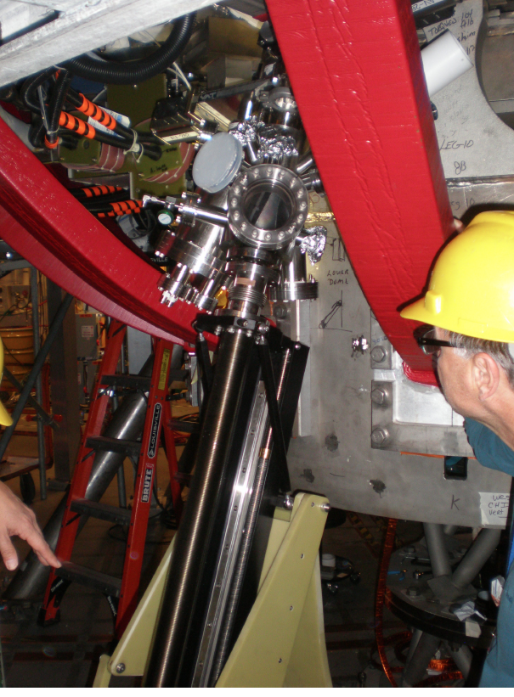
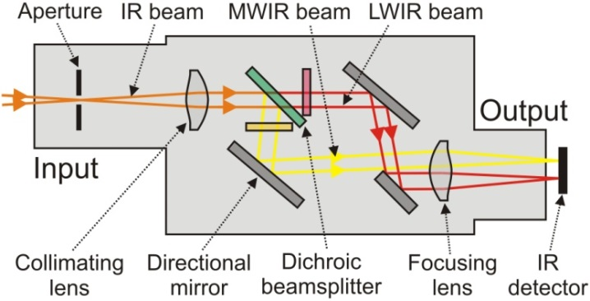
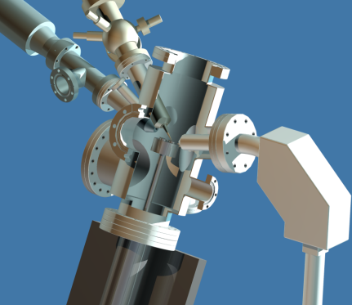
Enhanced Capability for PMI Research
Multi-Institutional Contributions
Divertor fast eroding thermocouples
Multiple fast 2D visible and IR cameras with full divertor coverage
Divertor Imaging
Spectrometer
ORNL
LLNL, ORNL, UT-K
LLNL
Li I
ORNL
C II
Dual-band fast IR Camera
MAPP probe for between-shots surface analysis – Now taking data
U. of Illinois, PPPL

Slide 11
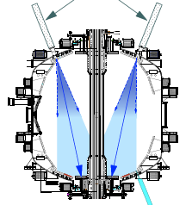
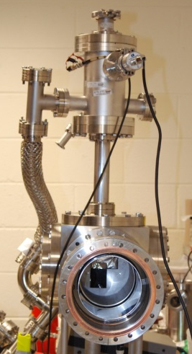
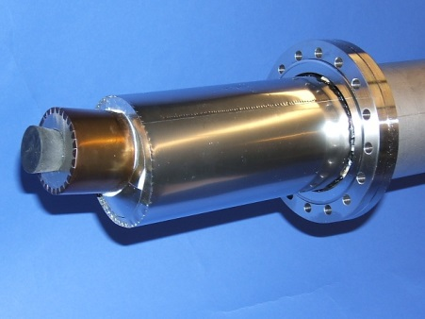
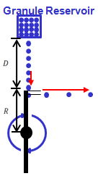
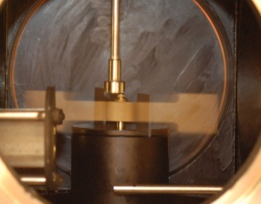
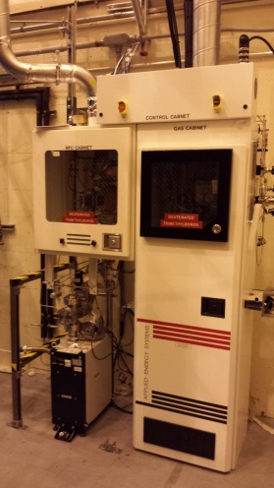
First Year Boundary Physics Tools
Boronization, Lithium Evaporators, Granule Injector
Lithium Evaporator (LITERs)
LITERs
Granule injector (GI) for ELM pacing
Successfully tested
on EAST and DIII-D
Granules: Li, B₄C, C
f ~ up to 500 Hz
Granular Reservoir
• LITERs filing set up in high bay south of NSTX-U Test Cell.
• Argon purge system implemented for Li safety, used for the quick argon vent.
• Expected to be operational in May.
Rotating Impeller
• Granule injector installed on NSTX-U.
• Undergoing commissioning and initial injection during the next plasma operation.
Boronization System
dTMB Gas Cabinet
for safety
• Multiple injection and glow made more uniform boronization.
• System is working very well. Multiple # of boronization including daily ones performed. Also being used for He glow discharges.
11

Slide 12
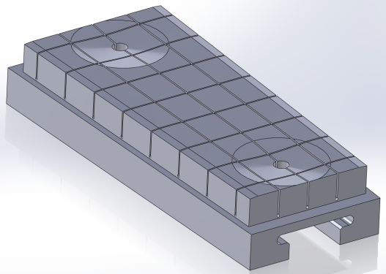
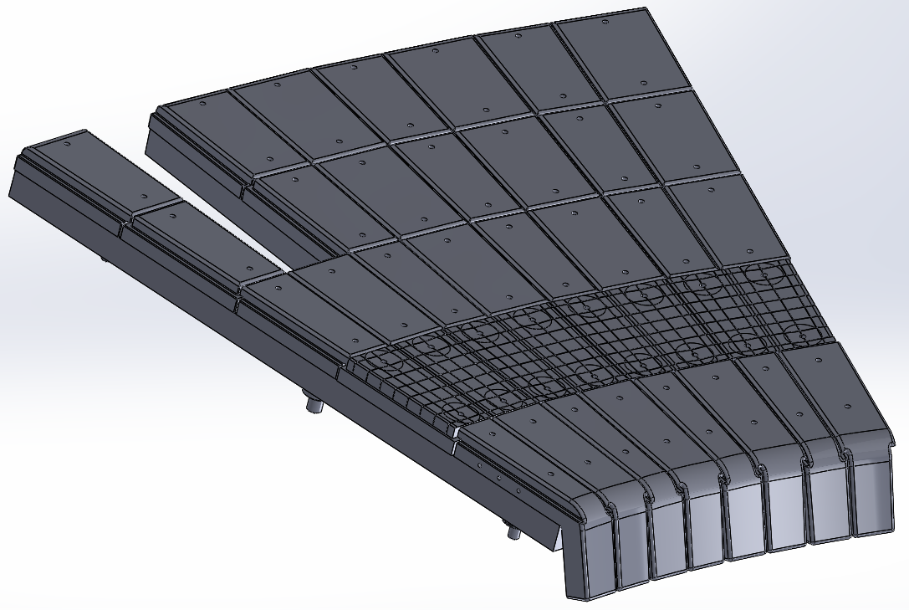
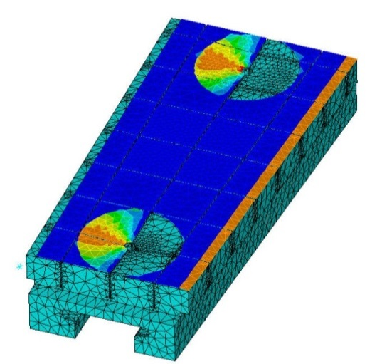
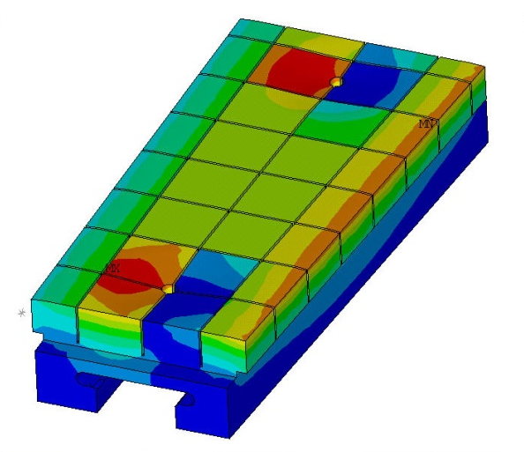
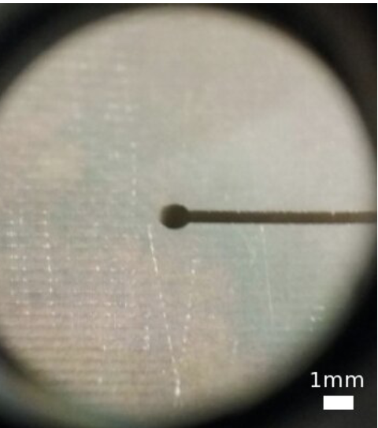
High-Z Tile to be installed for FY 2017 run
Design to replace a row of the graphite tiles in lower outer divertor
Successful FDR held in
February
  82% of raw materials on-site
  Fabrication contract placed
  Schedule to be delivered in September in time for the installation in NSTX-U.
Final design rated to 10 MW/m² for 1s heat flux for 1000s of cycles
  Installation flexibility introduced to accommodate “as built” vessel tolerances
Surface heat flux
Temperature
  Edge and access-way chamfers introduced to reduce heat-flux peaking
Test cut from one of the castellations performed
12

Slide 13
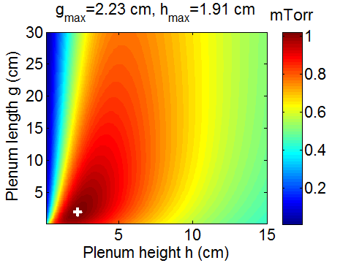
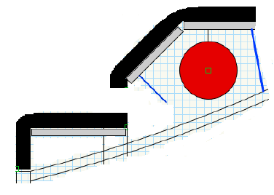
Lower Divertor Cryo-pump to Provide Pumping over a Wide Range of Divertor Geometries and Core Densities
Physics design completed in collaboration with ORNL.
  Defined the geometry, plenum sizes, ability to pump various geometries.
Conceptual design process has been initiated:
  Draft GRD has been formulated.
  Initial designer sketches of in-vessel implementation completed.
  Two types of PFCs being investigated.
  CHI/lower bullnose section may be pursued as separate job as it may be enhanced for high Z and flowing Li in the future.
  Goal is to to have the system ready for installation in the 2018-2019 outage under base funding.
Need 0.8 mTorr or better
Two PFC Options for CDR
350C
bake
350C
bake
Passive
bake
Or
A
B
PFC type:
Graphite
CHI/ lower bullnose
Baffle diagonal / upper bullnose
Baffle top / horizontal
tiles
High-Z, high q⊥
High-Z, low q⊥
13

Slide 14
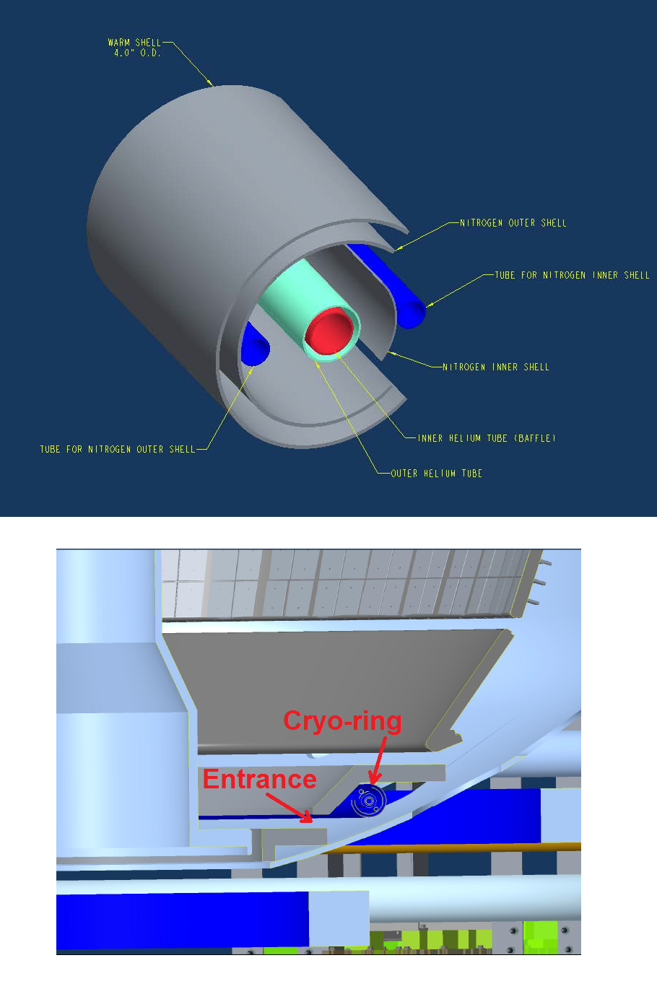

Divertor Cryo-pump Design Activities Started
Design also includes appropriate PFCs and L-He refrigerator
Cryo-ring
Initial in-vessel geometry has been laid out. MIT will design cryo-ring.
  Pump radius, throat dimensions taken from the modeling.
  The entire lower outer divertor region to be reduild.
• Cryo-baffle design to be finalized at CDR.
  Diagnostic access and cryo-ring maintainability are major design consideration.
  Two PFC options (Graphite or high Z) are pursued for CDR.
• A 400W liquid He refrigerator considered to reduce NBI operational risk and operational cost savings.
  A room adjacent to NSTX-U has been identified for energy efficient location with utilities already available.
  Replaces the outdated TFTR-era L-He refrigerator reducing risks to the NBI operations.
Transfer line layout
14

Slide 15
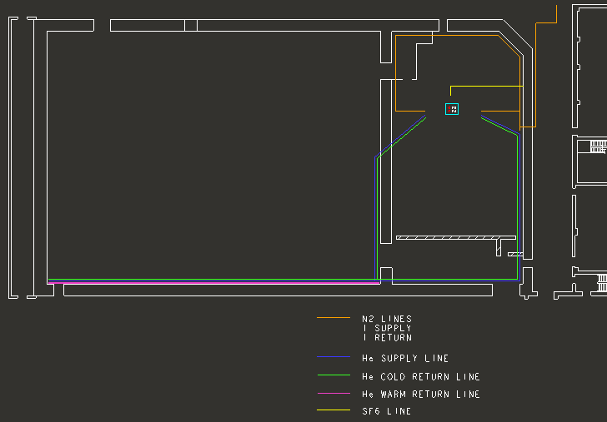
A new efficient 400 W liquid helium (L-He) refrigerator to minimize down time risk and reduce operating cost
Proposed 400 W L-He refrigerator ~ $2.5M
Former TFTR Test Cell
• To be located in the Cryogenics Compressor Room near NSTX-U, accommodates all envisioned loads by benefit of greatly reduced piping and heat loss (x 3-4).
• The unit would reuse power and space previously used for a 225 Watt refrigerator with all the utilities and compressors available.
• Benefit:
  Remove down time risk
  Increase available L-He for NSTX-U including NBI and Divertor Cryo-pump.
  Reduced operating and maintenance cost
NSTX-U
500 feet of supply and return piping
TFTR legacy liquid helium refrigerator
• 36 years old 800 W refrigerator for NBI #1 and 2 operating at near capacity due to long piping causes significant heat loss – also quite expensive to operate and maintain.
• If a cold box failure occurs, the repair will require reverse engineering and loss of several months will severely impact NSTX-U operations.

Slide 16
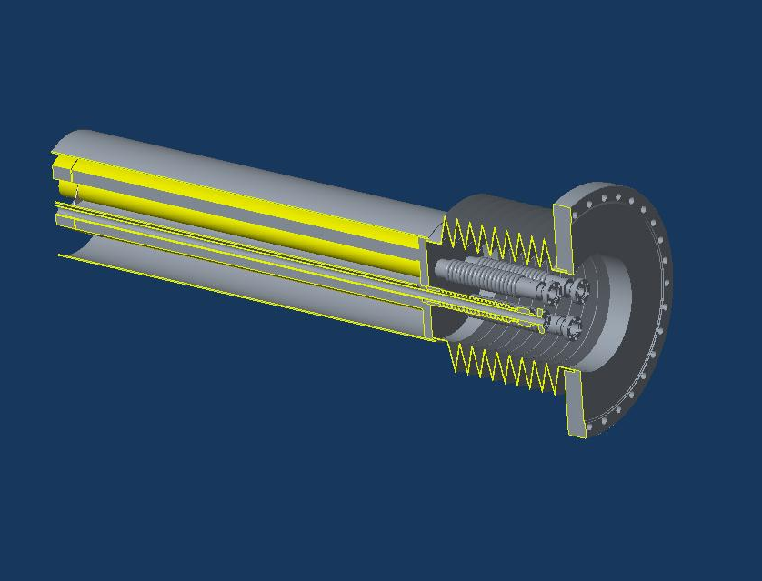
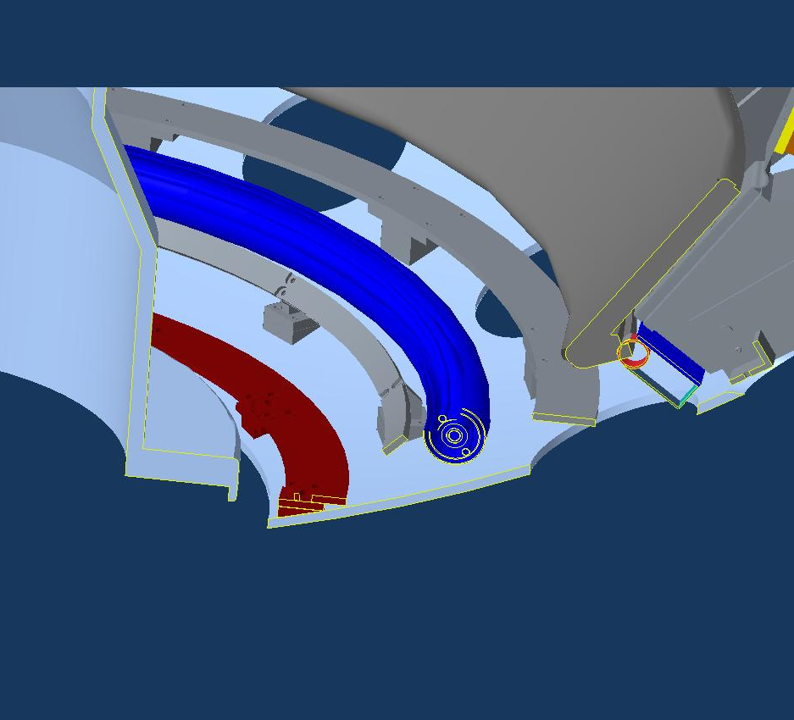
Implement Divertor Cryo-Pump with base funding
Exploring various options to minimize cost for timely completion
Schedule for Cryo-pump and PFCs:
  Start formal design collaboration with MIT in Feb 2016.
  CDR – planned in July 2016 with cost and schedule developed
  PDR – planned in Nov. 2016
  FDR – planned in March 2017
  Complete fabrication of in-vessel components – May 2018
  Complete installation of in-vessel and ex-vessel components – Feb. 2019
Cryogenic vacuum feedthrough concept.
Schedule for L-He refrigerator:
  PDR in June 2016 with external reviewers
  Start procurement – Sep. 2016.
  Start installation – June 2017
  Commission – Oct. 2017
Cryopump with redesigned divertor support structures
Transfer line layout
16

Slide 17
Five Year Facility Enhancement Plan (green – ongoing)
Incremental enables 5 year plan enhancements including NCC, ECH
Fiscal Year:
2015 | 2016 | 2017 | 2018 | 2019
Major enhancements:
Base funding
incremental funding
Upgrade Outage
1.5 → 2 MA, 1s → 5s
Run Weeks:
18
16
12-16
10-12
New
center-stack
Pulse-burst MPTS
Lower divertor cryo-pump
Boundary Science
+ Particle Control
High-Z tile row on lower OBD
Boronization
High-Z PFC diagnostics
Li granule injector
Scanning MLP
Upward
LiTER
Graphite CHI/Lower Bullnose
LiTER
APD-based GPI
MAPP
Resistive
Bolometer
MGI disruption mitigation
XICS
Off-midplane 3D coils (NCC)
Upgraded halo sensors
Core Science
sß
Enhanced MHD sensors
42 ch MPTS
Laser blow-off
CPS δB diag.
DBS, PCI, or other intermediate-k
48 ch BES
High k_{θ}
MSE/LIF
Charged fusion product
Neutron collimator
4 coil AE antenna
Establish control of:
Rotation
q_{min}
HHFW limiter upgrade
Snowflake
Integrated Scenarios
FIReTIP
n_{e}
Divertor P_{rad}
2nd NBI
1 MW ECH/EBW
Upgraded CHI for ~0.5MA
0.5-1 MA CHI
up to 1 MA plasma gun
17

Slide 18
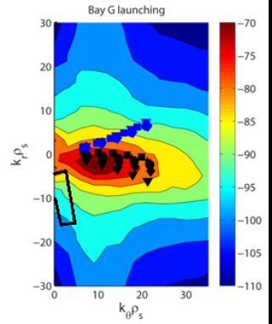
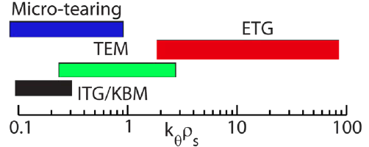
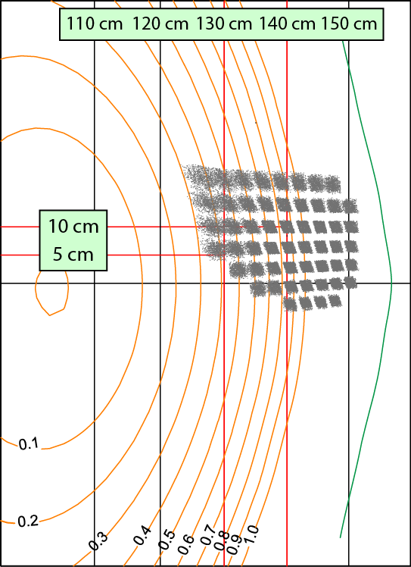
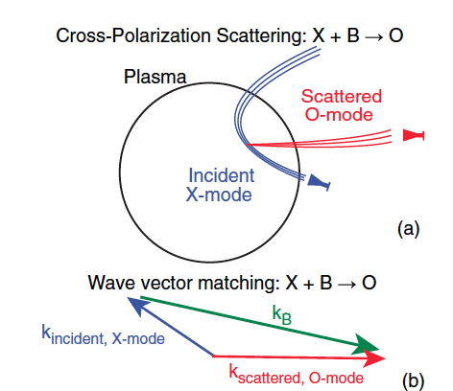
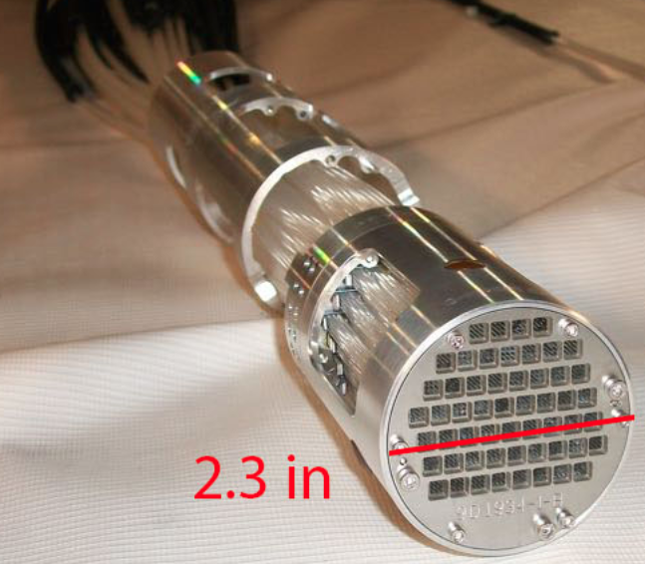
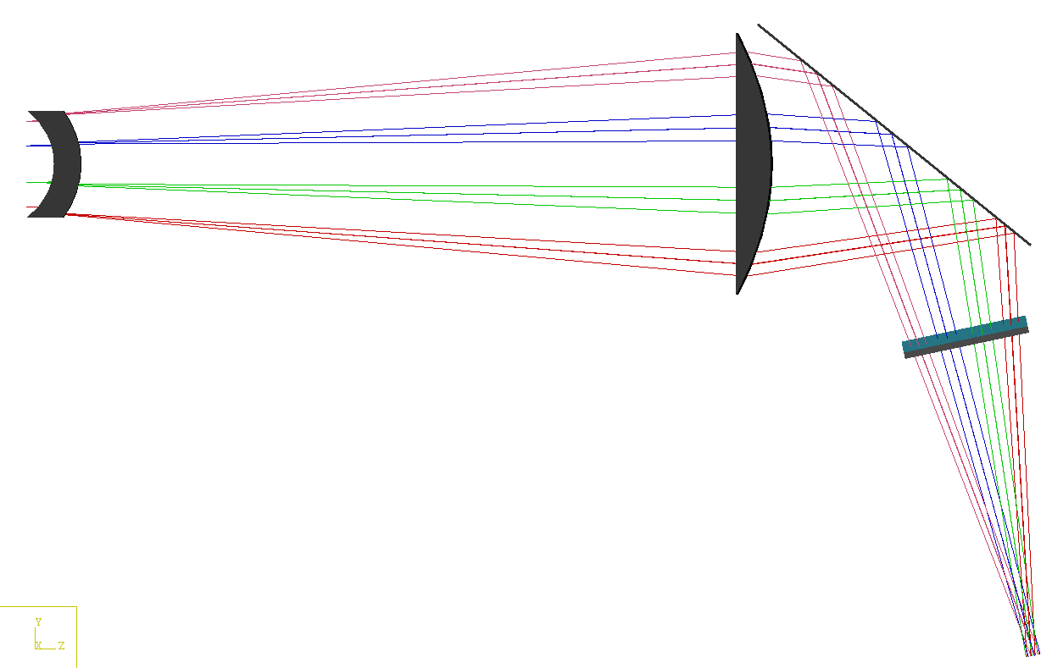
Microturbulence Diagnostics Being Enhanced
To measure ion to electron gyro-scale, magnetic fluctuations
Beam Emission Spectroscopy
for low k turbulence
48 chs being readied
Low k
High-k scattering for ETG
High k
Cross-Polarization Scattering for magnetic fluctuations being developed in collaboration with DIII-D and MAST
UC Davis
BES-2D-Fiber
Assembly
Collection optics (Bay L)
4x1 subharmonic mixer array
U Wisconsin
4–channel CPS system in 2017
UCLA
Available for FY 17

Slide 19
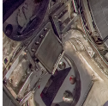
Enhanced FIDA will measure NBI distribution function
For NBI fast ion transport and current drive physics
Fast Ion D-Alpha Diagnostics
Taking data on NSTX-U
FIDA Views
CHI Gap
• Both vertical (perpendicular) and new tangential (parallel) FIDA systems are ready.
• Both FIDA systems have 10 ms, 5 cm, ≈ 10 keV resolutions.
Vertical
Center-Stack
Tangential
HHFW
Antennas
FY 2016 - 2017 Energetic Particle Conceptual Design and Diagnostic Upgrade
  SS-NPA installed and taking data.
  sFLIP installed for lost ion measurements
  Active 2 X 2 TAE antennas installed. Initially passive spectroscopy then active excitation at few kW level.
  Proto-type charged fusion product (CFP) profile diagnostic is being prepared to be installed.
  8+8 reflectometry array available for AEs.
TAE antennas
UCI
sFLIP
FIU
UCLA

Slide 20
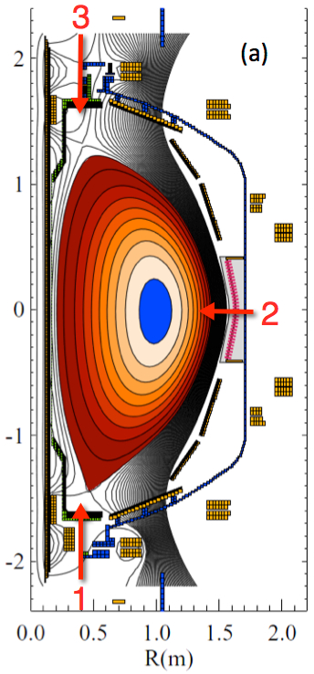
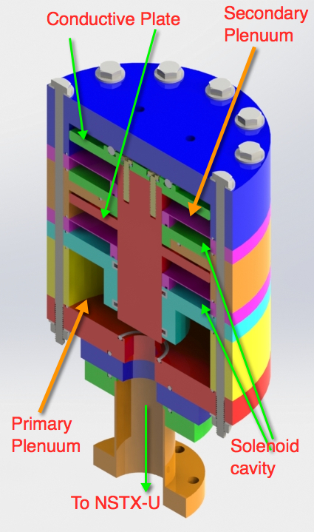
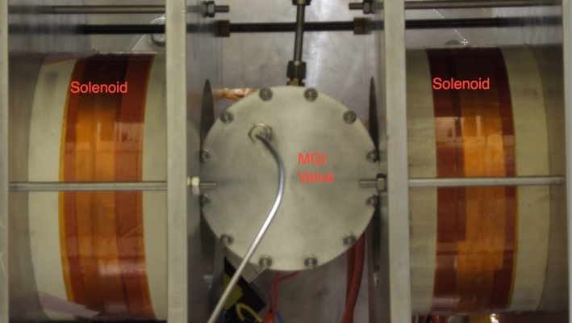
Disruption Mitigation System for NSTX-U
Massive gas injection system at multiple poloidal positions
NSTX-U MGI Valve
  - Massive gas injector system at multi
  poloidal location with identical injection set-up
  - Compact power supply proto-type tested at UW
  - A new double solenoid MGI design (zero net J x B
  torque) based on the ORNL ITER MGI design
  MGI also tested on the U. Washington test stand with magnetic field
Magnets
Magnets
MGI
Valve
U. Washington
• Successful final Design Review of MGI system was held on February 18, 2016.
• All the MGI components including MGI valves were delivered to PPPL from U. Washington and being installed on NSTX-U.
• Preliminary MGI test is planned in May, 2016 for the initial gas pulses into NSTX-U.

Slide 21
Flexible Mid-Plane Feedback Coils for MHD Studies
NCC will greatly enhance MHD physics studies and control
Full toroidal NCC array (2 x 12)
Partial toroidal NCC array (2 x 6)
Partial NCC
Full NCC
Existing
RWM
coils
Columbia U
General Atomics
• 6-channel Switching Power Amplifier (SPA) powers independent currents in existing EFC/RWM Coils supporting experiments
• NCC (a facility enhancement) can provide various NTV, RMP, RWM, and EF selectivity with flexibility of field spectrum (n ≤ 6 for full and n≤ 3 for partial)
Base Budget – NCC engineering conceptual design work to develop reliable cost and schedule is being concluded to focus engineering resources to divertor cryo-pump design.
Incremental Budget – Enables continued design, development, and installation of NCC.
21

Slide 22
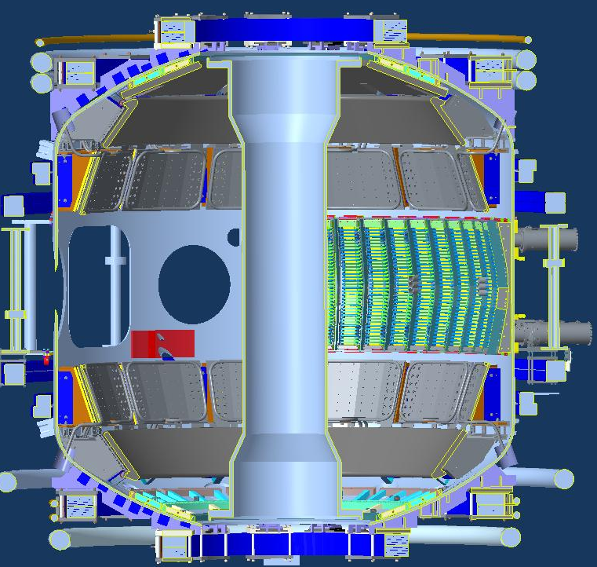
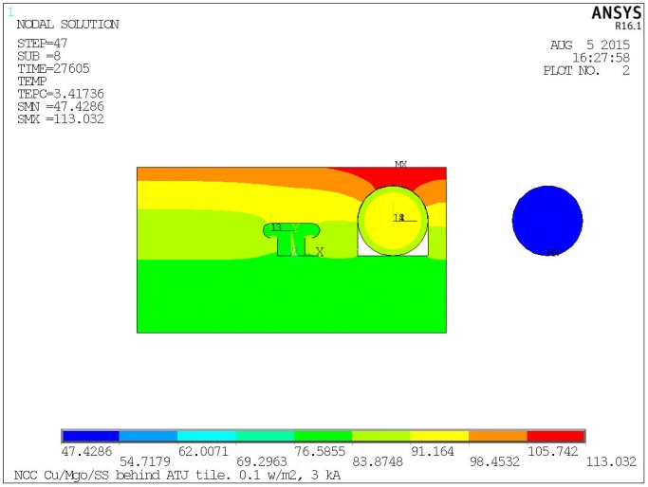
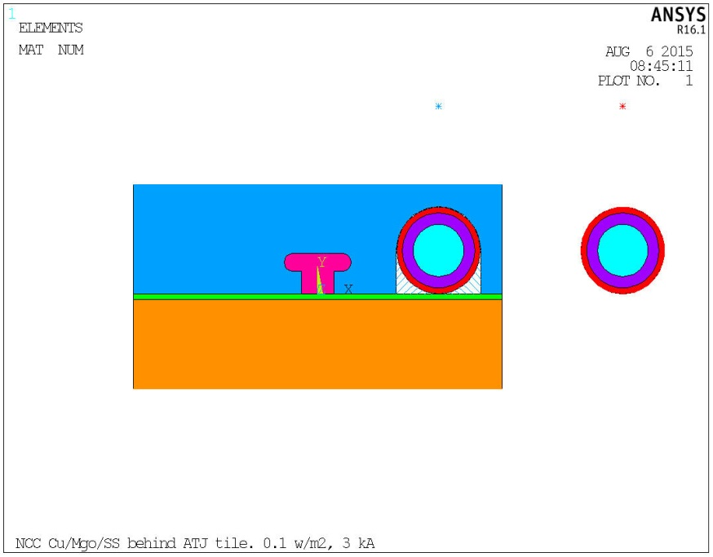
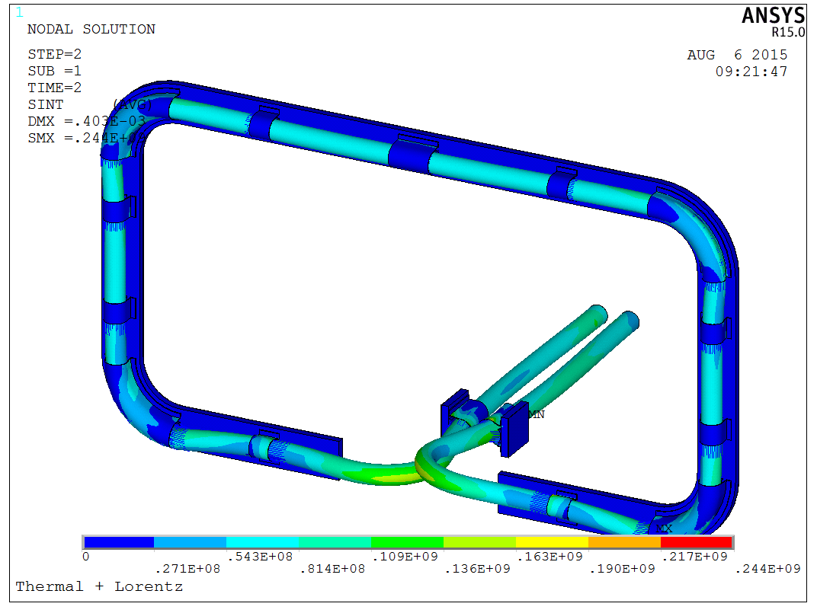
NCC Lorentz and Thermal
Stress Analysis
NCC Coils Design Activity Made Significant Progress
Test area prepared to perform conductor sample R&D
NCC = Non-axisymmetric Control Coil
2 x 12
Coil
Thermal Analysis
Tile
End of Last Pulse Temp (8 hours)
PP
Lead
3 kA,0.1 MW/m2 Plasma Heating,5s pulse,1200 s reprate
• Candidate conductor for test sample received for R&D.
• R&D facility prepared and test being conducted.
• The R&D selection criteria include thermal capability, manufacturability, impact on interfacing objects, fabrication lead time and cost.
• Cost and schedule will be prepared as part of the CDR which is targeted for May, 2016.
With Lead Clamp, 50 C Heat-up, 3kA+ Background Field
22

Slide 23
Five Year Facility Enhancement Plan (green – ongoing)
Incremental enables 5 year plan enhancements including NCC, ECH
Fiscal Year:
2015 | 2016 | 2017 | 2018 | 2019
Major enhancements:
Base funding
incremental funding
Upgrade Outage
1.5 → 2 MA, 1s → 5s
Run Weeks:
18
16
12-16
10-12
New
center-stack
Pulse-burst MPTS
Lower divertor cryo-pump
Boundary Science
+ Particle Control
High-Z tile row on lower OBD
Boronization
High-Z PFC diagnostics
Li granule injector
Scanning MLP
Upward
LiTER
Graphite CHI/Lower Bullnose
LiTER
APD-based GPI
MAPP
Resistive
Bolometer
MGI disruption mitigation
XICS
Off-midplane 3D coils (NCC)
Upgraded halo sensors
Core Science
sß
Enhanced MHD sensors
42 ch MPTS
Laser blow-off
CPS δB diag.
DBS, PCI, or other intermediate-k
48 ch BES
High k_{θ}
MSE/LIF
Charged fusion product
Neutron collimator
4 coil AE antenna
Establish control of:
Rotation
q_{min}
HHFW limiter upgrade
Snowflake
Integrated Scenarios
FIReTIP
n_{e}
Divertor P_{rad}
2nd NBI
1 MW ECH/EBW
Upgraded CHI for ~0.5MA
0.5-1 MA CHI
up to 1 MA plasma gun
23

Slide 24


Solenoid-free start-up in support of ST-FNSF
NSTX-U CHI configuration permits ~ 400 kA level start-up
CHI Start-Up in NSTX-U
QUEST CHI Experiment to test high-Z electrode operation
• Inj. Flux in NSTX-U is about 2.5 times higher than in NSTX
• NSTX-U coil insulation greatly enhanced for higher voltage ~ 3 kV operation
U. Washington
• The resistive voltage divider network was made functional, and many of the components related to a fast voltage monitoring system were installed.
• All of the connections of the gas lines to the CHI gas injection systems have been completed.
• Initial testing of the CHI system into a plasma load will begin in the near future.
U. Washington
An ST-FNSF like CHI configuration will undergo plasma tests on QUEST after FY 2016 NSTX-U operation (after July 2016).
All metal (high-Z) CHI electrodes provide valuable information for NSTX-U (presently graphite electrodes)

Slide 25



HHFW system will be ready for operation
Antenna plasma conditioning to start in April
New Compliant Antenna Feeds
Allow HHFW antenna feedthroughs to tolerate 2 MA disruptions
Antennas were re-installed with the new feeds and back-plate grounding
Transmission lines installed & tuned.
Additional ground installed
- Prototype compliant feeds tested to 46 kV in the RF test-stand. Benefit of back-plate grounding for arc prevention found.
- RF diagnostics also installed.
• All sources will be ready to support HHFW operation in April.

Slide 26



28 GHz ECH System Design Progressing Well
Complete conceptual design and cost/schedule this year
CHI can form a 200-400 kA seed plasma, but it is too cold for HHFW absorption.
Use of ECH can “bridge the T_{e} gap” to where HHFW and then NB current drive can support the ramp and sustain the current – crucial for OH solenoid-free compact STs
  Good first pass absorption predicted.
Goal of first ECH power in 2019 run with 15% incremental funding.
28 GHz 1 MW Tube by Tsukuba
28 GHz Gyrotron Room
NSTX-U
Test Cell
28 GHz Gyrotron Development
• 2nd generation 1.5 MW 28/35 GHz gyroton being developed at Tsukuba University. (See back-up slide). Power test to start in May.
• Incremental budget enables continued design and procurement of the ECH system.
Gyroton room
Power Supply Room
Gyrotron will be located in the TFTR basement. Stray magnetic fields was measured to be negligible
26

Slide 27
Presentation Outline
Facility Operations Status and Plan
Facility Enhancement Status and Plan
Facility Milestones and Budget
Summary

Slide 28


Base NSTX-U Facility/Diagnostic Milestones
To complete Cryo-pump, NCC, and ECH/EBW Engineering Designs in FY 2016
28

Slide 29
Summary of Facility and Diagnostics
Research operations successfully started
• Research operation started on December 18, 2015. With 7.23 run weeks achieved thus far we are at 40% of 18 run week target.
• The commissioning phase is nearly complete and the plasma operation is now becoming routine and the availability increasing to 90 – 100% range.
• NBI and boronization are now supporting operations with routine H-mode access.
• Very good progress on the plasma control system, quickly achieving H-mode and high performance discharges comparable to the best NSTX plasma parameters.
• A number of enhancements are being implemented to support the NSTX-U research plan. installation of high-Z tiles and complete conceptual engineering design for divertor cryo-pump, NCC, and ECH this year.
• Divertor cryo-pump, outer lower divertor PFCs will be implemented in the base plan.

Slide 30
Back-Up slides

Slide 31

Digital System Provides Electromechanical Coil Protection
DCPS supporting the research operation very nicely
Protects the NSTX-U coils and mechanical structure against electromagnetic loads
Computes forces and stresses in realtime based on reduced models of the full mechanical structure
Redundant systems
Full commissioning of the system went very well; DCPS is now routinely supporting operations.
Power Supply Suppress and Bypass
Coil and Plasma Current Measurements
Realtime Acquisition #1
Realtime Acquisition #2
Stand Alone Digital Coil Protection Computer
Digital Coil Protection & Plasma Control Computer
Level-1 Fault Interface
Rectifier Hardware Controls
Discussions on going with ITER for collaboration
Notes:
A bunch of sensors give conditioned current inputs
Output is Go/NoGo… Fault/No Fault

Slide 32
NSTX-U Operations Encountered # of Issues
All the issues were resolved
TF Water Fitting Repair – Cracked brass fitting –two out of 72 fittings - traced to possible stress during tightening. Made adjustment to procedure to minimize stress.
Gas Injection System - Traced to a pressure gauge in the high field side gas injection system – broke down due to changing gas line pressure - “Paschen” curve. Moved the pressure gauge to the high pressure side.
Water leaks in power supply room – changed hoses and components – this one could occur in the future because of the vast number of hoses and components.
Protection system related – DCPS and other protection systems – adjusted the protection systems after confirming safe operation.
Water leak in flow meter – broken plastic side wall - replaced all the meters of similar age (~ 16 years)
No significant loss of operations time due to motor generator nor NBI
32

Slide 33
Heating System Operations
Both Neutral Beams are still at LHe temperatures. Routine panel regens. Cold box regen this maintenance period after 15 months operation. NBI supporting experiments daily.
Neutral Beam #2
  N2A Source has operated to 86 kV.
  N2B Source has operated to 80 kV.
    High voltage crowbars under investigation this maintenance period.
  N2C Source has operated 80 kV.
Neutral Beam #1
  N1A Source has operated up to 76 kV.
  N1B Source has operated up to 70 kV 1 MW.
  N1C Source had operated up to 90 kV 2 MW.
HHFW Systems – Recovery Corrective Action Plan (CAP) activities to resume operations:
  HHFW #1-4 Recovery CAP completed. Awaiting AC Power to start conditioning.
  HHFW #5-6 testing done & CAP nearly completed. Awaiting AC Power to condition.
33

Slide 34
Excellent Progress on Magnetic Diagnostics
Plasma current, loop voltage, poloidal flux and field measurements in good shape supporting EFIT.
  All integrators recalibrated
  Rogowski coils fully calibrated, and pickup compensations established
  All Mirnov sensors and flux loops have had their position determinations refined based on calibration shots.
New diamagnetic loop system is now operational also supporting EFIT.
  Based on using the Rogowski return loop as a diamagnetic loop.
  Successfully implemented and eliminated the old TF-coil diamagnetic system.
High-n and high-f array is taking data.
  Used for detecting rotating Kink/Tearing modes, *AE modes.
RWM sensors are writing mode fit data to the tree.
  Realtime RWM sensor codes have also been upgraded, now in testing.
34

Slide 35
Significant Progress in Plasma Control System
Now supporting the research operations
PCS has been supporting plasma operations.
  Pre-programmed PF control & simple radial and vertical position control, I_{P} control.
  Gas injection and pre-fill control
  Real-time magnetic sensor calibrations
  Beam control from PCS
  Automatic discharge shutdown following disruption detection.
  rtEFIT running in the background on the control machines
  RWM/EF coil current control from PCS has been restored.
Some older less-reliable real-time digitizers have been replaced, and a new every-shot latency measurement system has been implemented.
Near term PCS steps
  Finish testing rtEFIT and begin to use ISOFLUX shape control
  Finish the recommissioning of the RWM/EF control algorithms
  Then move on to profile control and snowflake divertor control.
35

Slide 36
NSTX-U diagnostics commissioned or being prepared
More than half are led by collaborators
Ready now/commissioning
  Magnetics for equilibrium reconstruction
  Halo current detectors
  High-n and high-frequency Mirnov arrays
  RWM / Locked-mode sensors
  MPTS (42 ch, 60 Hz)
  T-CHERS: T_{i}(R), V_{φ}(r), n_{C}(R), n_{Li}(R), (51 ch)
  P-CHERS: V_{θ}(r) (71 ch)
  Edge Rotation Diagnostics (T_{i}, V_{φ}, V_{pol})
  Beam Emission Spectroscopy (48 ch)
  Midplane ME-SXR (200 ch)
  SAMI edge field pitch diagnoistc
  Midplane tangential AXUV bolometer array (40 ch)
  Ultra-soft x-ray arrays – multi-color
  Fast Ion D_{α} profile measurement (perp + tang)
  Solid-State neutral particle analyzer
  Neutron measurements
  Charged Fusion Product
  Fast IR camera (two color)
  Material Analysis and Particle Probe
  AXUV-based Divertor Bolometer
  Tile temperature thermocouple array
  Fast visible cameras
  Visible bremsstrahlung radiometer
  Visible and UV survey spectrometers
  VUV transmission grating spectrometer
  Visible filterscopes (hydrogen & impurity lines)
  Wall coupon analysis
  1-D CCD H_{α} cameras (divertor, midplane)
  2-D divertor fast visible cameras (4)
  Two-color intensified 2D cameras TWICE (2)
  Edge neutral density diagnostic ENDD
  IR cameras (30Hz) (3)
  Dust detector
  Edge Deposition Monitors
  Scrape-off layer reflectometer
  Edge neutral pressure gauges
Ready by mid-run
  Fast lost-ion probe (energy/pitch angle resolving)
  Microwave Reflectometer
  MSE-CIF (18 ch)
  MSE-LIF (20 ch)
  Divertor VUV Spectrometer (SPRED)
  Gas-puff Imaging (500kHz)
  Langmuir probe array
  Divertor fast eroding thermocouple
Ready by end of run
  FIReTIP interferometer
Ready next run year
  Laser blow-off system
  Poloidal FIR high-k scattering
  Midplane metal foil bolometer
  Metal foil divertor bolometer
New capability,
Enhanced capability
36

Slide 37





Tsukuba University is developing Prototype 28 / 35 GHz Gyrotron for NSTX-U & G-10/PDX
→ New design of cathode, cavity and mode converter for 1.5 – 2 MW
3
●Design Parameters of New Tube
Power (MW)
28 GHz
0
0
80
Beam Current (A)
3
2986 mm
Power (MW)
34.77 GHz
0
0
80
Beam Current (A)
TE_{8,5} (28 GHz) & TE_{10,6} (35 GHz) by the selection rule
• 2 MW calculated outputs at both 28 & 35 GHz are obtained.
• We (Tsukuba) started its fabrication and it will be tested this summer.

