Slide 1

NSTX-U Research Plans for FY2016-18
J. Menard, M. Ono - PPPL
For the NSTX-U Research Team
FY2018 FES Budget Planning Meeting
Germantown, MD
April 13, 2016

Slide 2
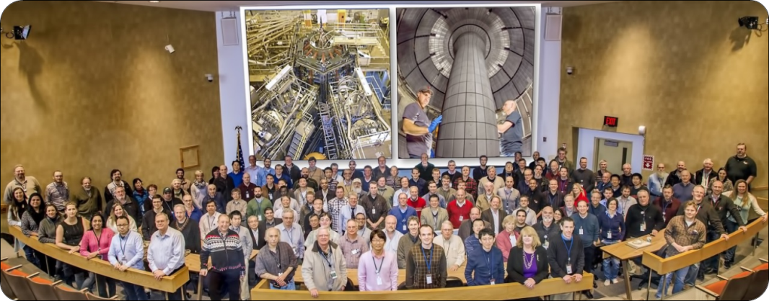
NSTX-U research benefits greatly from highly collaborative program
Domestic (33)
International (22)
402 team members
39 university faculty
21 post-docs
20 grad-students
356 data users
55 institutions
22 US Universities

Slide 3
Outline
NSTX highlight overview, NSTX-U run progress
NSTX-U mission, priorities, FY16-18 overview
FY16-18 research plans
Milestone summary
ITPA contributions
ST-FNSF / Pilot Plant study highlights
Summary
NSTX-U research plan well aligned with
2015 Community Workshop Reports and FES 10-year Plan

Slide 4

NSTX-U Research Team Has Been Scientifically Productive
Very Active in Scientific Conferences, Publications, and Collaborations
Strong APS meeting participation
  2014: 1 ST review talk, 5 NSTX invited talks, 44 posters
  2015: 3 NSTX invited talks, 54 posters
L. Delgado-Aparicio: DOE Early Career Award for research on impurity transport and control
Multitude of technical NSTX-U / next-step presentations at 2015 SOFE, Li Symposium, IAEA-TM on divertors
International ST Workshop: 78 talks+posters, 50% international
45 refereed publications for FY2015
34 IAEA FEC 2016 synopses on NSTX-U + ST-FNSF

Slide 5
NSTX-U Research Team Has Been Scientifically Productive
Very Active in Scientific Conferences, Publications, and Collaborations
Collaborative research contributions made in range of topics directly relevant to NSTX-U program
  DIII-D: Pedestal transport, fast-ions instabilities, RWM / RFA, QH-mode TEM particle transport, Li dropper, granule injector, snowflake/X divertors
  EAST: Lithium coating / wall physics, flowing liquid Li limiter
  KSTAR: NTV rotation damping, error fields, RMP
  C-Mod: ELM cycle / pedestal structure, high-Z spectroscopy
  MAST / York: Momentum transport studies / SAMI diagnostic
  QUEST: CHI + ECH start-up research, EBW-CD start-up modelling (new)
  ITPA halo current data / studies including DIII-D, AUG, C-Mod, NSTX

Slide 6
Propose to enhance collaboration with MAST-U, especially in boundary area
MAST-U construction nearing completion
  Late CY16 pump-down, commissioning, mid-CY17 plasmas
Opportunity to engage with MAST-U boundary program to complement NSTX-U by scoping exhaust solutions
  Comparison of divertor geometry (Super-X, snowflake, std.)
  Enhance MAST-U radiation diagnostics, leveraging NSTX-U
    ORNL-led (M.L. Reinke) w/ contributions from PPPL
  NSTX-U provides info on high-Z PFCs / impurity transport, liquid metals
Continue to grow links between ST programs and cover a wider range of science + engineering activities
  Increase MAST-U/UK research participation in NSTX-U (FY16-18)
  Develop and utilize remote collaboration capabilities / control room
  Assess facility enhancements
    MAST-U 3D field capabilities to help inform NSTX-U 3D coil / NCC design choices
  Continue joint work on ST FNSF / Pilot concepts

Slide 7
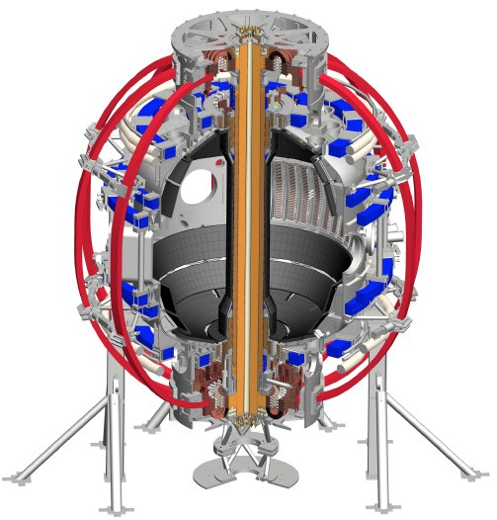
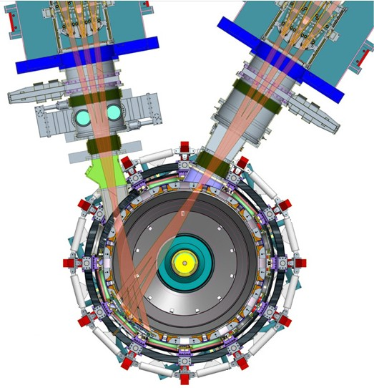
NSTX-U will access new physics with 2 major new tools:
1. New Central Magnet
2. Tangential 2nd Neutral Beam
Higher T, low ν* from low to high β
→ Unique regime, study new transport and stability physics
Full non-inductive current drive
→ Not demonstrated in ST at high-β_{T}
Essential for any future steady-state ST

Slide 8
NSTX-U will have major boost in performance
1. New Central Magnet
2. Tangential 2nd Neutral Beam
2017-2018 goals:
➢2× heating power (5 → 10MW)
Tangential NBI → 2× current drive efficiency
➢4× divertor heat flux (→ ITER levels)
➢Up to 10× higher nTτ_{E} (~MJ plasmas)
➢2× toroidal field (0.5 → 1T)
➢2× plasma current (1 → 2MA)
➢5× longer pulse (1 → 5s)

Slide 9
Outline
NSTX highlight overview, NSTX-U run progress
NSTX-U mission, priorities, FY16-18 overview
FY16-18 research plans
Milestone summary
ITPA contributions
ST-FNSF / Pilot Plant study highlights
Summary

Slide 10
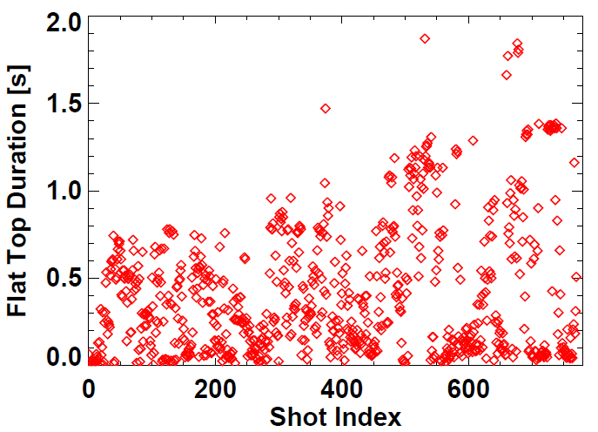
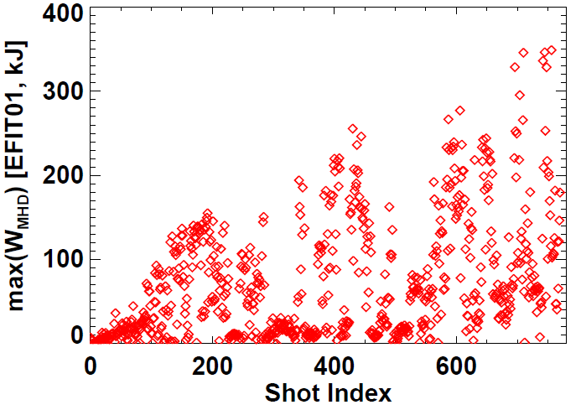
NSTX-U plasma commissioning status
~7 run weeks of ops, I_{P} = 0.5–1MA, boronized PFCs
Nearly all shots at B_{T} = 0.6-0.65T > NSTX max = 0.55T
All 6 NBI injected into plasmas, 4-6MW routinely available
Exceeded NSTX L & H-mode pulse-lengths
using 1MW L-modes (0.65, 0.8MA)
Approaching NSTX W_{TOT} record ~ 430kJ
NSTX record
NSTX record

Slide 11
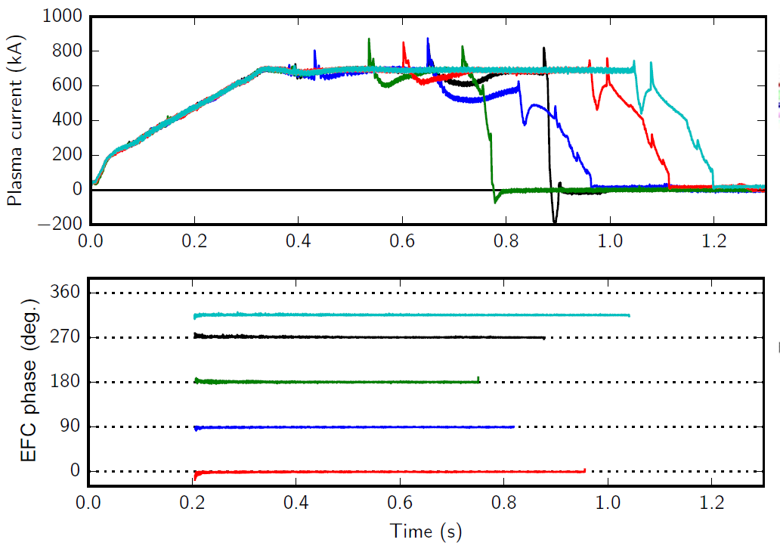
Optimal n=1 error field correction amplitude and phase identified to maximize pulse length, discharge performance
Dominant error-field source: PF5 vertical field coils
Long-pulse L-modes used to identify optimal correction amplitude, phase

Slide 12
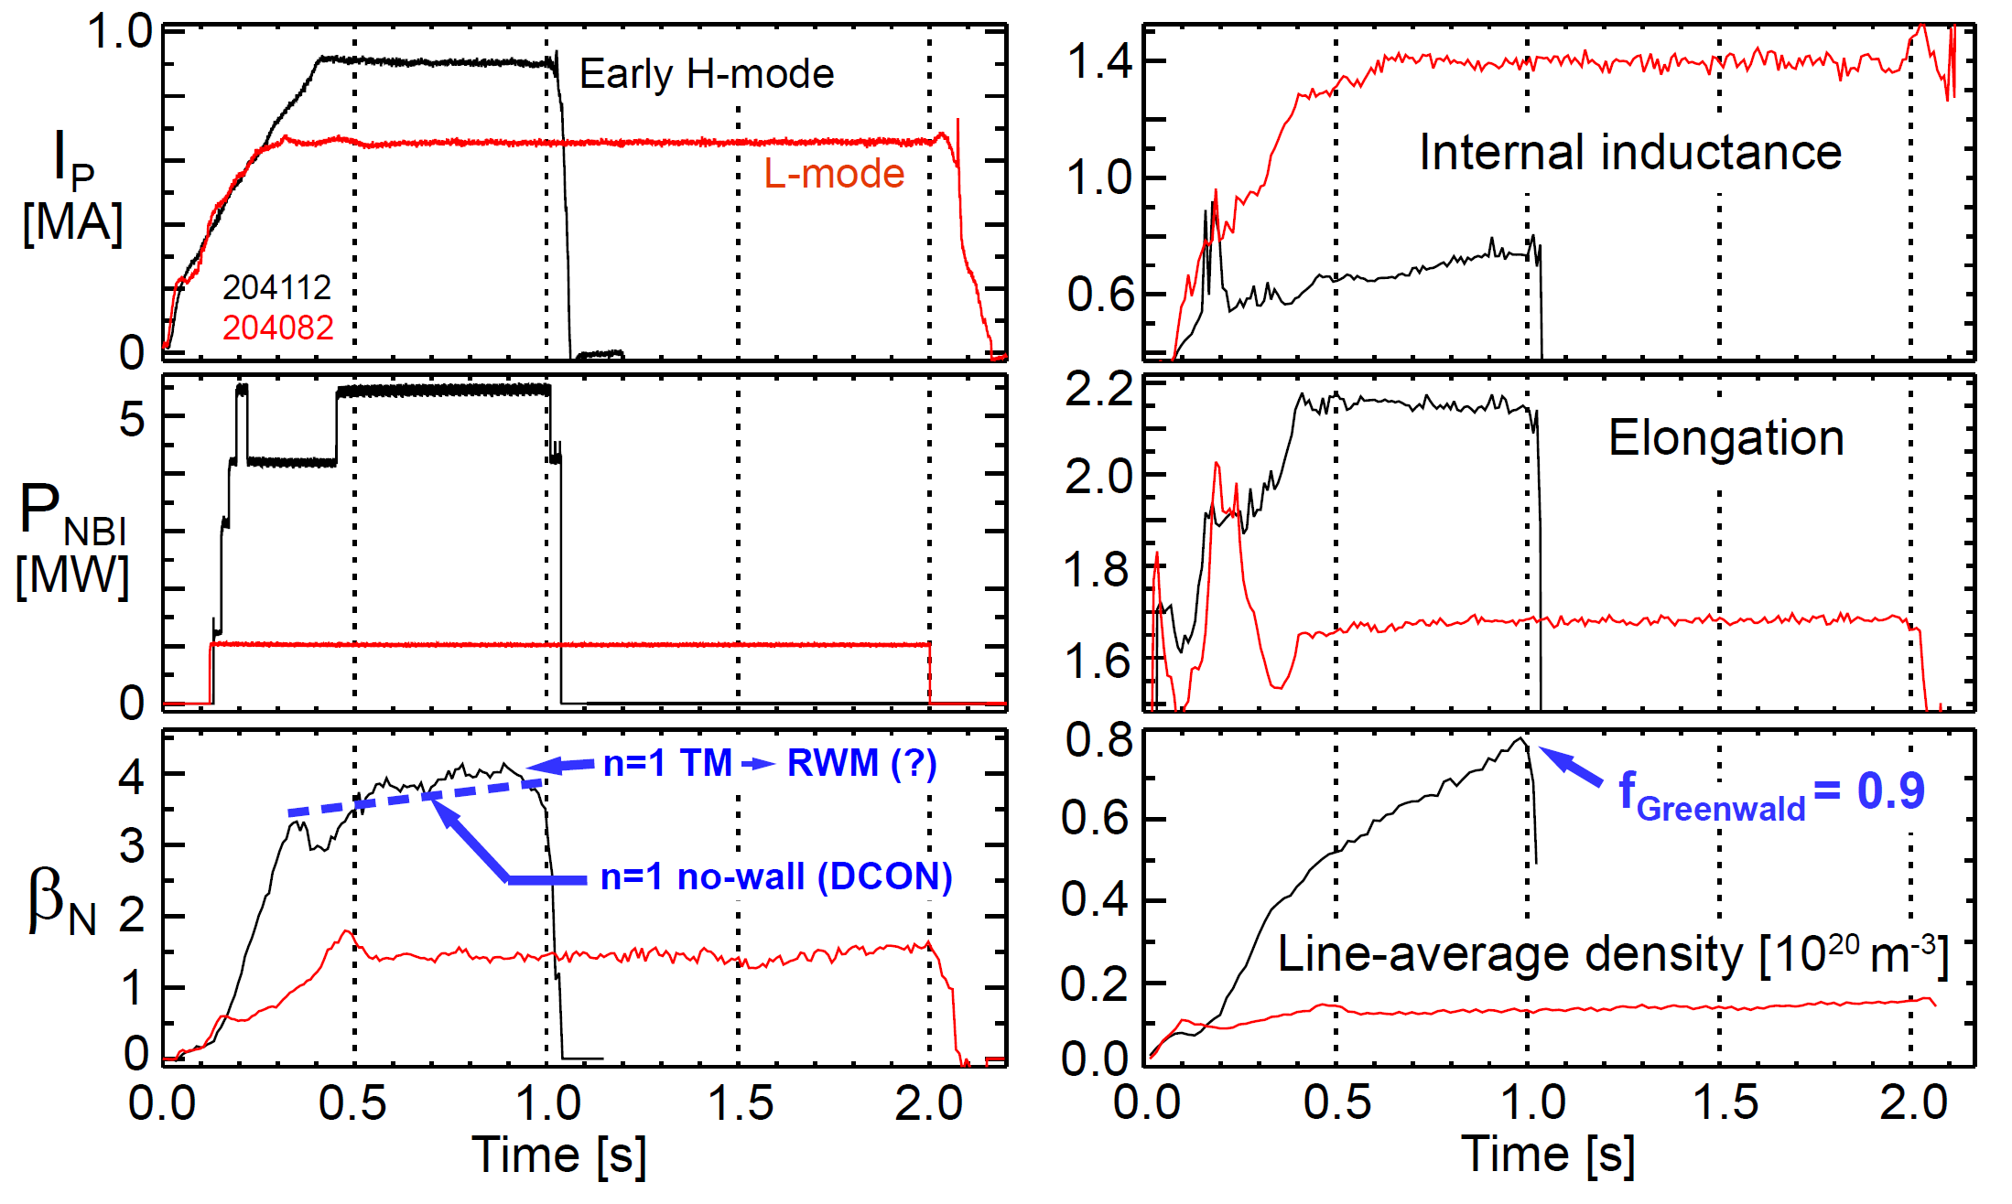
Examples of high-performance
L and H-modes achieved thus far
(motivates cryo-pump)
NEXT: Increase κ to avoid tearing, active RWM control, trigger ELMs (ΔR_{sep}, granule injector)

Slide 13
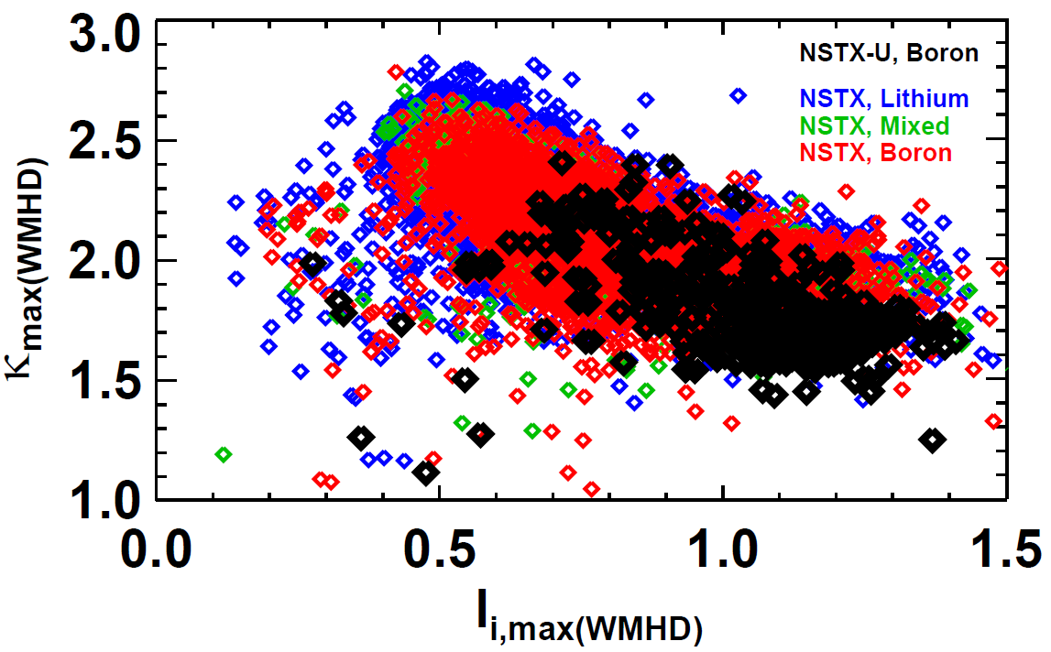
On path to high I_{P} without tearing modes by elevating q_{min} with early heating + H-mode → l_{i}=0.5-0.6, κ=2.5-2.7
Utilizing real-time EFIT / ISOFLUX (GA collaboration)
  Also utilizing improved vertical motion detection

Slide 14
Outline
NSTX highlight overview, NSTX-U run progress
NSTX-U mission, priorities, FY16-18 overview
FY16-18 research plans
Milestone summary
ITPA contributions
ST-FNSF / Pilot Plant study highlights
Summary

Slide 15
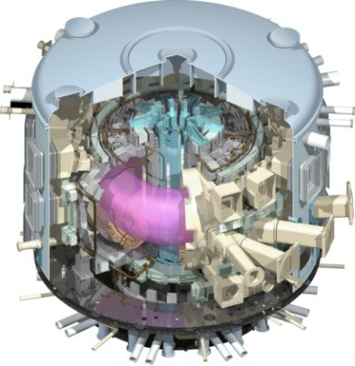
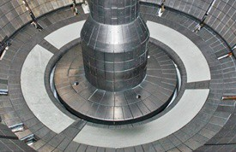
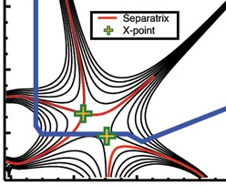
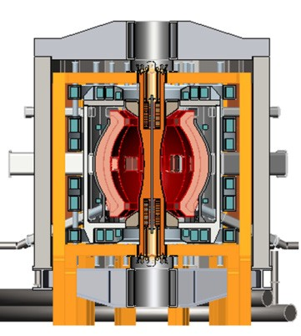
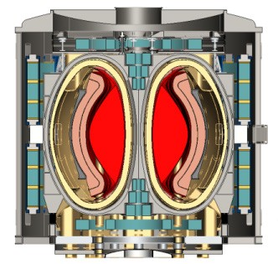
NSTX-U Mission Elements:
Explore unique ST parameter regimes to advance predictive capability - for ITER and beyond
ITER
Develop solutions for plasma- material interface (PMI)
Liquid metals / Lithium
Snowflake/X
ST-FNSF /
Pilot-Plant
Advance ST as Fusion Nuclear Science Facility and Pilot Plant

Slide 16
5 year goal: Establish core physics/scenarios for ST
10 year goal: Integrate high-performance core + metal walls
Next 5 years
Second 5 years
Establish ST physics / scenarios:
High-performance + metal walls
Confinement vs. β , collisionality
Sustain high β with advanced control
Non-inductive start-up, ramp-up
Mitigate high heat fluxes
Test high-Z divertor, Li vapor shielding
Convert all PFCs from C to high-Z
Static → flowing Li divertor module(s), full toroidal flowing Li divertor, high T_{wall}
5s → 10-20s for PFC/LM equilibration
Assess ST with high-Z, high-Z + Li
Inform choice of
FNSF configuration:
Inform choice of FNSF / DEMO
plasma facing materials:
Lower A or higher A?
Standard, snowflake, Super-X (MAST-U)?
High-Z consequences? need high-Z + Li?
Assess for both divertor and first-wall

Slide 17
NSTX-U will address key physics questions during next 3 years leveraging unique capabilities
What role do electromagnetic effects play in electron energy transport? (High β, lower ν*)
Can fast-ion instabilities be predicted and controlled for ITER and beyond? (Vary v_{f} /v_{A}, β_{f}, anisotropy)
Can ST operate near & above no-wall limit and 100% non-inductive?
  Only ST in world capable of this research critical for steady-state FNSF / Pilot Plant
What physics determines SOL heat flux width? (Low-A, 2× I_{P} , Li wall)
How do advanced divertors and Li impact edge transport, scenarios?
Establish ST physics / scenarios:
Confinement vs. β , collisionality
Sustain high β w/ advanced control
Non-inductive start-up, ramp-up
Mitigate high heat fluxes
Test high-Z divertor, Li vapor shielding

Slide 18
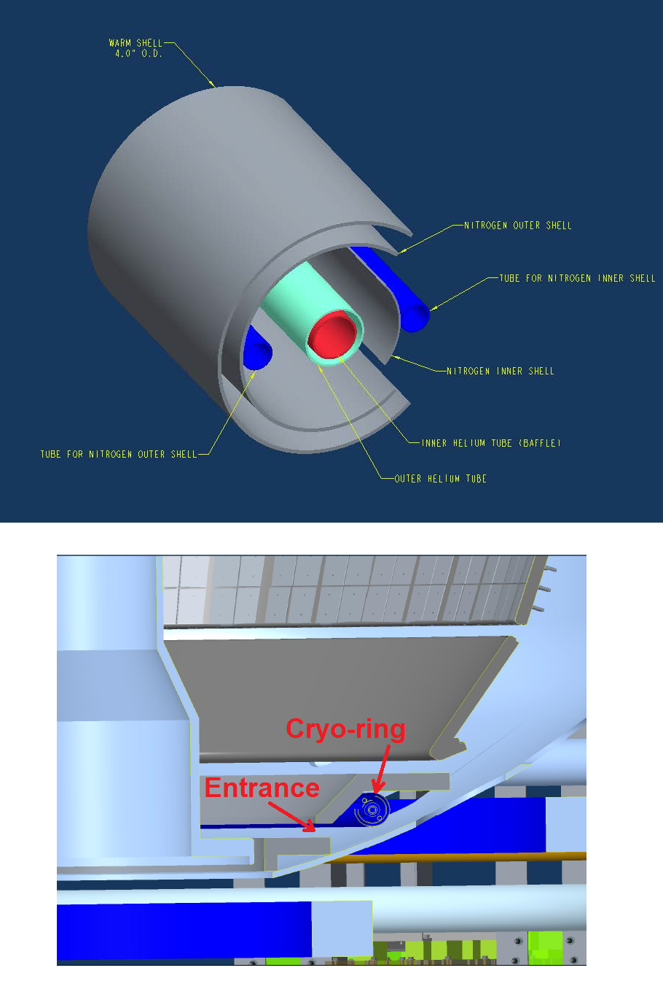
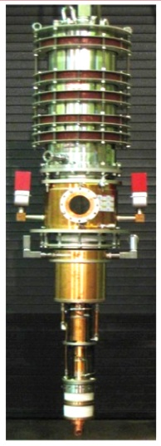
Prioritization of next major facility enhancements
1. Divertor cryo-pump with high-Z baffle
  Control density and ν* without Li, compare to Li
  High-Z cryo-baffle to accelerate transition to high-Z PFCs & support liquid Li/metal research
2. Non-axisymmetric control coils (NCC)
  Resonant, non-resonant NTV rotation control
  RMP ELM suppression (not yet achieved in ST)
  Enhanced RWM and EF control
OR
Full toroidal NCC array (2 x 12)
ECH: 28GHz / 1MW gyrotron (Tsukuba)
  Heat CHI target w/ ECH for HHFW
  EC/EBW-only CD for start-up
  Longer-term: EBW CD for sustainment
  Central e-heating for high-Z expulsion?
NCC
Existing
RWM
coils
Completing conceptual designs for above this FY
NCC or ECH require sustained incremental funding

Slide 19
FY16-18 planned research supports
5 highest priority goals of NSTX-U 5 year plan:
Purple boxes indicate Research milestone year and number in this presentation and FWP
R1#-#
Explore unique ST parameter regimes to advance predictive capability - for ITER and beyond
  Understand confinement and stability at high beta and low collisionality
  Study energetic particle physics prototypical of burning plasmas
Develop solutions for PMI challenge
3. Dissipate high edge heat loads using expanded magnetic fields + radiation
4. Compare performance of solid vs. liquid metal plasma facing components
Advance ST as possible FNSF / Pilot Plant
5. Form and sustain plasma current without transformer for steady-state ST

Slide 20
Outline
NSTX highlight overview, NSTX-U run progress
NSTX-U mission, priorities, FY16-18 overview
FY16-18 research plans
Milestone summary
ITPA contributions
ST-FNSF / Pilot Plant study highlights
Summary

Slide 21
FY16-18 planned research supports
5 highest priority goals of NSTX-U 5 year plan:
Core Science
Macroscopic Stability
Transport and Turbulence
Energetic Particles
Explore unique ST parameter regimes to advance predictive capability - for ITER and beyond
  Understand confinement and stability at high beta and low collisionality
  Study energetic particle physics prototypical of burning plasmas
Develop solutions for PMI challenge
3. Dissipate high edge heat loads using expanded magnetic fields + radiation
4. Compare performance of solid vs. liquid metal plasma facing components
Advance ST as possible FNSF / Pilot Plant
5. Form and sustain plasma current without transformer for steady-state ST

Slide 22
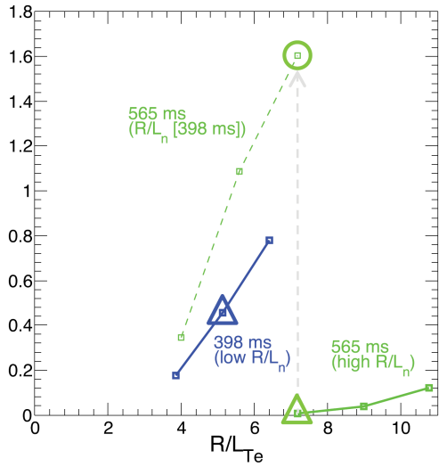
NSTX: Linear and non-linear gyrokinetic simulations have shown the role of ∇n_{e} in stabilizing ETG modes
Decrease in ETG turbulence amplitude with increasing ∇n_{e}
μwave
scattering
ETG
Scattering
region
grad T_{e} ~ constant
Measured δn/n, linear growth rates, non-linear Q_{e} all reduced by higher ∇n_{e}
γ_{lin} / (c_{s}/a)
Q_{e} [MW]
(δn/n)²
GS2
Expt
~1MW of e-heat transport from non-ETG?
Expt
GYRO
Low ∇n_{e}
High ∇n_{e}
Ruiz-Ruiz et al.
MIT grad student
PoP (2015)
k_{θ}/ρ_{s}
k_{θ}/ρ_{s}

Slide 23
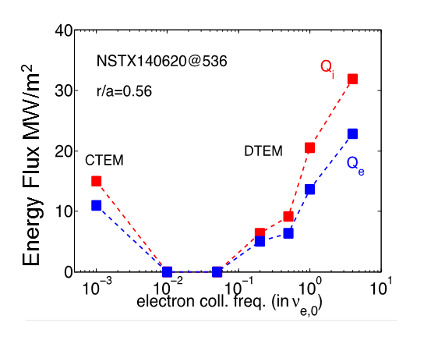
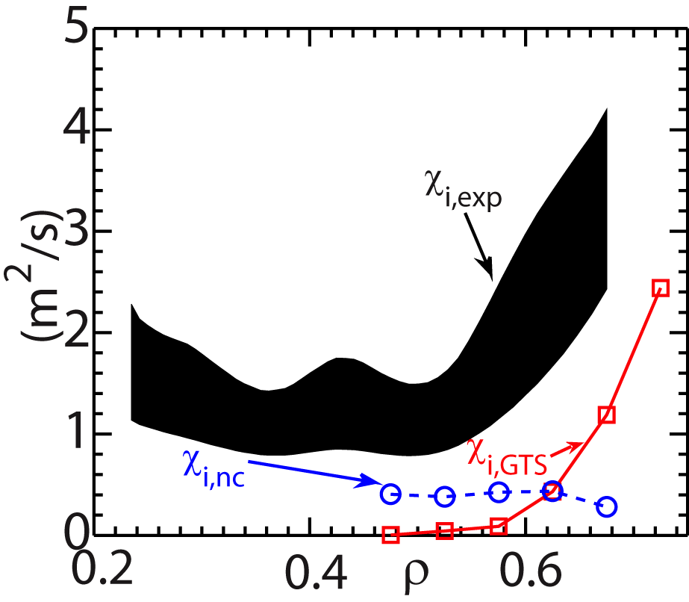
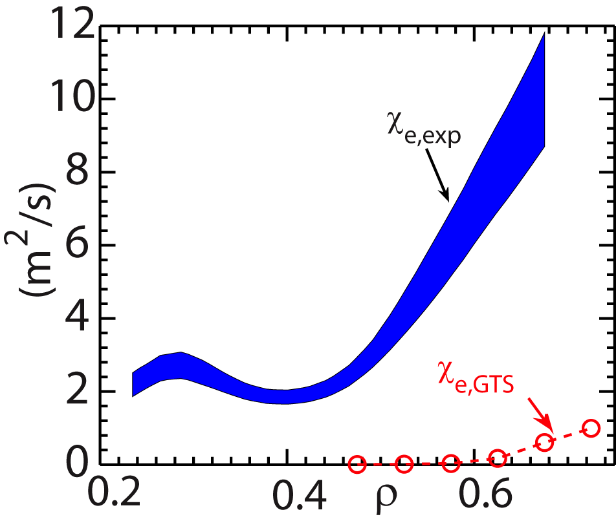
NSTX: Global non-linear GTS gyrokinetic simulations have identified multiple low-k turbulence transport mechanisms
Strong flow shear can destabilize Kelvin-Helmholtz instability
  Non-linear global GTS simulations
  K-H+ITG+Neo ion transport within factor of 2 of expt’l level
  Cannot account for electron transport
Recent GTS simulations have shown possible role of DTEM in contributing to observed favorable collisionality scaling (Bτ_{th}~ν_{*e}^{-0.8})
  In addition to microtearing
  Synergy with DIII-D work
Ions
Electrons
Energy Flux MW/m²
W. Wang et al., NF Letters, PoP (2015)

Slide 24
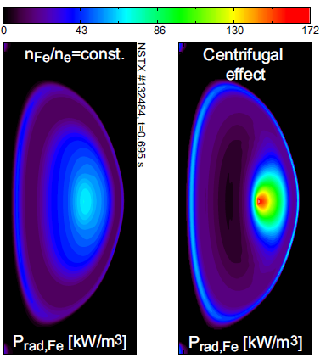

NSTX-U will study low- and high-Z impurity transport to assess potentially strong rotation effects
Will investigate if high-Z transport follows neoclassical including centrifugal effects
  Use 2nd NBI + NTV to vary rotation
Investigate particle transport using edge neutral measurement (D_{α} from MSE, BES; D_{β} camera) + DEGAS2 calculations
  Assess perturbative capability using TS, ME-SXR
  Perturbative particle transport measurements led on MAST in 2013 (Ren)
f₀=28 kHz
(M_{D,0}=0.56)
Collaboration with CCFE
Delgado-Aparicio, HTPD (2014)
Impurity transport studies: gas-puff (Ne, Ar), laser blow off (Ca, Mo, W – FY16, LLNL/JHU) and several diagnostic enhancements:
  Survey x-ray spectrometers (LLNL)
  XCIS: V_{ϕ,Z}, T_{Z}, n_{Z} (Ca, Ar, Mo, W) (MIT + PPPL)
  1D tangential mid-plane + 2D poloidal bolometers (PPPL + ORNL)

Slide 25
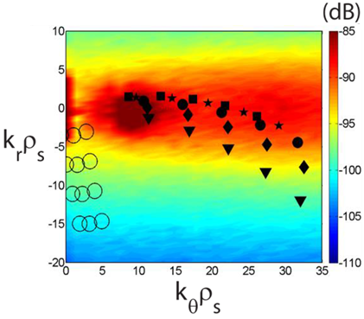
Transport and Turbulence Research Plans for FY2016-18:
First τ_{E} data at higher B_{T}, I_{P} + turbulence, develop reduced χ_{e} models
FY16: Extend ST confinement scalings and understanding with up to 60% increase in B_{T} and I_{P}
  Measure low-k δn (BES w/ increased edge channel count)
FY16-17: Develop and validate reduced transport models using ST data + linear and non-linear gyro-kinetic simulations
FY17-18: Extend confinement studies to full B_{T}, I_{P}, 2-3× lower ν*
R16-1
Simulated ETG in NSTX-U
Initial utilization of new high-k FIR scattering system for ETG turbulence
  Measure k_{r} & k_{θ} to study turbulence anisotropy
New high-k
Study turbulence vs. ν*, rotation, q with high-k + BES + cross-polarization-scattering (2018)
Previous high-k
R17-3
FY18: Assess impurity sources, edge/core impurity transport
  Utilize new laser blow-off system (LLNL) for edge impurity injection
R18-1

Slide 26
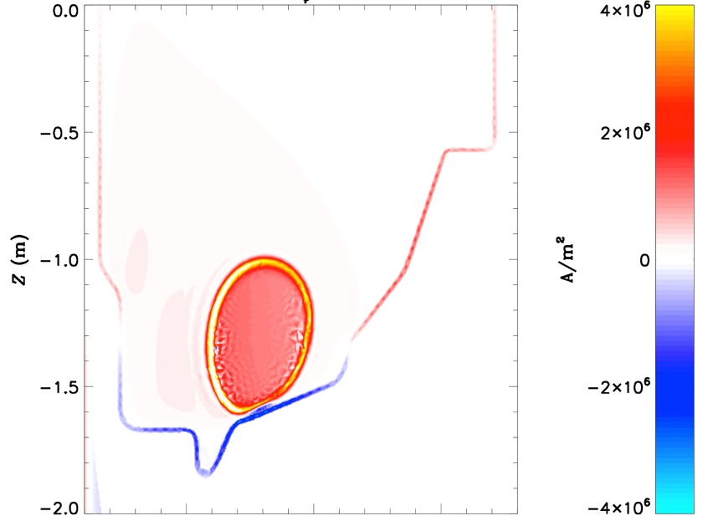
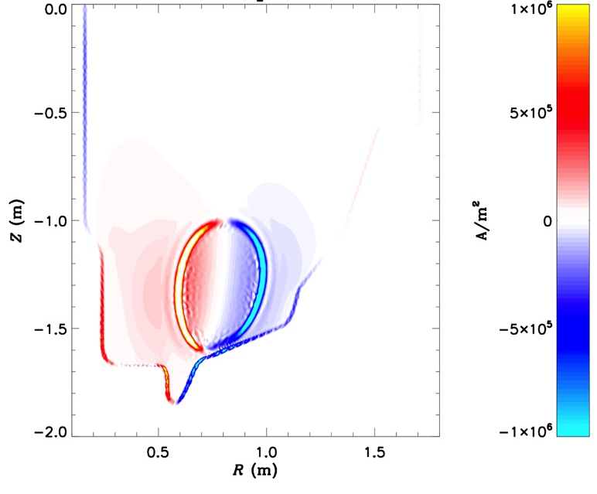
Using advanced simulation capabilities to model disruptions and halo currents for NSTX / NSTX-U
New resistive wall model in M3D-C1 allows unique capability to simulate mode locking and current-quench
Includes self-consistent treatment of rotation and halo currents
  We will seek to validate these models against NSTX-U data
J_{φ}
Halo currents
J_{Z}

Slide 27
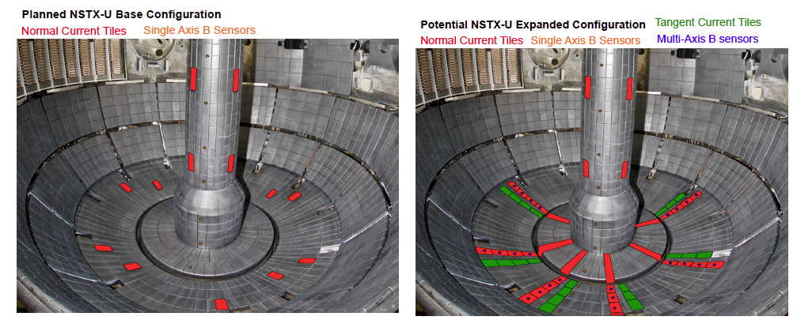
M3D-C¹ with resistive wall capability will be used to map out optimal placement of new B-sensors to study halo currents
Dynamics of halo currents and forces critical for ITER: particular concern are halo current asymmetries and rotation
New sensors will measure halo currents, B-fields and JxB forces in NSTX-U
Critical theoretical issues: (i) role of boundary conditions (ii) halo current distributions in 3D conducting structures (D. Pfefferle – post-doc)
Joint NSTX-U / Theory task
JRT-2016, R16-3, 17-2, 18-2

Slide 28
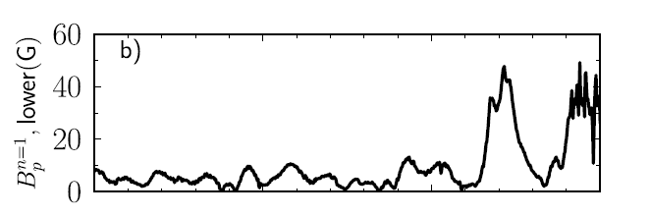

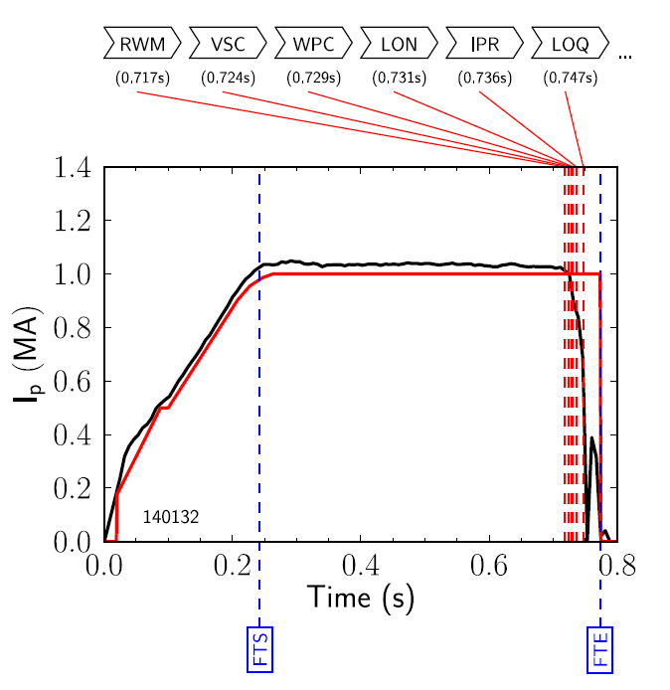

The DECAF code is being used to characterize disruption event chains on NSTX and NSTX-U, including RWMs
Disruption Event Characterization And Forecasting code
Structured to ease parallel development
Module grouping follows deVries
  BUT, easily appended or altered
Warning algorithm approach follows Gerhardt
  BUT, more flexible and extensive
Code control workbooks
Physical event modules
Density Limits
Confinement
Main data structure
Technical issues
Tokamak dynamics
Output processing
Power/current handling
Mode stability
Disruption event chain
  Resistive wall mode (RWM) > Vertical stability control (VSC) > … > Disruption
Longer-term: implement in real-time, link to avoidance/mitigation actuators

Slide 29
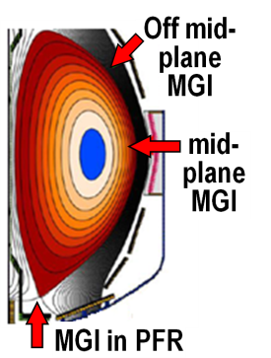
Macroscopic Stability Research Plans for FY2016-18:
Complete 3D coil CDR, re-establish high-β ops, assess MGI and halos
FY16: Finalize physics for NCC coil conceptual design
  Re-establish n=1-3 error-field correction, RWM control, minimize EF rotation damping, sustain operation above no-wall limit
  Test poloidal dependence of Massive Gas Injection (outboard vs. private flux region)
FY17: Contribute unique MGI data (low-A, injector location) for mitigation + warning, prediction
  Assess mitigation triggering via real-time warning in NSTX-U
R16-3
JRT-2016
First data from upgraded halo diagnostics
FY18: Control of current and rotation profiles to improve global stability limits and extend high performance operation
R18-2

Slide 30
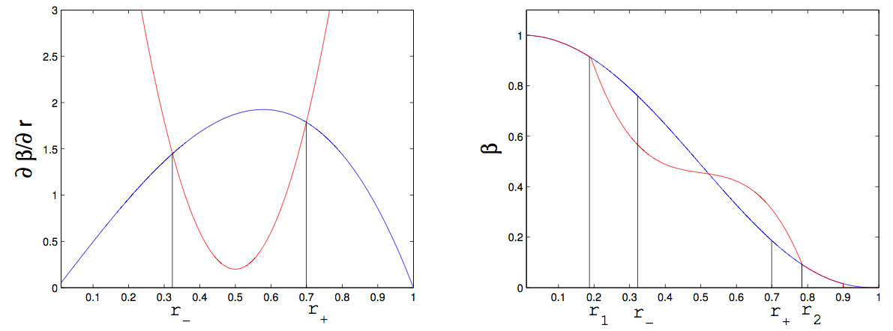
Models for fast ion profile relaxation in presence of AEs are being validated in-prep for NSTX-U
Critical Gradient Model (Gorelenkov)
  Compute critical ∂β_{EP}/∂r due to AE
  Mode growth/damping computed by NOVA-K
“Kick” model (Podesta et al., NF 2015)
  PDF computed by ORBIT & NOVA
  Kicks ~ mode amplitude
Gorelenkov
ΔP
Podesta
Critical gradient
Classical profile
ΔE
r₋
r₊
r₁
r₋
r₊
r₂
CG used to relax EP profile. It is broadened from the initially unstable one between r± → r_{1,2}
Both CGM and Kick models reproduce neutron deficit in an NSTX discharge with multiple unstable TAEs
  Models also being tested on DIII-D (JRT-15)
  Incorporating both models in TRANSP
Neutron Deficit %
Time (ms)

Slide 31

New NSTX-U result (preliminary): 2nd NBI fast-ion behavior consistent with classical slowing-down theory
R_{Tan}:
1C: 50cm
2C: 110cm
2A: 130cm
R16-2
The magnitude, rise and decay rates of neutron signal reasonably agree with the TRANSP prediction which assumes fast ions behave classically
  Some discrepancy in 2C decay rate → suggest some fast ion loss... due to small sawteeth?

Slide 32
NSTX: Large inferred anomalous core electron transport in presence of CAE/GAEs
Observation of high frequency Compressional/Global Alfven Eigenmodes (CAE/GAE) modes in plasma core associated with flattening of T_{e} profile (Stutman, Tritz - JHU)
  High level of transport (10-100 m²/s) inferred assuming classical beam physics
BES spectra show mode amplitudes peaking from R=115 to 120 cm (r/a~0.2 to 0.3), in region of enhanced transport
CAE/GAE
~δn amplitude of 738 kHZ CAE/GAE
Stutman
Smith
Is enhanced transport the full picture?

Slide 33
New NSTX-U result: Suppression of counter-propagating GAE observed for large R_{TAN} 2nd NBI
Top panel:
  GAE excited by inboard sources 1B / 1C (blue / cyan, lower panel)
Injection of outboard source 2B starts at 0.192s results in suppression of GAE.
  Suppression time ~10ms
  Suppression also with 2A, 2C
Observations consistent with model of cyclotron-resonant drive of GAE
Will investigate whether GAE absence impacts electron thermal transport
R16-2
IR18-2
→ 2nd NBI already powerful new tool for AE physics

Slide 34
Energetic Particle Physics Research Plans for FY2016-18:
Characterize new 2nd NBI, develop full + reduced fast-ion transport models
FY16: Measure fast-ion (FI) density profiles, confinement, current drive, AE stability
  Exploit new 2nd NBI and higher B_{T}, access to reduced v_{fast} / v_{A}
R16-2
FY17: Complete model χ_{e, AE} using measured CAE/GAE mode structures and HYM/ORBIT simulations (w/ T&T group)
  Does core T_{e} profile & peaking vary significantly with NBI tangency?
  Incremental: Assess fast-wave interactions with fast ions at increased field and current
FY18: Incremental: Assess role of fast-ion driven instabilities versus micro-turbulence in plasma thermal energy transport
  Joint between transport and energetic particle groups
IR17-1
IR18-2

Slide 35
FY16-18 planned research supports
5 highest priority goals of NSTX-U 5 year plan:
Explore unique ST parameter regimes to advance predictive capability - for ITER and beyond
  Understand confinement and stability at high beta and low collisionality
  Study energetic particle physics prototypical of burning plasmas
Develop solutions for PMI challenge
3. Dissipate high edge heat loads using expanded magnetic fields + radiation
4. Compare performance of solid vs. liquid metal plasma facing components
Advance ST as possible FNSF / Pilot Plant
5. Form and sustain plasma current without transformer for steady-state ST
Boundary Science
Pedestal
Divertor / SOL
Materials and PFCs

Slide 36




XGC1 simulations aiding in understanding of SOL heat flux width trends in NSTX
Experiment shows contraction of SOL heat flux width at midplane with I_{p} as well as influence of Li conditioning
XGC1 w/ collisions → similar trends
XGC-1:
20
NSTX
Experiment
0 mg
150 mg
300 mg
Full-f, global PIC, kinetic ions, fluid electrons (kinetic electrons under development)
Good candidate for exascale computing initiative
15
XGC1
B_{P} scan
Using 139047 at 665ms, 50 mg Li
λ_{q} (mm)
10
5
NSTX data and XGC-1: λ_{q} ~ 1/I_{P}^{1.5}
How will NSTX-U λ_{q} scale?
  Will SOL turbulence become important?
0
0.4 0.6 0.8 1 1.2 1.4
I_{P} (MA)
Heat flux width determined primarily by neoclassical processes
NSTX-U / PPPL
Theory Partnership

Slide 37
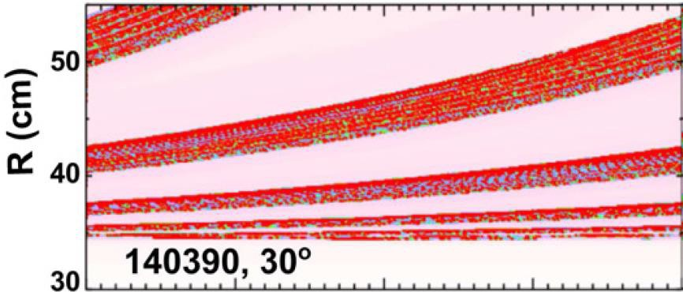
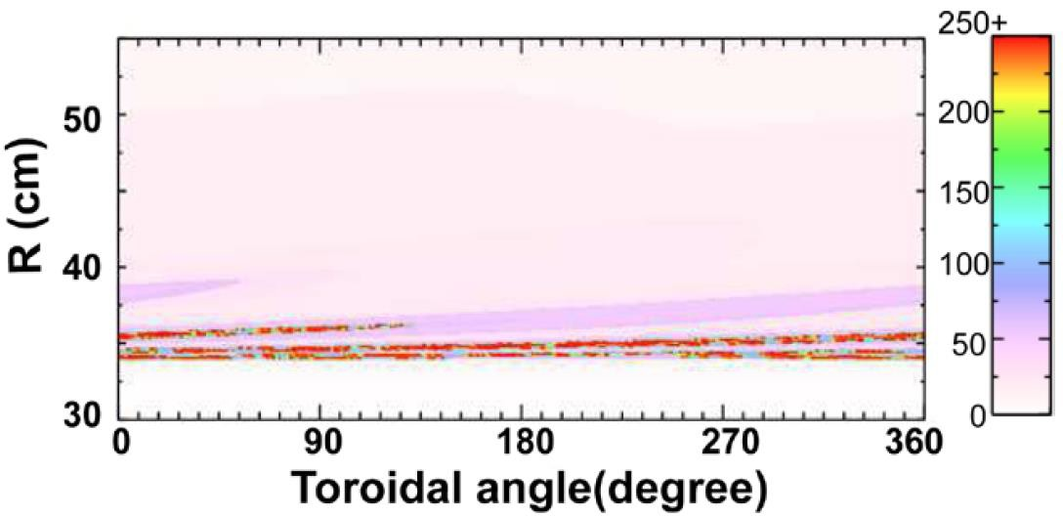

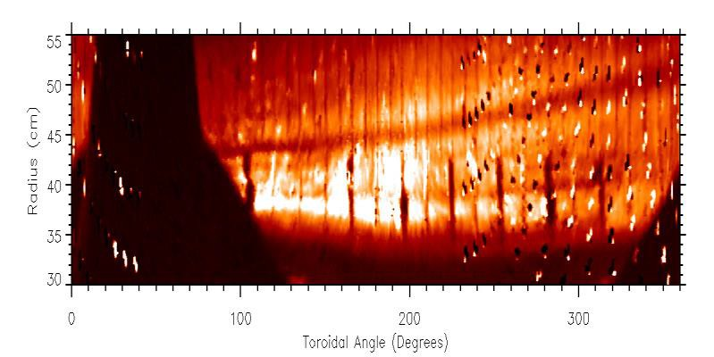

Improving understanding of role of plasma response in divertor footprint modification by 3-D fields in NSTX
n=1 perturbation very sensitive to plasma response –
amplification of footprint splitting is observed
IPEC
K. Kim, PPCF 57 (2015), 104002
Vacuum
0
90 180 270
Toroidal angle (degree)
360
Ideal plasma response substantially amplifies n=1 separatrix splitting → better agreement with IR camera data
Plasma response effects weaker for n=3 fields (not shown)
0
90
180
270
360
Toroidal angle (degree)
Important for ITER: n=1 EFC + higher-n RMP ELM suppression

Slide 38
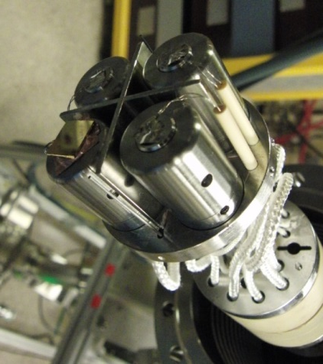
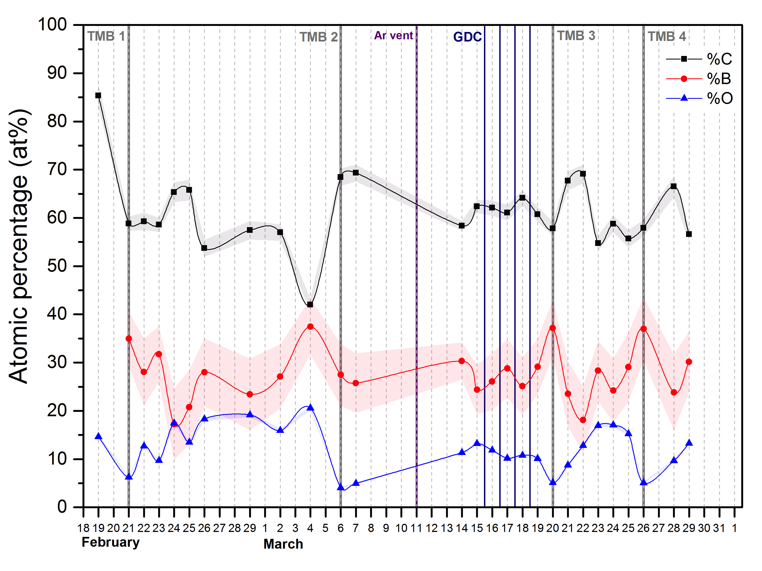
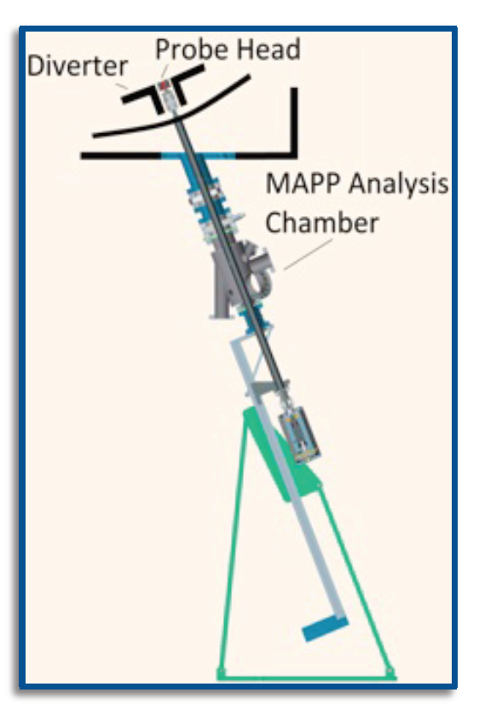

Material Analysis & Particle Probe (MAPP) commissioning providing new measurements of surface evolution in NSTX-U
Correlating B, O evolution w/ plasma performance
Implementing between-shots analysis capability this run
Will help understand complex Li chemistry and evolution

Slide 39
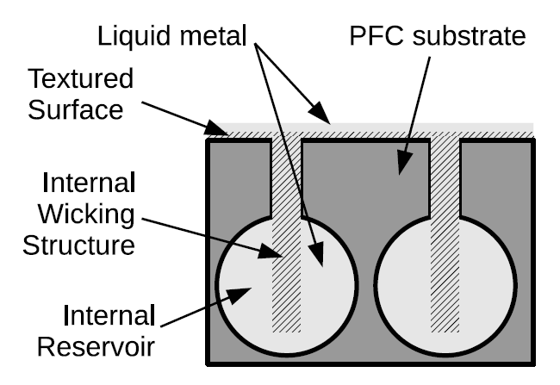
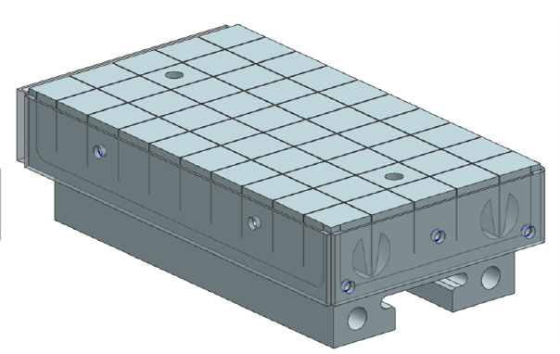
Developing tiles integrating high-Z substrate with (future) pre-filled Li reservoir to study flowing liquid metal PFCs
Base high-Z tiles without Li reservoir will be tested during FY17 run
  Full toroidal row on OB divertor
  Utilizes wire-EDM fabrication to obtain complex geometry
Pre-filled Li tile:
  Similar to capillary porous system (CPS) but applicable as divertor PFC
  Passive surface replenishment
  Test in FY2018 (if technically ready)
P. Rindt, TU/Eindhoven Thesis, Jaworski FED submitted

Slide 40
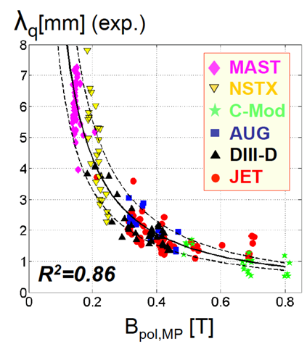
Boundary Science Research Plans for FY2016-18
Advance snowflake, cryo, pedestal, SOL studies, extend to higher B_{T}, I_{P}
FY15: Measure pedestal structure, SOL width, ELM types, snowflake performance at up to 60% higher I_{P}, B_{T}, 2× higher P_{NBI}
Lithium granule injector (LGI) ELM triggering for impurity control, Li coating performance in NSTX-U - compare to EAST/DIII-D results
R16-1
EAST: assess long-pulse particle/impurity control with triggered ELMs, cryo-pumping, lithiumization, high-Z PFCs
FY17: Increase I_{P} → 2MA → test snowflake, detachment, PFCs with q|| up to 4-5× higher than NSTX
Assess high-Z + lithium coated PFC performance with 1 row of high-Z tiles on outboard divertor (at large R)
FY18 (incremental): Investigate power/momentum balance for high density divertor operation (vapor shielding baseline)
R17-1
R17-2
IR18-1

Slide 41
FY16-18 planned research supports
5 highest priority goals of NSTX-U 5 year plan:
Explore unique ST parameter regimes to advance predictive capability - for ITER and beyond
  Understand confinement and stability at high beta and low collisionality
  Study energetic particle physics prototypical of burning plasmas
Develop solutions for PMI challenge
3. Dissipate high edge heat loads using expanded magnetic fields + radiation
4. Compare performance of solid vs. liquid metal plasma facing components
Advance ST as possible FNSF / Pilot Plant
5. Form and sustain plasma current without transformer for steady-state ST
Integrated Scenarios
Adv. scenarios and control
Start-up
Wave heating and CD

Slide 42
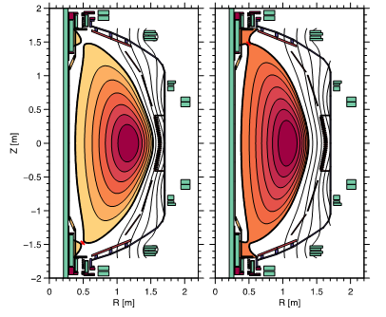
Using TRANSP to test q₀ and β_{N} control via beam power and outer gap size actuation
Boundary can have strong effect on q profile through
  Effect on beam deposition profile
  Effect on bootstrap current through change in elongation
Two reference boundaries with different outer gap sizes were chosen, and interpolated between based on the feedback controller request
Small outer gap
Large outer gap
M.D. Boyer, NF 2015

Slide 43
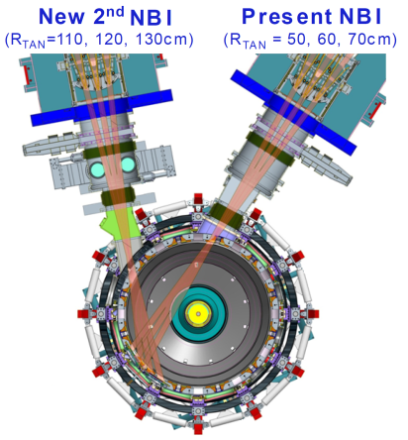

Simplified model used for rotation profile control design in NSTX-U
Using simplified form of toroidal momentum equation for design, profiles derived from TRANSP
Rotation
New NBI
(central torque)
3D Field Coil
(edge torque)
Notes:
\sum_i n_i m_i \langle R^2\rangle\frac{\partial \omega}{\partial t} = \left(\frac{\partial V}{\partial \rho}\right)^{-1}\frac{\partial}{\partial\rho}\left[\frac{\partial V}{\partial \rho}\sum_i n_i m_i \chi_\phi\langle R^2(\nabla\rho)^2\rangle\frac{\partial\omega}{\partial\rho}\right]+T_{NBI}+T_{NTV}

Slide 44

State-space controller achieves good tracking in TRANSP simulations
Rotation
Coil current
First
target
Second
target
Rotation (rad/s)
Coil current [A]
Stored energy
Beam power
Beam 1
Beam 2A
Beam 2B
Beam 2C
Energy (MJ)
Beam Power (MW)
First
target
Second
target
Time (s)
Time (s)

Slide 45
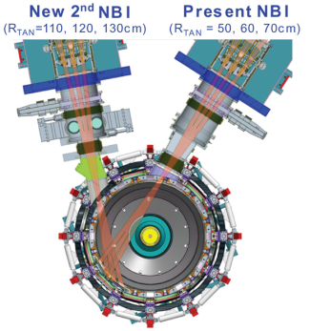
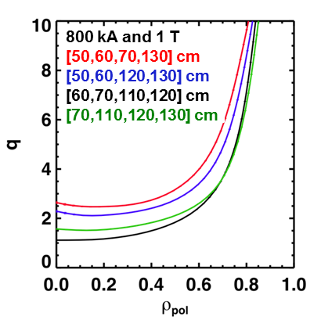
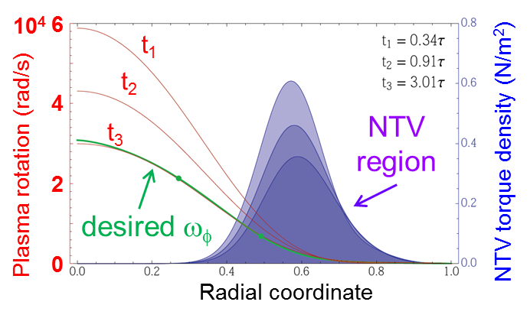
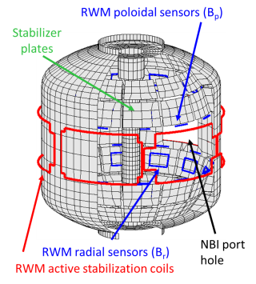
Advanced Scenarios and Control Research Plans for FY2016-18:
Implement advanced controls, explore high non-inductive & I_{P} scenarios
FY16: Re-establish NSTX-U control and plasma scenarios
  Vertical/shape control, NBI beta feedback control, EF/RWM control
Assess new 2nd NBI current-drive vs. R_{TAN}, n_{e}, outer gap
  Push toward 100% non-inductive at higher B_{T}, P_{NBI}
  Quantify impact of broadened J(r), p(r) on confinement, stability
Explore scenarios (τ_{E}, l_{i}, MHD) at up to 60% higher I_{P}, B_{T}
FY17: Explore scenarios at full I_{P} and B_{T} capability of NSTX-U
  Goal: Access 100% non-inductive, test small I_{P} overdrive
FY18: Control of current and rotation profiles to improve global stability limits and extend high performance operation
R16-3
R17-4
R18-2

Slide 46
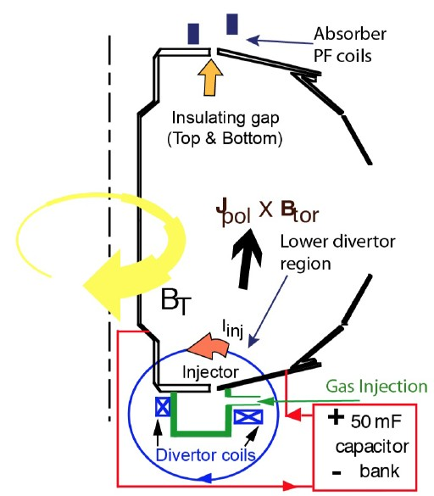
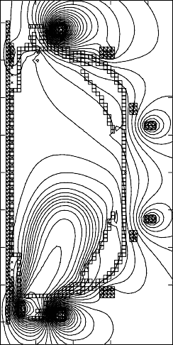
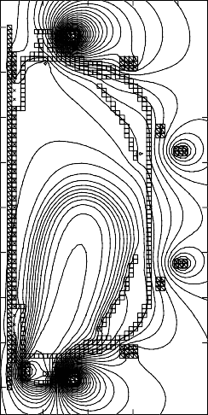
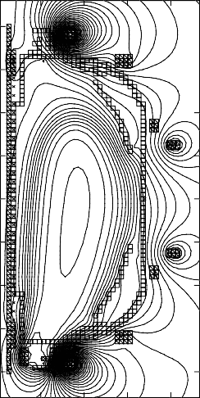

ST-FNSF may need solenoidless current start-up method
Coaxial Helicity Injection (CHI) effective for current initiation
CHI developed on HIT, HIT-II
Transferred to NSTX / NSTX-U
NSTX: 150-200kA closed flux current
NSTX-U: CHI projects to 300-400kA
TSC axisymmetric simulation of CHI startup
1.0 ms 1.6 ms 2.7 ms
2
Z (m)
0
-2
2
0
2
0
R (m)
R (m)
0
R (m)
2
R. Raman et al., PRL 2006

Slide 47
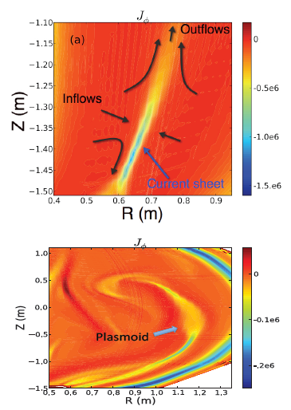

At high Lundquist number, plasmoid-mediated reconnection identified as assisting in flux closure
Sweet Parker (S-P) reconnection in the injector region at low Lundquist number
Plasmoids seen in NSTX CHI
Plasmoids potentially important for extrapolating CHI to FNSF
NIMROD Simulations
F. Ebrahimi, et al., PRL (2015)

Slide 48
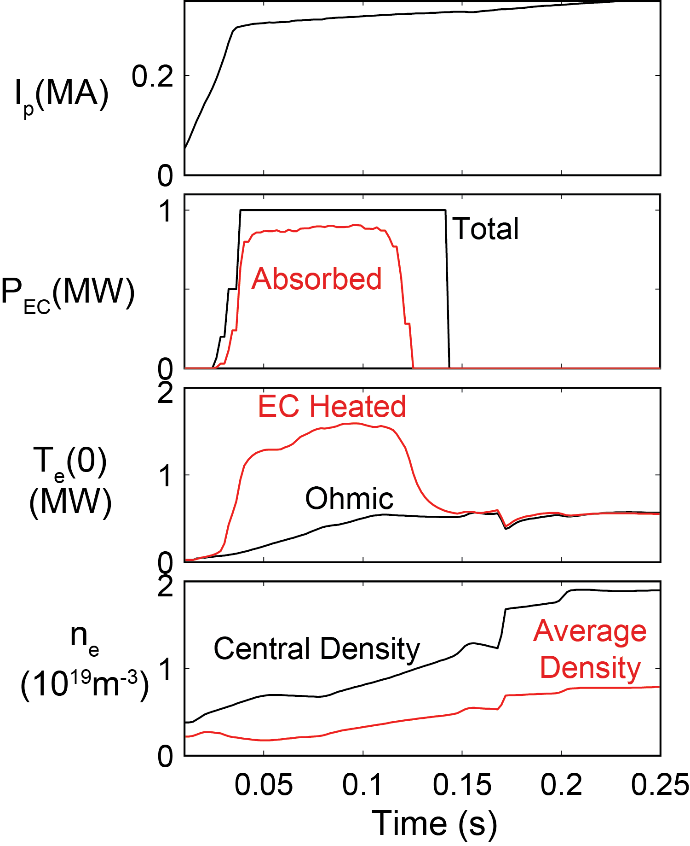
TRANSP simulations predict that 28 GHz ECH very effective at heating NSTX-U start-up plasmas
TRANSP time-dependent simulations with 1 MW of 28 GHz O-mode ECH predict a rapid increase in first-pass absorption from 5% to 75%
as T_{e}(0) increases from 10 eV
to 1 keV in ~10 ms
Issue: ECH can be used for ~150 ms before the plasma n_{e} > n_{cutoff}
Experiments: Get new density information
from CHI and low-I_{P} RF target plasmas
Modeling: Assess EC heating against plasma parameter variations

Slide 49
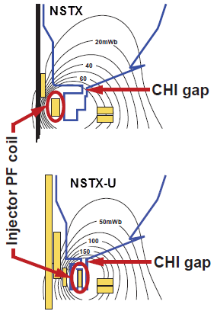
Solenoid-Free Start-up and Ramp-up Research Plans for FY2016-18:
Prepare CHI for NSTX-U, assess CHI/NBI start-up/ramp-up
FY16-17: Establish NSTX-U CHI, assess impact of new injector, gap, higher B_{T}
FY16-17: Initial tests of small NBI+BS overdrive ramp-up using new 2nd NBI and higher B_{T}
FY18: Assess transient CHI current start-up potential in NSTX-U
  Characterize maximum start-up current vs. injector flux, CHI voltage, toroidal field, high-power ECH (if available – incremental)
  Study reconnection region and plasmoid instabilities with improved cameras/imaging
R18-3

Slide 50


Wave Physics Research Plans for FY2016-18:
Simulate, develop reliable FW-heated H-mode, assess impurity control
FY16: First data on HHFW heating efficiency at higher B_{T}
FY17: Incremental: Assess fast-wave SOL losses and core thermal and fast-ion interactions at increased B_{T}, I_{P}
FY18: Assess HHFW as means of core impurity expulsion as well as a potential source of edge impurities
k_{φ} = 13 m⁻¹
Heating phasing
Lower SOL density (n_{ant} = 1x10¹² cm⁻³)
Higher SOL density (n_{ant} = 2x10¹² cm⁻³)
IR17-1
Cutoff layer
R18-1
AORSA simulations
N. Bertelli, NF 2015, 2016

Slide 51
Outline
NSTX highlight overview, NSTX-U run progress
NSTX-U mission, priorities, FY16-18 overview
FY16-18 research plans
Milestone summary
ITPA contributions
ST-FNSF / Pilot Plant study highlights
Summary

Slide 52
Administration FY2017 request-level provides run-time
and full field + current to exploit new Upgrade capabilities
FY2016
FY2017
FY2018
Run Weeks:
18
16
12
R16-1
R17-1
R18-1
Boundary Science
+ Particle Control
Assess H-mode confinement, pedestal, SOL characteristics at higher B_{T}, I_{P}, P_{NBI}
Assess scaling, mitigation of steady-state, transient heat-fluxes w/ advanced divertor operation at high power density
Assess impurity sources and edge and core impurity transport
R17-2
Assess high-Z divertor PFC performance and impact on operating scenarios
R16-2
R17-3
Assess effects of NBI injection on fast-ion f(v) and NBI-CD profile
Assess τ_{E} and local transport and turbulence at low ν* with full confinement and diagnostic capabilities
Core Science
Begin ~1 year outage for divertor cryo-pump
R18-2
R16-3
Control of current and rotation profiles to improve global stability limits and extend high performance operation
Integrated Scenarios
Develop physics + operational tools for high-performance: κ, δ, β, EF/RWM
R17-4
R18-3
Develop high-non-inductive fraction NBI H-modes for sustainment and ramp-up
Assess transient CHI current start-up potential in NSTX-U
FES 3 Facility Joint Research Target (JRT)
C-Mod leads JRT
DIII-D leads JRT
NSTX-U leads JRT
Assess disruption mitigation, initial
tests of real-time warning, prediction
Examine effect of configuration on operating space for dissipative divertors
TBD

Slide 53
accelerates transport, divertor, and RF research, strongly utilizes facility, supports high-priority enhancements
Incremental
FY2016
FY2017
FY2018
Run Weeks:
Incremental
18
16
18
12
16
R16-1
R17-1
R18-1
Boundary Science
+ Particle Control
Assess H-mode confinement, pedestal, SOL characteristics at higher B_{T}, I_{P}, P_{NBI}
Assess scaling, mitigation of steady-state, transient heat-fluxes w/ advanced divertor operation at high power density
Assess impurity sources and edge and core impurity transport
R17-2
IR18-1
Assess high-Z divertor PFC performance and impact on operating scenarios
Investigation of power and momentum balance for high density and impurity fraction divertor operation
R16-2
R17-3
IR18-2
Assess effects of NBI injection on fast-ion f(v) and NBI-CD profile
Assess τ_{E} and local transport and turbulence at low ν* with full confinement and diagnostic capabilities
Assess role of fast-ion driven instabilities versus micro-turbulence in plasma thermal energy transport
Core Science
Begin ~1 year outage for divertor cryo-pump
IR17-1
R18-2
R16-3
Assess fast-wave SOL losses, core thermal and fast ion interactions at increased field and current
Control of current and rotation profiles to improve global stability limits and extend high performance operation
Integrated Scenarios
Develop physics + operational tools for high-performance: κ, δ, β, EF/RWM
R17-4
R18-3
Develop high-non-inductive fraction NBI H-modes for sustainment and ramp-up
Assess transient CHI current start-up potential in NSTX-U
FES 3 Facility Joint Research Target (JRT)
C-Mod leads JRT
DIII-D leads JRT
NSTX-U leads JRT
Assess disruption mitigation, initial
tests of real-time warning, prediction
Examine effect of configuration on operating space for dissipative divertors
TBD

Slide 54
Outline
NSTX highlight overview, NSTX-U run progress
NSTX-U mission, priorities, FY16-18 overview
FY16-18 research plans
Milestone summary
ITPA contributions
ST-FNSF / Pilot Plant study highlights
Summary

Slide 55

Supporting ITER through ITPA participation
Active in 31 JEX/JACs with reps in every Task Group, leadership in several
New: NSTX-U can / will contribute to IOS controlled ramp-down studies for ITER

Slide 56


Recent design studies show ST potentially attractive as
Fusion Nuclear Science Facility (FNSF) and Pilot Plant
FNSF: Provide neutron fluence for material/component R&D (+ T self-sufficiency?)
Pilot Plant: Electrical self-sufficiency: Q_{eng} = P_{elec} / P_{consumed} ≥ 1 (+ FNSF mission?)
FNSF with copper TF coils
A=1.7, R₀ = 1.7m, κ_{x} = 2.7, B_{T}=3T
Fluence = 6MWy/m², TBR ~ 1
FNSF / Pilot Plant with HTS TF coils
A=2, R₀ = 3m, κ_{x} = 2.5, B_{T} = 4T
6MWy/m², TBR ~ 1, Q_{eng} ~ 1
Designs integrate ST higher κ , β_{N} and advanced divertors (+ HTS TF for Pilot Plant)
Paper submitted to Nuclear Fusion

Slide 57
Outline
NSTX highlight overview, NSTX-U run progress
NSTX-U mission, priorities, FY16-18 overview
FY16-18 research plans
Milestone summary
ITPA contributions
ST-FNSF / Pilot Plant study highlights
Summary

Slide 58
NSTX-U research program well aligned with
FESAC / FES / Community Workshop strategic priorities
Plasma material interactions
  Scrape off layer / divertor physics
  PMI and long pulse divertor simulators
  Engineering innovations for plasma exhaust
  Plasma core-edge integration
Transients
  Disruption prediction, avoidance, mitigation
  ELM suppression with RMP
  Naturally ELM-free operation
  ELM pacing
Integrated Simulations
  Disruption prevention, avoidance, mitigation
  Plasma boundary (Ped, SOL, PMI)
  Whole device modeling
Plasma science frontiers
Establishing physics basis for FNSF
NSTX-U contributions:
  Low-A, advanced divertors
  MAPP + surface science
  Liquid metal PFCs
  Long-term NSTX-U goal
  Kinetic MHD, PCS, MGI
  NCC RMP (incremental)
  Li-wall scenarios, EPH
  Granule injector, 3D fields
  Kinetic MHD codes
  XGC, UEDGE, Walldyn, …
  TRANSP, control models
  EM turbulence, plasmoids
  Entire NSTX-U Program

Slide 59
Summary: NSTX-U FY2016-18 research plan strongly supports FES 10 year vision, scientific organization
Burning Plasma Science: Foundations
  Expect transport, stability discoveries in new high-β + low-ν* regime
  Core: Non-linear AE* / fast-ion dynamics, disruptions, response to 3D δB
  Boundary: SOL-widths & turbulence, advanced divertors, Li-based PFCs
Burning Plasma Science: Long-Pulse
  PMI: EAST collaboration: long-pulse performance of high-Z, liquid metals
  FNSF: NSTX-U provides critical data on confinement, stability, sustainment
Burning Plasma Science: High-Power
  Robust Control: Goal: high-β + full non-inductive, disruption avoidance
Discovery Plasma Science
  Measurement Innovation: B / δB: MSE-LIF / CPS, PSI / SOL: MAPP / MLP
Incremental funding needed to fully utilize NSTX-U facility and implement high-priority enhancements
-5% in FY18 → 7 FTE reduction, delay divertor cryo-pump 0.5-1 year

Slide 60
Backup Slides

Slide 61
Summary of FY2016-18 NSTX-U Research Milestones
FY2016
  Obtain 1st data at 60% higher field/current, 2-3× longer pulse:
    Re-establish sustained low l_{i} / high-κ operation above no-wall limit
    Study thermal confinement, pedestal structure, SOL widths
    Assess current-drive, fast-ion instabilities from new 2nd NBI
FY2017
  Extend NSTX-U performance to full field, current (1T, 2MA)
    Assess divertor heat flux mitigation, confinement at full parameters
  Access full non-inductive, small current over-drive
  First 2D high-k scattering, test prototype high-Z tiles, HHFW
FY2018
  Study low-Z and high-Z impurity transport
  Assess causes of core electron thermal transport
  Test advanced q profile and rotation profile control
  Assess CHI plasma current start-up performance
  Divertor power and momentum balance (vapor shielding)
Milestone #
R16-3
R16-1
R16-2
R17-1,3
R17-4
R17-2
IR17-1
R18-1
IR18-2
R18-2
R18-3
IR18-1

Slide 62
NSTX-U boundary / PFC plan: add divertor cryo-pump, transition to high-Z wall, study flowing liquid metal PFCs
5yr goal: Integrate high τ_{E} and β_{T} with 100% non-inductive
10yr goal: Assess compatibility with high-Z and liquid lithium PFCs
2016
2017-18
2018-19
2020-21
2022-23
High-Z tile row
All high-Z FW +
divertors
+ flowing LLD
module
Cryo + full lower outboard high-Z divertor
Cryo + high-Z FW
B+C BN
Li High-Z
Lower OBD
high-Z row of tiles
and OBD
+ liquid Li divertor (LLD)
Downward Li evaporator +
Li granule injector
High-Z tile row (FY17)
Up + downward Li evaporator, possible pre-filled Li tiles (FY18)
High-Z baffle PFCs for liquid Li (including pre-filled)
Cryo-pump
or
Flowing Li module (Concept, location, size TBD)

Slide 63
NSTX-U 5 year plan: Develop physics/scenario understanding needed to assess ST viability as FNSF/DEMO, support ITER
2016 | 2017 | 2018 | 2019 | 2020 | 2021
Max B_{T} [T], I_{P} [MA]
0.8, 1.6
1, 2
Structural force
and coil heating
limit fractions
0.5, 0.5
1.0, 0.75
1.0, 1.0
Nominal τ_{pulse} [s]
1 – 2
2 – 4
4 – 5
Sustained β_{N}
3 – 5
4 – 6
NCC
5 – 6
ν* / ν* (NSTX)
0.6
0.4
Cryo
0.3 – 0.2
0.2 – 0.1
Inform choice
of FNSF/DEMO
aspect ratio
and divertor
Non-inductive
fraction (Δt ≥ τ_{CR})
70 – 90%
80 – 110%
90 – 120%
100 – 140%
NBI+BS I_{P} ramp-up: initial → final [MA]
0.6 → 0.8
0.5 → 0.9
0.4 → 1.0
ECH / EBW
CHI closed-flux
current [MA]
0.15 – 0.2
0.2 – 0.3
0.3 – 0.5
0.4 – 0.6
P_{heat} [MW] with
q_{peak} < 10MW/m²
8
10
15
20
Divertor heat-flux control
Snowflake and radiative divertor exhaust location
Lower
Lower or Upper
Lower + Upper
Cryo: access lowest ν*, compare to Li
ECH / EBW: bridge T_{e} gap from start-up to ramp-up
Off-midplane non-axisymmetric control coils (NCC): rotation profile control (NTV), sustain high β_{N}

Slide 64


NSTX-U Science organizational structure for 2015-2016:
3 Science Groups, 9 Topical Science Groups, 1 Task Force
12 collaborating institutions engaged in NSTX-U science program leadership
Each TSG has a leader, deputy, theory rep, and at
least 1 university rep to enhance university participation

Slide 65

NSTX-U has matched NSTX highest flat-top pressures for plasma currents up to 0.9MA
Near-term: I_{P} → 1.1 – 1.3MA
  Support core, pedestal, SOL scaling XPs, access higher W_{tot}, ⟨p⟩

Slide 66

New NSTX-U tool: Between and Among
Shot TRANSP (BEAST) will aid experiment execution
NSTX-U BEAST TRANSP run (no CHERS)
Typical BEAST run completed in 8 mins
  NSTX-U has 15-20 mins between shots
In preparation for next shot, session leader can gauge:
  Non-inductive fraction
  Beam loss
  Confinement quality
  Any TRANSP quantity…

Slide 67


Impurity Granule Injector (IGI) will be used on NSTX-U for pedestal / ELM control and scenario optimization
Successful EAST and DIII-D demonstrations / collaborations
  Capable of up to 0.5 kHz injection
IGI will be tested on NSTX-U for high-frequency ELM pacing
  Possible density control technique:
    Combine Li coatings for D pumping with LGI for ELM-expulsion of carbon
  Goal: reduce Z_{eff} to ~2-2.5
  Injection of Li granules could also potentially replenish PFC Li coatings
Using Neutral Gas Shielding (NGS) model to interpret granule ablation and penetration depth vs. mass
to tokamak

Slide 68

NSTX-U / STs will improve understanding of
RMP ELM mitigation / suppression physics
ELMs in STs and tokamaks respond to applied 3D fields in different ways
  RMP ELM suppression not achieved in STs (yet)
    3D fields triggered ELMs in NSTX
  Understanding such differences could greatly improve confidence in scaling RMP ELM mitigation to ITER
NSTX-U (with MAST-U) offer a unique capability to validate ELM suppression models across the ST and tokamak regimes
Modeling goal: Combine models of 3D perturbed equilibrium (M3D-C1) and transport (XGC) to yield a quantitative, predictive model for transport in 3D fields
M3D-C1 is being used to predict and optimize plasma response to NCC coils in NSTX-U

