Slide 1

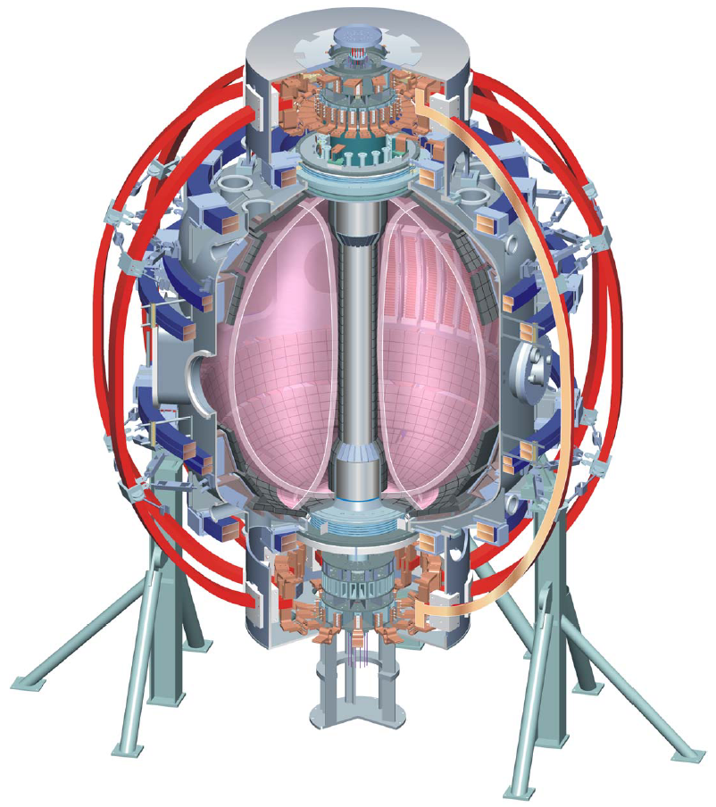
Supported by
NSTX Boundary Physics Topical Science Group Summary
College W&M
Colorado Sch Mines
Columbia U
Comp-X
General Atomics
INEL
Johns Hopkins U
LANL
LLNL
Lodestar
MIT
Nova Photonics
New York U
Old Dominion U
ORNL
PPPL
PSI
Princeton U
SNL
Think Tank, Inc.
UC Davis
UC Irvine
UCLA
UCSD
U Colorado
U Maryland
U Rochester
U Washington
U Wisconsin
V. A. Soukhanovskii, TSG Leader
Lawrence Livermore National Laboratory, Livermore, CA
R. Maingi, TSG Deputy
Oak Ridge National Laboratory, Oak Ridge, TN
D. P. Stotler, Theory & Modeling
Princeton Plasma Physics Laboratory, Princeton, NJ
FY 2009 NSTX Midrun assessment meeting
17 June 2009
Princeton, NJ
Culham Sci Ctr
U St. Andrews
York U
Chubu U
Fukui U
Hiroshima U
Hyogo U
Kyoto U
Kyushu U
Kyushu Tokai U
NIFS
Niigata U
U Tokyo
JAEA
Hebrew U
Ioffe Inst
RRC Kurchatov Inst
TRINITI
KBSI
KAIST
POSTECH
ASIPP
ENEA, Frascati
CEA, Cadarache
IPP, Jülich
IPP, Garching
ASCR, Czech Rep
U Quebec

Slide 2
Boundary Physics TSG priorities are defined by
DOE and NSTX Milestones
  FY 2009 DOE Joint Research Target (JRT, formerly JOULE) milestone: Conduct experiments on major fusion facilities to develop understanding of particle control and hydrogenic fuel retention in tokamaks.
  FY 2010 DOE Joint Research Target (JRT, formerly JOULE) milestone: Conduct experiments on major fusion facilities to improve understanding of the heat transport in the tokamak scrape-off layer (SOL) plasma, strengthening the basis for projecting divertor conditions in ITER.
  FY 2010 Research Milestone R(10-3): Assess H-mode pedestal characteristics and ELM stability as a function of collisionality and lithium conditioning.
ITPA participation, ITER needs
ST development path needs

Slide 3
Three Boundary Physics TSG priorities have been defined for FY 2009 run
Assess hydrogenic species retention, and characterize pumping of hydrogenic species by lithium coated plasma facing components (FY 2009 Joule milestone)
Determine the relationship of ELM properties to discharge boundary shape, lithium conditioning, and 3D resonant magnetic perturbations (RMPs), and compare stability of pedestal/ELMs with model calculations (R10-3)
Compare divertor heat flux widths to midplane density and temperature widths and edge turbulence characteristics, and determine the scaling of SOL and divertor heat transport (FY 2010 Joule milestone)

Slide 4
Summary of completed experiments
XP 911 - C. H. Skinner, FY 2009 Retention and pumping milestone
XP 923 - R. Maingi, FY 2010 SOL thermal transport milestone
XP 912 - V. A. Soukhanovskii, Pedestal fueling comparison with SGI and gas
B. Nelson, Divertor biasing with CHI

Slide 5

XP 911, Lithium pumping and retention, by C. H. Skinner et al.
132474 plasma
132497 gas-only
Pre-lithium
Gas balance measurements showed high (>90%) prompt retention, that decreased due to post-shot outgassing.
As part of a collaboration with Purdue University ATJ graphite, Si and Pd samples were exposed to the plasmas by a sample probe at Bay J.
After exposure, thermal desorption spectroscopy was performed on an ATJ sample. Background thermal desorption from samples unexposed to NSTX plasmas was also measured.
Twelve samples have been shipped to Purdue University for further surface analysis
In-vessel pressure torr D2
Prompt retention 89% ±5%
Thermal Desorption Spectroscopy

Slide 6
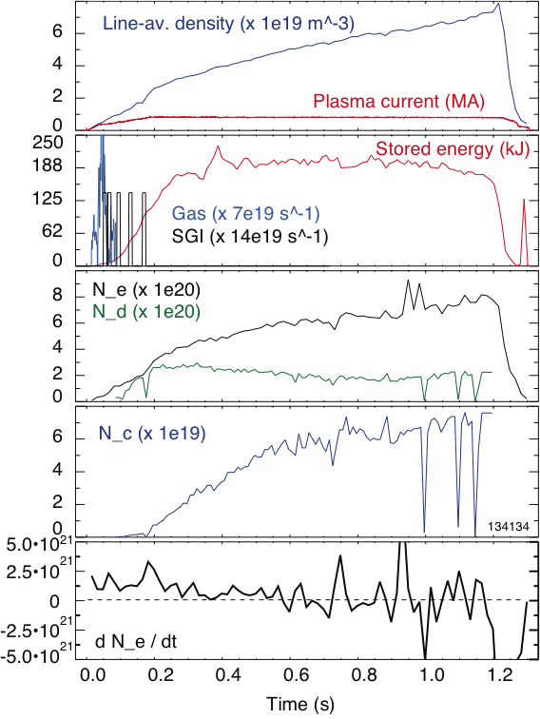
XP 912, Pedestal fueling comparison by SGI and LFS gas, by V. A. Soukhanovskii et al.
Obtained n_{e}-matched discharges with CS+LFS and CS+SGI fueling
  Needed 1.3-2 x rate of LFS gas injector to maintain same density
Obtained good n_{e} and T_{e} profiles (at outer gap ~ 10 cm) to compare SGI and LFS fueling
  Will analyze pedestal height and width in collaboration with ORNL
Developed shoulder and SGI long pulse fueling scenarios
Developed SGI-only fueling scenario with ion density control
  N_{i} constant, while N_{e} is rising due to carbon; LITER at 9 mg/min
Constant N_{i}

Slide 7
XP 923, Thermal SOL transport studies, by R. Maingi et al.
Goal: obtain heat flux and turbulence data for comparison with C-Mod, DIII-D
  Simulation with fluid and turbulence codes planned
I_{p} scan: 0.6–0.8 MA in 0.05 MA steps; P_{NBI} scan: 2–6 MW in 1 MW steps
Abbreviated P_{NBI} and I_{p} scans in high δ shape discharges
Note: running this XP early in year pre-lithium was tough, due to machine conditions. Limits:
  Fast IR camera only looking at low δ (ok later)
  Only 8 channels of new bolometer
  Likely require more data next year, analysis pending

Slide 8
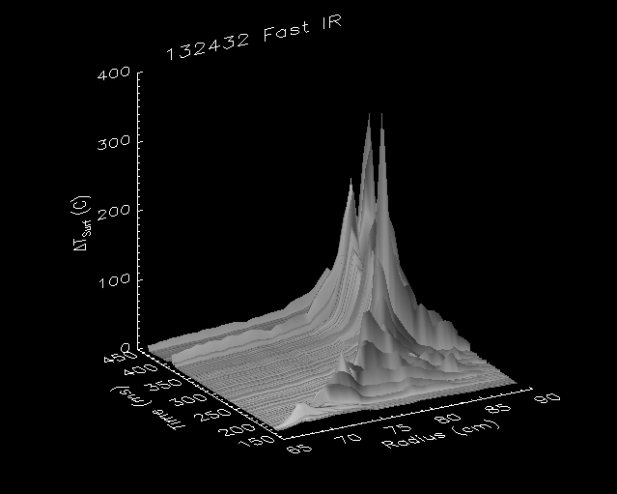
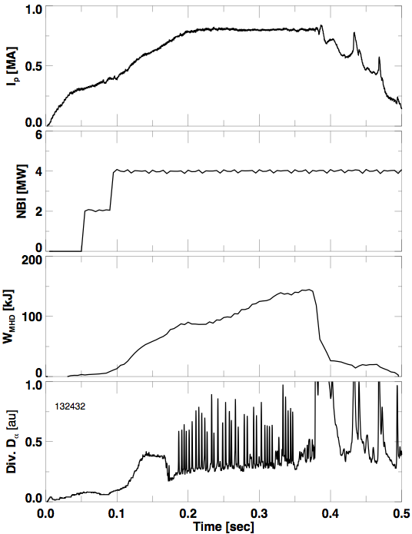
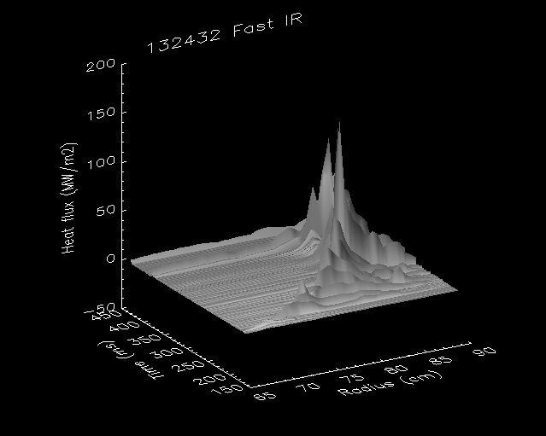
XP 923 obtained an initial data set for
FY 2010 JRT
Fast camera data – J.-W. Ahn (ORNL)

Slide 9
Boundary Physics TSG FY 2009 summary
Experiments completed to date
  C. H. Skinner, FY 2009 Retention and pumping milestone
  R. Maingi, FY 2010 SOL thermal transport milestone
  V. A. Soukhanovskii, Pedestal fueling comparison with SGI and gas
  B. Nelson, Divertor biasing with CHI
Revised prioritized list of remaining experiments
Top equal priority
  J. Canik, Magnetically triggered ELMs in Li-conditioned discharges (1 day)
  A. Sontag, ELM stability dependence on triangularity (1 day)
  S. J. Zweben, Ultra-high-speed GPI measurements of the L-H transition (0.3 day)
Second tier
  V. A. Soukhanovskii, Snowflake divertor (1 day)
  C. H. Skinner, Dust transport and modeling (0.5 day)
  V. A. Soukhanovskii, Radiative divertor with impurity injection (1 day)
  C. H. Skinner, Dust mobilization from ITER-scale castellation gap (1 day)

Slide 10
Boundary Physics TSG strongly supports the reversed B_{t} campaign proposal
Unique opportunity for BP TSG to study pedestal and ELM stability, SOL and divertor heat and particle transport in LSN discharges with B x grad B up
  Extensive diagnostic coverage of lower divertor
Two experiments proposed:
Operational space of L- and H-mode discharges, and L-H threshold at reversed B_{t} (1 day)
SOL and divertor transport and turbulence ("Edge characterization") with reversed B_{t} (2 days)
  Include scans of P_{NBI}, I_{p}, n_{e} (n_{i}) in low and high κ, δ configurations
  Focus on SOL / divertor measurements for transport and turbulence
  Divertor detachment with D₂ puffing
  Large database of B x grad B case from previous years for comparison
  Modeling with UEDGE, SOLPS, and BOUT codes for interpretation

