Slide 1
Status of 2010 Campaign Coordination Effort
E. Fredrickson & S. Sabbagh

Slide 2
Run time allocated vs. used
1 day = 8 hours
Average of 41.5 ‘good’ shots/day
TSG | 1st priority XP run days | 1st + 2nd priority XPs | Milestones | Days used | Days scheduled
Advanced Scenarios and Control | 6 | 8 | R(10-2) | 5.8 | 1.5
Boundary Physics | 8 | 10 | Joint, R(10-3) | 9.2 | 1.5
Lithium Research | 5.5 | 8 |  | 8.1 | 0
Macroscopic Stability | 6 | 8 | R(10-1) | 6.1 | 1
Solenoid-free Start-up and Ramp-up | 4.5 | 6 | R(10-2) | 0 | 4
Transport and Turbulence | 5.5 | 7 |  | 3.5 | 2.5
Wave-Particle Interactions | 6 | 8 | R(10-2) | 2 | 1.5
ITER high priority | 5 | 5.5 | R(10-1,2,3) | 2.7 | 3.5
Cross-cutting & Enabling | 13 | 14.5 | R(10-2) | 12.1 | 0.5
Total | 59.5 | 75 |  | 49.5 | 16

Slide 3
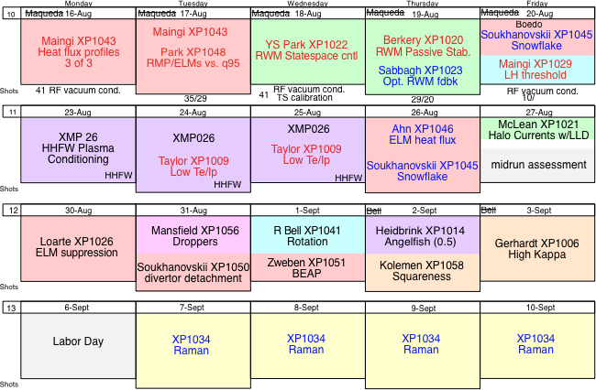
Short term schedule

Slide 4
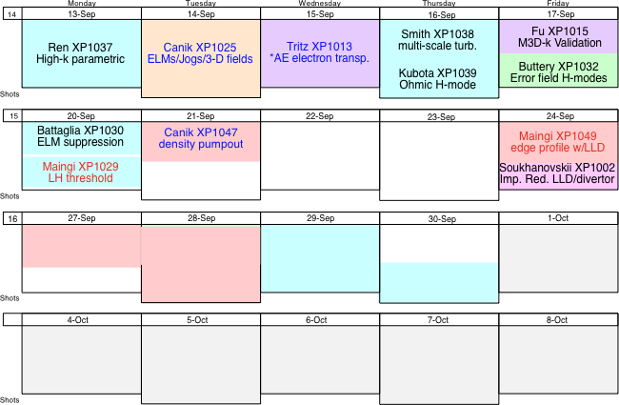
≈3.5 “unscheduled” days

