Slide 1
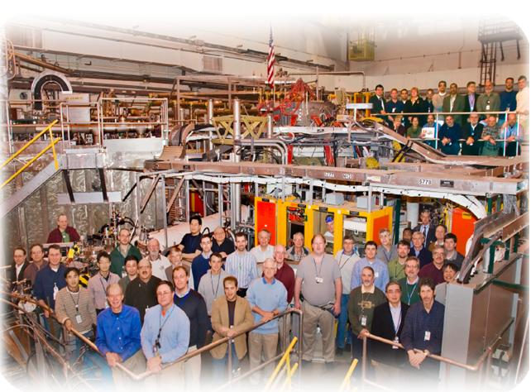
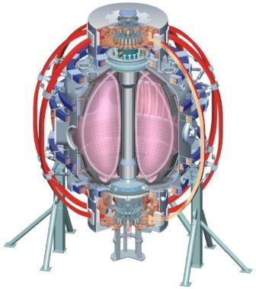
NSTX
Supported by
Preliminary Results from XP1020 RFA Measurements
College W&M
Colorado Sch Mines
Columbia U
CompX
General Atomics
INL
Johns Hopkins U
LANL
LLNL
Lodestar
MIT
Nova Photonics
New York U
Old Dominion U
ORNL
PPPL
PSI
Princeton U
Purdue U
SNL
Think Tank, Inc.
UC Davis
UC Irvine
UCLA
UCSD
U Colorado
U Illinois
U Maryland
U Rochester
U Washington
U Wisconsin
Culham Sci Ctr
U St. Andrews
York U
Chubu U
Fukui U
Hiroshima U
Hyogo U
Kyoto U
Kyushu U
Kyushu Tokai U
NIFS
Niigata U
U Tokyo
JAEA
Hebrew U
Ioffe Inst
RRC Kurchatov Inst
TRINITI
KBSI
KAIST
POSTECH
ASIPP
ENEA, Frascati
CEA, Cadarache
IPP, Jülich
IPP, Garching
ASCR, Czech Rep
U Quebec
J.W. Berkery
Department of Applied Physics, Columbia University, New York, NY, USA
NSTX Monday Physics Meeting
PPPL, Princeton, NJ
April 26th, 2010

Slide 2
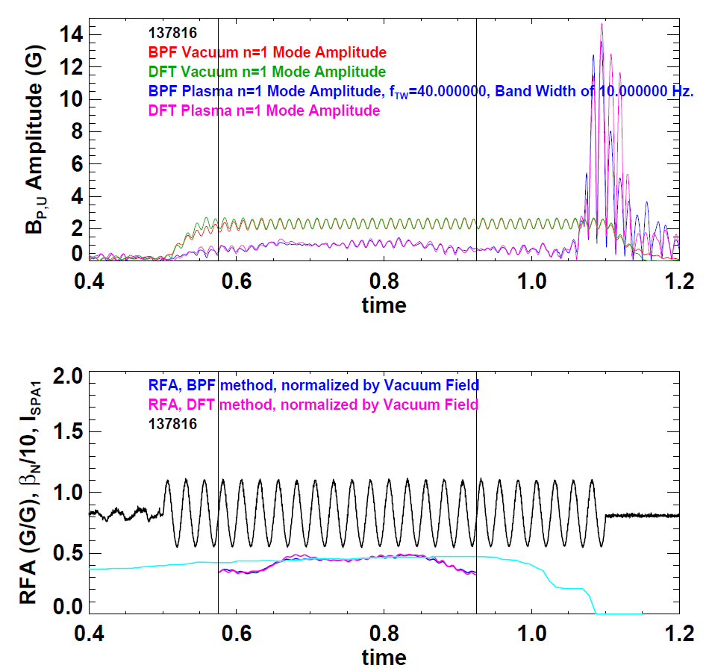
XP1020 RFA Analysis
  Half day on 4/15:
  24 shots
  16 with AC fields
  7 had enough cycles before disruption for analysis (and Thomson)
  3 long periods
  4 short
  RFA analysis code by S.P. Gerhardt

Slide 3
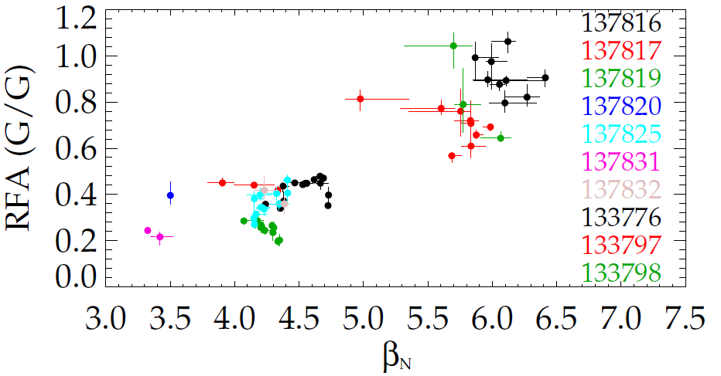
XP1020 RFA analysis
XP1020
XP935

Slide 4
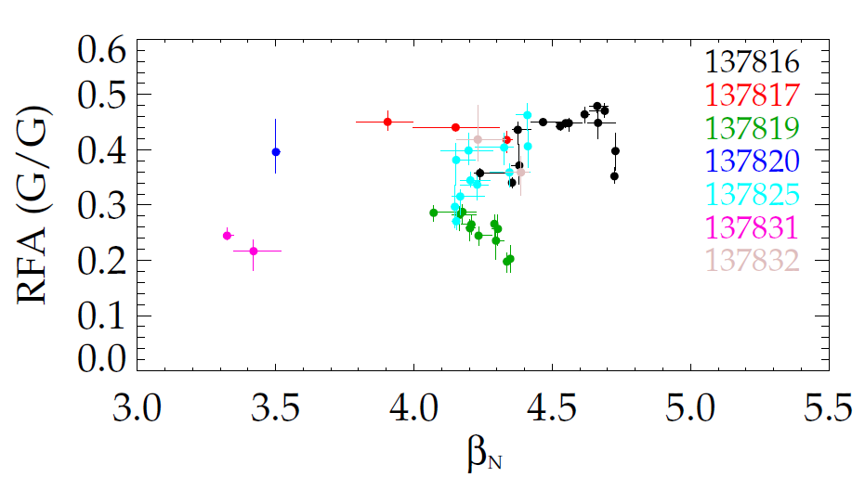
XP1020 RFA analysis

Slide 5
XP1020 RFA analysis

Slide 6
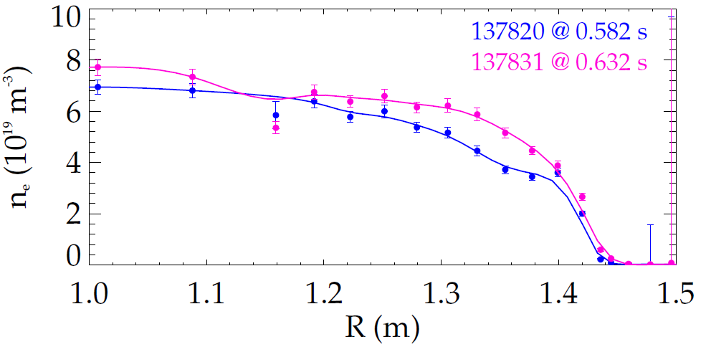
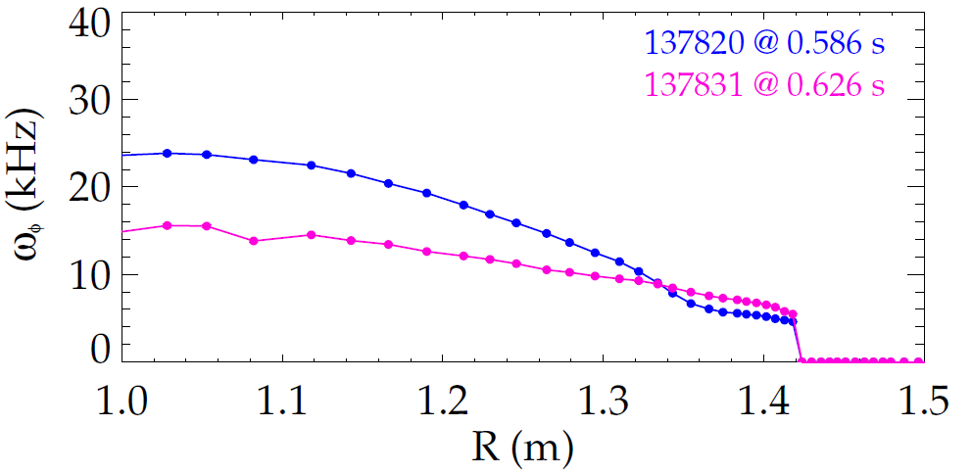
β_{N} = 3.5 comparison
less stable – higher ω_{φ}
more stable – lower ω_{φ}

Slide 7
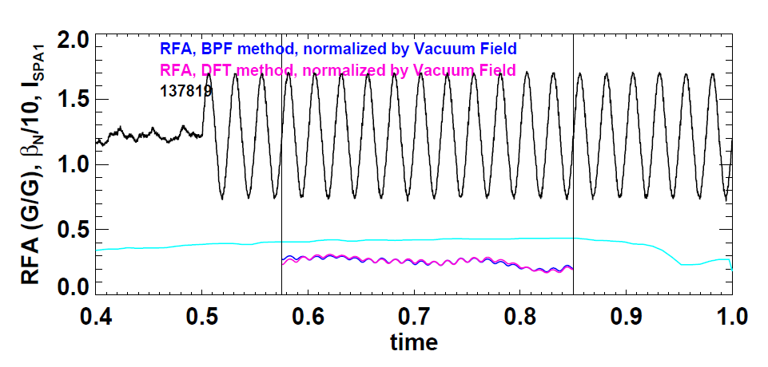
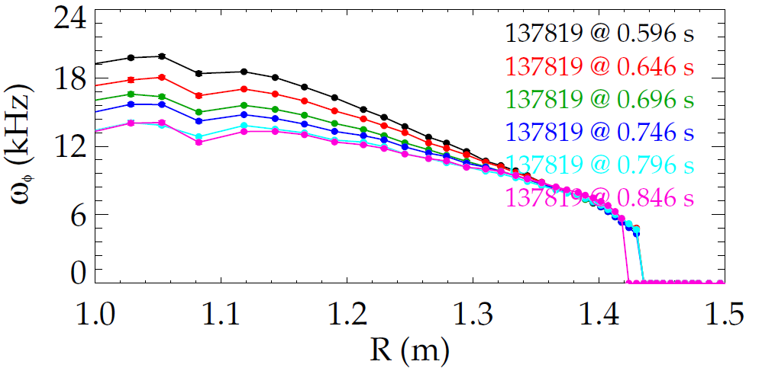
Evolution of RFA vs. time within a single shot, 137819
(Note: β_{N} and rotation are changing at the same time.)

Slide 8
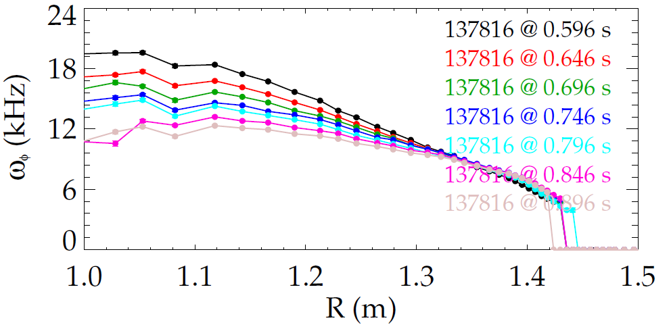
Evolution of RFA vs. time within a single shot, 137816
(Note: β_{N} and rotation are changing at the same time.)

Slide 10
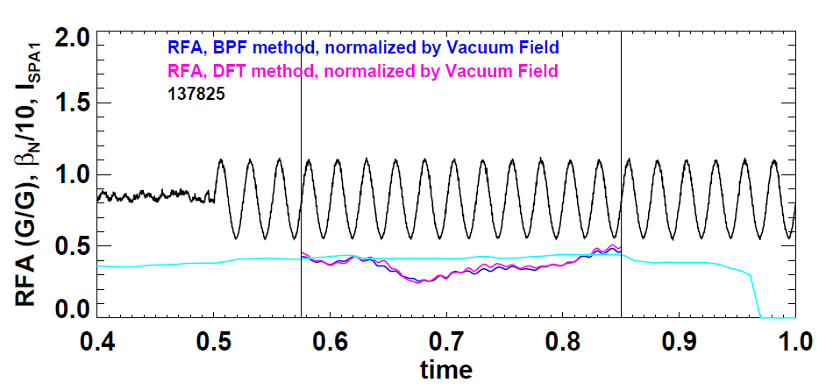
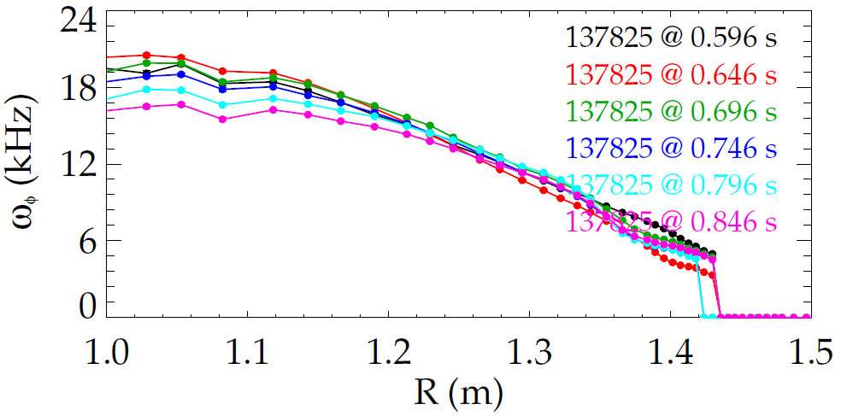
Evolution of RFA vs. time within a single shot, 137825
(Note: β_{N} and rotation are changing at the same time.)

Slide 11
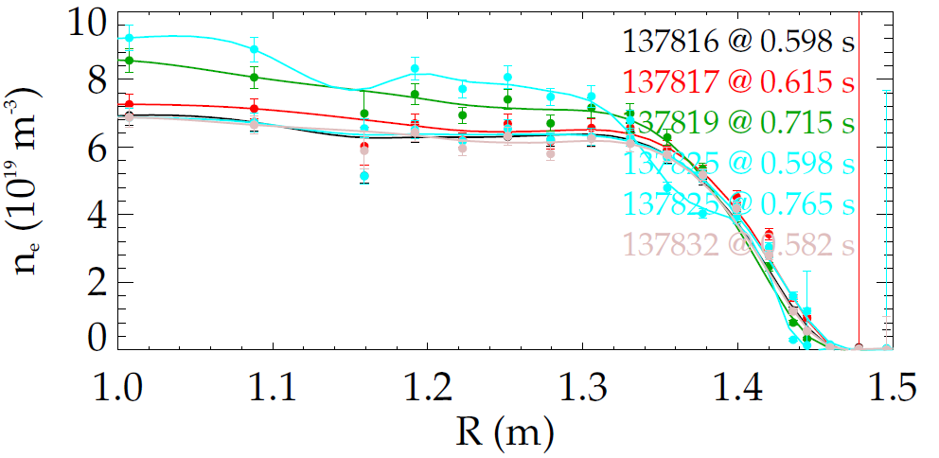
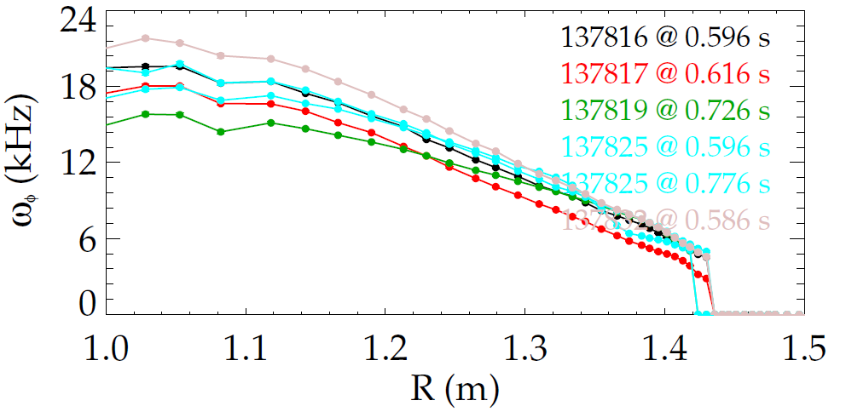
β_{N} = 4.25 comparison

Slide 12
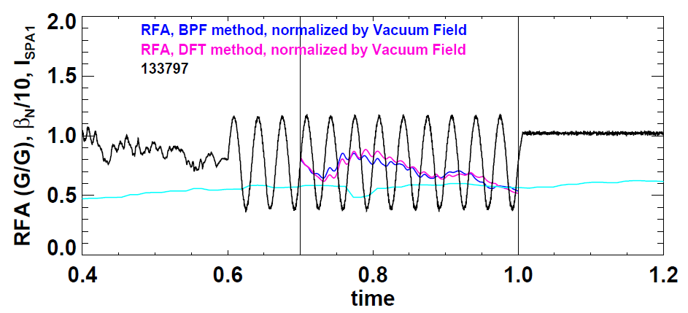
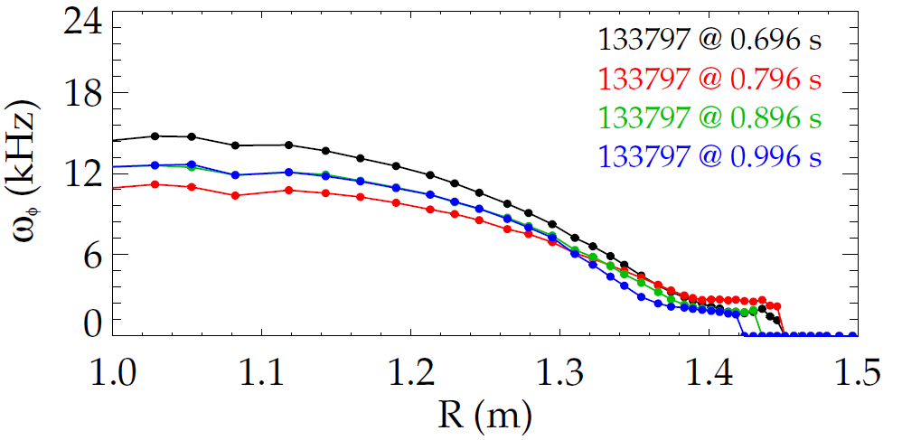
Evolution of RFA vs. time within a single shot, 133797
(Note: β_{N} and rotation are changing at the same time.)

Slide 13
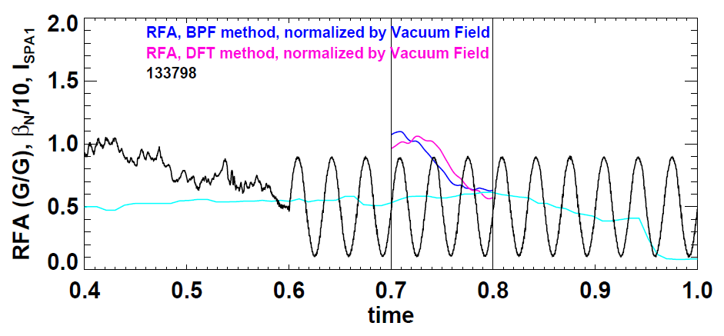
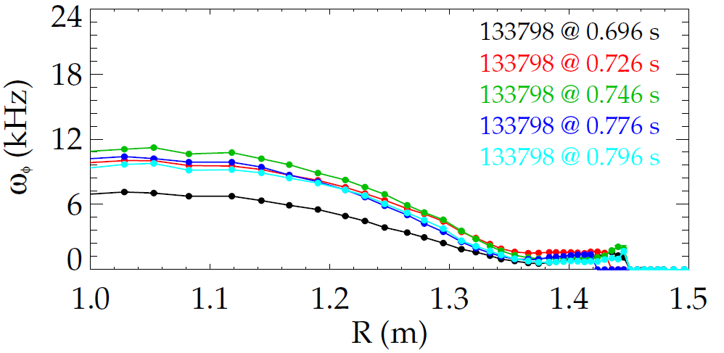
Evolution of RFA vs. time within a single shot, 133798
(Note: β_{N} and rotation are changing at the same time.)

