Slide 1


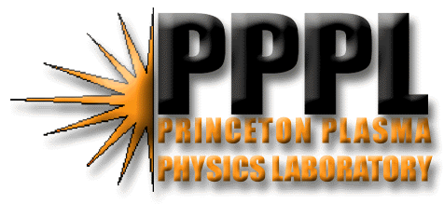
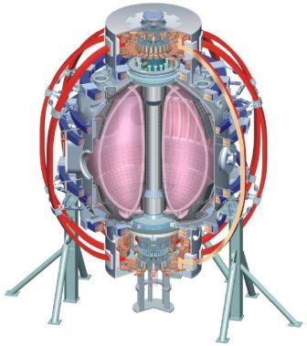
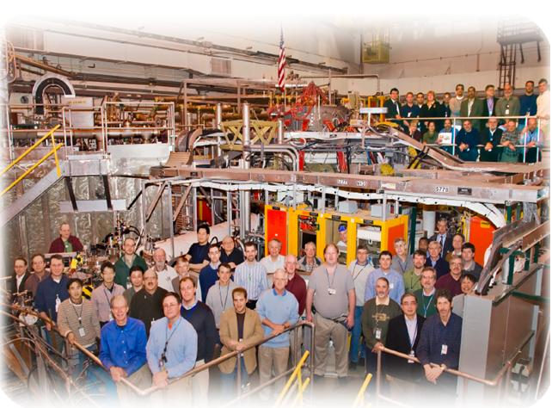

Supported by
Taming the plasma-material interface with the “snowflake” divertor
College W&M
Colorado Sch Mines
Columbia U
CompX
General Atomics
INEL
Johns Hopkins U
LANL
LLNL
Lodestar
MIT
Nova Photonics
New York U
Old Dominion U
ORNL
PPPL
PSI
Princeton U
Purdue U
SNL
Think Tank, Inc.
UC Davis
UC Irvine
UCLA
UCSD
U Colorado
U Illinois
U Maryland
U Rochester
U Washington
U Wisconsin
Culham Sci Ctr
U St. Andrews
York U
Chubu U
Fukui U
Hiroshima U
Hyogo U
Kyoto U
Kyushu U
Kyushu Tokai U
NIFS
Niigata U
U Tokyo
JAEA
Hebrew U
Ioffe Inst
RRC Kurchatov Inst
TRINITI
KBSI
KAIST
POSTECH
ASIPP
ENEA, Frascati
CEA, Cadarache
IPP, Jülich
IPP, Garching
ASCR, Czech Rep
U Quebec
V. A. Soukhanovskii, LLNL
and NSTX Team
Proposal for APS DPP 2010 Meeting Invited Talk Nomination
NSTX Physics Meeting
Princeton, NJ
3 May 2010

Slide 2
Outline
Motivation: PMI challenge
“Snowflake” divertor configuration idea by D. D. Ryutov
  Analytic theory and numerical modeling
NSTX results in hand
  Magnetic properties (area expansion, angles, SOL volume)
    Actual NSTX equilibria and ISOLVER models
  Magnetic control (SP control, X-point control with PCS)
  Main results: divertor peak heat flux reduction, impurity reduction
  Other results: pedestal stability, core confinement, divertor properties, compatibility with pumping scenarios, preliminary turbulence characteristics
Results to be obtained
  turbulence and blobs, heat flux scaling, SOL flows, impurity sources, ELM control, ion X-point loss
  UEDGE modeling of radiation and edge/SOL transport
Projections for future devices (NSTX-U, ST-CTF)

