Slide 1
First results from Transmission
Grating Imaging Spectrometer
D. Kumar, D. Stutman, K. Tritz, M. Finkenthal
Plasma Spectroscopy Group,
Department of Physics and Astronomy,
The Johns Hopkins University.

Slide 2
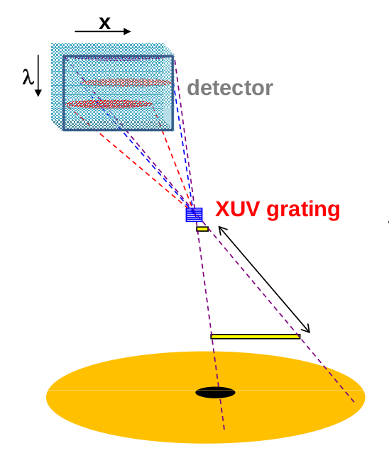
Device Setup
Motivation
  Provide impurity measurements for Multi-Energy Soft Xray system
  Impurity monitor in itself
Detection
  CsI coated MCP
  Phosphor screen
  CMOS imaging system

Slide 3
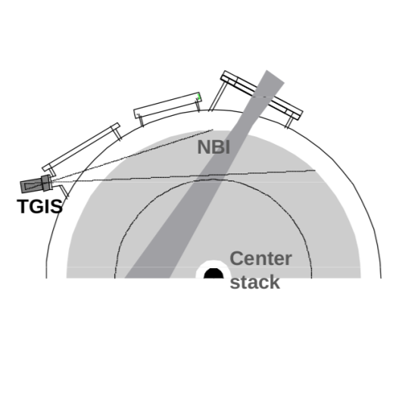
Device Setup
Design advantages
  Survey spectrometer (30 A – 700 A)
  Robust to neutrons
  Provide spatial impurity distribution
Beam excited charge exchange emission
Electron excited emission (edge and core)
Frame exposure = 380 ms

Slide 4
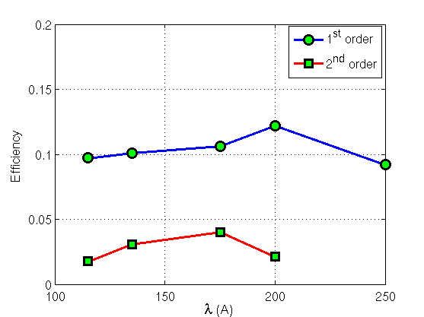
Grating details
Free standing Grating dimensions
  1 mm x 1 mm
  200 nm period
NIST calibrations

Slide 5
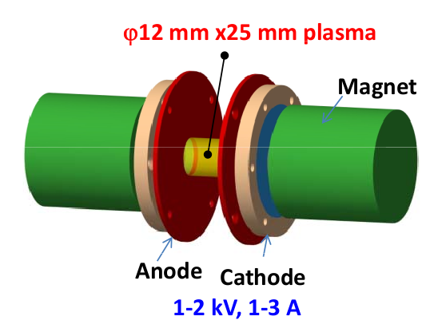
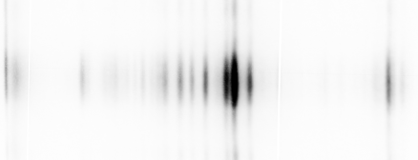
Calibration through PID spectra
Ne I 736
Ne II 461 A
Al IV 161 A
24 A

Slide 6
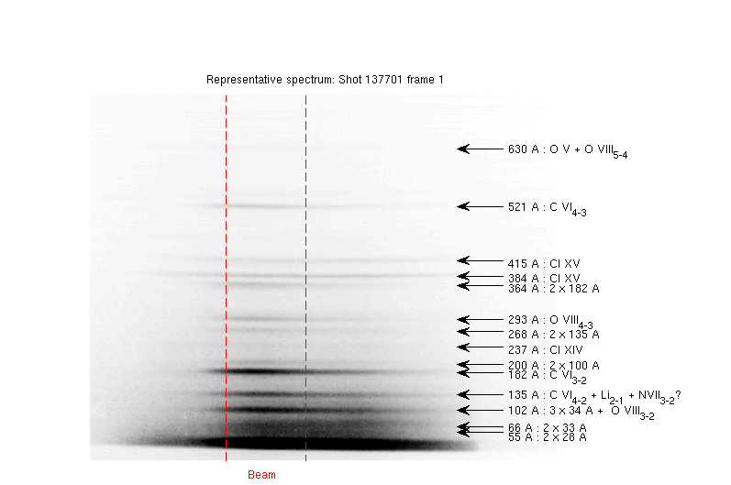
NSTX results – typical spectrum

Slide 7
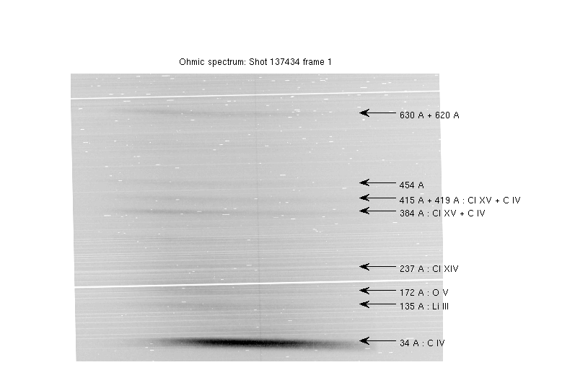
NSTX results – ohmic spectrum

Slide 8
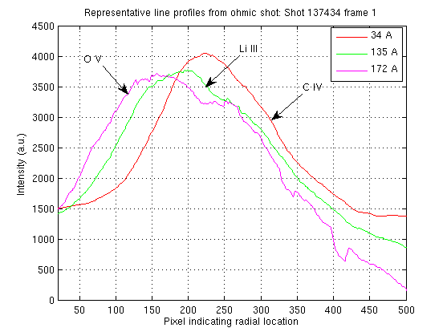
Ohmic shot – spatial profile (edge)

Slide 9
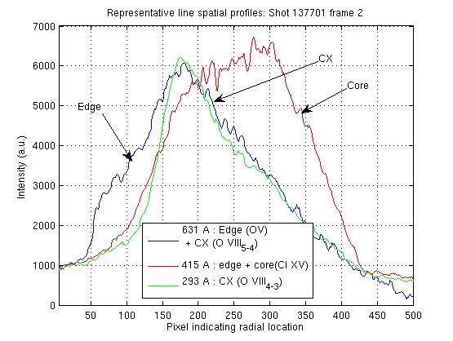
Typical shot – spatial profile
(Edge + CX + core)

Slide 10
Big Question – What about
Copper, Moly, Iron?

Slide 11
Copper
No Copper observed.
Reason – The absence of Cu XIX doublet lines (2p⁶3s – 2p⁶3p) at 273 A and 303 A.

Slide 12
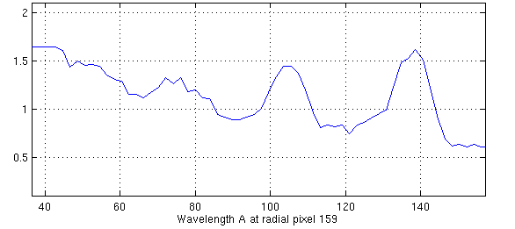
Molybdenum
74 A Mo peak correlates with (Mn like Mo)
  Some shots where DIM observed Mo
  No LITER and strike points on LLD
However, no effect of Mo on Z_{eff}
Data is noisy:

Slide 13
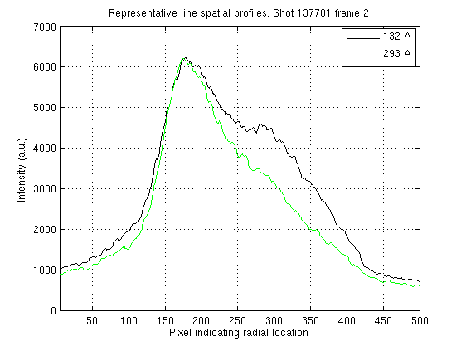
Lithium
Spatial profile of the ohmic spectrum at 135 A confirms that some Li does get into the plasma.
With NBI, the spatial profile indicates that there is something in addition to charge exchange.

Slide 14
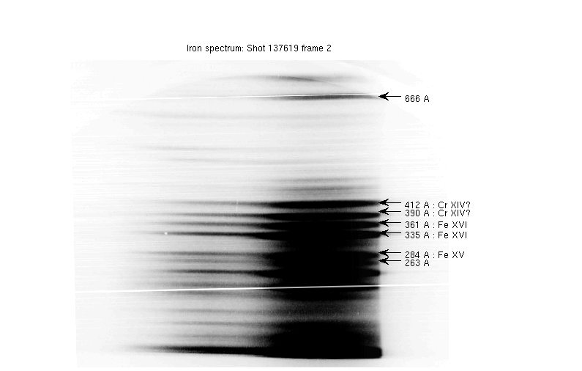
Iron
Metals observed sometimes in the second frame when P_{rad} rises.

Slide 15
What about Oxygen, Chlorine?

Slide 16
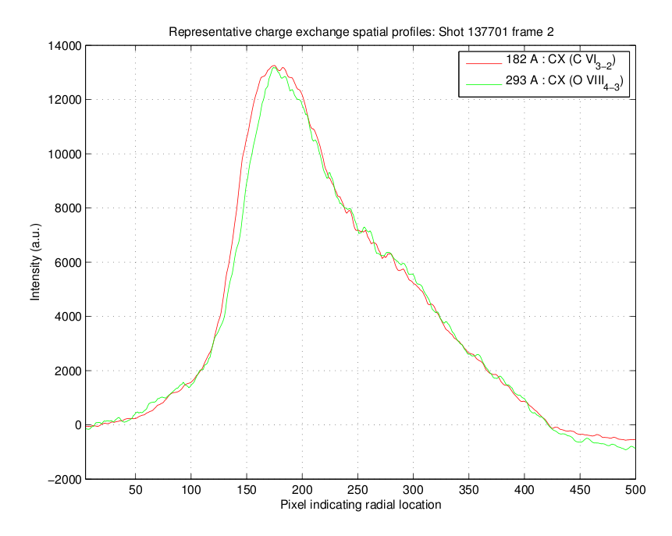


Oxygen
MCP needs to be calibrated for proper calculations
From C VI 182 and O VIII 293 A:
From C VI 521 and O VIII 293 A:
2.5

Slide 17
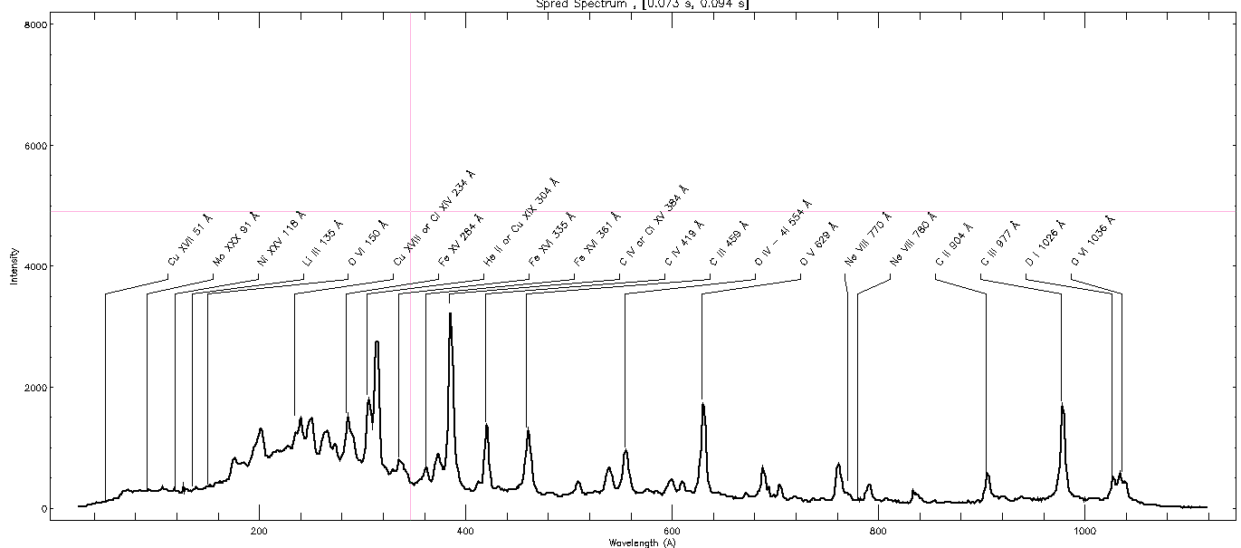
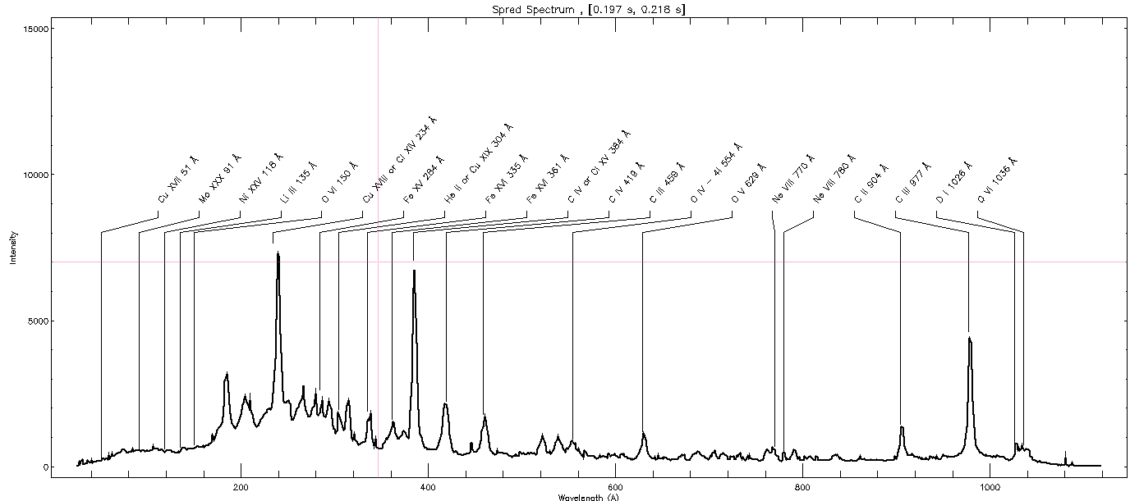
Chlorine (SPRED)
C IV 312 A
Cl XV 237 A

Slide 18
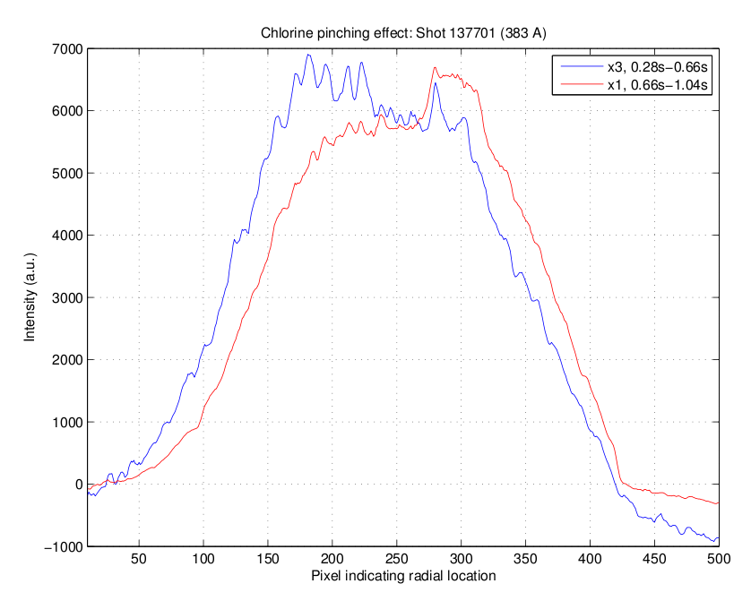
Chlorine (accumulation)

Slide 19
Summary of Cl
The presence of 237 A Cl XIV along with Cl XV lines at 384 A and 415 A clearly confirms Cl
Cl emission substantially brighter with NBI
Cl seems to accumulate (towards core) with time
SPRED indicates presence of Cl at least since March 2007

Slide 20
Conclusion
Results – C, O, Cl, Li, Fe, Mo (?), Cu
Future direction
  Geometric modeling
  High speed readout
  After run – Calibration of MCP efficiency

Slide 21
Acknowledgements
PPPL
  L. Roquemore
  R. Kaita
  V. Soukhanovskii
  C. Skinner
  S. Gerhardt
  G. Zimmer
  NSTX 2nd shift – John, Jerry & Ron
  VPL – Tommy
  J. Winston
  J. Dong
  J. Wertenbaker
SSL, Berkeley
  J. Lepson
NIST
  C. Tarrio

