Slide 1
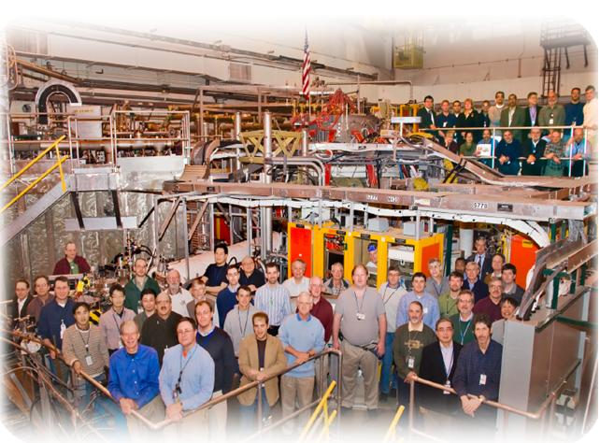
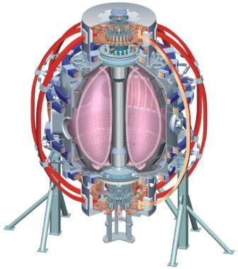
NSTX
Supported by
XP1046: Effect of externally applied 3-D fields
on divertor profiles
College W&M
Colorado Sch Mines
Columbia U
CompX
General Atomics
INEL
Johns Hopkins U
LANL
LLNL
Lodestar
MIT
Nova Photonics
New York U
Old Dominion U
ORNL
PPPL
PSI
Princeton U
Purdue U
SNL
Think Tank, Inc.
UC Davis
UC Irvine
UCLA
UCSD
U Colorado
U Illinois
U Maryland
U Rochester
U Washington
U Wisconsin
J-W. Ahn¹, M. Benjamin, J.M. Canik¹, T.K. Gray¹, A. Loarte², R. Maingi¹, A.G. McLean¹, J.-K. Park³, O. Schmitz⁴, and V. Soukhanovskii⁵
¹ORNL, ²ITER, ³PPPL, ⁴IPP-Julich,⁵LLNL
Culham Sci Ctr
U St. Andrews
York U
Chubu U
Fukui U
Hiroshima U
Hyogo U
Kyoto U
Kyushu U
Kyushu Tokai U
NIFS
Niigata U
U Tokyo
JAEA
Hebrew U
Ioffe Inst
RRC Kurchatov Inst
TRINITI
KBSI
KAIST
POSTECH
ASIPP
ENEA, Frascati
CEA, Cadarache
IPP, Jülich
IPP, Garching
ASCR, Czech Rep
U Quebec
Monday Physics Meeting
PPPL, August 2, 2010

Slide 2
Objectives of XP-1046
Understanding of how divertor profiles are modified by 3-D magnetic perturbations in steady state, ie no ELMs
Broad range of parameter scan (collisionality, Ip, and q95)
n=1 field rotation to check the possibility of asymmetric heat/particle deposition
Dependence of divertor profile modification on plasma shape parameters

Slide 3
Target discharges and the achieved ones
q95 and Ip scan + power scan:
shot matrix for (Bt=0.33T and 0.5T), (Ip=0.8MA and1.2MA)
(Bt, Ip) = (Bt=0.50T, Ip=0.8MA), P_{NBI} =3MW and 5MW √
(Bt=0.33T, Ip=0.8MA), P_{NBI} =3MW and 5MW
(Bt=0.50T, Ip=1.2MA), P_{NBI} =3MW and 5MW √
(Bt=0.33T, Ip=1.2MA), P_{NBI} =3MW and 5MW
→ (4 shots out of 8)
Rotation of n=1 field at 6 different phases by 60 degs
→ (0 shots out of 6)
Apply n=3 perturbation field to a low δ discharge:
At two different coil currents (I_{n=3}=0.5kA and 1kA)
→ (0 shots out of 2)
Unable to obtain long enough (>500ms) ELM-free H-mode

Slide 4
Some observations and present status
n=3 perturbation moves the striations radially out, often times including the original strike point
Once the striations are formed, there appears to be some ‘memory’ of them even during the zero coil current period
Limited dataset for ELM-free data with 3-D field applied
Data analysis for divertor profiles as a function of collisionality and q95 under way

Slide 5
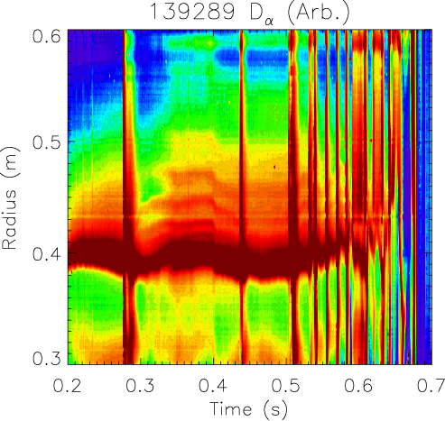
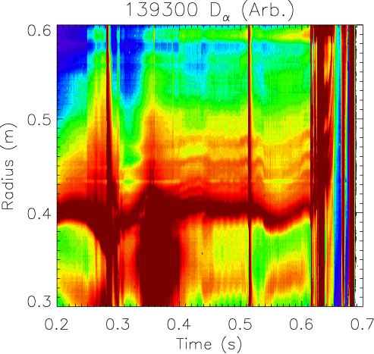
Formation of striations in D_{α} profile
ON
OFF
ON
OFF
ON
ON
ON
ON
OFF
OFF
OFF
OFF
n=3 perturbation applied in square waveform with 100ms or 35ms on period

Slide 6
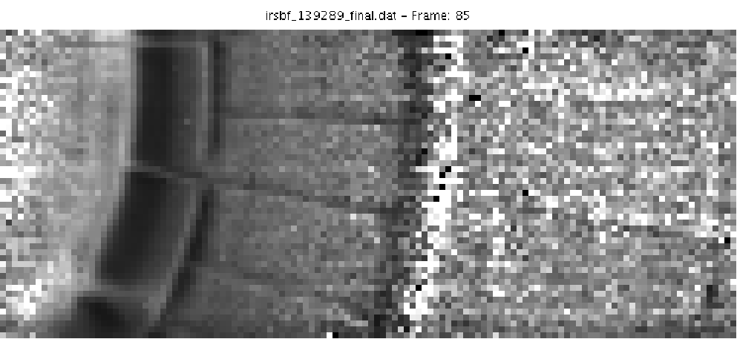
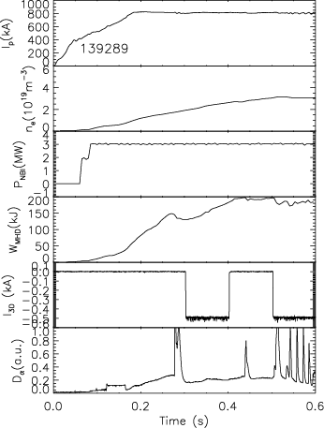
Striations in dual band IR data
t=295ms

Slide 7
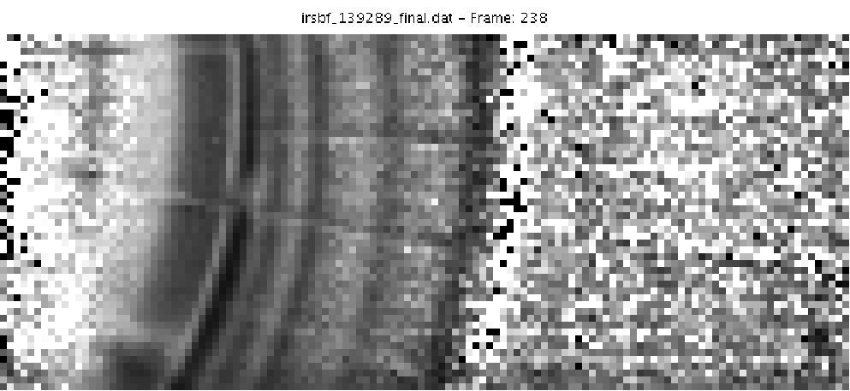
Striations in dual band IR data
t=295ms
t=390ms

Slide 8
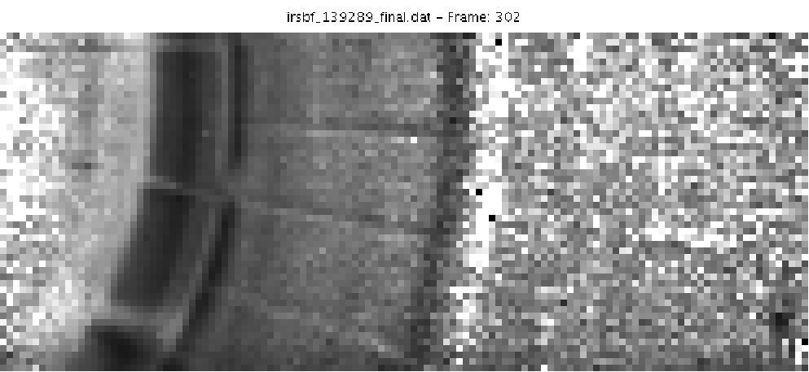
Striations in dual band IR data
t=295ms
t=390ms
t=430ms

