Slide 1


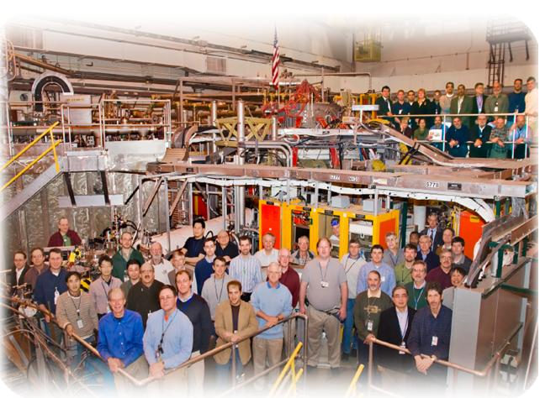
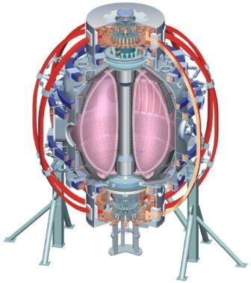
NSTX
Supported by
Vertical Stability for NSTX and NSTX-U
College W&M
Colorado Sch Mines
Columbia U
CompX
General Atomics
INL
Johns Hopkins U
LANL
LLNL
Lodestar
MIT
Nova Photonics
New York U
Old Dominion U
ORNL
PPPL
PSI
Princeton U
Purdue U
SNL
Think Tank, Inc.
UC Davis
UC Irvine
UCLA
UCSD
U Colorado
U Illinois
U Maryland
U Rochester
U Washington
U Wisconsin
Egemen Kolemen
D. A. Gates, S. Gerhardt
Culham Sci Ctr
U St. Andrews
York U
Chubu U
Fukui U
Hiroshima U
Hyogo U
Kyoto U
Kyushu U
Kyushu Tokai U
NIFS
Niigata U
U Tokyo
JAEA
Hebrew U
Ioffe Inst
RRC Kurchatov Inst
TRINITI
KBSI
KAIST
POSTECH
ASIPP
ENEA, Frascati
CEA, Cadarache
IPP, Jülich
IPP, Garching
ASCR, Czech Rep
U Quebec
Monday Physics Meeting
PPPL, NJ
Nov/15/2010

Slide 2
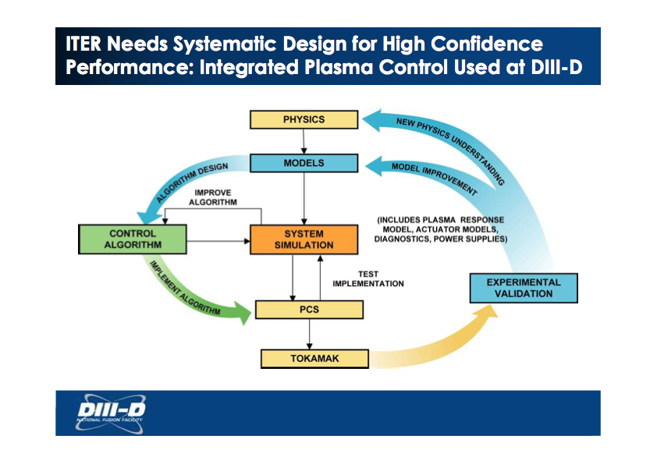
Vertical Displacement Measurements
Vertical displacement for controllable shots
(Cut off at the point of return)
Vertical displacement for uncontrollable shots
At 300 ms, we turned the controller off and let the plasma drift.
When we turned the control back on some of the shots recovered while others hit the wall.

Slide 3
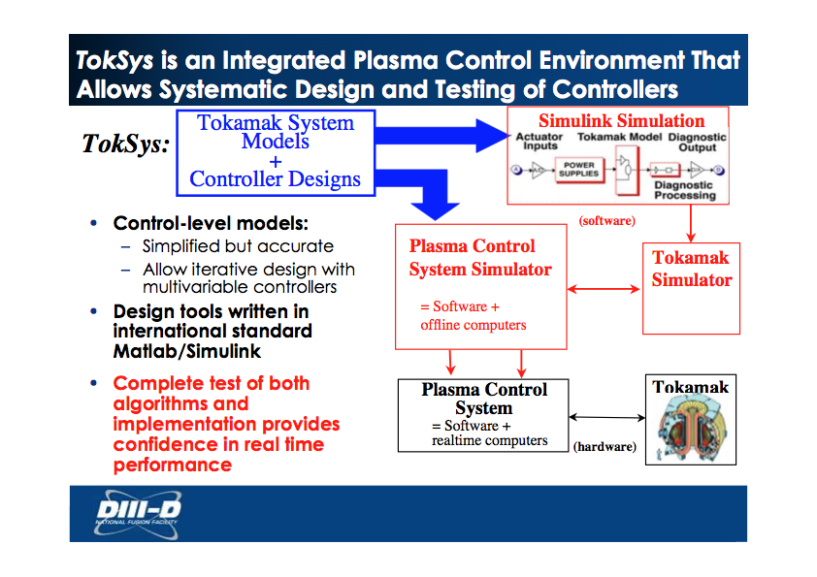

Vertical Displacement Measurements
Vertical displacement for controllable shots
(Cut off at the point of return)
Vertical displacement for uncontrollable shots
At 300 ms, we turned the controller off and let the plasma drift.
When we turned the control back on some of the shots recovered while others hit the wall.

Slide 4
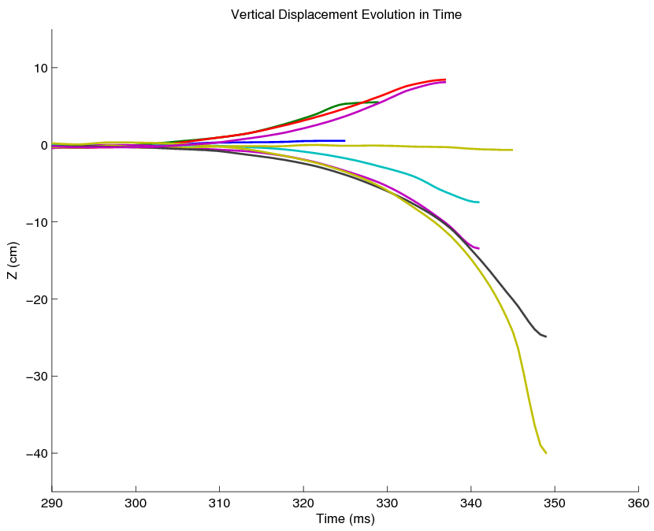
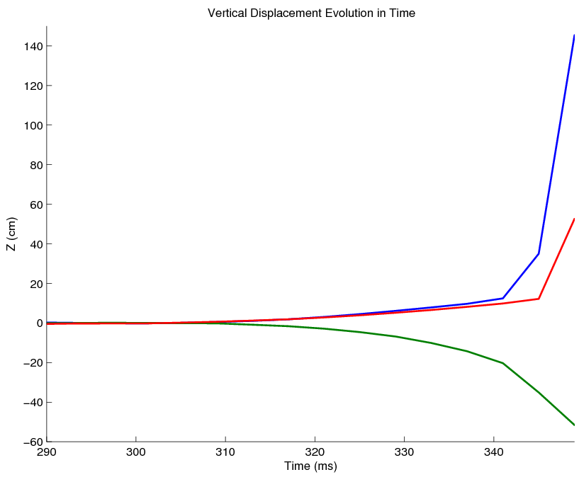
Vertical Displacement Measurements
Vertical displacement for controllable shots
(Cut off at the point of return)
Vertical displacement for uncontrollable shots
At 300 ms, we turned the controller off and let the plasma drift.
When we turned the control back on some of the shots recovered while others hit the wall.

Slide 5
Experimental EFIT02 Growth Rate (Gamma) 100-217 s^-1
 |  |  |  | Control Turned Off |  |  | Control Turned On |  |  | Peak Plasma Displacement |  |  | Gamma | Voltage
 | Egemen # | Shot | ms | t_0 | z_0 | li_0 | t_turn | z_turn | li_turn | t_f | z_f | li_f | s^-1 | ave Pf3U&2L
VDE +Z | 1 | 127074 | 20 | 0.301 | -0.0018 | 1.3436 | 0.32 | 0.0046 | 1.3865 | 0.325 | 0.005 | 1.3939 | no vde at all
 | 2 | 127075 | 20 | 0.301 | 0.0005 | 1.3774 | 0.32 | 0.0344 | 1.4927 | 0.329 | 0.0552 | 1.61 | 144 | 600
max controlled | 3 | 127076 | 30 | 0.301 | -0.0025 | 1.4768 | 0.33 | 0.0663 | 2.1936 | 0.337 | 0.0845 | 3.5009 | 127 | 1400
 | 14 | 127087 | 30 | 0.301 | -0.003 | 1.3482 | 0.33 | 0.0587 | 1.6485 | 0.337 | 0.0814 | 2.0792 | 153 | 1200
un-controlled | 10 | 127083 | 40 | 0.301 | -0.002 | 1.378 | 0.34 | 0.1176 | 3.5021 | 0.341 | 0.1244 | 3.7423 | 168 | 1600
un-controlled | 13 | 127086 | 40 | 0.301 | -0.0025 | 1.3885 | 0.34 | 0.0943 | 3.3401 | 0.349 | 0.5268 | 6.3724 | 103 | 1600
VDE -Z | 5 | 127078 | 35 | 0.301 | -0.0013 | 1.3602 | 0.335 | -0.0509 | 1.1928 | 0.341 | -0.0746 | 1.1584 | 166 | 800
 | 6 | 127079 | 35 | 0.301 | -0.0009 | 1.3592 | 0.335 | -0.0865 | 1.1954 | 0.341 | -0.1347 | 1.1683 | 110 | 1300
 | 7 | 127080 | 40 | 0.301 | -0.0037 | 1.4283 | 0.34 | -0.005 | 1.46 | 0.345 | -0.0066 | 1.4403 | no vde - control made unstable
 | 8 | 127081 | 40 | 0.301 | -0.0034 | 1.4129 | 0.34 | -0.1369 | 1.1969 | 0.349 | -0.2491 | 1.0877 | 100 | 1500
max controlled | 12 | 127085 | 40 | 0.301 | 0.0027 | 1.3899 | 0.34 | -0.1504 | 1.1748 | 0.349 | -0.4006 | 0.9388 | 145 | 1600
un-controlled | 11 | 127084 | 40 | 0.301 | 0.0001 | 1.3759 | 0.34 | -0.1879 | 1.1783 | 0.353 | -0.6069 | 0.7328 | 217 | 1600
straight VDE | 4 | 127077 | none |  |  |  |  |  |  |  |  |  | 113
Notes:
{\mathcal J} = \kappa_1 \int_t \int_\psi \left[ v_t(\psi,t) - v_t^*(\psi,t)\right]^2 d\psi\,dt + \kappa_2 \int_t \int_\psi f_\text{NBI}^2(\psi,t) d\psi\,dt
5

Slide 6
Experimental LRDFIT Growth Rate (Gamma) 54-95 s^-1
Notes:
{\mathcal J} = \kappa_1 \int_t \int_\psi \left[ v_t(\psi,t) - v_t^*(\psi,t)\right]^2 d\psi\,dt + \kappa_2 \int_t \int_\psi f_\text{NBI}^2(\psi,t) d\psi\,dt
6

Slide 7
Toksys Results Growth Rate (Gamma) 20-25 s^-1
Shot # Gamma s^-1
127077 23
127078 25
127079 24
127080 22
127081 24
127082 22
127083 20
127084 20
127085 21
127086 23
127087 21
Notes:
{\mathcal J} = \kappa_1 \int_t \int_\psi \left[ v_t(\psi,t) - v_t^*(\psi,t)\right]^2 d\psi\,dt + \kappa_2 \int_t \int_\psi f_\text{NBI}^2(\psi,t) d\psi\,dt
7

Slide 8
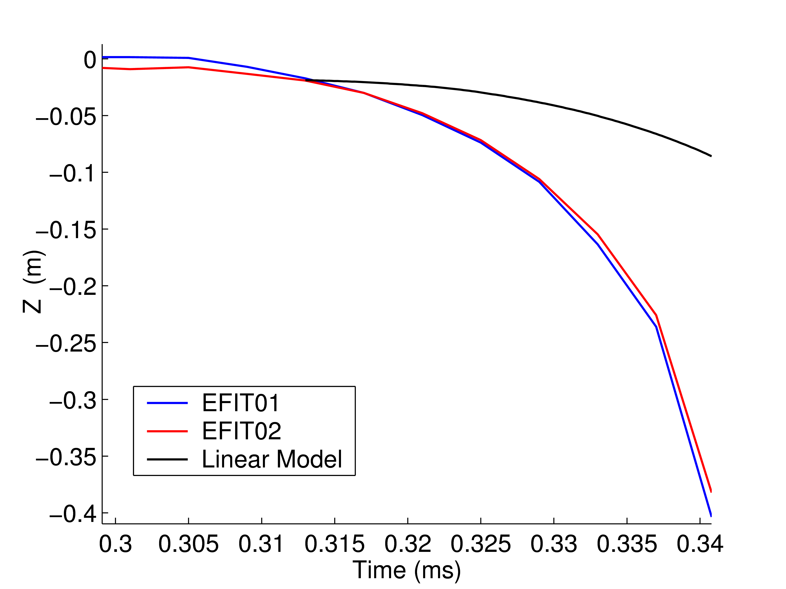
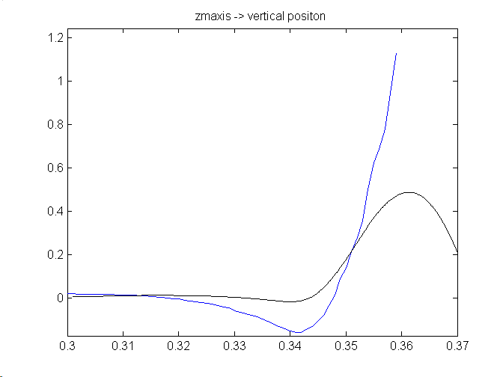
Mismatch Between XP and Toksys
XP data more unstable (3-4 times) than the model
Example of a mismatch between TokSys numerical plasma model and the experimental data. Depending on how the model is used plasma or te coil model.

Slide 9
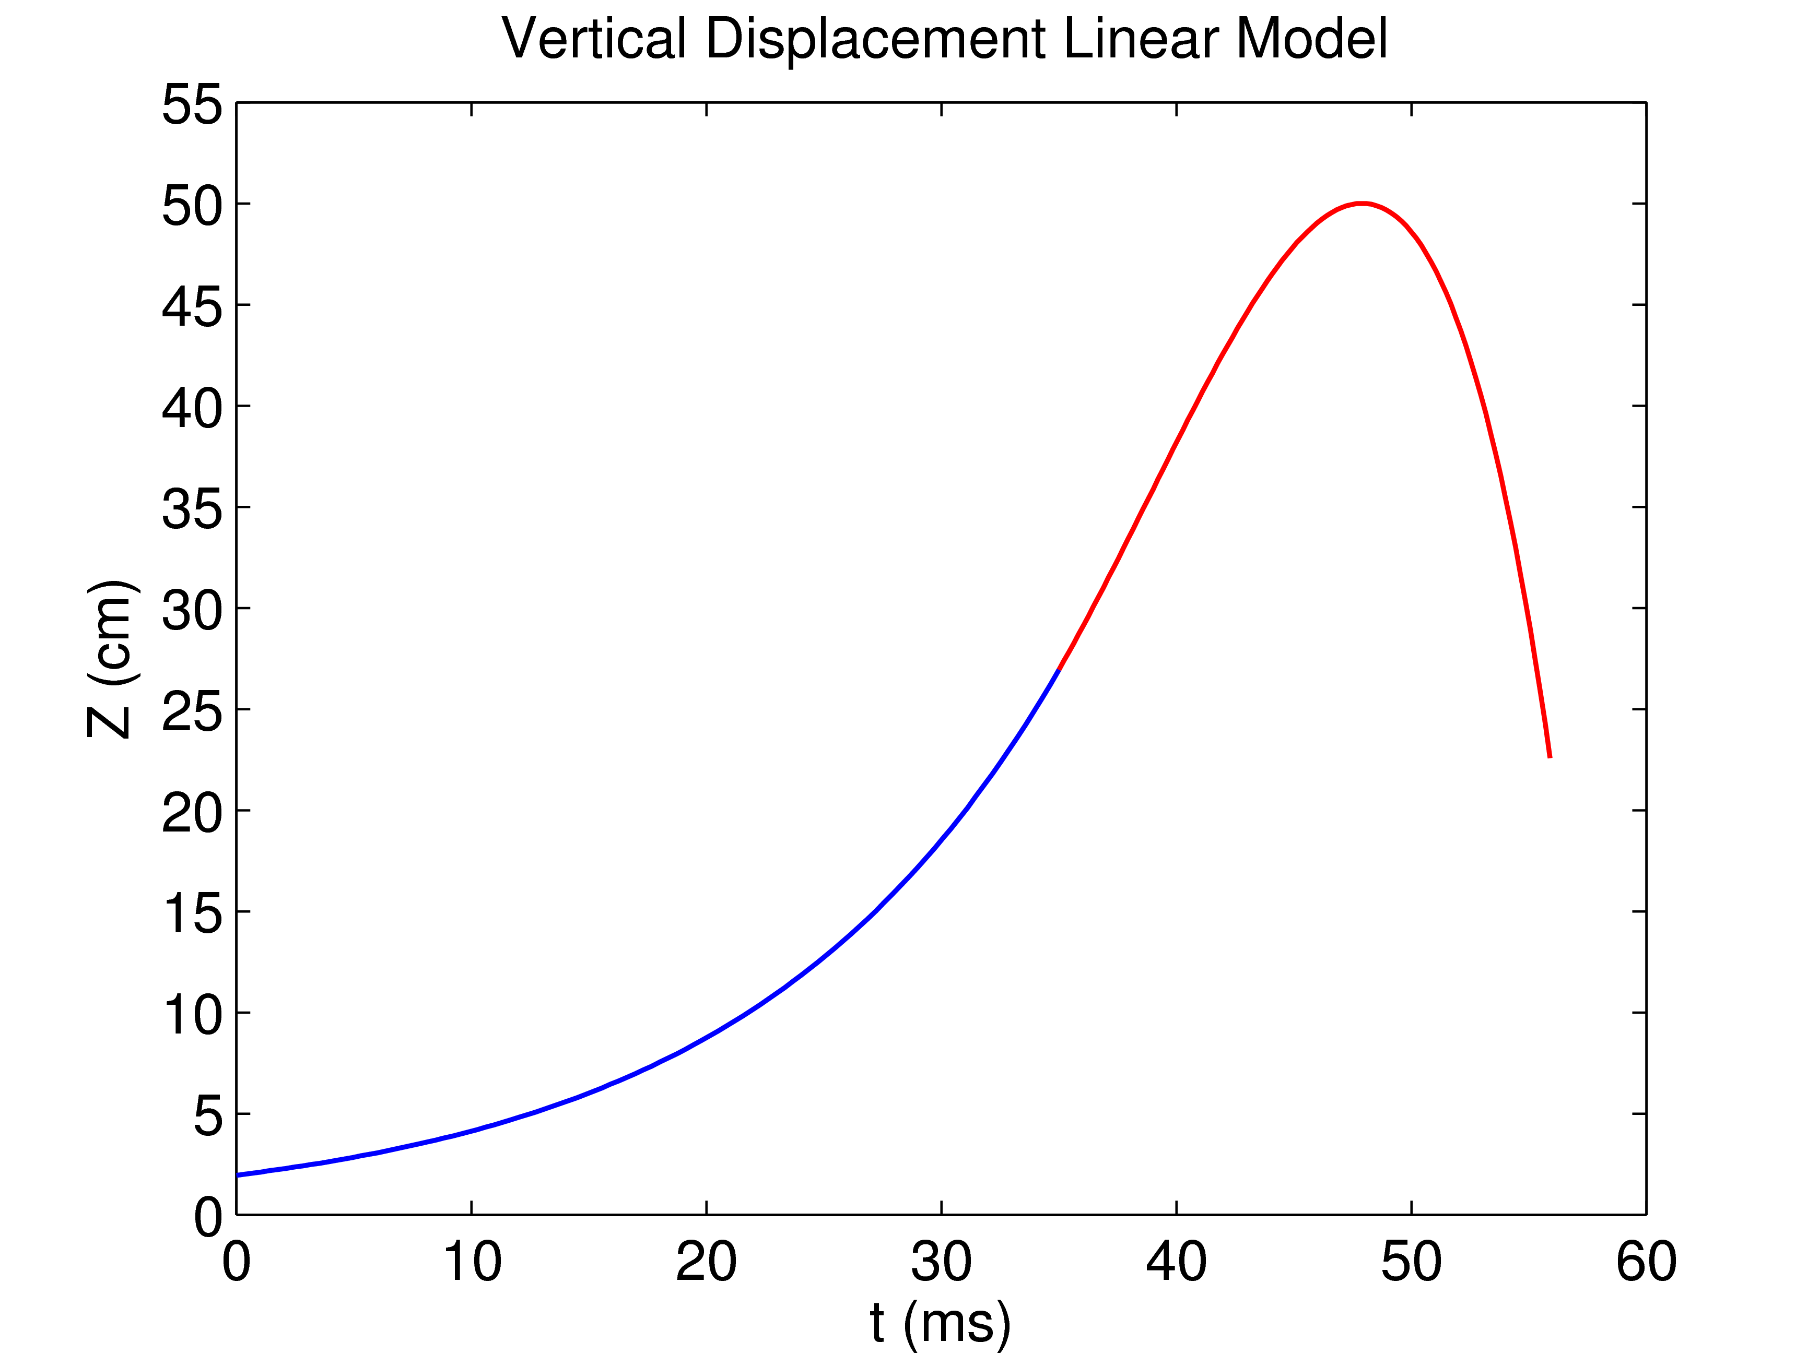
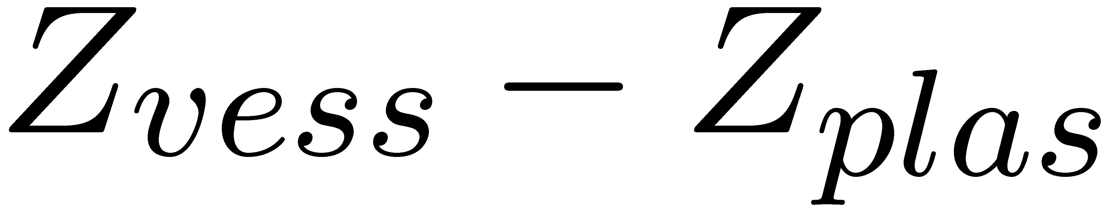

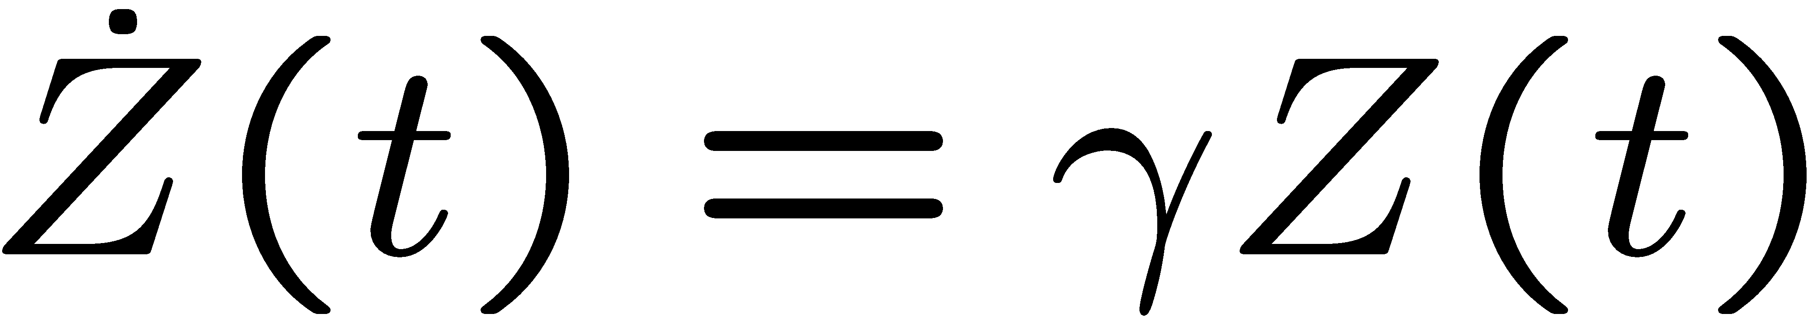
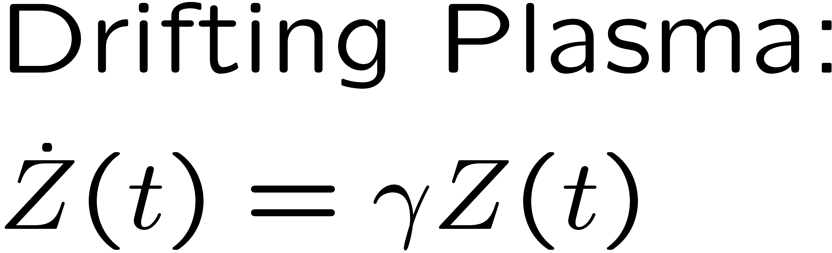
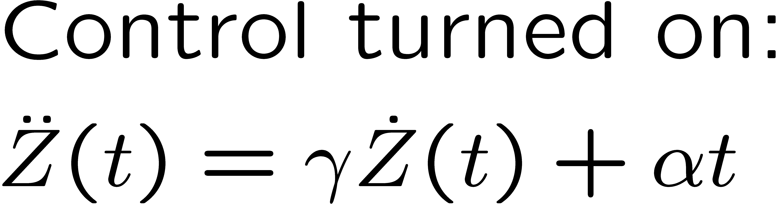
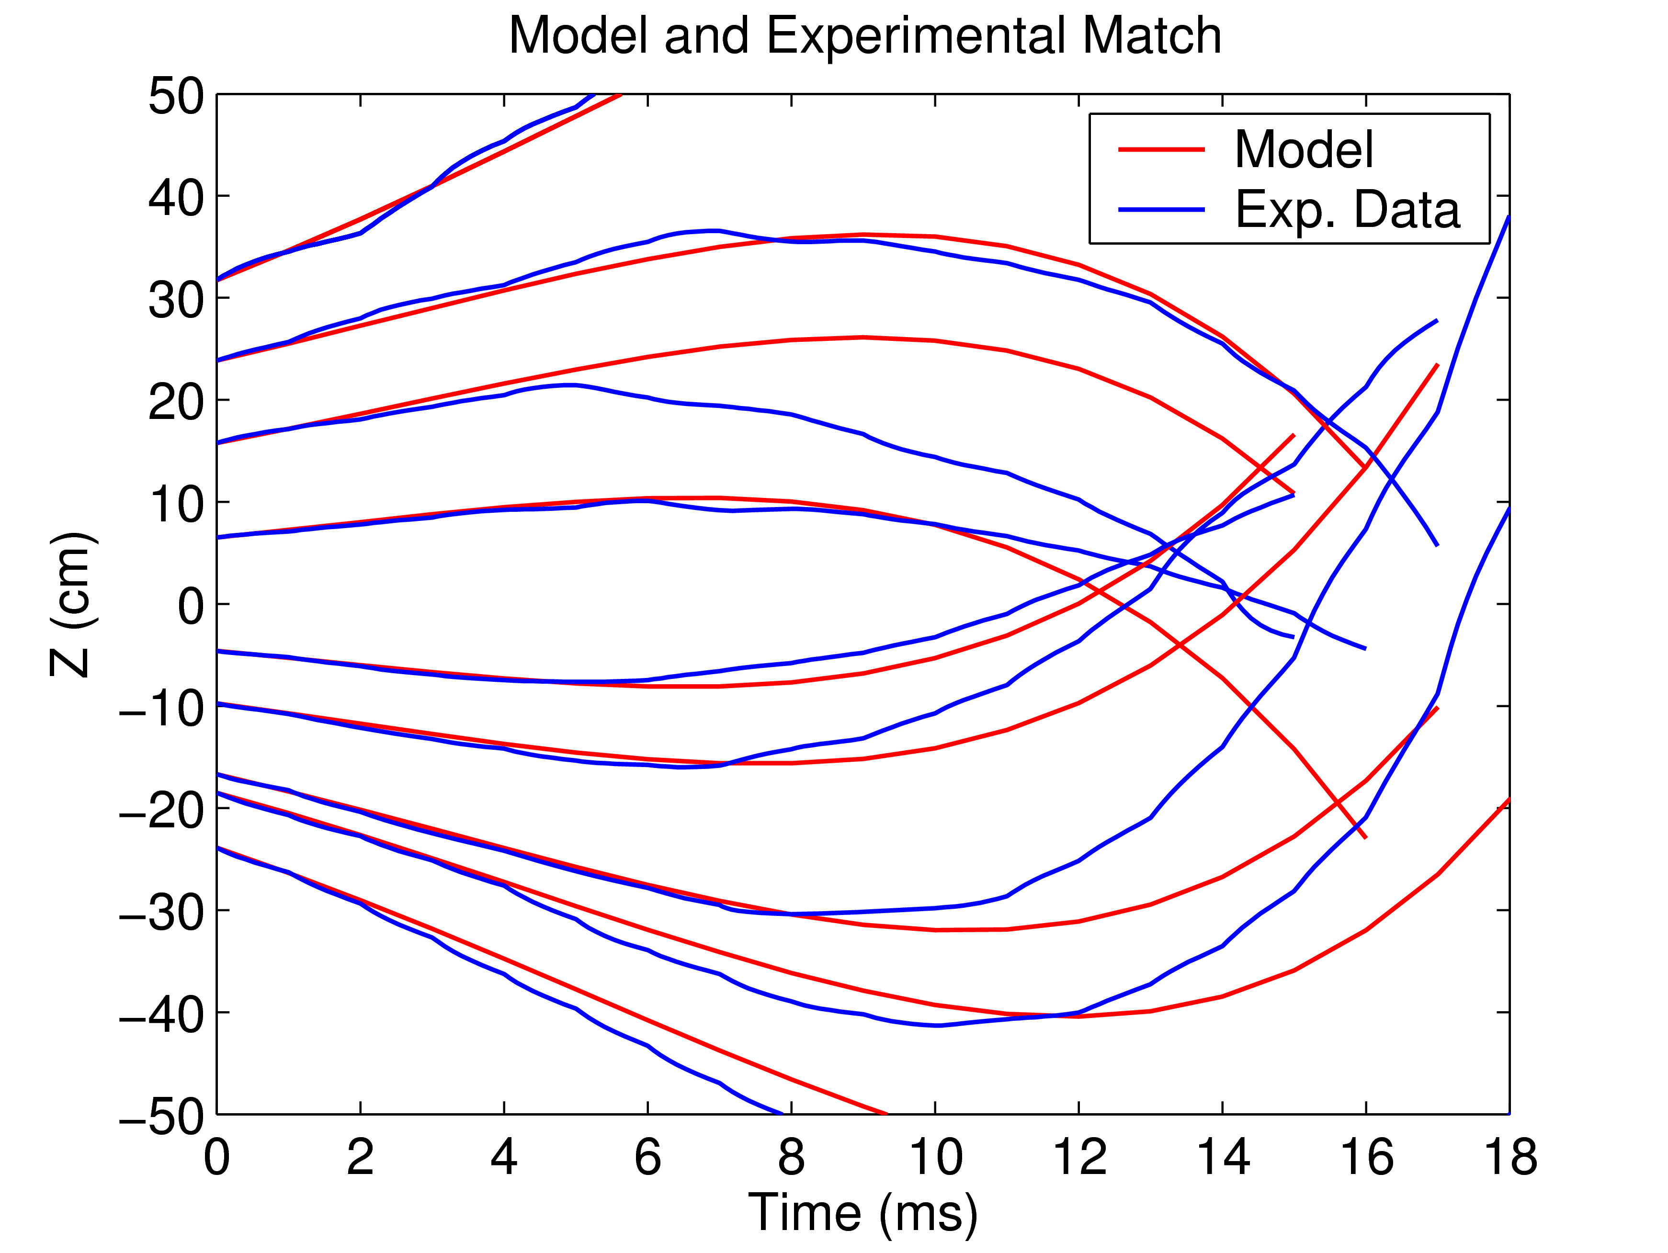

All XPs Can Be Modeled with the Same Two Parameters
Where γ =75s⁻¹. The first order effect of the coils on the vertical motion is assumed to be:
i.e. the current changes the velocity of the rigidly moving plasma. Also during the ramp up I is proportional to t. Combining these two effects, we can find an approximation for the dynamics of the vertical motion after the control is turned on as:
α is found by data fitting as 4.5e5
x
x
Notes:
{\mathcal J} = \kappa_1 \int_t \int_\psi \left[ v_t(\psi,t) - v_t^*(\psi,t)\right]^2 d\psi\,dt + \kappa_2 \int_t \int_\psi f_\text{NBI}^2(\psi,t) d\psi\,dt
9

Slide 10
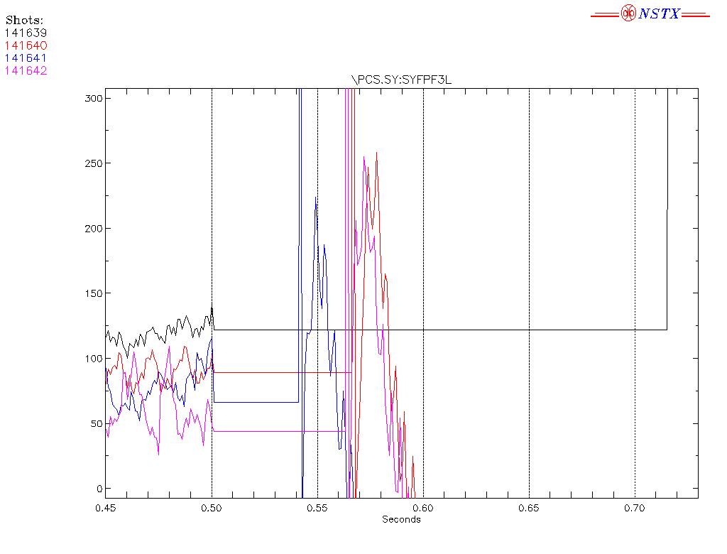
New Experiment: High Aspect Ratio Vertical Growth Rate
Notes:
{\mathcal J} = \kappa_1 \int_t \int_\psi \left[ v_t(\psi,t) - v_t^*(\psi,t)\right]^2 d\psi\,dt + \kappa_2 \int_t \int_\psi f_\text{NBI}^2(\psi,t) d\psi\,dt
10

Slide 11
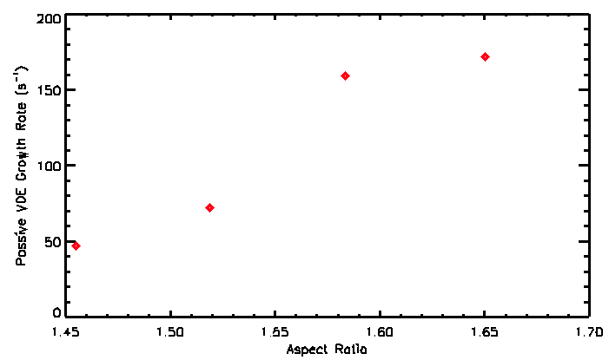
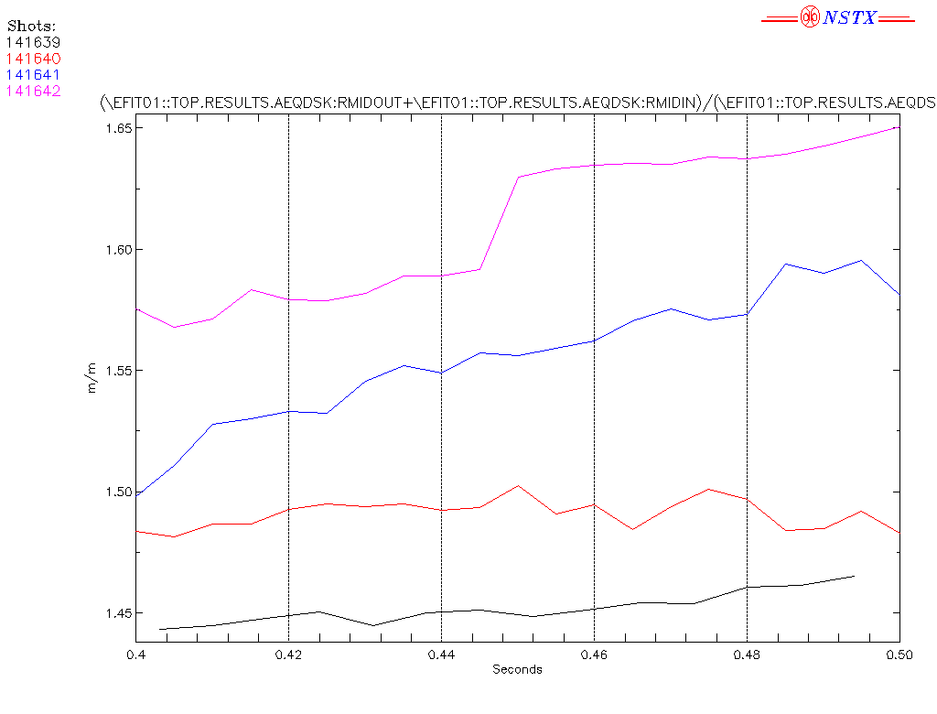
New Experimental Growth Rate (Gamma) 45-170 s^-1
versus 10-42 s^-1 for Model
RED: Data, BLUE: Model
141639 10
141640 33
141641 32
141642 42
Notes:
{\mathcal J} = \kappa_1 \int_t \int_\psi \left[ v_t(\psi,t) - v_t^*(\psi,t)\right]^2 d\psi\,dt + \kappa_2 \int_t \int_\psi f_\text{NBI}^2(\psi,t) d\psi\,dt
11

Slide 12
Solution? Play with the Fudge Factor
(scalegam or scale gamma)
What we really want to do is modify the model (hopefully via scaledzdis, but maybe it's one of our earlier flags? scalegam?) to match the experimental growth rate with the model.
I have a nstx build that increases the gamma from 25 to 100 s^-1. Im getting some weird results from the printout.

Slide 13
Solution? Better Power Supply Model
Ron and I are working on it.

Slide 17
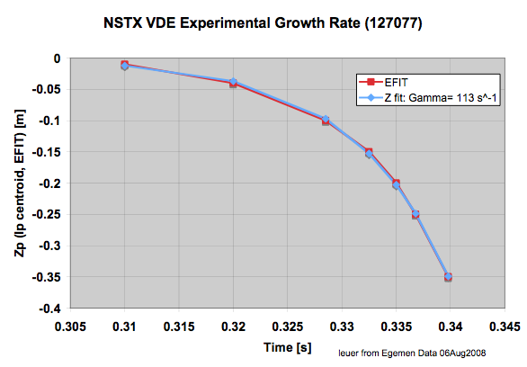
GA response
I fitted the experimental data you provided in the last plot with the typical exponential decay expected for vertical displacement and got a growth rate of 113 s^-1. See the accompanying plot. Fit is:Zp= Zo Exp (Gamma * (t-to) where: Gamma= 113s^-1, Z0= -.00897m, to=0.307s. This is much larger than the value reported by rzrig and may be because of the circuit being used. Tomorrow I'm going to try and generate the response using our NSTX Toksys here at GA to see if I get same numbers. Jim Leuer.

Slide 18
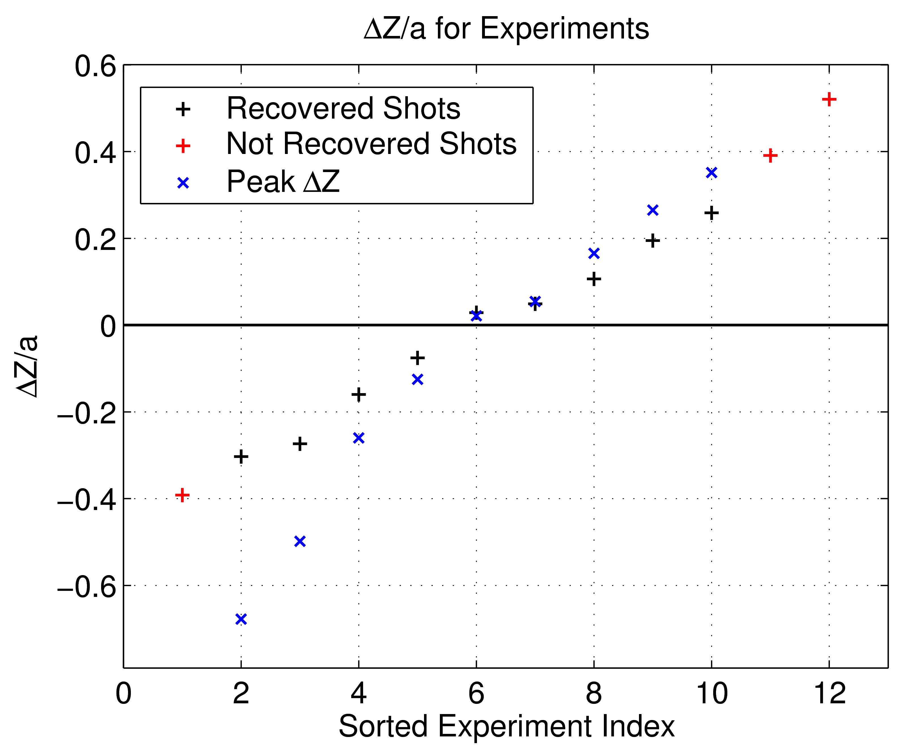
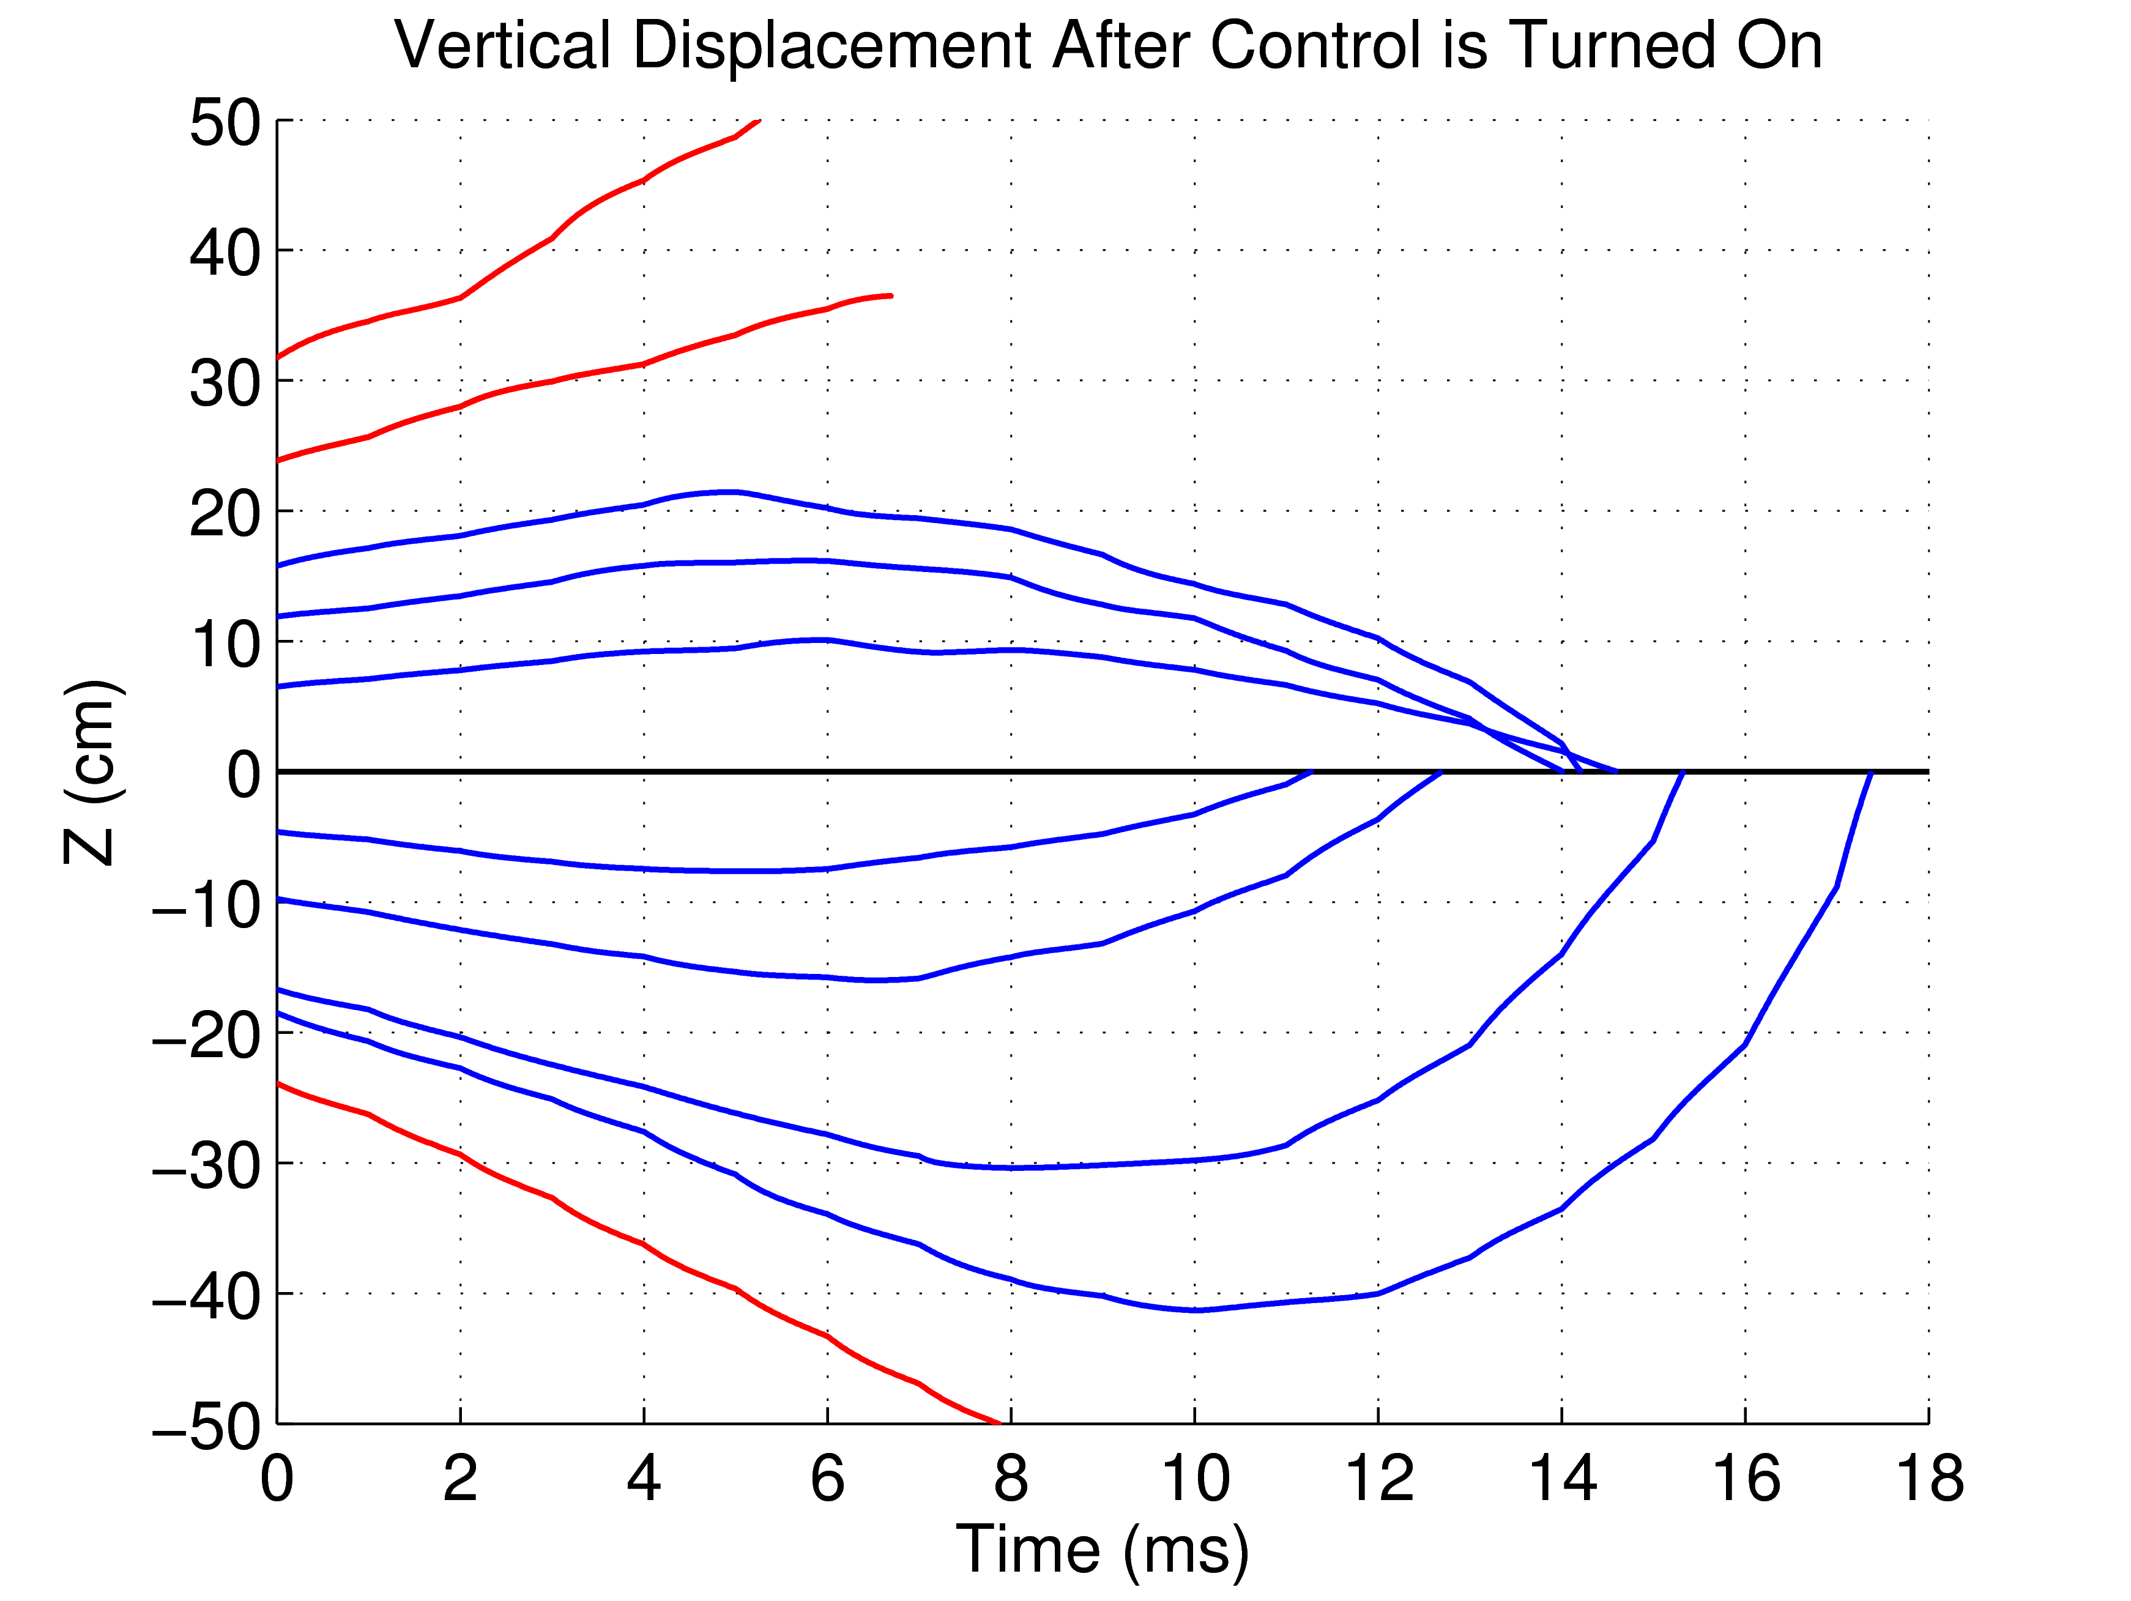
ΔZ_{max} XP
bb
+
+
x
Red lines show the shots were the vertical displacement was uncontrollable while the blue lines the controllable ones.
NSTX is (mostly) up/down symmetric (mirror symmetry).
ΔZ_{max} ~ [18 - 24] cm and ΔZ_{max}/a ~ [%30 - %39].
Notes:
{\mathcal J} = \kappa_1 \int_t \int_\psi \left[ v_t(\psi,t) - v_t^*(\psi,t)\right]^2 d\psi\,dt + \kappa_2 \int_t \int_\psi f_\text{NBI}^2(\psi,t) d\psi\,dt
18

Slide 19
Overview of Shape Control at NSTX
Fits found in MDSplus for NSTX shot 141642:
Fit Run time Run by Code Version Comment
-------- ---------------------------- ----------- ---------------- ----------------
EFIT01 Wed Oct 6 13:17:00 EDT 2010 FENXautoProcessed efitd6565d_v5.2u Magnetics-only-run-with-Mar10-external-magnetics-calibration-Jedge_finite
EFIT02 Wed Oct 6 13:18:32 EDT 2010 FENXautoProcessed efitd6565d_v5.2u Hybrid-kinetic-run-with-30-pt-Thomson-Pe,-diamagnetic-loop,-and-external-magnetics-calibration_to_1-4_percent_error-Jedge_finite
LRDFIT01 Thu Nov 11 22:56:05 2010 sgerhard LRDFITv3_82x82 Constraints: Magnetics
NSTX Cross Section:
Polodial Field coils and an example control segment.
Notes:
{\mathcal J} = \kappa_1 \int_t \int_\psi \left[ v_t(\psi,t) - v_t^*(\psi,t)\right]^2 d\psi\,dt + \kappa_2 \int_t \int_\psi f_\text{NBI}^2(\psi,t) d\psi\,dt
19

Slide 20
2009 Run: Outer/Inner Strike Point (SP) Control
; NOTES: All variables on the NSTX data tree are in MKS units. Poloidal flux is written as
; a stream function, and so is poloidal flux/2*PI (Wb/radian). Similarly, all derivatives
; with respect to poloidal flux (i.e. p') have units of (numerator unit)*(radian/Wb).
[ekolemen@sunfire04 ~/writekagfromdb]$ cat writekagcontrol.dat
[ekolemen@sunfire04 ~/writekagfromdb]$ ./writekagfromdb.x
IDL Version 7.0 (linux x86 m32). (c) 2007, ITT Visual Information Solutions
Installation number: 100897-3.
Licensed for use by: Princeton Plasma Physics Lab
Setting up for shot 141642
% MDSVALUE: Access denied, invalid user mapping at server
% Compiled module: MDSGETMSG.
% MDSOPEN: %NONAME-W-NOMSG, Message number 00000000
WARNING: Problem opening MDS+ tree EFIT02
Check that MDS+ server is available and reconstructions exist.
Exiting...
[ekolemen@sunfire04 ~/writekagfromdb]$
Inner/Outer SP control
Snowflake obtained via SP control at NSTX
Notes:
{\mathcal J} = \kappa_1 \int_t \int_\psi \left[ v_t(\psi,t) - v_t^*(\psi,t)\right]^2 d\psi\,dt + \kappa_2 \int_t \int_\psi f_\text{NBI}^2(\psi,t) d\psi\,dt
20

