Slide 1


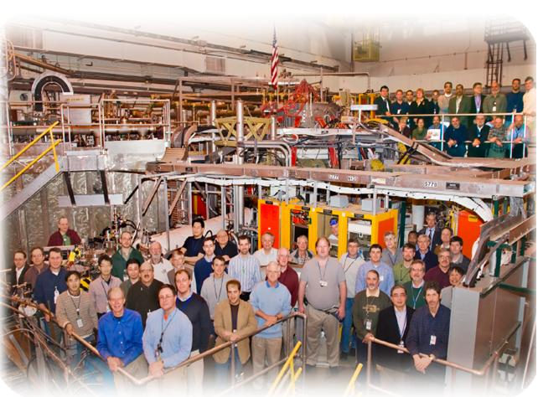
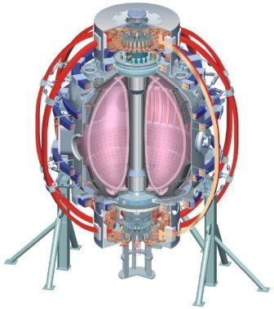
NSTX
Supported by
Physics and Control Considerations for a Steady State High-β Spherical Torus
College W&M
Colorado Sch Mines
Columbia U
CompX
General Atomics
INL
Johns Hopkins U
LANL
LLNL
Lodestar
MIT
Nova Photonics
New York U
Old Dominion U
ORNL
PPPL
PSI
Princeton U
Purdue U
SNL
Think Tank, Inc.
UC Davis
UC Irvine
UCLA
UCSD
U Colorado
U Illinois
U Maryland
U Rochester
U Washington
U Wisconsin
Stefan Gerhardt
PPPL
Culham Sci Ctr
U St. Andrews
York U
Chubu U
Fukui U
Hiroshima U
Hyogo U
Kyoto U
Kyushu U
Kyushu Tokai U
NIFS
Niigata U
U Tokyo
JAEA
Hebrew U
Ioffe Inst
RRC Kurchatov Inst
TRINITI
KBSI
KAIST
POSTECH
ASIPP
ENEA, Frascati
CEA, Cadarache
IPP, Jülich
IPP, Garching
ASCR, Czech Rep
U Quebec

Slide 2
A View of High-β ST Operation
(Essentially the Same as for Conventional Aspect Ratio)
Control
PWI
Global Stability
Current Drive
Transport
See T. Luce, Phys. Plasmas 18 For Discussion of Steady State Conventional Aspect Ratio Tokamaks

Slide 3
Overview
Take a narrow view: focus on global stability, current drive, confinement…and their control.
  Neglect critical issues of pedestal & divertor physics, PMI, energetic particle physics, plasma startup.
Outline:
  Basics: Historical & technical background of the ST.
  Optimization to high β.
  Current drive requirement.
  How transport impacts the above.
  Control considerations (time permitting).
Give you some sense of the interplay between, and optimization of, parameters called β_{N}, β_{T}, β_{P}, l_{i}, F_{P}, A=1/ε, κ, δ, H

Slide 4
Brief History of the ST
1980s
  Peng and Strickler (NF, 1986) synthesized many of the important advantages of the ST in a single reference:
    Natural high elongation, improved average field curvature & better utilization of the TF coil
1990s:
  START device demonstrated high β with at low-A and strong shaping.
  Theory studies demonstrated the existence of very attractive high-β equilibria.
2000s:
  NSTX and MAST demonstrated sustained high-performance plasmas.
  ST designs for a component test facility and a reactor appear.
2010s:
  NSTX and MAST are both approved for major upgrades.

Slide 5
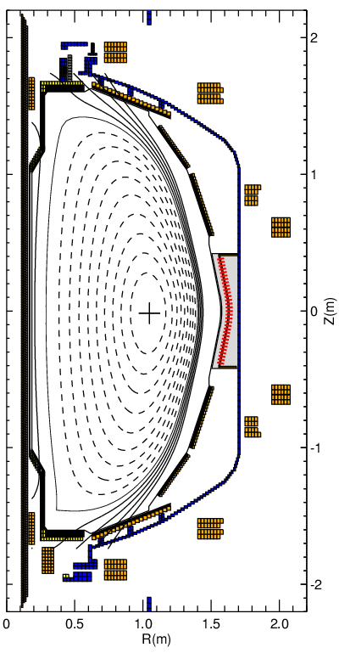
Major Components of An ST Like NSTX
Coils
Vertical Field: Anti-parallel to plasma current, counter-acts tendency for the plasma column to radially expand, controls the radius of the plasma.
F_{R}~J_{T}B_{Z}
Radial Field: Anti-parallel to plasma current, controls the elongation, vertical position.
Divertor: Parallel to the plasma current, “pull” an X-point, increase the elongation.
Solenoid: Current ramps through the shot, providing an inductive voltage to drive current (goal of research: eliminate this inductive current drive).
2a
h
R₀
R_{mag}

Slide 6
Must Have Strong Shaping and High β_{N} For an Efficient Reactor
Fusion power scales as n²T²~ B_{T}²β_{t}²
  B_{T} is limited by field at the coil, so we must maximize β_{t}.
Bootstrap current scales as f_{BS}=C_{BS}ε^{1/2}β_{P}.
  Want to maximize the self driven current, so maximize β_{P}.
What is the requirement for them both to be large?
  Consider definition of poloidal β:
  Approximate expression of the poloidal circumference l_{P}:
  Multiply β_{P} and β_{T} to get:
  Must have simultaneously high elongation and β_{N}.

Slide 7
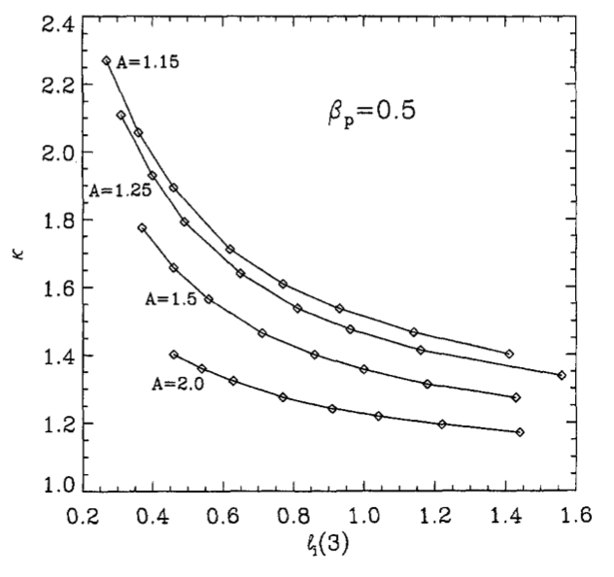
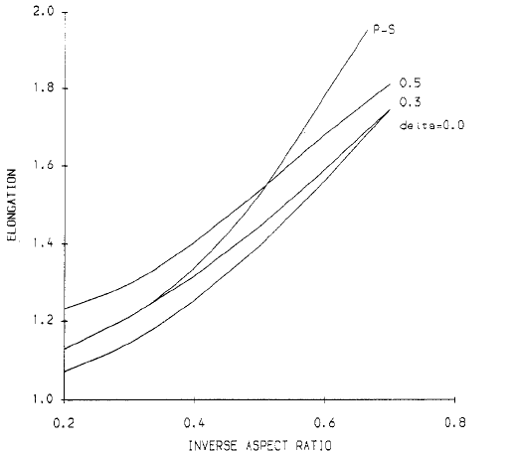
ST Plasmas are “Naturally Elongated”…
…and it Depends on the Current Profile
J.E. Menard, et al, Nuclear Fusion 37
vs.
“Natural Elongation” is the boundary elongation with a straight equilibrium field.
l_{i} indicates “peakedness” the current profile.
“low-l_{i}” means broad current profile.
elongation
Roberto & Galvao, Nuclear Fusion 32
NSTX
ε=1/A

Slide 8
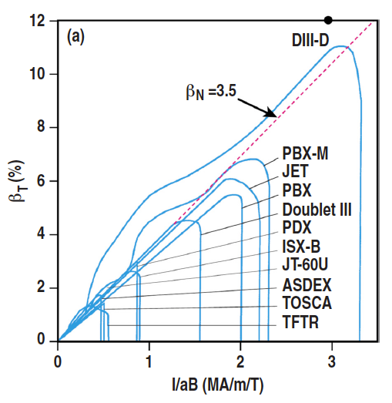
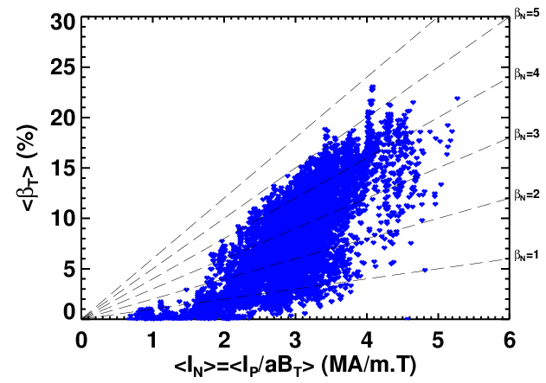
To Lowest Order, β_{N} Controls Ideal Stability
Troyon, others, showed that the β_{T} limit scales as I_{P}/aB_{T}.
  Based on calculations of low-n kink stability, high-n ballooning stability.
  Said another way, if you want high-β_{T}, must increase I_{P}/aB_{T}.
T. Luce, Phys. Plasmas 18

Slide 9
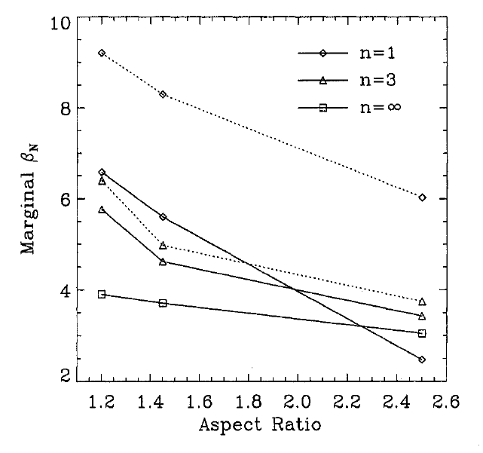
The β_{N} Limit Can Be Modified by Changes to the Plasma Shape….
Three important degrees of freedom in axisymmetric plasma boundary shaping.
  Aspect ratio (A): Better utilization of the good-curvature, high-TF region, increased safety factor.
  Elongation (κ): Increasing elongation increases q, improving the kink stability & increasing bootstrap currents.
  Triangularity (δ): Increasing the triangularity causes fields lines to spend more time in the high-field good-curvature region.
  Many more degrees of freedom are possible with non-axisymmetic shaping…this is a stellarator!
J.E. Menard, et al, Nuclear Fusion 37
n=1, nw
n=1, ww
n=3, nw
n=3, ww
Solid: No Wall (nw)
Dashed: Conformal Wall 0.4a from Plasma (ww)

Slide 10
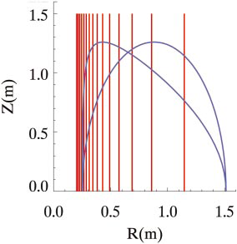
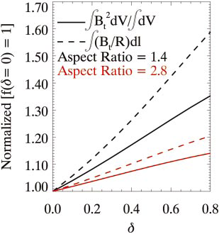
The β_{N} Limit Can Be Modified by Changes to the Plasma Shape….
Three important degrees of freedom in axisymmetric plasma boundary shaping.
  Aspect ratio (A): Better utilization of the good-curvature, high-TF region, increased safety factor.
  Elongation (κ): Increasing elongation increases q, improving the kink stability & increasing bootstrap currents.
  Triangularity (δ): Increasing the triangularity causes fields lines to spend more time in the high-field good-curvature region.
  Many more degrees of freedom are possible with non-axisymmetic shaping…this is a stellarator!
B_{T}~1/R
Boundaries with varying triangularity
A=1.4
A=2.8
D. Gates, et al, Phys. Plasmas 10

Slide 11
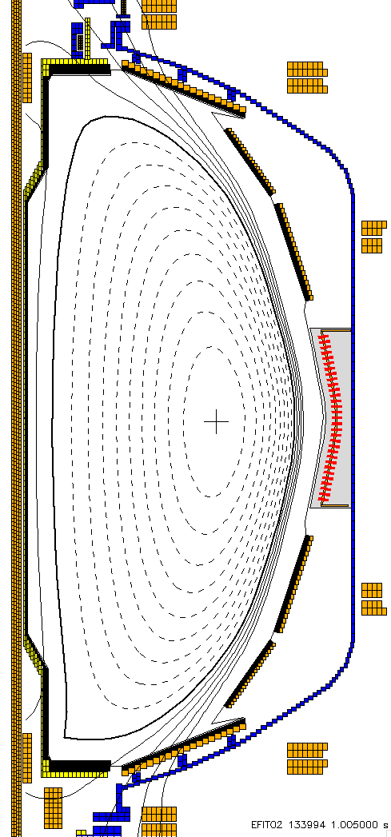
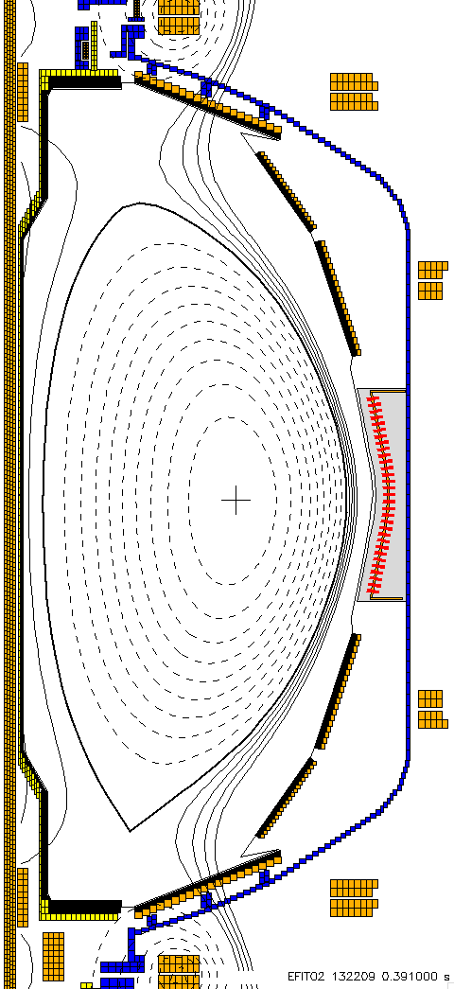
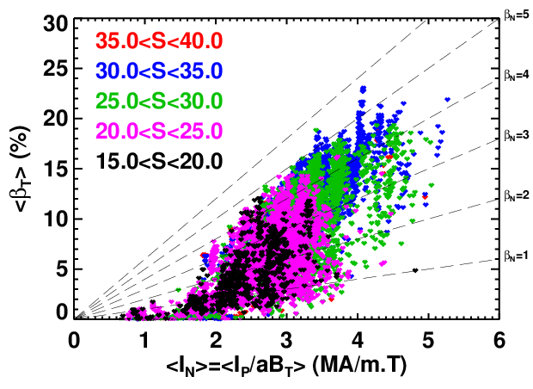
The β_{N} Limit Can Be Modified by Changes to the Plasma Shape….
Three important degrees of freedom in axisymmetric plasma boundary shaping.
  Aspect ratio (A): Better utilization of the good-curvature, high-TF region, increased safety factor.
  Elongation (κ): Increasing elongation increases q, improving the kink stability & increasing bootstrap currents.
  Triangularity (δ): Increasing the triangularity causes fields lines to spend more time in the high-field good-curvature region.
  Many more degrees of freedom are possible with non-axisymmetic shaping…this is a stellarator!
“Shape Parameter” S encapsulates shape effects.
133994,
S=37
132209,
S=20

Slide 12
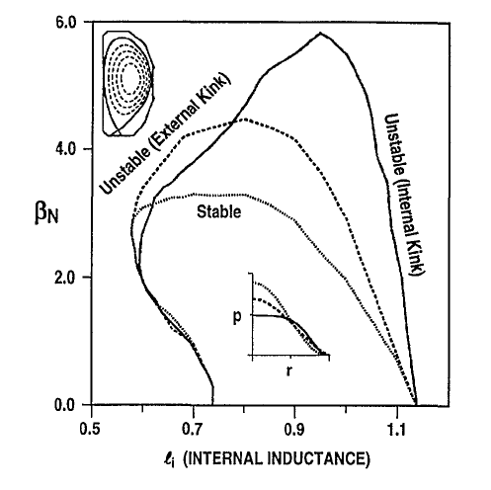
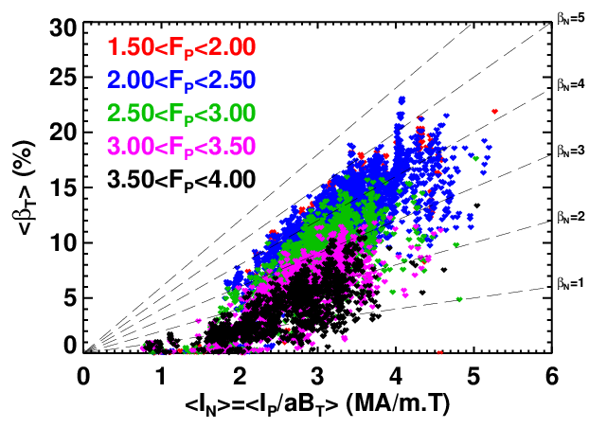
The β_{N} Limit Can Be Modified by Changes to the Plasma Shape….and the Profiles
Broad pressure profiles align the pressure gradient with region of large magnetic shear.
  Highest stability psooible with broadest profiles.
Instability predicted at both high & low l_{i}.
  High-l_{i} -> Internal kinks, low-l_{i} ->external kinks.
<β_{N}> vs. <F_{P}> in NSTX
Low pressure peaking required for high-β_{N}.
E.J. Strait, et al, Phys. Plasmas 5

Slide 13
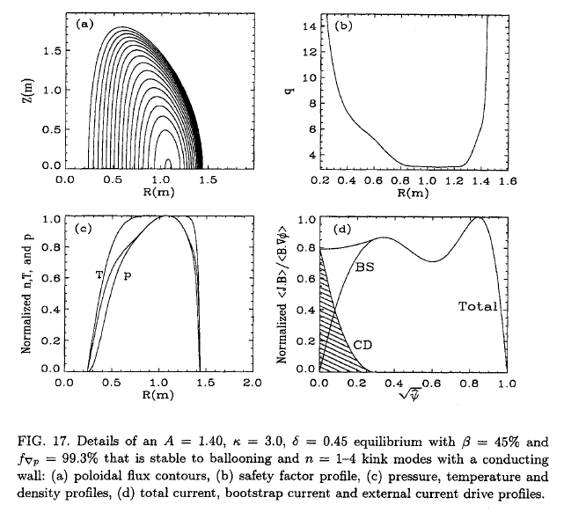
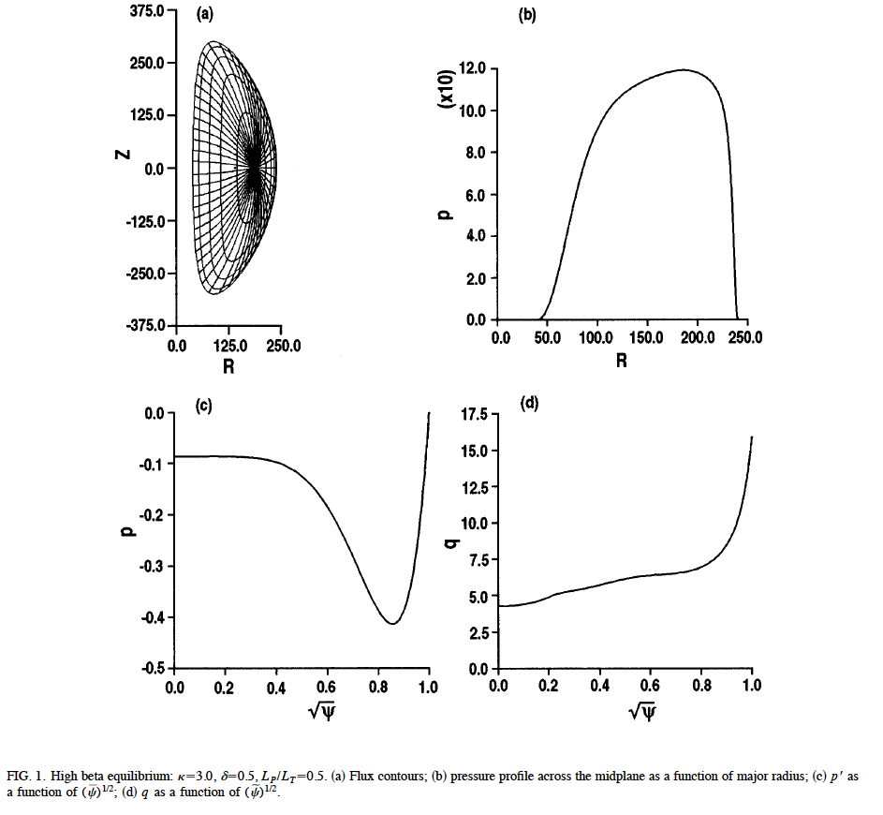
Theoretical Studies in the Late 1990s Showed the
Promise of the ST
Both cases stable to kink and ballooning instabilities, ~99% bootstrap driven
Strong shaping and broad pressure profiles are key.
J.E. Menard, et al, Nuclear Fusion 37
β_{T}=45%
R.L. Miller, et al, Physics of Plasmas 4
β_{T}=54%

Slide 14
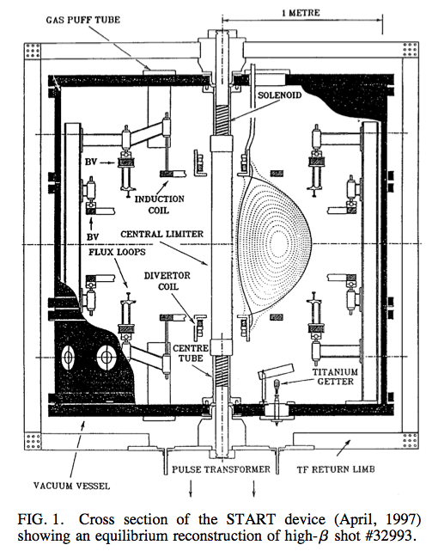
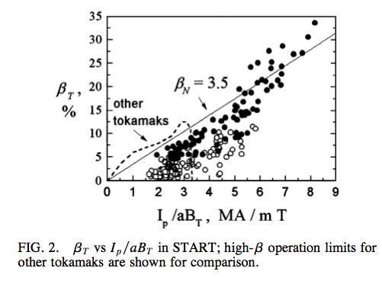
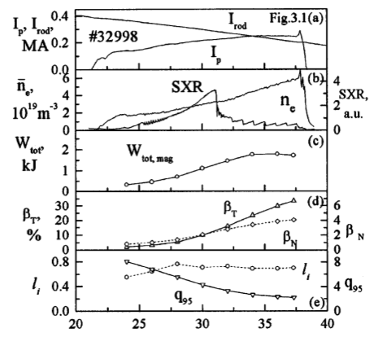
START Studies Demonstrated Highest-Ever β_{T} in a Tokamak-Like Device.
M. Gryaznevich, et al, PRL 1998

Slide 15
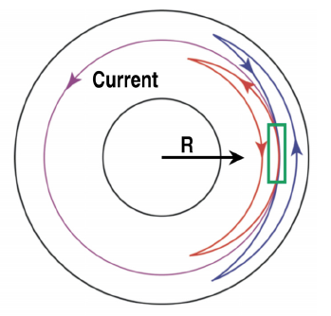
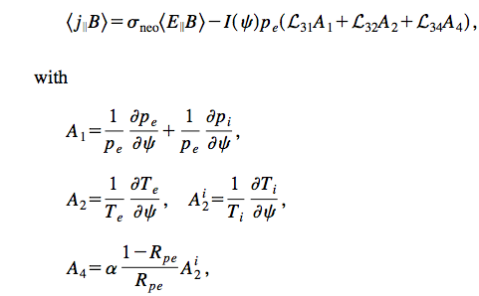
Plasmas Have the Ability To Drive Their Own
Toroidal Current
Consider the trapped particle orbits in the green box.
Net counter-clockwise current if:
  There is a density gradient:
    More particles on the red orbit.
  There is a temperature gradient:
    Particles on red orbit more faster.
Trapped particles do not make net current.
  But collisions with passing particles transfer the asymmetry…and a net current flows.
T. Luce, Phys. Plasmas 18
Simple Expression For Current Density
More General Expression:
Convert to Toroidal Current
Convert to Fraction of Total Current
O. Sauter, et al, Phys. Plasmas 6

Slide 16
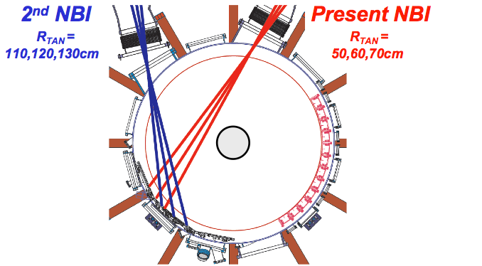
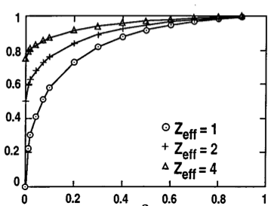
Neutral Beam Current Drive Typically Invoked to Supplement the Bootstrap Current
Neutral beams are the work-horse heating source for present and proposed STs.
  Can also inject momentum and drive current.
Current is due to the circulating fast ions.
Collisions would generally bring electrons along with ions, cancelling the current.
  Impurity ions and electron trapping impede this canceling current.
Remember, reduces plant efficiency to drive NBCD.
Lin-Liu & Hinton, Phys Plasmas 4
Fast ion current.
Computed via Monte Carlo methods for NSTX.
Increases when the slowing down time is longer:
Correction due to electron response, including neoclassical effects.
Computed analytically, for instance:
NSTX

Slide 17
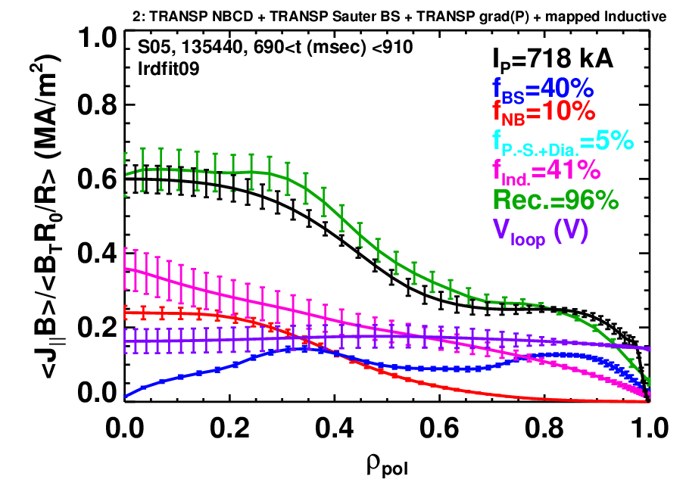
NSTX Studies Show Good Agreement Between Calculated Current Sources and Total Current Profile
Current Profile Reconstructed from…
Pressure-Driven Currents: Bootstrap, Pfirsch-Schlueter+Diamagnetic
Inductive current: time derivatives of reconstructed equilibria + neoclassical resistivity
Neutral Beam Current Drive from NUBEAM, with classical beam physics
Compare to…
Reconstructions constrained by MSE and T_{e} isotherm constraint
Choose time with no EP MHD or low-frequency kink/tearing
S.P. Gerhardt, Nuclear Fusion

Slide 18
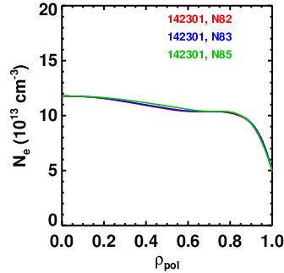
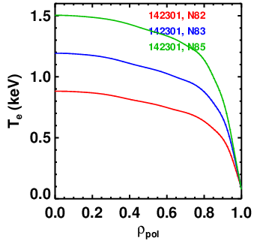
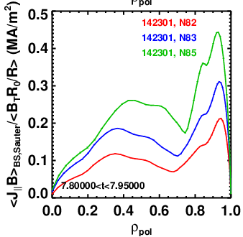
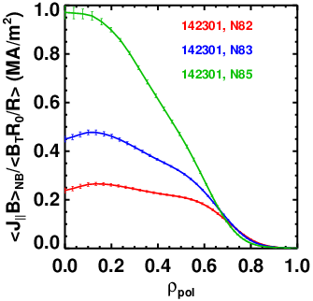
Non-Inductive Current Profiles Depend on the Electron Temperature (and others profiles as well).
Fix the electron density, Z_{eff} and scale T_{e} & T_{i}.
Calculations from TRANSP
Sauter model for Bootstrap currents
NUBEAM for NBCD
Beam currents tend to be centrally localized for these parameters.
Bootstrap currents tend to be edge localized in H-mode -> low-l_{i}
Simulations use all 6 Sources

Slide 19
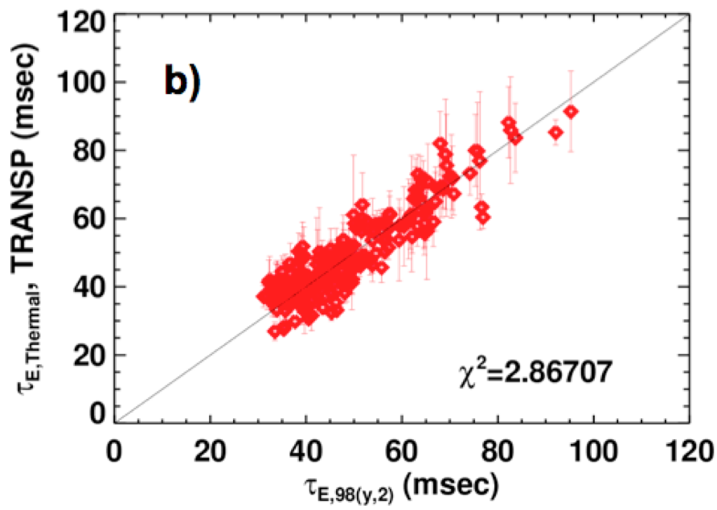
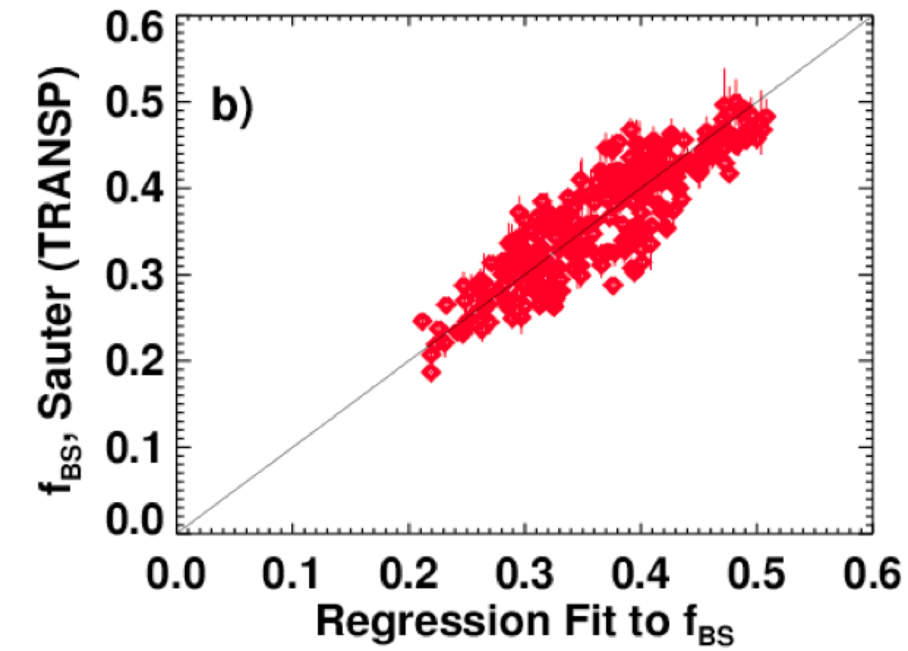
Plasma Transport Determines The Achievable Level Of Bootstrap Current (when stability is not violated)
Experimental Confinement Scaling
Bootstrap Fraction From Confinement Scaling
Bootstrap Fraction From Direct Regression
S.P. Gerhardt, submitted to Nuclear Fusion

Slide 20
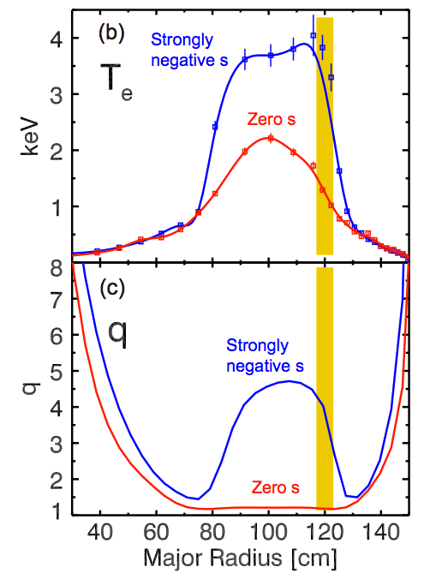
Internal Transport Barrier Formation is a More Complicated Interaction Between the Thermal and Current Profiles
Confinement depends on magnetic shear.
  Peak electron temperature typically occurs near location of most negative magnetic shear (in NSTX).
Strong gradient can produce strong bootstrap current.
  Modifies the q-profile…necessary to have current profile carefully “aligned” with the pressure profile.
Resulting configuration has a higher pressure peaking factor.
  is the ideal MHD stability acceptable in this scenario?
  Double tearing can also be unstable.
H. Yuh, Phys. Plasmas 16

Slide 21
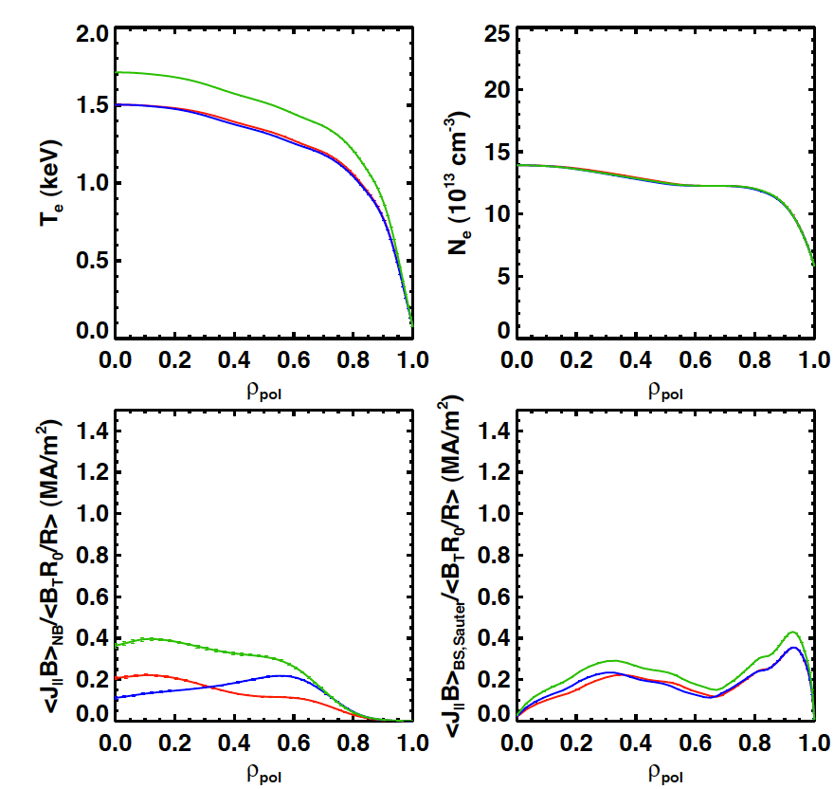
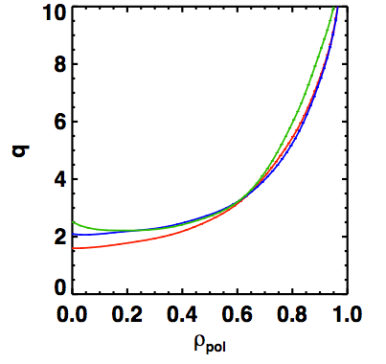
Changing Beam Sources Can Modify the Current
Profile Shape
50, 60, 70, 130
50, 60, 120, 130
All 6 Sources
Higher power case has higher T_{e}, and better NBCD efficiency.
Keeps q_{min} above 2, avoiding possibility of 2/1 tearing.
df
A=1.8, I_{P}=1300 kA, B_{T}=1.0

Slide 22
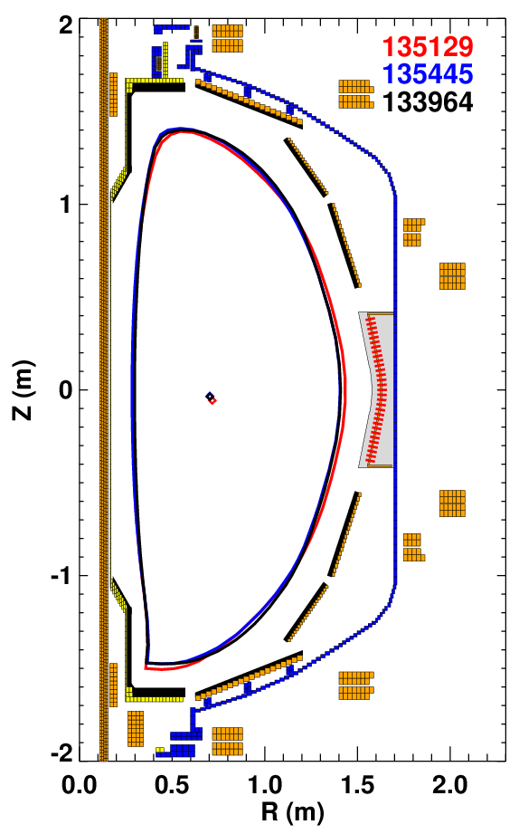
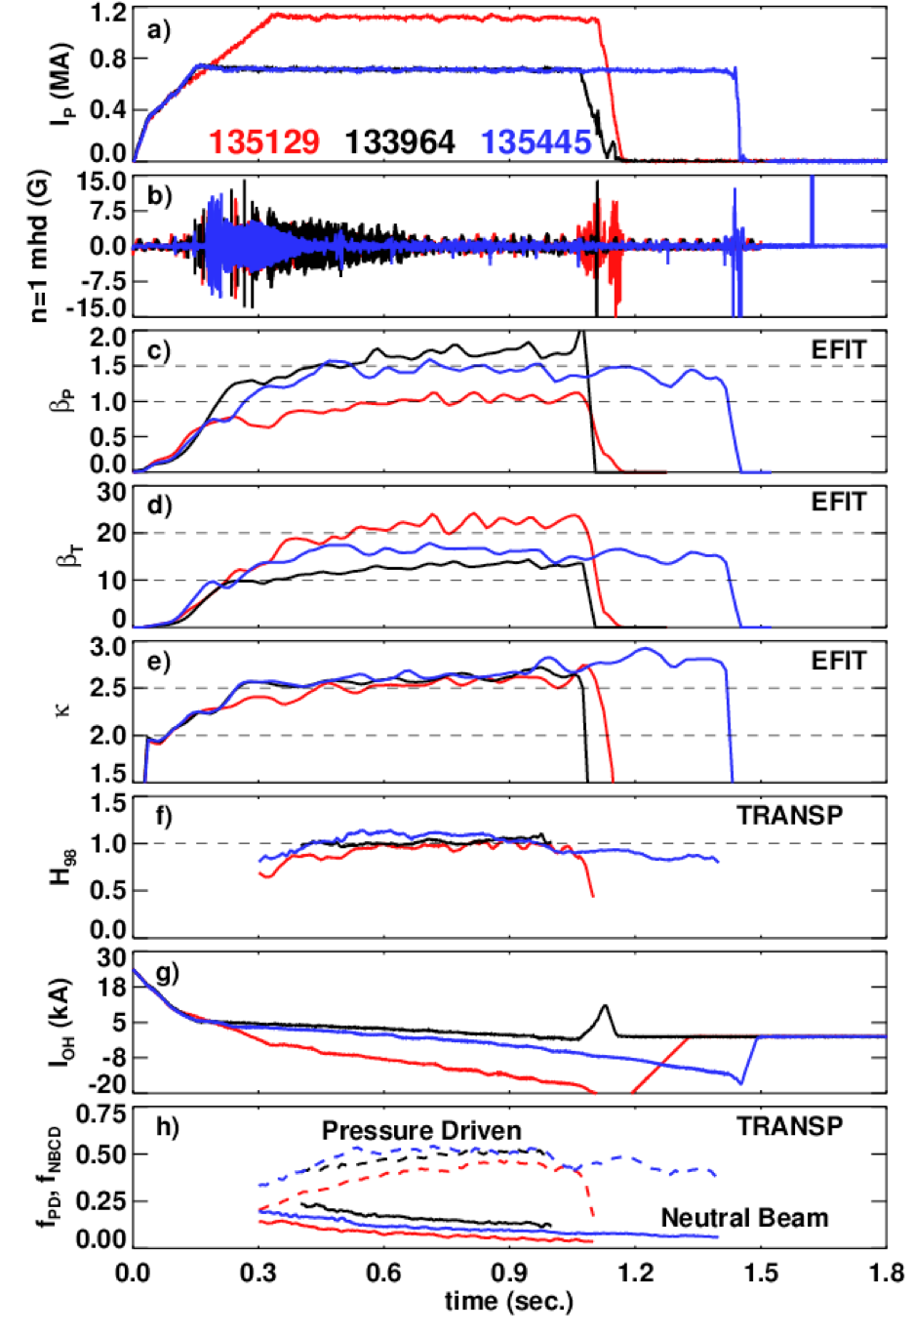
Best NSTX Discharges Combine Strong Shaping, Good Confinement, and Large Non-Inductive Currents
Optimized For:
High sustained β_{T} high non-inductive fraction longest-pulse
Aspect Ratios 1.45-1.55
S.P. Gerhardt, submitted to Nuclear Fusion

Slide 23
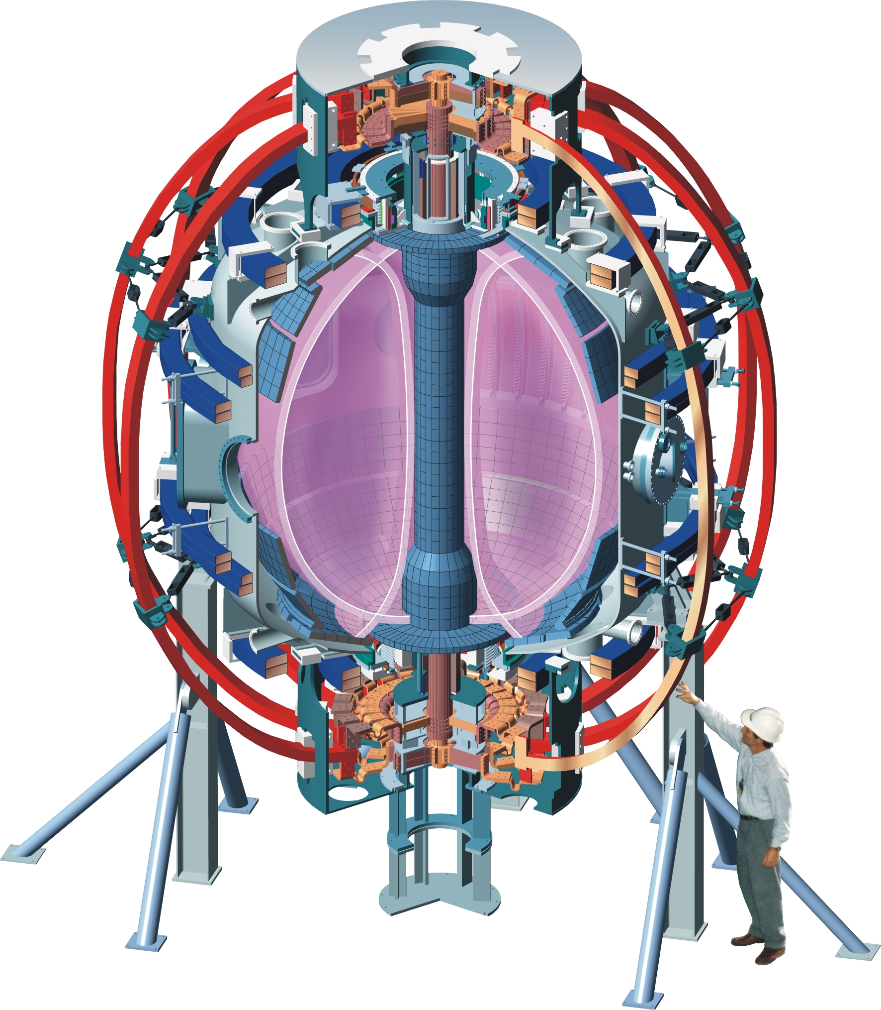
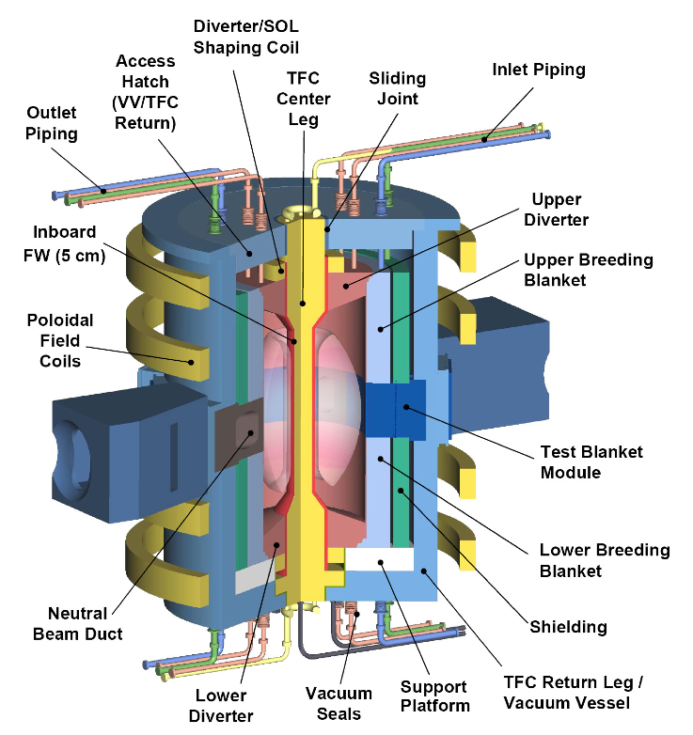
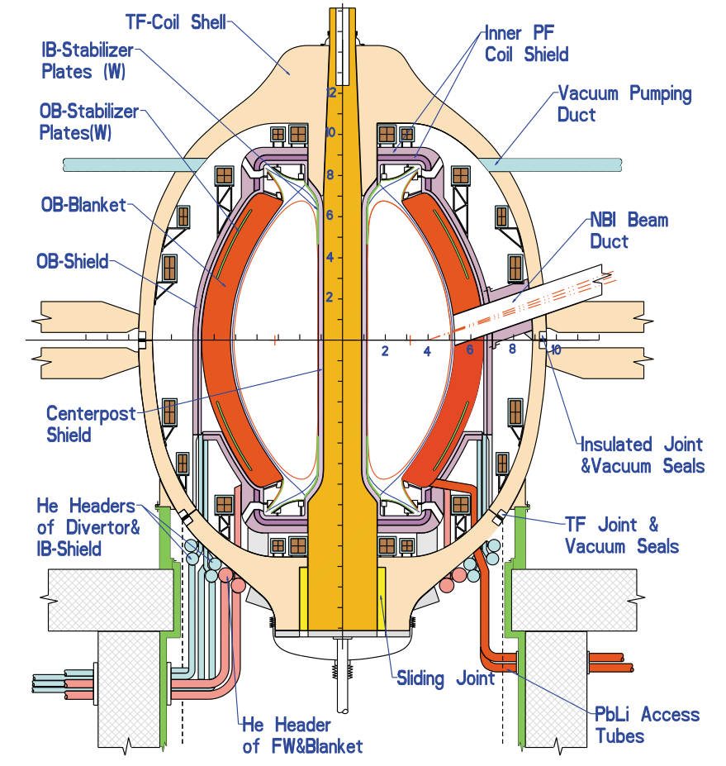
Large Steps Still Required For Next-Step Devices
 | NSTX¹ | ORNL CTF² | ARIES-ST³
R₀ (m) | 0.85 | 1.2 | 3.2
I_{P}/B_{T} (MA/T) | 1.0/0.55 | 8.2/1.13 | 29/2.1
β_{N} | 5.0 | 3.8 | 7.4
κ | 2.8 | 3.1 | 3.5
f_{BS} (%) | 50-60 | 50 | 96
P_{fusion} (MW) | 0 | 75 | 3000
[1] S.P. Gerhardt, et al., EXS/P2-08, IAEA FEC 2010.
[2] Y.K.M. Peng, et al., FT/P3-14, IAEA FEC 2008. WL= 1 MW/m²
[3] F. Najmabadi, et al., Fusion Engineering and Design, 2003.

Slide 24
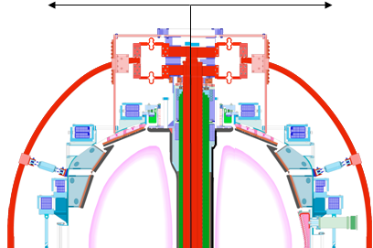
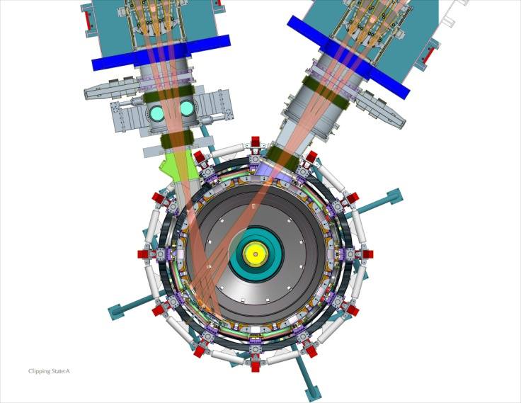
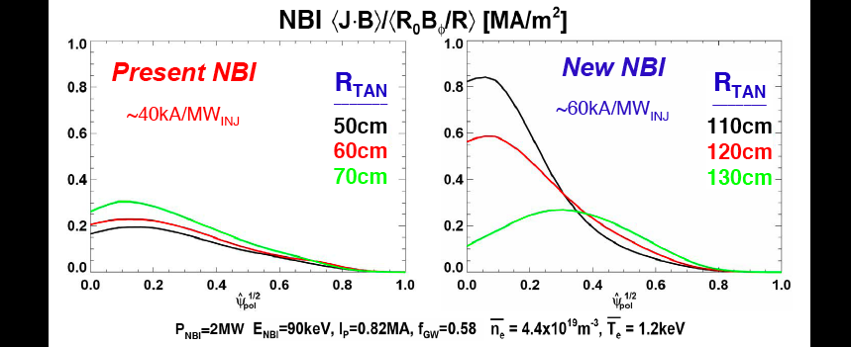
NSTX (and MAST) Are Planning Substantial Upgrades
New center stack for 1T, 2MA, 5s
2nd NBI with 5 MW, 5s at larger R_{TAN}
R₀ /a = 1.25-1.3 1.5-1.6
Present CS
New CS
2nd NBI
R_{TAN} =
110,120,130cm
Present NBI
R_{TAN} =
50,60,70cm
NBI current drive profiles [MA/m²]
New center column:
  1 MA -> 2MA,
  0.5T ->1T, 1.4 sec ->5.0 sec.
1 additional beamline with three sources.
Study transport, stability, current drive
  in low-collisionality plasmas with 100% non-inductive current drive.
Present NBI
2nd NBI
Normalized minor radius
Up to 2 times higher NBI current drive efficiency, and current profile control

Slide 25
Summary
Sustained, economical tokamak fusion power requires simultaneous high β_{N} and κ.
ST offers a potential route to maximizing these parameters.
  Strong shaping, profile optimization lead to further improvements.
Bootstrap and neutral beam current drive are the common non-inductive currents sources in present and future STs.
  Theory of these current drive sources is (mostly) verified.
Transport determines the level of these non-inductive currents, as well as the profile magnitudes and shapes…
  …which in turn determine the stability.
Best NSTX discharges optimize this physics for high-performance, but large steps are required for next-step devices.
  NSTX and MAST upgrades will help bridge the gap.

Slide 26
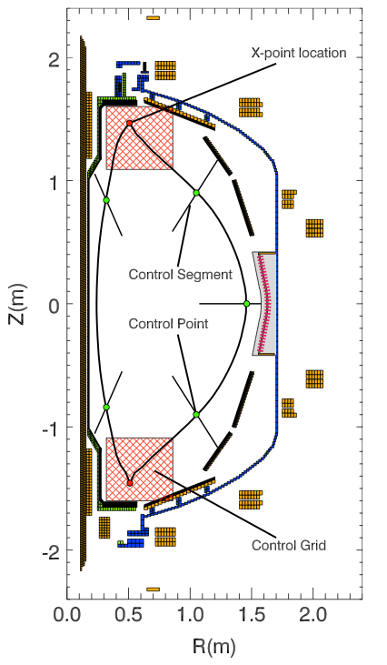
Control The Plasma Shape in With Realtime Grad-Shafranov Equation Solutions
Specify intersections of Control Segments with Desired Boundary
Reconstructed Plasma Boundary
Coil
Control Segment
e
Requested Boundary Intersection
Compute a solution to the Grad-Shafranov equation solution.
Compute the flux on control segment at intersection with boundary (ψ_{I}).
Compute the error
Adjust coil voltage as

Slide 27
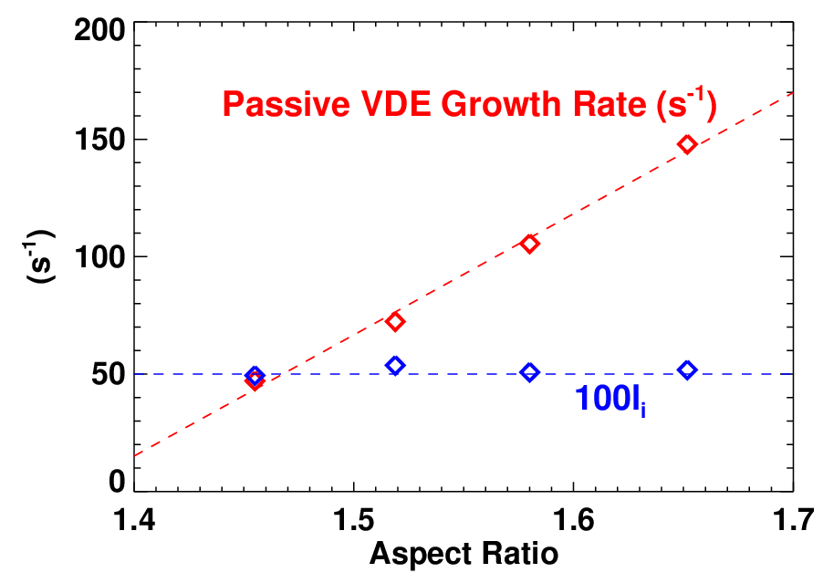
Simplest “Fast Feedback” System in NSTX: Vertical Position Control (I)
Large natural elongation of the ST stabilizes the “Vertical Displacement Event” (VDE)…to a point.
  VDE growth rate increases with A.
Fast vertical position control is required to keep plasma centered in vessel.
Internal inductance plays an important role. Higher-l_{i} means:
  The natural elongation is reduced.
  Current is farther from the coils, making them less effective for control.
PF-3U
PF-3L

Slide 28
Simplest “Fast Feedback” System in NSTX: Vertical Position Control (II)
VDE is too fast to be captured by the shape controller.
  Use an additional feedback system, based on the plasma velocity.
Two flux-loops are usually sufficient for control.
Apply a voltage to the “Radial Field” coil proportional inferred velocity.
PF-3U
PF-3L

Slide 29
Many Other Quantities are Under Feedback Control in NSTX…But Is this Feasible in Future Devices?
Other examples of control in NSTX:
  Slowly-growing n=1 kinks (resistive wall modes) are suppressed.
    Magnetic detection of kink-perturbation using 48 sensors, feedback with midplane coils.
    Key for providing reliable operation at high-β…big research program at NSTX.
  The plasma β_{N} is regulated.
    Use rtEFIT to measure β_{N}, modulate the heating sources.
  The plasma rotation will (soon) be controlled .
    Measure V_{f} with realtime CHERS, control with NB torque changes and magnetic braking.
Next-step devices pose many challenges for control:
  Can the appropriate real-time measurements be made in a neutron environment?
    e. g., neutron streaming limits available sizes of ports?
  Will we have the actuators available?
    e. g., internal coils for non-axisymmetric fields may not be available?
This is a key issue going to next-step devices.

Slide 30
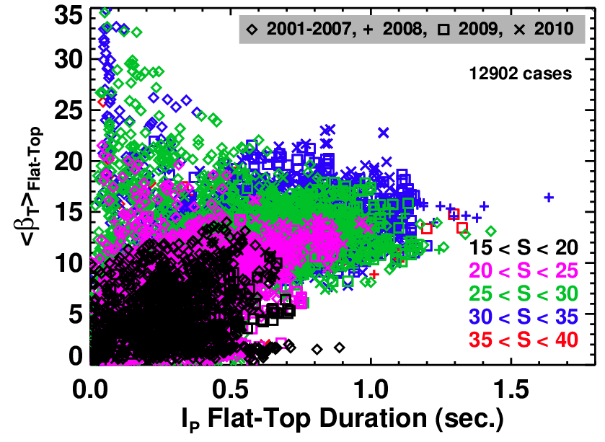
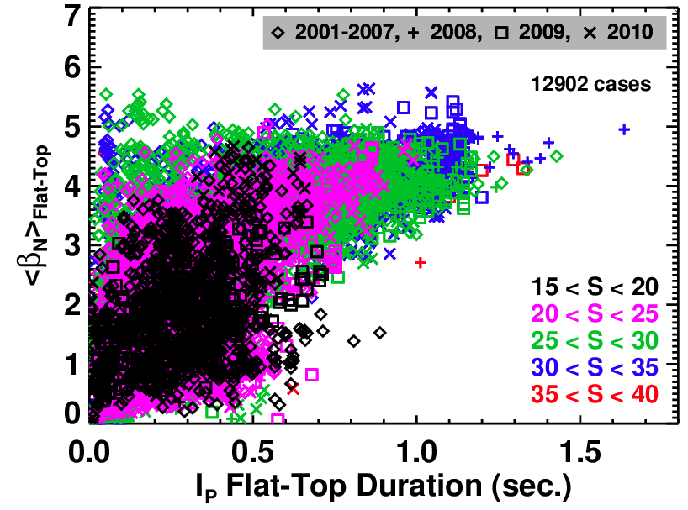
NSTX Shows a β_{N} Limit, Not a β_{T} Limit
Show β_{N} and β_{T} averaged over the pulse duration, and plotted against the pulse duration.
  But, what sets the β_{N} limit? Why is is 5 and not 3?

