Slide 1
Modeling Beam Ion Relaxation with application to DIII-D
K.Ghantous, N.N. Gorelenkov
PPPL, 2012

Slide 2
TAE Induced Losses of EP
Notes:
Add a picture of the distribution dependance on r and P_\phi.
Gamma \propto \partial f/\patrial r.. If resonances are to happen.
BUT! AE has alfvenic velocities that resonante with alphas. But they are continuum damped! aha... Buuutt… TAEs are not damped. Oops.
This can be dangerous to ITER.. And present day experiments operating in the regime are good experiments for testing theories and studying this interaction. We apply it on diiid ☺

Slide 3
QL model
Illustration of self consistent QL relaxation
where
where
instability
diffusion
Saturation at marginal stability
Notes:
The idea. Growth. Mode grows. Damping exists. Particle diffuse due to particle mode interacion. Gradient diminishes. Finally drive stops.
Great! Unless it reaches edge. And particles are lost.

Slide 4
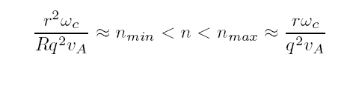
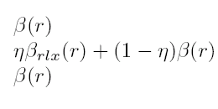

Reduced QL model
Using analytic expressions for finding the qualitative dependencies of the growth and damping rates on energetic particle’s β
the mode number, n
relative mode widths to particle orbit
Plasma parameters
Isotropy
The mode that are most unstable form a plateau¹ in n number where
Which is used to compute the critical conditions on the slope of the pressure profiles at each radial position r₀.
i.e
Kolesnichenko’s rough estimate for the percentage of particles that are resonant is η
¹Fu, Phys. Fluids B 4 (1992) 3722;

Slide 5
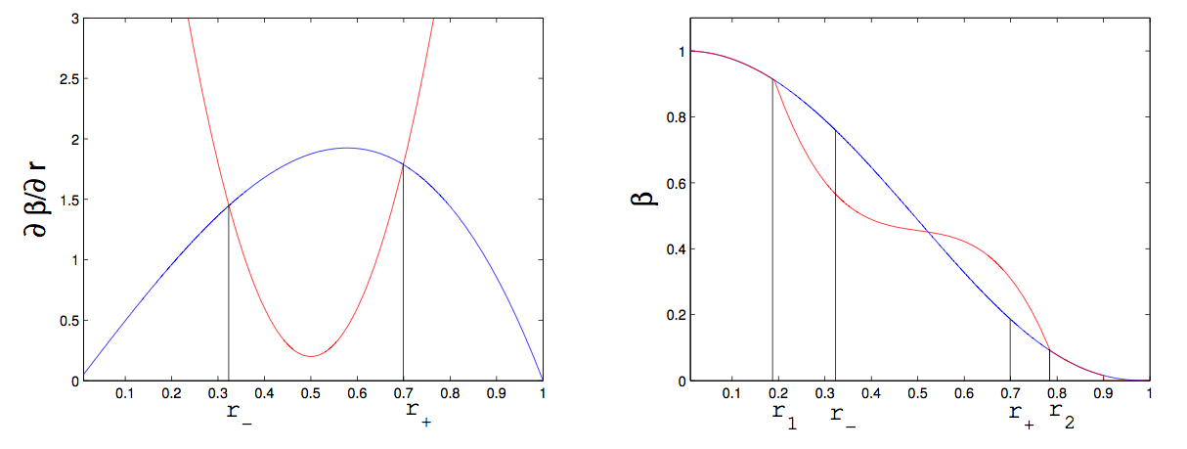
Integrating relaxed profiles.
With the constraints:
continuity
Particle conservation
Notes:
Explain in case of hits the walls.

Slide 6
NOVA and NOVA-K
To apply 1.5D on experimental results, NOVA and NOVA-K are used to give quantitative accuracy to the analytically computed profiles.
We find the two most localized modes from NOVA for a given n close to the expected values at the plateau.
We calculate the damping and maximum growth rate at the two locations, r1 and r2, to which the analytic rates are calibrated to by multiplying them by the following factor, g(r) .

Slide 7
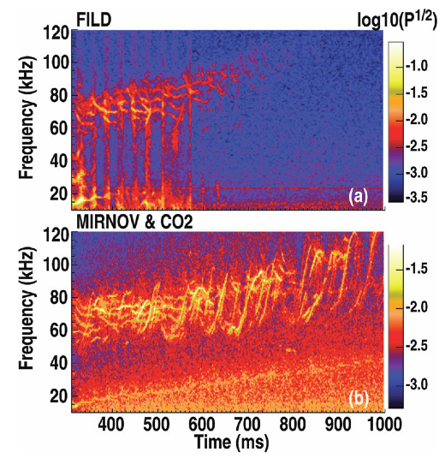
DIII-D beam losses and TAE activity

Slide 8
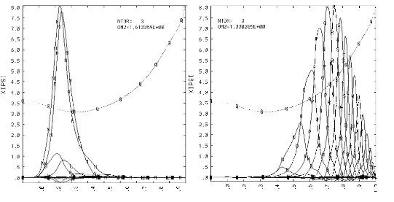
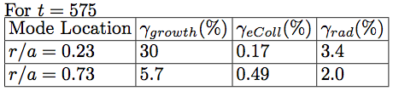
NOVA Computed rates of discharge #142111

Slide 9
Normalized rates for t=575 ms

Slide 10
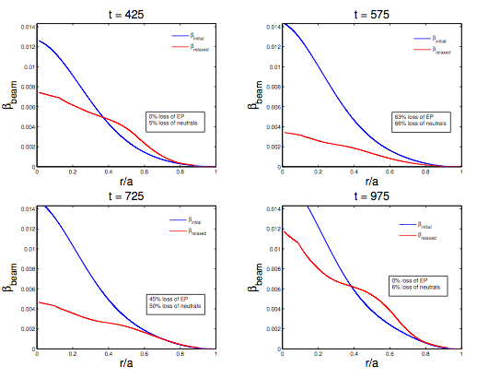
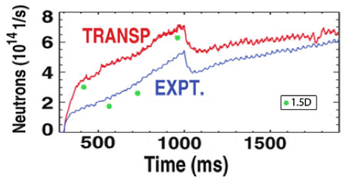
1.5D results

