Slide 1


PPPL,NFRI
Study of Error Field and
3D Plasma Response in KSTAR
Coll of Wm & Mary
Columbia U
CompX
General Atomics
FIU
INL
Johns Hopkins U
LANL
LLNL
Lodestar
MIT
Lehigh U
Nova Photonics
ORNL
PPPL
Princeton U
Purdue U
SNL
Think Tank, Inc.
UC Davis
UC Irvine
UCLA
UCSD
U Colorado
U Illinois
U Maryland
U Rochester
U Tennessee
U Tulsa
U Washington
U Wisconsin
X Science LLC
J.-K. Park¹, Y. M. Jeon²,
In collaboration with
J. E. Menard¹, K. Kim¹, J. H. Kim², W. H. Ko²,
J. G. Bak², S. G. Lee², K.-I. Yoo²,
and KSTAR Research Team
Culham Sci Ctr
York U
Chubu U
Fukui U
Hiroshima U
Hyogo U
Kyoto U
Kyushu U
Kyushu Tokai U
NIFS
Niigata U
U Tokyo
JAEA
Inst for Nucl Res, Kiev
Ioffe Inst
TRINITI
Chonbuk Natl U
NFRI
KAIST
POSTECH
Seoul Natl U
ASIPP
CIEMAT
FOM Inst DIFFER
ENEA, Frascati
CEA, Cadarache
IPP, Jülich
IPP, Garching
ASCR, Czech Rep
1 Princeton Plasma Physics Laboratory, USA
2 National Fusion Research Institute, Korea
PPPL-NFRI Collaboration Meeting
B318, PPPL
October 21, 2013

Slide 2
Outline
Intrinsic error field investigation and correction
  Investigation of source : n=1 compass scan
  Error field threshold : IPEC application
  Plans for collaboration
Magnetic braking and toroidal rotation control
  Test of magnetic braking
  Study of NTV physics and rotation control
  Plans for collaboration
3D plasma response and ELM control
  Plasma response analysis in RMP ELM experiments
  Plans for collaboration

Slide 3
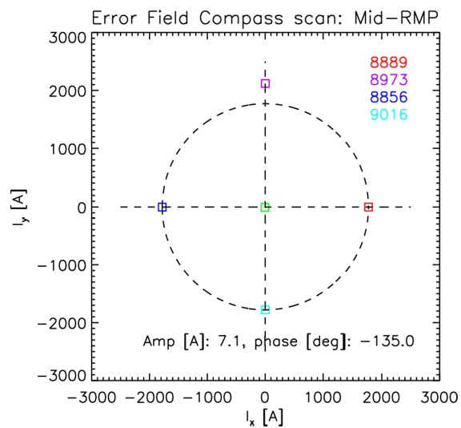
Toroidal compass scan has been used to find any intrinsic non-axisymmetry in KSTAR
Compass scan is to rotate a fixed non-axisymmetric magnetic field toroidally and to see difference in plasma response such as locking
2011~2013 results: Not yet clear indication of intrinsic error field
Locking threshold in RMP coil currents
2013 results
In courtesy of Y. In
Inferred error field in RMP coil currents

Slide 4
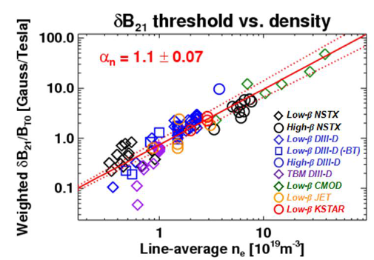
Error field threshold estimated by IPEC has been included in locking threshold scaling database
IPEC has been applied to estimate error field threshold from experiments and to include KSTAR in locking scaling database
2013: n=1+2 applications showed inverse correlation between NTV and locking threshold: will be analyzed in IPEC and POCA
[Park, IAEA (2012)]
Can be a good test for Cole’s theory (PRL, 2008)

Slide 5
Plans for collaboration on error field study
Error field investigation by compass scan
  With Y. In and Y. M. Jeon (NFRI)
  Complete compass scan using top-alone and bottom-alone coils
Error field threshold study
  With J. H. Kim (NFRI)
  Analyze locking threshold with non-resonant magnetic braking and propose experiments in H-mode
Error field correction if needed (depending on compass scan)
  Apply optimized correction to measure lower-bound of locking density
  Study error field correction in H-modes and optimize correction to minimize NTV damping
  Find error field source and develop error field model

Slide 6
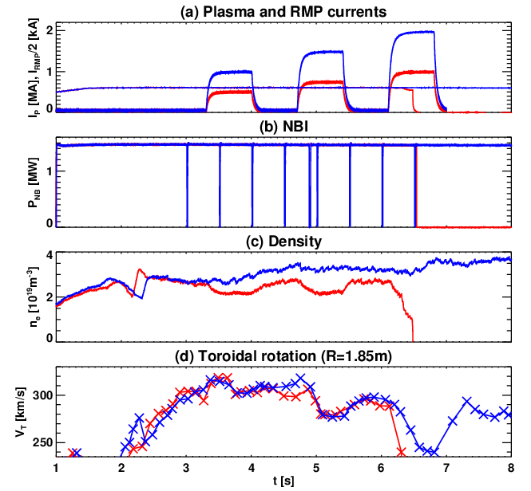
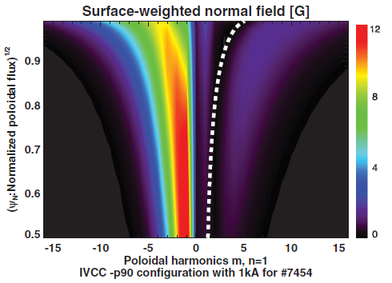
Highly non-resonant n=1 magnetic braking has been successfully tested for the first time
3 rows of internal coils in KSTAR can uniquely produce back-winding helical field and highly non-resonant n=1 magnetic braking
-90 phasing
+90 phasing
-90 phasing
m=nq
Density pump
Only NTV

Slide 7
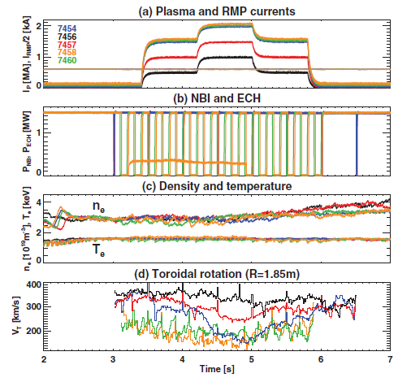
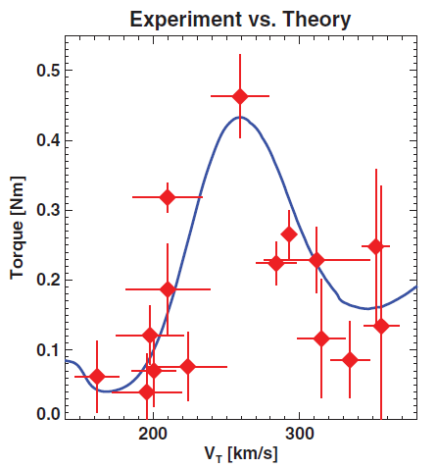
n=1 non-resonant braking led to observation of bounce-harmonic rotational resonance
n=1 can best separate rotational resonances: lω_{b}-nω_{P}~0
Strong resonance was identified as bounce-harmonic resonance
[Park, PRL (2013)]

Slide 8
Plans for collaboration
Test of magnetic braking
  With Y. M. Jeon and H. H. Lee (NFRI)
  n=2 magnetic braking to reach superbanana-plateau regime
Rotation control
  With Y. M. Jeon and W. H. Ko (NFRI)
  Use rotational resonances to establish stable rotational equilibrium and scenarios
NTV physics study
  With K. Kim, Z. Wang (PPPL), S. Satake (NIFS)
  Use advanced NTV modeling in various levels (IPEC-PENT, MARSK, MARSQ, POCA, FORTEC-3D codes)

Slide 9
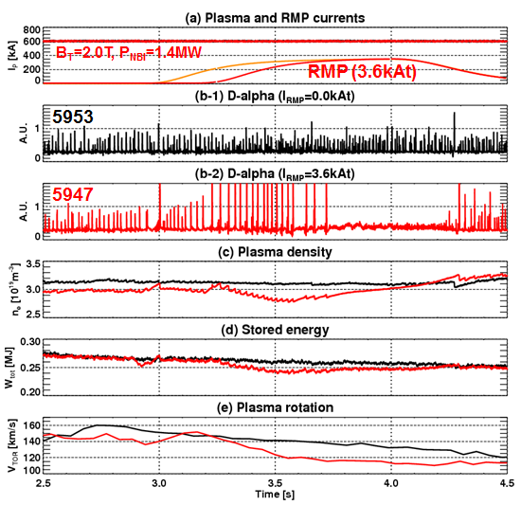
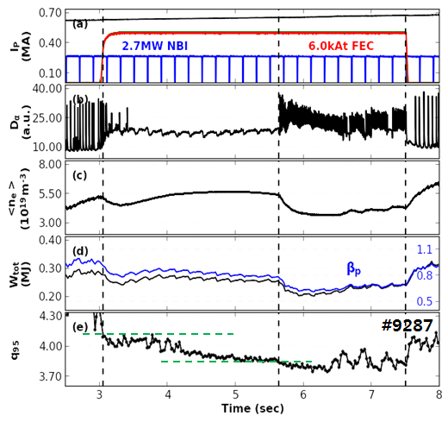
PPPL-NFRI collaboration has been synergetic for RMP ELM mitigation/suppression studies
2011: n=1 ELM suppression
2012-2013: n=2 ELM suppression
[Jeon, PRL (2012)]
q₉₅ window

Slide 10
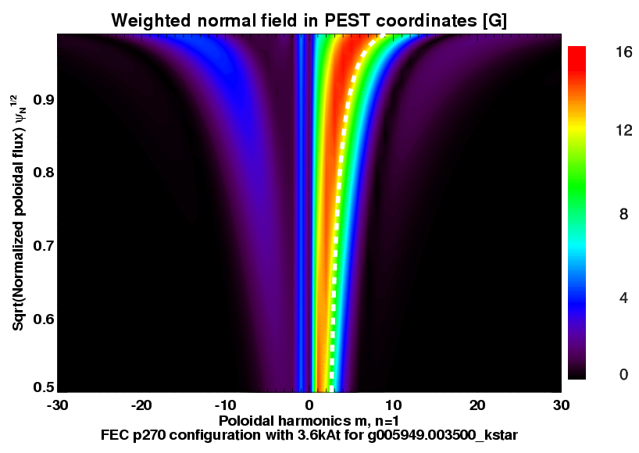
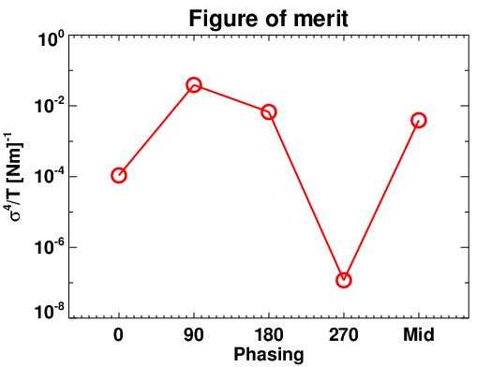
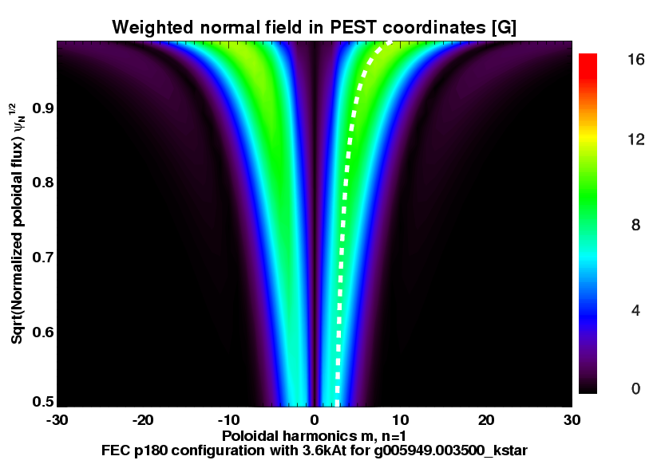
n=1 RMP configurations for ELM control have been optimized through collaboration
n=1 +90 phasing can maximize Chirikov overlap while minimizing NTV : ELM suppressed
n=1 +180 phasing can produce Kink-response : Locking occured
This subtle balance can vary as a function of q-profile
+90 phasing
+180 phasing

Slide 11
Plans for collaboration
Understand n=1 ELM suppression window
  With Y. M. Jeon (NFRI), T. E. Evans (GA)
  Q95~6.0, but plasma density or may also important parameters
Study n=1 RMP physics
  With Z. Wang (PPPL), T. E. Evans (GA)
  Apply various plasma response models (GPEC, MARSK, M3D-C1) to provide consistent understanding of n=1 RMP physics
Collaboration on RMP ELM suppression experiments
  With Y. M. Jeon, S. W. Yoon (NFRI)
  Propose and cooperate on ELM mitigation/suppression experiments

